Slide 1
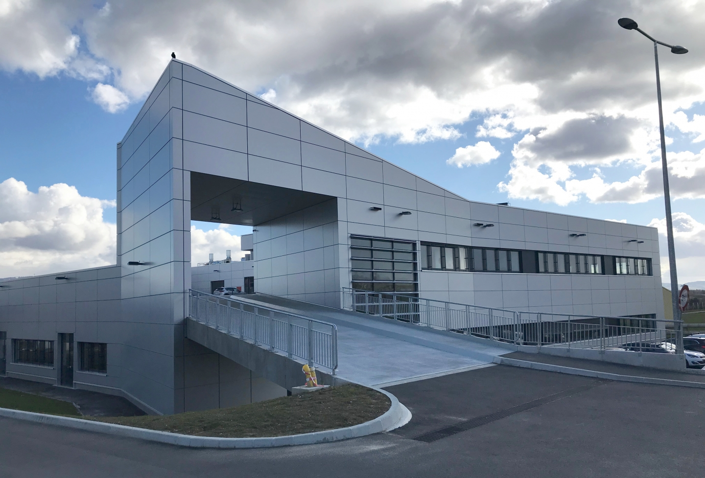
CERN MPT workshop
(Micro Pattern Technologies)

Slide 2
MPT activity
-20 persons.
-1400m2.
-100m2 clean room.
-Top class environnement protection:
-Waste water treatment plant.
-Large scrubbers for fume cleaning.
-Fire extinguisment water containment.
PCB: Printed Circuit Board
MPGD : Micro Pattern Gas Detectors
-GEM : Gas Electron Multiplier
-Micromegas or uMegas or MM: Micro mesh gaseous detector
-uRwell: Micro Resistive Well detectors

Slide 3
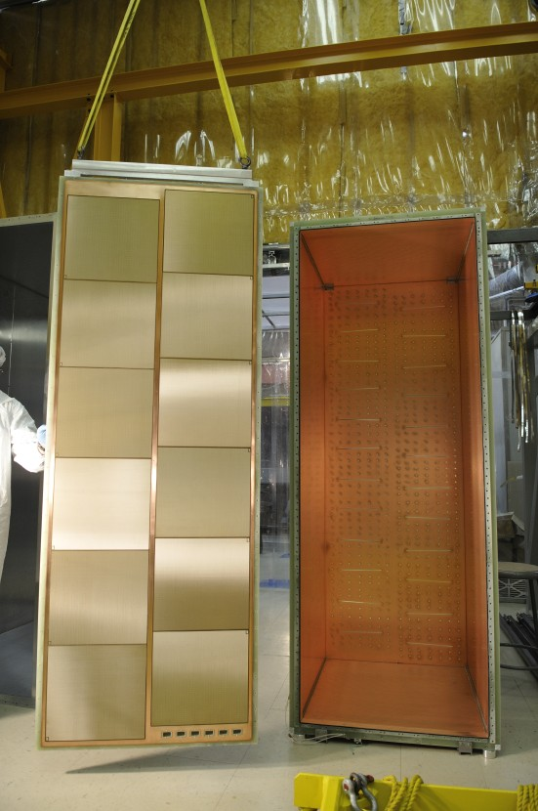
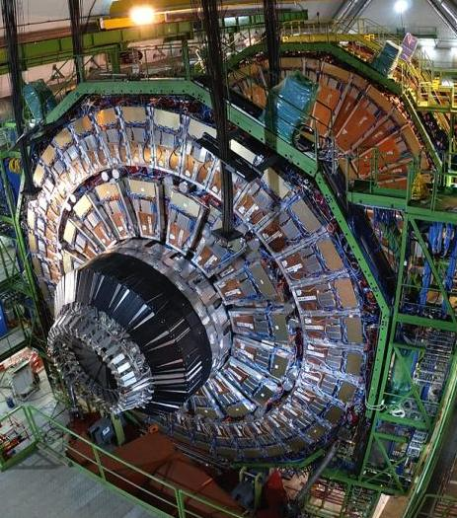
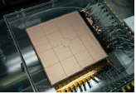
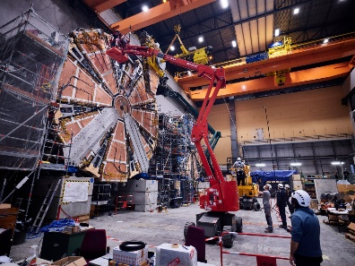
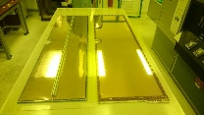
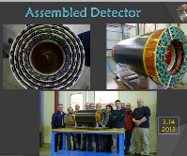
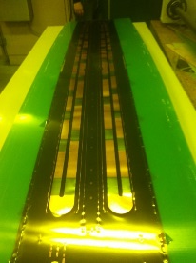
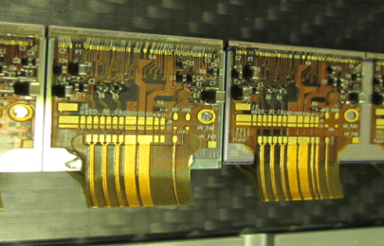
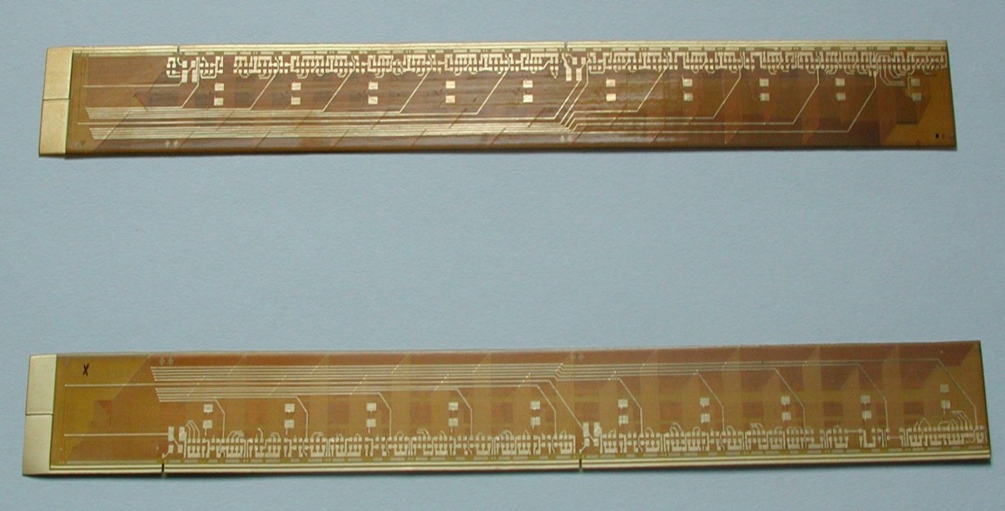
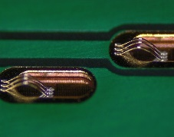
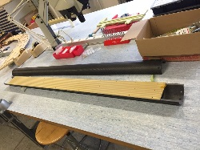
Examples of MPT activities
Micromegas
  ILC Calorimeter
  Minos TPC
  T2K
  ATLAS NSW
  Cast
  Panda X uBulk detectors
  TrexDM uBulk detectors
  TPC’s for Nuclear physics
  Beam for School
  T2K upgrade
  Clas12
  Scanpyramid
  Etc…
GEM :
  Compass
  CMS GEM GE1/1
  CMS GEM GE2/1
  ALICE TPC GEM
  CBM GEM for Fair
  BM@N (Baryonic Matter at the Nuclotron Dubna)
  Low material budget detectors (Hampton university)
  Kloe
  Totem
  LHC-B
  Phoenix TPC (Brookhaven)
  SBS tracker (Jefferson Lab)
  EIC tracking detectors (Jefferson Lab)
  Etc…
Inner trackers
  ALICE Inner tracker Al Bus
  Phoenix TPC AL bus
  ATLAS IBL
  ATLAS ITK
  LHCB data flexes
LHC
  Quench heaters
  Power Thick film resistors
  Magnetic sensors calibration
  Flexible heaters
  Diamond beam monitoring detectors
  Many Chemical milling
  RF Fingers

Slide 4
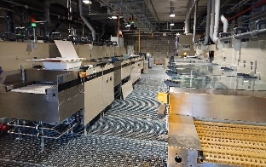
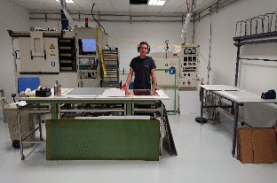
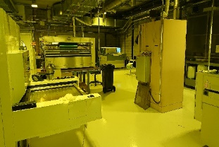
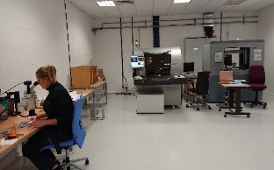
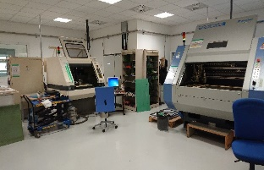
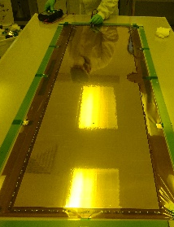
FSU Experts
-Photolithography (down to 30um line/space):
-Resist Lamination, spraying.
-UV exposure → LDI , STD , large , scanner.
-Resist Devellopment.
-Resist Stripping.
-Chemical etching:
-metals :Cu,Al,Ni,Au,Ti,W etc..
-Adam Drozd
-Guillaume Button
-Christophe Ferreira De Oliveira
-Pawel Dubert
-Galvanic and chemical plating:
-Cu, Ni, Au, In.
-Xavier Thery
-Vacuum press gluing.
-Jorge Penedo
-Optical & Electrical tests
-Elise Pechaud
-CNC Drilling/milling.
-Katia Jauregui
-Detectors production
-Zafer Budun
-Paul N’Guyen
-Patrick Ferreira De Oliveira
-Ercan Budun
Adam Drozd FSU team leader
Benilde Martins Administration

Slide 5
CERN Staff experts
-Design Bertrand Mehl
- Gazeous Detectors R&D Alexis Rodrigues
Olivier Pizzirusso
Antonio Teixeira
-Thin Film , Thick Film R&D Antonio Teixeira
-Vacuum deposition R&D Serge Ferry
-Chemical analysis Alexandra Gris

Slide 6
Introduction to MPGD detectors

Slide 7
Gaseous Detectors principle
Cathode
-
+
+
+
+
-
-
+
-
-
Ionization
Gas volume
Anode
Charged Particles

Slide 8
Gaseous Detectors principle
Cathode
-
-
+
+
+
+
+
+
+
-
+
-
+
-
Small Electric field
(100V/mm)
moves the charges
-
Ionization
-
-
-
-
Gas volume
Anode
Charged Particles

Slide 9
Gaseous Detectors principle
Cathode
-
-
-
+
+
+
+
Strong Electric field
(50kV/mm)
triggers an avalanche
multiplying electrons
+
+
+
-
+
-
+
-
Small Electric field
(100V/mm)
moves the charges
-
Ionization
-
-
-
-
Gas volume
Anode
Charged Particles
Output signal

Slide 10
Gaseous Detectors principle
Cathode
-
-
-
+
+
+
+
Strong Electric field
(50kV/mm)
triggers an avalanche
multiplying electrons
+
+
+
-
+
-
+
-
Small Electric field
(100V/mm)
moves the charges
-
Ionization
-
-
-
-
Gas volume
Anode
Charged Particles
Output signal
Any detector needs a low field region to do the ionization
and then move these primary charges in a high field region to amplify them

Slide 11
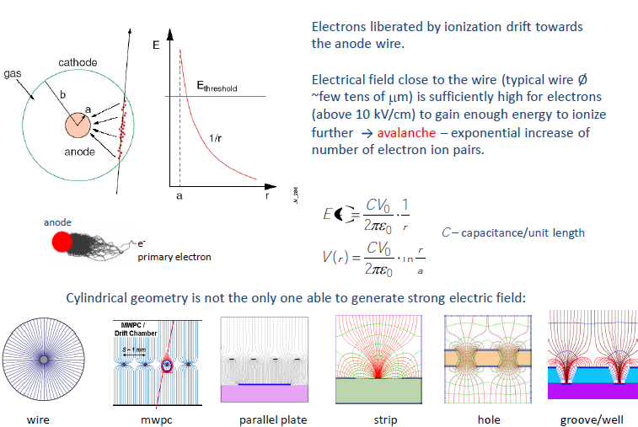
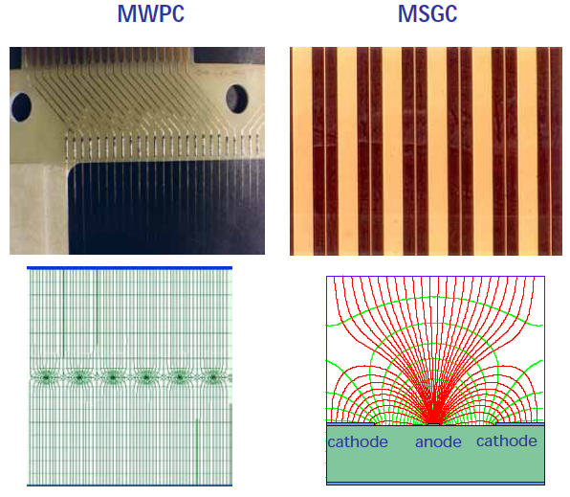
Different ways to get these 2 fields
Cathode
Cathode
Cathode
Cathode
cathode
cathode
anode
V2
V1
V1
anode
V1
anode
V1
V1
anode
anode
cathode
anode
The 2 regions are naturally obtained
because the field increases close
to the small Anodes wires
The 2 regions are obtained by adding electrodes
and 3D structures

Slide 12
Why MPGD ?
Wire chambers
slow ion evacuation
Limited read out granularity
Micro Pattern Gas Detectors
Faster ion evacuation
Higher spatial resolution
Reduced multiplication region size
MPGDs have detecting cells 10 times smaller than wire chambers structure
→ photolithographic technics

Slide 13
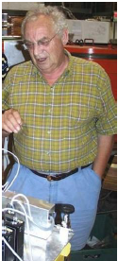
First MPGD → Micro Strip Gas Chamber (MSGC)
A. Oed
Nucl. Instr. and Meth. A263 (1988) 351.
RESULT:
Spatial resolution ~50μm
Rate capability ~10⁶ Hz/mm2
Pitch limited to 1 to 2mm due to mechanical and electrostatic forces.
Glass substrate with anode strips of 10 um with a pitch of 200 μm.
More simple than a wire Chamber.

Slide 14
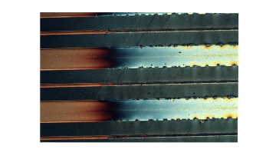
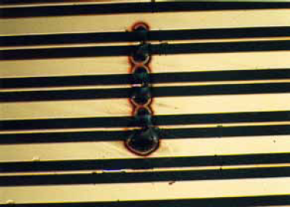
But as everybody knows there is always a problem
Spark damages coming
with heavy ionizing particles
→Unstoppable erosion of electrodes.
Too difficult to solve
Aging
→Creation of dendritic deposits
reducing the gain.
Same problem in Wire chambers
Also difficult to solve
Came a period where many different structures were tested by many labs to overcome such defects

Slide 15
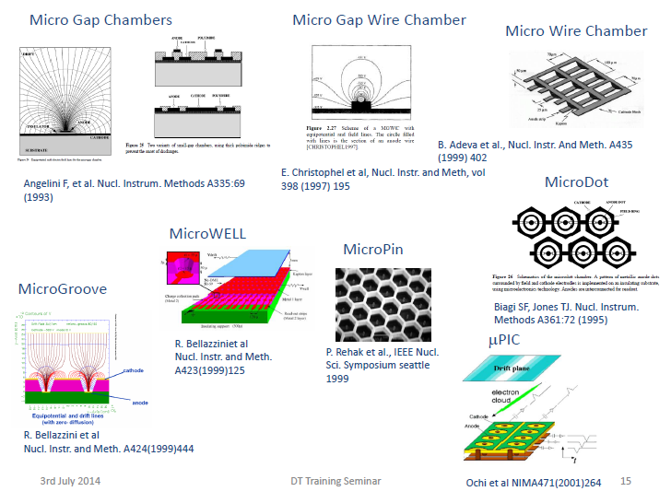
AND MANY OTHERS ….

Slide 16
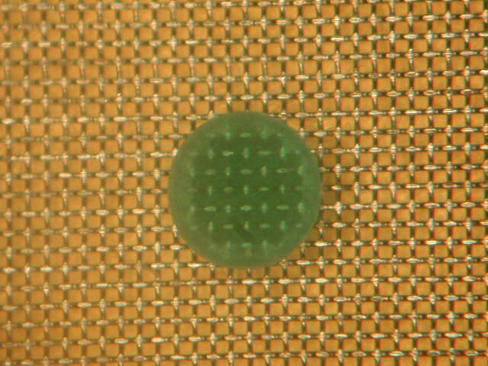
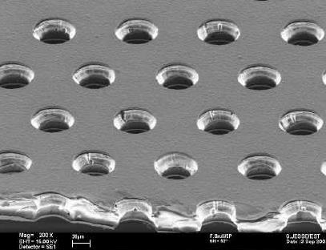
Nowadays, I think we can consider that the winners are:
GEM family
Micromegas family
GEM
Thick-GEM
uRwell
Micromegas
Resistive Micromegas
uBulk

Slide 17
Nowadays, I think we can consider that the winners are:
GEM family
Micromegas family
GEM
Thick-GEM
uRwell
Micromegas
Resistive Micromegas
uBulk

Slide 18
GEM production
the beginning

Slide 19
Interconnection technologies available at MPT in 1996
20um
MCM/D deposited
25um
Thin film technology
50um
Minimum line and space
MCM/C ceramic
75um
90um
MCM/L laminated
Technologies name
120um
Thick film technology
PCB
200um
MCM: Multi Chip Module
PCB: Printed Circuit Board
Screen printed circuits

Slide 20
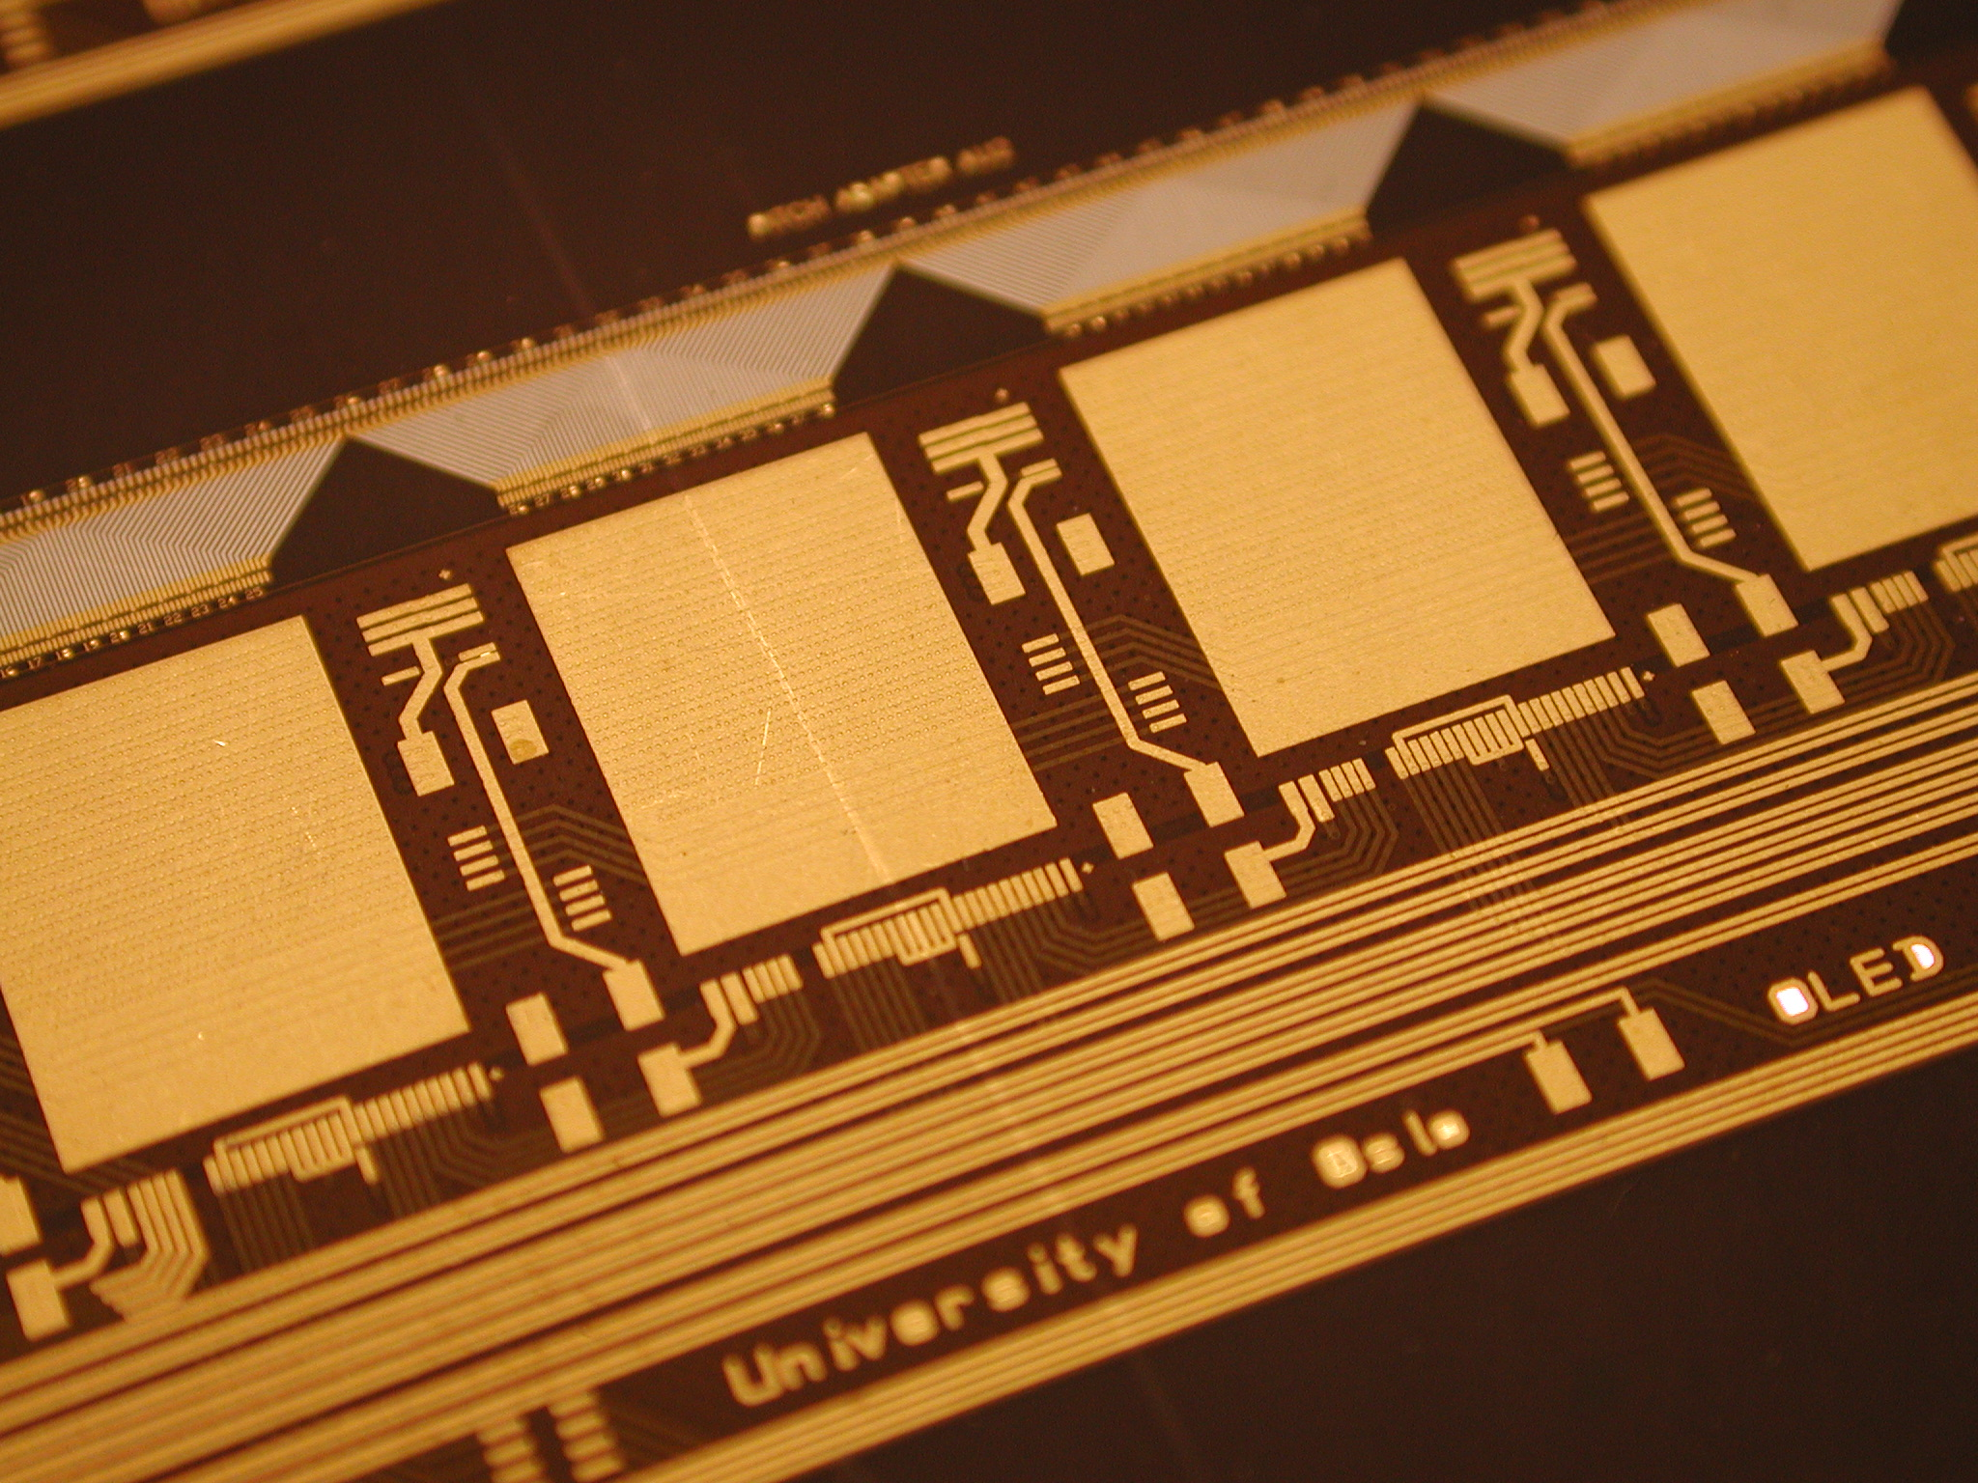
Interconnection technologies available at MPT in 1996
20um
MCM/D deposited
25um
Thin film technology
50um
Minimum line and space
MCM/C ceramic
75um
90um
MCM/L laminated
Technologies name
120um
Thick film technology
PCB
200um
MCM: Multi Chip Module
PCB: Printed Circuit Board
Screen printed circuits

Slide 21
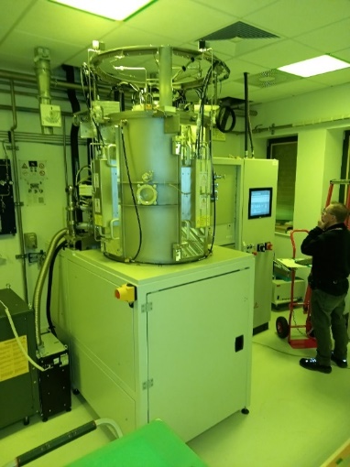
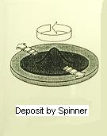
MCM / D
Atlas strip detectors R&D
Conductor material
  AL 10um
  Vacuum deposited
Dielectric material:
  Photo-imageable Liquid polyimide (PI)
  20um thick
  deposited with a spinner
Photolithography:
  Minimum track 20um
  Minimum via hole 25um
Substrate :
  TPG (Thermally annealed Pyrolytic Graphite)
liquid PI typical application:
-Chip Scale Package (CSP)
-or Chip passivation
Pb/Sn Bump
PI 2
PI 1
STD Wire-Bond Pad
Silicon Die (Chip)
But the important detail is :
PI stripper :Ethylene Diamine (EDA)

Slide 22
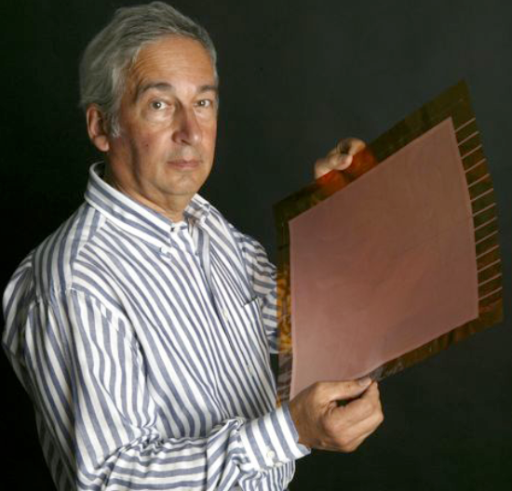
Fabio Sauli visit in 1996
Fabio was originally looking for a electron preamplifier stage to improve MSGCs
Request : foil with small holes of 100 to 200um
Electrode on both sides
And large size : 20cm x 10cm !

Slide 23
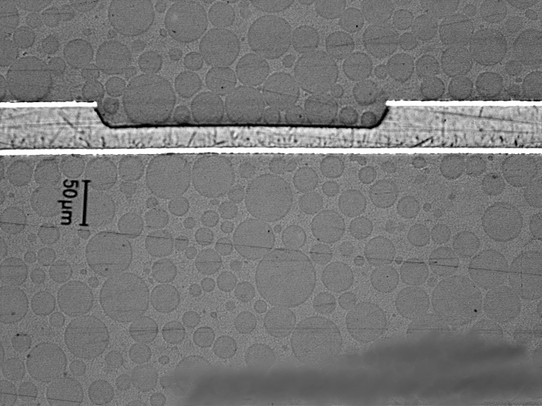
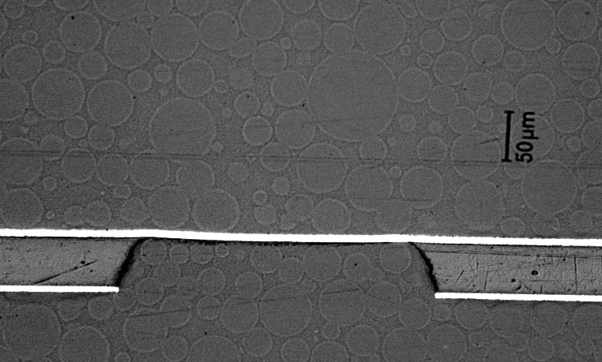
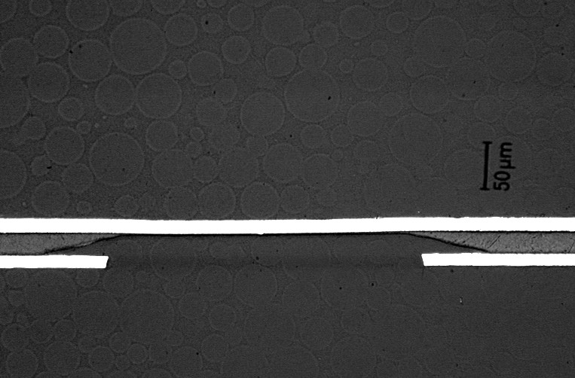
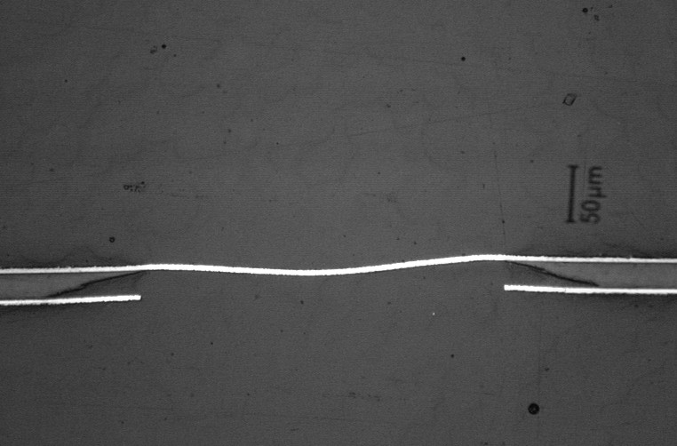
Survey on Polyimide etching with EDA
First type of polyimide:
Perfect anisotropic etching
No under etch
Perfect to make small holes
OK
OK
Second type of polyimide:
Fully isotropic etching
Not satisfactory
We were lucky to find
immediately a good candidate
since there is more than 50 different PI types on the market
bad
bad

Slide 24
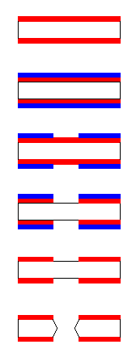
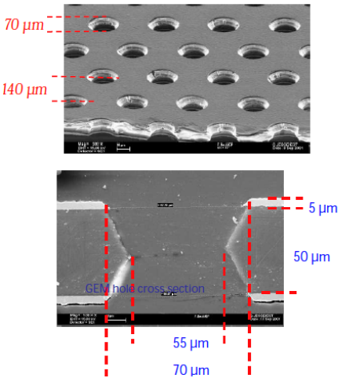
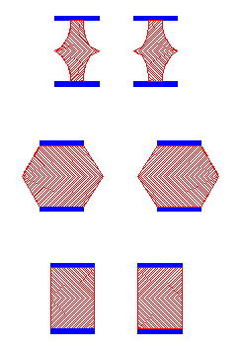
GEM Manufacturing Process
Optimum pattern for physics
Obtained after many trials
Vacuum deposited
copper on polyimide
Applying Resist
Bad
1
UV Exposure
& Development
OK
2
Copper Etching
OK
3
Resist Stripping
Polyimide Etching
and Cleaning

Slide 25
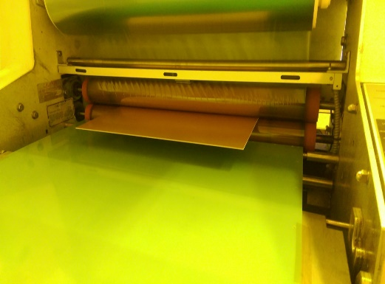
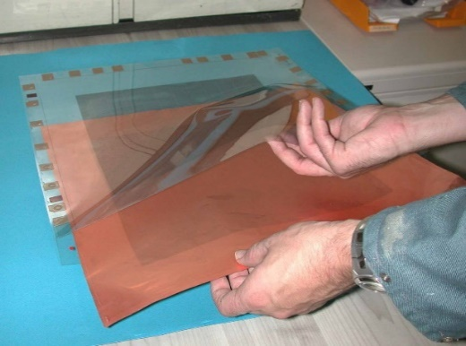
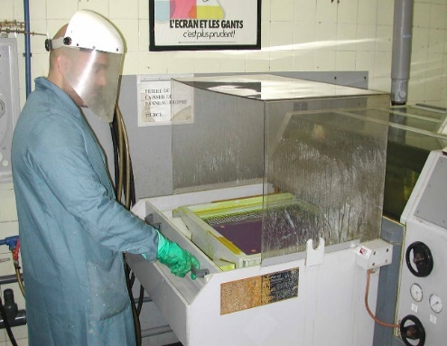
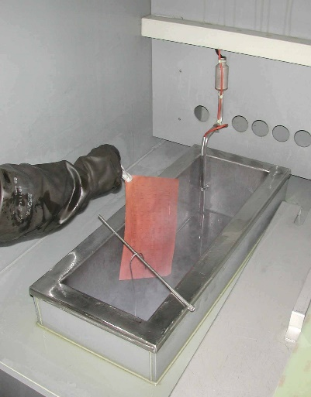
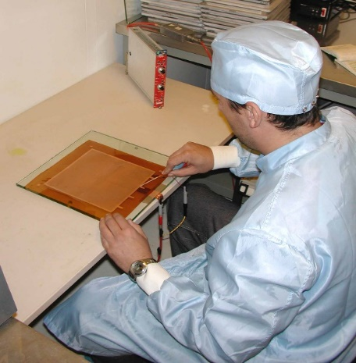



Manufacturing Process
Resist lamination
Image transfer
Copper Etching
PI Etching
2 aligned films pocket
Chemical spray
Dead bath
HV test
2nd copper etch
2nd image Transfer
2nd lamination

Slide 26
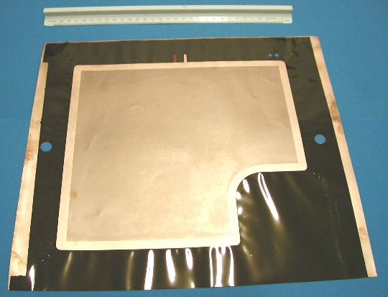
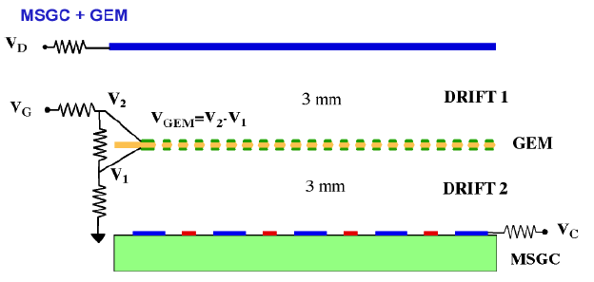
GEM first application
Reduce the spark risk on the MSGC by doing part of the amplification in the GEM
First real application:
Save the HERA-B Experiment
(300 GEMs)
200mm x 200mm
The GEM gas gain was only 10
Today the GEMs can reach easily a gain of many hundred

Slide 27
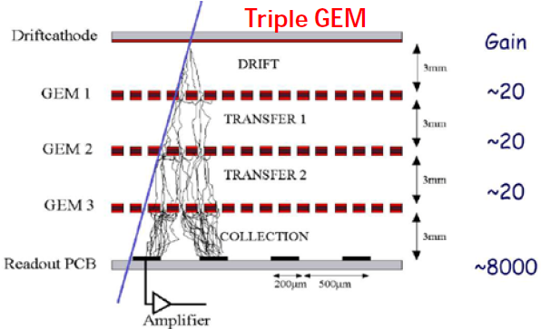
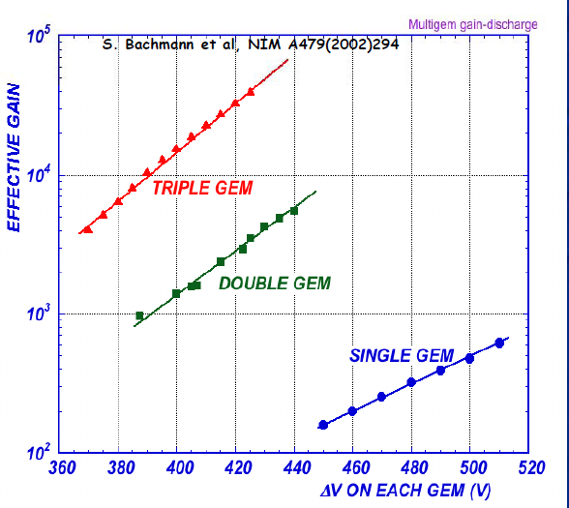
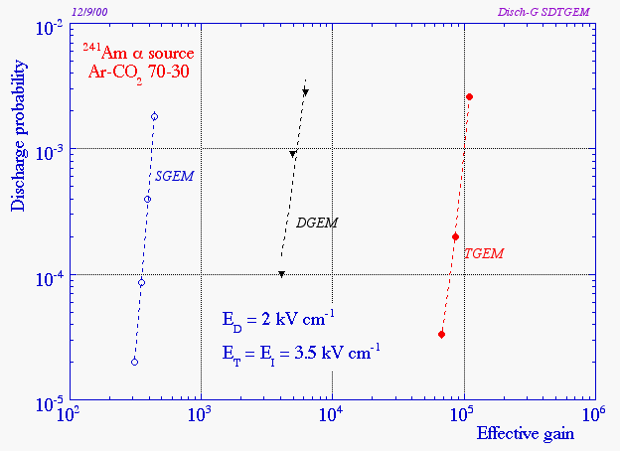
Triple GEM = detector
A cascade of multiple GEMs permit to reach high gains (> 10⁴) before discharges with lower voltage for each GEM.
Gain is increased by about one order of magnitude at each addition of a GEM.

Slide 28
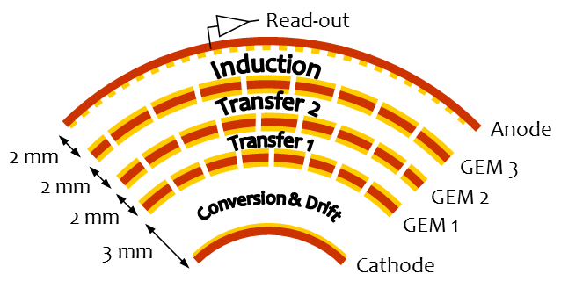
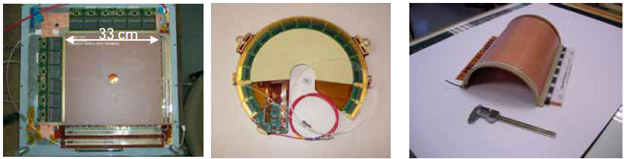
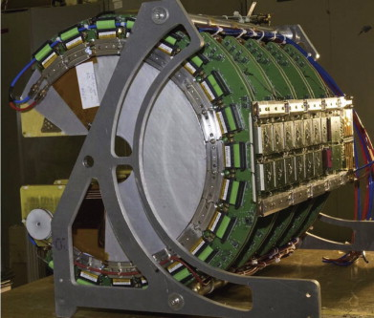
Triple GEM = detector
Compass settled all the parameters:
-GEM Segmentation
-HV distribution
-X/Y Read out board
-FE electronics
TOTEM
30cm diameter
Cylindrical R&D
40cm x 40cm

Slide 29
But the community started to ask for larger detectors.
We tried to increase the mask size using the same technique.
We faced unsolvable problems with mask alignment.
The cost of glass mask is prohibitive
15 000 CHF for 1m x 0.6m.
We manage to patch GEMs but this was a bit too complex.
We then tried to use the best automatic alignment machine available on the market.

Slide 30






LDI laser direct imaging
Top to bottom alignment :
Announced +/-15um
Real +/- 40 um
Direct laser exposure of resist
following a GERBER file.
Scanning process
Corners of a 800mm x 400mm GEM

Slide 31
LDI laser direct imaging
Top Vs bottom alignment :
Announced +/-15um
Real +/- 40 um
Direct laser exposure of resist
following a GERBER file.
Scanning process
Corners of a 800mm x 400mm GEM

Slide 32
Why not using only one mask to skip alignment?
1/ etch holes in the top copper with one mask
2/etch the Polyimide through the copper holes
3/ etch the bottom copper through the PI holes
Problem → how to etch the bottom copper without etching the TOP copper ?

Slide 33



Differential etching
Top
Bottom
  Working but:
  -Large rims
  -Bad yield
  -Hole shape too conical
  -Charging up
  -Lower gain

Slide 34
Differential etching
Top
Bottom
  Working but:
  -Large rims
  -Bad yield
  -Hole shape too conical
  -Charging up
  -Lower gain

Slide 35




Top copper plating protection
Top
Bottom

Slide 36
Top copper plating protection
Top
Bottom

Slide 37





Invert a Copper plating bath
Top
Bottom

Slide 38
Invert a Copper plating bath
Top
Bottom

Slide 39





Electro protection & chemical etching
TOP
Bottom

Slide 40
Electro protection & chemical etching
TOP
Perfect
Bottom

Slide 41


Double Mask Vs single mask
Base material : Polyimide 50um + 5um on both sides
Double mask
Single mask
Same base material
Hole patterning in Cu
Polyimide etch
Bottom electro etch
Second Polyimide Etch
Limited to 40cm x 40cm due to
  Mask precision and alignment
Limited to 2m x 60cm due to
  Base material
  Equipment

Slide 42



Single mask introduced cost reductions:
10cm x 10cm GEM example
The 10cm x 10cm double mask GEM cost is 300 CHF/piece
For 100 pieces with Single mask the cost dropped to 100 CHF/piece
For 10 000 pieces , less than 50 CHF

Slide 43




CMS GE1/1 application
Microscopic view
Single GEM
CMS experiment
Cross section
GE1/1 → 400 GEM (1.3m x 0.5m) made at CERN
GE2/1→ 1000 GEM (1.3m x 0.5m) CERN/Korea
GEM producers capabilities:
-CERN MPT : 500m2/year
-Mecaro Korea : 250m2/year
Mecaro will finish half of GE2/1 end 2023
MPT will finish the other half mid 2023
Triple GEM stack
GE1/1 Muon detector
CMS nose

Slide 44



And many many more
Other detectors using single mask technique
Future CMS ME0
KLOE – Cylindrical Detector
ALICE TPC – 700 GEM
-BM@N in Dubna
-SBS tracker Jefferson lab
-CBM at Fair
-BESIII China
-SOLID
-BONUS 12
-P-RAD
-S-Phenix TPC
-COMPASS upgrade
-GEM for nuclear physics TPCs
-ESS for neutron detectors
-and lot of small GEMs for academic purpose

Slide 45

Micromegas
George Charpak and Ioannis Giomataris

Slide 46

Principle

Slide 47



Micromegas during early days
-Electro formed mesh stretch on frame
→ ultra fragile
-Amplification gap defined with
fishing wires (really long & delicate job)
-Good detector but a pain to produce
-Low yield → small size
-Frame needed
frame
SACLAY
PCB with R/O structure
-Thin patterned copper 5um → still fragile
-Amplification pillars attached to mesh by process
-Pillars done by photolithography techniques
-low yield also → small size also
-Frame still needed
frame
CERN
PCB with R/O structure

Slide 48
Interconnection technologies available at MPT in 1996
20um
MCM/D deposited
25um
Thin film technology
50um
Minimum line and space
MCM/C ceramic
75um
90um
MCM/L laminated
Technologies name
120um
Thick film technology
PCB
200um
MCM: Multi Chip Module
PCB: Printed Circuit Board
Screen printed circuits

Slide 49

Interconnection technologies available at MPT in 1996
20um
MCM/D deposited
25um
Thin film technology
50um
Minimum line and space
MCM/C ceramic
75um
90um
MCM/L laminated
Technologies name
120um
Thick film technology
PCB
200um
MCM: Multi Chip Module
PCB: Printed Circuit Board
Screen printed circuits

Slide 50





MCM/C
-Conductive Layers: noble metals
-Dielectrics : Ceramic
-Sequentially printed layers
-850 Degrees curing
-Precise deposition
-Small sizes : 20cm x 10cm max
-High density
-High Thermal Conductivity
-Vacuum compatible
Screen printing machine
Screen with a patterned
Photo-imageable emulsion
on the mesh
Principle

Slide 51




Screen printing is quite common
Semi automatic screen printing machine
Printing area 2m x 0.9m for posters (Satigny)
Manual printing on a T-shirt
CERN precision machine 20cm x20cm
for Micro-electronic
Semi automatic CERN machine 1.5m x 2m
General purpose

Slide 52


Why not using this type of mesh for MM ?
Etched mesh
Mechanically robust
Low cost compared to Electroformed or etched
325 wires/inch → wire 24um → transparency 48%
400 wires/inch → wire 18 um → 49%
640 wires/inch → wire 15um → 39%
730 wires/inch → wire 13um → 40%
Available in rolls of 1.2m up to 1.7m
The answer came from Patrick Janneret PHD student
@ Neuchatel university.
Even if the idea was in the air , he was the first to ask us
to put spacing pillars on a woven mesh and test them.
And the results were really good.
This was the important missing detail to go for the next stage.
Woven mesh

Slide 53


With I.Giomataris we decided to develop these 2 structures
BULK Micromegas
Developed in 1 week
Floating mesh Micromegas
The detectors behavior were really good !
The technology spreading was quite rapid

Slide 54




BULK Micromegas detectors
T2K TPC ,J.Beucher
1.8m x 0.8m plane
With 12 detectors
ILC DHCAL , M.Chefdeville
1m x 1m plane
With 6 detectors
ATLAS NSW R&D, Joerg Wotschack
1.5m x 0.5m plane
Single panel
Muon detector in LHC background

Slide 55
But during the early phase of ATLAS NSW R&D we rapidly faced a big problem.
In presence of LHC background the detectors were continuously sparking , compromising seriously the use of this technology in HEP applications .
In close collaboration with Joerg Wotschack we decided to add resistive layers.
It took us 12 iterations to understand how to use resistive layers

Slide 56






R1-R2-R3-R4-R5-R6-R7
Resistive layer directly on R/O lines
PCB
PCB
PCB
Several resistive values and
Shapes have been tested
Test : apply a voltage above the
breakdown voltage of the gas (Air), with a really high current limitation (10mA)
All detectors died within a sec !
-Vertical resistive layer breakdown
-and massive Mesh melting

Slide 57
Then R9-R10
Cross section
PCB
Active area 100mm
PCB
Coverlay
65um
Resistive Strip
1MOhms / cm
Copper Strip 0.15mm x 100mm

Slide 58
Then R9-R10
Cross section
PCB
PCB
Coverlay
65um
Resistive Strip
1MOhms/cm
Copper Strip 0.15mm x 100mm
For the fist time a structure survived our test for more than 1mn.
We have anyway been able to damage the detectors .
Damages were always near the connection between resistive strip and copper strip.

Slide 59
And finally R11-12
Addition of an
embedded resistor
15 MOhms 5mm long
PCB
GND

Slide 60
And finally R11-12
Addition of an
embedded resistor
15 MOhms 5mm long
PCB
GND
Perfect behavior, sparks were quenched
This helped us to validate our electrical model of the spark mechanism

Slide 61


Validation with Neutron irradiation on R11-R12
(protons effect)

Slide 62
Validation with Neutron irradiation on R11-R12
(protons effect)
Nominal operation voltage

Slide 63
Validation with Neutron irradiation on R11-R12
(protons effect)
Peak current limited by the power supply
Increasing the current limit increases the peak currents
The real situation is even worse than this plot
Peak current is limited by the detector itself
Current peaks due to voltage ramp up

Slide 64
ATLAS NSW prototype production
50um Kapton + resistive strips
PCB + readout strips

Slide 65
50um Kapton + resistive strips
PCB + readout strips
25um solid Glue

Slide 66
50um Kapton + resistive strips
PCB + readout strips
25um solid Glue
High temp Gluing

Slide 67

50um Kapton + resistive strips
PCB + readout strips
25um solid Glue
High temp Gluing
Pillars deposit

Slide 68
50um Kapton + resistive strips
PCB + readout strips
25um solid Glue
High temp Gluing
mesh

Slide 69





Real ATLAS NSW prototype 1m x 2m
Open
Open
Closed
Closed

Slide 70

Atlas NSW
Close to 2000 Micromegas detectors produced with sizes up to 2m x 0.5m
PCBs with pillars built at ELTOS (IT) and ELVIA (FR)
Panels construction and detector Assy :
-Dubna
-INFN Frascati
-CEA Saclay
-LMU Munich
MPT participated largely to the R&D and was also involved in the mass production with industry
-Specification
-Companies selection
-Technology transfer

Slide 71






Unfortunately for other applications, we were really limited with resistive values obtained by screen printing.
So the last evolution is the introduction of
Vacuum deposited resistive DLC layers (Diamond Like Carbon).
This is the result of a large collaboration effort :
We can now access nearly all resistive values
(from kOhms to Gohms per Square) .

Slide 72




Kobe
ESS
China USTC
Initial results: example of 1m x 0.6m foils 500Kohms/square +/-60%
The error dropped today to values around +/- 30%

Slide 73
DLC brought new capabilities:
Possibility to make 2D Micromegas detectors.
Spark protection improvement.
Possibility to make High rate resistive detectors.
Better granularity thanks to the resistive spreading effect.
Removed the need of electronic FE protections.

Slide 74


High rate resistive Micromegas
Medium rate detectors 100kHz/cm2
Side evacuation of the charges
High rate detectors 10Mhz/cm2
Charge evacuation inside active area
Printed
Single layer screen printed strips
2 layers screen printed pads
DLC
1 DLC layer without pattern
Best results
2 DLC layers without patterns
LSBB
50cm x 50cm
X/Y 1mm/1mm
30M/Sqr DLC layer
Silver line evacuation
Mix
DLC and screen printed pads

Slide 75
uRwell
Result of all the accumulated knowhow

Slide 76




Initial Micro-well
Anode strips
Cathode
Close-up view
Square pattern used
in the early days
Anode strips
-3 x 3 cm Micro-well detector
-Ronaldo Bellazzini idea 1997
-Produced at MPT with GEM processes
-Really simple but abandoned due
to the impossibility to mitigate spark damages
R/O lines
Anode
cathode

Slide 77
15 years later: introduction of a resistive layer to control the sparks thanks to MM experience!
After vacuum gluing
DLC coated foil
Prepreg
‘Wellized’ with GEM process
Any PCB or flex with any kind of R/O structure
X/Y , UVW , Pads, Capacitive sharing etc..

Slide 78




We have then explored different ways to improve the rate capability
Medium rate µRwell
Lateral evacuation of charges
High rate uRwell
Charge evacuation in the active area
DLC connected with Cu strips on the DLC
1 DLC layer
DLC connected by plated grooves or holes
10cm x 10cm µRwell detector
“STD kit”
2 DLC layers connected by plated holes

Slide 79
Best compromise between performances & cost → PEP
P→ Pattern top copper
E→ Etch the kapton
P→ Plate with copper
Wellize

Slide 80
uRwell advantages
Total control of the released energy during a spark.
The control is so good that we can use the sparks to clean the detectors ! → We call it “E-cleaning”
The simplest uRwell is flexible → cylindrical detectors are easy to produce.
Low mass , low background
First time we have a detector production process fully compatible with mass production tools from PCB industry.
We are aiming to reach a point were one can buy a uRwell as a STD PCB ( Technology transfer on going )
Lower cost than GEMs or resistive MM

Slide 81




PEP examples
Frascati R&D
1D PEP uRwell
Active area:
40cm x 5cm
Frascati R&D
1D PEP uRwell
Active area:
30cm x 30cm
CLAS12 R&D
2D PEP uRwell
Active area:
150cm x 50cm
CLAS12 uRwell
rolled in the oven
for E-cleaning

Slide 82
Future
Vacuum deposition
Subtractive micro-structuring
    Chemical
    Laser
    Reactive Ion Etching Plasma (RIE)
    Directive RIE Plasma (DRIE)
Additive micro-structuring
    3D printing

Slide 83

Pulsed DC magnetron reactive vacuum deposition machine @CERN
Max foil size:
  -1.7m x 0.7m.
Useful size:
  -1.7m x 0.6m.
Budget:
-25% INFN
-25% CERN EP/DT group
-50% MPT self financing
Can deposit
  -metals
  -Dielectrics
  -alloys
  -Carbon structures
Market survey → 04/21
Invitation to tender → 05/21
Purchase order → 08/21
Delivery → 10/22
Operation → 11/22
5 targets.
3 simultaneous deposition.
3 gas inputs for reactive deposits:
  H2,N2,02,C2H2,Ar etc..
300 deg in built heater.
In built plasma cleaner
Fantastic help during from:
  DLC collaboration team

Slide 84

Future Program for our vacuum deposition machine
Aluminum GEM
DLC resistive GEM
-Aluminium GEMs
-Low mass detectors
-Continue to explore DLC possibilities
-Improve Uniformity : target → less than +/-5% error (1m x0.6m)
-DLC/Cr/Cu deposition needed for Micromegas high rate detectors and resistive GEM
-Study of strong photocathodes for PICOSEC detectors
-Neutron converter layers deposition like B4C
-Explore other resistive materials like Ge

Slide 85



Subtractive micro-structuring with chemistry
(Polyimide etching)
Now
Future
Dead Baths in a dedicated hood with scrubber :
-EDA based chemistry
-Ok up to 1000m2 projects
-Strict safety procedures.
Automatic Horizontal etching line :
-10 000m2 projects.
-Still EDA based chemistry
-We are now finalizing the design (quite complex).
-Could be ready for production next year (2024).
-No more individual protective equipment's (IPE)
-Hermetic machine .
-Less handling → Production cost reduction expected

Slide 86



Laser or plasma subtractive micro-structuring
C02 laser
UV laser
RIE Plasma
DRIE Plasma
Large punching spot
Thin spiral cut
-Many possible base Materials.
-Holes perfectly clean.
-Small patterns
-Limited in size
-Machine cost
-Many possible base Materials.
-Machines can drill both metals and polymers
-Too slow! 200 Holes/sec max
-Limited in size
-Machine cost
-Carbonization
-Modarate machine cost .
-Holes perfectly clean
-Not uniform on large size.
-Etching Isotropy too prononced.
-Perfect cylindrical holes.
-Holes perfectly clean
-Ultra precise patterns
-Sample size : dia 20cm max.
-Machine cost .
Really Interesting
Interesting

Slide 87



Additive Micro-structuring ink-jet printers

Slide 88
Many thanks for your attention !

