Slide 1

WG 3.5
Novel High Light Yield Scintillating Fibers
20-02-2023
Sune Jakobsen (CERN EP-DT-TP)
on behalf of EP R&D WP 3.5 (CERN and EPFL)
EP R&D Day 2023-1

Slide 2

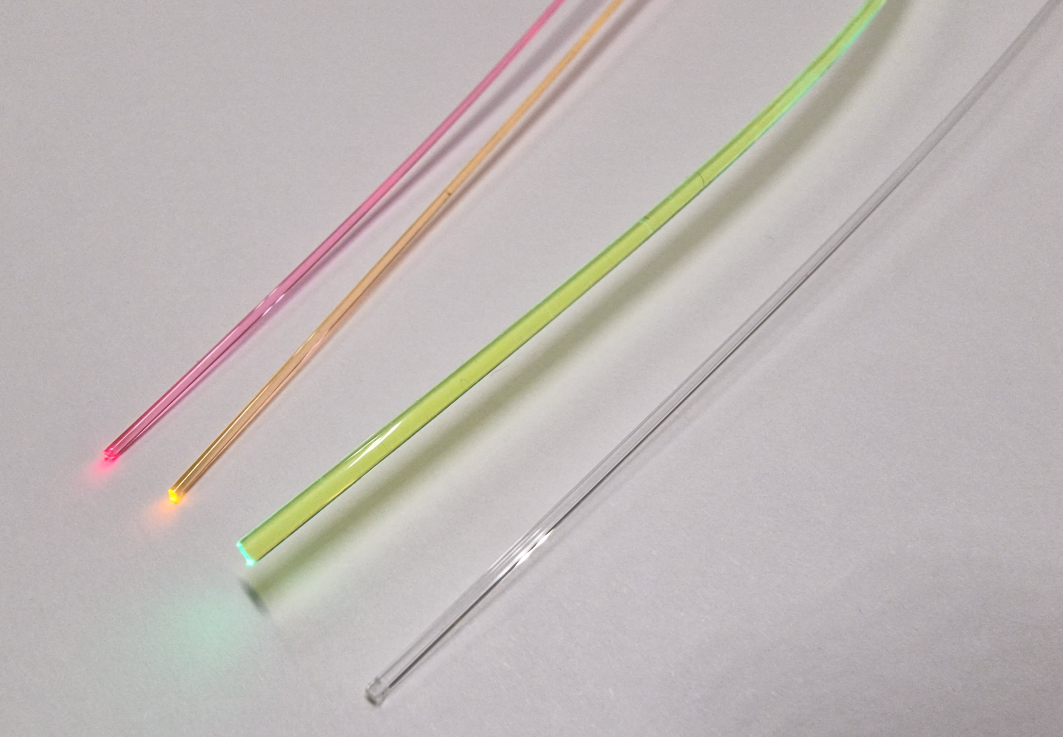
Novel High Light Yield Scintillating Fibers Wanted wavelength shifter
Novel High Light Yield Scintillating Fibers
A novel concept has been proposed to significantly increase the light yield in scintillating fibers.
The concept is also expected to lead to additional radiation tolerance.
The concept is still confidential: The aim is to only publish it after the concept has been proven on a protype fiber.
GIANT4 simulations shows a gain in light yield up to 85 %.
The fiber producer Kuraray is interested in the concept and has agreed to prototype it.
Before the prototyping can start, a wavelength shifter, wls, with specific properties need to be identified (see next slide).
We are collaborating with Copenhagen University chemistry department to find/make the needed wls.
A sub-optimal wls has been identified (gain of ~40 % light yield), but so far Copenhagen University has not agreed to make sufficient quantities for a fiber prototype and it still has to be proven that the wls is compatible with the base material.
We are therefore looking for other sources for the wls (see next slide).
When a wls is identified and a prototype fibers made (likely over several iterations), the plan is to:
Characterize the raw fiber (light yield, attenuation length, radiation tolerance, mechanical properties etc.)
Produce small prototype detectors and characterize the performance.
EP R&D Day 2023-1 WG3.5: Novel High Light Yield Scintillating Fibers 20-02-2023
Sune Jakobsen
2/3
Notes:
2

Slide 3

Novel High Light Yield Scintillating Fibers Wanted wavelength shifter
WANTED
Published or unpublished
Have you seen this wavelength shifter?
Big REWARD (for the HEP community): Novel high light yield scintillating fibers
Background from studentposters.co.uk
EP R&D Day 2023-1 WG3.5: Novel High Light Yield Scintillating Fibers 20-02-2023
Sune Jakobsen
3/3
Notes:
3

