Slide 1
Signal Integrity
and high-speed ASICs
David Porret PH/ESE
CERN EUG 26 2/2011

Slide 2
Outline
The GBT SerDes ASIC
Test setup
Building models of the setup
Simulations results vs. measurements
Conclusions and impressions

Slide 3
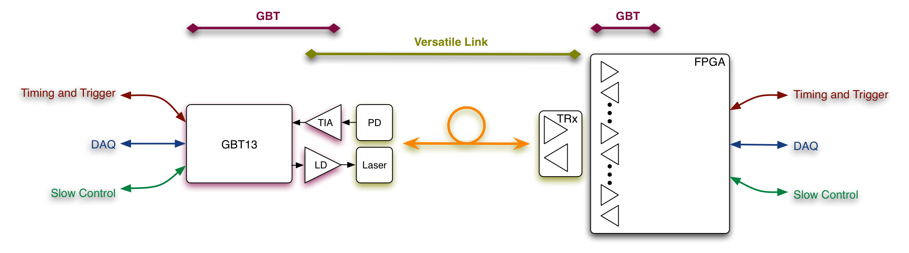
The GBT Project
Part of the Versatile Link project : Gigabit optical link for the LHC detectors.
Actually testing first version of the ASIC : GBT SerDes ,4.8 Gb/s serializer / deserializer.
On-Detector
Custom Electronics & Packaging
Radiation Hard
Off-Detector
Commercial Off-The-Shelf (COTS)
Custom Protocol

Slide 4
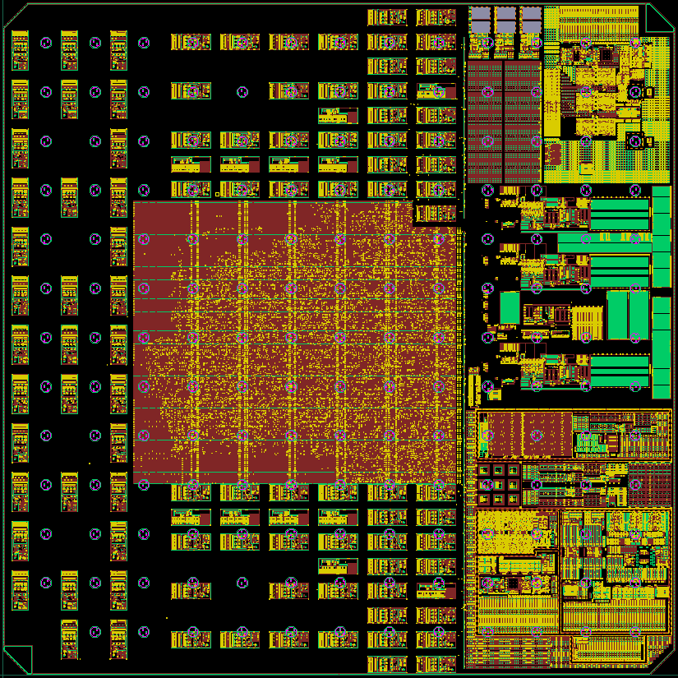
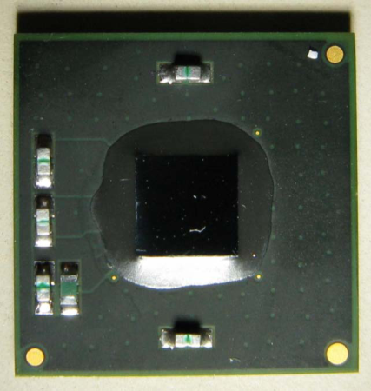
The GBT SerDes ASIC
=
130 nm CMOS technology
4x4 mm silicon die
12x12 mm 121 pins BGA Package

Slide 5
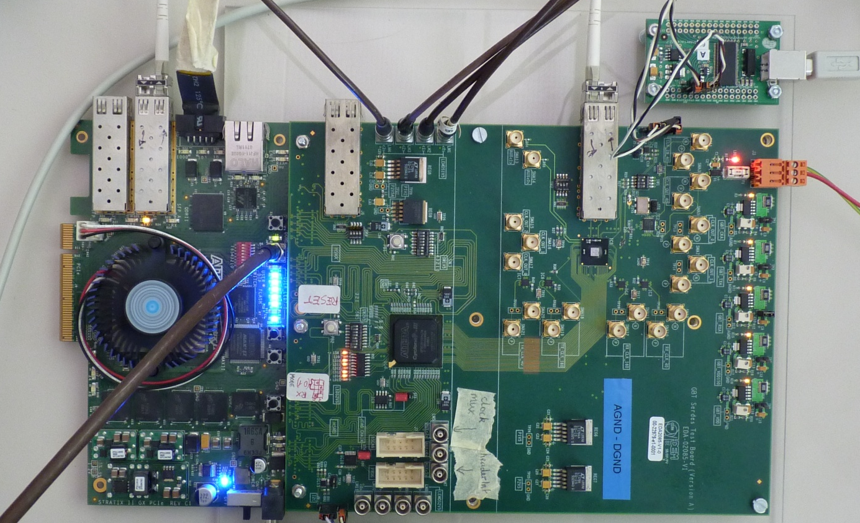
Test Setup
Conclusions from the TWEPP 2010 presentation
Almost all of the functions proved 100% functional (…)
For the De-serializer
  The clock recovery function works fine over the full range
  However, error free data reception at 4.8 Gb/s has not (yet?) been achieved!
    OK up to 2.4 Gb/s

Slide 6
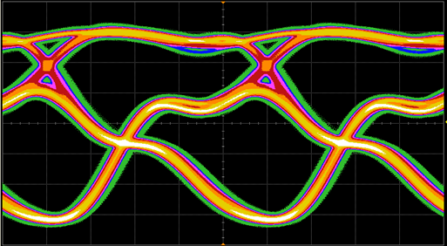
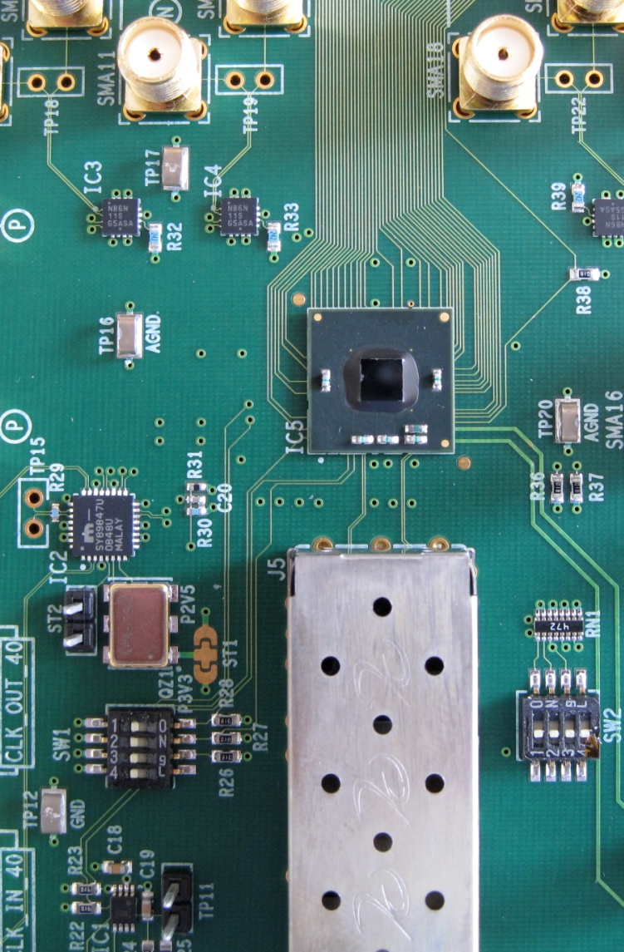
Test Setup
BGA Package
Silicon Die
Rx Termination
Tx Diff. Pair
4.8 Gb/s Frame
Probe Effect ?
Test board ?
Package ?
Chip Design ?
Rx Diff. Pair
SFP Module

Slide 7
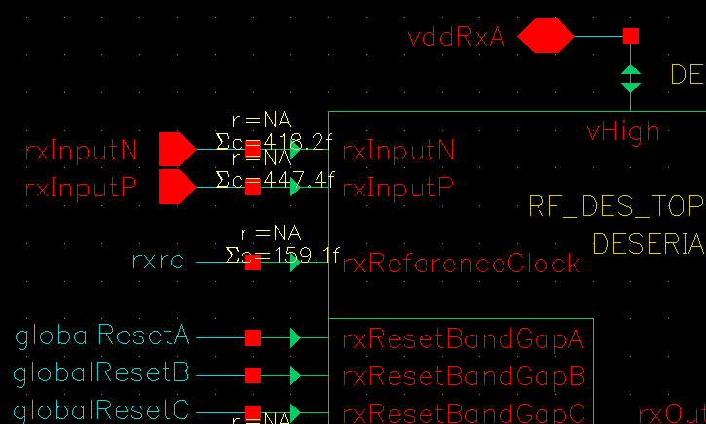
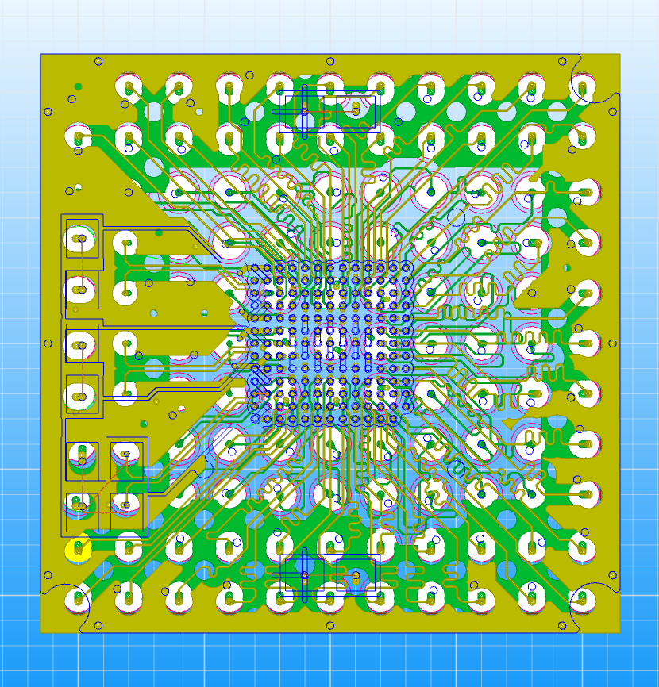
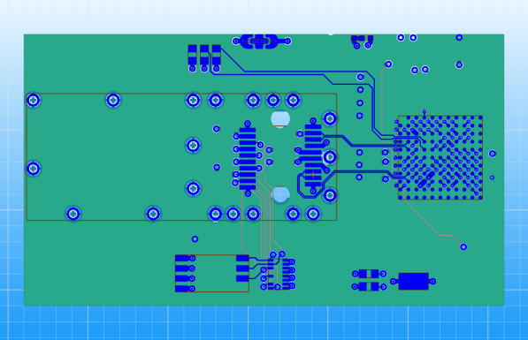
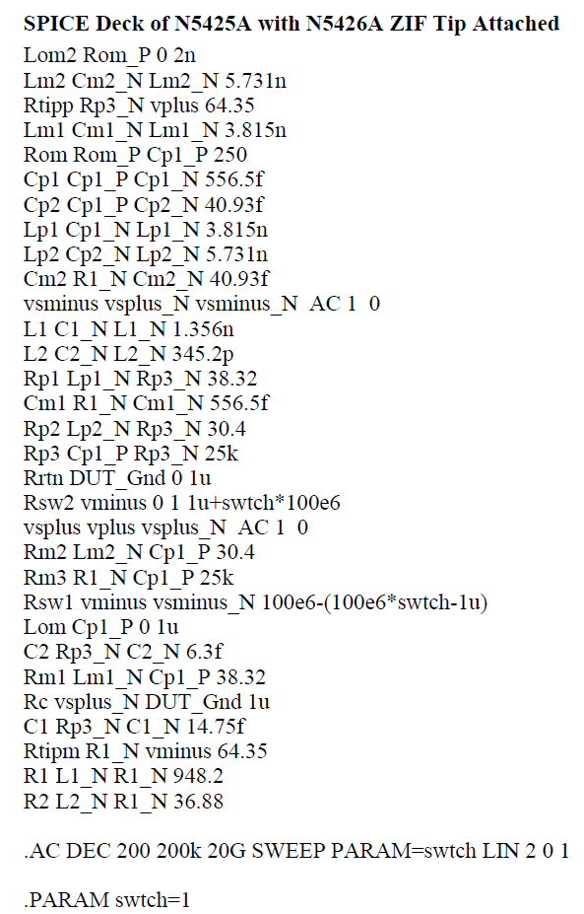
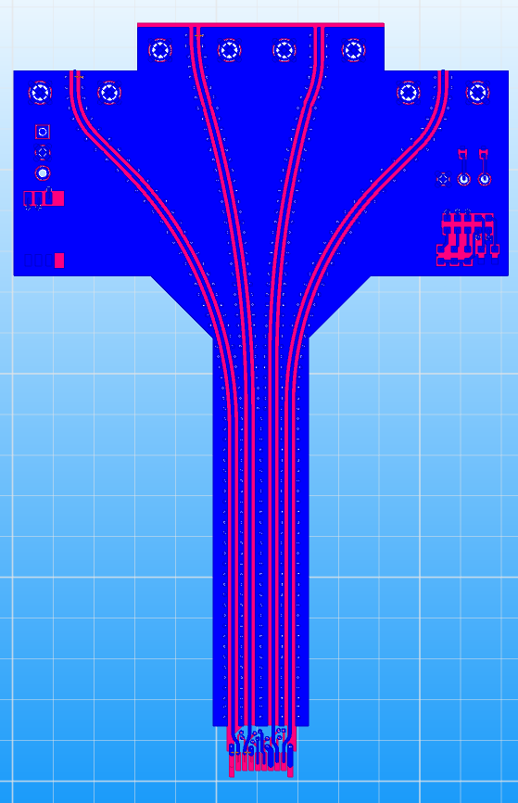


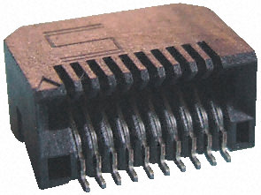
Modeling
SIwave
SIwave
S Parameters
Equivalent circuit
S Parameters
Spice Netlist
SIwave
S Parameters
HSpice Netlist
Ansoft Designer

Slide 8
Full Model in Designer

Slide 9
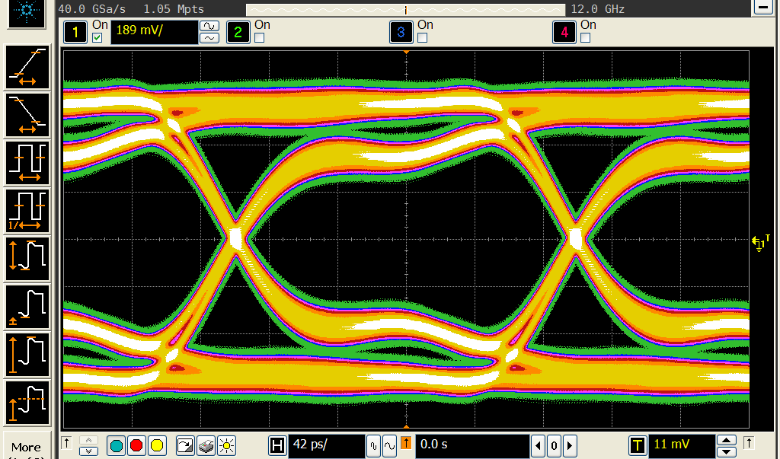
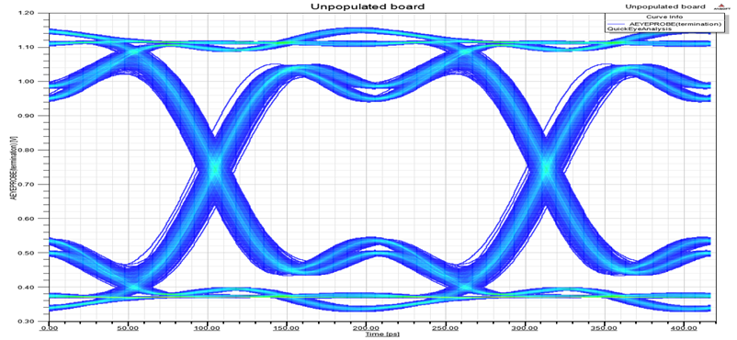
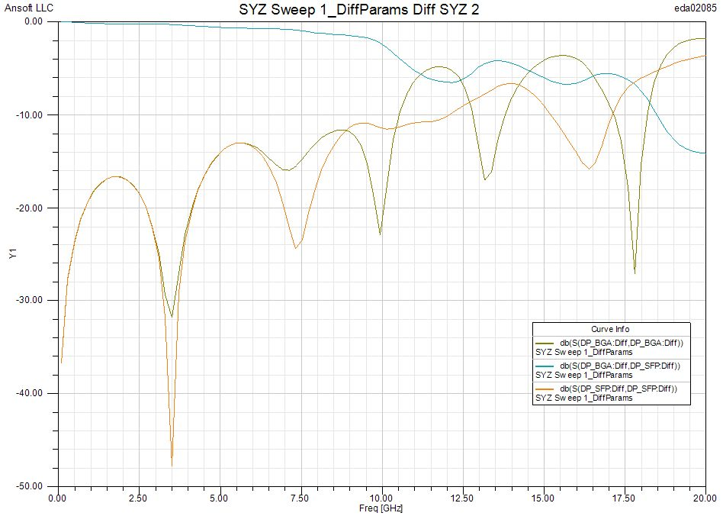
Test setup performance
Frequency domain simulation
Dielectric losses
Unpopulated board measurement and simulation with 100 ohms termination at the BGA pads

Slide 10
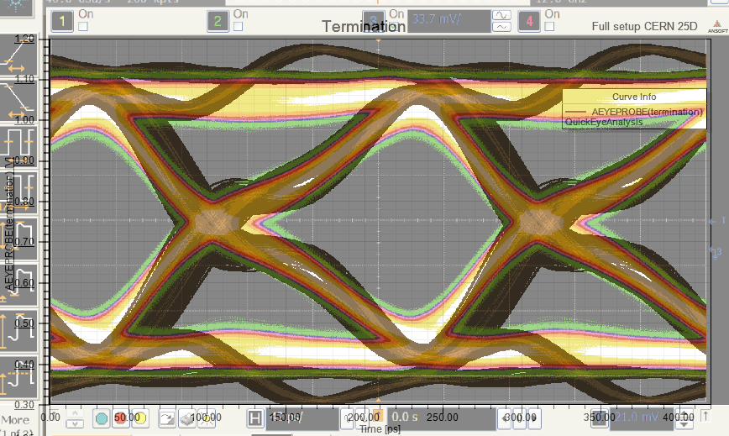
Simulation vs Measurement
Eye diagram
4.8 Gbps with PRBS pattern with probe model
“Ringing” on simulation ?

Slide 11
Simulation vs Measurement
TDR
Probe removed
Multiples comparisons show same behaviour but different absolute values

Slide 12
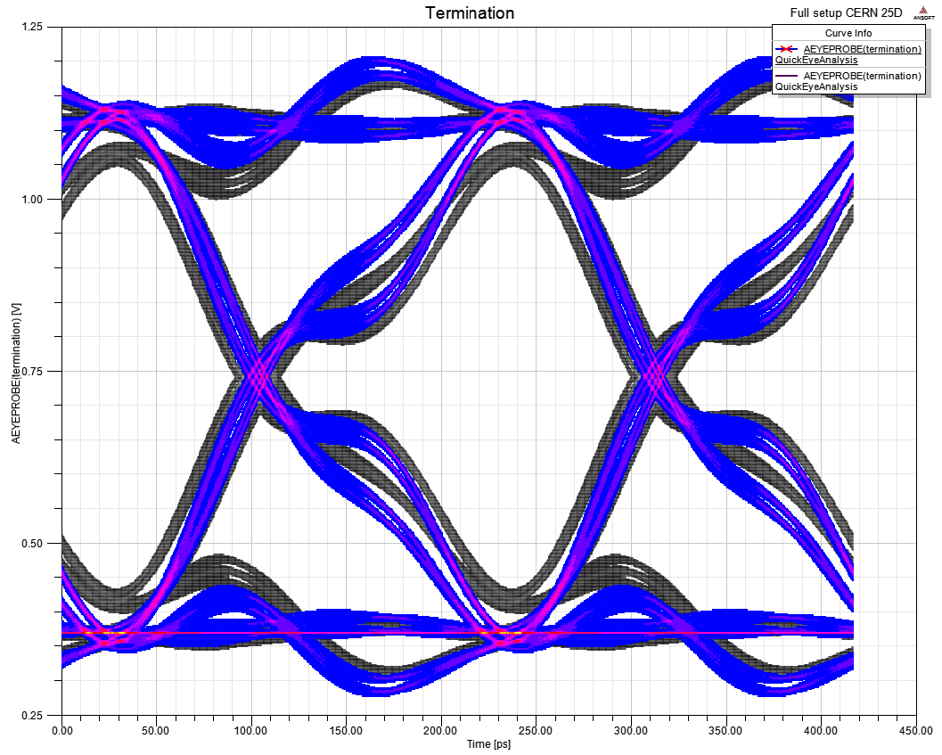
Probe Effect
Probe (gray)
No Probe (blue)

Slide 13
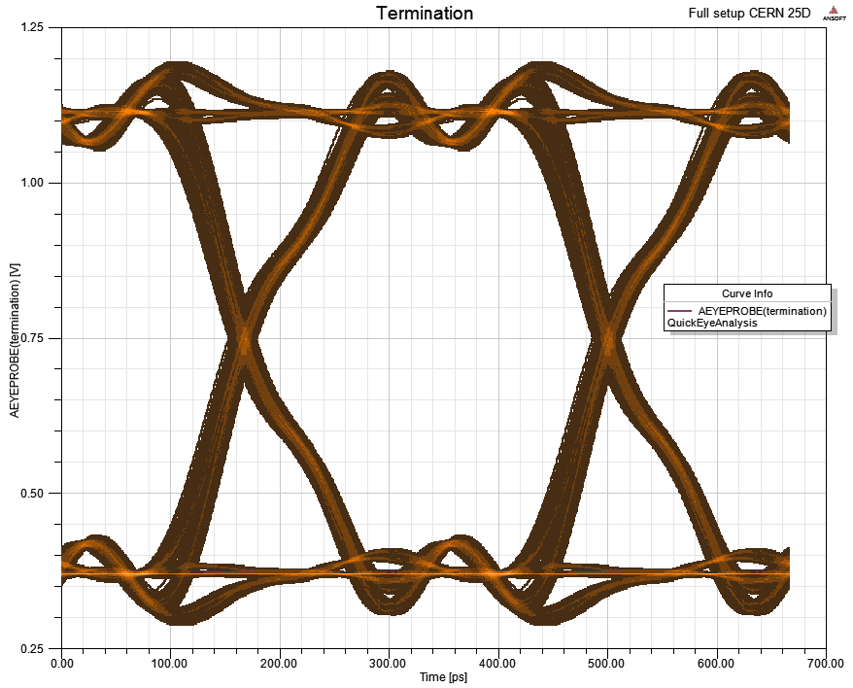
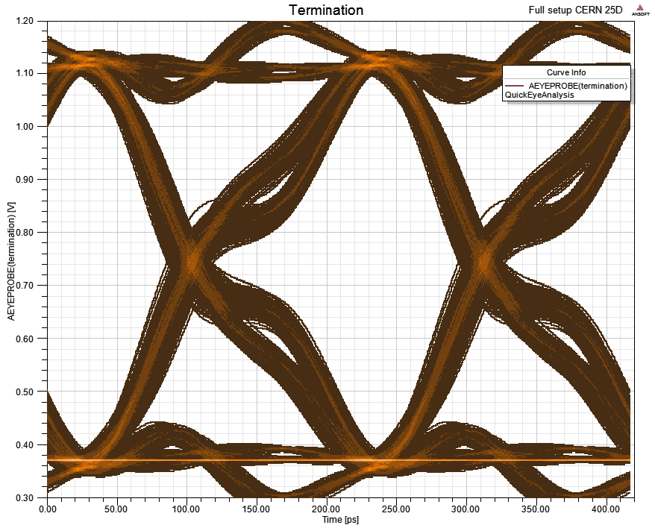
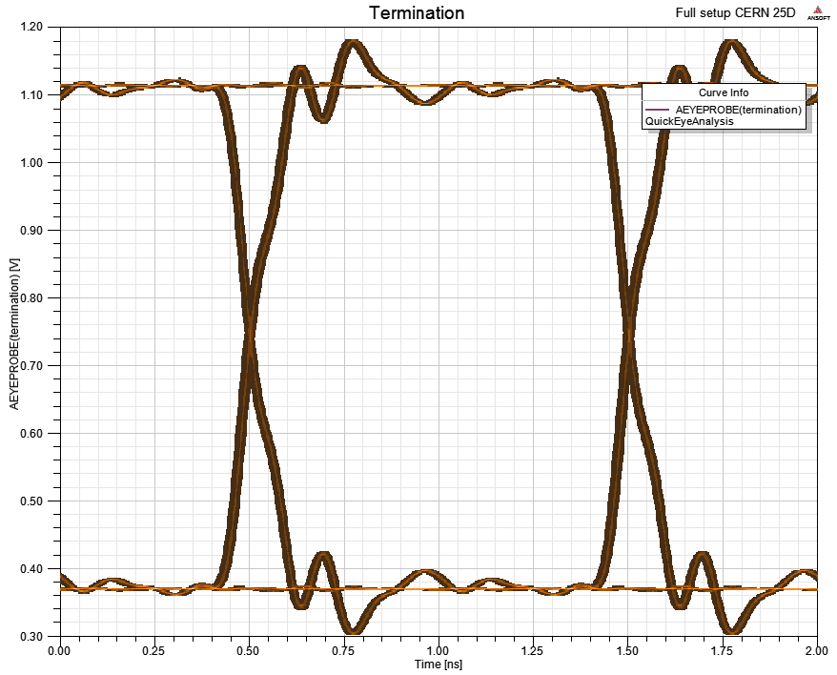
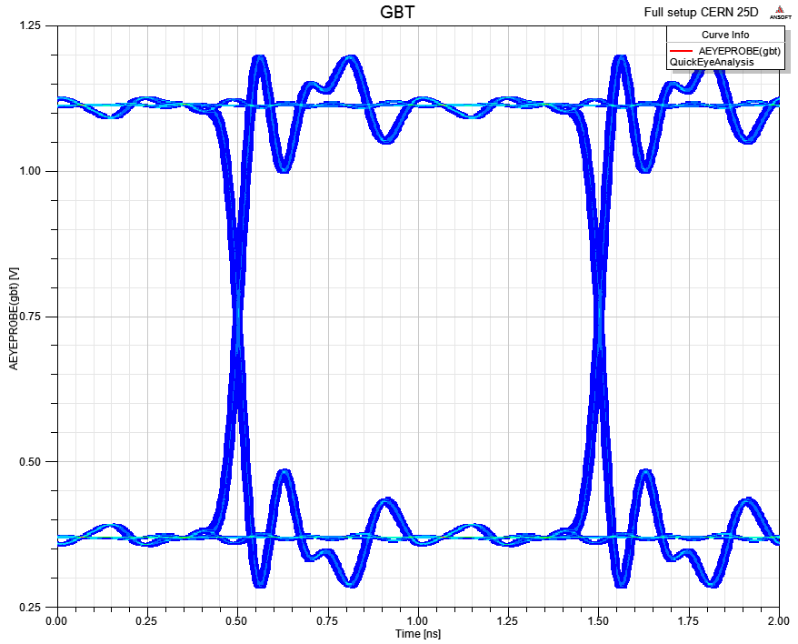
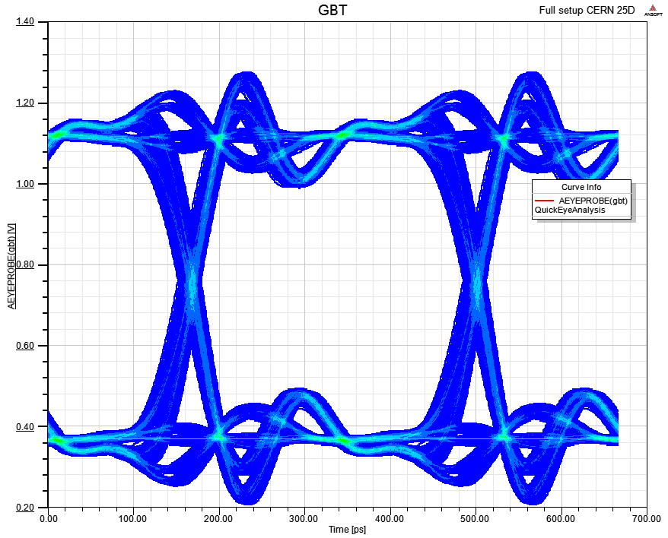
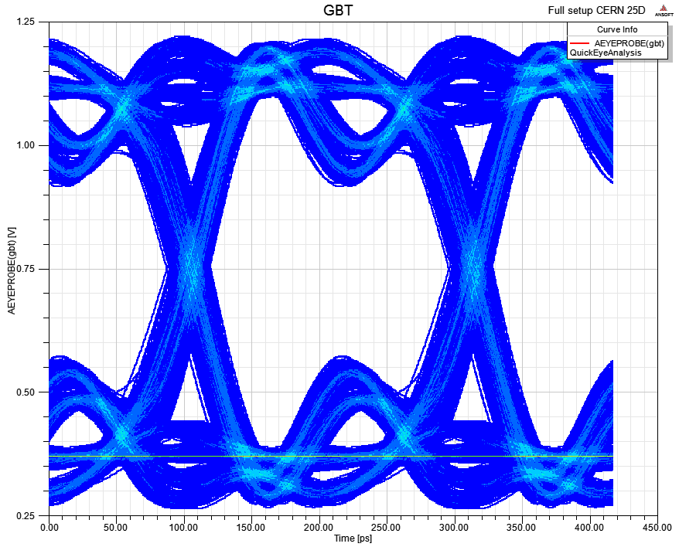
“Virtual Probing”
1Gbps
3.2Gbps
4.8Gbps
Termination
Silicon Die

Slide 14
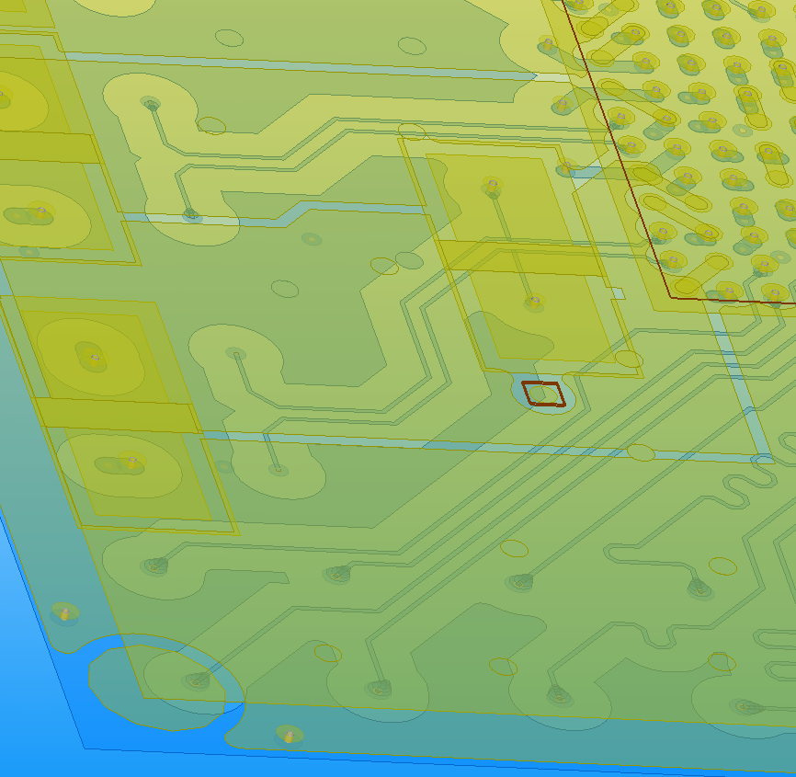
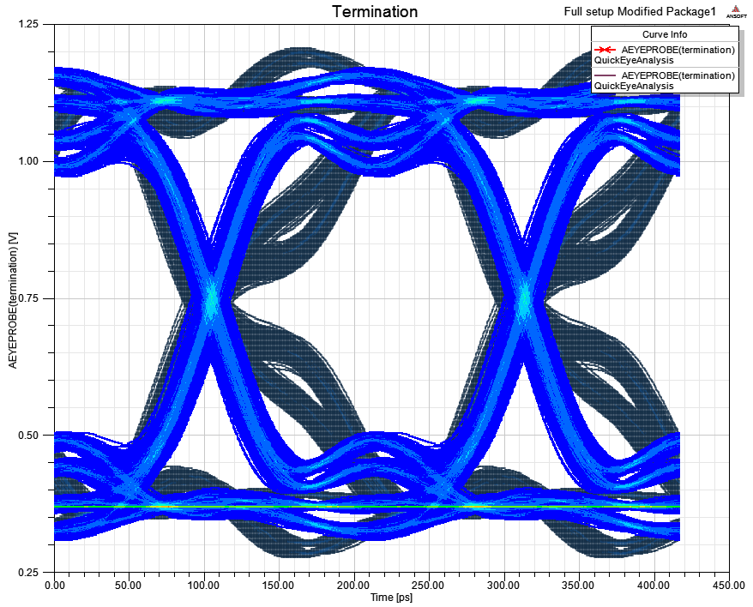
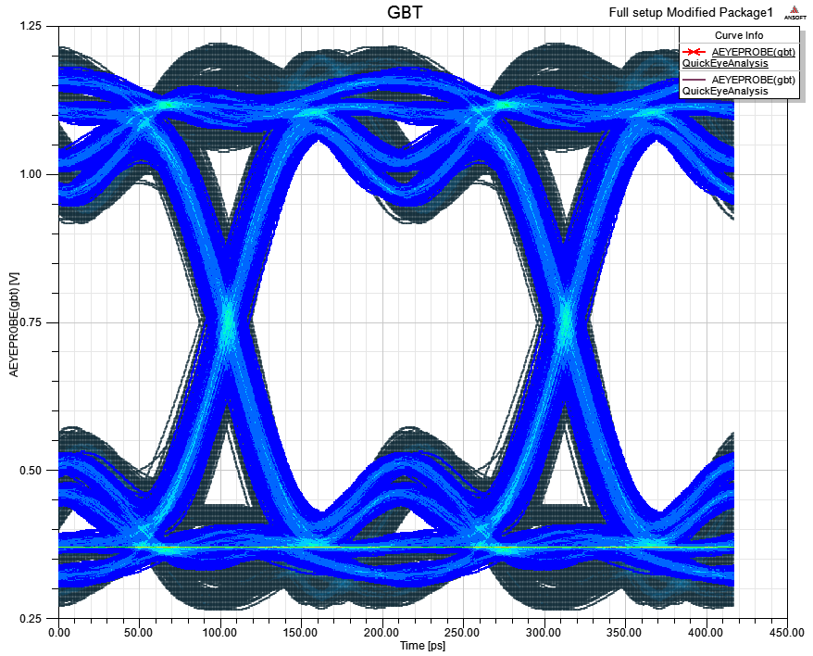
Improving the package
Dark blue = original design
Move the termination 3mm
closer to the die.

Slide 15
Conclusions (preliminary)
Probing at the termination is misleading, the signals at the input buffer are not that bad.
But things can be slightly improved :
  around the MECT connector. (future layout)
  in the package by moving the termination (actually discussed).
Linear frequency domain simulation shows package resonances ?

Slide 16
About the Ansoft suite
☺ Wide choice of models format (import /export).
☺ Dynamic links work well.
☺ Integration with Cadence Allegro is great.
☺ User friendly software.
☹ Tuner in Designer is too slow, not useable. (MWO better)
☹ Fine tuning in the layout may be complicated. (Allegro SI better choice)
But never forget it’s a just simulator.

Slide 17
Future work / perspectives
Compare results with Allegro SI.
3D models with HFSS.
De-embedding of measurements.
For microelectronic: debug the Spectre import from Silicon design. Export already successfully tested.
Power integrity.

