Slide 1
LHCONE L3VPN status update
Enzo Capone
Head of Research Engagement and Support
LHCONE-OPN Meeting
18th March 2023

Slide 2







































LHCONE around the world

Slide 3
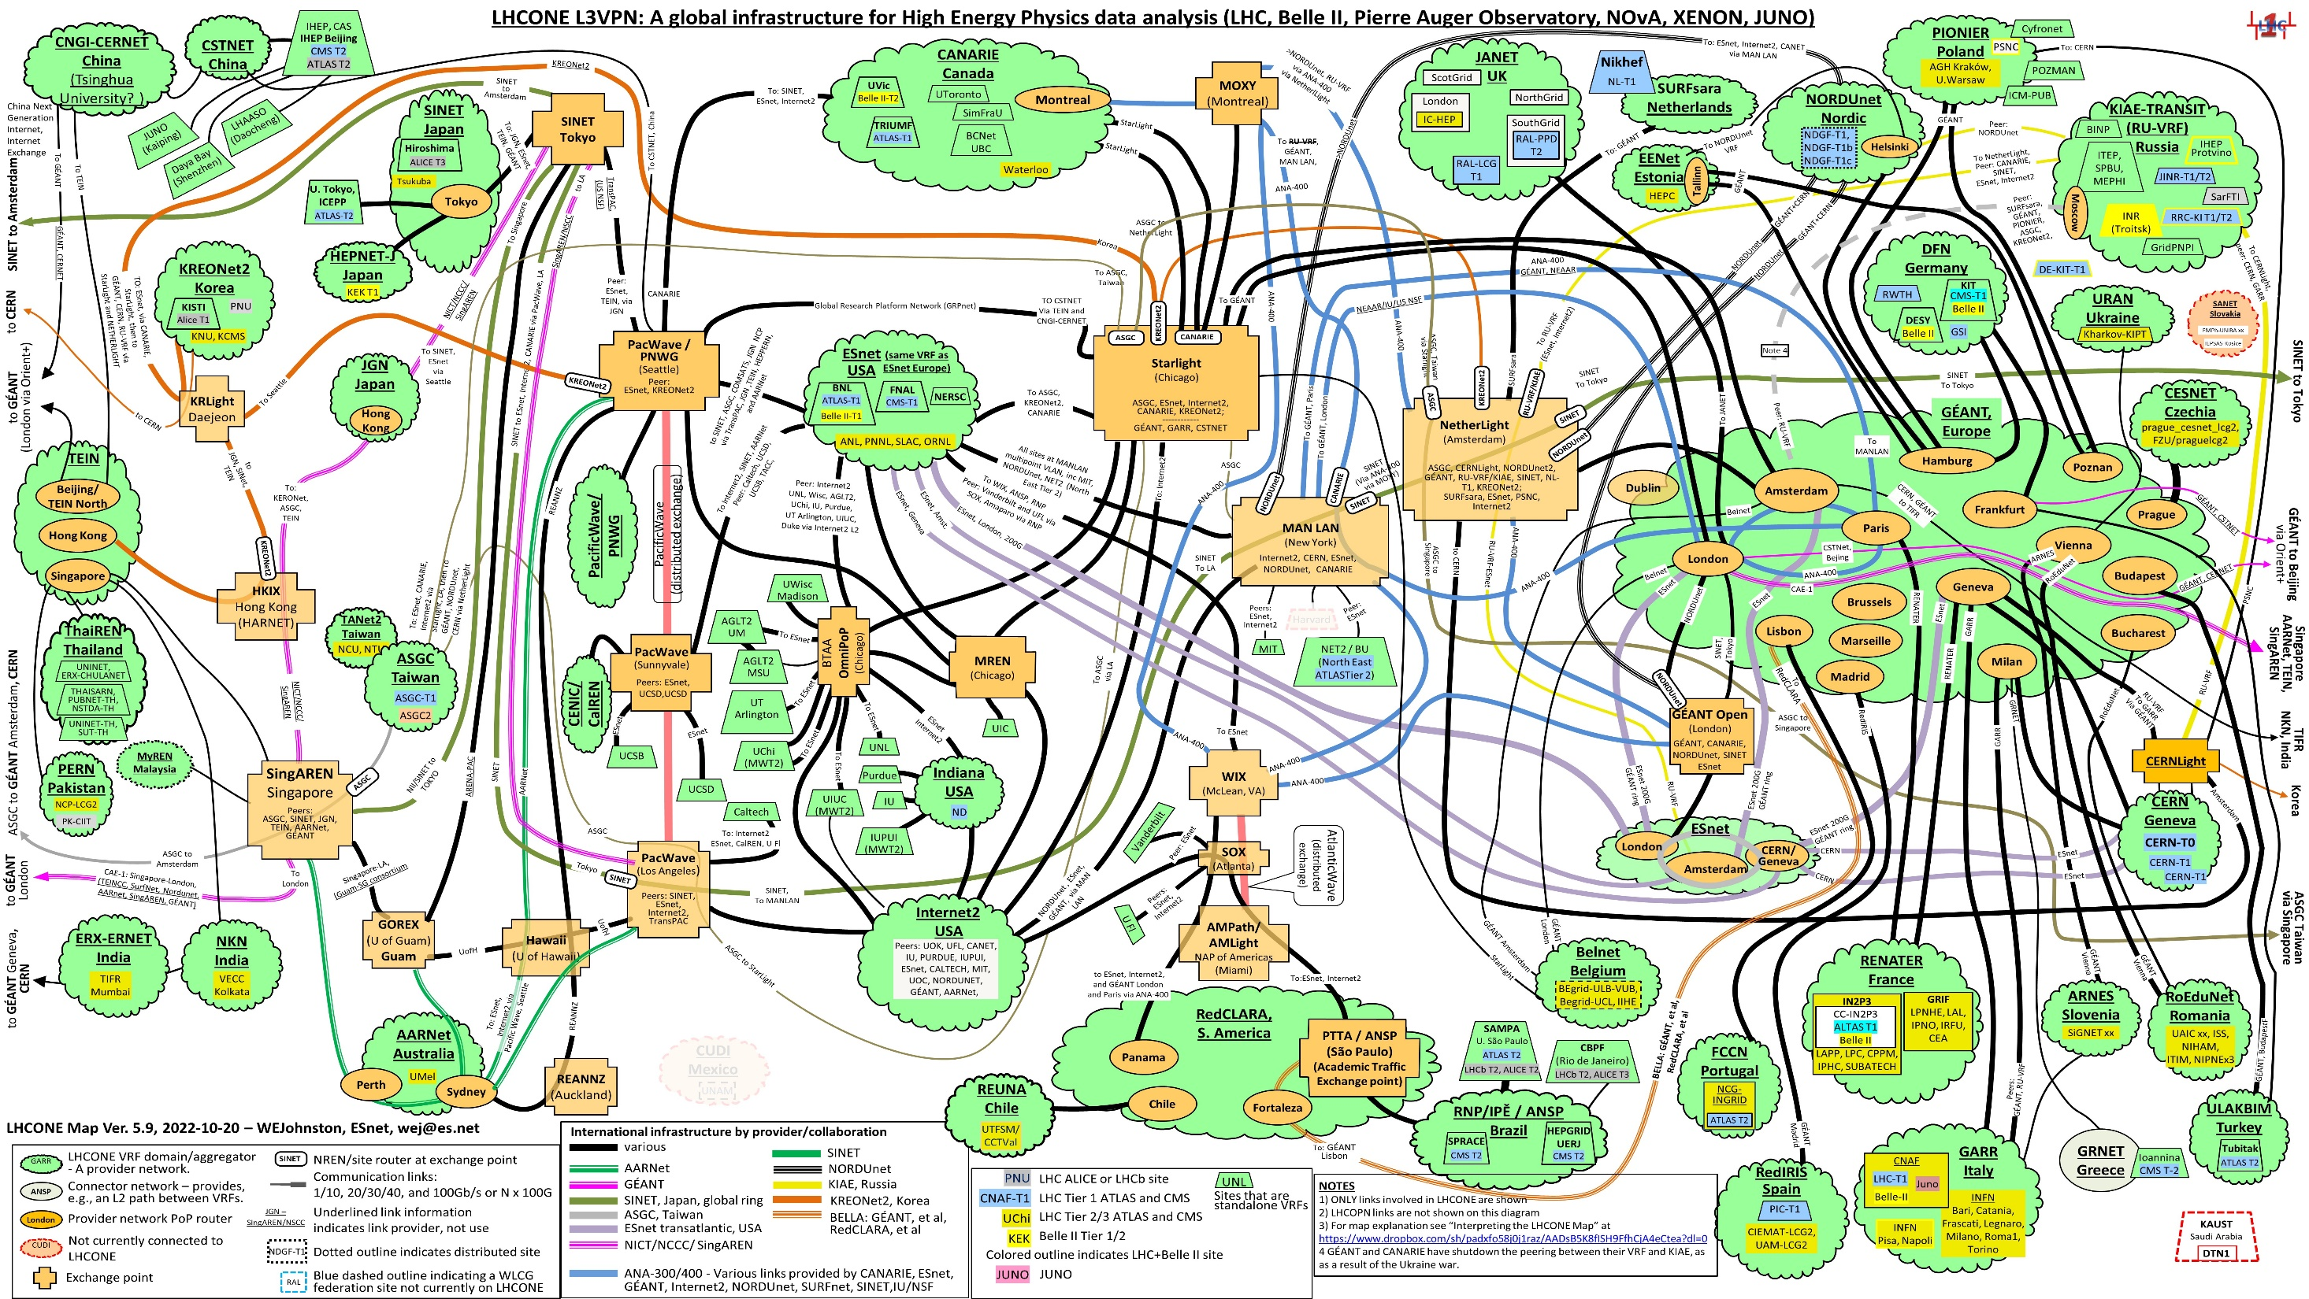

Slide 4
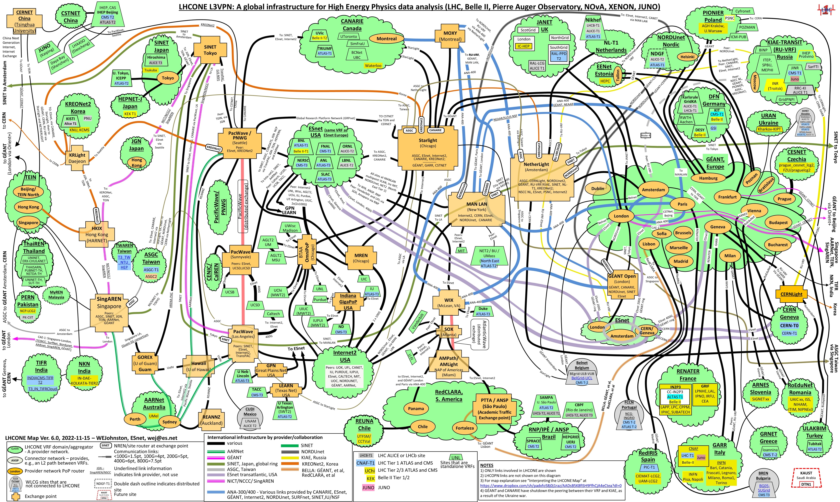
Notes:
No big changes in the last period. Mostly visualization tweaks

Slide 5
NRENs and sites news
CERN upgraded LHCONE access to 2 x 400G
RAL expanded the announced IP prefixes
Lawrence Berkeley National Laboratory (ESnet)
University of Massachusetts – Amherst (ESnet)

Slide 6
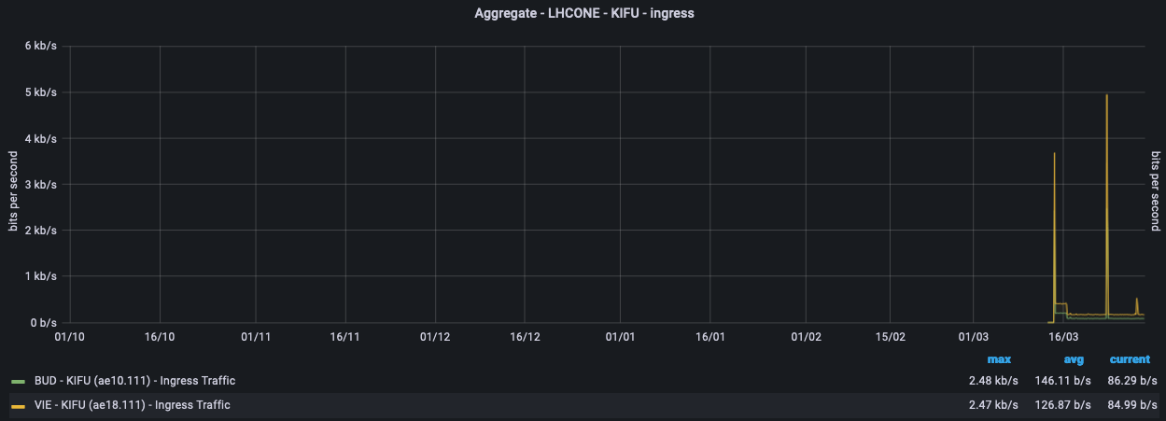
NRENs and sites news
New NORDUnet peering in AMS
KIFU joins LHCONE
  HU-HGCC-T2 (ALICE and CMS)
  T3-HU-Debrecen (CMS)

Slide 7
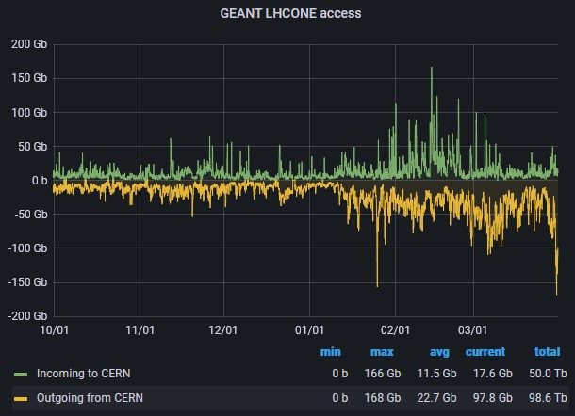
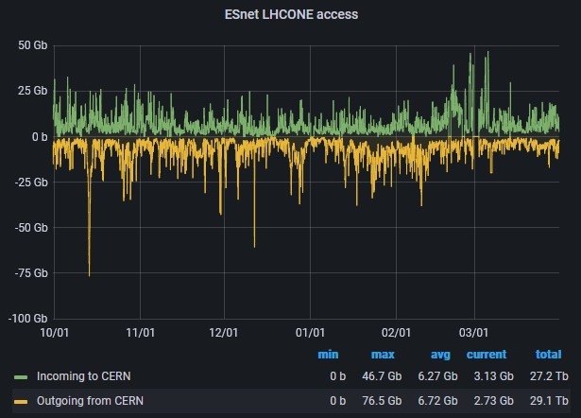

CERN
Notes:
https://monit-grafana-open.cern.ch
Quite an increment in the last 3 months of the traffic to/from GÉANT.

Slide 8
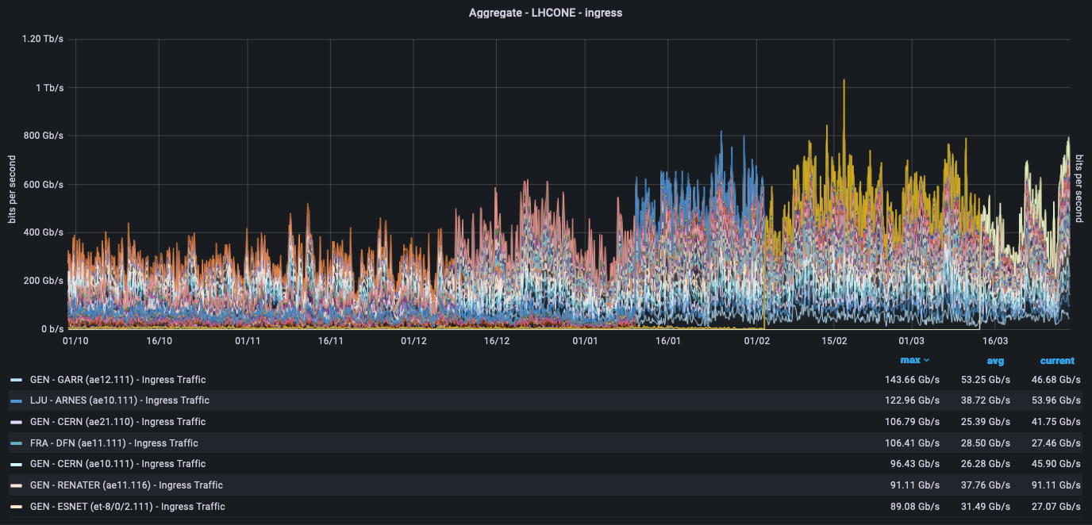
GÉANT overall
Notes:
Massive increase in traffic in the last 3 months. With a peak over 1Tbps!

Slide 9
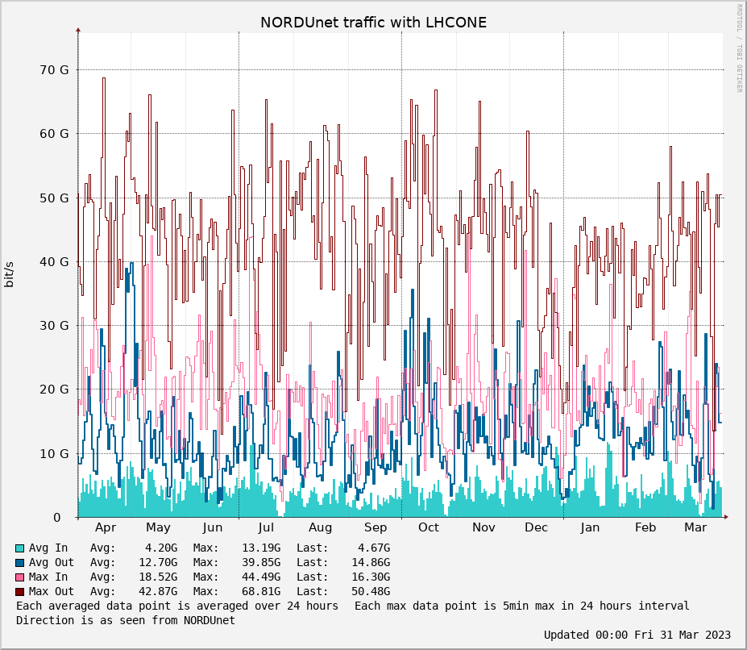
NORDUNet
Notes:
http://stats.nordu.net/connections.html
The graph shows total LHCONE traffic in NORDUnet which include links to CERN, GÉANT, Esnet and other connectors, in the last year.

Slide 10

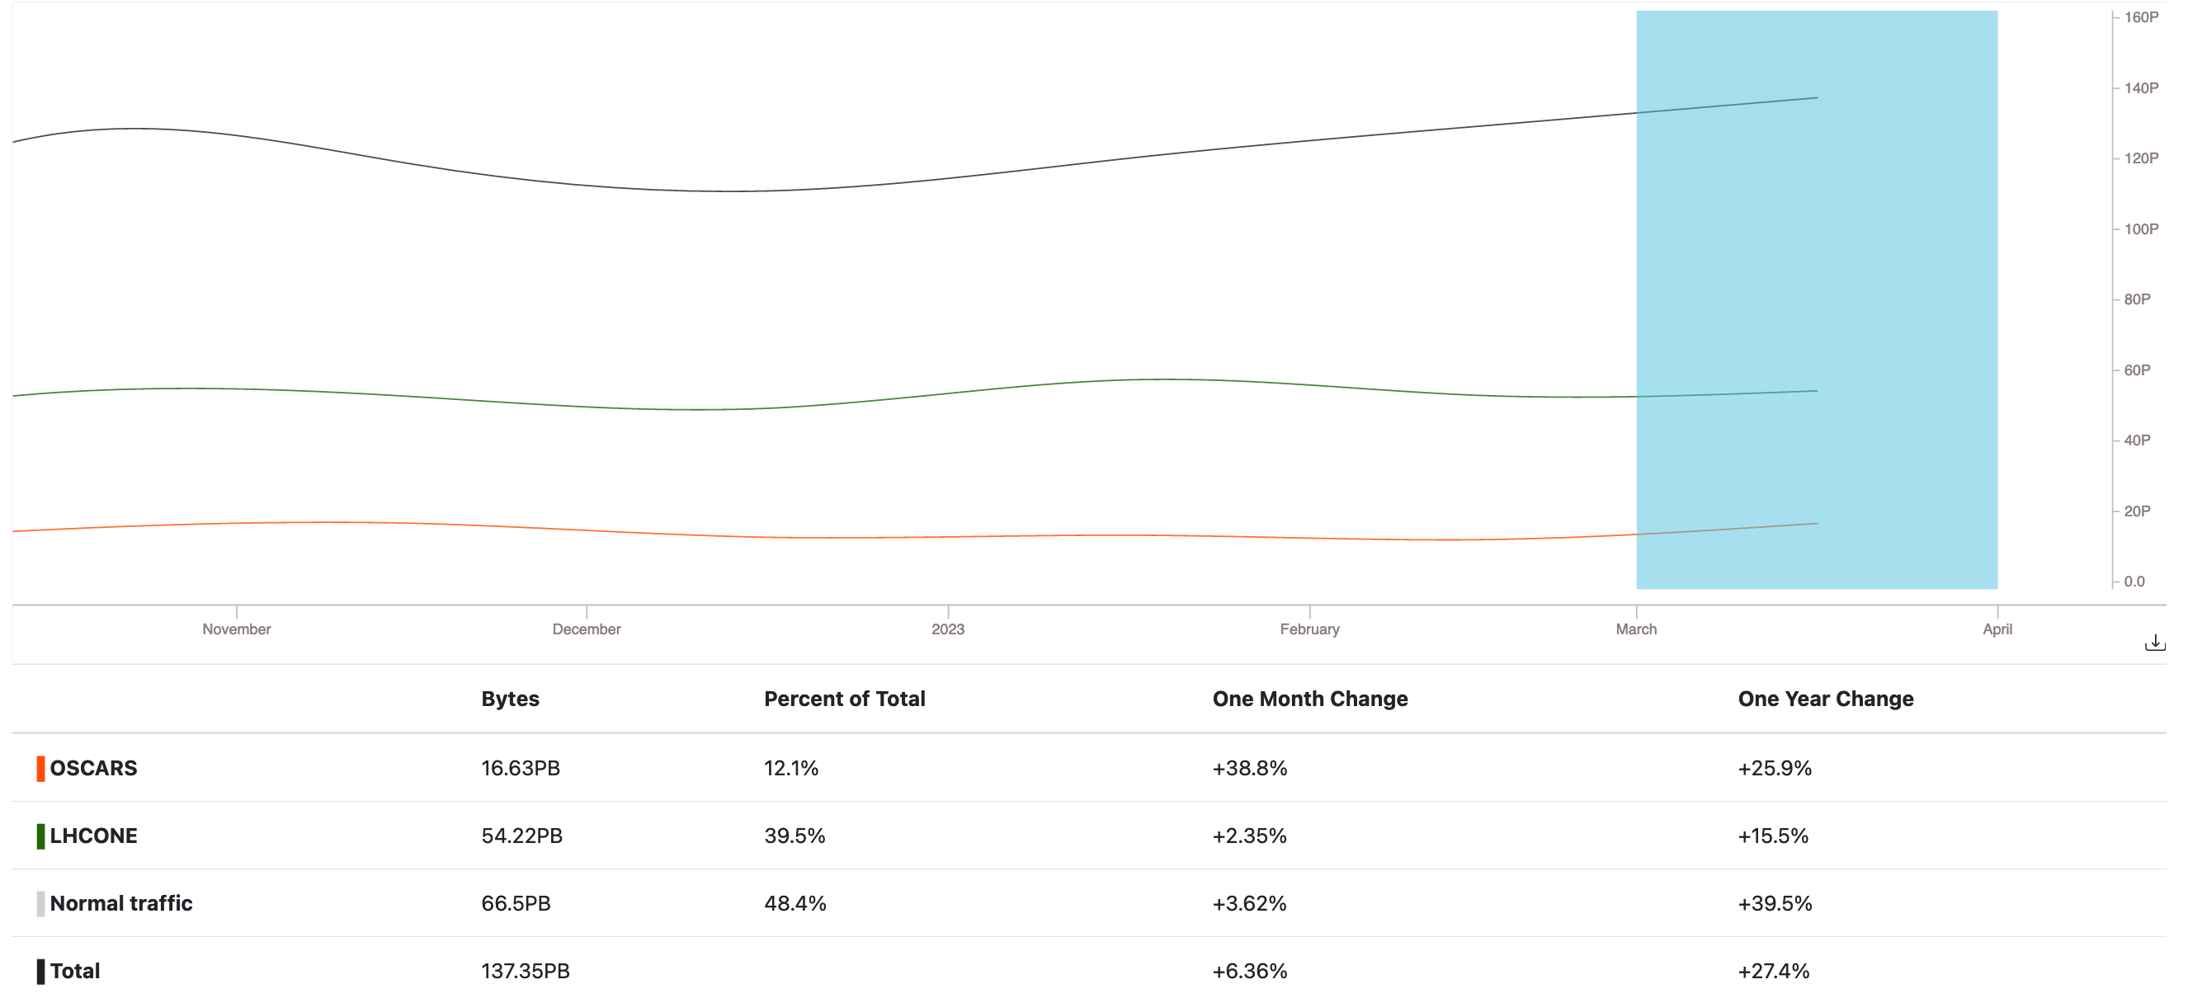
ESnet
Notes:
https://my.es.net/traffic-volume?t=6M&scale=linear
Here also a remarkable increase in LHCONE traffic. +15.5% YoY (and was 48% the previous period)

Slide 11

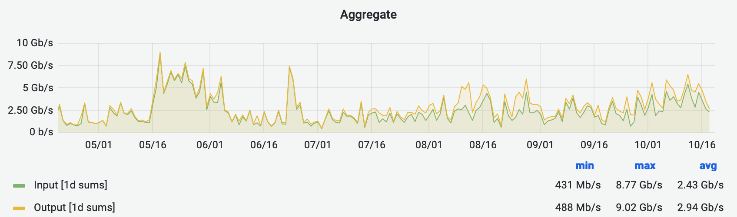
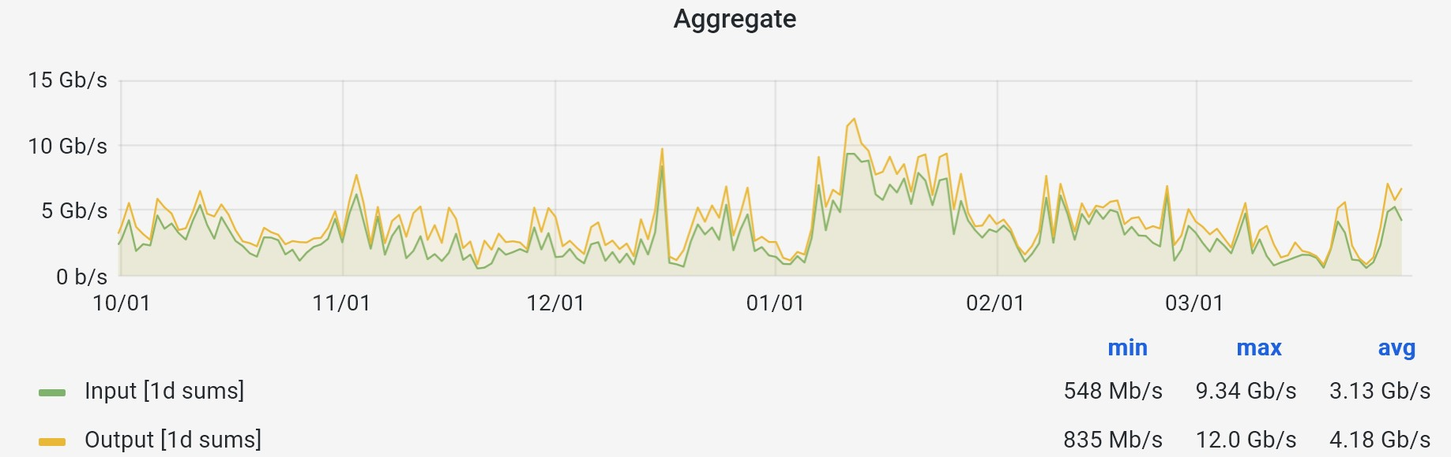
Internet2
Notes:
https://snapp-portal.net.internet2.edu/grafana/d/86accab5aab6402a726547024df93fbf2/browse-interfaces?orgId=2&from=now-6M&to=now&var-POP=All&var-Node=All&var-Search=lhcone&var-identifier=All&var-Metrics=input&var-Metrics=output&var-Aggregation=average
There’s a slight increase in the average traffic of I2 but nothing substantial

Slide 12
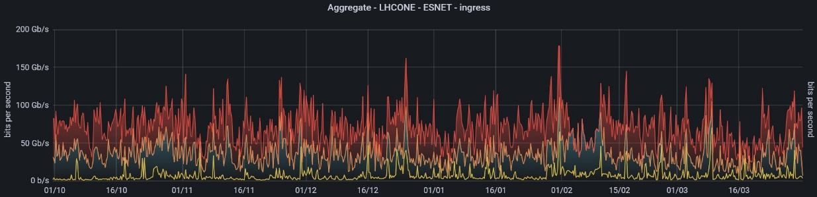
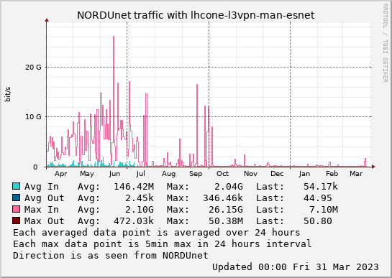

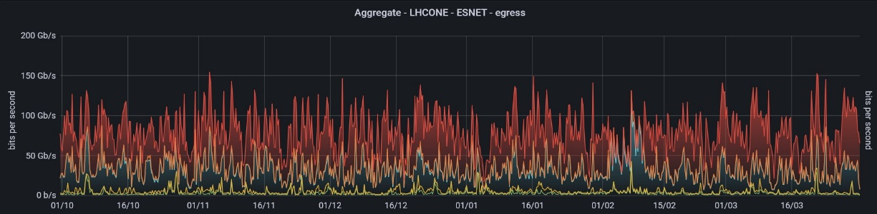
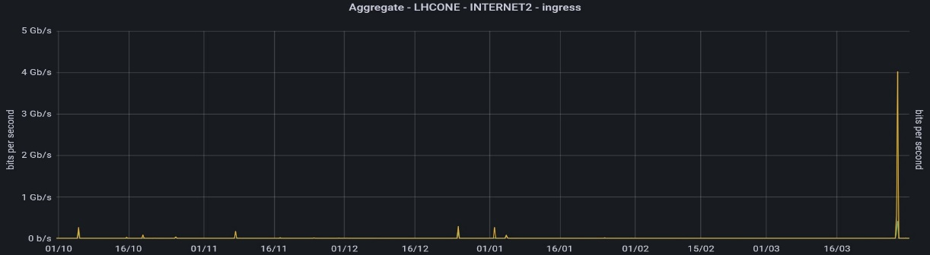
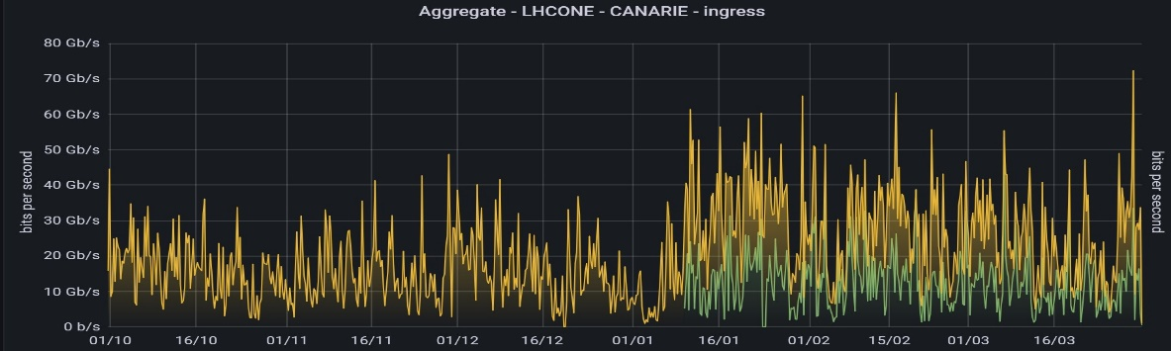

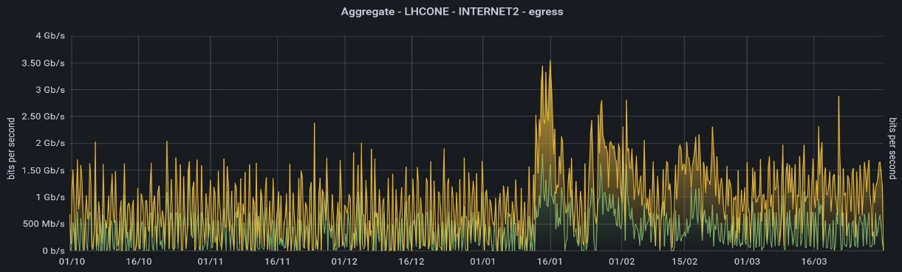
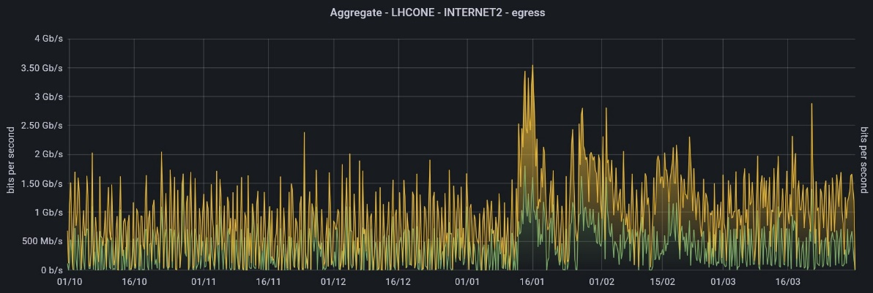
EU <-> North America
Notes:
traffic between EU and US has been pretty constantly high, on average. There’s a substantial decrease between NORDUnet and Esnet in the last 4 months, although conversely there’s an increase in the CERN-Esnet traffic, and also a slight increase of the data to/from CANARIE.
NORDUnet traffic to Esnet has been strangely low, according to their own monitoring.
As expected, given the previous slide on I2, the traffic there is pretty low.

Slide 13
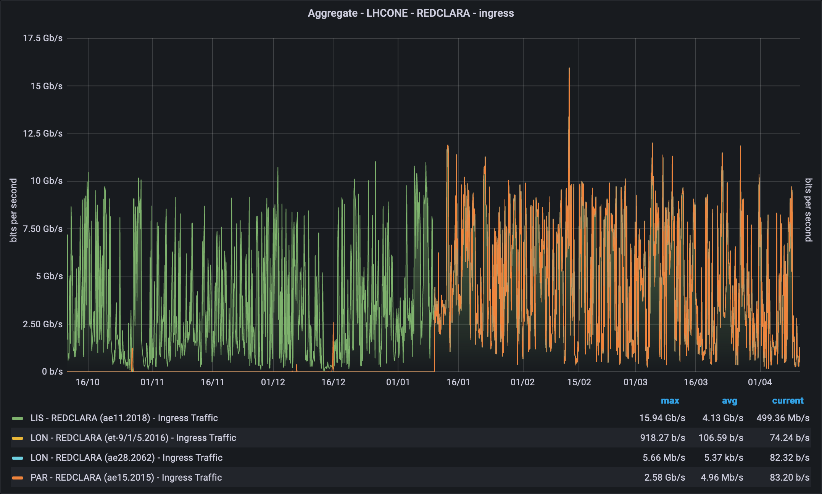



EU <-> Latin America
Notes:
The traffic using the now-not-so-new BELLA link is nicely constant too.

Slide 14
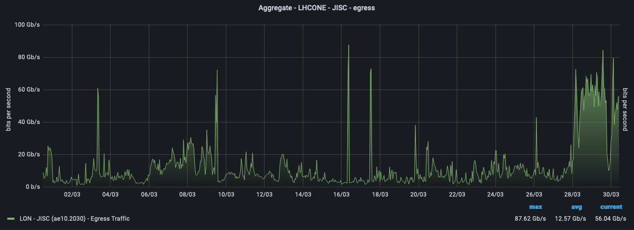
Highlight of the year
Notes:
The traffic to JISC has massively increased in the last few days of March, possibly linked to the change at RAL?

Slide 15
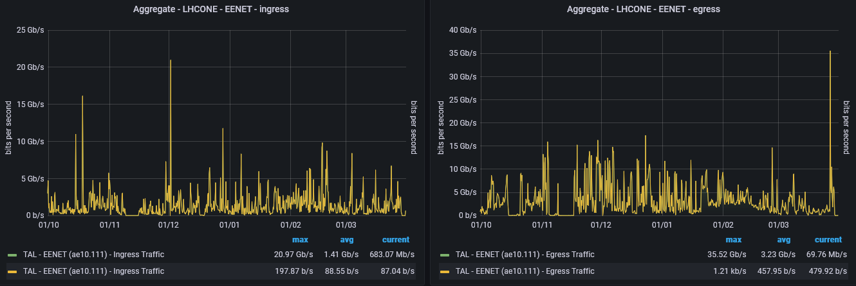
Highlight of the year
Notes:
A demonstration of why we engineer our capacity the way we do: peaks on the Eenet access port reaching almost 35Gbps, which justifies the upgrade to 100G access

Slide 16

Thank you!
vincenzo.capone@geant.org
@EnzinoCapone
www.geant.org
@GEANTnews
© GÉANT Association
As part of the GÉANT 2020 Framework Partnership Agreement (FPA), the project receives funding from the European Union's Horizon 2020 research and innovation programme under Grant Agreement No. 856726 (GN4-3).

