Slide 1
DUNE Use of LHCONE
Phil DeMar (FNAL) / Peter Clarke (Edinburgh)
Prague LHCOPN/LHCONE Meeting
April 19, 2023

Slide 2
DUNE Experiment

Slide 3
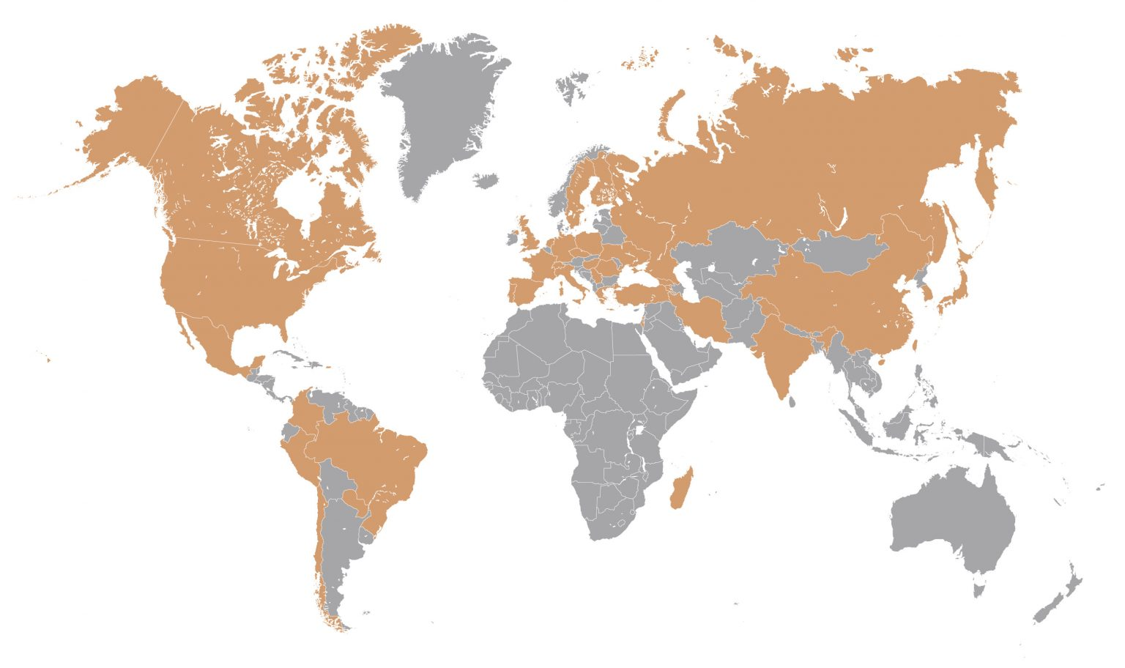
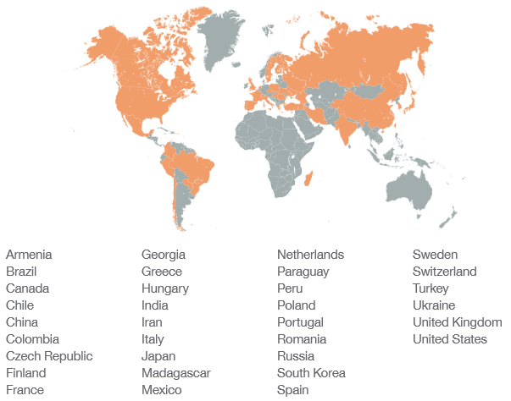
DUNE Collaboration
34 Countries
207 Institutions

Slide 4
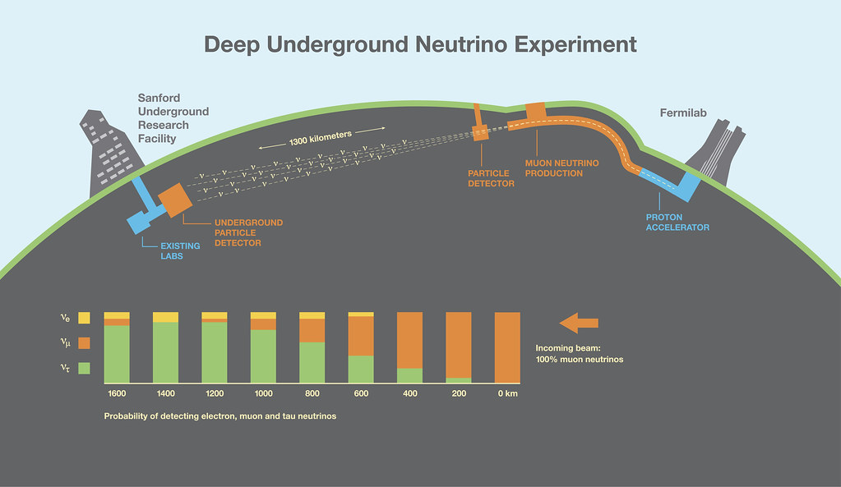
LBNF & DUNE Overview
Far
Detector
Near
Detector
Long-Baseline Neutrino Facility (LBNF):
  DOE project to provide facility infrastructure for neutrino R&D
Deep Underground Neutrino Experiment (DUNE):
  Constructs ND & FD detectors and runs the experiment
4/19/2023
Phil DeMar (FNAL) | LHCOPN/LHCONE Meeting (Prague)

Slide 5
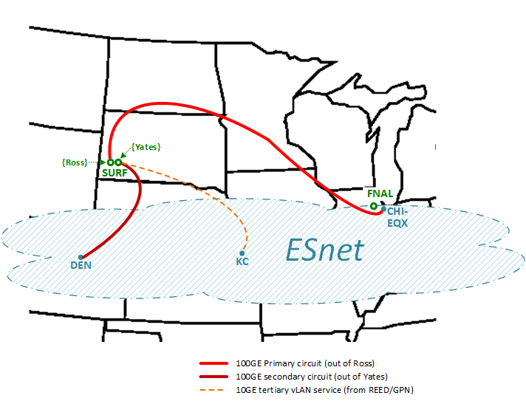
WAN Connectivity for DUNE Far Detector
(planned deployment ~2026-2028)
Geographically-diverse paths from different service providers
Note: These are dedicated/private circuits (unrelated to LHCONE...)
4/19/2023
Phil DeMar (FNAL) | LHCOPN/LHCONE Meeting (Prague)

Slide 6
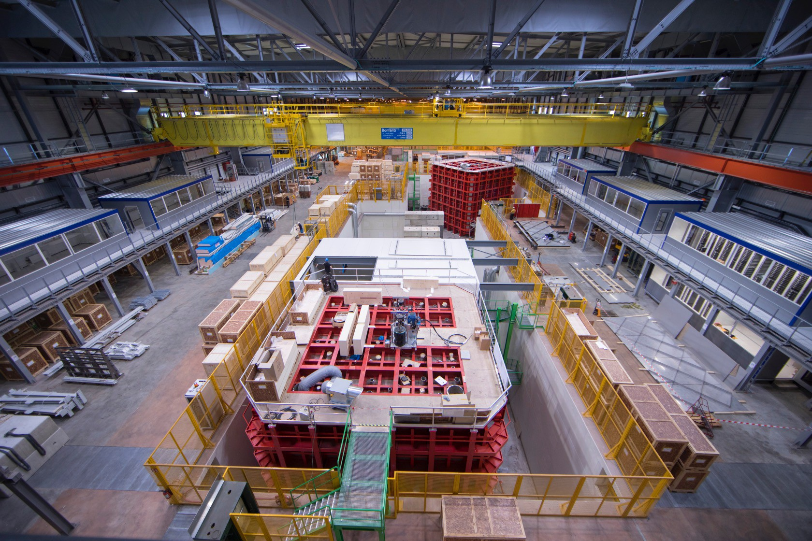
ProtoDUNE - “Small” Prototype Detector(s)
Constructed at CERN
Detector prototype(s) built at CERN:
  Scale is ~1:25
  Beam run in 2018:
    7 million events; ~2 PB of raw data in 6 weeks
  ProtoDUNE-2 beam to be run in 2023ish:
    With upgraded detectors
4/19/2023
Phil DeMar (FNAL) | LHCOPN/LHCONE Meeting (Prague)

Slide 7
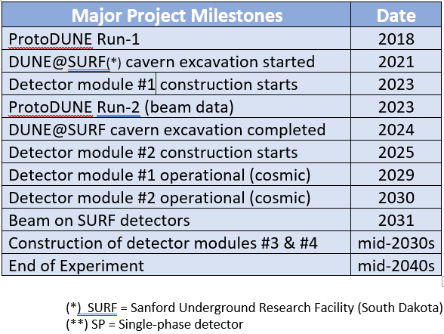


Current DUNE Experiment Timelines:
4/19/2023
Phil DeMar (FNAL) | LHCOPN/LHCONE Meeting (Prague)

Slide 8
DUNE Computing
Phil DeMar (FNAL) | LHCOPN/LHCONE Meeting (Prague)

Slide 9
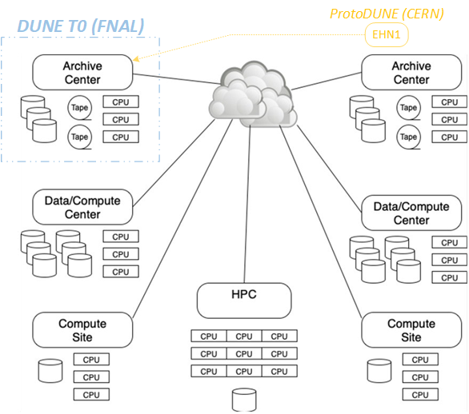
DUNE Computing Model
Similar to LHC, but service-based
Archival (raw data):
  1 copy kept at FNAL
  2nd copy shared at other archival sites
Production processing:
  Rucio-driven between data/compute centers
  Streaming between CPU-only sites and nearby data centers
  Opportunistic use of HPC/grid resources
4/19/2023
Phil DeMar (FNAL) | LHCOPN/LHCONE Meeting (Prague)

Slide 10
DUNE Rucio Storage Element (RSE) Sites
RUCIO/FTS3 used for dataset transfer and replication
Current RSE sites:
CERN EOS
PIC
CCIN2P3
FZU
TIFR (not commissioned yet)
JINR (not commissioned yet)
BNL
NERSC
NIKHEF
SURFSARA
GridPP (UK):
  LANCASTER
  MANCHESTER
  QMUL
  RAL_ECHO (ral tier-1)
  RAL-PP (ral tier-2)
4/19/2023
Phil DeMar (FNAL) | LHCOPN/LHCONE Meeting (Prague)

Slide 11
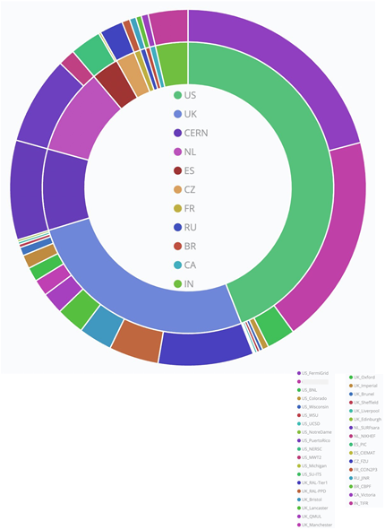
DUNE Computing Sites
Globally distributed:
  >50% of production (2022) wall hours from outside the US
Currently, 35 sites distributed across 11 nations
  Nearly all are LHC sites
Opportunistic use of HPC or grid resources as well
Mostly data → jobs at this point
  Planning on jobs → data capability as well
4/19/2023
Phil DeMar (FNAL) | LHCOPN/LHCONE Meeting (Prague)

Slide 12
DUNE Data Movement Expectations
DUNE projects(*) its data volumes to be ~5-10% of a large LHC experiment:
  For the short term = 5-10PB/yr
    Projects to 6-12Gb/s aggregate data movement average
  Experiment ramp-up/commissioning = 30PB/yr (capped)
    Roughly equivalent to LHC/CMS Run2 data
    Projects to ~50Gb/s aggregate data movement average
Data placement strategies will include popular data samples on both sides of the Atlantic
DUNE planning to participate in LHC DC-2
(*) DUNE Conceptual Design Report
4/19/2023
Phil DeMar (FNAL) | LHCOPN/LHCONE Meeting (Prague)

Slide 13
DUNE & LHCONE
Phil DeMar (FNAL) | LHCOPN/LHCONE Meeting (Prague)

Slide 14
NOvA & LHCONE (& DUNE...)
NOvA = NUMI Off-axis ve Appearance experiment
  Based at FNAL; far detector in Ash River, Minnesota
  In 2016, NOvA approved for LHCONE use for FZU <-> FNAL data movement
  NOvA’s raw data stored on FNAL public dCache facility:
    Different subnet block from FNAL CMS T1
    Public dCache subnet (131.225.69.0/24) advertised on LHCONE
    FNAL policy-routed NOvA traffic for FZU only
DUNE now uses FNAL public dCache facility as well
  UK DUNE sites recently noted path asymmetry for their DUNE traffic with FNAL:
    UK → FNAL via LHCONE (131.225.69.0/24 advertisement)
    FNAL →UK via general R&E path (no policy route)
4/19/2023
Phil DeMar (FNAL) | LHCOPN/LHCONE Meeting (Prague)

Slide 15
DUNE & LHCONE
Traffic from other DUNE sites observed using LHCONE to get to FNAL
  With corresponding asymmetry via general R&E paths
Highly likely DUNE traffic on LHCONE is also occurring between WLCG sites with shared storage facilities
4/19/2023
Phil DeMar (FNAL) | LHCOPN/LHCONE Meeting (Prague)

Slide 16
Rationale for DUNE use of LHCONE
DUNE traffic is already traversing LHCONE:
  Natural byproduct of WLCG sites with shared storage facilities
  Also a consequence of NOvA’s use of LHCONE
    With messy LHCONE/non-LHCONE traffic asymmetry at FNAL
DUNE site footprint overlays the existing LHCONE footprint:
  Most current or looming DUNE sites are already connected to LHCONE
    LHCONE’s security risk profile should be minimally affected by inclusion of DUNE
Projected DUNE data traffic should not have significant impact on network resources scaled to LHC support
4/19/2023
Phil DeMar (FNAL) | LHCOPN/LHCONE Meeting (Prague)

Slide 17
Rationale for Allowing DUNE to use LHCONE (cont)
It would be extremely difficult to disentangle DUNE/LHC traffic today:
  Current options for doing so are cumbersome and/or complex, requiring extreme effort and constant diligence
    This level of effort could impact the willingness of sites to contribute to DUNE computing
DUNE inclusion into LHCONE does not preclude a DUNEone type of implementation, as technologies evolve
  CERN <-> FNAL point-to-point circuit for ProtoDUNE traffic to remain in place and could provide a development environment
4/19/2023
Phil DeMar (FNAL) | LHCOPN/LHCONE Meeting (Prague)

Slide 18
Practical Outcome of DUNE Approved for LHCONE
FNAL would default to sending its public dCache traffic to LHCONE-connected sites via LHCONE:
  Any DUNE sites (PIC...) currently using a general internet path for FNAL DUNE traffic may reconfigure locally to use their LHCONE path
    Full disclosure: there are a number of other FNAL-based experiments (Minerva, Mu2e, Muon-G2, MicroBoone, Icarus) also using public dCache. However, their storage is modest and kept local with small exceptions.
4/19/2023
Phil DeMar (FNAL) | LHCOPN/LHCONE Meeting (Prague)

Slide 19
Summary
DUNE traffic is already intermingled with LHCONE traffic
DUNE sites overlay the LHCONE footprint
DUNE’s projected traffic loads are modest by LHC standards
Today, disentangling DUNE traffic from LHCONE would be very difficult from an effort perspective
DUNE use of LHCONE does not preclude a DUNEone / MultiOne type of overlay network in the future
4/19/2023
Phil DeMar (FNAL) | LHCOPN/LHCONE Meeting (Prague)

Slide 20
Extra Slides
Phil DeMar (FNAL) | LHCOPN/LHCONE Meeting (Prague)

Slide 21
DUNE Info
DUNE Conceptual Design Report:
  https://arxiv.org/abs/2210.15665
DUNE Use of LHCONE Memorandum:
  https://docs.dunescience.org/cgi-bin/sso/ShowDocument?docid=27500
DUNE Collaboration sites:
  https://lbnf-dune.fnal.gov/about/countries-and-institutions-participating-in-dune/
DUNE Automated Workflow Tests dashboard:
  https://justin.dune.hep.ac.uk/dashboard/?method=awt-results
4/19/2023
Phil DeMar (FNAL) | LHCOPN/LHCONE Meeting (Prague)

Slide 22




Origin of matter
Are neutrinos the reason the universe is made of matter?
Unification of forces
Einstein’s dream of a unified theory of matter and energy
Black hole formation
Detection of neutron star and black hole formations in “real” time
Neutrino
Science
Nucleon
Decay
SuperNova
Physics
4/19/2023
Phil DeMar (FNAL) | LHCOPN/LHCONE Meeting (Prague)

Slide 23
The Long Baseline Neutrino Facility (LBNF)
4/19/2023
Phil DeMar (FNAL) | LHCOPN/LHCONE Meeting (Prague)

Slide 24
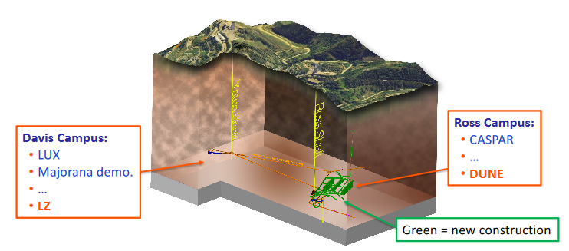
DUNE Far Detector Site @ SURF(*)
Ross Campus at 4850’ level
DUNE FD DAQ system extends across cavern and surface
  Fiber up both Ross & Yates shafts for resiliency
Yates Complex
(surface)
Ross Complex
(surface)
Yates shaft
Ross shaft
DUNE Cavern
(*) SURF = Sanford Underground Research Facility
4/19/2023
Phil DeMar (FNAL) | LHCOPN/LHCONE Meeting (Prague)

Slide 25
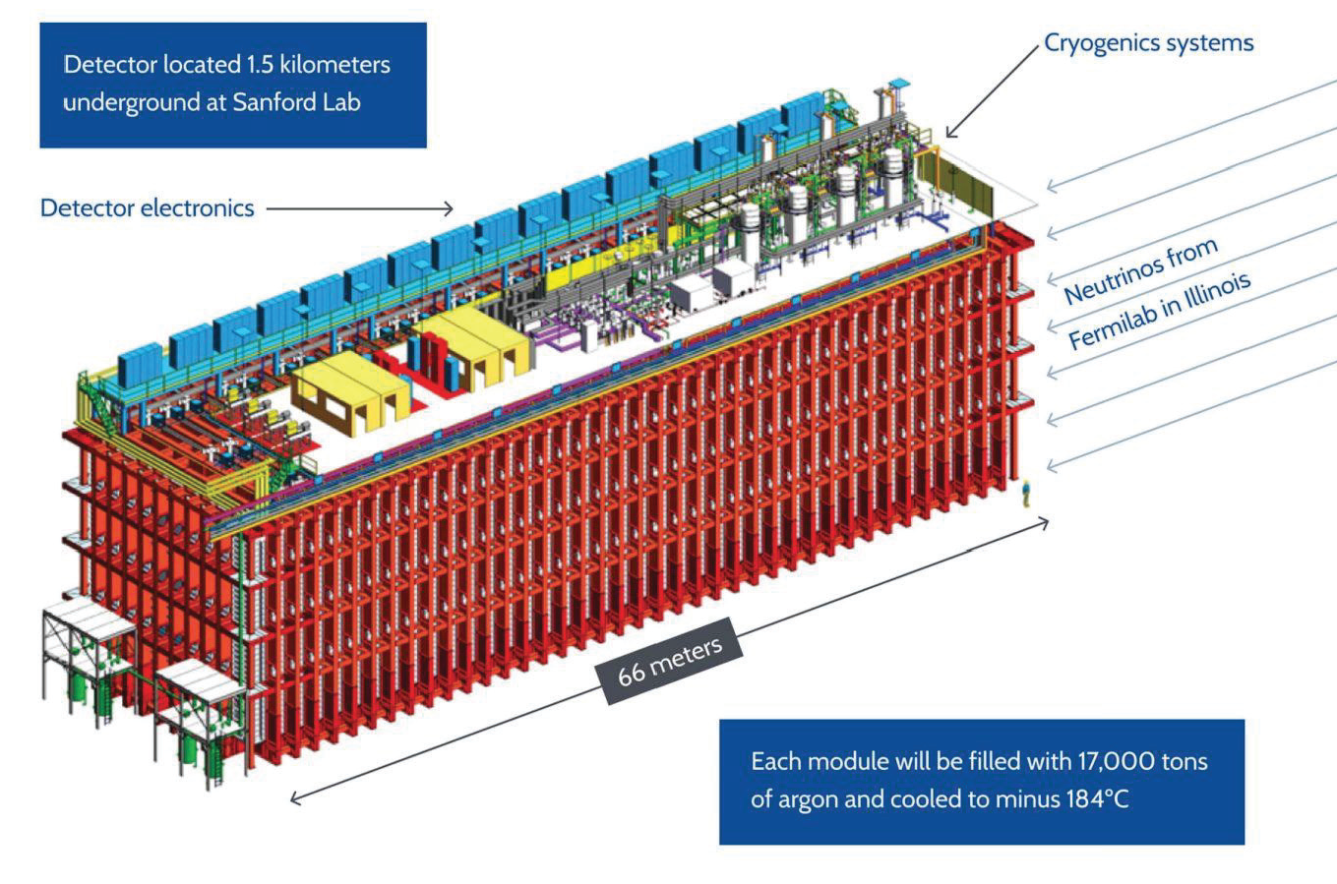
DUNE Far Detector Module (x2)
(for scale)
External Dimensions: 19.1m x 18.0m x 66.0m
4/19/2023
Phil DeMar (FNAL) | LHCOPN/LHCONE Meeting (Prague)

Slide 26
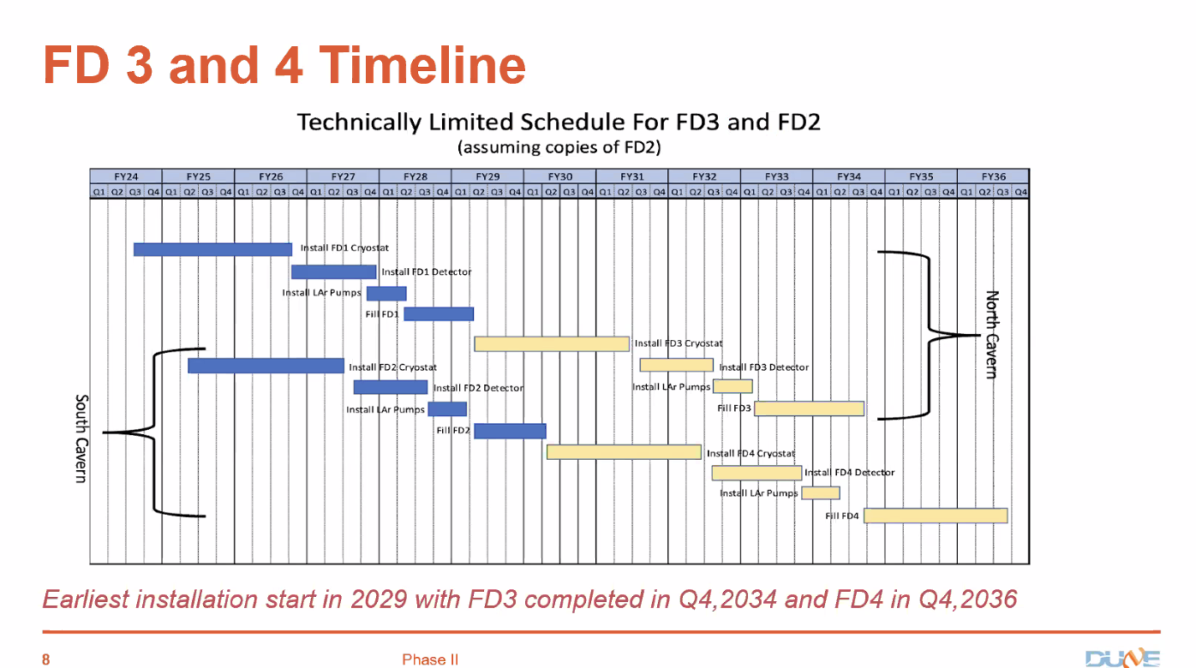
Phil DeMar (FNAL) | LHCOPN/LHCONE Meeting (Prague)

Slide 27
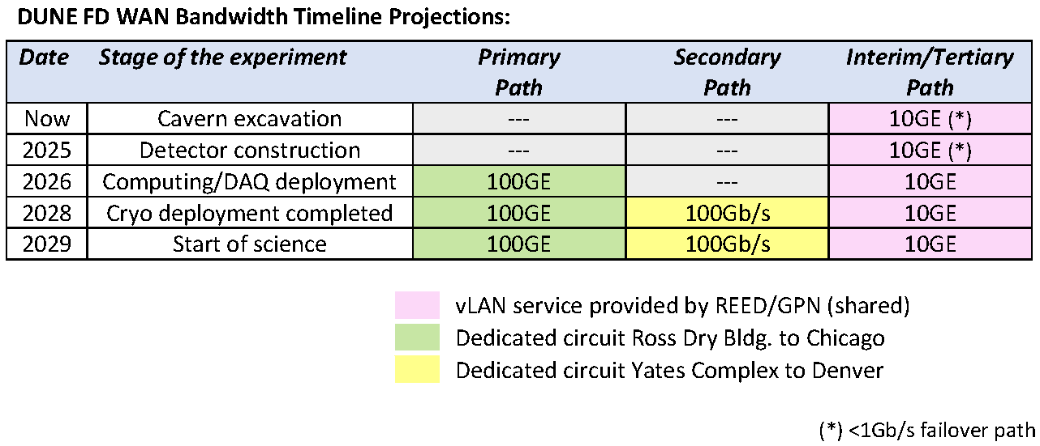
Timelines for DUNE FD WAN Services
Current projections of DUNE WAN service timelines:
REED 10GE vLAN service already deployed and in use
REED = South Dakota’s higher education network
4/19/2023
Phil DeMar (FNAL) | LHCOPN/LHCONE Meeting (Prague)

Slide 28
Supernova Computing & Data Movement
Supernova events are rare, but top priority when they occur:
  Beam physics is stopped
  Supernova data transferred immediately to FNAL
  Alerts issued
  False supernova triggers or planned trials expected (O)monthly
Supernova events expected to require spontaneous & very rapid computation:
  Expecting 200-400TB (uncompressed) readout
  Equivalent of 10k-40k CPUs needed for timely computation:
    FNAL local computing won’t be sufficient
    Distributed computing options still being discussed
  Potential impact on LHCONE is unclear, but unlikely
    In any case, duration would be (O)hours
4/19/2023
Phil DeMar (FNAL) | LHCOPN/LHCONE Meeting (Prague)

