Slide 1
Packet Pacing for TCP
Eli Dart
Energy Sciences Network (ESnet)
Lawrence Berkeley National Laboratory
LHCONE #50
Prague, CZ
19 April, 2023

Slide 2
Framing and Context
TCP has been and continues to be the workhorse protocol used by data transfer applications
  Internet’s Reliable byte-stream delivery protocol (in contrast to UDP)
  Underlying mechanism used by HTTP, Globus, FTP, etc.
TCP performance is badly impacted by even minor packet loss
TCP’s bursty behavior contributes to packet loss
  This is why we deploy deep buffers
  Deep buffers are expensive, and will go away in the future
Is there something we can do about all this?

Slide 3
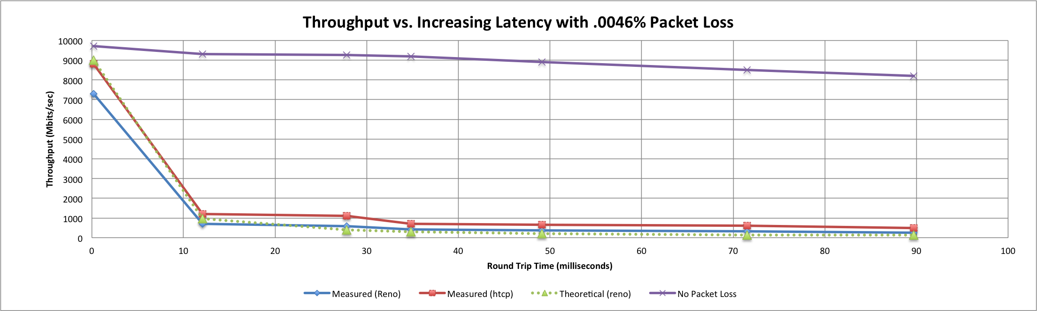
A small amount of packet loss makes a huge difference in TCP performance
Local
(LAN)
With loss, high performance beyond metro distances is essentially impossible
International
Metro Area
Regional
Continental
Measured (TCP Reno)
Measured (HTCP)
Theoretical (TCP Reno)
Measured (no loss)
Notes:
On a 10 Gb/s LAN path the impact of low packet loss rates is minimal
On a 10 Gb/s WAN path the impact of low packet loss rates is enormous
Beyond your metro area, zero loss is essentially required for performance
When global collaboration is the norm, nobody can afford to be a local-only resource

Slide 4
TCP is “bursty” – what does that mean?
TCP sends data when two conditions are true
  TCP has data to send, e.g. the application wrote to the socket
  The receiver has advertised available window space
  TCP sends data until one of these conditions is not true
Most host interfaces can send at wire speed
  This means that if TCP has data to send, and it hands the data off to the host NIC, the NIC will send packets at wire speed until done
  10G NICs send data at 10G, 100G NICs send data at 100G
On average the rate may be lower, but the instantaneous rate is wire speed
  A host that runs at 50% of wire speed on average might actually send at wire speed 50% of the time and sit idle 50% of the time

Slide 5
Consequences of TCP Burstiness
A wire-speed burst has no spare room in it (by definition)
  If a device can’t process the burst at wire speed, it must buffer or drop
  If the device can handle the burst, then it passes the burst on to the next device which must also handle it, buffer, or drop
This goes bad in several common ways
  Shallow switch buffers
  Slower receivers
  Speed mismatch on the path

Slide 6
Shallow Switch Buffers
The figure shows a switch with more egress traffic than it can instantaneously support
On average, the traffic from the two ingress interfaces will fit into the egress interface
In a given instant, the load may be greater than the speed of the egress interface
  The switch must buffer or drop
  If the switch cannot buffer the extra, the result is packet loss → poor performance

Slide 7
Slow Receive Host
If the host cannot receive packets at wire speed, it will drop them unless flow control is enabled
  Ethernet flow control (“pause frames”) allows the host to ask its first-hop switch to buffer on its behalf
  This immediately returns us to the shallow buffer switch problem
    If the switch can’t buffer the rest of the burst, it drops packets
    Deep buffer switches are better able to support receive hosts
Some ways to help
  NIC tuning (e.g. LRO)
  High CPU clock rate on the host
  Flow control + deep switch buffers
  But: we must engineer for this, and it can be costly

Slide 8
Speed Mismatch
This can be thought of as a variant of the fan-in problem
  Instead of background traffic reducing capacity, slower link speed reduces capacity
  The other semantics are very similar – buffer or drop
This can happen in many devices
  Routers, switches
  Hosts (slow receiver looks a lot like a speed mismatch)

Slide 9
Common Theme: Bursts Cause Problems
The fundamental issue is that, because of the way TCP behaves, we have to engineer for the instantaneous rate instead of the average rate
All of this is just so we can provide TCP with a loss-free IP layer to maintain performance
If we don’t engineer for peaks, TCP will underperform the average it could have achieved – because of packet loss caused by bursts
Is there a better way?

Slide 10
Smooth Out The Bursts: Pacing
Goal of pacing is to limit the burst rate of a TCP flow
Reduce the impact of bursts on buffers, receivers, etc.
It can sound backwards, but it works
  Reduce the available bandwidth to achieve performance
  This works because the performance impact from packet loss is so large

Slide 11

BBR TCP has built-in pacing
(slide from Matt Mathis presentation, March 2020)
BBR: new first principles for Congestion Control
  BBR builds an explicit model of the network
    Estimate max_BW and min_RTT
The BBR core algorithm:
  By default pace at a previously measured Max_BW
    Transmit based on a clock, not ACKs
  Vary the pacing rate to measure model parameters
    increase to observe new max rates
    decrease to observe the min RTT
    gather other signals such as ECN (bbr2)
BBR's "personality" is determined by the heuristics used to vary the rates and perform the measurements
  These heuristics are completely unspecified by the core algorithm
  Relatively easy to extend or adapt
  Many different heuristics algorithms can work together

Slide 12
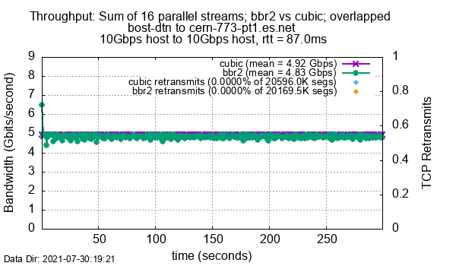
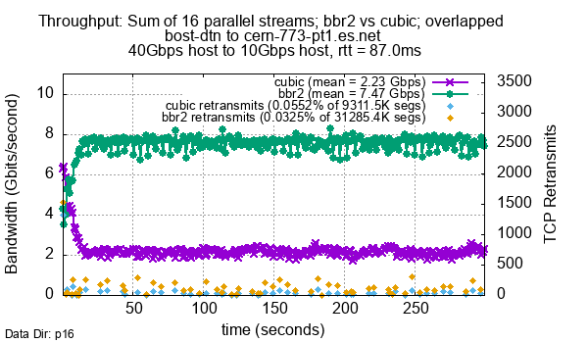
Pacing Used In BBRv2 Testing
10G sender (620 Mbps pacing/flow, 9.9G total)
40G sender (2.4 Gbps pacing/flow, 38.4G total)
No speed mismatch = No packet loss = CUBIC and BBRv2 are equivalent
But BBRv2 does much better when sender is faster than receiver
Notes:
Figure 8 in paper
similar results from the testbed, but not quite as dramatic: 4x vs 20x, possibly due to more buffering

Slide 13
Ideas to Explore
Can we come up with a simple pacing configuration for WLCG DTNs that improves performance?
What is the mix of host and network interface speeds in WLCG, and how might that affect a global pacing configuration?
What per-flow data rate do we need in WLCG? Is it different for different workflows? What does this mean for pacing config?
BBRv2 will probably make manual pacing configurations obsolete, but BBRv2 is years away (Google has not yet merged it upstream, so it hasn’t even begun the path to production distro kernels)

Slide 14
Thanks!
Eli Dart (dart@es.net)
Energy Sciences Network (ESnet)
Lawrence Berkeley National Laboratory
http://fasterdata.es.net/
http://my.es.net/
http://www.es.net/

