Slide 1
JUNO update
Giuseppe Andronico
LHCOPN-LHCONE meeting #50
April 18, 2023

Slide 2





Jiangmen Underground Neutrino Observatory summary
Data volume
Raw data: 2PB/year
Reconstructed data: 200 TB/year
Analysis data: 20 TB/year

Slide 3
JUNO experiment update
Mounting at JUNO site is going on well
Every day about 250 people at work on the several parts, on a tight schedule
Data taking start is foreseen in 2024 first months

Slide 4
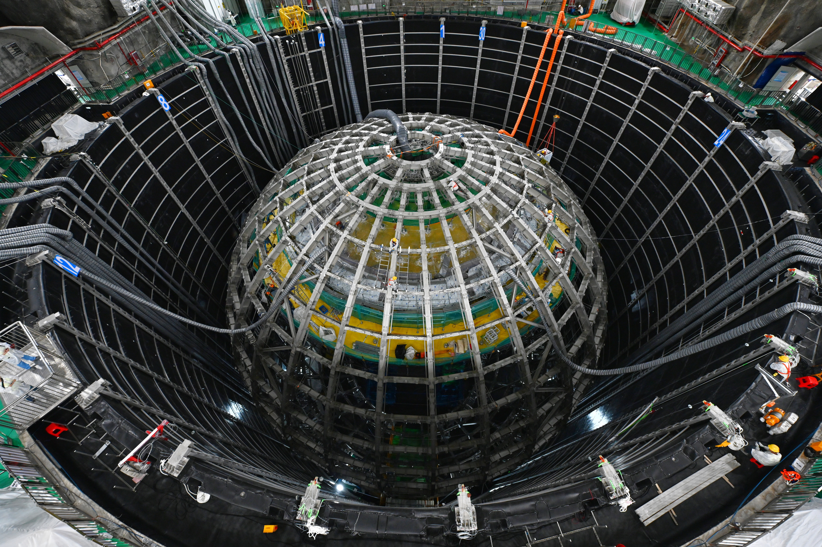
Installation status
Water pool liner: installed
Supporting structure: installed
Acrylic panels: being installed!
12/11/2022

Slide 5
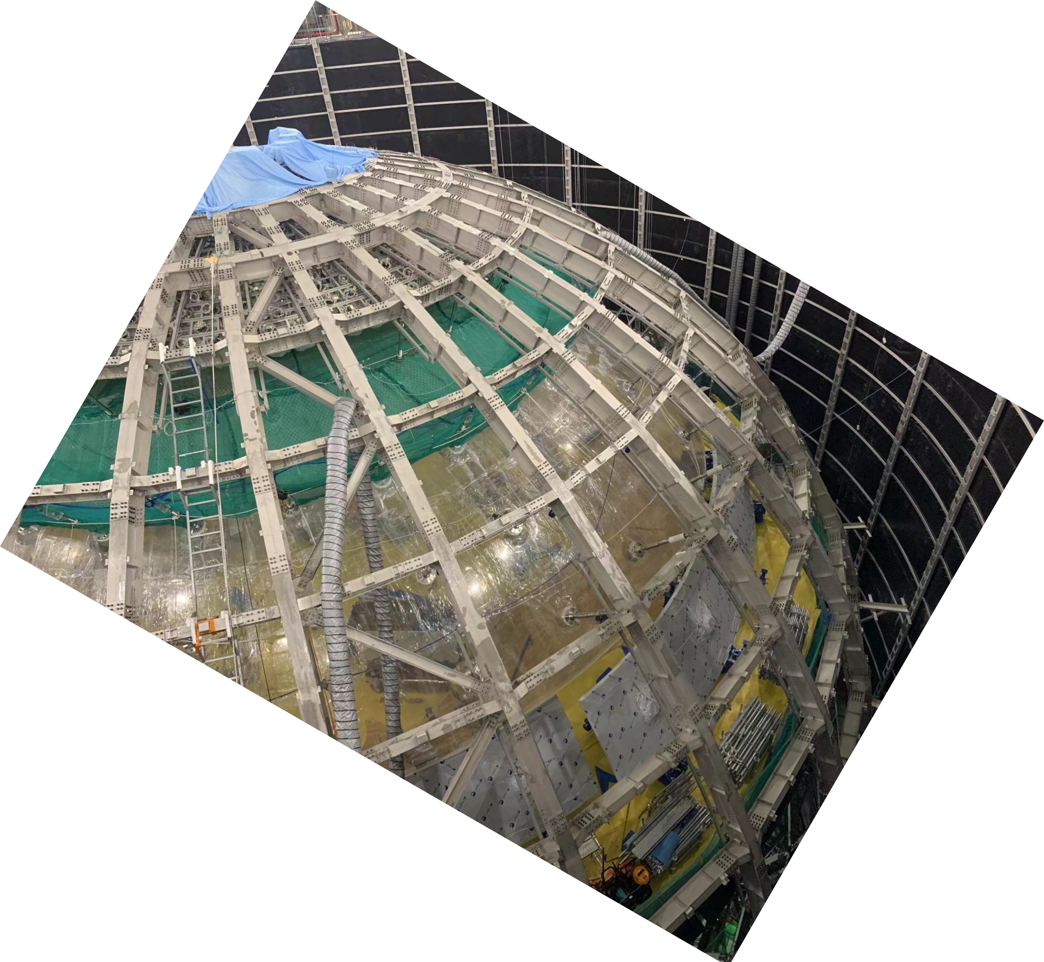
Installation status
Water pool liner: installed
Supporting structure: installed
Acrylic panels: being installed!
PMTs and electronics:
being installed!
12/11/2022
02/03/2023
7 / 23

Slide 6
JUNO DCI
JUNO Distributed Infrastructure is working well
Usage and data transfers are increasing
Training in progress, already 3 events done and a fourth is planned
We are working to migrate from X509 to tokens
In progress to participate to data challenge 2024

Slide 7
Network
JUNO sites connected to LHCONE
Connections to Russian sites (JINR, MSU): no on LHC but, in some way, working
Fixed several misconfigurations impacting on TPC, now working quite well
  Remain to fix a communiation problem between EOS and STORM for which tickets were submitted

Slide 8

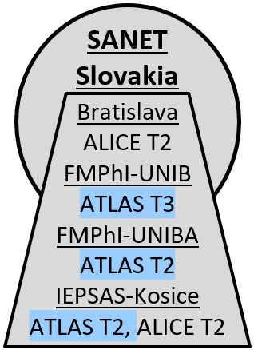
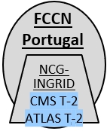

CERNET
China
(Tsinghua
University)
CSTNET
China
IHEP, CAS
IHEP Beijing
CMS T2
ATLAS T2
LHCONE L3VPN: A global infrastructure for High Energy Physics data analysis (LHC, Belle II, Pierre Auger Observatory, NOvA, XENON, JUNO)
PIONIER
Poland
Cyfronet
KREONet2
CANARIE
Canada
To NORDUnet,
RU-VRF
via ANA-400
via NetherlLight
JANET
UK
Nikhef
To: ESnet, Internet2, CANET
via MAN LAN
PSNC
To: CERN
JUNO
MOXY
(Montreal)
ScotGrid
LHCB-T1
AGH Kraków, U.Warsaw
POZMAN
To PacWave, Seattle
SINET
to Amsterdam
To: SINET,
ESnet, Internet2
UVic
UToronto
Montreal
ALICE-T1
NORDUnet
Nordic
ICM-PUB
China Next Generation Internet, Internet Exchange
SINET
Japan
SINET
Tokyo
Belle II-T2
London
NorthGrid
ATLAS-T1
JUNO
(Kaiping)
LHAASO
(Daocheng)
TRIUMF
SimFraU
StarLight
IC-HEP
SouthGrid
NL-T1
Netherlands
GÉANT
Peer: NORDUnet
BINP
KIAE-TRANSIT
(RU-VRF)
Russia
Daya Bay
(Shenzhen)
Hiroshima
To: JGN, ESnet,
TEIN, GÉANT
ATLAS-T1
BCNet
UBC
StarLight
To RU-VRF, GÉANT,
MAN LAN,
>NORDUnet
RAL-PPD
T2
To NORDUnet
VRF
NDGF
Helsinki
ITEP, SPBU, MEPHI
IHEP
Protvino
ALICE T3
RAL-LCG
ALICE T1
EENet
Estonia
ALICE-T2
To NetherLight, Peer: CANARIE, SINET,
ESnet, Internet2
To GÉANT
Waterloo
ATLAS-T1
JINR
SarFTI
To TEIN
U. Tokyo,
ICEPP
Tsukuba
to LA
ANA-400
CMS T1
SINET to Amsterdam
Tokyo
TransPAC, (US NSF)
HEPC
Tallinn
GÉANT
GÉANT+CERN
Peer:
NSCC NL,
GÉANT,
PIONIER,
ASGC,
KREONet2,
Moscow
INR (Troitsk)
JUNO
ATLAS-T2
To Singapore
SingAREN/NSCC
ASGC to
NetherLight
GÉANT+CERN
RRC-KI
ALICE T1
GÉANT, CERNET
KREONet2
Korea
HEPNET-J
Japan
To CSTNET, China
Korea
ANA-400
GÉANT, NEAAR
NORDUnet
NORDUnet
Karlsrule
GridKA
DFN
Germany
GridPNPI
To CERNLight,
peer: CERN, GARR
To ASGC,
Taiwan
ALICE-T1
KEK T1
NICT/NCCC/
SingAREN
Peer: TEIN, via JGN
To CANARIE
LHCb-T1
KIT
CMS-T1
Belle II
URAN
Ukraine
to CERN
TO: ESnet, via CANARIE, StarLight, then to
GÉANT, CERN, RU-VRF via StarLight and NETHERLIGHT
KISTI
PNU
Global Research Platform Network (GRPnet)
TO CSTNET
Via TEIN and
CERNET
To GÉANT
ANA-400
NEAAR/IU/US NSF
RWTH-Aachen
Alice T1
ESnet
USA
KREONet2
DESY
Belle II
GSI
Kharkov-KIPT
KNU, KCMS
To SINET, ESnet
via Seattle
PacWave /
PNWG
(Seattle)
(same VRF as
ESnet Europe)
ASGC
CANARIE
ANA-400
ASGC, Taiwan
via Starlight
To RU-VRF
Note 4
JGN
Japan
SINET to ESnet, Internet2, CANARIE via PacWave, LA
BNL
Starlight
(Chicago)
NSCC
to GÉANT
(London via Orient+)
KRLight
Daejeon
KREONet2
Peer:
ESnet, KREONet2
to SINET, ASGC, COMSATS, JGN NCP
via TransPAC, JGN ,TEIN, HEPPERN, and AARNet
ATLAS-T1
FNAL
ORNL
KREONet2
SINET
To Tokyo
CESNET
Czechia
SINET to Tokyo
To Seattle
Hong
Kong
Belle II-T1
CMS-T1
ALICE-T2
To ASGC,
KREONet2,
CANARIE
ASGC, ESnet, Internet2, CANARIE, KREONet2;
------------
GÉANT, GARR, CSTNET
ASGC
RU-VRF/KIAE
To Tokyo
To JANET
GÉANT,
Europe
to CERN
NERSC
ANL
LBNL
To GÉANT, Paris
NetherLight
(Amsterdam)
SINET
Peer: RU-VRF
prague_cesnet_lcg2,
FZU/praguelcg2
To Internet2, SINET,
AARNet
Peer: Caltech, UCSD,
UCSB, TACC,
CMS-T3
ATLAS-T3
ALICE-T2
To GÉANT, London
NORDUnet
To
MANLAN
TEIN
to
JGN, SINet, TEIN
SLAC
All sites at MANLAN multipoint VLAN, inc MIT,
NORDUnet, NET2 (North East Tier 2)
Hamburg
Poznan
Beijing/
TEIN North
To: KERONet,
ASGC, TEIN
Peer: Internet2
UNL, Wisc, AGLT2,
UChi, IU, Purdue,
UT Arlington, UIUC,
2x(2x100G)
ATLAS-T3
To: Internet2
ASGC
CANARIE
SINET
(Via ANA-400
via MOXY)
ASGC, CERNLight, NORDUnet2, GÉANT, RU-VRF/KIAE, SINET, NL-T1, KREONet2;
NSCC NL, ESnet, PSNC, Internet2
Dublin
Amsterdam
Bratislava
REANNZ
ESnet, Amst.
To WIX, ANSP, RNP
Peer: Vanderbilt and UFL via SOX, Amaparo via RNP
ANA-400
NORDUnet
SINET
Belnet
Paris
CERN, GÉANT
to TIFR
Frankfurt
Prague
GÉANT, CSTNET
Hong Kong
PacificWave/
PNWG
ESnet, Geneva
2x400G
MAN LAN
(New York)
PacificWave
(distributed exchange)
GPN
ESnet, London, 400G
ANA-400
Vienna
Singapore
KREONet2
LEARN
SINET
To LA
Internet2, CERN, ESnet, NORDUnet, CANARIE
ASGC to
Singapore
to CERN
RU-VRF-ESnet
London
CSTNet,
Bejing
ARNES
Budapest
GÉANT to Beijing
via Orient+
HKIX
Hong Kong
(HARNET)
To: ESnet, CANARIE, Internet2 via StarLight, LA, then To GÉANT, NORDUnet, CERN via NetherLight
UWisc
Madison
ANA-400
Belnet
ANA-400
Geneva
RoEduNet
GÉANT, CERNET
ESnet
CAE-1
Brussels
PSNC
AGLT2
UM
To ESnet
Peers:
ESnet,
Internet2
Peer:
ESnet
NORDUnet
ESnet
Sofia
RENATER
ESnet
Bucharest
ThaiREN
Thailand
TWAREN
Taiwan
To ESnet
BTAA
OmniPoP
(Chicago)
MREN
(Chicago)
MIT
NET2 / BU / UMass
(North East ATLAS T2)
SINET,
Tokyo
Lisbon
Marseille
GARR
Singapore
AARNet, TEIN,
SingAREN
UNINET,
ERX-CHULANET
T3_TW_NTU_HEP
ASGC
Taiwan
PacWave
(Sunnyvale)
AGLT2
MSU
To ASGC
via LA
Madrid
RENATER
Milan
THAISARN,
PUBNET-TH,
NSTDA-TH
NICT/NCCC/
SingAREN
ASGC-T1
CENIC/
CalREN
Peers: ESnet,
UCSD,UCSD
NORDUnet
To
RedCLARA
RoEduNet
RU-VRF
To GARR
Via GÉANT
RU-VRF
UNINET-TH,
SUT-TH
ASGC2
ESnet
ESnet
To ESnet
ESnet
Internet2
UIC
To ESnet
GÉANT Open
(London)
ASGC to
Singapore
RedIRIS
GRNET
TIFR
NKN, India
ASGC to GÉANT Amsterdam, CERN
MyREN
Malaysia
UCSB
400G
UChi
(MWT2)
To ESnet
UNL
IU
ANA-400
WIX
(McLean, VA)
GÉANT, CANARIE,
NORDUnet, SINET
ESnet
GARR
CERNLight
PERN
Pakistan
SingAREN
Singapore
SINET
To ESnet
Purdue
To ESnet
Indiana
GigaPoP
USA
ATLAS-T3
ANA-400
ASGC
NII/SINET to TOKYO
ARENA-PAC
AARNet
UCSD
UIUC
(MWT2)
To ESnet
ANA-400
Duke
ESnet 200G
GÉANT ring
RU-VRF
ESnet 200G
GÉANT ring
CERN
Geneva
Korea
NCP-LCG2
Peers:
ASGC, SINET, JGN, TEIN, AARNet, GÉANT
Caltech
To ESnet
2 x 100G
To ESnet
ATLAS-T3
ESnet
Amsterdam
PK-CIIT
IUPUI
(MWT2)
Vanderbilt
ESnet 400G
GÉANT ring
ASGC
To: Internet2,
ESnet
ND
Peer: ESnet
SOX
(Atlanta)
AtlanticWave
(distributed
exchange)
London
GÉANT
CERN-T0
to GÉANT
London
ASGC to
Amsterdam
To
London
Singapore-LA,
(Guam-SG consortium
Tokyo
PacWave
(Los Angeles)
400G
CMS-T3
Amsterdam
CERN/
Geneva
CERN
ESnet
CERN-T1
CAE-1: Singapore-London,
(TEINCC, SurfNet, Nordunet, AARnet, SingAREN, GÉANT)
SINET
Peers: SINET, ESnet, Internet2, TransPAC
To ESnet
SINET,
To MANLAN
NORDUnet , ESnet, GÉANT, via MAN LAN
Peers:
ESnet,
Internet2
CERN
ESnet
GOREX
(U of Guam)
Guam
Hawaii
(U of Hawaii)
UofH
Internet2
USA
U Fl
AMPath/
AMLight
NAP of Americas
(Miami)
GÉANT
London
ASGC Taiwan via Singapore
TIFR
India
NKN
India
UofH
GPN
(Great Plains Net)
USA
Peers: UOK, UFL, CANET,
IU, PURDUE, IUPUI,
ESnet, CALTECH, MIT,
UOC, NORDUNET,
GÉANT, AARNet,
GÉANT Amsterdam
Belnet
Belgium
RENATER
France
to GÉANT Geneva,
CERN
INDIACMS-TIFR
T2
IN-DAE-
KOLKATA-TIER2
U Neb
Lincoln
to ESnet, Internet2, and GÉANT London and Paris via ANA-400
To:ESnet, Internet2
StarLight
BEgrid-ULB-VUB
BelGrid-UCL
CMS T-2
GÉANT
Vienna
GÉANT
Vienna
T3_IN_TIFRCloud
To: ESnet,
Internet2 via
Pacific Wave, Seattle
ATLAS-T3
TACC
LEARN
(Texas Net)
USA
RedCLARA,
S. America
IN2P3
LAPP, LPC, CPPM, IPHC, SUBATECH
GRIF
LPNHE, LAL,
IPNO, IRFU,
CEA
ARNES
Slovenia
RoEduNet
Romania
AARNet
Australia
REANNZ
CMS-T3
PTTA / ANSP
(São Paulo)
(Academic Traffic
Exchange point)
SAMPA
U. São Paulo
BELLA: GÉANT, et al, RedCLARA, et al
FCCN
Portugal
CC-IN2P3
ALTAS T1
Belle II
SiGNET xx
UAIC xx, ISS,
NIHAM,
ITIM, NIPNEx3
REANNZ
(Auckland)
CUDI
Mexico
U Texas
Arlington
(SWT2)
ASGC to StarLight
Panama
ATLAS T2
CBPF
(Rio de Janeiro)
JUNO
GÉANT, BudapestF
Perth
UMel
Sydney
UNAM
ALICE T2
ATLAS-T2
REUNA
Chile
Chile
LHCb T2, ALICE T2
LHCb T2, ALICE T3
NCG-
INGRID
CMS T-2
ATLAS T-2
Peers:
GÉANT, RU-VRF
Fortaleza
RNP/IPĔ / ANSP
Brazil
GRNET
Greece
ULAKBIM
Turkey
LHCONE Map Ver. 6.0, 2022-11-15 – WEJohnston, ESnet, wej@es.net
International infrastructure by provider/collaboration
UTFSM/
CCTVal
SPRACE
HEPGRID
UERJ
GÉANT
Madrid
GARR
LHCONE VRF domain/aggregator
- A provider network.
SINET
NREN/site router at exchange point
various
SINET
To: GÉANT
Lisbon
CMS T2
CMS T2
CNAF
GARR
Italy
Ioannina
CMS T-2
Tubitak
Communication links:
<100G=1.5pt, 100G=4pt, 200G=5pt, 400G=6pt, 800G=7.5pt
AARNet
NORDUnet
LHCB-T1
RedIRIS
Spain
LHC-T1
ATLAS T2
ANSP
Connector network – provides,
e.g., an L2 path between VRFs.
GÉANT
KIAE, Russia
CNAF-T1
LHC ALICE or LHCb site
UNL
Belle-II
Juno
INFN
Bari, Catania,
Frascati, Legnaro,
Milano, Roma1,
Torino
Provider network PoP router
JGN – SingAREN/NSCC
Underlined link information indicates link provider, not use
SINET, Japan, global ring
KREONet2, Korea
LHC Tier 1 ATLAS and CMS
Sites that are
standalone VRFs
NOTES
1) ONLY links involved in LHCONE are shown
2) LHCOPN links are not shown on this diagram
3) For map explanation see “Interpreting the LHCONE Map” at https://www.dropbox.com/sh/padxfo58j0j1raz/AADsB5K8fISH9FfhCjA4eCtea?dl=0
4) GÉANT and CANARIE have shutdown the peering between their VRF and KIAE, as a result of the Ukraine war.
PIC-T1
London
ASGC, Taiwan
BELLA: GÉANT, et al, RedCLARA, et al
UChi
LHC Tier 2/3 ATLAS and CMS
BREN
Bulgaria
KAUST
Saudi Arabia
ESnet transatlantic, USA
KEK
Belle II Tier 1/2
CIEMAT-LCG2,
UAM-LCG2
INFN
Pisa, Napoli
WLCG sites that are
not connected to LHCONE
NDGF-T1
Double dash outline indicates distributed site
NICT/NCCC/ SingAREN
JUNO
JUNO
BG05-SUGrid
CMS T3
DTN1
Exchange point
Future site
ANA-300/400 - Various links provided by CANARIE, ESnet, GÉANT, Internet2, NORDUnet, SURFnet, SINET,IU/NSF

Slide 9
Network challenges

Slide 10
Network challenge 2021/22
Measurements made in different times, when teams in different data centers matched
Sometimes, when results where too much poor, some fine tuning work on network was needed
In green, couple of data centers important in the data flow proposal
  JUNO requires a minimum average badwidth of about 1.00 Gbps
Source | Destination | Date | Result
CNAF | IHEP | 22/03/2022 | 3.00
IHEP | CNAF | 22/03/2022 | 1.60
CC-IN2P3 | CNAF | 19/04/2022 | 7.00
CC-IN2P3 | IHEP | 19/04/2022 | 1.69
CC-IN2P3 | JINR | 19/04/2022 | 2.13
CNAF | CC-IN2P3 | 19/04/2022 | 10.00
IHEP | CC-IN2P3 | 19/04/2022 | 1.65
IHEP | JINR | 02/06/2022 | 1.00
JINR | IHEP | 02/06/2022 | 0.75
CNAF | JINR | 06/06/2022 | 10.00
JINR | CNAF | 06/06/2022 | 4.00
JINR | CC-IN2P3 | 11/07/2022 | 4.00
CNAF | MSU | 15/07/2022 | 0.50
MSU | CNAF | 15/07/2022 | 0.90

Slide 11
Network challenge 2022/23
Two people, Andrea Rendina at CNAF and Xuantong Zhang at IHEP, in charge of performing measurements in coordination with data centres
Measurements made in different times
Sometimes, when results where too much poor, some fine tuning work on network was needed
In green, couple of data centers important in the data flow proposal
  JUNO requires a minimum average badwidth of about 1.00 Gbps
Source | Destination | Date | Result
CNAF | IHEP | 08/03/2023 | 3.00
IHEP | CNAF | 08/03/2023 | 7.80
CC-IN2P3 | CNAF | 16/02/2023 | 9.00
CC-IN2P3 | IHEP | 13/12/2022 | 6.00
CC-IN2P3 | JINR | 07/03/2023 | 19.00
CNAF | CC-IN2P3 | 16/01/2023 | 15.00
IHEP | CC-IN2P3 | 13/12/2022 | 4.80
IHEP | JINR | 13/12/2022 | 1.80
JINR | IHEP | 13/12/2022 | 2.80
CNAF | JINR | 23/01/2023 | 12.80
JINR | CNAF | 24/01/2023 | 3.90
JINR | CC-IN2P3 | 08/03/2023 | 10.00
CNAF | MSU | 11/04/2023 | 8.50
MSU | CNAF | 11/04/2023 | 1.00

Slide 12
Improvements
2021/22
2022/23
Source | Destination | Date | Result
CNAF | IHEP | 22/03/2022 | 3.00
IHEP | CNAF | 22/03/2022 | 1.60
CC-IN2P3 | CNAF | 19/04/2022 | 7.00
CC-IN2P3 | IHEP | 19/04/2022 | 1.69
CC-IN2P3 | JINR | 19/04/2022 | 2.13
CNAF | CC-IN2P3 | 19/04/2022 | 10.00
IHEP | CC-IN2P3 | 19/04/2022 | 1.65
IHEP | JINR | 02/06/2022 | 1.00
JINR | IHEP | 02/06/2022 | 0.75
CNAF | JINR | 06/06/2022 | 10.00
JINR | CNAF | 06/06/2022 | 4.00
JINR | CC-IN2P3 | 11/07/2022 | 4.00
CNAF | MSU | 15/07/2022 | 0.50
MSU | CNAF | 15/07/2022 | 0.90
Source | Destination | Date | Result
CNAF | IHEP | 08/03/2023 | 3.00
IHEP | CNAF | 08/03/2023 | 7.80
CC-IN2P3 | CNAF | 16/02/2023 | 9.00
CC-IN2P3 | IHEP | 13/12/2022 | 6.00
CC-IN2P3 | JINR | 07/03/2023 | 19.00
CNAF | CC-IN2P3 | 16/01/2023 | 15.00
IHEP | CC-IN2P3 | 13/12/2022 | 4.80
IHEP | JINR | 13/12/2022 | 1.80
JINR | IHEP | 13/12/2022 | 2.80
CNAF | JINR | 23/01/2023 | 12.80
JINR | CNAF | 24/01/2023 | 3.90
JINR | CC-IN2P3 | 08/03/2023 | 10.00
CNAF | MSU | 11/04/2023 | 8.50
MSU | CNAF | 11/04/2023 | 1.00

Slide 13
What’s next
We used iperf on storage frontends, in next test we will use iperf servers
Working to have in perfmon servers pages from which to get data
Integrating some network data in monitoring dashboard, yet under development

Slide 14
Summary
JUNO central detector is actively under developmet, more or less in track with timeline
JUNO DCI operational and disseminated inside the community
Network is under assesment and monitoring
Thanks to all data centres and their teams for prompt and active support

Slide 15
Thank you

