Slide 1
Jumbo Frames
Chris Walker, Jisc, christopher.walker@jisc.ac.uk
Raul Lopes, Jisc, raul.lopes@jisc.ac.uk
Duncan Rand, Jisc duncan.rand@jisc.ac.uk
Tim Chown, Jisc, tim.chown@jisc.ac.uk
HEPiX IPv6 WG, CERN, 23 February 2023

Slide 2
Overview
Jumbo
Larger packets ( MTU=9000, rather than 1500)
Potential performance advantage of larger MTU
    Higher link capacities
    CPU clock speed not increasing
    Larger frames intuitively make sense
WLCG recommendation in 2018
  MTU (“jumbo frames”) recommendation for LHCONE and LHCOPN (cern.ch)
  Goal was to get NRENs to support jumbo frames
Is the time right to try it out?

Slide 3
What is the benefit?
In principle, higher throughput
Fewer packets to process means less load on CPU
Larger frame means faster ramp up / recovery for most TCP algorithms after a congestion event
The TCP calculator provided by SWITCH gives a theoretical (Mathis) perspective:
  https://www.switch.ch/network/tools/tcp_throughput
  Plug in MSS, RTT and estimated loss rate
  Rate <= MSS/RTT * 1/(sqrt(loss))
But real data trumps theory…

Slide 4
Network test data
Iperf (Raul from Jisc)
  Tcpmon (Richard Hughes-Jones – Geant)
Source | Destination | RTT | 9000 | 1500
SURF (NL) | RNP (Brazil) | 100ms | 31 Gbit/s | 20 Gbit/s
Jisc (London) | BNL (USA) | 100ms | 14 Gbit/s | 6 Gbit/s
SURF (NL) | Jisc (London) | 7.2 ms | 23 Gbit/s | 6 Gbit/s
Source | Destination | RTT | 9000 | 1500
London | Cambridge | 3ms | 37 Gbit/s | 15.8 Gbit/s
London | AARnet | 262ms | 21 Gbit/s | 3.4 Gbit/s

Slide 5
Jumbo Frames
What is a jumbo Frame?
MTU=9000 (IP layer)
  VLAN, VxLAN, MPLS etc all add extra overhead that switches routers need to provide
  https://indico.cern.ch/event/725706/contributions/3120030/attachments/1743507/2821722/LHCONE-MTU-recommendation.pdf
Can all NRENs carry this?
  Jisc can for IP, but may not be able to for Netpath links

Slide 6
Concerns?
What genuine concerns are there?
All hosts on a LAN must run 9000 MTU
  But is that a problem? Put non-jumbo hosts in another LAN?
Path MTU discovery (PMTUD) needs to work (to non jumbo sites)
  PMTUD (ICMP) packets may be blocked by
    Firewalls
    non routable addresses
    net.ipv4.tcp_mtu_probing=1 for IPv4?
  For IPv6, RFC4890 should be followed – don’t drop ICMPv6 PTB!

Slide 7
Thoughts?
Do we want to have another push on this?
  QMUL, RALPP already doing this
  Data transfer tests desirable
Is MTU=9000 agreed (at least at NREN level)?
  Do we need to test this?
What to advocate?
  (e.g., tips like net.ipv4.tcp_mtu_probing=1)
Next steps?

Slide 8
BACKUP SLIDES

Slide 9
Previous WLCG recommendation - 1
Context given in a LHCONE/LHCOPN meeting in October 2018
What is meant by MTU – “largest layer 3 (IP) data unit that can be communicated in a single network transaction”
“Jumbo frame” is ethernet frame with (IP) payload > 1500 bytes
Goal is “end-sites to be able to set their NIC MTU=9000 and have those packets be able to traverse the LHCONE/LHCOPN networks without fragmentation”
  Implicit choice of 9000MTU for hosts
There would usually be 14 to 22 bytes of framing
  MPLS adds additional 8 bytes, VXLAN adds 50 bytes

Slide 10
Previous WLCG recommendation - 2
The proposal (as written in 2018)
LHCONE/LHCOPN network paths should allow MTU size up to 9000 bytes and not block PMTUD packets (RFCs 1911, 1981 and 4821)
In practice this means that the frame size should be at least 9080 bytes for all devices on the path
ICMP “Fragmentation Needed” (Type 3, Code 4) should not be blocked by any devices on the path
https://indico.cern.ch/event/725706/contributions/3120030/attachments/1743507/2821722/LHCONE-MTU-recommendation.pdf

Slide 11
How jumbo is a jumbo frame?
What specific MTU do we mean?
The WLCG proposal used 9000MTU
Chris found a 2003 vintage statement by the Internet 2 Joint Engineering Team (JET) and US Federal government on adopting 9000MTU as the “jumbo” size:
  https://noc.net.internet2.edu/i2network/jumbo-frames/rrsum-almes-mtu.html
  Various reasons given, mostly technical but also ”9000 is an easy number to remember” (!)
Not clear how widely supported this is within NREN networks

Slide 12
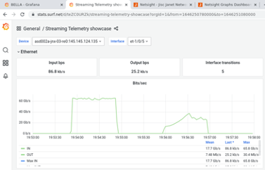
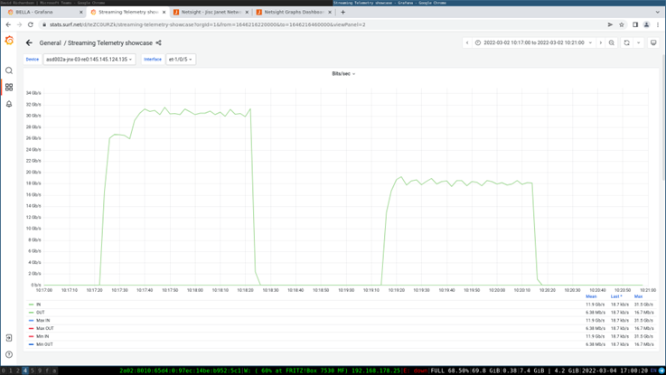
Experimental results - 1
SURF – RNP (Brazil)
Raul tested using perfSONAR’s pscheduler harness as part of a report for the GÉANT GN4-3 project
H-TCP, 4 streams, 256 MB windows
Results shown in SURF’s prototype streaming telemetry platform
  Top: iperf2: 65Gbit/s vs 40Gbit/s
  Bottom: iperf3: 31Gbit/s vs 20Gbit/s
9000MTU has 50% more throughput
See https://resources.geant.org/wp-content/uploads/2023/02/GN4-3_White-Paper_Network-Performance-Tests-Over-100G-BELLA-Link.pdf

Slide 13
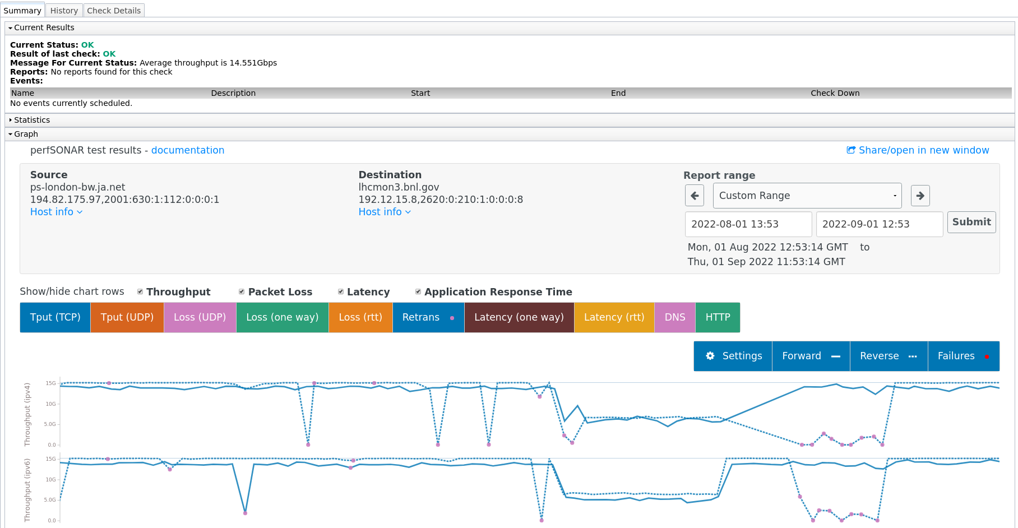
Experimental results - 2
Jisc London - BNL
Here Raul changed the tuning between two perfSONAR servers and noted the plotted results over time
The MTU is dropped from 9000 to 1500 for Jisc London to BNL (US), then raised again
Throughput falls 14Gbit/s to 6Gbit/s
(The second dip on the reverse path is where Raul sets the London pS node to default OS tuning)

Slide 14
Experimental results - 3
SURF to Jisc London – 9000 MTU
SURF to Jisc London – 1500 MTU
Interval Throughput Retransmits Current Window
0.0 - 1.0 24.38 Gbps 0 90.12 MBytes
1.0 - 2.0 27.57 Gbps 0 90.73 MBytes
2.0 - 3.0 22.58 Gbps 0 90.73 MBytes
3.0 - 4.0 25.98 Gbps 0 90.73 MBytes
4.0 - 5.0 23.03 Gbps 0 90.73 MBytes
5.0 - 6.0 22.75 Gbps 0 90.73 MBytes
6.0 - 7.0 22.41 Gbps 0 90.73 MBytes
7.0 - 8.0 21.82 Gbps 0 90.73 MBytes
8.0 - 9.0 21.93 Gbps 0 90.73 MBytes
9.0 - 10.0 20.06 Gbps 0 90.73 MBytes
Summary
Interval Throughput Retransmits Receiver Throughput
0.0 - 10.0 23.25 Gbps 0 23.23 Gbps
Interval Throughput Retransmits Current Window
0.0 - 1.0 8.91 Gbps 14145 10.54 MBytes
1.0 - 2.0 8.57 Gbps 0 10.68 MBytes
2.0 - 3.0 8.54 Gbps 263 5.41 MBytes
3.0 - 4.0 4.41 Gbps 0 5.55 MBytes
4.0 - 5.0 4.52 Gbps 0 5.69 MBytes
5.0 - 6.0 4.62 Gbps 0 5.86 MBytes
6.0 - 7.0 4.82 Gbps 0 6.18 MBytes
7.0 - 8.0 5.14 Gbps 0 6.65 MBytes
8.0 - 9.0 5.56 Gbps 0 7.25 MBytes
9.0 - 10.0 6.13 Gbps 0 8.02 MBytes
Summary
Interval Throughput Retransmits Receiver Throughput
0.0 - 10.0 6.12 Gbps 14408 6.09 Gbps
The above are tests Raul ran in March from a perfSONAR server in SURF to a Jisc server in London.
The results were similar for 12 x 10 second tests and 60 x 1 second tests. In both cases the 1500MTU tests had several instances of retransmissions throughout the test, which may have affected the window size and thus performance. Do larger frames reduce retransmissions? Further tests to follow!

