Slide 1

RAL Tier 1 & LHCONE update
LHCOPN-LHCONE #50
FZU
18 April 2023
Ian Collier

Slide 2



RAL Tier-1 network design
Super Spine
Other Services
Legacy
Tier-1
1600Gb/s
CTA
400Gb/s to Site Core
Tier-1 Spine
400Gb/s
200Gb/s to CERN
200Gb/s to JANET
(+ 200Gb/s backup)
~40PB storage
42k CPU cores

Slide 3
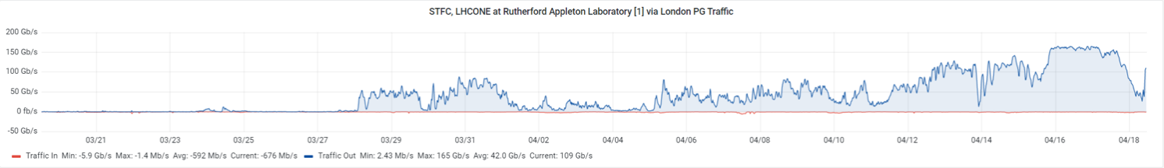
Joining the LHCONE
The legacy RAL tier-1 network had been designed back in 2009.
  Storage bypassed the site firewall and could make use of the LHCOPN link.
  Services and Worker Nodes were not.
Moving the WN on to the LHCONE involved taking them outside the firewall which required careful consideration.
  Various problems with IPtables and Docker needed to be resolved.
On 27th March we added ~520k HS06 of CPU capacity to the LHCONE.

Slide 4
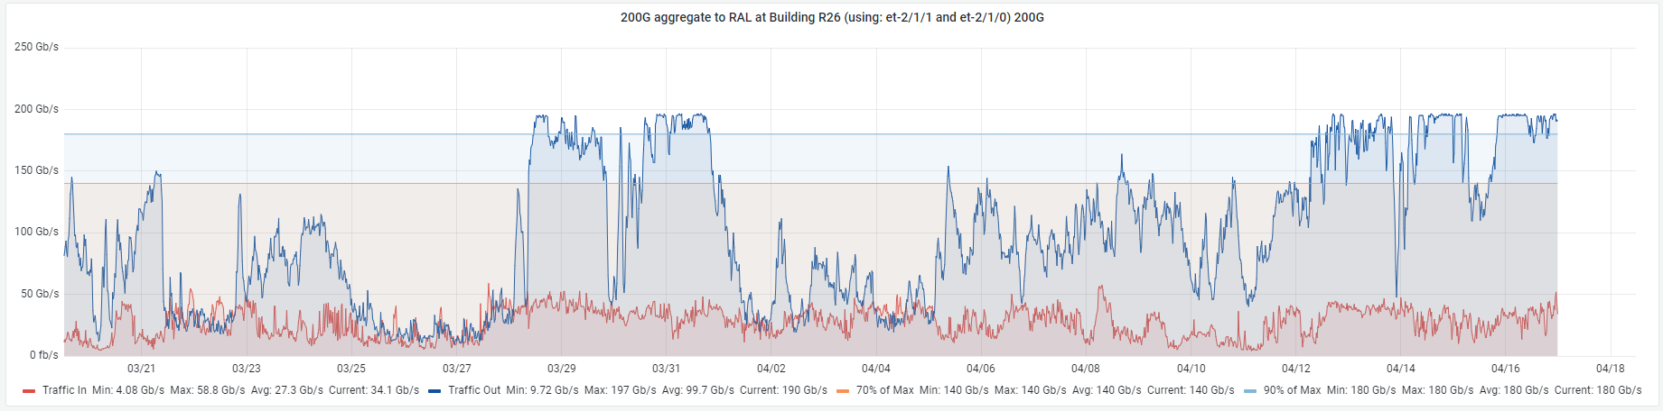
Too successful?
Since moving the WN, we have noticed several periods where the 200Gb/s site link to JANET is saturated!
We believe this is CMS jobs performing remote reads.
  We may need to limit the amount temporarily.

Slide 5
LHCOPN to the rescue..
We recently (March 2023) upgraded our OPN link from 100Gb/s to 200Gb/s although this second link is not yet connected.
  The other 100Gb/s link is still attached to the old network.
In the next few weeks we plan to connect the two 100Gb/s LHCOPN links to the new network providing us with 400Gb/s total capacity.
We will also be adding Echo (Disk) gateways to the LHCONE.
Antares (Tape) will follow although this will require a bit of work as it was originally intended to be internal only so we didn’t setup things like IPv6.

Slide 6
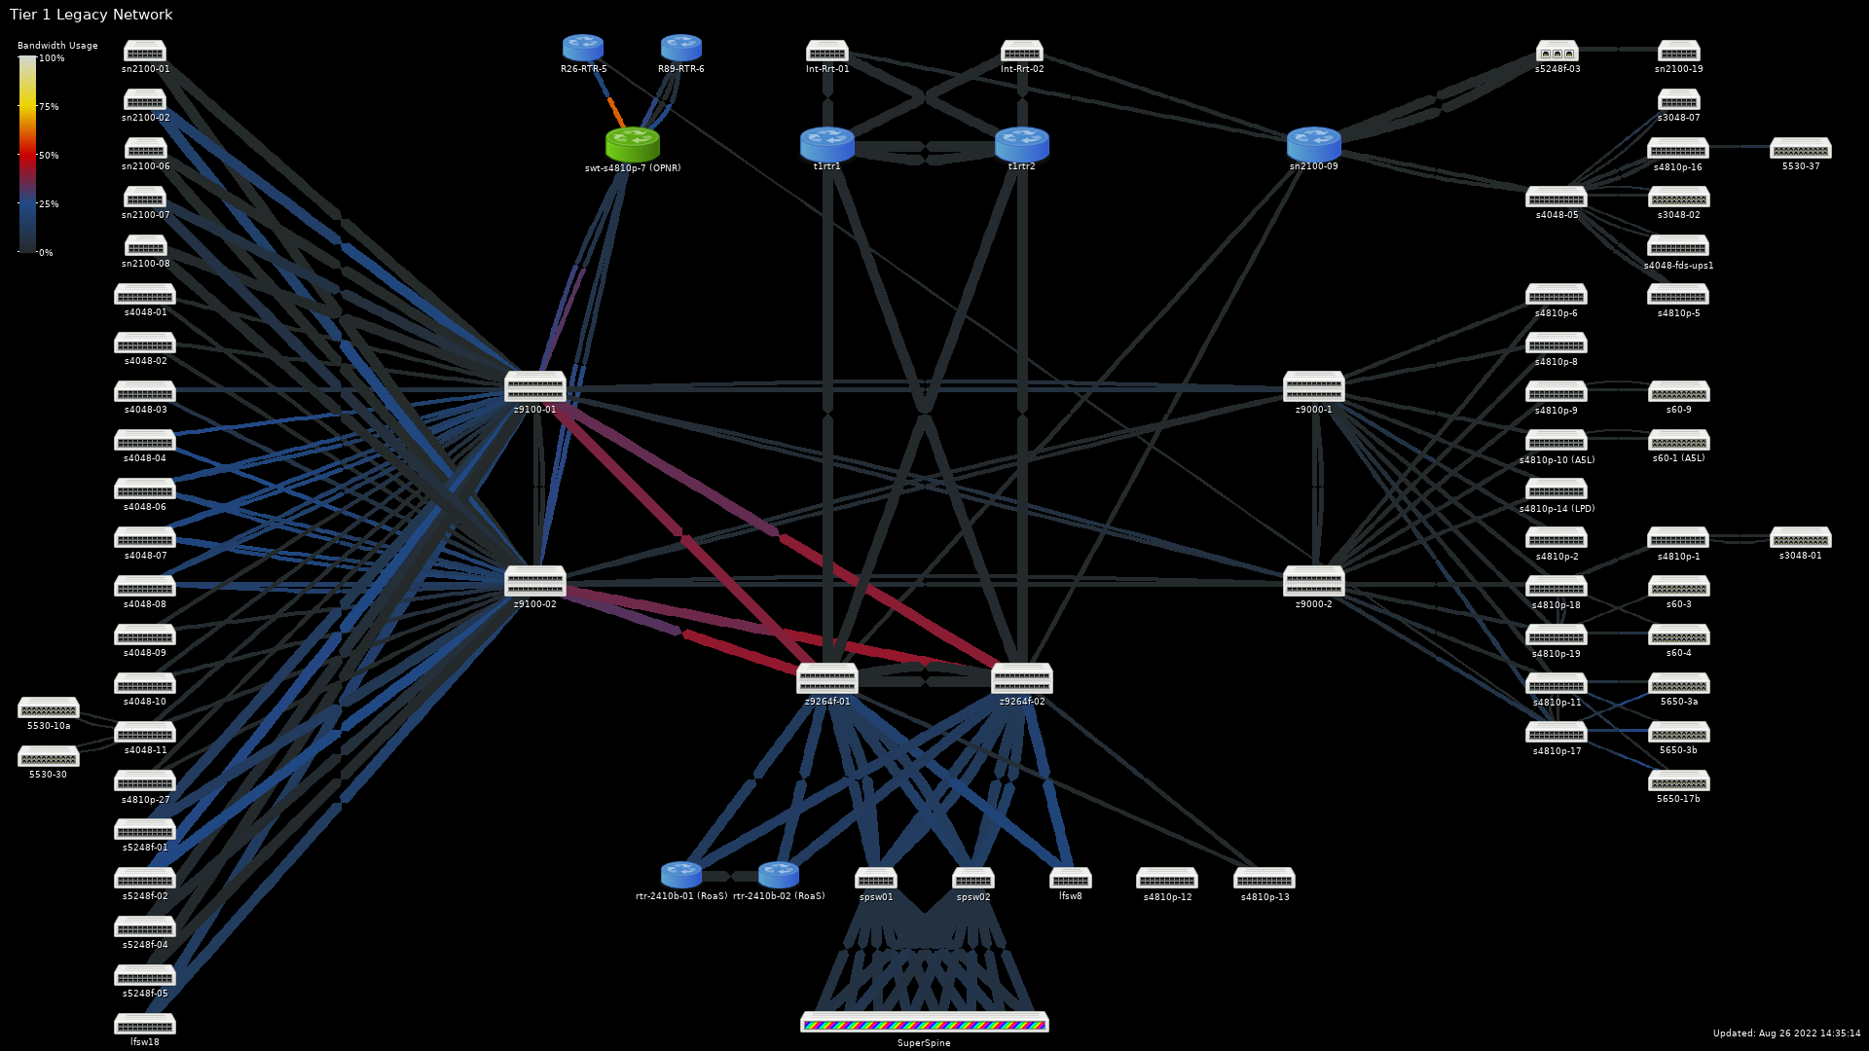
Where we started
Legacy Network — August 2022
(Mixed 10/40/100Gbps)

Slide 7
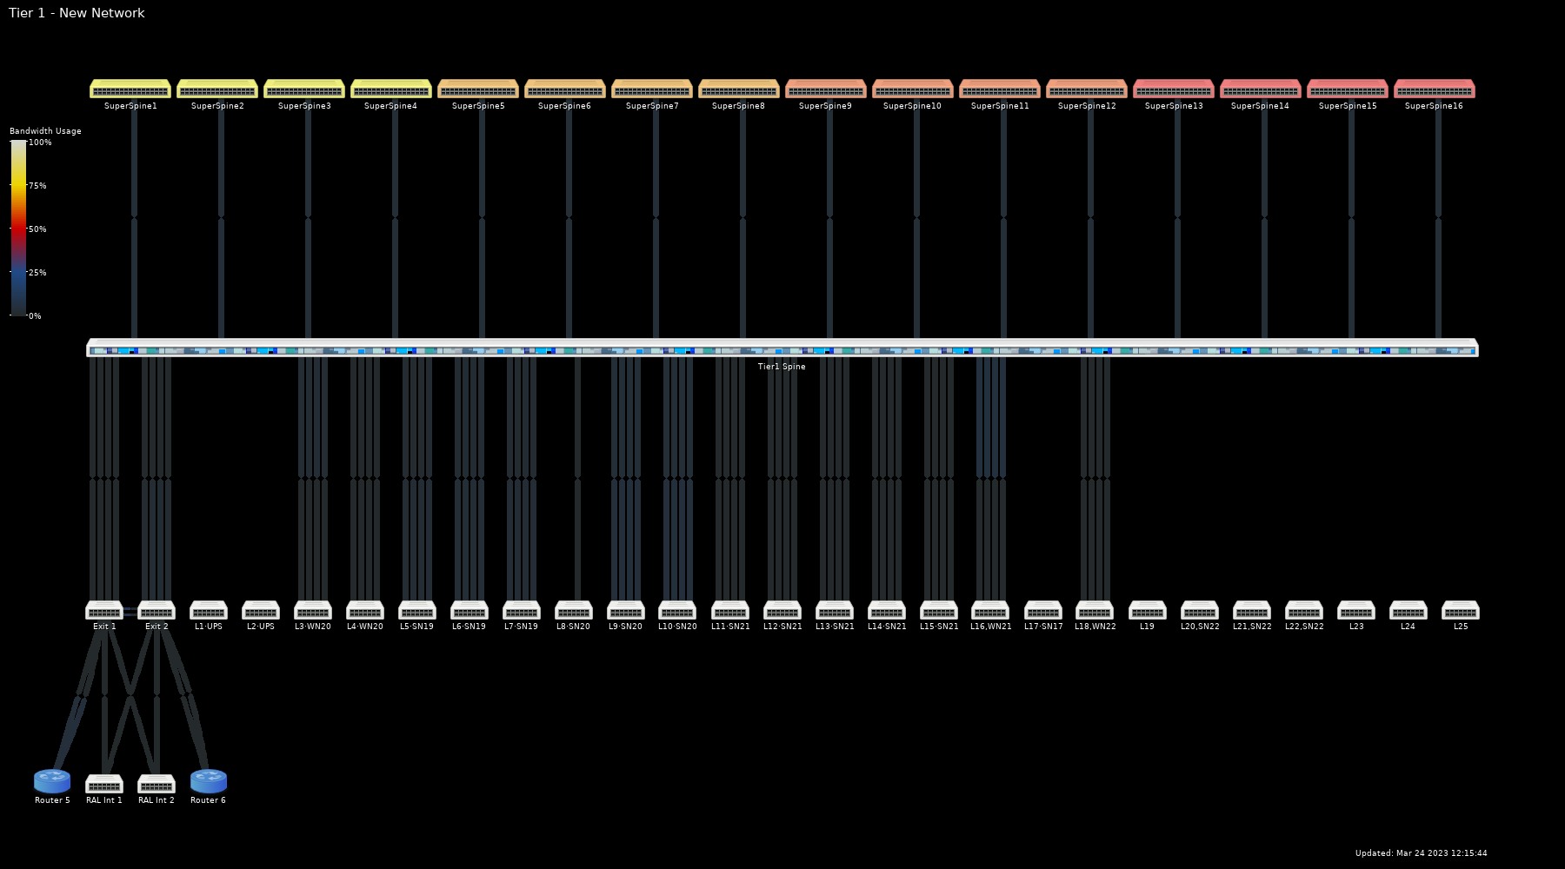
Where we’re heading…New Network — March 2023
(All links 100Gbps)

Slide 8
Legacy Network — August 2022
(Mixed 10/40/100Gbps)

Slide 9
Legacy Network — October 2022
(Mixed 10/40/100Gbps)

Slide 10
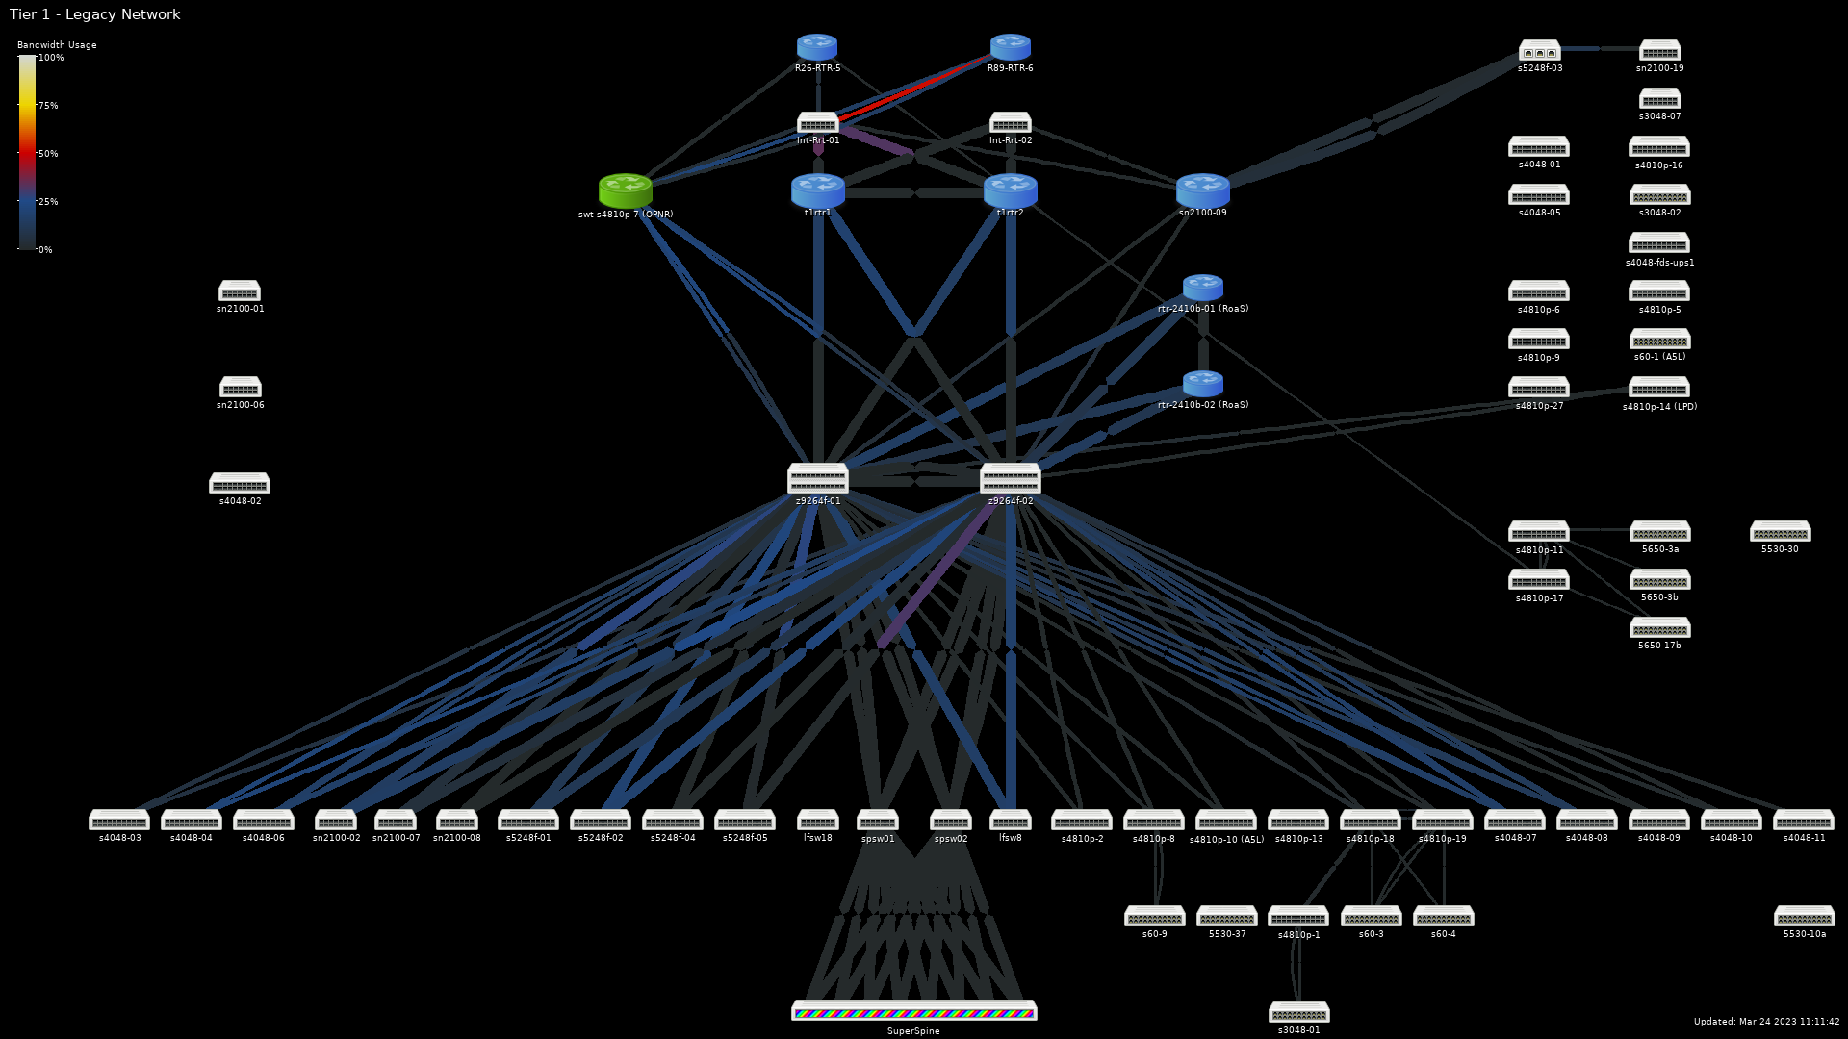
Legacy Network — March 2023
(Mixed 40/100Gbps)

Slide 11
New network
Four leaves of workers (almost) +1
  104% of 2023 CPU pledge (146% soon)
Eleven leaves of storage in production +6
  33% of Echo capacity
  FY2022 nodes currently being deployed

Slide 12
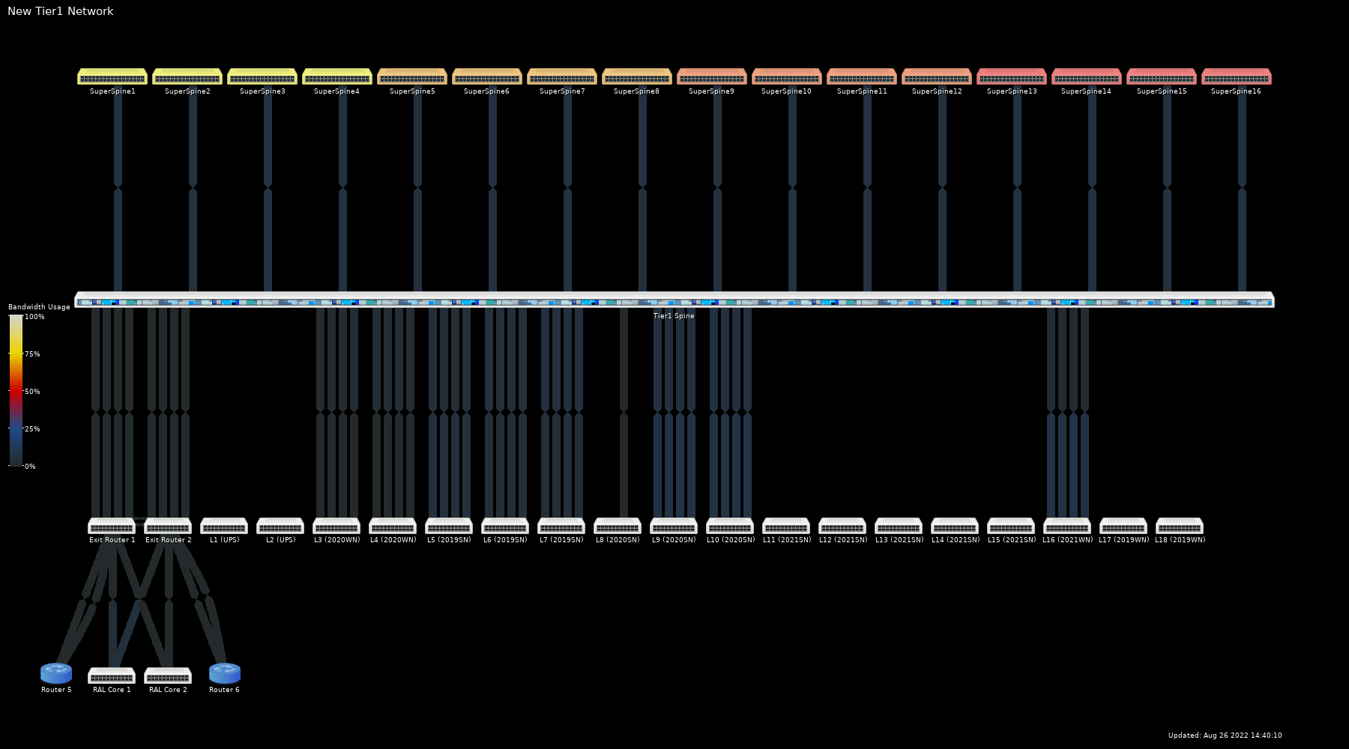
New Network — August 2022
(All links 100Gbps)

Slide 13
New Network — March 2023
(All links 100Gbps)

Slide 14
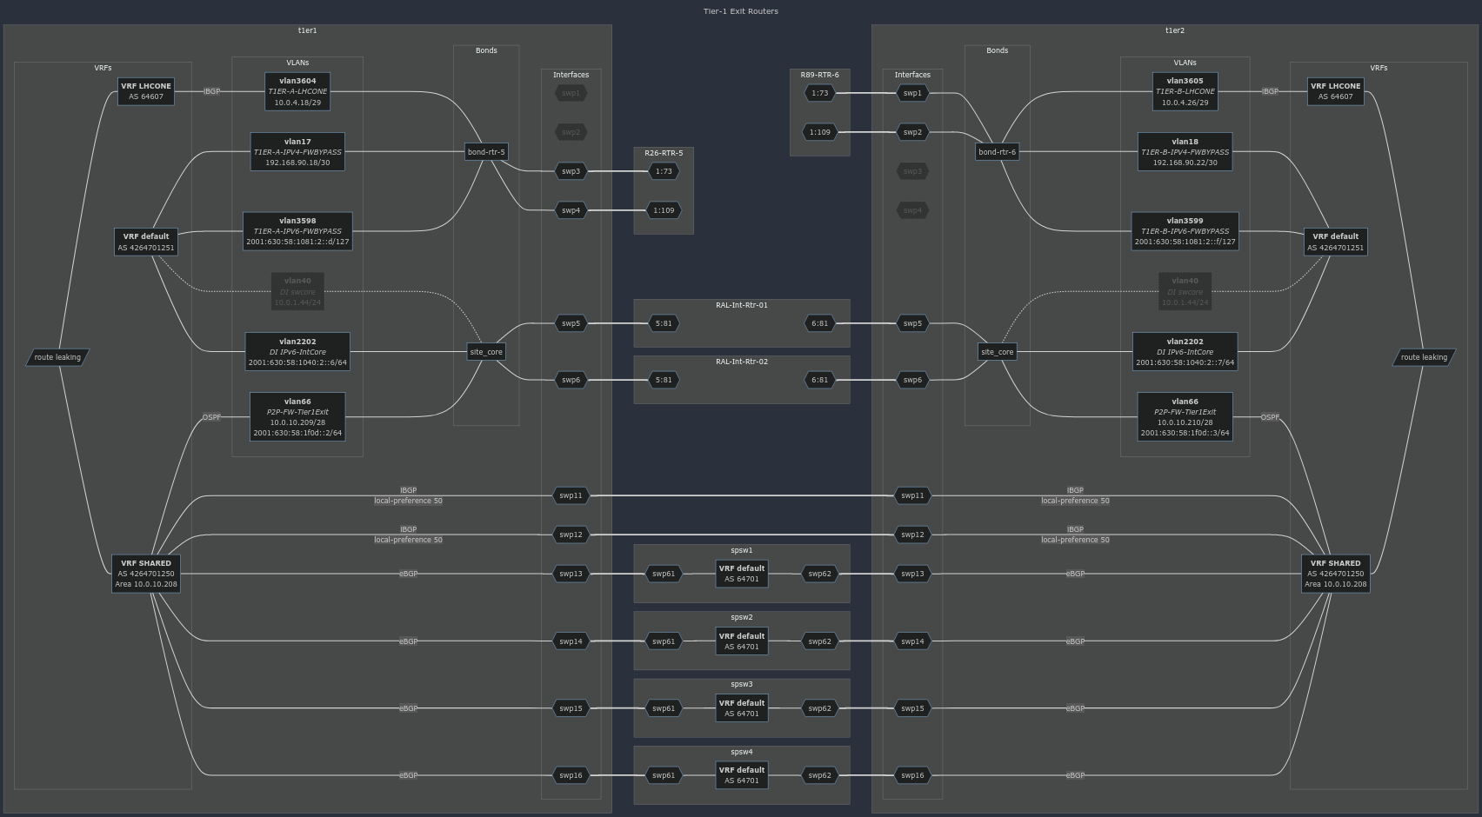
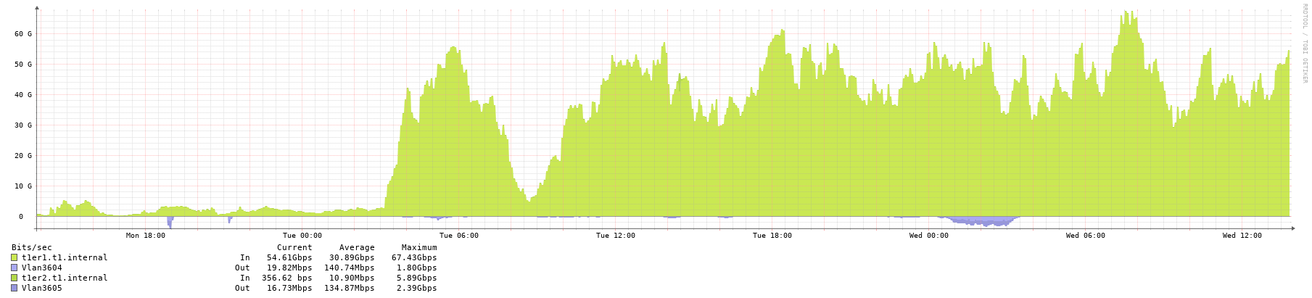
LHCONE
Peering with both Exit Routers
Everything on new network now advertised
  2020+ Worker nodes
  2019+ Storage
    No echo gateways (yet)

Slide 15
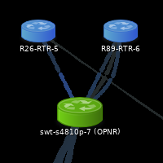
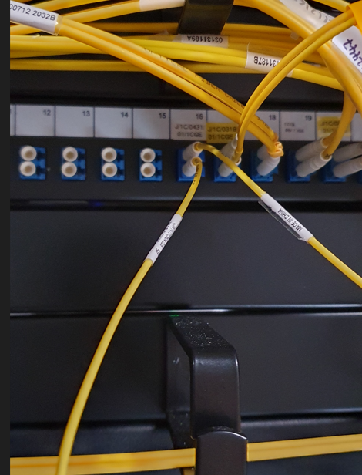
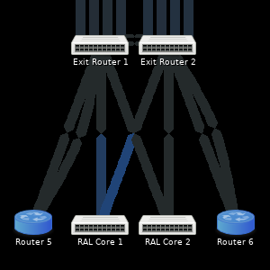
LHCOPN
Still peering with legacy OPNR via RAL Border Router 6.
Second 100Gbps link now provisioned!
  Will connect directly to
  Exit Router 2.
Then move existing link to
Exit Router 1.

Slide 16
Thank you
Facebook: Science and Technology Facilities Council
Twitter:@STFC_matters
YouTube: Science and Technology Facilities Council

