Slide 1

Continuous spectrum on cosmological collider
Shuntaro Aoki
(Chung-Ang University)
based on 2301.07920
CAU BSM workshop
23/2/2023

Slide 2
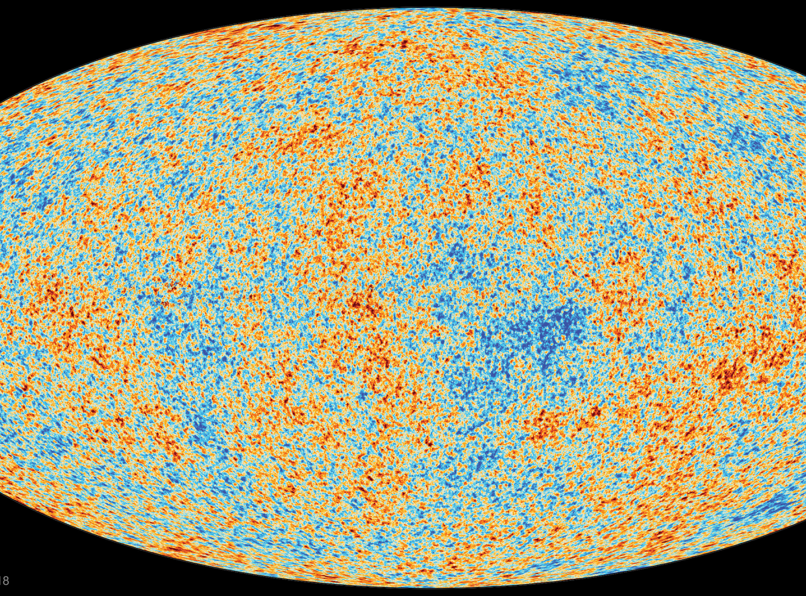





Inflationary observable
$$γ_{ij}$$
$ζ$
$$ζ′$$
$$γ_{ij}′$$
scalar power spectrum: $P_{ζ}$~ $\left\langle ζζ′\right\rangle$
tensor power spectrum: $P_{γ}$~ $\left\langle γγ′\right\rangle$
spectral tilt: $n_{s}−1=\frac{d\ln{P_{ζ}}}{d\ln{k}}$, …

Slide 3
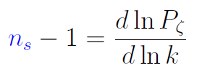
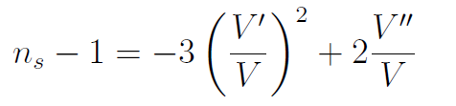
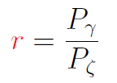
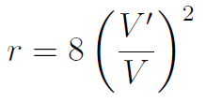
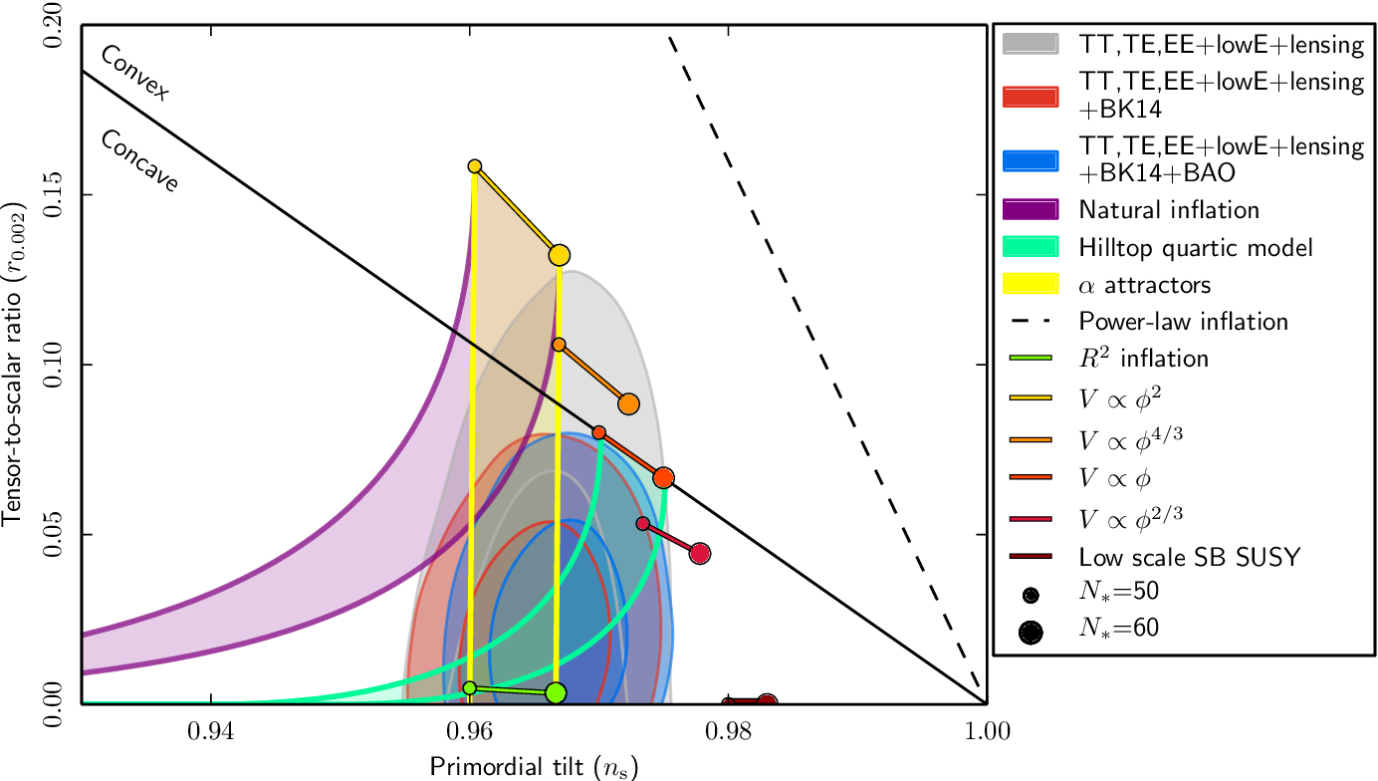


Restrictions on inflaton potential
$r$
Y. Akrami et al., Planck 2018
$n_{s}$

Slide 4
Beyond 2-pt. function: non-Gaussianity (NG)
$\left\langle ζ^{3}\right\rangle$ : Bispectrum, $\left\langle ζ^{4}\right\rangle$ : trispectrum,…

Slide 5

NG from self-interaction
$τ$

Slide 6

NG from self-interaction
$τ$
・ $f_{NL}\sim O(ε)$ for simple model
Maldacena ’03
simple : single scalar + Einstein gravity + canonical kinetic term + slow-roll

Slide 7
NG from self-interaction
$τ$
・ $f_{NL}\sim O(ε)$ for simple model
Maldacena ’03
simple : single scalar + Einstein gravity + canonical kinetic term + slow-roll
・ $f_{NL}≫1$ for more general class of inflation models

Slide 8
NG from self-interaction
$τ$
・ $f_{NL}\sim O(ε)$ for simple model
Maldacena ’03
simple : single scalar + Einstein gravity + canonical kinetic term + slow-roll
・ $f_{NL}≫1$ for more general class of inflation models
・ Observational constraints :
From Shellard’s slide

Slide 9
NG from self-interaction
$τ$
NG → strong restrictions on inflation models

Slide 10
NG from self-interaction
$τ$
NG → strong restrictions on inflation models
There’s more: Cosmological collider (CC)

Slide 11


Cosmological collider (CC)
$τ$
Chen, Wang, ’10
Baumann, Green, ’12
Noumi, Yamaguchi, Yokoyama, ’13
Arkani-Hamed, Maldacena, ’15
$σ$

Slide 12

Cosmological collider (CC)
$τ$
Chen, Wang, ’10
Baumann, Green, ’12
Noumi, Yamaguchi, Yokoyama, ’13
Arkani-Hamed, Maldacena, ’15
$σ$
・ NG can contain information of heavy (new) particle $σ$ with specific
oscillation signal

Slide 13
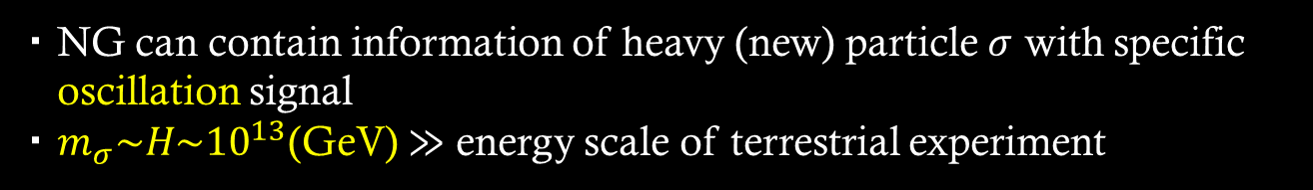
Cosmological collider (CC)
$τ$
Chen, Wang, ’10
Baumann, Green, ’12
Noumi, Yamaguchi, Yokoyama, ’13
Arkani-Hamed, Maldacena, ’15
$σ$
・ NG can contain information of heavy (new) particle $σ$ with specific
oscillation signal
・ $m_{σ}\sim H\sim {10}^{13}$(GeV) $≫$ energy scale of terrestrial experiment

Slide 14
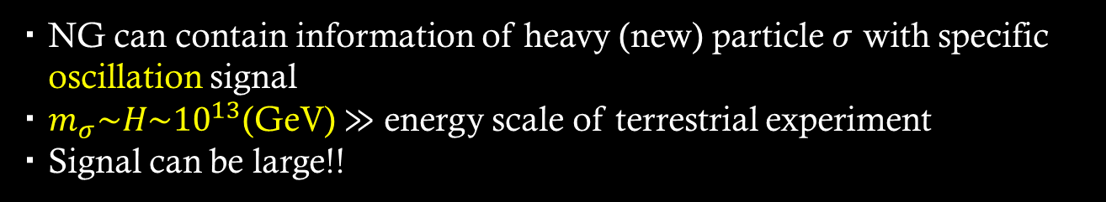
Cosmological collider (CC)
$τ$
Chen, Wang, ’10
Baumann, Green, ’12
Noumi, Yamaguchi, Yokoyama, ’13
Arkani-Hamed, Maldacena, ’15
$σ$
・ NG can contain information of heavy (new) particle $σ$ with specific
oscillation signal
・ $m_{σ}\sim H\sim {10}^{13}$(GeV) $≫$ energy scale of terrestrial experiment
・ Signal can be large!!

Slide 15
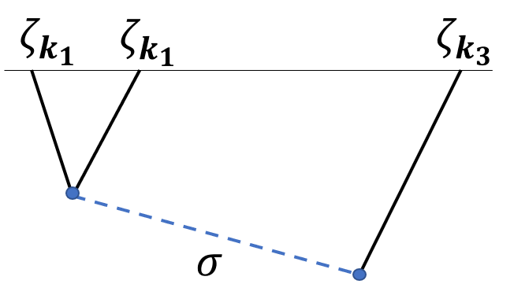
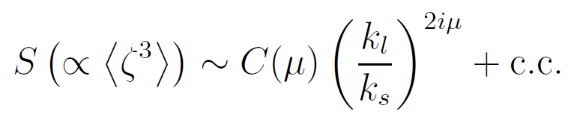
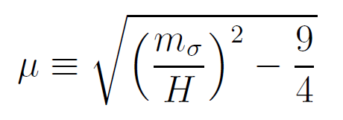



Example: scalar $σ$
oscillation
$τ$
squeezed limit ($k_{l}≡k_{3}≪k_{1,2}≡k_{s}$)
Can read off the mass of a new particle from frequency

Slide 16
Many works
On search for new physics
✓SUSY (Baumann, Green, ’12)
✓General interactions for a massive scalar by EFT approach
(Noumi, Yamaguchi, Yokoyama, ’13)
✓Higher spin (H. Lee, D. Baumann, and G. L. Pimentel, ’16)
✓Standard model particles, Neutrino (Chen, Wang, Xianyu, ’16)
✓Leptogenesis (Cui, Xianyu ’21)
✓GUT (Maru, Okawa, ’21)
…
Bootstrapping approach
Arkani-Hamed, Baumann, Lee, Pimentel ’18, ...

Slide 17
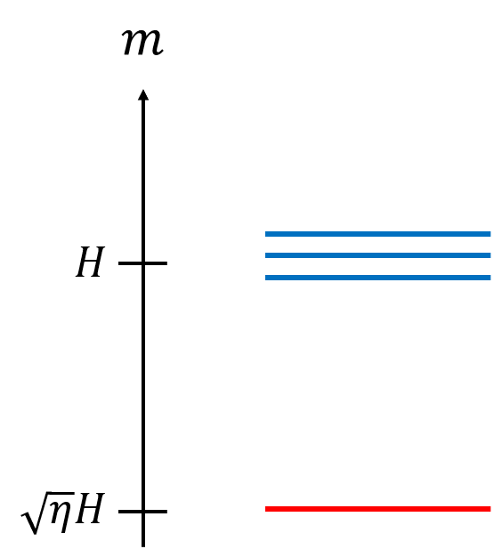

Question
✓ single particle with a definite mass and spin
Q. What about multiple particles case?
heavy particles
Natural setup for UV theory
(e.g., soft masses ~$H$ in supergravity)
inflaton

Slide 18

Multifiled on CC
✓Whole signal is governed by lightest particle
due to Boltzmann suppression ~ $e^{−πm/H}$
✓Non-trivial signal for (almost) degenerate masses
SA, M. Yamaguchi, JHEP 04 (2021) 127
L. Pinol, SA, S. Renaux-Petel, M. Yamaguchi, 2112.05710

Slide 19
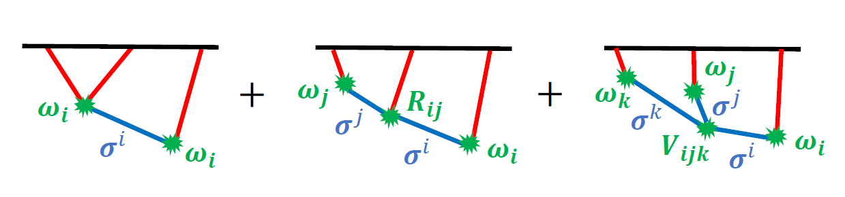
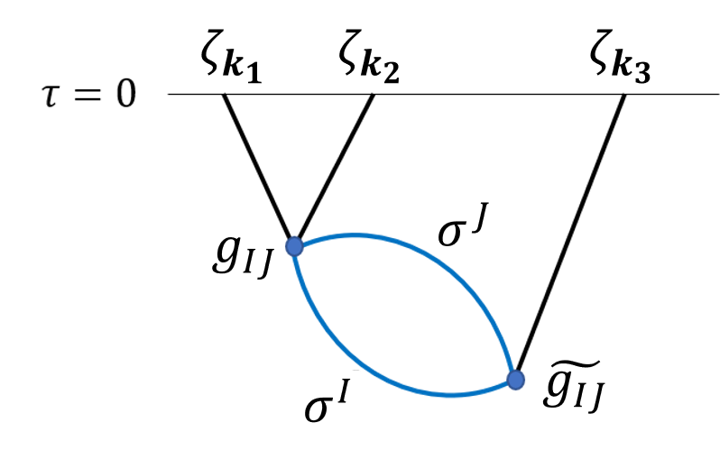
Multifiled on CC
✓Whole signal is governed by lightest particle
due to Boltzmann suppression ~ $e^{−πm/H}$
✓Non-trivial signal for (almost) degenerate masses
SA, M. Yamaguchi, JHEP 04 (2021) 127
L. Pinol, SA, S. Renaux-Petel, M. Yamaguchi, 2112.05710
tree level
loop level

Slide 20
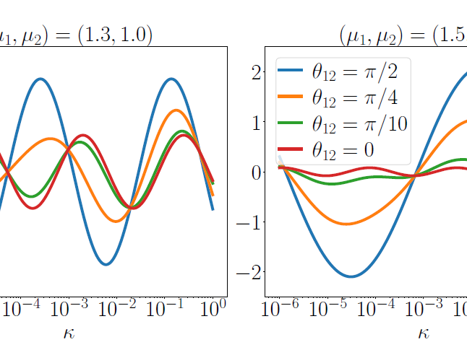
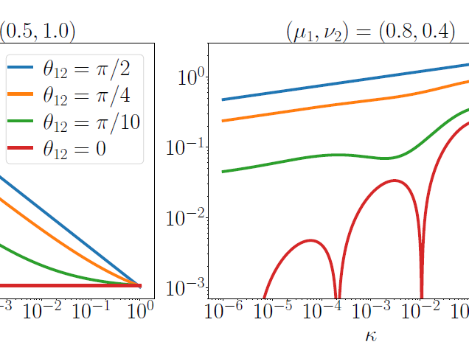
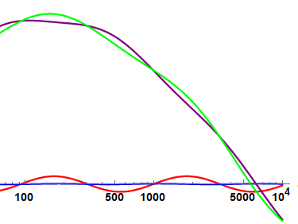
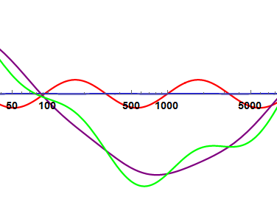
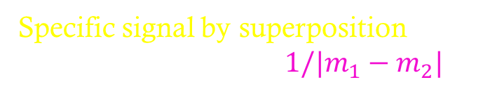
Multifiled on CC
✓Whole signal is governed by lightest particle
due to Boltzmann suppression ~ $e^{−πm/H}$
✓Non-trivial signal for (almost) degenerate masses
SA, M. Yamaguchi, JHEP 04 (2021) 127
L. Pinol, SA, S. Renaux-Petel, M. Yamaguchi, 2112.05710
Specific signal by superposition
e.g., wavelength with $1/|m_{1}−m_{2}|$

Slide 21
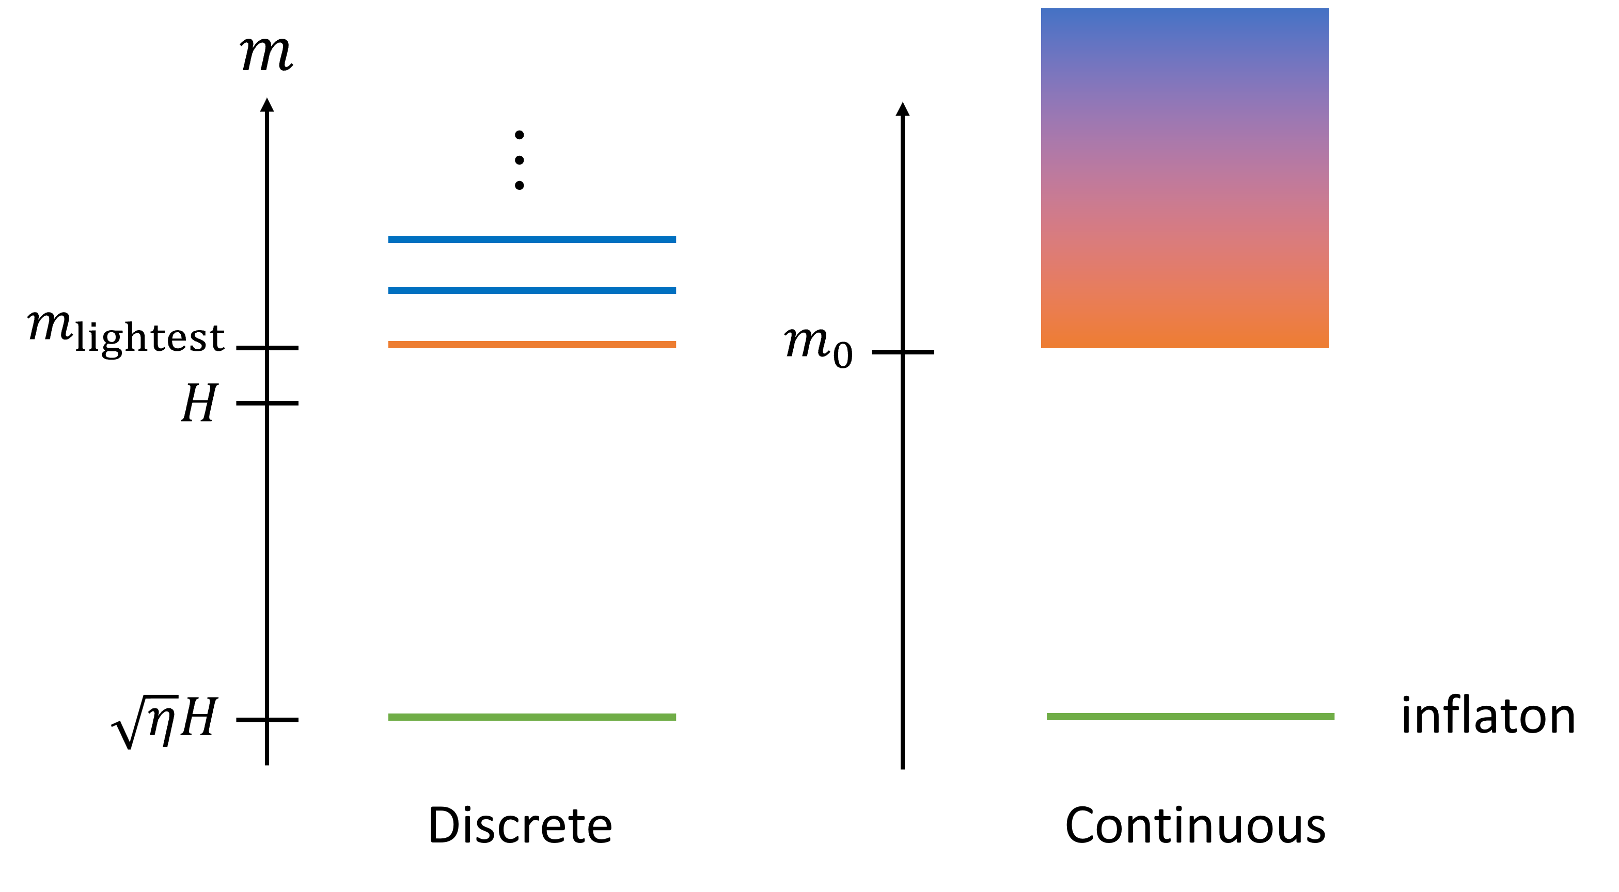

Today: what about continuous spectrum?
Motivated by some extra-dimension model
$m_{0}$: gap scale

Slide 22
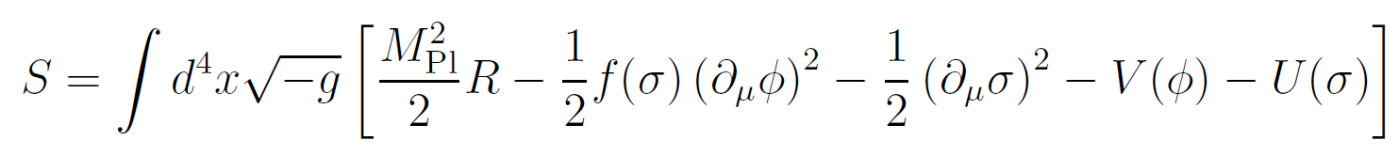
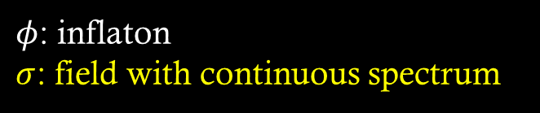
Setup
$φ$: inflaton
$σ$: field with continuous spectrum

Slide 23
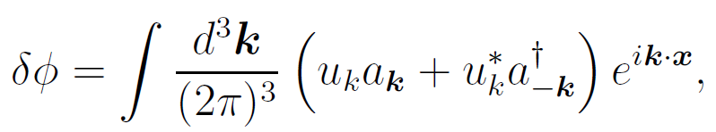
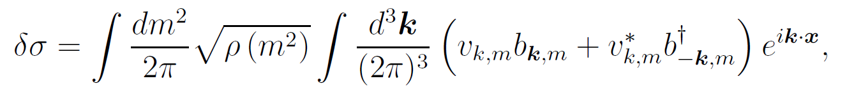

Setup
$φ$: inflaton
$σ$: field with continuous spectrum
Quantization of fluctuations
$ρ(m^{2})$: spectral density

Slide 24
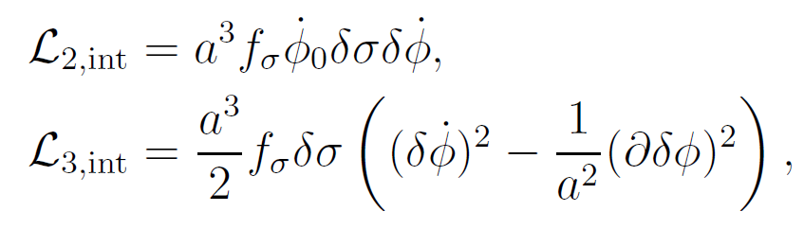
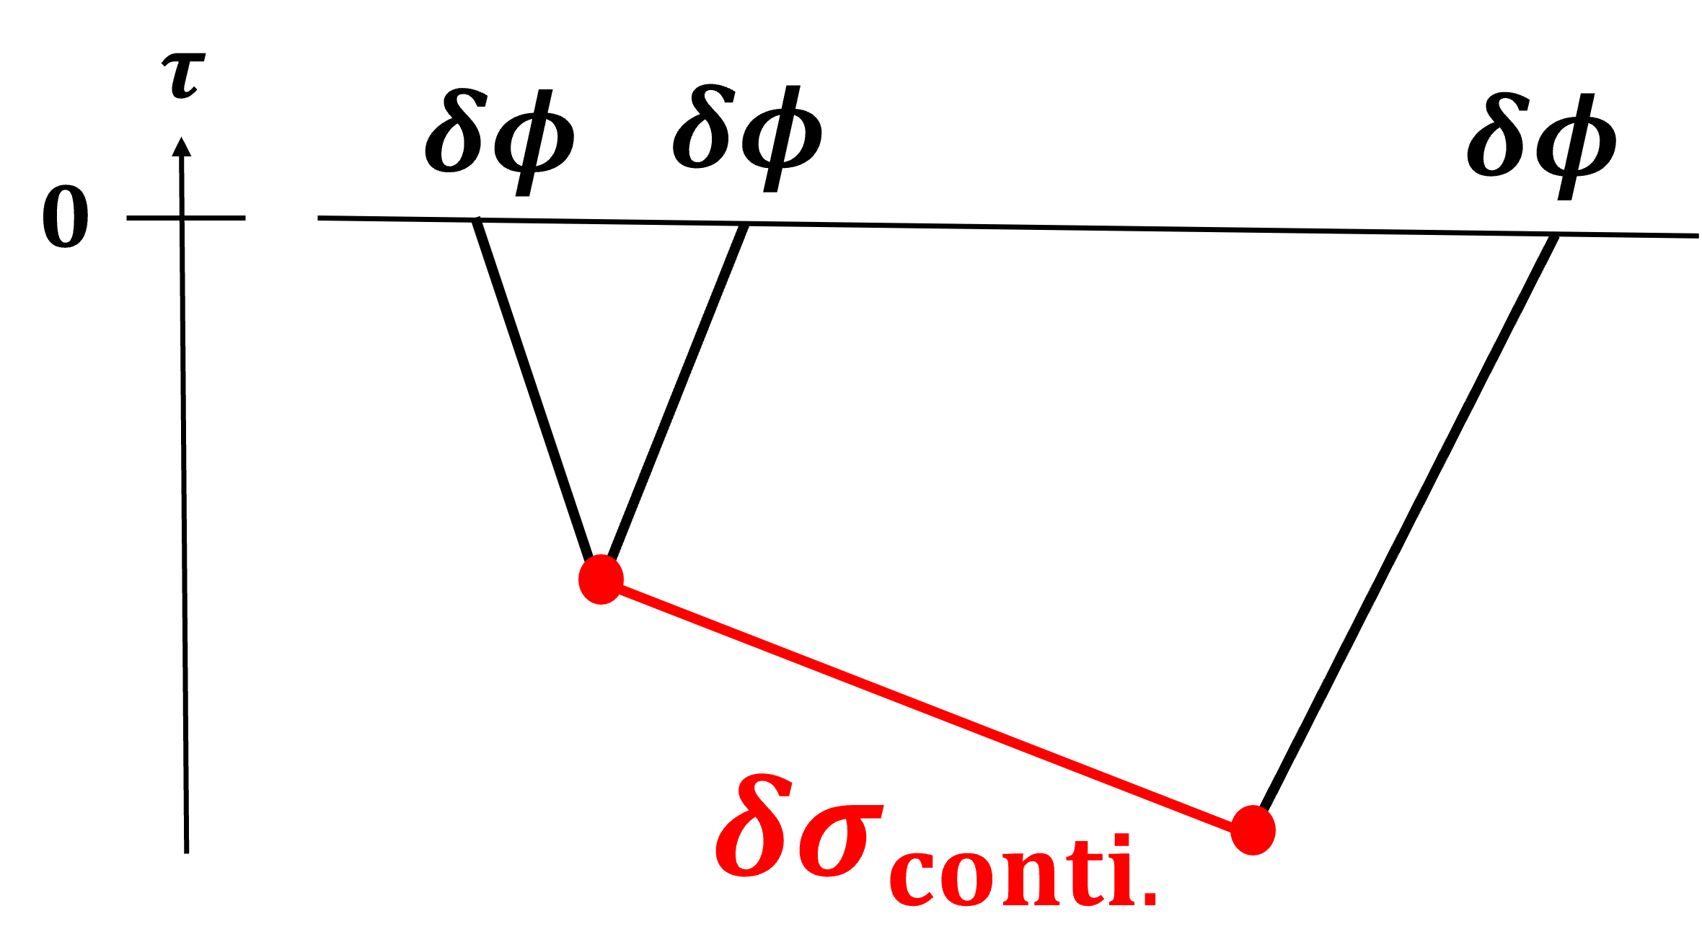
Interactions

Slide 25

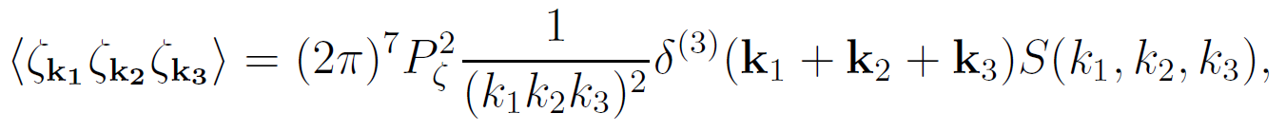

Observable:
Curvature perturbation
def. of shape function (~$f_{NL}$)

Slide 26
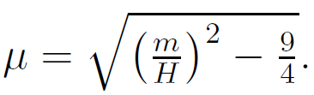
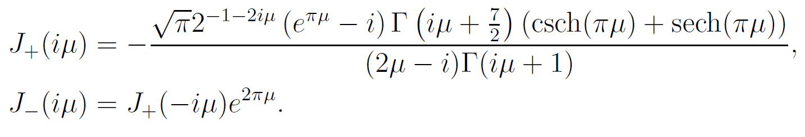
Result
Result in squeezed limit ($κ≡k_{1}/k_{3}≫1$)
New !!
coefficient (analytic expression)

Slide 27
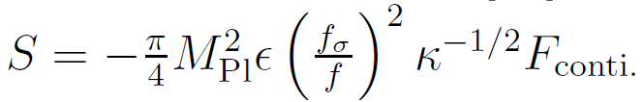
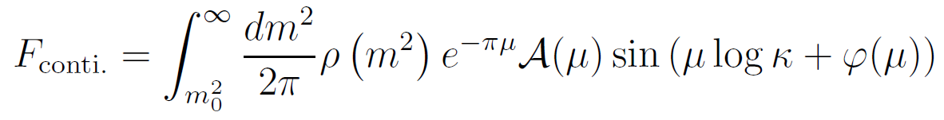
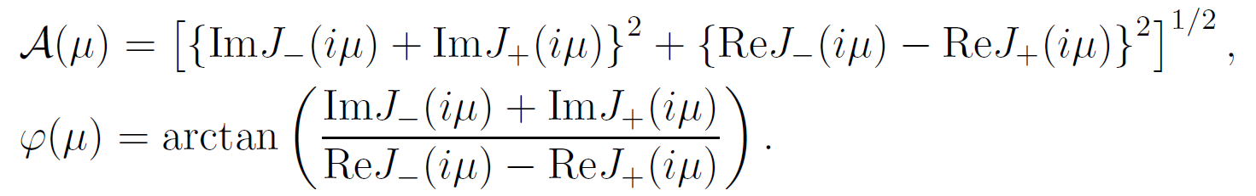

Result
Continuous case:
Usual case
(single particle with definite mass):

Slide 28
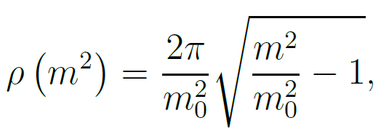
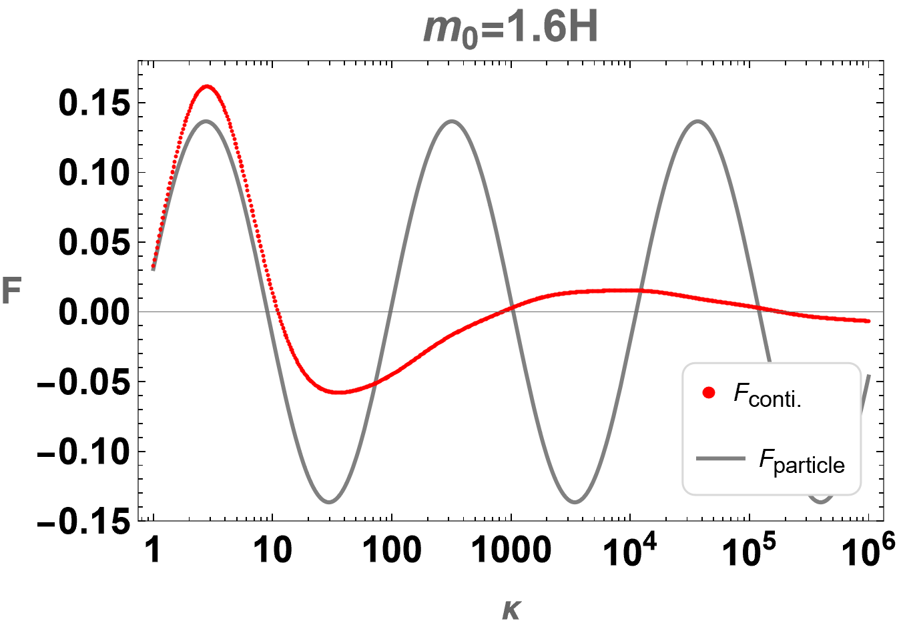
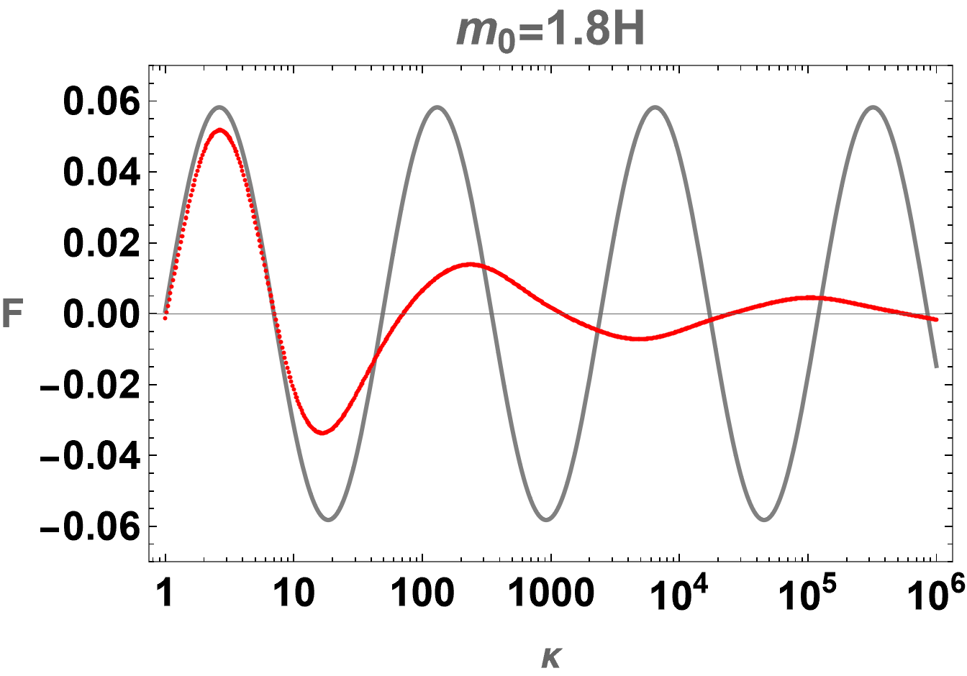
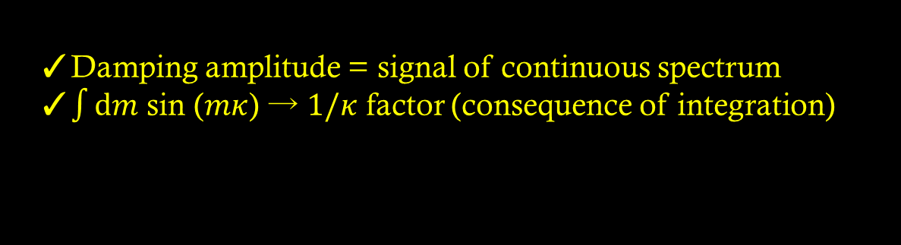
Result
choose a specific spectral density
E. Megıas, M. Quirsos,’19
C. Csaki, S. Hong, G. Kurup, S. J. Lee, M. Perelstein, W. Xue, ‘22
✓Damping amplitude = signal of continuous spectrum
✓$\int{dm}$ sin ($mκ$) → $1/κ$ factor (consequence of integration)

Slide 29
Summary
Cosmological collider (CC) is a new attractive tool for exploring high energy
Multiple field signature on CC (motivated by e.g., supergravity)
Continuous spectrum on CC (motivated by some extra dimensional models)
These signals cannot be mimicked by single particle with a definite mass → Strong evidence of multi particles & continuous spectrum
Interesting to think about embedding into concrete UV setup
✓non-trivial superposition for almost degenerate masses
✓damping effects in deep squeezed limit
Thank you for your attention !!

