Slide 1



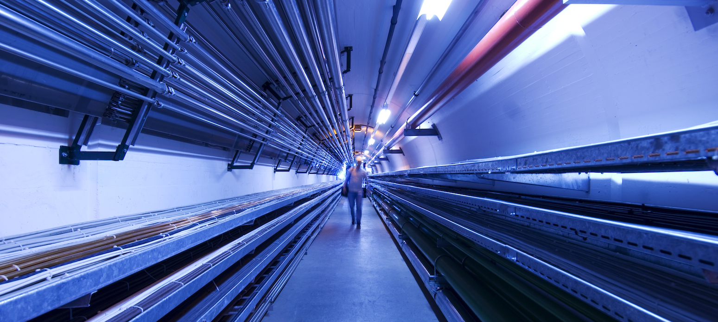
MuC Target Design Overview
Discussion of shared targetry needs between MuCol and mu2e
by Rui Franqueira Ximenes (CERN-SY-STI-TCD)
Marco Calviani, Francisco Javier Saura
Anton Lechner, Daniele Calzolari,
CERN – Systems Department
Sources Targets Interaction (STI)
Targets Collimators Dumps (TCD)
2023/01/31

Slide 2
Outline
Carbon target & target systems considerations
Design overview
Carbon Target & shielding feasibility studies
HLM Target - a possibility
Final remarks

Slide 3
Carbon target & target systems considerations
Target Physics requirements
Solenoid / Double Horn
Shielding
P+
µ
Cooling &
Capture
Target Engineering requirements
Proton driver
Carbon Target
Production
Pulse intensity
Pulse length
Pulse frequency
Beam size
Beam energy
Pion/Muon yield
Emittance
++…
++ Other requirements
Dynamic load
High temperature & average power
Fatigue
Radiation damage
Integration
Operation / Maintenance / Disposal
Design
Cooling
Sing/multiple rods
Length / λ
Diameter
Tilt
Target vessel size
Beam windows
Type of cooling
Passive/active
Parameters
Dedicated/shared
Material
Radio Protection
Material / alloy
Availability
Properties
Radiation damage
Services

Slide 4
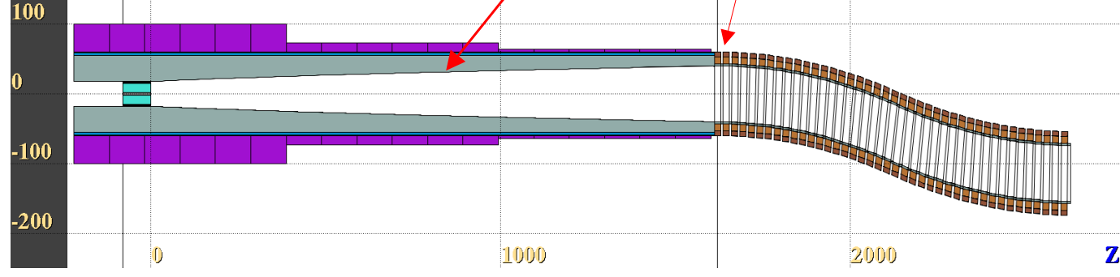
Carbon target & target systems considerations
  Energy deposition/dpa studies on the Target, windows, shielding, magnets, chicane
  Parameterization study / optimization of beam parameters
  (Conceptual) Engineering study of Target & Target Systems, shielding, p+ dump -> feasibility
  ++ iteration loops with p+ driver, magnets, cooling
Production target
Tapering region
Chicane
Eventually p+ dump

Slide 5
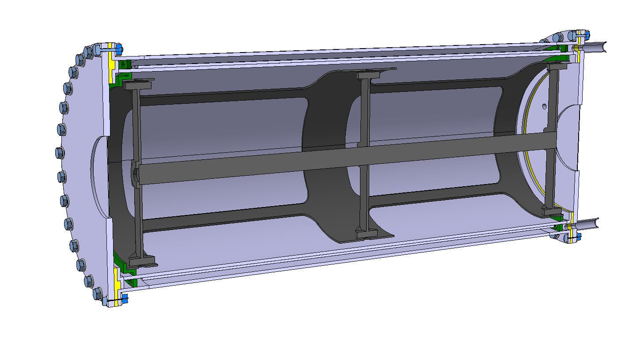
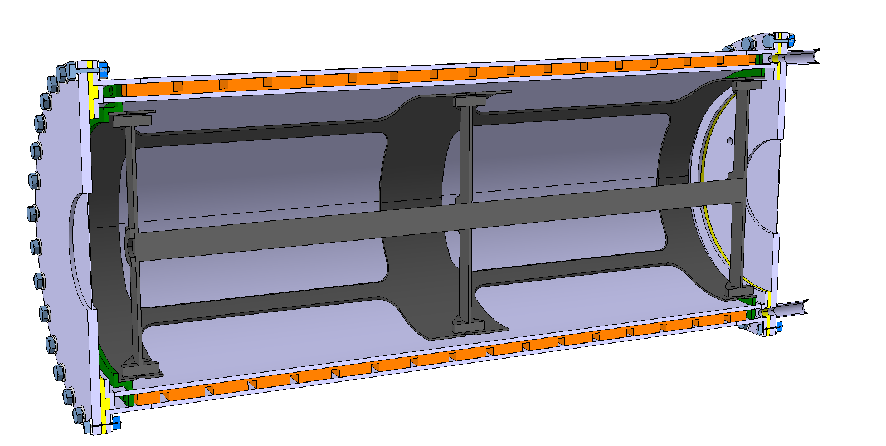
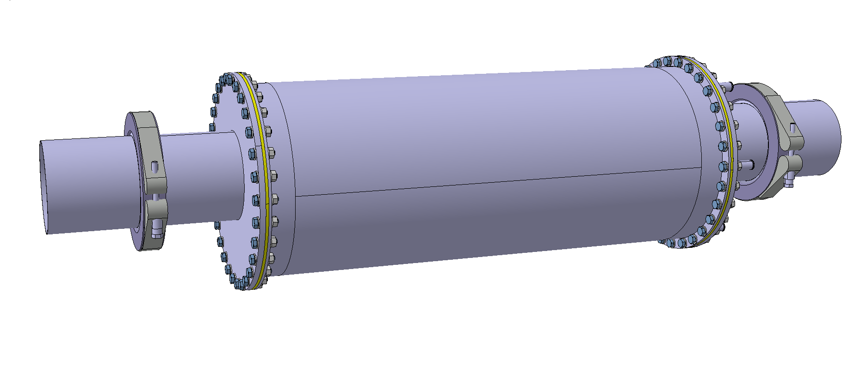
Carbon target concept
Water connections
Outer vessel
Inner vessel (finned)
Helium filling
Beam window
Beam
Serpentine cooling version
Axial block
Target
Target support tube
Tube support
Vessel support
5

Slide 6
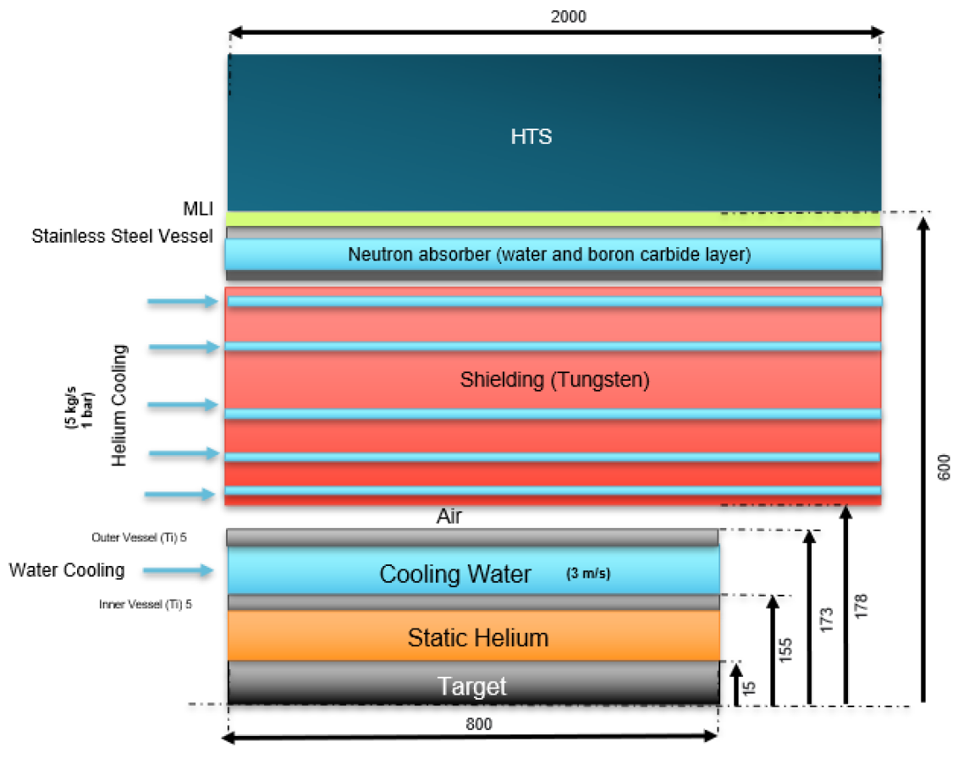
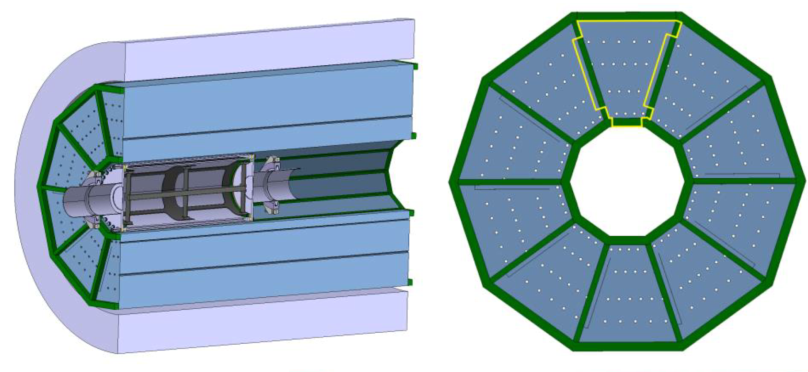
Carbon target concept
Target & shielding schematic (not at scale)
C-Target in static helium
Water cooled Ti vessel
Helium (gas) cooled W shielding
Moderator & neutron absorber at outer radius with water & Boron carbide
Conceptual shielding design
6

Slide 7
Carbon Target: engineering feasibility
Carbon Target
Study considerations
  Simple C-rod (L800 mm, 1.79 nuclear inelastic scattering lengths)
  Beam energy (5 GeV), bunch length (2ns) and average beam power (1.5 – 3 MW)
  Sensitivity study: thermal behavior as a function of beam sigma and frequency
  Studied cooling concepts:
    Only radiation cooling
    Natural convection + radiation cooling
    Forced convection cooling
  Structural calculation
  Note: Not coupled with any pion-muon physics optimization → purely thermo-mechanical feasibility assessment.
How much do we gain by playing with these beam parameters?
How can we cool it?
Does it ‘survive’?

Slide 8
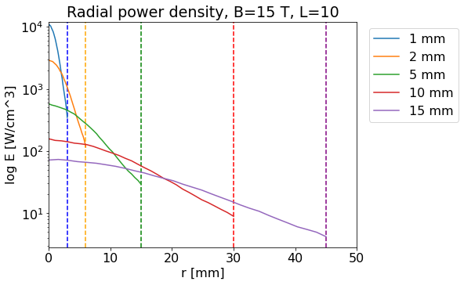
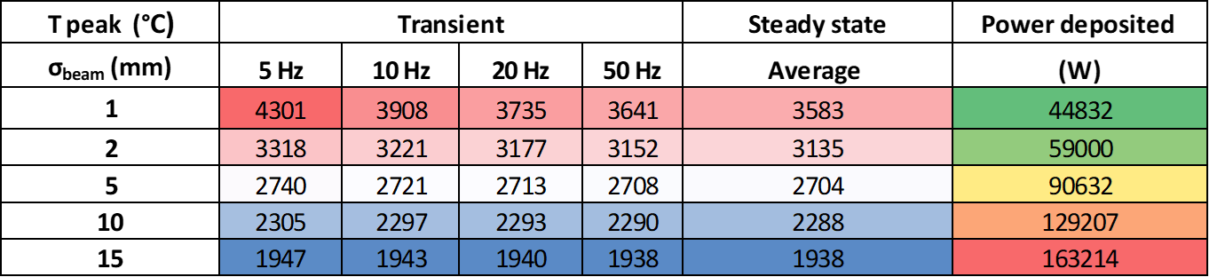
Carbon Target: engineering feasibility
Carbon Target
Maximum temperature and power deposition for 1.5 MW as function of the beam sigma.
Considering only radiative heat dissipation
  Beam size is driving parameter of target temperature (for a given average power)
  However, larger target D increases cooling requirements (for a given Radius – beam σ ratio)
  Pulse frequency (thus pulse intensity) driving parameter for thermal gradient and consequently dynamic stress of the target.
  Beam sizes of >5mm (1σ) recommended (on a thermal perspective. +info later)

Slide 9
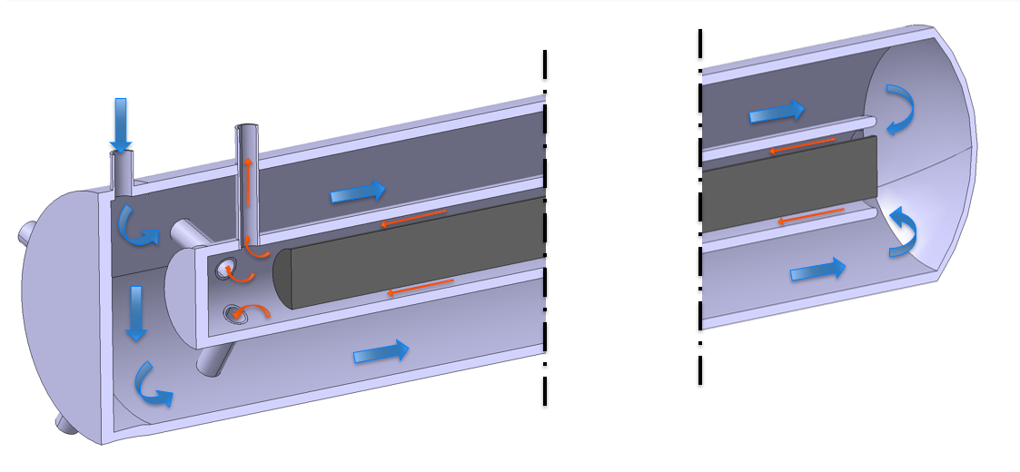
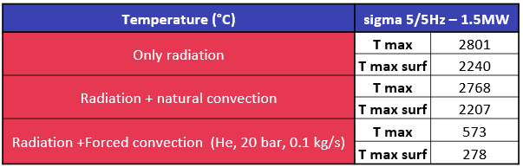
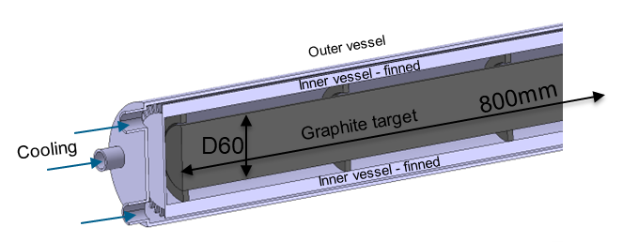
Carbon Target: engineering feasibility
Direct cooling considerations
Maximum temperature and power deposition for 1.5 MW as function of the beam sigma.
Old concepts
  Target Cooling
  Due to high T and sublimation of graphite, an enclosed ‘pressurized’ atmosphere is required.
  However, active cooling can be made indirectly. Heat dissipation mostly via radiation and natural convection. → target confinement / separation of cooling system is advantageous (maintenance, RP, disposal, cooling services requirements).

Slide 10
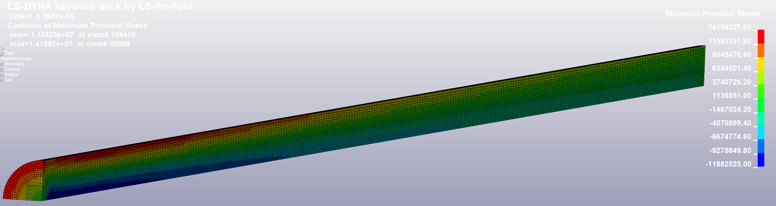
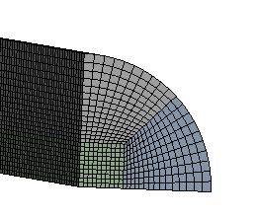
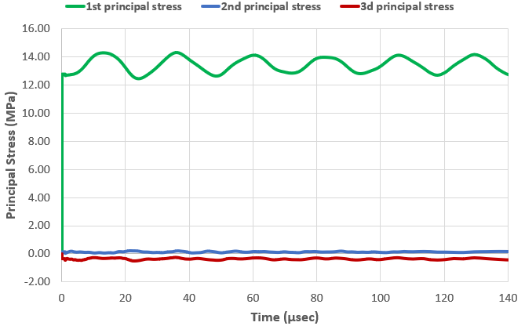
Carbon Target: engineering feasibility
HTC (from CFD calculation) + Radiative b.c
LS Dyna explicit structural simulation with time step resolution of stress waves speed propagation in graphite
Quadrilateral mesh, 2 mm
160.000 elements
Avg. skewness 0.08
Maximum 1st Principal Stress @ 1.06 e-05 s
  Target structural considerations
  1 single shot @(5GeV,1σ=5mm,5Hz,1.5MW)
    Max energy density = 95 J/g/pulse
  No showstopper in the structural point of view.
  Considered parameters results in a similar dynamic load as the CNGS target → Future dismantling/PIE to provide important data.

Slide 11
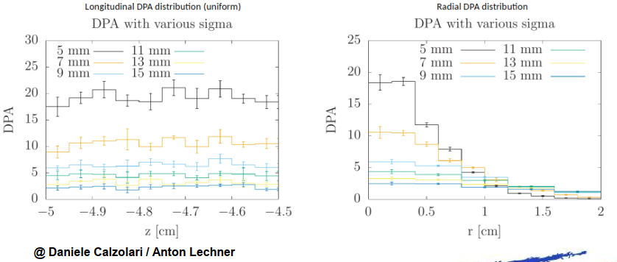
Carbon Target: engineering feasibility
Carbon Target
  For these beam parameters, C-Target seems feasible.
  However:
  Fatigue: extensive load cycles to be experienced by the target (10⁸ /y) at very high temperature.
  DPA: >1 dpa levels on the beam windows. Strategy to be defined. E.g. windowless, blown-up beam somewhere upstream, rotating window “dilution”, frequent window exchange.
  Beam power > 2 MW or more
  stringent beam parameters
DPA on windows for 1 MW

Slide 12
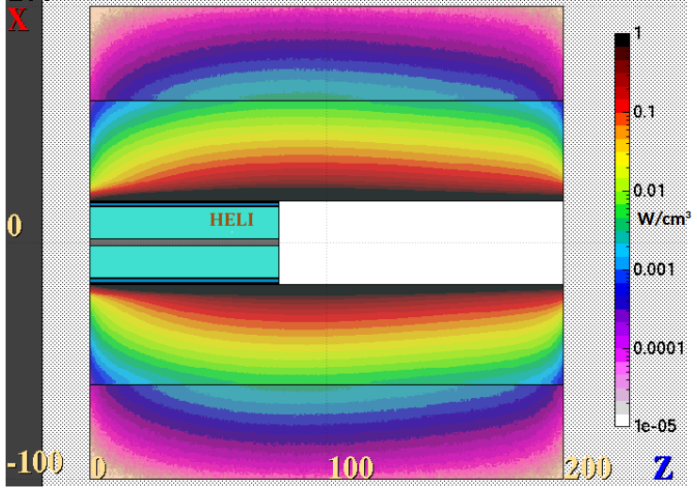
Target shielding
Energy deposition
The energy deposited on the target is only 5.5 % (D30xL800 mm) of the total beam power
Most of the thermal energy is deposited on the shielding (35.3 %).
Parameter | Thermal power | % of Beam Power
Shielding | 530 kW | 35.3 %
Target | 84 kW | 5.5 %
Al Vessel | 11 kW | 0.7 %
Water | 8 kW | 0.5 %
Helium | ~0 kW | ~0 %
TOTAL | ~634 kW | ~42 %
Power deposition provided by Daniele Calzolari SY-STI-BMI
https://indico.cern.ch/event/1176034/contributions/4939053

Slide 13
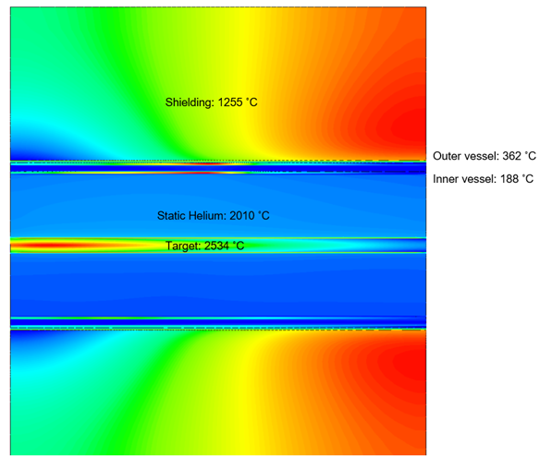
Target shielding: no cooling
Adiabatic
Shielding not cooled
Despite thermally possible, it would be far from conceivable with a SC Solenoid in the surroundings
Shared shielding-target water cooling circuit would be very challenging
Large target vessel is mostly to reduce temperature in the vessel – to be fined tune.

Slide 14
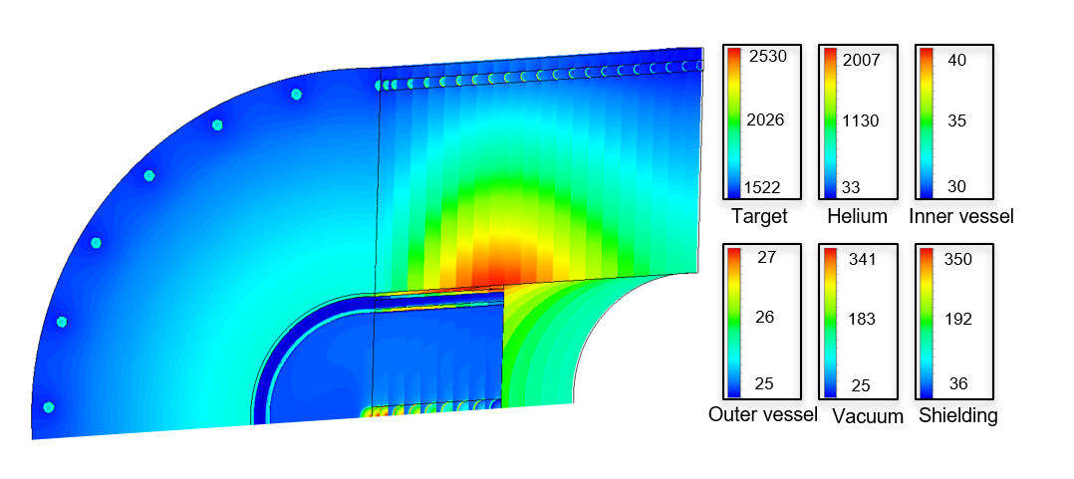
Target shielding: water cooled
Shielding water cooled
Cooling of the shielding is required but not a showstopper
Example of reasonable parameters:
Shielding
Cooling: 26 pipes w/ RT water @ 3m/s
max T = 350 °C
External max T = 80 °C
Target
Cooling: Annular RT water @ 3m/s
Max T = 2530 °C
Al vessel max T: of = 40 °C
He pressure ~1.5 bar

Slide 15
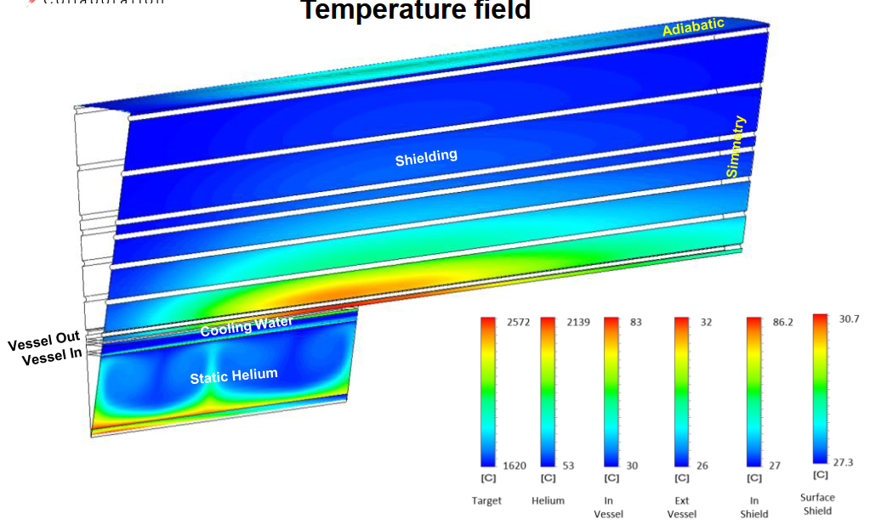
Target shielding: He cooled
Shielding He cooled
Looks feasible (for 2 MW facility):
He (gas cooled, 5kg/s at 1 bar)
Conceptual frame with 40 mm square SS profiles
Temperatures below 100 °C
First structural analysis suggest tensions around 150 Mpa (actually due to constrains from the supporting assembly). This value falls under the yield strength and fatigue limit of W

Slide 16
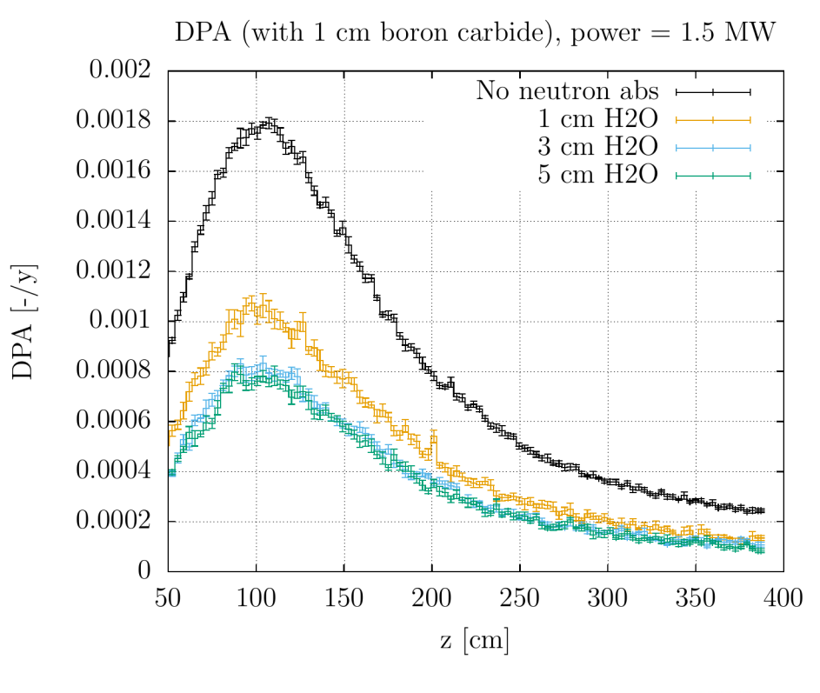
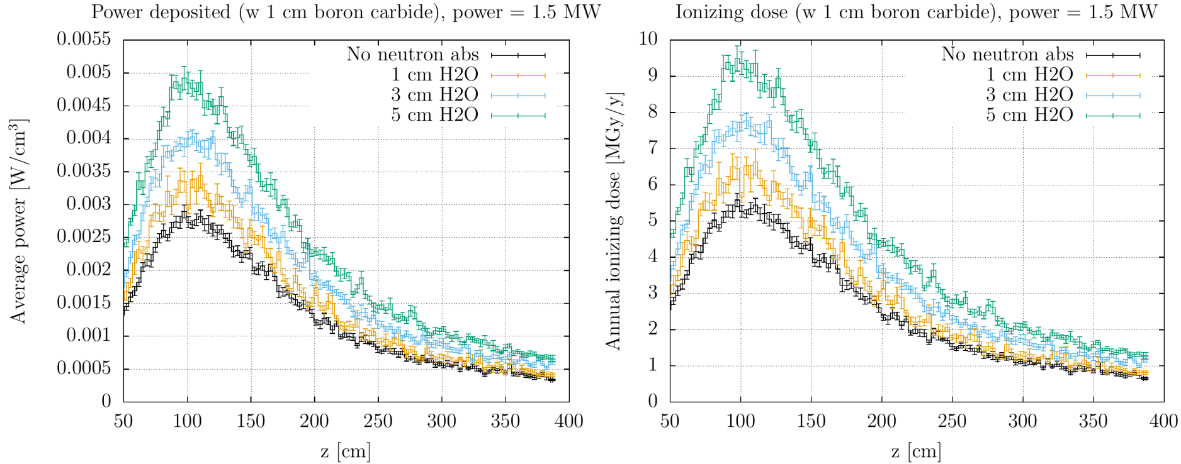
Target shielding: dpa optimization
Possible optimization to reduce radiation damage in HTS coils:
With neutron absorber, DPA reaches values of 8×10⁻⁴ DPA after 1 year
However, due to less W the Ionizing dose increases: >70 MGy after 10 years (3 cm H2O)

Slide 17
Carbon Target: pion/muon yield parameterization & energy deposition studies
  Energy deposition/ dpa studies until the chicane
  Pion/Muon yield parameterization study as a function of:
    Proton energy (3 – 10 GeV)
    Proton beam size (0.5 – 1.4 cm)
    Target diameter (1 – 9 beam sizes)
    Target length (50 – 150cm)
    Target angle with the solenoid axis (0 – 6deg)
    Shielding aperture (r 7 – 19 cm)
by Daniele Calzolari and Anton Lechner https://indico.cern.ch/event/1237101/contributions/5204412/attachments/2575066/4440149/angle_dpa_updateJan23.pdf

Slide 18
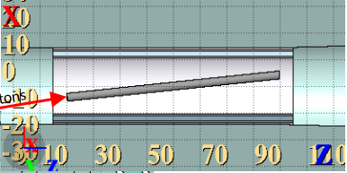
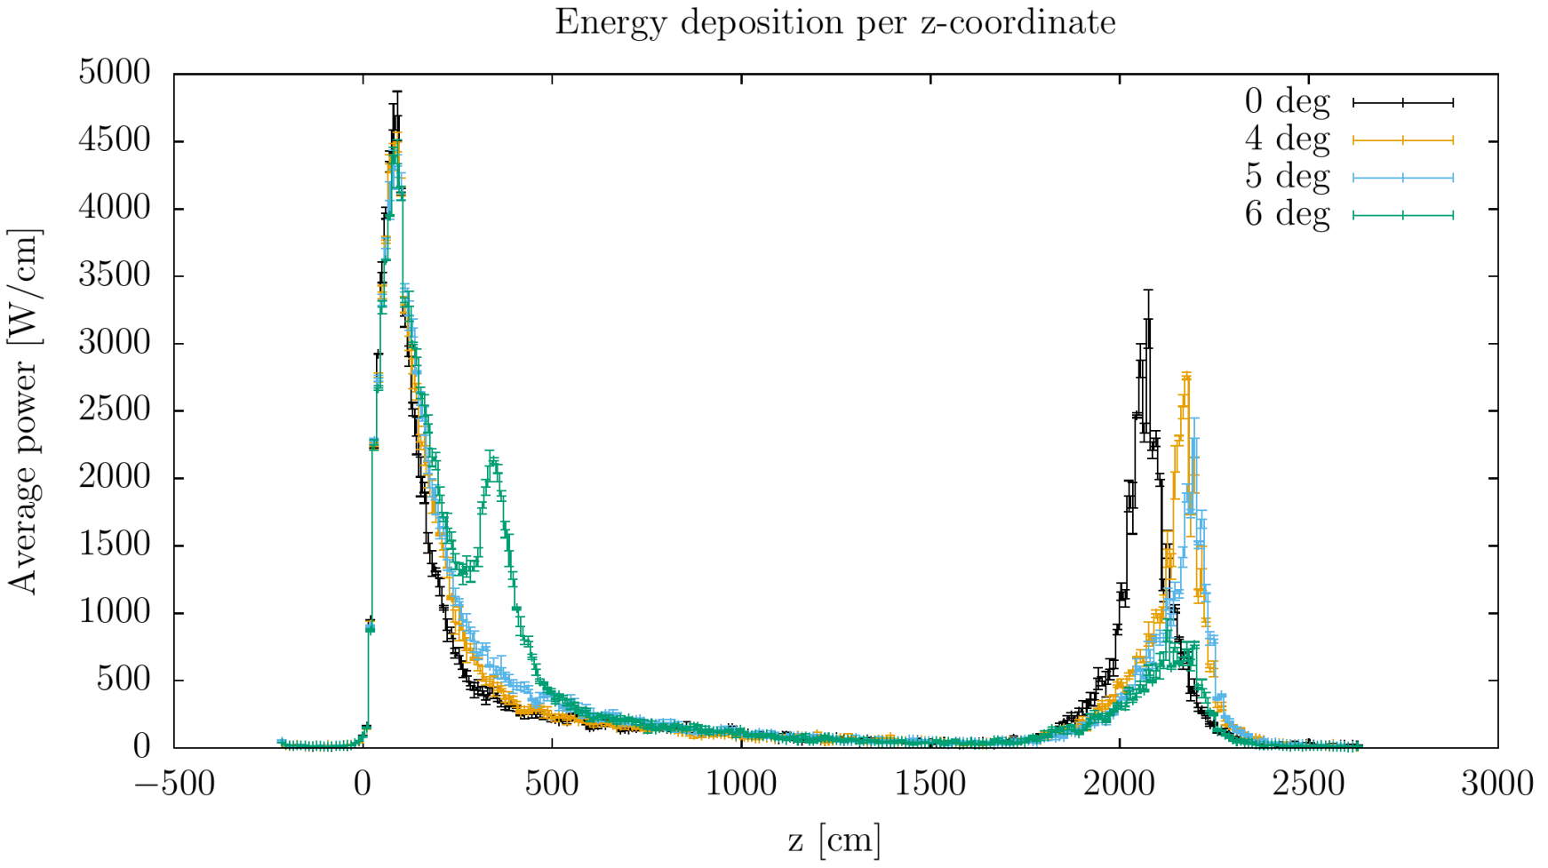
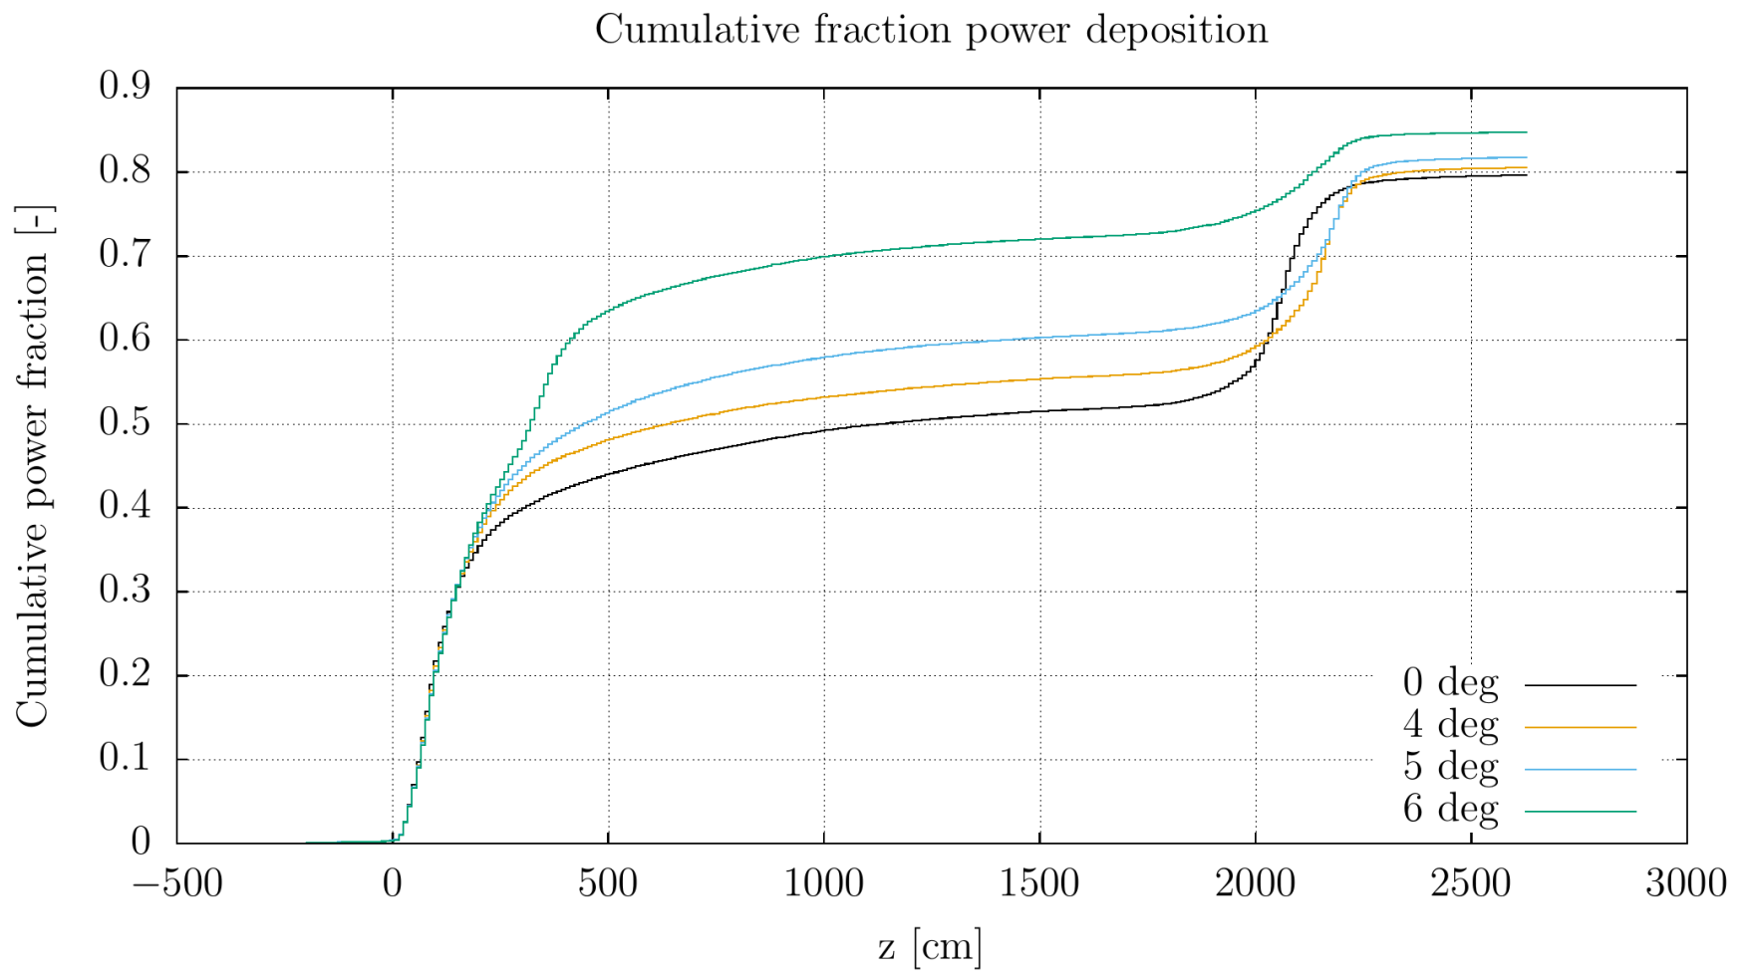
Carbon Target: pion/muon yield parameterization & energy deposition studies
  Energy deposition/ dpa studies

Slide 19
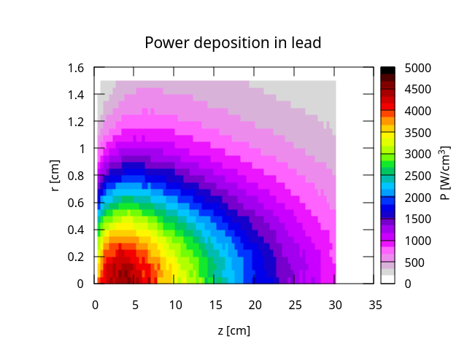
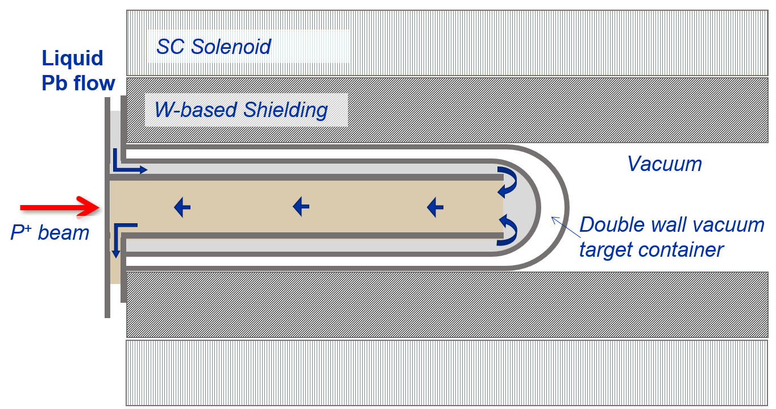
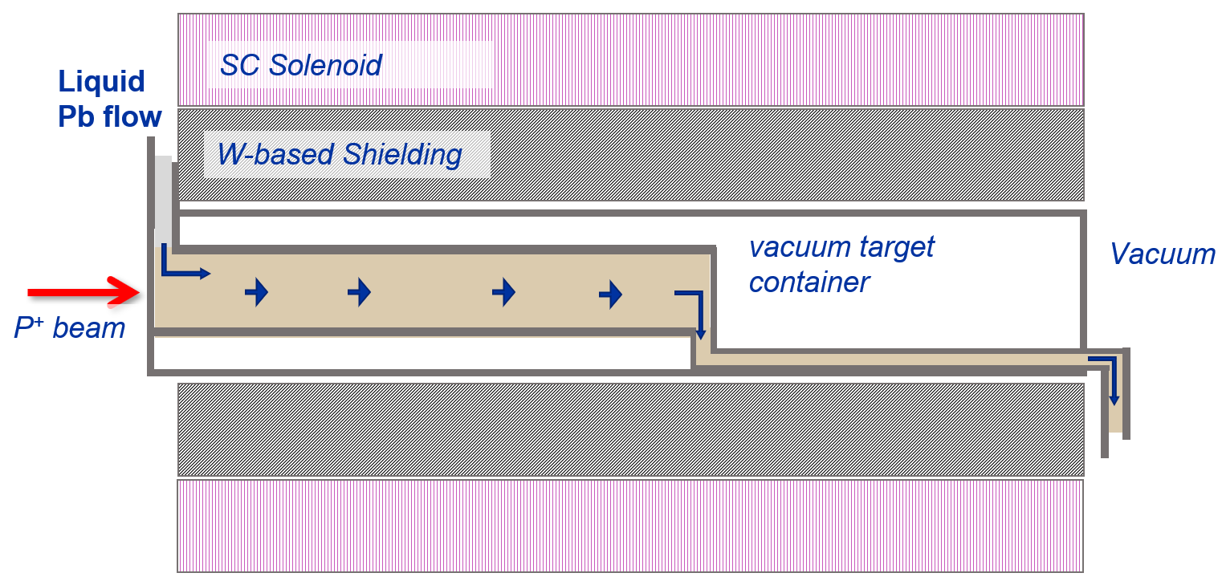
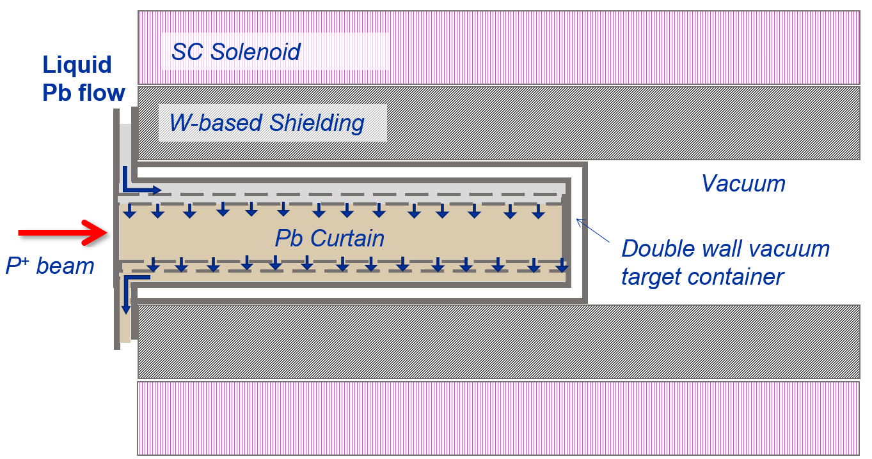
HLM Target - a possibility
Heavy liquid metal target (e.g. Liquid Pb or PbBi):
Likely allows higher beam power (> 2-3 MW)
Eventually advantageous in terms of waste disposal (e.g. can be poured into container)
Low radiation damage
No need for target cooling services
Challenging integration & remote handling
Risk of lead vaporization and/or pressure wave
Influence in the magnetic field
Beam windows design challenging (depending on concept (Pb curtain, jet, tubular flow).
Ongoing collaboration and assessments between CERN and ENEA (see Carlo Carrelli talk)
Possible HLM Target concepts

Slide 20
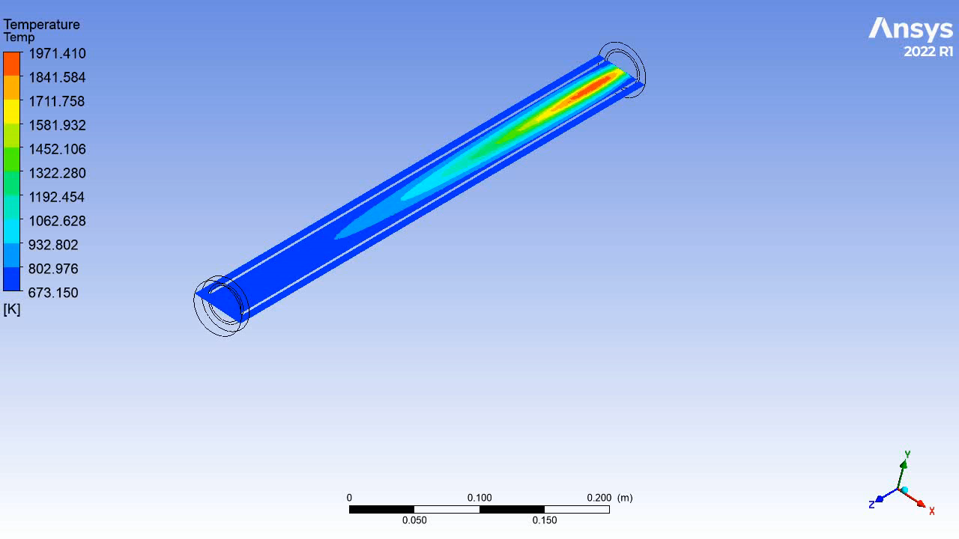
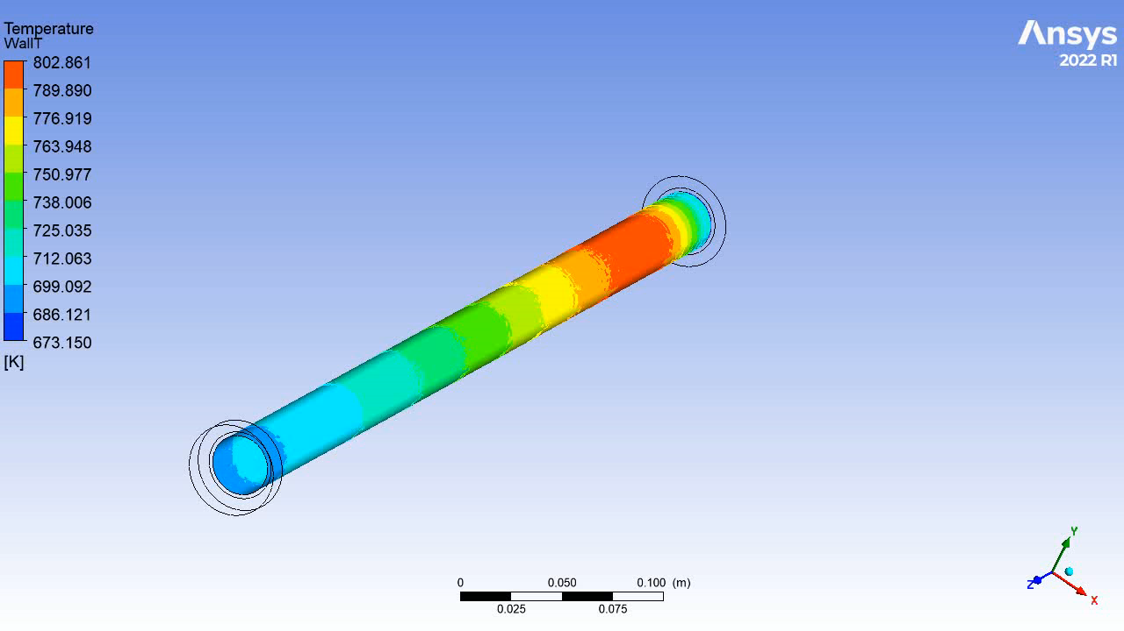
HLM Target - a possibility
Heavy liquid metal target (e.g. Liquid Pb or PbBi):
2ns every 0.2s, 2 MW beam power
Target volume: D30 x L509 mm (identical interaction length as C-Target
First assessment:
Around 2000K reached in pulse (near boiling T).
Vessel subjected to intense temperature gradient and values
Worrying pressure waves and vibrations due to quick lead thermal expansion.
Beam window gets too hot for common vessel materials
Different design concept under discussion

Slide 21
Conclusions
Interaction between different groups (proton driver, magnets, target, muon cooling, service groups) is key for efficient feasibility studies and optimization.
Possible to select range of beam parameters compatible with C-Target (both thermally and structurally) but coupling with physics performance is required.
Fatigue and radiation damage will be a major challenge of a solid target and of the beam windows. Topic to be discussed in the framework of the RaDIATE Collaboration
Operational experience and lessons learnt from CNGS PIE should strongly support the Muon Collider studies.
Shielding design highly coupled with Target/solenoid design and with (O)600kW cooling needs. P+ dump to be foreseen and integrated.
Feasibility of liquid lead target to be further studied (ongoing collaboration between CERN-STI & ENEA) but likely to by an alternative for > 2MW range operation

Slide 22

Thank you
very much for your attention

Slide 24
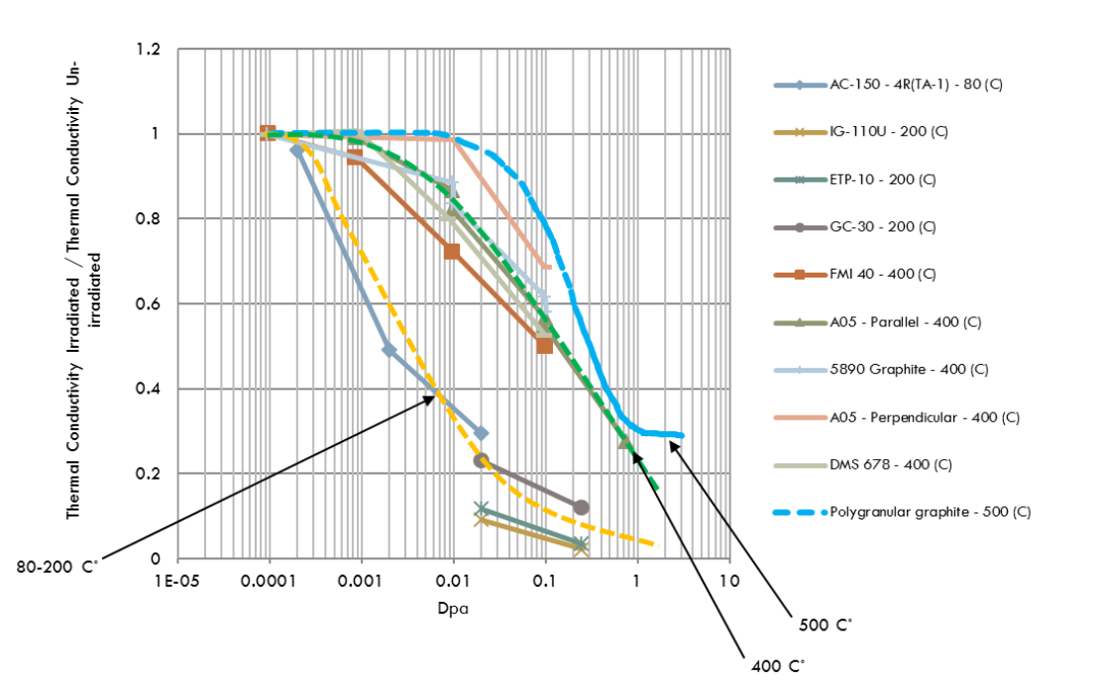
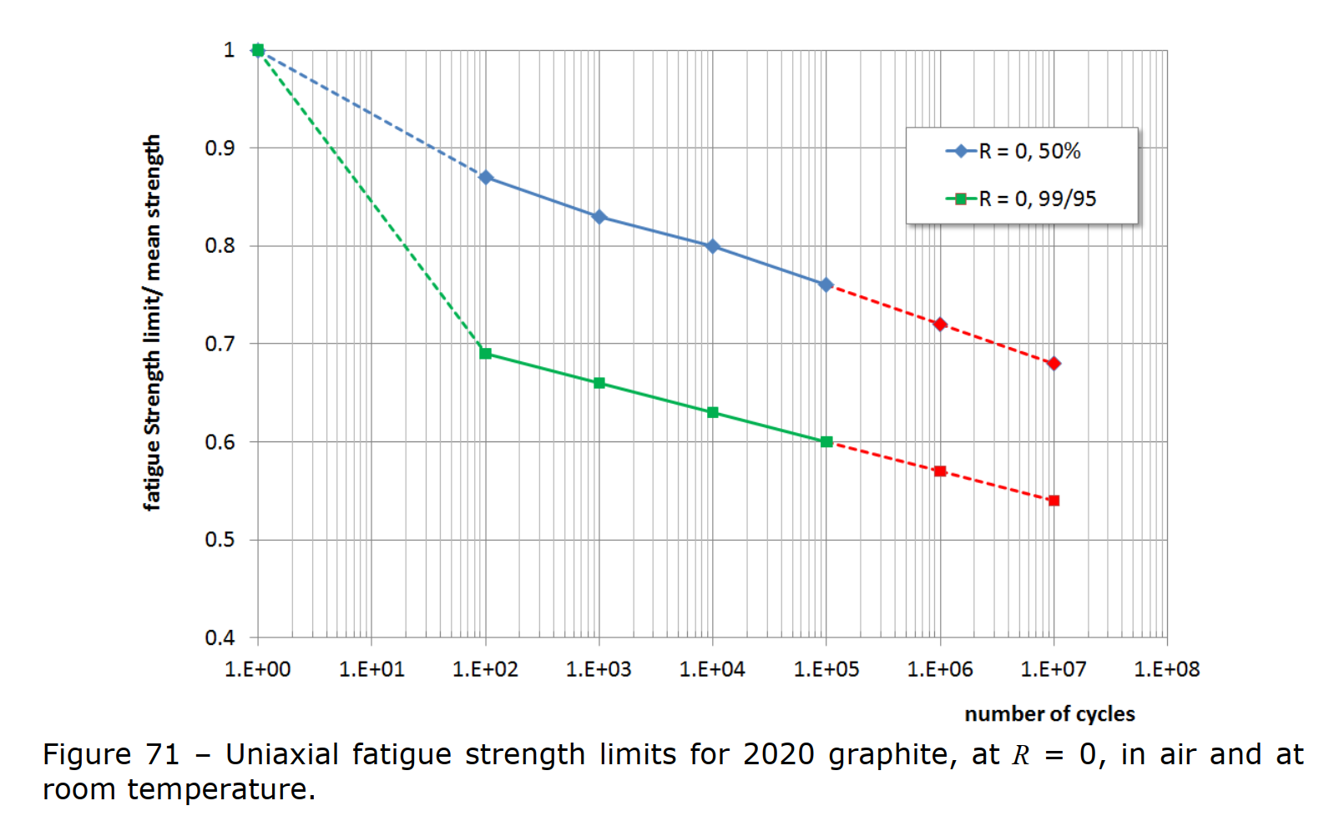
Change of thermal conductivity with DPA and Temperature

Slide 25
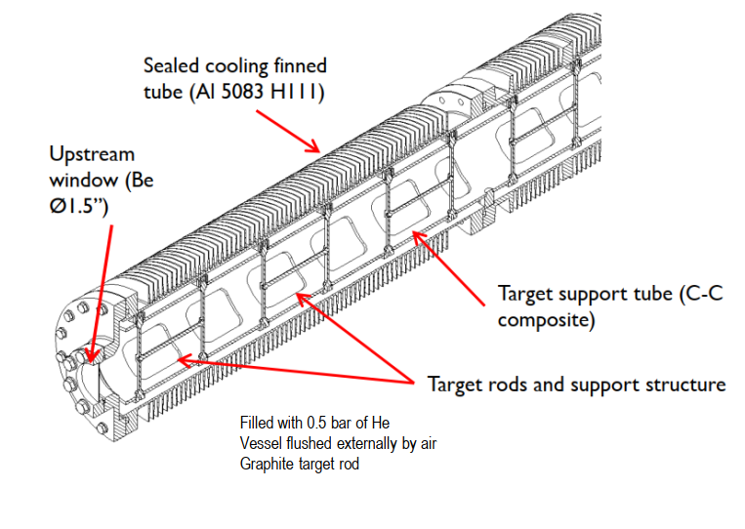
Muon Collider vs CNGS
Muon Collider vs CNGS
Parameter | CNGS Target | MuC Target
Beam energy | 400 GeV/c | 5 GeV/c
Beam cycle | 6 s | 0.2 s (5Hz)
Bunch length | 2 ns (4σ) | 2 ns
Batch length | 10.5 us (2100, 5ns spaced bunches) | 2 ns
P+/extraction | 2.0, 2.4, 3.5 x10¹³ (2 extr/cycle 50 msec apart) | 3.77 x 10¹⁴
Beam size on target (1σ) | 0.53 mm | 5 mm
Average Power | 520 kW (designed for 750 kW) | 1.5 MW

Slide 26
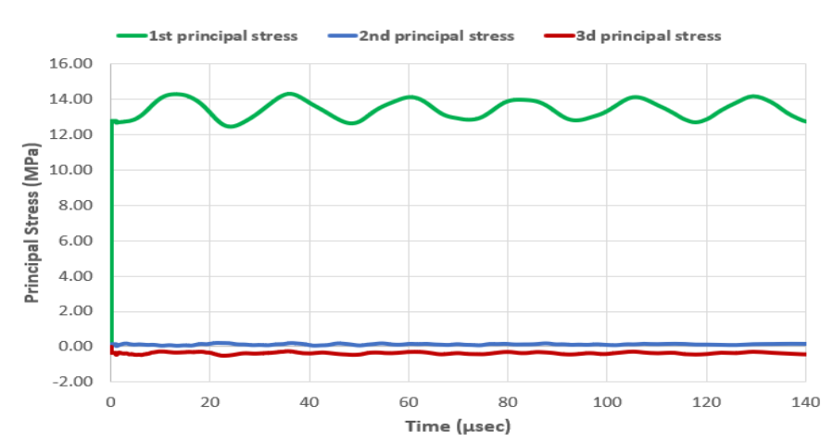
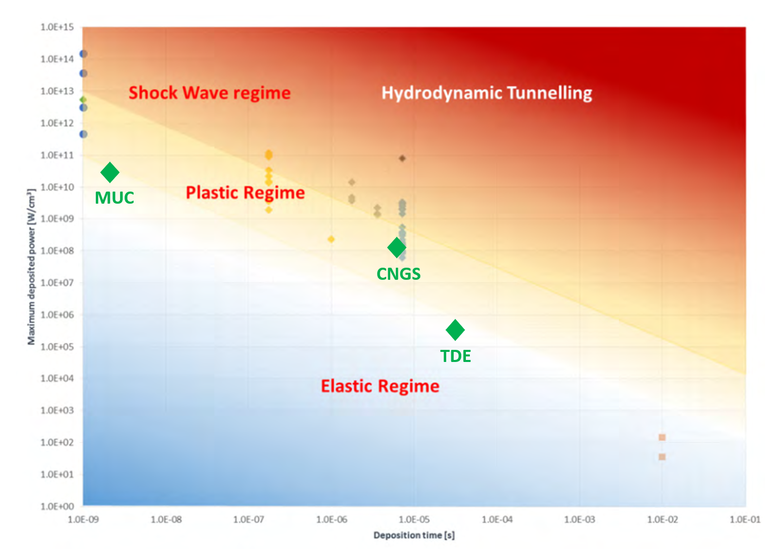
Muon Collider vs CNGS
Dynamic response
Dynamic structural calculations show that the MuC target “instantaneous survivability” seems possible.
MuC target is likely to stay in an identical dynamic response regime as the CNGS target
How about long-term effects?
MuC Target @ 5mm (1σ), 5 Hz, 1.5MW
Max deposited power [W/cm3]
Deposition time [s]
Dynamic regime comparison. Adapted from A. Bertarelli

Slide 27
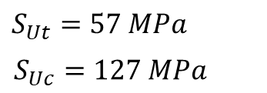
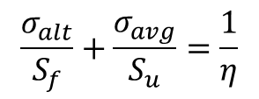

Carbon Target feasibility
Fatigue
*Literature indicates possible increase in fatigue strength under neutron irradiation (1.9-3.2E20 n/cm2) at 575-650 ˚C (IG110).
Manufacturing: considerations may play a role. E.g. Higher strength if machined along longitudinal axis.
Different C-based materials? 3D CC composite are good to prevent crack propagation but inferior in terms of T and radiation damage
MuC Target, amplitude of stress waves is small (2 MPa)
Goodman criteria (Goodman criteria is not suitable, only indicative)
A multiaxial & non-proportional loading suited criteria would be best. → Sines or Dan Van criteria w/ data of torsional resistance of graphite for 1.0E08 cycles, high T (2500 ˚C) and irradiated can improve estimation.
*Fatigue Failure and Fracture Mechanics of Graphites for Hight Temperature Engineering Testing Reactor

Slide 28
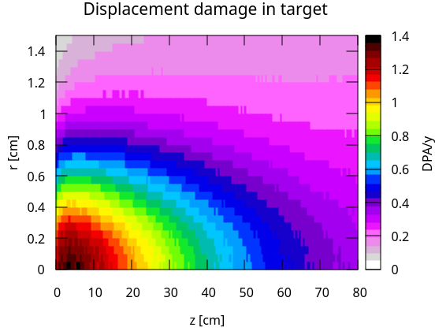
Carbon Target feasibility
Radiation damage
Example comparing with CNGS
Radiation damage may drive target life (target replacement)
MuC Target DPA normalized for 200days @1MW
Parameter | CNGS | Muon Colider 1.5MW
Proton fluence [p+/cm^{2]} | 5.77E+22 | 1.70E+21
PoT | 1.27E+20 | 1.32E+21
Beam size [mm] | 0.53 | 5
Extractions | 5.29E+06 | 5.51E+07
Integrated Op time [days] | 183 | 128
DPA | 1.5 | 1.5
*Literature indicates a lifetime for graphite of 1E21-1E22 p+/cm2
Radiation induced creep
Radiation swelling
Thermal conductivity loss (from 0.01 DPA, but loss is reduced with increased T)
Thermal diffusivity loss
Increase of stiffness and mechanical strength
High temperature may help recovering damage
Increase of fatigue resistance
*Radiation damage study of graphite and carbon-carbon composite target materials

Slide 29
Beam windows
Beam windows
Activities discussed in the framework of RaDIATE Collaboration
Preliminary energy deposition studies show very high DPA/y in the Muon Collider p+ beam windows.
  + info in Daniele Calzolari’s talk https://indico.cern.ch/event/1175126/contributions/5055295/
Will be a critical point in the design of the target.
Engineering studies will follow

