Slide 1
Muon Collider
(solenoid) Magnets Studies
Luca Bottura, F. Boattini, B. Caiffi, S. Mariotto, L. Quettier, M. Statera
on behalf of the Muons Magnets Working Group
KIT 25/1/2023

Slide 2
Scope of the talk
The solenoid challenges for a muon collider
Technical advances
Work organization
Summary and plans
This is work in progress

Slide 3
General guidelines
Magnets are relatively power hungry
  The main power consumption for superconducting magnets is for the cryogenic system
  The main power consumption for resistive magnets is to overcome resistive losses (active power, needs to be cooled away) and inductive voltages (reactive power, can be partly retrieved)
Magnets are relatively expensive infrastructure
  Unit cost is large due to the combination of costly materials, complex technology, large mass
  Magnets tend to pave extensively the whole accelerator complex
Seek for practical solutions to minimize capital investment (CAPEX) and operation costs (OPEX). It is unlikely that simple extrapolation of known technology will work, so we still require a large dose of innovation
Produce a credible and affordable accelerator complex design: technology is a mean, not the end of this work

Slide 4
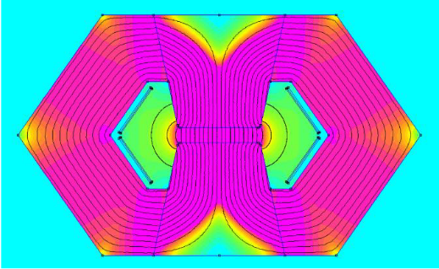
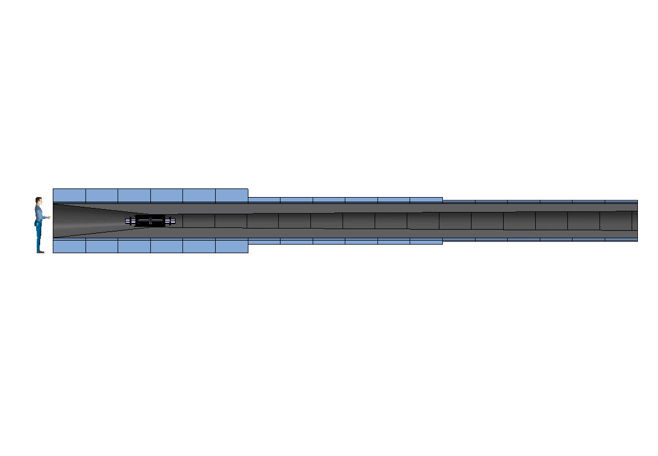
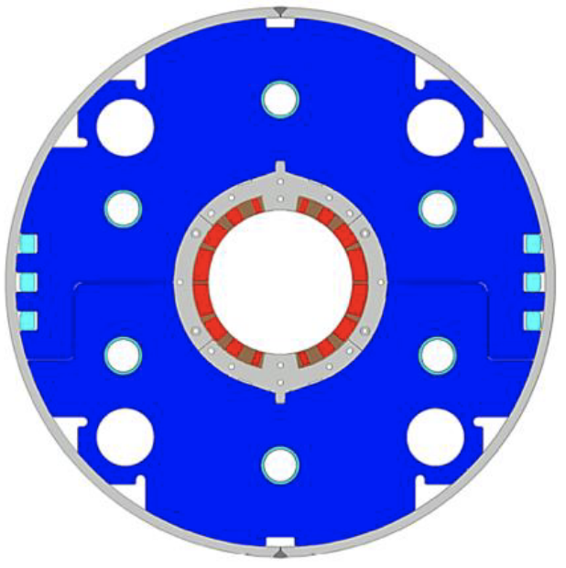
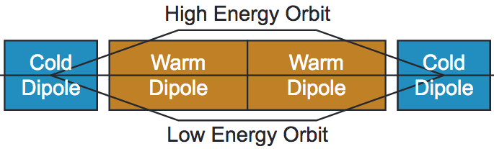
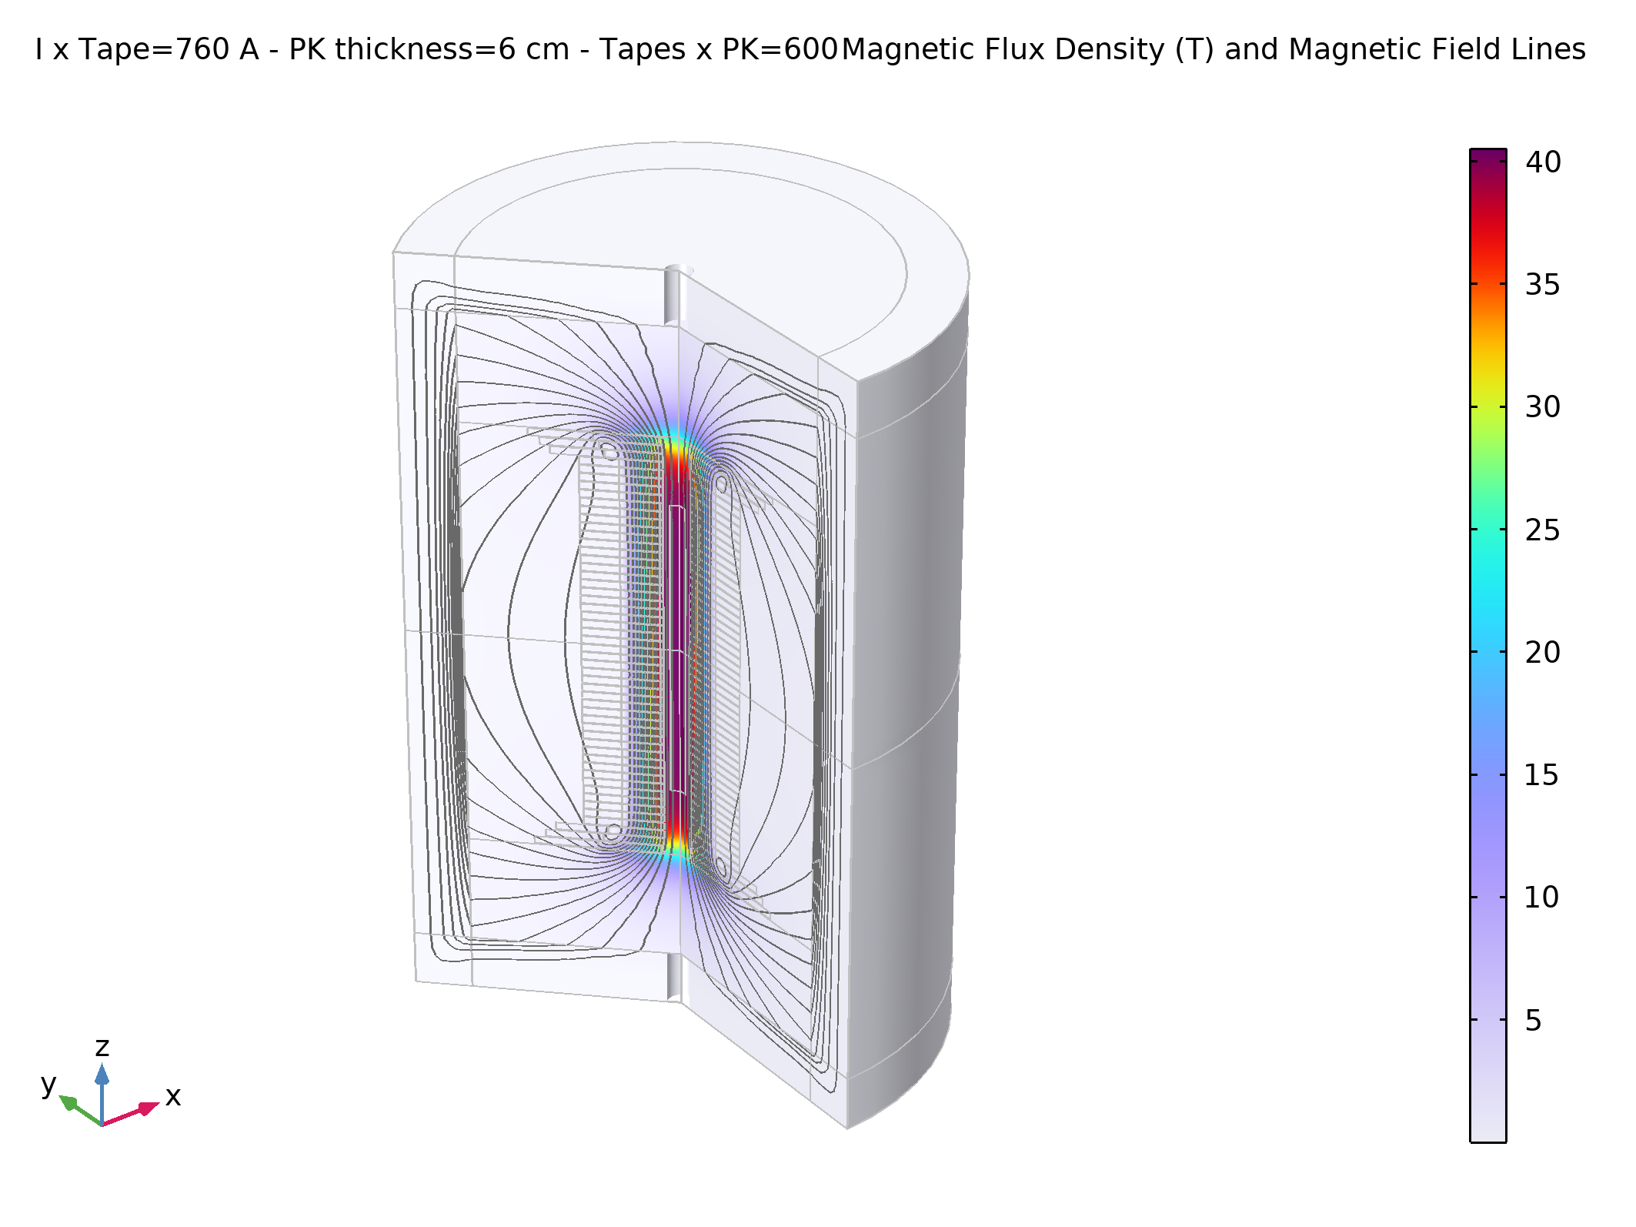
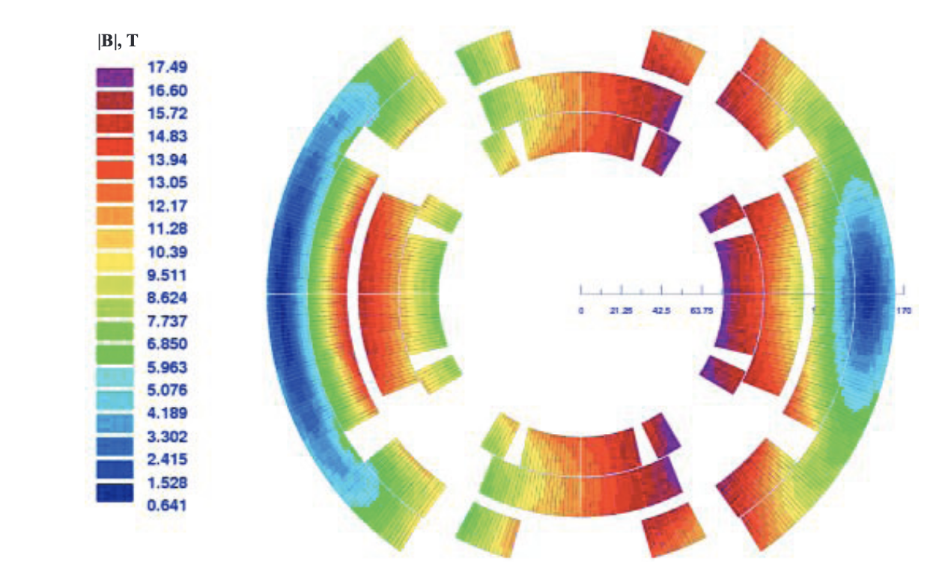
Magnet specifications
20 T, 200 mm
Radiation heat load ≈ 5…10 kW
Radiation dose: >> 20 MGy
NC ±1.8 T, 400 Hz, 100 mm x 30 mm
SC < 10T, ≈ 100 mm
> 40 T, 60 mm
16 T peak, 150 mm
Radiation heat load ≈ 5 W/m
Radiation dose ≈ 20…40 Mgy

Slide 5
The solenoid challenges – 1/2
20 T, 200 mm
Radiation heat load ≈ 5…10 kW
Radiation dose: 80 MGy
Large stored energy o(1) GJ, mass o(300) tons, cost o(100) M
Considerable RT and cryogenic heat load: RT power o(1) MW
Radiation dose o(80) MGy and radiation damage o(10⁻²) DPA

Slide 6
The solenoid challenges – 2/2
Total 1 km, o(1600) units of solenoid magnets up to o(20) T requires compact windings and careful cost optimization
UHF solenoids, with field beyond state-of-the-art o(40…60) T, calls for novel HTS technology
> 40 T, 60 mm

Slide 7
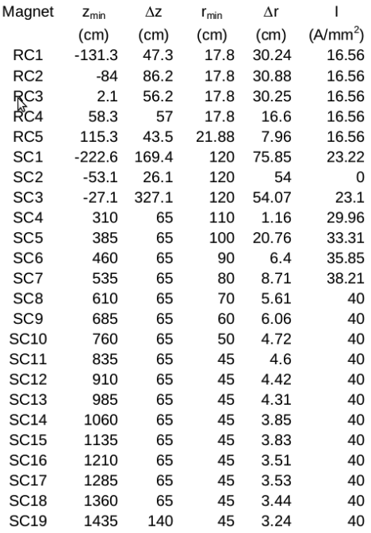
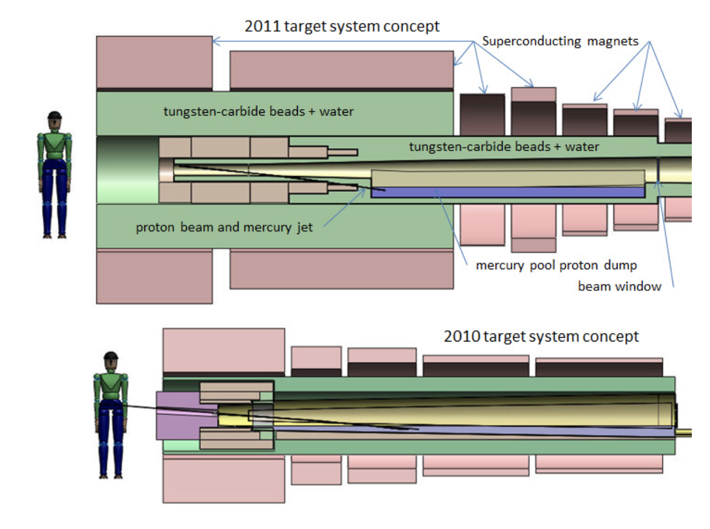
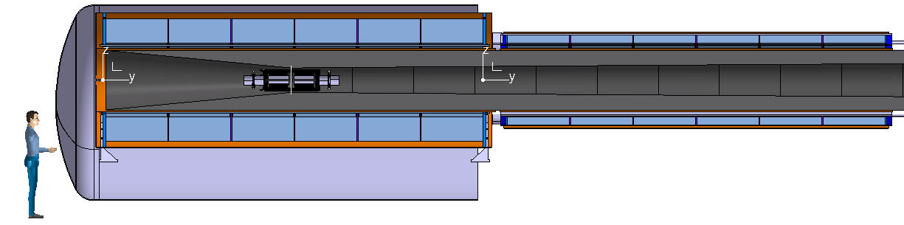
Target and capture – 1/4
Attempt to reduce the mass (CAPEX) of the system, and increase operating temperature to improve cryogenic CoP (OPEX)
US-MAP 2010 design
LTS (14 T) + NC (6 T)
US-MAP 2011 design
LTS (14 T) + NC (6 T)
H.G. Kirk, PAC 2011
MuCol 2022 design
HTS (20 T, 20 K)
A. Portone, P. Testoni (F4E)
L. Bottura, A. Kohleimainen (CERN)

Slide 8
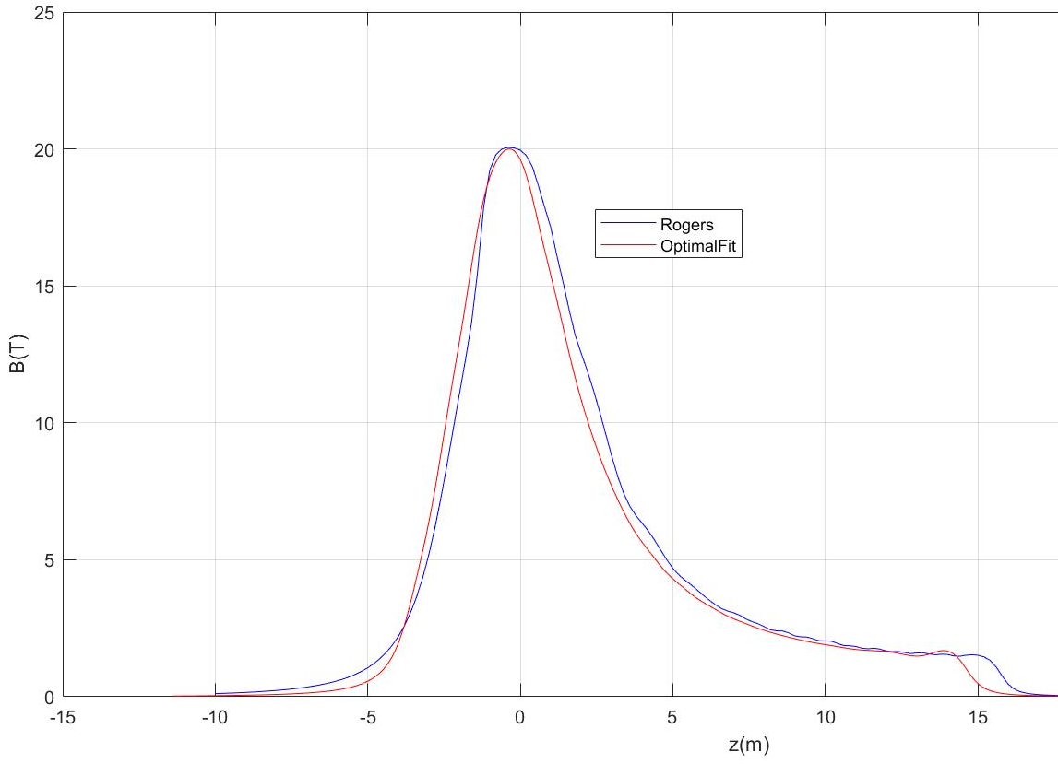
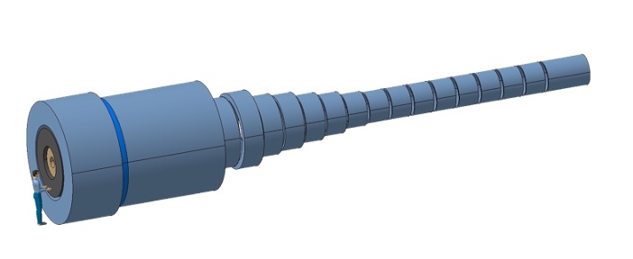
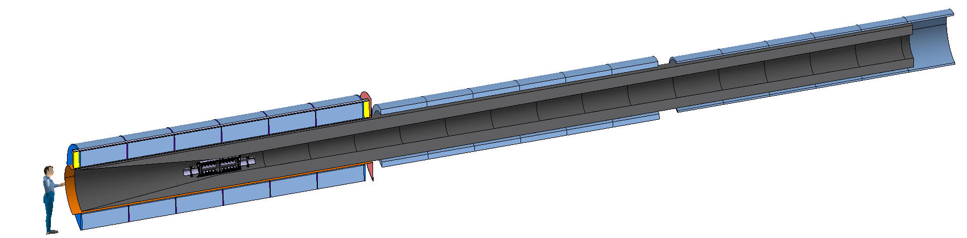
Target and capture – 2/4
E_{M} = 2.9 GJ
T_{op} = 4.2 K
M_{coils} = 200 tons
M_{shield} = 300 tons
P = 12 MW
US-MAP
Proposal
E_{M} = 1 GJ
T_{op} = 10…20 K
M_{coils} = 110 tons
M_{shield} = 196 tons
P = 1MW
A. Portone, P. Testoni, F4E

Slide 9
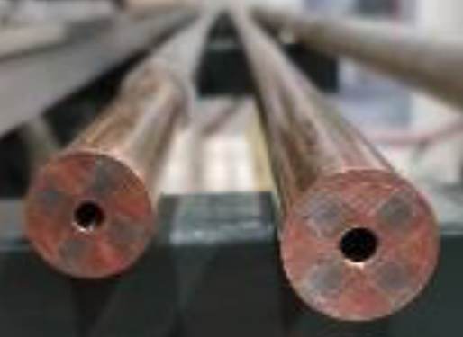
Target and capture – 3/4
MIT “VIPER” conductor
HTS conductor design
STAINLESS STEEL JACKET
COPPER SLEEVE
COPPER FORMER
SOLDERED HTS STACK
COOLING CHANNEL
Operating current: 58 kA
Operating field: 20 T
Operating temperature: 20 K
M. Takayasu et al., IEEE TAS, 21 (2011) 2340
Z. S. Hartwig et al., SUST, 33 (2020) 11LT01
9
25
40

Slide 10
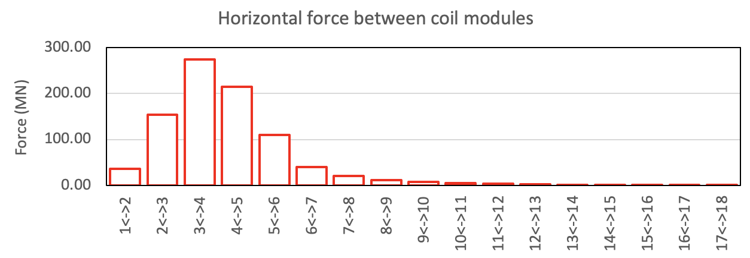
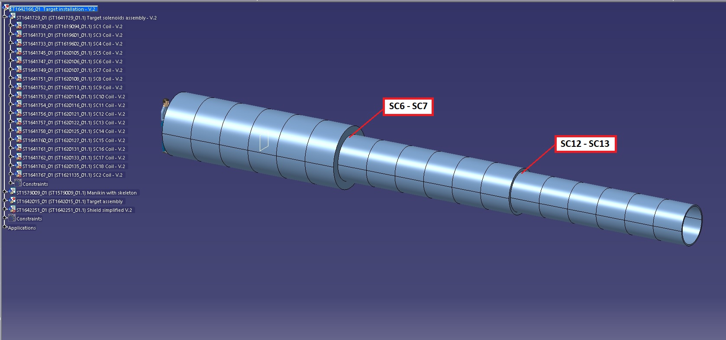
Target and capture – 4/4
A. Portone, P. Testoni, F4E
A. Kohleimainen (CERN)
2750 tons
2750 tons
100 tons
100 tons
50 tons
50 tons
Under study (among others)
  Magnetic configuration
  Mechanical support of coils and W-shield (195 tons)
  Integration in a cryostat
  Cooling and cryogenics
  ….

Slide 11
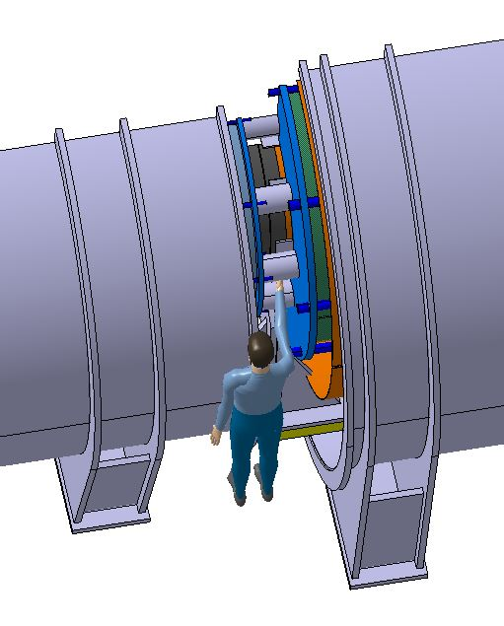
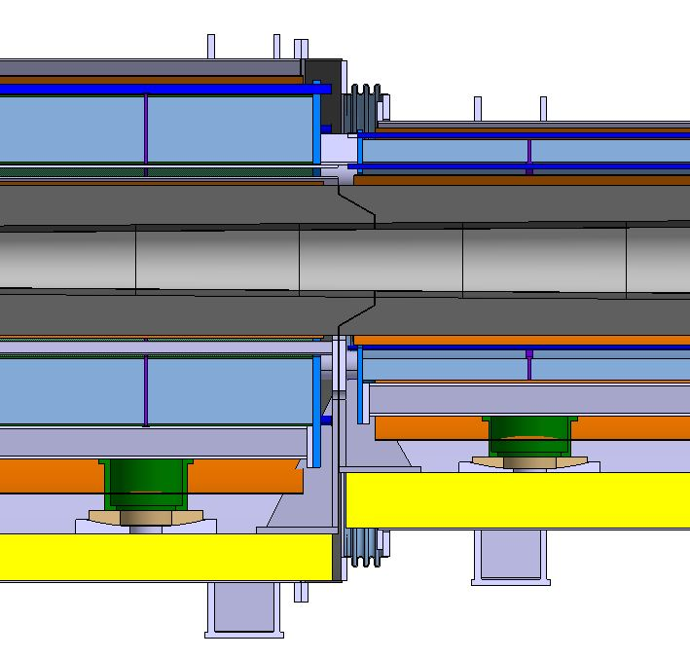
Integration work – 1/2
300 mm coil gap for supports and thermal shield
A. Kohleimainen (CERN)
Conical fitting ?
Difficult access to inter-coil space
Limit operations to:
intercoil support installation,
hydraulic connection, and
thermal shield closure
W-shield upport
Warm support
Cold support

Slide 12
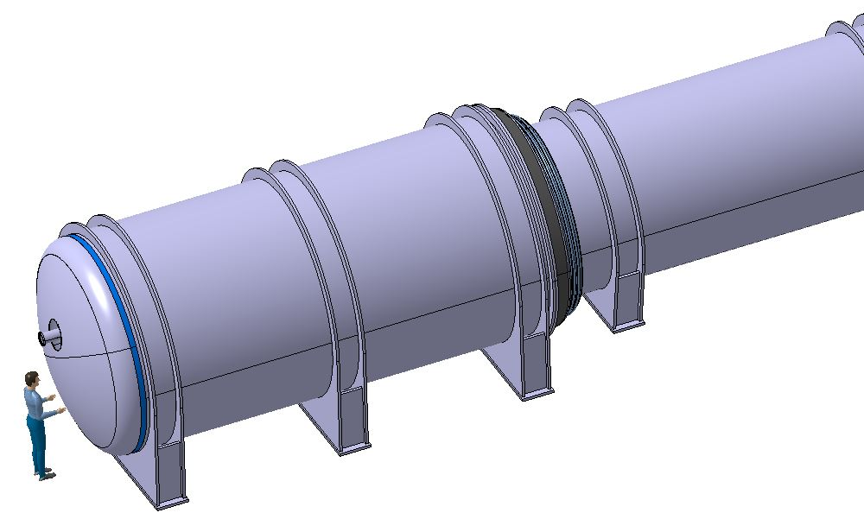
Integration work – 2/2
A. Kohleimainen (CERN)
Stray fields ?
Magnetic shielding ?
Bellows for interconnects
Max diameter 3.2 m
Vacuum loads support (70 tons)

Slide 13
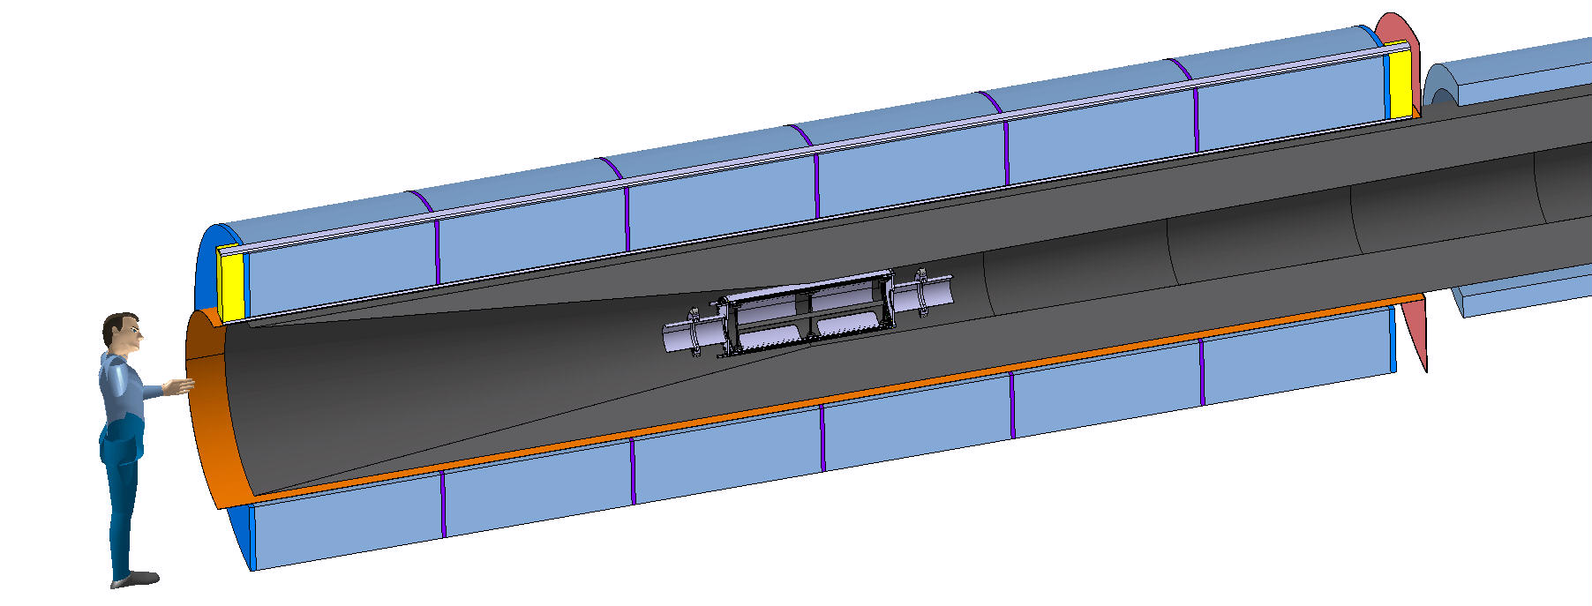
Many questions still
Pre-compression structure
On-going discussions, feel free to participate !
e.g. 2/2/2023 https://indico.cern.ch/event/1239921/
Composition, cooling ?
Maintenance ?
Beam phisics OK ?
Vacuum requirements ?
W Shield
Thermal shield
Target
Coil module
Thermal shield
A. Kohleimainen (CERN)

Slide 14
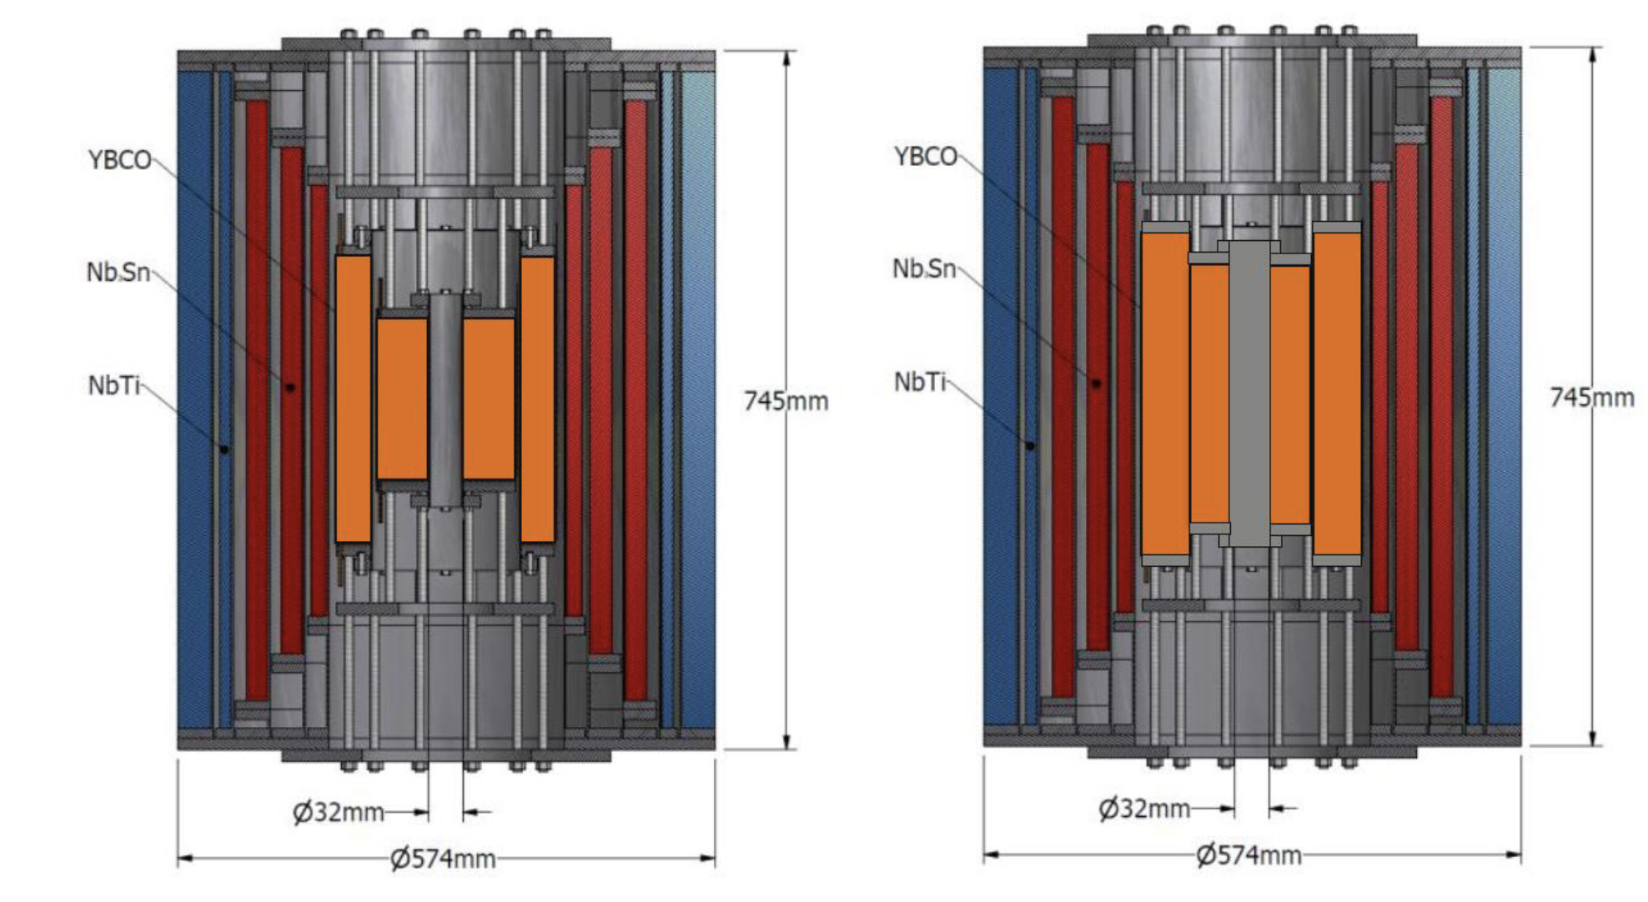
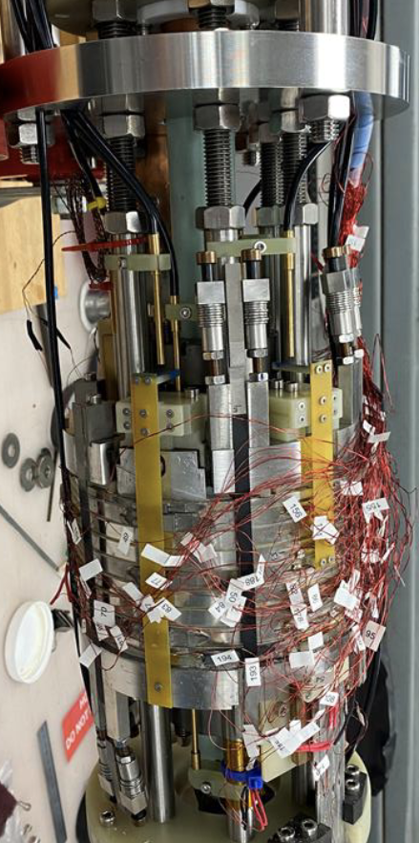
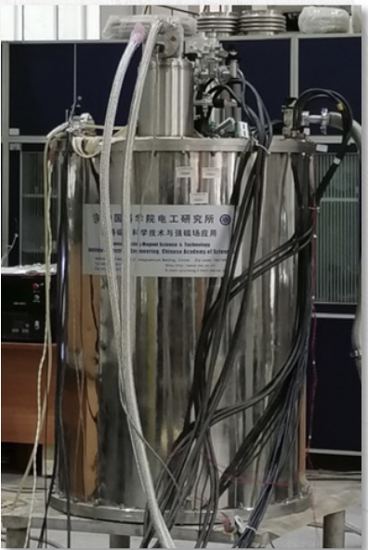
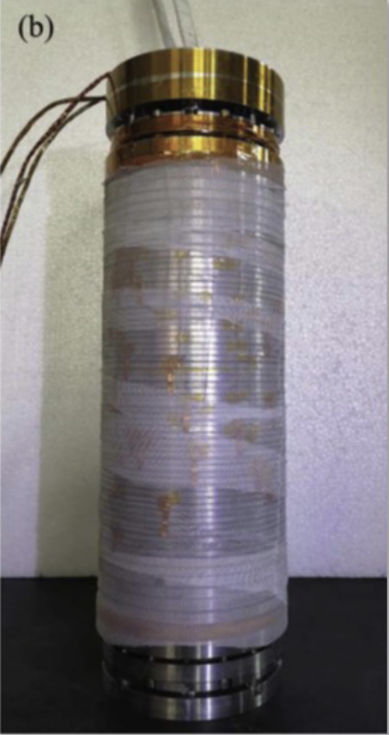
Final cooling – 1/3
Probe the limits of UHF solenoid magnets for the final cooling (performance)
Make windings compact to reduce mass (CAPEX)
LTS/HTS hybrids
Cross section of
32 T, 32 mm user facility solenoid
at NHMFL
Cartoon design of 40 T, 32 mm user facility solenoid (developmental)
Images of
32.35 T, 21 mm user facility solenoid
at CAS-IEE
R&D test
achieved 25.4 T
At NHMFL
I. Dixon, NHMFL

Slide 15
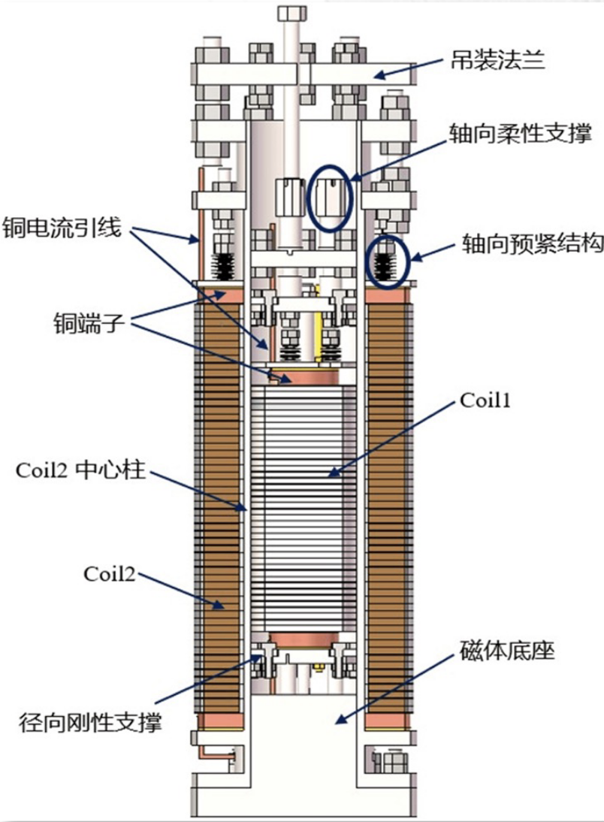
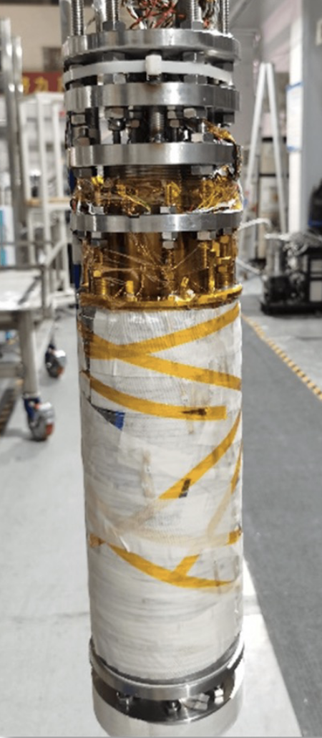
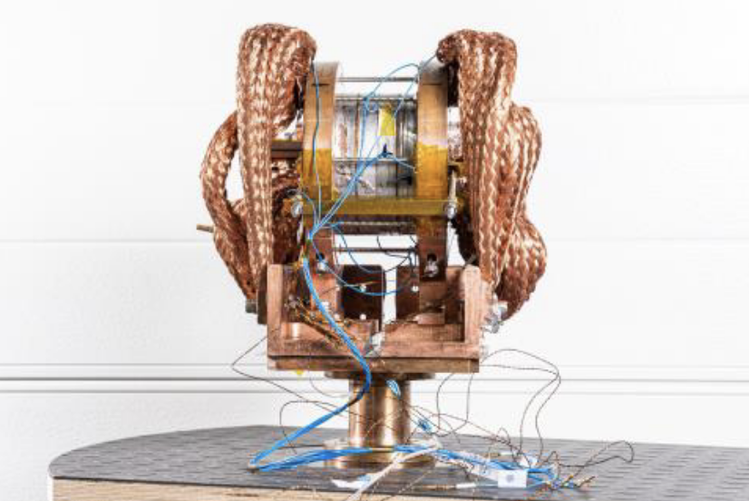
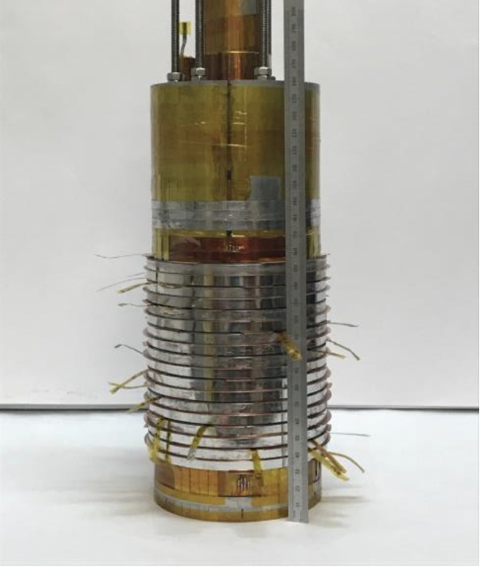
Final cooling – 2/3
Probe the limits of UHF solenoid magnets for the final cooling (performance)
Make windings compact to reduce mass (CAPEX)
All-HTS
REBCO insulated coil
achieved 24.1 T
at CAS-IPP
R&D NI coil achieved 18 T
at PSI
R&D NI insert coil achieved 32.5 T
at LNCMI
J. Kosse, PSI
J.-B. Song, LNCMI
B. Song, SST

Slide 16
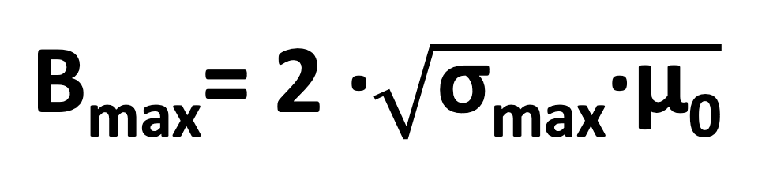

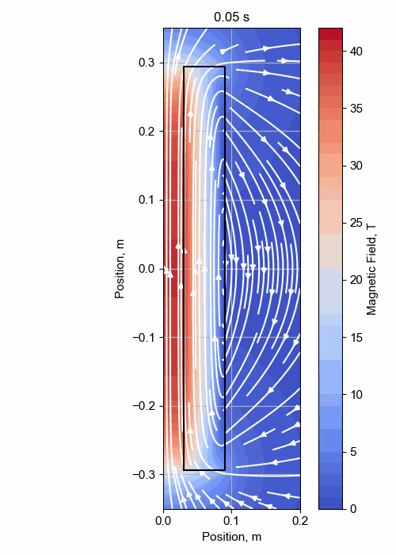
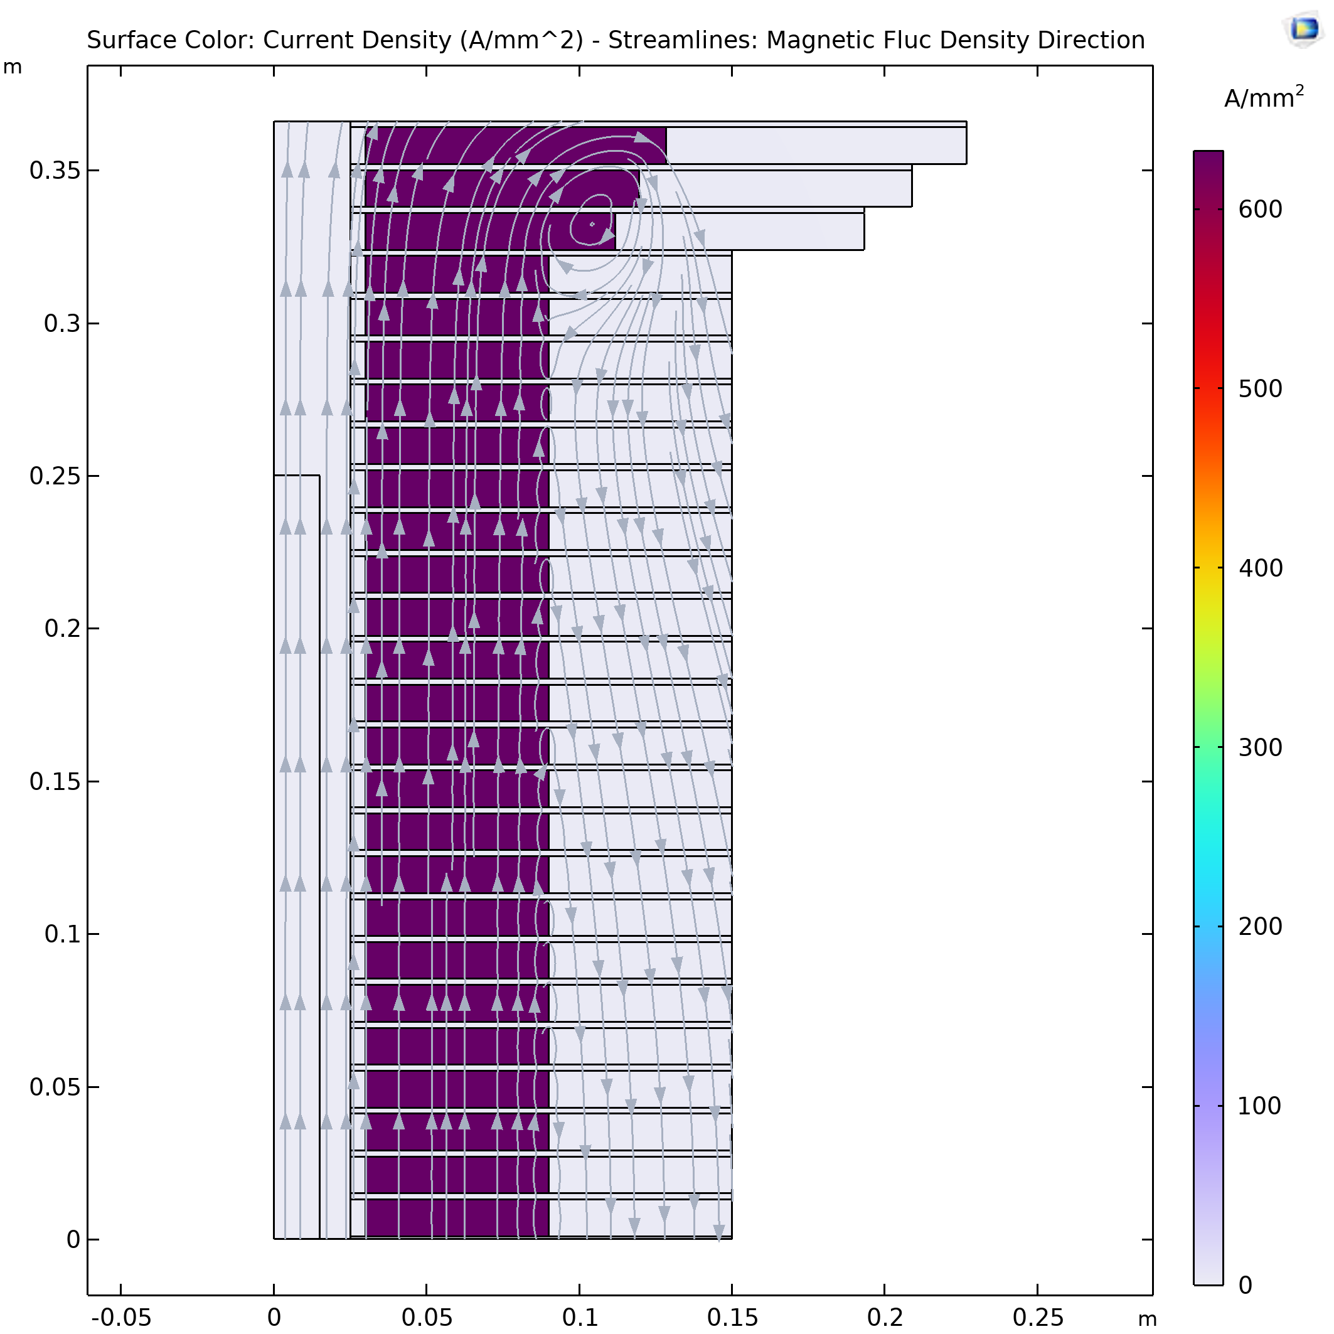
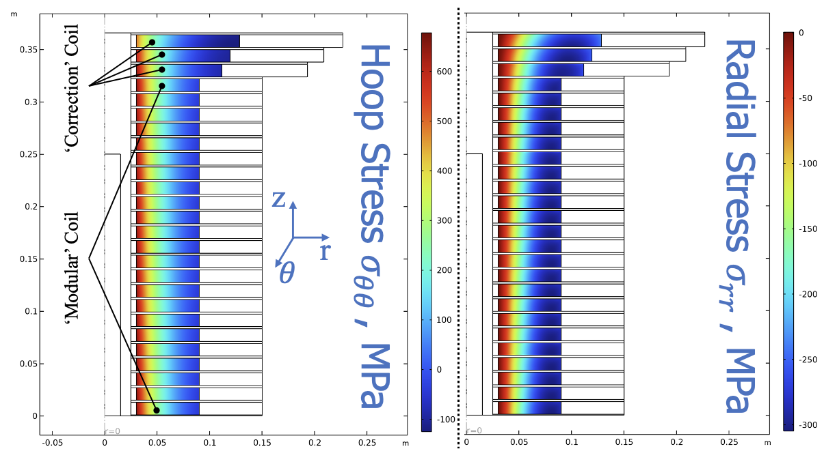
Final cooling (40 T) – 3/3
σ_{max} = 600 MPa
A. Dudarev, CERN
Inner Ring
‘Correction’ Coil
Outer Ring
Bore
‘Modular’ Coil
40 T solenoid design
1 % Field Homogeneity
Support Plate
B. Bordini, CERN
B. Bordini, CERN
T. Mulder, CERN

Slide 17
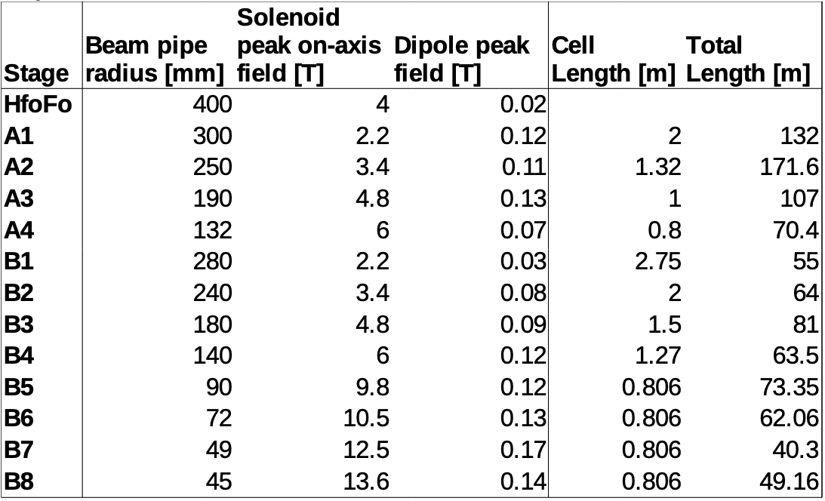
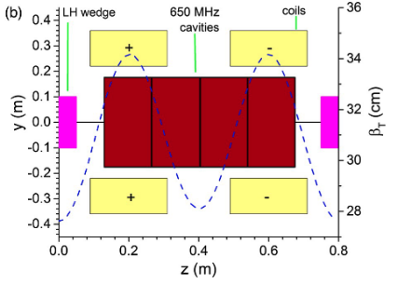
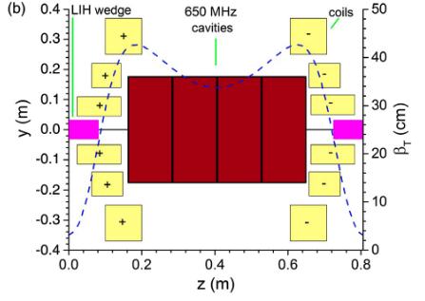
6D cooling
On-axis field and field profile B(s)
Aperture and clearances
Energy deposition, radiation dose, DPA’s
Good starting point, magnet work is starting
https://indico.cern.ch/event/1147941/contributions/4851978

Slide 18
Scope of the talk
The four main magnet challenges for a muon collider
Technical advances
A digression on HTS
Work organization
Summary and plans

Slide 19
Tasks
Task 1
Technical Coordination and Integration
The organization of the tasks overlaps with the EU MuCol study
The scope of the work in most tasks, however, extends beyond the EU proposal (e.g. target solenoid study, HTS tape procurement and measurements, test of HTS pancakes, …)
Most tasks activities also rely on advances and synergy with other projects and programs (e.g. HFM, UHF solenoid R&D, HTS fusion magnets R&D, HTS generators R&D, …)
Task 2
Target, Capture and Cooling Magnets
Magnet Systems
Task 3
Fast Cycled Accelerator Magnets
Task 4
Collider Ring Magnets

Slide 20
The Team and the work – 1/2
Task 1
Technical Coordination and Integration
Participants
  CERN (LB, SF)
  CEA (LQ)
Activities
  Periodic meeting of the “muons magnets Working Group”
  Machine configuration (“magnet catalogue”)
  Interface to physics, radiation, vacuum, cryogenics, safety and RP
  Review of radiation hardness of superconductors and insulation systems (joint activity with radiation studies)
  Documentation and reporting
Task 2
Target, Capture and Cooling Magnets
Magnet Systems
Task 3
Fast Cycled Accelerator Magnets
Task 4
Collider Ring Magnets

Slide 21
The Team and the work – 2/2
Task 1
Technical Coordination and Integration
Participants
  INFN (MS)
  CEA (LQ, PhD)
  CERN (AD, BB, TM, LB, AK, CA, AB)
  CNRS (XC)
  F4E (AP, PT)
  KIT (TA)
  PSI (JK)
  SOTON (YY, post-doc)
  UNIGE (CS)
  TWENTE (HTK, AK, post-doc)
Activities (≈ 12 months)
  Conductor review and specification
  Design of target and capture channel solenoids
  Design of final cooling solenoid
  Procurement and electro-mechanical characterization (UHF) of test HTS material
  Pancake model coils, engineering design, manufacturing solutions, mechanical and powering tests
Task 2
Target, Capture and Cooling Magnets
Magnet Systems
Task 3
Fast Cycled Accelerator Magnets
Task 4
Collider Ring Magnets

Slide 22
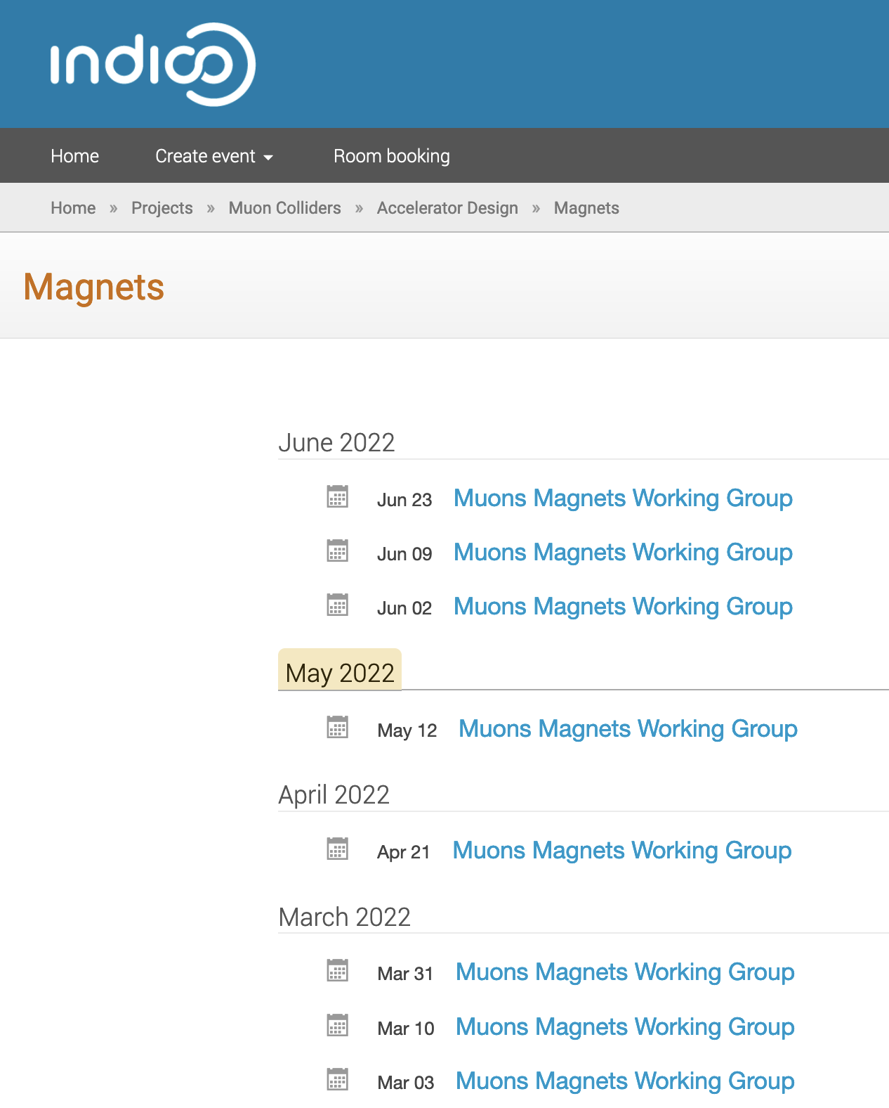
Muons Magnets WG
Twenty-one meetings to date, with participants from m ost collaborating institutes and universities
Since April we meet:
  to “learn” about the previous work (MAP) and advances in relevant fields,
  to discuss in an informal setting initial ideas and options, and
  in preparation of upcoming activities, in particular the EU MuCol
Site: https://indico.cern.ch/category/13958/
Mailing list: muoncollider-magnets@cern.ch

Slide 23
Summary and Plans
The grand challenges have been identified, they represent well the envelope of design and performance issues. Work has started to see what are the limits, propose technical solutions and associated R&D
The challenges are aligned with the structure of MuCol (Tasks 7.2, 7.3 and 7.4). This simplifies the forming and coordination work with the team. We plan to continue along these lines
The interaction with the other ”specialties” has started, to discuss specifications, give and receive feedback on feasibility:
  Beam optics
  Impedance limitations
  Radiation heat loads, dose and damage
  Vacuum and cryogenics
It looks like HTS can make a huge difference towards a compact, energy efficient and sustainable collider. Priority will be devoted to this R&D

