Slide 1


Recent Results of
Quarkonia Production at CMS
Dong Ho Moon
(Chonnam National University)
HIM Winter 2014, Pusan
6th December, 2014

Slide 2
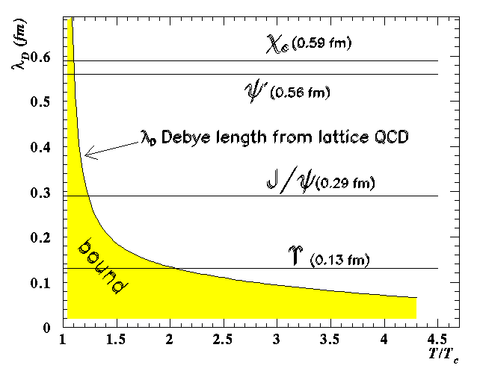
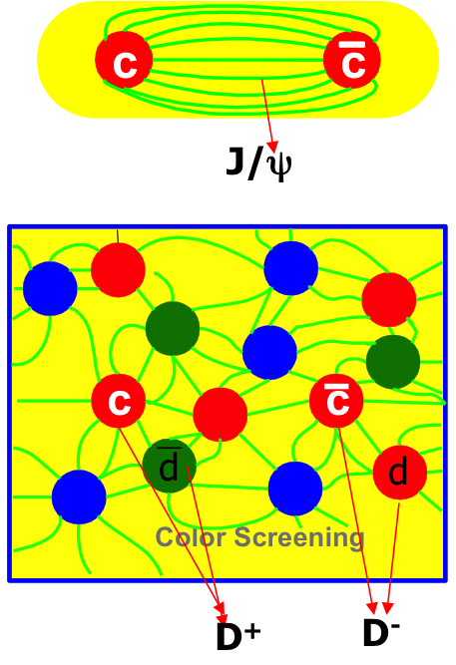
Quarkonia Suppression in Hot Medium
One of striking signatures for Quark-Gluon-Plasma (QGP) formation
Sequential melting : different binding energies → bound states are melt sequentially in hot medium
Quenched heavy quarks (energy loss): A.Rothkopf, PRL 108(2012) 162001
Sequential melting → a QGP thermometer
H. Satz, NPA 783 (2007) 249c.
2013 Heavy Flavor Measurements at RHIC and LHC (W. Xie)
Notes:
Why we are interested in quarkonia measurment ?
Because this is one of strking signatures for quark-gluon-plasma formation. Quarkonia is expected to be melt in the extreemly hot and densed qcd medium.
if the debye screening radius is smaller than their binding radius. This plot is the debye screening radius as a function of temperature to critical temperature of the medium.
As you can see, the screening radius is getting smaller increasing the temperature of medium. at the intersection of each quarkonia states they will be melt. They have different binding energy
so, they will be melt sequentially from the lowest one to highest one. We call it sequential melting scenario.
And the energy loss of heavy quarks is one of significant source of quarkonia production in heavy ion collisions according to this paper.
So, quarkonia study is expected to give some hints to understand more about the hot and densed qcd medium
The extra effect : CNM in initial state and recombination in final state

Slide 3
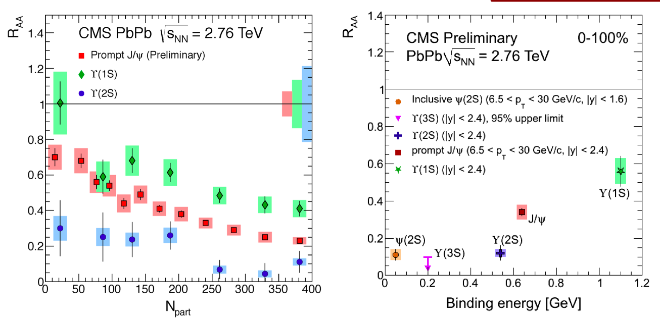
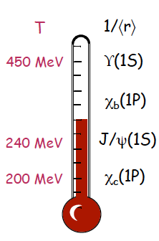
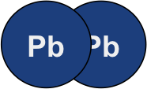
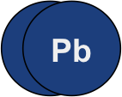
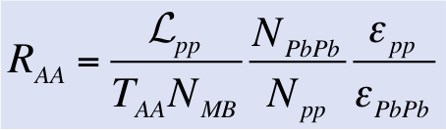
Quarkonia Suppression in Hot Medium
CMS-PAS-HIN-12-014
PRL 109 (2012) 222301
Observed
Significant suppression of J/ψ and ϒ (1S, 2S, 3S) at PbPb collisions
Expected hierarchy in the suppression of the states with different binding energy
Notes:
I would like to show J/psi v2 as the further study of charmonium side and
bottominium in ppb

Slide 4
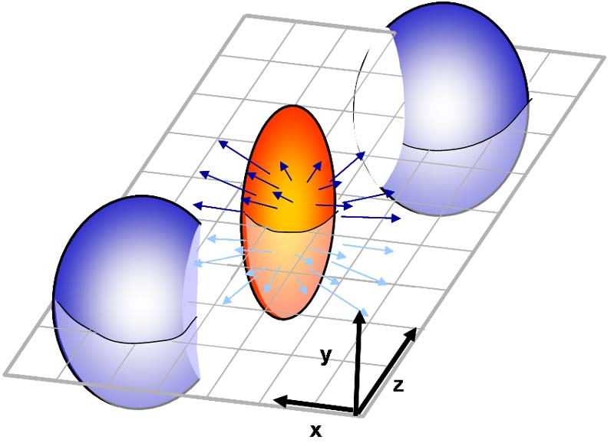
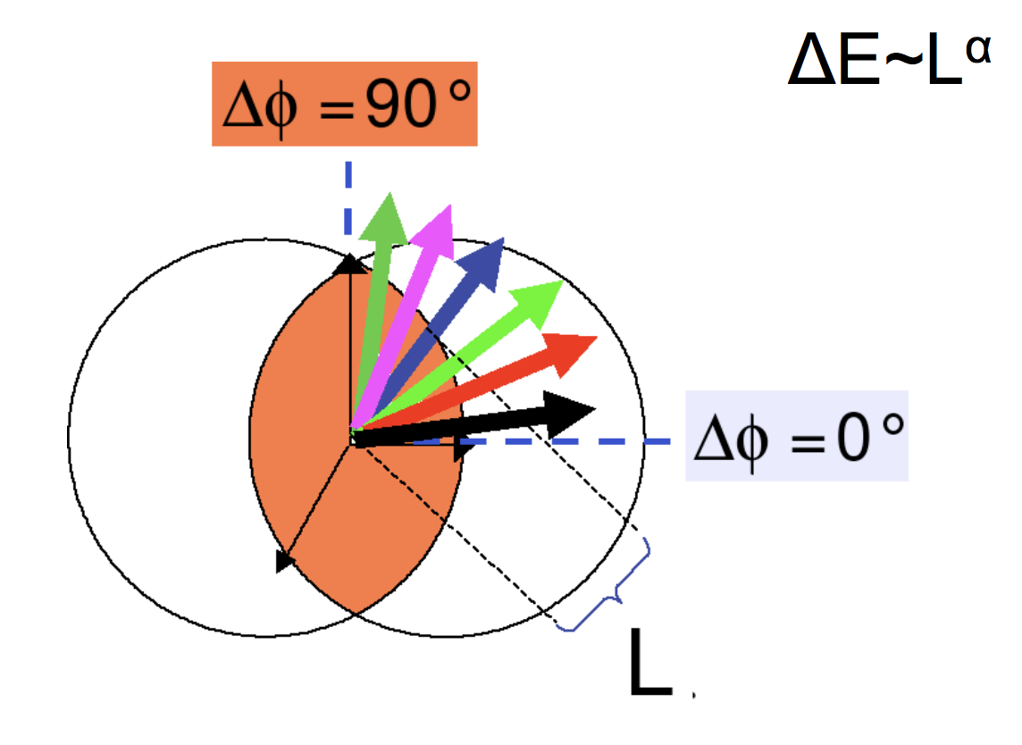
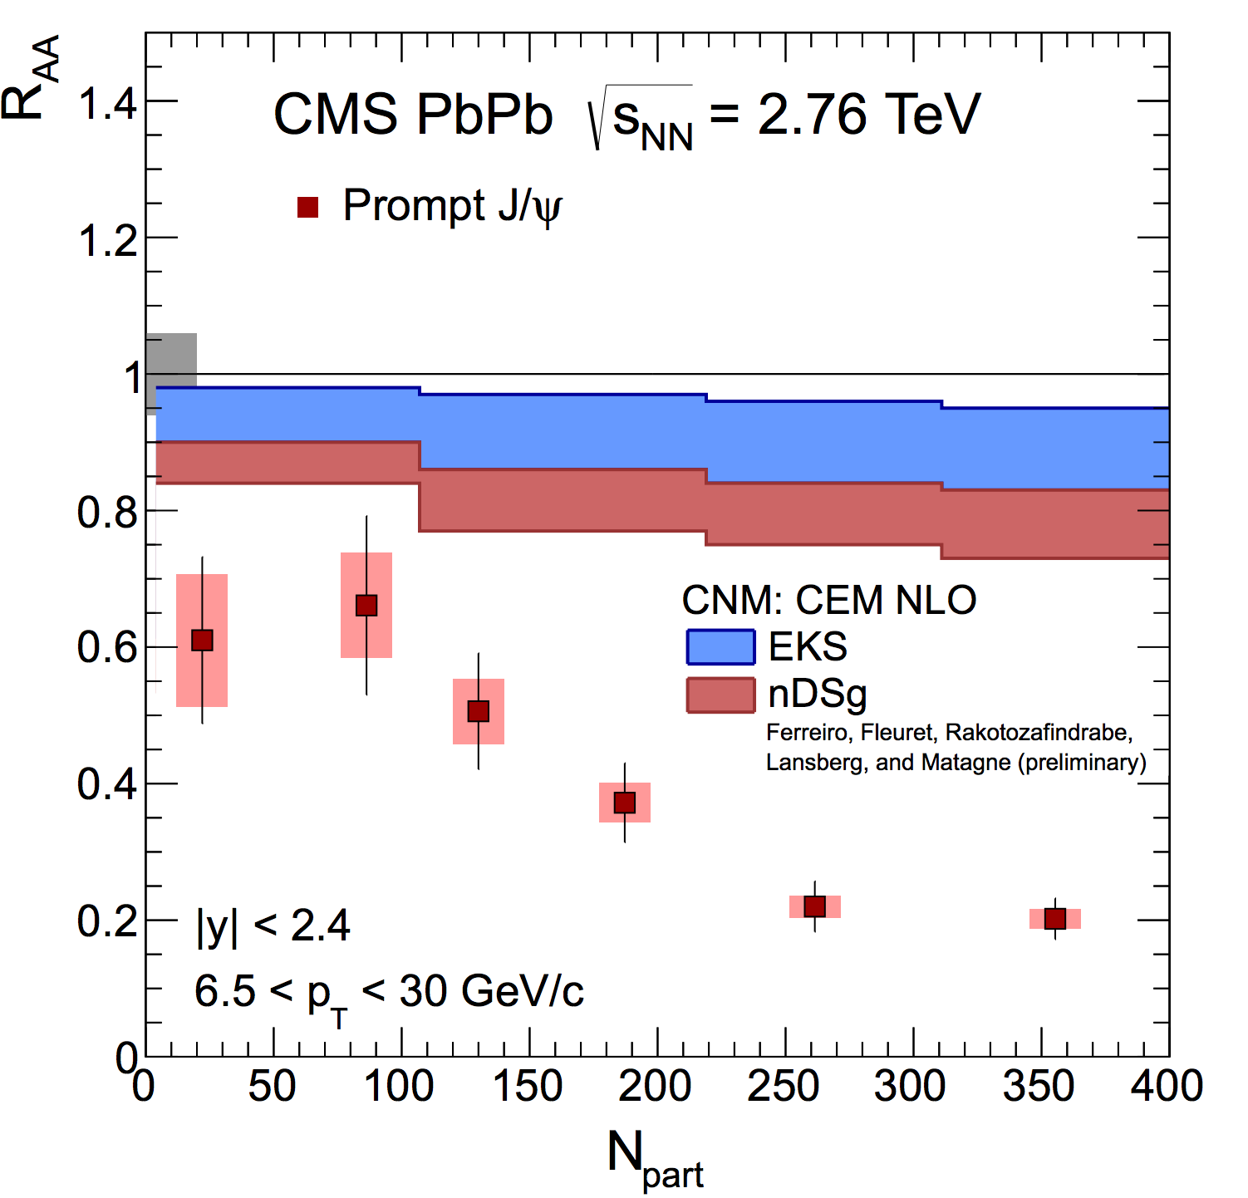
Quarkonia Study at CMS
Today focus
In PbPb collisions :
  Suppression of J/ψ again but dependence on new variable : reaction plane
In pPb collisions :
  The pure suppression of quarkonia from the QGP : distinguish Cold Nuclear Matter (CNM) effect from QGP
  ϒ (1S, 2S, 3S) : published at JHEP (JHEP 04 (2014) 103)
  J/ψ : ongoing (KU group)
ϕ
ψ_{R}
Notes:
I would like to show J/psi v2 as the further study of charmonium side and
bottominium in ppb

Slide 5
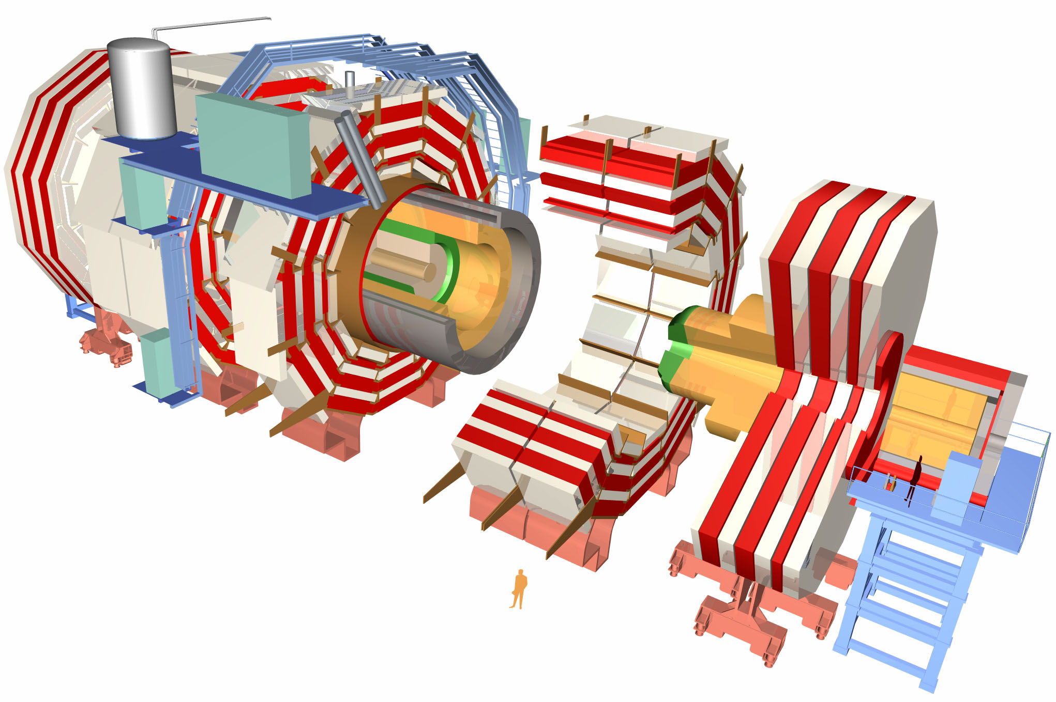
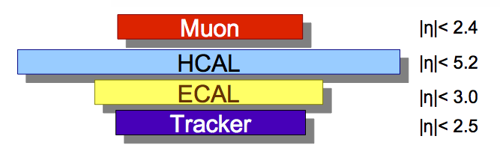
CMS detector
Magnetic Field : 3.8 T
Inner Tracker
(Silicon Strip & Pixel)
Hadron Forward
Calorimeter (HF)
Muon Chamber
(DT, RPC)
Muon Chamber
(CSC, RPC)

Slide 6
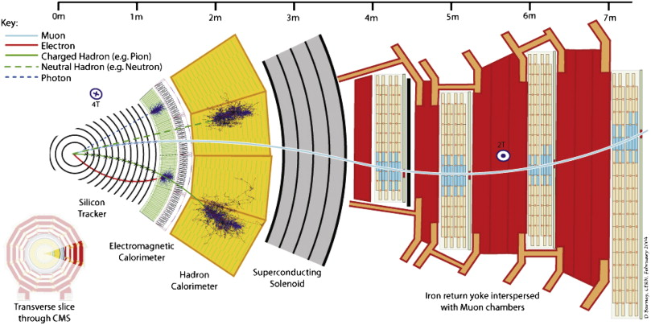
Muon Reconstruction in CMS
global muon
Inner track
standalone muon
Muon Reconstruction
J/ψ in PbPb : reconstructed by global muon
ϒ in pPb : reconstructed by tracker muon
Muon tracks in muon chamber (or segments) + tracks in inner tracker
Excellent momentum resolution of tracking system.
Overall resolution: 1~2 %

Slide 7
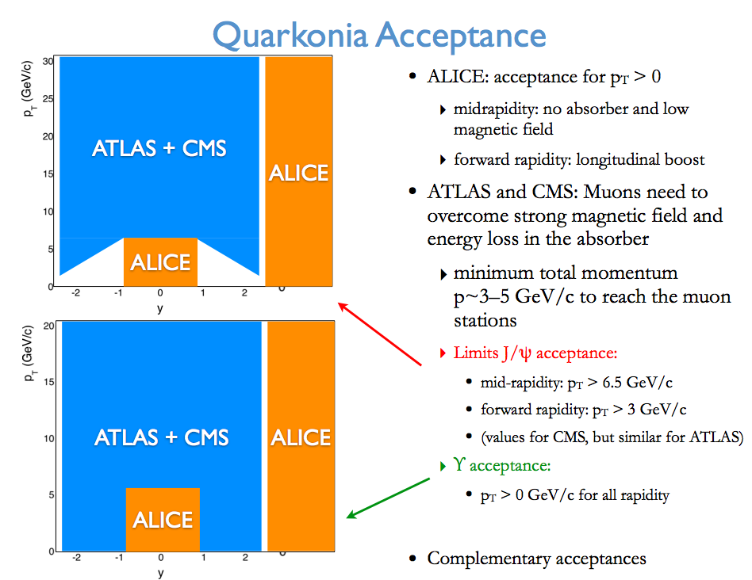
Muon Reconstruction in CMS
global muon
Inner track
standalone muon
Muon Reconstruction
Muon tracks in muon chamber (or segments) + tracks in inner tracker
Excellent momentum resolution of tracking system.
Overall resolution: 1~2 %

Slide 8
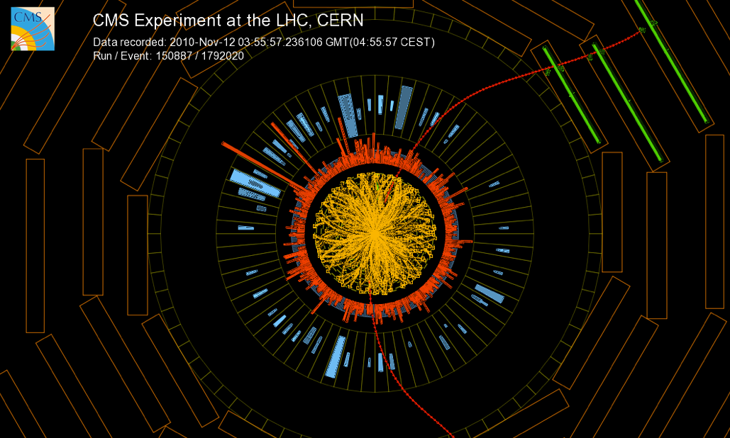
Charmonium Measurements in PbPb

Slide 9

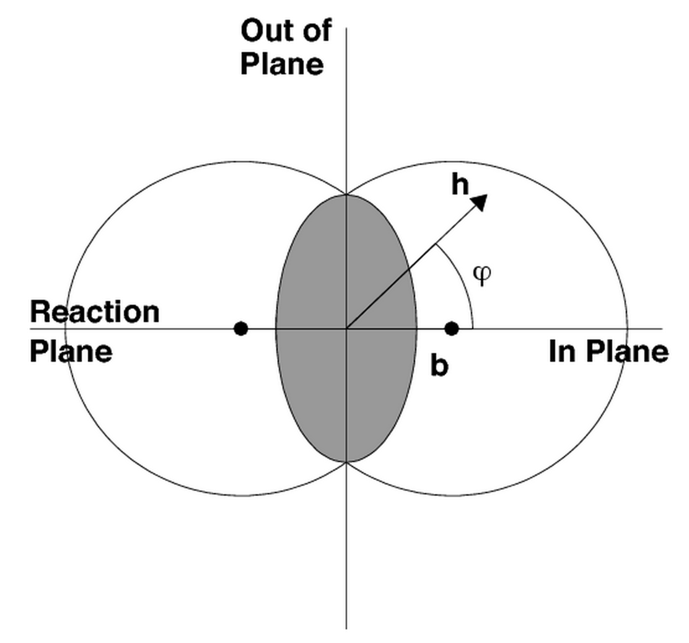
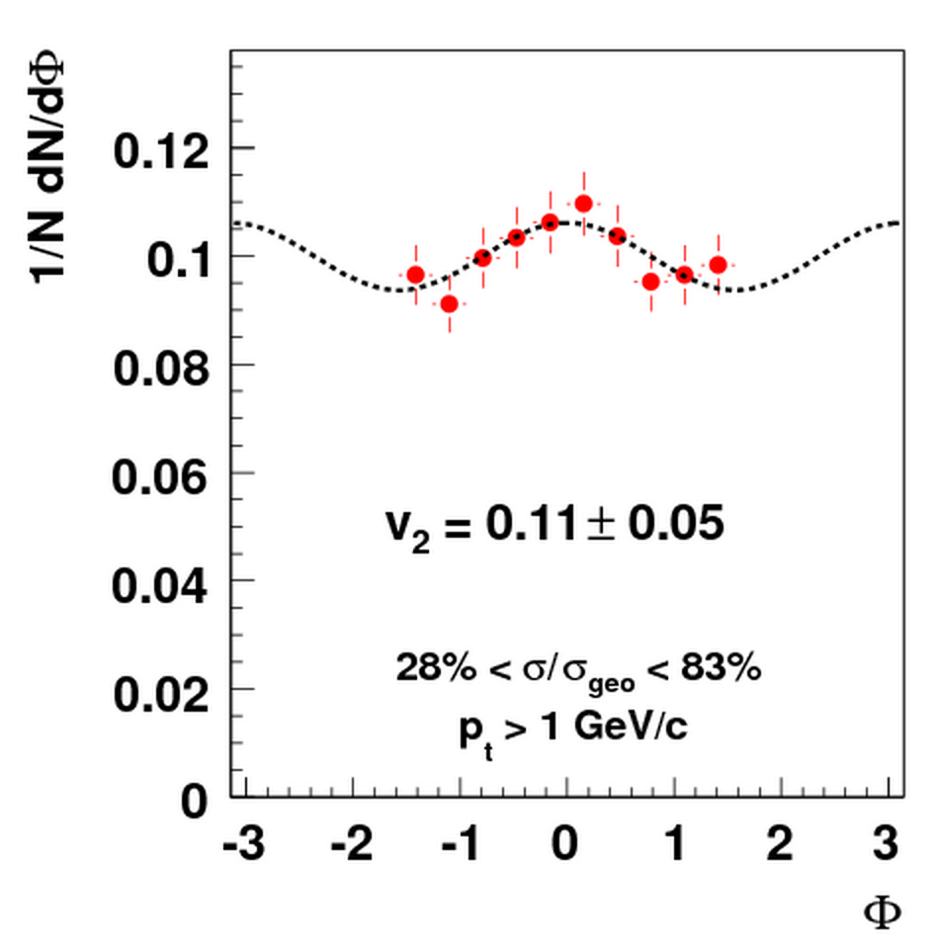
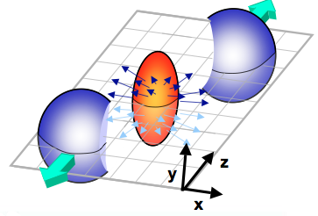
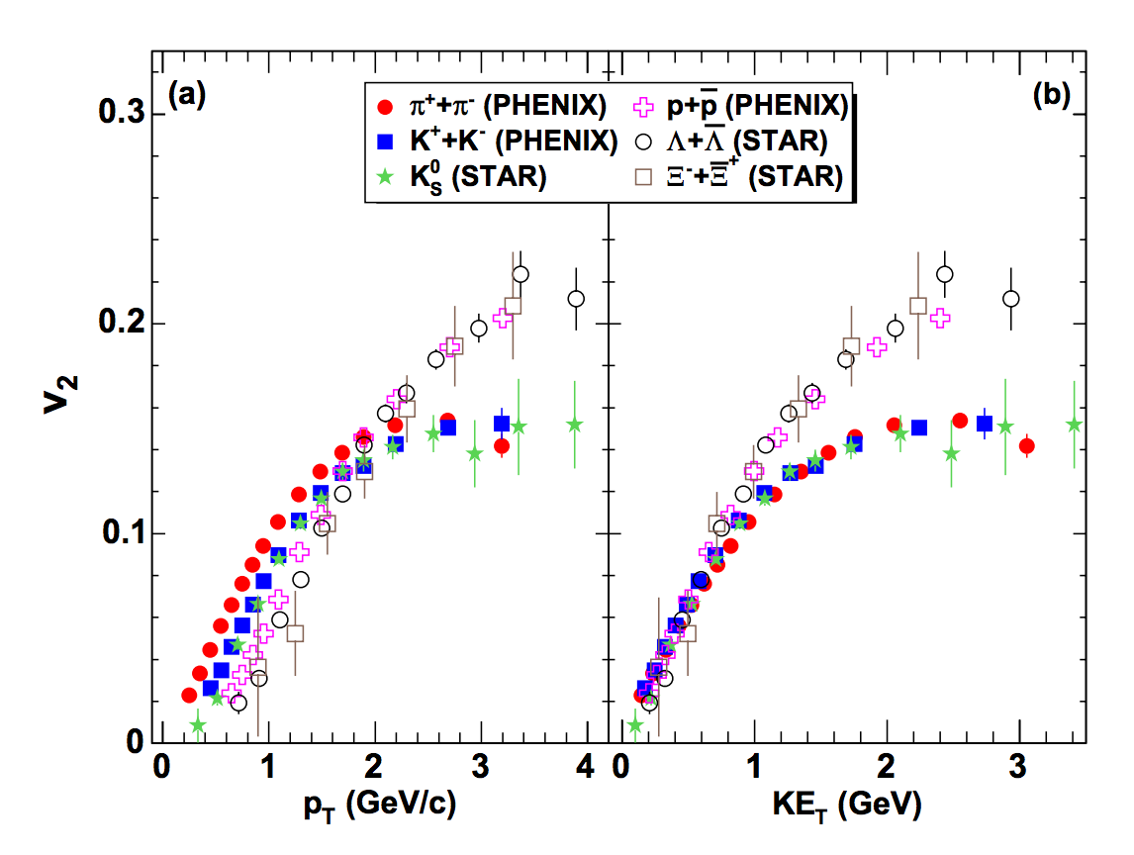
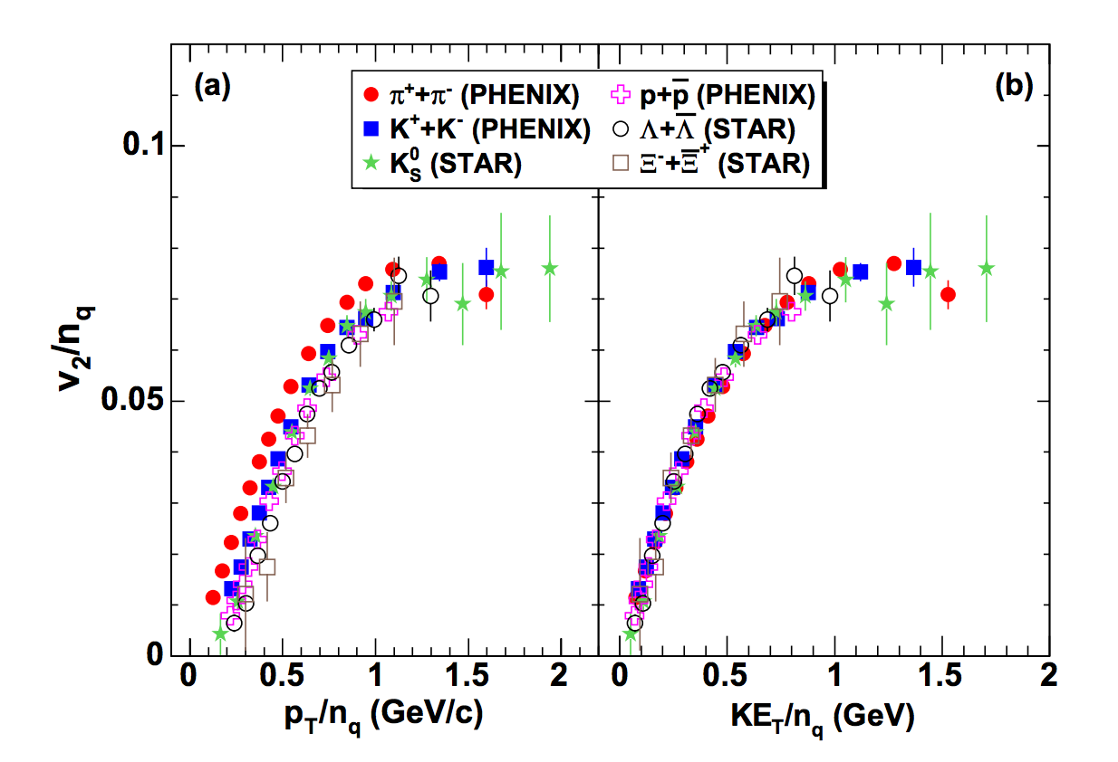
What is azimuthal anisotropy (v₂) ?
Quark
Scaling

Slide 10
NPE v₂ at RHIC and prediction of J/ψ v₂ at LHC
NPE (Non Photonic Electron) v₂
Prediction of elliptic flow of J/ψ
STAR
arXiv:1210.5199
Nucl.Phys.A834 (2010) 317c
NPE has significant elliptic flow (v₂).
It should be inherited to quarkonia,
which indicates the existence
non-zero v₂ of quarkonia
Significant elliptic flow (v₂) may be
expected at LHC energy
due to the significant
contribution of regenerated J/ψ

Slide 11
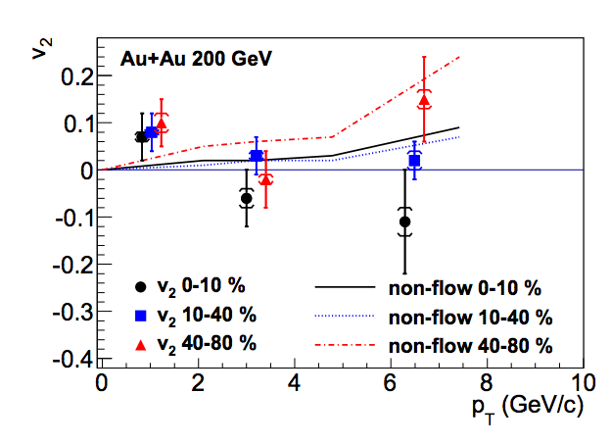
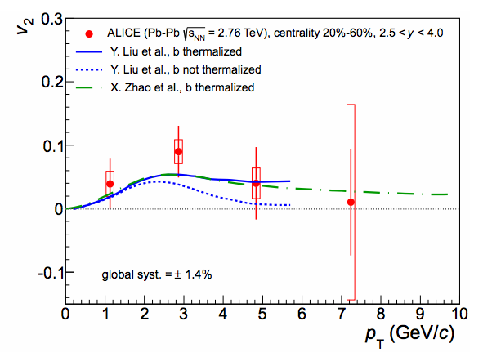
J/ψ Azimuthal Anisotropy at RHIC and LHC
STAR and ALICE measured inclusive J/ψ v₂
Phys. Rev. Lett. 111,
102301 (2013)
STAR
ALICE
Phys. Rev. Lett. 111,
052301 (2013)
ALICE observed non-zero
v₂ in 2 - 4 GeV/c region.
Data covers both of
b-contribution models.
STAR measured compatible zero
v₂ from 2 GeV/c in whole p_{T} region.
CMS challenge:
1) Prompt and non-prompt J/ψ separation
2) Extend high p_{T} region

Slide 12
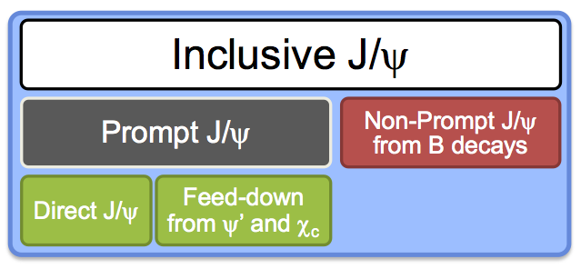
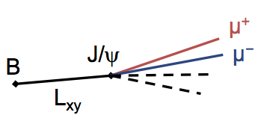
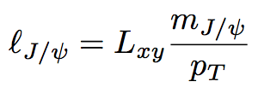
Prompt & Non-prompt J/ψ Separation
Charm
Beauty
Reconstruct opposite sign muon vertex
2-D unbinned maximum likelihood fit of
dimuon mass and pseudo-proper decay
length (l_{J/ψ})
CMS-PAS-HIN-12-014

Slide 13
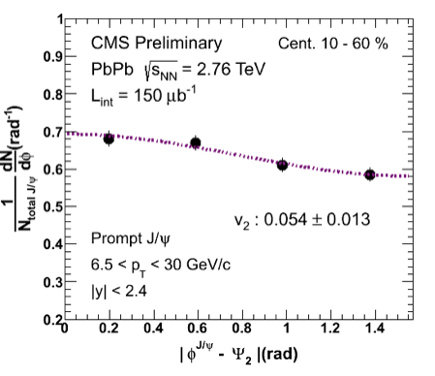

J/ψ Azimuthal Anisotropy in CMS
ϕ
ψ_{R}
CMS-PAS-HIN-12-001
Event plane method
Integrated v₂ for Prompt J/ψ (p_{T} > 6.5 GeV/c)
  0.054 ± 0.013 (stat.) ± 0.006 (syst.) in |y| < 2.4, 10-60 %
  significant (3.8σ) v₂ at high-p_{T} prompt J/ψ

Slide 14
J/ψ Azimuthal Anisotropy in CMS
CMS-PAS-HIN-12-001
No strong dependences of centrality, p_{T}, rapidity
Low p_{T} (3-6.5 GeV/c) measured in forward (1.6<|y|<2.4)

Slide 15
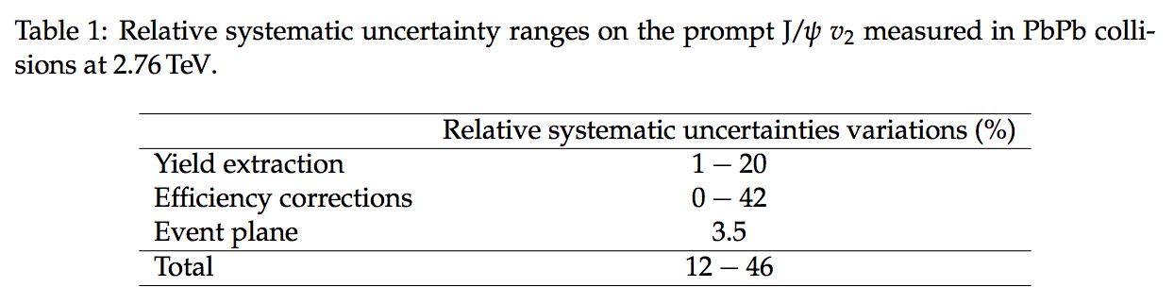
J/ψ Azimuthal Anisotropy in CMS
Systematic uncertainty

Slide 16
J/ψ Azimuthal Anisotropy Comparison
CMS-PAS-HIN-12-001
Phys. Rev. Lett. 111, 052301 (2013)
Phys. Rev. Lett. 111, 162301 (2013)
Extended available measurement up to high p_{T} region (6.5 – 30 GeV/c) and observed non-zero v₂
No significant dependence of p_{T}

Slide 17
J/ψ Azimuthal Anisotropy Comparison
CMS-PAS-HIN-12-001
Rev. Lett. 109 (2012) 022301
Phys. Rev. Lett. 111 102301 (2013)
Comparison to charged hadrons
and D mesons
1) low p_{T}
light quark ≈ c+light quark > c+c quark
2) high p_{T}
light quark ≈ c+light quark ≈ c+c quark

Slide 18
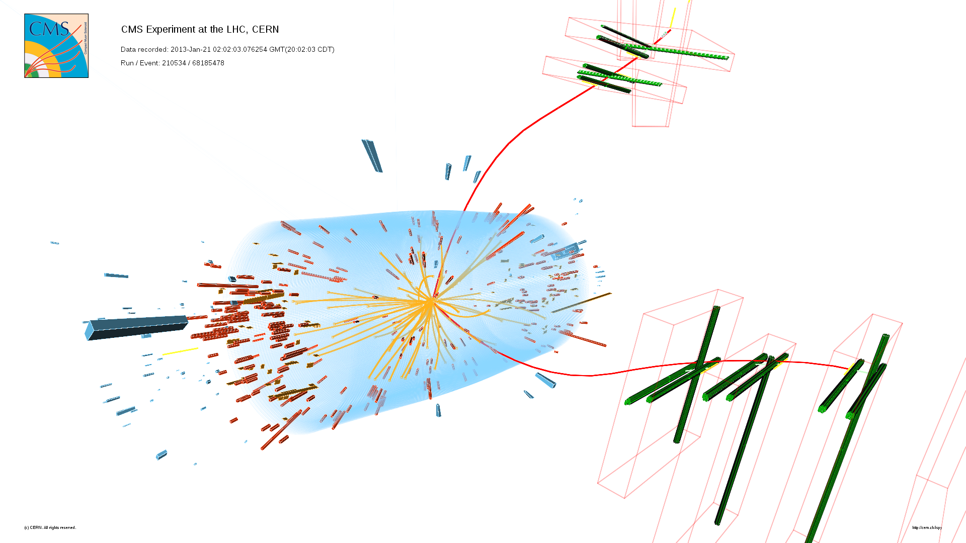
Bottomonium Measurements in pPb

Slide 19
Dimuon spectrum in 2013 pPb
L_{int} = 35 nb⁻¹
pp √s = 2.76 TeV : 5.4 pb⁻¹
~20 times larger than 2010 (231 nb⁻¹)

Slide 20
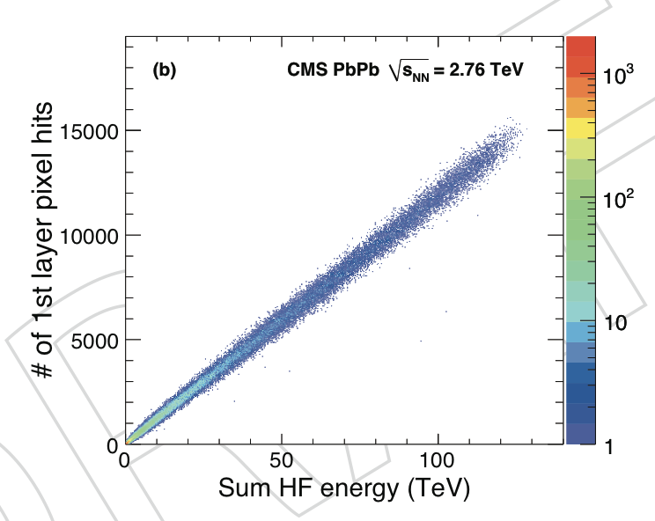
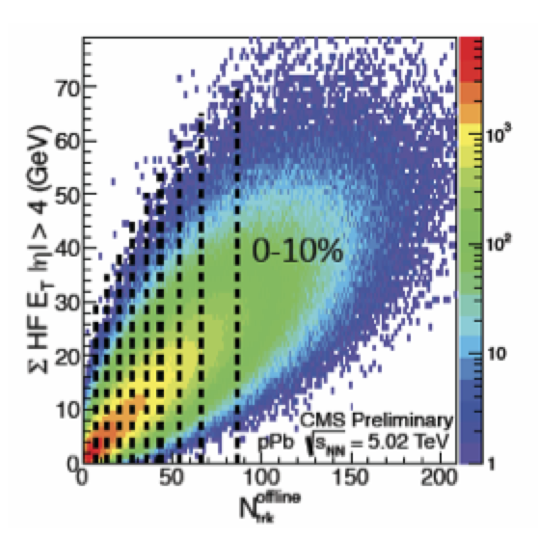
pPb Collisions at 2013
pPb collisions: the bridge between pp and PbPb collisions, to understand CNM effect from QGP.
pPb asymmetric collisions (~0.47 rapidity boost)
  analysis window |y_{CM}| < 1.93
Centrality dependence
  Not easy to determine centrality in pPb collisions
Ref. system | Pb+p
LAB |  | -2.4 | -0.47 | 1.5
Collision (CM) |  | -1.9 | 0.00 | 1.9
pPb
PbPb

Slide 21
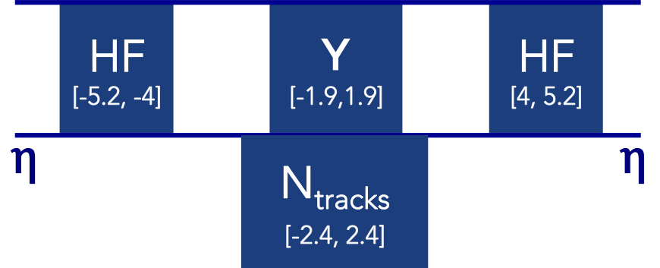
pPb Collisions at 2013
pPb collisions: the bridge between pp and PbPb collisions, to understand CNM effect from QGP.
pPb asymmetric collisions (~0.47 rapidity boost)
  analysis window |y_{CM}| < 1.93
Binning in 2 event-activity variables:
  Corrected N_{tracks} (|η| < 2.4, p_{T} > 400 MeV/c)
  Raw transverse energy measured in HF, E_{T} (|η| > 4.0)
Ref. system | Pb+p
LAB |  | -2.4 | -0.47 | 1.5
Collision (CM) |  | -1.9 | 0.00 | 1.9

Slide 22
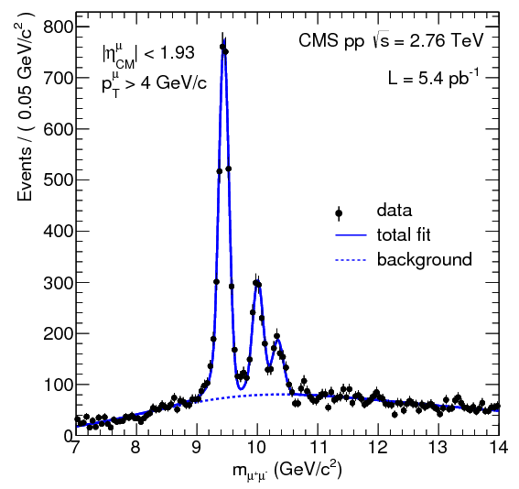
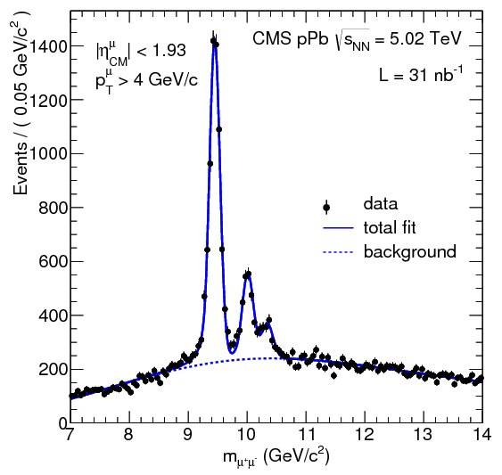
Invariant Mass Distributions
Signal extractions
Un-binned maximum log likelihood fit
  ➢ Signal : 3 Crystal-Ball function (Gaussian with low-side tail with power-law)
  ➢ Background : error function * exponential (all background parameters free)
JHEP 04 (2014) 103

Slide 23
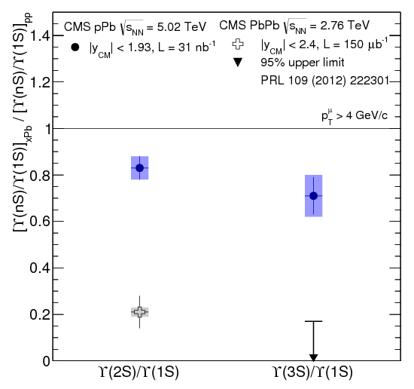
Double Ratio
pPb vs PbPb: stronger final state effects in PbPb compared to pPb
pPb vs pp: indication (significance < 3σ) of additional effects on the excited states in pPb
JHEP 04 (2014) 103

Slide 24
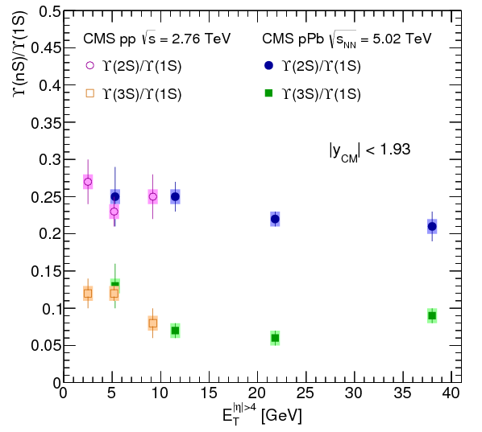
Υ(nS)/Υ(1S) vs E_{T} (|η| > 4)
Weak dependence of excited to the ground state ratio with respect to the E_{T}(|η|>4)
JHEP 04 (2014) 103

Slide 25
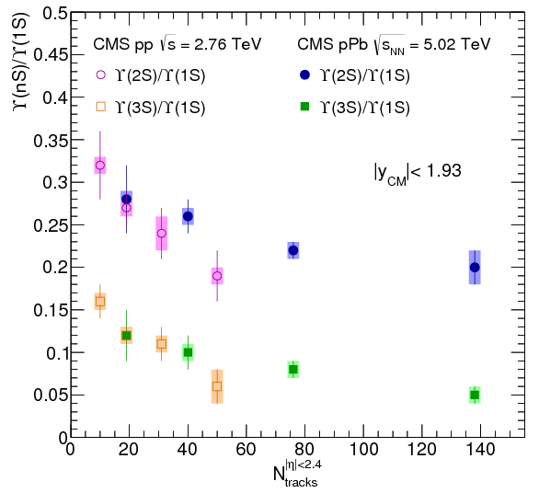
Υ(nS)/Υ(1S) vs N_{tracks} (|η| < 2.4)
Significant decrease of Υ(nS)/Υ(1S) with increasing multiplicity, in pPb and pp
Possible ways to produce this dependence
  - Υ would affect the multiplicity or Multiplicity would affect the Υ
JHEP 04 (2014) 103

Slide 26
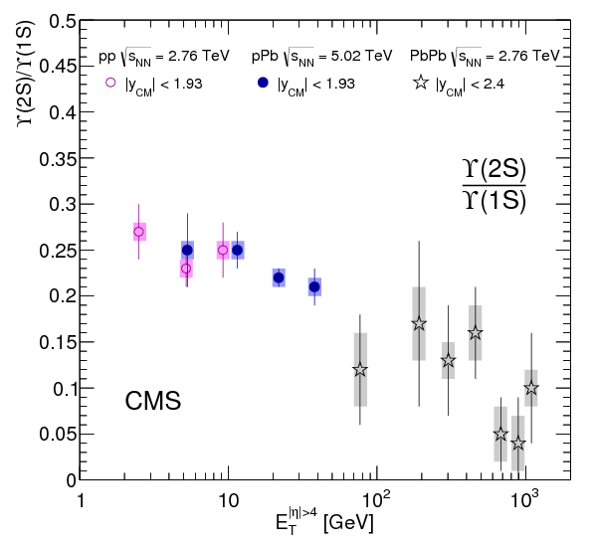
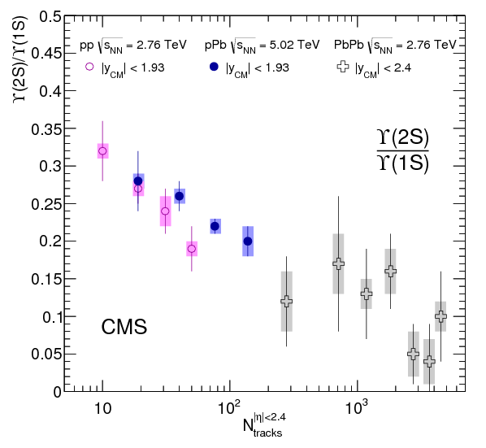
Υ(2S)/Υ(1S) compare PbPb
PbPb : no significant dependence on E_{T}(|η|>4) and N_{tracks}, but large uncertainties
PbPb points are below all the pPb data but large uncertainties to tell if already in most central pPb the level of suppression is the same as in PbPb peripheral
JHEP 04 (2014) 103

Slide 27
Self-normalized Yields: Υ(nS)/<Υ(nS)>
Υ(nS)/<Υ(nS)>: in the line at the whole E_{T}(|η|>4)
JHEP 04 (2014) 103

Slide 28
Self-normalized Yields: Υ(nS)/<Υ(nS)>
Υ(nS)/<Υ(nS)> vs N_{tracks}
  Less consistent behavior (related to the Υ(nS)/Υ(1S) variations)
JHEP 04 (2014) 103

Slide 29
Self-normalized Yields: Υ(nS)/<Υ(nS)>
PLB 712 (2012) 165
Υ(nS)/<Υ(nS)> vs N_{tracks}
  Less consistent behavior (related to the Υ(nS)/Υ(1S) variations)
JHEP 04 (2014) 103

Slide 30
Self-normalized Yields: Υ(nS)/<Υ(nS)>
PLB 712 (2012) 165
Υ(nS)/<Υ(nS)> vs N_{tracks}
  Less consistent behavior (related to the Υ(nS)/Υ(1S) variations)
  Multi parton interaction : should be same in 1S, 2S and 3S but even pp with high multiplicity shows differences
JHEP 04 (2014) 103

Slide 31
Summary
Observed non-zero v₂ of prompt J/ψ and even in high p_{T} region (> 6.5 GeV/c)
  Find proper fit setting in low p_{T} and forward region
  First time to measure v₂ of non-prompt J/ψ
ϒ results in pPb would give us some indications of initial state effect on the suppression in PbPb

Slide 32
Back up

Slide 33
ALICE Multiplicity dependence

Slide 34
R_{AA} vs binding energy
https://twiki.cern.ch/twiki/bin/view/CMSPublic/PhysicsResultsHIN12014

Slide 35
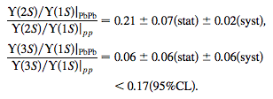

Results from PbPb Collisions
Double Ratio
R_{AA}
CMS HIN-11-011
PRL 109 (2012) 222301
Υ(3S) are more suppressed than Υ(2S).
Ordering: R_{AA}(Υ(3S)) < R_{AA}(Υ(2S)) < R_{AA}(Υ(1S))
Υ(2S) and Υ(3S) are more
suppressed than Υ(1S)

Slide 36
J/ψ Azimuthal Anisotropy in CMS

Slide 37
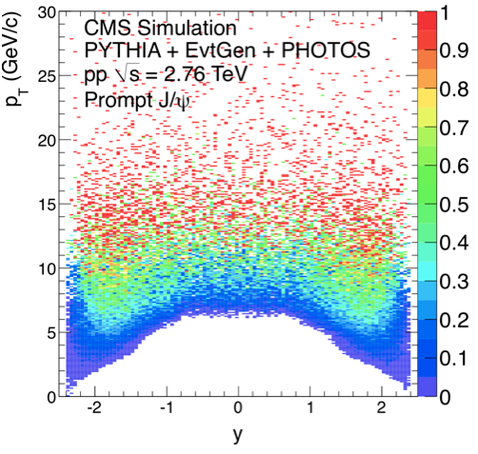
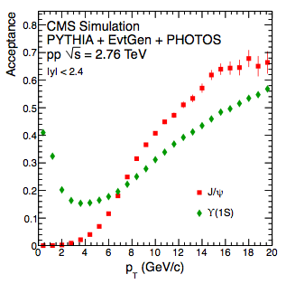
Muon Pair Acceptance

Slide 38
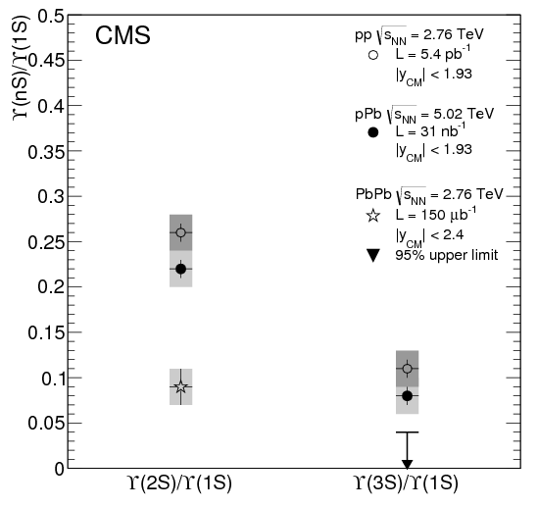
Υ(nS)/Υ(1S) vs E_{T} (|η| > 4)
Weak dependence of excited to the ground state ratio with respect to the E_{T}(|η|>4)
CMS-PAS-HIN-13-003
arXiv:1312.6300

Slide 39
J/ψ Azimuthal Anisotropy in CMS
STAR and ALICE measured inclusive J/ψ’s v₂
STAR measured compatible zero v₂ from 2 GeV/c in whole p_{T} region
ALICE observed non-zero v₂ in 2 - 4 GeV/c region
Possible scenarios : regeneration of J/ψ or path-length dependence of suppression (less suppressed in-plane than out-plane)
Prompt and non-prompt J/ψ separation is important: charmonium vs open bottom
Phys. Rev. Lett. 111,
102301 (2013)
STAR
Phys. Rev. Lett. 111,
052301 (2013)
ϕ
ψ_{R}

Slide 40
The life of Quarkonia in the Medium can be Complicated
Observed J/ψ is a mixture of direct production+feeddown (R. Vogt: Phys. Rep. 310, 197 (1999)).
  All J/ψ ~ 0.6J/ψ(Direct) + ~0.3 χ_{c} + ~0.1ψ’
  B meson feed down.
    Important to disentangle different component
Suppression and enhancement in the “cold” nuclear medium
  Nuclear Absorption, Gluon shadowing, initial state energy loss, Cronin effect and gluon saturation (CGC)
  Study p+A collisions
Hot/dense medium effect
  J/ψ, ϒ dissociation, i.e. suppression
  Recombination, i.e. enhancement
  Study different species, e.g. J/psi, ϒ
  Study at different energy, i.e. RHIC, LHC
c
J/ψ
c
c
D⁺

Slide 41
Summary
Charmonium in PbPb
  Prompt J/ψ integrated v₂ (10-60%, |y| < 2.4 and 6.5 < p_{T} < 30 GeV/c)
    0.054 ± 0.013 (stat.) ± 0.006 (syst.) (3.8σ)
Bottomonia in pp & pPb
  Double ratios [Υ(nS)/Υ(1S)]_{pPb}/[Υ(nS)/Υ(1S)]_{pp}
    Higher than in PbPb: stronger final state effects in PbPb than in pPb
    Hint to the presence of additional effects (like CNM) in pPb than in pp
  Υ(nS)/Υ(1S): decrease with increase of particle multiplicity in both pp and pPb
    Reflect an influence of the ‘medium’ on the Υ
    Reflect a different multiplicity associated with the Υ states production
  Υ(nS)/<Υ(nS)>: increase with increasing event activity in pp, pPb and PbPb

Slide 42
<Ncoll>

Slide 43
Systematics

Slide 44
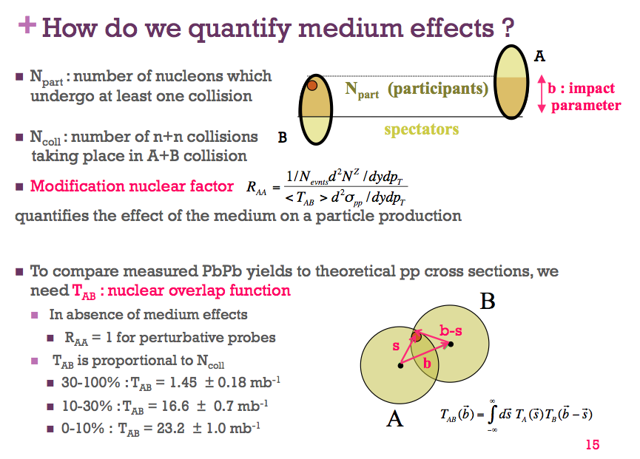
Nuclear Modification Factor
R_{AA} description
Lamia, B. “Observation of Z Boson Production in Heavy Ion Collisions at CMS”
Moriond QCD and High Energy Interactions, 2011
Dong Ho Moon, 7th Apr.

Slide 45
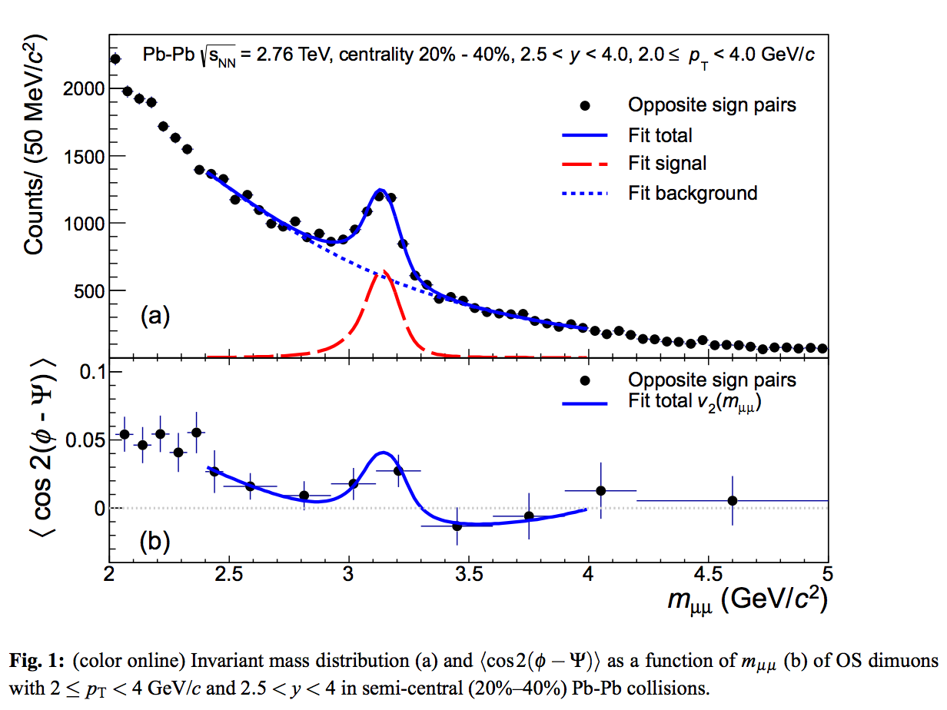
J/ψ v₂ at ALICE

Slide 46
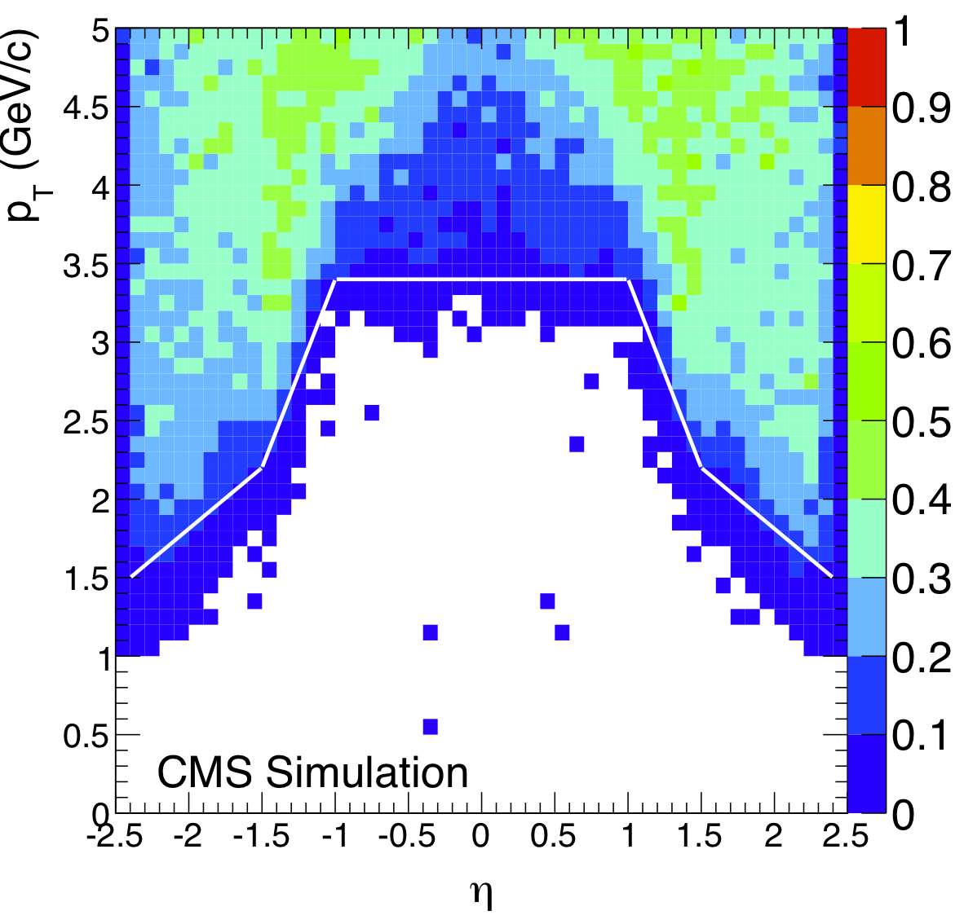
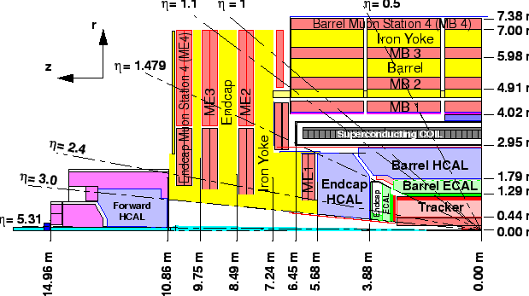
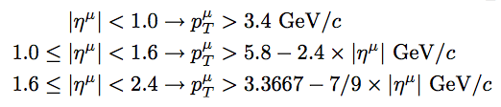
Single Muon Acceptance
✔ Acceptance definition:
Range of p_{T} and eta of
reconstructable muon
(RecoMu/GenMu ≥ 10%)
CNU Colloquium, 25 September 2014, Dong Ho Moon

Slide 47
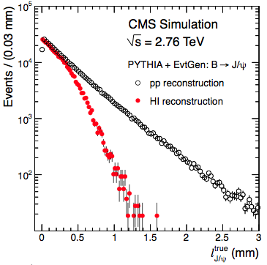
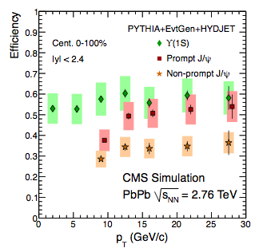
Reconstruction Efficiency

Slide 48
Acceptance
Notes:
PRL 109, 222301 (2012)

Slide 49
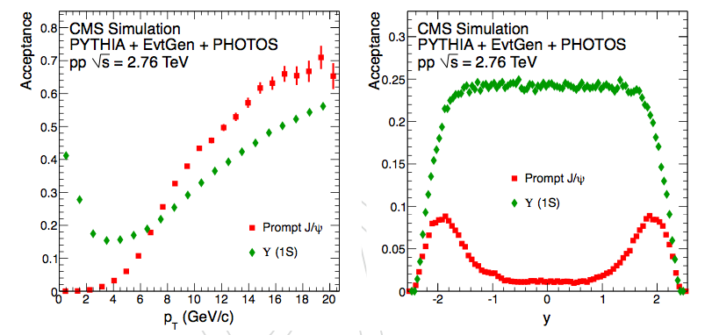
Correction (Acceptance)
PYTHIA+EventGen+PHOTOS simulation at √s = 2.76 TeV
Total acceptance : 0.296, 0.0 ≤ |y| < 2.4, 6.5 ≤ p_{T} < 30.0 (GeV/c)

Slide 50
Υ(nS)/Υ(1S) vs E_{T} (|η| > 4)
Weak dependence of excited to the ground state ratio with respect to the E_{T}(|η|>4)
CMS-PAS-HIN-13-003
arXiv:1312.6300

Slide 51
Υ(nS)/Υ(1S) vs N_{tracks} (|η| < 2.4)
Significant decrease of Υ(nS)/Υ(1S) with increasing multiplicity, in pPb and pp
Possible ways to produce this dependence
  - Υ would affect the multiplicity or Multiplicity would affect the Υ
CMS-PAS-HIN-13-003
arXiv:1312.6300

Slide 52
Υ(2S)/Υ(1S) compare PbPb
PbPb : no significant dependence on E_{T}(|η|>4) and N_{tracks}, but large uncertainties
PbPb points are below all the pPb data but large uncertainties to tell if already in most central pPb the level of suppression is the same as in PbPb peripheral
CMS-PAS-HIN-13-003
arXiv:1312.6300

Slide 53
Self-normalized Yields: Υ(nS)/<Υ(nS)>
Υ(nS)/<Υ(nS)>: in the line at the whole E_{T}(|η|>4)
CMS-PAS-HIN-13-003
arXiv:1312.6300

Slide 54
Self-normalized Yields: Υ(nS)/<Υ(nS)>
Υ(nS)/<Υ(nS)> vs N_{tracks}
  Less consistent behavior (related to the Υ(nS)/Υ(1S) variations)
CMS-PAS-HIN-13-003
arXiv:1312.6300

Slide 55
Self-normalized Yields: Υ(nS)/<Υ(nS)>
PLB 712 (2012) 165
Υ(nS)/<Υ(nS)> vs N_{tracks}
  Less consistent behavior (related to the Υ(nS)/Υ(1S) variations)
CMS-PAS-HIN-13-003
arXiv:1312.6300

Slide 56
Self-normalized Yields: Υ(nS)/<Υ(nS)>
PLB 712 (2012) 165
Υ(nS)/<Υ(nS)> vs N_{tracks}
  Less consistent behavior (related to the Υ(nS)/Υ(1S) variations)
  Multi parton interaction : should be same in 1S, 2S and 3S but even pp with high multiplicity shows differences
CMS-PAS-HIN-13-003
arXiv:1312.6300

Slide 57

Self-normalized Yields: Υ(nS)/<Υ(nS)>

Slide 58


Slide 59
Contents
Introduction
Charmonium measurements
  Prompt J/ψ azimuthal anisotropy in PbPb collisions
Bottomonium measurements
  pp & pPb collisions
Summary

Slide 60

pp DiMuon

