Slide 1
Prospects of RPC Triggers for CMS
and PHENIX Experiments
K. S. Lee
Korea University & Korea Detector Laboratory

Slide 2
Contents
1. Introductions
2. Trigger RPCs in upgraded PHENIX
3. Upgrade of Trigger RPCs for CMS
- PHASE I: 4-th RPC station in Endcap RPC system
- PHASE II: high-η RPCs in Endcap RPC system
4. Summary

Slide 3
1. Introductions
  Why Resistive Plate Chambers for large detector systems in Nuclear & High-energy Physics ?
  - The fastest detector responses with fairly good time resolution for high-energy particle detections.
  - Thin detector structure to cover a large detection area.
  - Trigger detectors to be installed together with tracking chambers to obtain fast HIT response data for times and positions for particle tracking
  - Small radiation thickness (thin detector thickness)
  → minimally effect on the meaningful particle track to be reconstructed.
  - No wires used → relatively low costs
  - Gaseous detectors → radiation hard for high-rate radiation environments
  Guarantee reliable operation for long-period experiments

Slide 4
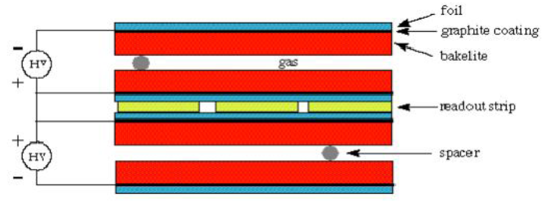
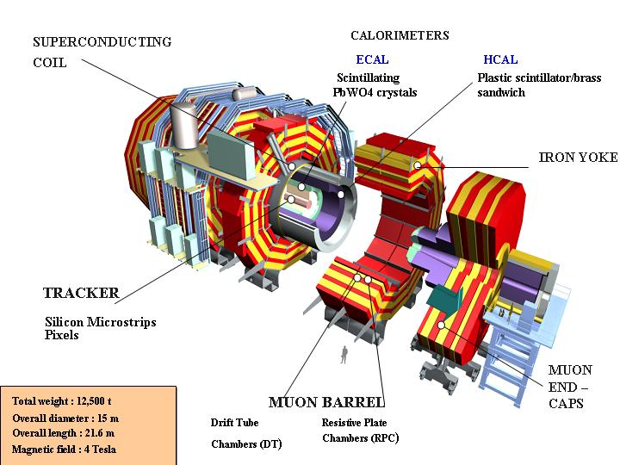
  Large-area triggers for large area trigger detections
  (CMS, ATLAS, & LHC-b in LHC, PHENIX in RHIC)
  - 2-mm thick single or double-gap RPCs
  - Required time resolution: 1 ~ 2 ns
  - Less sensitive to neutral background particles
  - Required rate capabilities: 10 ~ 1 kHz/cm²
  - Digitization only for hits to provide fast hit data
  (measuring positions & times, no ADC)
  - Resistive plate: HPL(ρ~10¹⁰Ωcm) or glass(ρ>10¹²Ωcm)
CMS
PHENIX
Muon Arms

Slide 5
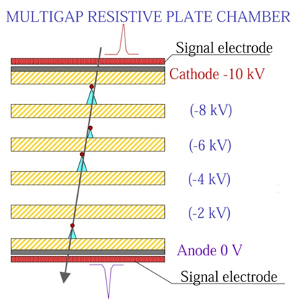
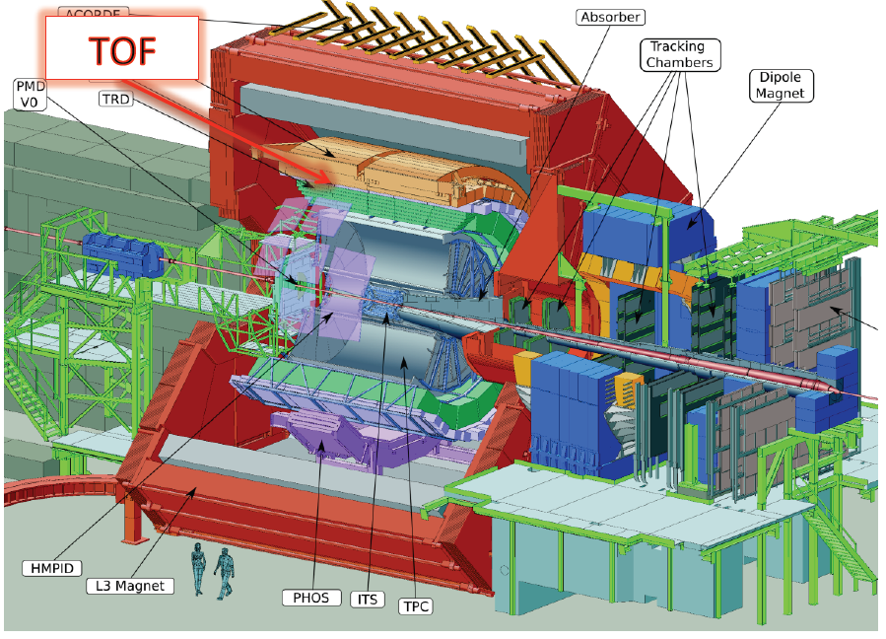
  For TOF measurements (timing RPCs)
  (ALICE in LHC, STAR in RHIC, and CBM @FAIR)
  - ~ 0.25 mm thick multi-gap glass RPCs (6 or 8 gaps)
  - Required fairly time resolution for TOF measurements:
  σ = 50 ~ 100 ps
  - Rate capabilities:
  < 1 kHz/cm² with normal glass
  > 10 kHz/cm² with low resistive glass (ρ~10¹⁰ Ωcm)
  - Digitization for times, positions, and charges
  (requiring both TDC and ADC measurements)
CBM = Compressed Baryonic Matter
ALICE

Slide 6
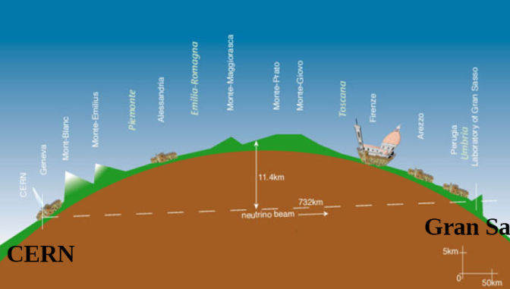
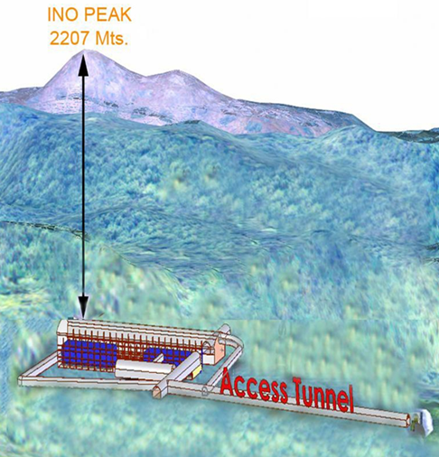
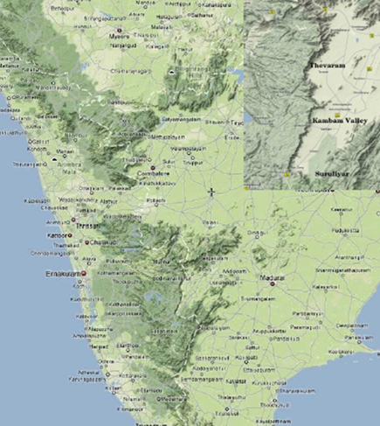
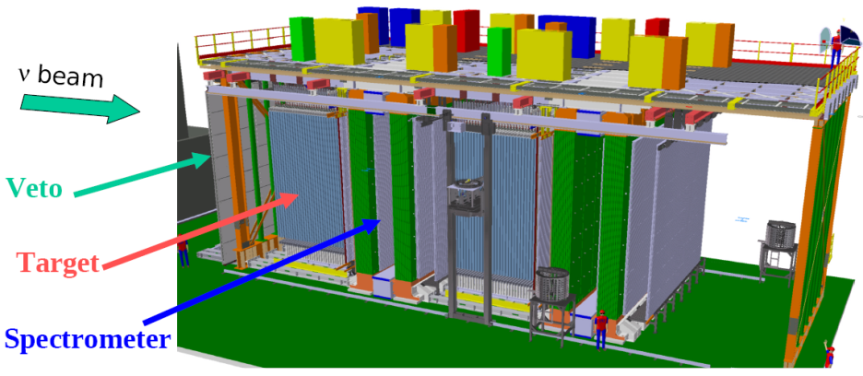
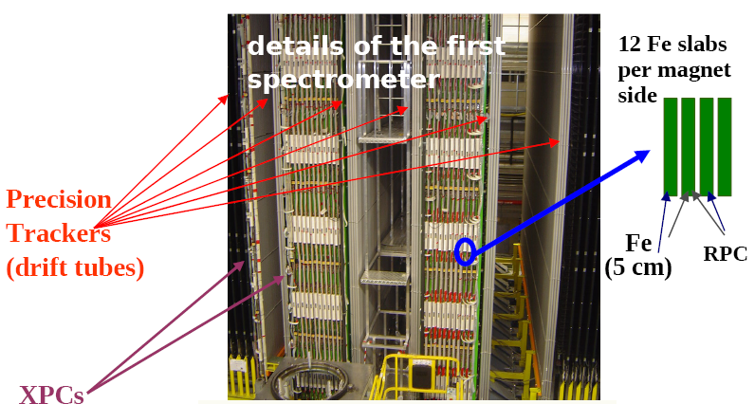
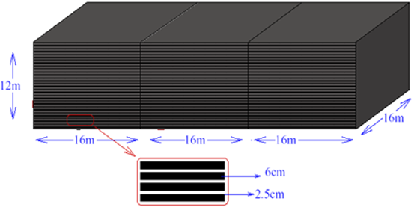
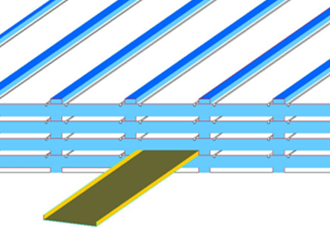
  For measurements of neutrino oscillations (INO and OPERA)
  - INO (Indian Neutrino Observatory) measures neutrino oscillated muons (2018 ?)
  Deep inside a mine to suppress detection of cosmic muons
  High resistive normal glass single-gap RPCs to suppress noises
  Avalanche-mode operation
  - OPERA (Oscillation Project with Emulsion tRacking Apparatus)
  measures neutrino oscillated τ’s
  High resistive single-gap HPL RPCs
  Streamer-mode (avalanche-mode ?) operation
OPERA
INO

Slide 7
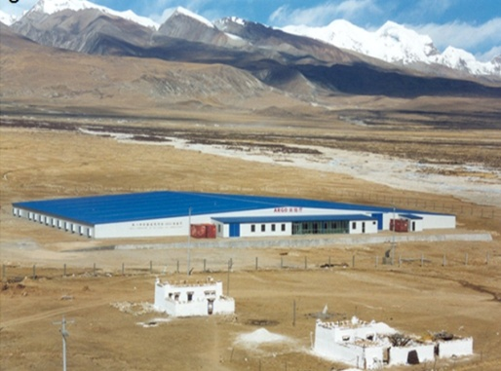
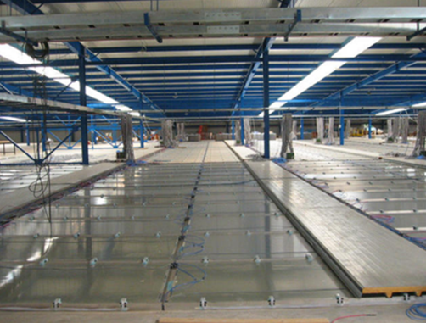
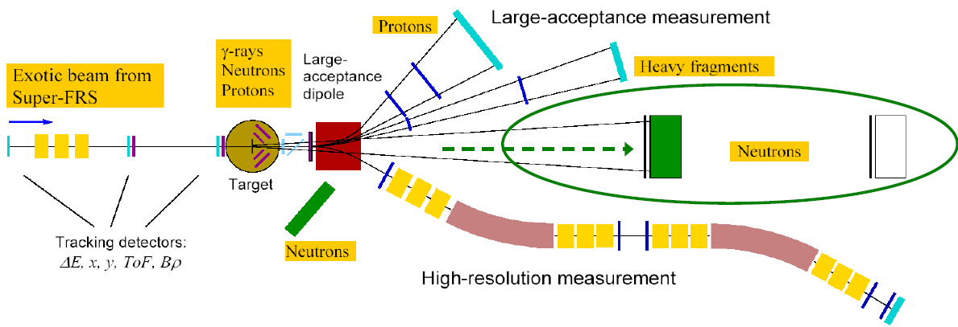
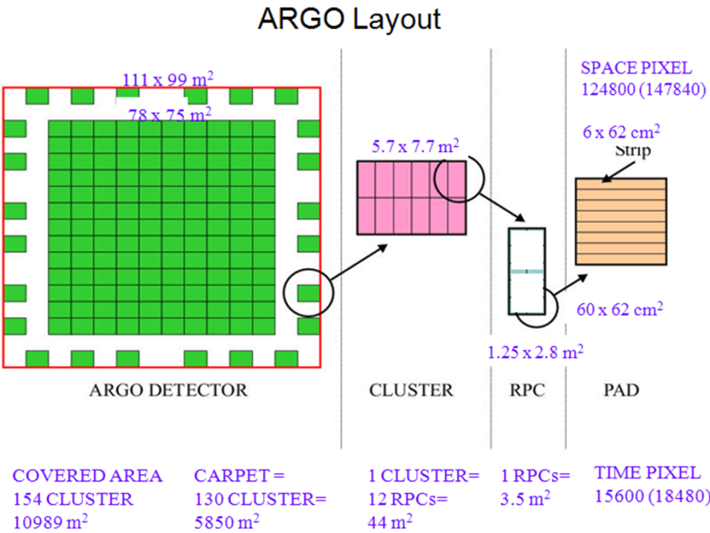
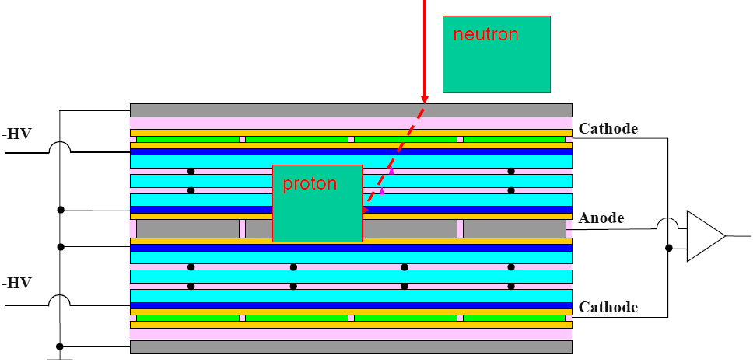
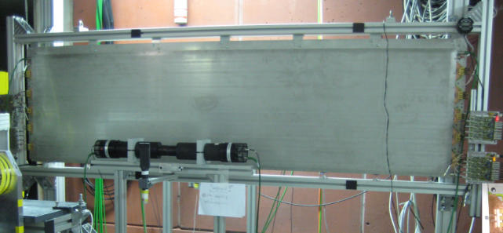
  For measurement of cosmic rays
  (ARGO @YBJ)
  - ARGO measures muons, electrons, and gammas in cosmic-ray bursts
  - High resistive double-gap HPL RPCs
  - Streamer-mode operation
  Neutron calorimeters
  - Neutron measurements for RI reactions
  - Detectable neutron energy: 0.2 ~ 1 GeV
  Expected ε > 90% for 400 MeV neutrons
  - Steel converters + multi-gap RPCs
  - Required time resolution ~ 100 ps
  - Advantage of multi-neutron events over plastic scintillator arrays
ARGO@YBJ
R3B Experiment @FAIR
2012 RPC conference

Slide 8
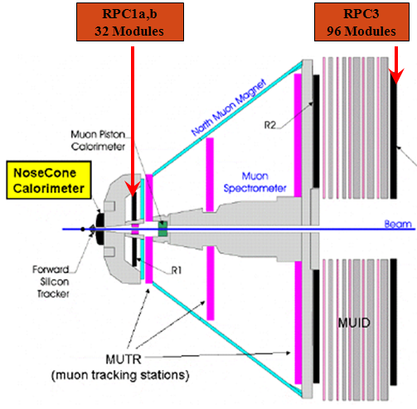
Trigger RPCs in upgraded PHENIX
Motivation of RPC triggers
The new spin physics with a higher energy requires more effective triggers in removing beam related backgrounds.
→ L = 1.6 ⅹ 10³² cm⁻²s⁻¹ with a total cross section (60 mb) at √s = 500 GeV
→ Needs higher background reduction factor ~ 10000 including safety factor 2.
RPCs in avalanche mode are enable to satisfy the condition
→ Time resolution (including electronics) < 2 ns.
→ Required rate capability < 1 kHz/cm².
→ Noise rate < 5 Hz/cm² in the detector level.
Upscope PHENIX TDR (2007)
Coverage : 1.2 < η < 2.4 for North,
1.2 < η < 2.2 for South

Slide 9
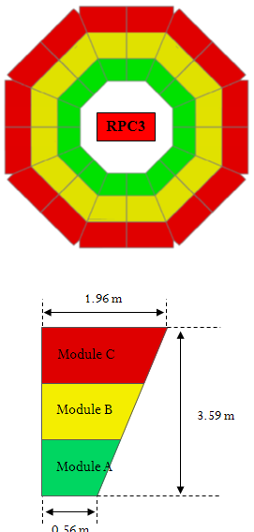
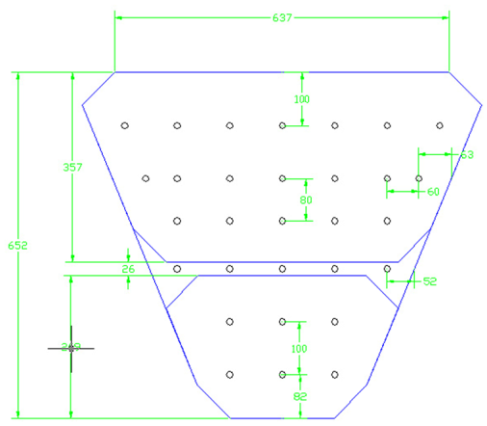
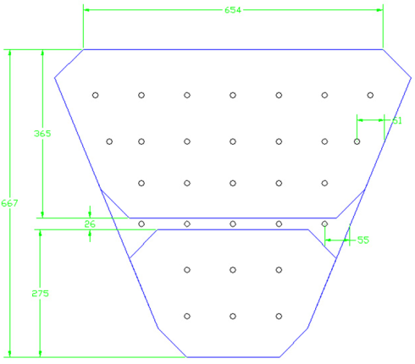
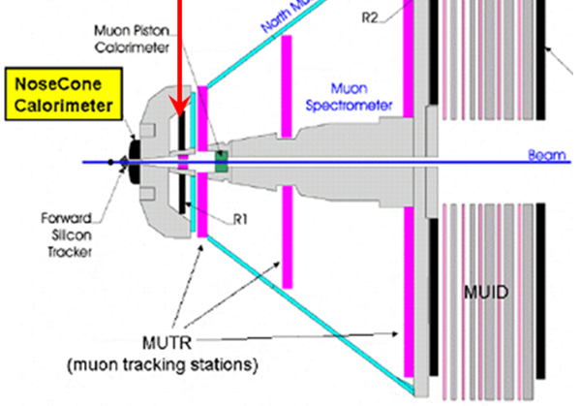
RPC station 3
32 half octants (16 in each arm)
Three RPCs modules in a half octant
→ totally 96 double-gap RPC modules
RPC station 1
16 half octants (8 in each arm)
One double-gap RPC module in a half octant
→ totally 16 double-gap RPC modules
N1A1
N1A2

Slide 10
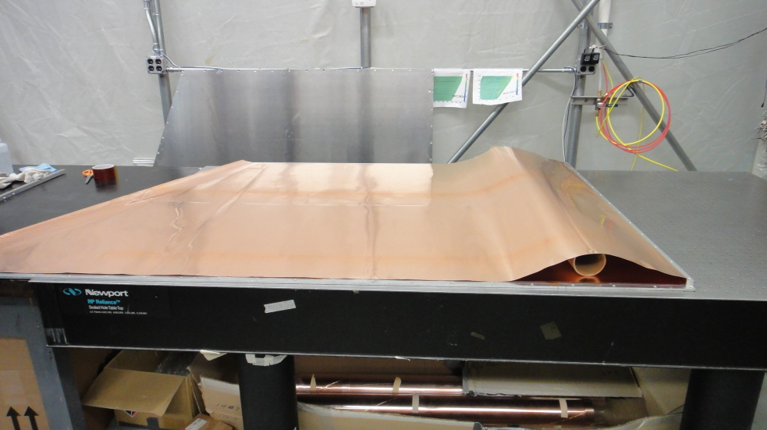
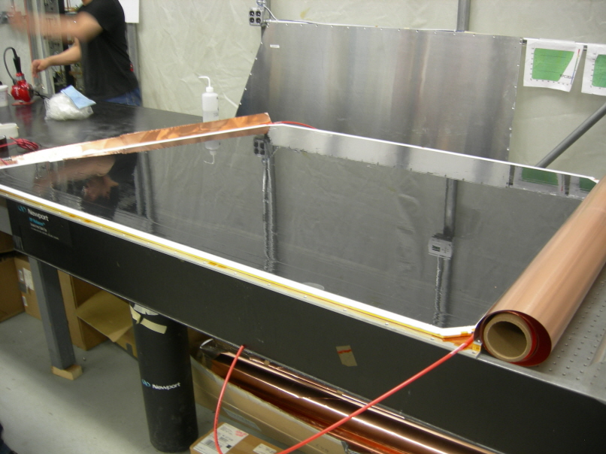
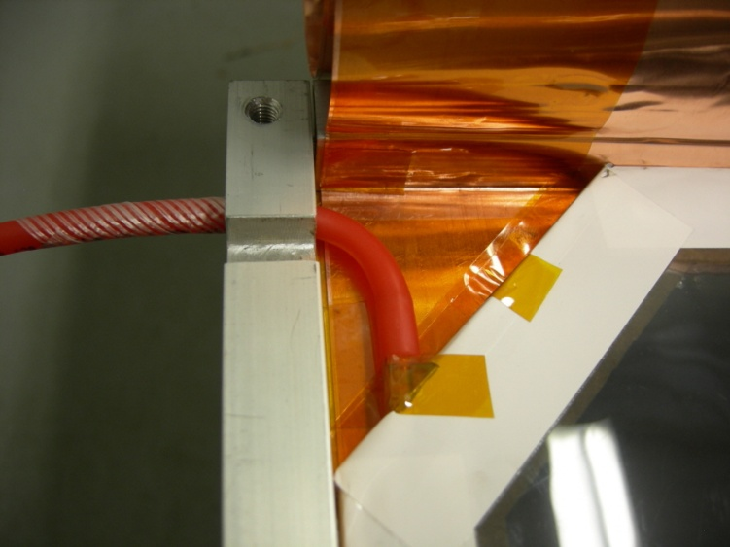
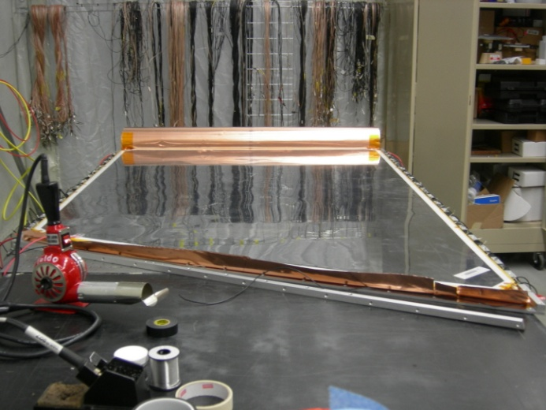
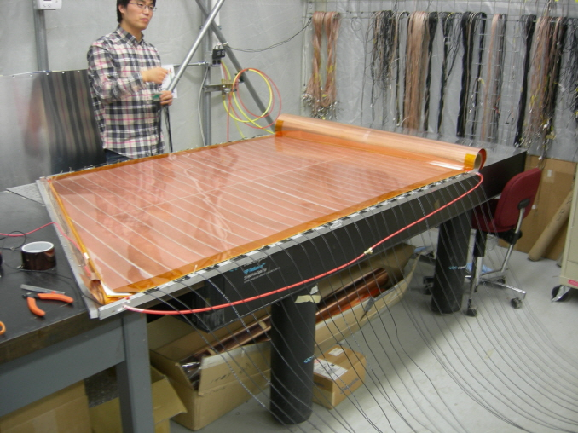
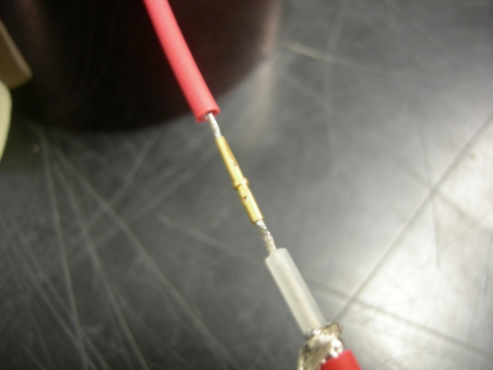
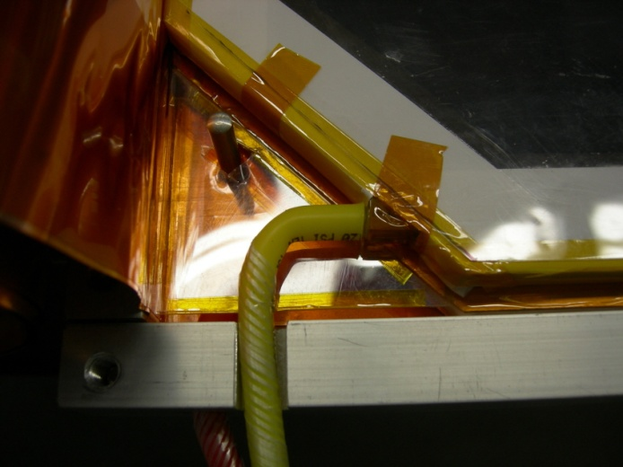
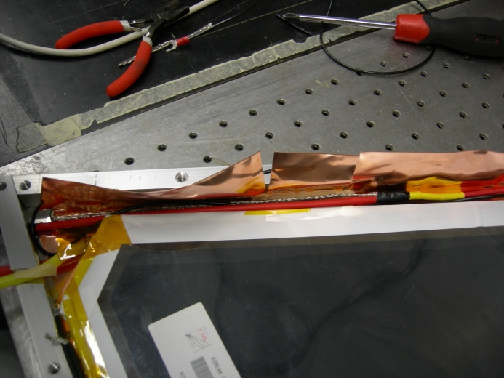
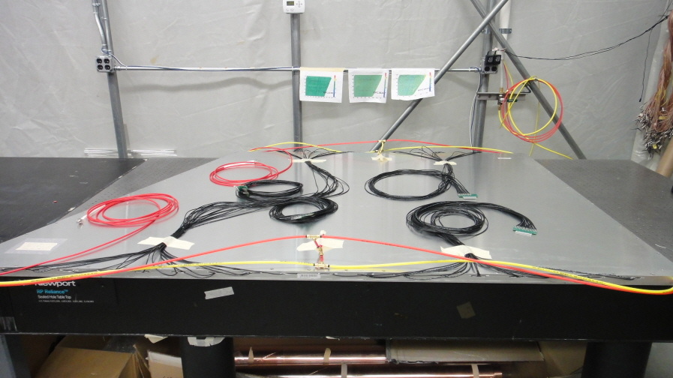
Assembly of detector modules → QC test on each RPC module
Kim Chong
Place lower gap into Cu foil & Connect Polyethylene gas tubes
Connected gas tube
Connect CPE cable to H.V cable on the bottom RPC gap
Put upper gap on the readout strip
Put readout strip on the lower gap
Before wrap the Cu foil
Connect CPE cable to the H.V cable (upper gap)
Fully assembled RPC detector module
Connect gas tubes to the upper gap

Slide 11
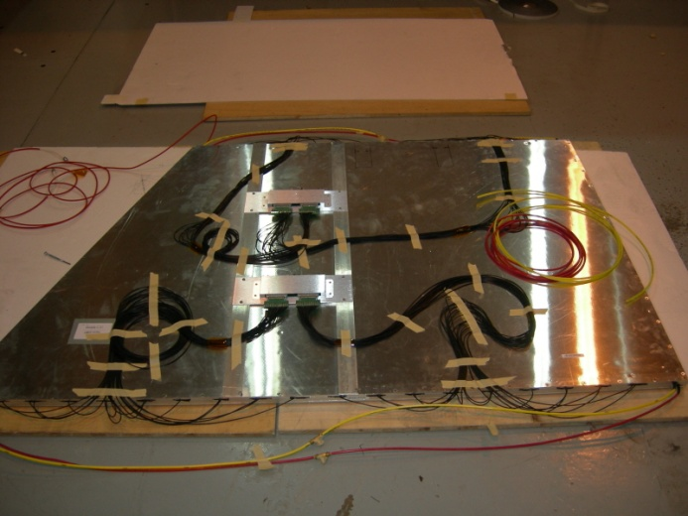
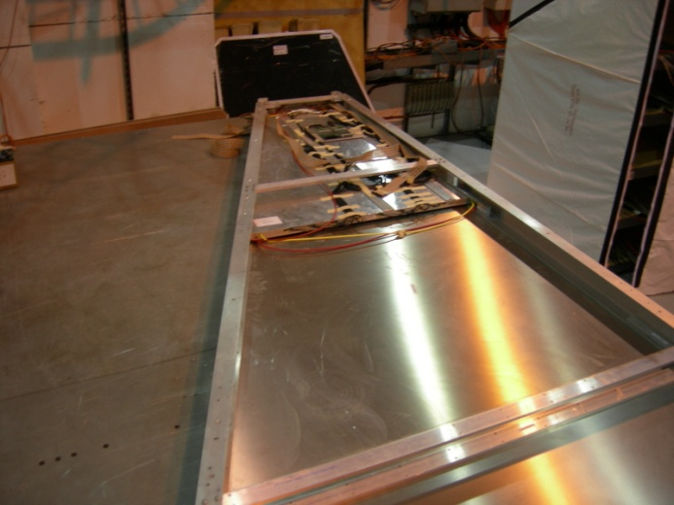
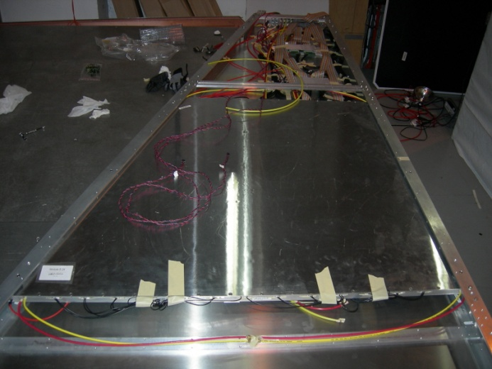
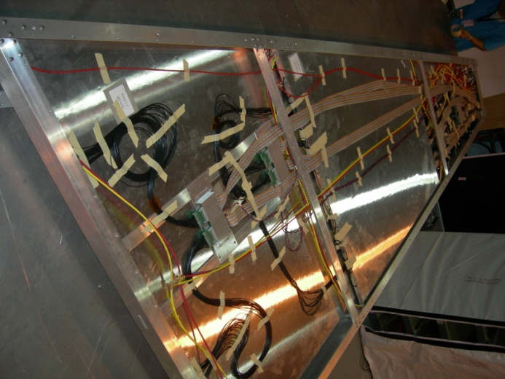
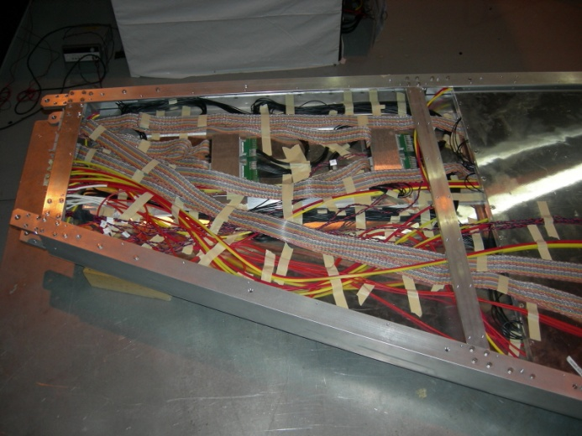
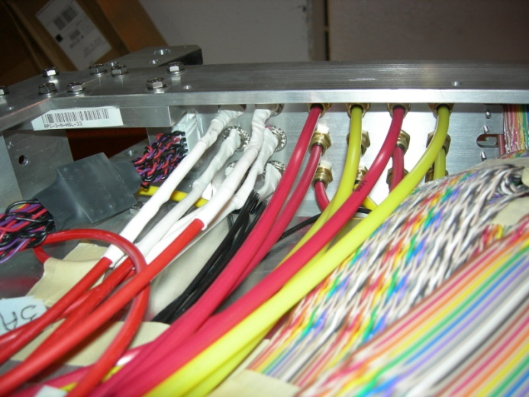
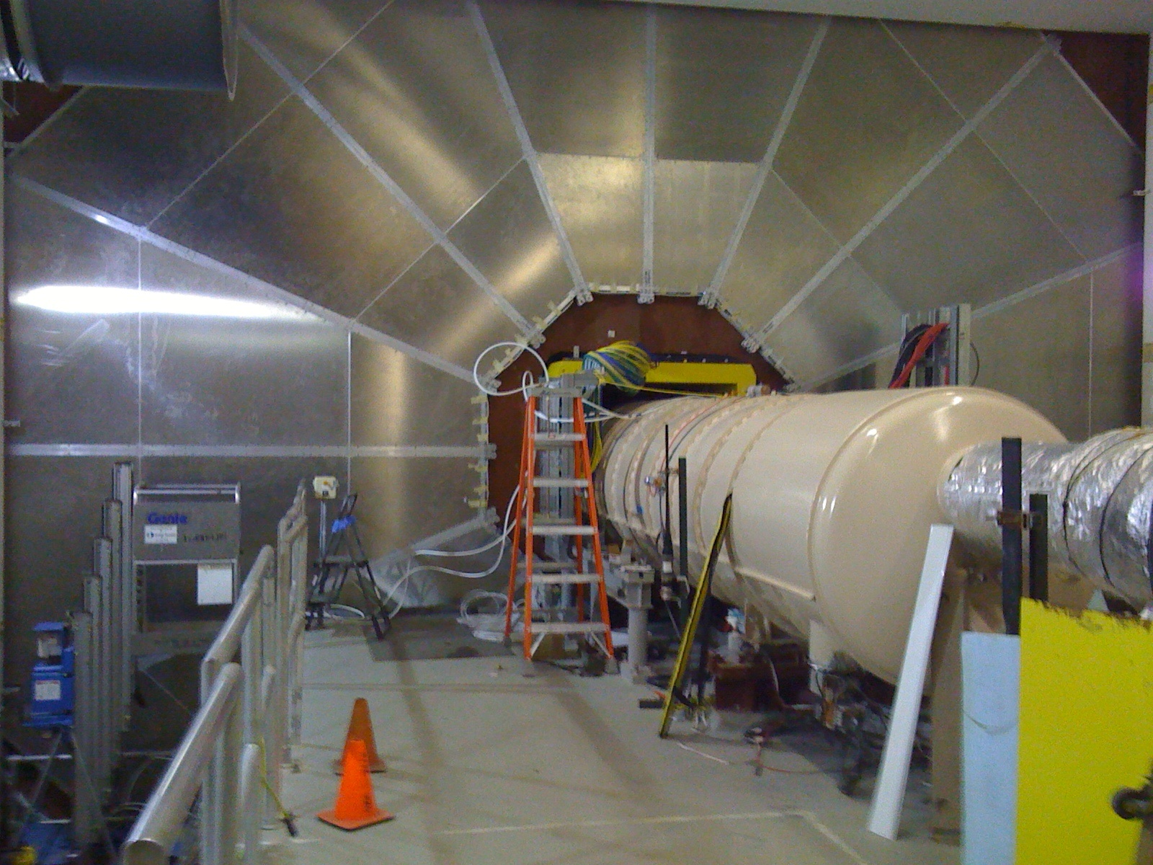
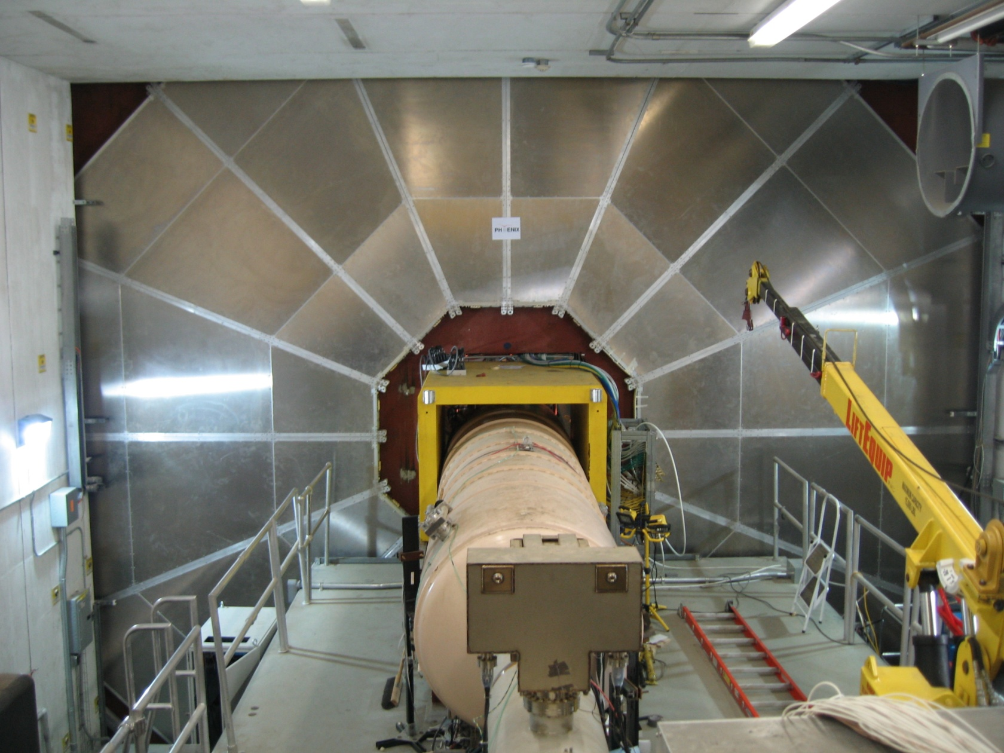
Assembly an half octant (super module) at RPC Station 3
Kim Chong
Route service lines of the module
for the assembly
Insert prepared modules
to the HO frame
Insert prepared modules
to the HO frame (2)
Insert prepared modules
to the HO frame (3)
Connect & Re-route service lines
to the patch pannel
View from inside of patch pannel
RPC3N - installation (Nov. 11th, 2009)
RPC3S - installation (Sep. 22nd , 2010)

Slide 12
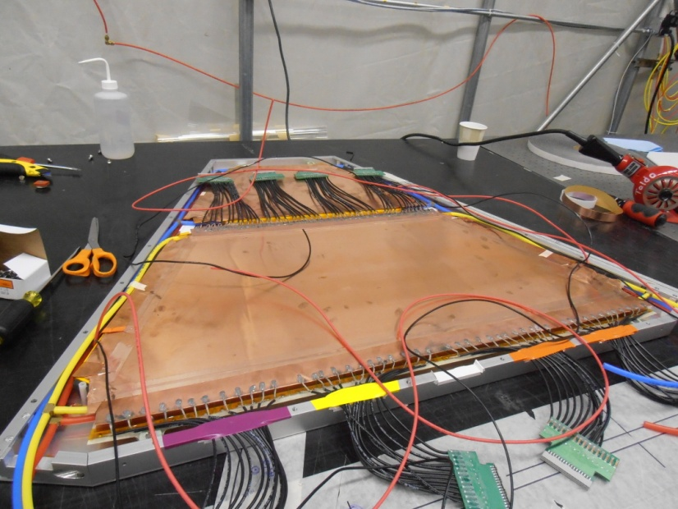
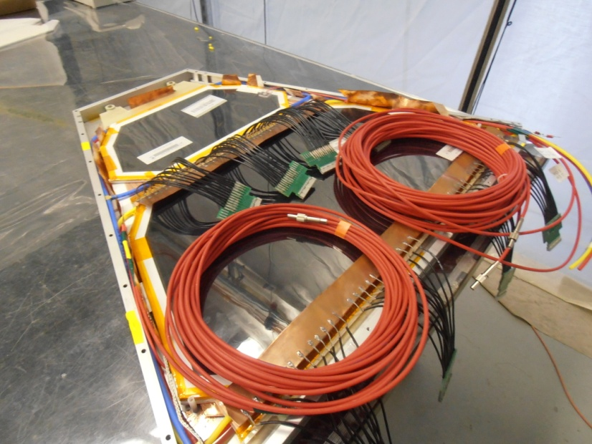
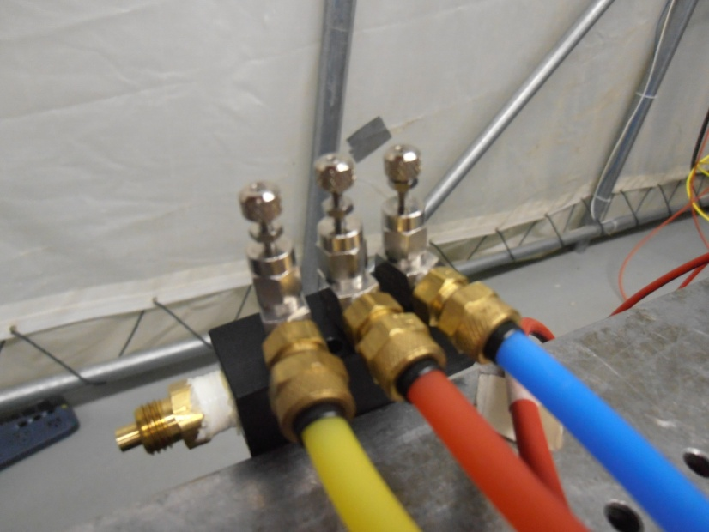
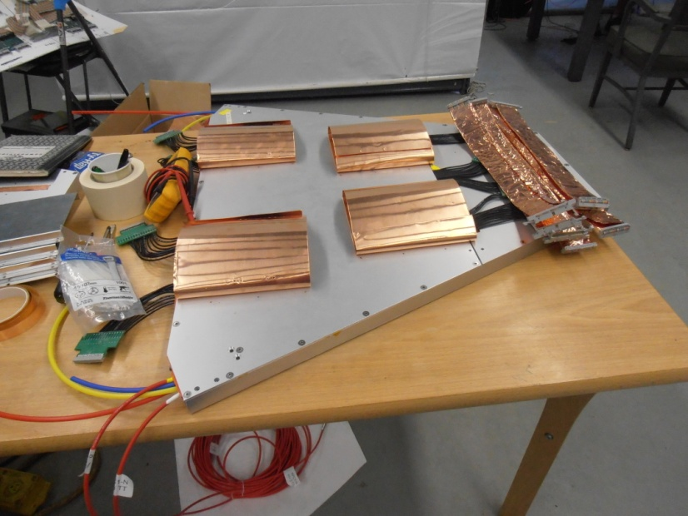
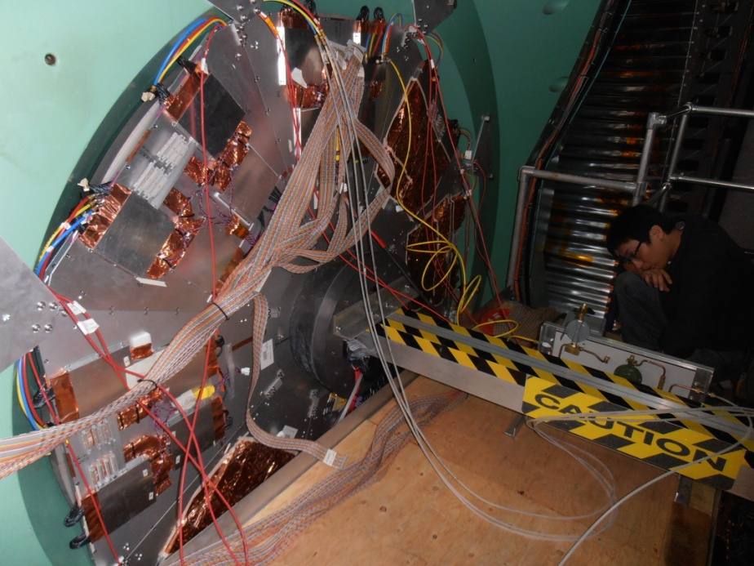
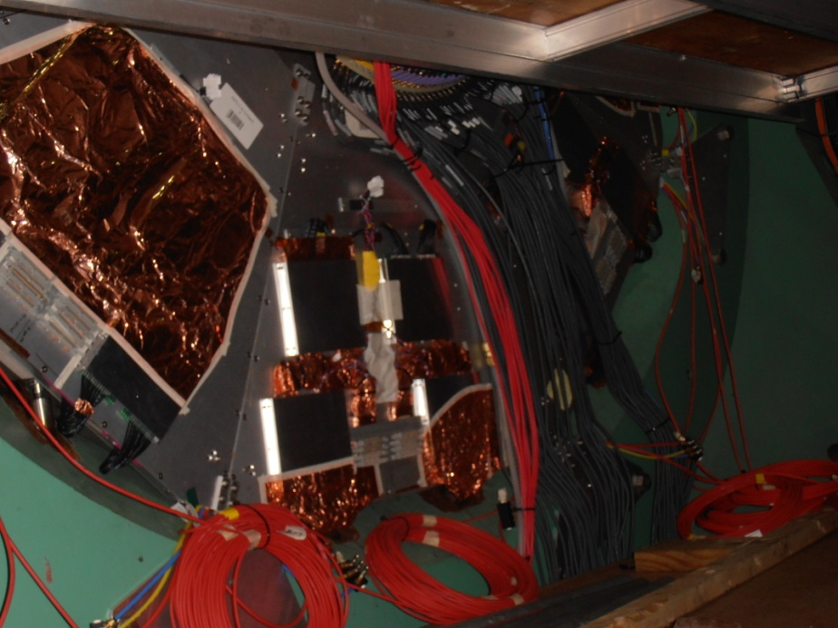
Assembly of an half octant at RPC Station 1
Kim Chong
Kim Young Jin
& many students
RPC1N - installation (Sep. 22nd , 2011)

Slide 13
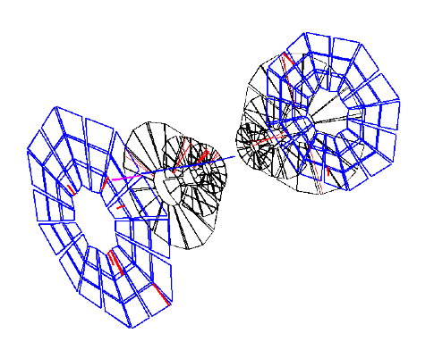
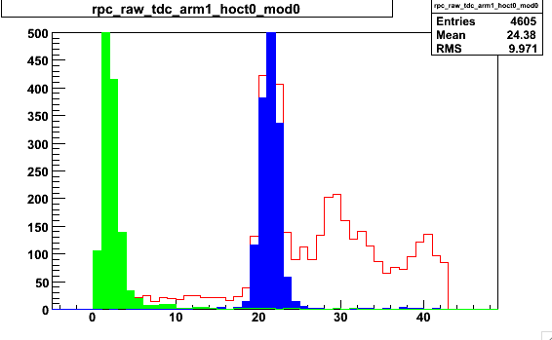
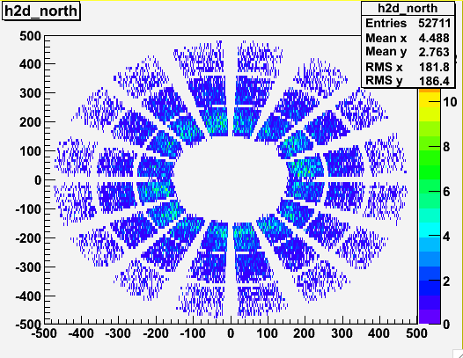
3D Event display
Kim Chong
Measurement of RPC Station 3 data in RUN 11
Relative efficiency calculation:
# of hits on RPC / # of projected track on RPC
= # of RPC TDC count / # of Muons
Projected hits on RPC3
* Muon tracks at boundaries cut out
RPC coincidence
timing hit
Count
Raw RPC TDC distribution
TDC (106 ns for 44 bins)

Slide 14
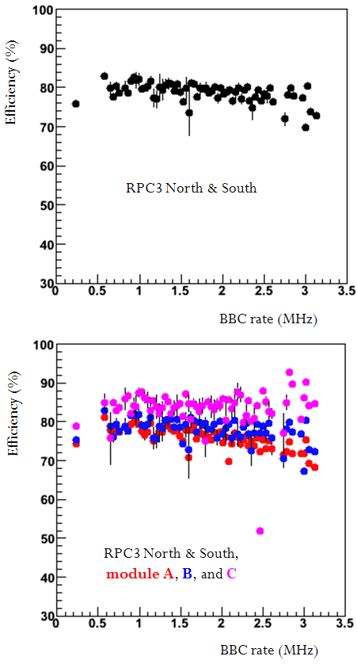
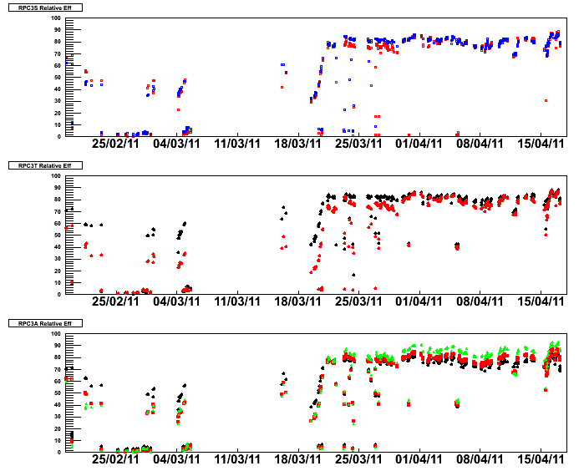
Efficiency in runs
Kim Chong
RUN 11, pp 500 GeV
Geometrical inefficiency
is included
Blue: south
Red: north
Efficiency (%)
Black: top side
Red: bottom side
Black: module A
Red: module B
Green: module C
Before gas mixture optimization:
High dark current
After gas mixture optimization:
the dark current problem resolved

Slide 15

3. Upgrade of Trigger RPCs for CMS
Current RPC System for the Compact Muon Solenoid

Slide 16




► RPCs System for the Compact Muon Solenoid (CMS/TDR LHCC/CERN 97-32)
- RPCs in Barrel + Endcap cover η < 2.1
- The angular coverage ~ 3 π
► Barrel RPCs
- 6 stations (layers)
- Fully covering up to η = 0.8
- Partially covering up to η = ~ 1.2
► Endcap RPCs
- 2 wings (RE+, RE-)
- 4 stations (RE1, RE2, RE3, RE4) in each wing
- Covering 0.92 < η <2.1
Low-η
Forward
RPCs
4-th Station
(on going)
RE3
RE2
RE1
RE4/3
RE3/3
RE2/3
Barrel RPCs
RE1/3
RE4/2
RE3/2
RE2/2
RE1/2
High-η Forward
RPCs (Plan)
RE3/1
RE2/1
RE3/1
RE2/1
RE1/1

Slide 17







Installation of BARREL RPCs
ISR
DT-RPC coupling
DT-RPC test at ISR
DT-RPC envelope
2004-2008
DT-RPC installed
DT-RPC at SX5
DT-RPC commissioning
17

Slide 18


Installation of
Endcap RPCs in |η| < 1.6
RE1/2 & RE1/3 : 144 RPCs
2007 - 2009
RE2/2 & RE2/3 : 144 RPCs
RE3/2 & RE3/3 : 144 RPCs
RE2/2 & RE2/3
on the back of YE1

Slide 19





Trigger performances
BARREL
ENDCAP
Efficiencies for single muons for various p_{T} selections
Geometrical inefficiency is also included

Slide 20

Upgrade of RPC triggers for the future CMS
► Why do we have to fully construct the Endcap RPC system ?
- The CMS was design to optimize detection of the muons from Higgs.
- Only 3 RPC stations in 1.6 < η.
- There is NO RPC muon trigger in 1.6 < η < 2.1.
► What we plan to do until the first shutdown of the LHC ?
- Planning the full construction of the endcap RPC system, as described
in the CMS muon TDR (LHCC 97-32).
- First, installation of the missing
RE4 in |η| < 1.6 (PHASE I)
- Second, extension of the RPC trigger
coverage up to |η| = 2.1 (PHASE II)

Slide 21


PHASE I: 4-th RPC station in Endcap RPC system
Installation RPCs proposed in the TDR LHCC-97-32
- 6 RPC stations in BARRAELs in 0.0 <|η|< 0.92
- 6 layers overlapped in 0.92 <η< 1.1
- 4 RPC stations in ENDCAP in 0.92 <|η|< 2.1
In the Current ENDCAP composed of 3 RPC stations
covering 0.92 <η< 1.6 → Trigger requiring 3/3
Trigger efficiency of the muon system is low due to
- Absence of the 4-th station (PHASE I)
- Absence of the RPC covering 1.6 <η< 2.1 triggers.
(PHASE II)
Global Muon Trigger efficiency
proposed in the TDR LHCC-97-32
Low-η
Forward
RPCs
4-th Station
(on going)
RE4/3
RE3/3
RE2/3
RE1/3
Barrel RPCs
RPC Trigger Efficiencies
RED: requiring 3/4 with a new 4th station
BLUE: requiring 3/3 with current 3 stations
RE4/2
RE3/2
RE2/2
RE1/2
High-η Forward
RPCs (Plan)
RE3/1
RE2/1
RE2/1
!!!
RE3/1
RE1/1
HIM2012

Slide 22
Roles:
Korea (KODEL Korea Univ., and Seoul Univ.)
- Production & QC of single gaps
CERN
- Integration of the new Endcap RPC system
- RPC assembly & test for QA
Italy (INFN + GT)
- Integration of the upscope project
- Qualified HPL plates for RPC gaps
- New Front-End-Electronics and the technical support
Belgium Group (Vrije Univ. etc...)
- Integration of the new Endcap RPC system
- RPC assembly & test for QA
Chinese Group
- Parts for detectors (Honeycomb panels, frames …)
- Participation in the assembly and test for the high-η RPCs
Indian Group (NPD-BARC, Panjab Univ.)
- RPC assembly and the test for QA

Slide 23




KODEL
Gap production facilities used for the previous CMS & PHENIX RPCs
New Facilities of glue dispense and leak test for QC

Slide 24



CERN
Assembly & test facilities at the old spacer in the ISR tunnel were moved to a new in BLD 904.
Detector assembly site: Facilities of assembly & test at NPD-Barc, India

Slide 25


PHASE II: high-η RPCs in Endcap RPC system
(Many R&Ds and proposals)
Insert via rails
► RE1/1 RPCs at YE1 :
- High priority among RPCs in 1.6 <η< 2.1
- Advantage of RE1/1 : RPCs closest to pp collision
vertex with presence of strong magnetic fields.
- Expect an effective rejection of the beam-related
backgrounds (Gammas, neutrons, charged pions…)
for the muon triggers.
Have to insert trigger detectors in the CMS end-cap noses
Rotate in place

Slide 26


1) Standard double-gap phenolic RPC
Double-gap RPCs are VALID for RE1/1 when maximum rate ~ 400 Hz/cm² @ L = 10³⁴ cm² s⁻¹
Kim Hyuncheol, Cho Sung Woong, Jung Min Soo
  4 RE1/1 RPC modules installed in the CMS nose-cone (2009)

Slide 27



2) Multi-gap RPCs
R&D aiming to develop HPL multigap panel-type RPCs
working with max. background rates ~ 3 kHz cm⁻² @ L ~ 10³⁵ cm² s⁻¹
Direction → Smaller detector charges
To reduce aging at high rate background
To enhance high rate capability
Higher rate capability ← lower avalanche charge
- Rate capability ~ 1/ ρ
- Smaller q_{e} → higher rate capability
(actually related to the ion charge Q)
Typical glass multigap RPCs
- q_{e} < 1 pC (~ 0.5 pC)
- ρ = 10¹² ~ 10¹³ Ω cm for normal glass
= 10⁹ ~ 10¹⁰ Ω cm (ceramic & low res. glass)
Then, what if multi-gap RPCs with
high-pressure laminated (HPL) plates ?
- q_{e} ~ 1 pC
- Phenolic HPL → ρ = 10¹⁰ ~ 10¹¹ Ω cm
- Oiling required to reduce noises
Shin Seung Su

Slide 28
4- or 6-gap RPCs in high-η region of the CMS ?
- Same gas system → same gas mixture
- Same electronics → same front-end-electronics (FEE) and so on
Timing RPCs
q_{e}
Other characteristics
Construction method
Electronics
2-mm thick 2-gap RPCs
 | 2-gap RPCs | 4-gap RPCs | 6-gap RPCs
Each gap thickness | 2.0 mm | 1.0 mm | 0.66 mm
Total gap thickness | 4.0 mm | 4.0 mm | 4.0 mm
<q_{e}> at ~ mid of plateau | 4.0 pC (Thr~200 fC) | 1.5 pC (Thr~150 fC) | 0.9 pC (Thr~100 fC)
Type of resistive plates | HPL | HPL | HPL
Thickness of HPL | 2.0 mm | 2.0 mm | 1.0 mm
Resistivity of HPL | 1 ~ 6 ⅹ10¹⁰ Ωcm (for CMS) | ~ 10¹⁰ Ωcm (Italian HPL) | ~ 10¹¹ Ωcm (Korean HPL)

Slide 29

Constructions of prototype detectors
Detector structures
Oiled Phenolic HPL Multigap Panel-type
RPCs for CMS high-η triggers
Panel-shape multigap RPCs
~ Two separated gas envelopes + a strip panel
Each gas envelope ~ 2 gaps in 4-gap RPCs
3 gaps in 6-gap RPCs
Prototype detectors
4-gap RPC: 45 x 45 cm² (active area)
- HPL : 2 mm
- Coin spacers : 1000 ± 10 μm (Polycarbonate)
- Strip pitch = 27 mm
6-gap RPC: 15 x 29 cm² (active area)
- HPL : 1 mm
- Coin spacers : 660 ± 10 μm (Polycarbonate)
- Strip pitch = 20 mm
4-gap RPC
6-gap RPC
Edge spacer
PET two layers
~ 0.40 mm
Graphite
HPL~ 1.0 mm
25 mm
10 mm
7.5 mm
0.65 mm gaps
0.66 mm
thick spacers
Strips with 20 mm pitches
0.2 mm PET
16.0 mm
0.65 mm gaps

Slide 30



Constructions
of prototypes
6-gap RPC
4-gap RPC

Slide 31


Efficiencies & mean fast charges
Mean q_{e} (avalanches only) at the efficiency plateau region
4-gap RPC: q_{e} = 1.51 ± 0.06 pC with ε = 0.98 (by TDC) at 10.95 kV
6-gap RPC: q_{e} = 0.88 ± 0.05 pC with ε = 0.98 (by TDC) at 12.24 kV
<-> ~ 4.0 pC for a standard double-gap RPCs
4-gap RPC
6-gap RPC
ε=0.95
q_{e} = 1.20 pC
@ε=0.95
q_{e} = 0.84 pC
@ε=0.95

Slide 32



Pulse distributions
- For 2-gap RPCs
q_{e} < 10 pC for CMS Barrel RPCs
q_{e} < 20 pC for CMS Forward RPCs (no termination)
- For 4-gap RPCs: q_{s} < 10 pC (no termination)
- For 6-gap RPCs: q_{e} < 5 pC (no termination)
4-gap RPC
2-gap RPC
8.97kV/atm, 0.3% SF6
6-gap RPC
Avalanches
Transition
region
Avalanches
9.17kV/atm, 0.3% SF6
Streamers
Transition
region
Avalanches
Transition
region
Streamers
9.36kV/atm, 0.3% SF6
Streamers

Slide 33




3) GEMs at RE1/1 both for triggering & tracking
- Compact detector structure
- Rate capability > 10⁵/cm²
- Tracking capability
- RE1/1: no access allowed
→ Radiation hardness
- Problem: too many channels
# of ch/det. = 8960
# of detector = 72
RD51 & A. Sharma

Slide 34




Muon-beam
test at
GIF/CERN
Time resolution ~ 5 ns

Slide 35
4. Summary
1) The current RPCs in PHENIX
- The operation & performance have been optimized through RUN11&12.
2) Upscope of CMS RPCs
- The current system works with a minimal coverage for muons
- PHASE I upgrade (2012 ~ 2014) :
RE4 station to enhance the single muon efficiency in η < 1.6
- PHASE II upgrade (from 2015 ?) :
Trigger/tracker detectors in 1.6 < η < 2.1
3) PHASE I project for CMS
- Completion of gaps ~ April 2013.
- Completion of RPC module ~ end of 2013.
- Installation ~ mid of 2014.
4) PHASEII project for CMS: detector options are still in an open question
Plans will be discussed in March CMS week.
- Standard double-gap RPCs -> NOT adequate for SLHC
- Multigap HPL RPCs -> promising (also reasonable for sPHENIX ?)
- GEM (triggering + tracking) for the innermost RE1/1 -> promising but too expensive

Slide 36
BACKUPS

Slide 37


1. Physics motivation of the fast muon trigger
upgrade for the PHENIX muon Arms
Exclusive reactions by using polarized protons Fundamental questions lying in the proton spin
- Nucleon structure by measuring polarized quark & gluon distributions, and transverse spin effect
2. W-production to probe polarized Sea and Valence quark distributions
3. W± prod. ratio → Flavor asymmetry of light
sea quarks in nucleons
4. Dimuon measurement for J/ψ suppression in HI physics to probe QGP
Upscope PHENIX TDR (2007)
Figures obtained from Matthias Grosse Perdekamp U. of Illinois U. C.
Direct photon production
(probe gluon content with quark probes)
quark
photon
gluon
quark
W-boson production

Slide 38

On YE+1 yoke equipped with CSC/RPC packages (inner ring) and RE1/3 RPC’s (outer ring).
The ME1/3 CSC’s now cover the RPC outer ring and hence complete the first muon station on YE+1.
W. Vandoninck

Slide 39




Gamma-induced currents/unit area
↔ Q_{e} (avalanche charge)
2-gap RPC data measured in 2005
96.2% C₂H₂F₄ + 3.5% iC₄H₁₀ + 0.3% water, Active area: 30 ⅹ30 cm²
At ~ 1.0 kHz cm⁻²
~ 105 μA m⁻²
for 4-gap RPCs
→ i ~ 200 μA in a 2-m² RPC
~ 330 μA m⁻²
for 2-gap RPCs
→ i ~ 600 μA in a 2-m² RPC
RPC1
RPC2
RPC3
RPC4

Slide 40




Prototype
Real size:GE1/1
A. Sharma RD51

Slide 41
For the low-η trigger (|η| < 1.6) of the RE system,
1. The trigger of requiring 4 hits out of 5 stations will provides us high trigger efficiencies with low trigger rates.
2. The logic 4/5 for the low η RE can more effectively remove ghost hits for the CSC tracking system.

Slide 42



J/ψ in pp collisions
M. Jo

Slide 43


Υ in pp collisions
M. Jo
Dimuons in Pb-Pb Collisions

