Slide 1
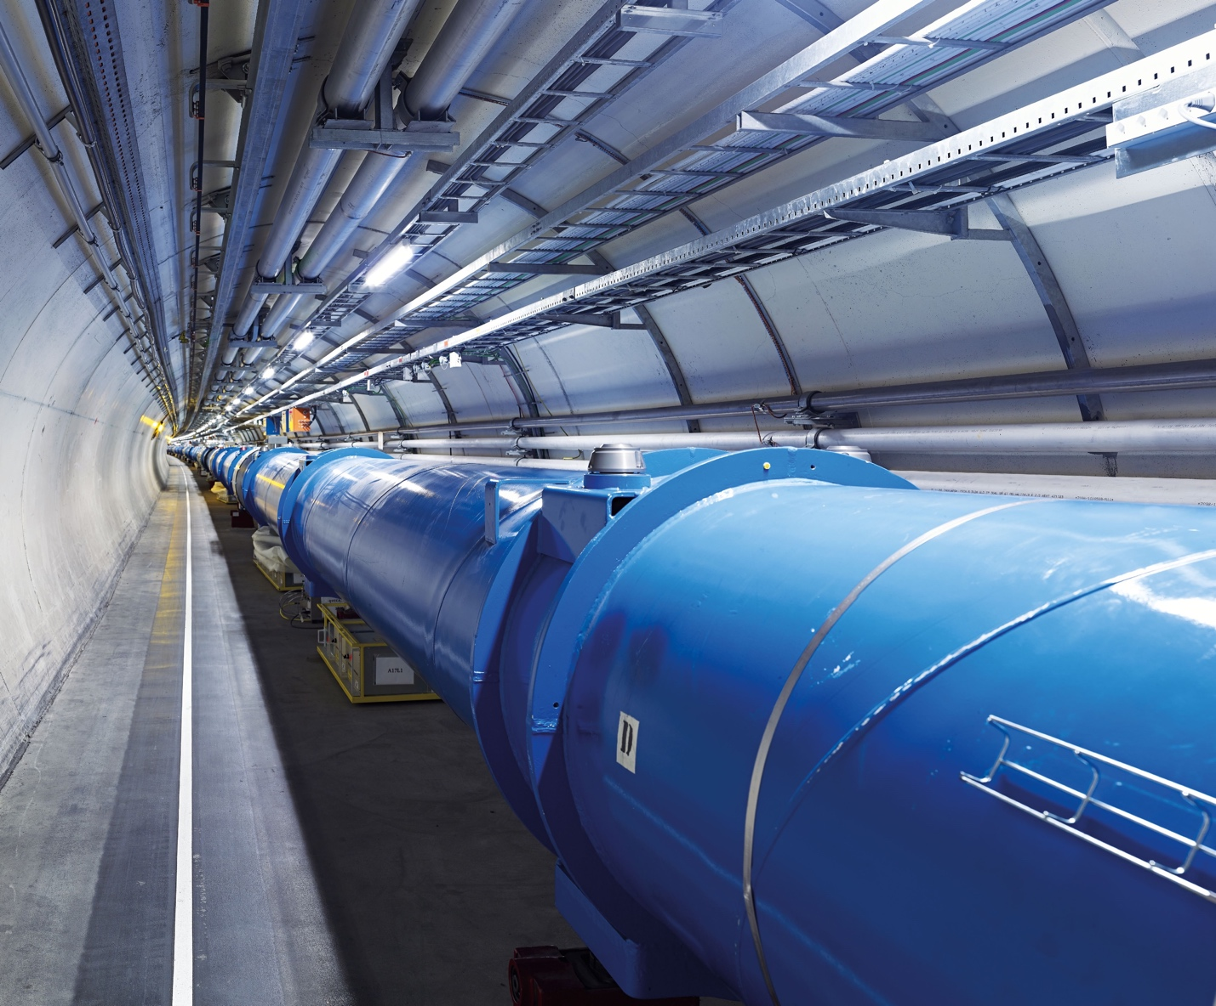
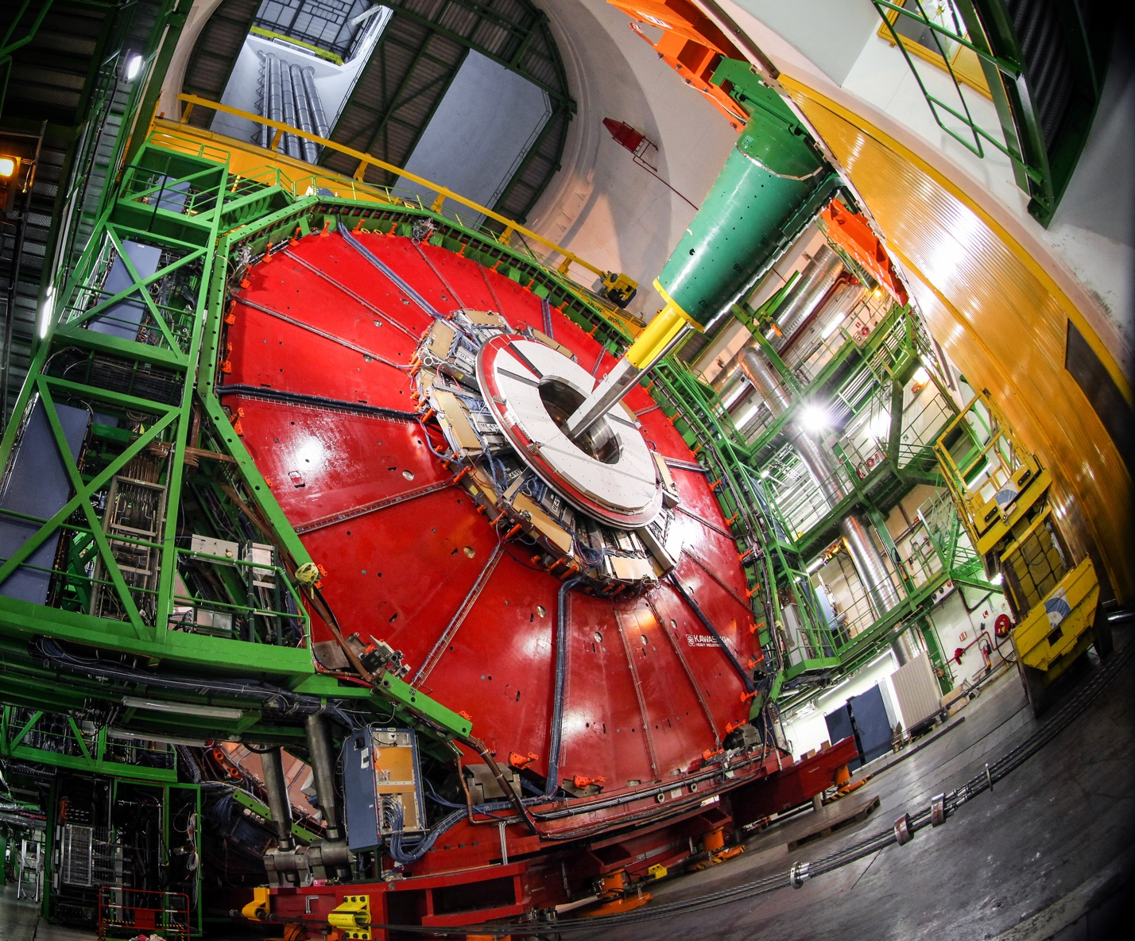
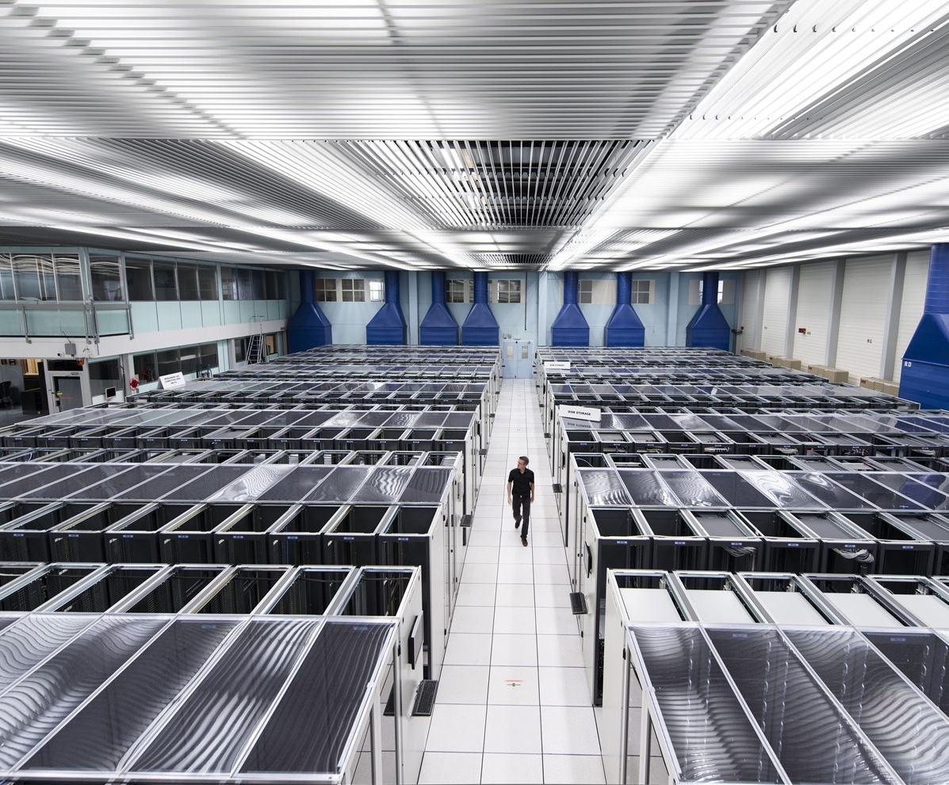
CERN
We develop technology to advance the limits of what is possible
We build the largest machines to study the smallest particles in the universe
We perform world-class research in theoretical and experimental particle physics
ACCELERATORS
Build by CERN (80%) and few international partners
DETECTORS
Build largely (80%) by external partners (Univ. and Labs) but assembled and operated at CERN
COMPUTING
Distributed

Slide 2

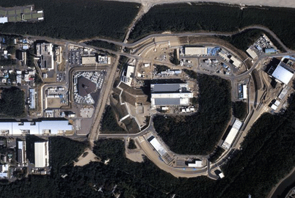
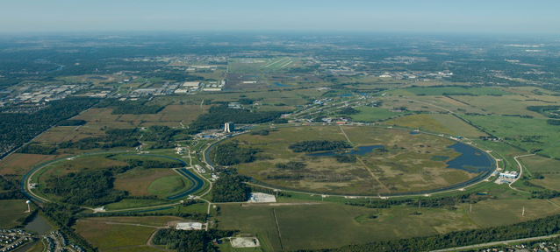
Accelerators
Outline:
Particle Physics: main goals the next decades, its instruments
Accelerators and accelerator physics
General issues – beam dynamics (transv. and long.), luminosity, magnets and RF cavities (all very brief)
Circular machines with focus on protons
Linear accelerators for electron-positrons
If time permits: plasma, neutrinos and muons, machines outside particle physics
Steinar Stapnes, CERN
Notes:
2

Slide 3
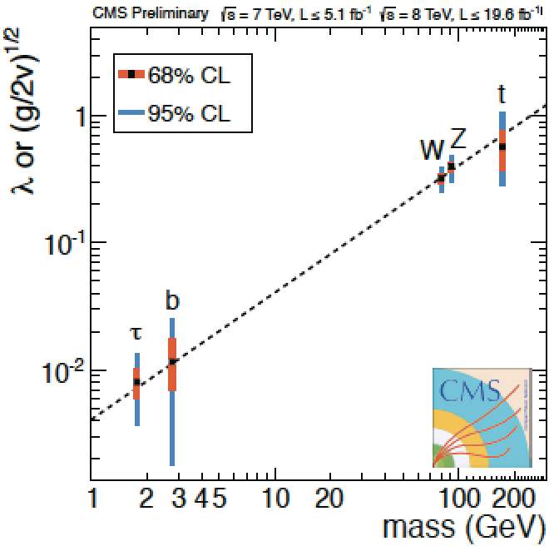

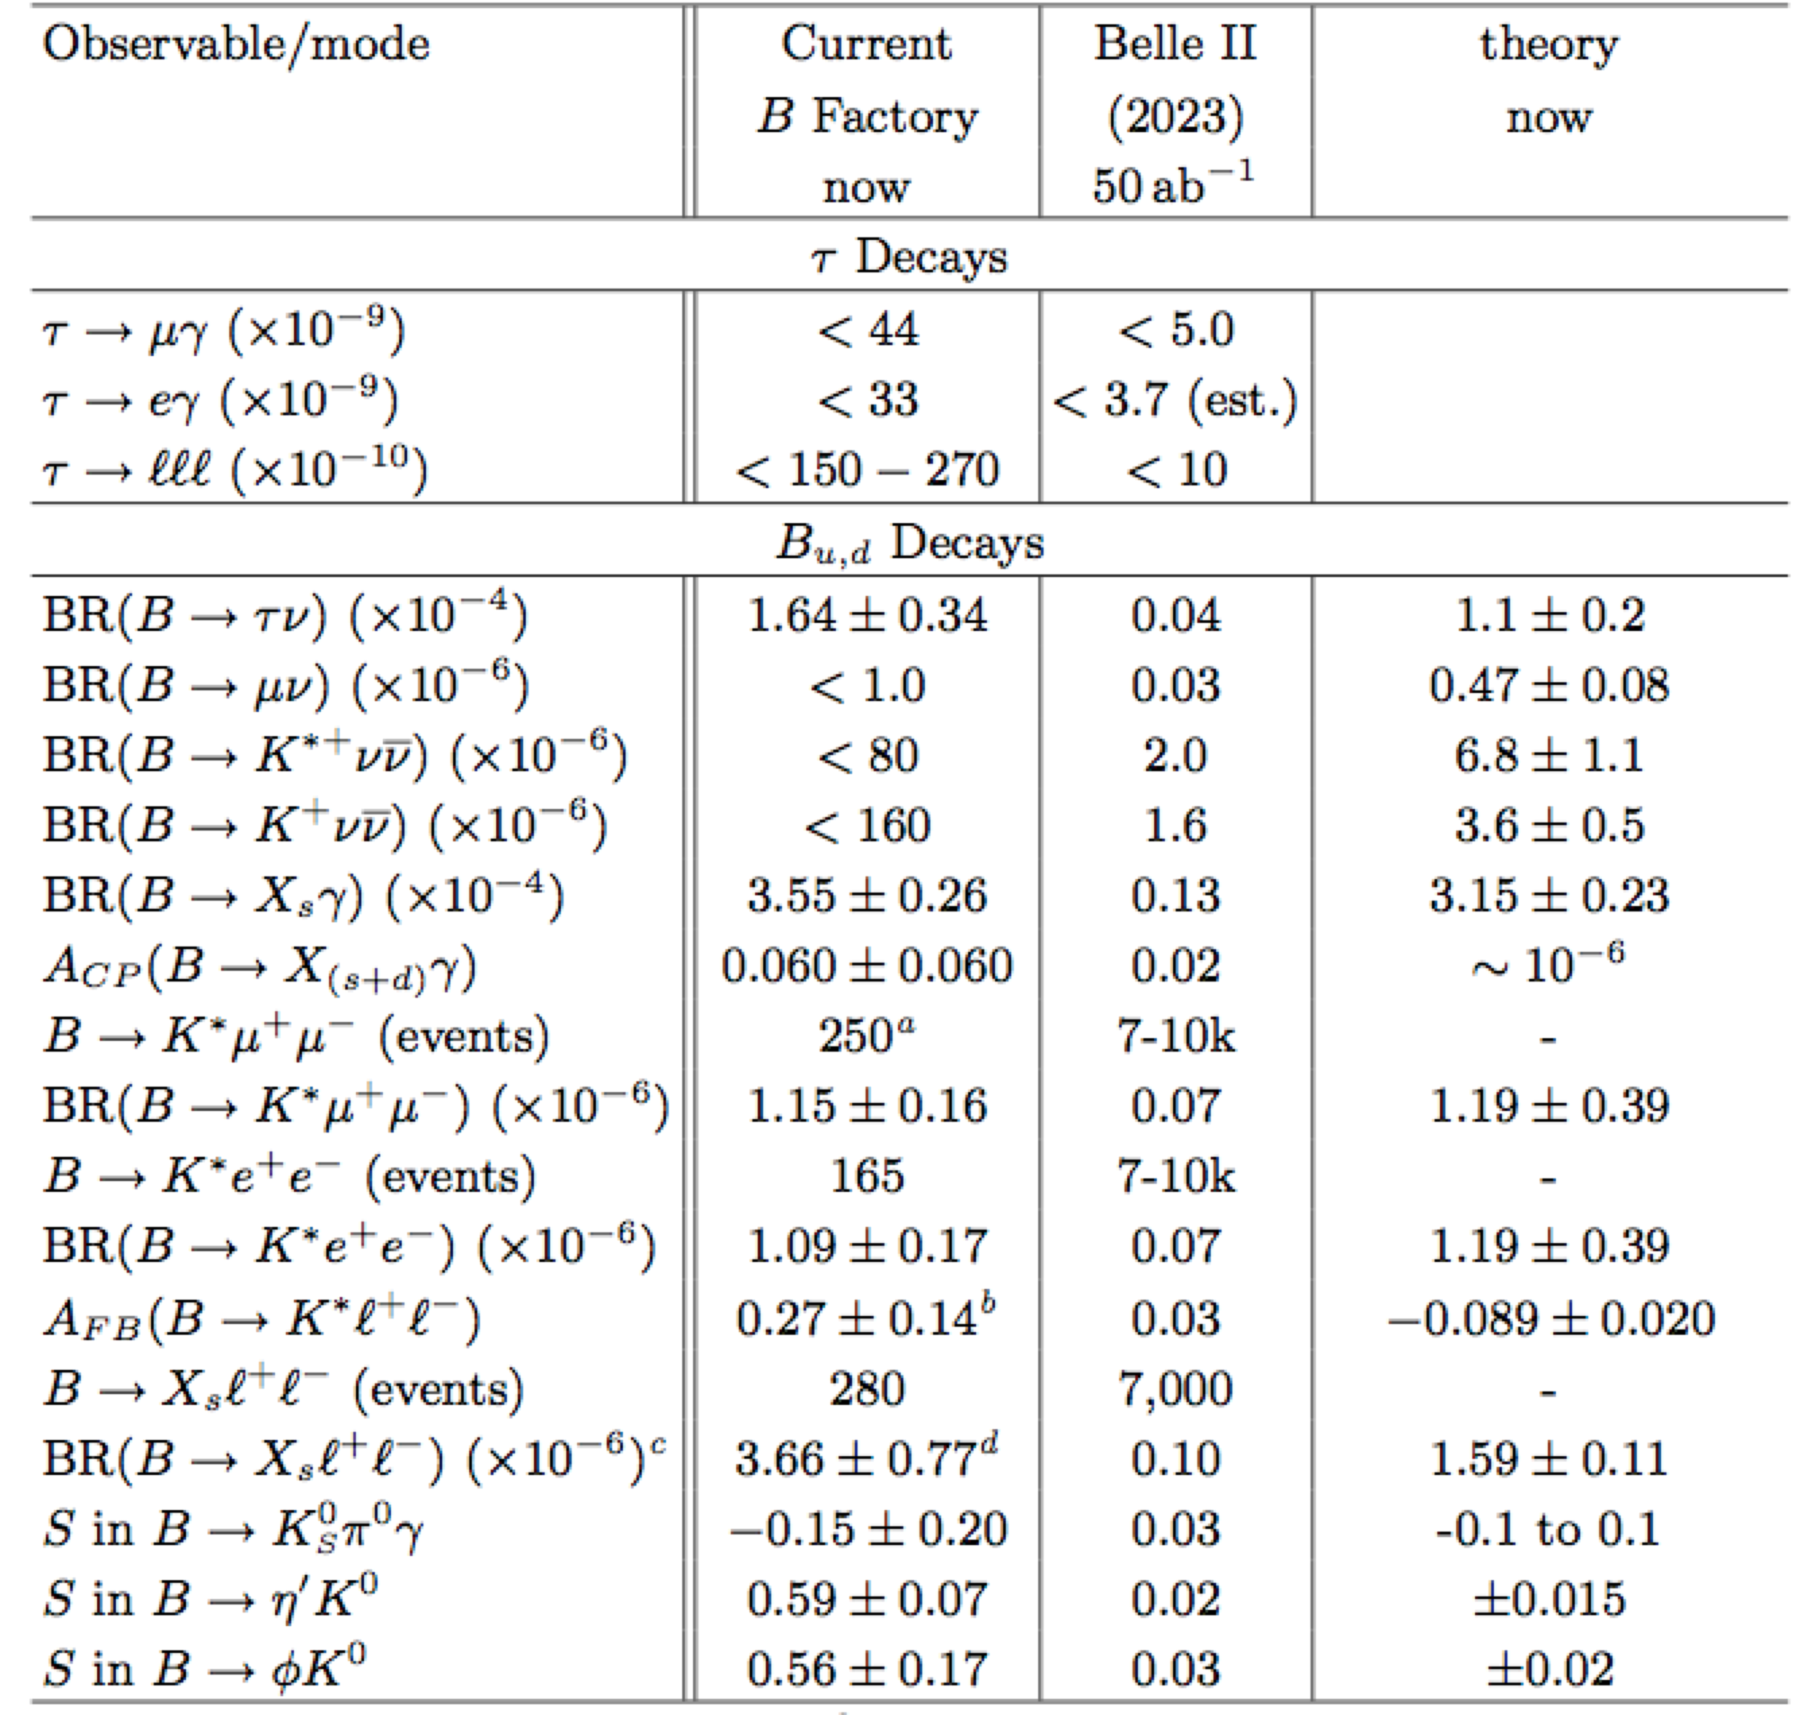
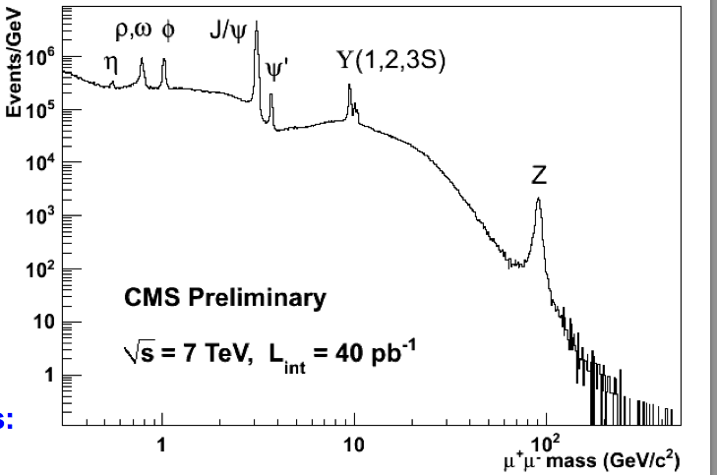
The Standard Model
3

Slide 4
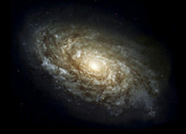
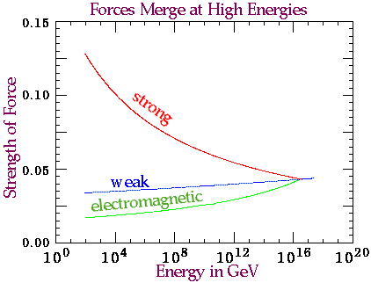
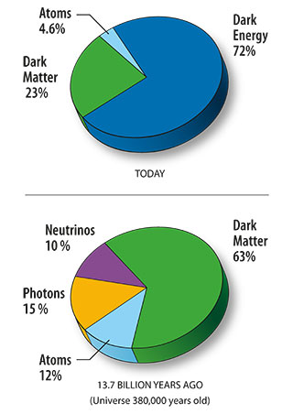
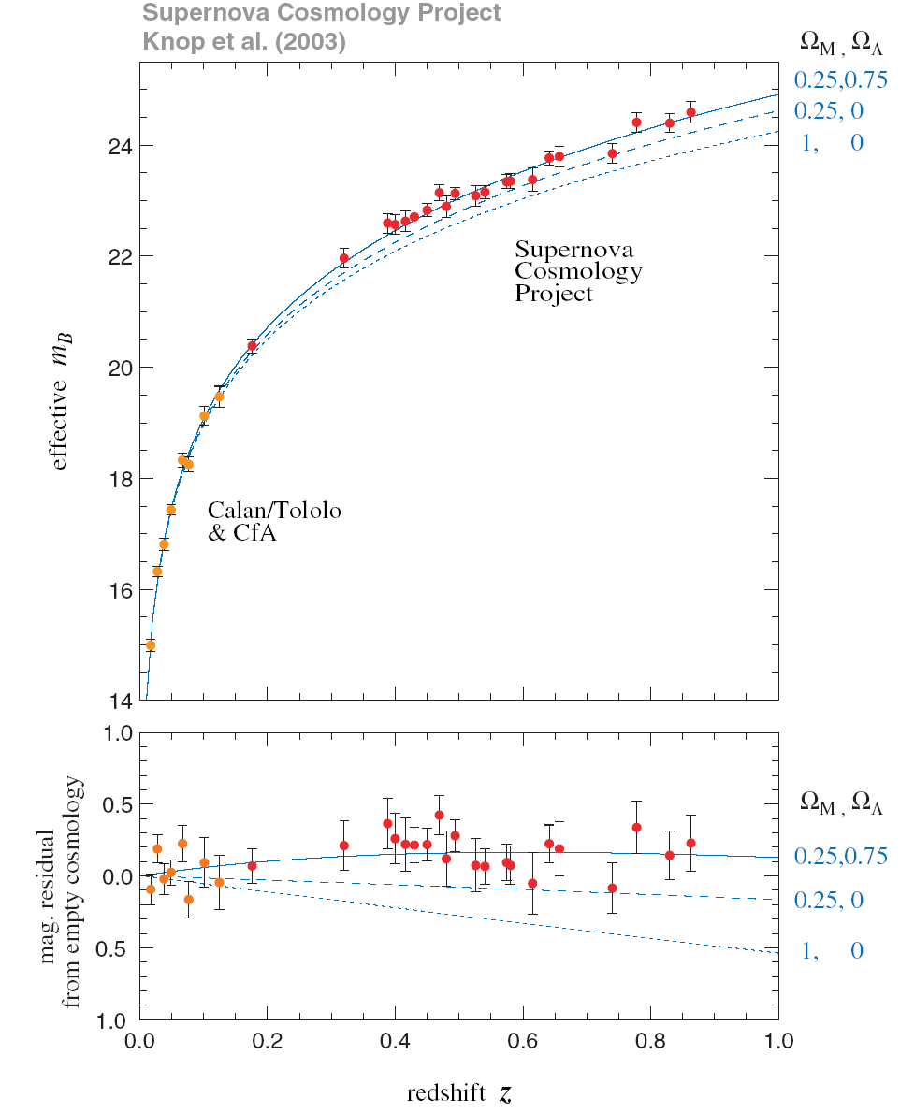
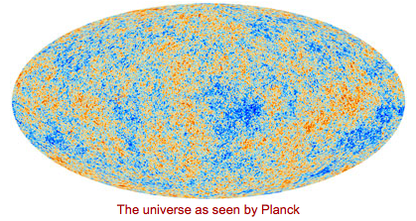
Beyond the Standard Model
Unknowns:
Flavour structure
Matter-antimatter
Why is the Higgs so light
Forces merging ?
Gravity
…

Slide 5
E=mc² -> create new particles in collisions, study our universe at its infancy
Wavelength λ ~ 1/E
-> probe matter at small scales

Slide 6
Experimental Particle Physics
Accelerators
  Luminosity, energy, quantum numbers, physics goals
Detectors
  Efficiency, speed, granularity, resolution, physics goals
Trigger/DAQ
  Efficiency, compression, through-put, physics models
Offline analysis
  Signal and background, physics models.
The primary factors for a successful experiment are the accelerator and detector
trigger system, and losses there are not recoverable.

Slide 7
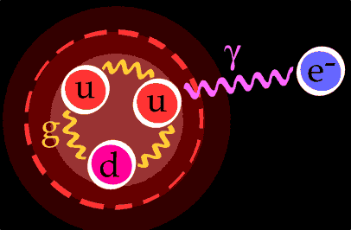
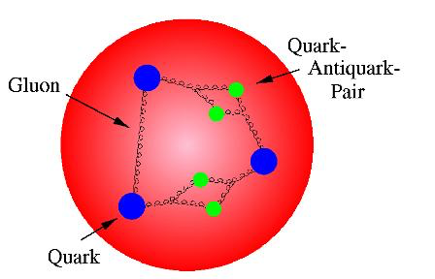
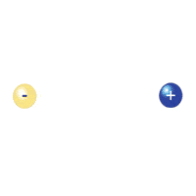
Particle types to accelerate
proton mass
electron mass
≈ 2000
Not so many choices:
  Need stable charges particles: protons, electrons, (muons), ions – most used: electrons and protons
  Secondary beams: photons, pions, kaons, neutrons, neutrinos, …..
Proton collisions: compound particles
  Mix of quarks, anti-quarks and gluons: variety of processes
  Parton energy spread
  QCD processes large background sources (see later)
Electron/positron collisions: elementary particles
  Collision process known
  Well defined energy
  Background from other physics limited (see later)

Slide 8
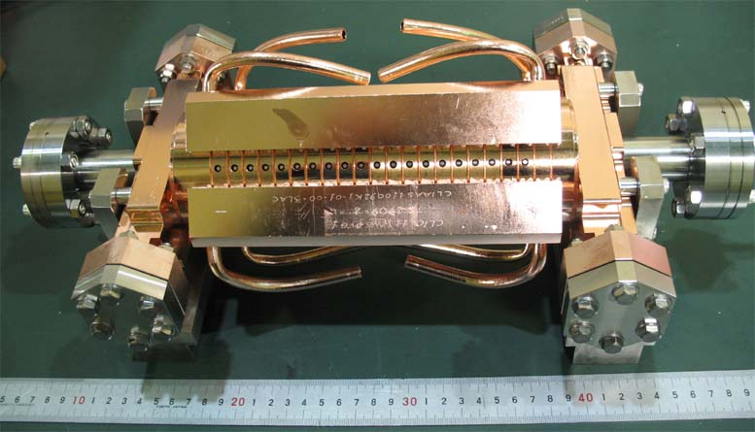
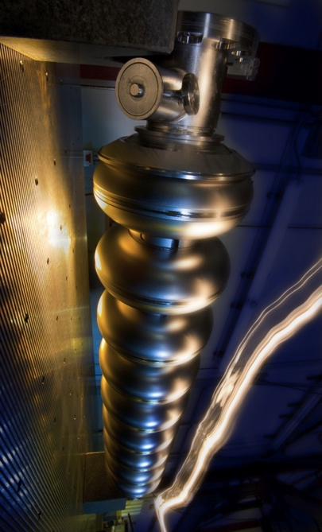
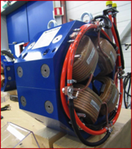
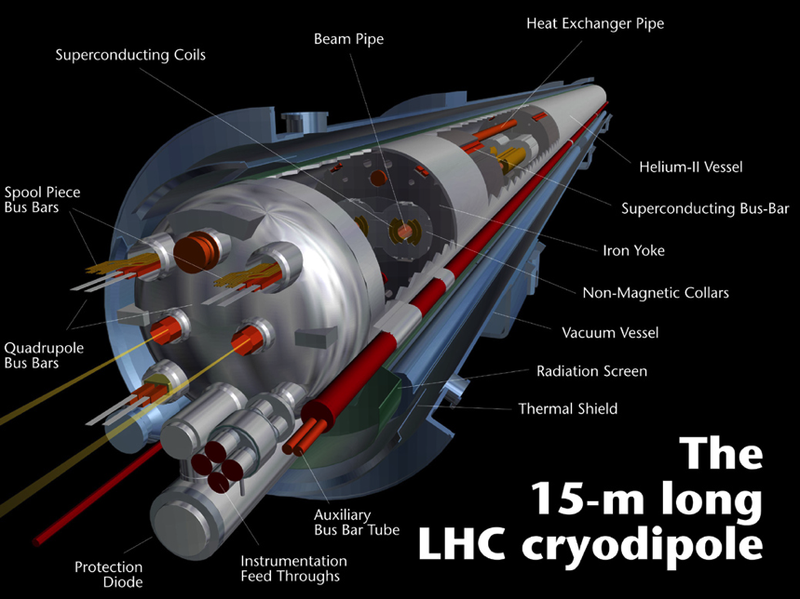
Lorentz equation
The two main tasks of an accelerator
  Increase the particle energy
  Change the particle direction (follow a given trajectory, focusing “bunches” of particles)
Lorentz equation:
F_{B} ⊥ v ⇒ F_{B} does no work on the particle
  Only F_{E} can increase the particle energy
F_{E} or F_{B} for deflection? v ≈ c ⇒ Magnetic field of 1 T (feasible) same bending power as en electric field of 3⋅10⁸ V/m (NOT feasible)
  F_{B} is by far the most effective in order to change the particle direction

Slide 9
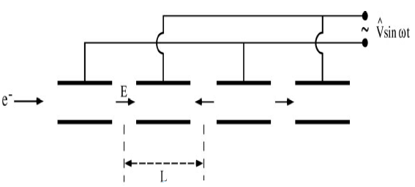
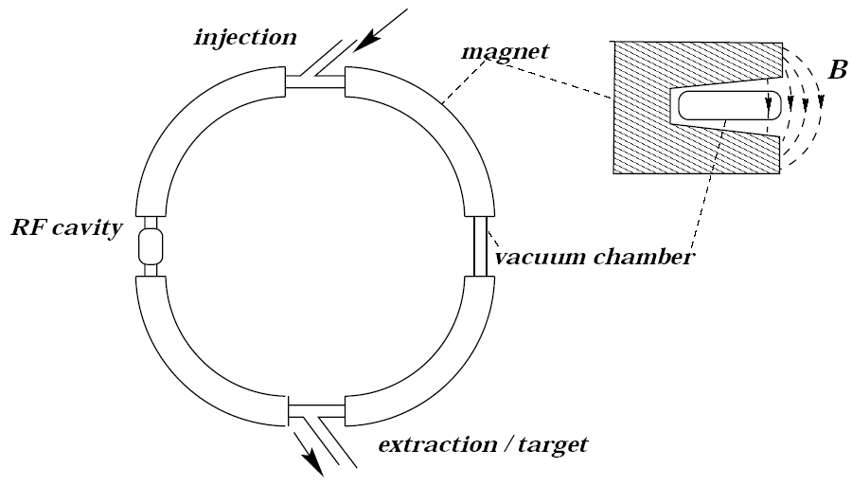
Why many circular accelerators?
Technological limit on the electrical field in an RF cavity (breakdown)
Gives a limited ΔE per distance
⇒ Circular accelerators, in order to re-use the same RF cavity
This requires a bending field F_{B} in order to follow a circular trajectory
In circular arc sections the magnetic field must provide the desired radius,
hence the energy achievable is limited by radius (i.e. cost) and bending field
(other effects as radiation losses in super conducting magnets and overall beam power represent additional challenges for future circular hadron machines)
These considerations are applicable for other particles as electrons and muons as well
… will come back to limitations of circular colliders in particular for electrons forcing us to go linear

Slide 10
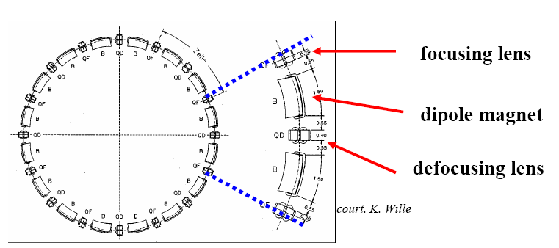
The Lattice of an accelerator
An accelerator is composed of bending magnets, focusing magnets and usually also sextupole magnets
The ensemble of magnets in the accelerator constitutes the “accelerator lattice”

Slide 11
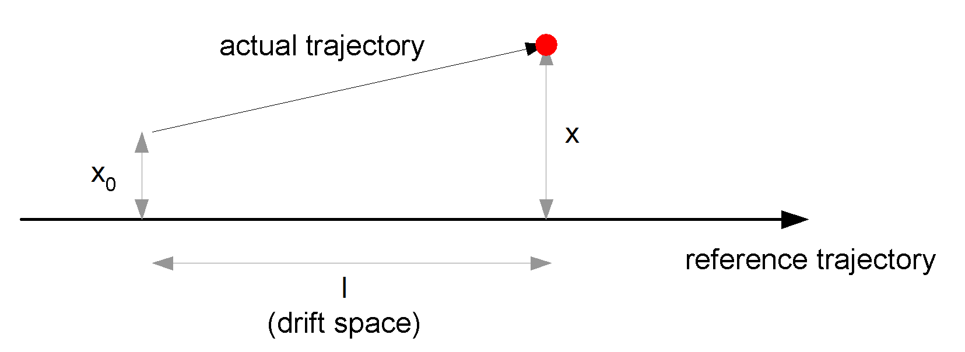
M: drift space
The element with the simplest transfer matrix M: drift space between magnets (no field), with length l :
Written out this gives:
This simply says that in a drift space x’ is unchanged, and x drifts

Slide 12
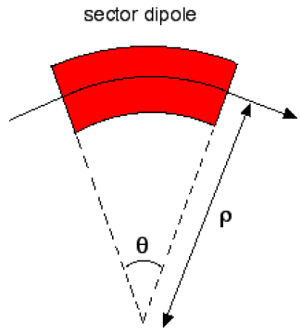
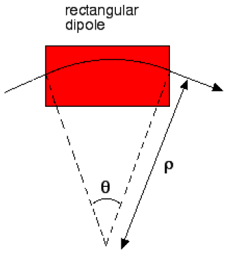
Dipole transfer matrix
Bending magnets introduce focusing terms as well.
The solution of Hill’s equation provides the focusing terms for a idealized sector dipole :
The more common type of dipole found in accelerators is a rectangular dipole, which does not provide the focusing term.

Slide 13
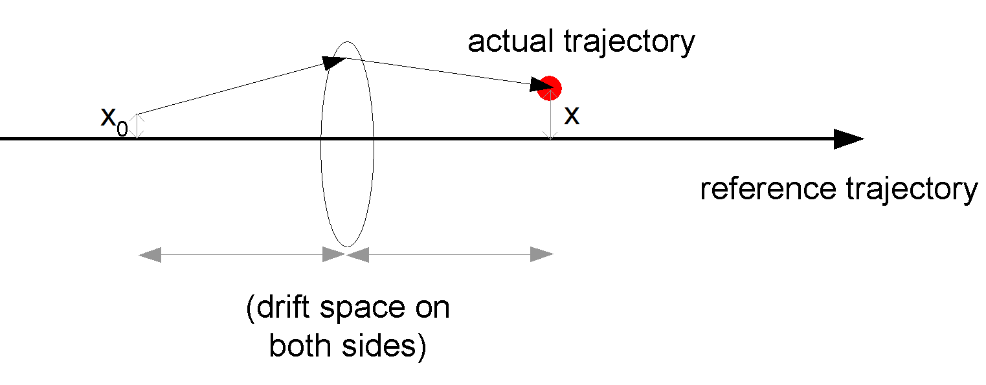
Quadrupole transfer matrix
Full solution :
Thin lens approximation :
  Real quadrupole may be modeled as a infinitely thin lens that focuses or defocuses, plus the drift space to represent the length of the quadrupole
  valid if focal length f=1/kl >> l
Written out multiplication:
-1/f is a focusing term
A defocusing quadrupole in x (rotated 90°): -f → f
k [m⁻²]
l [m]

Slide 14
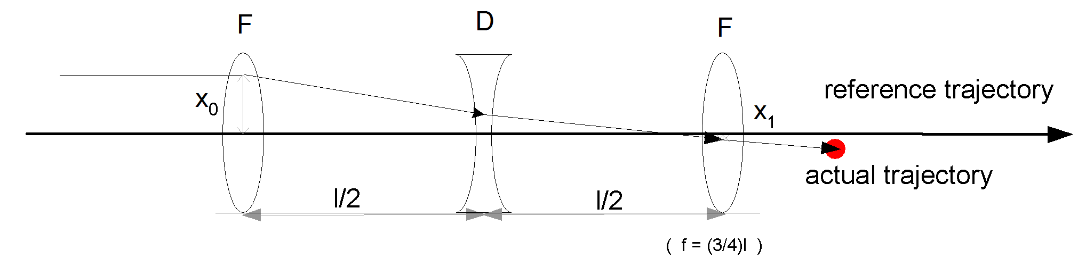
Quadrupole FODO doublet
A FODO quadrupole doublet consist of a focusing quadrupole followed by a drift, a defocusing quadrupole and a drift
Using the thin lens approximation we can calculate the total matrix :
FODO is focusing in both the horizontal and the vertical planes (since changing plane equals f = -f )

Slide 15
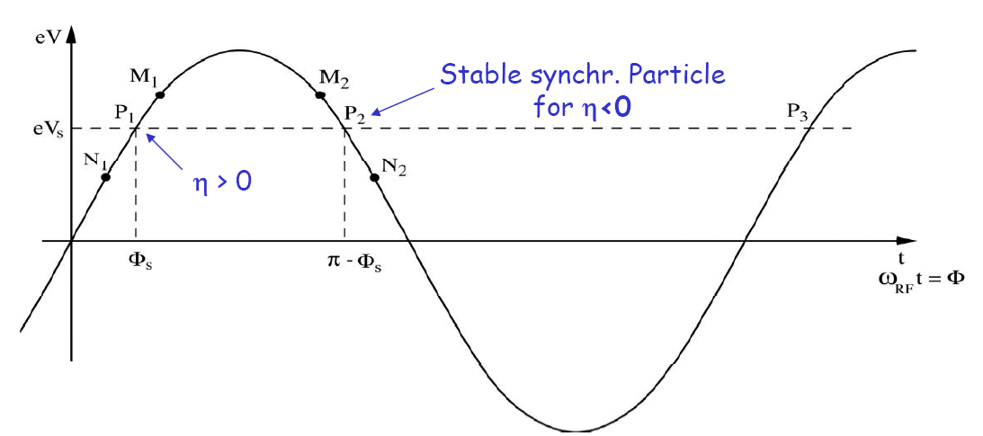
Phase stability in a synchrotron
h>0: velocity increase dominates, f_{r} increases
Synchronous particle stable for 0º<f_{s}<90º
  A particle N₁ arriving early with f= f_{s}-Df will get a lower energy kick, and arrive relatively later next pass
  A particle M₁ arriving late with f= f_{s}+Df will get a higher energy kick, and arrive relatively earlier next pass
h<0: stability for 90º<f_{s}<180º
h=0 at the transition energy. When the synchrotron reaches this energy, the RF phase needs to be switched rapidly from f_{s} to 180-f_{s}

Slide 16
Particle Physics accelerators: LHC as primary example
14 TeV proton-proton accelerator-collider built in the LEP tunnel
Lead-Lead (Lead-proton) collisions
1983 : First studies for the LHC project
: First magnet model (feasibility)
: Approval of the LHC by the CERN Council
1996-1999 : Series production industrialisation
1998 : Declaration of Public Utility & Start of
civil engineering
1998-2000 : Placement of the main production contracts
2004 : Start of the LHC installation
2005-2007 : Magnets Installation in the tunnel
2006-2008 : Hardware commissioning
2008-2009 : Beam commissioning and repair
2009-2040 : Physics exploitation

Slide 17

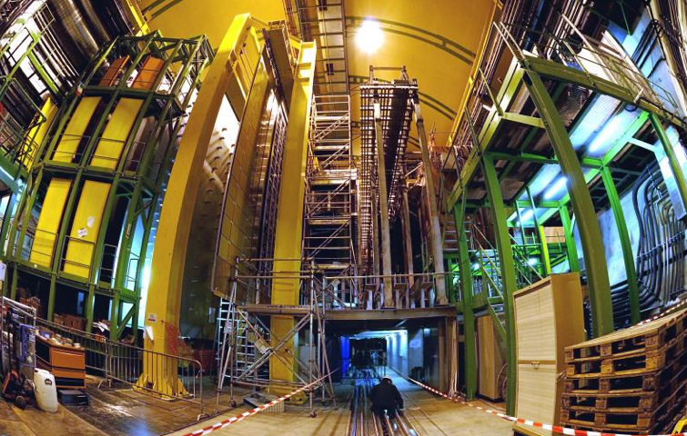


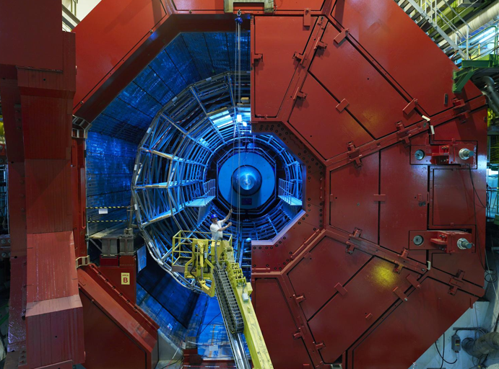


The LHC complex
LHC: a New Era in Fundamental Science
LHCb
CMS
ATLAS
ALICE
LHC ring:
27 km circumference
Notes:
17

Slide 18
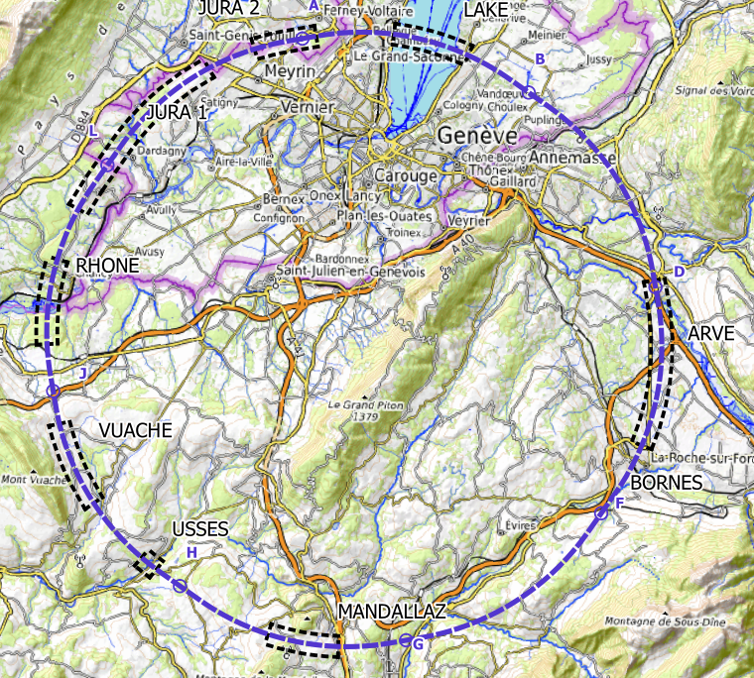
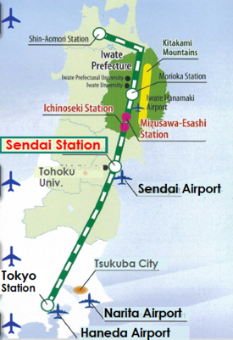
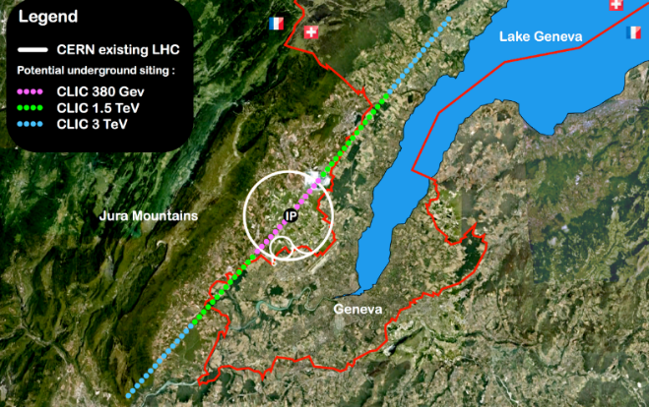
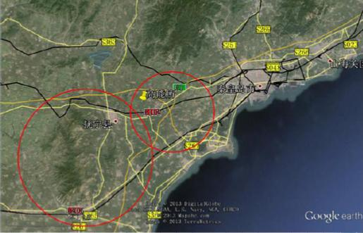

Higgs factories
Need e+e- collisions at least at 250 GeV, four main alternatives (plus various less developed ideas):
ILC in Japan (linear) FCC at CERN (ring)
CLIC at CERN (linear) CEPC in China (ring)
Linear colliders: 13 (Higgs) -> 50 (max) km to get to 1-3 TeV
Rings ~100km, can be used for protons
after
`

Slide 19


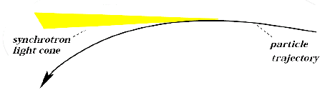
Limitations - synchrotron radiation
We want E_{cm} as high as possible for new particle accelerators
Circular colliders ⇒ synchrotron radiation loss:
For electrons a severe limitation, size and costs
explode – go linear
Less of a problem with protons (size of ring
driven by magnet technology but radiation
losses also there becoming significant for the
components)
damping ring
e+
e-
source
beam delivery
main linac

Slide 20

Generic Linear Collider
The key parameters: Energy and luminosity
The critical steps (in next slides):
Create low emittance beams (sources, injector, damping rings, ring to main linac - RTML)
Acceleration in main linac (energy increase per length)
Supply energy as efficient as possible to beam (high power at 12 GHz)
Nano-beams: Squeeze the beam (Beam Delivery System- BDS), i.e. reduce β

Slide 22
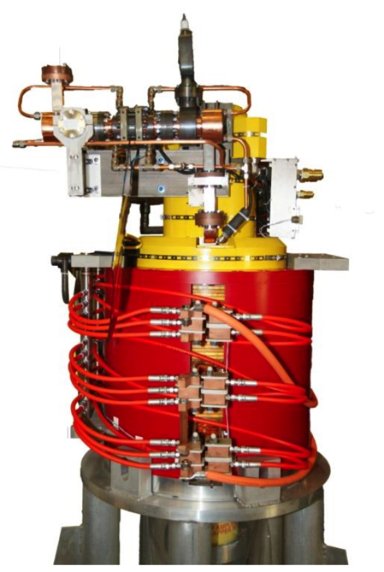
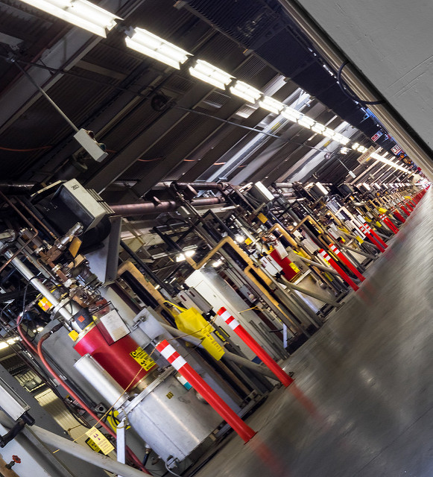
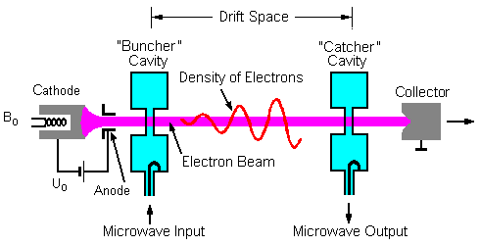
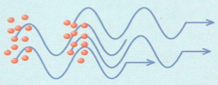
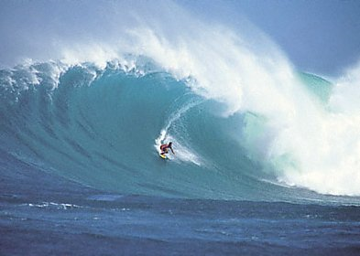
Power and acceleration
RF power
source
RF
load
particle bunch
electric field

Slide 23
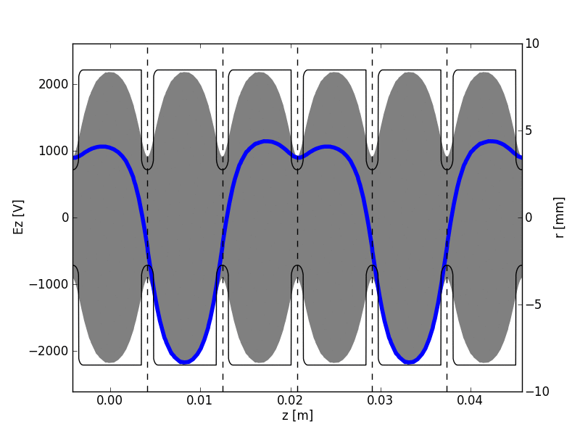
Optimal beam phasing
Another animation from Kyrre Sjøbæk, showing optimal phasing of a beam (red) in a periodic loaded structure.

Slide 24
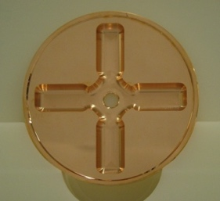
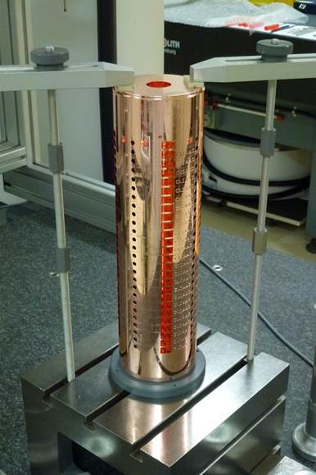
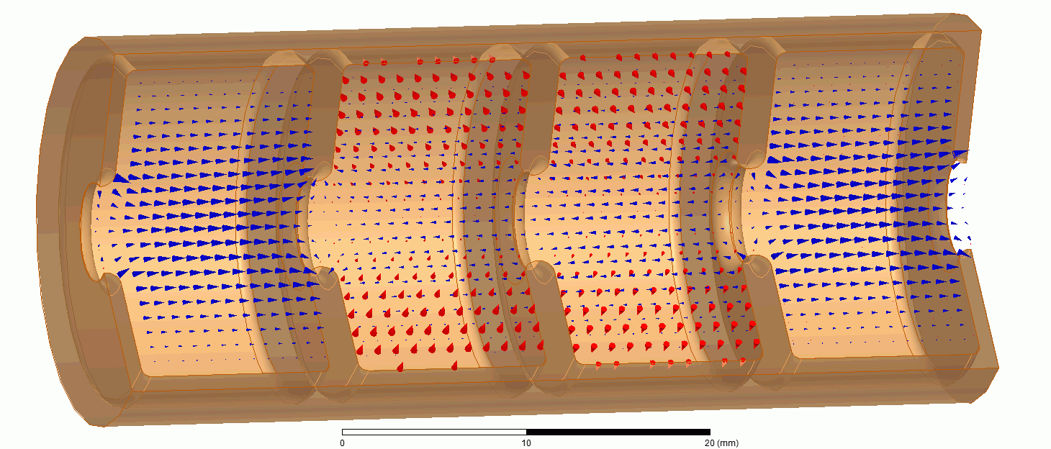
Maximize acceleration per meter
A high-gradient accelerating structure, 12 GHz, maximize acceleration field E
RF (radio frequency) accelerator: synchronise particle with an RF electromagnetic wave

Slide 25

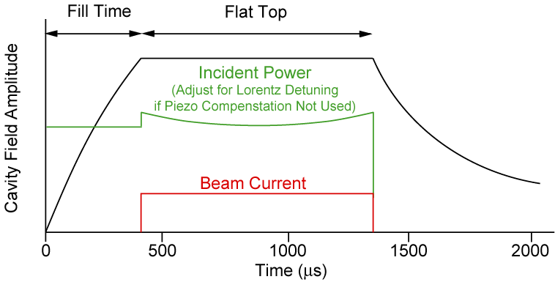
ILC: SCRF
Ultra-high Q₀ (10¹⁰)
  Almost zero power (heat) in cavity walls (in SC RF the main efficiency issues related to fill factors and cryogenics)
  Standing wave cavities with low peak power requirements
  Long beam pulse (~1 ms) - favourable for feed-backs within the pulse train
Low impedance
  beam generates low “wakefields”
  relatively large structures (1.3 GHz)

Slide 26
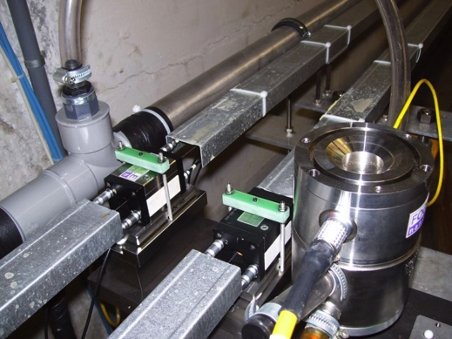
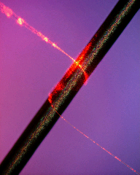

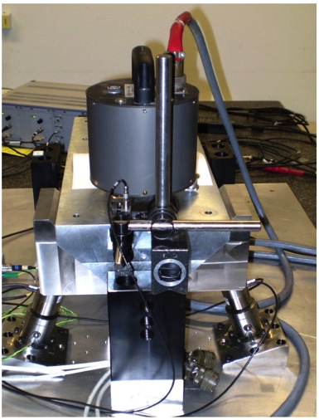
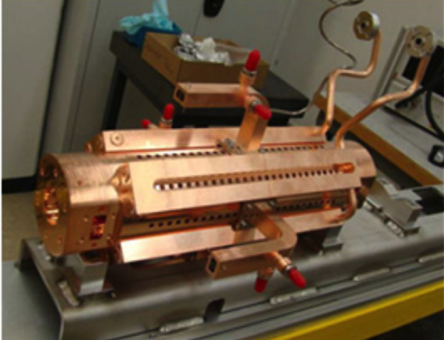

Nano-beams
σ_{x}=40 nm, σ_{y}=1nm (CLIC parameters at 3 TeV)
Vertical bunch-width of a water molecule, truly nanobeams
The strategy:
Align components (10μm over 200m)
Control/damp vibrations (from ground to accelerator)
Measure beam positions – steer beam and optimize positions
Algorithms for measurements, beam and component optimization, feedbacks
Tests in small accelerators of equipment and algorithms (FACET at Stanford, ATF2 at KEK, CTF3, Light-sources)

Slide 27










Evolution of Fermilab Neutrino Experiments
Detector complete
taking data
→700 kW in 2016
NOvA (far)
Surface
14 kton
MINOS+ (far)
at 2340 ft level
5 kton
Operating
since 2005
350 kW (>400 kW)
735 km (on-axis)
MINOS (near)
LBNE
1300 km (on-axis)
810 km (off-axis)
MINERvA
“LBNF” Far detector
at 4850 ft level
>10 kton → 40 kton LAr TPC
700 kW → 1.2 MW(PIP II)
→ 2.3 MW
New beamline
Near detector
NOvA
(near)
MicroBooNE
commissioning
(LAr TPC)

Slide 28

The T2K project (Tokai to Kamioka)

Slide 29


Muon collider collaboration
Possible to join muon collaboration (acc or phys/det), also an EU design study

Slide 30

Principle of Electron Driven Plasma

Slide 31






Despite their impact on science, most accelerators that have been built are used for other purposes
About 30,000 accelerators are in use world wide
  Sales of accelerators > $ 2 B /yr and growing
  Accelerators touch over $ 500B /yr in products
  Major Impact on our economy, health, and well being
  Mostly small room size systems – but ranging up to a 1km or 2 (for example light sources, neutron facilities)
Radiation therapy
Shrink wrapped food
Digital Electronics
From talk by N.Lockyer

Slide 33


Synchrotron Light Sources: about 50 storage ring based
60‘000 users world-wide
Established, mature technology
From L.Rivkin EPFL

Slide 34






X-Ray Free Electron Lasers
LCLS I, II 2009, 2019
From L.Rivkin EPFL
PAL XFEL 2016
SwissFEL 2017
SHINE, Shanghai, under construction
SACLA 2011
8.5 GeV, 60 Hz NC
European XFEL 2017
DESY, Hamburg

Slide 35



Trend towards compact machines – in Norway too?
Local accelerators for research as basis for innovations
Place in existing University (<100-200 MNOK), fit in modest building, broad user community
Example:
Compact electron linac 30-200 MeV
Collider with laser, Inv. Compton Scattering, small ligthsource (materials, pharma, drugs, bilogical samples, imaging, R&D for use in silicon industry)
Collide with neutron target: TOF neutrons (materials mostly)
Isotopes
Cleaning and inspection
Tests bench for medical acc. (e.g Flash theraphy)
Accelerator R&D (e.g. plasma to make even more compact) and detector system irradiation and testbeam
At some point we should or could consider a research accelerator in Norway ..

Slide 36


Slide 37



Slide 38


Slide 39




Slide 40



CERN’s training, education and outreach programmes
300 Undergraduate students in
Summer programmes
>3000 registered PhD students.
>1000 Fellows, Technical and Doctoral Students in research and applied physics, engineering and computing.
13 304 teachers since 1998 and 2000 participants in the webinar since 2020.
Numbers for Norway
3 summer students during 2019
158 teachers in Teacher Programmes since 1998
2 teams in BL4S competition since 2014
800 students participating in S’Cool LAB since 2015
1444 visitors in 2019
151 000 visitors on guided tours of CERN in 2019, from 95 countries.
CERN engages with citizens
across the globe:
on-site and travelling exhibitions
in 15 countries, > 1 million visitors
Science Gateway will open in 2023, expanding CERN’s outreach reach and impact, locally and globally.
https://careers.smartrecruiters.com/CERN/students
Notes:
THE NUMBERS ON THIS SLIDE NEED REGULAR UPDATING
CERN schools: High Energy Physics; Computing; Accelerator

Slide 41
Key points
The focus is moving from the Standard Model (~4%) to what is beyond (the rest)
Accelerators are widely used advanced instruments (30000), requiring multi-disciplinary skills to design, construct and operate
Particle physics uses the largest and there are probably a few thousand accelerator scientists engaged in major labs world-wide in “our” field
The developments (design, technical developments, tests of single elements or systems, industrial (pre)-productions – and also civil engineering, conventional systems, power and cost optimizations, are done by international teams/collaborations, usually led a major lab with special interest in the project but with world-wide participation since the technology developments and knowledge are transferable to other and/or local projects
Major projects are underway in Europe, US and Japan, and even more major projects are being studied for possible implementation in Japan, Europe and China longer term
Underpinning these developments are existing successful projects in particle physics (LHC, neutrino facilities, flavour factories) and increasingly light-sources, electron linacs and neutron facilities for industrial or research purposes outside particle physics
Norway very active at CERN – many opportunities as students or for first jobs

Slide 42

Single particle coordinates
We usually describe particle movement in a particle accelerator in a frame co-moving with a reference position at the beam center
The state of a particle is characterized by the deviation from the reference position along the three spatial dimensions,
  (x, y, z)
and their complementary dimensions, for example
  (x’ ≈ dx/ds, y’ ≈ dy/ds, E).
The choices are not unique.
The coordinates are usually given in the laboratory frame
y
p_{y}
y’≈dy/ds
p_{z}
z
s: co-ordinate
along accelerator

Slide 43


It’s about a beam, in 6D
y(x, y, z)
Any charged particle beams, taken at a given point in time, can be characterized as a distribution in 6D phase space.

Slide 44

The phase-space ellipse
Envelope of particle motion :
Particles with different phase and equal emittance.

Slide 45




Beta function and emittance
Evolution of the transverse phase-space in free space along the beamline :
s= √(eb (s))
Two key concepts that defines a charged particle beam:
Beta function, b(s): how well the beam is focussed. Minimum, b*, at the beam waist.
Emittance, e: beam quality, phase-space area; e = √(<y²><y’²> - <y y’>²)

