Slide 1
Future Linear Colliders
Carbon Footprint Study
13/01/2023

Slide 2
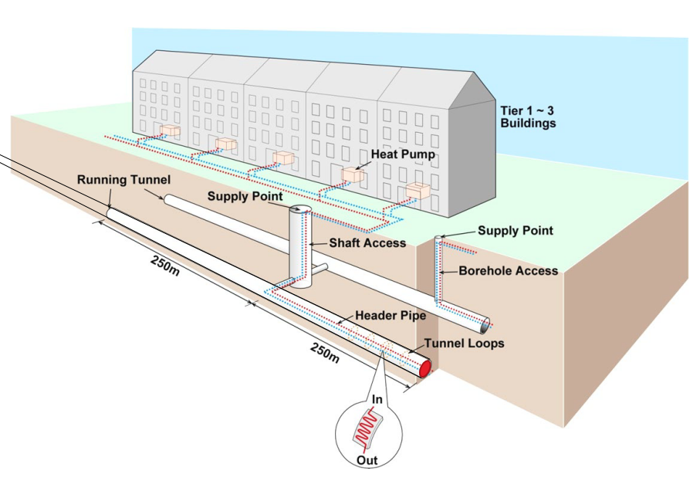
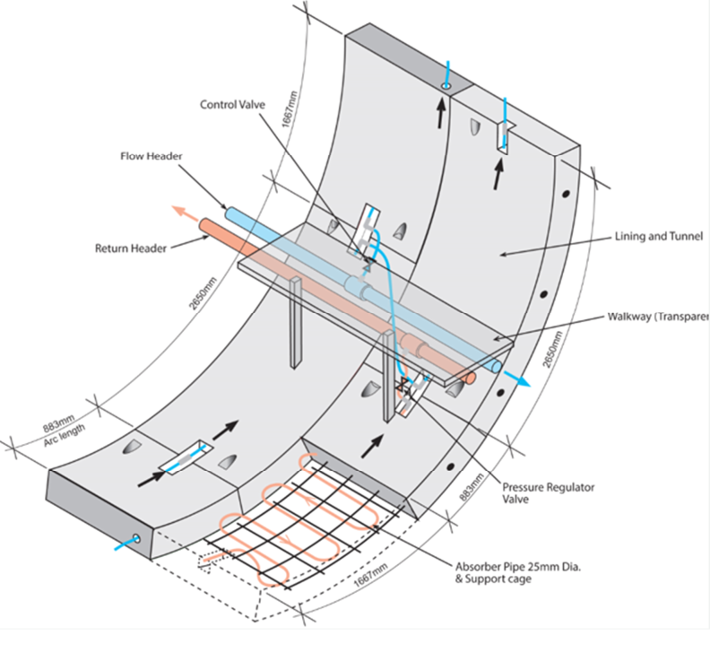
Heat Recovery Study 2022

Slide 3
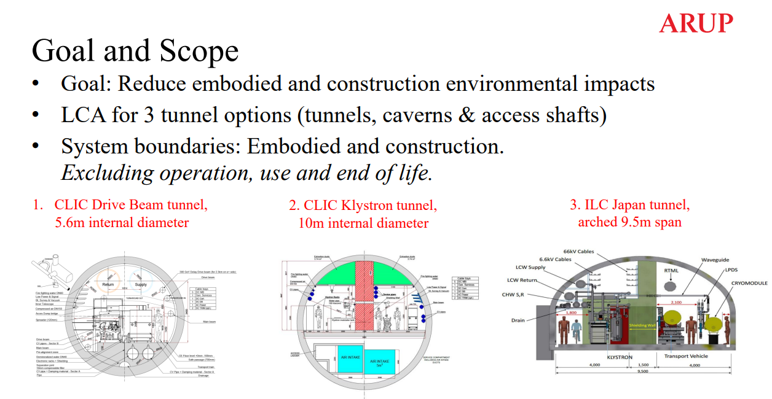
LCA

Slide 4
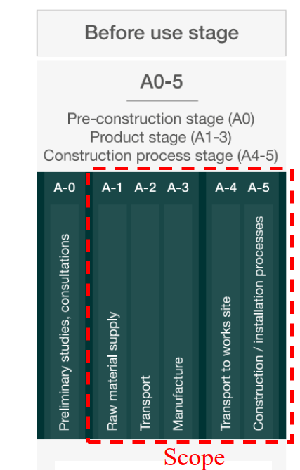
LCA
Phase 1
  Desk Study and Design Intent
  CLIC and ILC data review in parallel
  Undertake LCA with parametric models, A1-A3
  Interim report production March 2023
Phase 2
  LCA to A4-A5
  Final LCA report May 2023
  SLAC workshop May 2023

