Slide 1

Area Integration Reports USC55 & RRs
- Information needed for the cost evaluation
J. Oliveira – WP15 Integration & (De-)Installation
WP15 Integration Meeting #216 20/01/2023

Slide 2
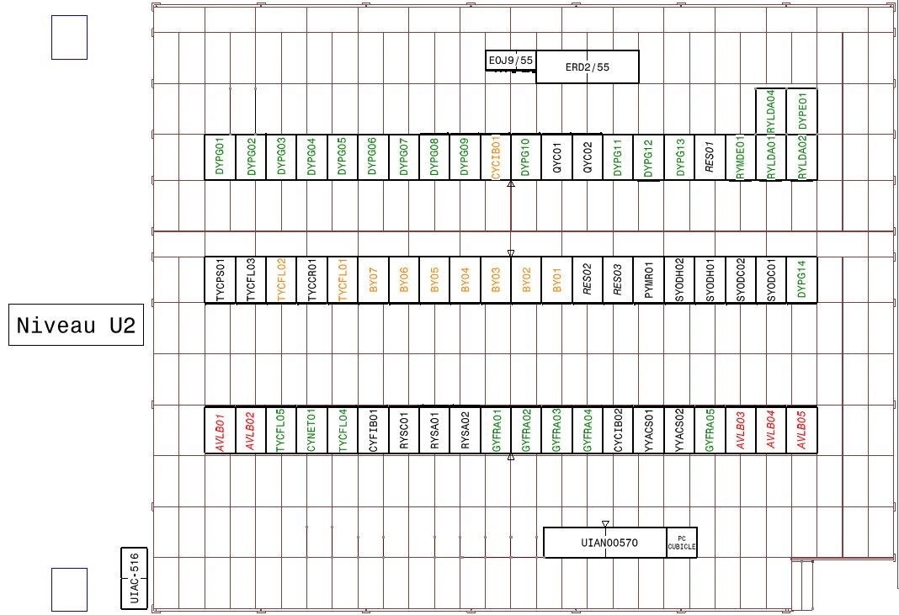
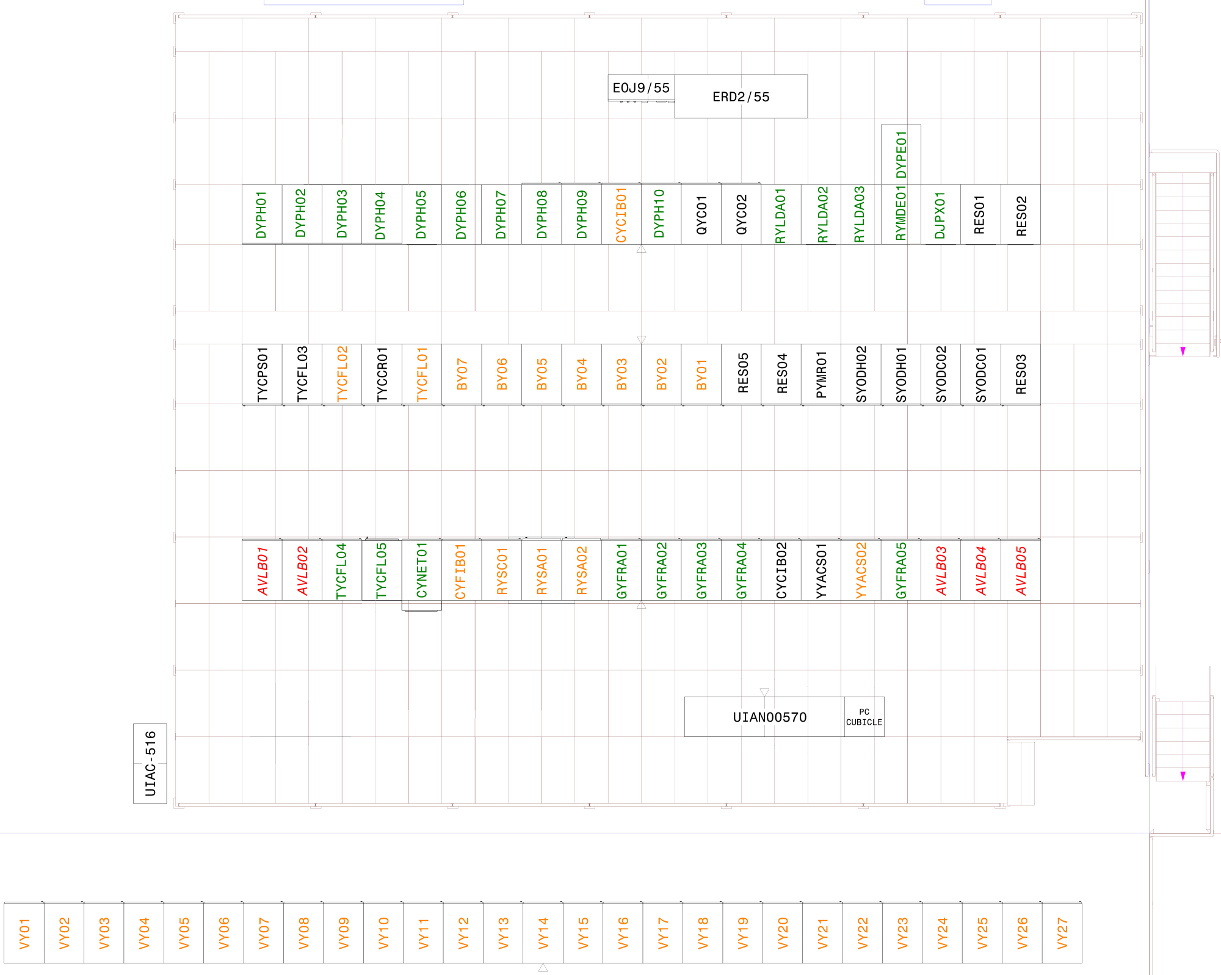
USC55 Baseline Evolution
Baseline March 2020
Version 1.2
Baseline November 2022
Version 1.4

Slide 3
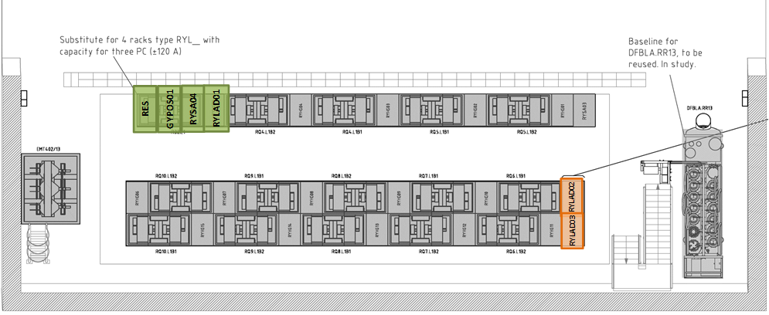
RR13 Baseline Evolution Floor 0
Baseline April 2020
Version 2.1
November 2022
Version 2.3

Slide 4
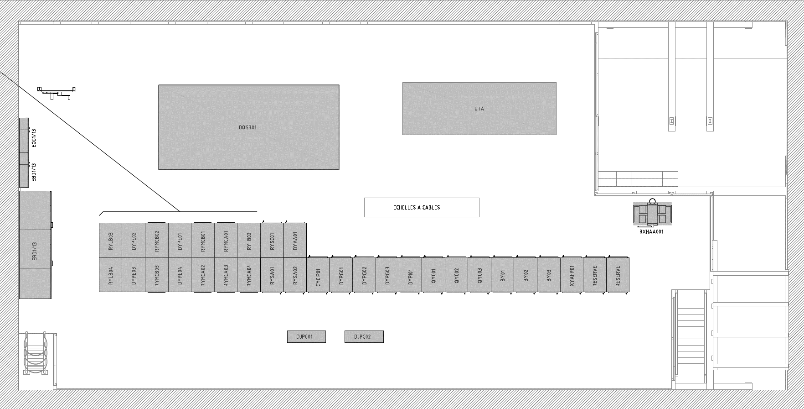
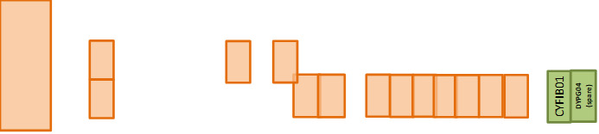
RR13 Baseline Evolution Floor 1
Baseline April 2020
Version 2.1
November 2022
Version 2.3

Slide 5
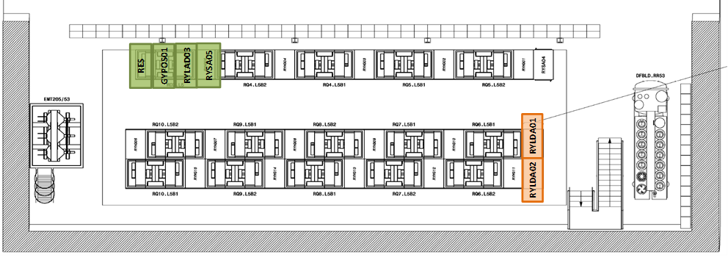
RR53 Baseline Floor 0
Baseline April 2020
Version 2.1
November 2022
Version 2.3

Slide 6
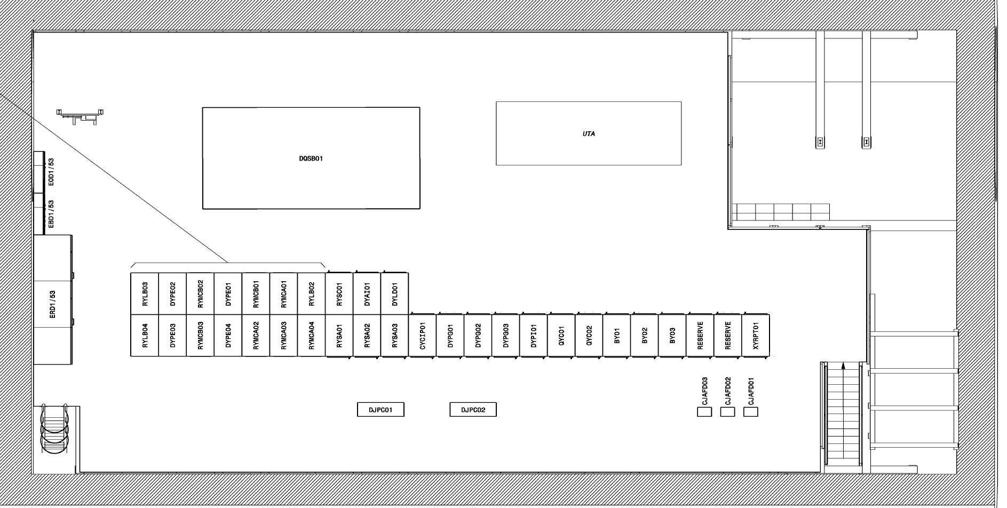
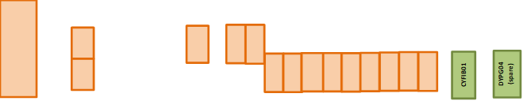
RR53 Baseline Floor 1
Baseline April 2020
Version 2.1
November 2022
Version 2.3

Slide 7
Requests related to the changes
Cabling de-installation - DEC (Demande d’Enlevement de Câbles)
RACK installation - SNOW Ticket numbers for the DIR (Demande d’Installation de Racks)
  https://cern.service-now.com/service-portal/service-element.do?name=rack-installation.
SIGNAL Cabling installation - SNOW Ticket numbers of the DIC (Demande d’Installation de Cables)
Fibre Cabling installation - SNOW Ticket number of the DIF (Demande d’Installation de Fibres)
Power Request – Table attached in the correspondent Area Integration Report
 | LOAD NOMINAL AVERAGE CONSUMPTION |  | LOAD PEAK MAXIMUM CONSUMPTION
RACK IDENTIFIER | LOAD AVERAGE [kW] | LOAD AVERAGE [kVA] | LOAD PEAK [kW] | LOAD PEAK [kVA] | Duration for Peak Load | LOAD [power factor] | Simultaneity factor | Type of network | Voltage Level (230V,400V,3.3kV,18kV ) | Dual Power Supply | Type of circuit breaker (if known) | Responsible | Comments

Slide 8
Differences between the Powering Requests and the Area Integration Reports
On the USC55:
  DYPE01, DJPX01 new are missing on the Power Request
  CYCB01, CYNET01, YYACS02 to be modified are missing on the Power Request
  RYMCB01, RYMCC01, SIMA.USC55.5LM03S are missing on the AIR table
  RYSC01 is identified as moved in the Power Request but in AIR is kept in the same place.
  RYCA02, DYPG01, DYPG02, CYCP01, RYMCB05, TYCFL01, TYCFL02, BY01, MYWIC01, DYXE01, YYACS03, XYRPT01, XYRPT02, XYRPT03, UIAN00567, FCTIR00083, FCTIR00069, FCTIR00065 to be removed are missing on the Power Request. However, it is baseline that the powering equipment is left in place for racks but not for equipment.
On the RR13/17:
  GYPOS01, CYFIB01 new are missing on the Power Request
  QYC01, QYC02, CYCIP01, DYPG01, DYPG02, DYPG03, DYAB01, DYAA01 to be modified are missing on the Power Request
  XYAFP01 to be removed are missing on the Power Request. However, it is baseline that the powering equipment is left in place for racks but not for equipment.
On the RR53/57:
  GYPOS01, CYFIB01 new are missing on the Power Request
  QYC01, QYC02, QYC03, CYCIP01, DYPG01, DYPG02, DYPG03, DYAI01, DYAJ01, DYLD01, DYLE01, DYPI01 to be modified are missing on the Power Request
  XYRPT01 to be removed are missing on the Power Request. However, it is baseline that the powering equipment is left in place for racks but not for equipment.

Slide 9
Actions to be carried
What? | Who? | When?
Provide feedback on the Area Integration Report to release them | All equipment owners | 2 weeks
Correct and verify the power request given to EN-EL | All equipment owners | 2 weeks
Provide the cost estimation according to the data provided and in situ inspections | EN-EL | 2.5 months

Slide 10

Thank you for your time.
“If I have seen further, it is by standing on the shoulders of Giants.”
From a letter to Robert Hooke in 1675, Sir Isaac Newton PRS.
And a very special thanks to all the colleagues that contributed to this presentation.

Slide 11
Spare Slides

Slide 12
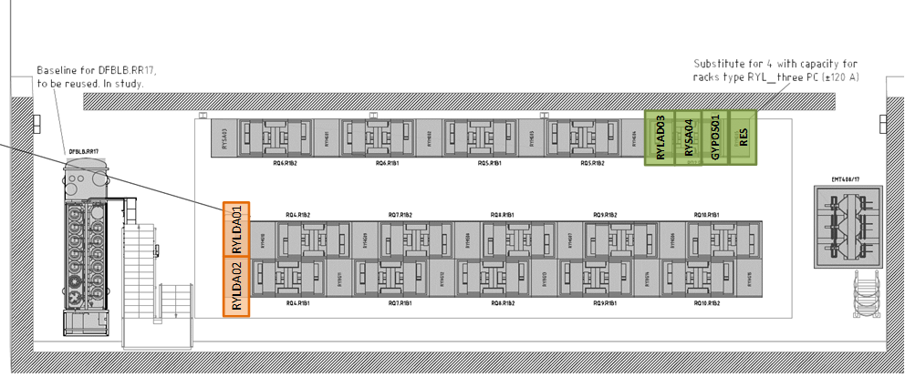
RR17 Baseline Evolution Floor 0
Baseline April 2020
Version 2.1
November 2022
Version 2.3

Slide 13
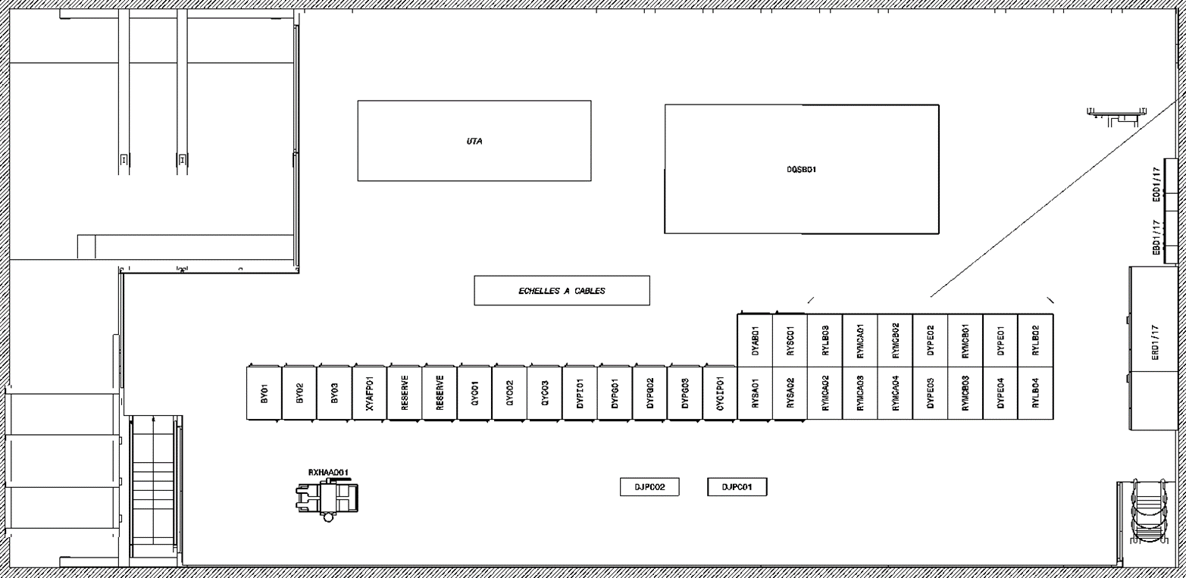
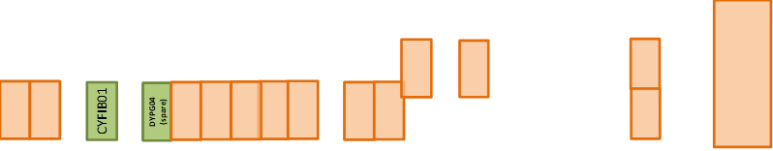
RR17 Baseline Evolution Floor 1
Baseline April 2020
Version 2.1
November 2022
Version 2.3

Slide 14
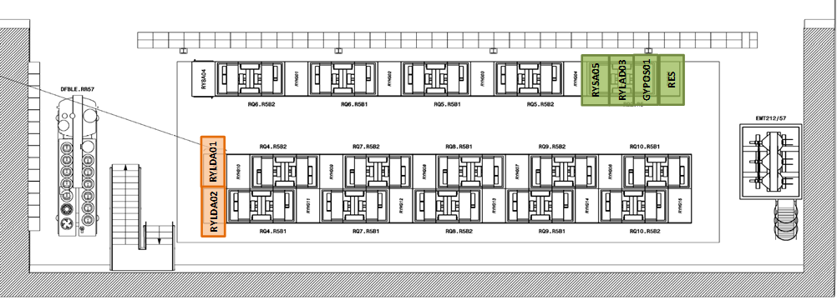
RR57 Baseline Floor 0
Baseline April 2020
Version 2.1
November 2022
Version 2.3

Slide 15
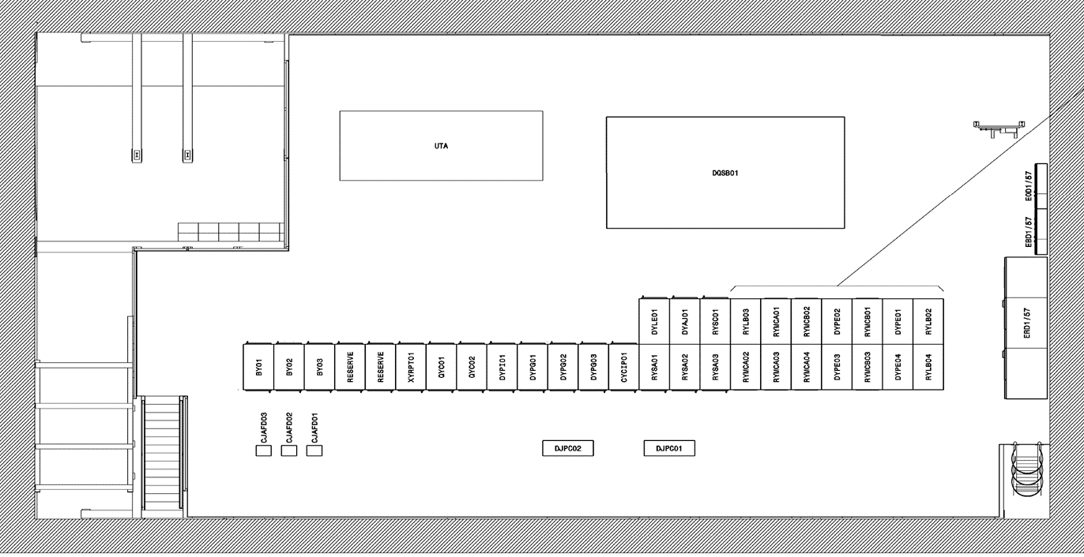
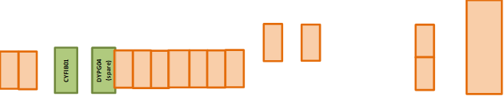
RR57 Baseline Floor 1
Baseline April 2020
Version 2.1
November 2022
Version 2.3

