Slide 1

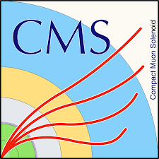
Material analysis of the MWPC electrodes irradiated in longevity tests
“Aging 2023: 3rd International Conference on Detector Stability and Aging Phenomena in Gaseous Detectors, 6-10 Nov 2023, CERN, Geneva (Switzerland)“
Aleksandra Radulovic¹, Dubravka Milovanovic¹, Nebojsa Begovic¹, Gennady Gavrilov², Katerina Kuznetsova^{2,3}, Andrey Korytov³, Guenakh Mitselmakher³, Armando Lanaro⁴, Petar Adzic⁵, Predrag Milenovic⁵
¹Institute of General and Physical Chemistry, Belgrade, Serbia
²NRC Kurchatov Institute PNPI, St. Petersburg, RU
³University of Florida, USA
⁴University of Wisconsin Madison, USA
⁵Faculty of Physics, University of Belgrade, Belgrade, Serbia

Slide 2
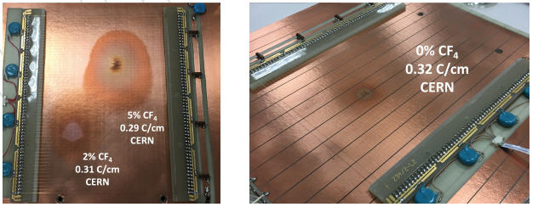
Aging of Multi Wire Proportional Chamber
Cathode Strip Chamber (CSC) is Multi Wire Proportional Chamber (MPWC), composed of alternating layers of cathode strip planes and anode wire planes inside a gas volume.
MWPC electrodes
Cathode panels: polycarbonate plates with a honeycomb hexagonal structure fixed between the sheets of Cu-foil-coated glass-reinforced FR4 plastic with strips milled into copper.
Anode panels: gold-plated tungsten wires, 50 µm in diameter.
Although, no signs of CSC detection performance degradation were observed, except for the HFO tests where dark current increase was detected, visible changes are observed on the electrode surfaces.
Analyzed electrodes
Cathode panel
Anode wire panels
Cathode plates and anode wires from CSC prototypes
Several longevity tests with local irradiation were performed:
gas mixture 40% Ar + 50% CO₂ + 10% CF₄ , accum. charge ~ 1.3 C/cm (Physics of Atomic Nuclei, 2019, Vol. 82, No. 9, pp. 1252–1262)
gas mixtures 40% Ar + (55-60)% CO₂ + x% CF₄, x = 0, 2 and 5%, accum. charge ~ 0.24 C/cm (European Physical Journal Plus, accepted)
gas mixture 40% Ar + 58% CO₂ + 2% HFO1234ze, accum. charge ~ 1.3 C/cm, HFO1234ze - C₃H₂F₄ (CF₃CH=CHF) (Physics of Atomic Nuclei, 2020, Vol. 83, No. 10, pp. 1449–1458).
The electrode samples were analyzed at public funded research facilities in Belgrade.

Slide 3
Physical and chemical characterization of materials
Characterization is the application of various analytical techniques in order to fully understand the nature of the material from different aspects. Analytical techniques are used to determine physical and chemical properties of the material – identify (qualitative) and quantify (amount) chemically, measure physical parameters (electrical properties etc.)
Combining various analytical techniques operating at different scales (nano, micro and meso), provide complementary results comprising:
surface morphology and roughness
elemental composition
structural information
  middle range ordering at the molecular level (functional groups, e.g. O-H, C-H, etc.)
  long range ordering (crystal or amorphous structure)
To determine a degree of deterioration of the electrode’s surface (physical aspect) and to analyse the deposit formed (chemical aspect) in plasma chemical reaction, analytical techniques well established in the field of materials science were used.

Slide 4
Physical and chemical techniques in electrode aging studies
How are deposits formed on the electrode surfaces
  products of multiple reactions simultaneously occurring in the avalanche plasma
  mechanism of deposit formation on the electrodes in such complex system is far from fully understood.
Limiting factors in electrode analysis are sampling (cutting of the sample) and contamination of the sample during transport, handling and measurements.
Systematic effects cannot be excluded:
  contamination by carbon (instrument chamber contamination, improper sample handling etc.)
  to overcome such problems, every measurement of the aged electrodes was compared to the virgin (reference) electrode that was not exposed to the process of aging.
The goal of this work was to establish unified approach to problems relevant to characterization, through setting analytical protocols adapted to particularity of the analysis, optimizing the existing analytical methods, sampling, handling and measurement protocols as well as interpretation of the results, thus enabling comparison of results between different laboratories.

Slide 5
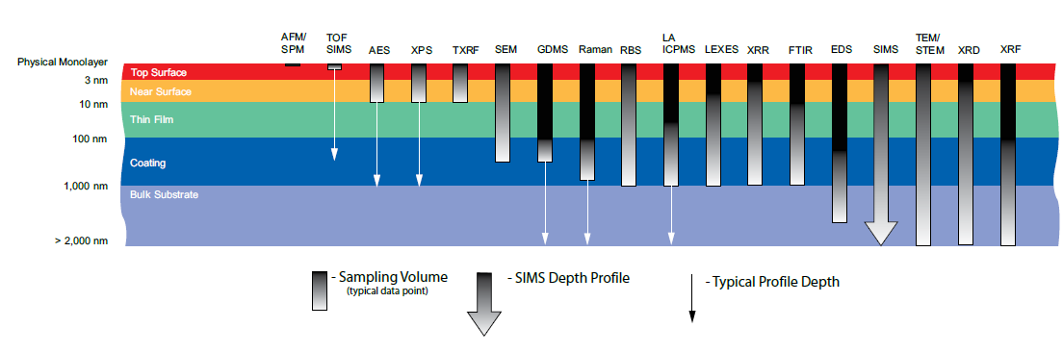
Physical and chemical techniques in electrode aging studies
We present a set of complementary analytical techniques which give a detailed characterization of deposits accumulated on MWPC electrodes
Typical analyses depths of characterization techniques
Multi-layered nature of deposit demands combination of analytical techniques with different penetration depths:
Atomic Force Microscopy (AFM): No penetration
Time of Flight Secondary Ion Spectroscopy (ToF-SIMS): 1-2 nm, depth profiling up to several hundred nm
X-ray Photoelectron spectroscopy (XPS): ~ 5 nm, depth profiling up to 1 µm
Scanning Electron Microscopy (SEM/EDXS): < 2 µm
Fourier Transform Infrared (FTIR) and Raman Spectroscopy: < 2-3 µm
X-ray Diffraction (XRD): < 15 µm
Cathode investigation techniques | OM, AFM, SEM, EDS, FTIR, Raman, XRD, XPS, ToF-SIMS
Anode wire investigation techniques | OM, SEM, EDS, Raman, XPS, ToF-SIMS (limitations: round shape, small diameter)

Slide 6
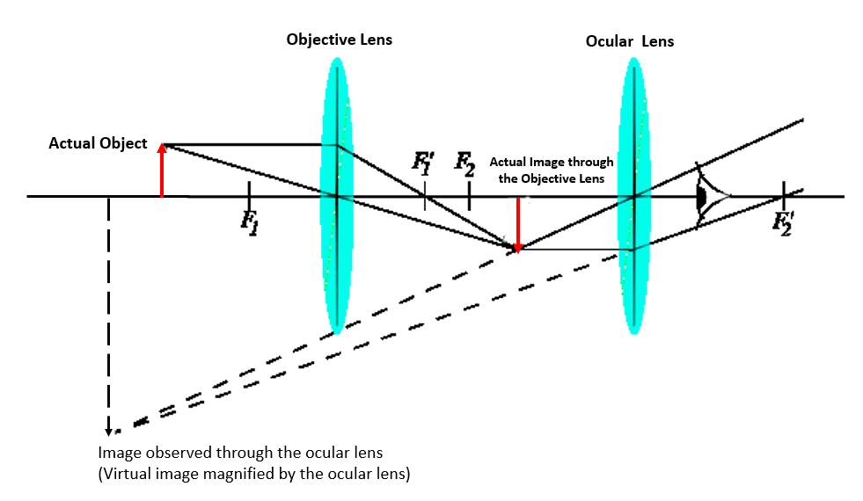
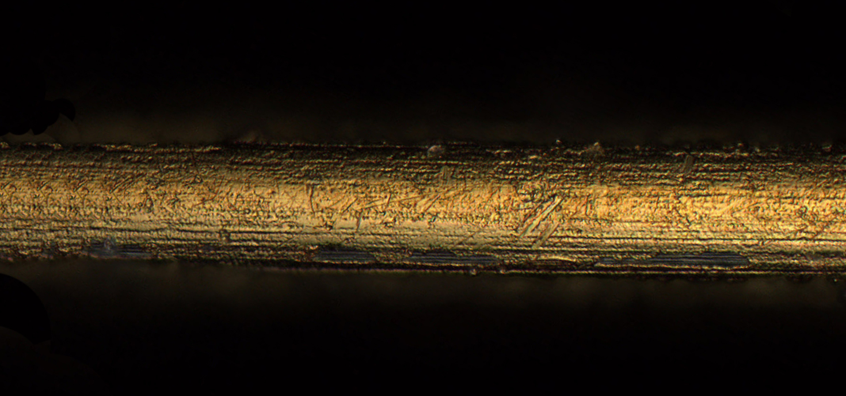
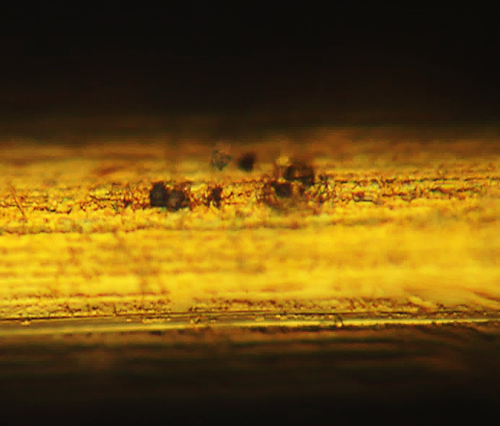
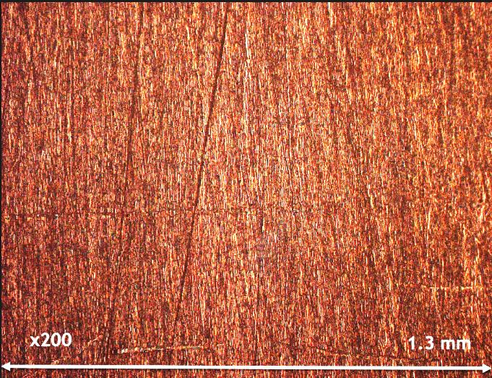
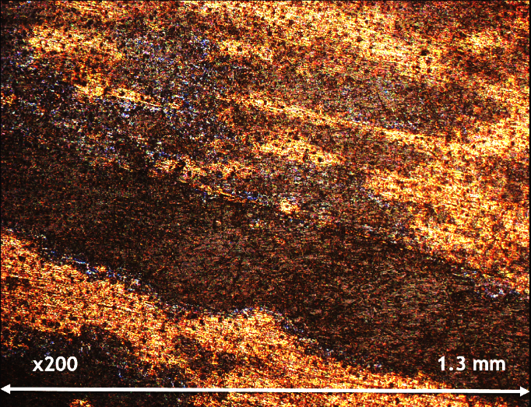
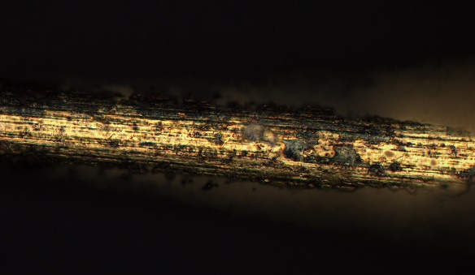
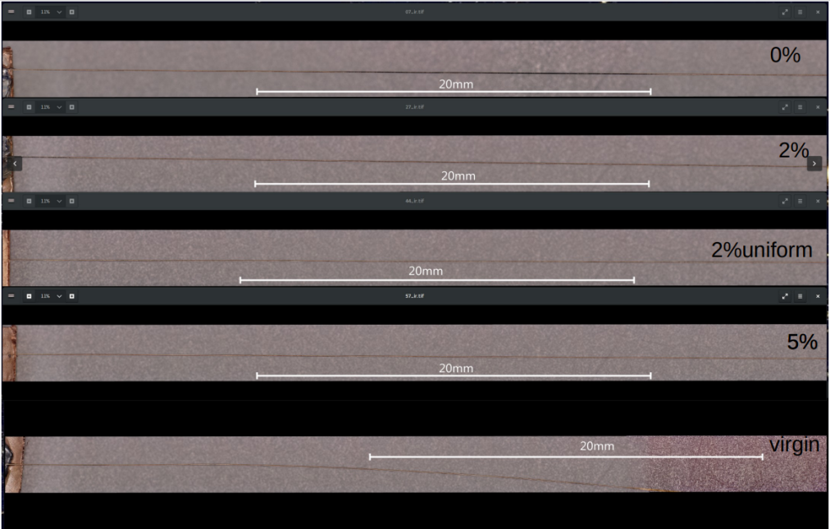
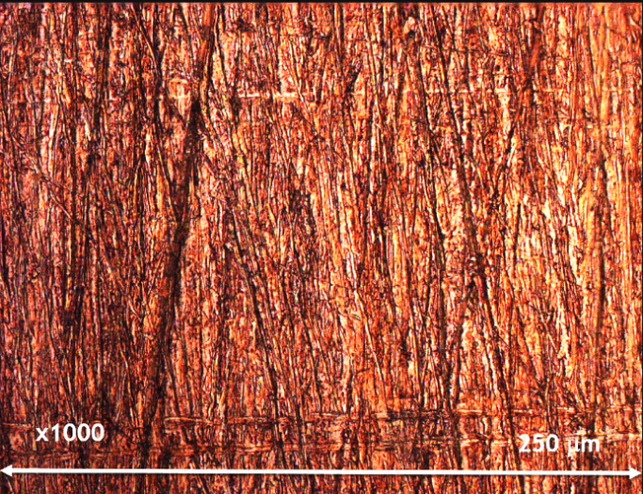
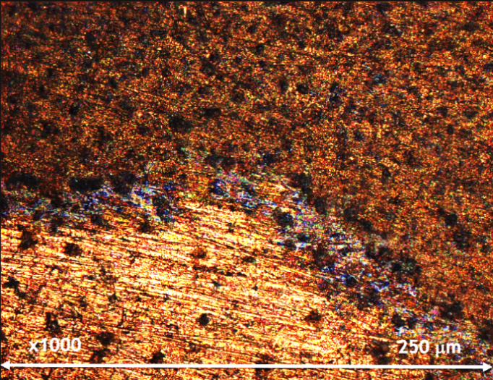
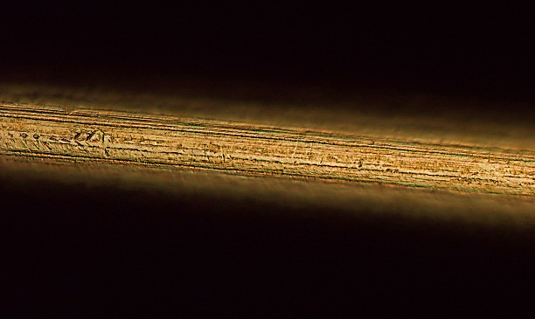
Optical Microscopy (OM)
Investigation of large surface areas for cracks, deposits and other defects in reflected light
Optical magnification principle
Anode wires
Cathode plates
Virgin
10% CF₄ Irradiated
10% CF₄ Irradiated
10% CF₄ Irradiated
250 µm
0% CF₄ Irradiated
Darkening of the wires
250 µm
Virgin
250 µm

Slide 7
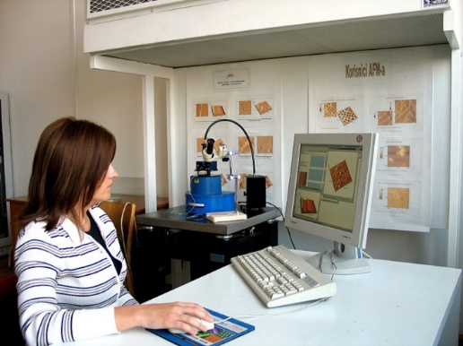
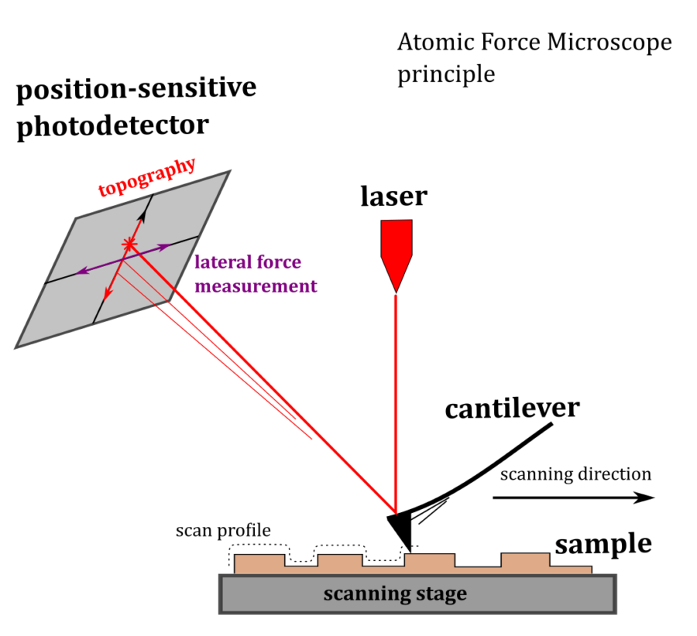
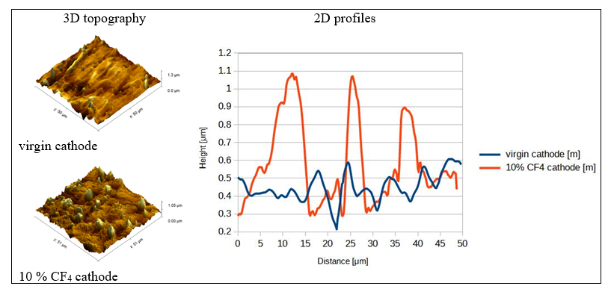
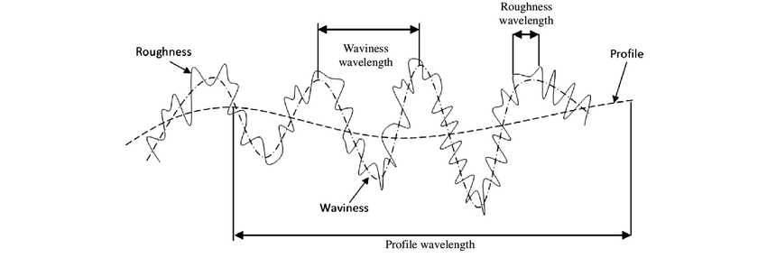
Atomic Force Microscopy (AFM)
Providing a topographical image of the surface with atomic resolution
Comparison of topography and surface roughness between virgin and aged cathode
2D topography
Relationship between roughness, waviness and profile
virgin cathode
Scanning area is chosen (max 100 µm²)
Ra and RMS are both representations of surface roughness, but each is calculated differently.
Ra is calculated as the Roughness Average of a surfaces measured microscopic peaks and valleys.
RMS is calculated as the Root Mean Square of a surfaces measured microscopic peaks and valleys.
250 µm
10%CF₄ cathode
Surface roughness parameters (50 µm x 50 µm area)
Sample | Ra (nm) | Rms (nm)
Virgin Cathode | 66.5 ± 2.3 | 89.7 ± 3. 1
Aged Cathode Irr. 10%CF4 | 84.9 ± 4.9 | 135.8 ± 6.4
250 µm

Slide 8
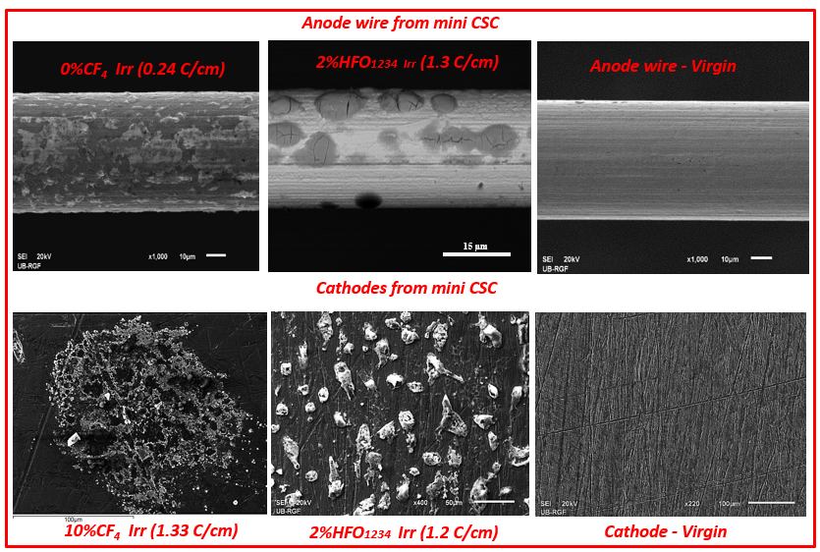
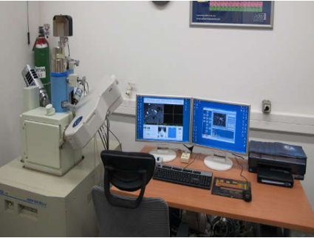
Characteristics
Method for high resolution surface images
Uses electrons for imaging
Measuring in:
- secondary (SE) and
- backscattered electron (BSE) contrast
Magnification range from 100 to 1.000.000
Non-destructive
Scanning Electron Microscopy (SEM)
delivers electron image of the surface of examined material in the range of mm to nm thus providing information about the surface morphology
SE micrographs of electrodes from mini CSC
Surface morphology - Secondary electron (SE) Imaging
focused electron beam scanning a sample surface triggers emission of secondary electrons
Surface-sensitive (topographic) information of the sample
Displaying particle morphology (impression of 3D)
250 µm
250 µm

Slide 9
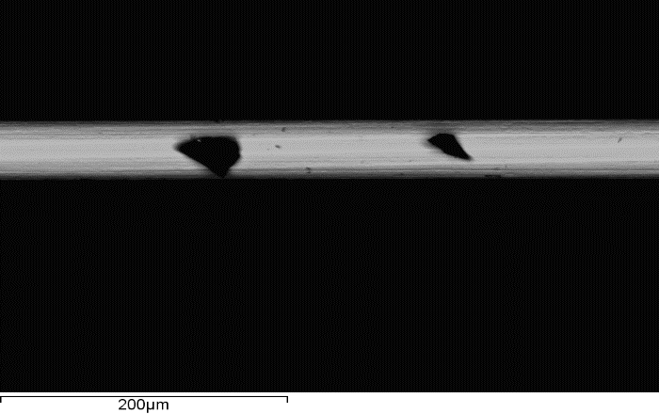
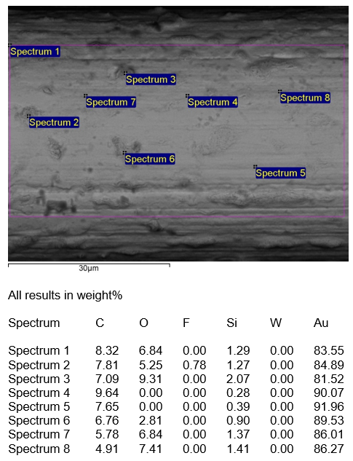
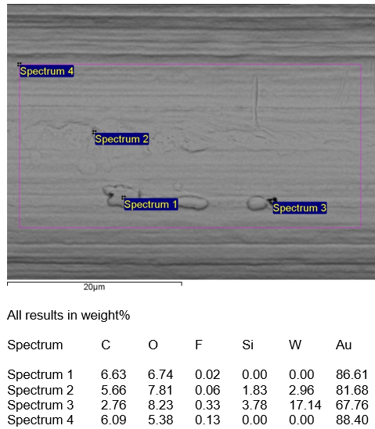
Energy Dispersive X-ray Spectroscopy (EDS)
Characteristic X-rays produced by the interaction of electrons with the sample are used to detect and measure the abundance of elements in the sample (penetration depth 0.5-2 μm)
EDS analysis in regions
elemental distribution along wire length
EDS analysis in specific points in two different wire regions
0% CF₄ Irr
central region of the wire
close to the edge of the wire
EDS analyses were performed in 20 regions along wire length.
Regions were ~0.45 mm in length
We define the size of the region and perform measurements randomly - elemental distribution along wire length
0% CF₄ Irr
0% CF₄ Irr
We measure an average content of detected elements on the electrode surface and thus make comparative studies of different longevity tests.
Band of uncertainty for C
measured on two different EDS instruments
250 µm
Risks and limitations
Detection limit (not suitable for low concentration < 0.1%)
Not reliable for light elements (semi-quantitative Z<11)
Volatile-bearing compounds
Chamber/sample contamination: improper sample handling, reactive samples (interactions with O_{2,} CO_{2,} SO₂ etc. from air-forming deposits)
Remedy: e.g. storing the samples in vacuum desiccator
250 µm

Slide 10
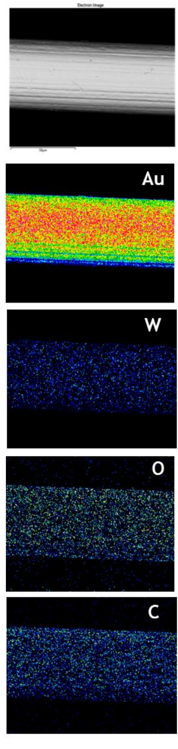
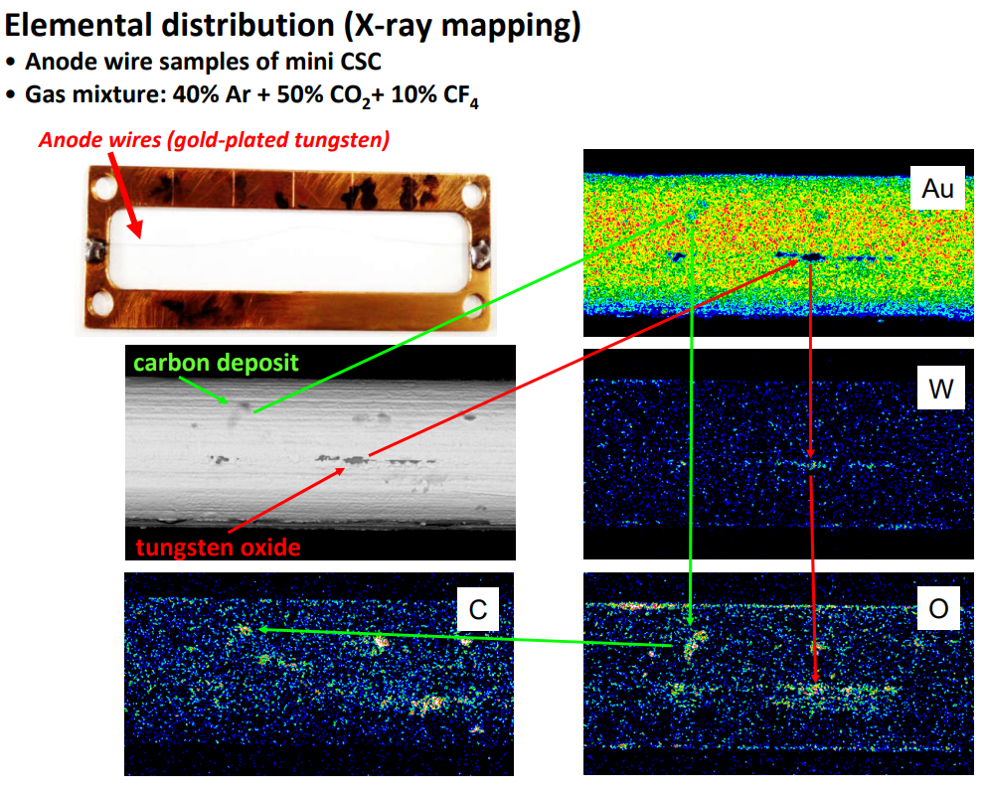
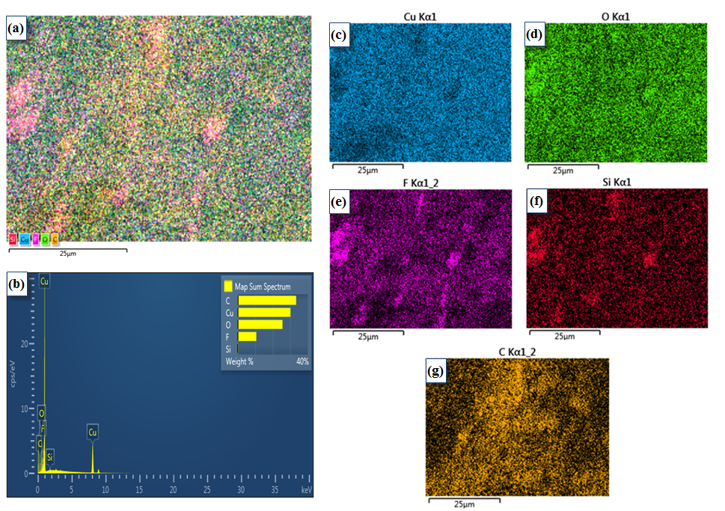
Elemental distribution (X-ray Mapping)
Virgin anode wire
Characteristic X-rays produced by the interaction of electrons with the sample are used to produce spatial distribution of individual elements specified by distinctive colors; brighter areas correspond to a higher concentration of an element of interest.
The mapping shows a correlation between morphological features and the constituent elements on the surface and between concentrations of the detected elements.
Gas mixture:40%Ar + 50%CO₂+ 10%CF₄
Cathode plate
Anode wire
250 µm
O, F and Si are characterized with matching distribution indicating formation of Si-O-F polymers
Detection of cracks in gold plating and carbon spots
250 µm

Slide 11
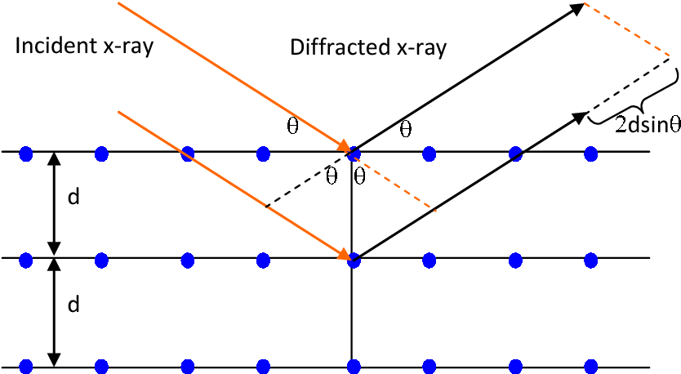
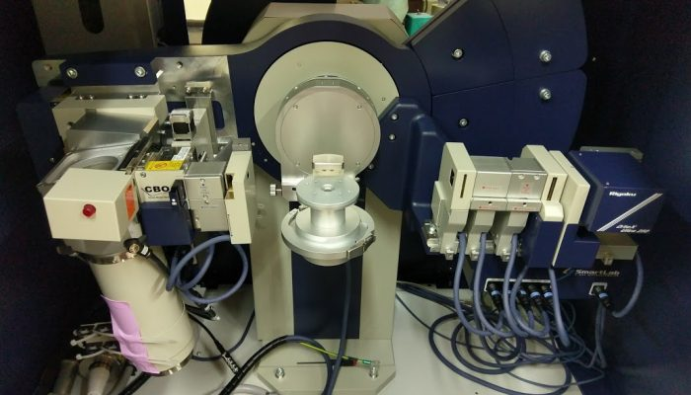
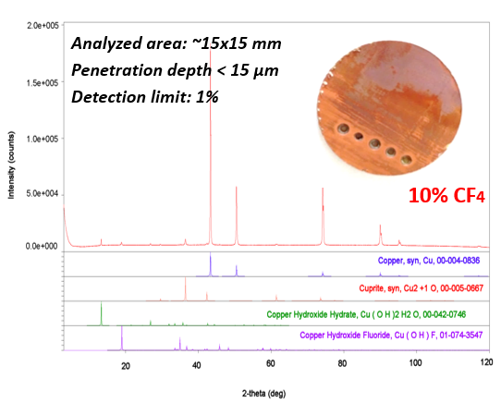
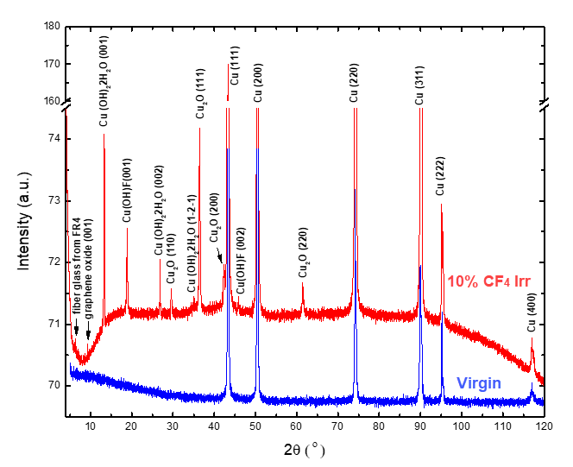
X-Ray Diffraction (XRD)
Long range order in crystal structures:
measures the angle of the beam scattered from crystal planes thus giving the information on periodic atomic arrangements in a given material, which is used for identification of crystal phases in material.
Crystal phase identification
Comparison of XRD patterns of virgin and aged 10% CF₄ cathode

Slide 12
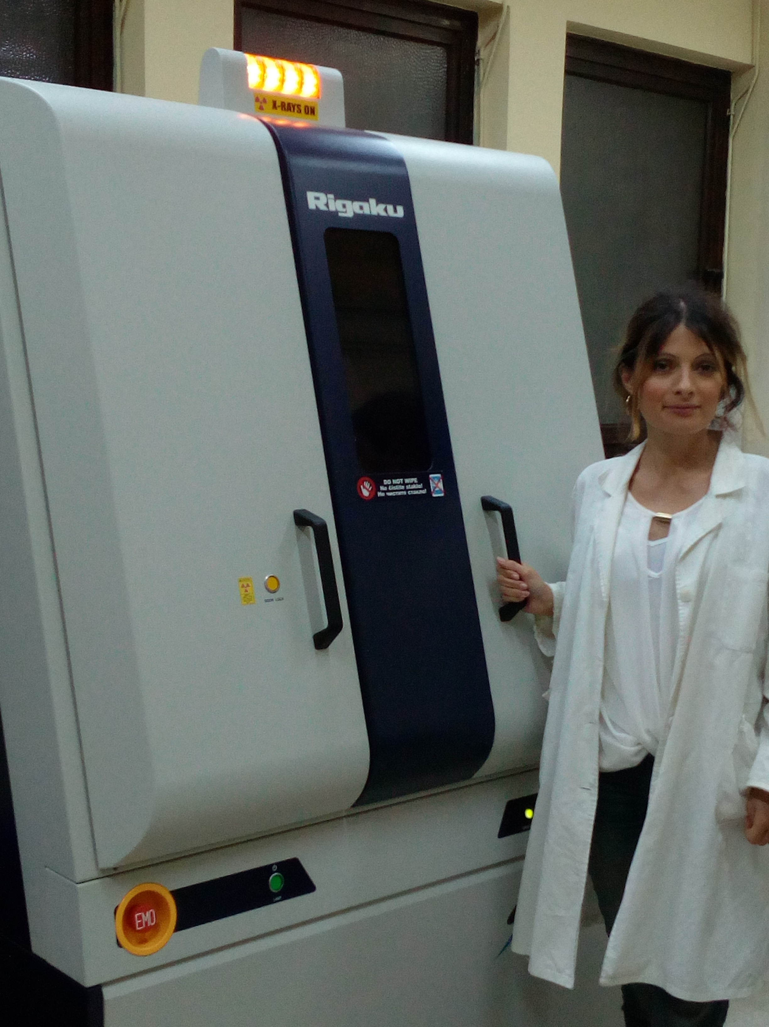
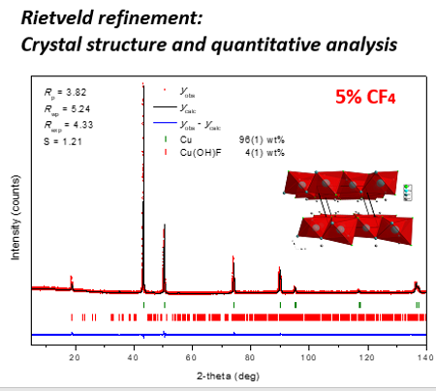
X-Ray Diffraction (XRD)
Rietveld refinement
Crystal structure and quantitative analysis of deposit constituents on cathode surface
Copper hydroxide fluoride Cu(OH)F forms layers of edge-sharing Cu(OH)₃F₃ polyhedra, which are connected by hydrogen bonds.
Quantitative phase analysis showed that 4(1) wt% of Cu(OH)F and 96(1) wt% of Cu constitute surface in the center of the irradiated area of cathode in 5 % CF₄ trial.
Characterization of anode wire by XRD is problematic due to it`s geometry (round shape, small diameter) - upgrade is needed for micro-diffraction measurement – external laboratory).

Slide 13
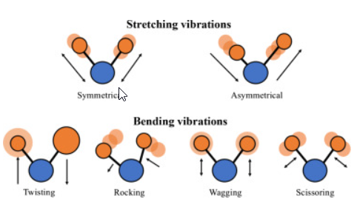
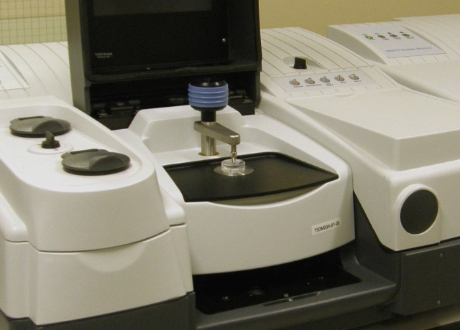
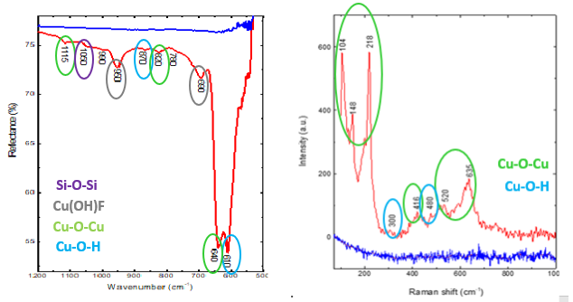
Vibrational spectroscopy (FTIR and Raman)
Vibrational (Fourier Transform Infrared – FTIR and Raman) Spectroscopy
Middle range order in crystal and amorphous structures: measures interaction of radiation with chemical bonds within a material thus giving information on functional groups within a molecule and energy of chemical bonds
Comparison of ATR-FTIR and Raman spectra of virgin and aged 10% CF₄ cathode
Raman spectra
ATR-FTIR spectrometer
ATR- FTIR spectra
ATR-FTIR spectroscopy
-penetration depth 0.5 - 2 μm
- detection limit: ~0.1 wt%
- analyzed area ~2x2 mm²
Raman spectroscopy
-penetration depth 0.5 - 3 μm
- detection limit: ~0.1 wt%
- analyzed area ~2x2 µm²
Cu-O-Cu, Cu-O-H, Cu-O-F and Si-O-Si bonds are detected on the surface of aged cathode
Flat line obtained for virgin cathode is due to inactive metal Cu-Cu vibrational modes

Slide 14
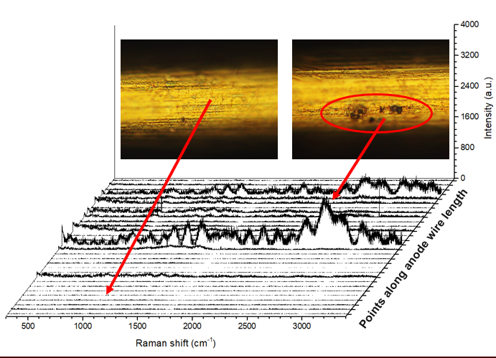
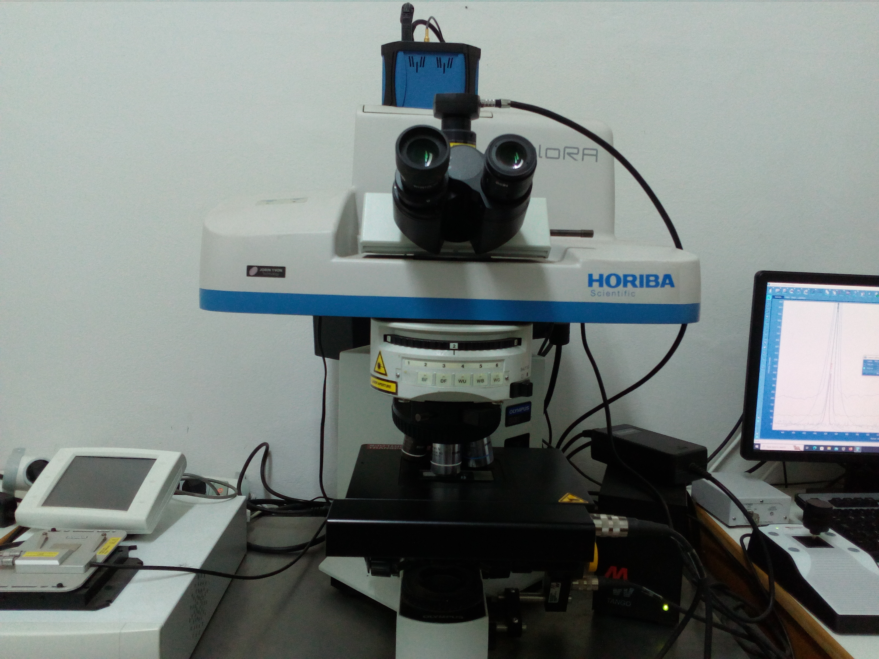
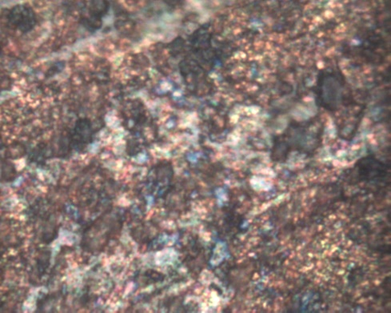
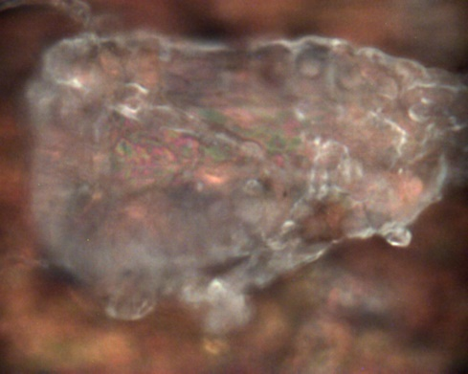
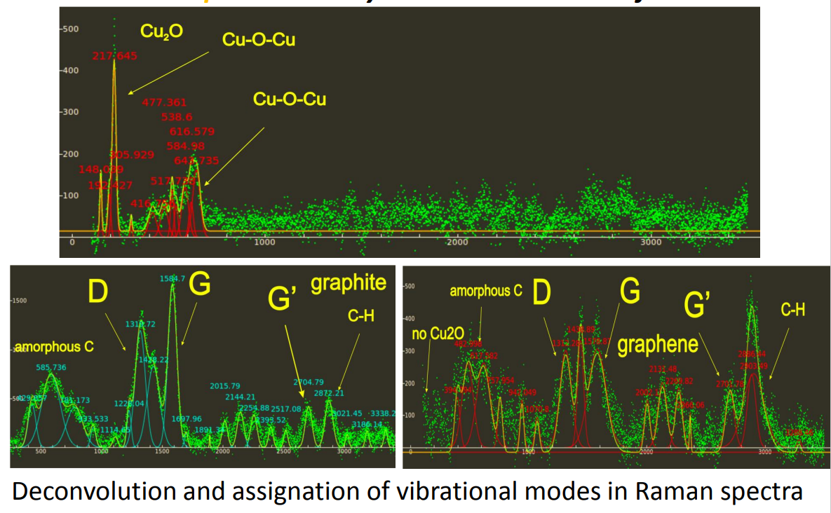
Micro-Raman spectroscopy
Micro-Raman spectroscopy of
anode wires (distribution along wire length)
Coupled with optical microscope, we can select points of interest (~2µm in diameter) to investigate structural elements (functional groups) of the deposit constituents formed on electrode surface or perform measurement over the larger area, thus obtaining information on deposit distribution (possibility of mapping).
10% CF₄
Micro-Raman spectroscopy of cathode surface
10% CF₄
Deconvolution and assignation of vibrational modes in Raman in different points on the cathode
Raman spectroscopy is the most valuable technique for characterizing carbon-based structures as it is sensitive to highly symmetric covalent bonds, which is of particular interest due to different electrical properties of variously doped graphene derivatives.

Slide 15
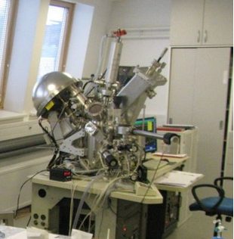
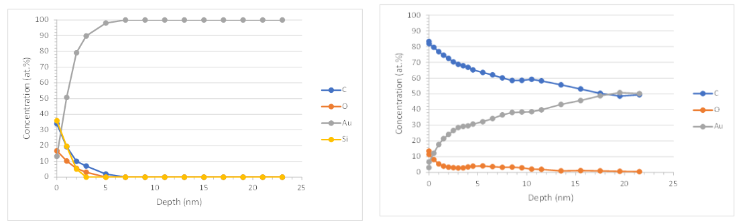
X-ray Photoelectron Spectroscopy (XPS)
Uses an X-ray beam to excite the elements on the surface of a sample, leading to a release of photoelectrons.
By analyzing the energy of photoelectrons, the following information are collected: chemical and electronic state of a sample's elemental components, chemical bonding of elements and quantitative elemental composition, from surface to a penetration depth of 20-30 nm in thin films and multilayered structures.
XPS depth profiles
Cathode plates
Anode wires
Virgin
10% CF₄ Irr
Virgin
10% CF₄ Irr
Carbon atomic concentration remained constant > 80 at% for aged cathode and up 50 at% present at aged anode, even at the 20 nm depth, implying the carbon presence below the surface can be attributed to the carbon deposit, in graphite/graphene form.

Slide 16
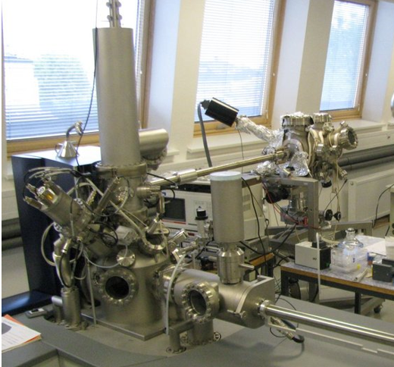
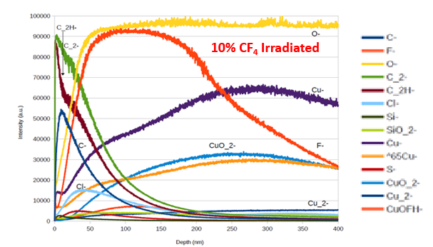
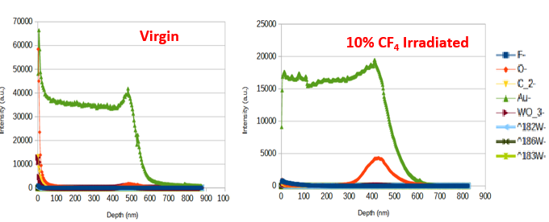
Time of Flight - Secondary Ion Mass Spectroscopy (ToF-SIMS)
ToF-SIMS method is used to get additional information about the depth distribution and the types of species on the surface. Negative ions emitted from surface are analyzed.
Quantitative analyses (in %) is not possible with SIMS technique.
Cathode plate
Anode wires
Analyzed area of 100 x 100 µm²
SIMS depth profiles of selected signals obtained on aged cathode versus depth
Sputter diagrams of the virgin and aged anode wires
The use of ToF-SIMS for wires is under question
The cathode surface is covered with Cu-oxide and C-compounds, while Cl, S, C-H can originate from contamination or interaction during operation. Beneath the surface is a region rich with F (300 nm thick), most likely interacting with Cu and Cu-oxide.
In aged anode increased O signal at Au/W interface is detected.

Slide 17
Summary of obtained results
Comparison of results for irradiated cathode and anode samples
0, 2, 5% CF₄ and 2% HFO1234ze
Cathode samples
Anode wire samples
WOx
Si
See the “Studies toward reduction or replacement of CF4 in the CMS CSC working gas mixture” by Katerina Kuznetsova

Slide 18
Conclusion
Analysis of the microstructure of the deposits by combining various analytical techniques that operate at different scales (nano, micro and meso) with different penetration depth provided detailed analysis of electrode deterioration which can:
  enable better understanding of the deposition mechanism in plasma chemical reactions
  further help in evaluating optimal working conditions of proportional gas chambers (selecting optimal gas mixture and construction materials of the detector).
The goal of this work is to establish unified approach to problems relevant to analysis by:
  standardization of optimized analytical methods, sampling, handling and measurement protocols
  interpretation of the results
  thus enabling comparison of results between different longevity tests and different laboratories and creating network for exchange of knowledge and ideas.

Slide 19
Future plans
Eco gas search
More studies of CSC with miniCSC using different gases with small prototypes
Searches for eco gases, ideas what to do with them from the chemistry point of view, prediction of the gas properties (chemical reactivity, electronegativity, ionization properties).
Optimization of the composition of the working gas mixture to provide similar performance (gas gain) as the currently used.
Collaboration with CSC
Open for collaboration with other groups
Adding new analytical techniques and their optimization
Introducing additional analytical techniques to have complete set of protocol measurement in order to obtain reliable results.
Overcoming problems by adapting the techniques toward assessing the selected sample properties and establishing methodology for interpretation of acquired results which will be starting point for future research and routine.

Slide 20
Backup slides

Slide 21
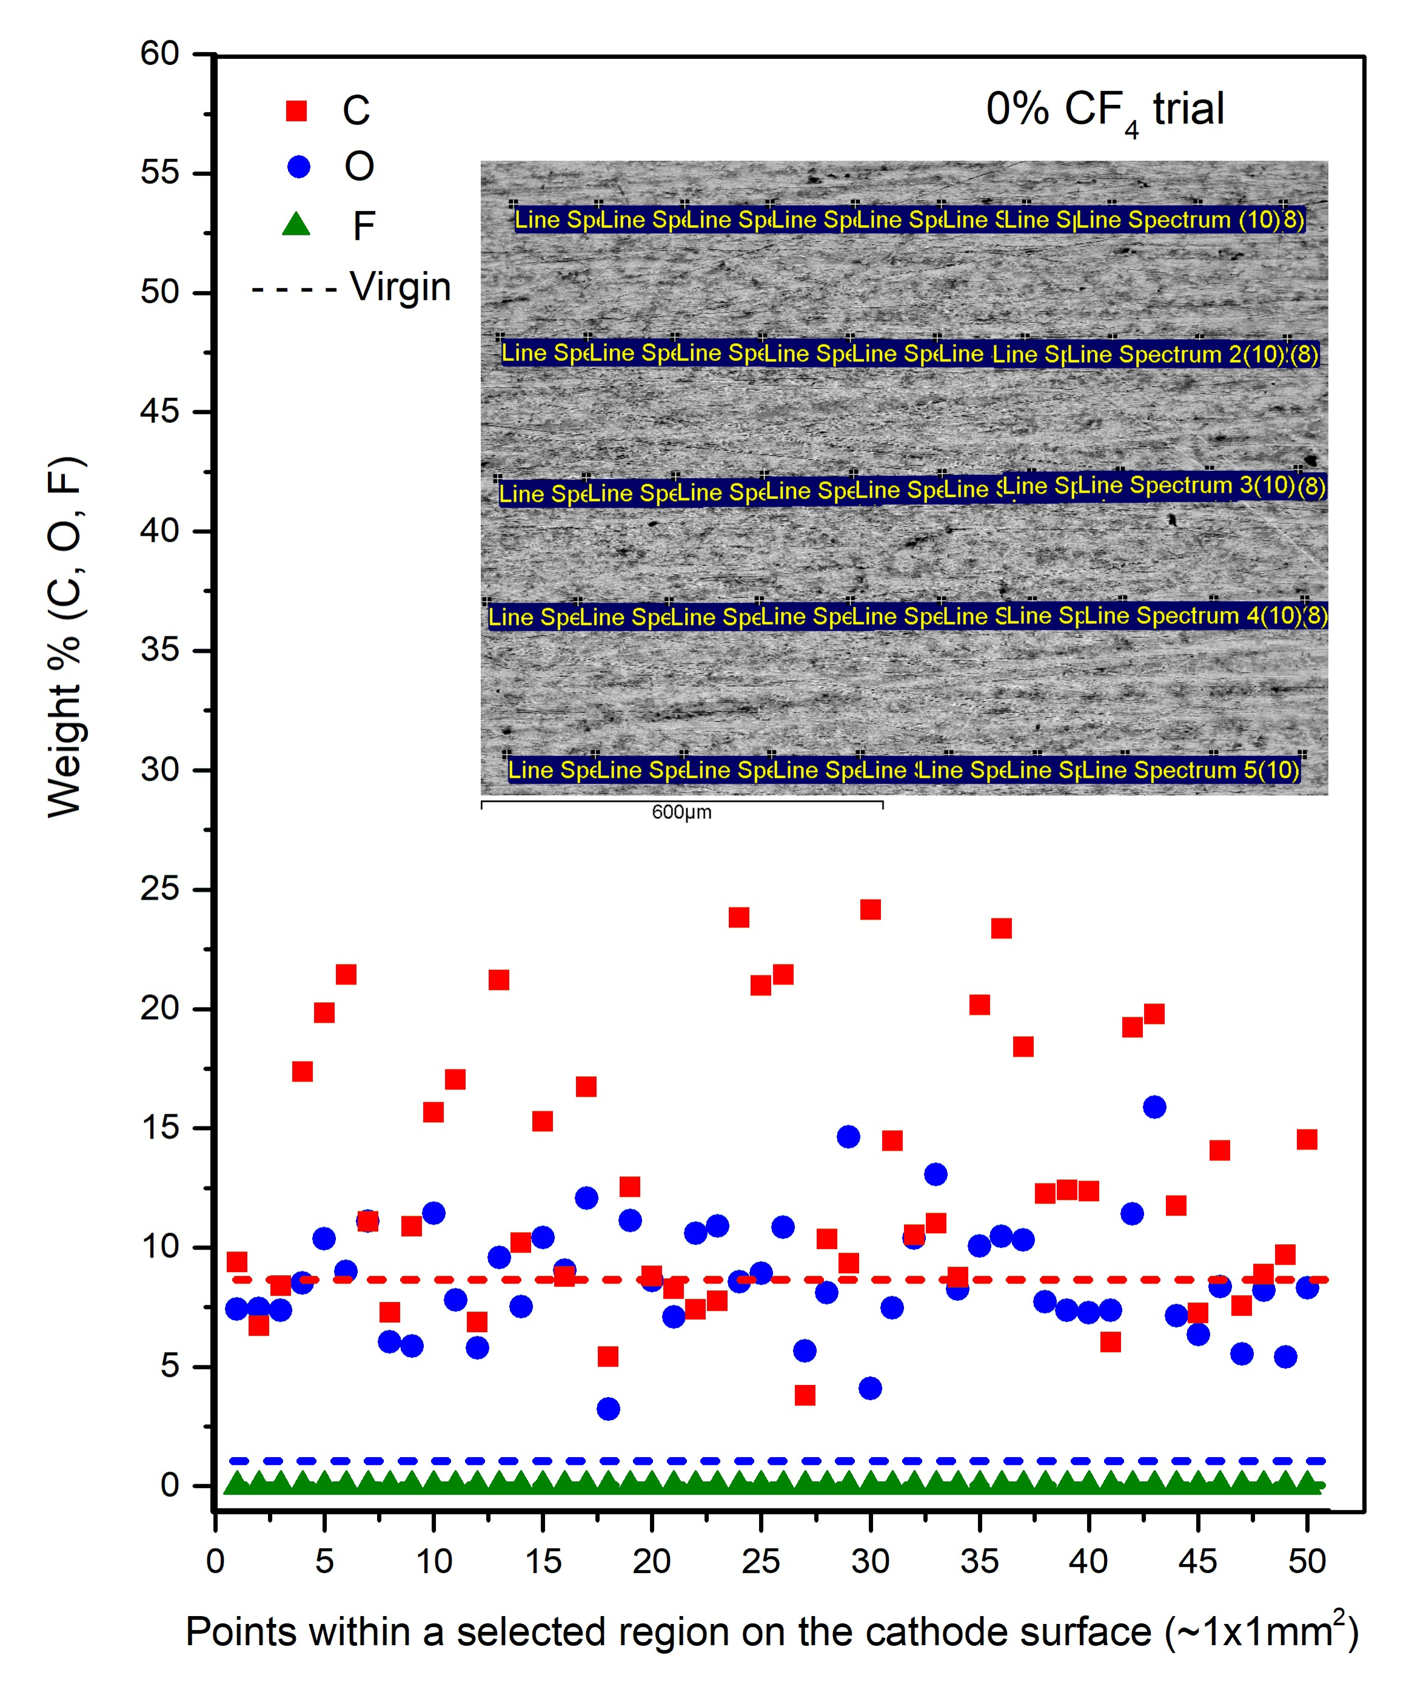
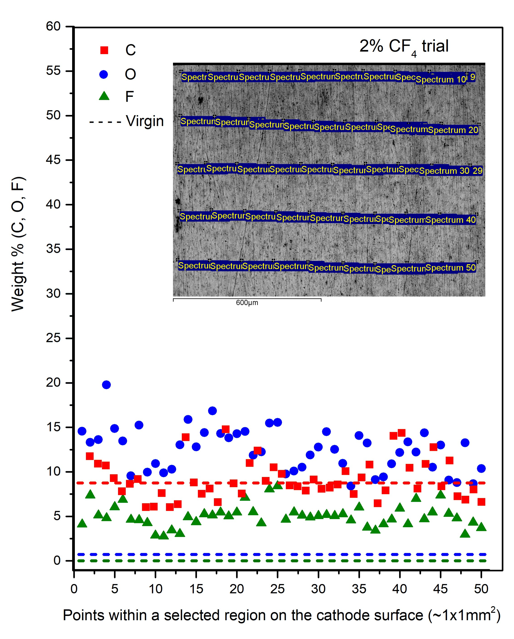
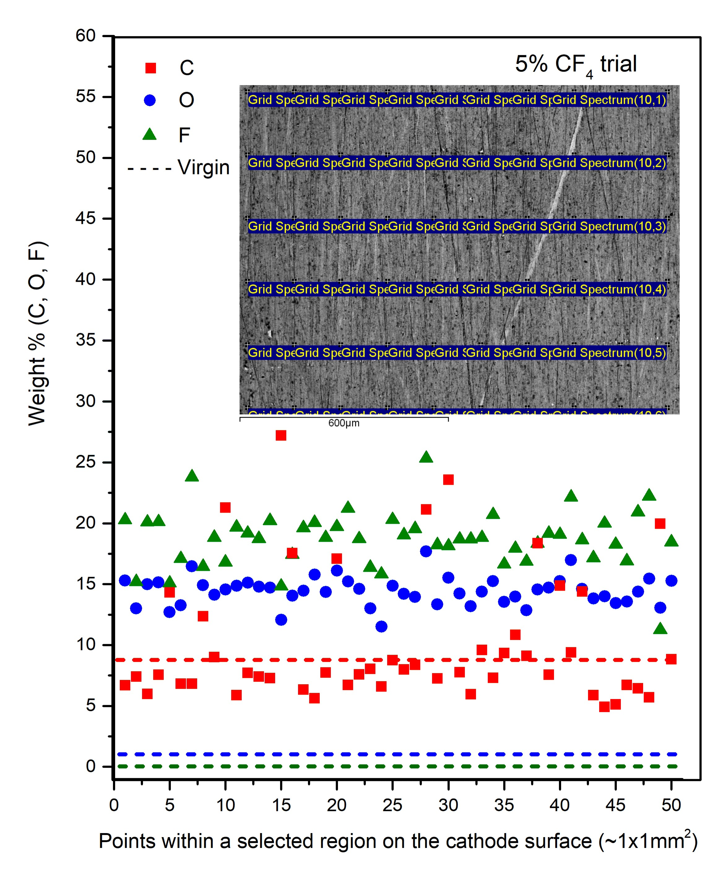
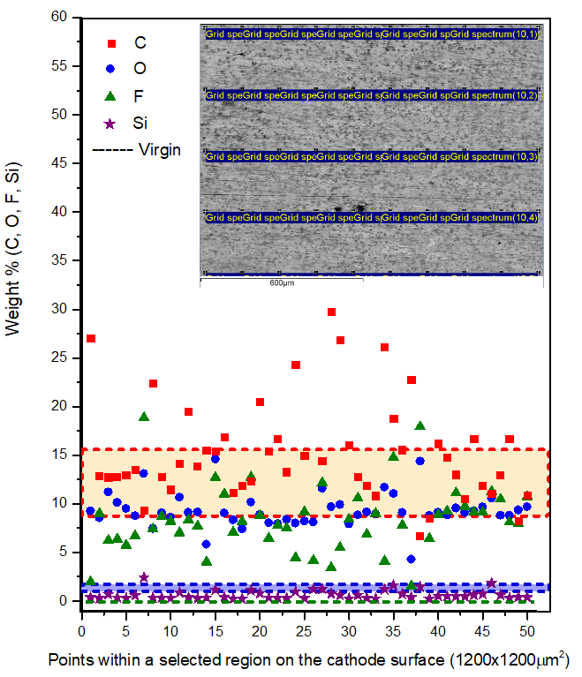
Comparison of elemental distributions over the selected regions of cathodes (0, 2, 5 and 10% CF₄) in the center of irradiated zone
10% CF₄ trial
250 µm
250 µm

Slide 22
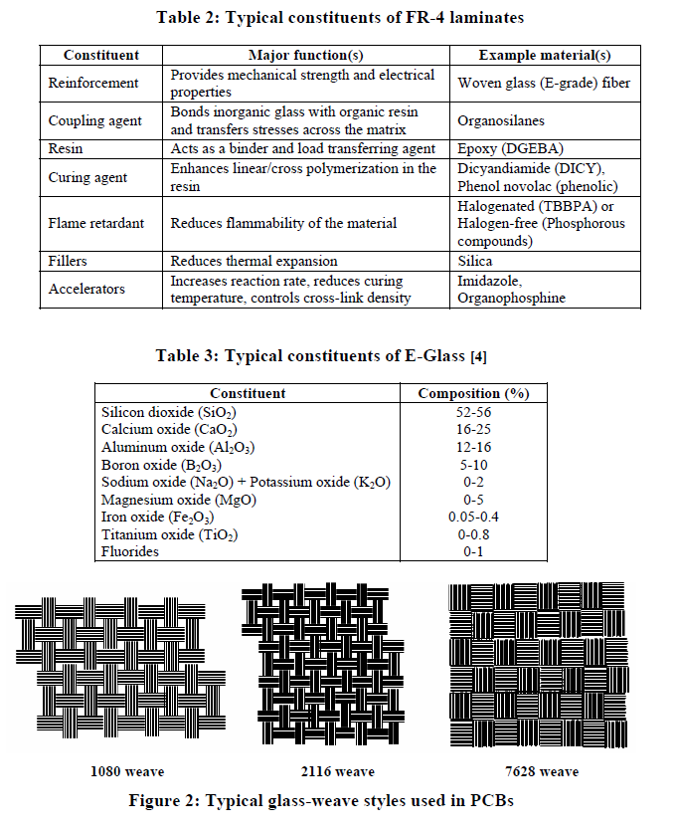
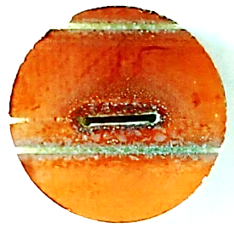



Analysis of FR4 material
Comparison of FTIR spectra of FR4 material
from PNPI and CERN 904
Higher Si content
EDS analysis of the cathode surface (PNPI)
Can samples with different FR4 material be compared?

