Slide 1
Aging effects at the FRIB's Advanced Rare Isotope Separator diagnostics detectors
Salvatore Di Carlo
Detector Physicist
dicarlo@frib.msu.edu
7 November 2023

Slide 2
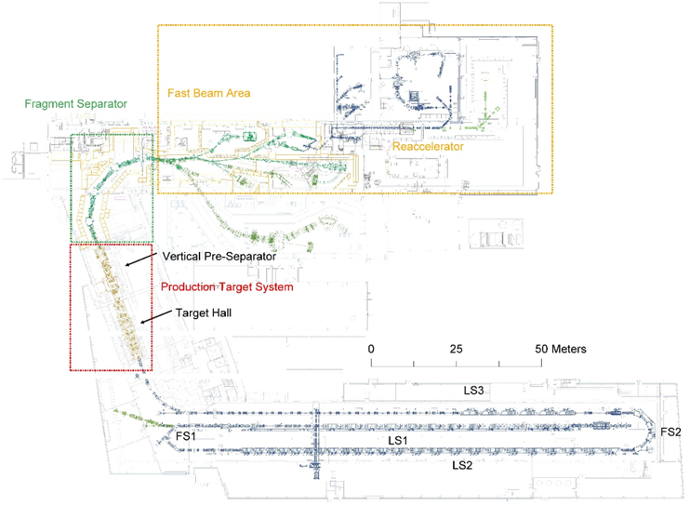
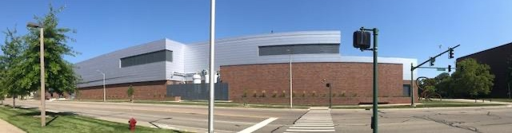
Facility For Rare Isotope Beams (FRIB)
US DOE Office of Science scientific user facility
Provides rare isotope beams
Construction started in 2008 and finished 2022.
Successfully completed several experiments
Open to researchers from around the world
Located at Michigan State University, MI, USA

Slide 3
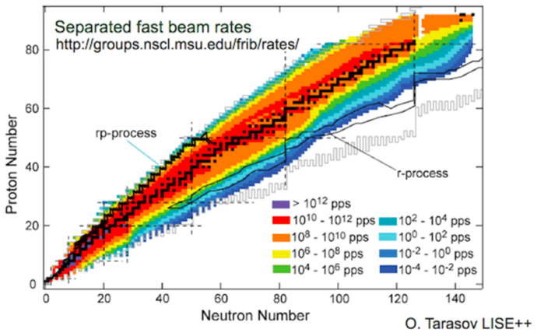
FRIB’s Key Features
400 kW beam power
Experiments with fast (200 MeV/u), stopped (trapped), and reaccelerated beams (0.6 to 10 MeV/u)
In-flight isotopes separation provides:
  Fast development time for any isotope
  Beams of all elements and short half-lives
Capability to harvest isotopes from beam dump water
Notes:
8 p𝜇A or 5 x 10¹³ ²³⁸U /s
42 p𝜇A or 2.6 x 10¹⁴ ⁴⁸Ca /s

Slide 4
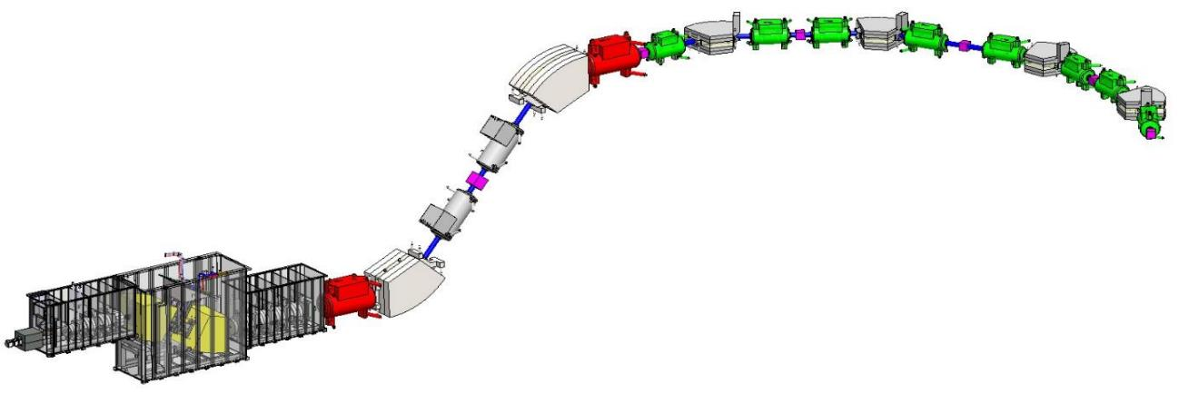
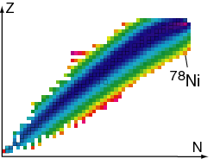
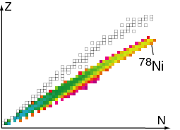
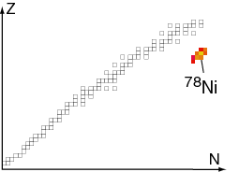
FRIB Enables Progress in Four Areas
Nuclear structure:
  Study of predictive model of nuclei & their interactions, many-body problem & physics of complex system
Astrophysics:
Origin of the elements, energy generation in stars, stellar evolution & the resulting compact objects
Fundamental symmetries:
Effects of symmetry violations are amplified in certain nuclei
Applications:
  Medicine, energy, material sciences, national security, etc.
Advance Rare Isotope Separator (ARIS)
Hausmann et al., NIM B317 (2013)
10m
3-stage fragment separator for collection and purification of rare isotope beams.
Target-Carbon disk
Fragments after target
Fragments after wedge
Fragments at focal plane
Example:
⁷⁸Ni from ⁸⁶Kr at 200 MeV/u

Slide 5
Science Opportunities at FRIB with Fast, Stopped, Reaccelerated Beams
Start Date | Primary Beam | Energy [MeV/u] | Rare Isotope Beam | Energy [MeV/u] | Location
April 5 2023 | Xe-124 | 227 | Ru-89 | 146 | S3 - S800
May 4 2023 | Ar-40 | 200 | Mg-29 | 94 | N4
May 4 2023 | Ar-40 | 200 | O-24 | 115 | TH - FDSi
June 4 2023 | Zn-64 | 240 | Cu-59 | 29 | S3 - S800
June 24 2023 | Ar-36 | 210 | P-26 | 101 | N4 - LEGP
July 16 2023 | Ca-48 | 197 | S-44 | 91.5 | S3 - S800
July 25 2023 | Ca-48 | 216.7 | Si-42 | 89.3 | S3 - S800

Slide 6
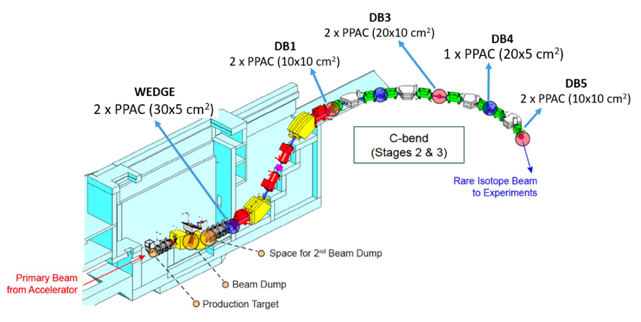
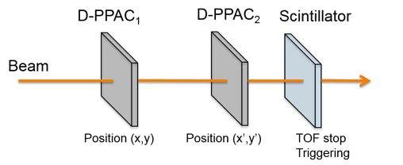
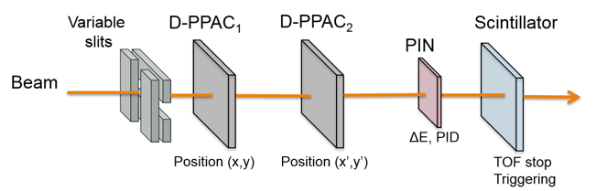
ARIS Diagnostics Detectors
Diagnostics boxes: Tracking and Particle Identification (PID)
-) Beam profile/quality, transmission studies, beam shaping and tuning. (Wedge/DB1/DB3/DB4/DB5)
-) Event-by-event particle positions & angles measurement ➔ D-PPACs
-) Timing measurement ➔ TOF detector – (Scintillator EJ-232)
-) Measurement of the Energy loss ➔ Silicon PIN diode (Micro-semiconductor MSX25)
In the rest of the talk, I will show aging in D-PPAC and TOF detectors and possible alternatives/solutions
DB3
DB5

Slide 7
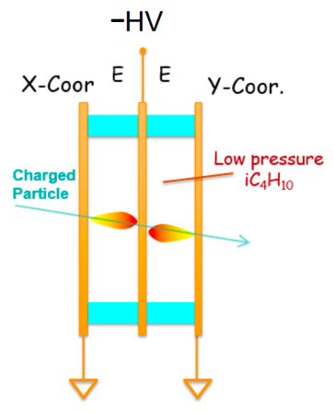
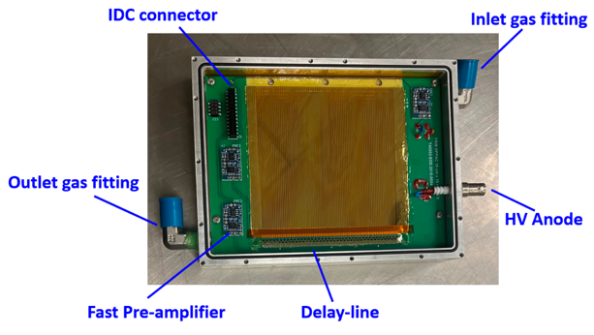
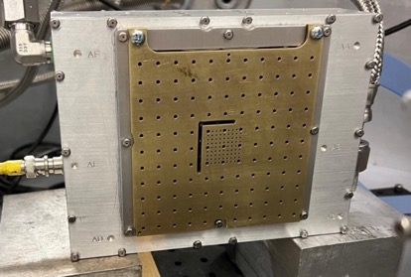
Parallel Plate Avalanche Counter (PPAC) at FRIB
Cathode
(uniform foil)
Anode
(striped foil)
Event-by-event heavy-ion position and timing measurements
Electrode foils distance: 3.5 mm
Applied Bias: -200 V/mm
Typical signal: 300mV
Typical SNR: ~30
Materials used:
  Electrodes: three 0.75um Polypropylene (density 0.9 g/cc) foils with 150nm evaporated metal layer
  Gas: 55 mm of iC4H10 at 7 Torr
  Pressure windows: two 6um Mylar (density 1.39 g/cc) foils
  Al equivalent 2.4 mg/cm2 or 9.0 um
iC4H10:
10eV ion. pot.
Quencher
Fast
Chem. stable
0.5 mm
resolution

Slide 8
Aging in PPACs
Aging issues mostly on cathode electrode (central foil) due to intense ions flux (thermal, chemical effects).
Anodes bombarded by electrons show modest damage.
Progressive degradation of the metal surface -> slow decline in detection efficiency
Needs frequent replacement of cathode electrode to restore the PPAC’s efficiency. -> Development of cathode boards for easy swap
Long exposure to sporadic discharge events also contribute to the aging of the metal layer
Gold
Chromium
Aluminum
Gold

Slide 9
Discharge Mechanisms in PPACs
Mechanical imperfections (bad detector):
  Sharp edges at high potential
  Dust or conductive materials between electrodes
Slow Breakdown (us to ms):
  Photon-feedback
  Ion-feedback
Fast breakdown (tens of ns):
  Combination of photoionization and distortion of electric field in proximity of the avalanche caused by space-charge effects
High beam rates:
  Merging of consecutive avalanches occurring at the same location

Slide 10
Two Types of Damage Observed
Aluminum
Gold
Electrical trees: branching, tree-like structures that grow on the surface (several cm)
Electrical circles: circular or ring-shaped localized patterns (~1cm diameter)
Damage in PPACs is usually more localized on gold electrodes (circles) and more extended on aluminum electrodes (trees)
Aluminum

Slide 11
Choice of Electrode Materials
An electron gun evaporator is used to metalize polypropylene foils (150nm)
Electrode materials tested:
  Aluminum
  Gold
  Chromium (high melting point)
To be tested:
  Silver
  Carbon
Present operational choice:
  Gold cathode (uniform) and Aluminum anodes (striped).
Further to test:
  Foil conditioning (e.g. UV light)
  ➔ improve adhesion metal/polypropylene
  Multi metal layers
  ➔ improve mechanical stability
Gold
Chromium
 | Carbon | Aluminum | Chromium | Silver | Gold
Atomic number | 6 | 13 | 24 | 47 | 79
Density (g/cm3) | 1.8 - 3.5 | 2.7 | 7.19 | 10.49 | 19.3
Melting point (°C) | 3550 | 660.32 | 1857 | 961.78 | 1064.18

Slide 12
Replace thin foil with wires
Use of wires instead of evaporated Polypropylene foils
  More robust to ion bombardment
  Loss of detection efficiency (charge states production and straggling)
Gold Plated Tungsten Wires:
  12 um diameter
  1 mm pitch
  ~98.8% surface optically transparent
PPAC -> Wire chamber
  Fast timing signals (10ns rise time)
Under development

Slide 13
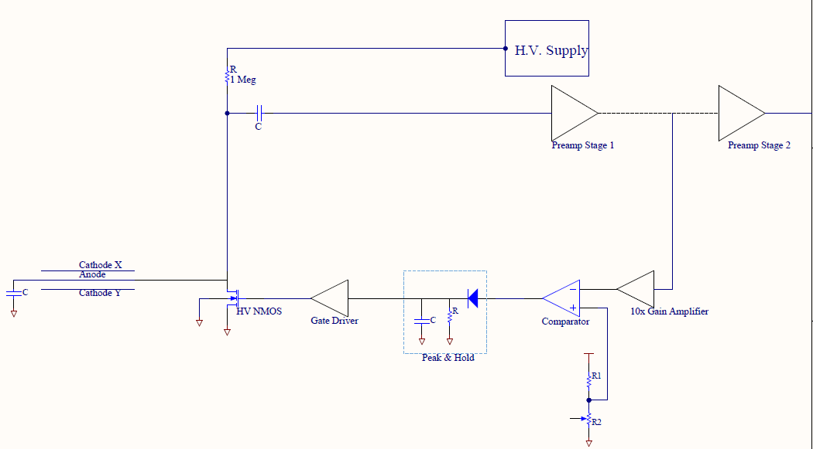
FRIB Anti Discharge Unit (ADU)
ADU will protect the electrodes foils from damage due to spark events.
Measures anode response and quickly grounds HV bias in case signal is too large, which could lead to short circuit between electrodes.
Circuit is divided into several stages:
  1st stage preamp ➔ 10x gain amp ➔ comparator ➔ peak & hold ➔ gate driver ➔ HV NMOS
in vacuum
sits on fast preamp
ADU
PPAC
Courtesy of K. Saini, T. Larter (FRIB)
UNDER DEVELOPMENT

Slide 14
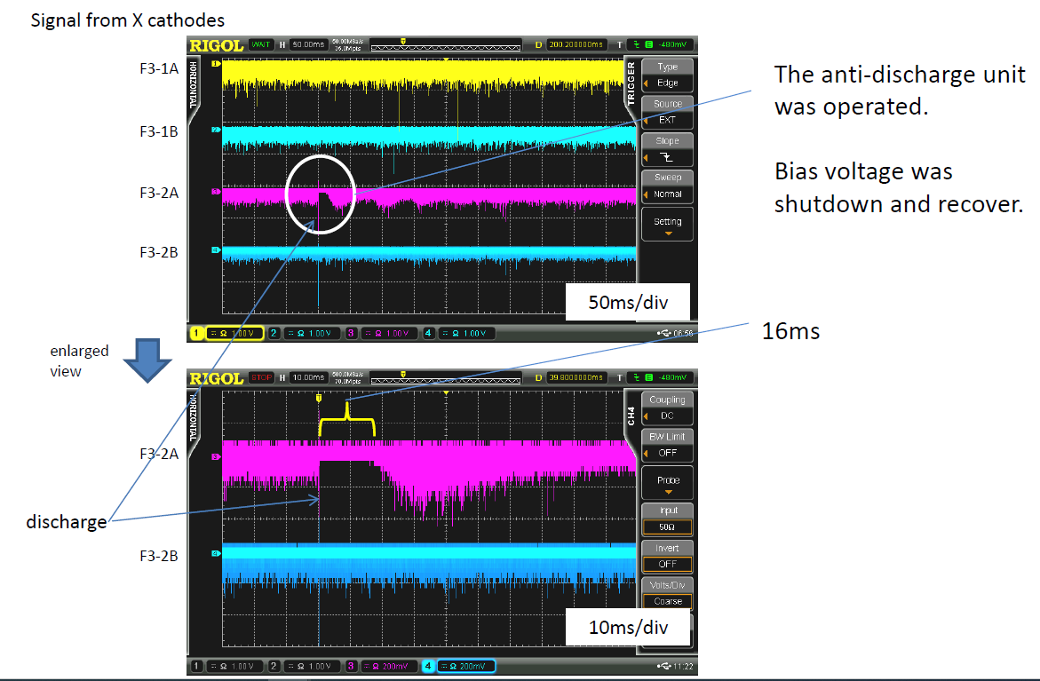
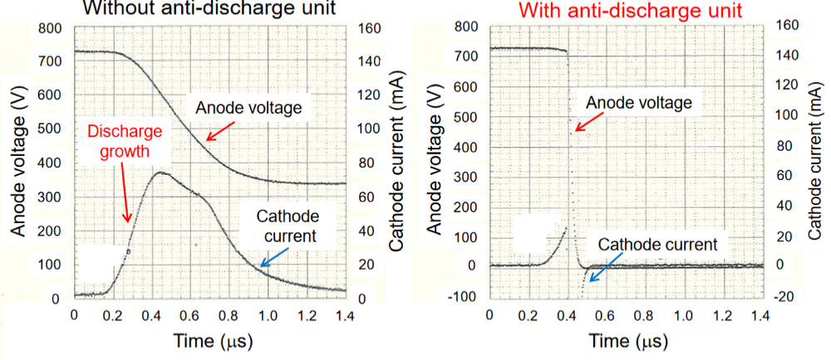
RIKEN ADU system
Originally developed by Kumagai-san (RIKEN) for delay-line PPAC application
Drop of the anode potential during discharges within a few tens of ns.
Prevent development of discharges
Reduced recovery time
➔ from a few seconds to a few tens of ms
Taken from Y. Sato (RIKEN) presentation.

Slide 15
Plastic Scintillator for ToF Measurements
Hamamatsu H6533-20 PMT
PMMA light guide
ELJEN EJ-232 (0.15mm thickness) plastic scintillator
Timing resolution ~200 psec

Slide 16
Aging Effects in Plastic Scintillators
Plastic scintillator material does not sustain large radiation doses at high rates (>1MHz) for prolonged period of time.
Scintillator replacement is necessary during experiment runs, degradation is fast (hours/days).
Alternative solutions for ToF are under development (PPAC, Optical PPAC, multi wire detectors, diamond detectors).

Slide 17
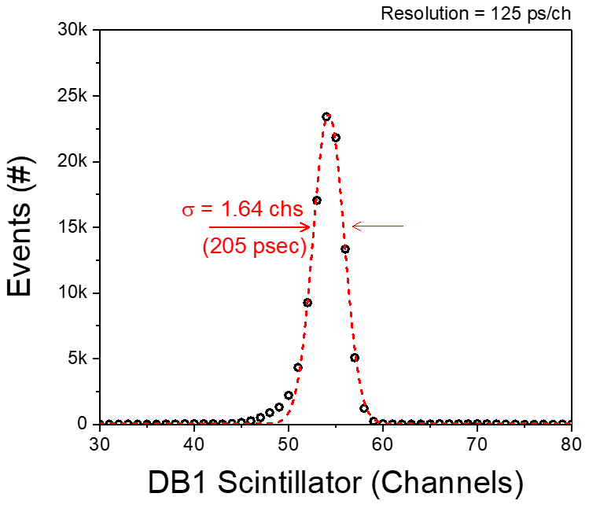
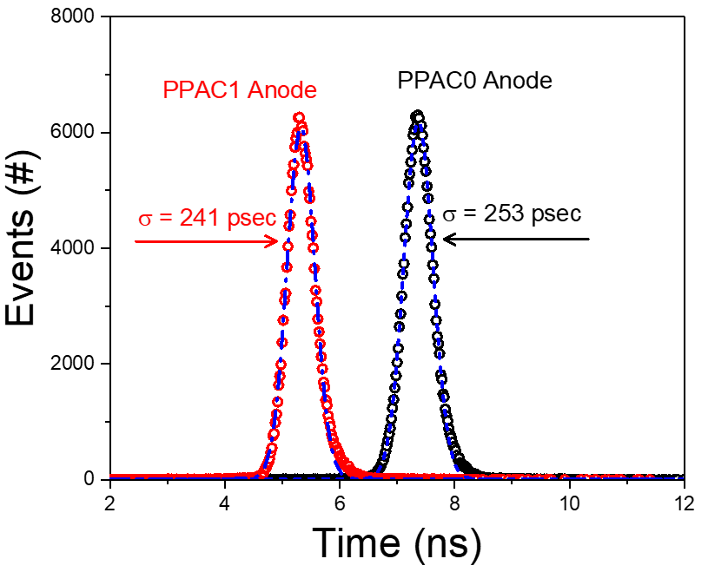
Time of flight based on PPAC
PPACs ToF test at FRIB February 2023
Time resolution a few hundred ps comparable to small-area plastic scintillator detectors
Under the same condition of absorbed dose, the degradation of PPAC performance is generally slower than that of plastic scintillators.
New PPACs built in 2023 all provide timing signals by design.
Scint
PPACs

Slide 18
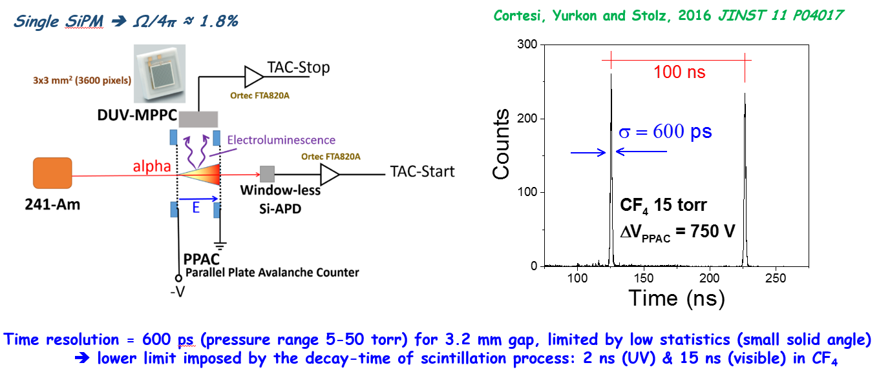
ToF based on Optical PPAC
Measures scintillation light produced during avalanche processes
Advantages:
-) Compact, small ToF system with high resolution
-) Reduced aging if used with wire electrodes
-) Unaffected by magnetic fields

Slide 19
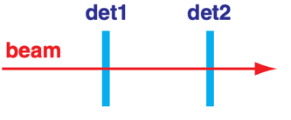
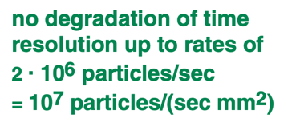
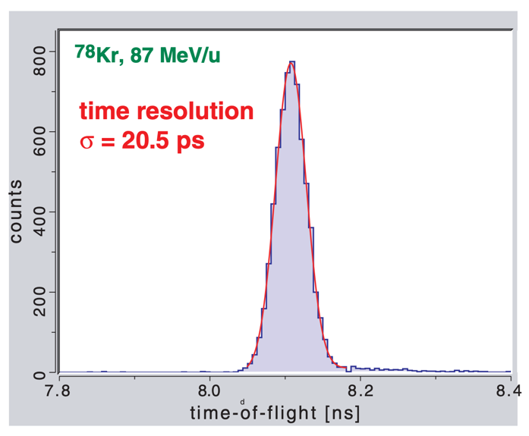
Use of Diamond Detectors for Timing Measurements
2012 test at NSCL (MSU) shows excellent time resolution
Radiation hardness -> Longer lifetime than plastic scintillator is expected
Expensive ~$60 per mm2
Difficult to produce in large sizes, uses at FRIB require 15x15mm2 up to 40x40mm2
Tests with first prototype pCVD 200um thick and 30x30mm2 area expected in 2024
20um
sCVD
35um
sCVD
Taken from A. Stoltz (FRIB) presentation.

Slide 20
Conclusions
ARIS detectors are used for event-by-event heavy-ion tracking (PPAC) and timing measurements (scintillator + PMT).
Detectors are subject to aging due to exposure to high rates of ions and/or sporadic discharge events that can cause a decline in efficiency
Developing techniques to mitigate PPAC’s aging:
  tests with new electrode materials
  conditioning
  use of wires
  Anti Discharge Unit development
Studying feasibility of radiation resistant alternative to scintillators for ToF:
  PPACs
  optical PPACs
  diamond detectors

