Slide 1

MAJOR REFERENCES
John Kadyk: Proceedings of the Workshop on Radiation Damage to Wire Chambers. LBL-21170 (1986).
John Kadyk: Wire Chamber Aging. Nucl. Instr. Meth. A300 (1991) 436
Marcus Hohmann: Aging phenomena in gaseous detectors-perspectives from the 2001 workshop. Nucl. Instr. Meth. A494 (2002)494.
Mar Capeáns: Aging and materials: lessons for detectors and gas systems. Nucl. Instr. Meth. A515(2003)73.
Maxym Titov: Radiation damage and long-term aging in gas detectors. Proc. 42nd Workshop of the INFN ELOISATRON Project (2003)
Fabio Sauli: Gaseous Radiation Detectors: Fundaments and Applications. Cambridge University Press (2014).
RD10: ﻿A study to improve the radiation hardness of gaseous detectors for use at very high luminosity
RD28: Development of microstrip gas chambers for high-rate applications
RD51: Development of Micro-Pattern Gas Detectors Technomogies
GDD: Gas Detectors Development Group (CERN)
☛ Special Thanks to Eraldo Oliveri
Limited to MWPCs & MPGDs

Slide 2
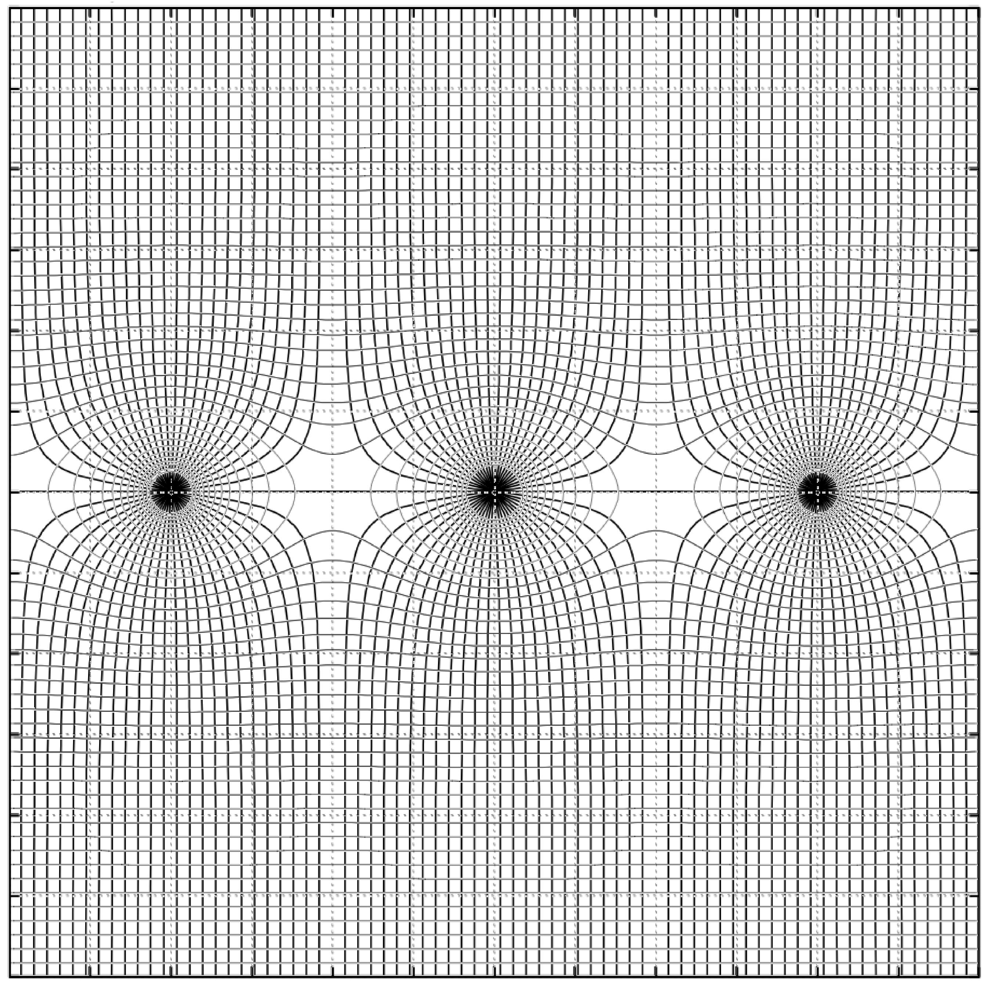
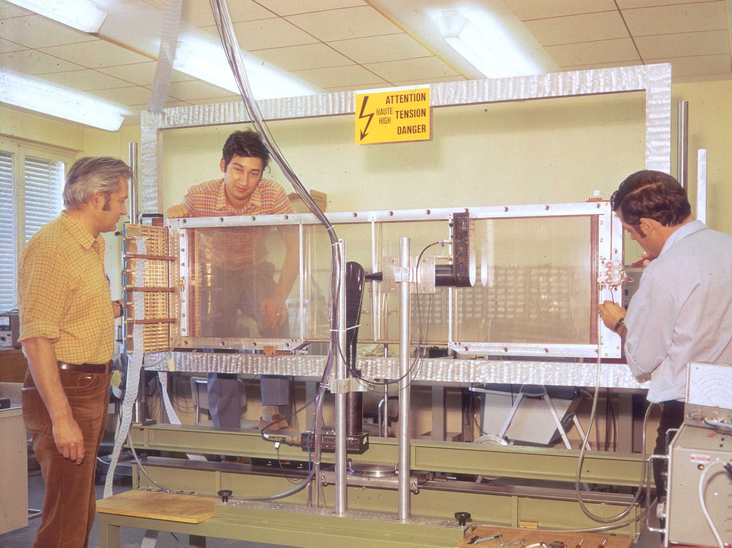
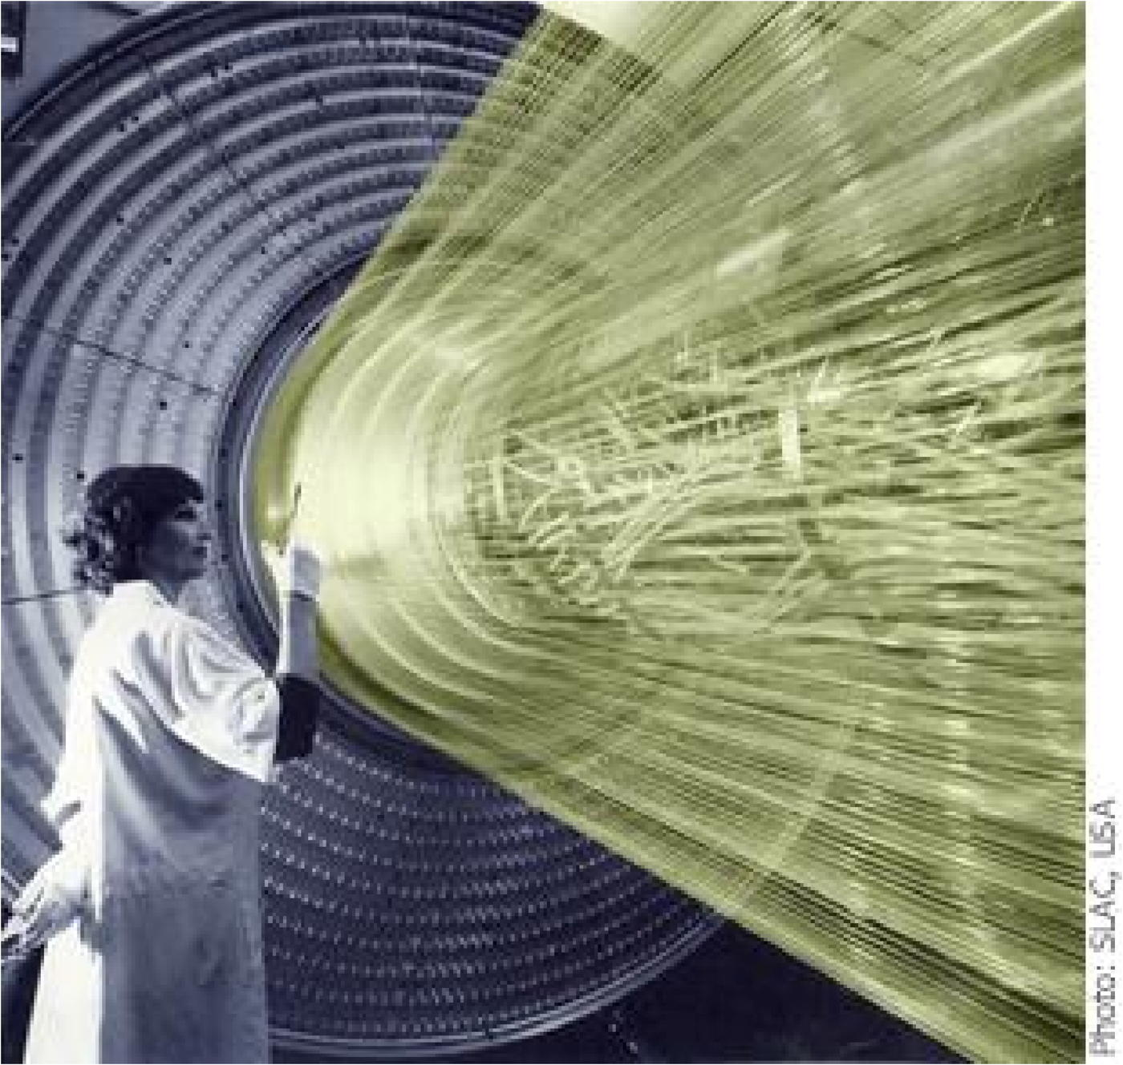
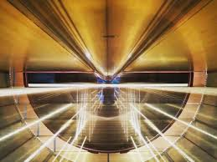
1968: Multiwire Proportional Chamber
Drift Chambers
Time Projection
Jet Chambers
….
G. Charpak et al,
Nucl. Instr. Meth. 62(1968)282

Slide 3
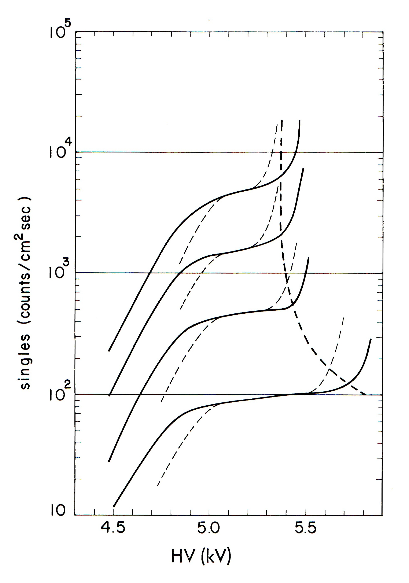


AGING OF MWPCs
Deterioration of Performances under Irradiation:
Rate Dependence of Gain
Higher Noise
The Night Sky
Magic Gas
Ar-iC₄H₁₀-CF₃Br
After
~ 10⁷ cm⁻² 𝞫 ⁹⁰Sr
G. Charpak et al, Nucl. Instr. Meth. 99(1972)269

Slide 4
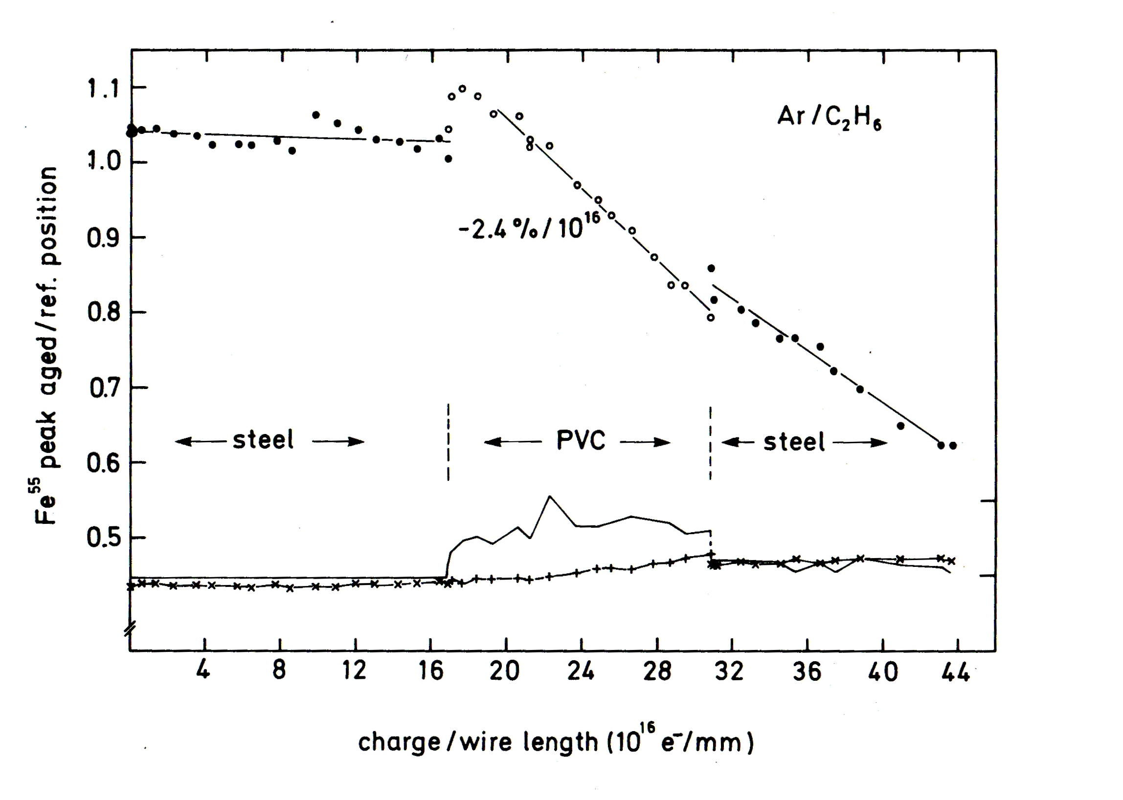
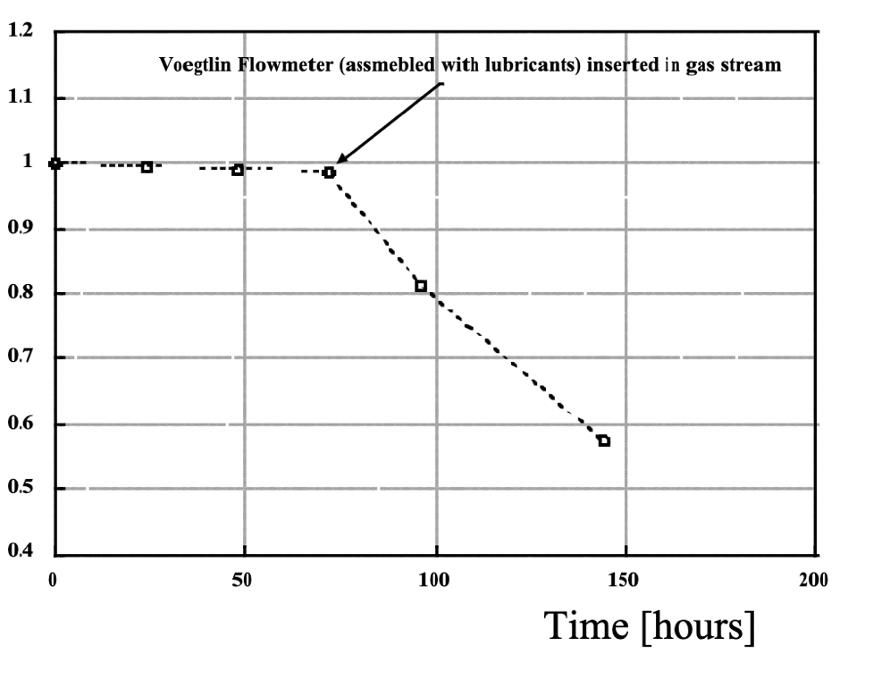
Examples of the Effect of Trace Pollutants in the Gas
Adding a Short PVC Tube
Change of a Gas Flowmeter
ATLAS/TRT Straws
R. Kotthaus,
Nucl. Instr. Meth. A252 (1986) 531
M. Capeáns,
ICFA Instr. Bull. (2002)
PLASTICIZERS
SILICON COMPOUNDS

Slide 5
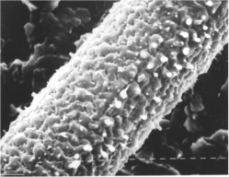
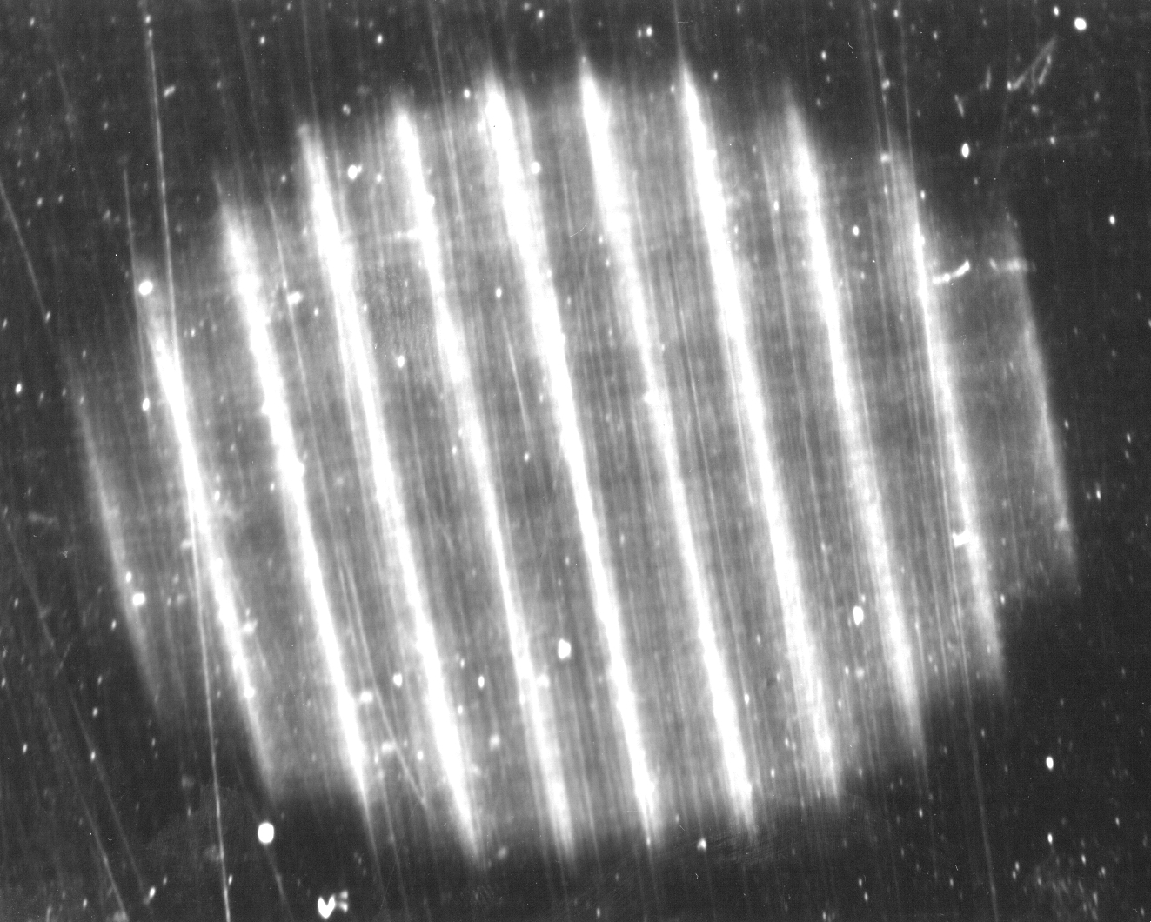
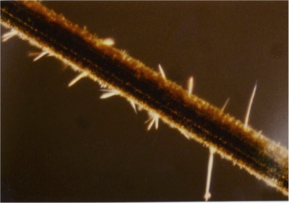

Deposit on Anodes and Cathodes
Polymers of organic quencher
Pollutants
Materials Outgassing
SILICONE Deposits
(see Later)

Slide 6
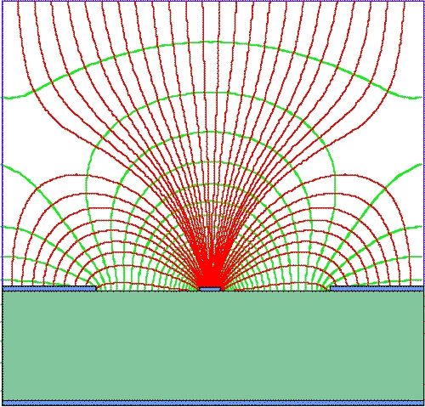
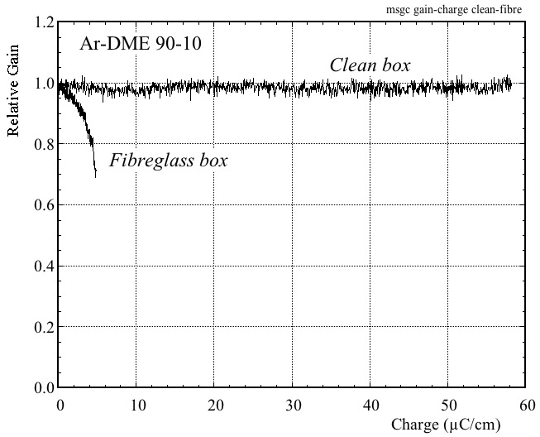
1988: Micro-Strip Gas Counter (MSGC)
Extreme Dependence on Gas Purity
A. Oed,
Nucl. Instr. Meth. 263(1988)351
R. Bouclier et al, Nucl. Instr. Meth. A348(1994)109

Slide 7
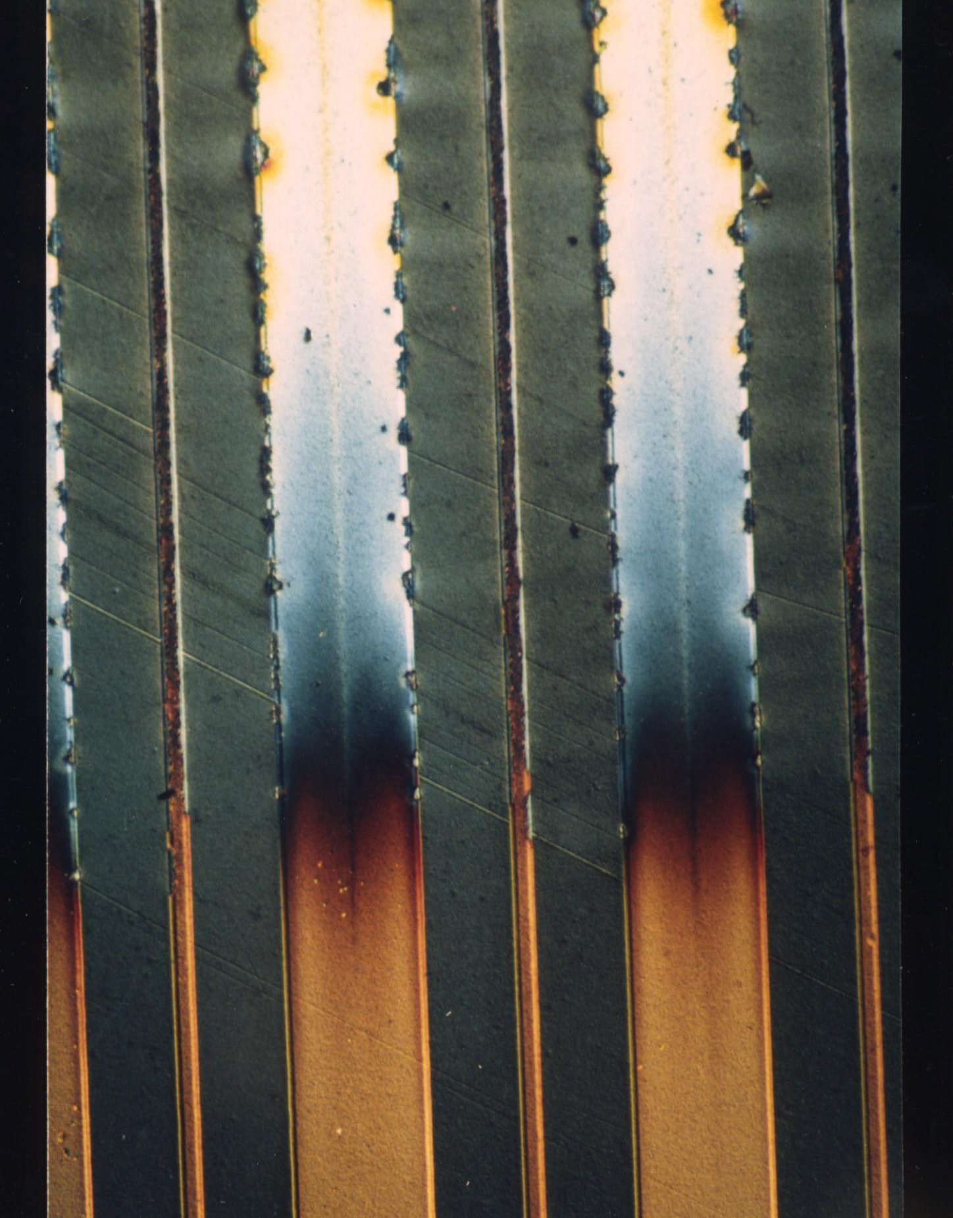
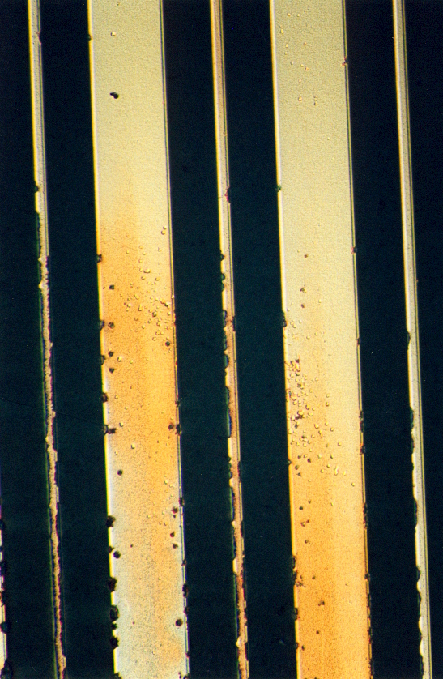
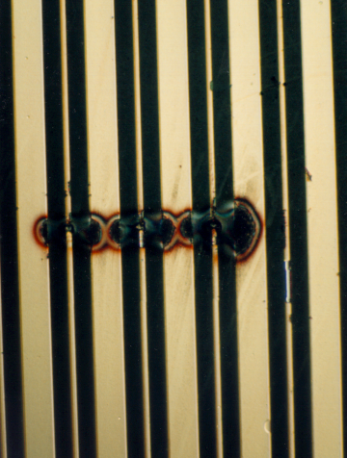
MSGC: Aging and Discharges
Discolorations (Deposits?)
Pitting (Micro-Discharges)
Full Discharge
AGING
☛ Discharges: See Piotr Gasik Talk
DISCHARGES

Slide 8
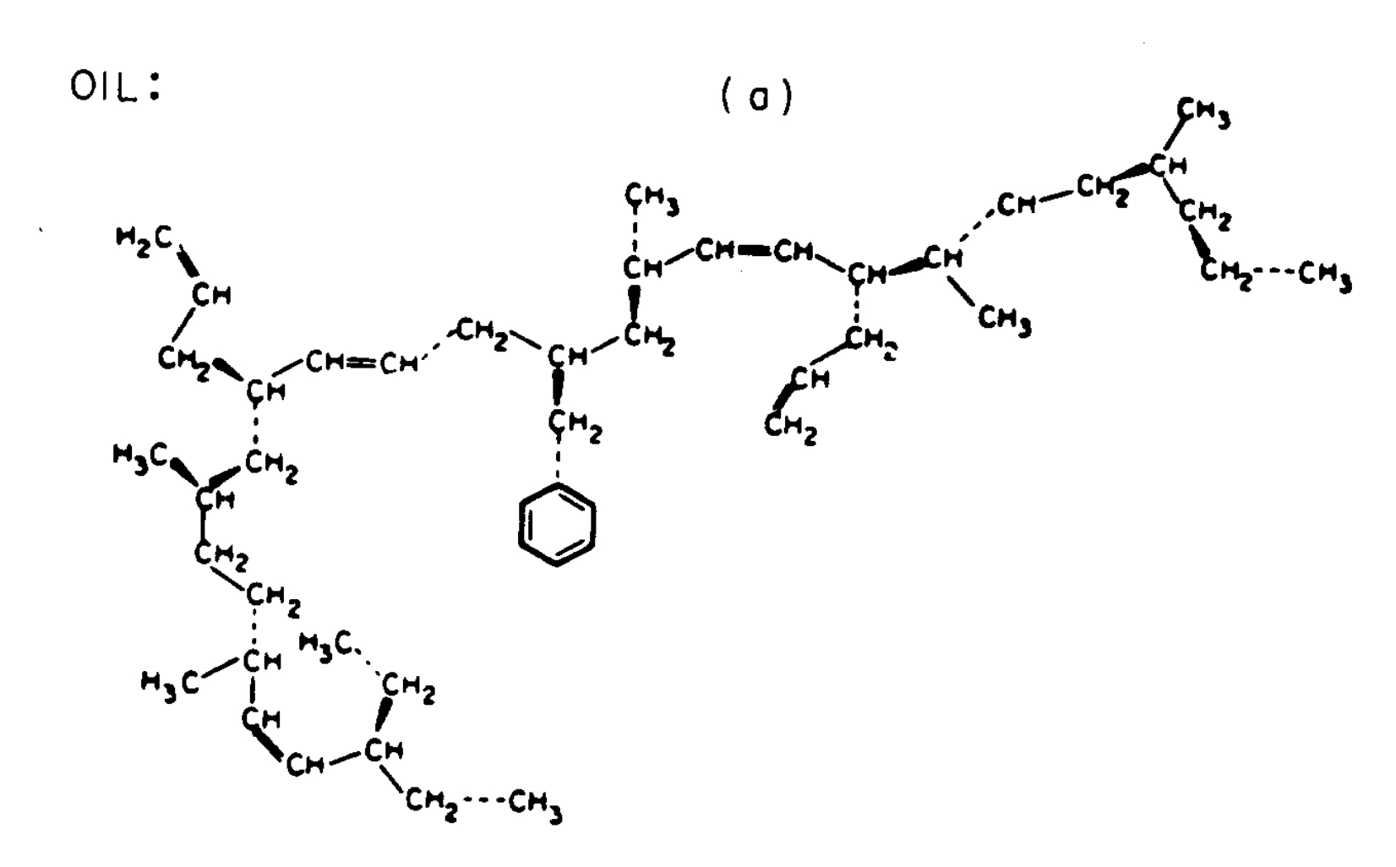
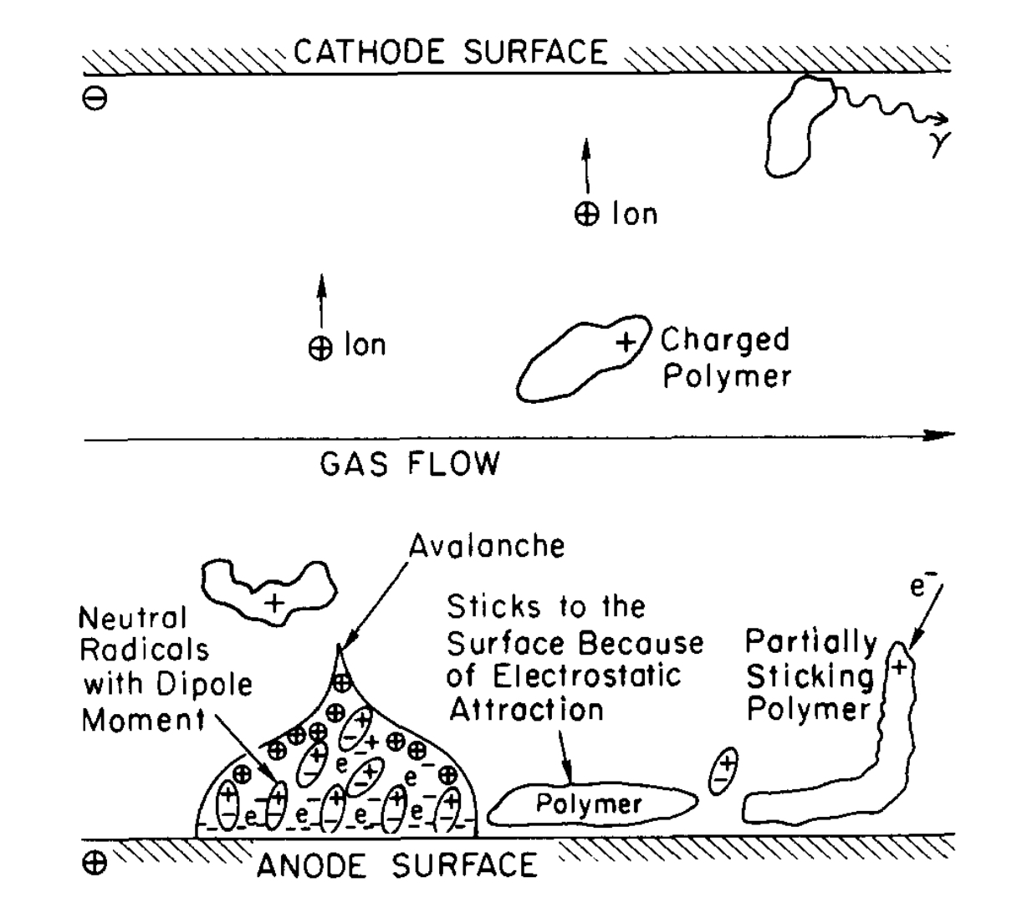
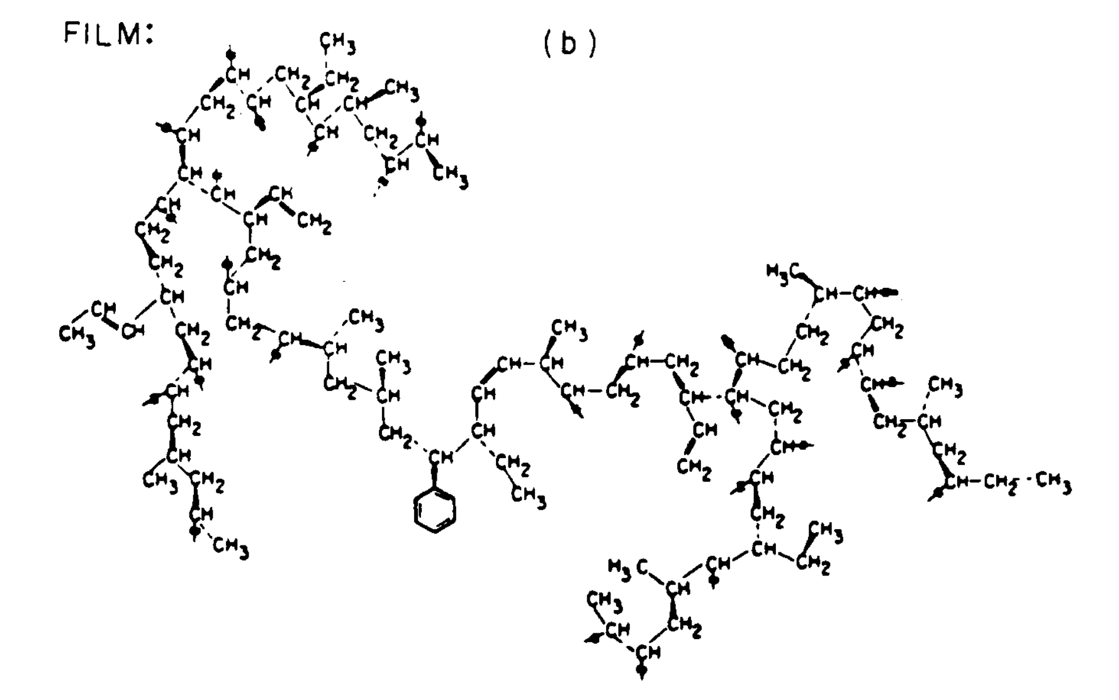
Mechanisms of Polymer Formation
Plasma Chemistry
Polyethylene Compounds
﻿e+CH₄ → CH₂:+H₂+e
Production of CH₂: radicals
(precursors of Polyethylene)
J. Va'vra,
Nucl. Instr. Meth. A252(1986)547
☛ Plasma Chemistry See Katerina Kudnetzova

Slide 9
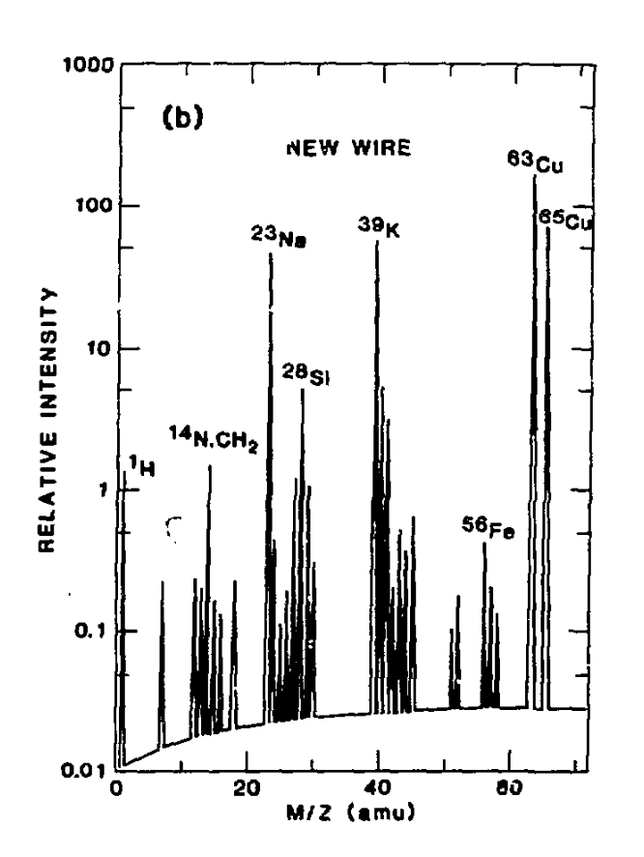
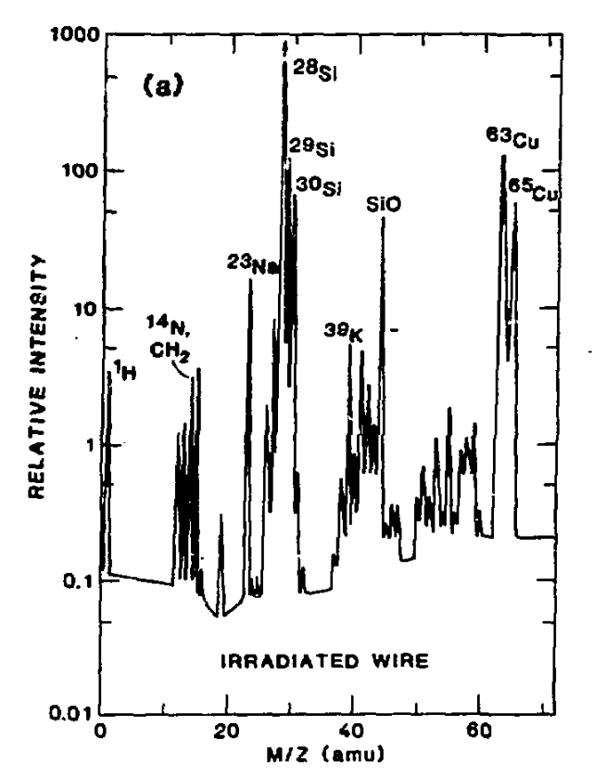
Silicone Compouds Deposits
Anode Wire Surface Analysis with Ion Microprobe Mass Analysis
NEW WIRE
IRRADIATED WIRE
W. Haberichter and H Spinka, AHL-HEP-CP-86-10
Silicone from Materials→ J. Kadyk, Nucl. Instr. Meth. 300A(1991)436

Slide 10
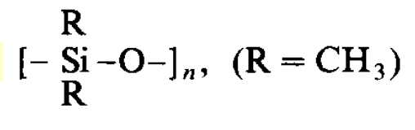
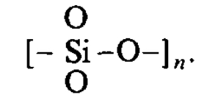
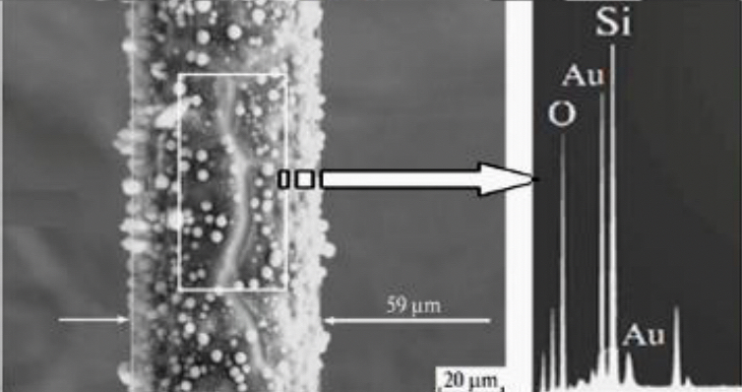
Very Effective Formation in the Avalanche of Silicone Polymers
Polysilicon
Silicate
AVOID:
Plasticizers (Phtalates)
Sealant: RTV
Vacuum Grease
Oil Bubblers
Silicone oil (Dow 704)
Duo-Seal
Epoxies: G10
…. and many others
G. Gavrilov et al. Phys. Part. Nuclei 49(2018)33

Slide 11
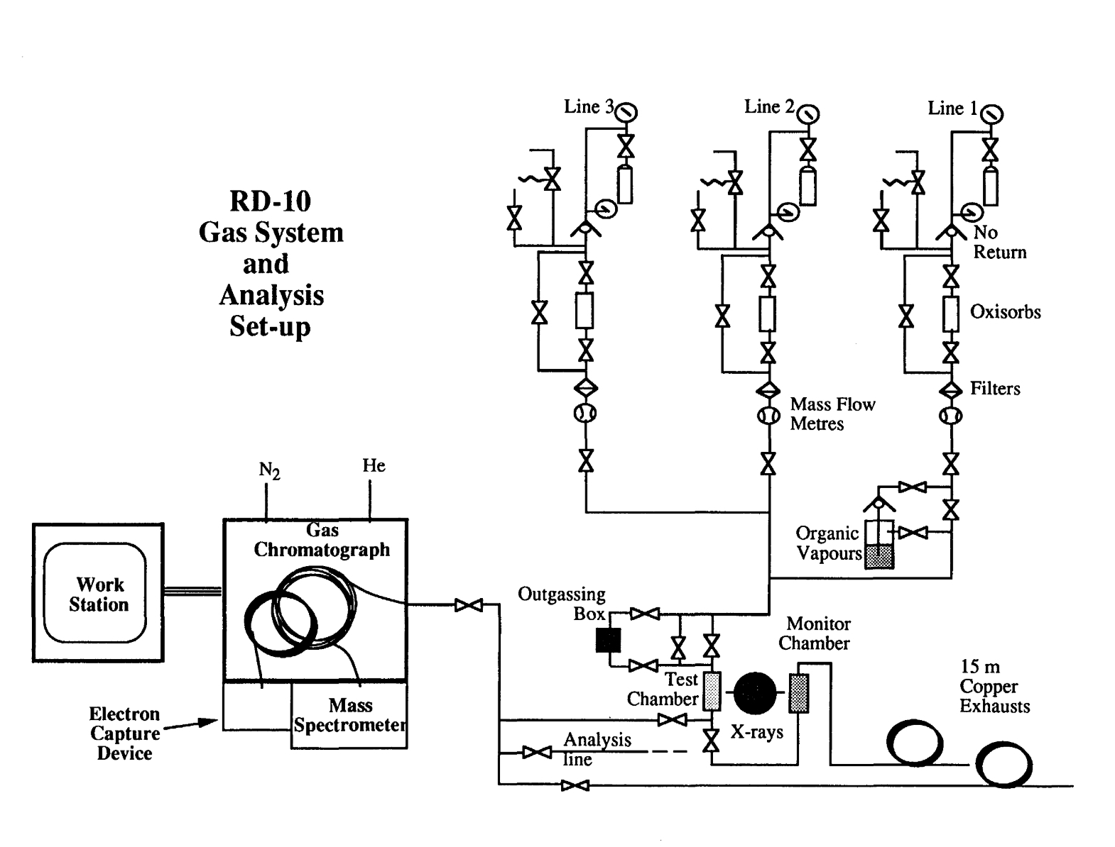
RD10-RD28 Setup at CERN:
Study of Aging of Detectors Under Irradiation
M. Capeáns: Nucl. Instr. Meth. A515(2003)73.

Slide 12
Units Used for Long-Term Aging Studies:
Irradiation Time
Radiation Flux : Counts/cm²
Charge per unit Surface: Coulomb/cm²
Charge per unit Wire Length: Coulomb/mm
LHC Years
Accelerated lifetime measurements:
High source intensity
High charge gain
Both ➙ Local Charge Density 10 to 100 times than normal

Slide 13
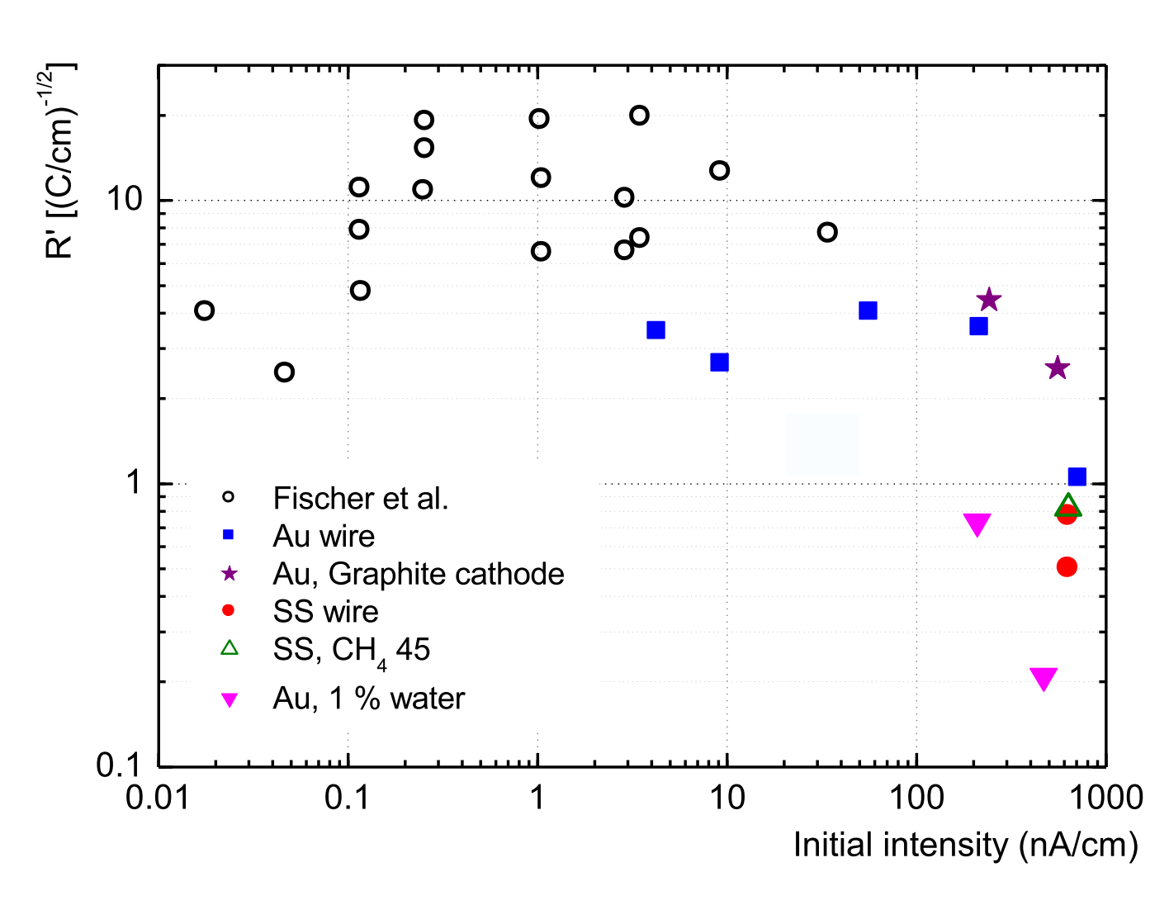
CAVEAT: HIGH-RATE MEASUREMENTS ARE OPTIMISTIC !
Effect on Ageing Rate of Irradiation Current Density:
M. Capeáns Nucl. Instr. Meth. A515(2003)73

Slide 14
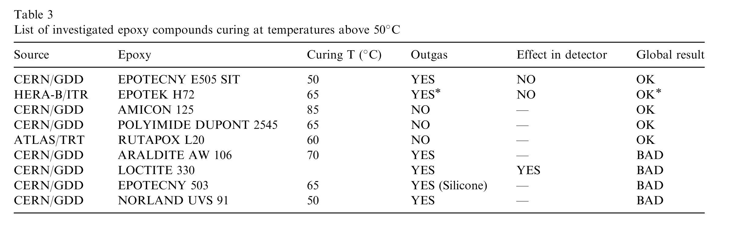
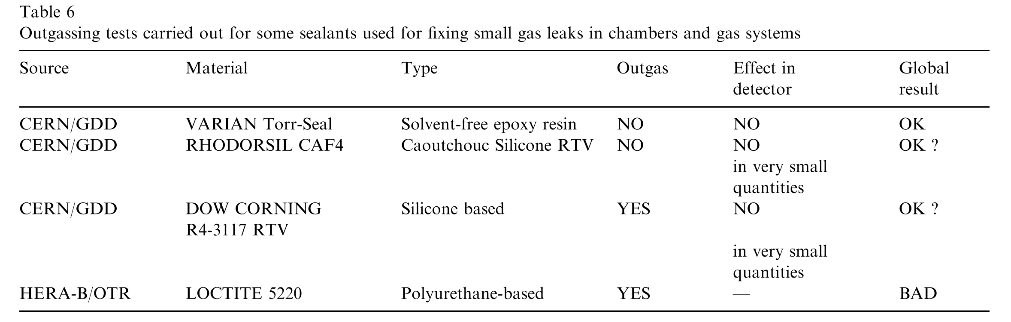
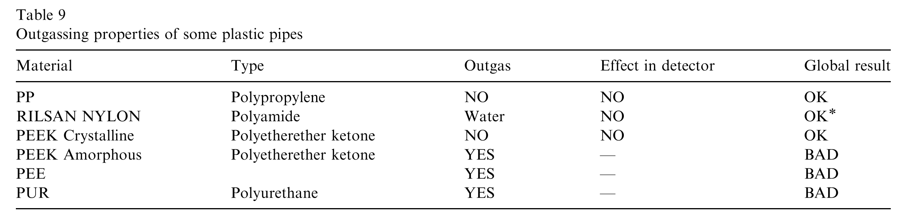
Materials Outgassing and Effects on Detectors
M. Capeáns: Nucl. Instr. Meth. A515(2003)73.
☛ Maxym Titov: Gaseous Detectors and Radiation Hardness

Slide 15
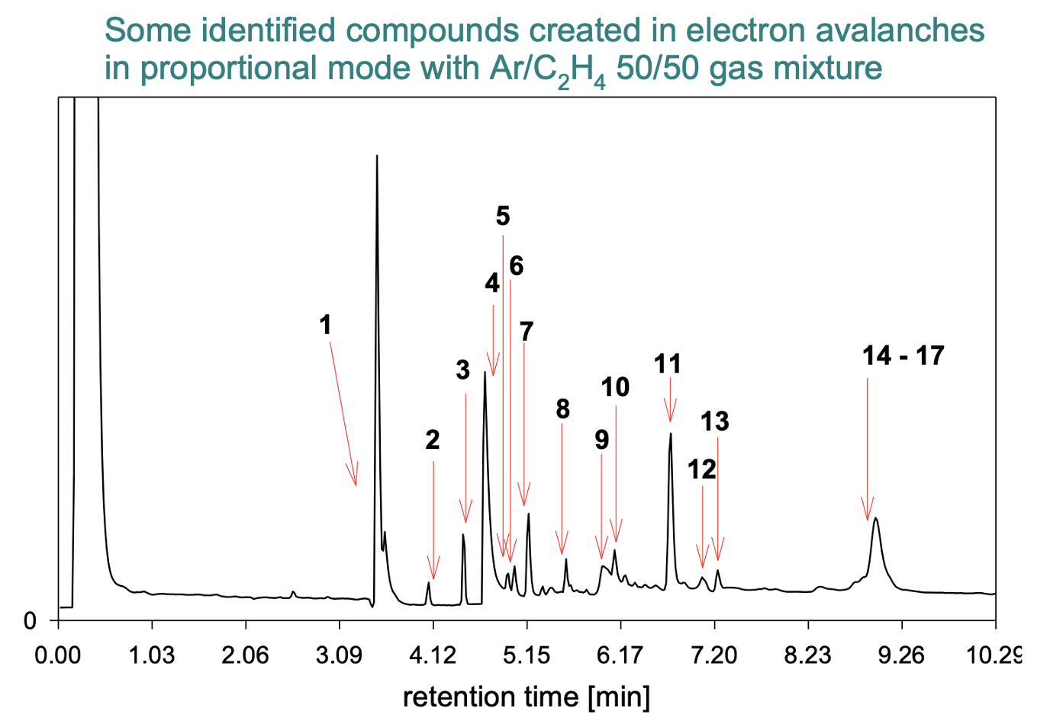
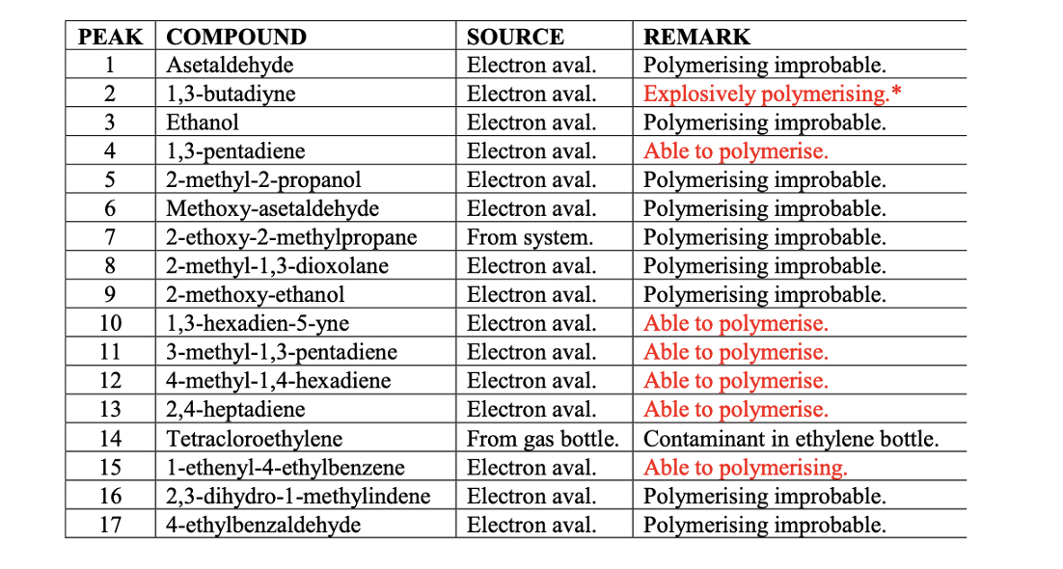
More Studies on Wire Chamber Chemistry
K. Kurvinen, RD-51 WG2 meeting 10 Dec. 2008

Slide 16
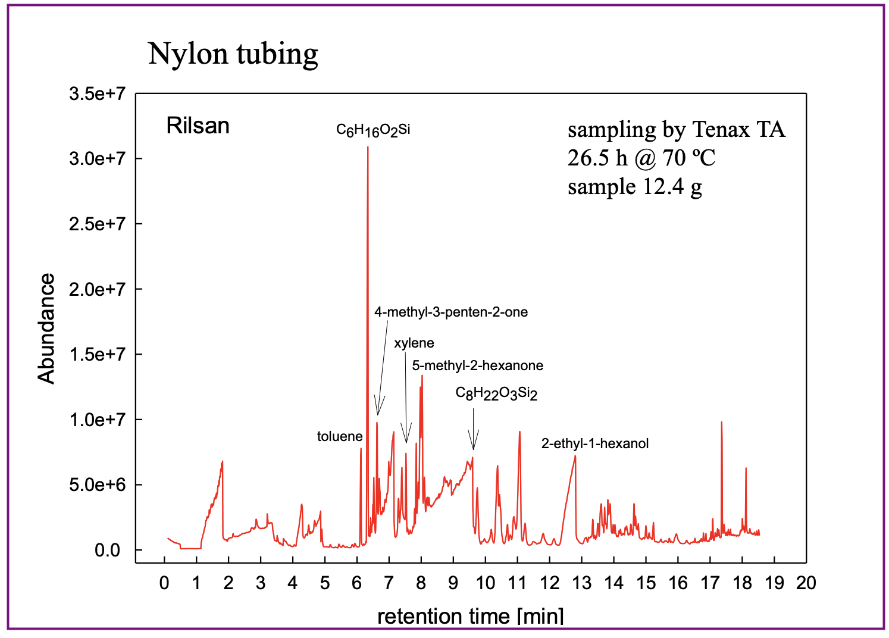
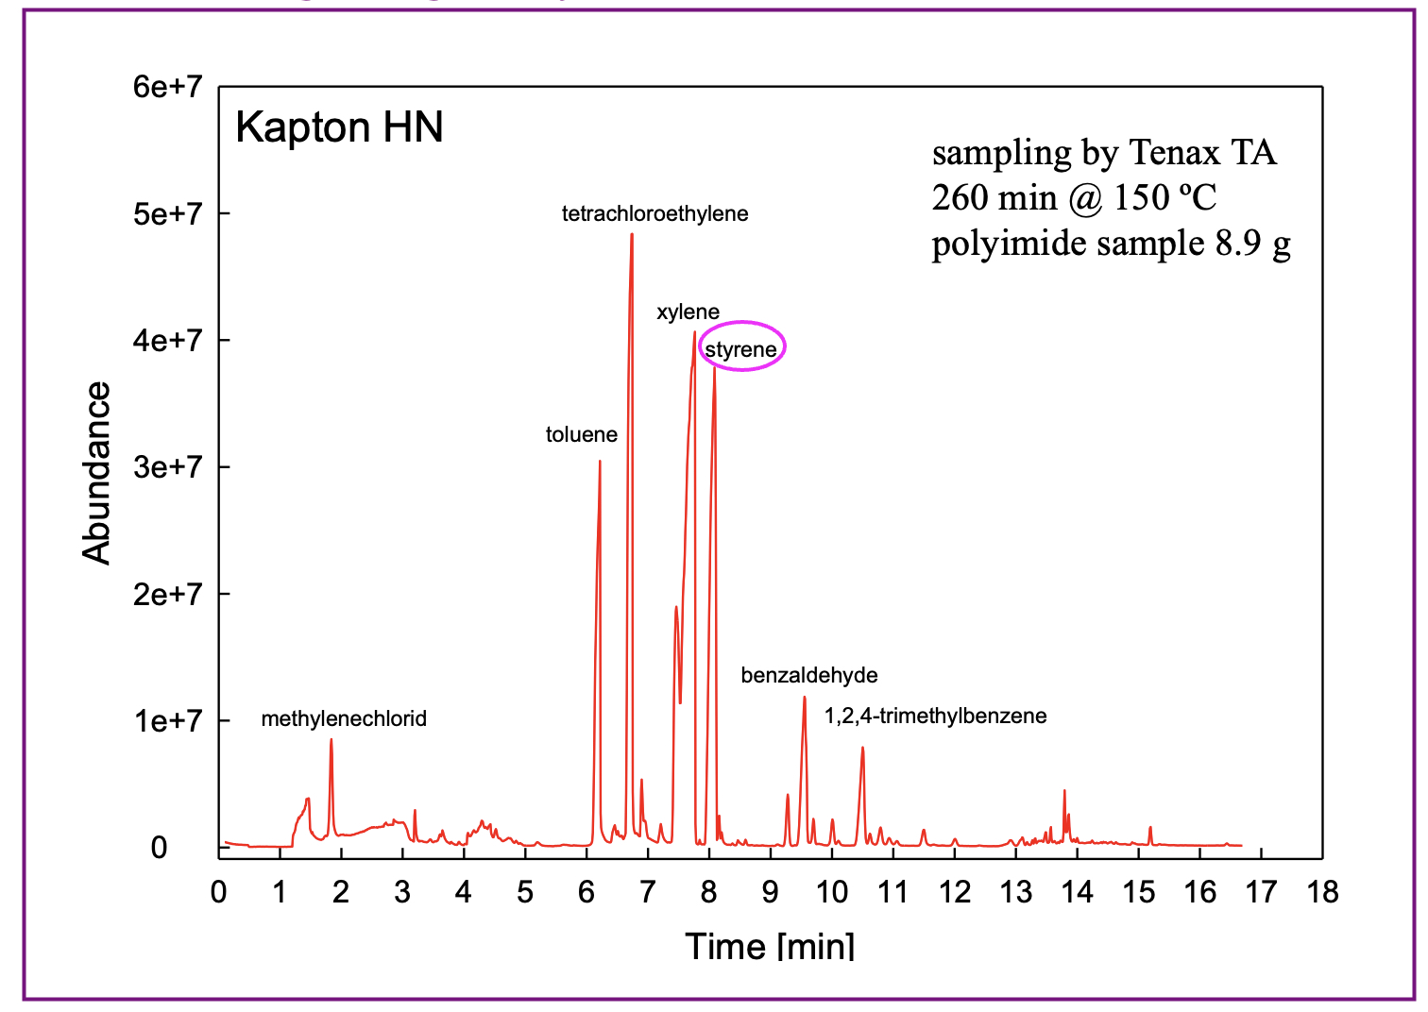
Outgassing of Nylon Tubing
K. Kurvinen, RD-51 WG2 meeting 10th Dec. 2008

Slide 17
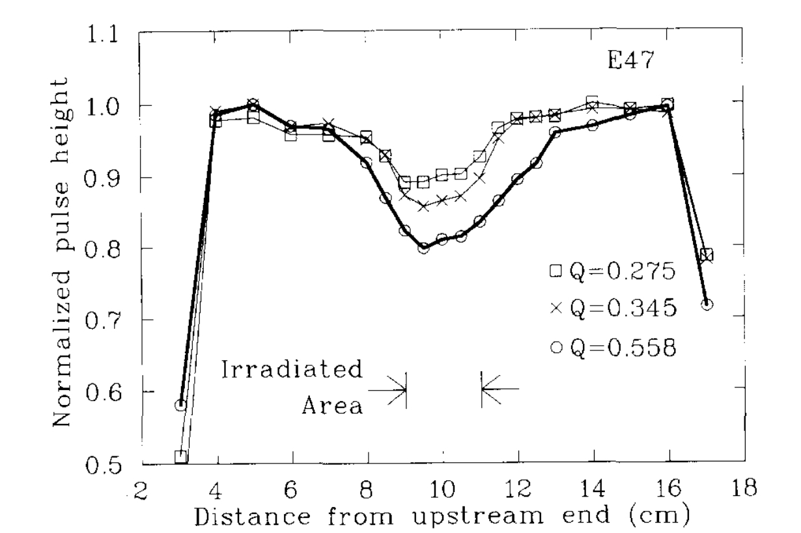
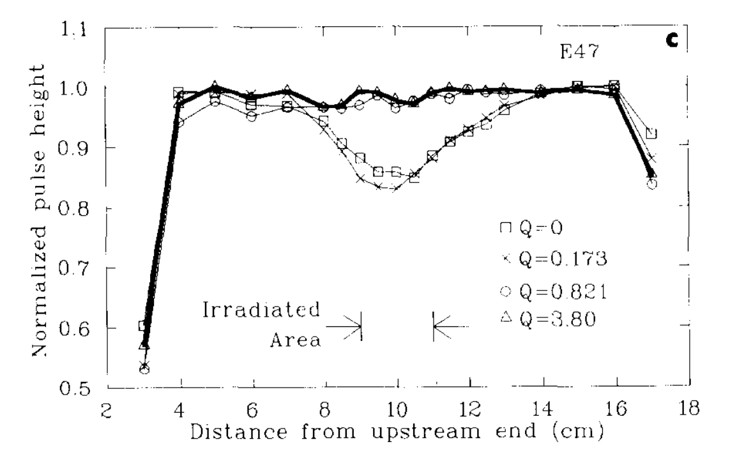
The CF₄ Case: Benefits and Harms
Very Fast Drift Velocity and Low Diffusion
Dissociates to Reactive Species uner Avalanche Conditions
CF₄ + e --> CF₃* + F*+ e
CF₄ + e --> CF₂* + 2F*+ e
CF₄ + e --> CF₃⁻ + F*
F + H₂O → HF
Efficient Etching of Deposits on Wires
Wire Chamber Aging
Recovery With CF₄
Ar-C₂H₆
CF₄-iC₄H₁₀
10 mC ⁹⁰Sr
R. Openshaw et al, Nucl. Instr. Meth A307(1991)298
CAVEAT:
CF₄ dissociation products react also with the detector building materials !

Slide 18
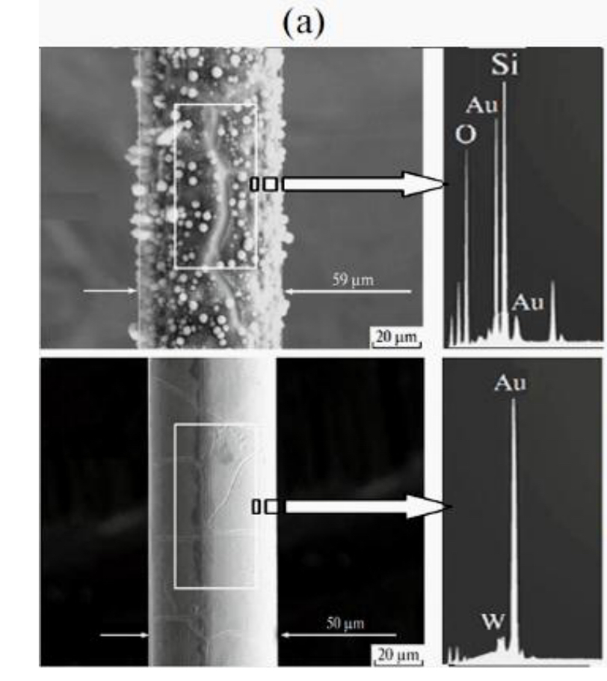
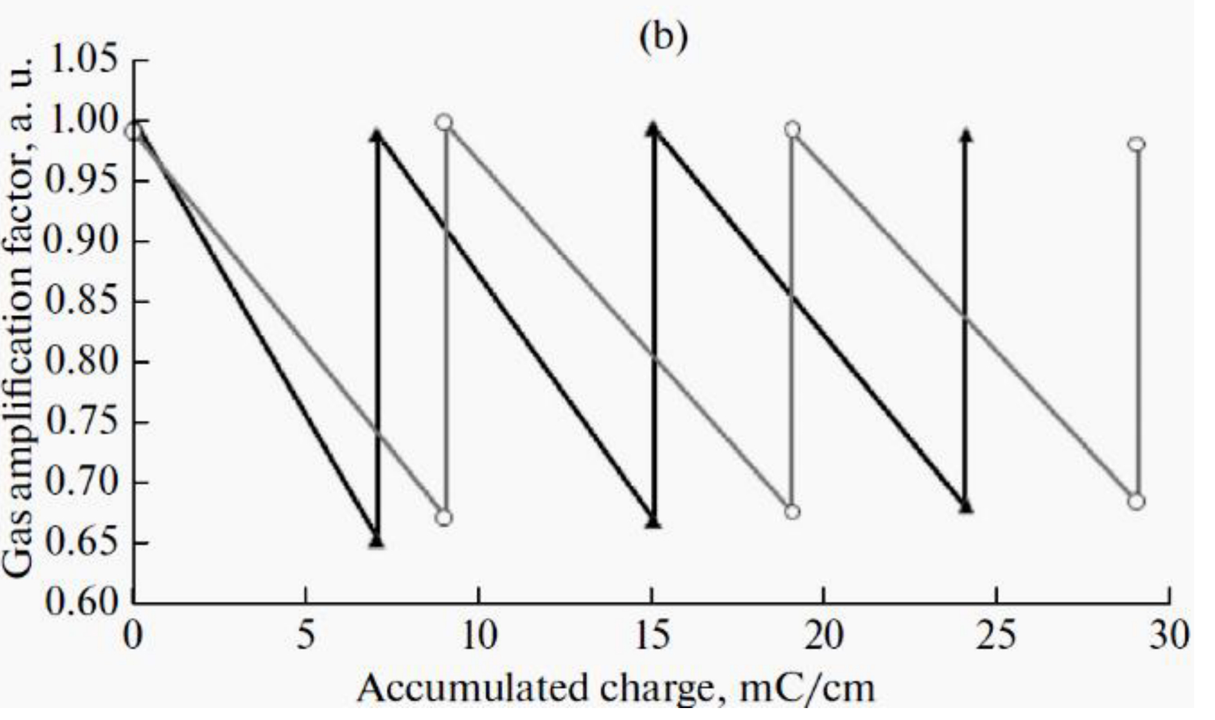
Anode Wire Aging Recovery in CF₄
Aged Wire Irradiated with ⁵⁵Fe source in ﻿Ar-CO2 + 10% CF4
"Training": Cyclic Exposure to ⁹⁰Sr Source
in 80% CF₄-20% CO₂
G. Gavrilov et al, ﻿Physics of Particles and Nuclei49(2018)33

Slide 19
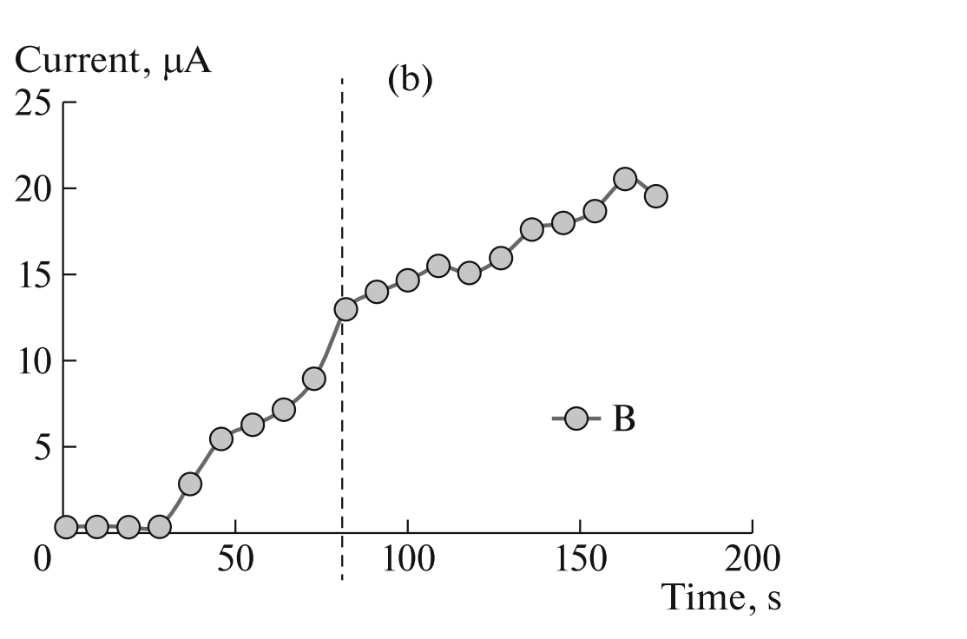
Cathode Field Emission – Malter Effect
The Current Increase due to Malter Effect continues after removal of source
+
-
-
-
LHCb Muon MWPC:
+
+
+
+
+
+
Source Removed
Positive Ions Deposit on the Thin Insukating Layer and Create an Electric dipole Field Extracting Electrons
Self-Sustained Effect Leading to Current Increase and Discharge
Rate Dependent
Enhanced Sensitivity to Light
G. Gavrilov et al,
Phys. Atomic Nuclei 82(2019)1273

Slide 20
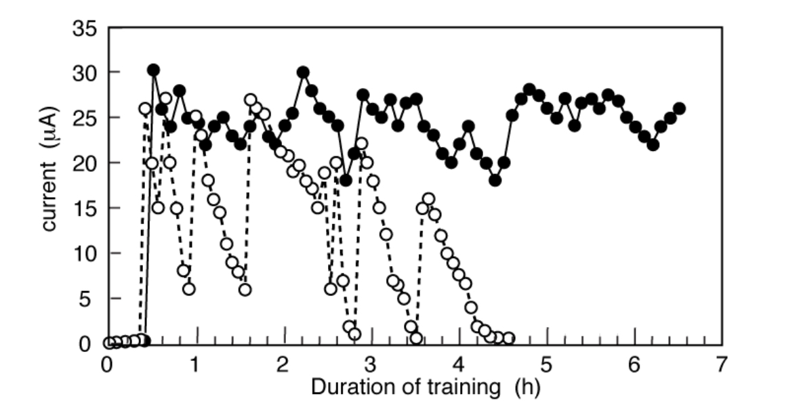
LHCb Muon Chambers : ~ 1400 MWPC with Ar-CO₂-CF₄
Operated for 9 years without gain reduction
~ 20% MWPC developed high current and HV trips, attributed to Malter effect on Cathodes
TRAINING : Reduction of Mather CurrentAdding O₂ to Ar-CO₂₋CF₄
Malter Current
Standard Mixture
+2% O₂ Training
F. P. Albicocco et al, JINST 14(2019)P11031

Slide 21
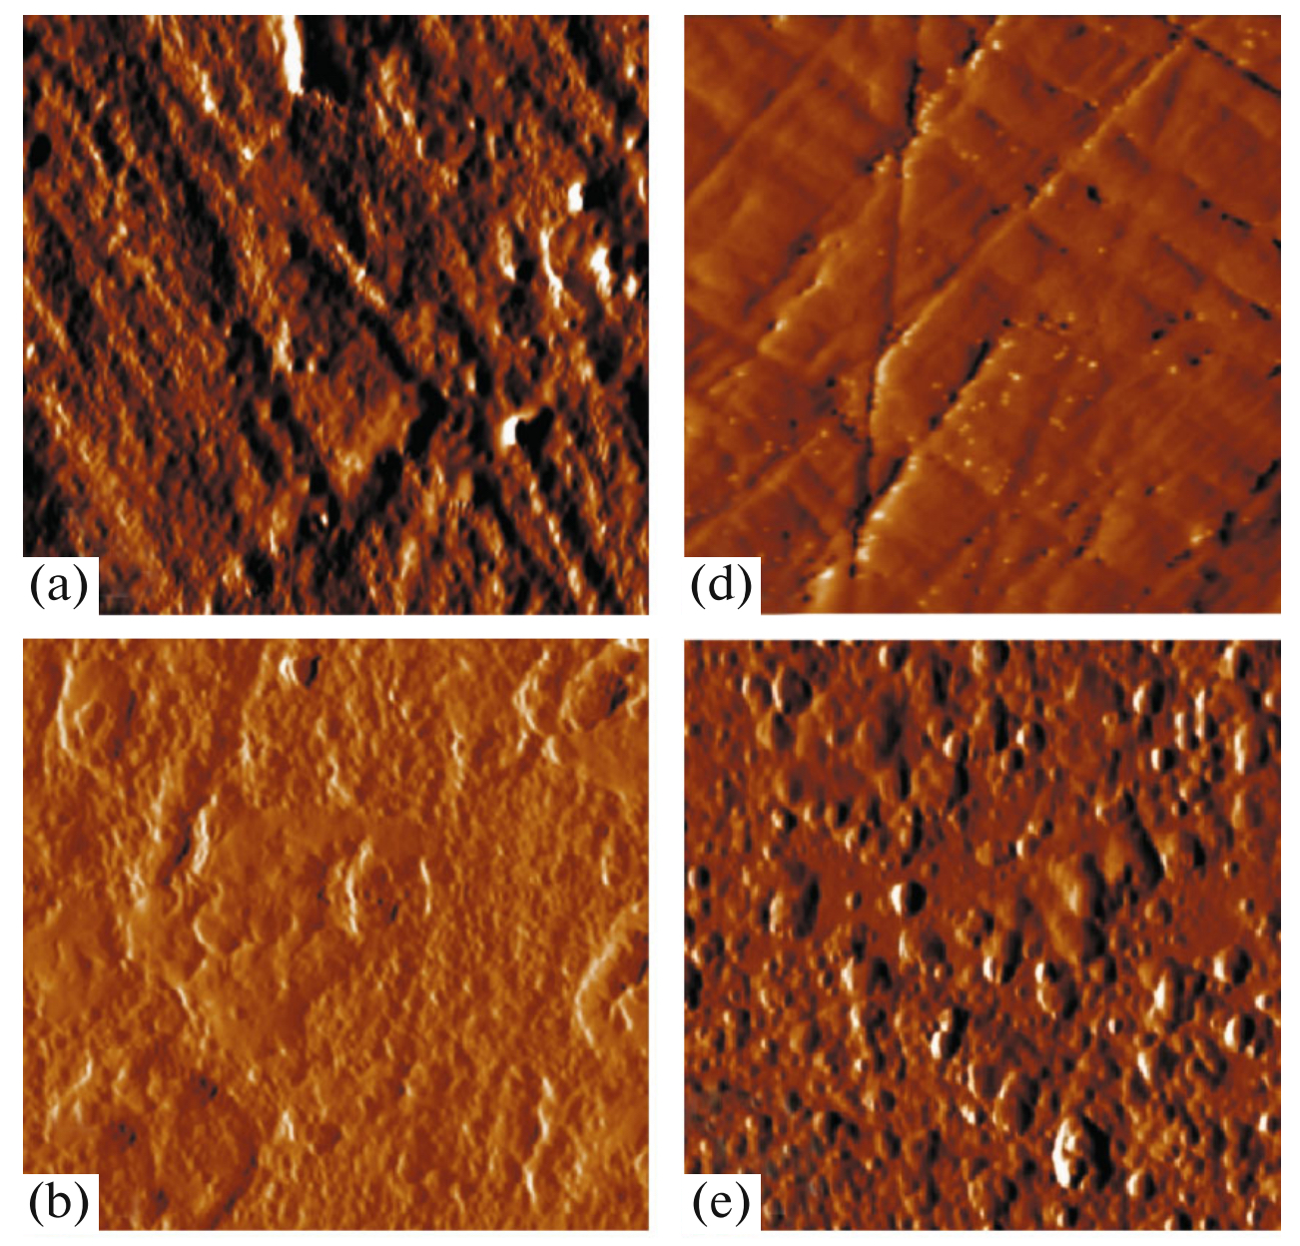
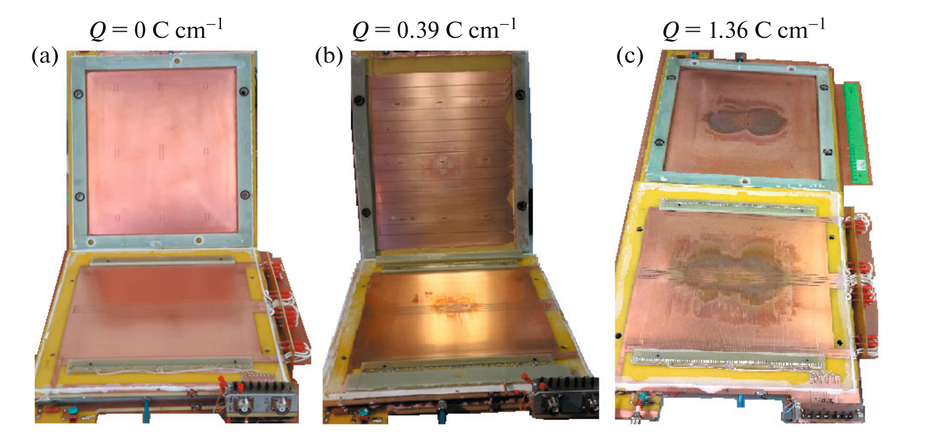
Catode Plane Damage in CMS CSC Chambers
The gas mixture used, (Argon-CO₂–CF₄) prevents the formation of anode and cathode deposits; damages to electrodes under sustained irradiation are attributed to CO₂ dissociation products (O* , CO* O₂ , O₃).
M. A, Buzoveria et al, Phys. Atomic Nuclei 82(2019) 1252
CAVEAT: CF₄ is Expensive, Difficult to Procure and Greenhouse Gas
Search for Eco-Friendly Replacements:
☛ Beatrice Mandelli, Maxym Titov + Many Presentations

Slide 22
GOLDEN RULES OF AGING PREVENTION
Ultra-Pure gases
Non-Organic Quenchers (CO₂)
Choice of non-Outgassing Building Materials
Non-Polymerizing Additives: Methylal, Propilic Alcohol
Improved Cleaning Protocols
Avoid Silicon-Containing Materials: Tubing, Sealings, ….
Zapping: Burning Deposits with High Current on Anodes
Addition of Compounds with Etching Properties (O₂ , CF₄)
The Creation of Reactive Species is Enhanced at High Values of the electric field

Slide 23
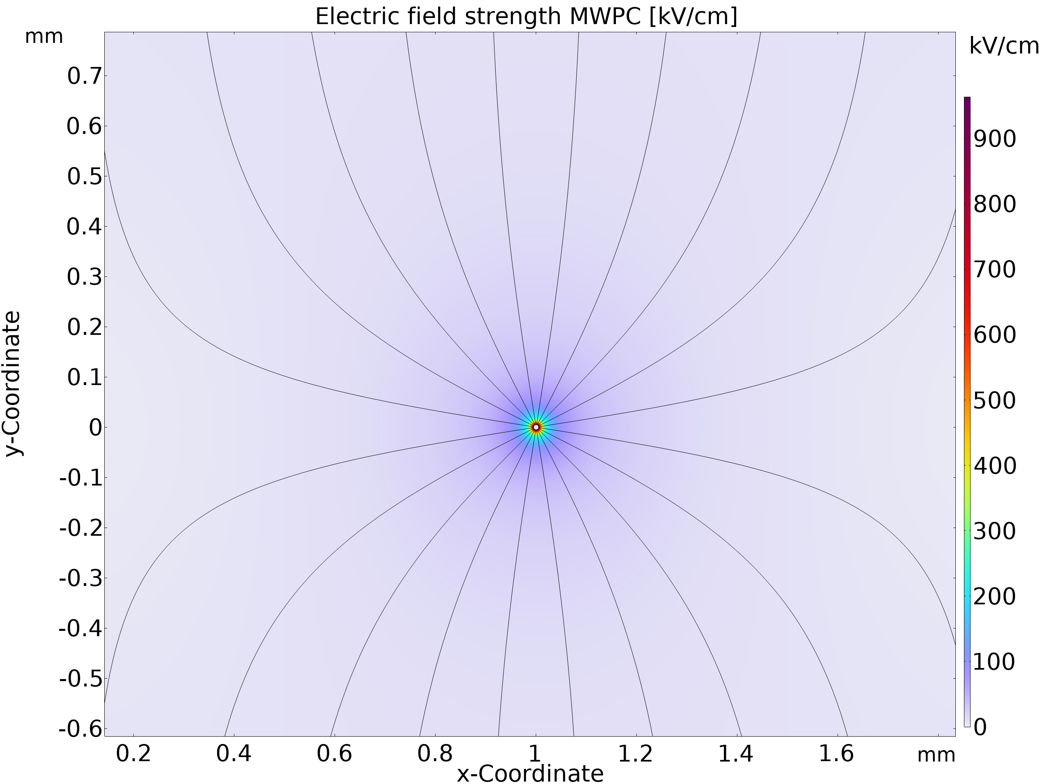
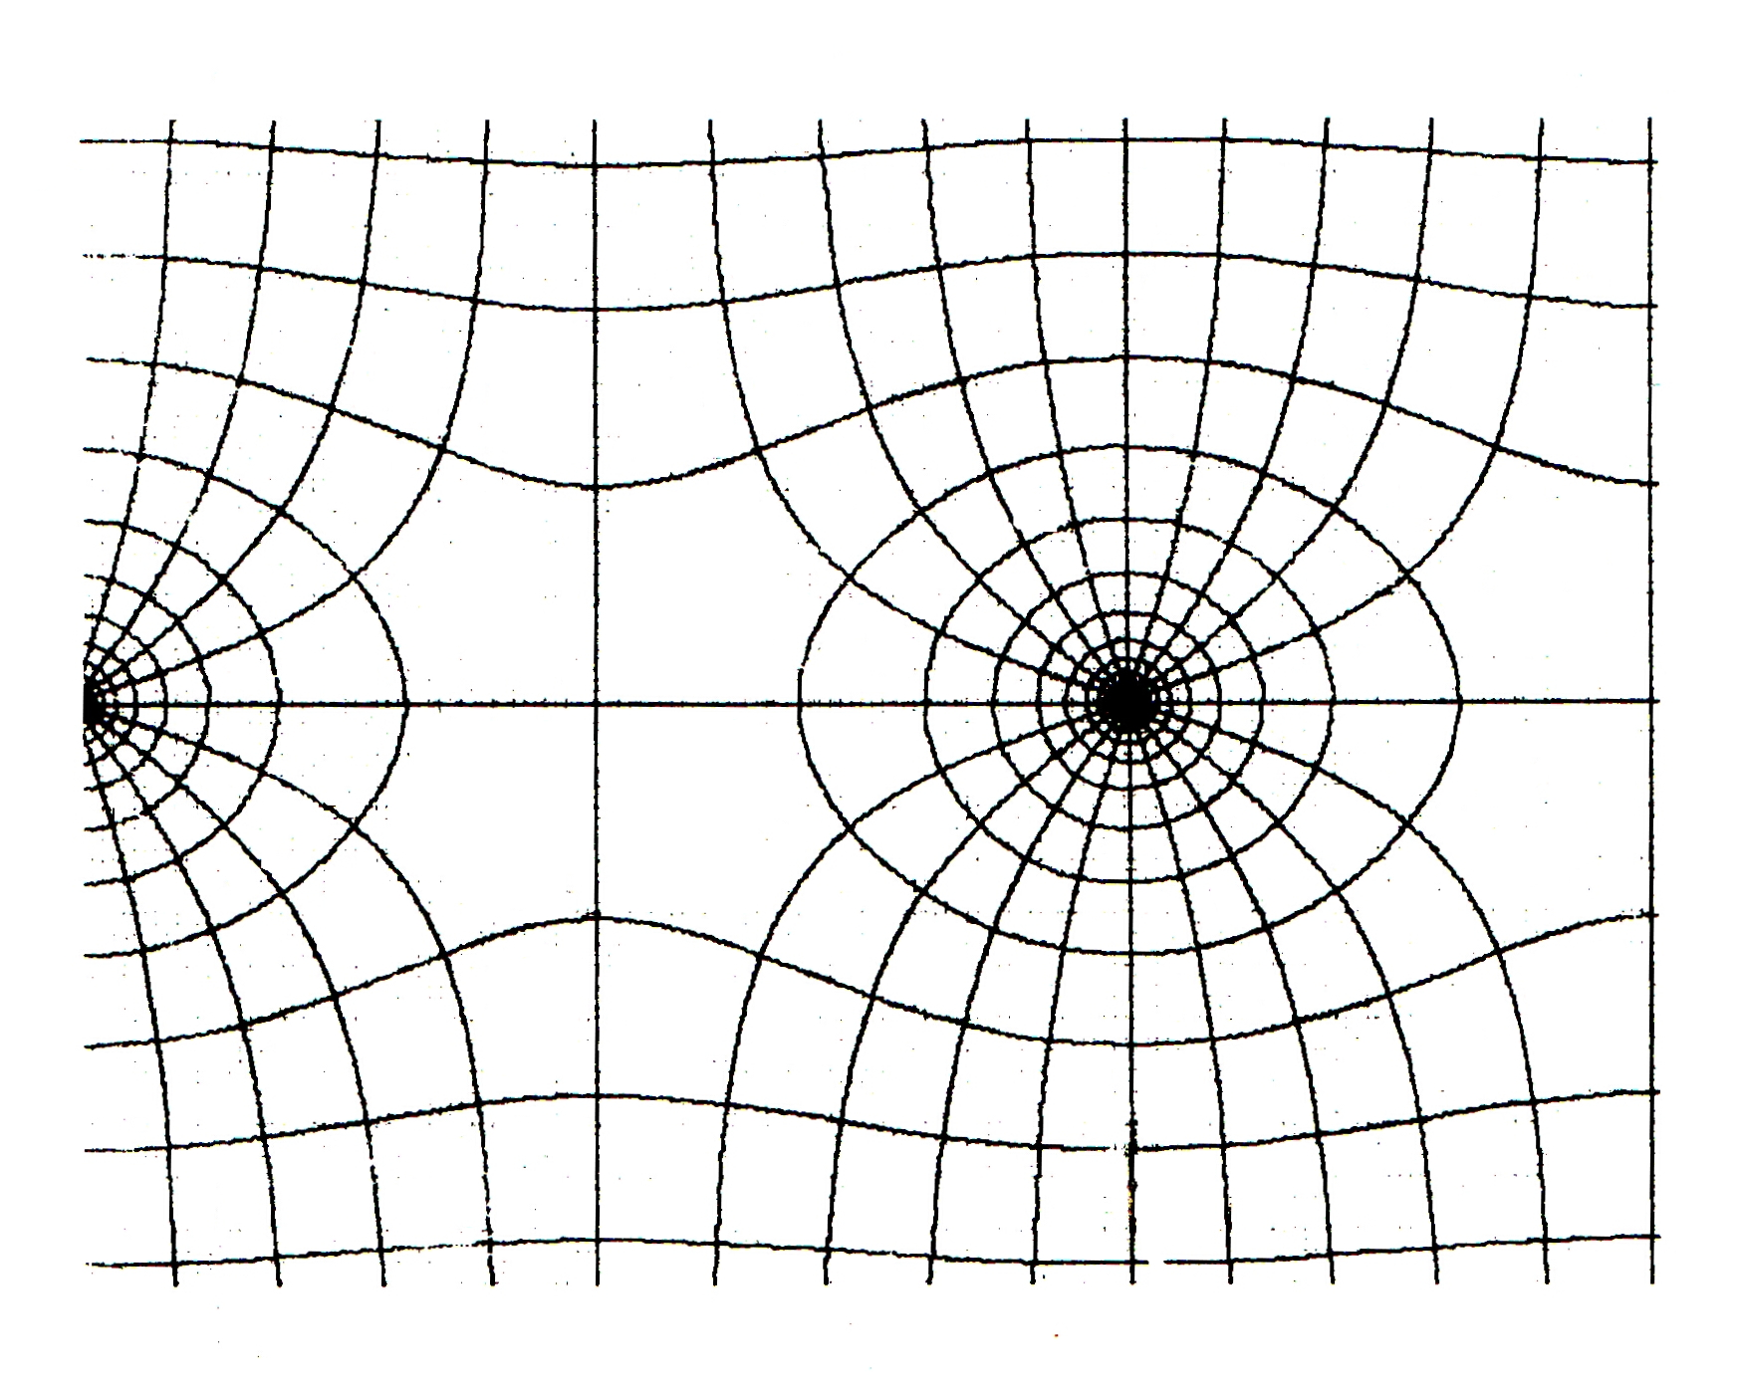
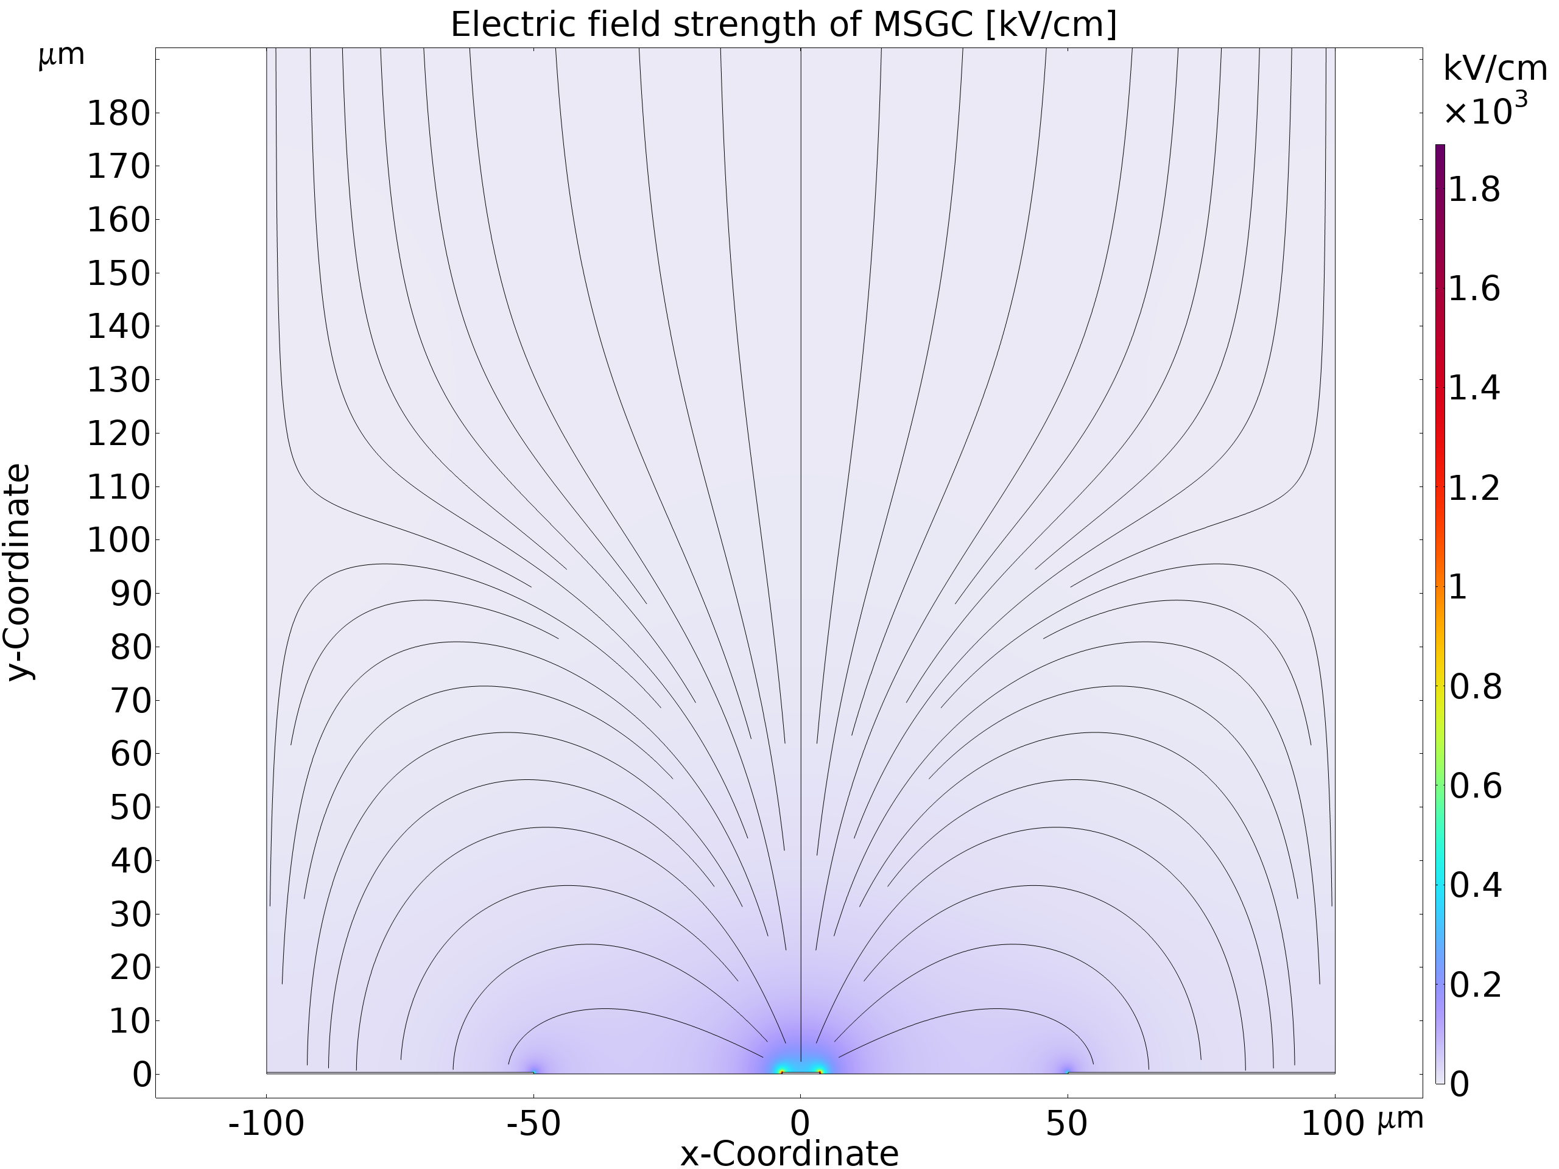
Maximum Electric Field in MWPC & MSGC:
MWPC
E ~ 500 kV/cm
Computed by Djunes Janssens (CERN-GDD)
MSGC
E ~ 400 kV/cm

Slide 24
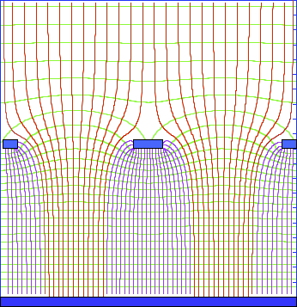
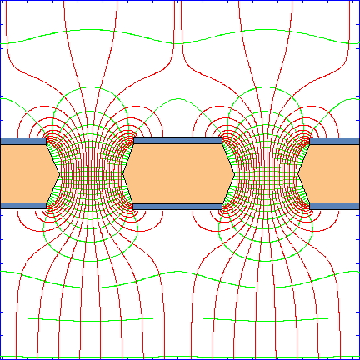
The Solution: Get Rid of Thin Wires and Strips
➽ Micro-Pattern Gas Detectors (MPGD)
MICROMEGAS
Gas Electron Multiplier (GEM)
Y. Giomataris et al,
Nucl. Instr. Meth. A376(1996)29
F. Sauli,
Nucl. Instr. Meth. A386(1997)531
+
MiroGroove, MicroGap,MicroPixel
Resistive Plate Well ………..

Slide 25
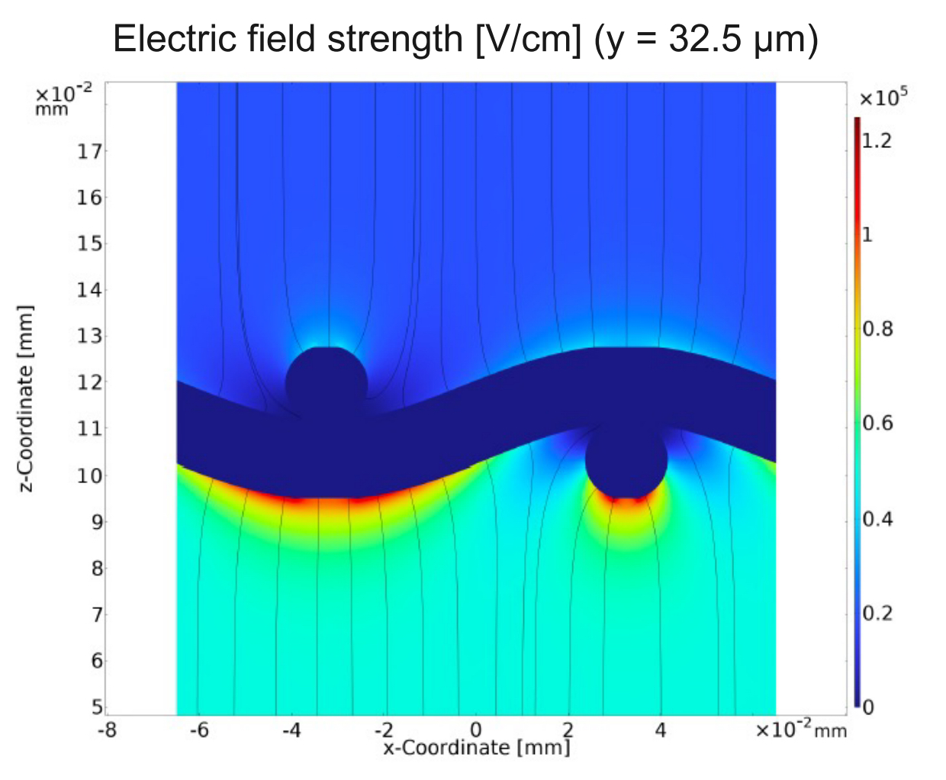
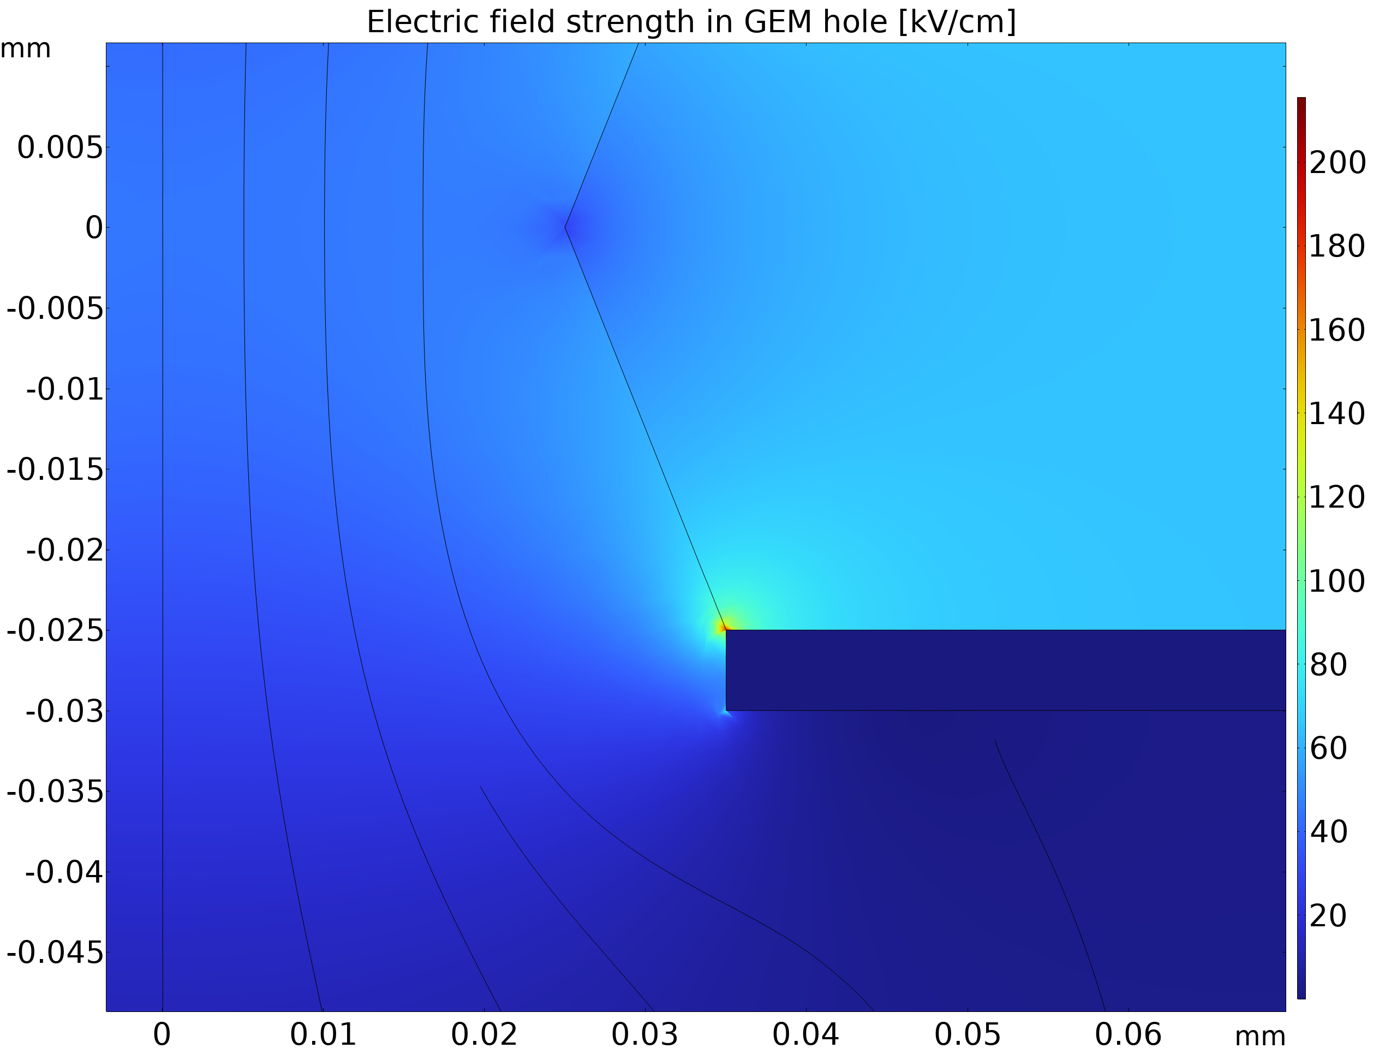
Electric Field Strength: MICROMEGAS & GEM
MICROMEGAS
Interwoven
Micromesh
E~20 kV/cm
E~ 100 kV/cm
GEM
Computed by Djunes Janssens (CERN-GDD)
E~ 140 kV/cm
Lower GEM Hole Edge
E~30 kV/cm

Slide 26
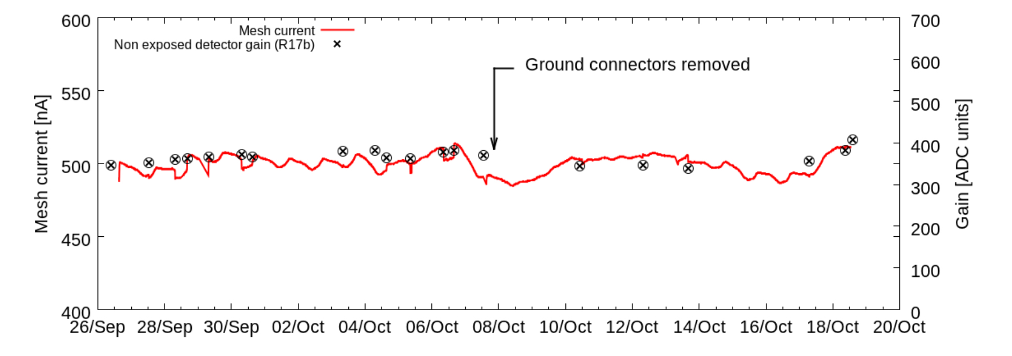
Long-Term Aging Measurements: MICROMEGAS
HL-LHC ATLAS Upgrade
X-Ray Generator 11 kV
Ar-CO₂ (90-10)
918 mC on 4 cm² (230 mC/cm²)
J. Galan et al, JINST7(2012) ﻿C01041

Slide 27
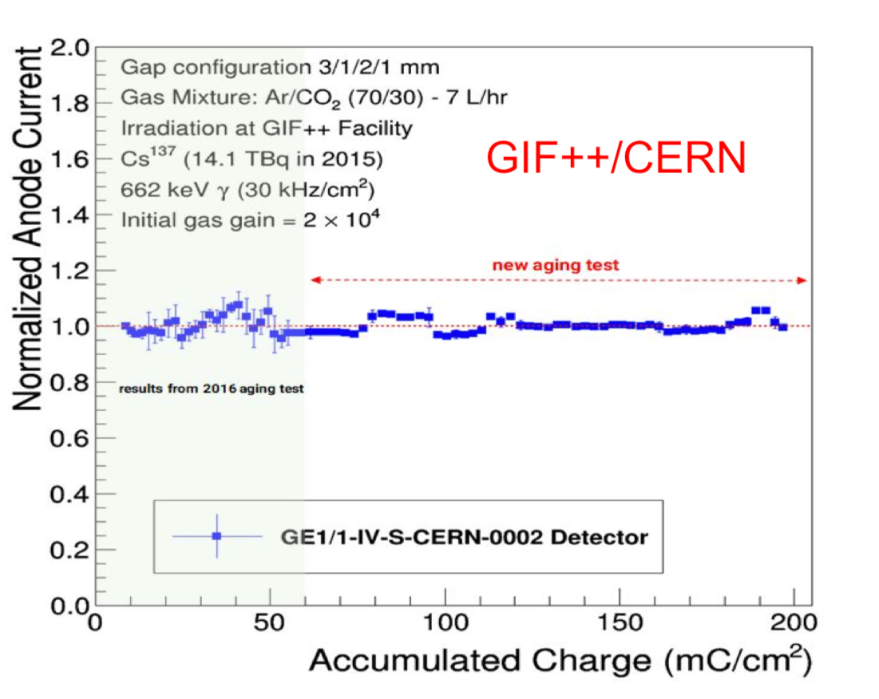
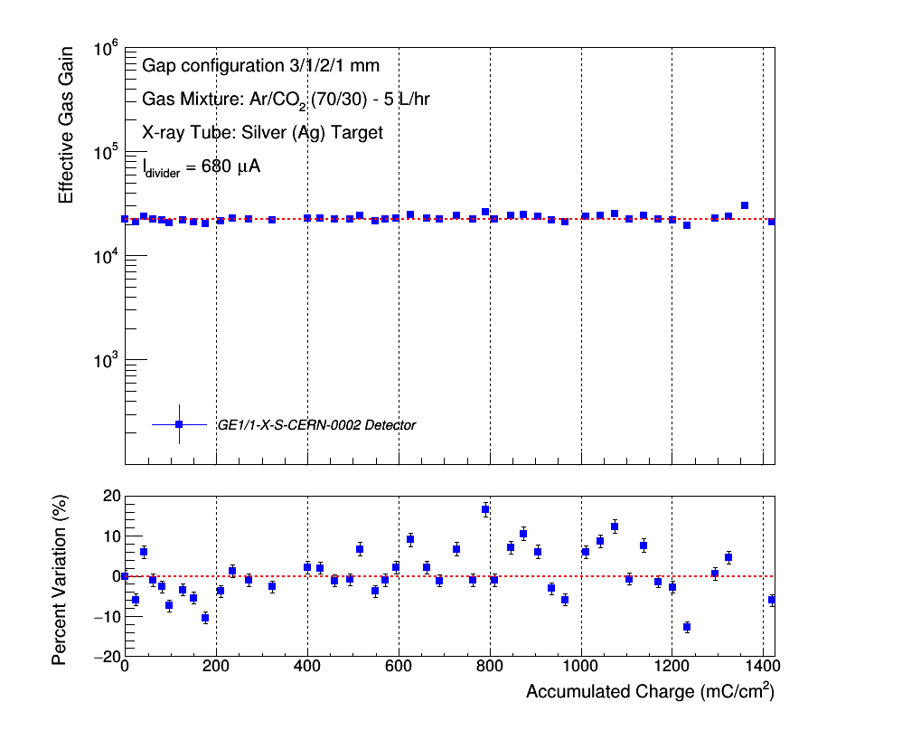
Long-Term Aging Mesurements
CMS Forward Muon Triple-GEM Upgrade
Ar-CO₂(70-30)
X-Ray Source
F. Fallavollita, PhD Theses Pavia Univ. (2019)

Slide 28



CAVEAT:
MPGD ARE ALSO SENSITIVE TO POLLUTANTS!
COMPASS Pixel GEM– After Four Years of Operation (165 mC/cm²)
Silicon Coating: (R₂SiO) - Sulphur: Sulphuric Acid (H₂SO₄)
The Culptit: External Sealant DowCorning 1-2577
C. Dreisbach, MPGD Conf. Zaragoza (2013)

Slide 29



ALICE TPC AGING in Ar-CH₄
Hydrocarbon Deposits on Copper
﻿M. Jung, Ch. Garabatos and R. Negrão, RD51 Coll. Meeting Munich 19/06/2018

Slide 30


ALICE TPC AGING in Ar-CH₄
Recovery after Replacement of CH₄ with CO₂
Circular Halo Around Holes
Kapton Ablation? Outgassing from Epoxy?
﻿M. Jung, Master Thesis, Univ. Frankfurt (2019)
For Updates: ☛ See Other Presentations at this Conference

Slide 31


GEM: Silicon Deposits on Rim
SEM Analysis after long-Term Irradiation
J.A.Merlin
RD51 Miniweek CERN 4-7 Dic 2018

Slide 32

CONCLUSIONS (IF ANY!)
Despite many problems, wire-based detector systems have been successfully operated for over two decades
The development of novel MPGD devices and a better understanding of the aging processes have extended the lifetime of existing systems, as amply documented by the work discussed at this conference
A continuing development effort is needed to ensure operation at the ever increasing luminosity of colliders

Slide 33

Everybody's Dream

