Slide 1
The ATLAS TRT ageing laboratory

Slide 2
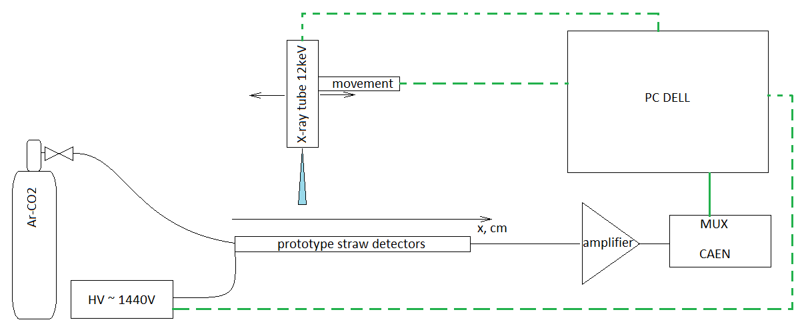
Introduction
- TRT anode wires will accumulate more than 10 C/cm. Special measures are taken to avoid ageing effects.
- Lab started to operate more than 20 years ago as a detector material validation lab. on the basis of Fabio Sauli
set up. We use 3rd generation of the setup. It operates now in a continuous mode.
- All TRT detector components in the past and now are checked for ageing.
- Special ageing validation procedure was developed and used during tests.
- Two types of ageing effects may happen in the TRT straw chambers - silicon deposition on the anode wire and organic deposition on the straw
- The sources of silicon or organic ageing are traces of oil, lubricants or components of used material which
could pollute the active gas.
- the straws we use in our setup is similar to the ATLAS TRT ones.
- if during the test we see ageing the straw could potentially can be polluted. They can be recovered after
X-ray exposure with Ar+CF4 + CO2 mixture and the straw voltage corresponding to current density 200nA/cm.
- Now set-up works in a fully automatic mode.
Principal scheme of the TRT ageing setup.
Gas mixture Ar-CO₂ 70%-30%
Gas flow 10x nominal: 1.5 cm³/min/straw
Voltage V = 1440 V
Current density: 100 nA/cm
Exposure collimator – 10mm
Scanning collimator – 1 mm
Validation time: 200 h

Slide 3
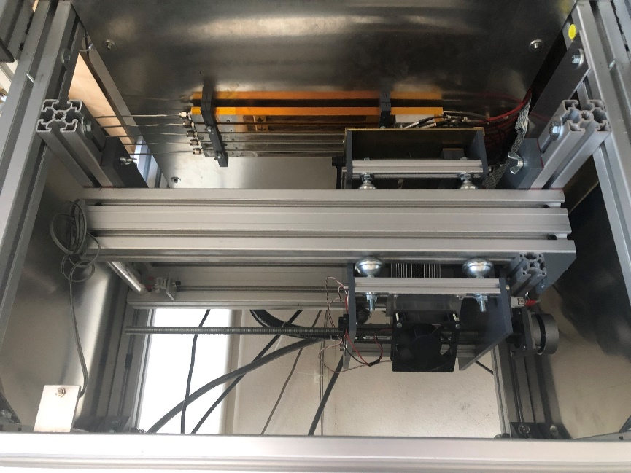
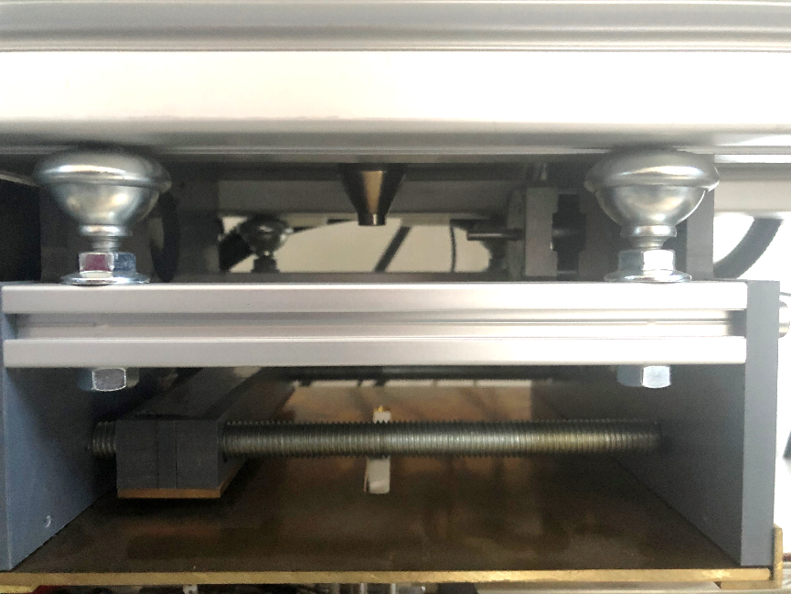
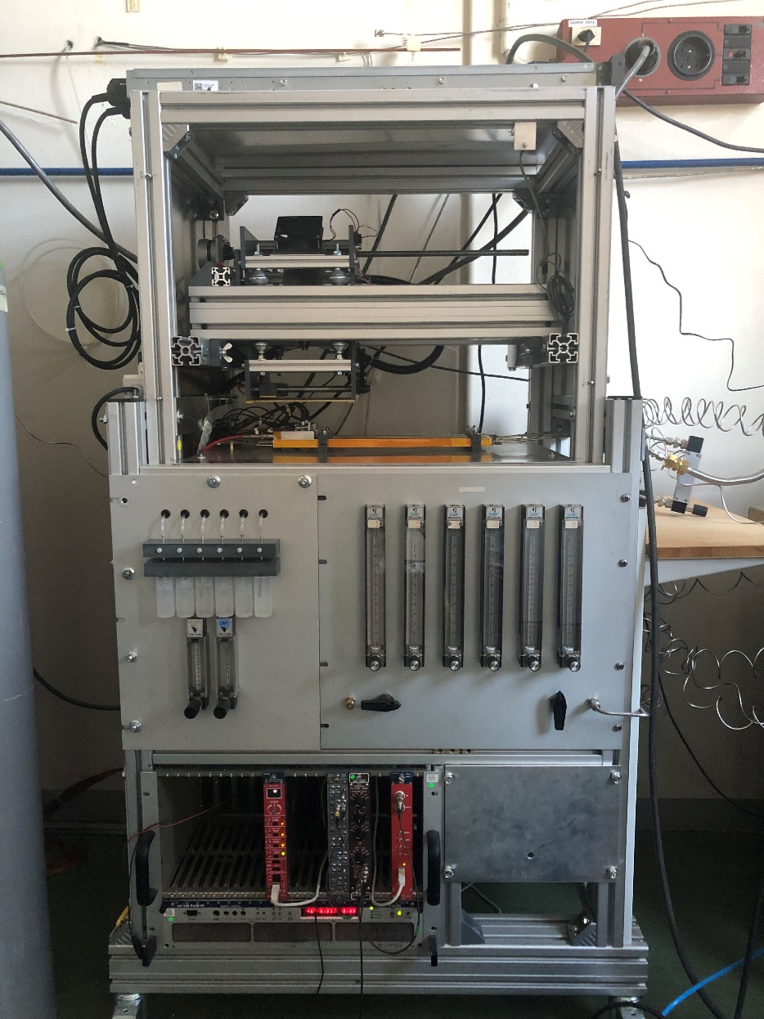
TRT automated ageing setup (3rd generation of the setup)
Setup consists of 5 prototypes with three straw tube in each. It means we have 5 channels to test.
Gas mixture: bottle -> pressure regulator -> flowmeter -> tested component -> straw prototype
High Voltage CAEN, remote control via USB
Movement system & Collimator controlled by microcontroller
Mini-X X-ray tube
Signal via amplification and MUX send to multichannel analyser CAEN
Software and user interface to control the setup

Slide 4
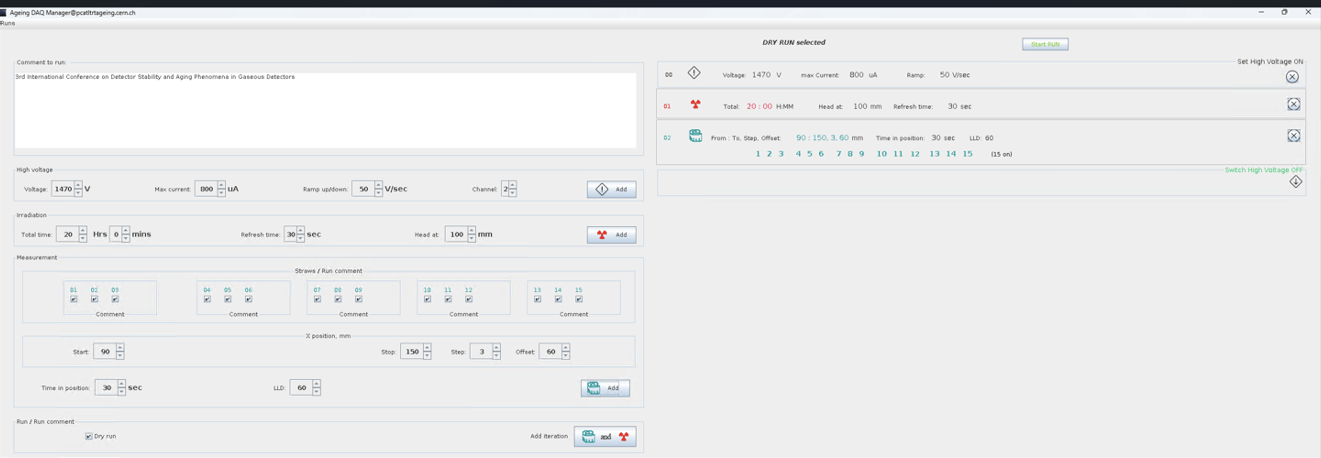
TRT automated ageing setup (2nd version)
We have two SW to run the setup. Now we used new version of SW. The test consists of cycles of x-ray exposure (10mm width collimator) and scanning with a narrow X-ray beam along the straws (1mm width collimator).
Signal amplitude is measured during the scan. At chosen operation conditions 200h irradiation considered to be sufficient to take acceptance decision.
Expert‘s interface with general settings

Slide 5
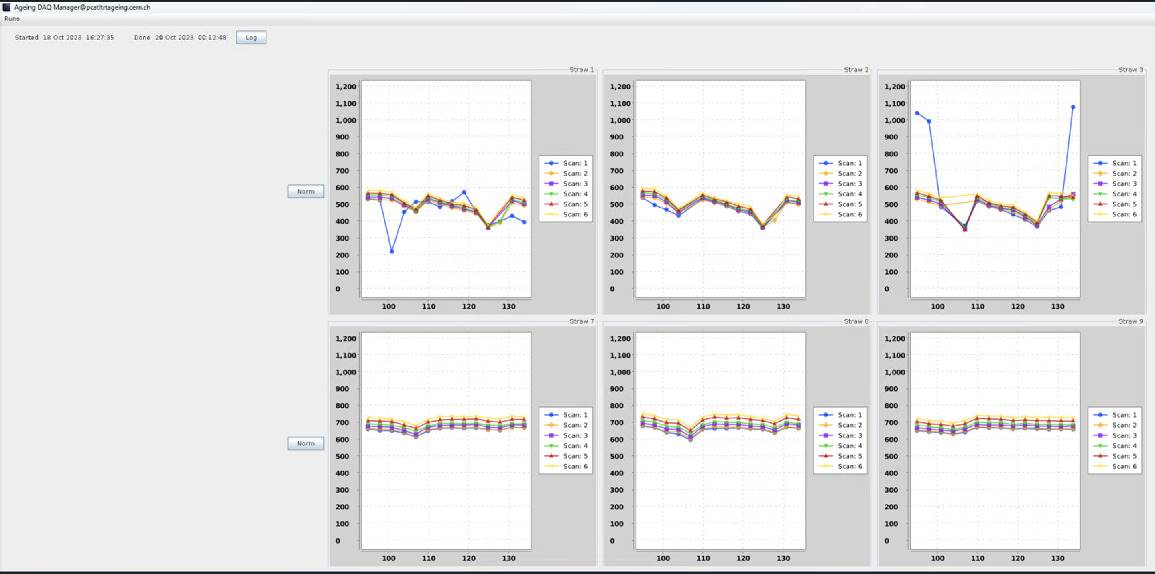
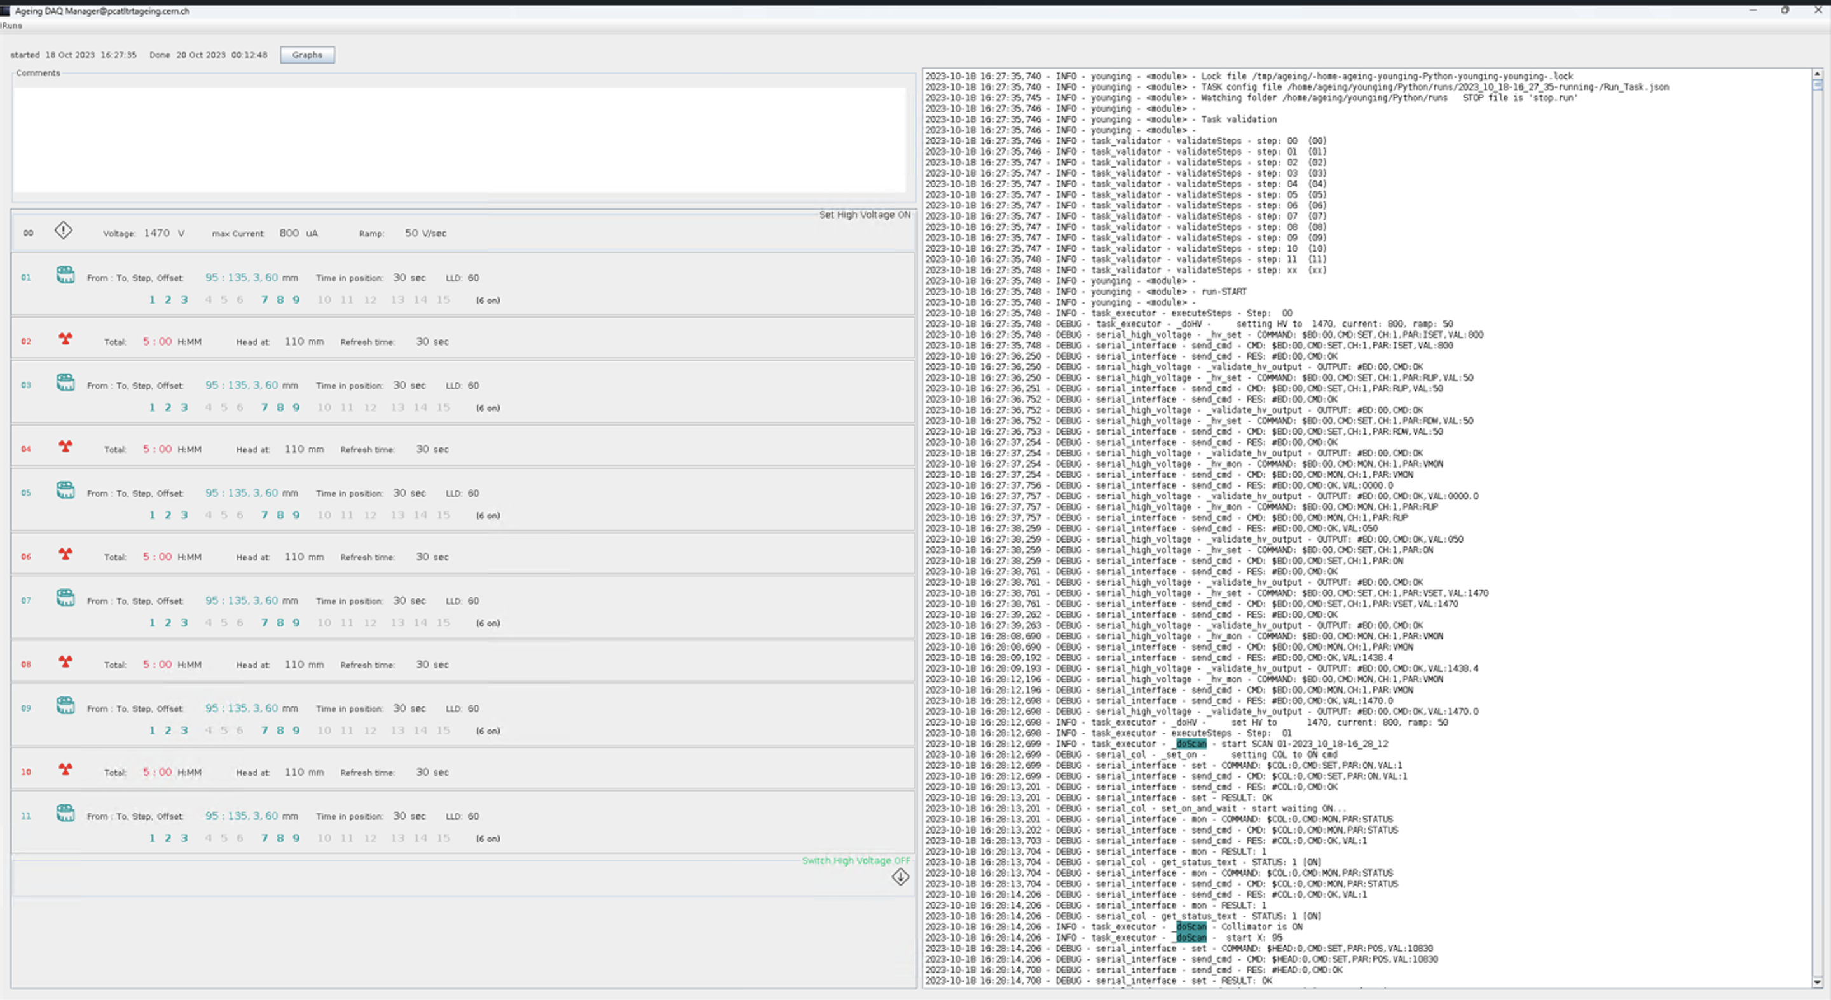
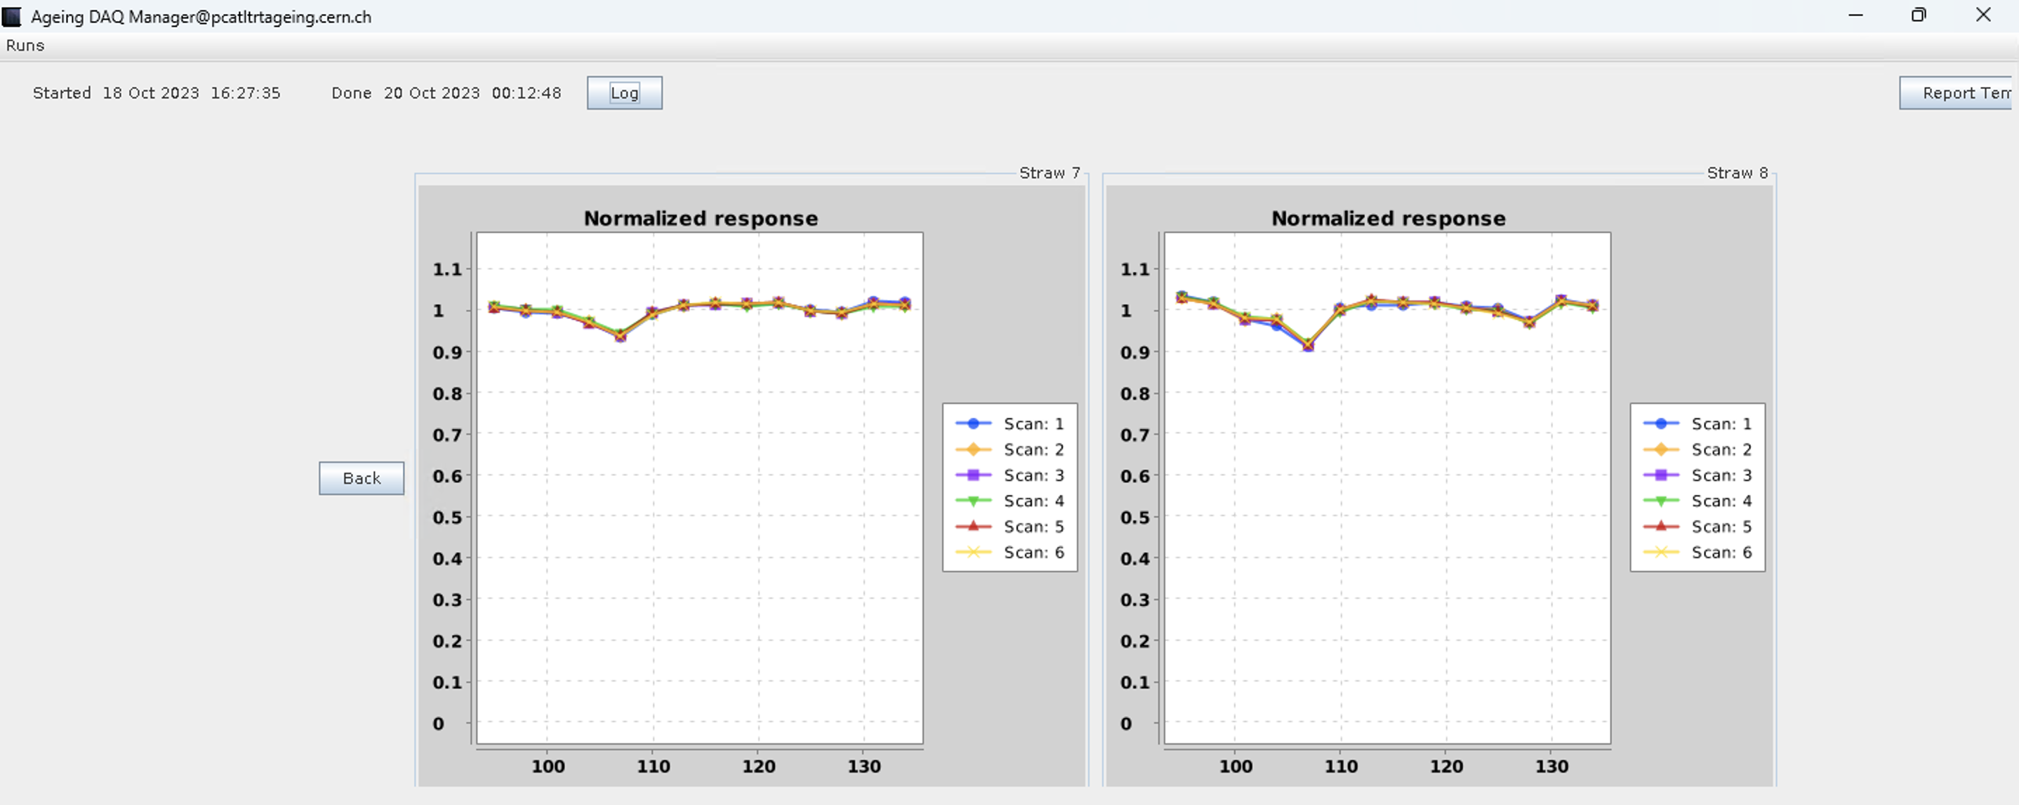
TRT automated ageing setup
This is example of plots of amplitude scan of the straw with no Ageing seen after X-ray exposure
General Graphs and settings/errors logs available.
It have possibility to normalize response

Slide 6
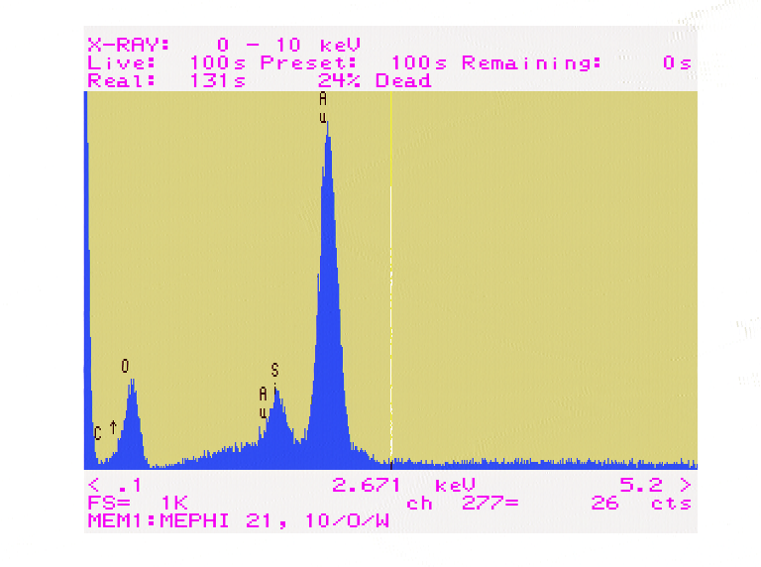
Si ageing in the Xe-CO₂-O₂ gas mixture
Back up slide
Before irradiation
After 66h of irradiation
Si
The most probable reason for this effect is Si pollution of the gas system components (residual of the Si-based lubricants).
Aging happens at the beginning of the irradiation area.

Slide 7
Statistics
Max capacity of the setup is test of 5 gas components in 14 days
Each year we have about 60 samples tested
1% of the samples were rejected because of ageing. Sometimes cleaning of the sample helps, sometimes it is enough to flush well the component before the test
No investigation is going on the setup. Just testing of ageing effect yes/no
This year we tested 35 samples by now
All files stored on our PC. Copy of reports we sent to the CERN gas group. The plan is to have a database accessible on web.

