Slide 1


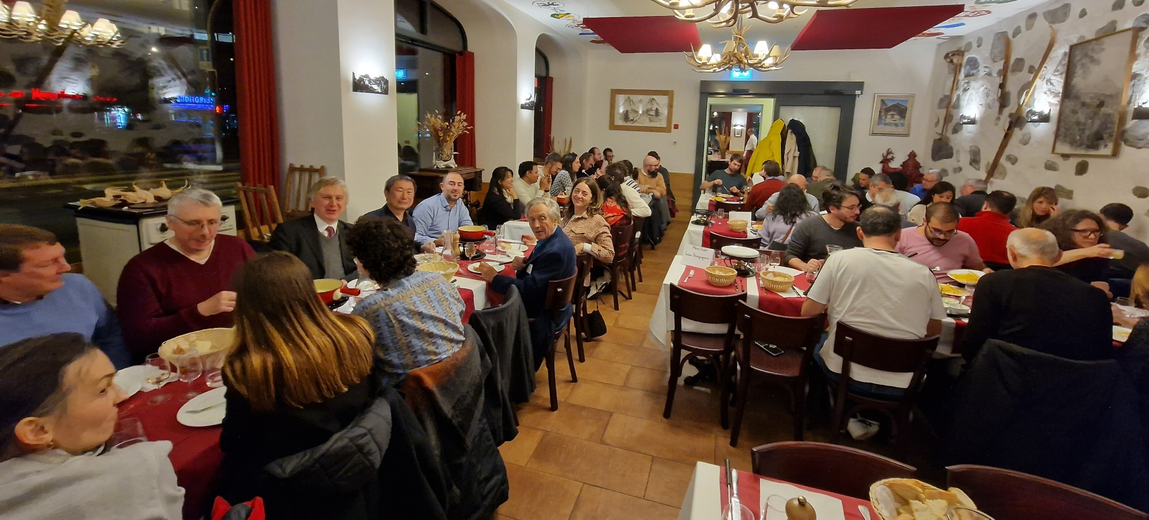
Homeworks

Slide 2
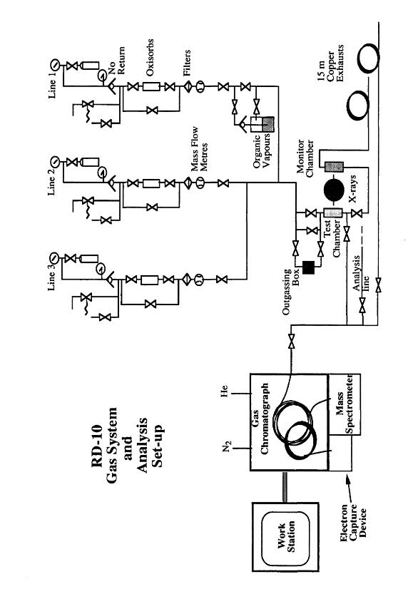
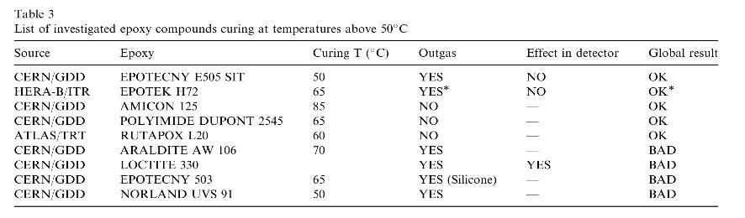
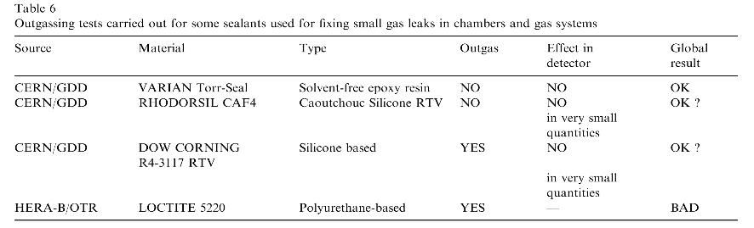
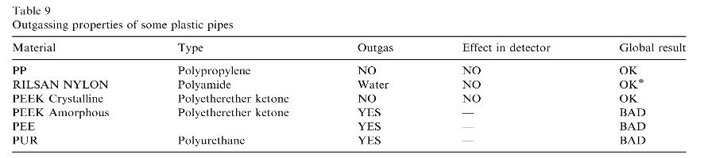
Selection of detector (and services) components
Materials Outgassing and Effects on Detectors
https://detector-gas-systems.web.cern.ch/Material%20and%20Standards/pipematerials.htm
https://detector-gas-systems.web.cern.ch/Material%20and%20Standards/elastomer.htm
M. Capeáns: Nucl. Instr. Meth. A515(2003)73.

Slide 3
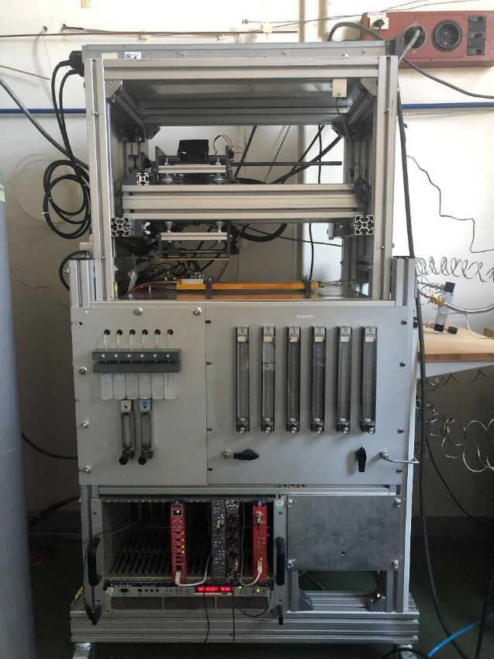
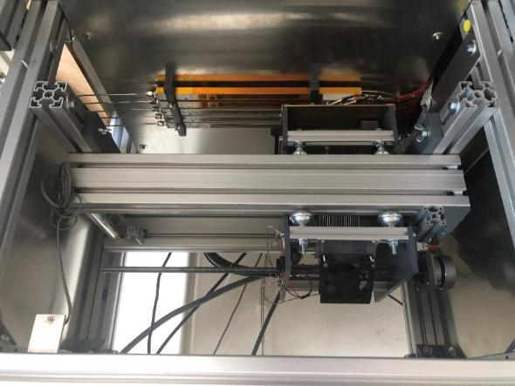
Currently used setup at CERN (from TRT)
Other setups
Different characteristics
Work on setups, database of components and materials
→ must be restarted

Slide 4
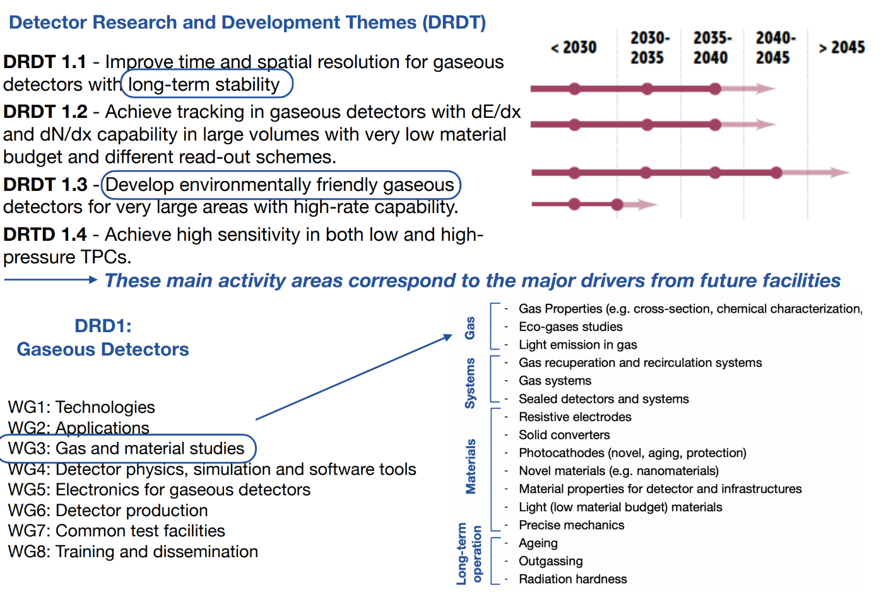
DRD1 development themes
DRD1 Working Groups
WG1: technologies
WG2: Applications
WG3: Gas and materials
WG4: Detector physics, simulation and software tools
WG5: Electronics
WG6: Detector production
WG7: Common facilities
WG8: Training and dissemination

Slide 5
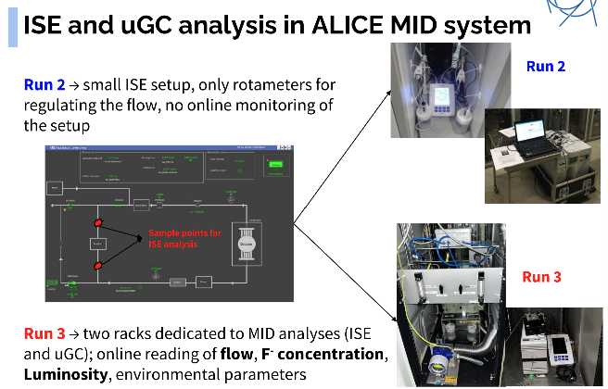
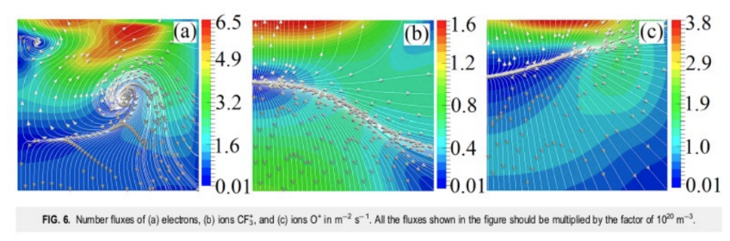
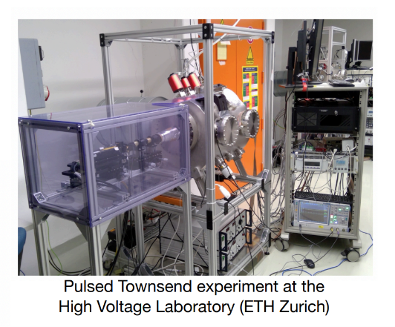
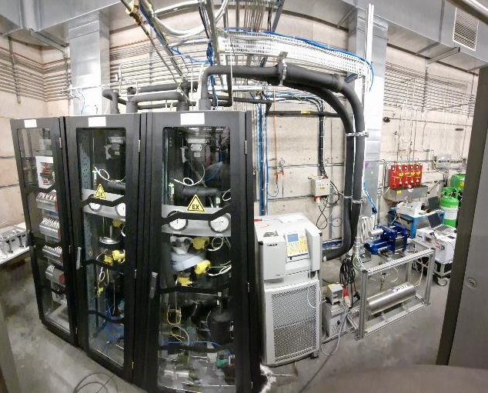

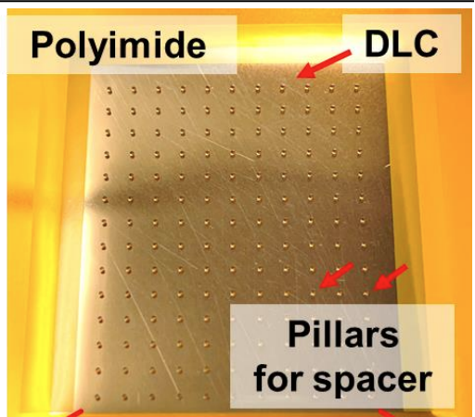
Enlarge the collaboration: physicist & chemist & engineer
Analytical chemistry
Simulation and quantum chemical calculation
Discharge and
its simulation
Gas plants
New material

Slide 6
People and collaborations
Keep experience and expertise and transfer to
young researchers working in large collaborations.
Examples:
A
B
C
D

Slide 7
DRD1 collaboration
Remember nominations for spokespersons and collaboration board chair
Deadline for nominations: November 18th
Contact your institute representant in the provisional collaboration board

