Slide 1
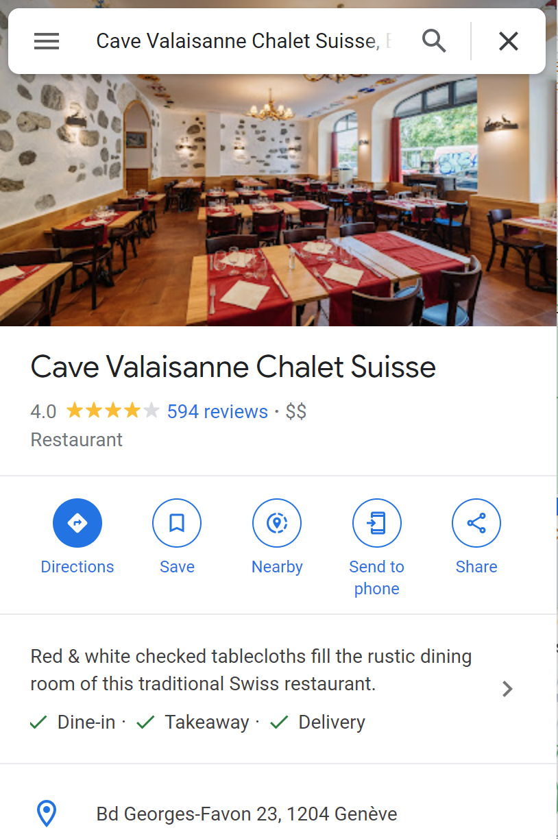
Practical info
Social dinner starting at 7:30 pm at restaurant
Meeting at 6.30 pm at the Mezzanine
By public transportation → tpg tram number 18
One way ticket costs 3 CHF
On the way back, make sure the final destination of the tram is CERN
(some are stopping in Meyrin)

Slide 2
