Slide 1

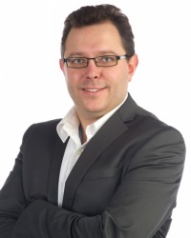
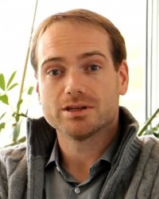
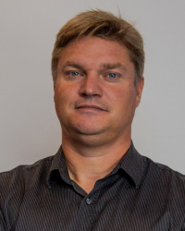
Welkom in het CERN
6-7 februari 2023
Jorgen D’Hondt
Steven Lowette
Michael Tytgat

Slide 2
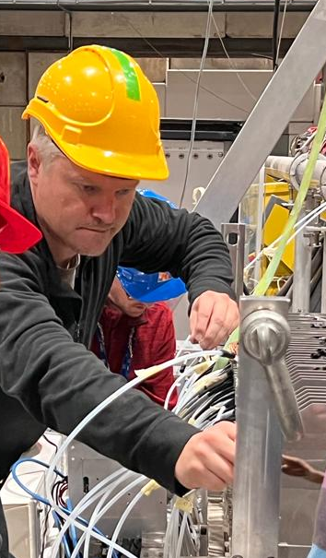
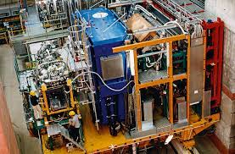
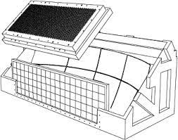
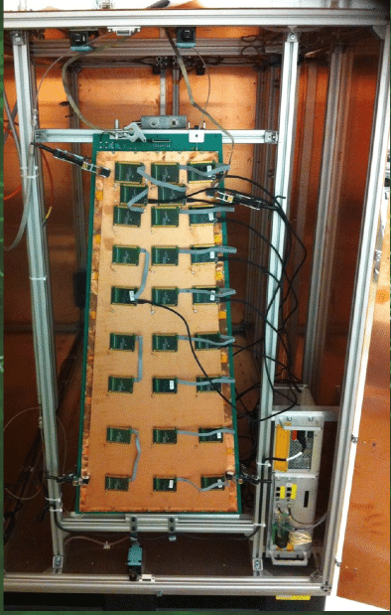
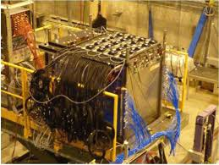
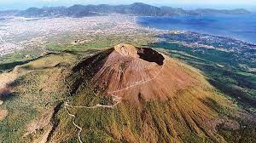
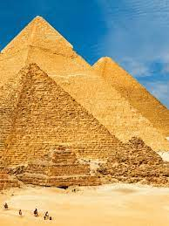
Short CV – Michael Tytgat
Koninklijk Atheneum Kortrijk (math/science)
1991-1995: Cand/Lic. in Physics
1995-2001: PhD in Physics (hep-ex)
2001-2010: FWO Postdoctoral Fellow @ UGent
2006-2007: Visiting Scientist @ CERN
2010-2012: Postdoctoral Assistant @ UGent
2012-2022: Research Engineer @ UGent
2016-present: Guest Lecturer @ UMons
2023-present: Guest Professor @ UGent
2023-present: Professor @ VUB
Research History
Virtual Compton Scattering below π-threshold @MAMI: 1994-1997
HERMES @HERA: 1995-2007
Exclusive vector meson production
Ring Imaging Cherenkov detector
Recoil detector, including project management
CMS @CERN: 2006-present
Established CMS@UGent in 2007 and co-leading team since then
Muon-RPC since 2007
Muon-GEM since 2009 (co-founder of CMS-GEM project)
BSM physics searches
Numerous level-1 & 2 management positions within CMS Muons
RD51 R&D on Micro-Pattern Gaseous Detectors: 2009-present
GEMs, Thick-GEMs, Fast Timing Micropattern Gaseous detectors
CALICE R&D on Calorimetry for Future Colliders: 2009-present
Semi-Digital Hadron Calorimeter development
Muon Radiography: 2017-present
Muraves @ Vesuvius volcano
SciDEP @ Egyptian Pyramids
Belgian Portable Muoscope project
Main research topics @ VUB
CMS @CERN
Phase-2 upgrades (Tracker, Muon-RPC/GEM)
Searches for BSM through flavor physics studies
Future Colliders (FCC/ILC)
Detector R&D (e.g. gaseous for muons, calorimeters)
Heavy flavor physics studies
Non-HEP applications of Muon Radiography
Main interest in geoscience & archaeology

Slide 3
What is CERN about ?
CERN
  Original meaning: Conseil Européen pour la Recherche Nucléaire
  Current meaning: European Organization for Nuclear Research
CERN’s mission
          C → International Collaboration, i.e. unite people from different countries and cultures
          E → Education and knowledge sharing, i.e. train scientists and engineers of tomorrow
          R → Fundamental Research, i.e. push back the frontiers of knowledge, e.g. secrets of the Big Bang, what was matter like within the first moments of the Universe’s existence ?
          N → New technologies for accelerators and detectors; information technology (the Web and the GRID); medicine diagnosis and therapy
CERN has particle accelerators and many experiments to discover and study the building blocks of the universe
CERN is an open laboratory, with certain constraints and regulations
Every year, ~ 130 000 people visit CERN

Slide 4
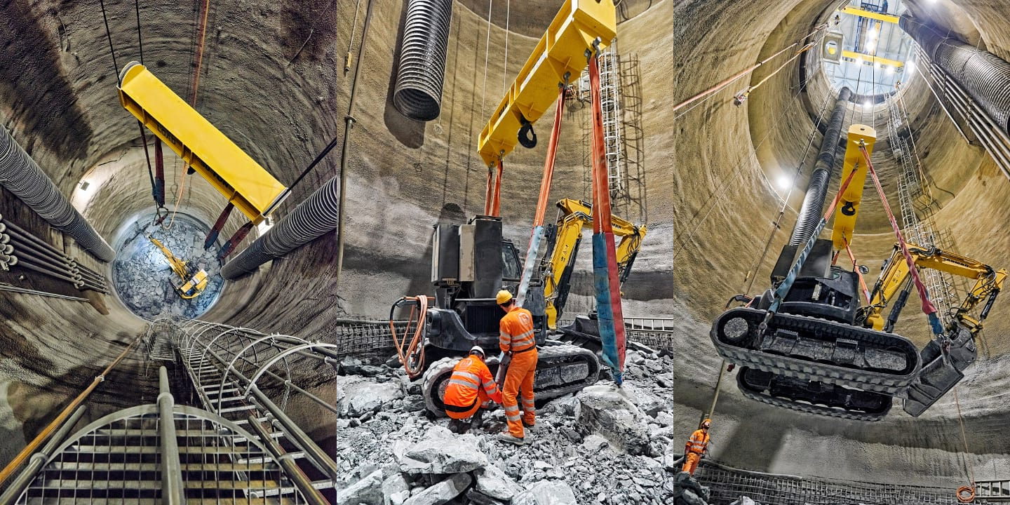
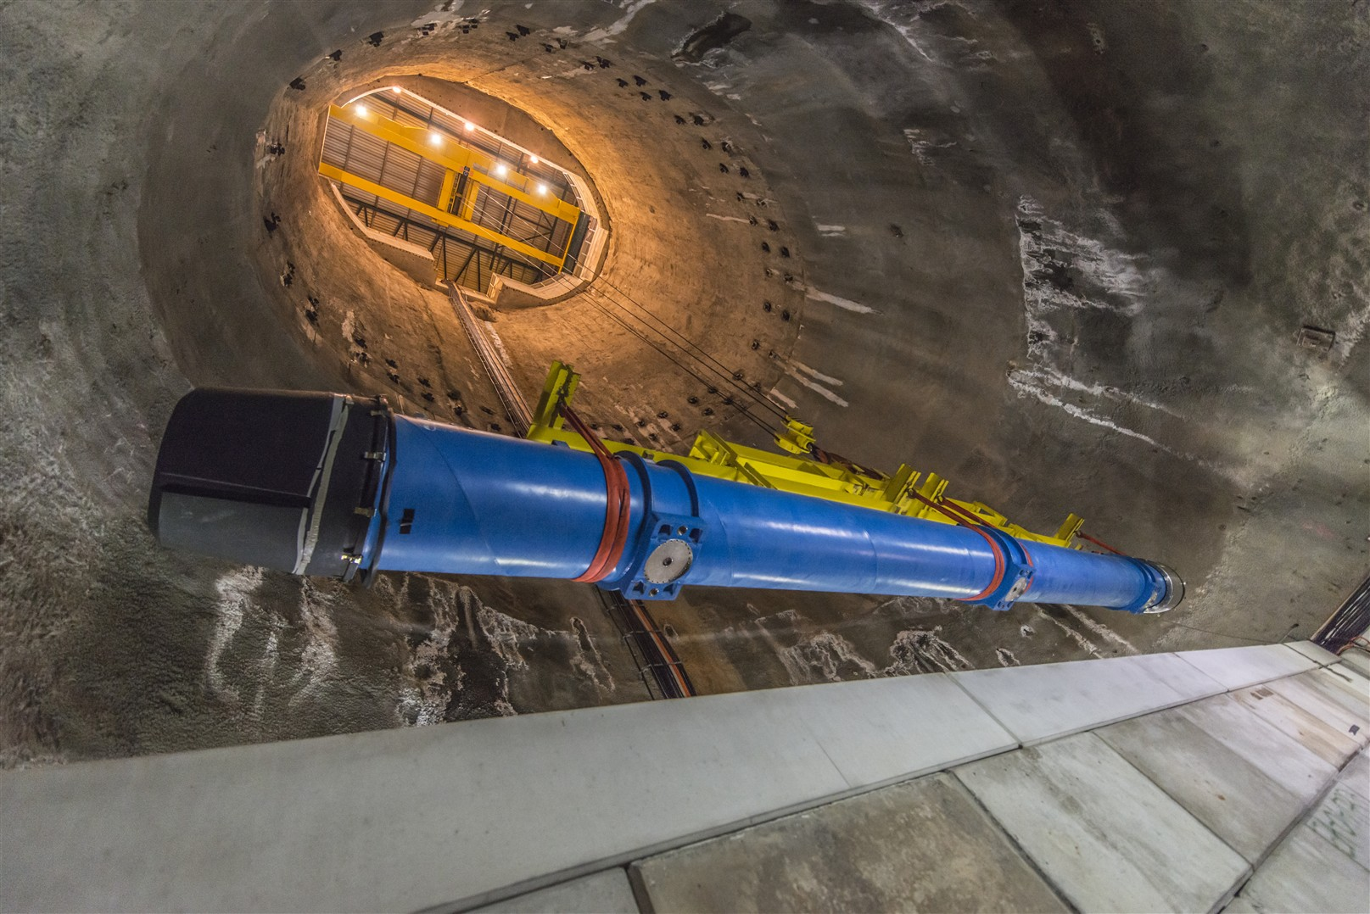
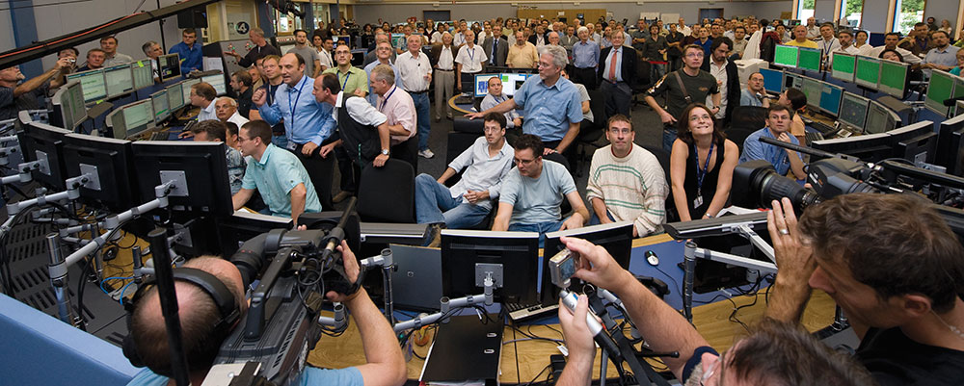
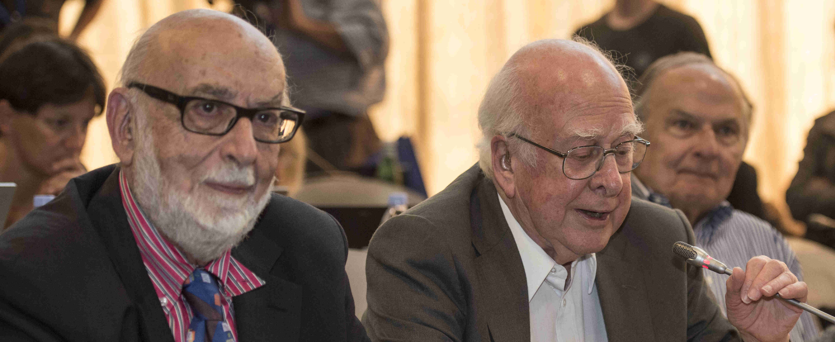
Short History of CERN
1949: first steps towards civilian research in nuclear technology; CERN origins: putting Europe back on the research map in the post-WOII era
1952: foundation of CERN under auspices of UNESCO
1953: CERN charter is signed
1954: completion of the ratification by 12 founding states (including Belgium); start of the construction: CERN began to materialize
1957: CERN’s first accelerator: the synchrocyclotron
1959: the Proton Synchrotron (PS) starts up
1971: first proton collisions: Intersecting Storage Rings
1976: Super Proton Synchrotron (SPS) starts up
1983: W and Z bosons are discovered
1989: first injection in the Large Electron Positron collider (LEP)
1990: first web site and server are up
2008: Large Hadron Collider (LHC) starts up
2012: ATLAS&CMS experiments observe a particle consistent with the Brout-Englert-Higgs boson

Slide 5
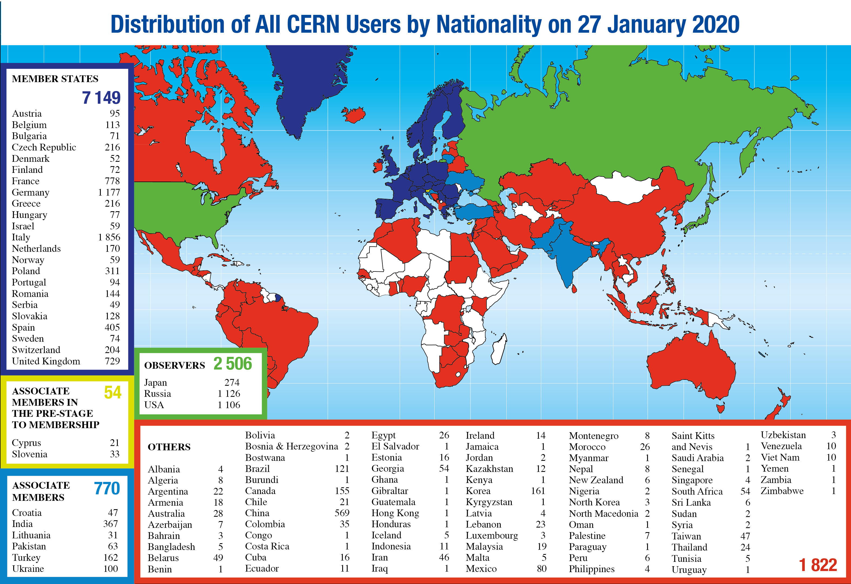
CERN Users
~3000 people employed by CERN: physicists, engineers, computer scientists, mathematicians, technicians, secretaries, fire brigade, health & safety experts, security, etc
>10000 physicists from all over the world associated with CERN

Slide 6
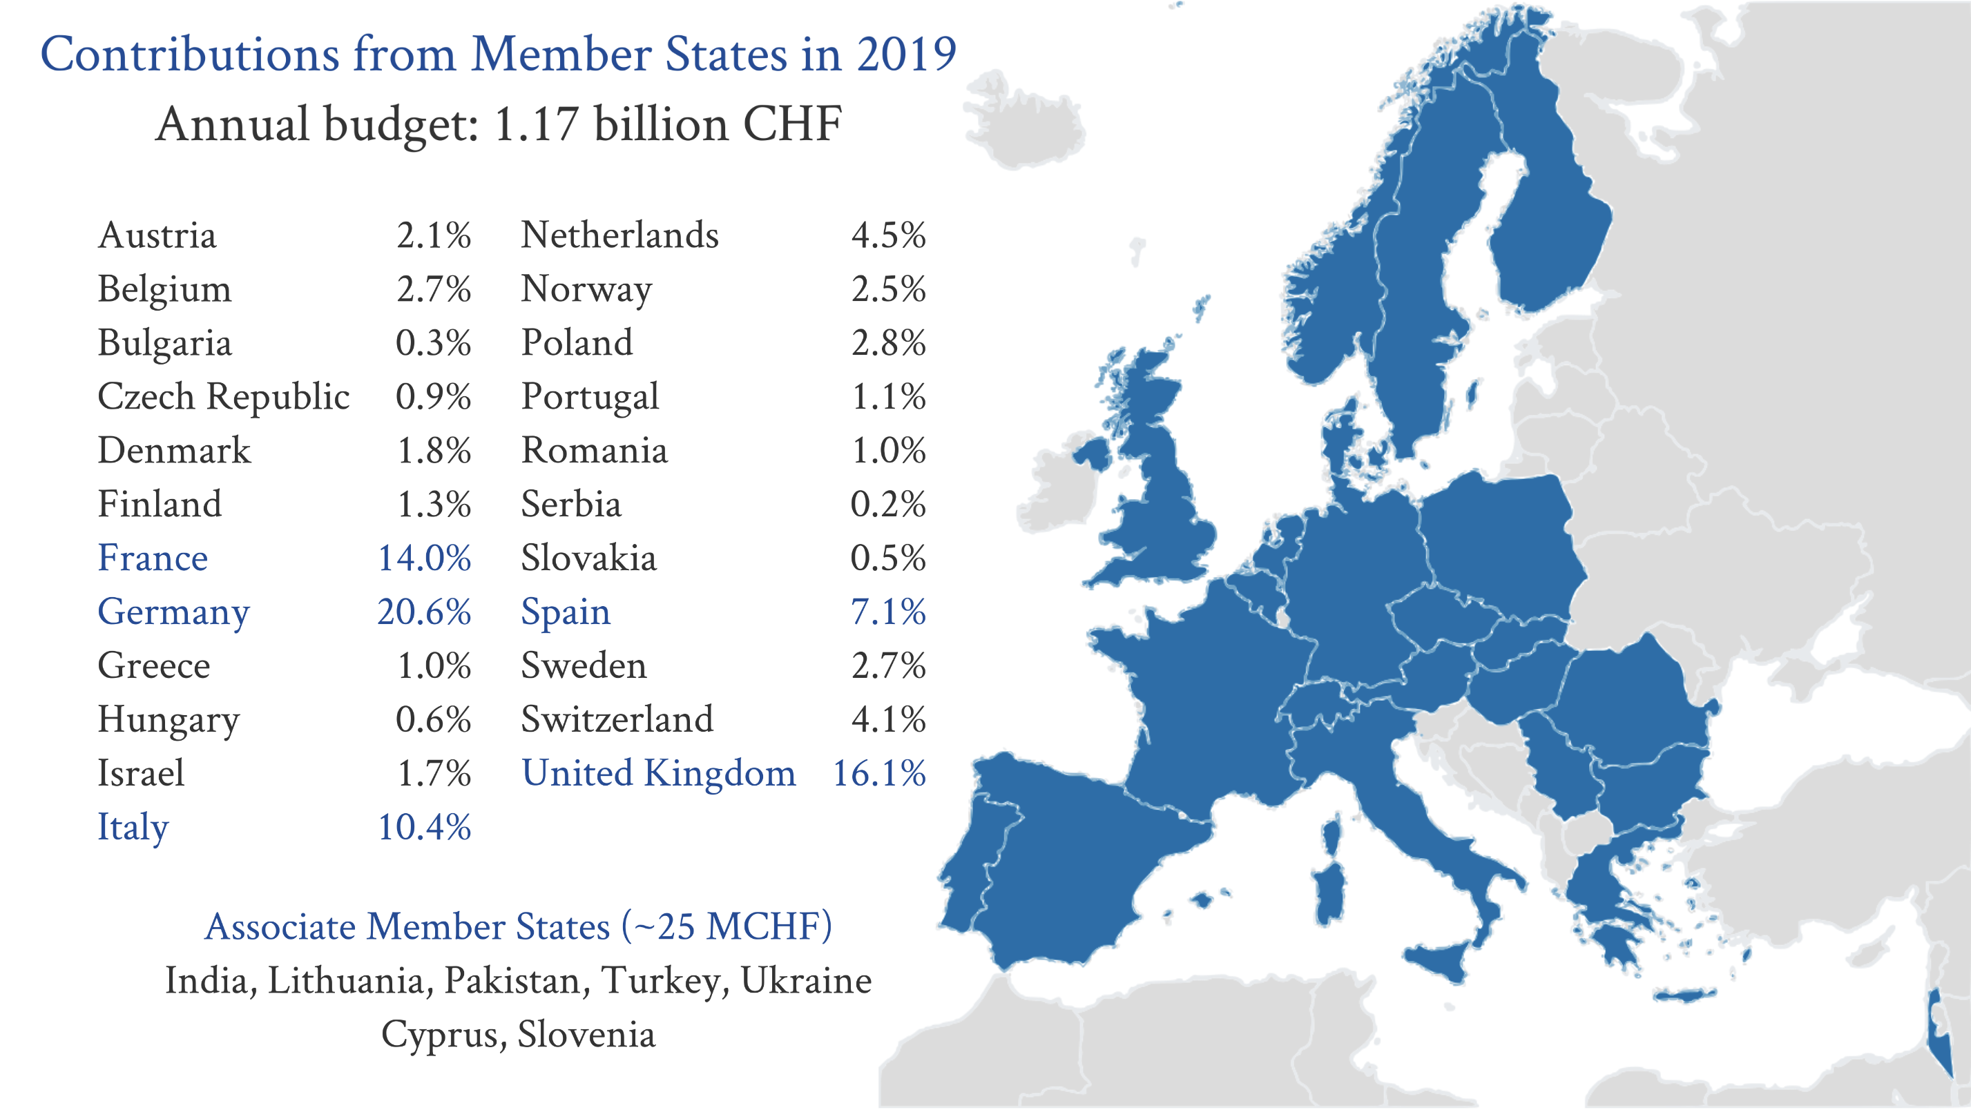
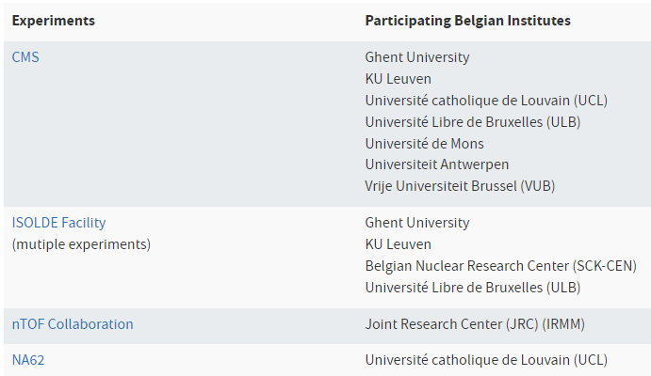
Belgium in CERN
Belgium as founding member of CERN
Belgian physicist Léon van Hove as Director-General of CERN (1976-1980)
Main past/present experimental contributions include experiments with neutrino beams, the electron-positron collider, the large hadron collider and nuclear physics experiments at ISOLDE facility
Today’s main focus of HEP Belgium at CERN on CMS@LHC: construction of forward silicon tracker, forward RPC and GEM muon systems & CASTOR forward calorimeter; CMS Tier-2 center @ VUB/UCLouvain; numerous data reconstruction algorithms and physics analyses

Slide 7
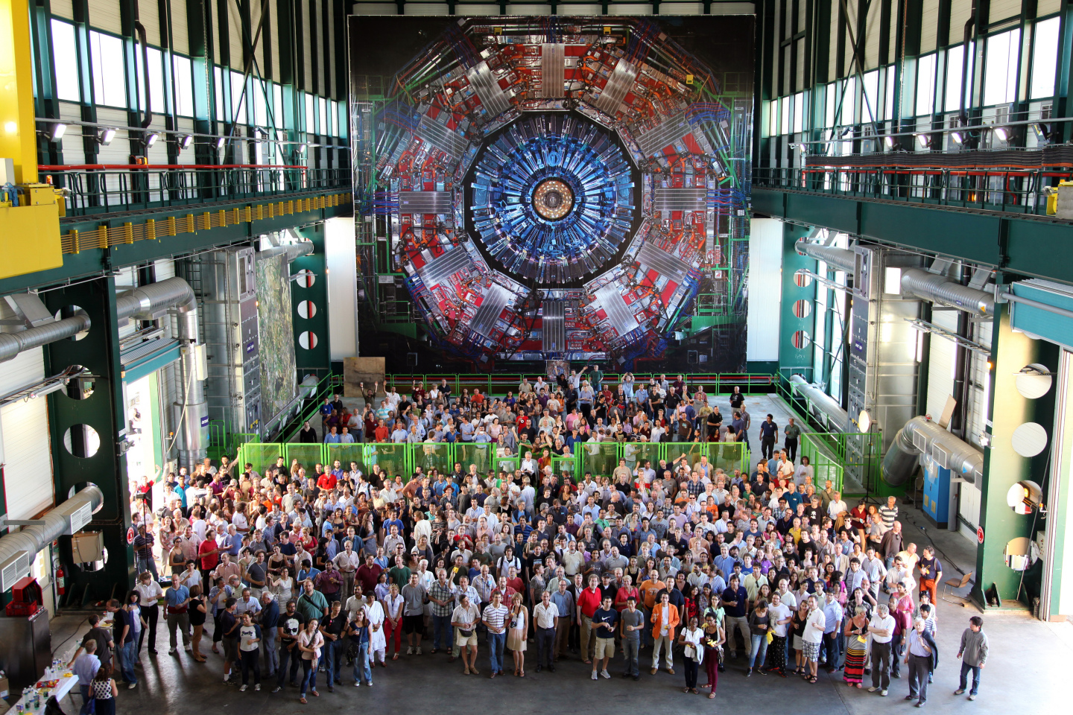
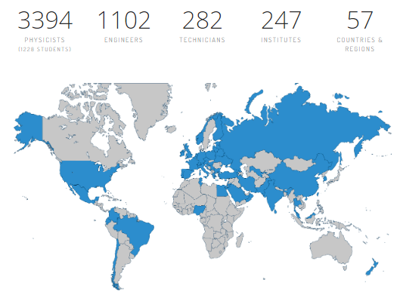
CMS Experiment
Belgian main contributions

Slide 8
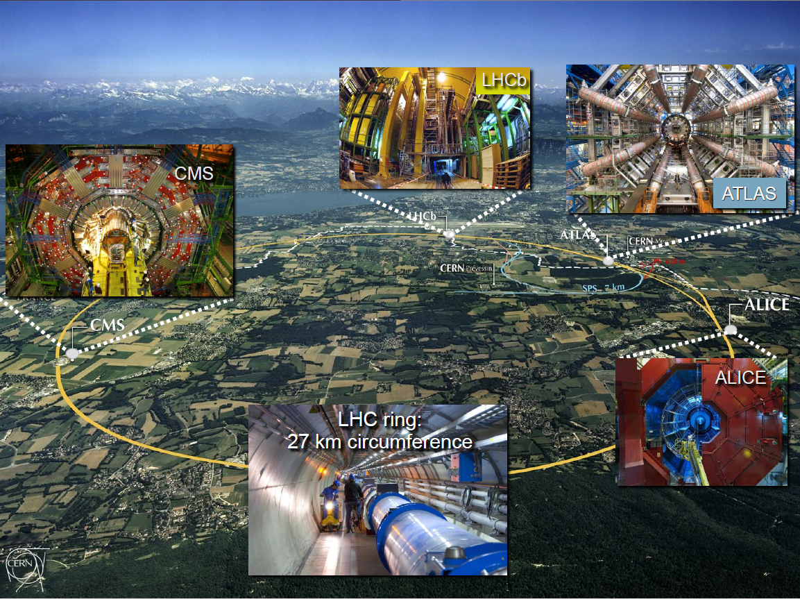
Now Go and Explore !
Taking photographs is allowed everywhere, i.e. at any place where you are allowed to go ☺
Social media: #CERN, #CMSExperiment, #WeAreVUB …
Don’t hesitate to ask questions !
CERN Information: www.cern.ch
CERN TV: www.youtube.com/cern
CMS Information: cms.cern
CMS Social Media:
www.facebook.com/CMSexperiment
twitter.com/CMSexperiment
www.youtube.com/watch?v=S99d9BQmGB0
www.instagram.com/cmsexperiment/
«Magic does not happen here, magic is being explained» (Tom Hanks, during his visit to CERN in 2009 for the Angels and Demons movie)

