Slide 1
OP Shutdown lectures:
RF Beam Control
Arthur Spierer with the contributions of P. Baudrenghien, R. Borner, J. Egli, F. Follin, G. Hagmann, G. Kotzian, K. Li, G. Papotti, A. Rey, I. Stachon, M. Suminski, OP-SPS, RF-FB and RF-CS
22nd of February 2022

Slide 2
Overview
Go through the operational tools to setup and debug the RF beam control
  Revolution frequency
  Rephasing
  Beam loops and RF pick-ups
  RF manipulations for ions
  RF gymnastics
Overview of the Low Level RF hardware and concepts

Slide 3
Revolution Frequency Generation

Slide 4
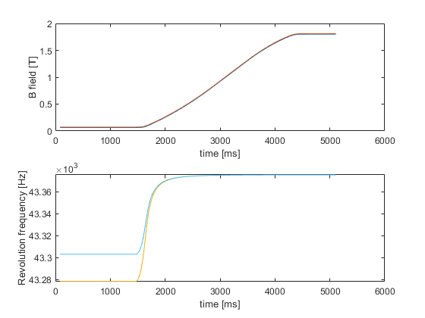
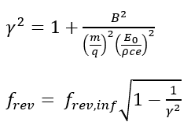
Revolution frequency generation
The revolution frequency is computed by the Beam Control (LLRF) from a measurement or a function of the bending magnetic field
It also requires SPS machine parameters such as the radius, transition energy, particle mass over charge, radial steering
What is B0?
It replaces the value of the measurement at flat bottom to provide a defined and stable frequency for injection
Until BtrainEnable timing

Slide 5
Quick reminder on the NCO
Numerically Controlled Oscillator
Synchronized over White Rabbit (WR) network (Ethernet + precision timing)
Example: PS – SPS synchro

Slide 6
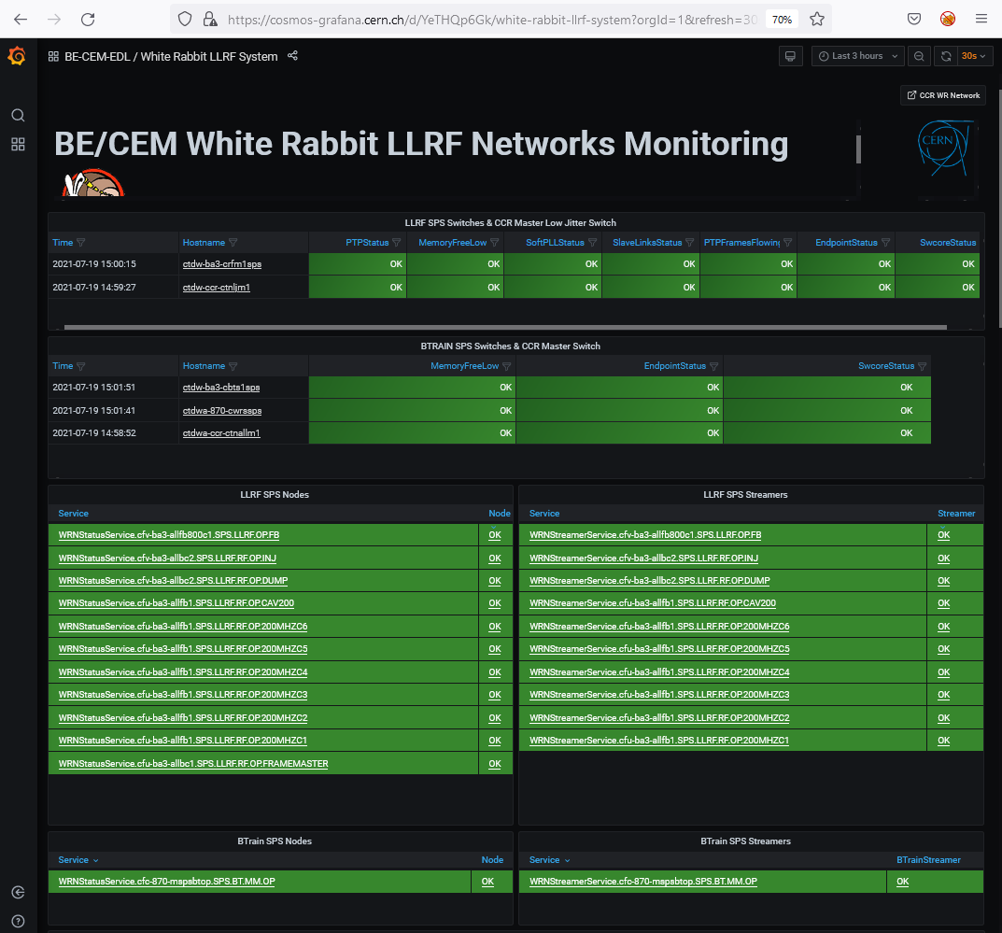
Revolution frequency distribution
Several equipment rely on the revolution frequency or a multiple of it
  RF Cavity controllers, kickers, injection/extraction synchro, beam instrumentation, …
It is distributed digitally over a white rabbit network (Frequency Tuning Word) and also in analog via copper/fibers
CCM -> White Rabbit LLRF Monitoring
Switches: WR support
LLRF nodes: reboot/LLRF expert

Slide 7
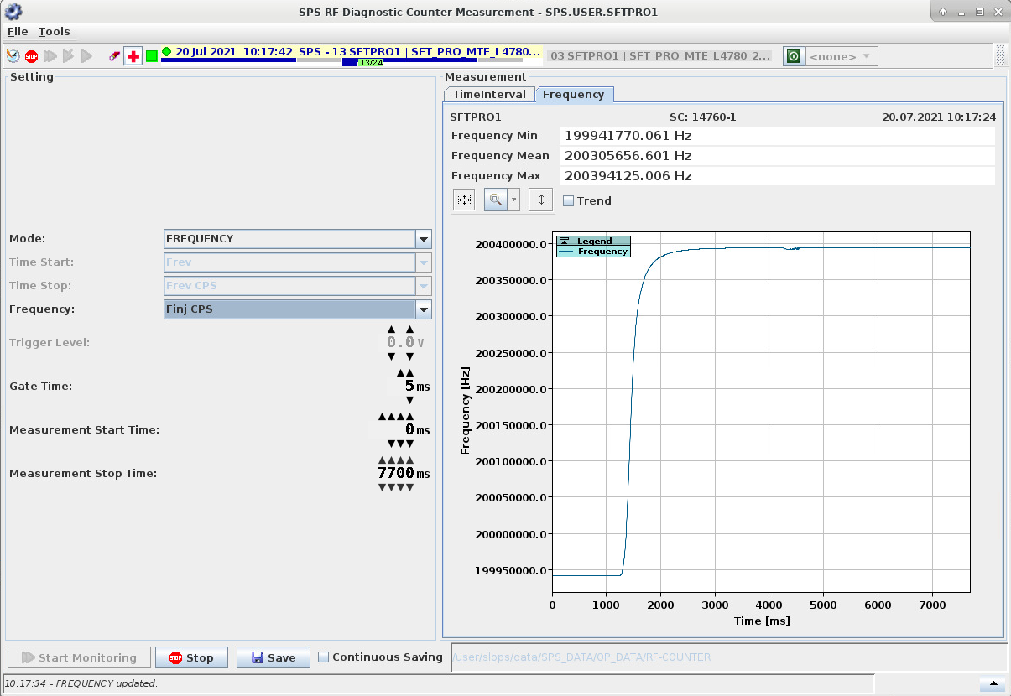
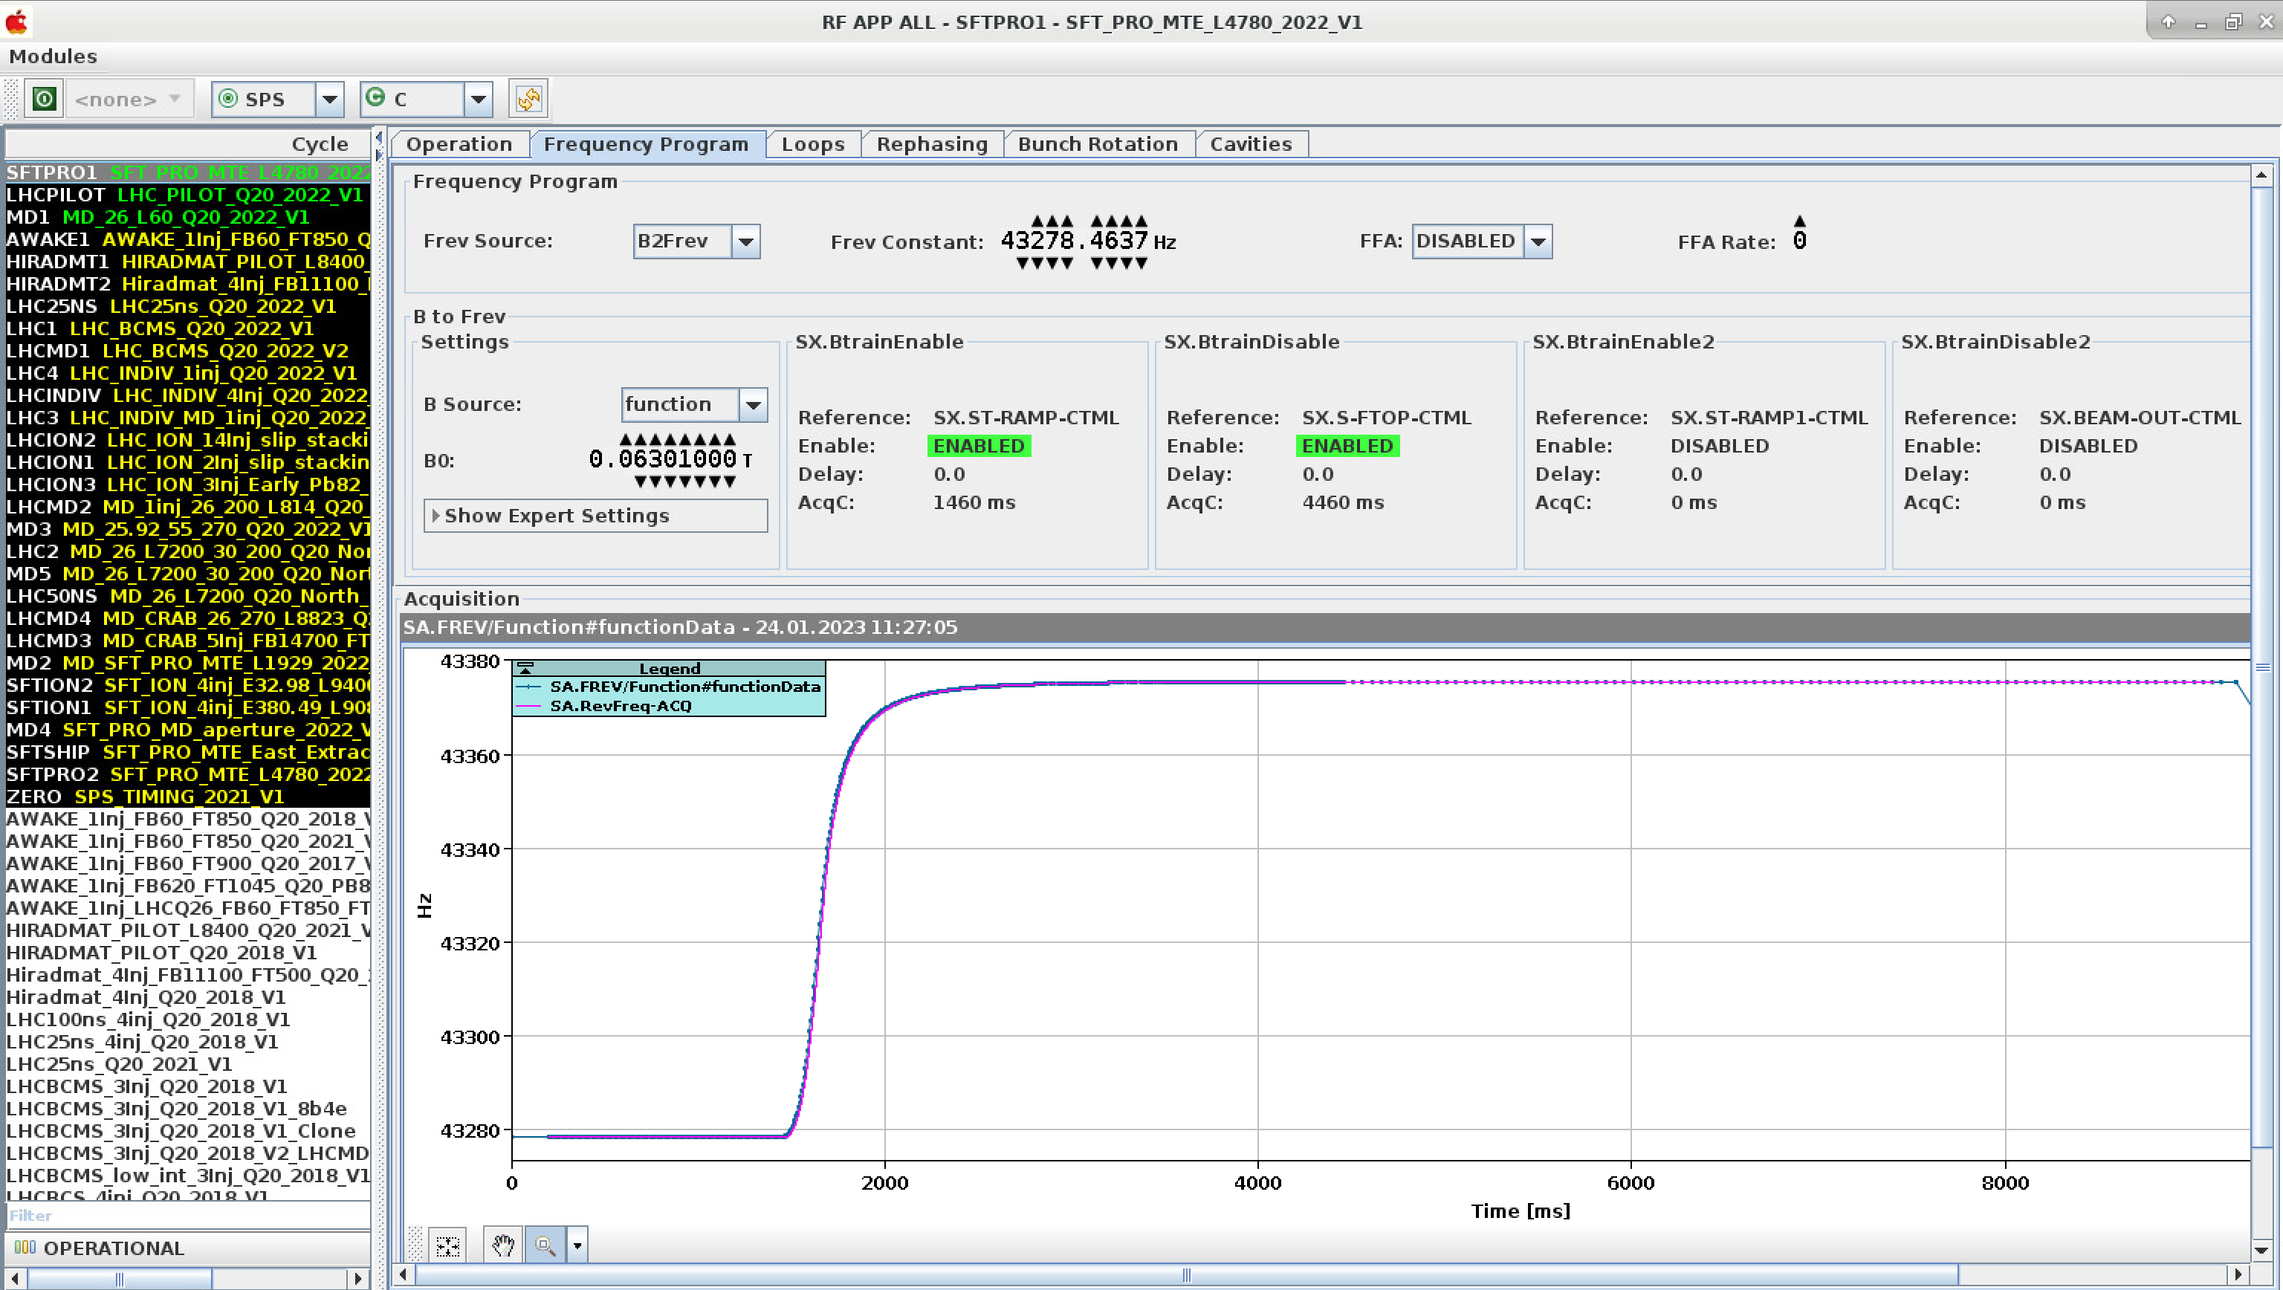
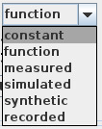
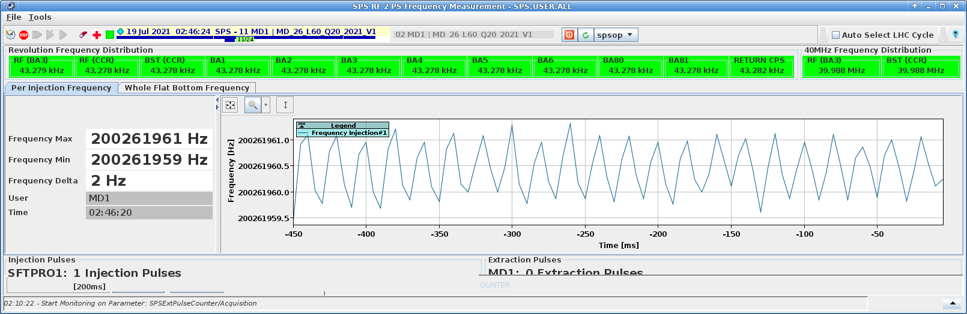
Revolution frequency debugging
CCM -> Diagnostic counter:
Independent frequency measurement of
  Fc, Frf Ext (400 MHz rephasing)
  Frev to PS (Synchro)
  Frf to PS (Synchro)
  Frev Frf
Pink: acquisition, blue: function
- Frequency is flat -> LLRF crash
- Wrong frequency -> Wrong setting? Not driven?
- Noisy -> Problem with a loop / pick-up chain
CCM -> SPS 2 PS RF frequency Measurement: Reports issue with the injection frequency
CCM -> RF APP ALL: Main entry point for LLRF Beam Control (F. Follin)

Slide 8
Rephasing

Slide 9
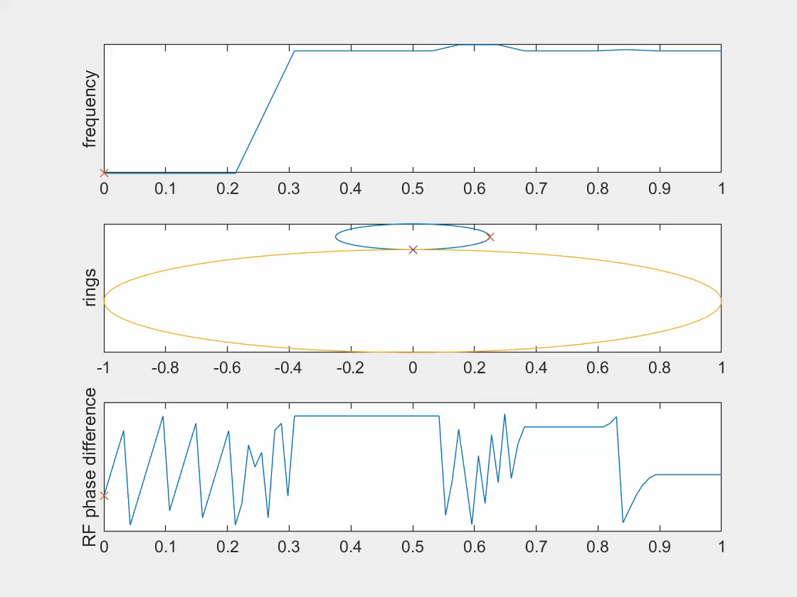
Rephasing principle
Stage 1:
to target frequency
Stage 2:
cogging
Stage 3:
PLL
The rephasing is a synchronization sequence to rotate and extract the beam in the correct bucket (LHC, AWAKE)
The reference is f_{c} , the common frequency between two machine (provided by downstream machine)
  For LHC, f_{c} = frev_{LHC}/7 = frev_{SPS}/27 = ~1.6 kHz
  For AWAKE, f_{c} is synchronized with the laser pulse
Once the first bunch is in the correct position the SPS RF is locked to the master machine RF with a feedback (PLL)

Slide 10
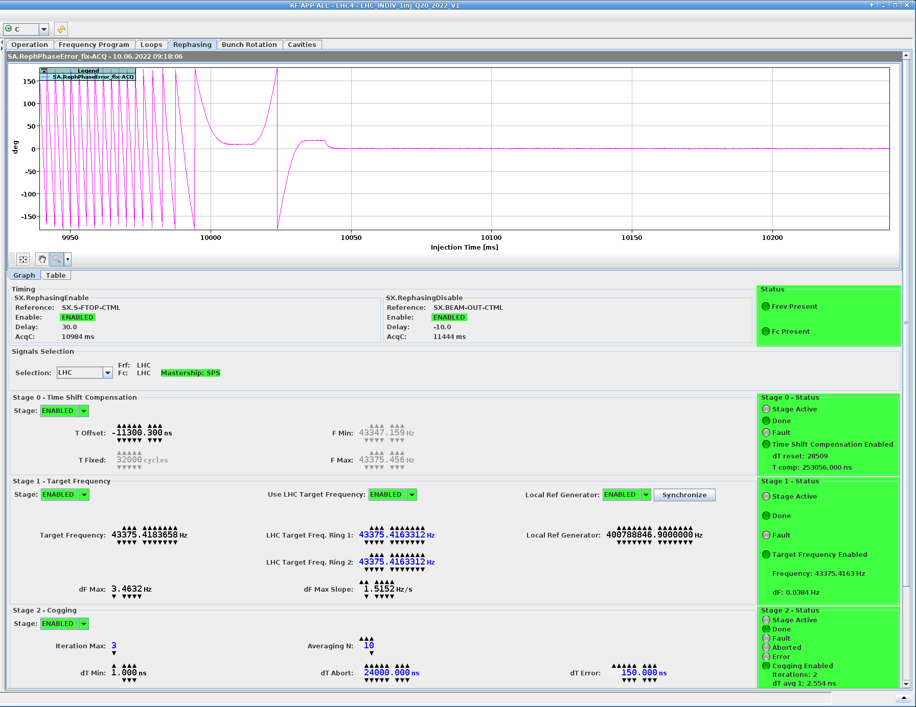
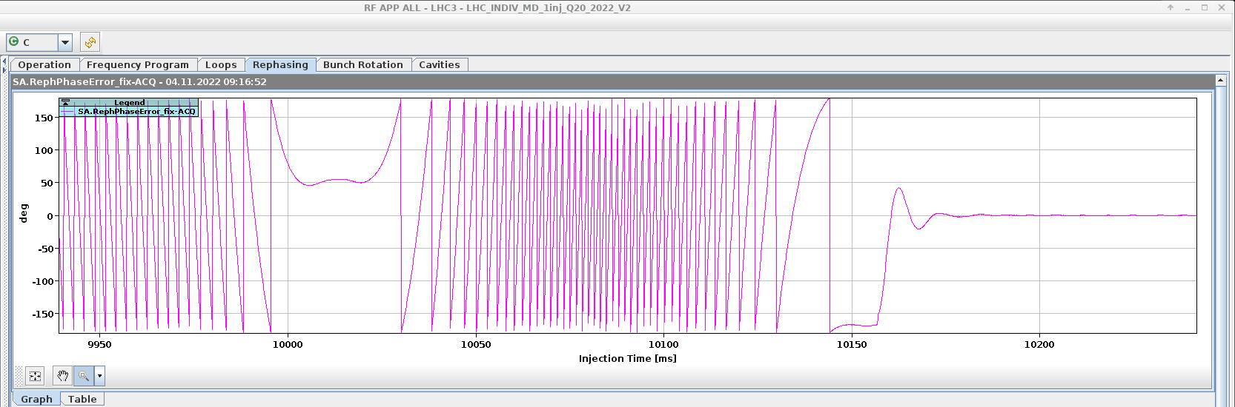
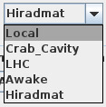
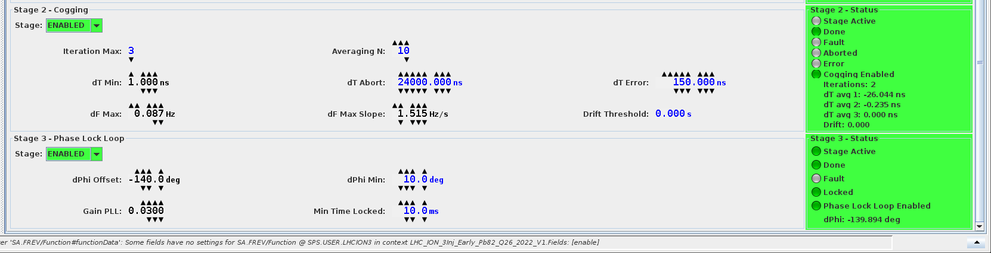
Rephasing setting up
Setting the signal sources
  The rephasing can operate on LHC, AWAKE or a local RF/pulse generator during setting up
T offset (stage 0) is a delay used to adjust the position at extraction. It is adjusted with the BQM first bunch position as reference.
  With a fine adjustment, the phase when locking the PLL is brought towards zero to avoid a bucket jump.
The target frequency (stage 1) is set either to LHC (automatically tracking) or manually entered for other targets
The cogging settings (stage 2) define the shape of the frequency bumps
The phase lock loop (stage 3) dPhi offset is adjusted with the BQM fine bunch position as reference.
If the sequence cannot execute withing the allocated time, stage 0 will be optimized at the next cycle
CCM -> RF APP ALL: Rephasing tab

Slide 11
Rephasing common issues
Missing Fc
  Can be checked with diagnostic counter
  If present and frequency correct -> LLRF issue
Wrong target frequency
  Phase is not flat during measurement
  If PLL locks, can cause radial steering
Cogging fails
  Leave at least one training cycle
  Check fc
A status will be added for frf.ext presence
CCM -> RF APP ALL: Rephasing tab

Slide 12
Beam-based loops
Two systems: phase + synchro loops or phase + radial loops

Slide 13
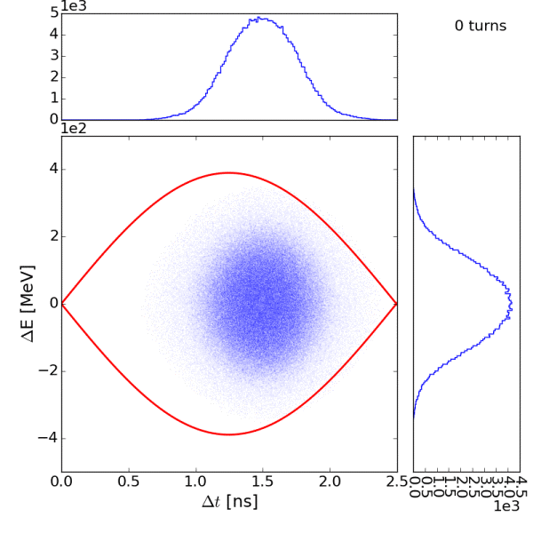

Phase and synchro loop, what for
The Phase loop reduces the jitter between beam phase and Cavity Field
  It damps the injection phase/energy errors
  It reduces the effect of RF noise (longitudinal emittance growth)
The Synchro loop locks the RF onto an phase reference (program)
  It is essential at injection (bunch into bucket transfer)
  It can be used in the ramp if the reference RF follows the momentum ramp
  It is essential at extraction (locks the SPS buckets onto the LHC or AWAKE reference)
Phase space evolution: phase error at injection
Analysis by H. Timko

Slide 14
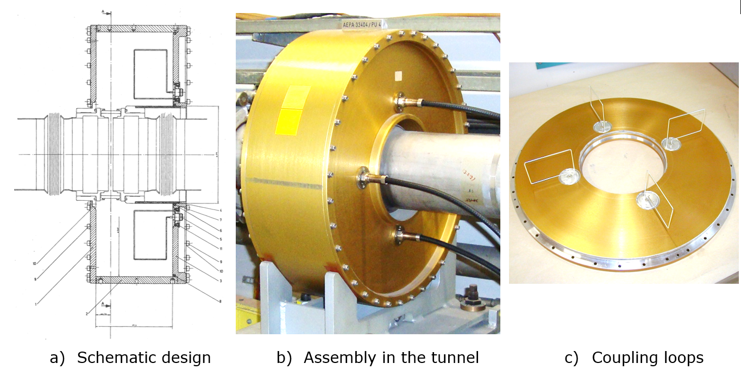
Narrow band Phase pickup principle
The passing bunch induces a resonance in the cavity, its centre frequency is 200 MHz.
After filtering (band pass) and gain adjustment, we can compare it to the accelerating RF and extract the phase
Resonant phase pickup
Picture courtesy of xxx

Slide 15
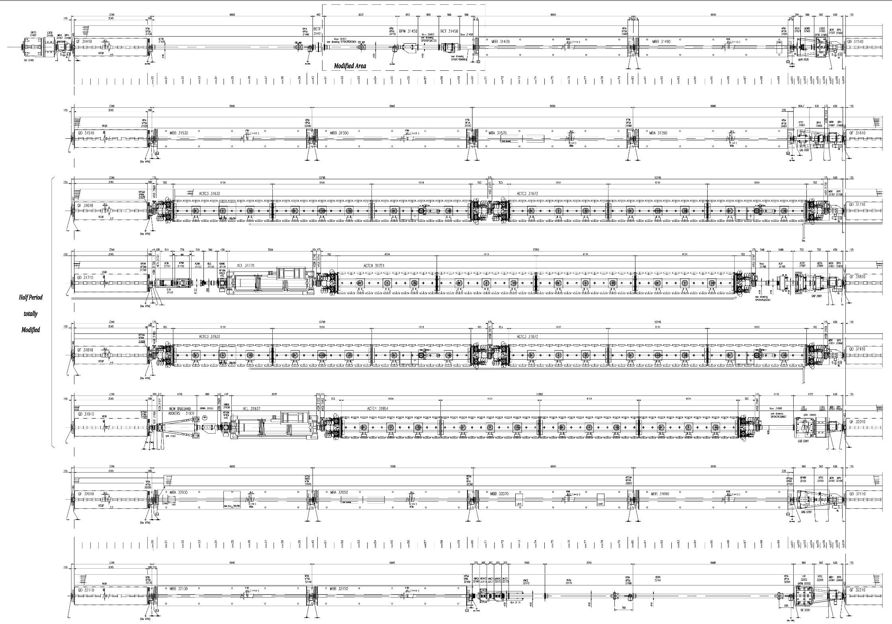
Where are the pick-ups
Longitudinal Narrow band (resonant)
  AEPC.31801 (1)
  AEP.31799 (2)
Longitudinal Wide band (wall current)
  AEW.31731 (3)
  AEWA.31733 (4)
Transverse Narrow band
  BPCR.31202 (5)
  AERB.31302 (6)
Transvers Wide band
  BPWA.31101 (7)
  BPW.31456 (8)
8
TWC 200
TWC 200
3
4
TWC 800
TWC 200
2
1
TWC 200
TWC 200
TWC 800
TWC 200
LSS3 arrangement
edms.cern.ch/ui/file/1155058/AB/spslnins0106-vAB.pdf

Slide 16
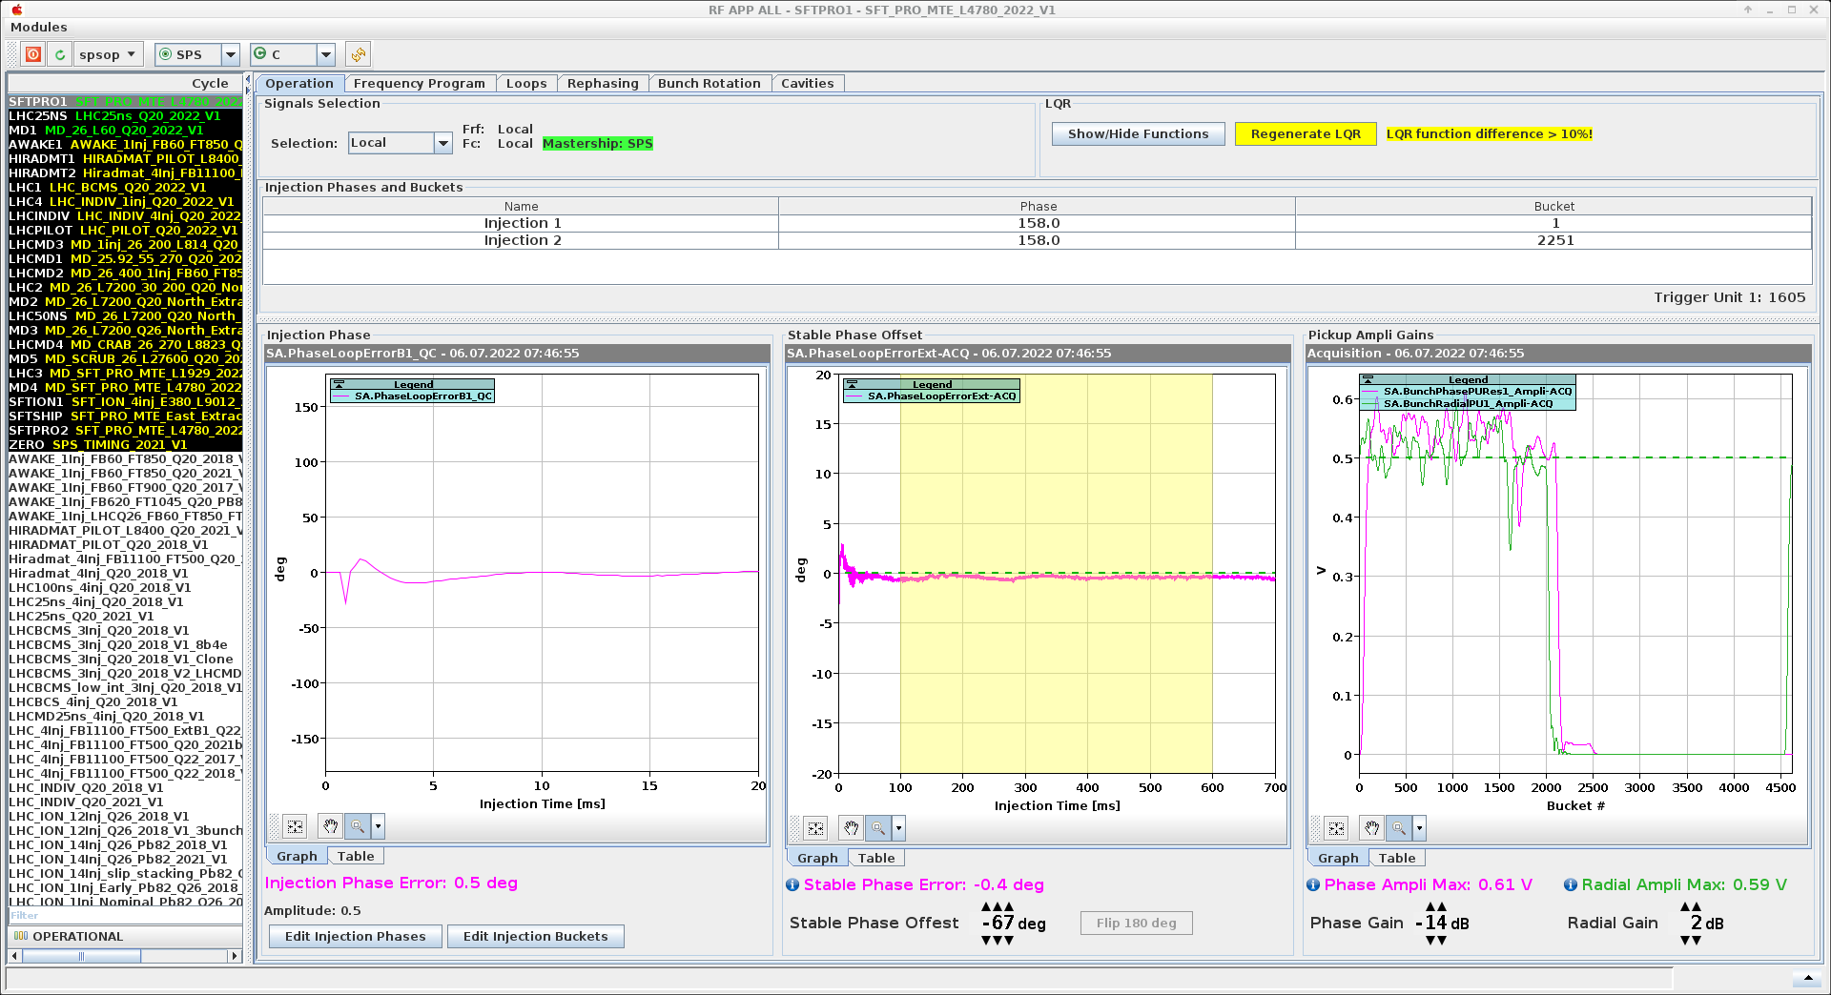
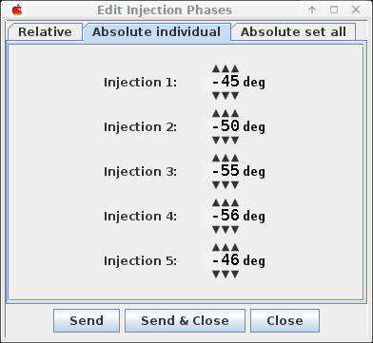
Injection phase
Adjust pick-up gain to have ~0.5 peak amplitude (0.25 for slip-stacking)
Adjust injection phase to get first point around zero degrees
Adjust stable phase offset to get the injection plateau around zero degrees
Warning: if the beam de-bunches and intensity goes below threshold -> no more acquisition
  Maybe flip 180 degrees
For high intensity beams, the
feed forward will prevent
over-compensation
CCM -> RF APP ALL: Operation tab

Slide 17
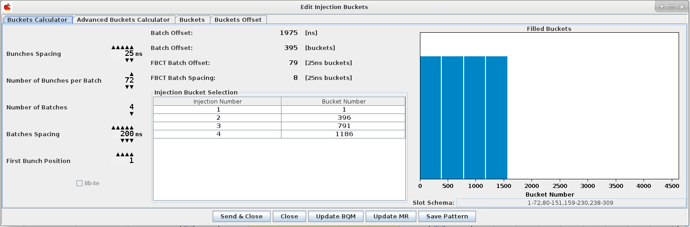
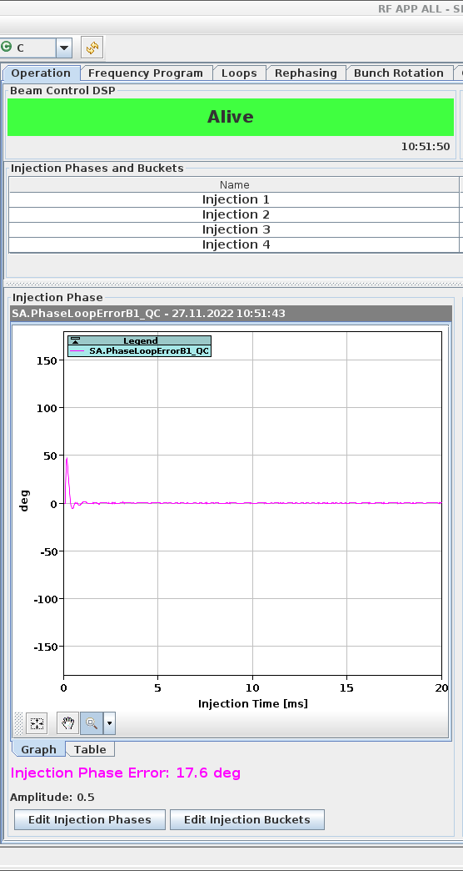
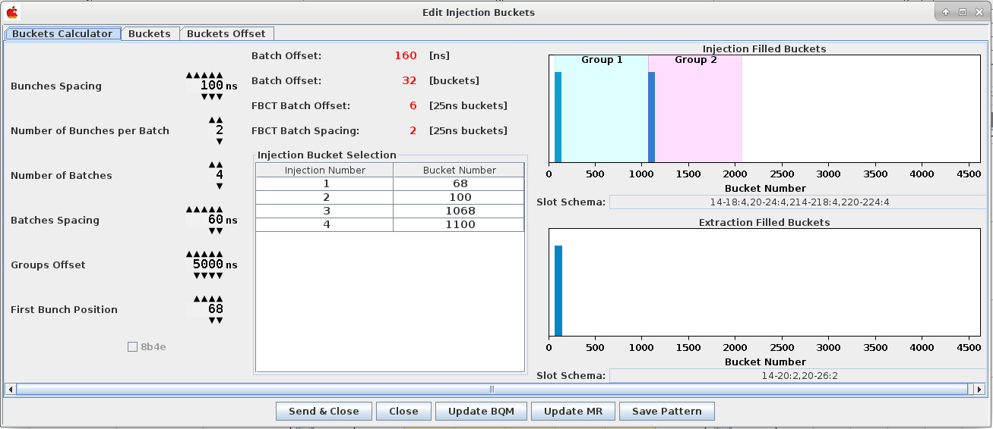
Masks
Injection buckets setup
  Used by loops masks
  BQM
  Mountain range
For ions slip stacking, the additional group offset attributes bunches to the two phase loop
LHC25ns
LHCION1

Slide 18
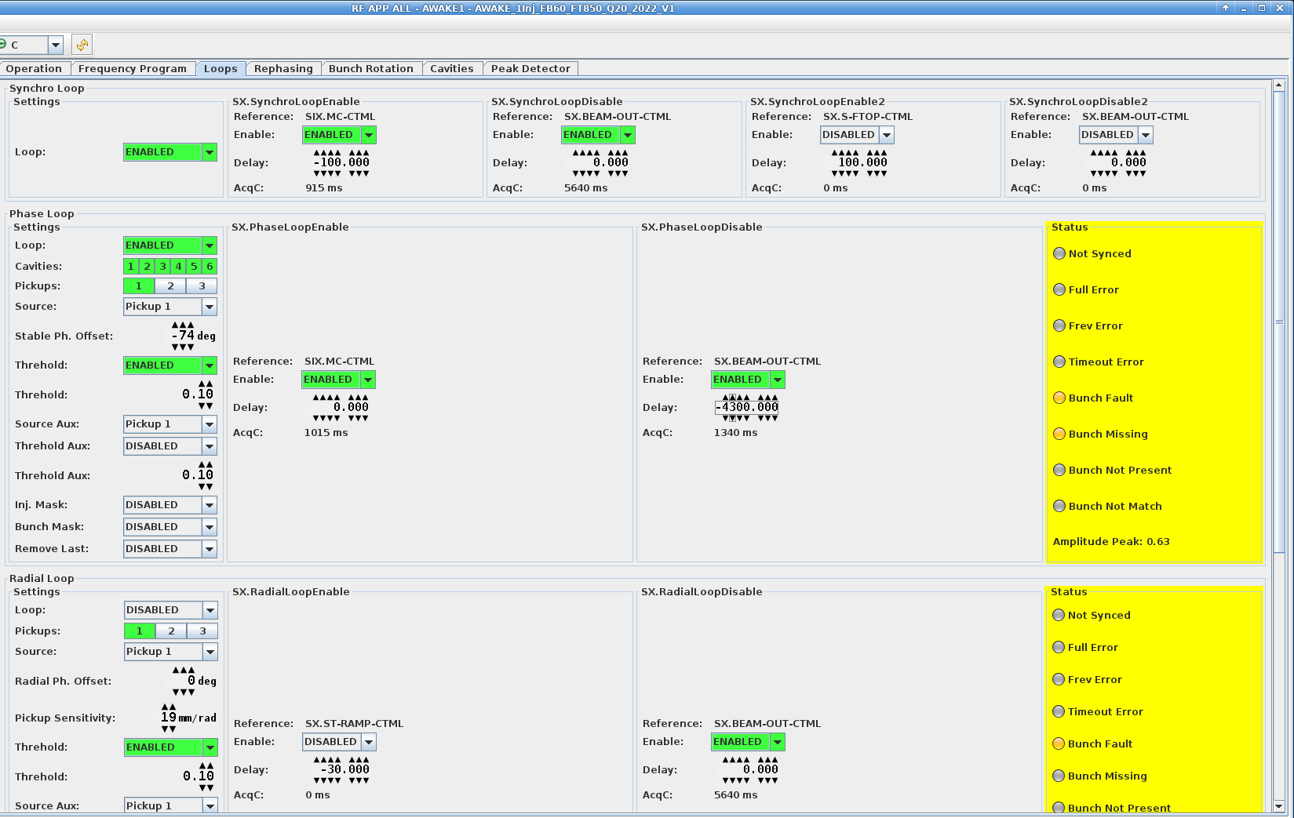
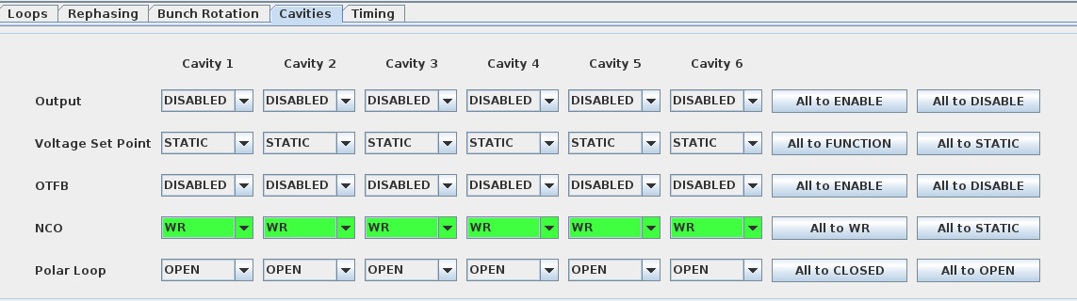
Status and controls
Enable/disable loops
Setup cavities/pickup sources
Setup masking and bunch detection threshold
To monitor the status : If boxes go red, it is likely a synchronization issue with a cavity controller (It might be set on static frequency or crashed)
CCM -> RF APP ALL: Cavities tab
CCM -> RF APP ALL: Loops tab

Slide 19
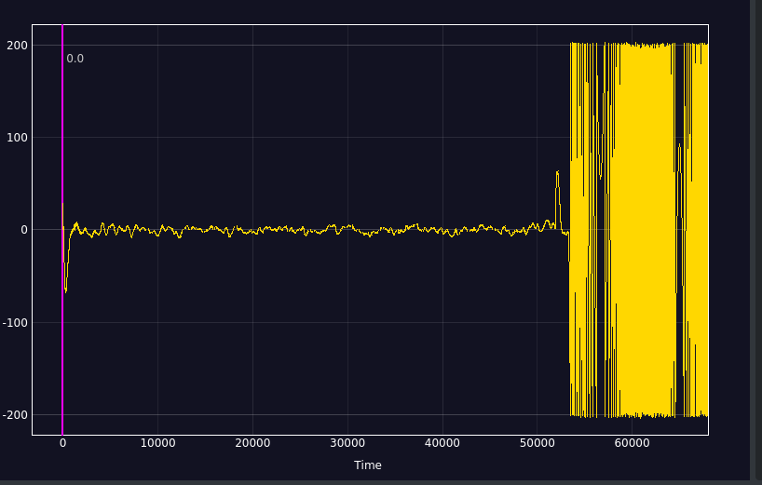
Beam loops: Synchro loop error (SFTPRO)
CCM -> Megadrive: Synchro loop error
Phase [deg]
Injection batch 1
Energy mismatch
Injection batch 2
Some difference in energy
Switch Synchro-Radial loops
Ramp with radial loop. Synchro loop unlocks

Slide 20
phase and radial loop, what for
The Phase loop reduces the jitter between beam phase and Cavity Field
The Radial loop keeps the mean orbit centred
  It is essential to cross transition (where a small RF frequency error results in very large orbit displacement) -> control of frequency is not sufficient
  It cannot be used at injection as it does not guarantee constant RF frequency (influence of the errors in radial measurements)
Cycles
  SFTPRO
  SFTION, LHCION

Slide 21
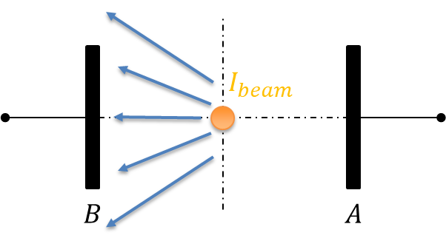
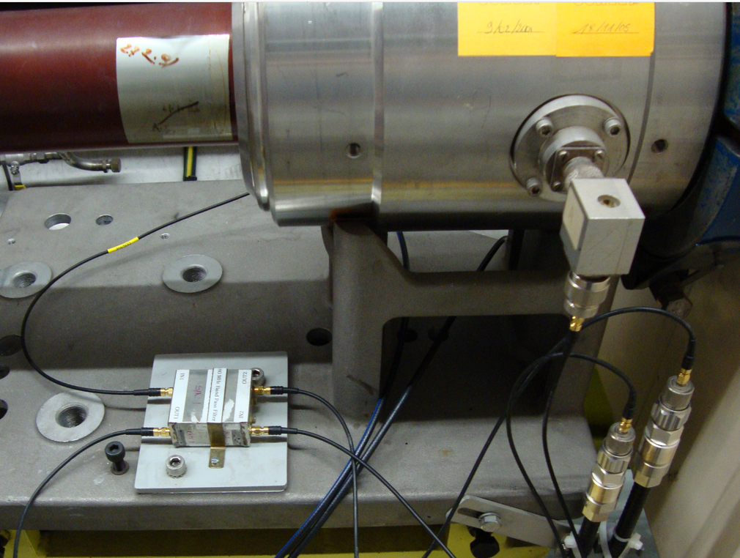
Radial pick-up principle
Two opposing electrodes, A and B are sensing the beam induced electro-magnetic field
The electrode voltage is fed in a 90° hybrid, where the amplitude difference due to beam position is translated into a phase difference.
The radial position is ~proportional to the extracted phase
Radial pick-up electrodes A and B Drawing courtesy of G. Kotzian
AERB.31302 electrostatic pick-up
Picture courtesy of T. Bohl

Slide 22
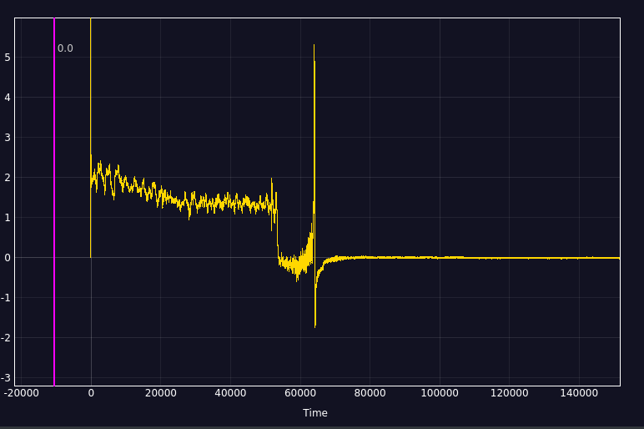
Radial loop error signal
CCM -> Mega Drive: radial loop error
Filling with Synchro loop: Radial position is not regulated well (B field decay)
Switch from Synchro to Radial loop: Radial position regulated to zero
Transition crossing
Radial position regulated at zero during ramp and flat top. Important for slow extraction

Slide 23
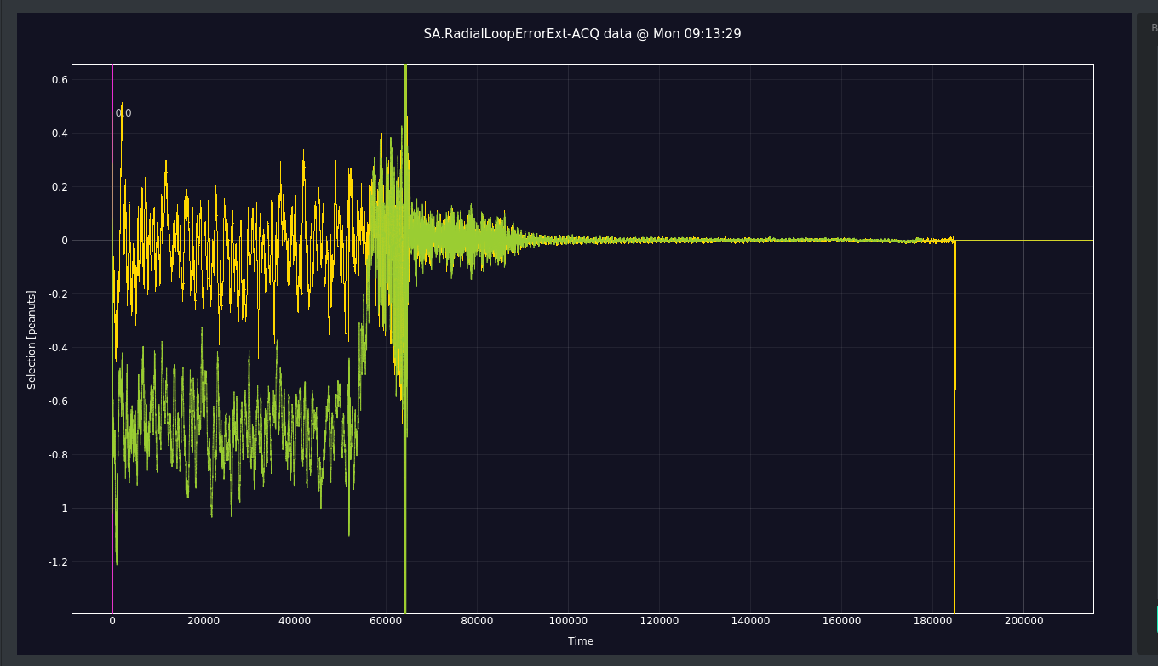
Radial loop calibration
Radial calibration against mean orbit at flat bottom (YASP)
Done only a beam commissioning, unless it drifts…
Calibrated (yellow)
Un-calibrated (green)

Slide 24
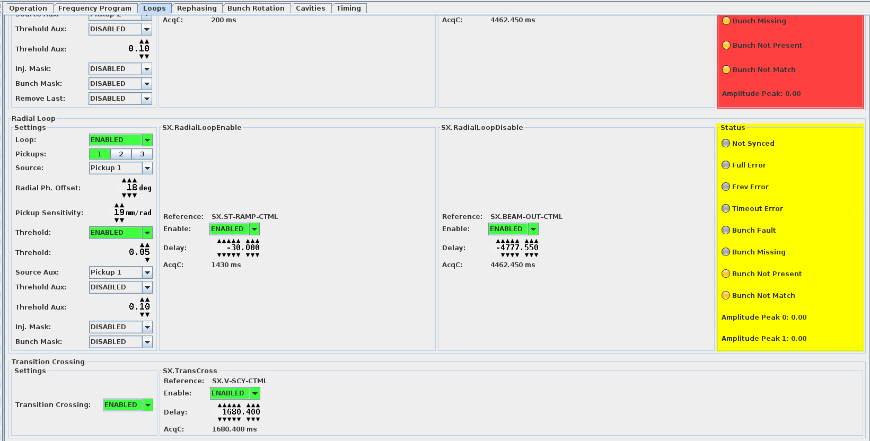
Radial loop controls
Enable/disable
Calibration offset
  ~0.16 mm/deg
Threshold
Transition crossing
  Flip the phase of 180°
  Change sign of radial loop
CCM -> RF APP ALL: Loops tab

Slide 25
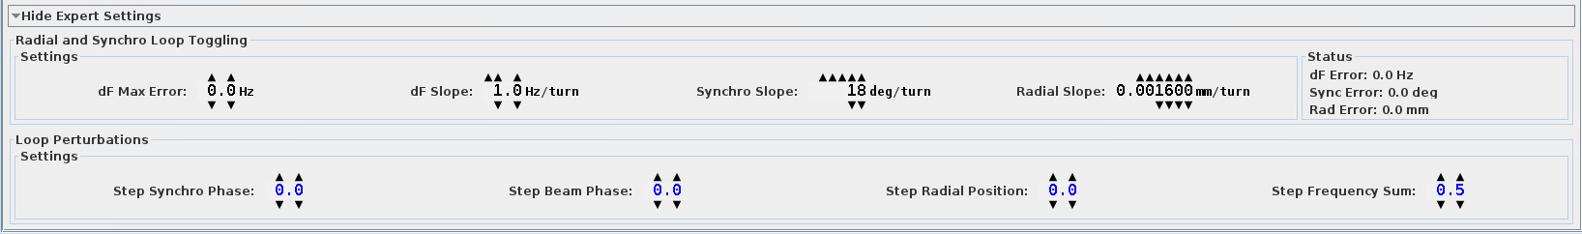
Loops switching: Synchro to radial loop
FT protons, LHC and FT Ions
  Automatically when radial loop enable timing occurs
  Switches immediately without transient by “hiding” the potential radial error with an offset
  Slowly ramp down the offset
Generated settings suit all cases
  If zero: an offset is kept during all the cycle
  If too big: Causes RF phase transients
Decay speed of the loop error offset at the moment of switching
Decay speed of the frequency contribution of the loop that is switched off
CCM -> RF APP ALL: Loops tab bottom hidden expert setting !

Slide 26
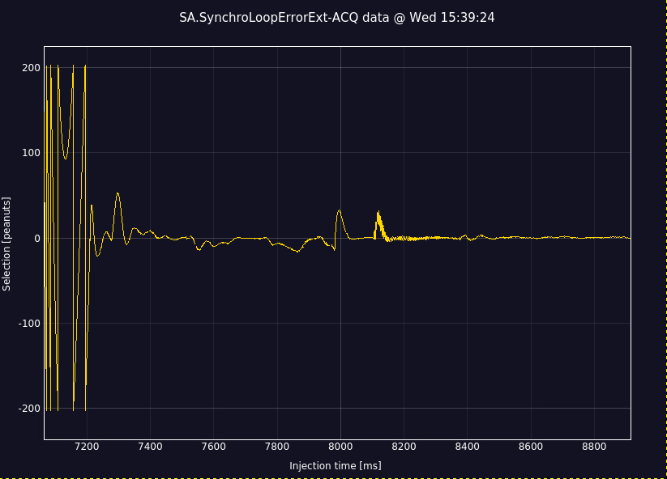
Loops switching: Radial to synchro loop
From radial to synchro loop (LHC Ions before rephasing)
  Automatically when synchro loop enable timing occurs
  Turns radial loop off and ramp to program
  frequency + “beating offset”
  Wait for zero crossing of the synchro loop error
  Switch and ramp down beating offset
Replaces the need for a radial bump and several timings
Beating frequency (program vs. current phase)
Zero-crossing: synchro loop closes

Slide 27
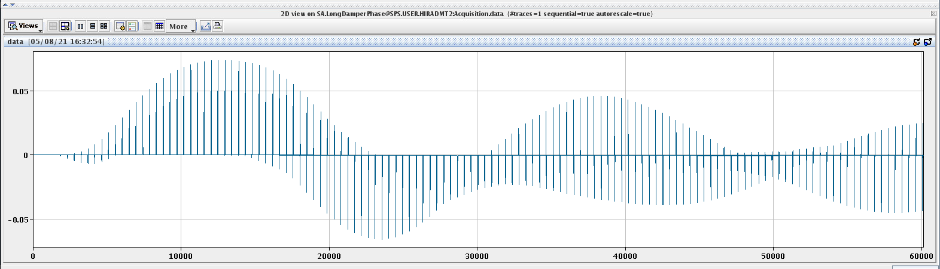
Longitudinal Damper principle
Bunch by bunch feedback to prevent longitudinal Coupled-Bunch Instabilities
Modulates the phase of the 200 MHz RF cavities
Damps last injection oscillations without “shaking” the circulating beam using masks for the phase loop
Cycles
  High intensity LHC
  AWAKE 3e11 ppb
Phase kicks from the longitudinal damper to a single bunch

Slide 28
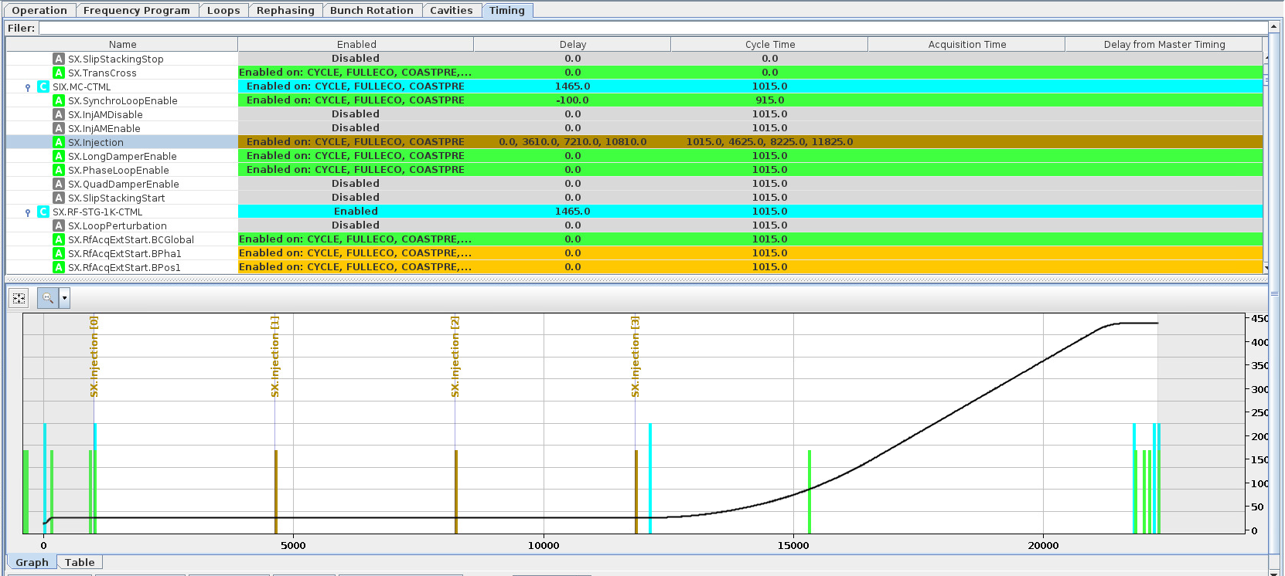
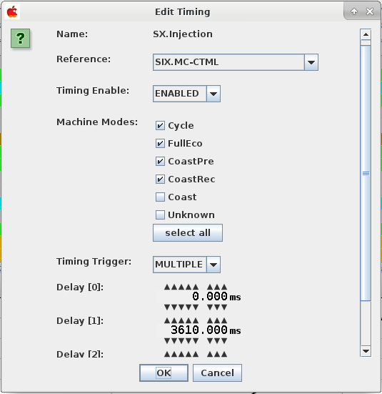
Longitudinal Damper setting up
The timings must be setup
  Start and stop (usually stopped beginning of the ramp when controlled blow-up starts)
  Injections
The masks (filling pattern) should correspond to the beam
It must be enabled in the cavity controllers
CCM -> RF APP ALL: timing tab
CCM -> RF APP ALL: Bottom of loops tab

Slide 29
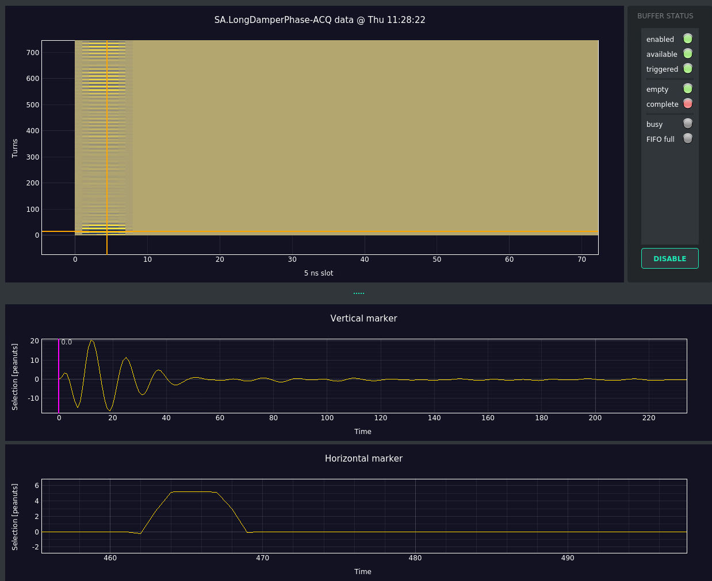
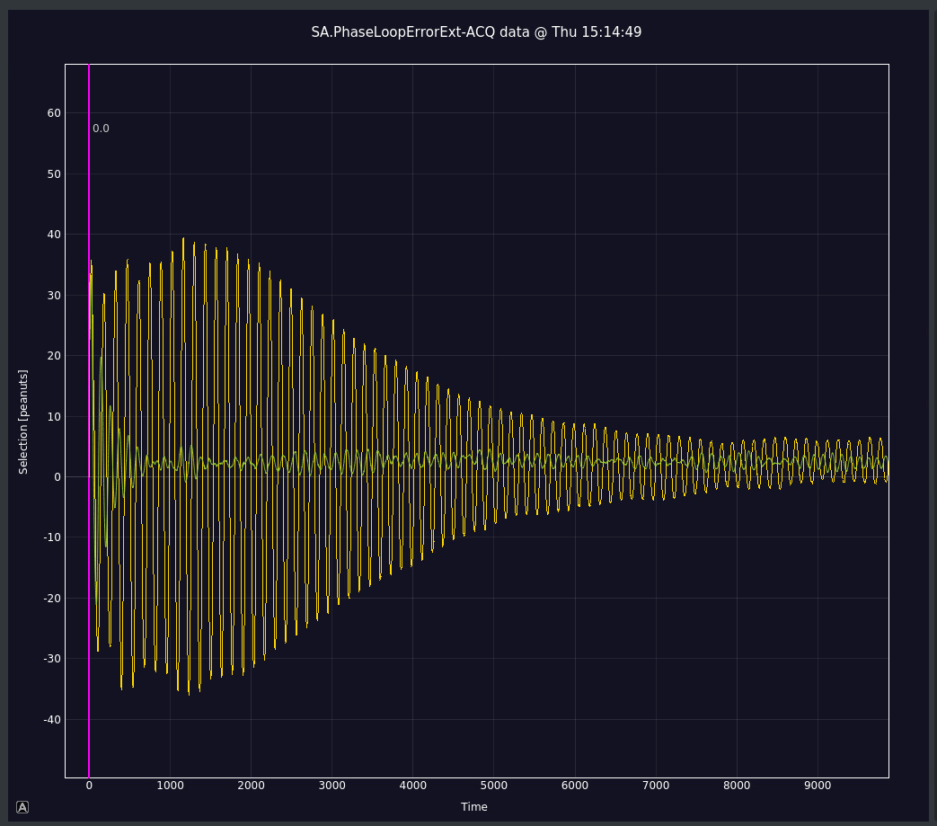
Longitudinal Damper setting up
Observation
If unstable: The LD tracks the synchrotron tune, the calculated one (LSA function) should be within 10% of the real one.
CCM -> Mega Drive: longitudinal damper phase
CCM -> Mega Drive: Damps injection oscillations but slower than phase loop (Green trace LD active)

Slide 30
Beam-based loops summary
Loops are only active when enabled + timing
 | LHC protons | FT protons | AWAKE | LHC ions | FT ions
Phase loop | Yes | Yes | Yes | Yes | Yes
Synchro loop | Yes | Yes | Yes | Yes: injection + flat top | Yes
Radial loop | No | Yes: start ramp | No | Yes: start ramp | Yes: start ramp 2
Long. damper | High intensity / multi-batch | No | Yes: start ramp 3e11 | No | No

Slide 31
RF manipulations for ions

Slide 32
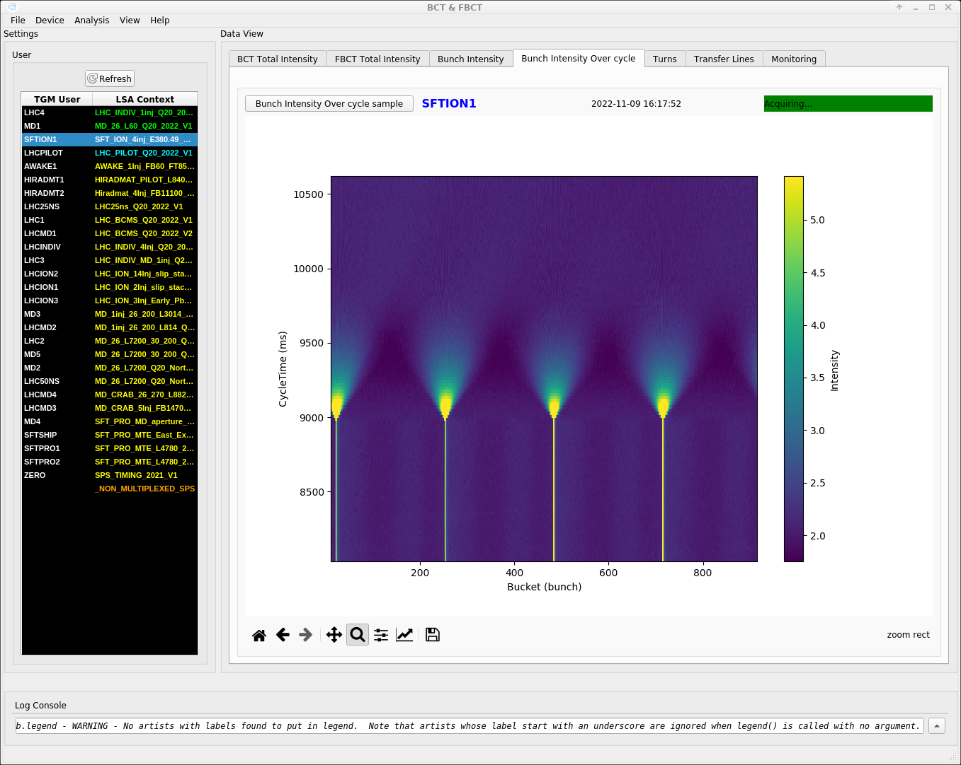
RF manipulation for fixed target ions:
De-bunching and recapture
4 ion bunches injected distributed along the ring
  4x FM and AM modulation (Fixed Frequency Acceleration)
The RF is cut at intermediate flat top and the beam de-bunches
  We switch the Pickup source to high gain frontend (timing)
Recapture and acceleration to flat top with radial loop
CCM -> BCTs

Slide 33
RF manipulation for fixed target ions:
De-bunching and recapture
Cycle timing
To disable de-bunching (for transverse setup)
  Disable TWC200 RF OFF
  Disable Pickup switching
Bunch rotation is setup as for SFTPRO

Slide 34
Beam loops: Pick-up selection
Enable pickups
  1: standard
  2: High gain (iFT)
  3: Wideband
Select source and auxiliary source
Setup timing
  SX.PhasePUAmplified
  SX.PhasePUStandard
  SX.RadialPUAmplified
  SX.RadialPUStandard
CCM -> RF APP ALL: Loops tab

Slide 35
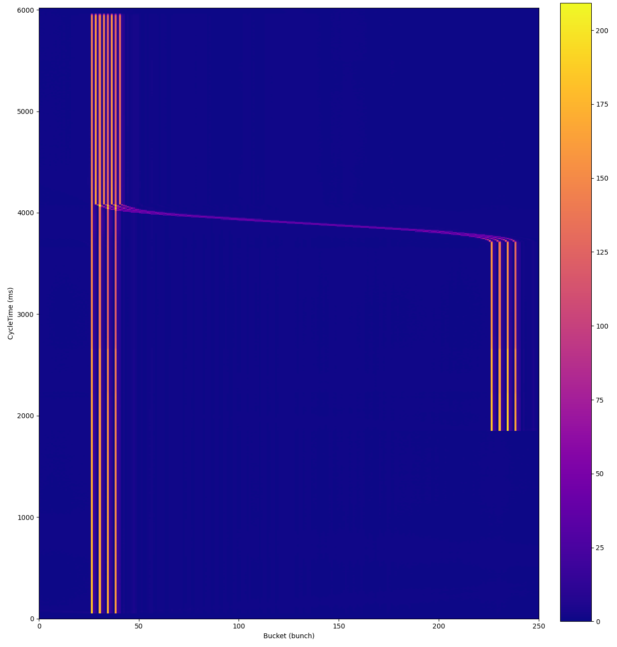
RF manipulation for LHC ions: slip stacking
To decrease the bunch spacing from 100 ns to 50 ns
Accelerate from 2 to 14 batches of ions with FFA (Fixed frequency Acceleration)
Split the modulation around groups to control them separately (two phase/synchro loops)
Apply frequency bumps, the LLRF detects the recapture time and uses the voltage jump settings
Go back to synchro loop and rephasing
Troubleshooting
  Setup filling pattern
  Enable masks
  Set pickup amplitude to half as usual (0.25 instead of 0.5)
  How to enable/disable slip-stacking? (not that easy because of voltage functions)
CCM -> BCTs

Slide 36
RF manipulation for LHC ions: slip stacking
Phase loop masks principle
The phase loop error is an average over a range of bunches in the turn
  Two groups = two averages during slip stacking
  When bunches from different groups start overlapping the reading is ignored
CCM -> RF APP ALL: operation tab -> edit injection bucket
Phase loop masking during slip-stacking: the bunches in the red area are masked

Slide 37
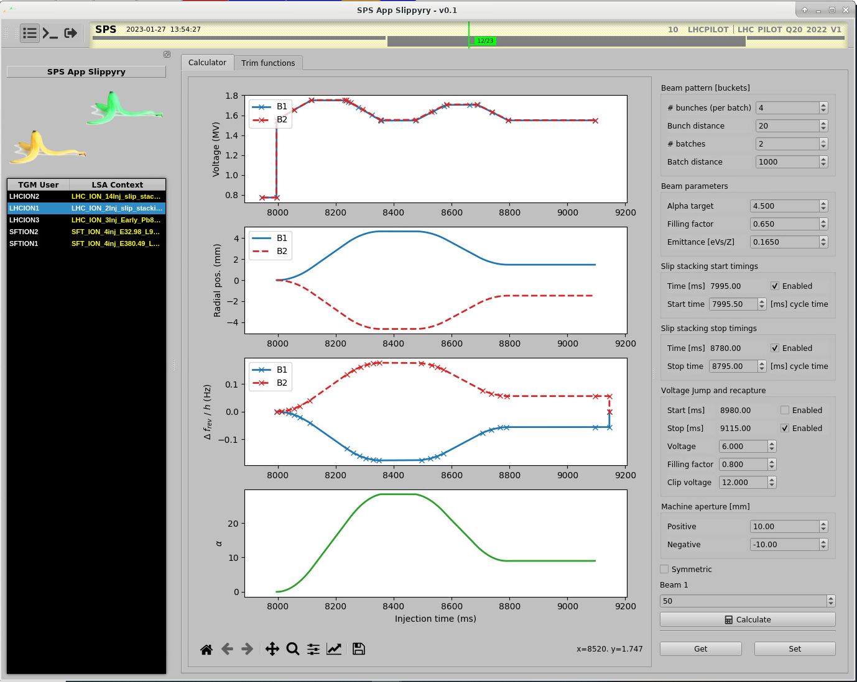
RF manipulation for LHC ions: slip stacking
cycle timing
Parameters generation
CCM -> slippyry: computes the frequency and voltage program for the slippage

Slide 38
RF gymnastics

Slide 39
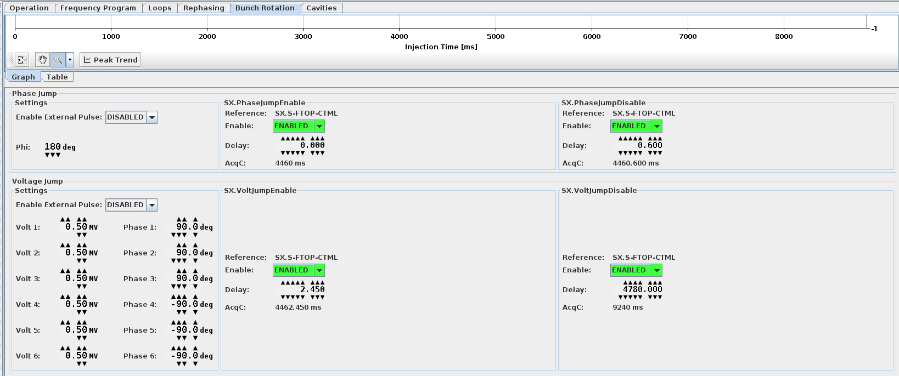
Bunch rotation for fixed target protons and ions
Jump to unstable phase
To increase momentum spread before slow extraction (uniform spill)
CCM -> RF APP ALL: Bunch rotation tab
Ensure Voltages are set for full counter phasing (+/- 90°)
Optimize the timings 2 and 3

Slide 40
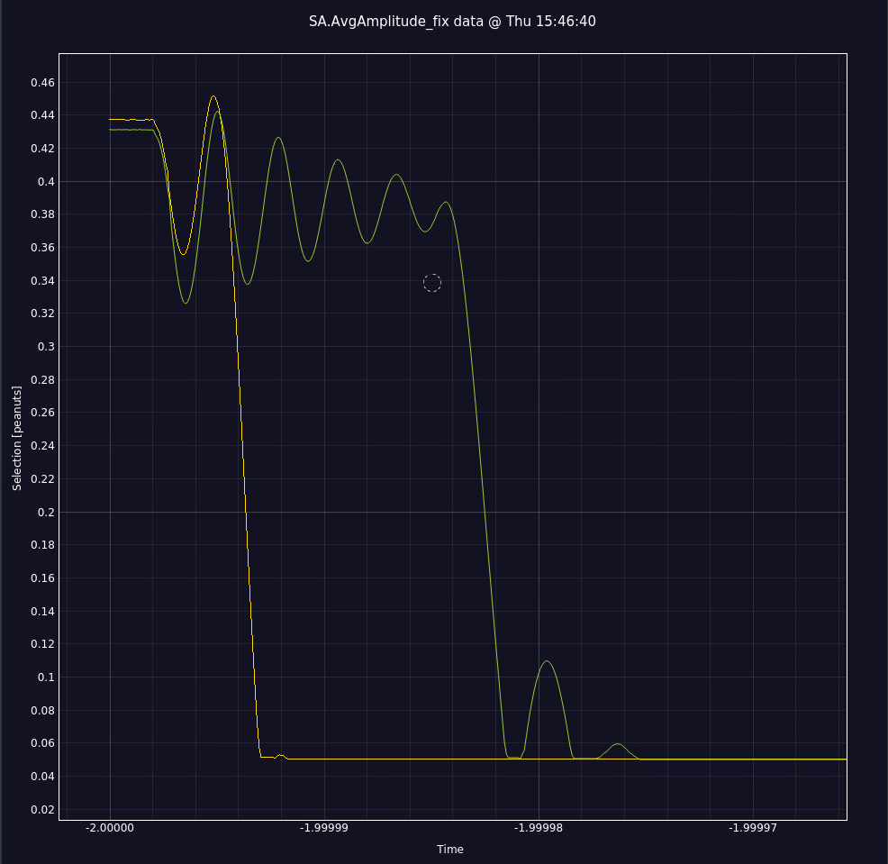
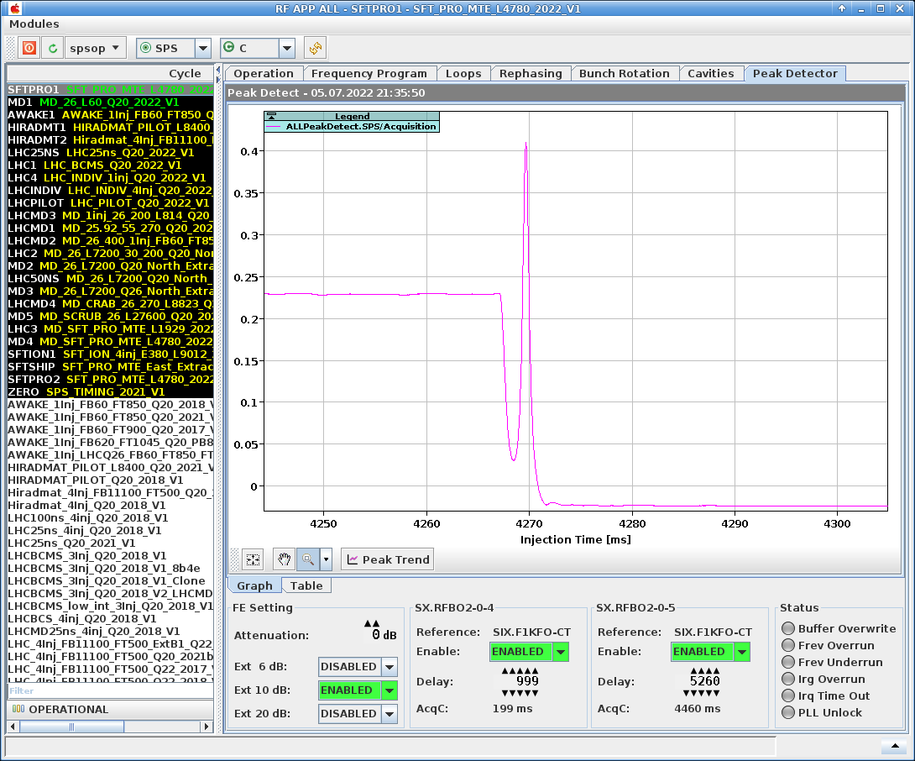
Bunch rotation for fixed target protons and ions
CCM -> RF APP ALL: Peak Detector tab
CCM -> Mega Drive: AvgAmplitude (useful when too little signal for peak detect)

Slide 41
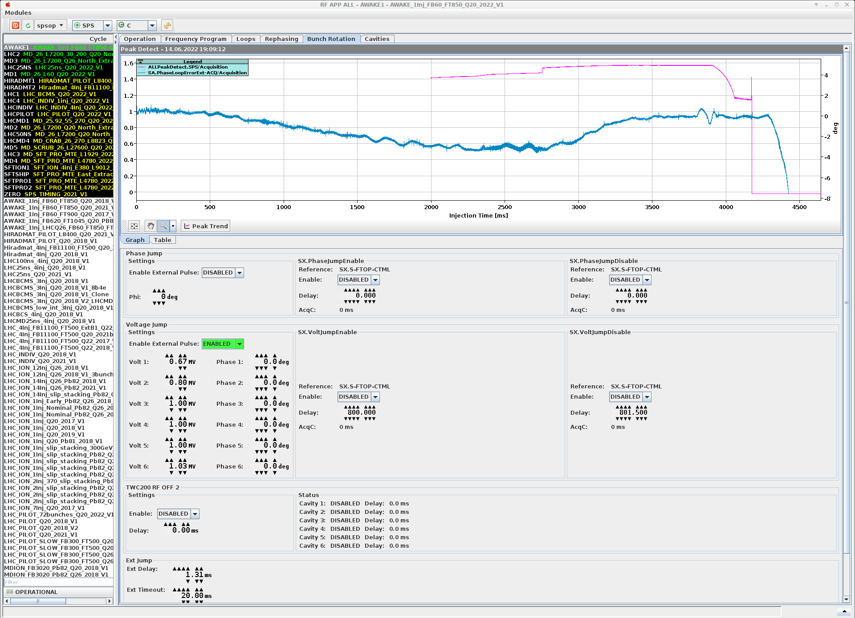
Bunch rotation for AWAKE
By voltage jump
To shorten the bunch at extraction
The voltage/phase jump can be made less steep!
CCM -> RF APP ALL: Bunch rotation tab
Optimize the peak amplitude at extraction with Ext Delay
Push voltages to a stable maximum
The timeout avoids staying at maximum power

Slide 42
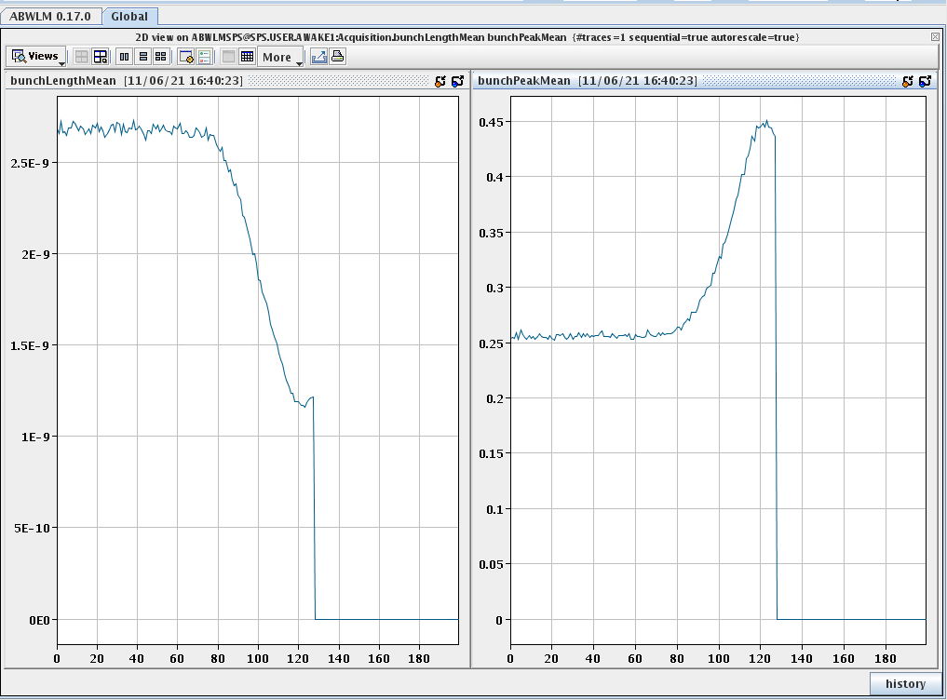
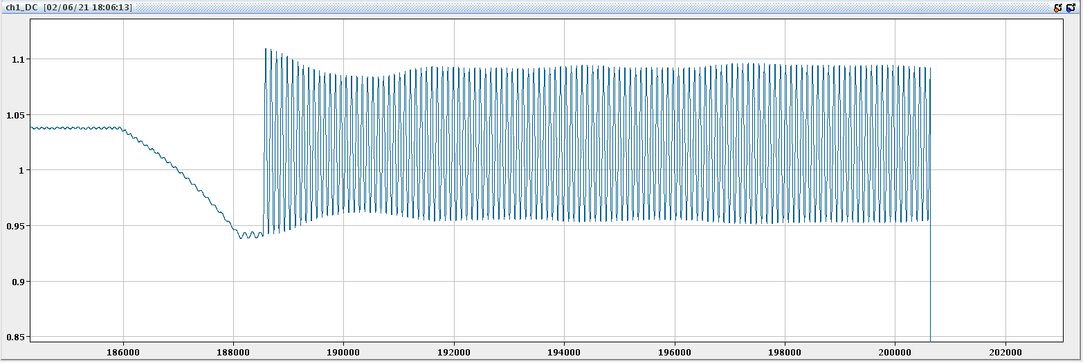
RF gymnastics: Bunch rotation for AWAKE
CCM -> RF APP ALL: bunch rotation tab (pink trace is bunch peak)
CCM -> ABWLM bunchLengthMean / bunchPeakMean
Peak detect: If the beam is not extracted, the bunch keeps oscillating (quadrupole)

Slide 43
References
LLRF Piquet Training #1 and #2
  https://indico.cern.ch/event/1060631/ - LLRF and beams setting up
  https://indico.cern.ch/event/1061720/ - Beam Control and the use of White Rabbit
Beam Control FW
  https://edms.cern.ch/document/2089558/0.1 - Detailed documentation on beam control LLRF
Details on pick-ups / Frontends and Firmware
  https://wikis.cern.ch/pages/viewpage.action?pageId=153716061
Details on WR network
IPAC paper on the SPS beam control
  https://cds.cern.ch/record/2845762?ln=en - Beam Control
  https://cds.cern.ch/record/2845800?ln=en - Lead Ions acceleration
Longitudinal dynamics and beam-based loops in synchrotrons
  https://cds.cern.ch/record/1415913?ln=en - CAS 2010 P. Baudrenghien
  https://cds.cern.ch/record/702642?ln=en - CAS 2000 P. Baudrenghien

Slide 44
Summary of upgrades of 2023
Rephasing phase error around 0 even while using phase offset
Rephasing optimizing only when beam present (issue with LHC ions)
Loop freeze timing (EBC and more)
Hopefully a cure for instabilities with synchro loop
New Phase/Radial High Gain chains for Ions
  New pick-up switching mechanism
Robustness improvements

Slide 45
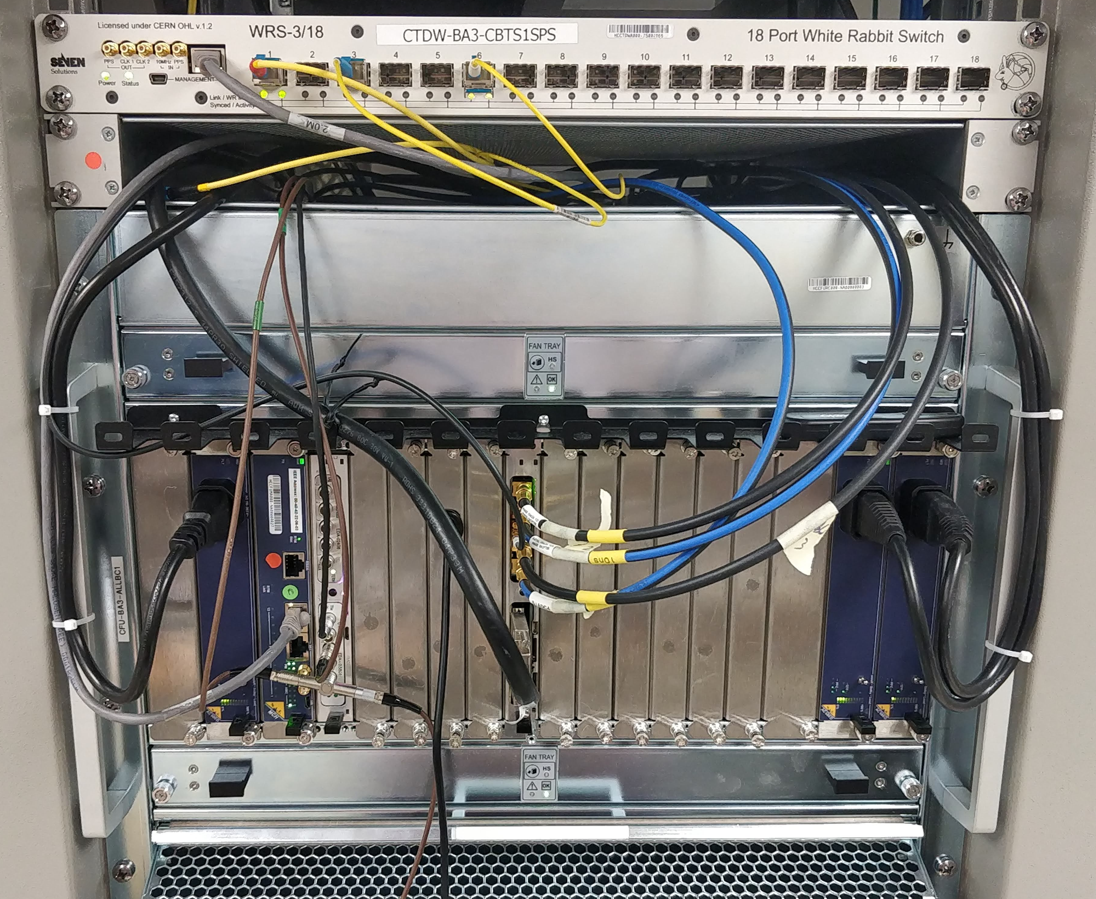
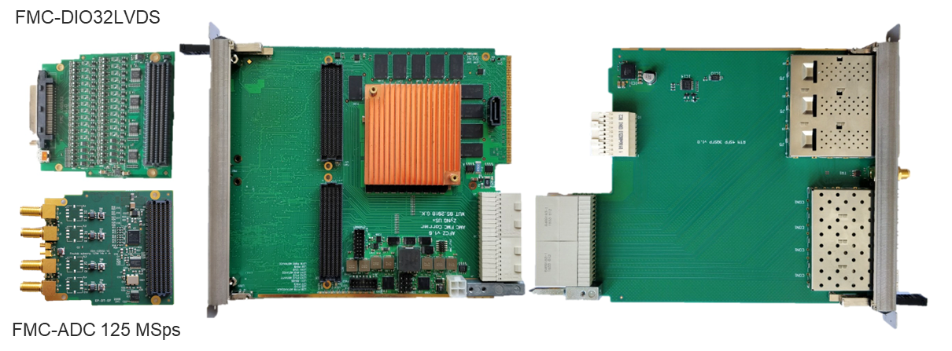
Beam Control Hardware
Where all these parameters end-up
MicroTCA crate in BA3 Faraday Cage
FPGA Carrier board

Slide 46
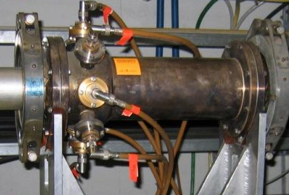
Wideband longitudinal pickup coming soon
5 Giga Samples per second (instead of 125 MSps for narrowband)
  Bunch profile (Useful for observation too)
  Bunch by bunch measurement for phase loop -> ideal for slip stacking
Wall current pickup (AEW)

Slide 47
Spare slides

