Slide 1
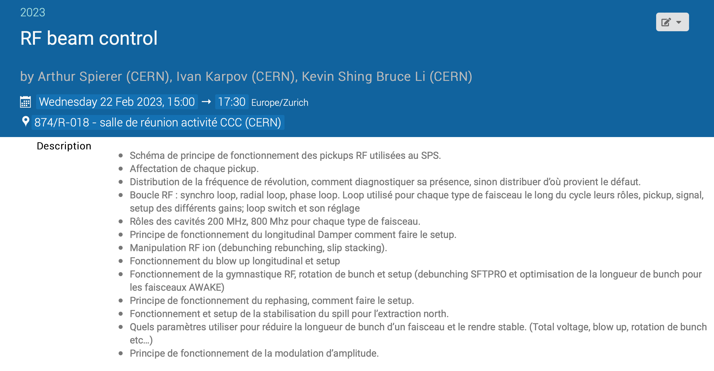
This lecture
A range of different topics to cover during the lecture
→ Split them into 2 parts
Many thanks to colleagues from RF and OP groups!

Slide 2
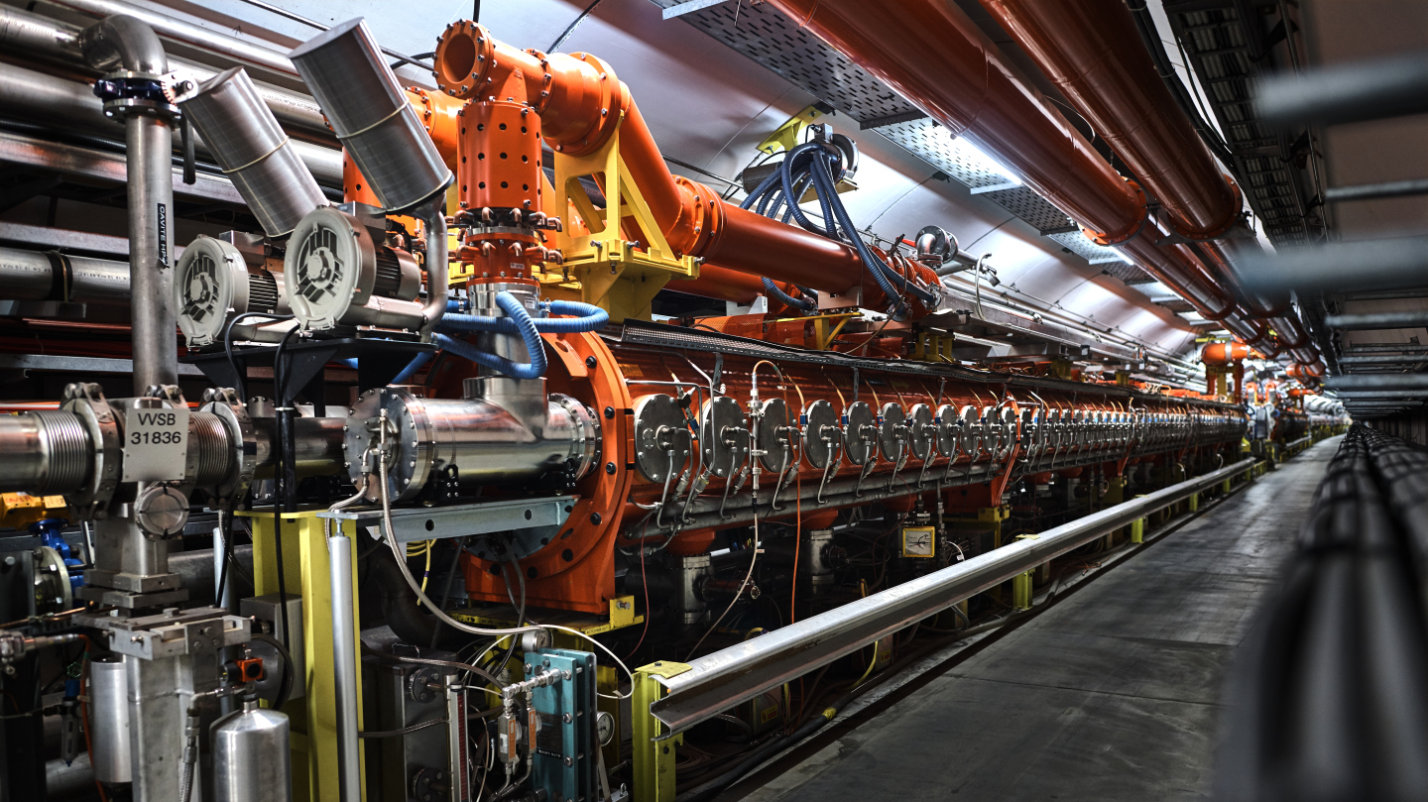
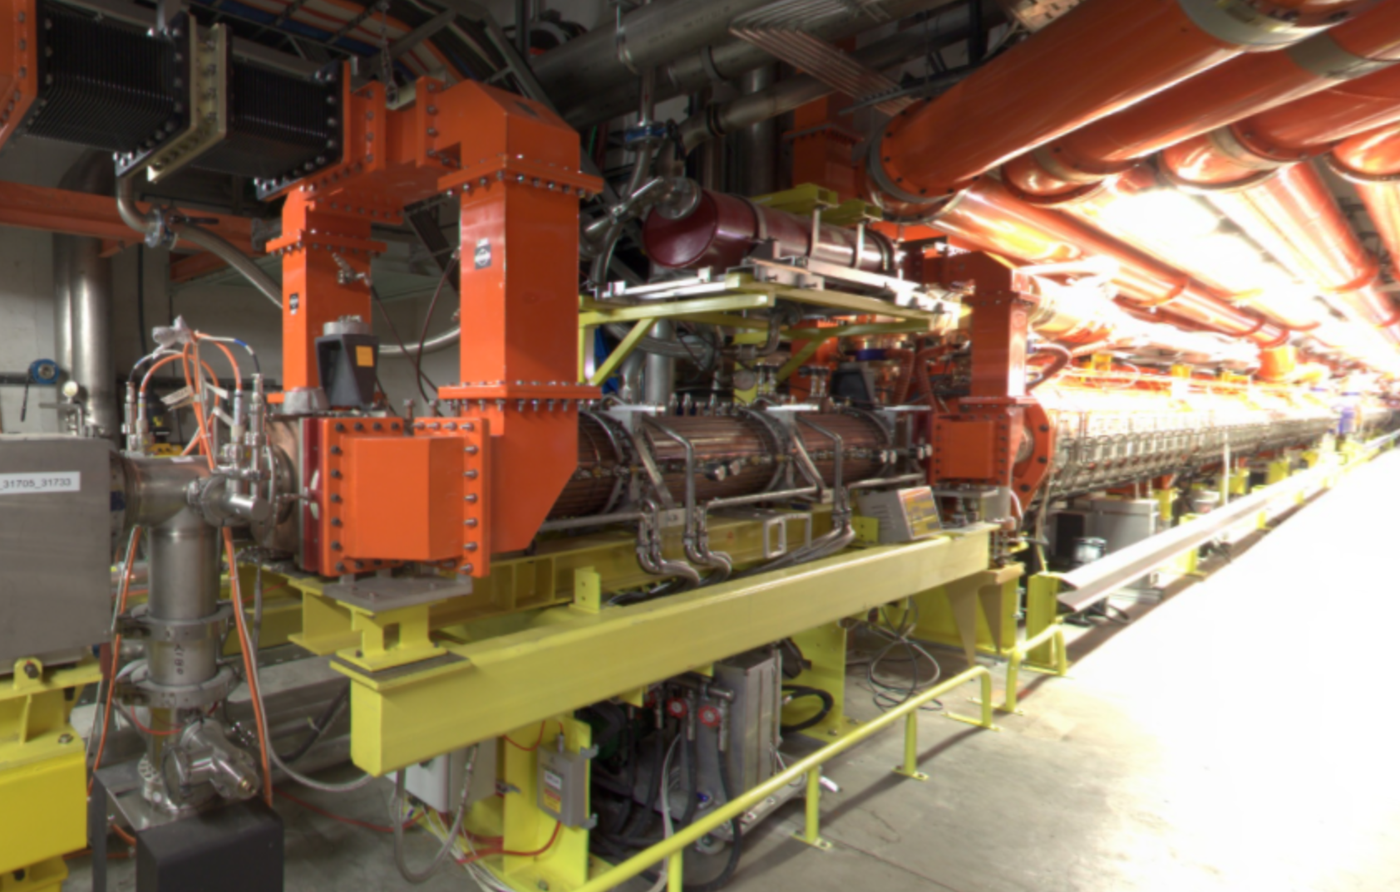
SPS RF systems
6 cavities operating at ~200 MHz
(4x3x11 + 2x4x11 cells)
are used for acceleration and all RF gymnastics/manipulations
2 cavities operating at ~800 MHz
(2x3x11 cells)
Improve longitudinal stability for most of the operational cycles
Are used for empty bucket channelling (OP shutdown lecture of P. Arrutia)

Slide 3
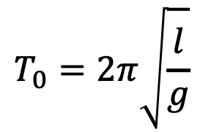
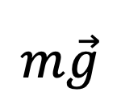


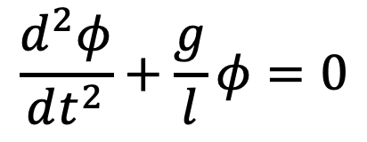

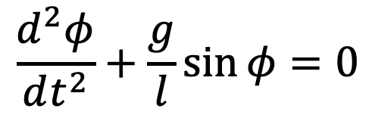
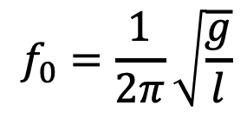
“Useful” analogies
Single-particle dynamics in the longitudinal plane is very similar to the dynamics of a simple gravity pendulum
$$l$$
The magnitude of the gravitational field
$$φ$$
$$\frac{d^{2}φ}{dt^{2}}+\frac{g}{l}\sin{φ=0}$$
$$φ≪1$$
$$\frac{d^{2}φ}{dt^{2}}+\frac{g}{l}φ=0$$
$$m\vec{g}$$
the length of the rod
$$T_{0}=2π\sqrt{\frac{l}{g}}$$
$$f_{0}=\frac{1}{2π}\sqrt{\frac{g}{l}}$$
Period and frequency of small-amplitude oscillations:
and

Slide 4
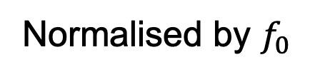
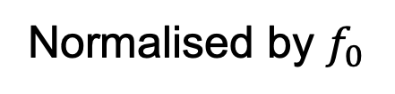
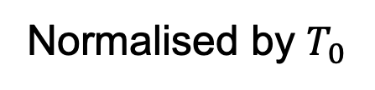
Some definitions
No oscillations
Faster osc.
Normalised by $T_{0}$
Slower osc.
Separatrix
Action variable
Normalised by $f_{0}$
Normalised by $f_{0}$

Slide 5

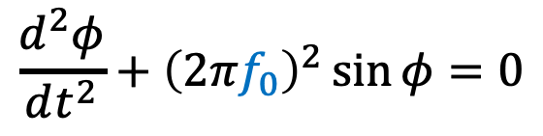
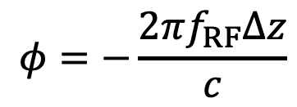

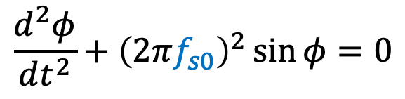
Relation to synchrotrons
Turn-by-turn picture without acceleration
Non-synchronous particle (oscillates)
Different orbit
$$Δz$$
Designed orbit
Synchronous particle (don’t “move”)
Gravity pendulum
$$\frac{d^{2}φ}{dt^{2}}+{\left(2πf_{0}\right)}^{2}\sin{φ=0}$$
Non-synchronous particle
$$\frac{d^{2}φ}{dt^{2}}+{\left(2πf_{s0}\right)}^{2}\sin{φ=0}$$
200 MHz RF system
“new”
$$φ=−\frac{2πf_{RF}Δz}{c}$$
Small-amplitude synchrotron frequency

Slide 6
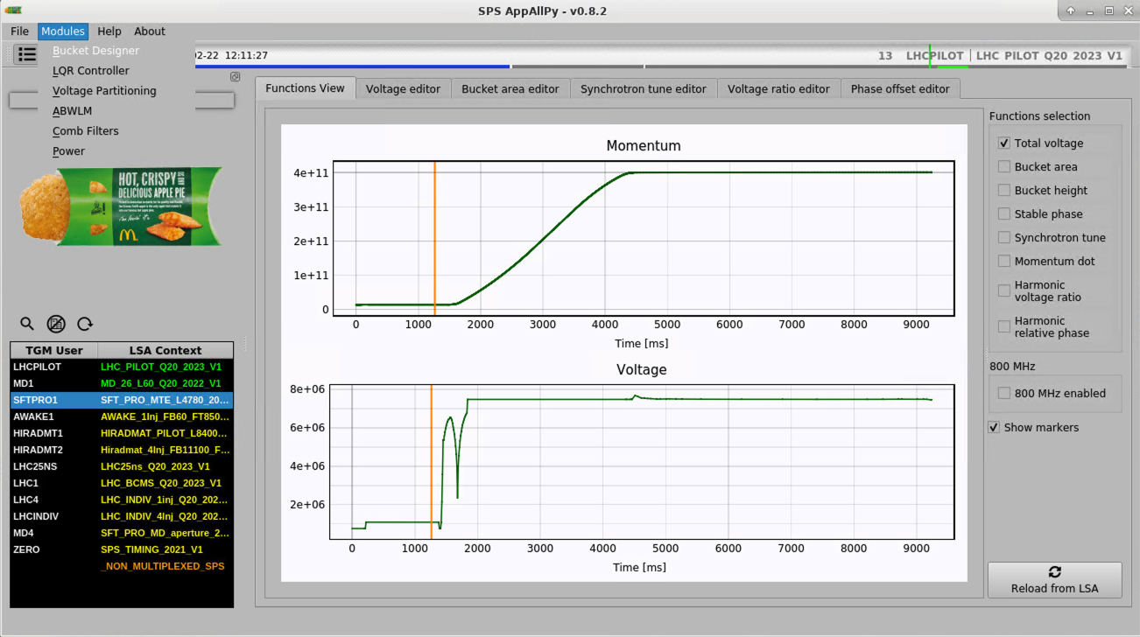
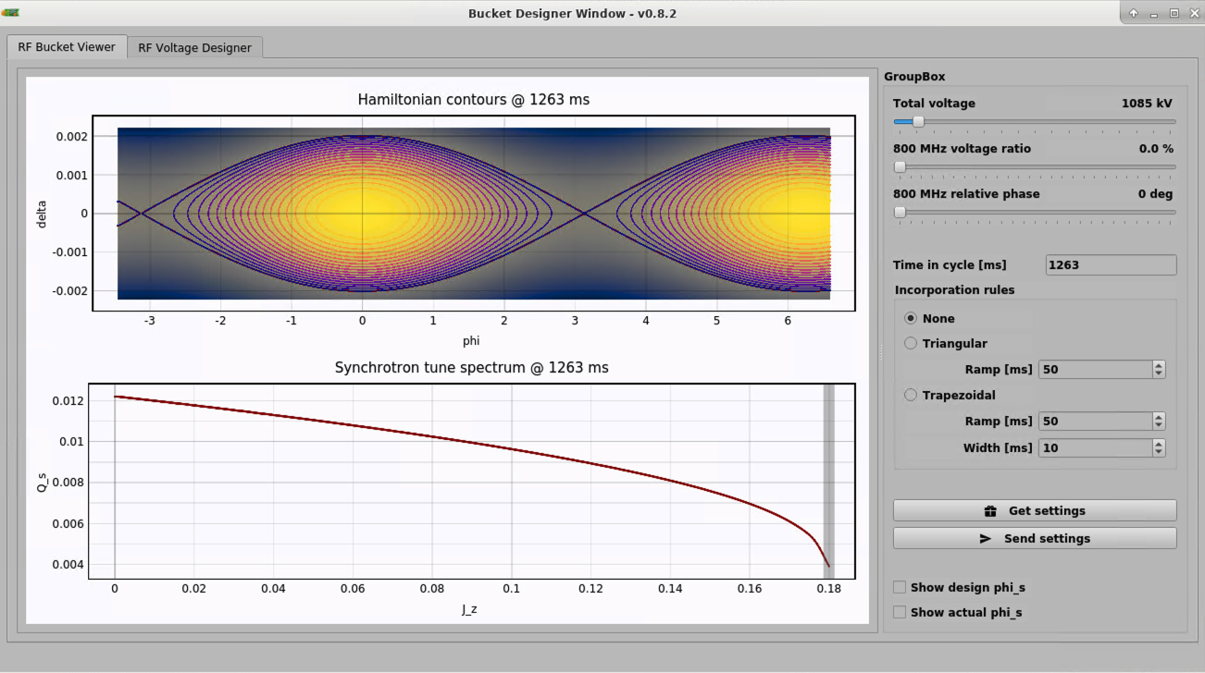
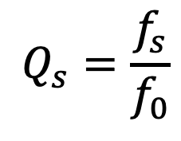
SPS AppAllPy
$$Q_{s}=\frac{f_{s}}{f_{0}}$$

Slide 7
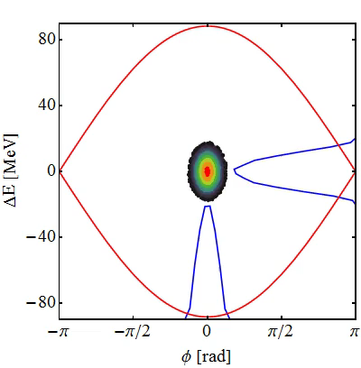
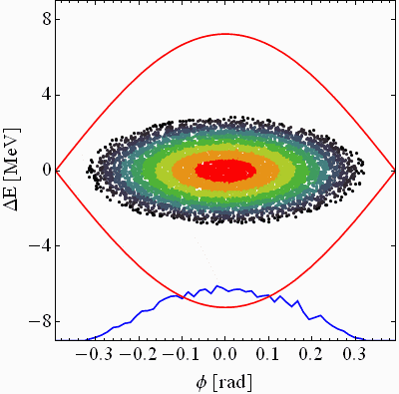
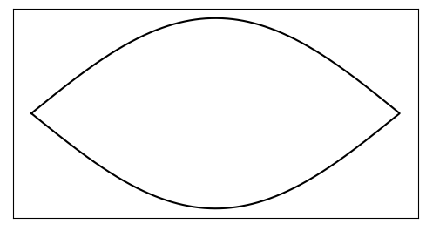
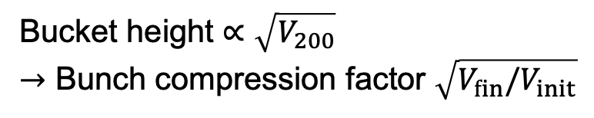
Bunch rotation
RF voltage jump for AWAKE
RF phase jump by 180 deg. and back for SFTPRO
Bucket height $∝\sqrt{V_{200}}$
$→$ Bunch compression factor $\sqrt{V_{fin}/V_{init}}$
Courtesy H. Damerau

Slide 8
Demonstration with pendulums
Takeaway points:
Coherent vs incoherent
Frequency spread
External excitation
Stabilization

Slide 9
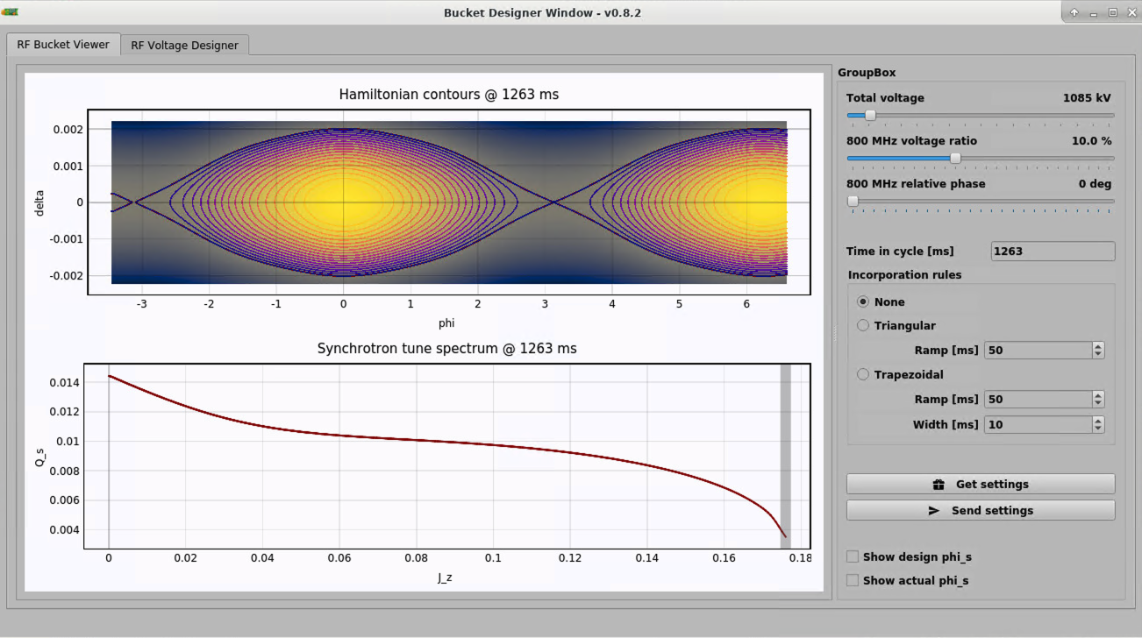
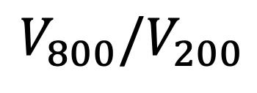
Synchrotron frequency with 800 MHz RF system
$$V_{800}/V_{200}$$
800 MHz significantly increases the synchrotron frequency spread,

Slide 10

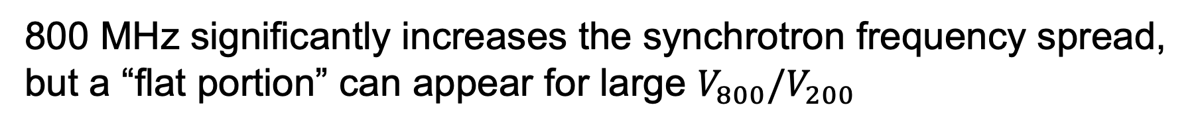
Synchrotron frequency with 800 MHz RF system
$$V_{800}/V_{200}$$
800 MHz significantly increases the synchrotron frequency spread, but a “flat portion” can appear for large $V_{800}/V_{200}$

Slide 11
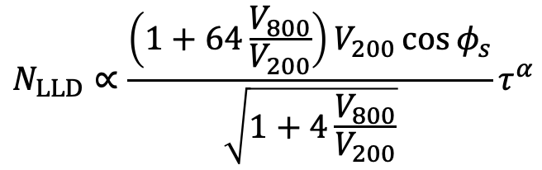

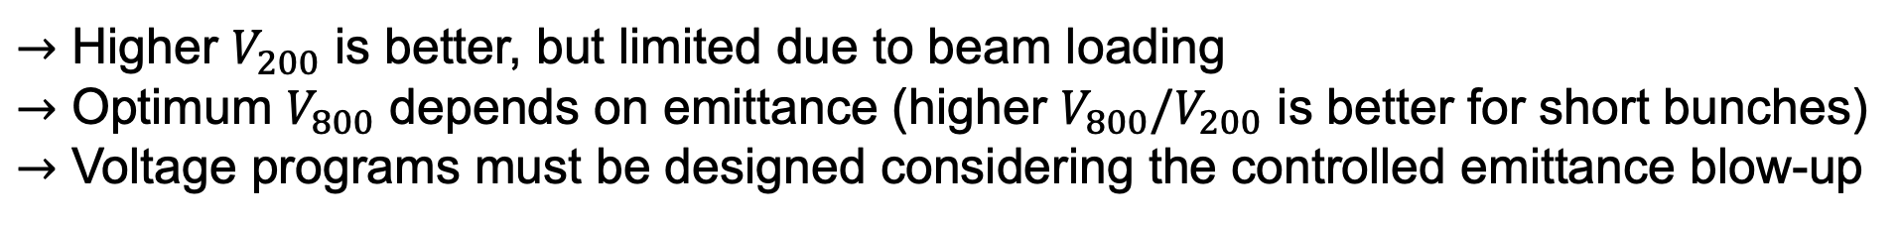

Longitudinal multi-bunch stability during acceleration
Bunch intensity
Beam loading limit
Coupled-bunch instability threshold is linked to the single-bunch loss of Landau damping threshold
(IK and E. Shaposhnikova, IPAC 2022)
unstable
The flat portion of synchrotron frequency distribution
$→$ ongoing work of
L. Intelisano
stable
LLD threshold in double RF
(L. Intelisano, et al, HB 2021)
bunches
$$N_{LLD}∝\frac{\left(1+64\frac{V_{800}}{V_{200}}\right)V_{200}\cos{φ_{s}}}{\sqrt{1+4\frac{V_{800}}{V_{200}}}}τ^{α}$$
$$α≈3−4$$
Bunch length
Initial emittance + (un) controlled blow-up
$→$ Higher $V_{200}$ is better, but limited due to beam loading
$→$ Optimum $V_{800}$ depends on emittance (higher $V_{800}/V_{200}$ is better for short bunches)
$→$ Voltage programs must be designed considering the controlled emittance blow-up

Slide 12
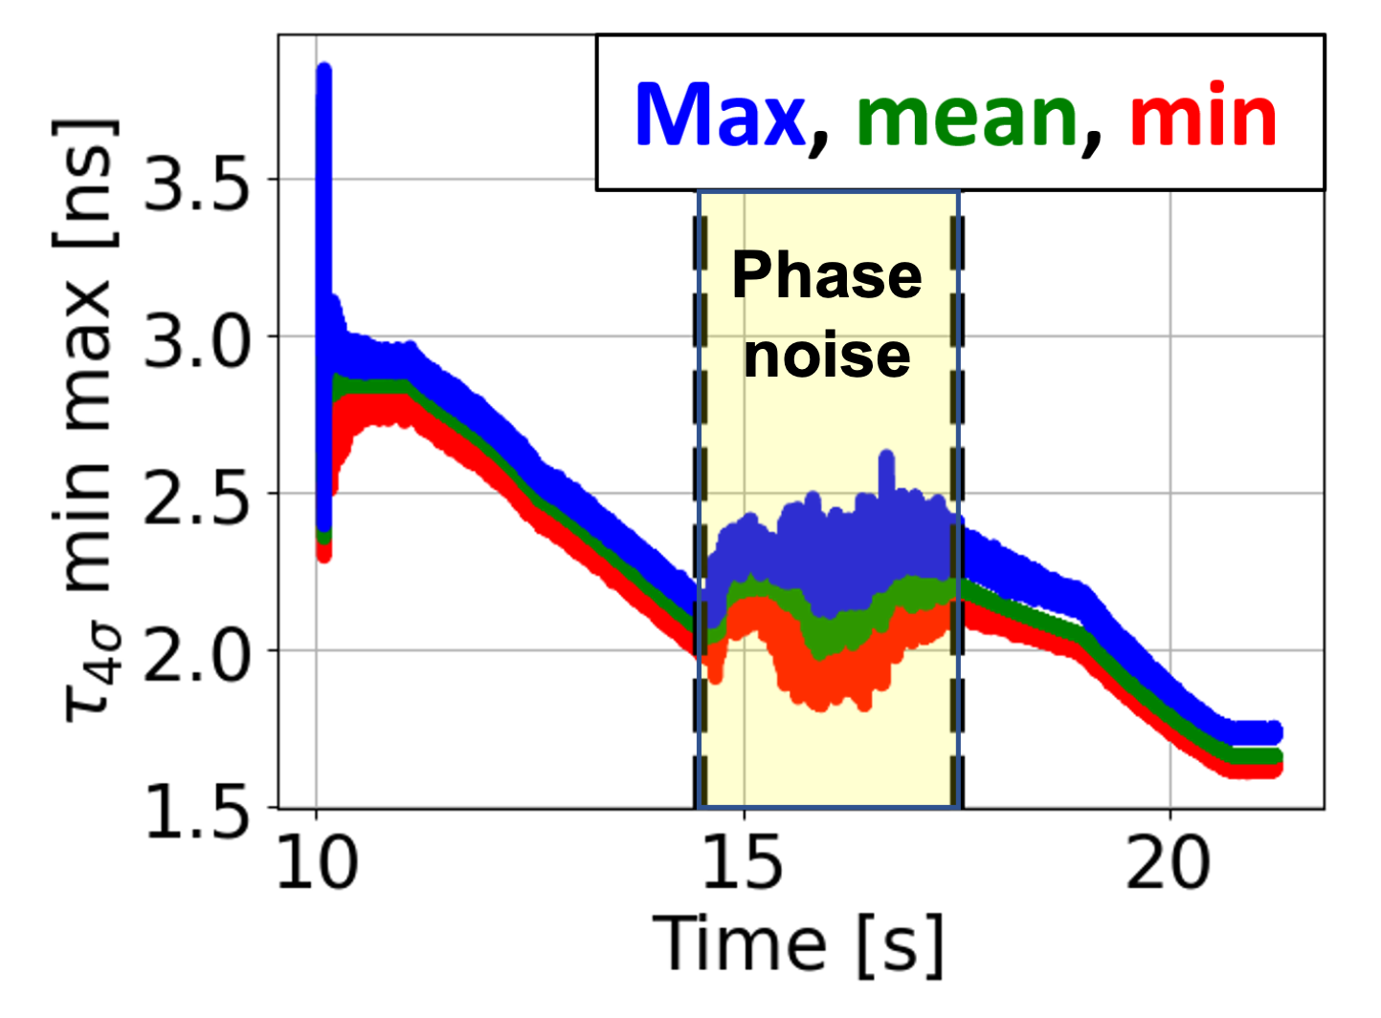
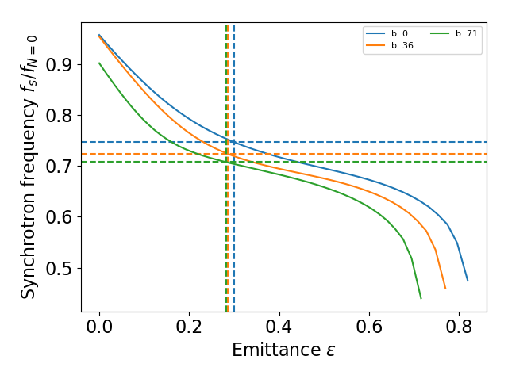
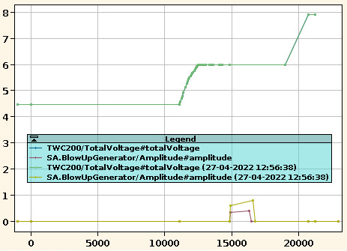
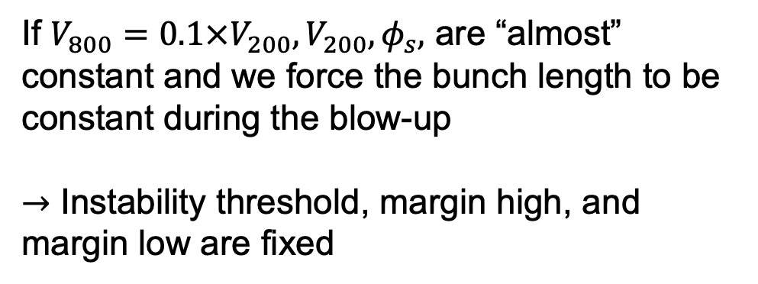
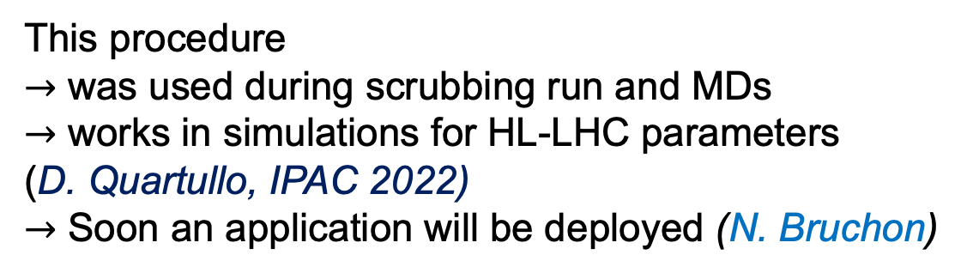
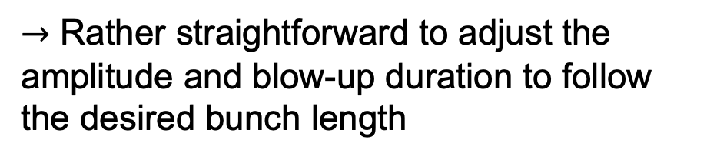
Approach to simplify setting-up
Total RF voltage and synchronous phase
If $V_{800}{=0.1×V}_{200},V_{200}, φ_{s},$ are “almost” constant and we force the bunch length to be constant during the blow-up
$→$ Instability threshold, margin high, and margin low are fixed
Bunch length evolution for 72 bunches
Bunch length 2 ns, 72 bunches, 1.8e11 ppb
Acceleration of 72 bunches with 1.8e11
Bunch intensity
Margin high
Blow-up window
unstable
Blow-up
$→$ Rather straightforward to adjust the amplitude and blow-up duration to follow the desired bunch length
stable
Margin low
bunches
This procedure
$→$ was used during scrubbing run and MDs
$→$ works in simulations for HL-LHC parameters
(D. Quartullo, IPAC 2022)
$→$ Soon an application will be deployed (N. Bruchon)
Bunch length

Slide 13
Automatic setting up of controlled blow-up
Details are in (N. Bruchon, ML and data analytics community forum, 30.11.2022)

Slide 14
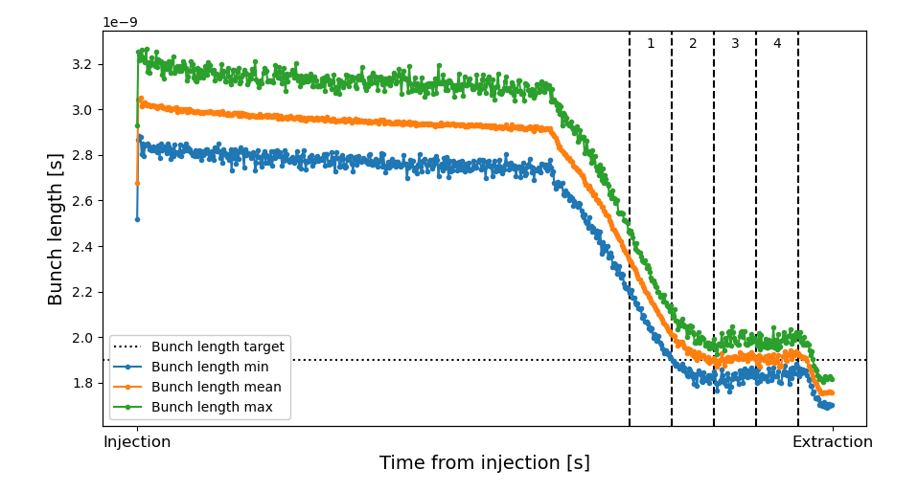
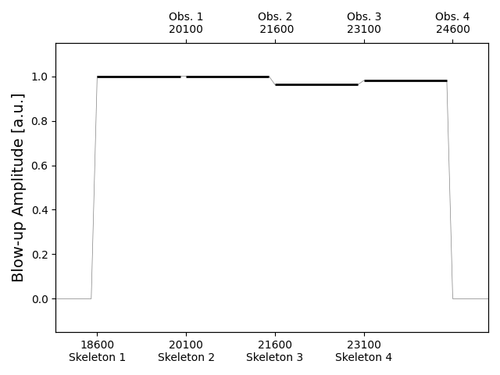
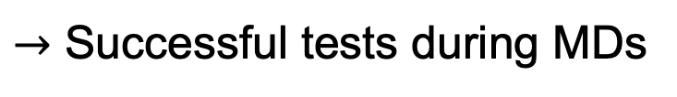
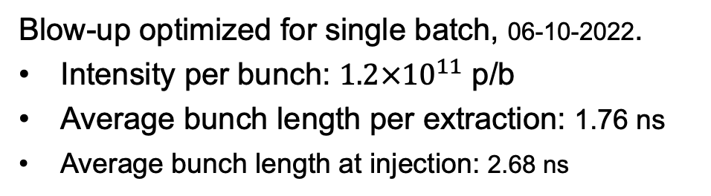

Automatic setting up of controlled blow-up
Blow-up optimized for single batch, 06-10-2022.
Intensity per bunch: $1.2×{10}^{11}$ p/b
Average bunch length per extraction: 1.76 ns
Average bunch length at injection: 2.68 ns
$$σ_{ }^{∗}$$
$→$ Successful tests during MDs
Details are in (N. Bruchon, ML and data analytics community forum, 30.11.2022)

