Slide 1


SPS Interlocks
SIS : Software Interlock System
BIS : Beam Interlock System
S. MASSOT/E. VEYRUNES
Thanks J. RIDEWOOD for translation
SPS training
25 January 2023

Slide 2
OUTLINE
Serge
SIS : Tree-like structure, exporter, time of the evaluation
Accelerator mode
  Common modes
  No Extraction mode
  FTARGET mode
  Extraction to HiradMat/AWAKE/LHC mode
BIS ring arming sequence
Eric
Injection BIS time shift compared to Ring BIS (start cycle), interaction with SBDS, BHZ377 and BHZ378, MKP.
How to diagnose the cause of a non-rearming of the injection BIS
Equation details for extraction BIS
New Features
Extra slides :
  SIS Coding
  SIS vs LSA
  RBAC
  CCDE list generation
  Delay for injection

Slide 3
SIS : Tree-like structure, exporter, time of the evaluation
SIS monitors ~ 1045 devices, ~ 9498 logics inputs, states and settings covering the SPS and its transfer lines.
The acquired values are analysed (tested) and converted into a logical state (TRUE or FALSE).
The logical states are grouped into tree-like structures and combined using logical operators (AND or OR). In the simplest case an ‘AND’ of all conditions is performed.
The top of the tree corresponds to a SOFTWARE PERMIT (SW_PERMIT) which itself is either TRUE or FALSE:
  TRUE : OK for beam operation.
  FALSE : one or more tests indicate an abnormal situation.
>> the status of the SW_PERMIT is exported to HW interlock and timing systems.

Slide 4
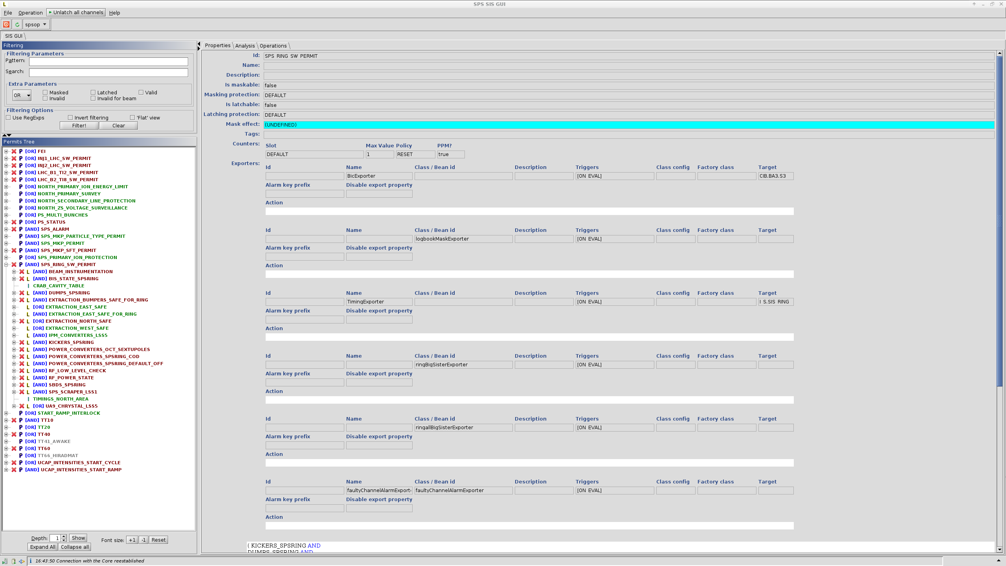
SIS : Tree-like structure, exporter, time of the evaluation
LHC
NA
PS
Inhibit/IONS
RING
Extraction line/AWAKE/HiRadMat
Experimental Permits

Slide 5
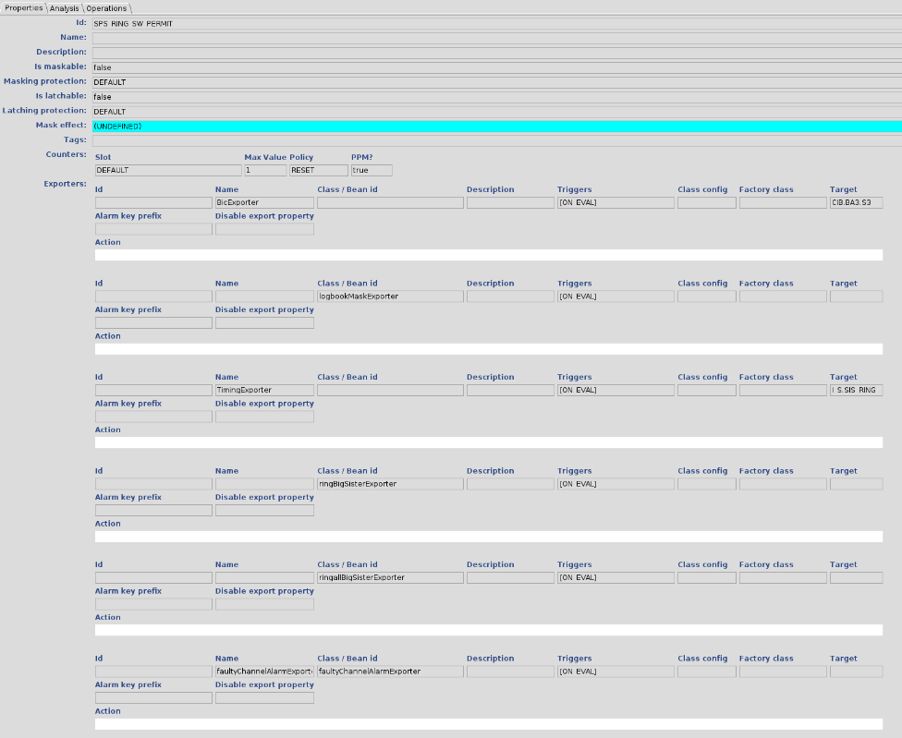
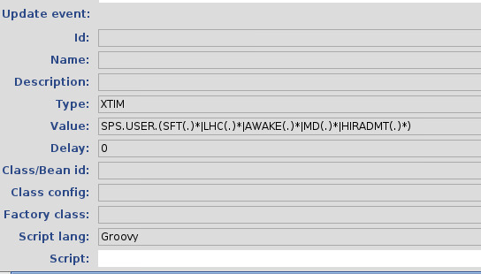
SIS : Tree-like structure, exporter, time of the evaluation
Input Id:SPS_RING_SW_PERMIT
Exporter name : BicExporter TimingExporter
Target : CIB.BA3.S3
I.S.SIS.RING
Class/Bean id :
logbookMaskExporter
ringBigSisterExporter
ringallBigSisterExporter

Slide 6
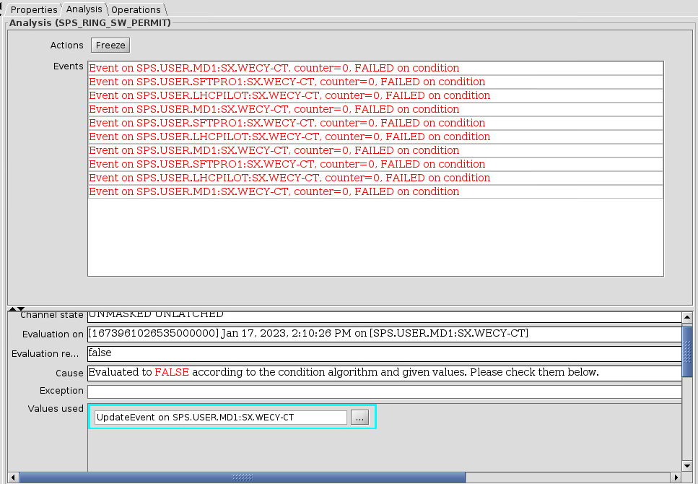
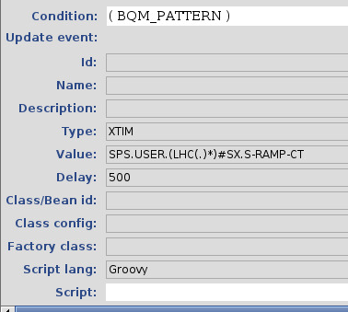
SIS : Tree-like structure, exporter, time of the evaluation
Permit trigger: Might be XTIM or Timer – if Timer the used value returned is on null
Each input will be evaluated on the defined XTIM or Timer

Slide 7
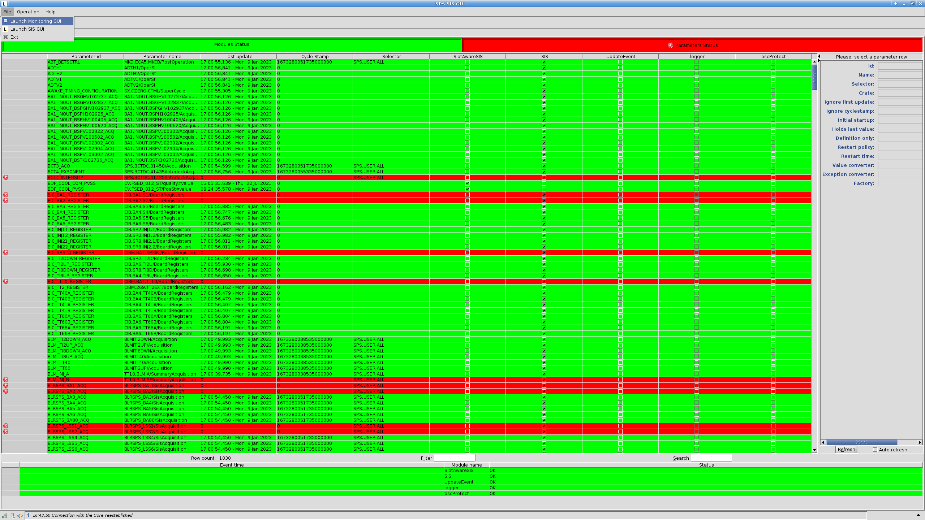
SIS : Tree-like structure, exporter, time of the evaluation
1045 devices monitored (can be use several times)
  - JAPC monitoring GUI

Slide 8
Accelerator mode
● The SW_PERMIT depends on the SPS beam modes:
→ Some tests are automatically ignored in certain modes or/and depending on the USER Timing
→ SIS will ALWAYS check that the beam mode is consistent with the state of some key elements (TEDs and extraction elements).
If an inconsistency is detected, one or more SW_PERMITs will automatically return FALSE and stop all beams affected by such an inconsistency.

Slide 9
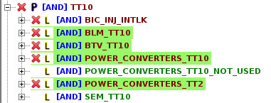
Common modes
TT10 Permit :
Has to be true for all modes
Check:
  Injection BIC – miss 1 cycle
  Easier to diagnose input
  BLM TT10
  BTV and SEM position
  FGC injection current
  BHZ state in TT2
Accelerator mode
25-01-23

Slide 10
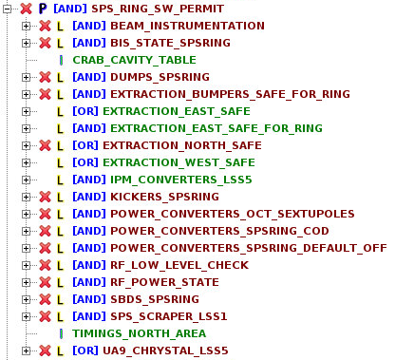

No extraction mode
SPS_RING_SW_PERMIT :
Test if all the Extraction elements are in the same and correct state (Safe for beam)
Example for TT20:
(Extraction Bumpers OFF, Septa OFF, ZS OFF, Girder position (TBD), etc...).
If the conditions are true, the RING_Permit will allow beam but the related Permit (TT20, TT40, TT60) has to be true
I.e TT20:
Same for every Extraction line
TT20 linked to CIB.BA2.S2
Accelerator mode
25-01-23

Slide 11
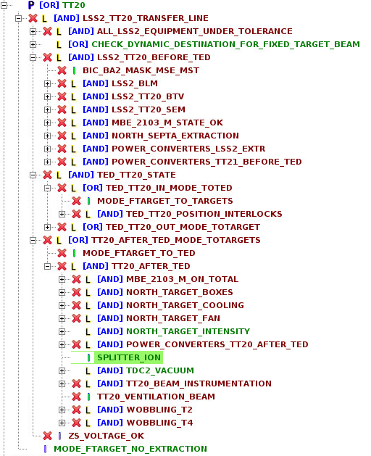
FTARGET mode
No Extraction – seen before
TT20-TED mode:
  Test/check all elements before TED TT20.
  Mask/ignore all elements after TED TT20
  Mode of the MBE_2103 has to be PARTIAL (TBD)
  Access possible in BA80 and downstream
  (EIS to be safe for access – TBSE, TED, MBE Partial mode)
To Target mode:
  Test/check all elements up to targets.
  Mode of the MBE_2103 has to be TOTAL
  No access possible in BA80 and BA81
Accelerator mode
25-01-23
25-01-23

Slide 12
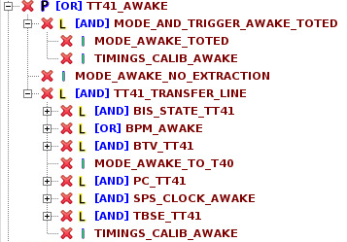
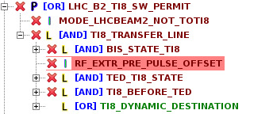
LHC Beam2 - AWAKE
No Extraction – TT40 extraction elements (seen before)
  Both LHC Beam 2 and AWAKE in No Extraction mode
  → Inconsistency problem
  TT40-TED mode:
  Test/check all elements before TED TT40
  Mask/ignore all elements after TED TT40
  Both LHC Beam 2 and AWAKE to TED TT40 mode
  Access possible in Ti8 and AWAKE – doesn’t mean all the conditions are met for access
To Target mode: (LHC-Ring2/TI8-TED and T40)
  Test/check all elements
  Key elements (EIS) might create an inconsistency
  FEI or switch position (RBI.81607) might be tricky
Accelerator mode
Similar configuration for west extraction to LHC Beam 1 and HiradMat except from a dedicated Switch Power Converter
25-01-23

Slide 13
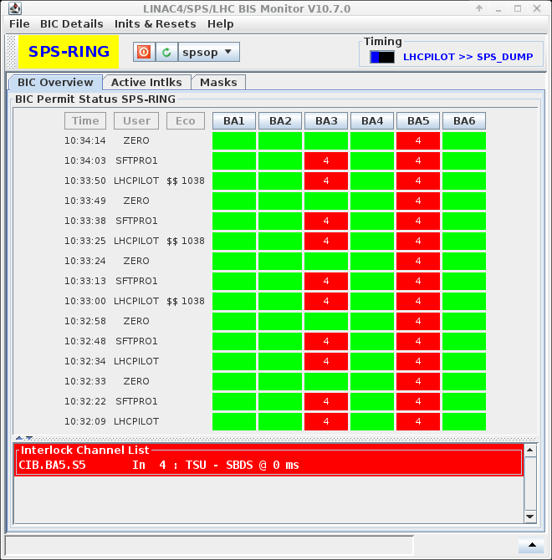
BIS Ring arming sequence
TSU Arming check
BIS OK
INJ BIS OK
Beam
SIS Evaluation OK (WECY)
STD Dump
TSU – Early Dump (-1ms)
BIS OK
25-01-23

Slide 14
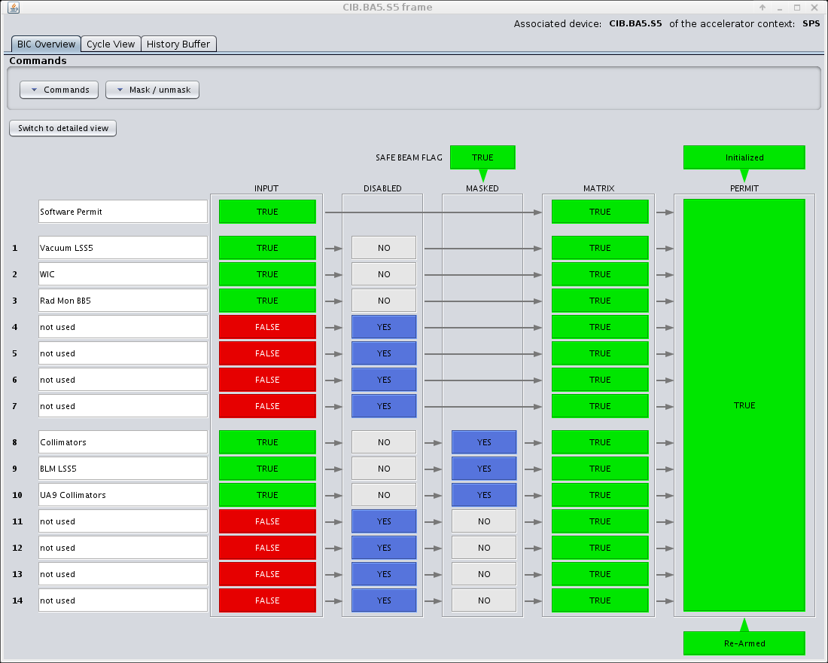
Relation with BIS
SW Exporter RING:
  BA3
  I_S_SIS (Timing condition)
  PS played spare cycle
SW Exporter TT20:
  BA2
  I_S_SIS_TT20
  PS played spare cycle
SW Exporter TT10:
  TT2EXT (master of TT10 and SPSINJ)
  I_S_SIS_TT10
  PS played spare cycle
SW FEI Exporter :
  BA1, TT40A, TT60A
SW Exporter Permit INJ/LHC :
  TI2D, TI2U, TI8D and TI8U
SW Exporter Permit TT40/TT60 :
  TT40A, TT40B, TT60A and TT60B
SW Exporter Permit TT41_Awake:
  TT41A, TT41B
SW Exporter Permit TT66_Hiradmat:
  TT66A and TT66B
25-01-23

Slide 15
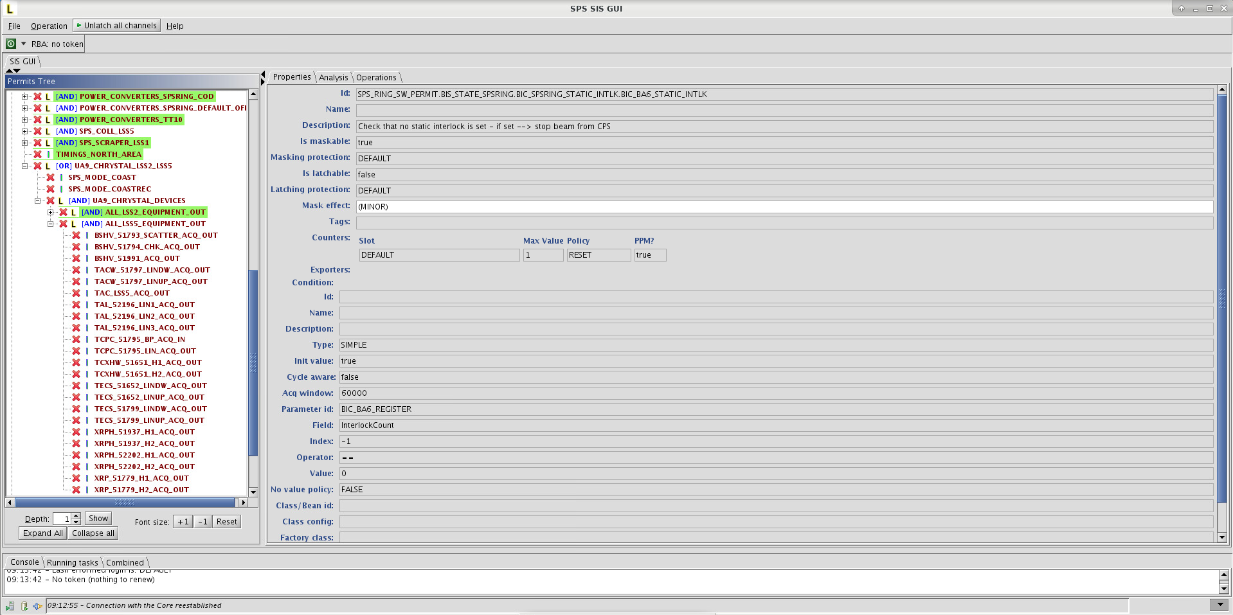
Relation with BIS
SIS helps to diagnose BIS interlock
25-01-23

Slide 16
Injection BIS shift compared to Ring BIS (start cycle), interaction with SBDS, BHZ377 and BHZ378, MKP.
SIS interaction with BIS :
SPS RING exporter :
  I.S.SIS_SPS
  BIS Software Permit
TT10 exporter :
  I.S.SIS_TT10
  BIS Software Permit

Slide 17
Injection BIS shift compared to Ring BIS (start cycle), interaction with SBDS, BHZ377 and BHZ378, MKP.
SPS INJ BIC :
MKP and MDSH.11971 :
Beam :
  MKP : pulsing
  MDSH.11971 : ECONOMY
Start Dynamique Economie, Monitored in SIS
No Beam :
  MKP : not pulsing
  MDSH.11971 : CYCLING
More info :
https://edms.cern.ch/document/2339661/1
25-01-23

Slide 18
Injection BIS shift compared to Ring BIS (start cycle), interaction with SBDS, BHZ377 and BHZ378, MKP.
TT2-TT10 Master BIC:
BHZ377/8 :
  Needs 350 ms before SIX-Events
More info :
https://edms.cern.ch/document/2339661/1
25-01-23

Slide 19
Injection BIS shift compared to Ring BIS (start cycle), interaction with SBDS, BHZ377 and BHZ378, MKP.
TSU arming acts on :
  Beam Permit
  SBDS
  Needs 450 ms before SIX-Events
MKP state is also a key element for Injection BIS
More info :
https://edms.cern.ch/document/2738576/1
25-01-23

Slide 20
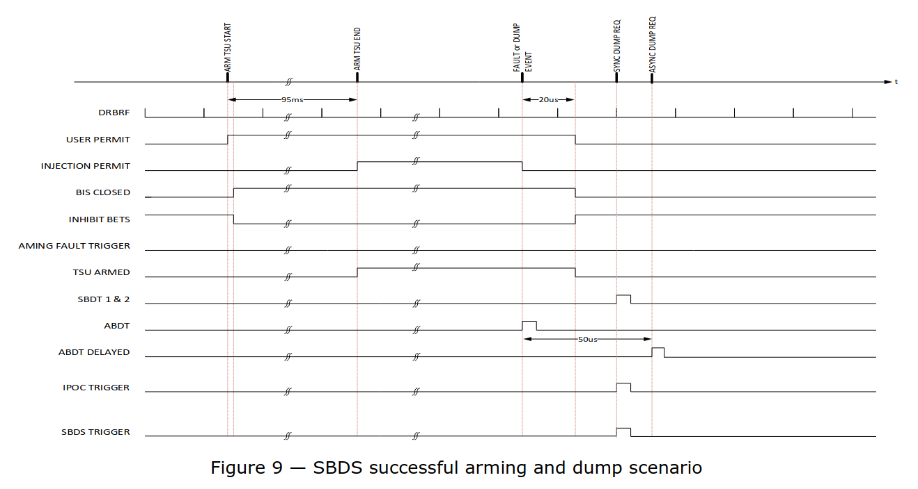
TSU Arming
https://edms.cern.ch/document/2738576/1

Slide 21
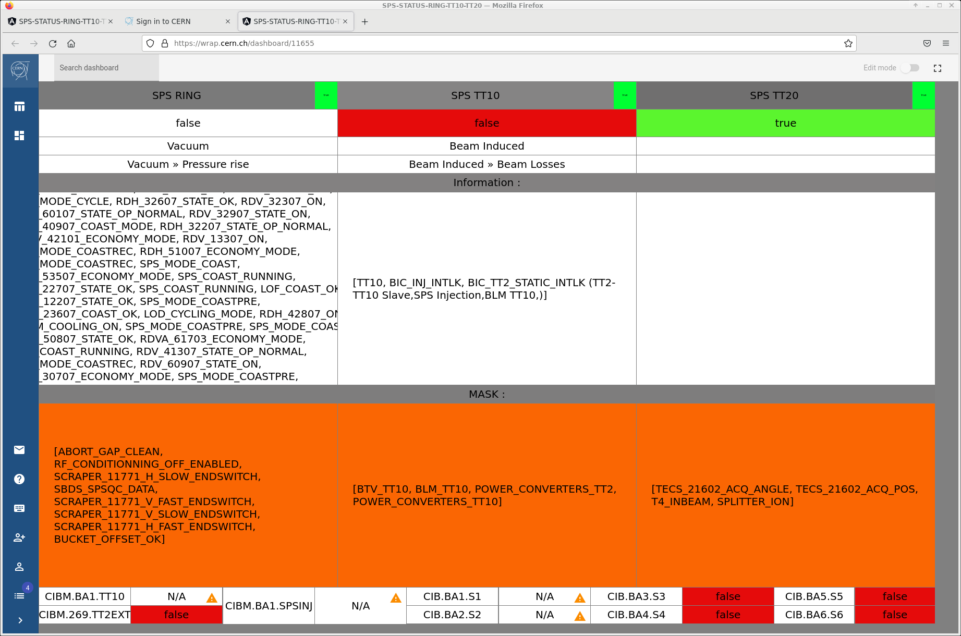
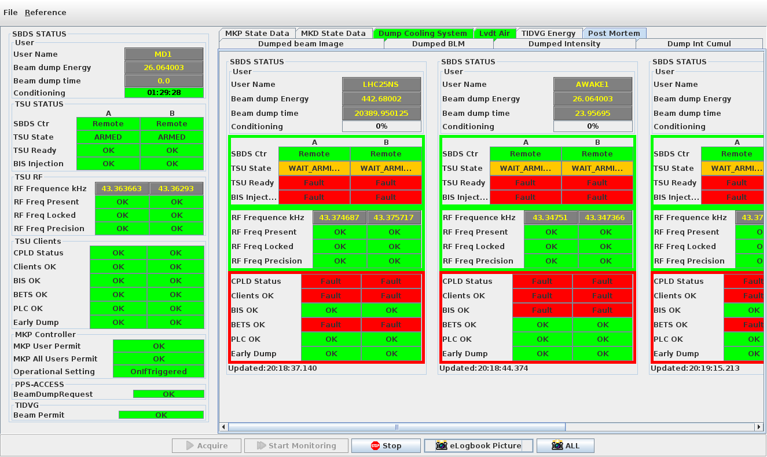
How to diagnose the cause of a non-rearming of BIS Injection BIS
SPS Beam Permit
SBDS Failed
25-01-23

Slide 22
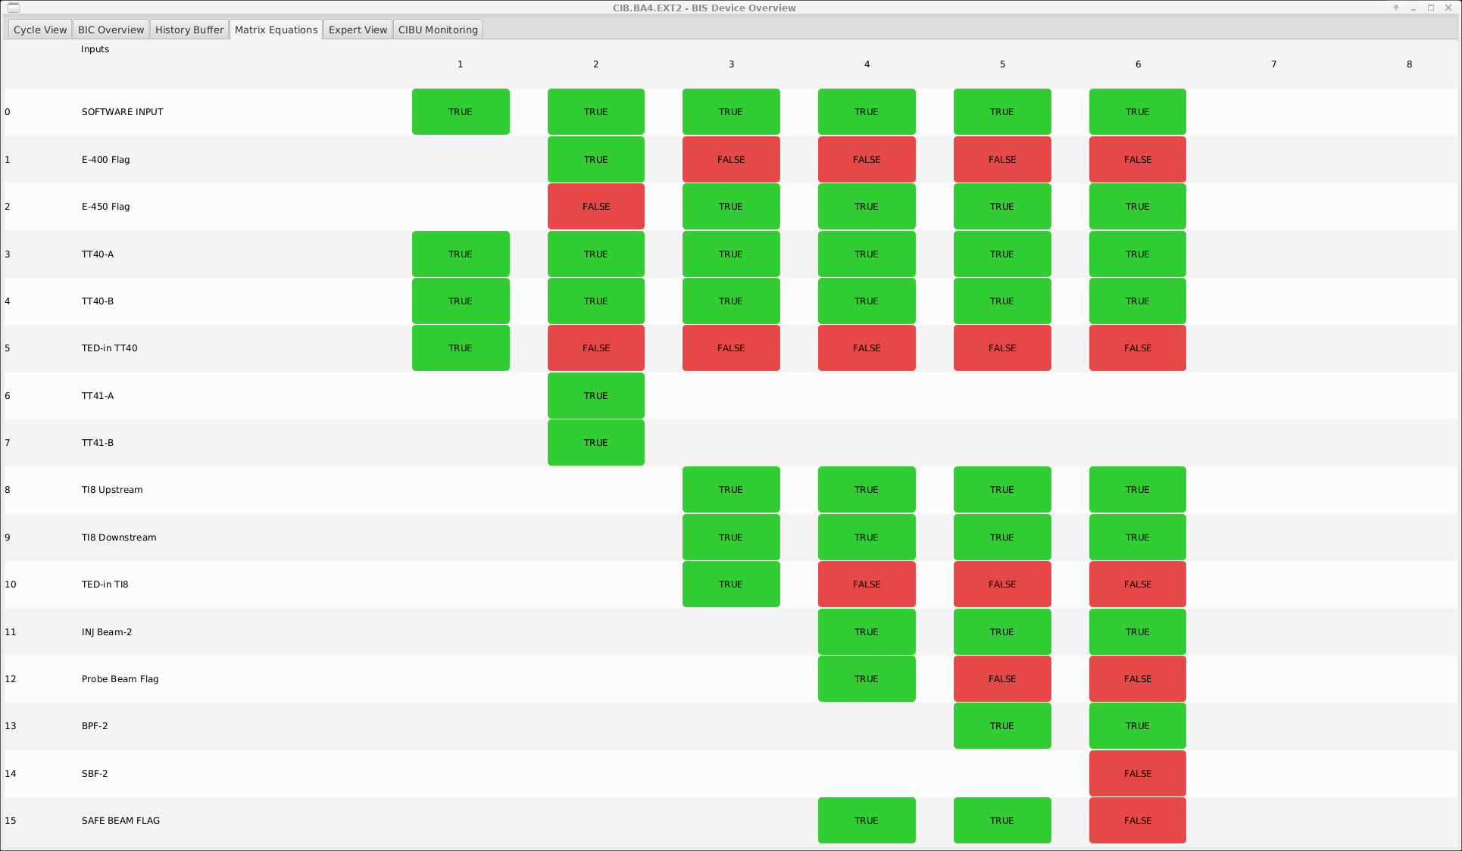
Equation details for Extraction BIS
To TED TT40
To AWAKE
To TED TI8
To LHC PILOT
T0 LHC PILOT PRESENCE
To LHC High Beam
25-01-23

Slide 23

Equation details for Extraction BIS
To TED TT60
To IRADMAT
To TED TI2
To LHC PILOT
T0 LHC PILOT PRESENCE
To LHC High Beam
25-01-23

Slide 24
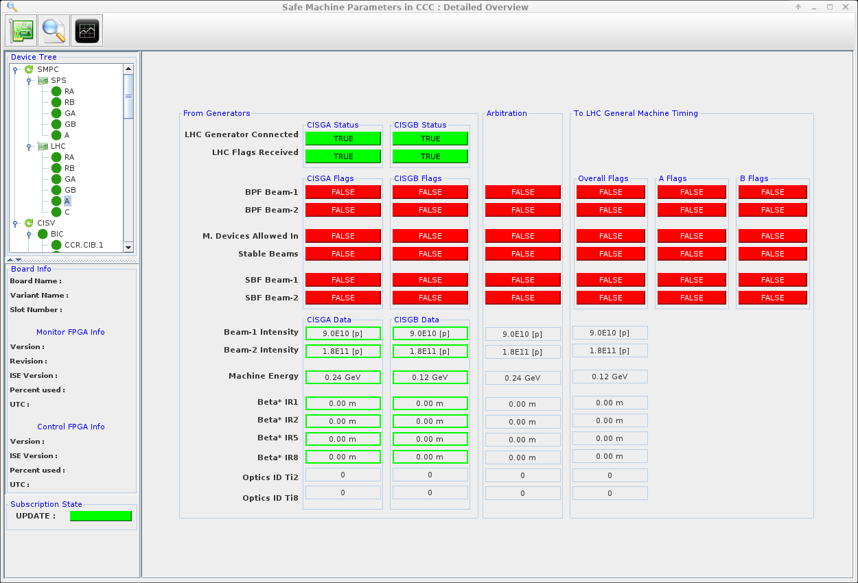
Equation details for Extraction BIS
25-01-23

Slide 25
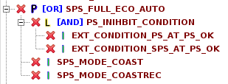

New Features
Added Full ECO auto
BUCKET OFFSET OK :
  Check Bunch spacing :
    Use Timing (SFT Beam, LHC Beam)
    Use LSA cycle name (Single bunch, LHC Standard, BCMS, 8b4E)
  Hybrid not yet in the list (to be masked).
  Ions (waiting for RF team to define first bucket) (to be masked).
RF AMPLITUDE MODULATION
RF CPU OK :
  Reboot cfu-ba3-allbc1
Update BTV devices name from BTV.XXXX to BTVI.XXXX
Discovered BTV in ring not checked in SIS.
25-01-23

Slide 26

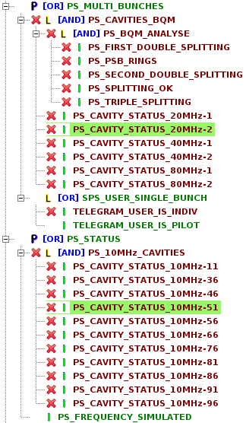
New Features
FEI Server requires a re-drive when a new cycle is made resident
PS Diagnostic :
  Input Masked are
spare
  No exporter (interlock)
  Just for information
  Developed with collaboration with M. Coly and A. Lasheen/A. Huschauer
25-01-23

Slide 28
SIS coding
Programed in :
Macro
Velocity
Xml
Java
Groovy
25-01-23

Slide 29
SIS vs ISA
25-01-23

Slide 30
RBAC Level1
LEVEL1 with role SPS-SIS-SPS :
  PMI2 Doors
  DUMP INTENSITY
DEDAULT with ROLE SPS-MCS
NO MASK POSSIBLE :
  STD Standard
25-01-23

Slide 31
CCDE list generation (COD, SEM, BTV)
Extract from CCDE :
public class ExtractDevicesNamesForListCOD {
public static final String CLASS_NAME = "FGC_63";
public static final String[] BA = { "BA1", "BA2", "BA3", "BA4", "BA5", "BA6" };
private static final String LIST_NAME = "SPS-COD-Power-Converters-List.vm";
private static final String ACCELERATORZONE = "RING";
private static final String TIMINGDOMAIN = "SPS";
/**
*
*/
public ExtractDevicesNamesForListCOD() {
String path = "src/test/cern/sps/sis/extractor/lists/" + LIST_NAME;
File myObj = new File(path);
FileWriter myWriter = null;
try {
if (!myObj.exists()) {
System.out.println("File created: " + myObj.getName());
myObj.createNewFile();
myWriter = new FileWriter(path);
myWriter.write("## the lists of COD PCs for the SPS ring" + "',\n");
} else {…..
List COD
## the lists of COD PCs for the SPS ring',
#set( $CODSext1List= ["RDH_10207",
"RDH_10407",
"RDH_10607",
"RDH_10807",
"RDH_11007",
"RDH_11207",
"RDH_11407",
"RDH_11607",
"RDH_11820",
"RDH_12007",
....
List SEM NA, TT10, TT20
## the lists of SEM for NA',
#set( $SEMINOUTMOTORNORTHList= ["BA80_INOUT_BSPH211548",
"BA81_INOUT_BSPHV043062",
"BA81_INOUT_BSPHV043167",
...
#set( $SEMBStepMotorVMENORTHList= ["P42_BBSH_43166-STEP",
"P42_BBSH_43224-STEP",
"P42_BBSH_43281-STEP",
"P42_BSMH_45819-STEP",
"P42_BSMV_45819-STEP”
…
25-01-23

Slide 32
Delay for Injection
https://edms.cern.ch/document/2339661/1
25-01-23

Slide 33
Delay for Injection
https://edms.cern.ch/document/2339661/1
25-01-23

