Slide 1
EIC Project Update
Elke Aschenauer and Rolf Ent
Co-Associate Directors for the Experimental Program
ePIC General Meeting
June 23rd 2023

Slide 2
Focus of Recent Activities
Experimental Program Project Stuff
  Upcoming Reviews
  Project Information
Integration
  Finalize solenoid design
    flux return layout
    cryo-can design
  Tracker optimization
  optimizing PID detectors
    optimizing installation procedure to ease design
  Integrating barrel imaging calorimeter
  continued optimization of far-forward and far-backward region
  generating as much room for services as possible with keeping acceptance maximized

Slide 3

Upcoming in your EIC Detector Arena
July 5 + 6: Particle Id Detectors Interim Design Review
    Reviewers: Peter Krizan (U Ljubljana), Floris Keizer (CERN), Ana Amelia Machado (UniCamp), Koji Nakumura (KEK), Justin Stevens (W&M)
July 21: Final Design Review of the PbWO4 Crystals for the ePIC Backward EM Calorimeter
    Reviewers: Eugene Chudakov (JLab), Dipangkar Dutta (MSU)
August (TBD): Likely one-two further Final Design Reviews for Long-Lead Procurement candidate items
August 28 + August 31: DAC Review of Detector R&D – had to split in two separate days to make it work with DAC
    FY23 progress
    FY24 continuation requests
August 29 + 30: DOE CD-3A Design Review by DAC
October 5 + 6: Final Design Review of Magnet (MARCO)
October 10-12: DOE CD-3A Director’s Review
TBD : DOE CD-3A Independent Cost Review
November 14-16: DOE CD-3A Independent Project Review
December 7 + 8: 2nd Resource Review Board meeting @ GWU
December (TBD): Preliminary Design Review of Far-Forward/Far- Backward Detectors

Slide 4
Long Lead Procurements Overview
Selection already accounts for design changes and recent technology choices
WBS 6.10.07 1.7 T Solenoid
  Magnet is long-lead as the detector assembly and installation requires the availability of the fully-tested magnet
  Limited world-wide vendors and long production time (estimated from 12 GeV magnets)
Electromagnetic and Hadronic Calorimeters and SiPMs
  WBS 6.10.04, 05, 06 SiPMs for calorimeters and dRICH
    Need 735000 SiPMs of 6 different types
  WBS 6.10.05 PbWO4 – crystals
  WBS 6.10.05 fECAL and Barrel ECal SciFi need in total ~8000 km
  WBS 6.10.06 forward HCal: Steel and Tungsten plates and backward HCal steel
All these long-lead items are driven by
  limited world-wide vendors → competition by other projects around the world
  production times and capability and/or labor-intensive manufacturing tasks
  SiPMs staggered procurement
Final Design Reviews for LLPs to justify specifications for procurement on the July – August time frame

Slide 5
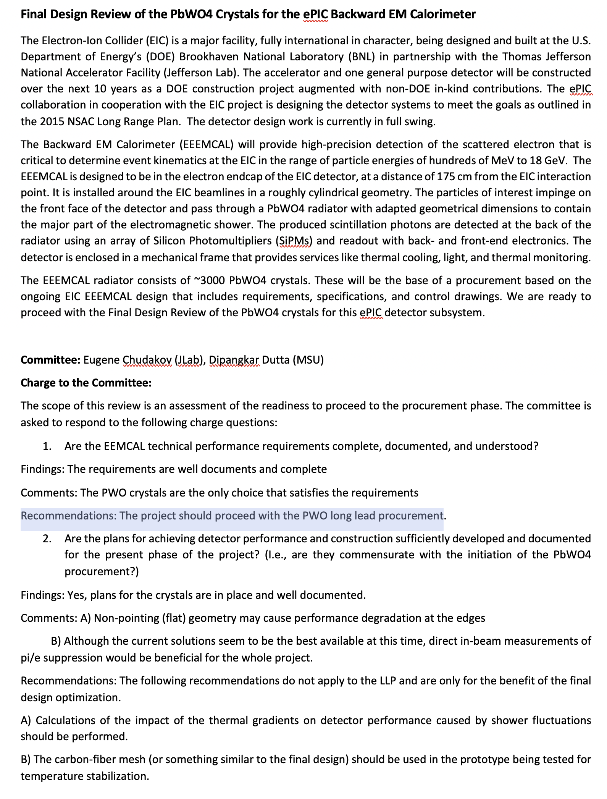
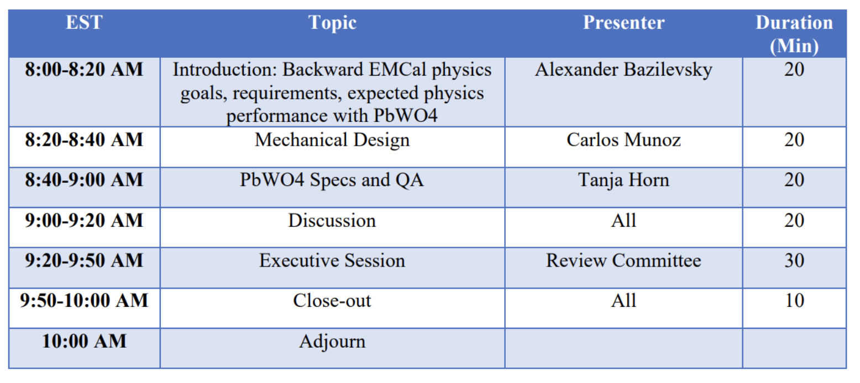
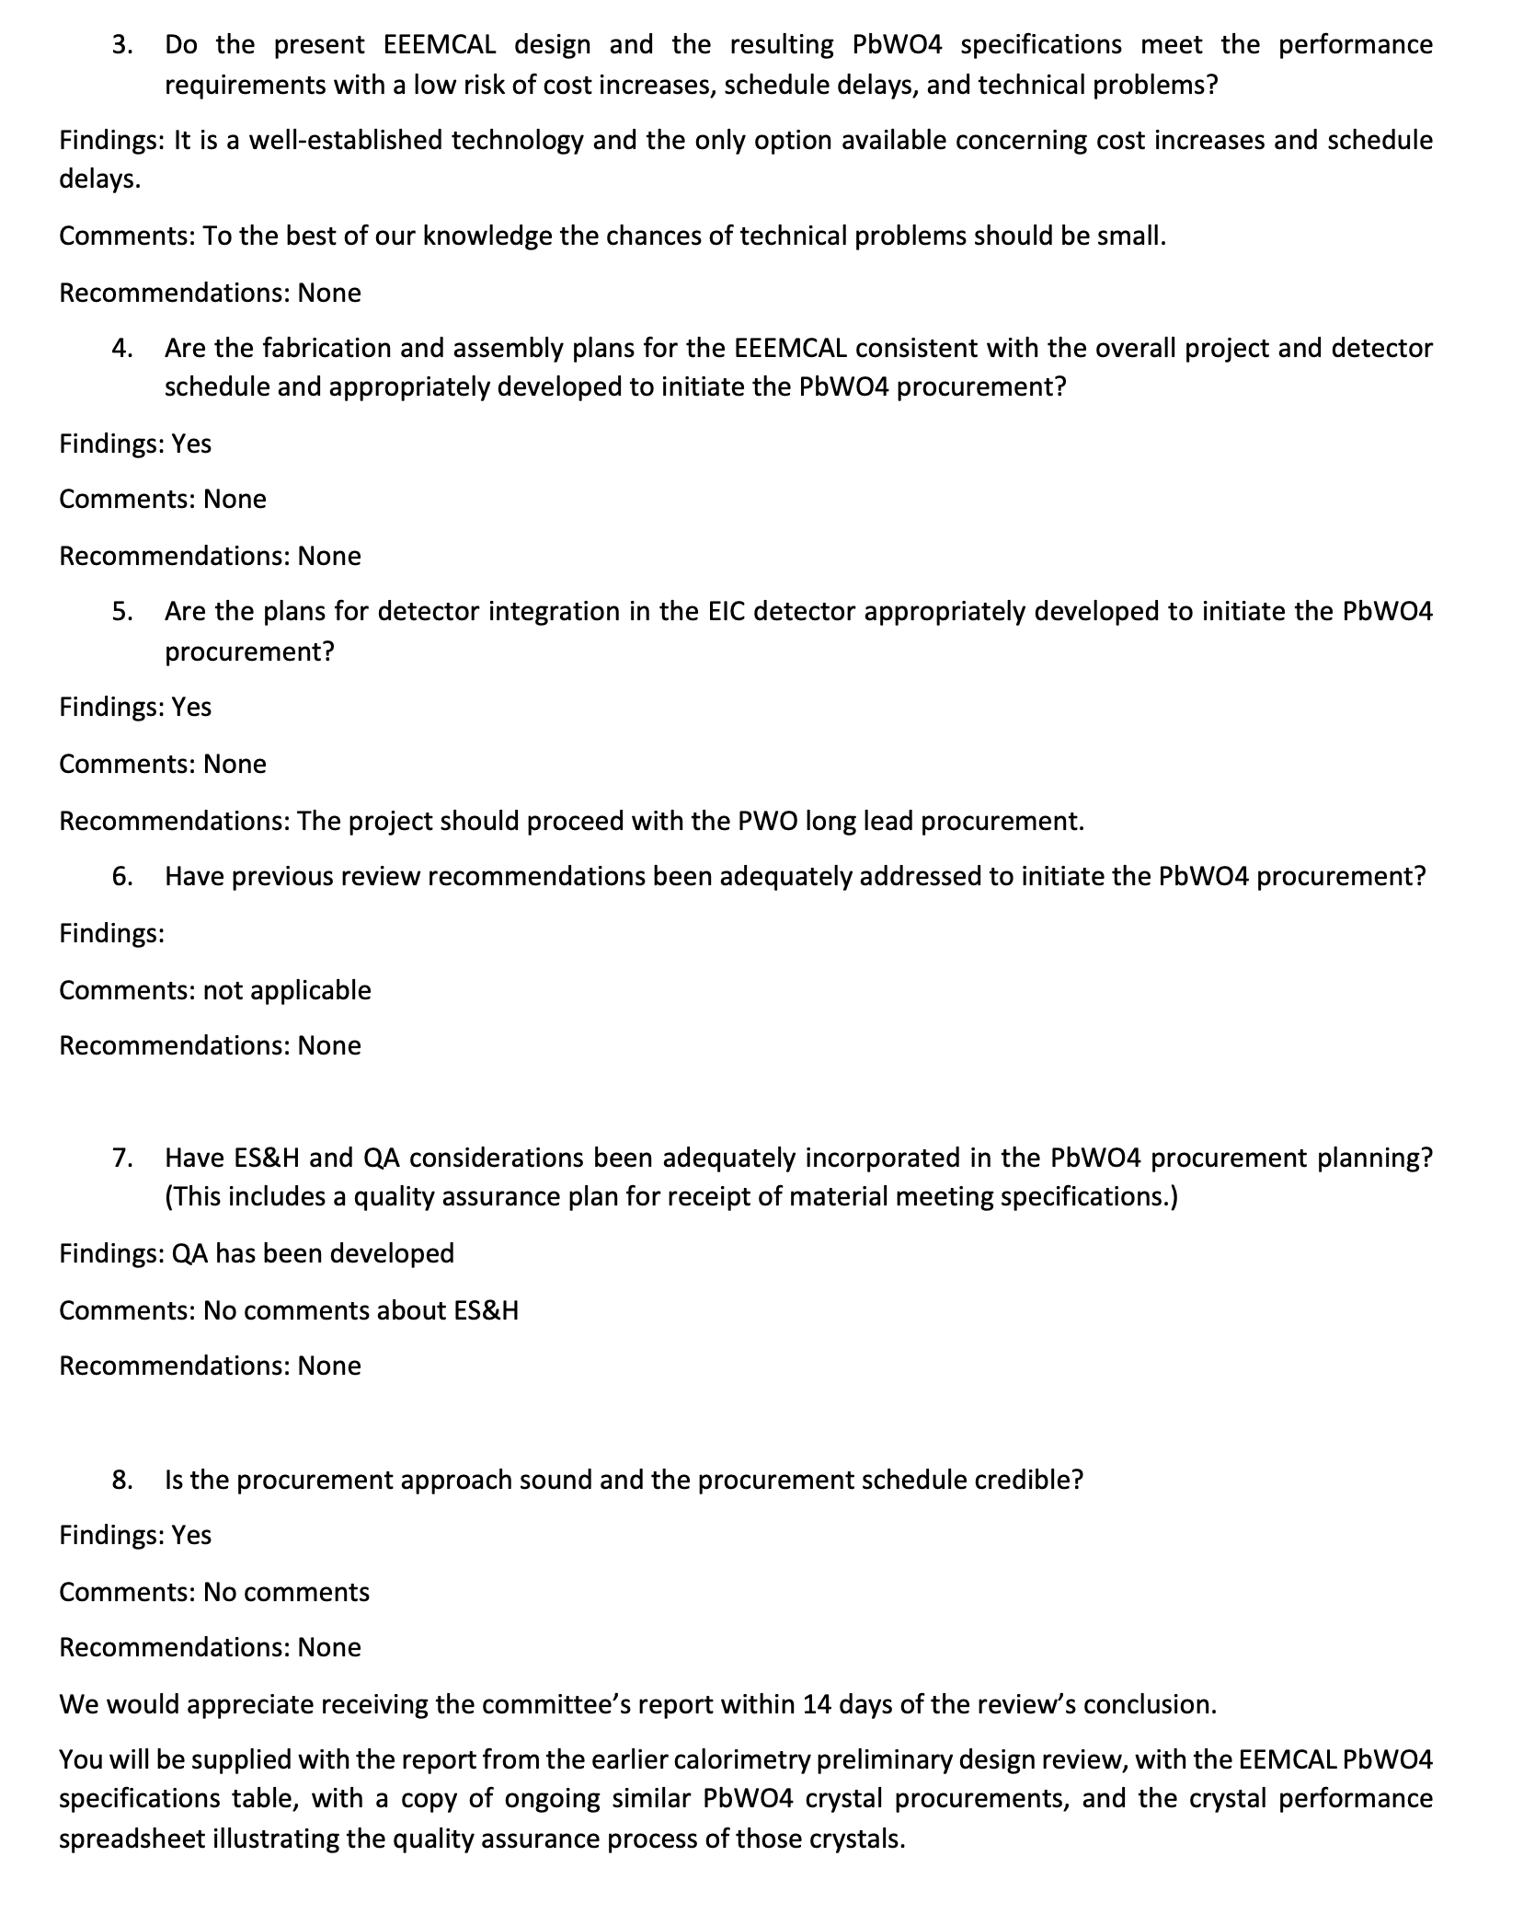
PbWO4 Crystals FDR
Passed – planning in place, design sufficiently mature
Two recommendations are to improve overall design
Other LLP reviews will be very similar

Slide 6
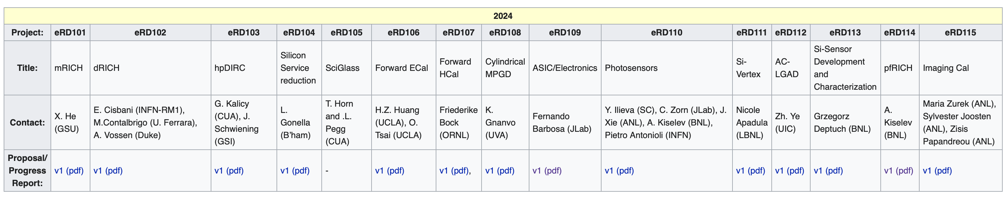
EIC Project Detector R&D
https://wiki.bnl.gov/conferences/index.php/ProjectRandDFY24
Review by DAC:
Monday August 28 and Thursday August 31.
Preliminary agenda: https://indico.bnl.gov/event/20113/
DAC Membership:
Edward Kinney (Chair) | Boulder CO
Ken Wyllie | CERN
Petra Merkel | FNAL
Antonis Papanestis | Rutherford Appleton Laboratory
Peter Krizan | U Ljubljana
Ana Amelia Machado | University of Campinas, Brazil
Heidi Schellman | Oregon State
Brigitte Vachon | McGill
Stefano Miscetti | INFN Frascati
Etiennette Auffray | CERN
Andrew White | U. Texas Arlington
Chi Yang | SDU China
new members
Remember:
exchange 1/3 of the committee every year

Slide 7
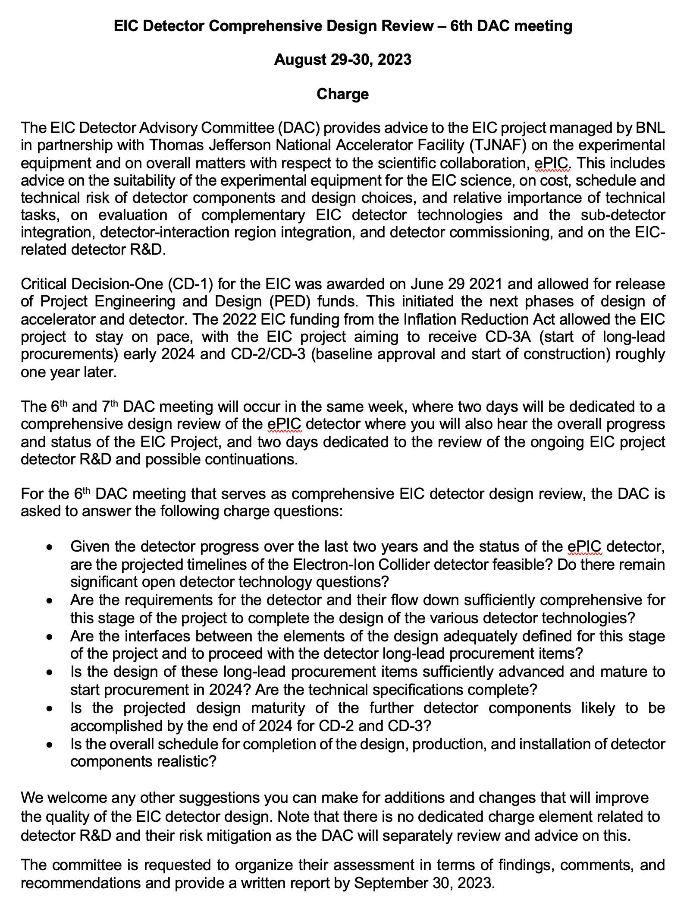
DOE CD-3A Design Review
Reviewers: DAC

Slide 8
Follow up on recent ePIC technology choices
The path to integrate the recent technology changes, Barrel Ecal and backward RICH,
by ePIC into the EIC Project baseline
Remember: five-step change control process
  The detector collaboration initiates a possible change in baseline scope
  The collaboration technical board or equivalent ensures the change is consistent
  with the NAS science requirements and initiates the change request
  → prepare input for the TCCB
  detailed changes in cost, schedule and risk → implement in P6
  science and technical justification for the change ← input from ePIC
  started with backward RICH as it is a less complex case
  The detector TCCB collects wide input, discusses, and gives advise
  The Project Technical Director gives approval
  The EIC Management Team needs to approve the formal baseline change control
  → process for both detectors needs to be complete by the DAC technical design review

Slide 9
Follow up on recent ePIC technology choices
backward RICH:
fully integrated in P6 (changes to WBS 6.10.03 and 6.10.08)
  no changes in either cost, schedule or risk
→ no change request needed
→ will document change in detector technology through filing a record of decision
Barrel ECal:
nearly fully integrated in P6 (changes to WBS 6.10.05 and 6.10.08)
  WBS 6.10.05 = P6 cost ($19.1M) + ~$2.5M
  WBS 6.10.00 = P6 cost reduced by ~$0.4M
WBS 6.10.10 – Detector Infrastructure & Integration
  expect some reduction in labor and materials
Expect imaging calorimeter costs to be P6 + ~$2M
Sci-Glass based calorimeter due to geometry change would also require P6 + ~$4.5M
($4.435M was already added to 11/28/22 in EIC scope cost changes list)
Expect to require lite version of change control request for detector technology change

Slide 10
What Is Coming Up – TDR
We will start the process of writing a draft TDR later this year, and then this will continue towards a first version of a TDR in 2024.
Working model will be similar as we used to create the CDR, Elke/Rolf with engagement of ePIC leadership, and a mix of the project CAMs and EPIC WG representatives. At the late phases the editing rights will become more restricted. We plan to use where we can input from the CDR, YR, proposals, technical notes, etc.
Chapter 2: Physics Goals and Requirements (should be short, < 50 pages)
2.1 EIC Context and History (like CDR 2.2 or YR section 1)
2.2 The Science Goals of the EIC and the Machine Parameters (like CDR 2.3)
2.3 The EIC Science (follow YR structure)
2.4 Scientific Requirements
Chapter 3: Interaction Region 6 Overview (Elke/Rolf contributing)
Chapter 8: Experimental Systems (can be long such that we can use as standalone detector TDR)
8.1 Experimental Equipment Requirements Summary (like CDR 8.2)
8.2 General Detector Considerations and Operations Challenges (YR 10, CDR 8.3)
8.3 EIC Detector
8.4 Detector R&D Summary
8.5 Detector Integration
8.6 Detector Commissioning and Pre-Operations
Chapter 11: Commissioning (Elke/Rolf contributing)
Appendix-B: Integration of a Second Experiment (mainly emphasizing feasibility, luminosity sharing, polarization with two experiments, and first-order checks of magnets/acceptance)

Slide 11
(Draft) TDR – more details on section on Experimental Systems
.
8.1 Experimental Equipment Requirements Summary (like CDR 8.2)
8.2 General Detector Considerations and Operations Challenges (YR 10 and CDR 8.3)
8.2.1 Beam Energies, Polarization, Versatility, Luminosities (like YR 10.1)
8.2.2 Rates and Multiplicities (like CDR 8.3.1)
8.2.3 Interaction Region Integration, Vacuum and Backgrounds (like CDR 8.3.2)
8.2.4 Systematic Uncertainties (like YR 10.5)
8.3 EPIC Detector CAM(s) and ePIC collaboration contact(s)
8.3.1 Magnet For each subsection end with R&D and design maturity
8.3.2 Tracking
8.3.3 Electromagnetic Calorimetry
8.3.4 Hadronic Calorimetry
8.3.5 Particle Identification
8.3.6 Far-Forward Detectors
8.3.7 Far-Backward Detectors
8.3.8 Polarimetry and Luminosity Detector
8.3.9 Readout Electronics and Data Acquisition
8.3.10 Software, Data Analysis and Data Preservation (EICUG SWG?)
8.4 Detector R&D Summary
8.5 Detector Integration (Walt, Rahul, Tim/Christian, Fernando, Roland, Dan, Elke, Rolf)
8.5.1 Experimental and Assembly Hall Infrastructure (like CDR 8.7.1, YR 13.1)
8.5.2 Interaction Region and Protection (include also YR 13.2)
8.5.3 Support Frames and Installation Fixtures (new, ask Roland and Walt to draft)
8.5.4 Detector Alignment (like YR 13.4)
8.5.5 Schedule and Installation (like CDR 8.7.2, YR 13.3)
8.5.6 Access and Maintenance (like CDR 8.7.3, YR 13.5)
8.5.7 System Engineering and Interface Controls (links to later global Section 12 on System Engineering)
8.6 Detector Commissioning and Pre-Operations

Slide 12
Non-DOE Interest & In-Kind - Updated
Entity | Interest and Important Facts
NSF | NSF-MSRI pre-proposal submitted by 10 US universities – aims at full scope of backward EM calorimetry (eECal). Armenia, Czech, France/IN2P3 as unfunded contributors. Invited to submit proposal. Final NSF review is ongoing.
CERN | MAPS sensor design developed by CERN/ITS-3 Group providing synergy with ALICE. Synergy of gaseous-based Cherenkov detectors and photon-sensors with ALICE & LHCb. Synergy of Forward AC-LGAD design with CMS endcap timing layer.
Armenia | Contributions, mainly labor to eECal and many EM calorimetry and particle id detectors component tests.
Canada | EIC included in 2022 Canadian Subatomic Physics Long-Range Plan; Interested in Compton Polarimetry, Barrel Electromagnetic Calorimetry and Software
China | Forward EM Calorimeter
Czech | Working with funding agency; Interested in eECal (PbWO4 crystals and glass) and Silicon
France/IRFU | Interested in MPGD/racking, electronics. Provided in-kind contributions to SC magnet design and interested to continue labor oversight during magnet construction.
France/IN2P3 | International contribution to backward EM calorimetry (including in-kind design) and to readout electronics (two ASICs for AC-LGAD detectors and Calorimetry). IRFU & IN2P3 discussing together for higher-level contributions.
India | Consortium is working with Funding agency; Interested in detector software (non-project scientific contribution), contributions to DAQ/slow controls. Investigating further hardware contributions (including possible links with Si plants).
Italy/INFN | Aims at major scope of forward particle identification detector (dRICH), at (part of) the Si/MAPS tracker scope, and at photo-sensor contributions. Further investigating possible interest in EIC detector magnet scope.
Israel | B0 Detectors (Si tracking and PbWO4)
Japan | Interested in a US-Japan agreement; Aims at full scope of Zero-Degree Calorimeter in collaboration with Taiwan/Korea. Pursuit of full scope of barrel AC-LGAD detector as EIC-Asia consortium. Contribution to DAQ/streaming. Possible aerogel.
Korea | Aims at major scope for fiber-based barrel EM calorimeter, Also work packages for barrel AC-LGAD and Si-based hadronic calorimetry for ZDC.as part of EIC-Asia consortium (includes also Japan,Taiwan), Collaboration on Si tracking detector.
Poland | Actively working with ministry/funding agency; Interested in detectors along the beam line (luminosity detector, Roman Pots)
Taiwan | Pursuit of full scope of barrel AC-LGAD as part of EIC-Asia consortium. LYSO-based EM calorimeter for ZDC, Also optical readout/fiber. Possible later interest in PCBs. Computing.
UK | STFC seed funding for UK detector R&D (3M£). Interest in Si/MAPS tracker, polarimetry and detectors along the beams (Low-Q2/TimePix). Follow-up STFC/UKRI request for 5-7 years submitted early 2023 (includes accelerator part).

Slide 13
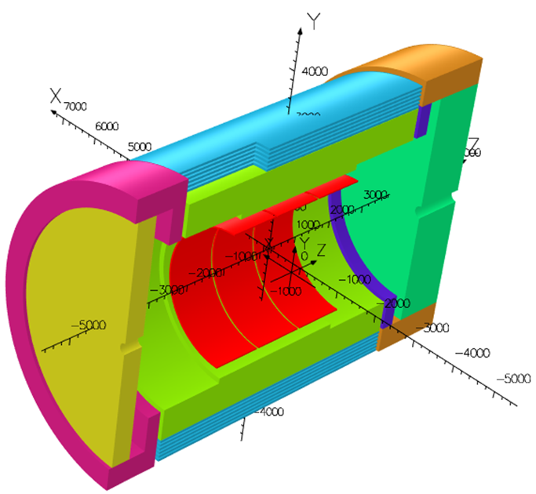
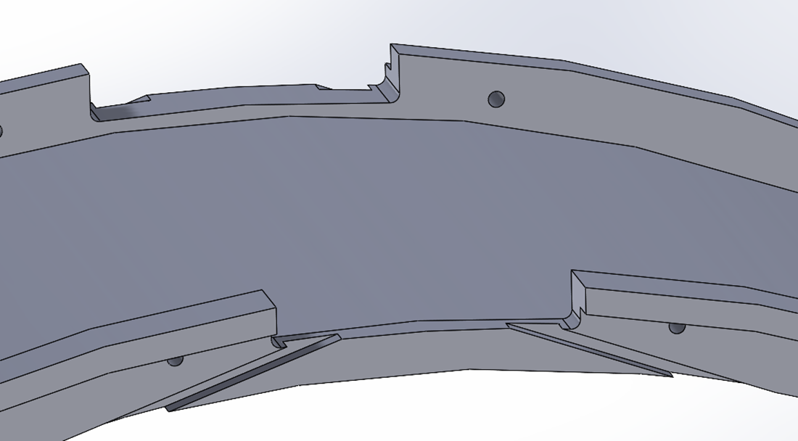
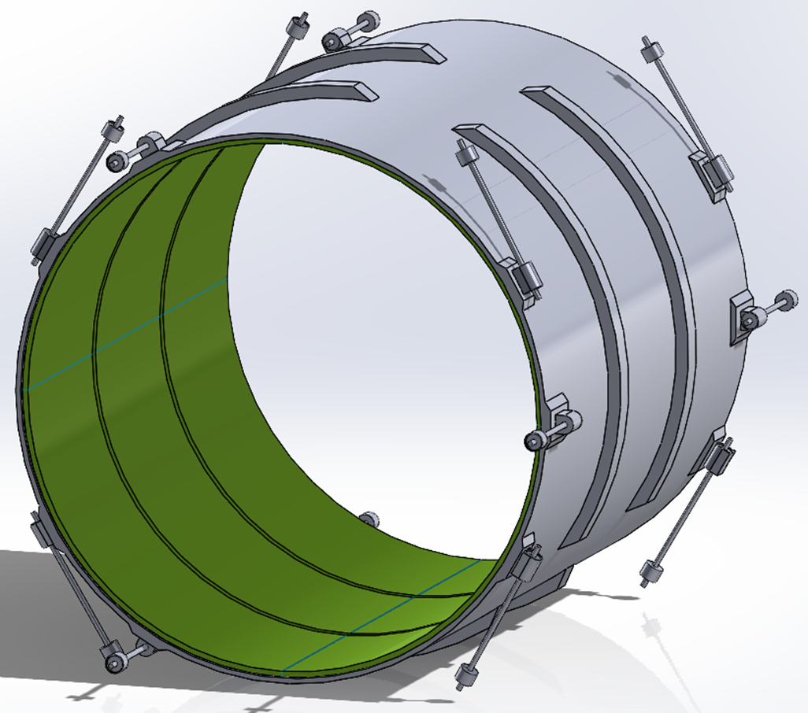
MARCO Magnet Design Details
Conductor is based on CEA-Saclay experience as used for previous magnets.
Contract for conductor test samples in place with viable vendor.
Coil is divided in 3 modules with 557 Turns each. This is done mainly to accommodate possible conductor length.
Flux return steel layout fully defined to minimize forces and fringe fields (~10G)
See solenoid report by Valerio Calvelli on Thursday morning
The two most important design parameters are conservative: large temperature margin and large critical current margin
Conductor exits
Mechanical analysis undergoing final checks

Slide 14
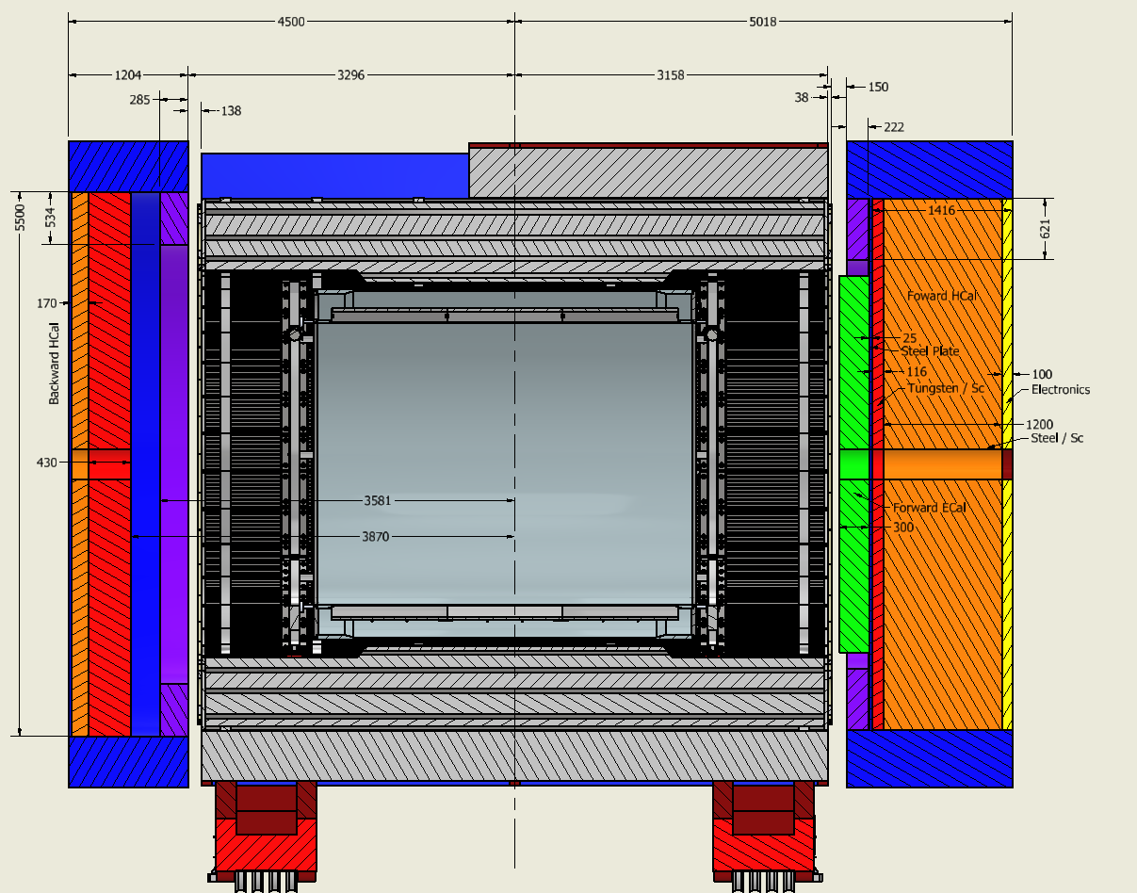
Final Layout of Flux Return and HCals
Note: detector is aligned with electron beam → 8mrad rotation also for endcaps
Steel
Stainless Steel
Steel
backward HCal was
further optimized to provide better overlap with barrel Hcal
→ separated the flux return from the backward HCal
→ need to use stainless steel as absorber

Slide 15
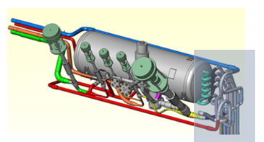
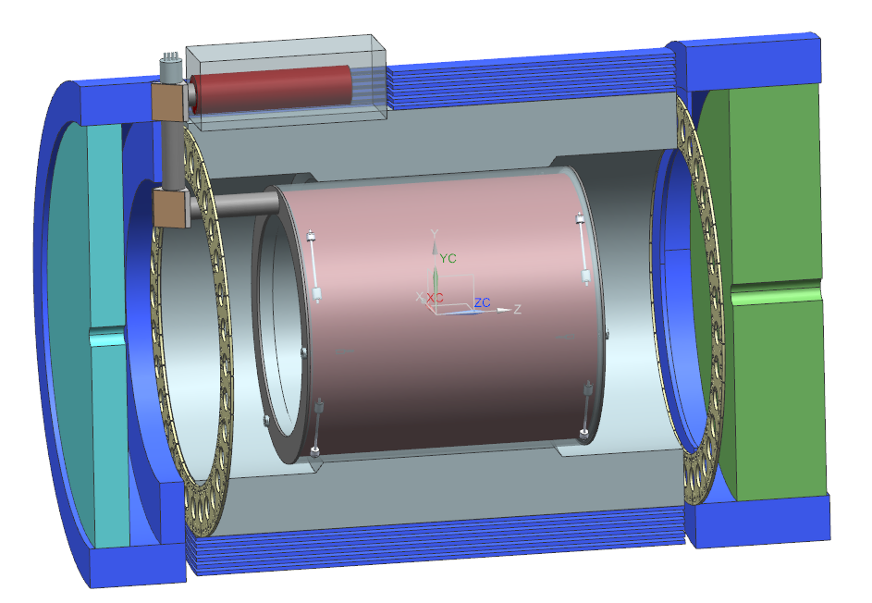
Cryo-Can Layout
Phase Separator
Phase Separator envelope for tubing and valves
No need to modify any barrel HCal sectors
will need to integrate cut-out in the backward endcap shielding

Slide 16
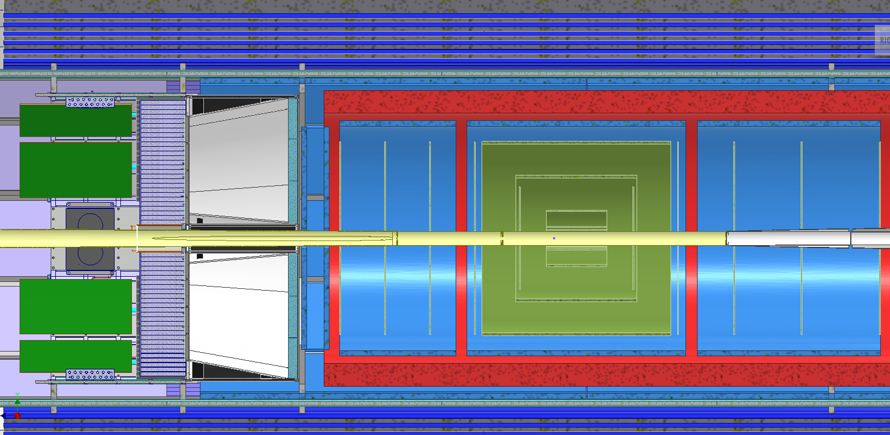
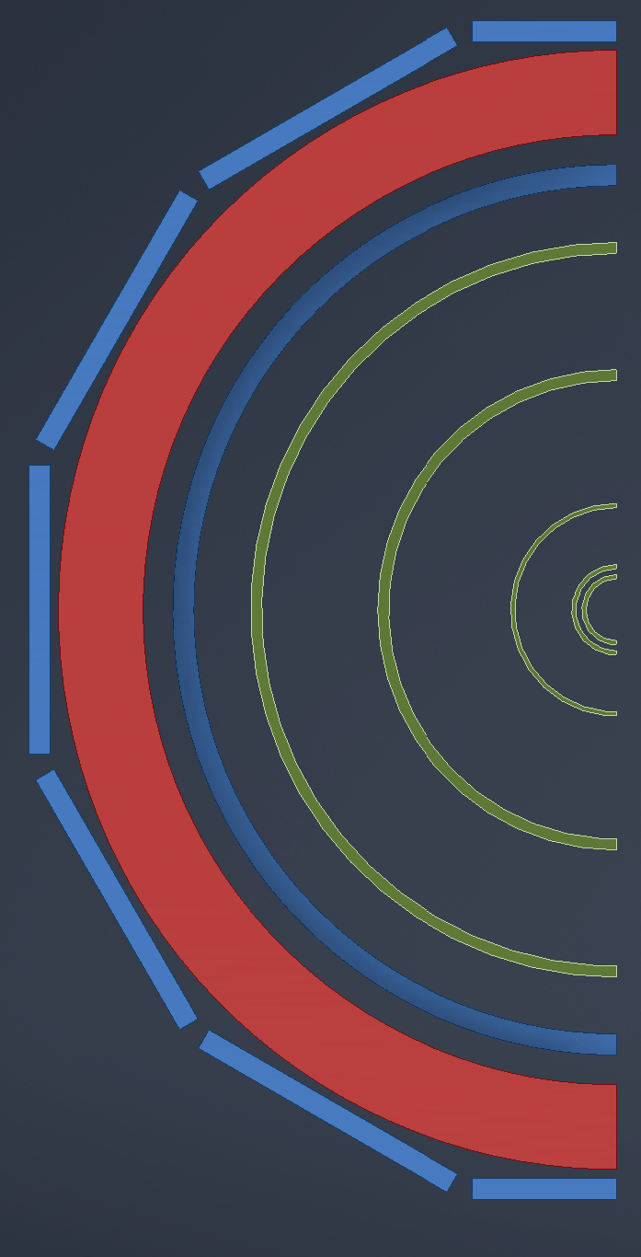
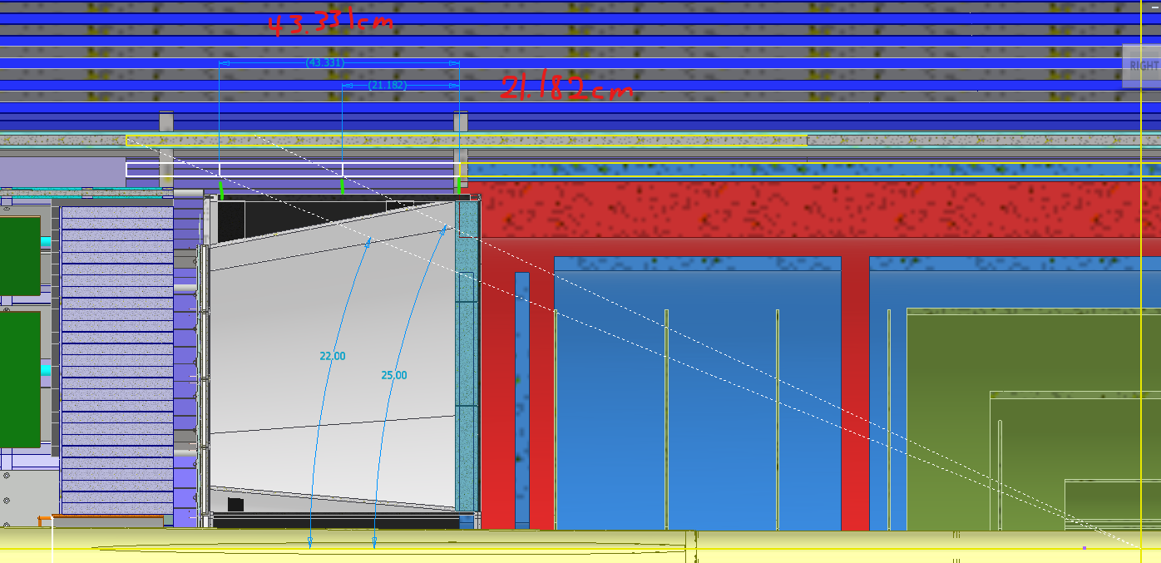
Integration of optimized tracking
For details on the why see Ernst talk today and
https://indico.bnl.gov/event/19854/contributions/77603/attachments/48017/81517/20230615%20-%20ePIC%20Tracking%20WG.pdf
MPGD
Outer-MPGD Barrel extended to cover active region of DIRC → will be integrated in DIRC support
Outer MPGD barrel is composed from flat detectors following the DIRC segmentation
Inner MPGD Barrel and ToF will have one support also supporting all Discs and MAPS barrels

Slide 17
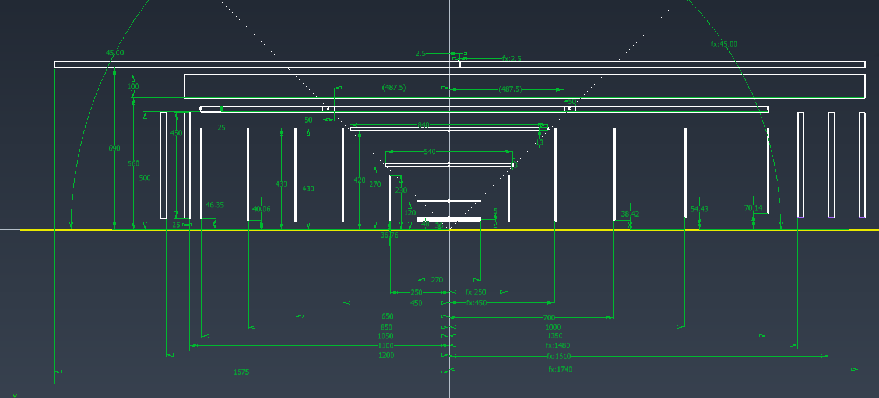
Integration of optimized tracking
Have met with MAPS and MPGD DSCs to update services
ePIC.Interface Control Document for Services.052023.xlsx
Note: the tracker starting from the ToF inwards will be installed as one
piece together with the beam pipe

Slide 18
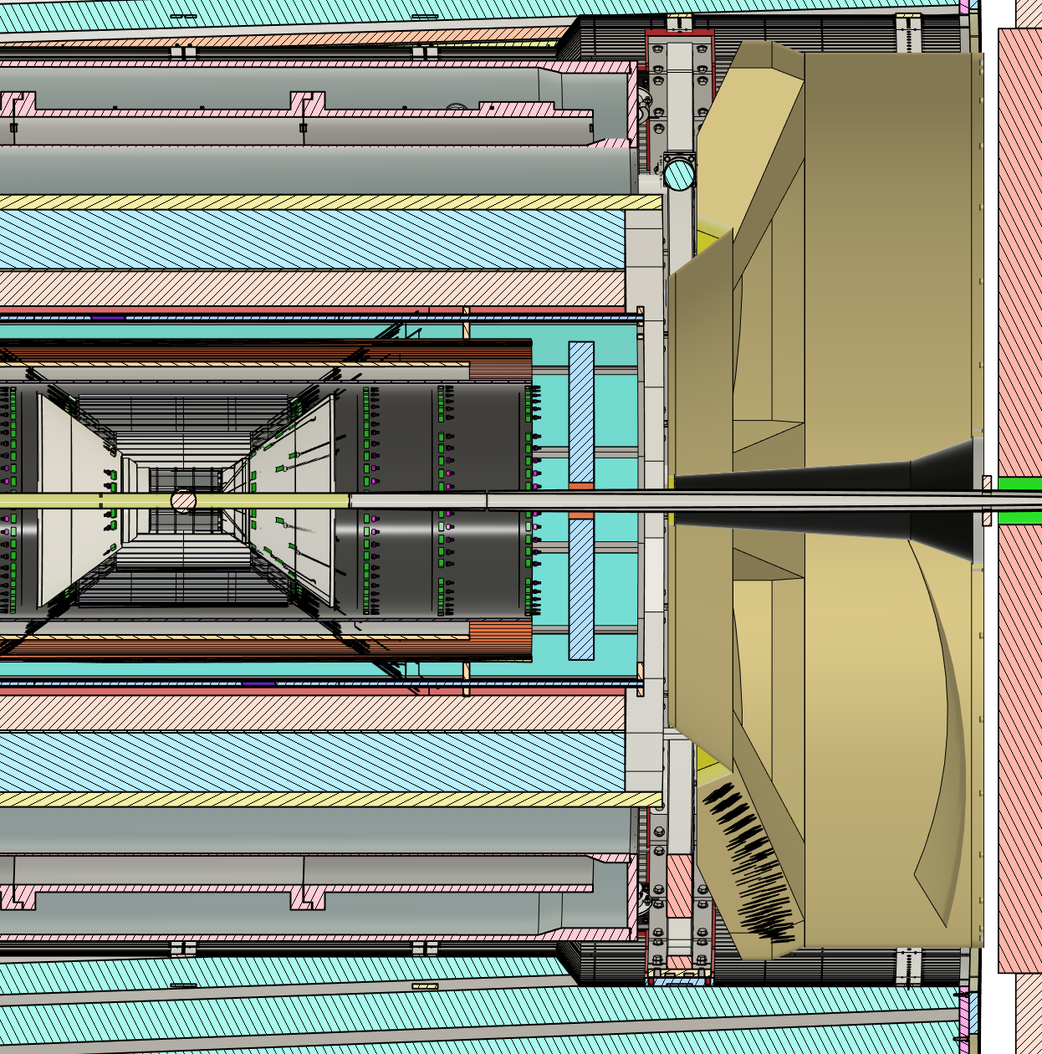
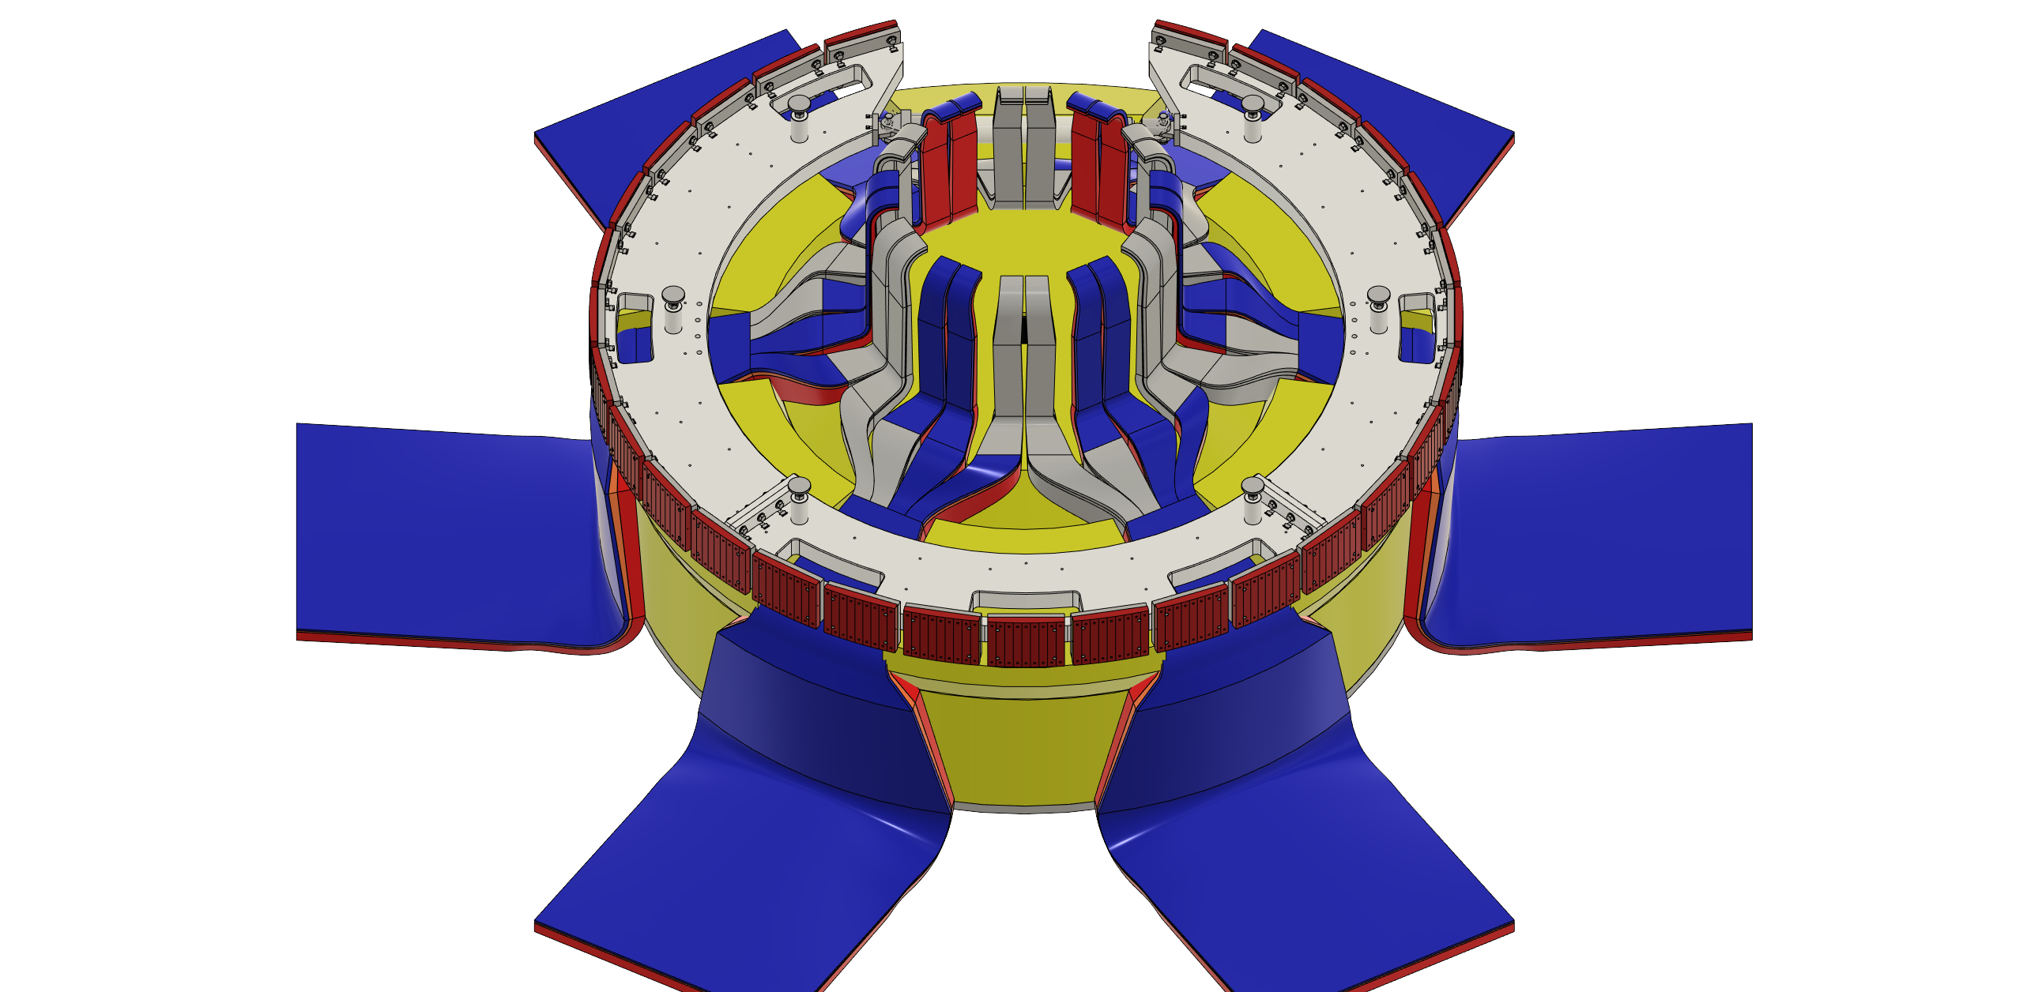
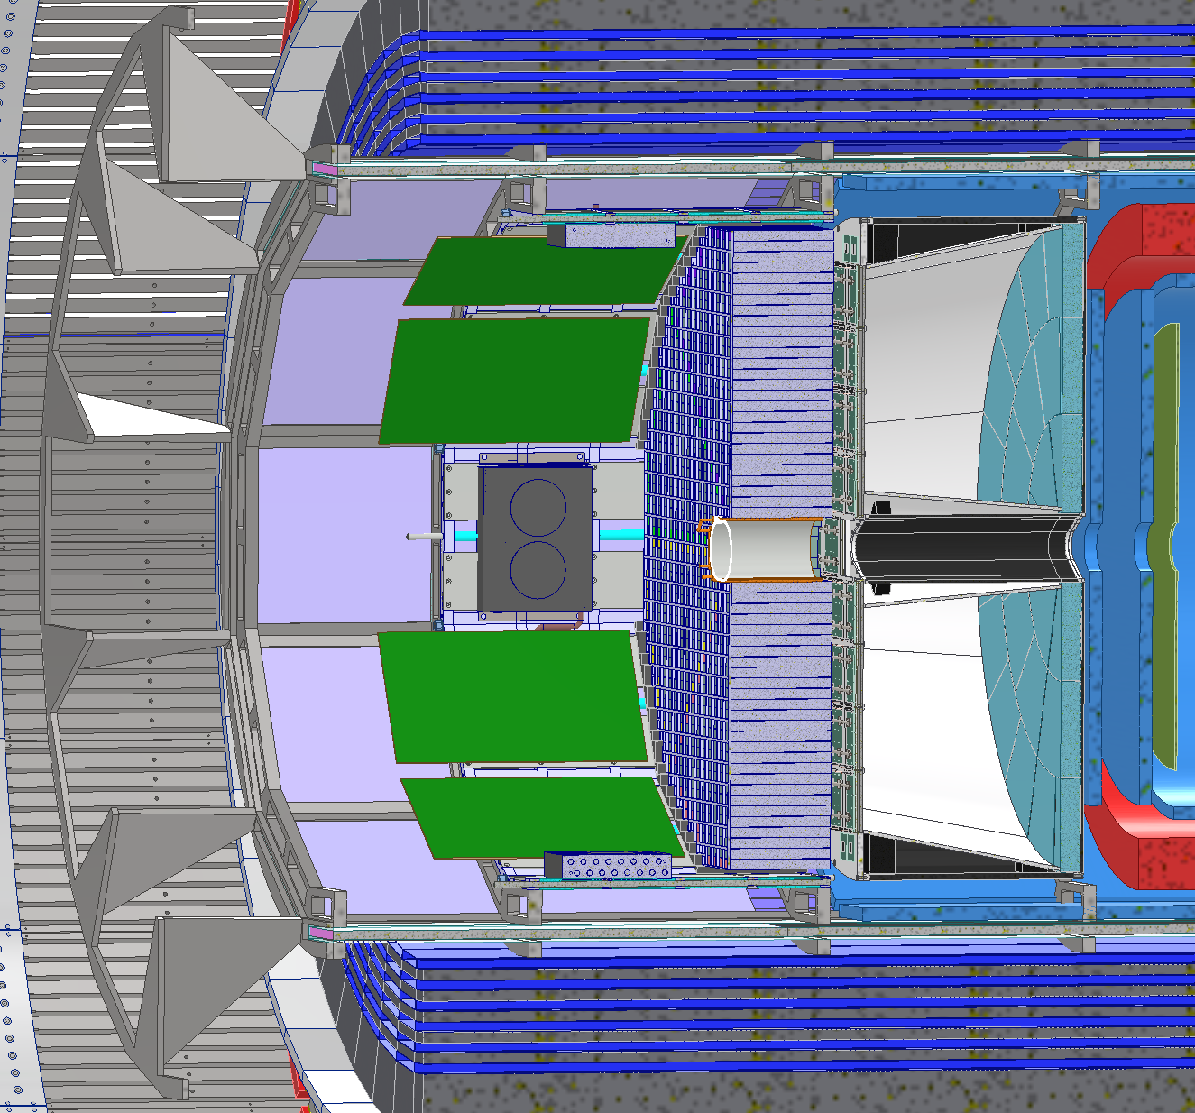
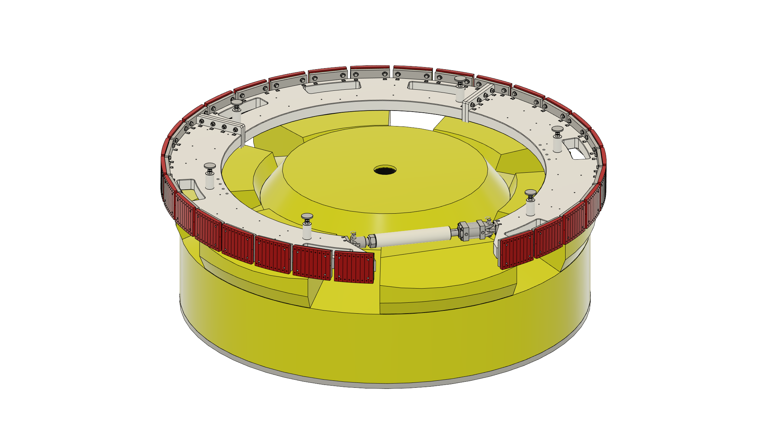
PID Detectors
pfRICH needed to be shortened in
expansion volume by 5cm to accommodate the 2 new MPGD disks
dRICH was moved 5cm in z to minimize interference with support rings
Remaining small interference still needs to be resolved → modify rings and/or optimize sensor boxes

Slide 19

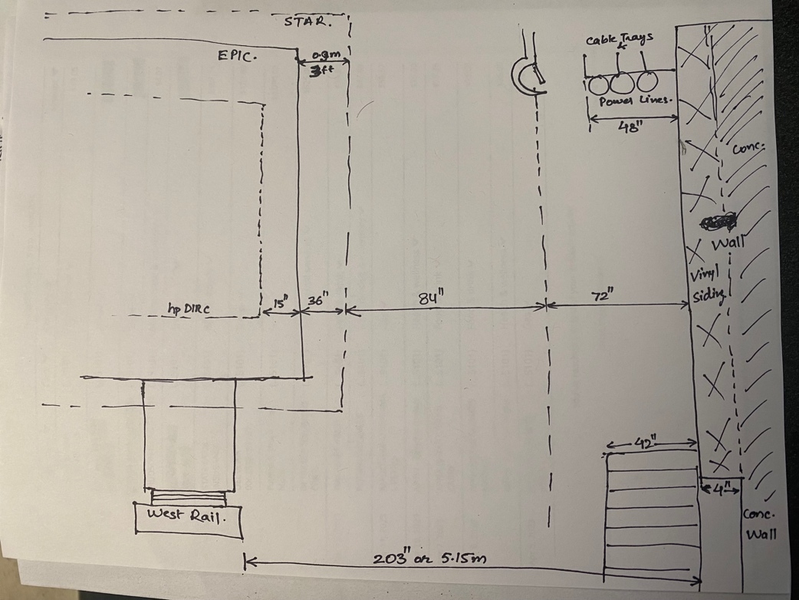
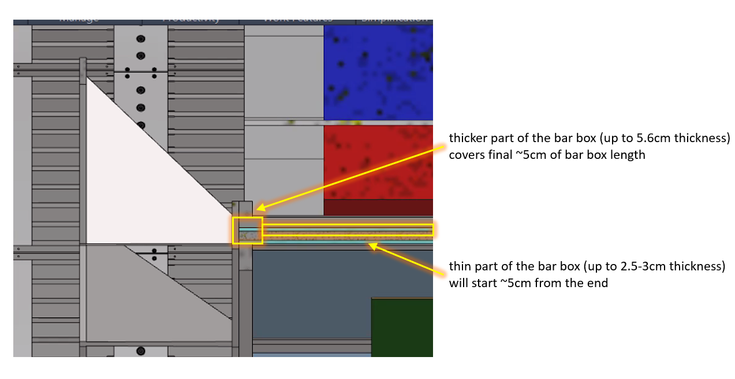
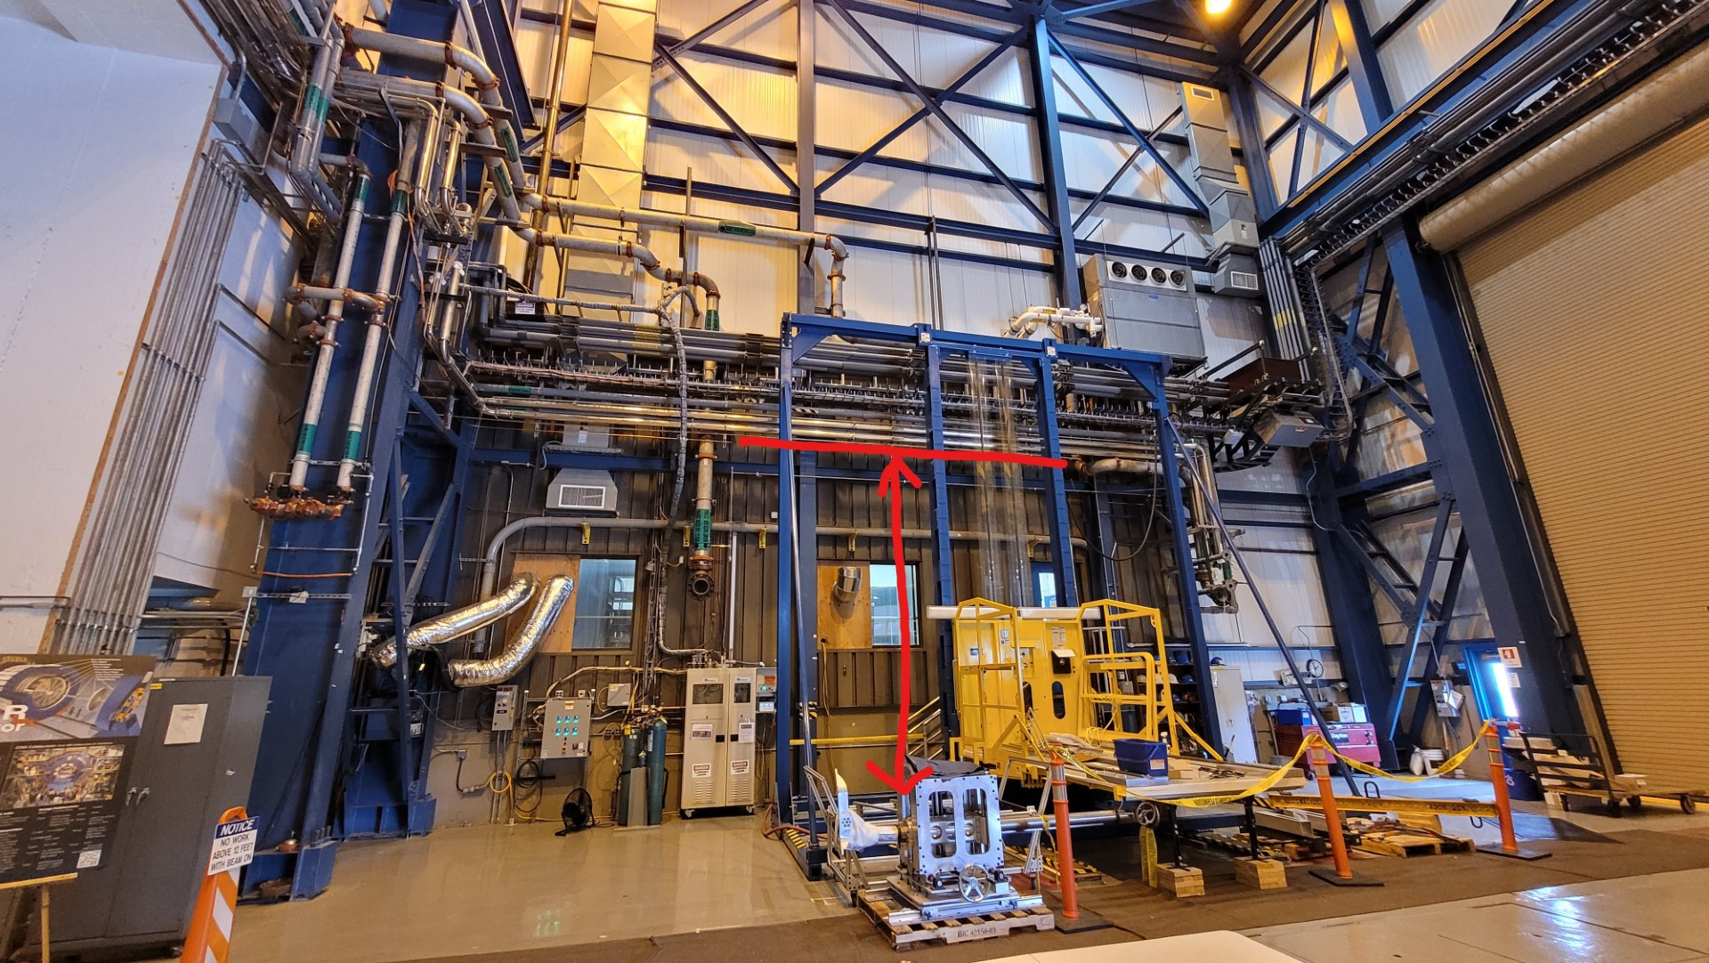
DIRC
New Installation plan:
  after careful evaluation found the place to install from the lepton side tight but doable
Further optimization ongoing:
  frame is optimized to integrate outer MPGD barrel
  to provide as much space as possible for services
  minimize material before imaging ECal
If more space for services is needed after recent update,
will have to bite the bullet and move
DIRC and Barrel ECal to larger radii

Slide 20
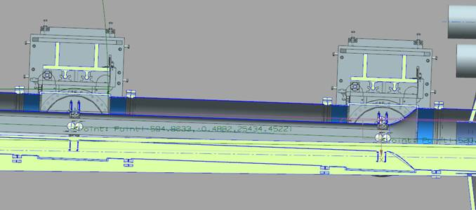
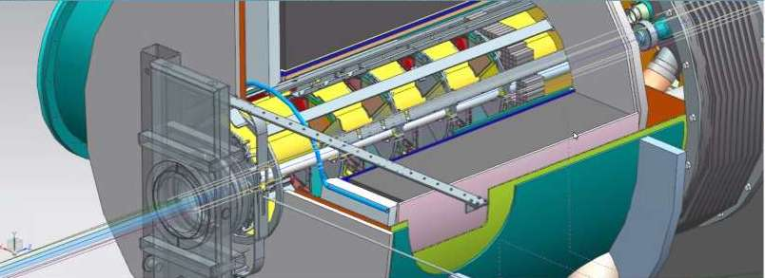
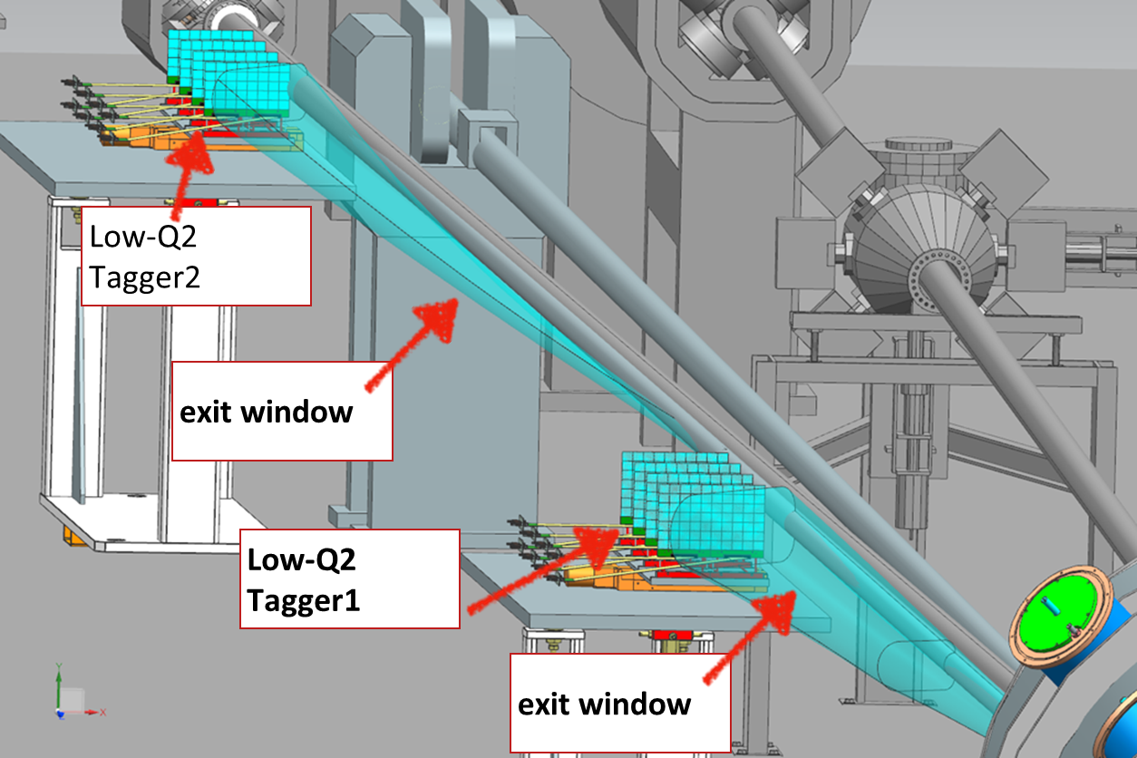
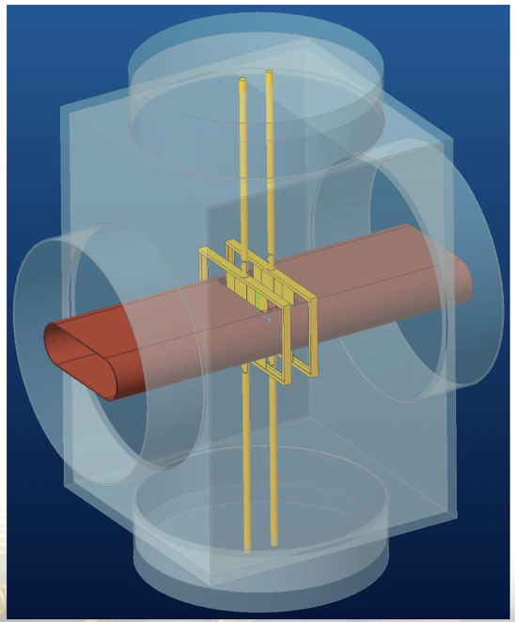
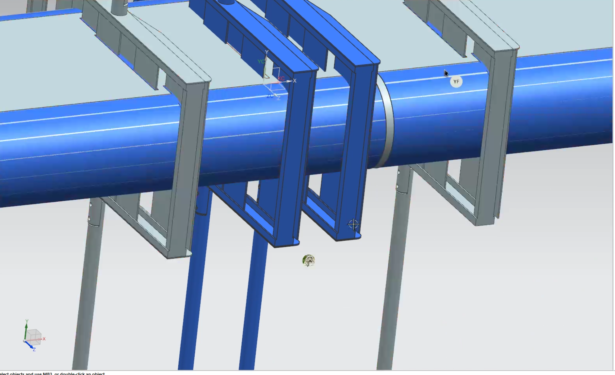
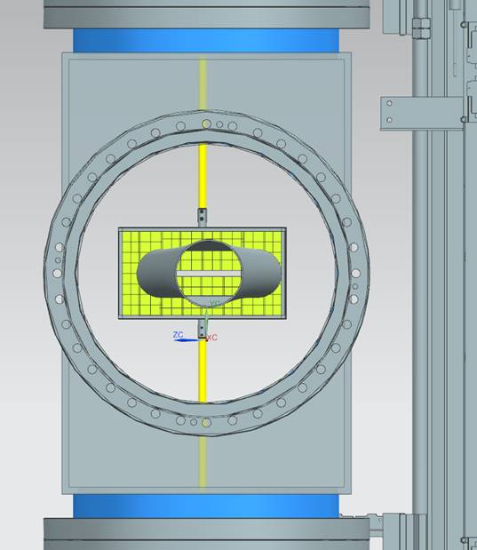
Far-forward/far-backward integration
Integration with accelerator/RF / impedance calculations
  hadron line : Roman Pots/Off-Momentum detectors
  electron line: exit window for low-Q2 taggers
B0-detectors support and installation (only 13cm in front!)
Detector placement (accelerator design is still a bit in flux): ZDC
Off-Momentum detectors (OMD) and the neutron cone
(courtesy Yulia)
OMD
OMD
B0 installation
p
n
Negative side of OMD
Only 13 cm (!) space for installation
Roman Pots integration

Slide 21
What Else
Design support for Barrel-ToF and inner MPGD barrel including support for inner tracker barrels and disks
integrate ROBs in the detector volume → needed now locking down design
Finalize readout chains for different subdetectors
layout racks on south platform and DAQ room
optimize how to open endcaps and provide full access to collider equipment in the tunnel also during operation
update geometry data base, all figures and provide 2d space allocation plots → see next slide
Organize meetings with sub-systems per category, i.e. Tracking, HCals, ECals & PID, to discuss services, readout chain, requirements, …
  → ”finalize” as much information as possible before DAC design review in late August/early September

Slide 23
Where to find Information
Wiki-page: https://wiki.bnl.gov/EPIC/index.php?title=Project_Information
Public Sharepoint: ePIC
Detector Requirements: https://eic.jlab.org/Requirements/
Geometry Database: https://eic.jlab.org/Geometry/Detector/Detector-20230108185912.html
Updated ePIC figures: Updated ePIC Figures

Slide 24
Big Thanks to the ME engineering team
Alex, Andy, Avishay, Chinmay, Dan, Elliot, Julien,
Jonathan, Josh, Karim, Kevin, Peter, Roland, Rahul,
Ron, Tom
and to the collaboration for all the help

Slide 25


Slide 26


Slide 27

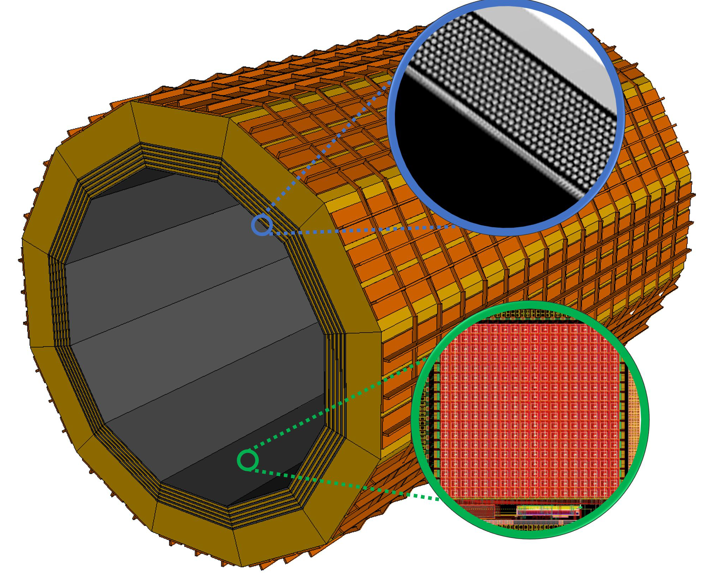
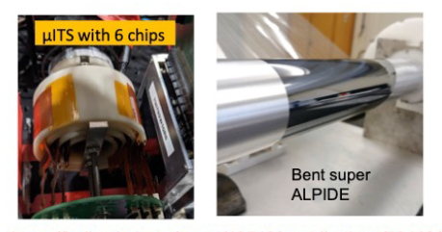
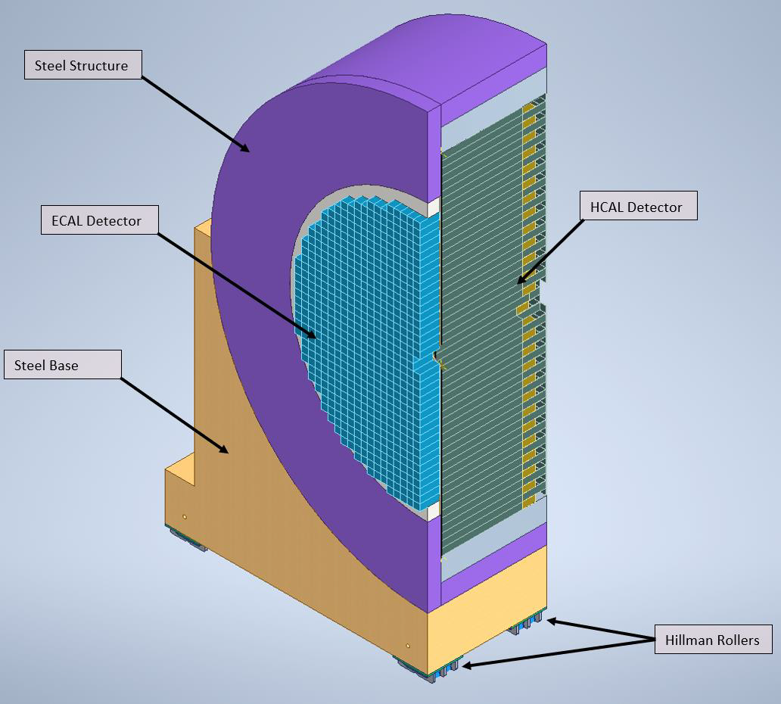
US National Laboratory Partnerships
Argonne National Lab – Barrel (Imaging) EM Calorimeter
  Pb/SciFi (with SiPM as photonsensor) with a hybrid imaging part (w. 6 layers of ASTROPIX)
  Led by ANL in collaboration with Canada and Korea Groups
Lawrence Berkeley National Lab – Monolithic Active Pixel Silicon (MAPS)
  MAPS Vertex and Barrel layers (led by LBNL and UK Groups)
  Synergy with MAPS forward and backward disks
Oak Ridge National Lab – Forward Hadron Calorimeter
  Longitudinally separated Steel/Sc & W/Sc sandwich with SiPMs embedded in Scintillator, with a high-resolution W/Sc insert
  Led by ORNL in collaboration with 10 other US institutions
Other partnerships to mention: Los Alamos National Lab, MIT-Bates Research and Engineering Center

Slide 28
International Engagement
We have had many meetings and site visits in 2022 & 2023, including:
Japan - EIC Collaboration Meeting via Zoom on June 22, 2022 (Elke & Rolf)
US-Israel BSF visit to BNL on September 12, 2022 (Haiyan, Rolf, Mike F/DOE)
Visit to meet and discuss EIC -South Africa consortium at INPC (International Nuclear Physics Conference) in Cape Town, South Africa Sep 9-17, 2022 (Elke)
EIC-Project - Taiwan Exp. Program Informational Mtg Sept 19, 2022 (Elke & Rolf)
Visit to BNL by Japan representatives on November 01-02, 2022: two persons (Okamura and Kadotani) from Embassy of Japan (working under Koji Aribayashi), together with one (Sakuraba) from Japan Consulate of NY (Elke participating)
APCTP Workshop on the Physics of Electron-Ion Collider (First EIC-Asia meeting) at ACTP-Korea from November 2-4, 2022 (Jim, Abhay, Mike F/DOE, also Tim H/DOE and Rolf remote) https://indico.knu.ac.kr/event/592/
Visit to meet and discuss EIC-Latin America consortium at the Latin American Symposium on High Energy Physics November 14-18, 2022 (Elke)
Visit to meet and discuss EIC-India participation in EIC from December 18-20, 2022 (Abhay, Elke)
EIC-Asia workshop in RIKEN-Wako, Japan from March 16-18 (Elke, Rolf, Abhay)
Visit to Brazil as part of POETIC-X, discuss EIC-Brazil opportunities - 10th Int’l Conf. on Physics Opportunities at an Electron-Ion Collider, May 2-6, 2023 (Abhay, Elke)

Slide 29
Technical Change Control Process - Detector
Copy process as has been used for the accelerator as it works well.
will have more people with detector expertise in the TCCB for such change requests. We need to involve the detector collaboration to initiate documentation for change requests and use their technical board or equivalent to ensure the change request is consistent with the NAS science requirements, and then use the "detector TCCB" to ensure the project part.
As final step it goes to the EMT for the formal approval.
Proposed detector TCCB:
  Qiong Wu (chair)
  Person with detector experience to take notes and help Qiong
  Elke Aschenauer
  Rolf Ent
  detector lead mechanical engineer (Rahul Sharma, 6.10.10 CAM)
  detector lead electronics engineer (Fernando Barbosa, 6.10.08 CAM)
  two members of the ePIC collaboration (for example the lead of the detector/technical board, perhaps a technical coordinator if there is one) – TIME TO ASSIGN NAMES
  three accelerator L2 leads or alternate: HSR, ESR and IR to ensure overlap
  relevant L3 CAM of the WBS the change is requested for
  add subject matter experts as needed (for example Charlie Folz for infrastructure).
Always included in TCCB process: Ferdinand Willeke and Todd Satogata
Note: After the TCCB advise, the formal baseline change control is done through the EMT but in obeyance of the various thresholds in the Project Execution Plan.
From January 9th ePIC meeting

Slide 30
(Draft) TDR – more details on Appendix B
.
Appendix B Integration of a Second Experiment
B.1 2nd Interaction Region (high-level goal on ensuring feasibility - 2021 position paper)
(Rolf, Elke, Angelika)
B.2 Luminosity sharing and requirements (Christoph, Todd)
B.3 Polarization with two experiments (Eliana)
B.4 IR definition and layout (include 3D CAD/Sketchup) (Randy, Scott, Vasiliy, Angelika)
B.5 Magnet and forward-detection checks (Renuka, Alex, Elke/Rolf)
B.6 Outstanding issues (Elke/Rolf)
B.7 Experiment Complementarity (like YR 12 or like new EIC White Paper)

Slide 31
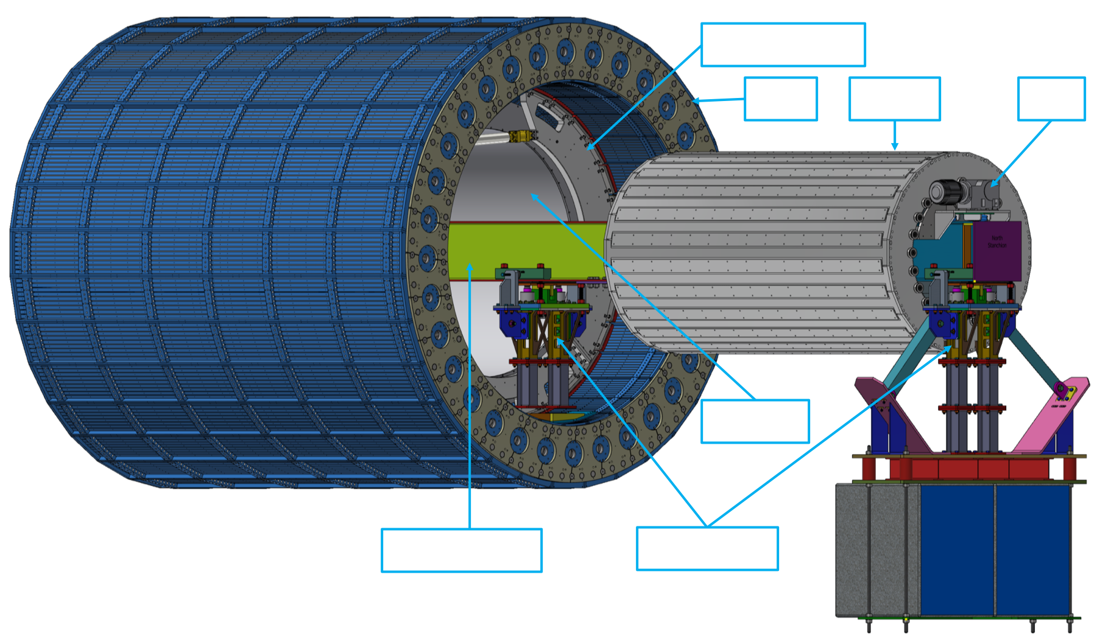
Barrel ECal Integration
Great progress on the mechanical engineering, integration and first installation ideas during Barrel ECal focus week
A lot more work to be done, but of to an excellent start
exact radial position will be fixed after next iteration of DIRC support structure and next all service iteration is done

Slide 32
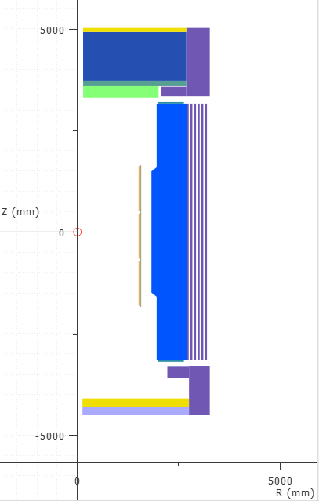
Layout of Magnetic Materials now given
(courtesy Valerio, Renuka et al)
Parameter | V7.6.2.2.7 | V7.6.2.2.8 | V7.6.2.2.9 | V7.6.2.2.10a |  | Units
Current | 3924 |  |  |  |  | A
# turns | 1668
B₀ | 2.000 | 2.008 | 2.007 | 2.007 |  | T
Bpeak MOD 1 | 2.672 | 2.657 | 2.638 | 2.660 |  | T
Bpeak MOD 2 | 2.476 | 2.478 | 2.478 | 2.478 |  | T
Bpeak MOD 3 | 2.651 | 2.670 | 2.656 | 2.671 |  | T
Energy | 45.294 | 45.369 | 45.352 | 45.524 |  | MJ
Inductance | 5.8839 | 5.8929 | 5.8907 | 5.877 |  | H
Fz MOD 1 | 11.98 | 11.86 | 11.94 | 11.92 |  | MN
Fz MOD 2 | 458 | 45238 | 52776 | 58.4 |  | kN
Fz MOD 3 | -11.98 | -12.00 | -12.06 | -12.00 |  | MN
Fz tot | -5.6 | -104.376 | -63.7 | -29.3 |  | kN
B5300 | 14.3 | 17.9 | 16.9 | 15.8 |  | G
B7200 | 8.7 | 11.5 | 11.5 | 11.0 |  | G
B3400 | 1.0 | 2.0 | 2.2 | 2.8 |  | G
Remaining deltas to fringe field specifications (10G) we will fix locally (as needed)
Backup as likely included in Valerio’s talk

