Slide 1
Update about the Accelerator and IR
Christoph Montag, BNL
ePIC Meeting, Warsaw
July 26 - 29 2023

Slide 2
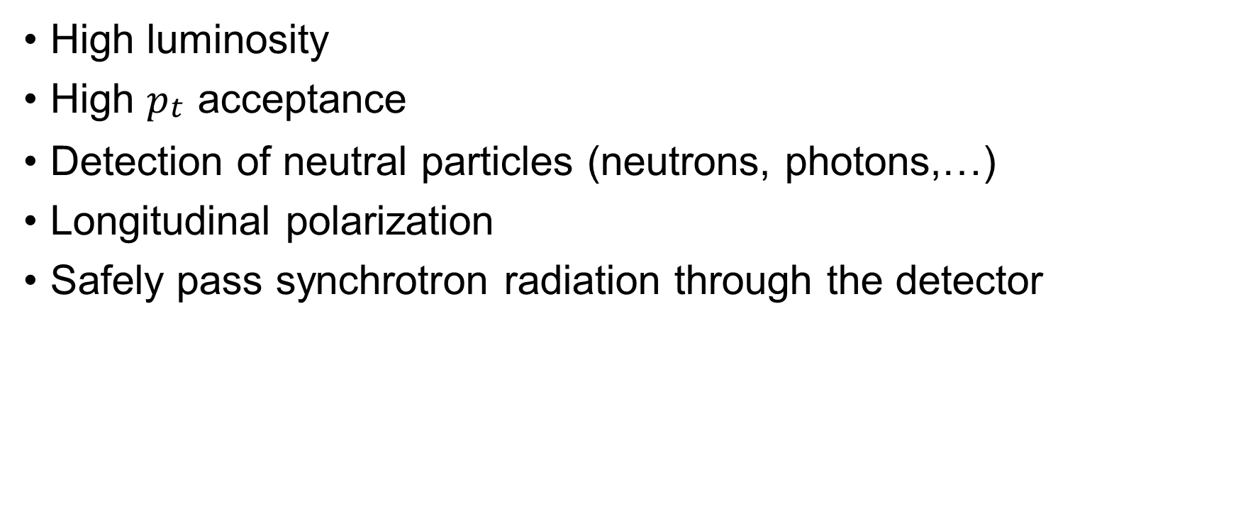
EIC Interaction Region Requirements
High luminosity
High $p_{\begin{aligned}t \\ \end{aligned}}$ acceptance
Detection of neutral particles (neutrons, photons,…)
Longitudinal polarization
Safely pass synchrotron radiation through the detector

Slide 3
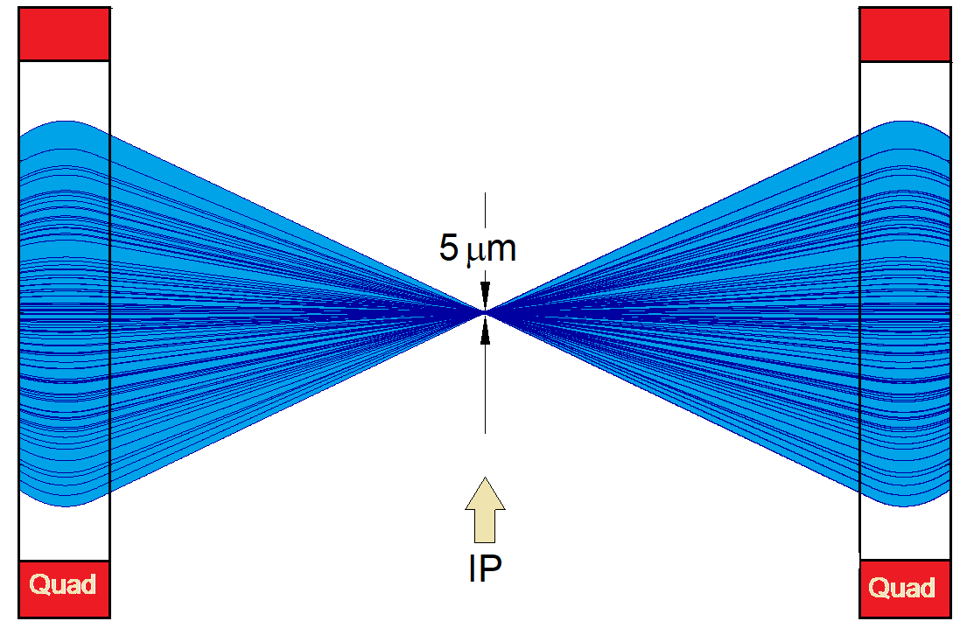
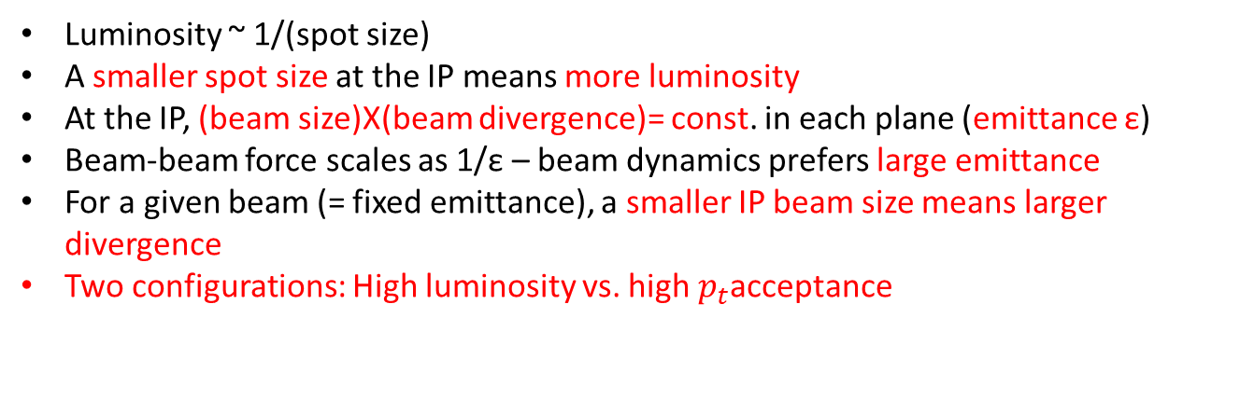
Luminosity and Focusing
Luminosity ~ 1/(spot size)
A smaller spot size at the IP means more luminosity
At the IP, (beam size)X(beam divergence)= const. in each plane (emittance ε)
Beam-beam force scales as 1/ε – beam dynamics prefers large emittance
For a given beam (= fixed emittance), a smaller IP beam size means larger divergence
Two configurations: High luminosity vs. high $p_{t}$acceptance
Strong focusing β_{y} =5 cm
A larger beam divergence leads to a larger beam size at the nearest focusing magnets – (size at magnet)=(divergence)X(distance)
Magnets need to have larger aperture while gradient (= focusing strength) remains the same – peak field at magnet poles is technically limited
Focusing elements for both beams need to be as close as possible to the IP

Slide 4
Crossing Angle Collisions
Beam energies of electrons and hadrons are vastly different in EIC
Focusing elements for electrons would have only little effect on hadrons, while hadron magnets would overfocus electrons
Beams need to be separated into their respective focusing systems as close as possible to the IP
A separator dipole would have to deflect the (“weaker”) electrons and would therefore generate a wide synchrotron radiation fan that would need to pass through the detector – requires large beam pipe diameter (HERA-II)
Best solution: Crossing angle collisions!

Slide 5
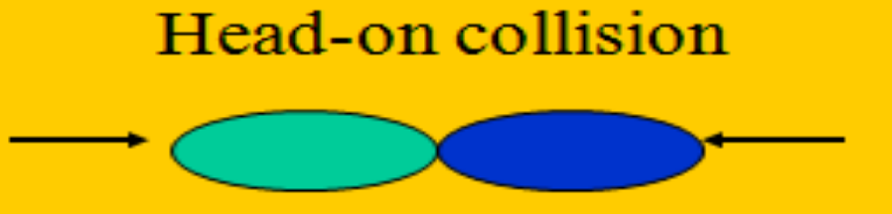
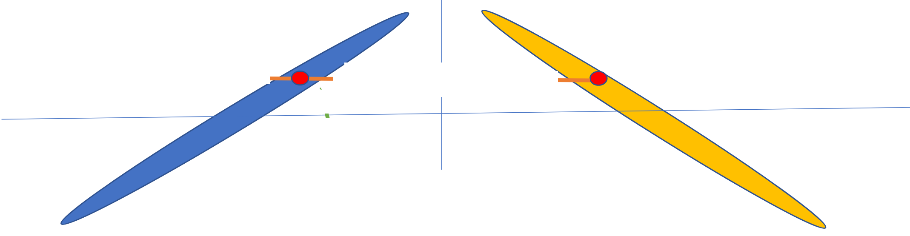
Crossing Angle and Luminosity
In head-on collisions, every beam particle in one beam can potentially interact with every particle in the other beam
Long (~+/-6 cm), skinny (100 um) bunches colliding at an angle have very little overlap
With 25 mrad crossing angle, each particle can only interact with a +/-4 mm thick slice of the +/-6 cm long oncoming bunch

Slide 6
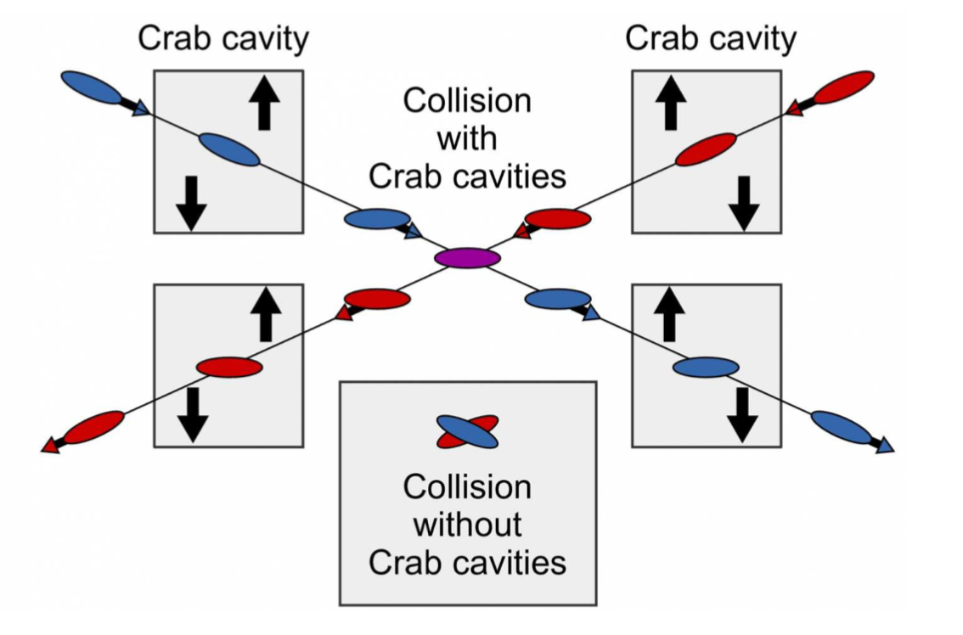
Crab Crossing to the Rescue
Head-on collision geometry is restored by rotating the bunches before colliding (“crab crossing”)
Bunch rotation (“crabbing”) is accomplished by transversely deflecting RF resonators (“crab cavities”)
Actual collision point moves laterally during bunch interaction

Slide 7
Detector Solenoid Effects
Coherent orbit distortion
Transverse coupling
Rotation of the crabbing plane
Polarization tilt

Slide 8









Coherent Distortion of Ion Orbit
Top view
Ions
Side view
Ions
$$e^{−}$$
$$e^{−}$$
$$B_{z}$$
$$B_{x}$$
$$\vec{B}$$
End view
Ions
Vertical kicks by the
solenoid fringe fields
$\frac{θ}{2}=\frac{1}{2}\frac{B_{sol}L}{2Bρ}<22$ mrad (41 GeV)
$$⊗$$
Rotation of the interaction plane
inversely proportional to the beam energy

Slide 9





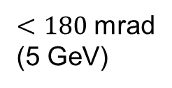
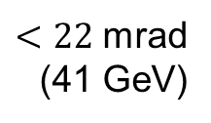
Transverse Coupling
Coupling is in general a global effect and involves consideration of the entire ring or the entire coupled section
Potential for negative dynamic effects
Can leads to redistribution of the horizontal and vertical emittances ⇒ smaller beam “flatness” ⇒ luminosity reduction
If not locally compensated at the IP can lead to change in the transverse beam shape ⇒ potential for luminosity reduction (beams enter solenoid uncoupled):
$$σ_{x}/σ_{y}\sim 10 μm$$
No solenoid + no coupling =
Full overlap ⇒ Full luminosity
Solenoid + coupling not compensated =
Partial overlap ⇒ Reduced luminosity
Solenoid + coupling compensated =
Full overlap ⇒ Full luminosity
$$σ_{x}\sim 100 μm$$
Ions
$$e^{−}$$
$$e^{−}$$
$$σ_{y}\sim 10 μm$$
$<180$ mrad
(5 GeV)
$<22$ mrad
(41 GeV)

Slide 10



Rotation of Crabbing Plane
Another aspect of coupling
Potential for negative dynamic effects
Impact on luminosity
$$e^{−}$$
Top view
No solenoid + no coupling =
Full overlap ⇒ Full luminosity
$$σ_{x}\sim 100 μm$$
Ions
$$σ_{z}\sim 6 cm$$
Solenoid + rotation not compensated =
Partial overlap = Reduced luminosity

Slide 11

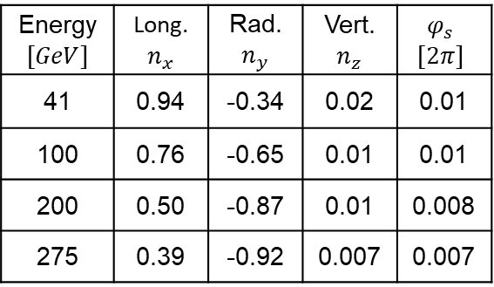




Polarization Tilt
The baseline scheme has no strong correctors on the rear side, so the polarization tilt is due to the rear side of the solenoid
Polarization orientation at the IP in this scenario is compensated by the rear ion spin rotator
The net spin effect of the entire IR involves account of the contribution of the forward side
The forward spin rotator compensation the remaining net effect
Top view
Ions
Energy $$[GeV]$$ | Long. $n_{x}$ | Rad. $n_{y}$ | Vert. $n_{z}$ | $$φ_{s}$$ $$[2π]$$
41 | 0.94 | -0.34 | 0.02 | 0.01
100 | 0.76 | -0.65 | 0.01 | 0.01
200 | 0.50 | -0.87 | 0.01 | 0.008
275 | 0.39 | -0.92 | 0.007 | 0.007
$$e^{−}$$
$$B_{z}$$
$$\vec{P}$$
$$B_{x}$$
$$\vec{B}$$

Slide 12
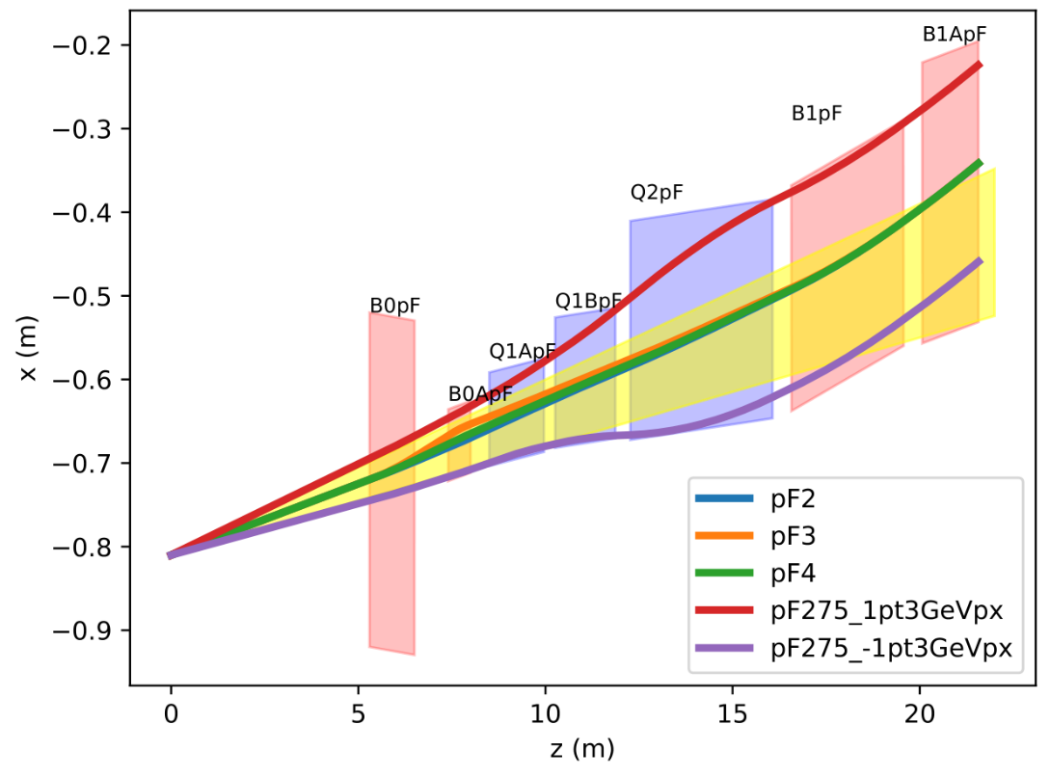

Hadron Forward – Large Apertures for low $p_{t}$ Acceptance
Magnet aperture optimization:
  Magnets yawed and shifted
  Magnets split in two (e.g. Q1A and Q1B)
Dipoles to separate beam from neutrons
275 GeV
41 GeV
100 GeV
275 GeV
41 GeV
100 GeV
275 GeV +1.3 GeV p_{x}
275 GeV -1.3 GeV p_{x}

Slide 13
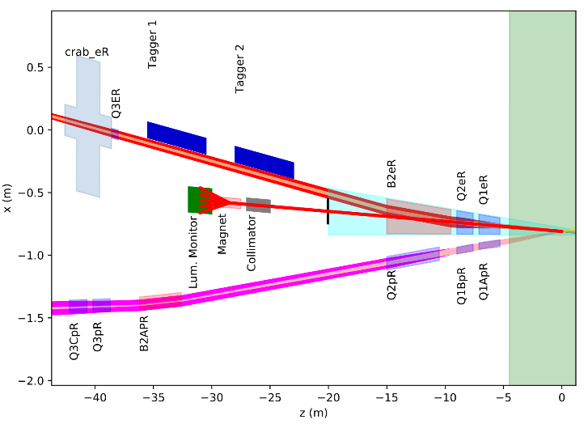
Electron Rear: Large Apertures to Pass Synchrotron Radiation Fan

Slide 14
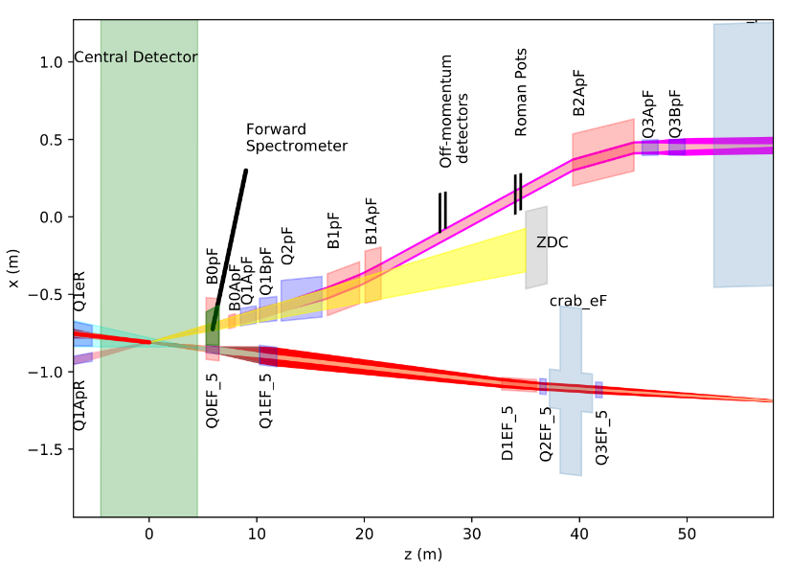
IR Magnets
Rear: RHIC sec 6
Forward: RHIC sec 5
Hadrons
Electrons
Hadrons
Electrons
16 SC magnets to be built (4.5 K and 1.9 K)
10 direct wind magnets:
  Q1eR, Q2eR, B2eR, Q1ApR, Q1BpR, Q2pR, Q0eF, B0pF, B0ApF, Q1eF
6 collared magnets (incl. B2pF)
  Q1ApF, Q1BpF, Q2pF, B1pF, B1ApF, B2pF

Slide 15
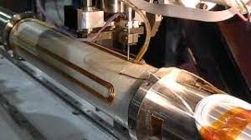
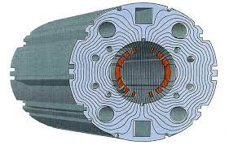
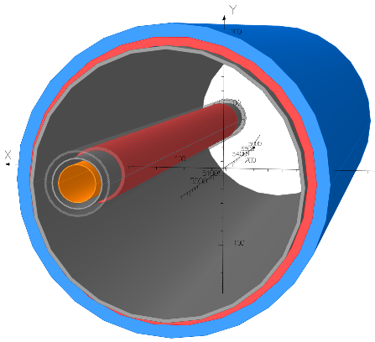
Superconducting IR magnets
10 direct-wind magnets
6 collared magnets
B0 – an electron quadrupole
inside a hadron spectrometer dipole

Slide 16
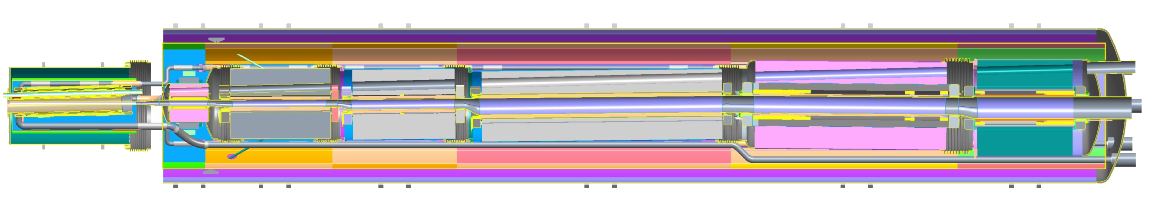
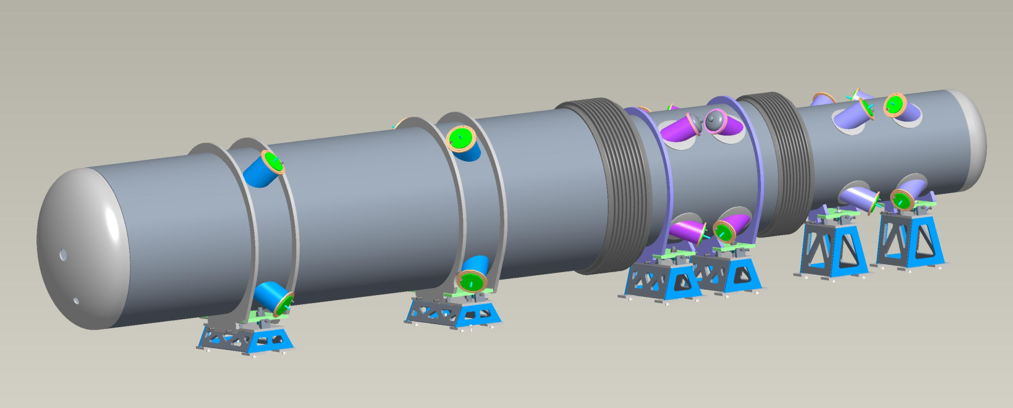
IR Magnet cryostats
Q0EF
Q1EF
Near IP End
Incoming Electron Beam
e
h
Outgoing Hadron Beam
B0PF
B0APF
Q1APF
Q1BPF
Q2PF
B1PF
B1APF
Electron and hadron magnets densely packed,
side-by-side in a common cryostat on either side
of the detector

Slide 17
Spin Rotators
Both electrons and protons will have longitudinal polarization at the IP
Hadron spin rotators will be taken from present RHIC (helical dipoles)
Electron spin rotators are based on solenoid magnets with subsequent dipole – large (> +/- 100 m) chunk of beamline with fixed geometry, challenging to fit into existing tunnel

Slide 18
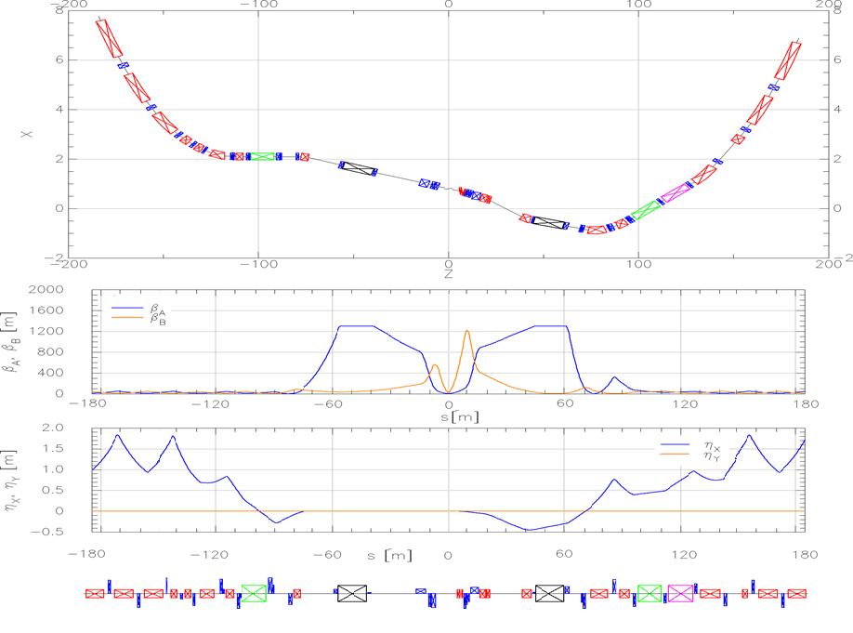
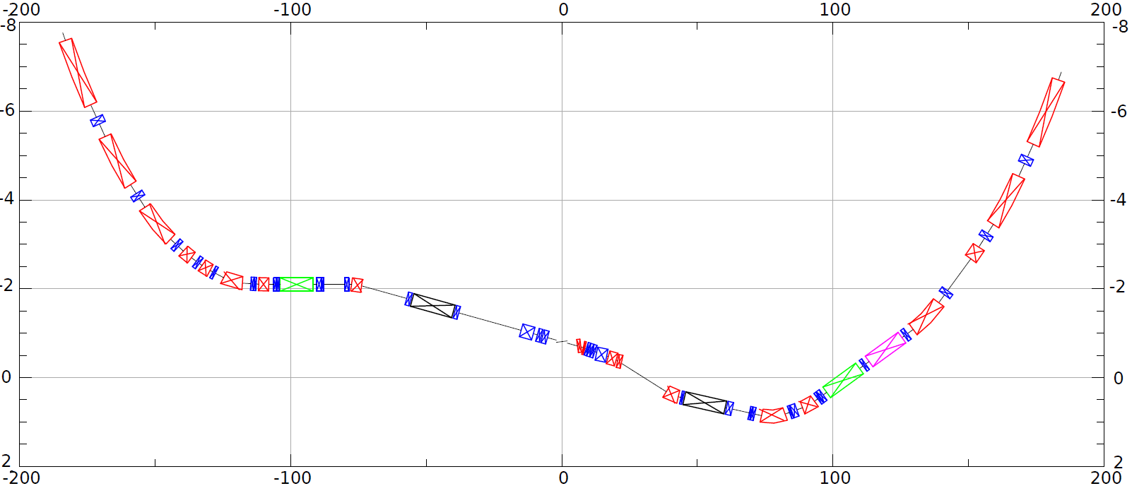
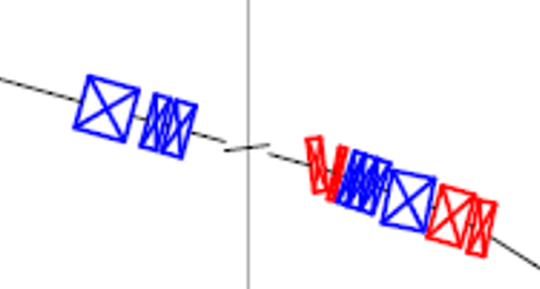
HSR layout in IR6
Forward and rear hadron lattice matched into RHIC
  Snake at correct angle
  Beta = 1300m at crab cavities
    Hor. phase advance 90º
  Matching Magnets
    Mostly repurposed RHIC magnets
    few additional magnets required (some SC)
    Some need re-cryostating
h
HSR Arc
Crab–in
Crab –out
HSR Arc
Spin
Rotator
Snake
matching
Off momentum Detectors
Spin Rotator
ESR Lumi-Monitor
matching
Approximate ESR path
Zero Deg Calorimeter
Detector region
B0pF spectrometer
Nov 2021 layout
3 Dipoles and 3 Quadrupoles in one shared cryostat

Slide 19
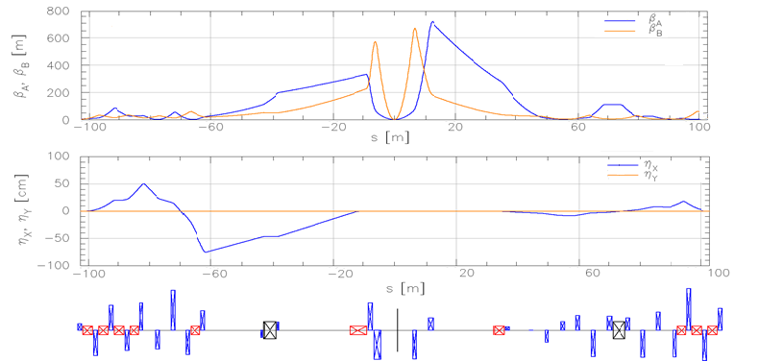
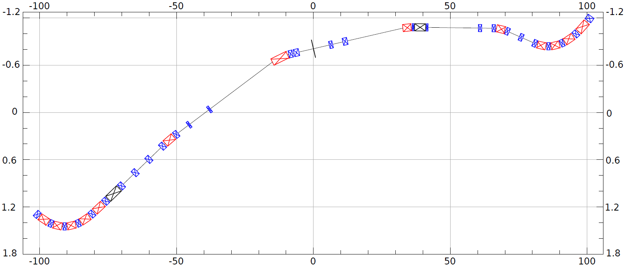
ESR layout in IR6
Design to:
Provide room for detector components
Mitigate synchrotron radiation issues
Provide longitudinal spin (new spin rotators)
Match into the arcs
Provide conditions for crabbing
Allow 3 rings and beam elements
e
~130m
Spin Rotation Solenoids
6GeV
Crab –in
IP Focusing
18GeV
Lumi-Monitor
B2eR
~130m
Spin Rotation Solenoids
E-taggers
Polarimeter Laser
Detector region
Longitudinal spin
B1eF
Crabbed beam.
Crab–out

Slide 20
Luminosity Sharing with two IRs
Both electrons and hadrons are at the beam-beam limit with one collision point – they would not “survive” a second IR
To enable two collision points, both electron and hadron bunch intensity would have to be reduced by a factor two – resulting luminosity at each IR would be factor 4 smaller
Instead, we modify the fill pattern such that half the bunches collide in IR6, while the other half collides in IR8
As a result, total luminosity is preserved, and each detector gets half of the total – a maximum 5e33 each instead of 1e34 with a single IR

Slide 21
Summary
EIC interaction region is highly optimized, but any IR design is always a compromise between luminosity, acceptance, cost, risk, …
Design is driven by physics and detector needs, in close collaboration with experimenters
Inner IR is practically frozen
Remaining work concentrates on small geometric adjustments in the matching section towards the arcs, to fit everything into the tunnel

Slide 22
Supplemental Slides

Slide 23
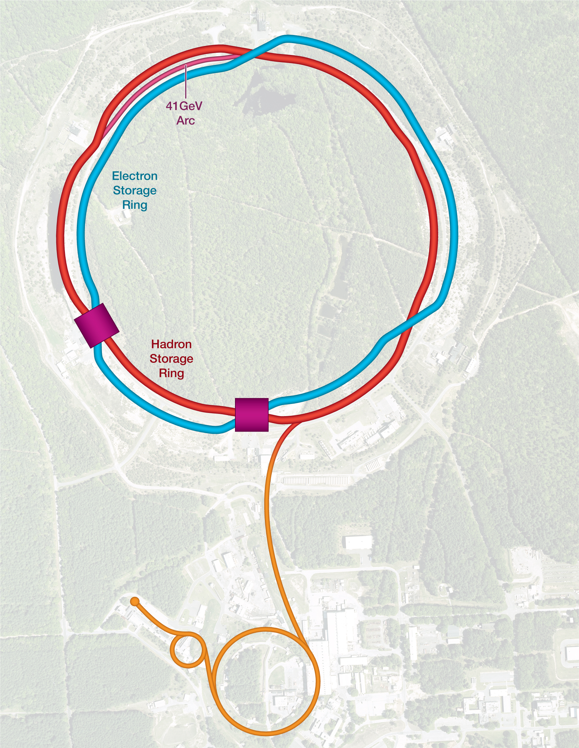
Collision Synchronization
HSR needs to operate over a wide energy range
Changing the beam energy in the HSR causes a significant velocity change
To keep the two beams in collision, they have to be synchronized so bunches arrive at the detector(s) at the same time
Synchronization accomplished by path length change
Between 100 and 275 GeV (protons), this can be done by a small radial shift – there is enough room in the beampipe
For lower energies, use an inner instead of an outer arc as a shortcut. 90 cm path length difference corresponds to 41 GeV proton beam energy

Slide 24
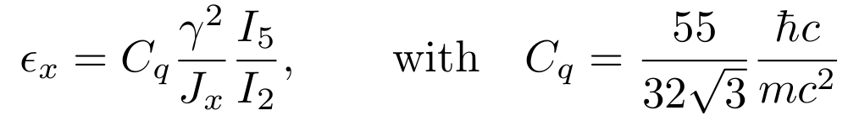
Emittance Control in the ESR
EIC needs 24 nm emittance from 5 to 18 GeV for optimum luminosity, but equilibrium emittance in an electron storage ring depends on beam energy:
Betatron phase advance μ per FODO cell is the “knob” to adjust the emittance
60 degrees at 10 GeV and 90 degrees at 18 GeV both yield ~24 nm
“super-bends” for emittance generation below 10 GeV

Slide 25
Beam Energies
γ range for hadrons:
  γ = 43.7 through “41 GeV arc”
  107 < γ < 293 with radial shift
Maximum hadron energy:
  E [eV] < 916*c [m/sec]*Z/A
Electron energies:
  5 to 10 GeV, with 60 degree lattice
  and super-bends
  18 GeV, with 90 degree lattice
  Energies between 10 and 18 GeV are feasible, but at somewhat reduced luminosity due to non-optimum emittance, scaling as $γ^{2}$

Slide 26
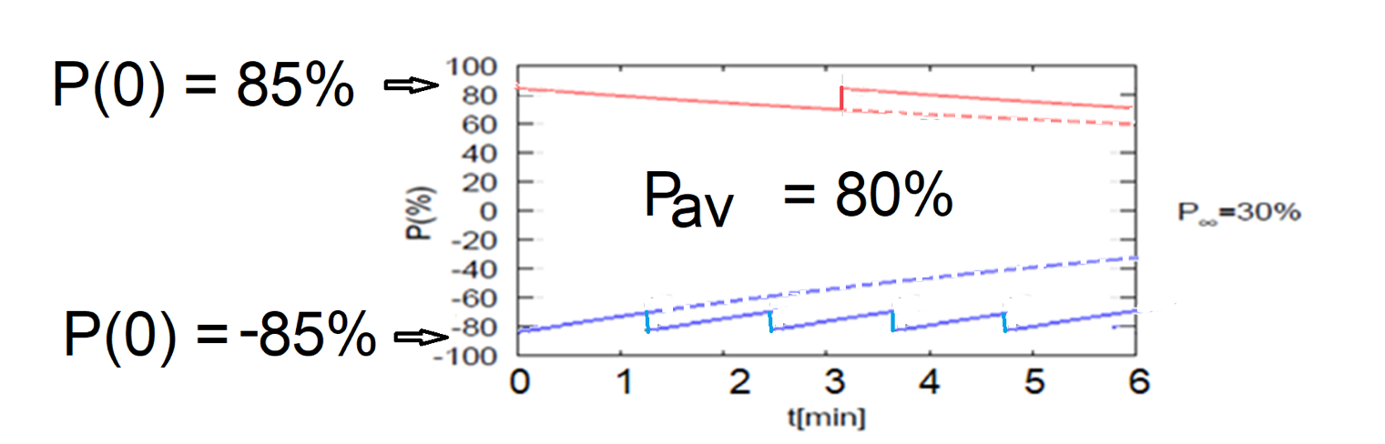
High Average Electron Polarization
Frequent injection of bunches with high initial polarization of 85%
Initial polarization decays towards P∞
At 18 GeV, every bunch is replaced (on average) after 2.2 min with RCS cycling rate of 2Hz
B P
B P
Refilled every 1.2 minutes
Refilled every 3.2 minutes
Re-injection
P_{av}=80%
P∞= 30%
(conservative)
P_{av}=80%
Re-injections

Slide 27

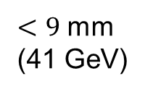
Correction of Ion Orbit
The closer the kicks to the IP, the smaller the orbit excursion
Orbit excursion inversely proportional to the beam momentum
Concern for field non-linearity at large offsets
Side view
Ions
$<9$ mm
(41 GeV)
$$e^{−}$$
Vertical kick #1
(radial magnetic field)
Vertical kick #2

Slide 28
Rotation of Crabbing Plane Solution
Pre-rotated the crabbing plane using vertical crabbing kicks: ~140 kV for ions and ~430 kV for electrons
Top view
Solenoid + rotation compensated =
Full overlap ⇒ Full luminosity

Slide 29
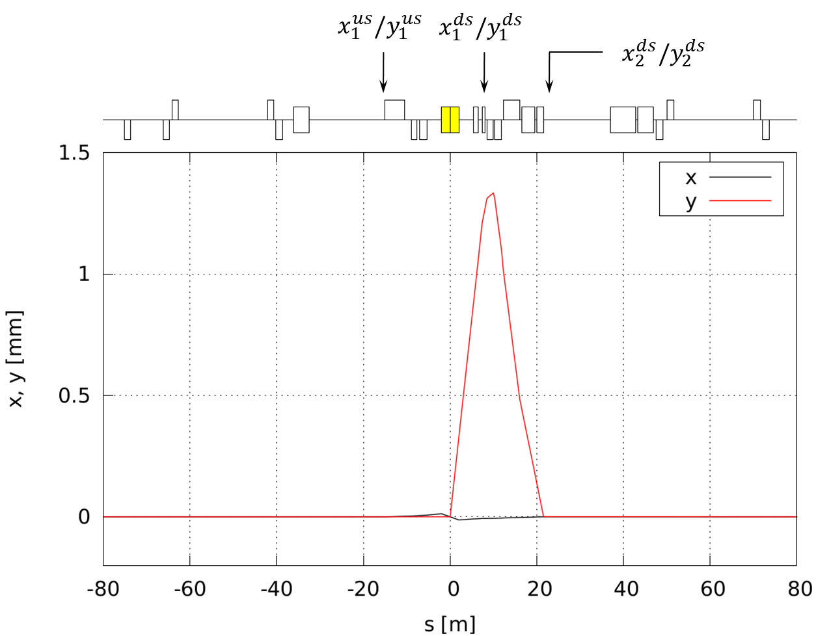
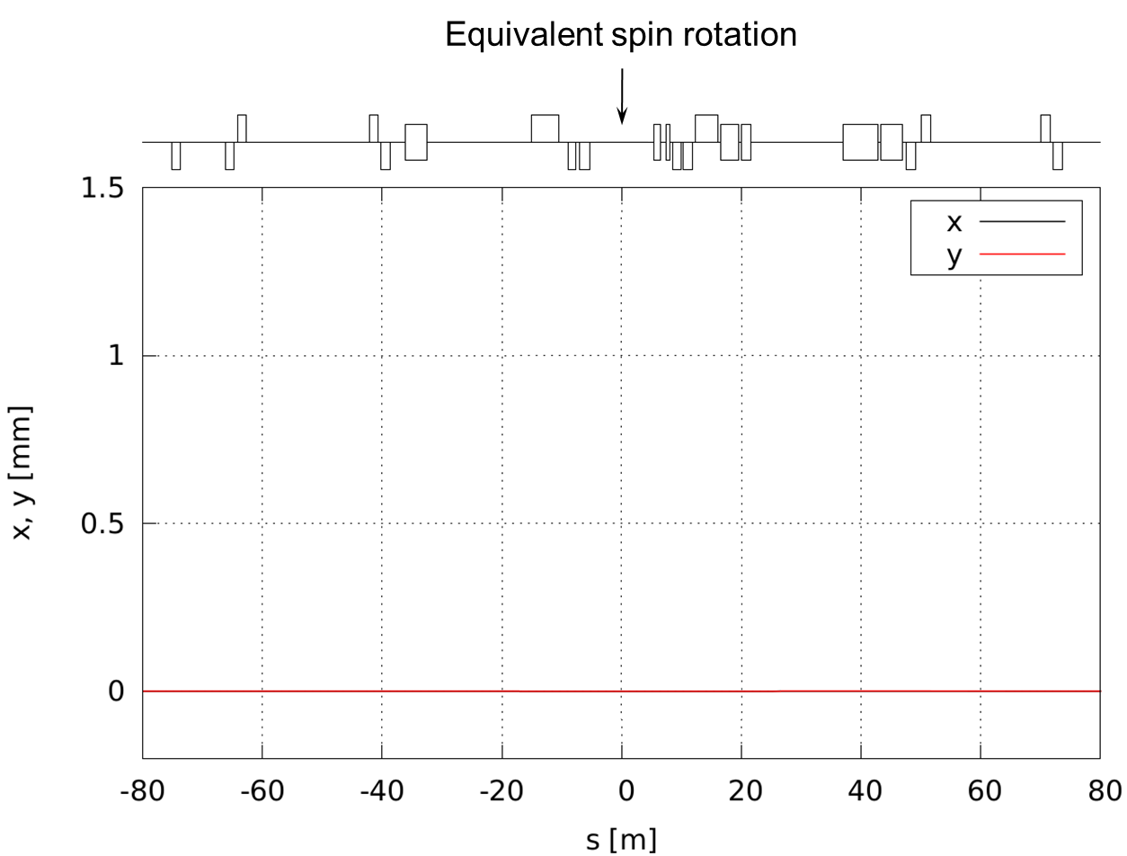




Net Effect of IR on Ion Spin
$$M_{tot}$$
$$M_{us}$$
$$M_{ds}$$
Energy $$[GeV]$$ | Long. $n_{x}$ | Rad. $n_{y}$ | Vert. $n_{z}$ | $$φ_{s}$$ $$[2π]$$
41 | 0.98 | 0.18 | -0.076 | 0.038
100 | 0.97 | 0.23 | -0.047 | -0.035
200 | 0.93 | -0.37 | -0.029 | 0.021
275 | 0.88 | -0.48 | -0.025 | -0.035

