Slide 1

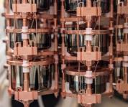
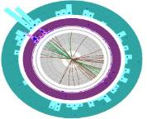
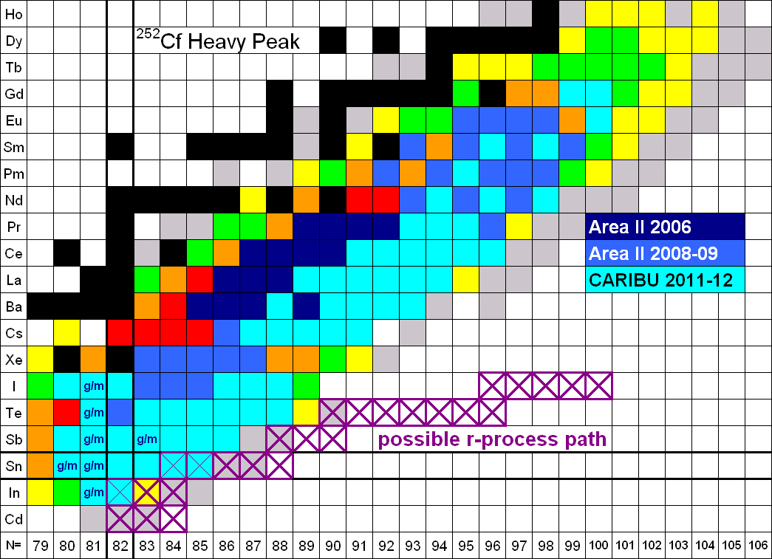
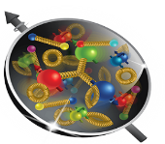
DOE Perspectives on the Electron-Ion Collider
EIC User Group Meeting
July 24, 2023
Dr. T. J. Hallman
Associate Director of the Office of Science
for Nuclear Physics

Slide 2
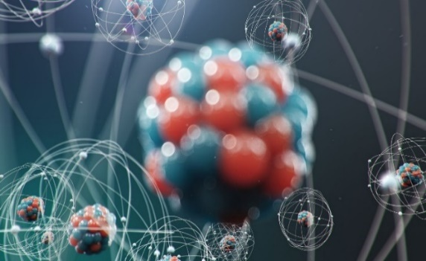
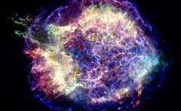
Prime NP Deliverable: New Knowledge & Tech Via Basic NP R&D
Discovering and understanding new forms of nuclear matter
        Quark-Gluon Plasma at RHIC
        Four new Super-Heavy Nuclei
New discoveries
        Natural radiation frustrates quantum coherence times
        Direct production of matter from an electro-magnetic field (e⁺e⁻ pairs)
        Neutron skins exist on heavy nuclei
New technology important for future needs
        First ever demonstration of accelerator bunched-beam cooling
        FEL ERL development using LERF
R&D integration that enables important applications (prospecting, isotopes)
Nuclear data & knowledge for a suite of applications
        Space exploration
        Reactor design
        Nuclear forensics / Nonproliferation
A highly trained, “nuclear-literate”, workforce with specialized skills
The Structure of the Atomic Nucleus
The Birth of Nuclei in Astronomical Processes
Probing Universal Laws in Nuclear Decays
2

Slide 3
Planned NP Research Horizons in FY24 and Beyond
Discovery of the origin of mass, proton spin, and comprehensive tomography of the proton
Search for anomalous atomic electric-dipole moments at FRIB as a signal of new physics using laser trapped isotopes
Search for anomalous parity violation in electron scattering as a signal of new physics using MOLLER at JLAB
Search for the next superheavy nucleus (A = 120) at the LBNL 88 inch cyclotron
Understanding the equation of state of the quark-gluon plasma using sPHENIX at RHIC
Expanding the boundary of present knowledge of how heavy elements are produced in the cosmos via never-before-produced heavy neutron-rich nuclei at FRIB
Discovering ways to suppress the effects of natural radiation on quantum coherence times
Quantum step forward in rare search capability via AI/ML pattern recognition software
Significantly advancing imaging technology for the physical sciences.

Slide 4
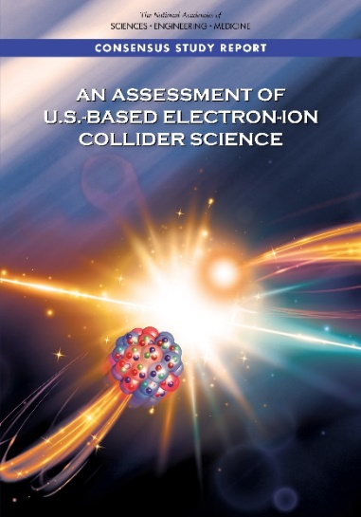
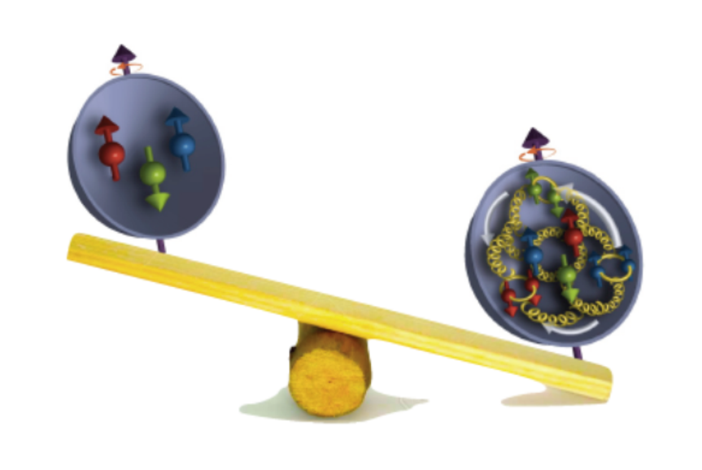
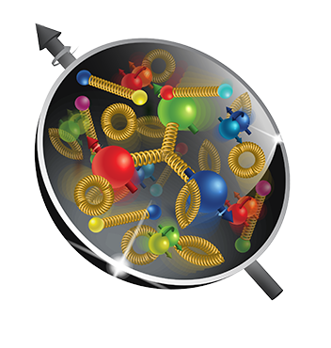
The Next Super High Power, Polarized High Energy Microscope:
The Electron-Ion Collider
U.S. National Academy of Science Report: AN ASSESSMENT OF U.S.-BASED ELECTRON-ION COLLIDER SCIENCE
“An EIC can uniquely address three profound questions
About nucleons—neutrons and protons—and how they
are assembled to form the nuclei of atoms:
• How does the mass of the nucleon arise?
• How does the spin of the nucleon arise?
• What are the emergent properties of dense systems of gluons?”
The EIC would be a unique facility & maintain leadership in nuclear science
The EIC would continue to advance innovation in the science and technology of colliders

Slide 5

The DOE NP High-Level Work Plan
Operate and get science out from the Relativistic Heavy Ion Collider (RHIC),the Continuous Electron Beam Accelerator Facility (CEBAF), the Argonne Tandem Linac Accelerator System (ATLAS) and the Facility for Rare Isotope Beams (FRIB)
Make progress on a U.S.-led ton-scale neutrino-less double beta decay experiment.
Start construction of a high-energy high-luminosity polarized electron-ion collider (EIC)
Implement smaller scale instrumentation to take advantage of facility capabilities
The work plan centers on NP’s mission to understand all forms of nuclear matter to benefit energy, commerce, medicine, and national security. A new Long Range Plan is in development by NSAC.

Slide 6
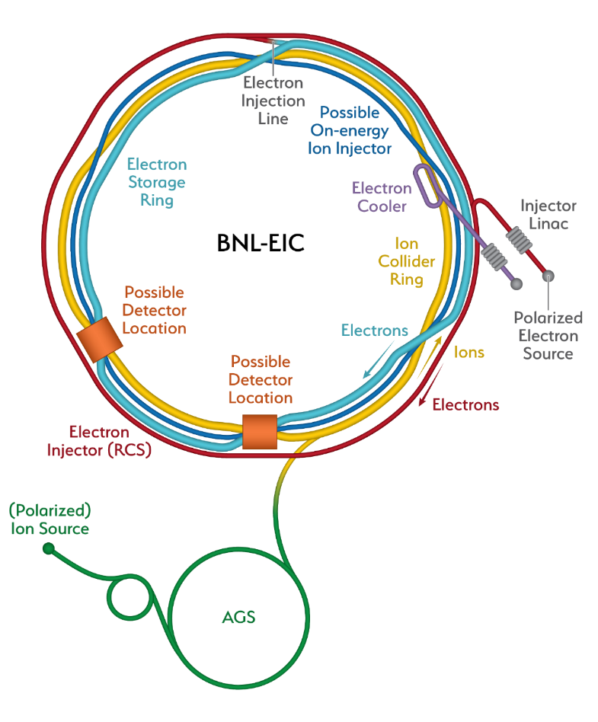
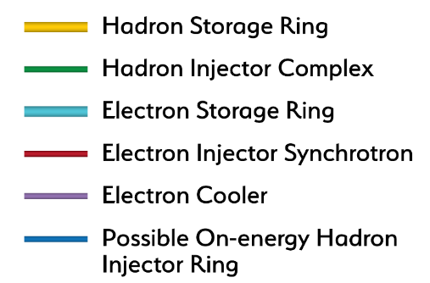
Constructing Capability to Advance Knowledge Throughout The Century: the Future Electron-Ion Collider
Recent Progress
Successful OPA Progress Review 1/ 2023
Significant Project staffing increases via IRA
Pursuing Long Lead (CD3a) followed by CD-2
Project Detector Location
The EIC will be the most advanced accelerator in the world and the only new collider built for decades. It will keep capabilities in accelerators physics challenged
6

Slide 7


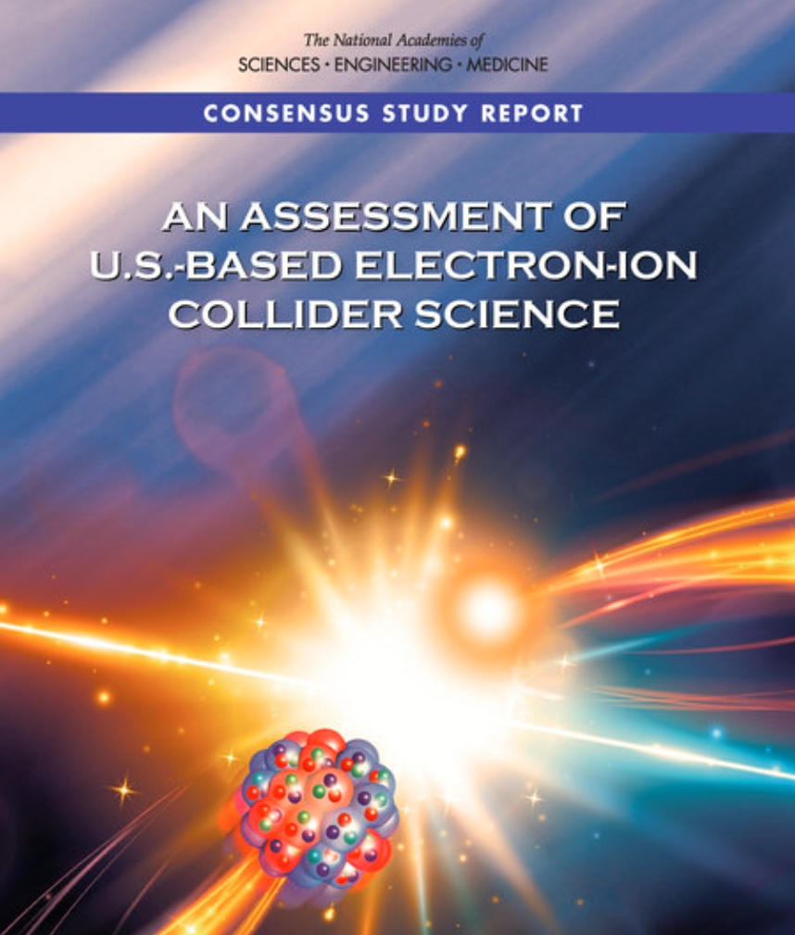
EIC Science-Driven Requirements
Project Design Goals
High Luminosity: L= 10³³ – 10³⁴cm⁻²sec⁻¹, 10 – 100 fb⁻¹/year
Highly Polarized Beams: 70%
Large Center of Mass Energy Range: E_{cm} = 20 – 140 GeV
Large Ion Species Range: protons – Uranium
Large Detector Acceptance and
Good Background Conditions
Accommodate a Second Interaction Region (IR)
Conceptual design scope and expected performance meets or exceed NSAC Long Range Plan (2015) and the EIC White Paper requirements endorsed by NAS (2018)

Slide 8
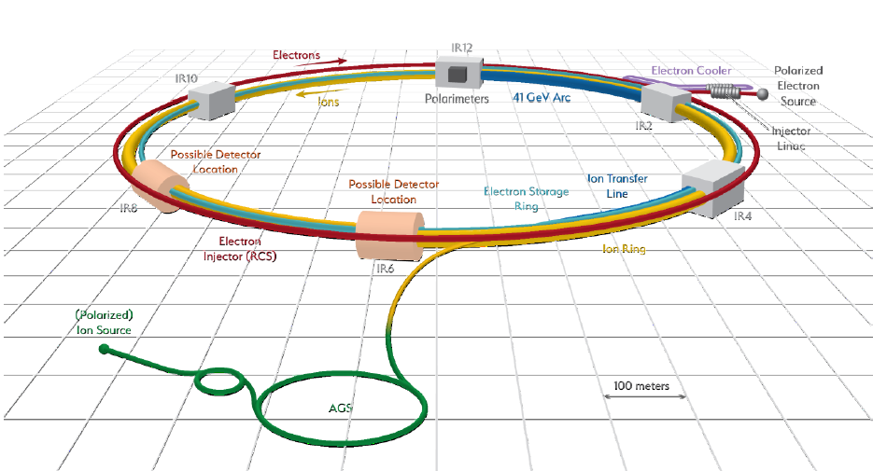
Progress Continues on the Electron-Ion Collider
CD-1 was attained in June 2021.
Located at BNL and with TJNAF as a major partner. Estimated cost between $1.7 and $2.8 billion.
Utilizes existing RHIC assets; adds electron storage ring, & electron cooling
$ ~90M anticipated detector in-kind (~30%)
$ ~50M anticipated accelerator in-kind (~5%)
$ 100M grant from New York State
The EIC Project continues to target sufficient progress to be prepared for a CD-2 Review in the first half of FY 2025. The timing is important to attempt to match the RHIC timeline and avoid loss of needed skills in FY 2025.

Slide 9
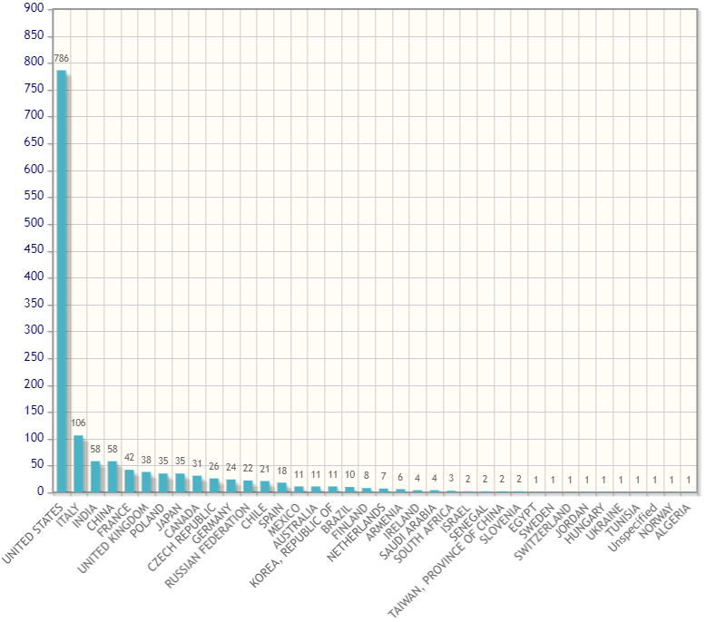
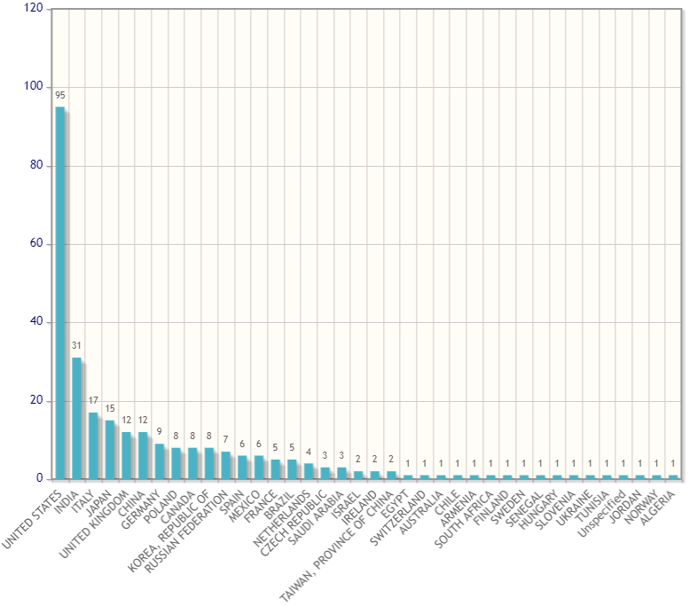
The EIC User Group Continues to Have an Enormous Impact
There are now >1391 EIC Highly Active Users from 277 Institutions in 37 countries
EIC Users by Country
EIC Institutions by Country

Slide 10
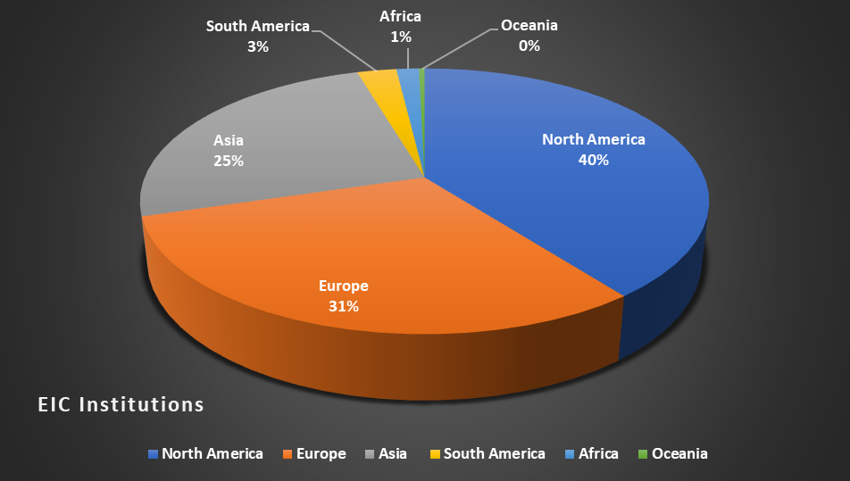
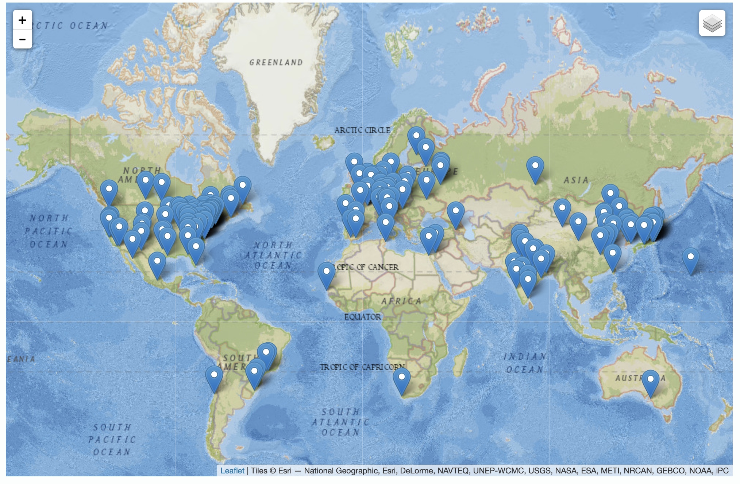
10
The EIC is International At Its Core
EIC Users Group Formed in 2016
EICUG.ORG
Status January 2023:
Collaborators 1391
Institutions 277
Countries 37

Slide 11
As Is The Vision for It’s Governance
The EIC Advisory Board
Name | Affiliation
Stuart Henderson, Chair | TJNAF, USA
Diego Bettoni | INFN, Italy
Paul Kearns | ANL, USA
Mike Lamont | CERN, Switzerland
Lia Merminga | FNAL, USA
Reynald Pain | IN2P3/CNRS, France
Franck Sabatié | CEA, France
Nigel Smith | TRIUMF, Canada
Mark Thomson | STFC, United Kingdom
Mike Witherell | LBNL, USA
Maria Chamizo-Llatas, Scientific Secretary | BNL, USA
Laboratory and National Program Leaders from Around the World

Slide 12
Current EIC Resource Review Board To Discuss International Contributions
Name (Members) | Affiliation | Country | Funding Agency/PI
Samson, Claire | Canada Foundation for Innovation (CFI) | Canada | Funding Agency
Vyšinka ,Marek | Ministry of Education, Youth and Sports | Czech Republic | Funding Agency
Sabatie, Franck | Institut de Recherche sur les Lois Fondamentales de l’Univers (Irfu-SPhN), CEA-Saclay | France | Funding Agency
Grasso, Marcella | IN2P3/CNRS | France | Funding Agency
Lucotte, Arnaud | IN2P3/CNRS | France | Funding Agency
Bettoni, Diego | Instituto Nazionale de Fisica Nucleare (INFN) | Italy | Funding Agency
Nania, Rosario | Instituto Nazionale de Fisica Nucleare (INFN) | Italy | Funding Agency
Moon, Young Kun | Research Promotion Division at the Ministry of Science and ICT | Korea | Funding Agency
Gaczyński, Mateusz | Department of Innovation and Development, Ministry of Science and Higher Education | Poland | Funding Agency
Blaire, Grahme | UK Science and Technology Facilities Council (STFC) | United Kingdom | Funding Agency
Hiscock, Jenny | UK Science and Technology Facilities Council (STFC) | United Kingdom | Funding Agency
Hallman, Timothy | DOE Office of Nuclear Physics | United States | Funding Agency
Name (Observers) | Affiliation | Country | Funding Agency/PI
Hayotsyan, Sargis | State Science Committee of Armenia | Armenia | Funding Agency
Mohanty, Bedanga | NISER | India | Funding Agency
Nxomani, Clifford | National Research Foundation | South Africa | Funding Agency

Slide 13
PIs participating in the Resource Review Board To Discuss International Contributions
Name (PI) | Affiliation | Country
Machado, Ana Amelia | UNICAMP | Brazil
Huber, Garth | University of Regina | Canada
Bielčík, Jaroslav | Czech Technical University, Prague | Czech Republic
Munoz Camacho, Carlos | IJCLab | France
Antonioli, Pietro | INFN Bologna | Italy
Goto, Yuji | RIKEN | Japan
Gunji, Taku | Center for Nuclear Study, University of Tokyo | Japan
Ka, Oumar | Cheikh Anta Diop University | Senegal
Jones, Pete | iThemba Labs | South Africa
Joo, Kyungseon | University of Connecticut | South Korea
Oh, Yongseok | Kyungpook National University | South Korea
Yang, Yi | National Cheng Kung University | Taiwan
Jones, Peter | University of Birmingham | UK

Slide 14
NP - FY 2024 President's Request
Office of Science
Program Details - Category
FY 2024 Senate Mark - Nuclear Physics
(B/A in thousands)
 |  | FY 2022 |  |  | FY 2023 |  | FY 2024 |  | FY 2024 |  | FY 2024 Senate Mark vs FY 2024 Request |  | FY 2024 Senate Mark vs FY 2023 Enacted
 |  | Enacted |  |  | Enacted |  | Request |  | House Mark | Senate Mark
 |  | Regular | IRA Supp. |  | Regular |  | Regular |  | Regular
Nuclear Physics
Medium Energy, Research |  | 53,404 | ... |  | 59,083 |  | 55,555 |  | 51,724 | 55,555 | ... | ... | -3,528 | -5.97%
Medium Energy, Operations |  | 142,709 | ... |  | 149,834 |  | 141,930 |  | 150,000 | 143,430 | 1,500 | 1.06% | -6,404 | -4.27%
Medium Energy Physics |  | 196,113 | ... |  | 208,917 |  | 197,485 |  | 201,724 | 198,985 | 1,500 | 0.76% | -9,932 | -4.75%
Heavy Ion, Research |  | 46,505 | ... |  | 46,149 |  | 47,454 |  | 46,704 | 47,454 | ... | ... | 1,305 | 2.83%
Heavy Ion, Operations |  | 183,943 | ... |  | 182,087 |  | 176,195 |  | 166,684 | 178,695 | 2,500 | 1.42% | -3,392 | -1.86%
Heavy Ion, Projects |  | 25,013 | 10,000 |  | 20,000 |  | 2,850 |  | 2,850 | 2,850 | ... | ... | -17,150 | -85.75%
Heavy Ion Physics |  | 255,461 | 10,000 |  | 248,236 |  | 226,499 |  | 216,238 | 228,999 | 2,500 | 1.10% | -19,237 | -7.75%
Low Energy, Research |  | 73,935 | ... |  | 77,651 |  | 78,409 |  | 76,909 | 78,409 | ... | ... | 758 | 0.98%
Low Energy, Operations |  | 107,831 | ... |  | 128,579 |  | 127,624 |  | 132,487 | 130,624 | 3,000 | 2.35% | 2,045 | 1.59%
Low Energy, Projects |  | 17,400 | 78,760 |  | 23,940 |  | 9,259 |  | 18,000 | 9,259 | ... | ... | -14,681 | -61.32%
Low Energy Physics |  | 199,166 | 78,760 |  | 230,170 |  | 215,292 |  | 227,396 | 218,292 | 3,000 | 1.39% | -11,878 | -5.16%
Theory, Research |  | 57,260 | ... |  | 67,873 |  | 77,142 |  | 59,642 | 77,142 | ... | ... | 9,269 | 13.66%
Nuclear Theory |  | 57,260 | ... |  | 67,873 |  | 77,142 |  | 59,642 | 77,142 | ... | ... | 9,269 | 13.66%
Program Subtotal |  | 708,000 | 88,760 |  | 755,196 |  | 716,418 |  | 705,000 | 723,418 | 7,000 | 0.98% | -31,778 | -4.21%
20-SC-52, Electron Ion Collider EIC, BNL |  | 20,000 | 128,240 |  | 50,000 |  | 95,000 |  | 95,000 | 95,000 | ... | ... | 45,000 | 90.00%
Construction Subtotal |  | 20,000 | 128,240 |  | 50,000 |  | 95,000 |  | 95,000 | 95,000 | ... | ... | 45,000 | 90.00%
Total Nuclear Physics |  | 728,000 | 217,000 |  | 805,196 |  | 811,418 |  | 800,000 | 818,418 | 7,000 | 0.86% | 13,222 | 1.64%
The TEC funding appropriated for EIC in FY 2023 is $70M. In addition, the EIC received $138M in Inflation Reduction Act Funding

Slide 15
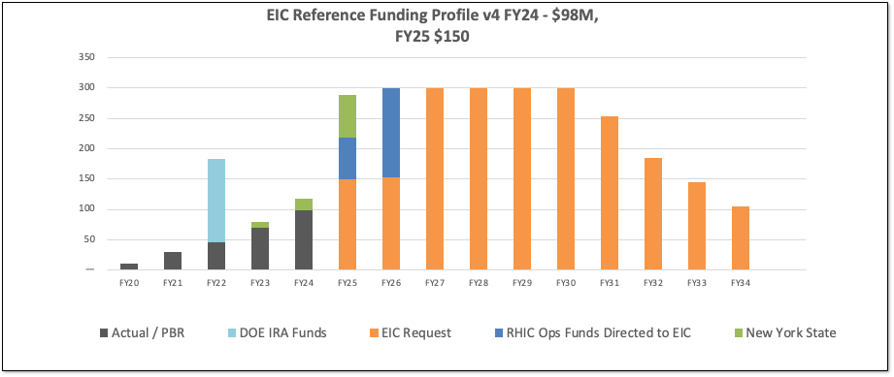
EIC Reference Funding Plan
DOE Inflation Reduction Act funding of $138M allocated at very end of FY2022. FY2023 funding is $70M. DOE request and U.S. House Mark for FY2024 is $98M.
RHIC shut down planned for end of June 2025. Significant RHIC Operations funding will be redirected to EIC construction starting in FY2025 and reaching ~$150M/year in FY2026.
Current funding request supports DOE CD-3A, Long Lead Procurement Approval (LLP), in January 2024. LLP items mitigate risks: technical, supply chain, inflation, and schedule.
FY2025 request is a major challenge given the Fiscal Responsibility Act signed earlier this month.

Slide 16
EIC History and Plans
Event | Date
CD-0, Mission Need Approved | December 2019
DOE Site Selection Announced | January 2020
BNL - TJNAF Partnership Agreement Established | May 2020
CD-1, Alternative Selection and Cost Range Approved | June 2021
CD-3A, Long Lead Procurement | January 2024
CD-2/3, Performance Baseline/Construction Start | April 2025
RHIC Shut Down | June 2025

Slide 17
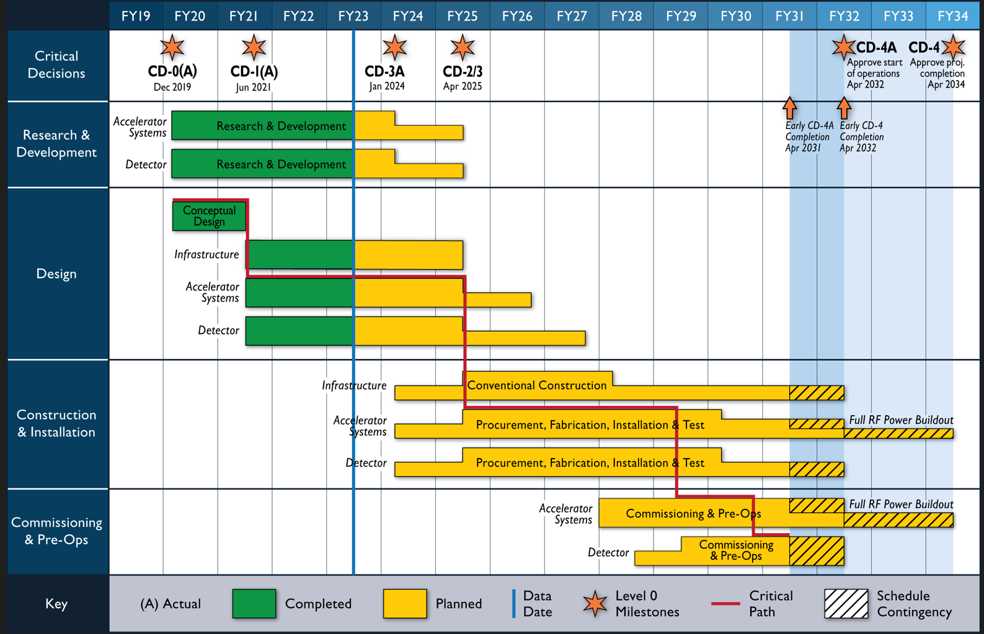
EIC Schedule

Slide 18
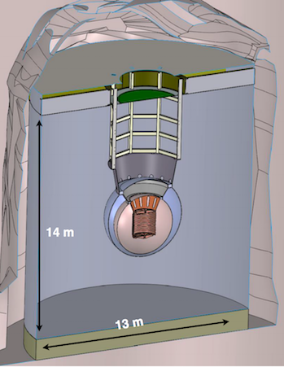
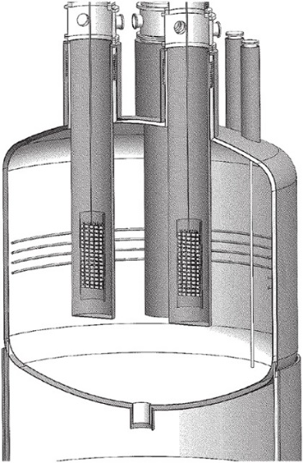
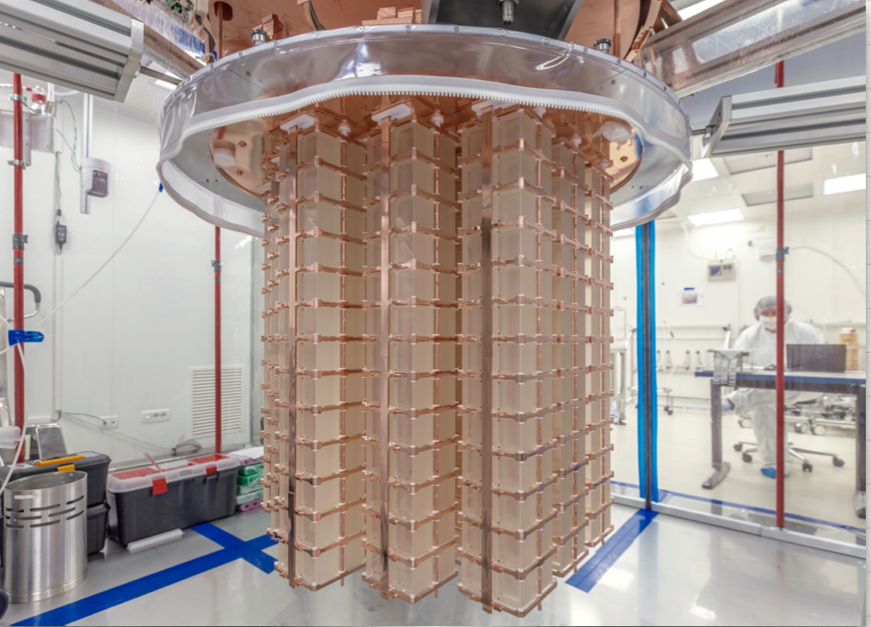
The Other Priority of the 2015 Long Range Plan for Nuclear Science: Neutrinoless Double Beta Decay
Between IRA funding and NP Program Funding, approximately $12.8 M allocated to the three technologies being explored LEGEND 1000, nEXO, and CUPID since FY 2020.
Additional resources provided by international partners
Inability to procure isotopes from Russia is creating serious challenges
The next DBD international occurred on April 27, 2023 at SNOLab in Canada. A Virtual Global DBD Observatory is being established.
NP is thinking about options to demonstrate a proof-of-principle isotope procurement test
Three Proposed Technologies
  Scintillating bolometry (CUPID, ¹⁰⁰Mo enriched Li₂Mo₄ crystals)
  Enriched ⁷⁶Ge crystals (LEGEND-1000, drifted charge, point contact detectors)
  Liquid Xenon TPC (nEXO, light via SiPM, drifted ionization)
TeO₂ Crystals from CUORE
Potential Partners:
Italy, Canada, and Germany

Slide 19
Snapshot of the Status of NP Projects
Project | Location | Status | Cost | CPI | SPI | CD-4 | Operation cost plan
Construction Projects
Facility for Rare Isotope Beams (FRIB) * | MSU | CD-4 | $730M | 1.00 | 1.00 | 6/2022 | Included in NP budget formulation
Electron-Ion Collider (EIC) | BNL | CD-1 | $1.7B to $2.8B |  |  | Q4 FY33 | RHIC operations funds redirected to EIC project recovered for EIC operations
Major Items of Equipment
Gamma Ray Energy Tracking Array (GRETA) ^{FF} | LBNL | CD-2/3 | $58.3M | 0.97 | 0.93 | 4/2028 | Mostly covered by host laboratory operations experimental support
Super Pioneering High Energy Nuclear Interaction Experiment (sPHENIX) * | BNL | PD-4 | $26.5M | 1.00 | 1.00 | 12/2022 | Covered by RHIC operations experimental support
Measurement of Lepton-Lepton Electroweak Reactions (MOLLER) ^{FF} | TJNAF | CD-3A | $45.8M to $56.6M |  |  | Q4 FY27 | Covered by TJNAF operations experimental support
High Rigidity Spectrometer (HRS) | MSU | CD-1 | $85.0M to $111.4M |  |  | Q2 FY29 | Covered by FRIB operations experimental support
Ton Scale Neutrinoless Double Beta Decay (TS-NLDBD) | TBD | CD-0 | $215M to $250M |  |  | TBD | TBD
Blue (*) indicates “Completed”, green (^{FF}) “Fully Funded”, and purple italic “Substantially Funded”
Smaller NP Projects are being “cleared off the books”

Slide 20
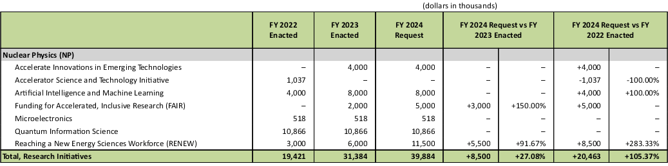
NP - Research Initiatives

Slide 21
Which Raises a Thought
The Hallman Challenge:
Consider creating a dedicated WBS activity, with a budget, a CAM, etc.to integrate/build AI into the operational controls for the EIC machine “from the beginning”.

Slide 22
DOE NP Outlook On The EIC
The EIC Project is making steady progress, towards CD3a (Long Lead Procurement), and the next DOE gateway CD-2 (Approve Performance Baseline).
The EIC is intended to be fully international in character. For those countries interested in collaborating, now is a good time to become involved and express your interest. All are welcome at any time, but the pace of the project will require clear understanding of “who will do what” in time to baseline the project in FY 2025.
Although not yet baselined, increased support from annual appropriations will continue to be important to enable timely progress and a smooth transition of workforce from the Relativistic Heavy Ion Collider in FY 2025.
International contributions and very careful Project Management will be crucial to contain cost growth and maintain schedule.

Slide 23
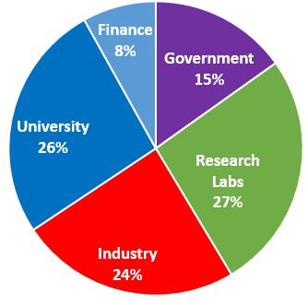
A Second Very High priority: Training in Nuclear Science
Highly Specialized Technical skills
Creative problem analysis/solving ability
Scientific communication skills
Resilience/perseverance despite set-backs
Self confidence
Time management ability
Project planning skills
Ability to work within a large collaboration
Leadership development
The result is an essential national core competency useful not only for “things nuclear”, but for a variety of other challenging pursuits as well
Where NP PhDs go
U.S. science, commerce, medicine, defense —all benefit, in part, from a stable level of sustained competence, capability, capacity, and leadership in nuclear physics;

Slide 24
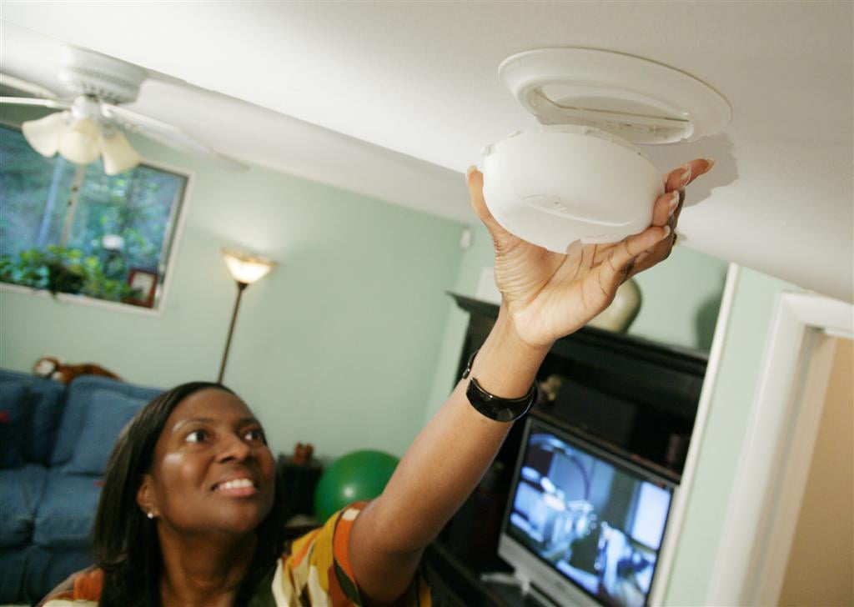
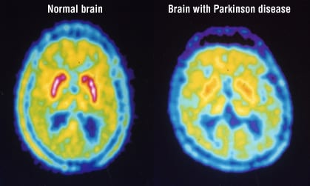
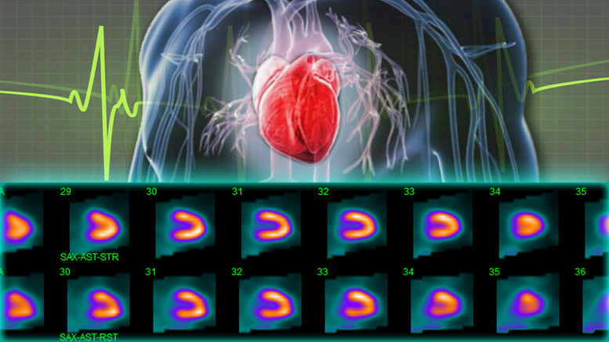
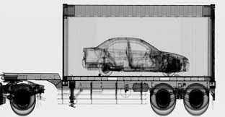
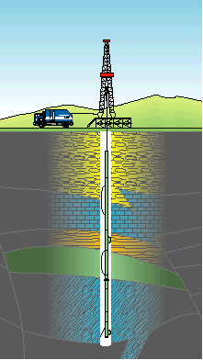
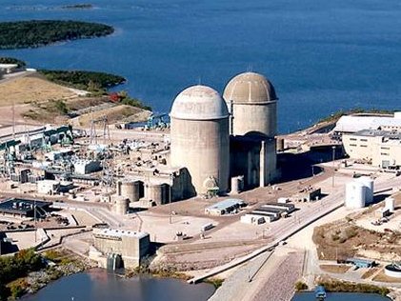
A Third Priority: Better Living Through Apps of Nuclear Physics
Fire safety in your house
Heart Health
Food safety
Medical Diagnosis
Carbon free electricity generation
Port of entry security
Metastasized cancer treatment
Oil and gas prospecting
Deep space exploration
Lasting joint replacements
National Security
24

Slide 25
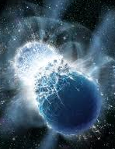
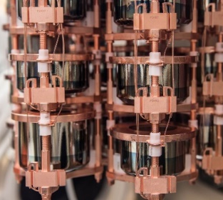
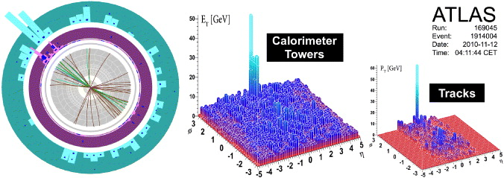
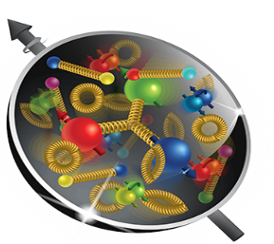
Nuclear Physics
Discovering, exploring, and understanding all forms of nuclear matter
      Understanding why matter takes on the specific forms observed in nature and how that knowledge can benefit energy, commerce, medicine, and security, by:
  Mapping the quantum cosmos inside the proton using the future Electron-Ion Collider
  Discovering the properties of the novel quark-gluon plasma RHIC, LHC
  Exploring the mechanism underlying the confinement of quarks and gluons via CEBAF and RHIC
  Searching for new exotic particles and violations of nature’s symmetries at CEBAF, FRIB, ATLAS
  Determining the limits of nuclear existence and how are heavy elements made via FRIB and ATLAS
  Discovering if the neutrino its own anti-particle or if the neutron’s precise properties point to new physics via Neutrino-less Double Beta Decay and Neutron Electric dipole Moment
  Exploring the strong force in many-body systems via SciDAC, Core Research, QIS/QC, AI/ML
  Advancing Nuclear Data for Space, Energy, and Research through Nuclear Data and AI/ML

Slide 26
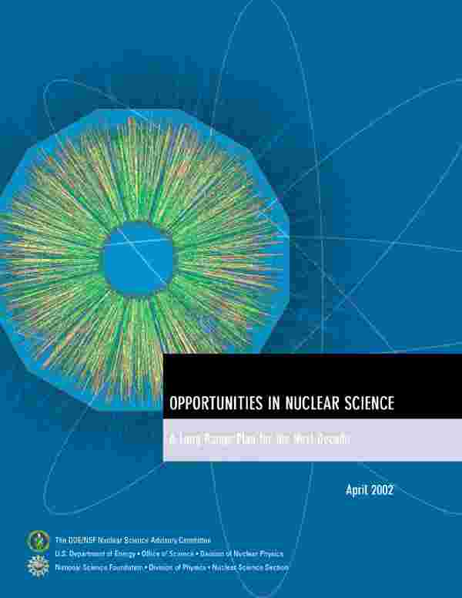
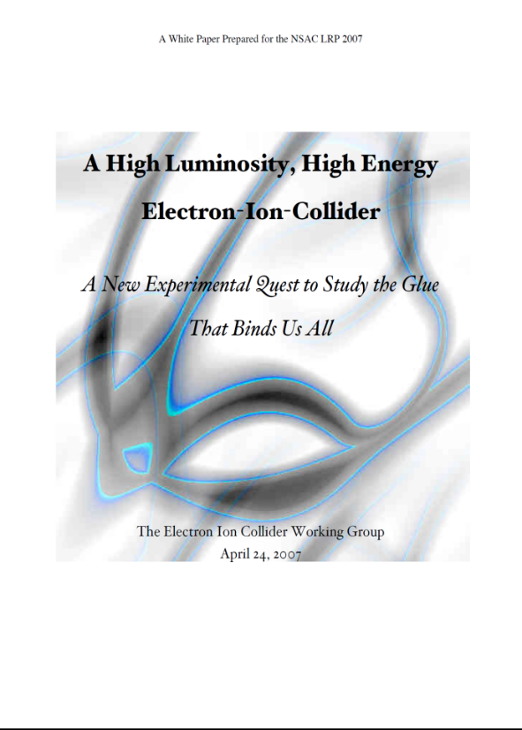


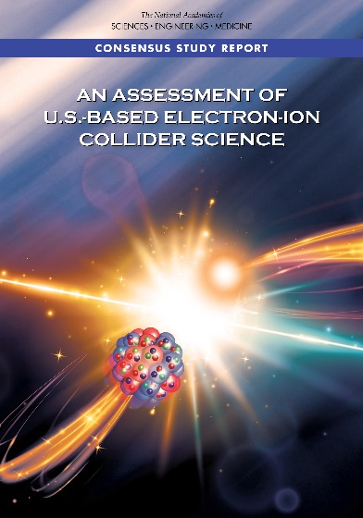
Developing the EIC Science Case
2002
A strong community emphasis on the urgent need for a machine to illuminate the dynamical basis of hadron structure in terms of the fundamental quark and gluon fields has been a persistent message for almost two decades
2007
2009
2010
Gluons and the Quark Sea at High Energies
2012
“a high-energy high-luminosity polarized EIC [is] the highest priority for new facility construction following the completion of FRIB.”
2013
Major Nuclear Physics Facilities for the Next Decade
2015
NSAC
“…essential accelerator and detector R&D [for EIC] should be given very high priority
in the short term.”
“We recommend the allocation of resources …to lay the foundation for a polarized Electron-Ion Collider…”
March 14, 2013
2018
“..a new dedicated facility will be essential for answering some of the most central questions.”
“The quantitative study of matter in this new regime [where abundant gluons dominate] requires a new experimental facility: an Electron Ion Collider.”
Electron-Ion Collider absolutely central to the nuclear science program of the next decade.

Slide 27
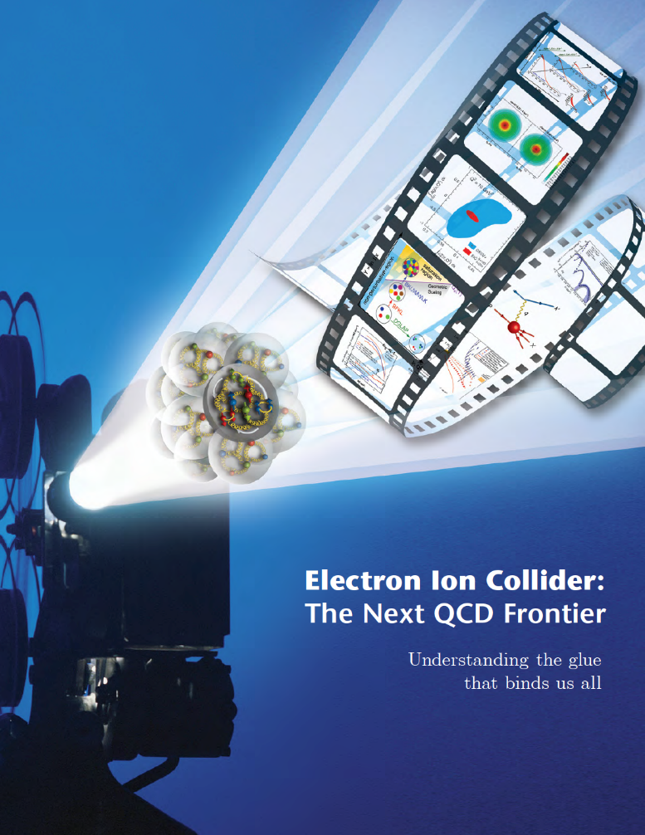
NSAC 2015 LRP Performance Parameters
NSAC Performance Parameters:
A - Polarized e, p, light nuclei
B - Ion beam from deuterons to the heaviest table nuclei
C - Center of Mass energy 20-100 GeV
D - Capable of future Center of Mass upgrade to 140 GeV
E - High collision luminosity ~10³³-10³⁴ cm⁻² S⁻¹
F - More than one Interaction Region
stable nuclei
Community and NSAC defined the parameters of machine needed to address the science.

Slide 28
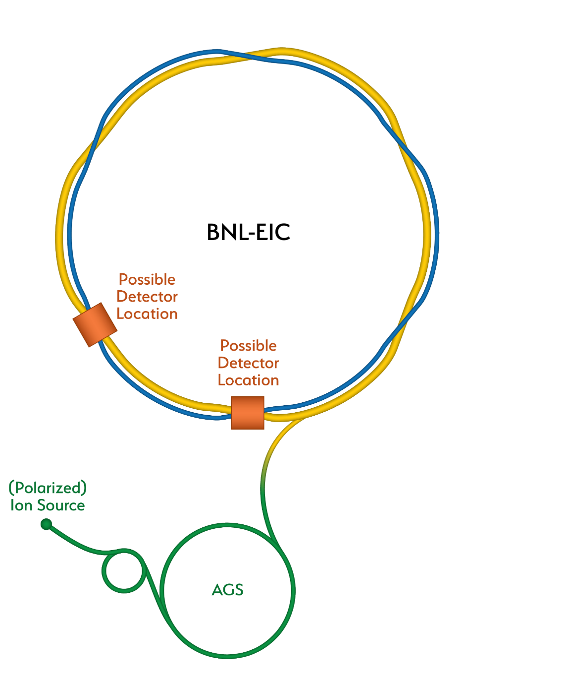
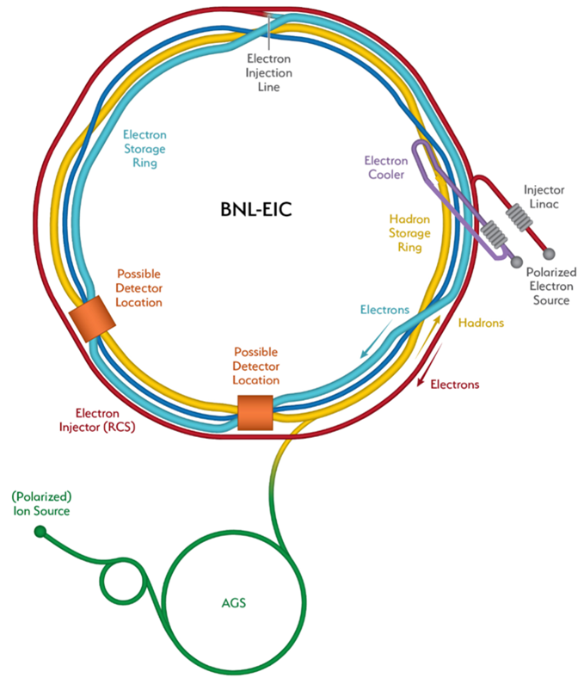
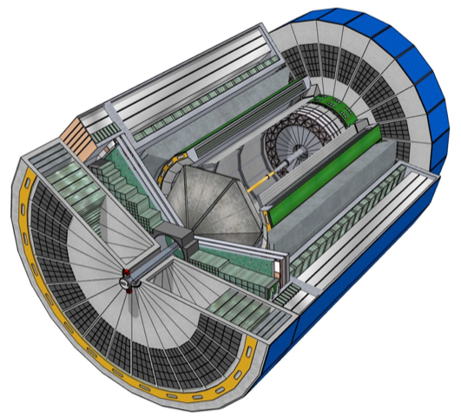
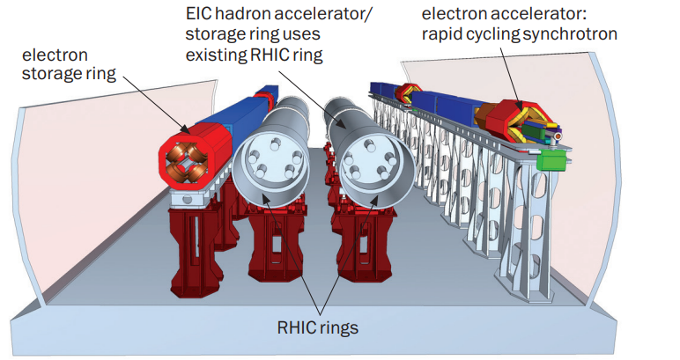
Preliminary Scope Overview
Current plan has the RHIC facility shutting down in 2025 and being modified for the EIC.
RHIC
New systems include:
Polarized electron source,
Injector linac,
Electron cooler complex,
Rapid Cycling Synchrotron(RCS)
Electron storage ring (ESR),
Interaction region (IR) with 1 detector,
Capability for implementing 2 IRs
Infrastructure improvements.
(ESR)
EIC
(HSR)
Detector

