Slide 1
Update from the EIC Project Management
Jim Yeck
EIC Project Director
EIC User Group Meeting
July 25, 2023

Slide 2
Outline
EIC Requirements
Management and Organization
Funding and Schedule Plans
CD-3A and CD-2 Planning Perspective
Accomplishments
Opportunities and Challenges
Summary

Slide 3



Project Requirements
Project Design Goals
High Luminosity: L= 10³³ – 10³⁴cm⁻²sec⁻¹, 10 – 100 fb⁻¹/year
Highly Polarized Beams: 70%
Large Center of Mass Energy Range: E_{cm} = 20 – 140 GeV
Large Ion Species Range: protons – Uranium
Large Detector Acceptance and
Good Background Conditions
Accommodate a Second Interaction Region (IR)
Conceptual design scope and expected performance meets or exceed NSAC Long Range Plan (2015) and the EIC White Paper requirements endorsed by NAS (2018).

Slide 4
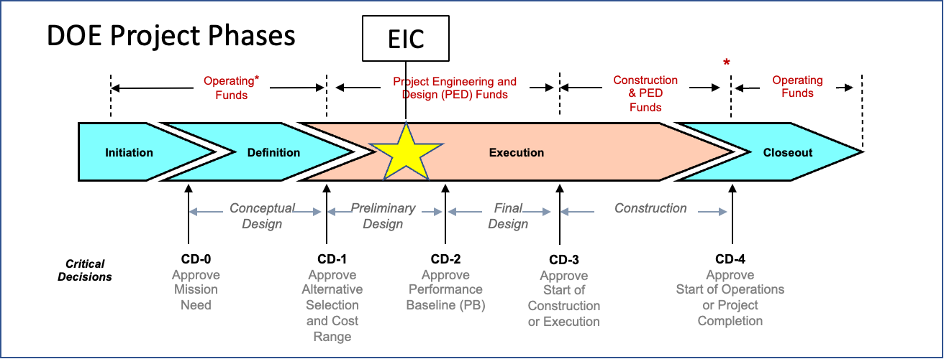
EIC Project History and Plans
CD-0, Mission Need Approved | December 2019
DOE Site Selection Announced | January 2020
CD-1, Alternative Selection and Cost Range, Approved | June 2021
CD-3A, Long Lead Procurement | January 2024
CD-2/3, Performance Baseline/Construction Start | April 2025
RHIC Shut Down | June 2025

Slide 5
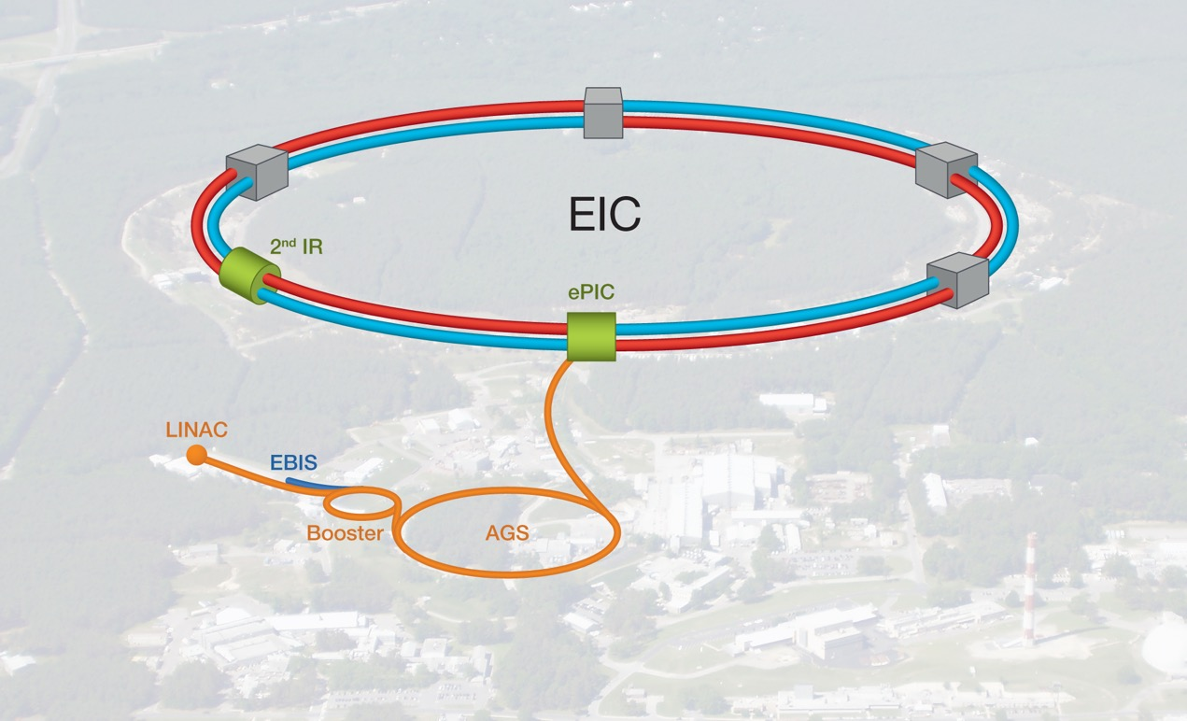
EIC Double Ring Design
Based on Existing RHIC Facility
RHIC Operations Concludes in 2025

Slide 6
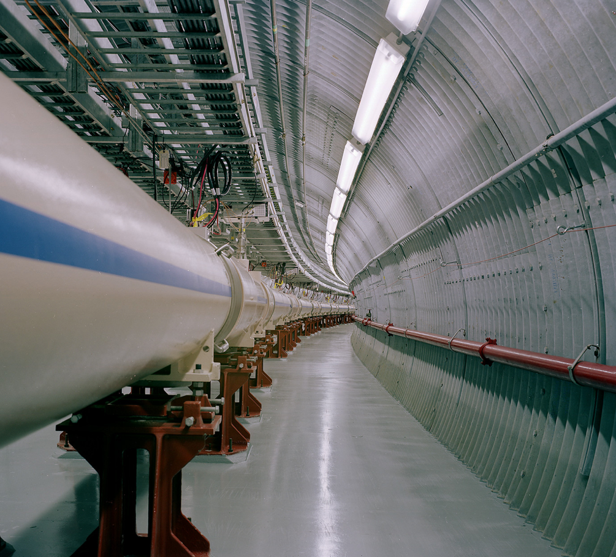
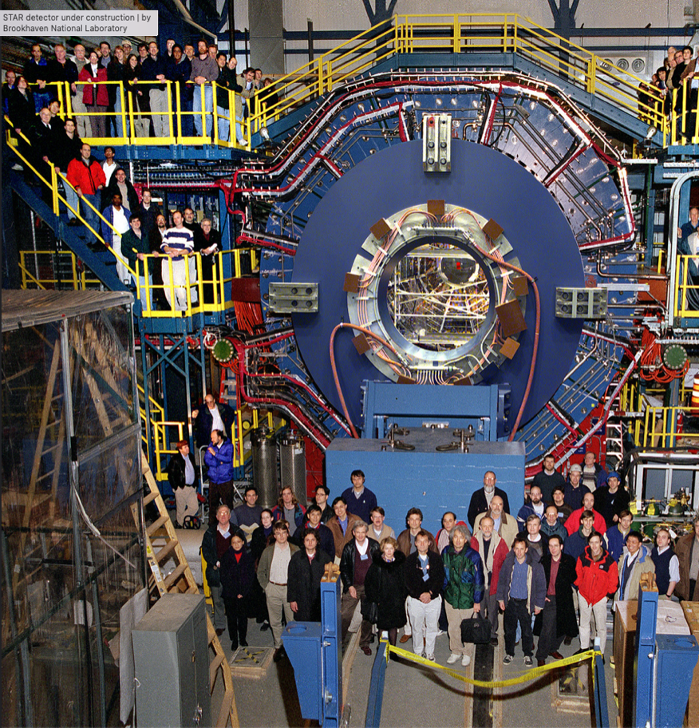
RHIC Infrastructure

Slide 7
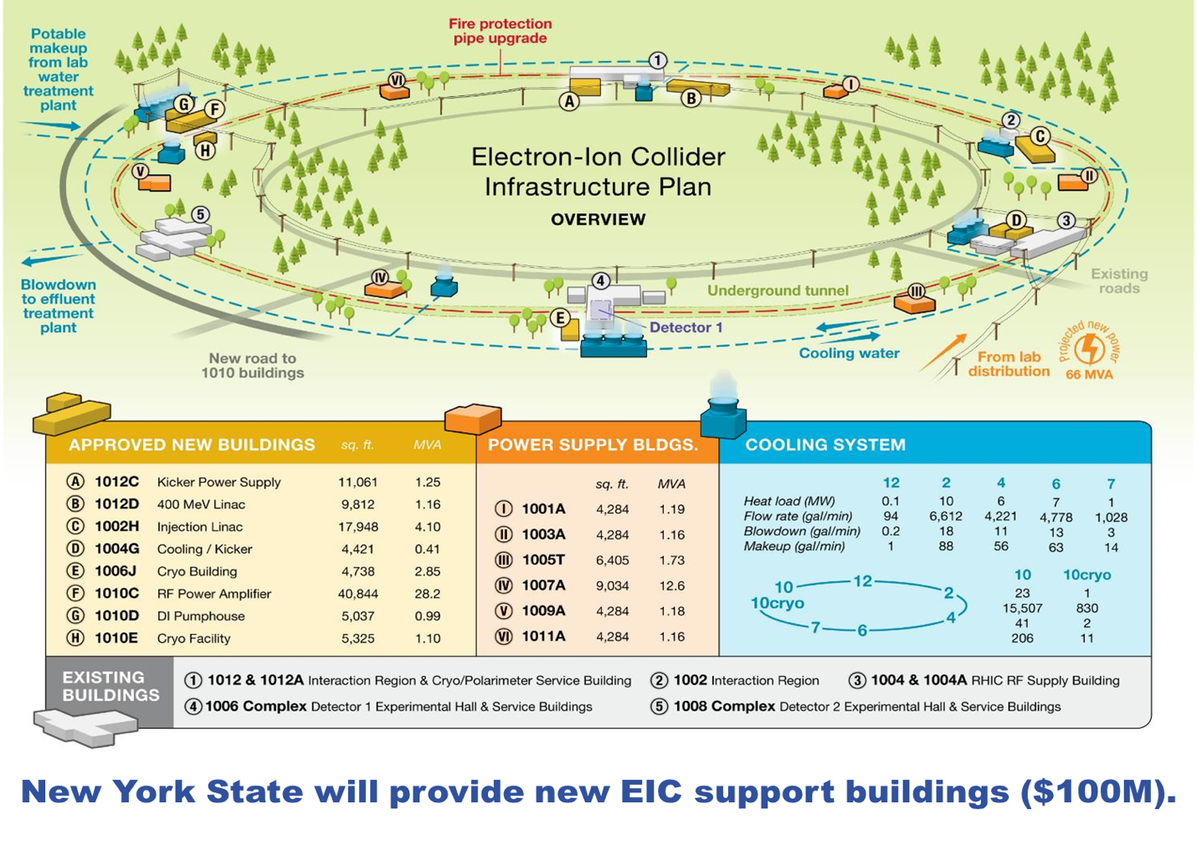

Slide 8
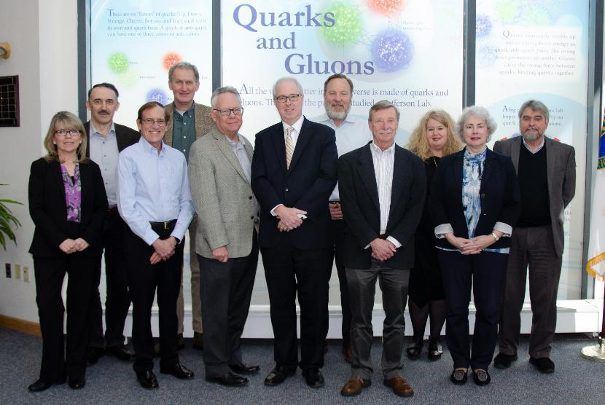
BNL/TJNAF Special Partnership
BNL/JLab partnership established in early 2020
Integrated management and scope
Serve together as hosts for the EIC experimental program

Slide 9

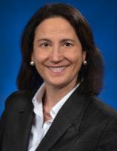





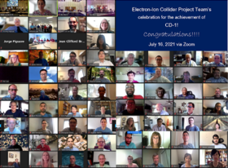
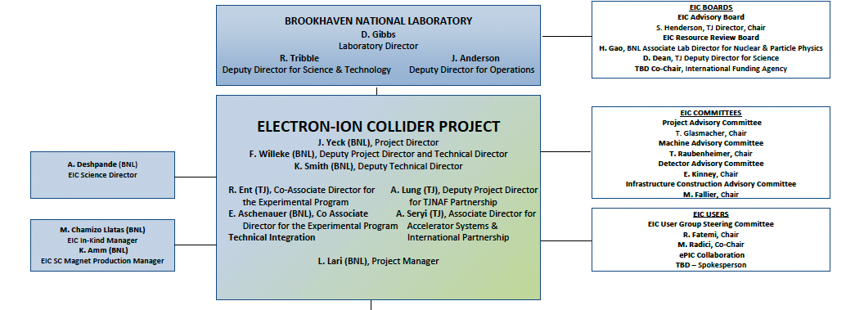






9

Slide 10
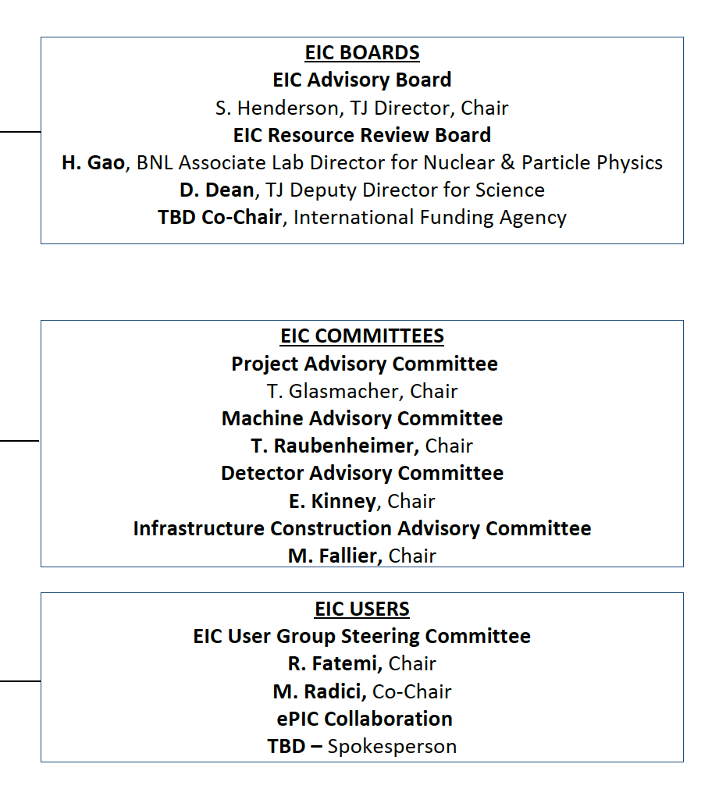
Boards and Advisory Committees
10
D. Bettoni
DOE, BNL, and JLab envision an EIC facility that is “fully international in character.”
International EIC Advisory Board provides oversight and advice on the construction of the facility, focusing on the accelerator: ANL, BNL, FNAL, LBNL, TJNAF, TRIUMF - Canada, IN2P3 and CEA - France, STFC - UK, INFN - Italy.
International EIC Resource Review Board provides oversight of experiments, 1st meeting April 2023. Delegates from Africa, Asia, Europe, North and South America.
International EIC Project Advisory Committee provides advice on the successful delivery of the DOE Project including management, scope, schedule, cost, and performance.
John Lajoie, Spokesperson
Silvia Dalla Torre, Deputy Spokesperson

Slide 11
EIC Advisory Board
Directors of labs participating in the EIC accelerator design and construction, chaired by JLab Director
Meets 3-4 times per year, last meeting on June 29, 2023
June meeting approved charter and provided recommendations:
  BNL: Expeditiously move forward with a design contract with Saclay for the solenoid spin rotator magnets.
  JLAB: Evaluate the benefit/risk to the project of the PERLE cryomodule proposal.
  BNL/JLab: Establish an accelerator collaboration with the proper structure and regular meetings.
  EIC Project and Partners: Finalize scope with partners.
  EIC Project: Define high-level risks and milestones at the appropriate level to be monitored by the EIC Advisory Board.

Slide 12
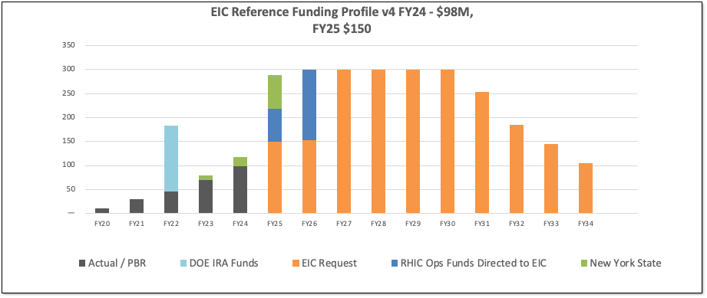
DOE Reference Funding Plan
12
DOE Inflation Reduction Act funding of $138M allocated in September 2022. Actual FY2023 funding is $70M. DOE request for FY2024 is $98M.
RHIC shut down planned for June 2025. Significant RHIC Operations funding will be redirected to EIC construction starting in FY2025 and reaching ~$150M/year in FY2026.
Current funding supports DOE CD-3A, Long Lead Procurement Approval, in January 2024. Long lead procurement mitigate risks: technical, supply chain, inflation, and schedule.

Slide 13
Funding and DOE Critical Decisions
Inflation Reduction Act (IRA) funding of $138M provided at the end of 2022 supports CD-3A, Long Lead Procurement Approval, plans
FY2024 funding is expected to be $98M
Substantial redirection of funding from RHIC operations into EIC construction starting in 2025
FY2025 funding will be critical to achieving the CD-2/3 approval schedule
  Priority is securing CD-2 prior to planned conclusion of RHIC ops in 2025 and the efficient transition from RHIC ops into EIC construction

Slide 14
EIC Project & Design Reviews
Event | Date
Office of Project Assessment Status Review | October 19-21, 2021
Fundamental Power Coupler Design Review (PDR) | June 18, 2021
Federal Project Director Status Update | June 28-30, 2021
EIC ESR Vacuum Systems and Impedance (CDR) | November 8, 2021
IR Design & MDI Review (CDR) | April 6, 2022
EIC Source and 400 MeV Pre-Injector Linac Systems Review (PDR) | July 14, 2022
Electronics/Computing Subsystem Status Review (CDR) | August 29, 2023
DET - Magnet Subsystem Design (PDR) | October 18, 2022
ESR Single Cell Cavity Review (PDR) | October 27, 2022
Crab Cavity R&D Prototype (PDR) | November 2, 2022
Cryogenics Satellite Plant and 2K & 4k Distribution (PDR-1) | November 15, 2022
Hadronic Calorimetry Subsystem Status Review (PDR-1) | December 6, 2022

Slide 15
EIC Project & Design Reviews (cont.)
Event | Date
Polarimetry & Luminosity Detector Status Review (PDR-1) | January 17, 2023
Office of Project Assessment Status Review | January 31-February 2, 2023
591 MHz First Article Single Cell Cavity String Components (PDR) | April 20, 2023
EIC High Power FPC (FDR-1) | April 28, 2023
591 MHz HP-SSA Engineering Demonstration Units (FDR) | May 16, 2021
RCS Arc Vacuum Chambers (PDR) | June 9, 2023
SC Magnet Wire Specification (FDR) | June 15, 2023
HSR BPM Cryo Buttons & Cryo Cables (PDR) | June 20, 2023
400 MeV Linac System (FDR) | June 23, 2023
Long-Lead Procurement Cost Review | June 26-29, 2023
SC Magnet Schedule Review | June 26-29, 2023
Secondary Unit Substations (FDR) | July 24, 2023

Slide 16
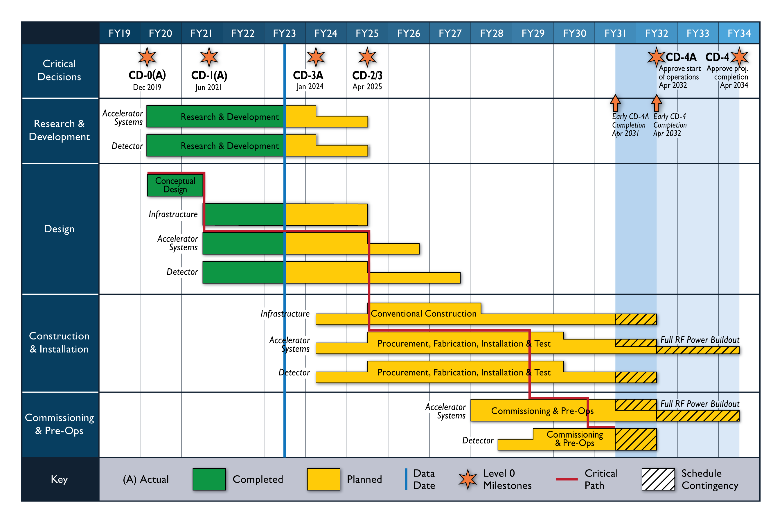
Schedule

Slide 17
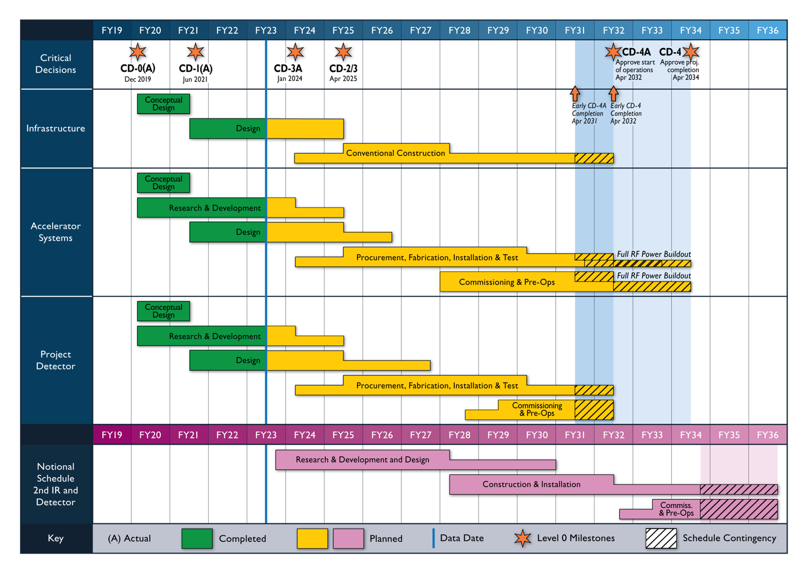
Reference Schedule for 2nd IR and Detector
17

Slide 18
Recent Accomplishments
Contract for Architecture / Engineering Services for Infrastructure signed in June. Construction Management / General Contractor acquisition plans prepared. New York State funding buildings. Team clarifying requirements and sustainability goals.
Increased Accelerator staffing and collaboration with US labs and international partners. Overall design and lattice stabilized to serve as the basis of engineering design.
Detector technology choices and design prepared by the ePIC collaboration with support from the project. Resource Review Board established to engage funding agencies in planning.
CD-3A case and viability established. Performance measurement baseline in preparation (CD-3A & CD-2) by the Project Management team (L1, L2, L3, L4, …).
International partners participating in the development of the Governance model. Working to prepare a facility that is international in character.

Slide 19
Challenges
Affordability – The cost range for the EIC project is higher than can be accommodated by current DOE ONP funding levels. The EIC construction phase requires an increase in the annual funding for ONP/EIC followed by the substantial redirection of funding from RHIC operations. The reference funding plan provides $300M/year starting in FY2026.
DOE M&O Contractor SOP vs Project Needs – Successful large science projects require modifying many of the host Laboratory’s operational functions to facilitate the project’s construction. The EIC project team is working with the host labs and the EIC Project Advisory Committee (PAC) to position the EIC project for success (recent PAC report).
In-kind Schedules – Schedule of in-kind contributions are often a challenge given the timing of funding agency decisions. A proactive approach is taken to ensure issues are resolved.

Slide 20
Summary
EIC is a unique, high-energy, high-luminosity, polarized beam collider that will be one of the most challenging and exciting accelerator complexes ever built -- only collider in next decade(s).
EIC project scope includes the complete infrastructure, accelerators, and detector required to meet the performance and science requirements.
Strong support for the EIC with increasing international engagement.
  ePIC Collaboration formed
  1st Resource Review Board meeting in April 2023 and 2nd meeting planned for December 2023
We are successfully building the collaborations and project team, establishing partnerships, preparing for DOE CD-3A, and making the maximum technical progress with the funding available.

Slide 21
Questions?

