Slide 1

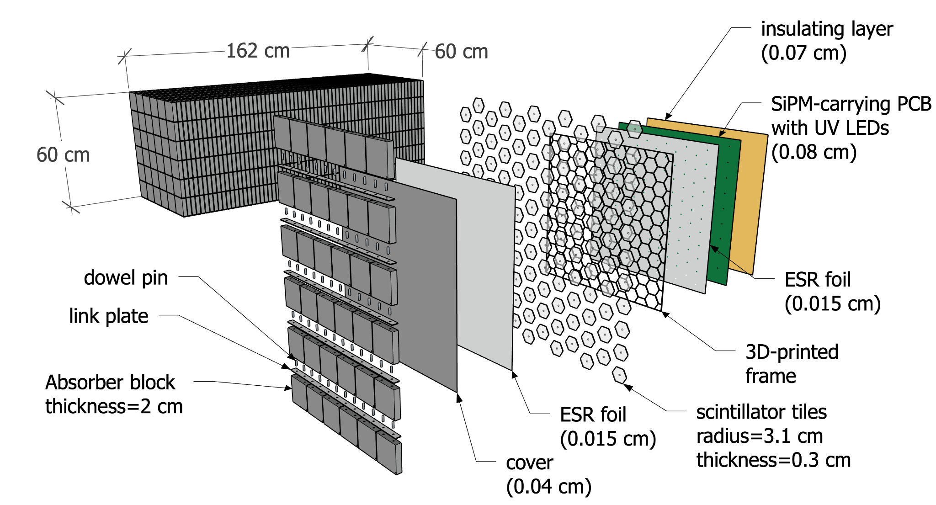
A SiPM-on-tile Zero Degree Calorimeter
Sean Preins
EIC Early Career Workshop
7/25/2023 (updated)

Slide 2
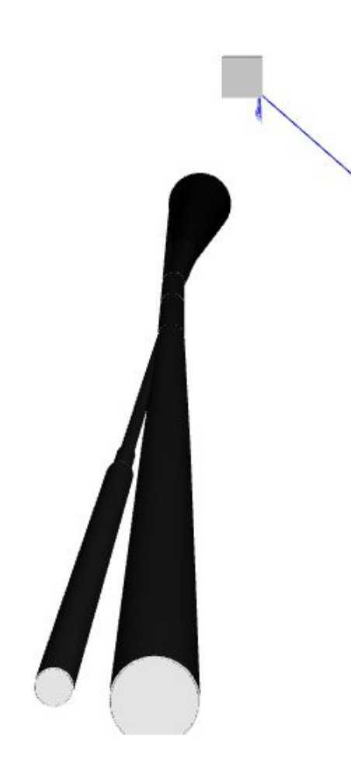
Motivation
A Zero Degree Calorimeter would be situated far downstream of the proton beam, where charged particles have been steered away
The physics goals for the ZDC benefit from high resolution position reconstruction for neutrons, which works well with a high granularity SiPM-on-tile imaging calorimeter design
Although SiPMs are susceptible to radiation damage, an easily accessible design can allow for regular annealing and replacing
Using iron absorber plates can reduce cost, simplify construction, and compensation can be done via software

Slide 3
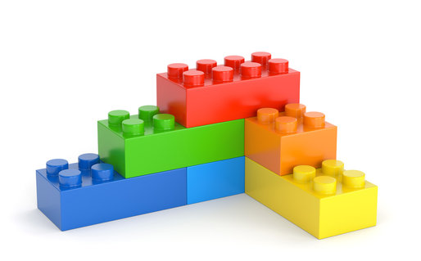
A SiPM-on-Tile ZDC for ePIC
Reuses STAR-HCAL Fe blocks
Utilizes a similar SiPM-on-Tile design as the calorimeter insert
Uses ~5x5 cm² hexagon tiles

Slide 4
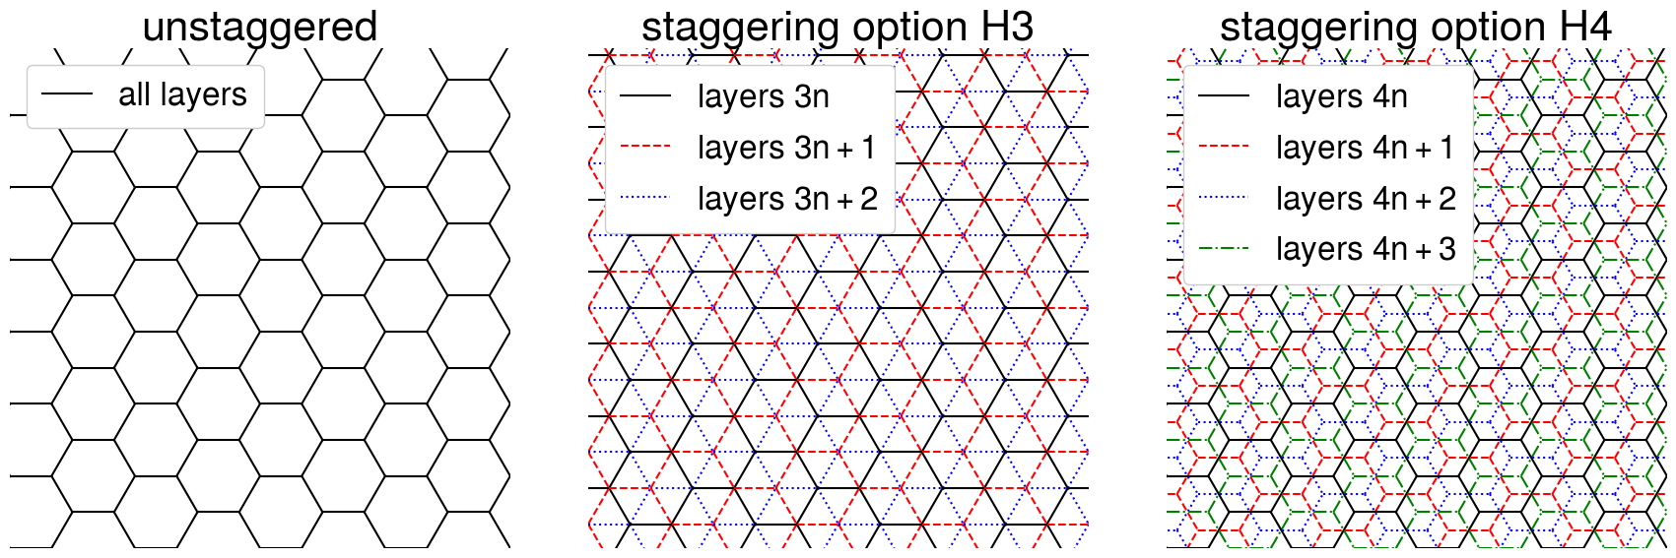
Tile Staggering
Hexagons were chosen minimize dead space, and improve tile response uniformity
Staggering layers can improve angular resolution and optimize performance

Slide 5
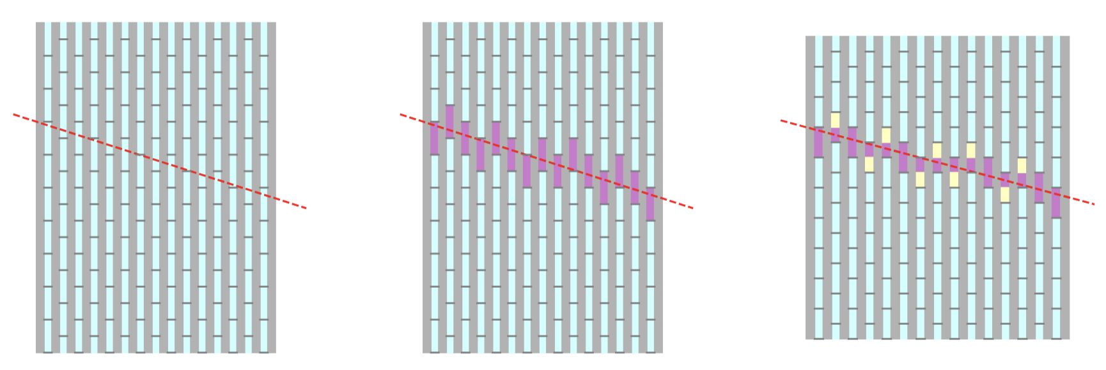
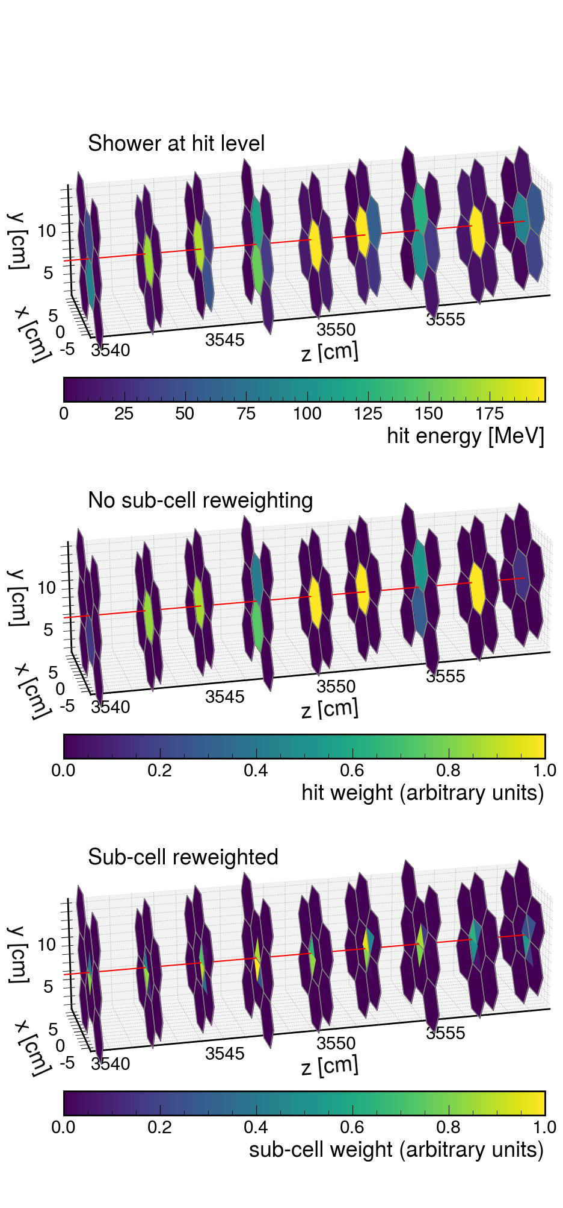
Tile Staggering

Slide 6
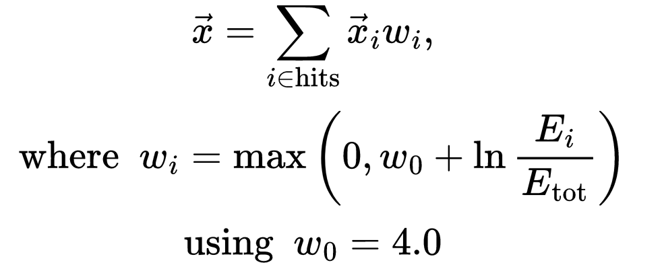
Traditional Shower Position Reconstruction
Traditional method of shower position reconstruction uses cell-energy logarithmic weighting
𝒘₀ was picked to be 4.0, but this value was not optimized

Slide 7
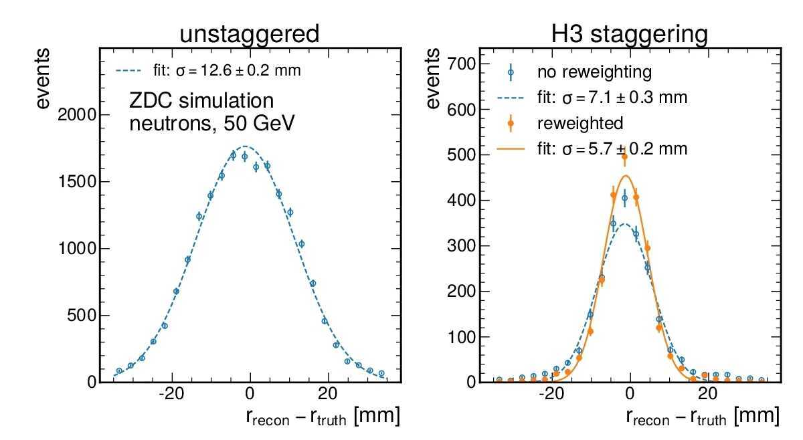
Position Resolution with and without staggering
Using GEANT4 in the DD4HEP framework, we simulated single 50 GeV neutron events
We observe significant improvements with staggering, even with a simple algorithm

Slide 8

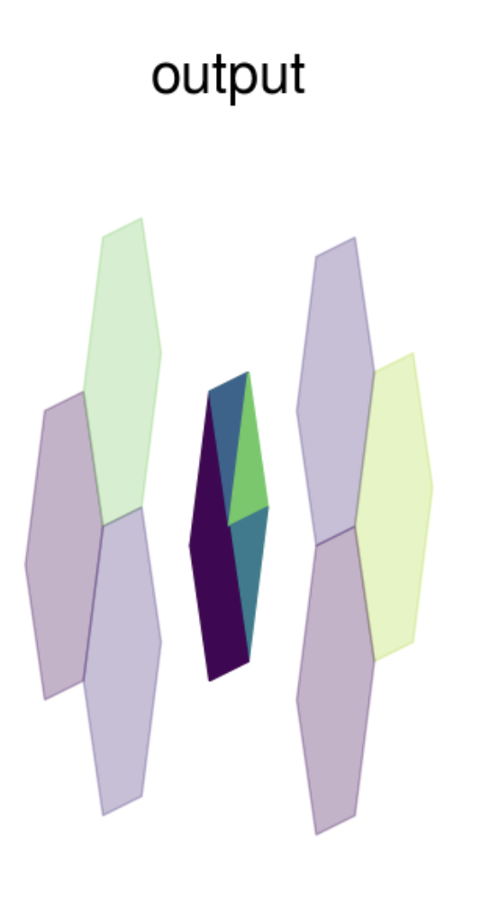
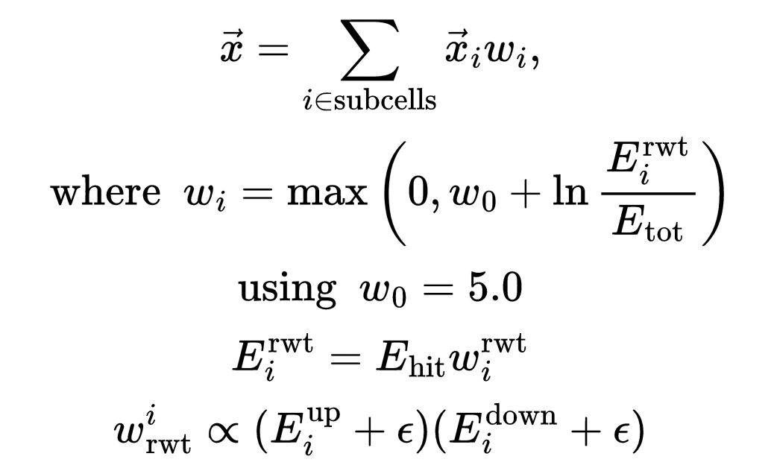
Shower Position Reconstruction with Sub-Cell Weighting
Each cell is divided into “sub-cells”, with energy contributions from overlapping cells upstream and downstream
Credit to Dr Sebouh Paul for developing the HEXSPLIT algorithm

Slide 9
Staggering and sub-cell reweighting improves position resolution by factor of 2!

Slide 10
SiPM-on-tile ZDC Position Resolution
Simulated performance exceeds Yellow Report requirements
Position reconstruction algorithm can be optimized further
Detector geometry parameters can be tuned to improve performance even further, such as cell size

Slide 11
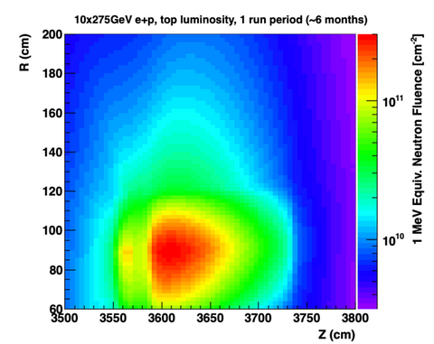
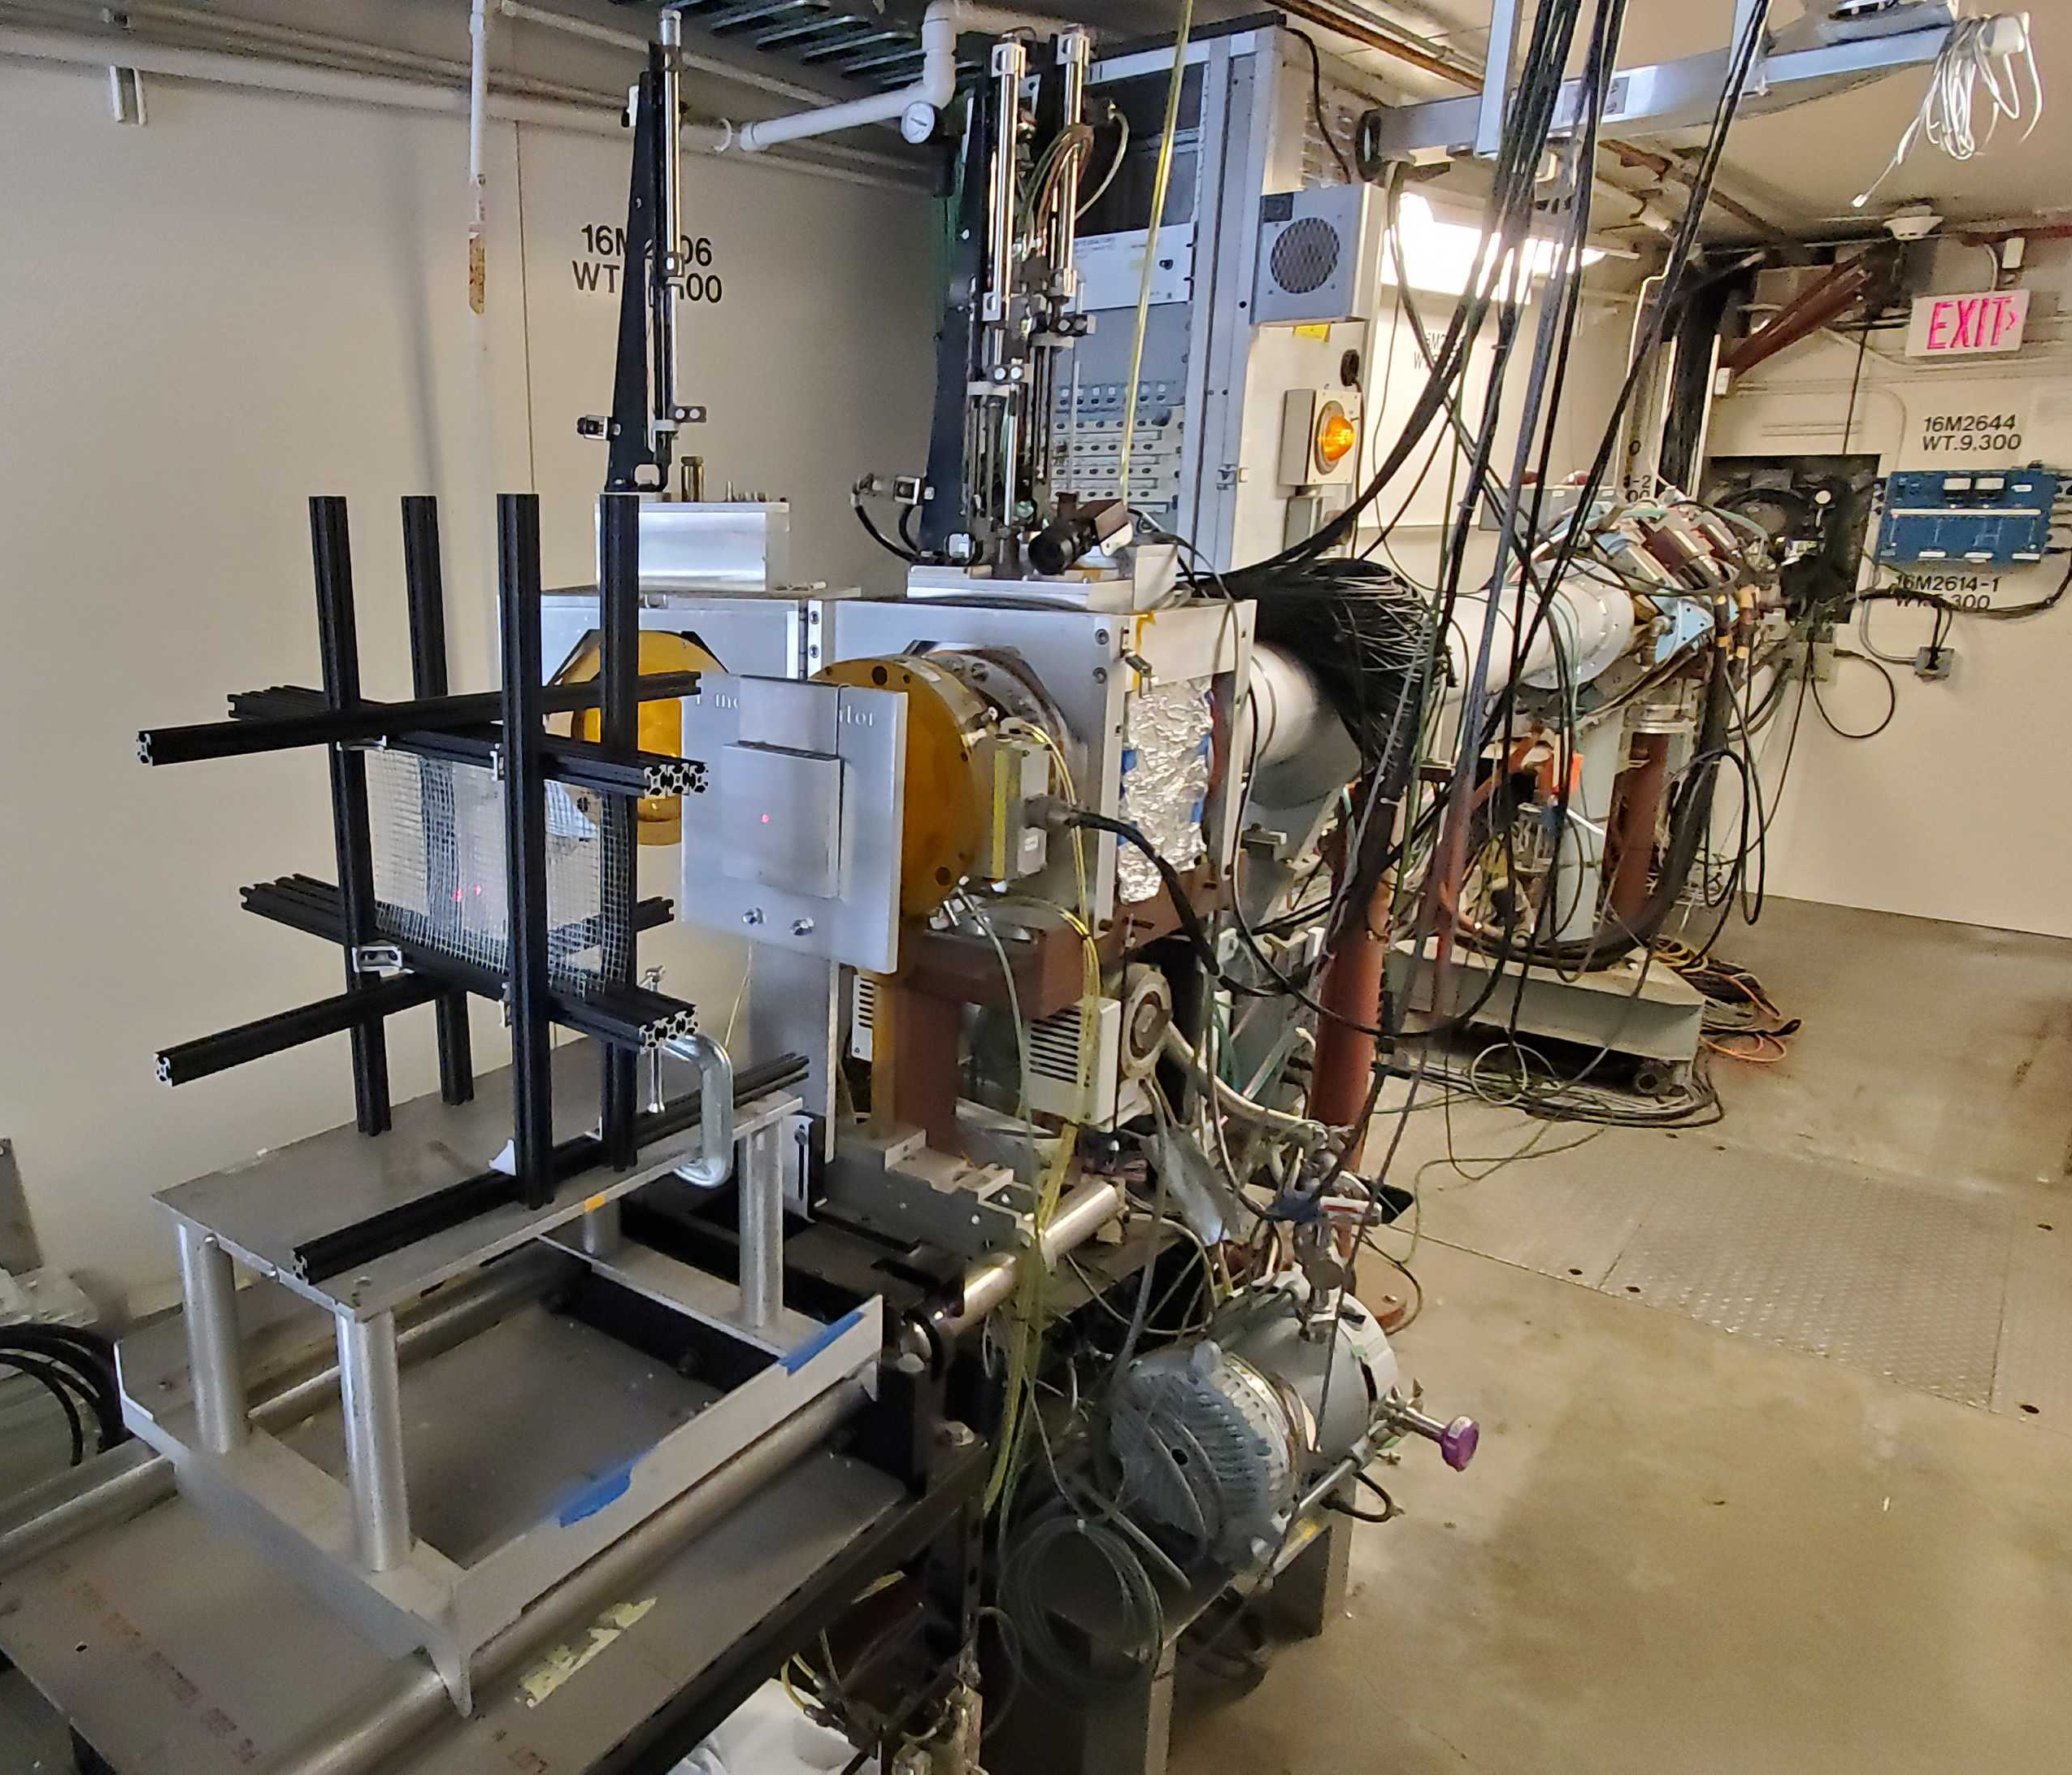
Neutron Flux Expected in the ZDC Region
SiPMs can survive this neutron flux for the course of one run
After each run, SiPMs can be annealed to recover functionality
Berkeley radiation test incoming!
1 MeV equivalent neutron fluence for minimum-bias PYTHIA e+p events at 10x275 GeV at top luminosity for 6 months
https://wiki.bnl.gov/EPIC/index.php?title=Radiation_Doses

Slide 12
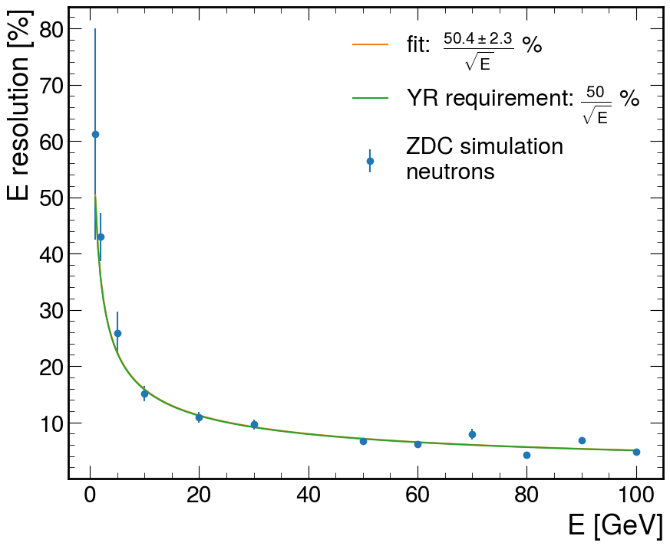
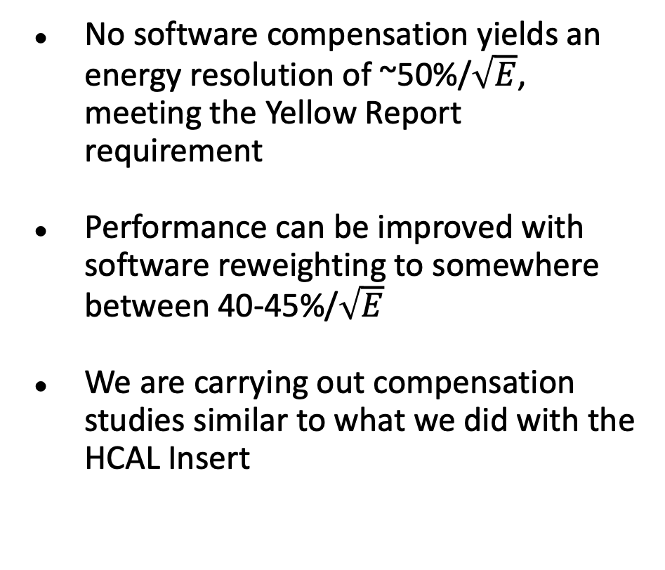
Energy Resolution Before Software Compensation
No software compensation yields an energy resolution of ~50%/$\sqrt{E}$, meeting the Yellow Report requirement
Performance can be improved with software reweighting to somewhere between 40-45%/$\sqrt{E}$
We are carrying out compensation studies similar to what we did with the HCAL Insert

Slide 13
Summary
An HCAL Insert-style ZDC meets the Yellow Report requirements for both position and energy resolution
Compensation via reweighting can take advantage of the high granularity design
Fe absorber blocks can be recycled from STAR, significantly helping cost and construction
Each channel can be easily calibrated and monitored individually via LEDs
SiPMs remain accessible for easy maintenance, annealing will help the ZDC survive in the high fluence environment long-term

