Slide 1

ISOLDE Technical Report for the INTC
Richard Catherall EN-STI
2nd February 2011

Slide 2
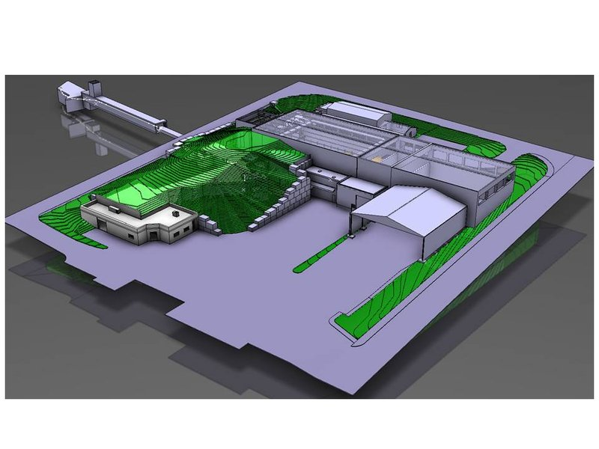
Agenda
Shutdown Work
  FE#7 installation
  REX upgrade
  RILIS upgrade
  On-going work
Safety

Slide 3
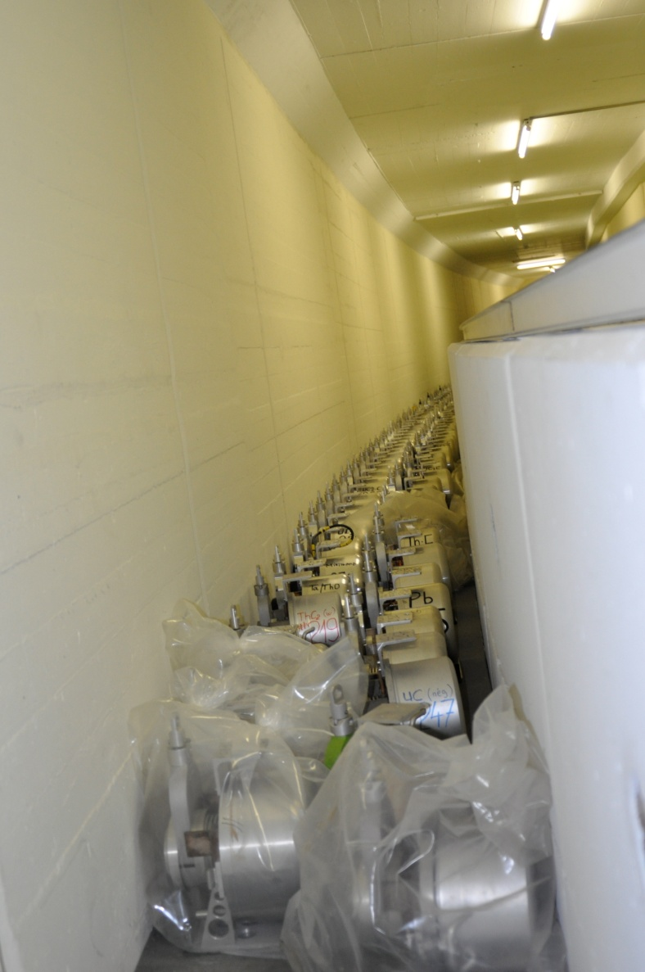
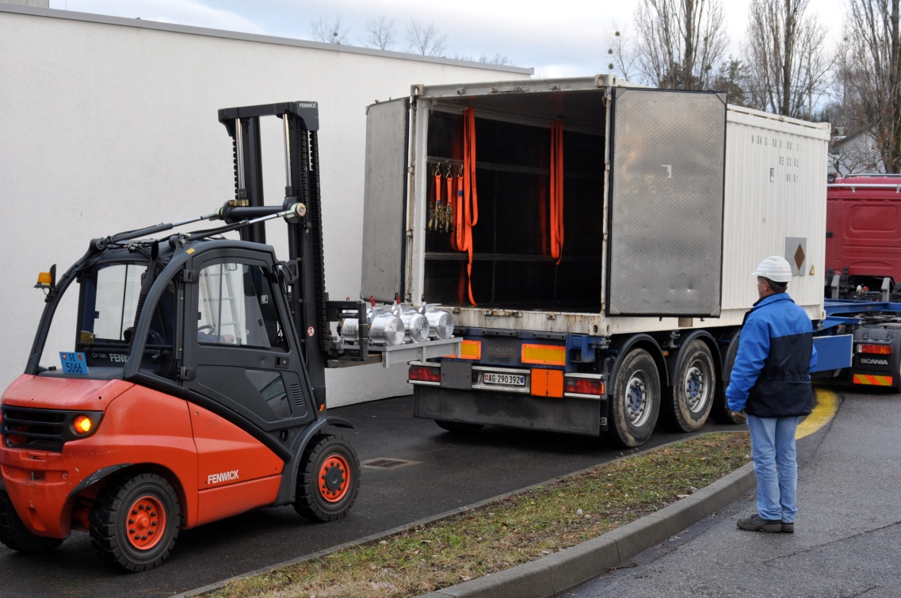
Target Removal
Shutdown Work
Use of Type A transport container as requested by RP.
  Implications to be assessed
New 5 year buffer zone under construction
  Gives time for hot cell construction
B. Crepieux

Slide 4
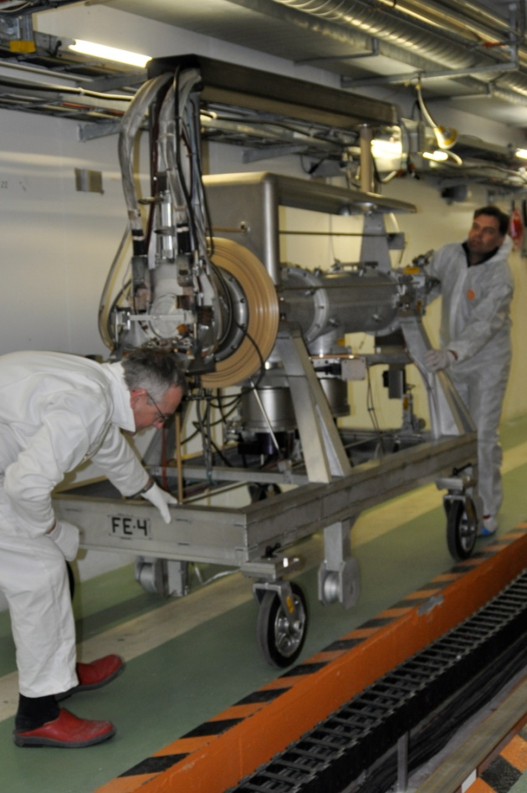
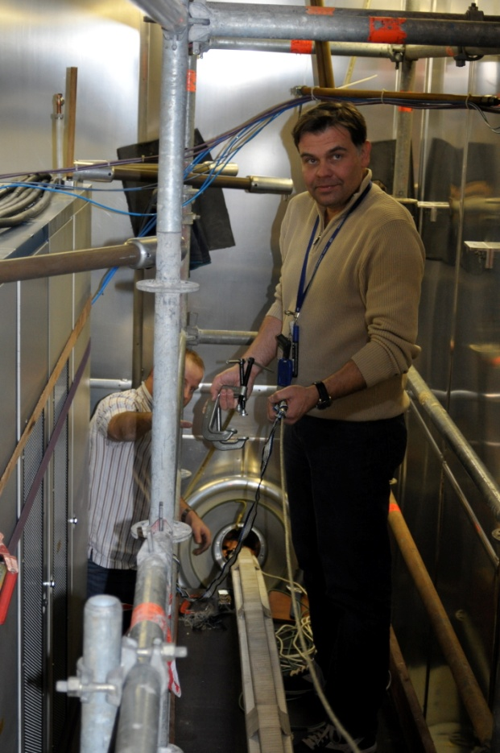
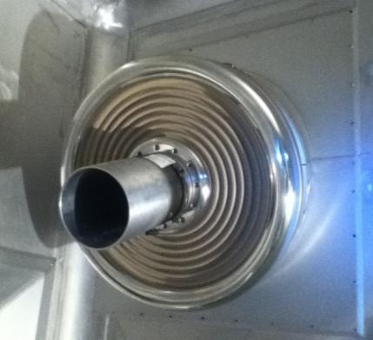
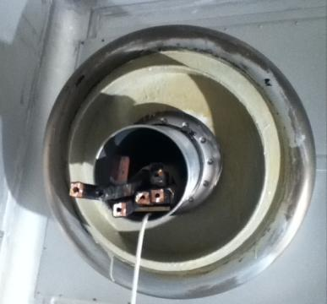
Front End #7
Shutdown Work
Front End #4 removed successfully
Cables and insulator successfully removed
New insulator in place
Difficulty in assuring cable passage between FE faraday cage and separator area.
Phases 1 → 80% of provisional collective dose
Phase 2 →~60% PCD
S. Marzari, T. Giles, T. Stora, E. Barbero, M. Owen

Slide 5
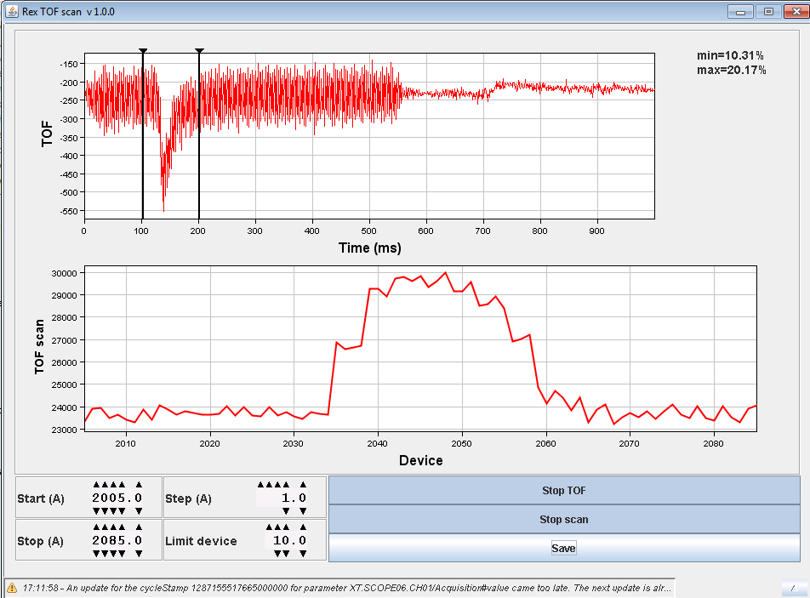
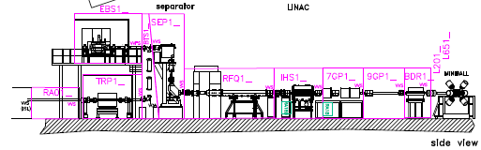
REX Upgrade
Shutdown Work
REXTRAP Controls
1. Dismantling of the old system (FINISHED)
2. Electronics racks cleared (FINISHED)
3. Hardware installation (ONGOING)
4. Local validation of PLC and power supplies (TO BE DONE during February)
5. FESA validation (ONGOING)
Applications
Timing editor application (ONGOING)
Electrode graph display (FINISHED…to be tested when all the hardware will be in place)
Time of Flight application (FINISHED)
Scanning application (TO BE DONE during February)
RF editor application (TO BE DONE during February)
REX Vacuum Controls
Cables removed
Cabling divided between TE-VSC and EN-EL as a function of priorities
  EBIS
  TRAP
  SEPARATOR
E. Piselli, J. Sanchez, F. Wenander, S. Blanchard

Slide 6
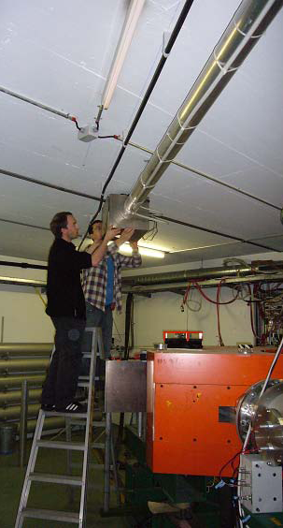
RILIS
Shutdown Work
Move the dye laser system to the new tables to make space for the new Ti:Sa lasers and move the pump laser chiller to the roof of the cabin.
Install the Ti:Sa laser system (Nd:YAG pump laser and 2 or 3 Ti:Sa lasers, plus multiple harmonic generation units).
Redesign the HRS launch mirror system to include a 4th path for ISCOOL pumping.
Install the laser path for ISCOOL pumping in the HRS separator zone.
  Optimize the little remaining space in the RILIS cabin
  remove the electronics racks and desks and replace with a new compact workbench and shelving area.
  Install a frame, laminar flowbox and safety shielding around the Ti:Sa section of the RILIS table.
LIST Tests on-going at off-line separator
  Tl ions have been extracted
  Preparations for installation on FE#7 on-going
B. Marsh, S. Roth, D. Fink & V. Fedosseev

Slide 7
On-going Shutdown Work
Shutdown Work
Pico-ampere meters for Faraday cups
  Cabling and hardware installation on-going
  Waiting for software installation
Redundancy in tunnel fire detection implemented
  Cause of “false” fire alarm in 2010
Tesla meters for the HRS magnets to be moved externally.
Complete renovation of ISOLDE timing
  New distribution hardware this shutdown
  Timing signal cards to be addressed next shutdown
General maintenance
  HT, vacuum, controls, robots,FE#6, beam instrumentation, power supplies, magnets…and a lot more.
E, Siesling, G. J. Focker, D. Raffourt, P. Fernier, T. Giles

Slide 8
Safety
Safety
ALARA Level 3
  Most interventions in the shielded areas of ISOLDE are classed as level 3 ALARA with respect to the present criteria.
  The contamination criteria is the main reason for so many level 3 ALARA committees
    9/14 level 3 over last year.
  5 ALARA level 3 interventions addressed in the last 2 months
      Protocol still unclear
      4/5 interventions have been “accepted” by derogation
      High impact on resources and planning
Visits
  New rules for visits to controlled radiation areas…to be announced
Traceability
  Investigating possible use of Timber database (used by LHC) to monitor machine operation and RIB distribution.
A-P Bernardes, E. Macario, A. Dorsival

