Slide 1


Report on HIE-ISOLDE Project
Yacine Kadi on behalf of the HIE-ISOLDE project team
INTC, 2 February 2011

Slide 2

Project Status
CATHI Project
      5 Fellows in Feb. 2011
      9 new positions posted
Submission of Spanish Grant proposal
      2 projects within “Industry for Science Program” => 250 k€, 4FTE => APPROVED
Interregional Program IV A of the European Union
      Construction of a fully equipped cryomodule prototype => 600 k€ => APPROVED
New Cavity RF tests taking place @ SM18
2nd prototype cavity in preparation
New layout of the facility almost frozen (new buildings)
IAP review Jan. 20-21, 2011
⏎
⏎
⏎
⏎

Slide 3
CATHI Open Positions
(until Jan.4 2011)
ESR2: Cavity and Cryomodule tests
ESR4: New Magnet
ESR5: Development and participation to the integration studies
ESR6: Development and participation to the control, alignment and positioning metrology
ESR8: Target material studies
ESR13: Cooling and Ventilation Design Study
ESR14: Design study of the vacuum system for the Front End of the Isolde facility

Slide 4
CATHI Positions to be opened
(Feb. 2011)
ESR9: Target conceptual design#1
ESR10: Target conceptual design#2
ESR11: Extraction optics and front-end design
ESR12: Low-level controls
ESR15: Off-line separator and High-resolution separator magnet
ESR16: RFQ cooler and pre-separator
ER3: Design study of a replacement charge breeder for REXEBIS
⏎

Slide 5
Planning of RF Measurements for Prototype Cavities 1 & 2
Jan. 10 – Feb. 15 => 4th cold RF tests of high-β prototype cavity#1
    10 – 14 Jan. => measurement of the coupler line -> thermalization is OK
    17 – 21 Jan. => extraction of cavity#1 and disassembly of coupler line -> done
    24 – 28 Jan. => fixing coupler line and reassembly of cavity#1 -> done
    31 – 8 Feb. => RF conditioning and tests -> in progress
Jan. 17 – Mar. 15 => 1st cold RF tests of high-β prototype cavity#2
    17 – 21 Jan. => conditioning of sputtering chamber -> done
    24 – 8 Feb. => preparation and sputtering of cavity#2 -> in progress
    9 – 18 Feb. => transport to SM18, assembly of cryostat and cool down
    21 – 4 Mar. => RF conditioning and tests
Mar. 1 – Apr. 15 => new cold RF tests of high-β prototype cavity#1
    New sputtering
Mar. 31 – May. 15 => new cold RF tests of high-β prototype cavity#2
    New sputtering

Slide 6
Resources Available
Cavity Assembly and RF tests => 4 FTE
Cavity Preparation and Sputtering => 4 FTE
Operation Cryogenic System => 1-2 FTE
Critical Aspects
    Availability of clean room operator, cavity preparation
    Availability of clean room in Building 252 and SM18
    Conflicts with cavity R&D for SPL, CLIC and LHC spare cavity
⏎

Slide 7
Material Budget
HIE-ISOLDE Linac (M. Pasini BE/RF) |  |  |  |  |  | Total | 2010 | 2011
SC Cavity RF | EIS-PRJ | WP2.1 | 69520 | BE | RF | 2269 | 0 | 221
SC Cavity Design & Manufacturing | EIS-PRJ | WP2.2.1 | 55601 | EN | HDO | 3700 | 196 | 544
SC Cavity Sputtering | EIS-PRJ | WP2.2.2 | 99796 | TE | VSC | 553 | 75 | 63
SC Cavity Sputtering (IS) | EIS-PRJ | WP2.2.2 | 99796 | TE | VSC | 355 | 4 | 73
SC Cavity Test | EIS-PRJ | WP4.1 | 69521 | BE | RF | 51 | 51 | 0
SC solenoids | EIS-PRJ | WP2.6 | 99157 | TE | MSC | 656 | 29 | 82
SC solenoids QPS | EIS-PRJ | WP2.6.4 | 99689 | TE | MPE | 200 | 0 | 30
Cryomodules | EIS-PRJ | WP2.4 | 99158 | TE | MSC | 4600 | 2 | 198
Cryomodules (Des. Off.) | EIS-PRJ | WP2.4.1 | 55602 | EN | HDO | 413 | 0 | 130
Cryomodule Test | EIS-PRJ | WP4.2 | 99159 | TE | MSC | 0 | 0 | 0
Beam Dynamics | EIS-PRJ | WP2.3 | 69522 | BE | RF | 0 | 0 | 0
Beam Instrumentations | EIS-PRJ | WP2.5 | 64520 | BE | BI | 1450 | 0 | 112
Beam Transfer Line | EIS-PRJ | WP2.7 | 99160 | TE | MSC | 1710 | 0 | 100
Linac Integration/Installation | EIS-PRJ | WP2.8 WP4.4 | 55603 | EN | MEF | 166 | 18 | 28
Linac Commissioning | EIS-PRJ | WP4.5 | 69523 | BE | RF | 0 | 0 | 0
Vacuum | EIS-PRJ | WP2.9 | 99798 | TE | VSC | 1400 | 0 | 200
Survey | EIS-PRJ | WP2.10 | 61520 | BE | ABP | 201 | 0 | 65
Total |  |  |  |  |  | 17724 | 375 | 1847

Slide 8
Material Budget
HIE-ISOLDE Infrastructure (D. Parchet GS/SEM) |  |  |  |  |  | Total | 2010 | 2011
Civil engineering | EIS-PRJ | WP3.1 | 76155 | GS | SEM | 1645 | 4 | 773
Integration | EIS-PRJ | WP3.2 | 55613 | EN | MEF | 114 | 0 | 77
Handling systems | EIS-PRJ | WP4.3 | 55614 | EN | HE | 139 | 0 | 0
Transport & Handling services | EIS-PRJ | WP4.3 | 55617 | EN | HE | 232 | 0 | 46
Cooling & ventilation | EIS-PRJ | WP3.3 | 55604 | EN | CV | 2784 | 0 | 225
Electrical systems | EIS-PRJ | WP3.4 | 55605 | EN | EL | 1330 | 0 | 300
Cryogenic system | EIS-PRJ | WP3.5 | 99537 | TE | CRG | 4823 | 14 | 78
Power converters | EIS-PRJ | WP3.6 | 99641 | TE | EPC | 2225 | 0 | 269
Industrial Control systems | EIS-PRJ | WP3.7 | 55615 | EN | ICE | 56 | 0 | 56
Beam Control systems | EIS-PRJ | WP3.8 | 66520 | BE | CO | 70 | 0 | 28
Interlocks | EIS-PRJ | WP3.9 | 99688 | TE | MPE | 185 | 0 | 0
Total |  |  |  |  |  | 13603 | 18 | 1852

Slide 9
Material Budget
HIE-ISOLDE Design Study (R. Catherall EN/STI) |  |  |  |  |  | Total | 2010 | 2011
Target & Front end Design | EIS-PRJ | WP5.1, 5.2.2, 5.2.3 | 55606 | EN | STI | 556 | 0 | 255
HV and High Current Systems | EIS-PRJ | WP5.2.1 | 99223 | TE | ABT | 232 | 0 | 28
Beam Diagnostics | EIS-PRJ | WP5.3 | 64520 | BE | BI | 0 | 0 | 0
Layout upgrade | EIS-PRJ | WP6.1 | 55616 | EN | MEF | 111 | 0 | 0
Cooling and Ventilation | EIS-PRJ | WP6.2 | 55607 | EN | CV | 111 | 0 | 0
Electrical systems | EIS-PRJ | WP6.3 | 55608 | EN | EL | 0 | 0 | 0
Transport & Handling | EIS-PRJ | WP6.4 | 55618 | EN | HE | 58 | 15 | 43
Vacuum | EIS-PRJ | WP6.5 | 99799 | TE | VSC | 93 | 0 | 46
Survey | EIS-PRJ | WP6.6 | 61520 | BE | ABP | 0 | 0 | 0
Civil engineering | EIS-PRJ | WP6.7 | 76155 | GS | SEM | 46 | 0 | 0
LL controls | EIS-PRJ | WP6.8 | 55609 | EN | STI | 93 | 0 | 0
Off line separator | EIS-PRJ | WP7.1 | 55610 | EN | STI | 185 | 0 | 93
Separator areas | EIS-PRJ | WP7.2 | 55611 | EN | STI | 209 | 0 | 93
Experiment Hall | EIS-PRJ | WP7.3 | 55612 | EN | MEF | 111 | 0 | 56
Beam lines | EIS-PRJ | WP7.4 | 61522 | BE | ABP | 185 | 0 | 46
Total |  |  |  |  |  | 1991 | 15 | 660

Slide 10
Material Budget
Title | PPA | Work Package | Code | Dep. | Group | Total Request
HIE-ISOLDE Safety (A.P. Bernardes EN/STI)
Safety Coordinator | EIS-PRJ | WP8.1 | 70155 | GS | DI | 0
Radiation Protection | EIS-PRJ | WP8.2 |  | DGS | RP | 464
Access System | EIS-PRJ | WP8.3 | 72155 | GS | ASE | 153
Fire & Gaz Detection | EIS-PRJ | WP8.4 | 72155 | GS | ASE | 72
Total |  |  |  |  |  | 689

Slide 11
Status of External Funding
(assured)
R&D activity, part of LINAC funded from K.U. Leuven – Belgium (4.3 MCHF + 4 FTE) -> 2 MCHF available for 2011 and 340 kEUR/yr (2012-2015)
Contribution from ISOLDE Coll. (1.0 MCHF + 9 FTE) -> 840 kCHF for 2011 and 380 kCHF/yr (2012-2015)
Other beam quality investments (new RILIS, RFQ cooler, charge breeding) – funded by Sweden, UK and Germany (4 MCHF)
Spanish Grant proposal:
    “Industry for Science Program” => 250 k€, 2FTE => APPROVED
    MiCINN project => 998 k€, 1FTE => not retained, to be resubmitted in April 2011
Interregional Program IV A of the European Union
    Construction of a fully equipped cryomodule prototype => 600 k€ => APPROVED

Slide 12
Status of External Funding
(applied for)
Additional application to the Wallenberg Foundation (Sweden) => LOI submitted for 2.5 MEUR
Spanish Grant proposal:
    MiCINN project => 998 k€, 1FTE => not retained, to be resubmitted in April 2011
KoRIA Project —> discussion to fund 1 fully equipped high-beta cryomodule => ~1.5 MCHF + FTE’s => KoRIA-ISOLDE Collaboration next on the agenda of the CERN-Korea Committee (CKC)
India RIB Project —> discussion to be engaged soon (planned visit in April)

Slide 13
Status of External Funding
45% of external (7.4 MCHF out 17.7 MCHF) assured
Construction of the machine (incl. beam lines) will be staged according to availability of funds and/or in kind contributions
⏎

Slide 14
Joint HIE-SC IAP meeting, Jan.20-21
14:00 Welcome (Sergio Bertolucci )
14:10 Framework and Physics (Yorick Blumenfeld)
14:55 Overview of the project; budget and management (Yacine Kadi)
1 5:40 Coffee
16:00 Technical choices and prototyping (Matteo Pasini)
16:45 High Intensity Design Study (Richard Catherall)
17:15 Implementation and Infrastructure (Erwin Siesling)
17:45 Safety (Ana-Paula Bernardes)
Friday Jan 21, 2011
8:30 IAP Closed Meeting
11:00 Preliminary oral report of IAP to Steering Committee
12:00 End
http://indico.cern.ch/conferenceDisplay.py?confId=123039

Slide 15
Project Structure of HIE-ISOLDE

Slide 16
Prel. Recommendations from IAP
Positive review
Accelerate SC Cavity prototype cold tests @ SM18
Speed up Cryostat design
=> contacts with industry
RP studies should be performed => impact on layout of experimental facility
Enhance coordination with physics group and collaboration with SPIRAL2
Plan for 10 A MeV but priority is 5.5 A MeV

Slide 17
HIE-ISOLDE Schedule
Important milestones for Energy Upgrade:
Start project Jan 1st 2010
Start construction by Jun 2011
Launch Procurement of Cryogenics equipment:
  Finance Committee by Sep. 2011
Cryogenics installed and commissioned end 2013
High energy beam line (5.5 MeV/u) installed by Apr 2014
10 MeV/u Linac installed by 2015/2016
Installation organized inline with L4 and PSB commissioning
PSB SHUTDOWN
Physics @ 5.5 A MeV
5.5 MeV/u Linac commissioned
10 MeV/u Linac commissioned

Slide 18
Status of HIE-ISOLDE Collaborations
K.U. Leuven – Belgium (Active)
Cockcroft Institute, Liverpool and Manchester Uni. – UK (Active)
ESS and Uni. Lund (Active)
LNL-INFN – Italy (MoU)
GANIL/Spiral-2 – France (MoU)
VECC & SAHA- INDIA (MoU)
SKKU-Korea (MoU)

Slide 19
Outlook
SC Cavity prototype cold tests @ SM18 => June 2011
Start of the civil engineering works => May 2011
Cryomodule Design => end 2011
Radiation protection calculations => summer 2011
Ordering of the Cryogenics Plant => FC Sep. 2011

Slide 20
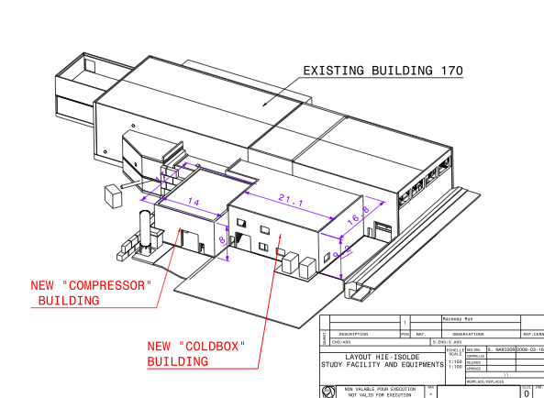

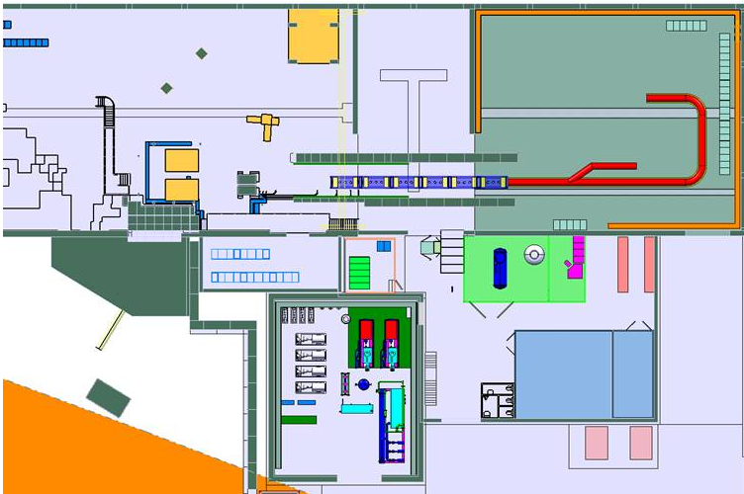
Thank you very much for your attention
CERN teams involved with the HIE-ISOLDE project
ISOLDE Collaboration
Ext. partners

