Slide 1
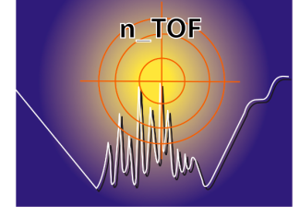


Status of the n-TOF experiment
E.Chiaveri
(EN-STI-EET)
On behalf of n_TOF collaboration

Slide 2


ITEMS
Experimental campaign 2010
Experimental campaign 2011
EAR2 (experimental Area 2)
Summary

Slide 3
Experimental campaign 2010: HIGHLIGHTS
The campaign 2010 has been excellent in terms of beam efficiency and innovation:
First experimental campaign making use of the ¹⁰B-water moderation circuit
First experimental campaign making use of the Work Sector Type-A (WSTA)
Successful measurements of ⁵⁴Fe σ(n,γ)
Successful measurement of ²⁴¹Am (4GBq) combining TAC (4π BaF₂) + C₆D₆
First test at n_TOF for measuring (n,lcp) with diamond (xCVD) detectors
First n_TOF experiment for simultaneous (n,γ)+(n,f): TAC+MGAS
First n_TOF experiment for Angular Distributions of fission fragments (PPAC)
Results of ongoing analysis from 2009/10 campaigns already presented in several International Conferences /Workshops: ND-2010, EFNUDAT-2010, NPA-V, …

Slide 4
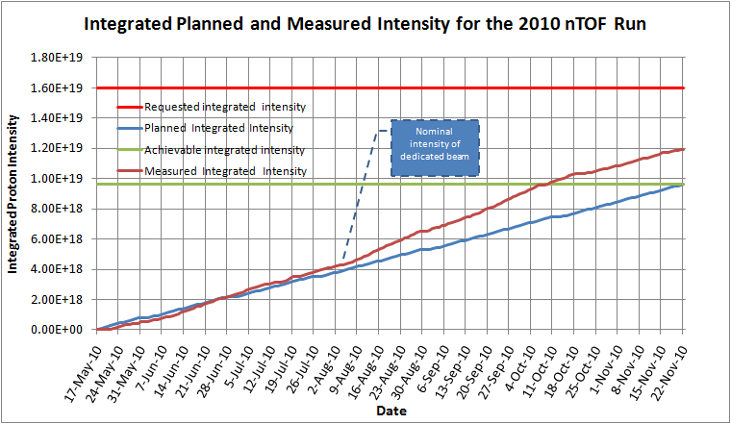

Slide 5
Summary of the n_TOF-Ph2 experimental campaign 2010
Document No | Proposal | Measurement | Detectors | # Protons | Dates
- | - | Start Up | All | 1.0E+17 | 18/5-21/5
CERN-INTC-2008-035 | n_TOF-12: New target commissioning and beam characterization | ¹⁰B water commisioning | PTB, SiMon, MGAS, XY-MGAS, C6D6 | 2.1E+18 | 22/5-27/6
CERN-INTC-2006-012 | n_TOF-13: The role of Fe and Ni for s-process nucleosynthesis … | ⁵⁴Fe(n,g) | C6D6 | 2.0E+18 | 28/6-2/8
- | Start up of the ²⁴¹Am measurementrs: RP issues, high activity on detectors, etc. | ²⁴¹Am(n,g) | C6D6 | 1.0E+18 | 3/8-18/8
CERN-INTC-2009-025 | n_TOF-15: Neutron capture cross section measurements of ²³⁸U, ²⁴¹Am and ²⁴³Am at n_TOF | ²⁴¹Am(n,g) | C6D6 | 1.3E+18 | 19/8-7/9
- | Start up of the ²⁴¹Am measurementrs: RP issues, high activity on detectors, etc. | ²⁴¹Am(n,g) | TAC | 4.0E+17 | 8/9-14/9
CERN-INTC-2009-025 | n_TOF-15: Neutron capture cross section measurements of ²³⁸U, ²⁴¹Am and ²⁴³Am at n_TOF | ²⁴¹Am(n,g) | TAC | 2.1E+18 | 15/9-10/10
CERN-INTC-2010-037 | LOI: Validation of simultaneous measurement of capture and fission reactions at n_TOF | ²³⁵U(n,g) ²³⁵U(n,f) | TAC + MGAS | 6.0E+17 | 11/10-18/10
CERN-INTC-20106-016 | n_TOF-14: Angular distributions in the neutron-induced fission of actinides | ²³²Th(n,f), ^{235,238}U(n,f) | PPAC | 2.0E+18 | 19/10-23/11
 | TOTAL 2010 |  |  | 1.16E+19 | 18/5-23/11

Slide 6
Experimental campaign 2010: ⁶²Ni(n,γ)
The unprecedented accuracy of the nTOF measurements solves the contradiction between different Cross Section Evaluations
Yield
E (keV)
collaboration meeting

Slide 7
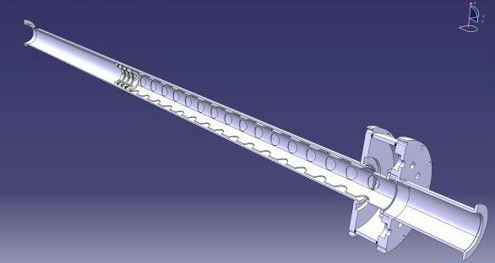
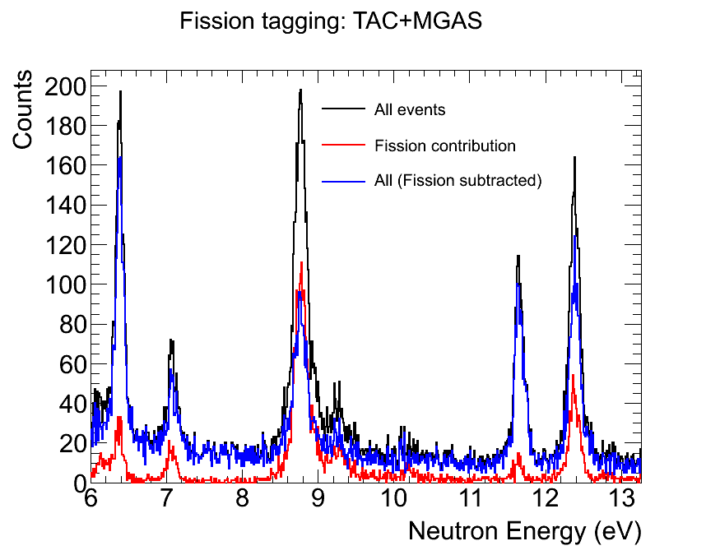
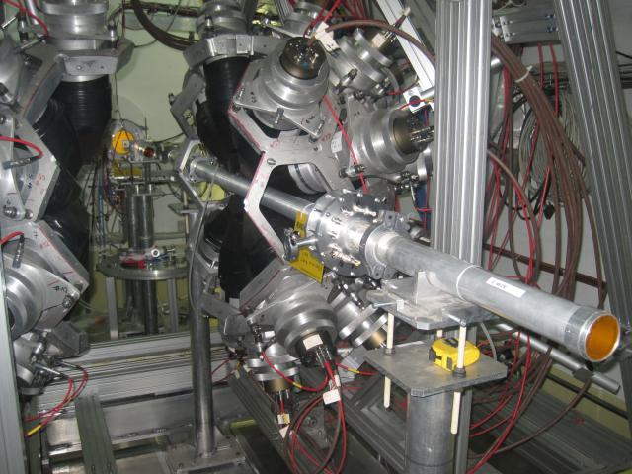
Experimental campaign 2010: Simultaneous (n,γ)/(n,f)
Fission tagging chamber fabricated at CERN
Test experiment performed during a 7 days campaign
(n,γ) dominated

Slide 8
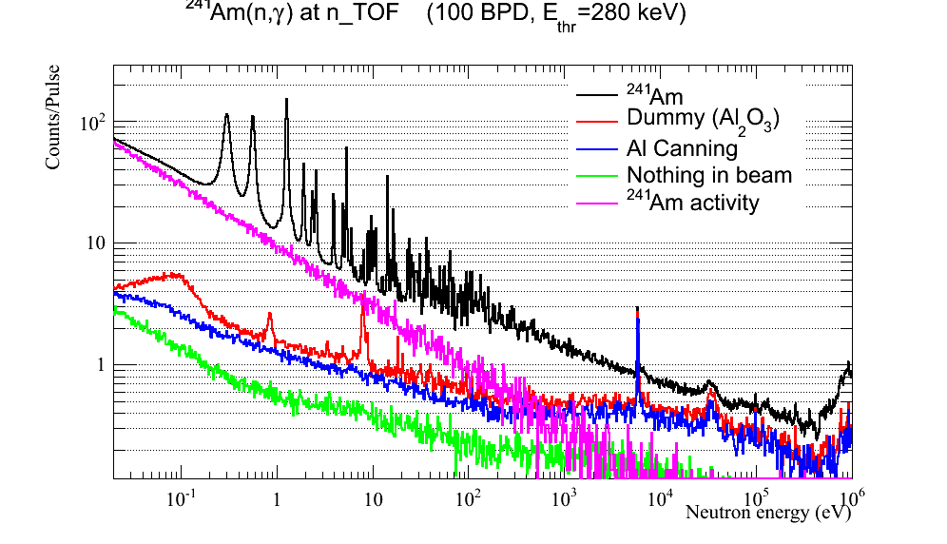
Experimental campaign 2010: ²⁴¹Am(n,γ)
First ever measurement recording data from thermal to 1 MeV ins single shot!

Slide 9
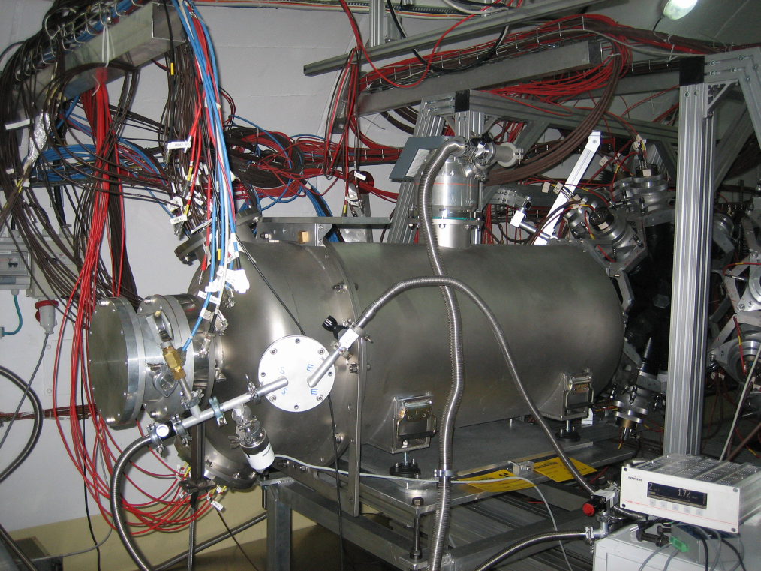
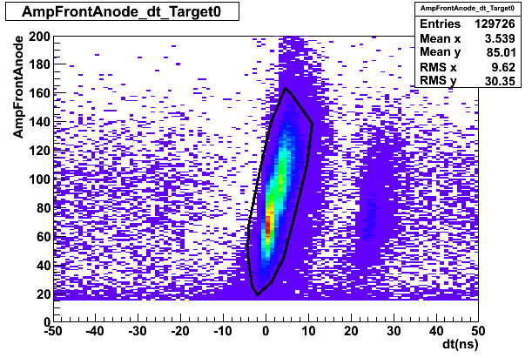
Experimental campaign 2010: Ang. Distr. Of Fission Fragments
PPAC with 10 parallel plate detectors tilted 45 degrees with respect to the beam.
9 samples: ²³⁵U, ²³⁸U, ²³⁷Np and 6x²³²Th.
Fission from ²³⁵U target
Background from neighboring ²³⁸U target

Slide 10
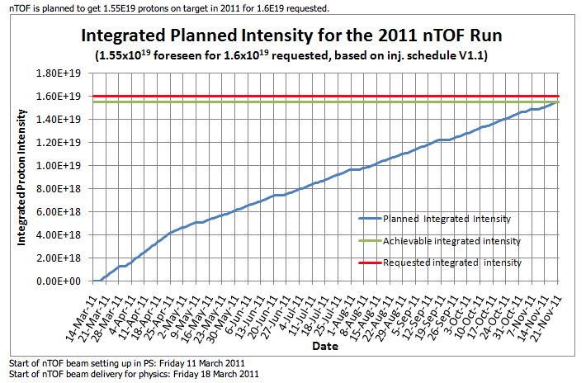

Slide 11
Experimental campaign 2011: PLANS
The campaign 2011 will provide finally a total of 1.55 e19 protons/year, which will allow to advance in most of the approved proposals.
Some innovations:
First use of MGAS for measuring ³³S σ(n,α): isotope for possible medical appliction
First use of a large area pCVD diamond for σ(n,α) beyond the MeV frontier
First use of MGAS for measuring σ(n,f) at high energy: ^{240,242}Pu
First ever measurement of the radioactive ⁶³Ni σ(n,γ)
The challenges will mainly come from:
the use of new (or combinations) of detection systems
the unprecedented aimed accuracy for the ²³⁸U(n,γ) measurement:
  2-3% overall accuracy between thermal and 1 MeV!!
The n_TOF Collaboration will benefit from the arrival of new members:
Oak Ridge National Laboratory (USA)
IRMM Geel (Belgium)
University of Zagreb (Croatia)
University of Manchester
University of York
University of Thessaloniki

Slide 12
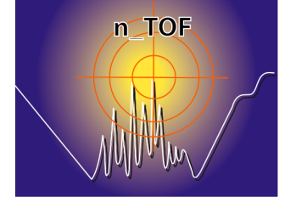
Preliminary n_TOF measurement plan for 2011
INTC Reference | Measurement | Detector | Expected dates | Comments
 | Start Up | Varii | 17/3 - 22/3 | Varii
CERN-INTC-2006-012 | ⁵⁷Fe(n, γ) | C6D6 | 22/3 – 10/4
CERN-INTC-2010-067 | ⁶³Ni(n, γ) | C6D6 | 10/4 – 20/5
CERN-INTC-2010-037 | ^{240,242}Pu(n,f) | MGAS | 10/4 – 20/5 | In parallel with ⁶³Ni Splitted in half: 2011-2012
CERN-INTC-2009-025 | ²³⁸U(n, γ) | TAC+C6D6 | 20/5 – 5/9
CERN-INTC-2010-065 | ²³⁶U(n,γ) | TAC+C6D6 | 5/9- 3/11
CERN-INTC-2010-061 | ¹⁰B(n, α) | pCVD | 3/11 – 13-11
CERN-INTC-2006-016 | FF Ang. Dist. | PPAC | 13/11 - 23/11 | Pending 5e17 p. from 2010
CERN-INTC-2010-023 | ³³S(n,α) | MGAS | 12/11 - 22/11 | In parallel with PPAC
The total of 1.55∙10¹⁹ protons will be allocated in order to carry out a total of 8 measurements using:
  11 different samples
  5 detection systems
  2 different collimator configurations

Slide 13
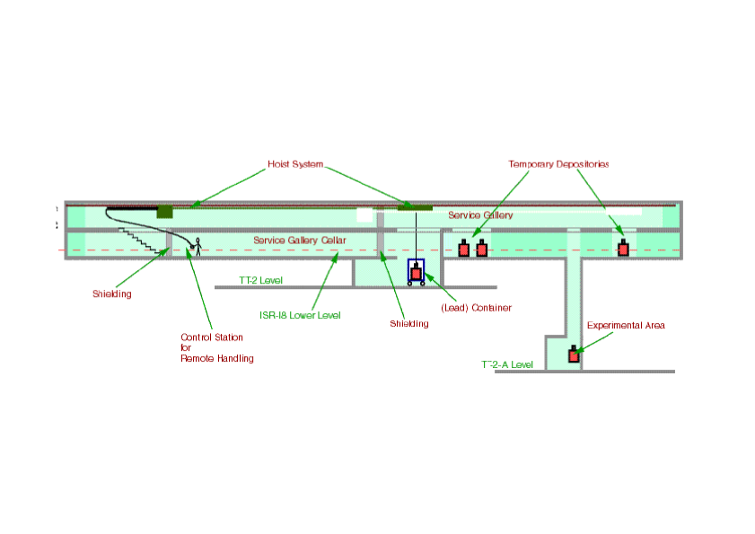
EAR-2
New
Experimental
Area (EAR-2)
~ 20 m
10 m
n_TOF target
EAR-1
(at 185 m)
Flight-path length : ~20 m
at 90° respect to p-beam direction
expected neutron flux enhancement
drastic reduction of the t₀ flash

Slide 14
Perspectives of Nuclear Physics in Europe
NuPECC Long Range Plan 2010
[…] Next generation neutron time of-flight facilities such as n_TOF2 … with unsurpassed neutron fluxes are necessary to perform
such measurements [neutron capture cross sections … for unstable nuclei [which are] still not known with sufficient accuracy]. Pag.142
Europe has to date been well provided for in terms of neutron beams for neutron capture studies, with a number of active facilities and the recently upgraded n-TOF facility at CERN. However […] there is a need for a new generation of such facilities with greatly increased neutron fluxes and better TOF measuring capability Pag.146
Support to […] installations at large scale facilities that are unique to provide
high quality nuclear data essential for nuclear energy applications should be guaranteed [as in the case of the] n_TOF at CERN with the construction of the short flight path … Page 179

Slide 15
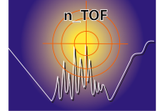
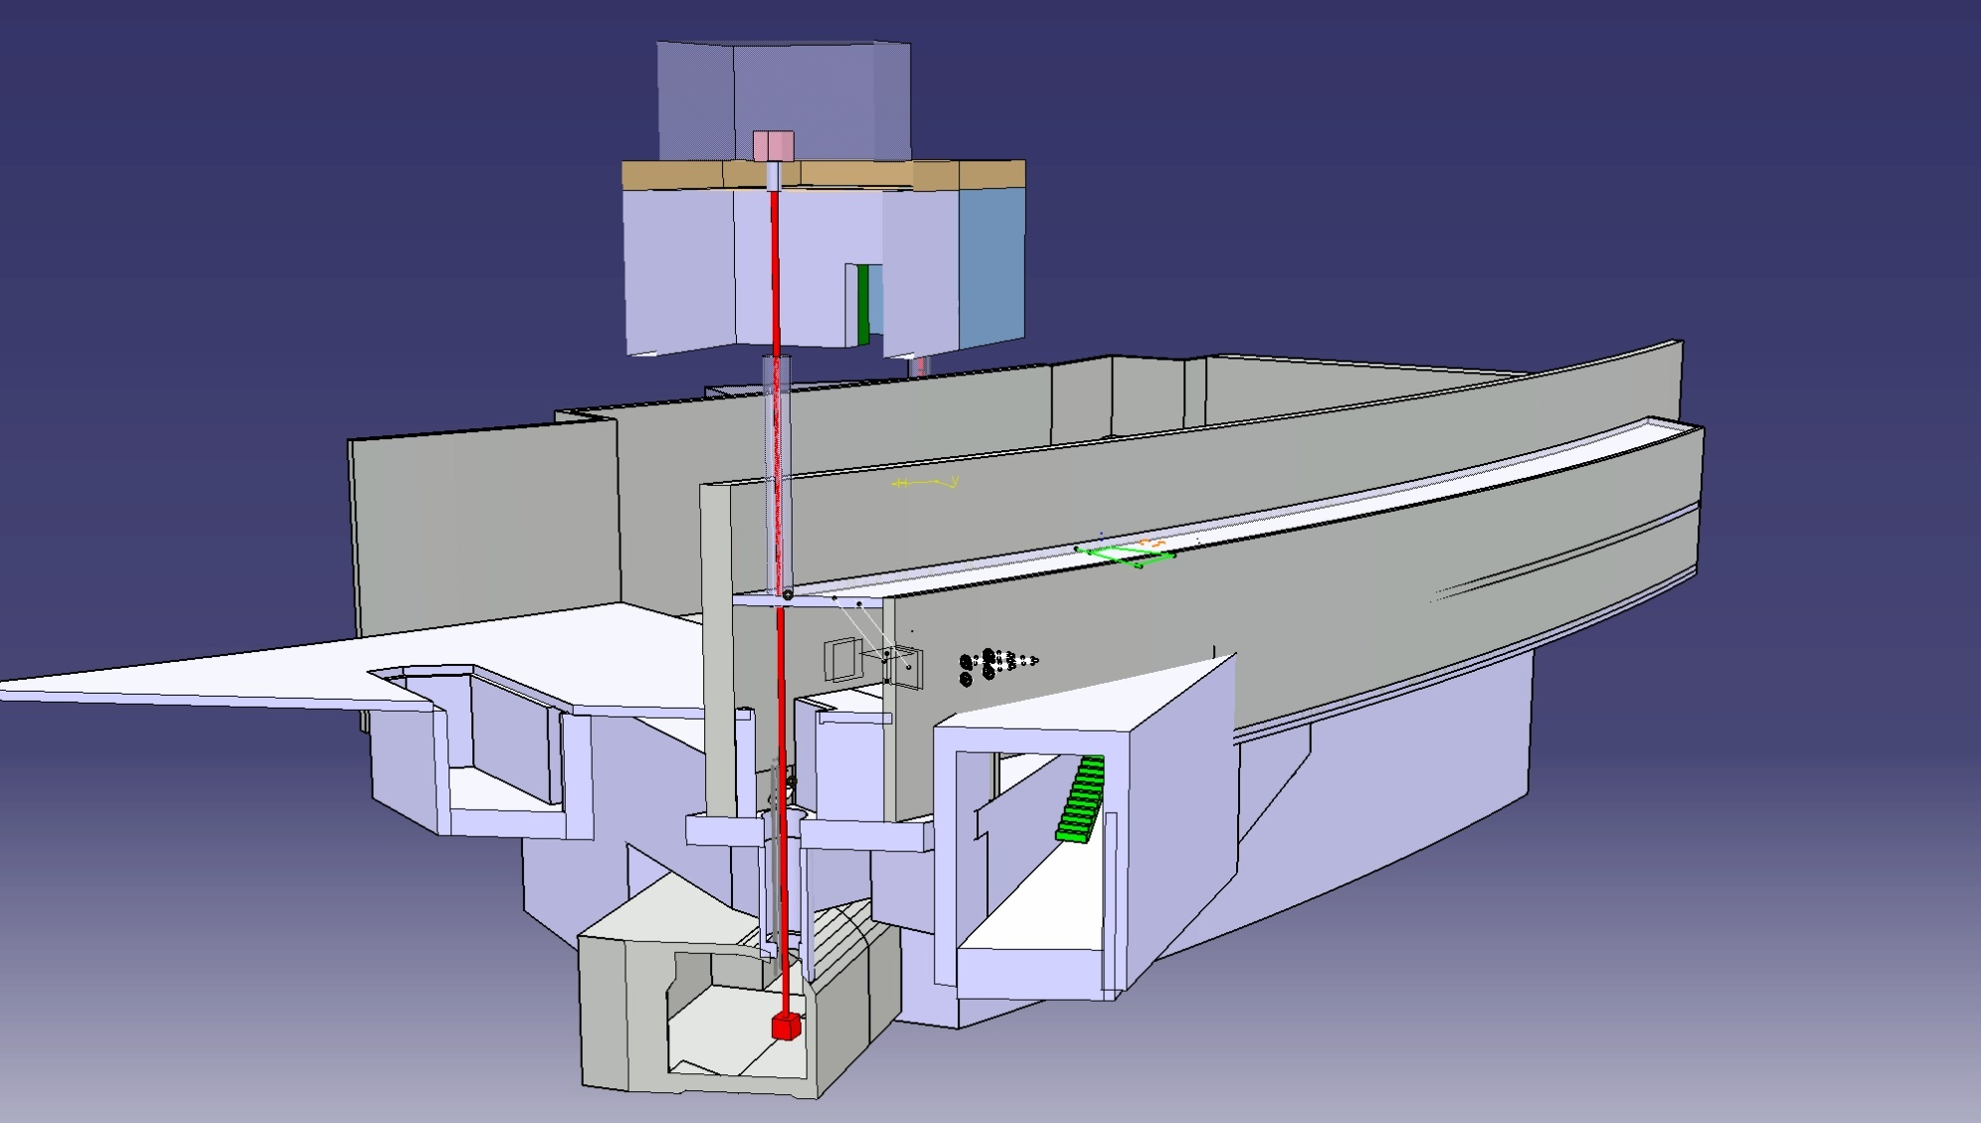
Overview of the n_TOF spallation target area
EAR2 (@20 m from pit, above ground)
To be built
ISR
Technical gallery (@10 m from pit)
Existing hole
n_TOF target pit

Slide 16
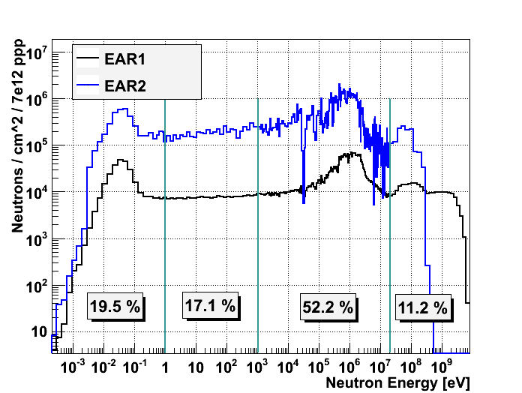
Neutron Fluence

Slide 17

EAR-2 Experiments
Experiments in EAR-2 can be performed :
on very small samples
(important to reduce mass of unstable samples
and in cases where sample material is limited)
on isotopes with very small cross sections
(where signal/background ratio is crucial)
in much shorter time
(measurements can be eventualy repeated to reduce
systematic uncertainties)

Slide 18
EAR-2 Nuclear Transmutation
From the transmutation projects (or future generation nuclear energy systems), the EAR2 would allow to measure the fission cross-section of Pu isotopes and minor actinides with half lives of a few tens of years.
Although short lived, it may be convenient to burn those actinides in future systems (either ADS or Gen IV fast reactors), together with their neighboring long-lived isotopes.
Important Candidates:
Fission Cross Section :238Pu (87.7 y)/241Pu (14.1 y) 244Cm(18.1 y)
Capture Cross Section : 242Am (141 y)/ 243Cm (29.1 y) and
231Pa(32400 y)

Slide 19
EAR-2: Nuclear Astrophysics
Nucleosynthesis by the slow neutron capture process
represents a unique tool for studying the related abundances through the tight correlation with the experimental (n, γ) cross sections.
The EAR-2 options for measurements of so far
inaccessible reaction rates will provide a boost for our
understanding of neutron capture nucleosynthesis during the
He burning phases of stellar evolution, which played a crucial
role in the history of the Universe, because they contributed half of the abundances between Fe and Bi.
important candidates for EAR-2:
⁷⁹Se, ⁹⁰Sr, ⁹³Zr, ¹⁰⁷Pd, ¹³⁵Cs, ¹⁴⁷Pm, ¹⁶³Ho,¹⁷¹Tm, ¹⁸²Hf, ²⁰⁴Tl

Slide 20
EAR2: highlight of possible applications
Neutron fluence for neutron-induced fission and/or capture measurement on small masses
@ 20 m
7-8*10⁶ n/cm²/pulse
>20 MeV 8-9*10⁵ n/cm²/pulse
Testing of active electronic equipments for LHC and other applications.
@20 m
>20 MeV 8-9*10⁵ n/cm²/pulse
^{1Pulse every 3 sec} 5-10*10¹⁰n/cm²/week
Passive irradiation of (small) equipment in high fluence environment (ITER, IFMIF, …)
@1.5 m
1-2*10¹⁰n/cm²/pulse
^{1Pulse every 3 se} → ~ 3*10¹⁵n/cm²/week
PRELIMINARY

Slide 21
n_TOF Facility Summary
Work Sector Type A experimental area
  Converted the actual experimental area to a Work Sector Type A → no major restrictions on radioactive samples measurement
  Significant improvements in measurement capabilities
Operation of a borated water moderation system
  Improvements of γ background conditions
2010 experimental campaign
  Program completed and analysis ongoing
2011 experimental campaign
Official schedule under preparation
EAR-2 (Experimental Area 2)
Feasibility study ongoing
Platform for n_TOF data dissemination in collaboration with the European Nuclear Data Evaluation Team (JEFF-NEA)

