Slide 1
Extending and Refining the Mass Surface around ²⁰⁸Pb
High-Precision Penning-Trap Mass Spectrometry with ISOLTRAP
Susanne Kreim
February 2nd 2011
Overview
Technical Possibilities
Physics Aims

Slide 2
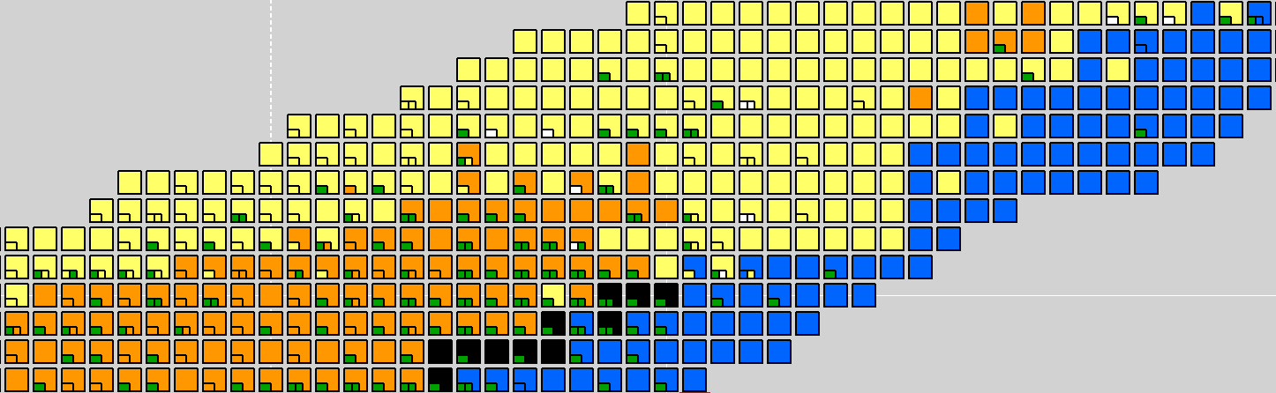
Physics Interest
octupole deformation
r-process
→ nucleosynthesis path
α-decay chains
Z=82
N=112
N=126
mid-shell behavior
→ shape coexistence
→ octupole correlations
→ isomerism
robustness of shell closure
→ residual interaction
→ shell gap

Slide 3
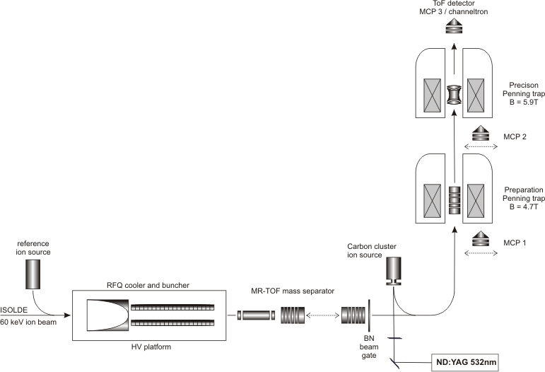
Current Performance of ISOLTRAP
Accuracy ≈ 1·10⁻⁸ achievable via frequency measurement to extract wanted mass
Half-life ≈ 60ms
Production yield ≈ 100 ions per second
Efficiency ≈ 1%
Resolving power for isobar separation ≈ 10⁵
Contamination ratio ≈ 10⁴:1 plus ≈ 10³:1
Resolving power for isomer separation ≈ 10⁷
Time-of-flight detection via “Ramsey method”
Installed 2010
M. Mukherjee et al., Eur. Phys. J. D 22, 53 (2003)

Slide 4
Technical Achievements
N-rich Au: newly developed RILIS scheme available
  Suppression of Hg and Pb achievable
Hg and Pb isotopes:
  Tl and Fr suppressed by quartz transfer line due to further development
  For n-deficient Hg and Pb current state-of-the-art targets sufficient
At isotopes: RILIS ionization scheme successfully tested in 2010
  Fr contamination for A ≥ 203 removable by ISOLDE
  Required resolving power and contamination ratio of Fr, Ra and Tl (n-deficient) lie well within the demonstrated capability of the MR-ToF mass separator
Fr isotopes:
  Sepration of isobars possible due to improvement in selectivity at ISOLTRAP

Slide 5
Beam Time Requests
Nuclei | Shifts | Target | Ion Source
^{185m,190m}Au | 8 | UCx | RILIS or hot plasma
^{202,204,205}Au | 10 | UCx | RILIS
^{183m}Hg | 2 | Molten Pb | VADIS
^{185m,189m}Pb | 4 | UCx | RILIS
^{194m,196,197,198,202,220-223}At | 26 | UCx | RILIS
^{200,201,202,206,226-234}Fr | 26 | UCx | RILIS
Half-lives between 50ms and 10m
  5 cases not known or extrapolated
Mass uncertainty between 30 and 400keV
  40% extrapolated or not known
Yield between 10⁰ and 10⁹ ions/µC
  measured and extrapolated, already demonstrated at ISOLTRAP
MR-ToF mass separator calibration 0.3 shifts per A → 9 additional shifts

Slide 6
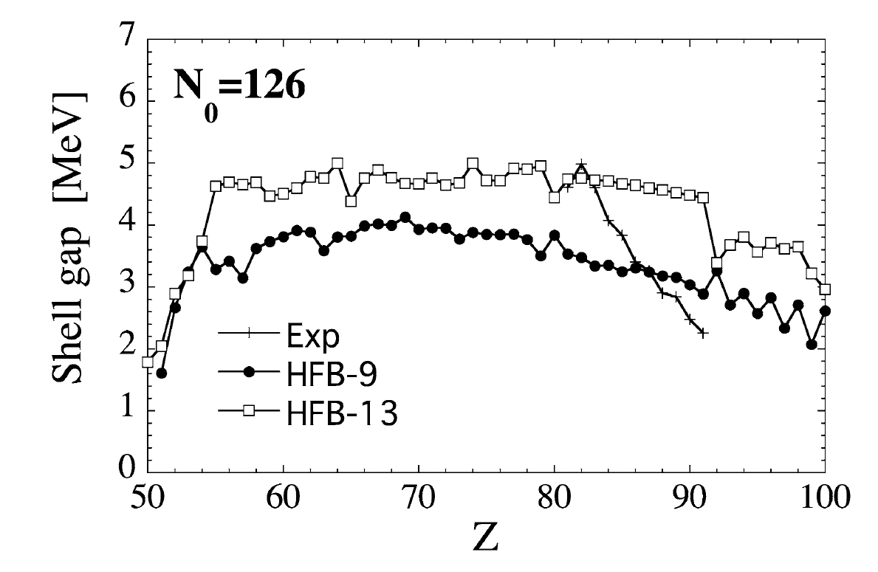
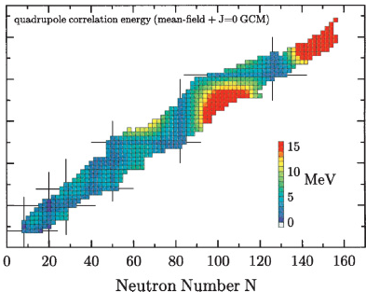
Nuclear Structure
Evolution of shell strength -- Au, Hg
  Test mean field approaches
  S. Goriely et al., Nucl. Phys. A 773, 279 (2006)
  Going beyond the mean field
  Input for shell model calculations
Mid-shell behavior -- At, Fr
  Study isotopic chains to look for transitional regions
  Onset of deformation acessible due to smaller uncertainties
  M. Bender et al., Phys. Rev. C 73, 034322 (2006)
  Higher-order nucleon interaction
  Adjustment of mass models, e.g. HFB-13

Slide 7
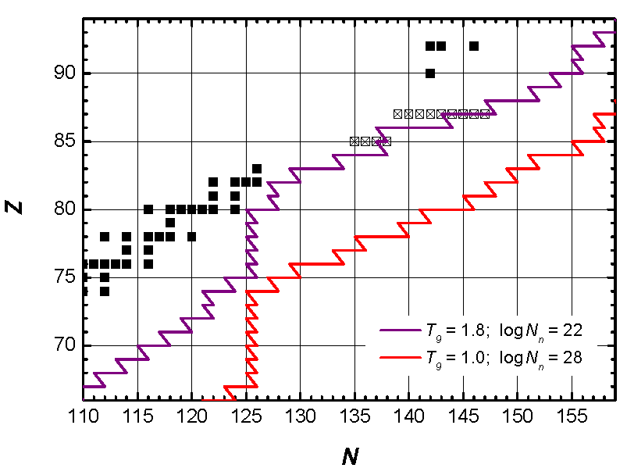
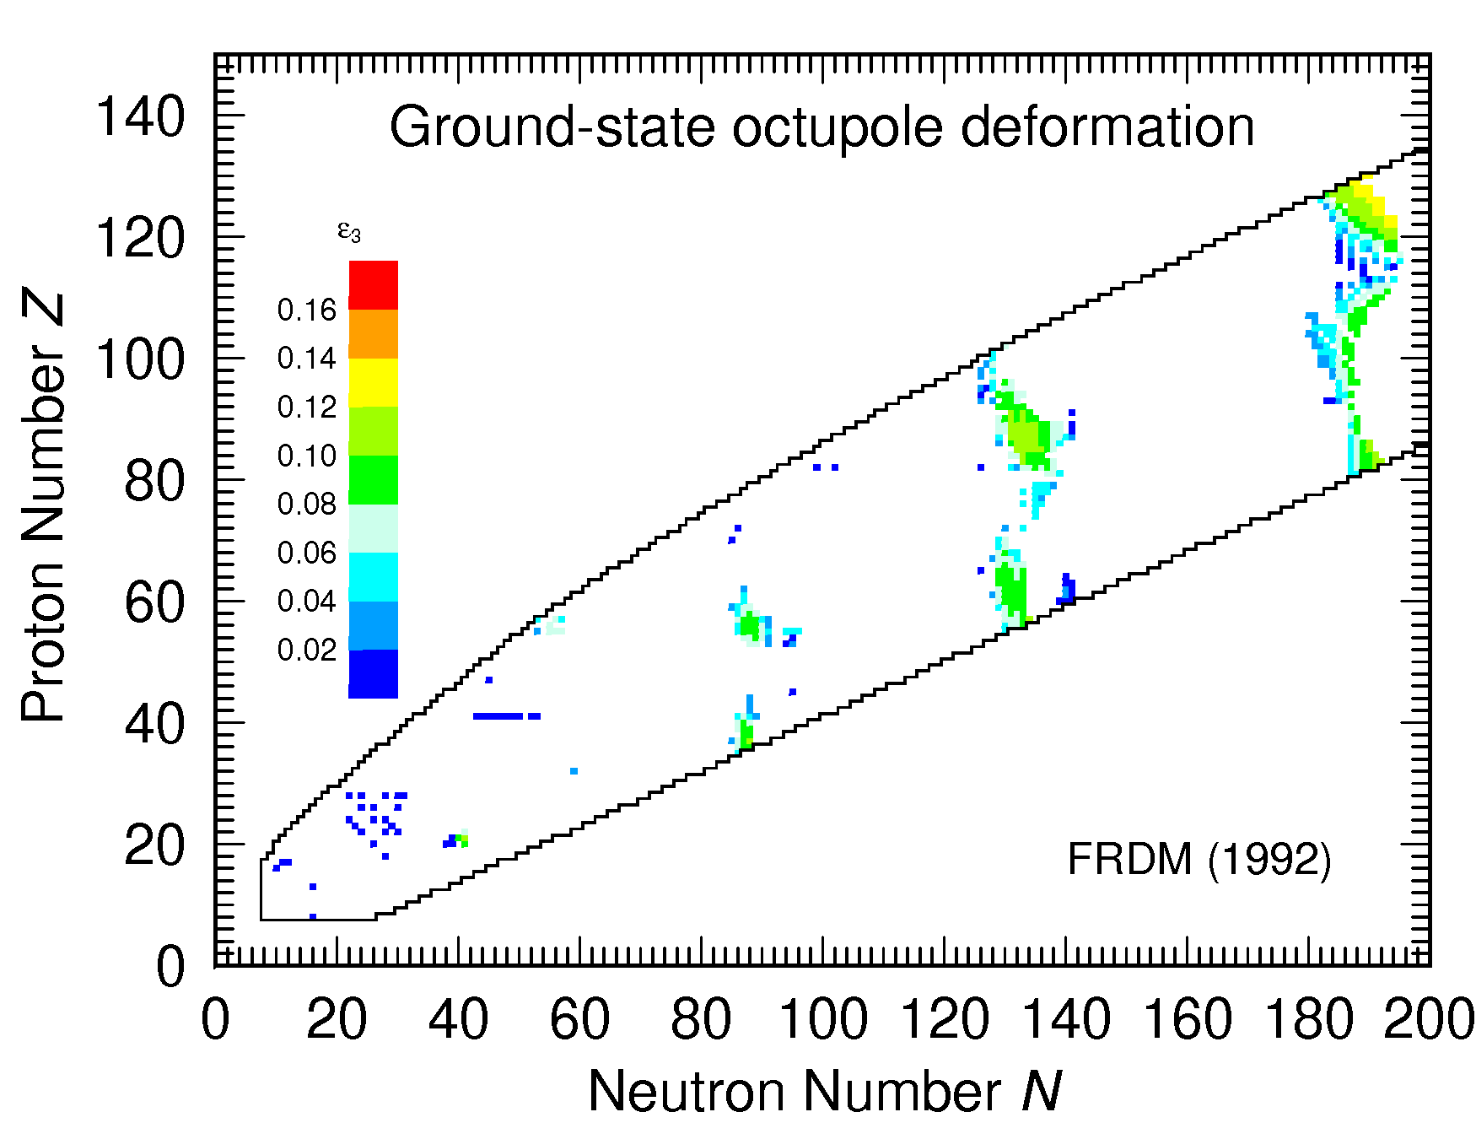
R-Process and Deformation
r-process -- At, Fr
  Modeling of nucleosynthesis path
  Consolidate nucleosynthesis path with
  additional data
  D. Neidherr et al., Phys. Rev. Lett. 102, 122503 (2009)
Octupole Deformation -- At, Fr
  Shape parametrization within FRDM
  P. Möller et al., Atomic D. and Nucl. D. T. 59, 185 (1995)
  Map evolution of changes in energy
  D. Neidherr et al., Phys. Rev. Lett. 102, 122503 (2009)
  D. Neidherr et al., Phys. Rev. C 80, 044323 (2009)
Region to investigate

Slide 8
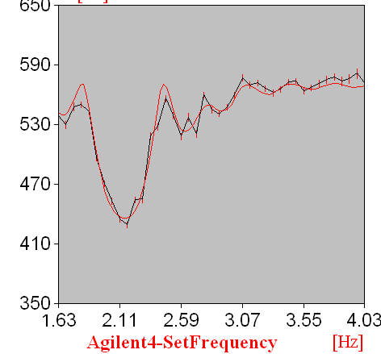
Isomerism
Isomerism -- Au, Hg, Pb, At, Fr
  Low-lying isomeric states paired with shape coexistence or transformations
  shape coexistence in ¹⁸⁶Pb
  shape staggering of Hg istotopes
  Unambiguous identification with ISOLTRAP as input for spectroscopy experiments
  S. Schwarz et al., Nucl. Phys. A 693, 533 (2001)
  J. van Roosbroeck et al., Phys. Rev. Lett. 92, 112501 (2004)
  States can be resolved with Penning-trap
  mass spectrometry using the time-of-flight
  detection technique
¹⁹⁴Tl
Time of flight / µs
ground state
isomer
Frequency – 468260 / Hz

Slide 9
Priorities
2011 high priority (unknown or extrapolated masses / half-lives)
  r-process / octupole deformation
  ²²⁶⁻²²⁸Fr, ²³¹⁻²³⁴Fr, ²²¹⁻²²³At 21 shifts + 3 shifts
  Shell strength
  ^{202, 204,205}Au 10 shifts + 1 shift
2011/2012 medium-high priority
  Shell strength
  ^{207,209,210}Hg 0 shifts
  Study of Isomerism
  ^{185m, 190m}Au, ^{183m}Hg, ^{185m, 190m}Pb, ^{198m}At, ^{200m,202m}Fr 18 shifts + 3 shifts
2012 medium priority
  Mid-shell behavior
  At and Fr isotopes 27 shifts + 3 shifts

Slide 10
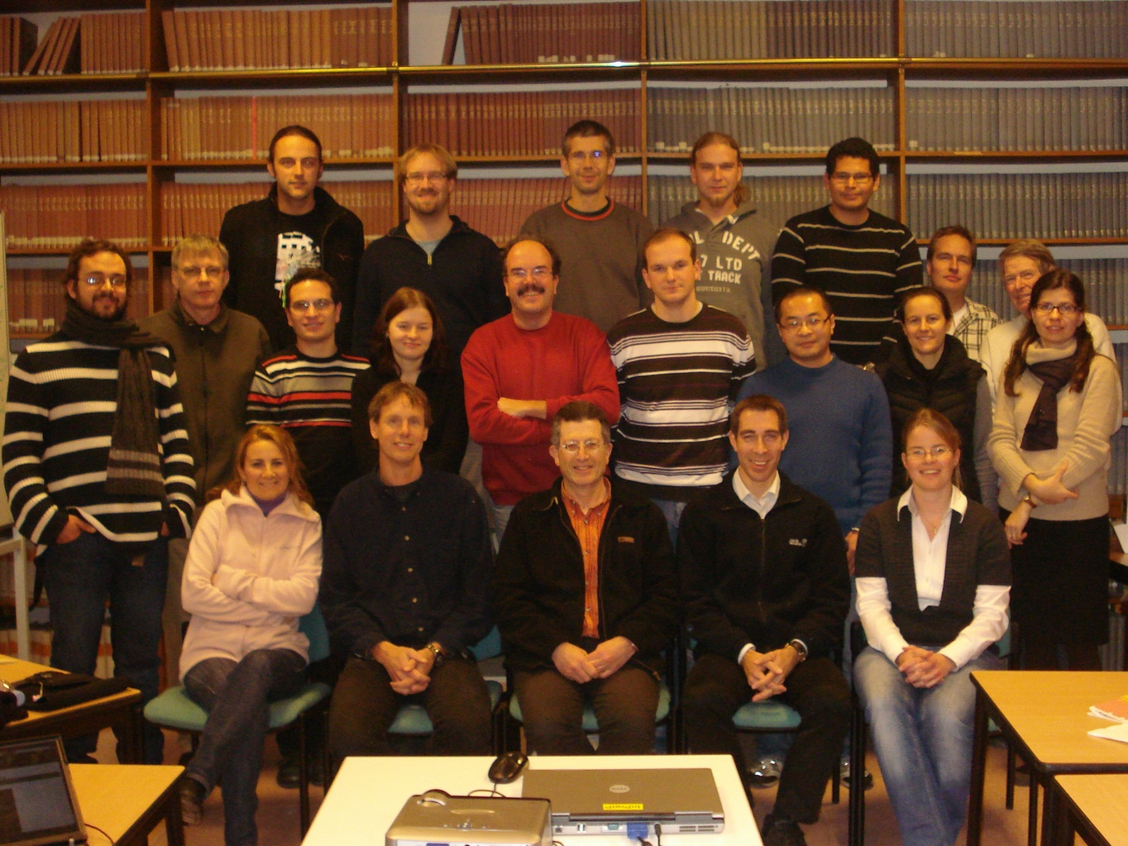


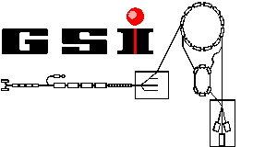



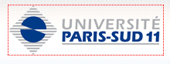

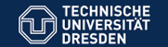
The ISOLTRAP Collaboration
Thank you!
Missing: S. Eliseev, S. George, A. Herlert, S. Naimi, D. Neidherr, S. Schwarz

Slide 11
Future Developments
N-deficient Au:
  RILIS or hot plasma ion source because of higher yields
  Target and ion source development (TISD) in cooperation with ISOLTRAP needed
Hg and Pb isotopes:
  Couple technical development of beam extraction to physics of this proposal
  Outcome of Au measurements to be used towards ThO target development
At isotopes: RILIS ionization scheme successfully tested in 2010
  ISOLTRAP used as monitoring tool for TISD regarding yield enhancement
Fr isotopes:
  Yield of Ra contamination not higher than Fr
  Sepration possible due to improvement in selectivity at ISOLTRAP

Slide 12
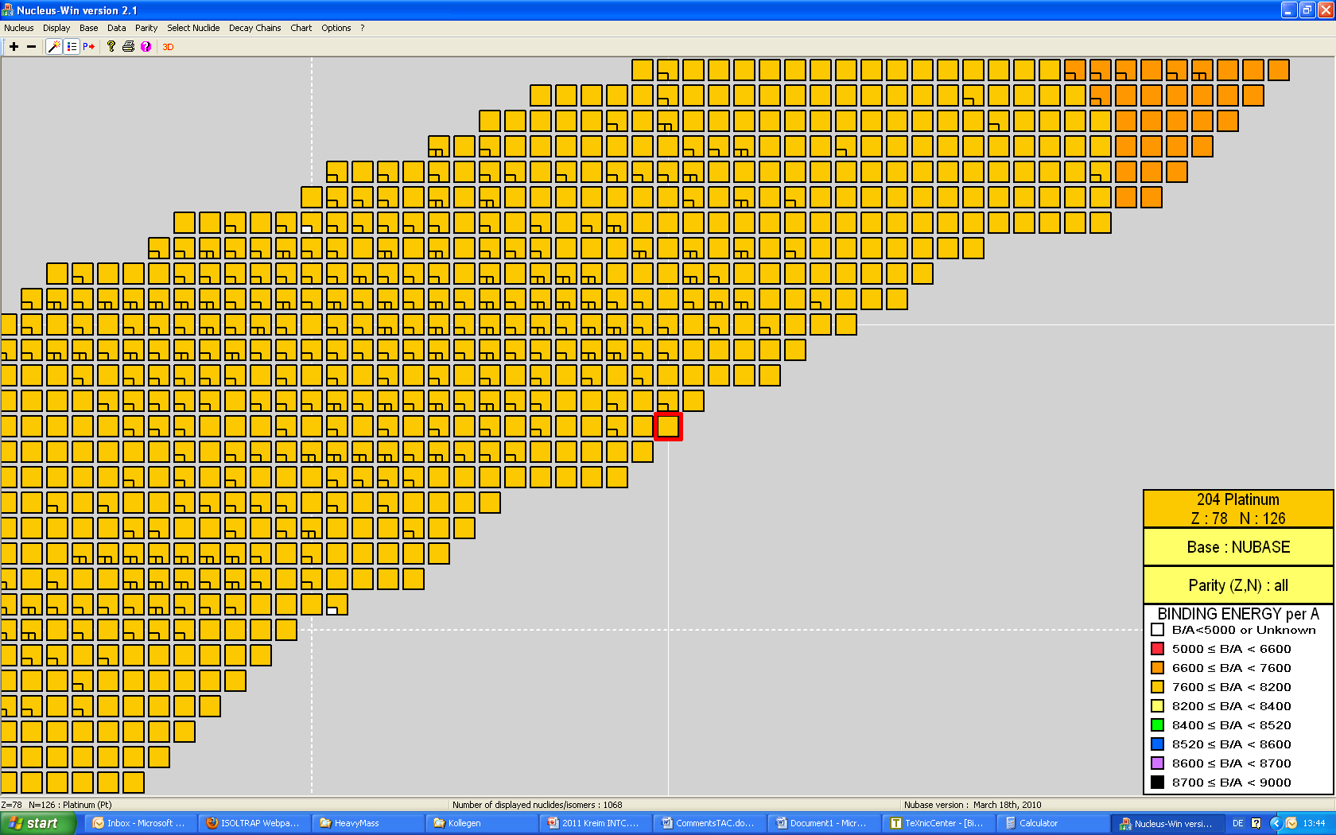
Achievements and Aims
Rn
Not shown:
Rn isotopes
Tl isotopes (IS 463)
Po isotopes (INTC-P-293)
Po
Pb
Z=82
Status 2002:
Accuracy 1·10⁻⁷
Resolving power 3.7·10⁶
Hg
N=126
Fr
At
Bi
Z=82
Tl
Au
N=112
N=126

Slide 13
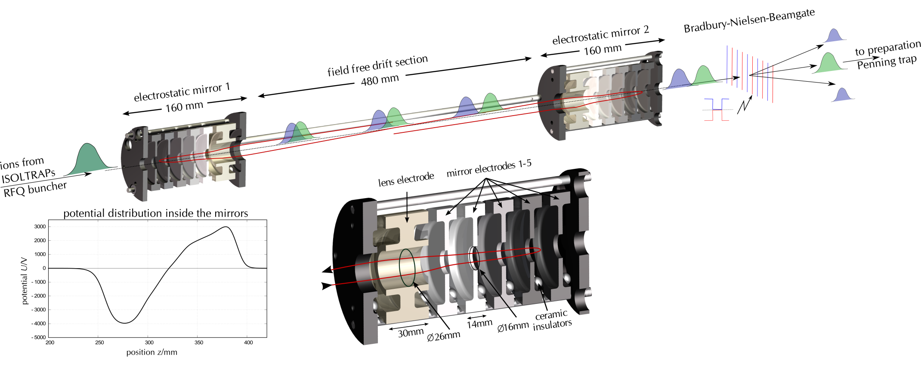
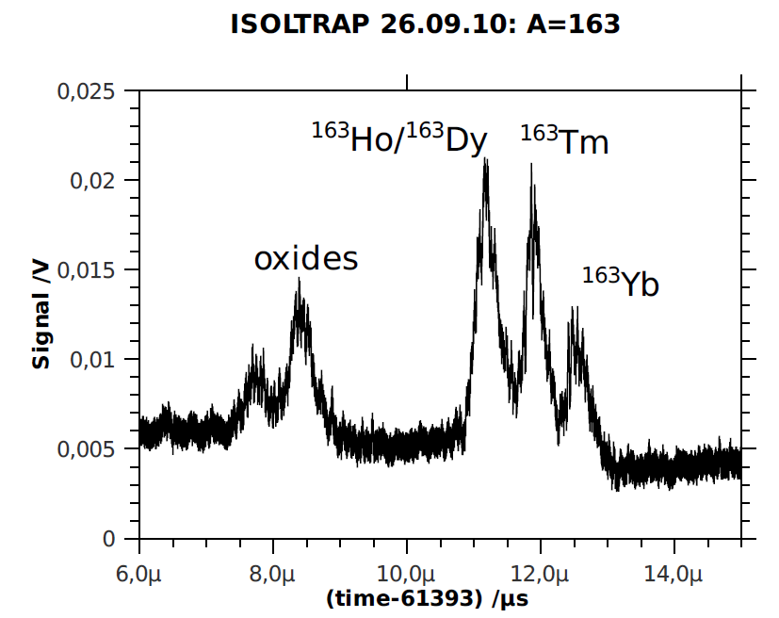
Auxiliary Isobaric Purification
Mass resolving power of MR-ToF mass separator of about R=200,000
Bradbury-Nielsen beam gate used to select the wanted species

Slide 14
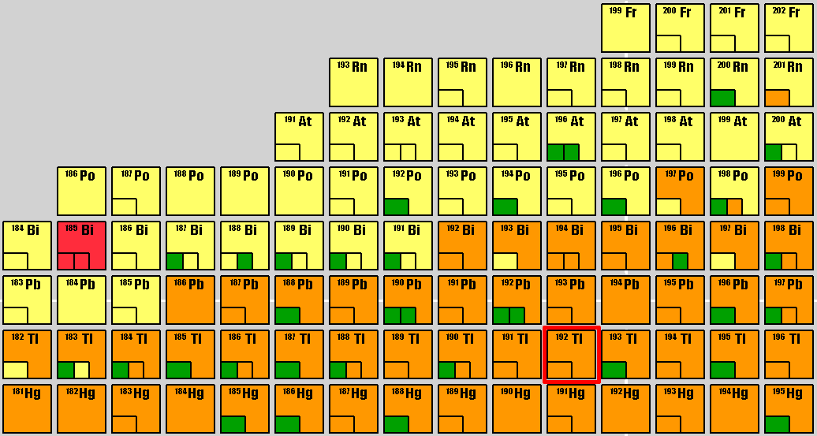
α-Decay
α-decay chains -- Pb, At, Fr
  Small uncertainty of Q_{α}-value
α-decay
β⁺-decay
Internal transition

