Slide 1
Coulomb excitation of ¹¹⁶Te and ¹¹⁸Te: a study of collectivity above the Z=50 shell gap
Resubmission of Proposal P-277
Tuomas Grahn
University of Jyväskylä
Helsinki Institute of Physics
INTC meeting 2.2.2011

Slide 2
Outline
Physics background
Proposed experiment
Beam time request

Slide 3
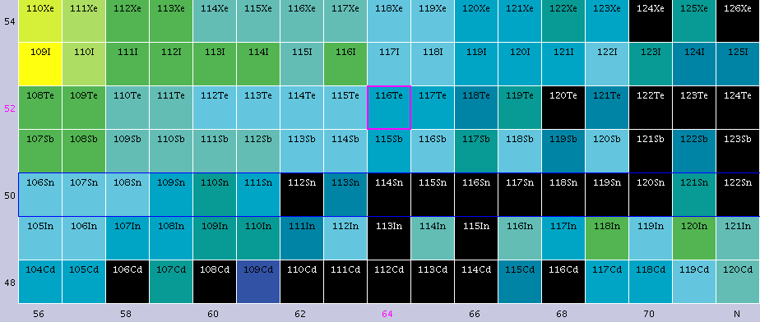
Physics background
In neutron-deficient nuclei around the Z=50 shell gap many unusual phenomena have been observed.
In Te nuclei, valence protons and neutrons occupy overlapping orbitals ⇒ p-n interaction is expected to be strong (+ the tensor force between the g_{7/2} (j<) and d_{5/2}(j’>) orbitals).
N=66
Z=50

Slide 4
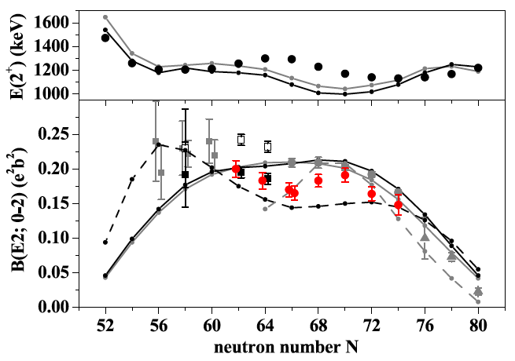
Physics background
B(E2;0⁺→2⁺) values for the neutron-deficient Sn nuclei have been measured.
Deviations from the seniority scheme when approaching the N=Z=50 shell gap and at the neutron mid shell have been observed.
Highlights the need of precision measurements in this region.
A. Junglaus et al., Phys. Lett. B 695, 110 (2011)

Slide 5
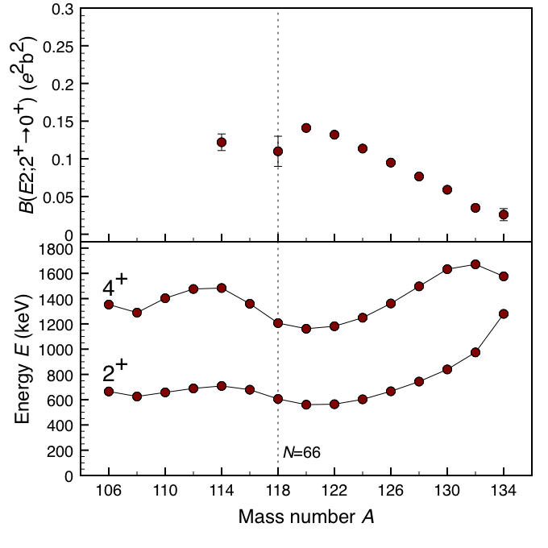
Physics background
The 2⁺ and 4⁺ states minimise their energies near the neutron mid shell at N=66.
Consequently, transition probabilities increase towards the mid shell.
However, available experimental data suggests reduction of collectivity at the mid shell.

Slide 6
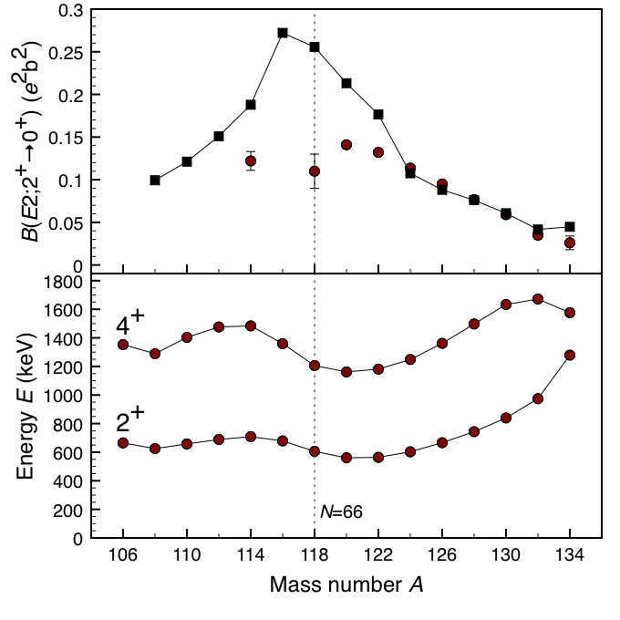
Physics background
Constrained HFB + GCM + 5 dimensional collective quadrupole Hamiltonian with the Gogny D1S interaction.
J.-P. Delaroche et al. Phys. Rev. C 81 014303 (2010)
Similar behaviour also predicted by two other studies (configuration mixing with Gogny D1S, IBA, Refs [13] & [14] of the proposal).

Slide 7
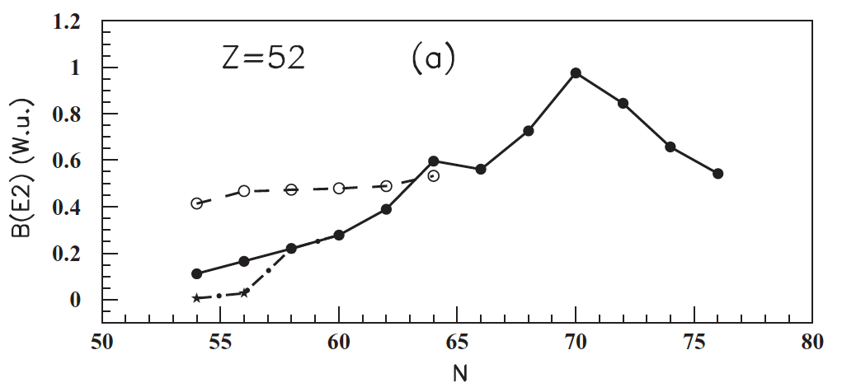
Physics background
However, the study of Delion et al. (Phys. Rev. C 82, 024307 (2010)) contradicts the other predictions.
QRPA calculations with different p-n interaction parameterisations.
Nuclear structure of the light Te nuclei not well understood.
Constant QQ strength
p-n coupling strength changes
¹¹⁶Te
¹²⁰Te
¹¹⁸Te
p-n pairing gap changes

Slide 8
Proposed experiment
Objectives of the proposed study:
  To probe collectivity and wave functions around the N=66 neutron mid shell by measuring the
  B(E2;0⁺→2⁺) value in ¹¹⁶Te and ¹¹⁸Te, for which different predictions exist.
  To initiate beam and target developments for Coulomb excitation and transfer studies of more neutron-deficient Te using HIE-ISOLDE (LoI endorsed).

Slide 9
Proposed experiment
¹¹⁶Te can be produced using the ZrO₂ primary ISOLDE target and the hot plasma ion source through spallation of 1.5 mass% hafnium impurities [U. Köster et al., NIM B 204 (2003) 303] (yield 10⁶/μC).
HfO₂ or CeO₂ primary targets are likely to be more suitable for the production of the neutron-deficient Te beams (also noted on the TAC report).
Beam purity can be improved with RILIS. TAC report: development of the RILIS scheme for Te should be started.
Therefore, 3 shifts of beam time is requested for the beam development prior the Coulomb excitation run.

Slide 10
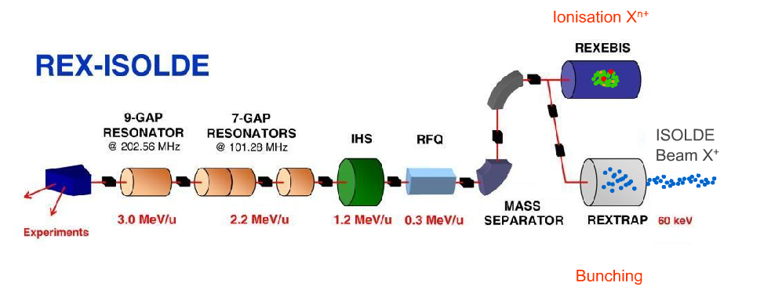
Proposed experiment
The mass separated ¹¹⁶Te and ¹¹⁸Te beams will be charge bred in REX-EBIS in order to obtain required charge state for the REX linear accelerator.
Post-accelerated (E=2.7 MeV/u) beams will be Coulomb excited with a 2 mg/cm² ⁶⁴Zn target.
Coulomb excitation γ-ray yield will be recorded with the MINIBALL γ-ray spectrometer.

Slide 11
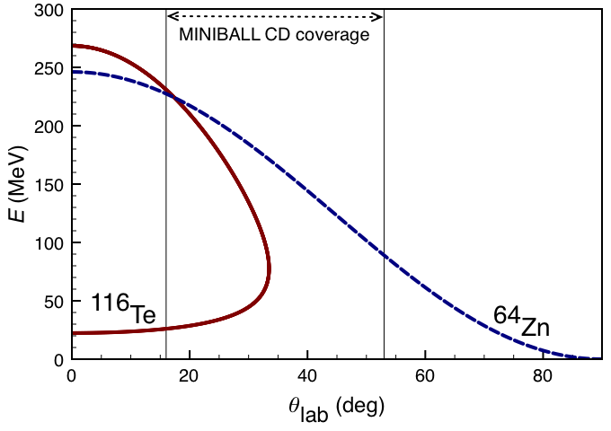
Proposed experiment
Coulomb excitation events can be distinguished by detecting both the target and projectile nuclei in the MINIBALL CD Si detector.
Particle-γ-ray coincidences required.
2.7 MeV/u ¹¹⁶Te beam on the 2 mg/cm² ⁶⁴Zn target.

Slide 12
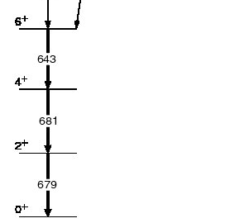
Proposed experiment
Reported ISOLDE primary yield for ¹¹⁶Te: 10⁶/μC
Assumptions: 1% REX transmission efficiency, 10% MINIBALL efficiency @ ~600 keV, transition matrix element 0.75 e²b².
A yield estimate using the Coulomb excitation code GOSIA ⇒ 260 γ-ray events for the 2⁺→0⁺_{g.s.} transition in ¹¹⁶Te (¹¹⁸Te) per an 8 hour shift.
With 2.7 MeV/u second order excitations negligible.
Partial level scheme of ¹¹⁶Te

Slide 13
Beam time request
3 shifts are requested for the target development and the yield measurement.
Further 3 shifts are requested for the REX set up.
6 shifts are requested for the Coulomb excitation of ¹¹⁶Te and ¹¹⁸Te each.
  ~1500 γ-ray events for the 2⁺→0⁺ transition in ¹¹⁶Te
  ~540 γ-ray events for the 2⁺→0⁺ transition in ⁶⁴Zn (target excitations)
In total, 18 shifts are requested.

Slide 14
Collaboration
CERN-ISOLDE (J. Pakarinen, D. Voulot, F. Wenander)
KTH Stockholm (T. Bäck, B. Cederwall, A. Johnson)
KU Leuven (N. Bree, I.G. Darby, J. Diriken, M. Huyse, E. Rapisarda,
P. Van Duppen)
STFC Daresbury Laboratory (J. Simpson)
TU Darmstadt (T. Bloch, S. Bönig, T. Kröll, J. Leske, N. Pietralla,
M. Scheck)
University of Jyväskylä (T. Grahn, R. Julin, P. Rahkila, M. Sandzelius)
University of Liverpool (P. A. Butler, D. O’Donnell, L. P. Gaffney,
D. T. Joss, R. D. Page, E. S. Paul)
University of Lund (J. Cederkäll, C. Fahlander)
University of the West of Scotland (B. Hadinia, J. F. Smith)
University of York (H. Al-Azri, D. G. Jenkins, B. Joshi, B. S. Nara Singh,
A. Nicholls, R. Wadsworth)
Yale University (T. Ahn, V. Werner)

