Slide 1
Shape effects along the Z=82 line: study of the beta decay of ^{186,188}Pb
A. Algora, B. Rubio, J. L. Taín, M. E. Estevez, J. Agramunt, E. Valencia, C. Domingo, S. Origo, A. Krasznahorkay, M. Csatlos, Zs. Dombrádi, D. Sohler, J. Timár, W. Gelletly, P. Sarriguren, M. J. G. Borge, O. Tengblad, E. Nácher, A. Jungclaus, L. M. Fraile, O. Moreno, D. Fedosseev, B. A. Marsh, D. Fedorov, A. Frank, A. N. Andreyev, B. Akkus, Y. Oktem, E. Ganioglu, L. Susam, R. Burcu Cakirli
Addendum to ISOLDE Experimental Proposal IS440
CERN-INTC-2011-004, INTC-P-199-ADD-1
Spokespersons: A. Algora, B. Rubio, W. Gelletly
ISOLDE contact: M. Kowaslka

Slide 2
General Motivations
(IS440 + Addendum)
Neutron deficient Pb isotopes have been the subject of intensive exp. and theoretical work (shape coexistence, see for example ^{186,188}Pb)
Theoretical calculations by P. Sarriguren et al. show that the GT strength distributions show clearly different patterns depending on the deformation of the parent nucleus (PRC 72 (2005) 054317, PRC 73 (2006) 054317)
Based on similar theoretical results for the A≈80 region, we have been able to determine the deformation of ⁷⁴Kr and ^{76,78}Sr by means of the TOTAL ABSORPTION TECHNIQUE (TAS)
Preliminary results of the IS440 show the potential of the technique in this region

Slide 3
Theoretical Background of the Shape Coexistence Phenomenon ( quick overview)
In the shell model picture: intruder 0⁺ states are interpreted as two- and four-quasiparticle configurations.
Phenomenological mean field models and Strutinsky method predict the existence of several competing minima in the deformation surface of these nuclei.
Self-consistent mean field calculations and calculations including correlations beyond the mean field with Skyrme and Gogny forces confirm these results.
The problem has also been studied in the framework of the IBM.

Slide 4
Hartree-Fock calculations: ¹⁸⁴⁻¹⁹⁴Pb
(P. Sarriguren et al. PRC 72 (2005) 054317)
Hartree-Fock mean field calculations using an effective two-body Skyrme interaction and including pairing correlations in the BCS approximation. In this framework single part. energies, wave functions and occupation probabilities are generated from the mean field
Two forces were considered: Sk3 and SG2
Different profiles depending on the shape
One important result: the profiles of the B(GT) distributions for the different deformations are not dependent on the forces and on the pairing interactions used =>the B(GT) profile is characteristic of the shape
(O. Moreno et al. , PRC 73 (2006) 054317) used SLy4, res. sim.)

Slide 5
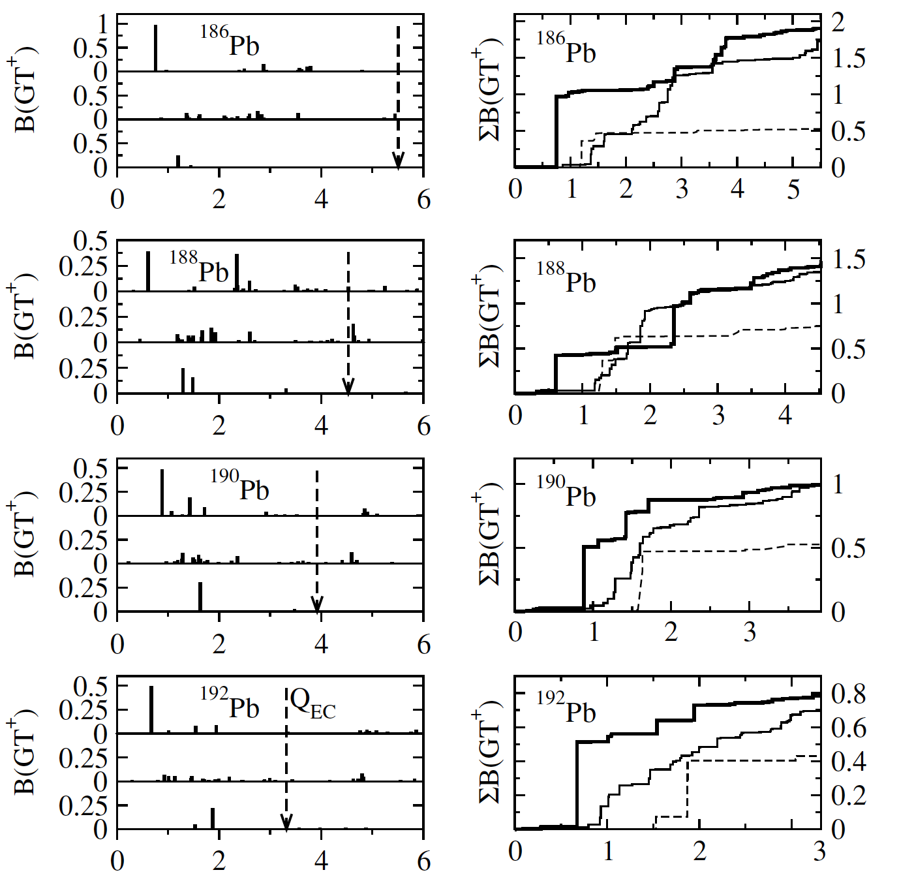
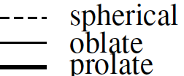
The B(GT)
Profiles
PRC 73 (2006) 054317

Slide 6

How to measure the B(GT)
Theoretical quantity
Strength function
Beta feeding
Half life of parent
Relationship
Fermi function

Slide 7
Total absorption spectroscopy
NaI
γ₁
E₂
β−feeding
γ₂
γ₂
E₁
γ₁
N
I_{β}
Ideal case: beta minus decay, and no contamination.
There is need for a 100% efficient summing device
E₂
Ex in the daughter

Slide 8
Total Absorption Spectroscopy
NaI
EC:
γ₁
β⁺:
γ₂
511 keV
1022 keV
N
511 keV
EC
β⁺
E2
E
Real case: two processes in the beta plus/EC case.
We need to distinguish between them.

Slide 9
Total absorption spectroscopy
X-ray Detector
N
NaI
EC
E₂
E
γ₁
Positron Detector
β⁺
γ₂
E2
E
511 keV
After an ideal deconvolution and sum
511 keV
I _{β}
Solution: use of coincidences with ancillary detectors
E₂

Slide 10
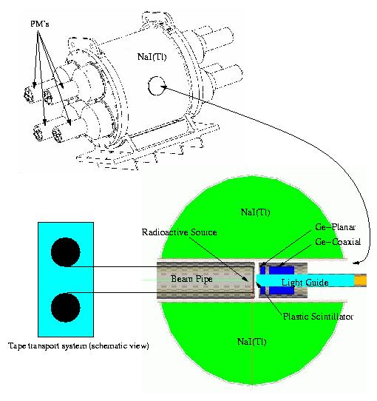

Lucrecia, Total Absorption Gamma Spectrometer at CERN
A large NaI cylindrical crystal 38 cm Ø, 38cm length
An X-ray detector (Ge)
A β detector
Collection point inside the crystal

Slide 11
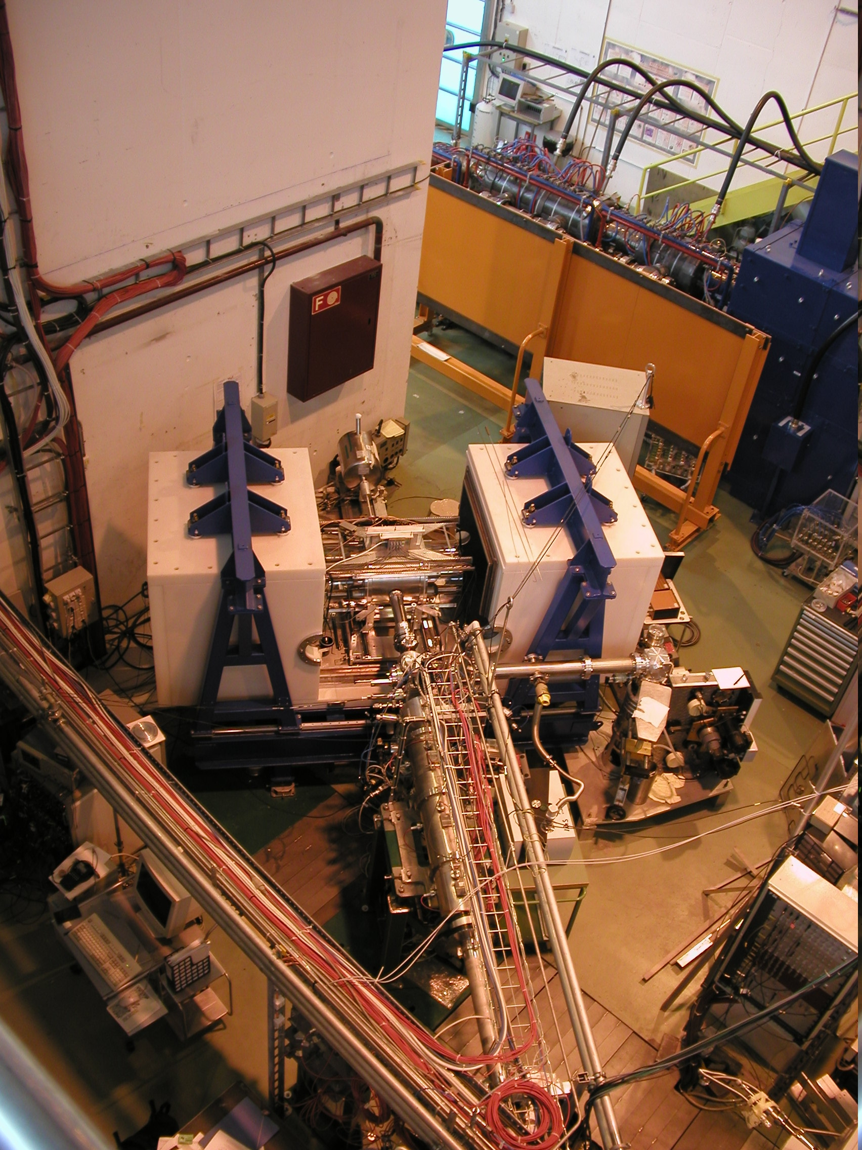
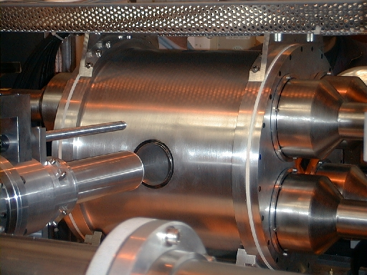
Lucrecia, the TAS at ISOLDE
Analysis is difficult
d=R(B).f
Method of analysis developed by
the Valencia group
NIM A 571, 710 (2007)
NIM A 571, 728 (2007)

Slide 12

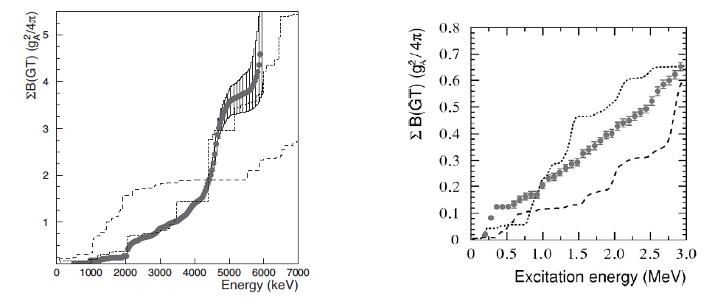
Very prolate N=Z nucleus
Mixture of prolate and oblate
76Sr
74Kr
prolate
oblate
oblate
prolate
E. Nácher et al. PRL 92 (2004) 232501 and
PhD thesis Valencia
Ground state of 76Sr prolate (β20.4) as indicated in Lister et al., PRC 42 (1990) R1191
E. Poirier et al., Phys. Rev. C 69, 034307 (2004) and PhD thesis Starsbourg
Ground state of 74Kr:(60±8)% oblate, in agreement with other exp results and with theoretical calculations (A. Petrovici et al.)

Slide 13
Experimental Motivations
New insight into the problem of shape coexistence in the region. “Independent way” to study the problem since it does not depend on assumptions made in other nuclei except for the gs. It is also complementary to other studies (isotope shift, charge radii).
Our measurements can validate the application of this method in this region. Future studies of Pt, Hg, Po cases.
Proper measurements of the B(GT) offer means to test further nuclear models in this region.
Exploit the availability of more pure beams (RILIS)

Slide 14
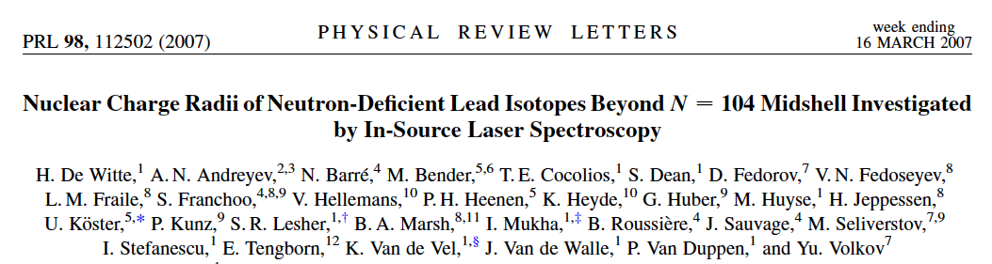
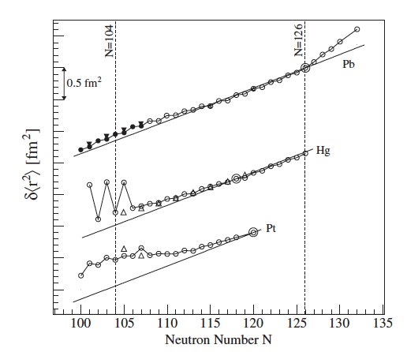
Objective: Pb-s are expected to be spherical. Our idea was to confirm the viability of the method in the region for later extending it to other cases of interest (Hg, Pt, Po cases)

Slide 15
Summary of IS440
15 shifts were requested to study the beta decay of ^{188,190,192}Pb.
7 shifts were approved to show the viability of the study.
6 (5 according to my counting) shifts were used to measure ^{188,190,192}Pb using the TAS in coincidence with X-rays of the Tl daughter isotopes (EC component). 1 shift was not used (2?).
Analysis of ^{190,192}Pb is practically finished. The analysis of ¹⁸⁸Pb requires a better knowledge of the level scheme from high resolution. These analyses are part of the thesis of E. Estevez, that should be finished this year.

Slide 16
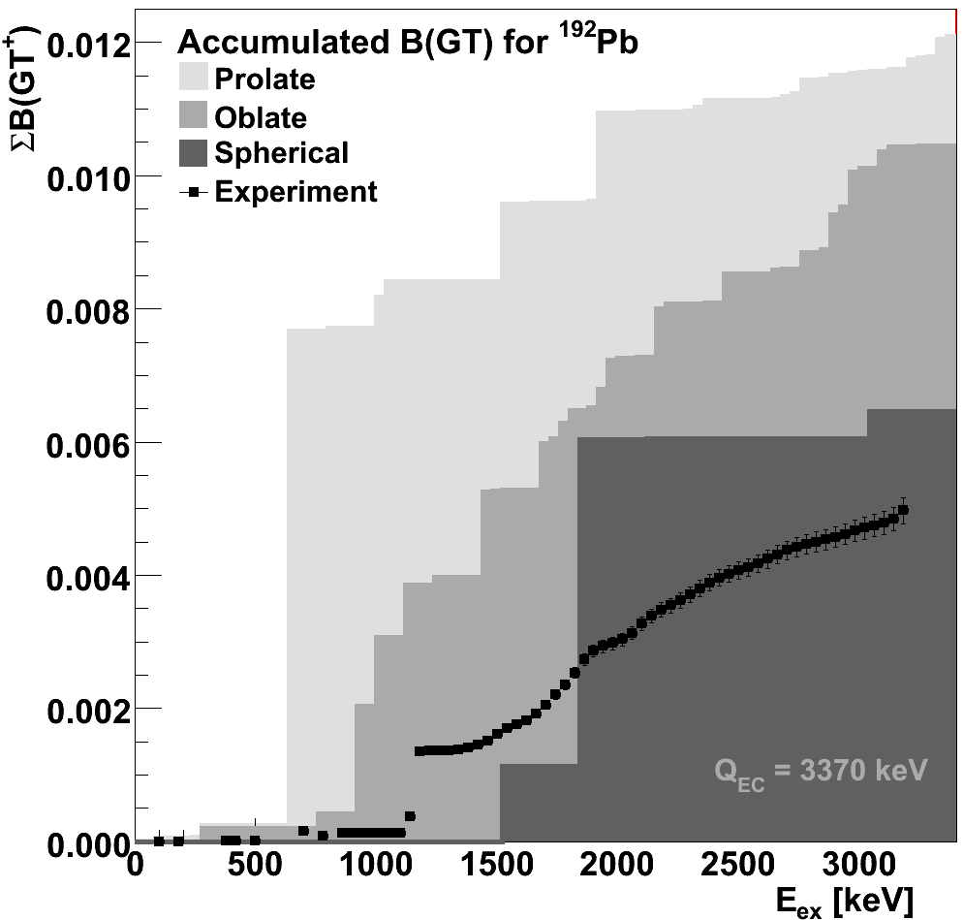
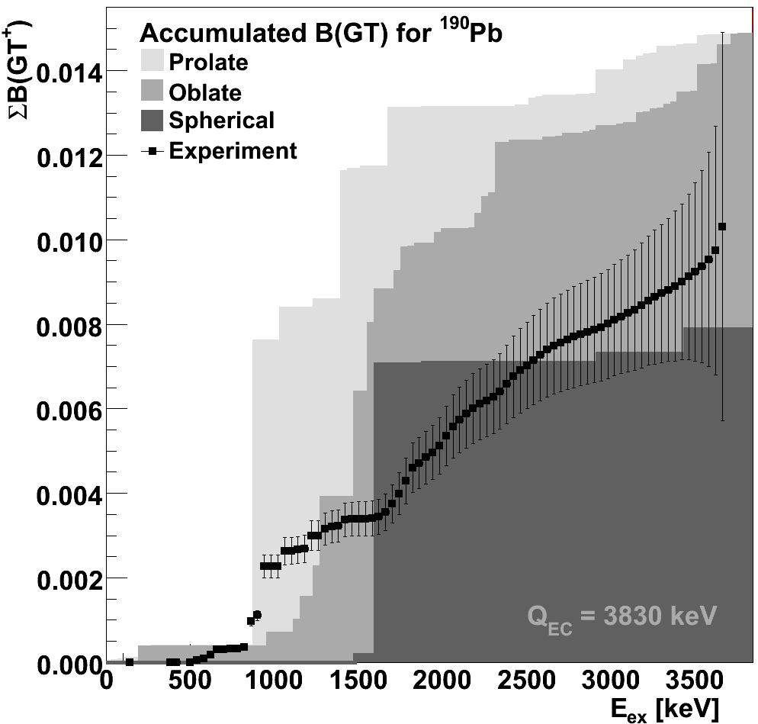
IS440 preliminary results: ^{190,192}Pb
Thesis work of E. Estevez, in preparation.
Theory from PRC 72, 054317 (2005)
Preliminary results consistent with spherical picture, less impressive than in the A≈80 region. Calculations may require fine-tuning
Notes:
186Pb decay high resolution unknown
188Pb decay poorly known
Pb are spherical
Hg shape evolution
Pt the same

Slide 17
Experimental Details (Addendum)
We propose to use the Laser Ion Source RILIS to clean the nuclear species of interest and UCx/graph. target with Ta ionizer.
TAS technique in combination with ancillary detectors, new feature: the addition of a particle telescope (dE-E)
Analysis of the EC component (coincidence with X-rays) with the programs and algorithms developed by the Valencia Group
High resolution measurements are required (separate experiment), to provide data for the TAS analysis and they are interesting in itself.

Slide 18
Beam request for the addendum
6 shifts are required for the TAS measurement of the ¹⁸⁶Pb isotope (estimated to reach 400000 counts in the EC spectrum with a 3% Pb purity of the beam using RILIS).
2 shifts are required for the measurement of the daughter activities of ¹⁸⁶Pb (TAS) and background.
2 shifts are required for the TAS measurement of the ¹⁸⁸Pb isotope (beta delayed p- emission in combination with the TAS).
1 shift is required for the on-line calibration using the ²⁴Na (TAS)
2 shifts are required for the ¹⁸⁸Pb high-resolution measurement.
6 shifts are required for the ¹⁸⁶Pb high-resolution measurement.

Slide 19
Experimental details
Isotope | Half life | EC branch (%) | Sp (keV) | Q_{EC}(keV) | Status
¹⁸⁶Pb | 4.82(3) s | 60(8) | 1303(185) | 5509(185) | proposed
¹⁸⁸Pb | 25.1(1) s | 90.7(8) | 1520(40) | 4530(30) | to be completed
¹⁹⁰Pb | 71(1) s | 99.6(4) | 1990(60) | 3920(50) | done
¹⁹²Pb | 3.5(1) min | 99.9941(7) | 2570(40) | 3320(30) | done

Slide 20
Thank you

Slide 21
Spare Slides

Slide 22
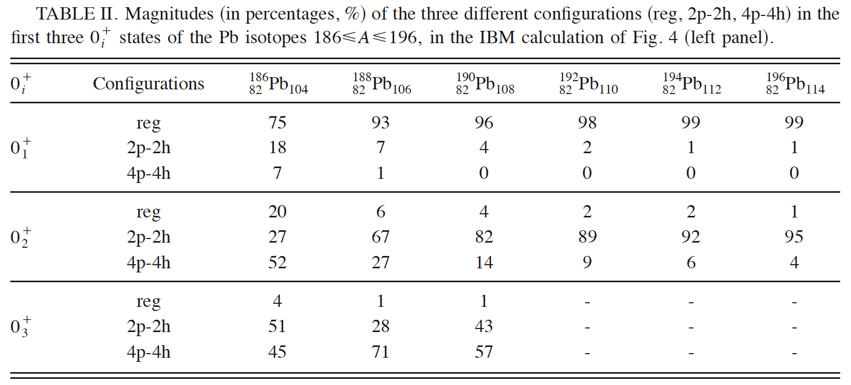
Mixing prediction
Fossion et al. PRC 73 (2006) 054317, within IBM

Slide 23
The B(GT) Profiles I

Slide 24
The B(GT) Profiles II

Slide 25
Experimental details IS440
Isotope | Half life | EC branch (%) | Sp (keV) | Q_{EC}(keV)
¹⁸⁸Pb | 25.1(1)s | 90.7(8) | 1520(40) | 4530(30)
¹⁹⁰Pb | 71(1) s | 99.6(4) | 1990(60) | 3920(50)
¹⁹²Pb | 3.5(1) min | 99.9941(7) | 2570(40) | 3320(30)

Slide 26
Beamtime Requirements (IS440)
Target: UCx/graphite target with a Nb surface ionization ion source (U. Köster et al. NIM B 204 (2003) 347)
RILIS is required
9 shifts are required for the ¹⁸⁸⁻¹⁹²Pb isotopes (TAS, TAS & β-delayed particles)
3 shifts are required for measuring the daughter activities
2 shifts are required for the ¹⁸⁸Pb high resolution measurement
1 shift is required for the on-line calibration (²⁴Na source)

Slide 27
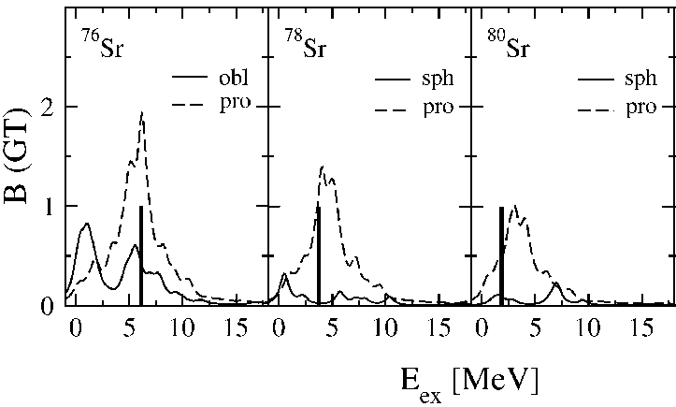
P. Sarriguren et al., Nuc. Phys. A635 (1999) 13
Qß
Theoretical calculations predict different B(GT) distributions for oblate, prolate and spherical shape of the ground state.
[Original idea I. Hamamoto et al., Z. Phys. A353 (1995) 145]
Followed up by Sarriguren and collaborators and
Petrovici and collaborators

Slide 28
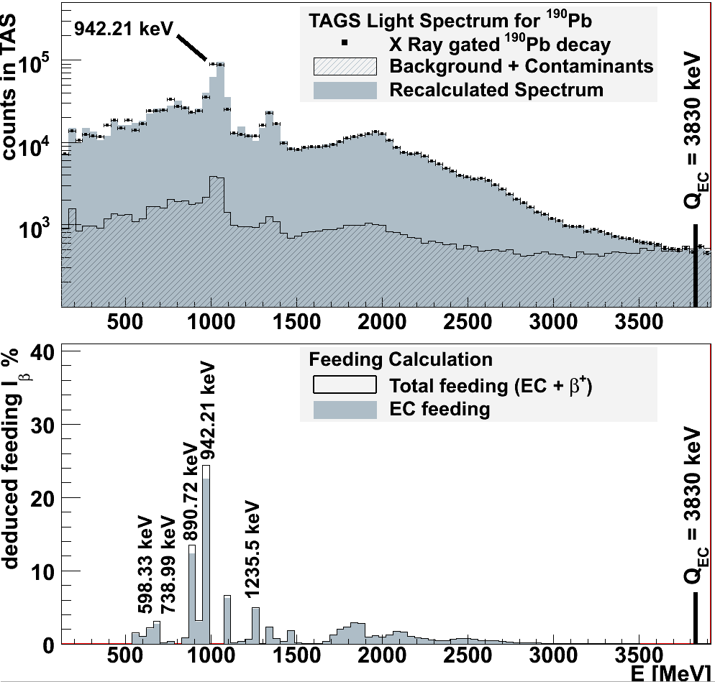
Preliminary results: ¹⁹⁰Pb
Thesis work of E. Estevez, in preparation.
Theory from PRC 72, 054317 (2005)
Preliminary results consistent with spherical picture. Calculations may require fine-tuning
Notes:
186Pb decay high resolution unknown
188Pb decay poorly known
Pb are spherical
Hg shape evolution
Pt the same

Slide 29
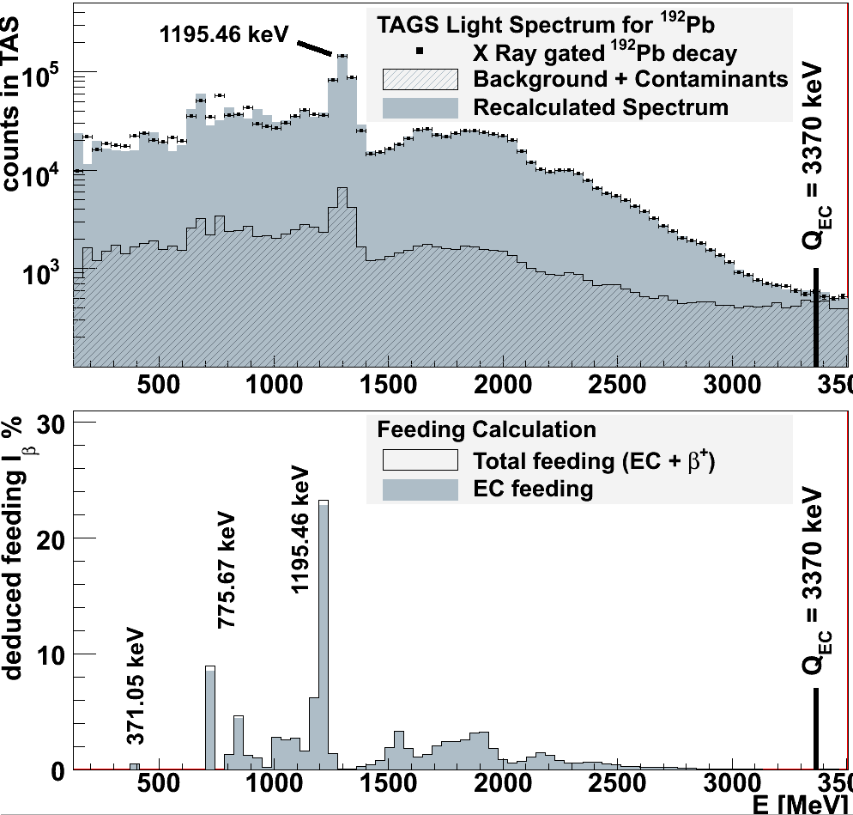
Preliminary results: ¹⁹²Pb
Thesis work of E. Estevez, in preparation.
Theory from PRC 72, 054317 (2005)
Preliminary results consistent with spherical picture. Calculations may require fine-tuning
Notes:
186Pb decay high resolution unknown
188Pb decay poorly known
Pb are spherical
Hg shape evolution
Pt the same

Slide 30
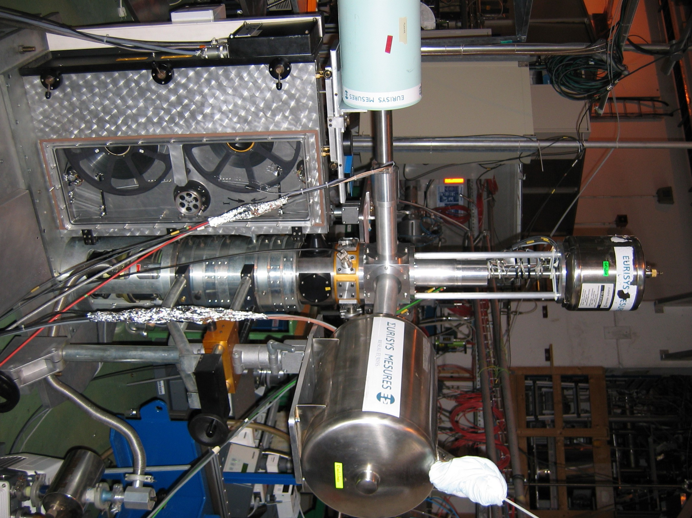
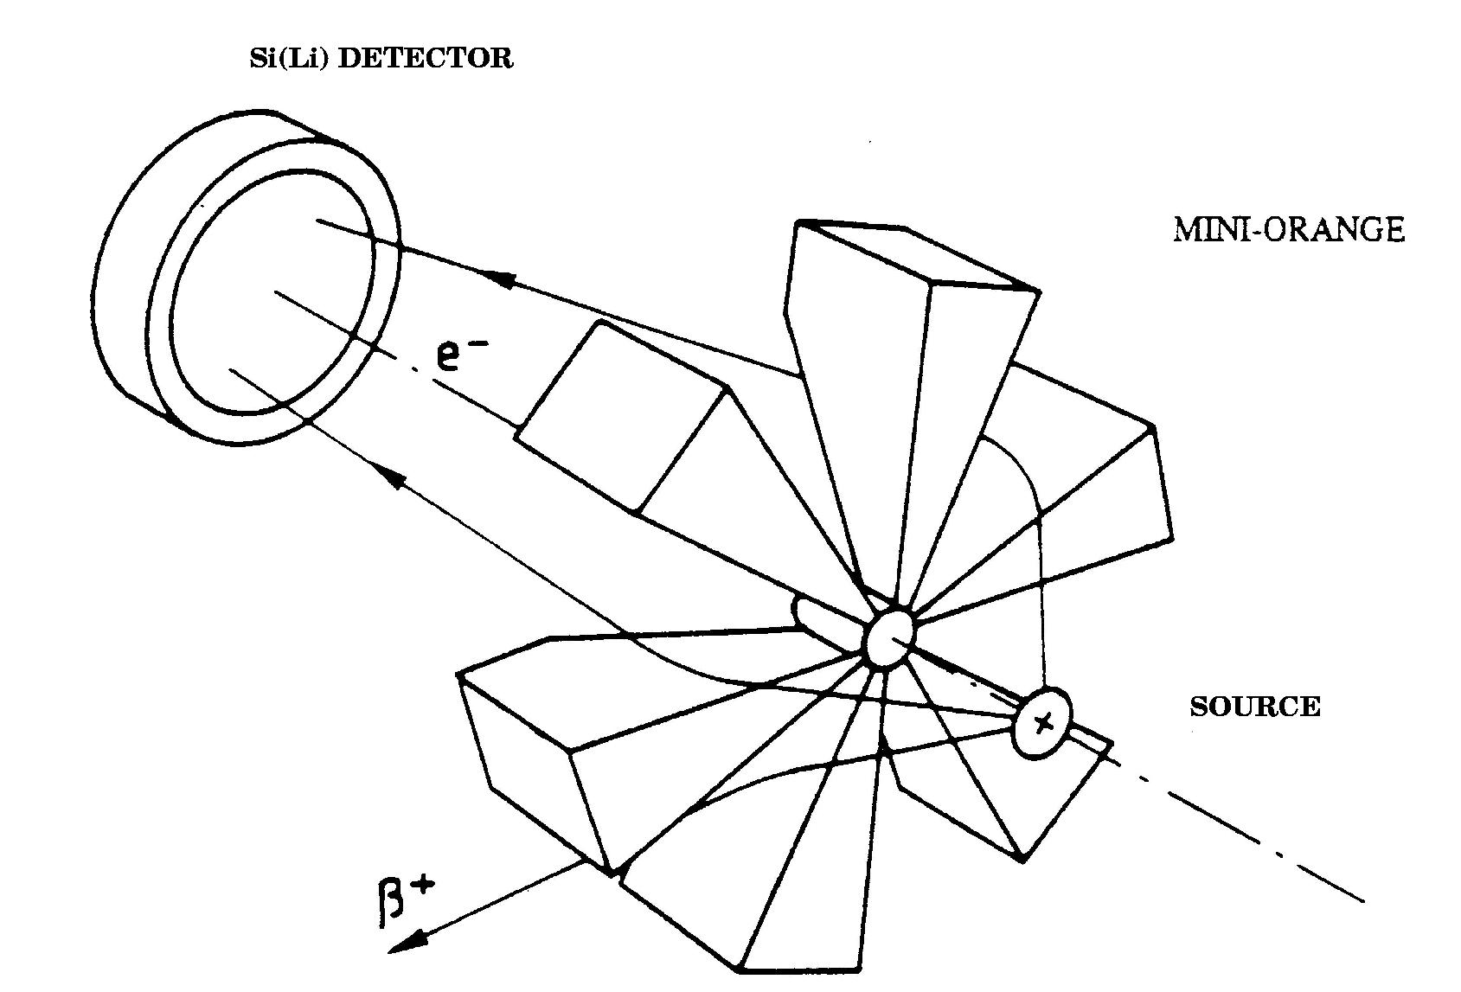
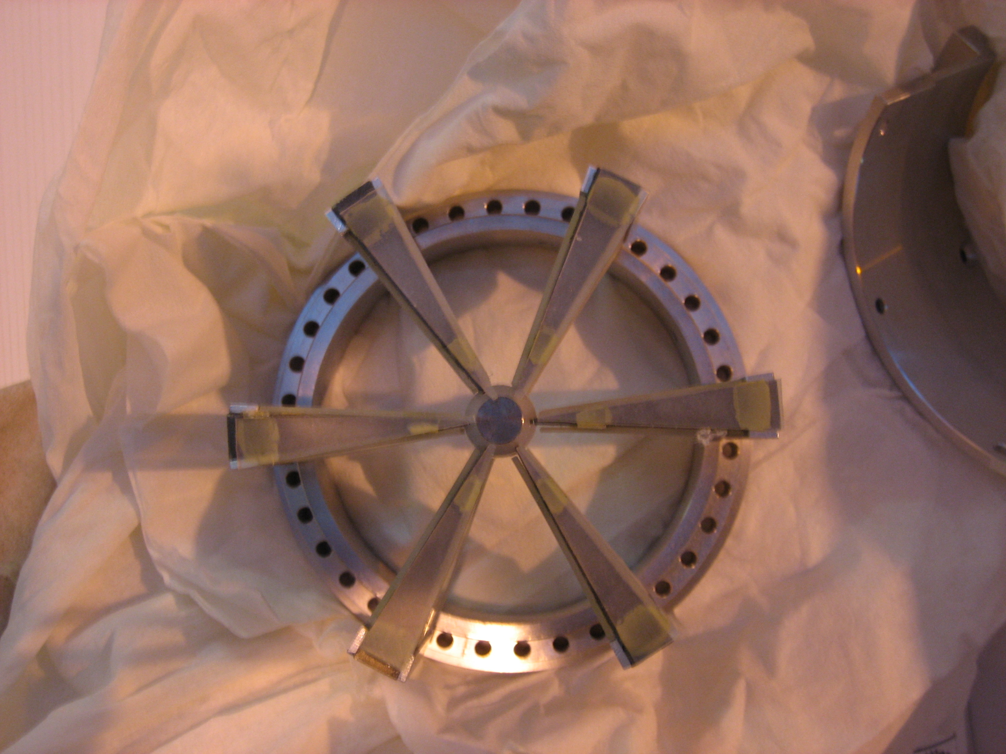
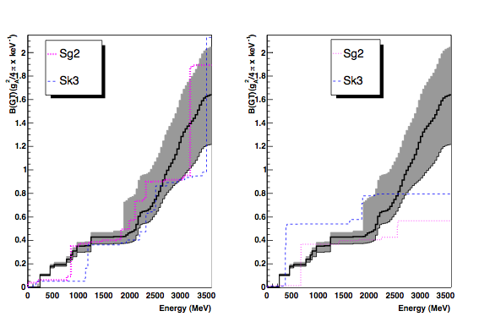
In order to properly analyse Tas data
One needs some high resolution data
And the electron conversion information
78Sr needed a
larger effort due
to the lack of experimental
information
Clearly prolate
78Sr
Similarly 72Kr analysis,
needed camplementary
information
and the analysis is still
in progrees
J.A Briz
Ph.D thesis Madrid
Pérez
Ph. D thesis Valencia (almost finisched)

Slide 31
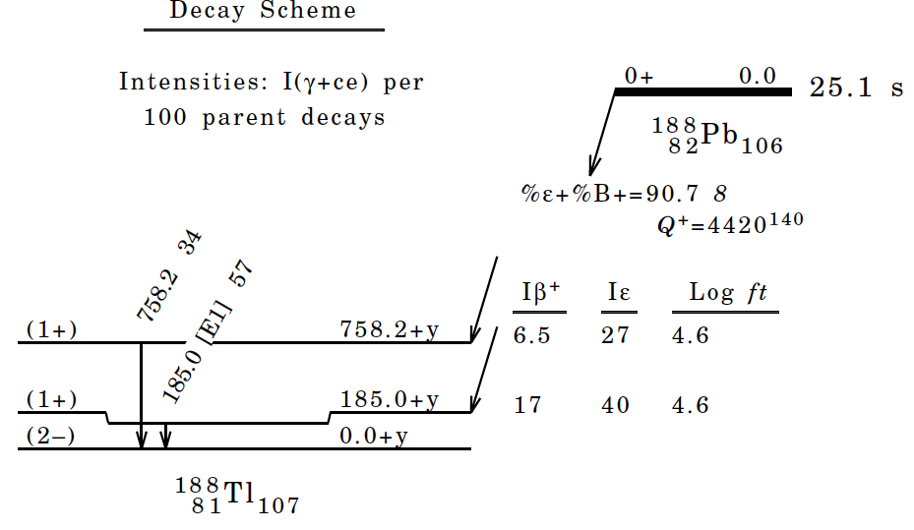
The decay of ¹⁸⁸Pb: what is presently known

Slide 32
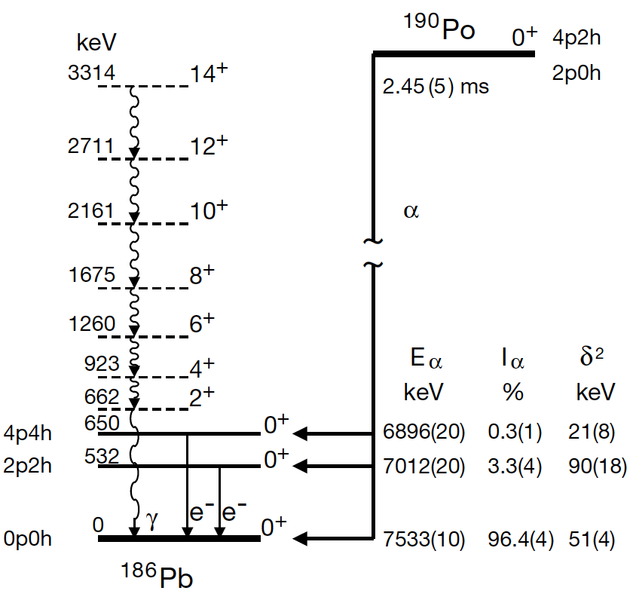
Intruder 0+ states in ¹⁸⁶Pb
N. Andreyev et al.
Nature 405 (2000) 430

Slide 33
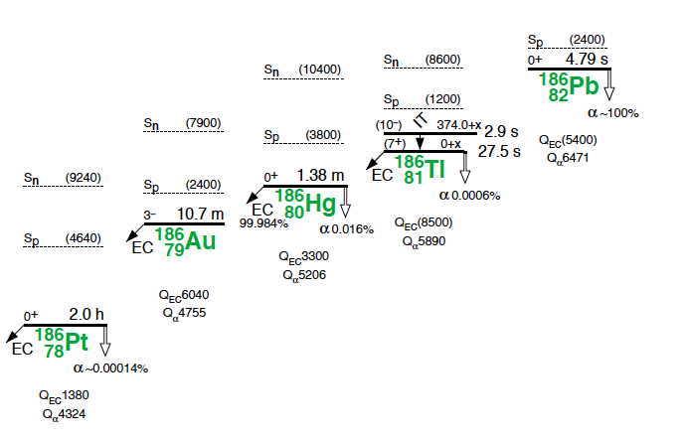
A=186 : what is presently known

Slide 34
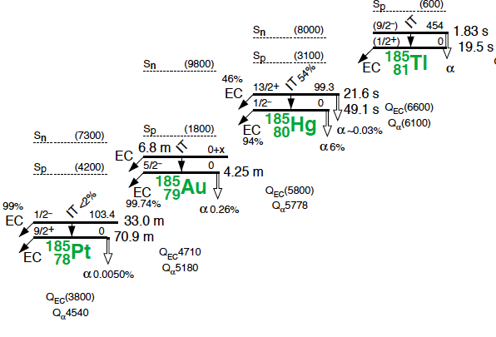
A=185 : what is presently known

Slide 35
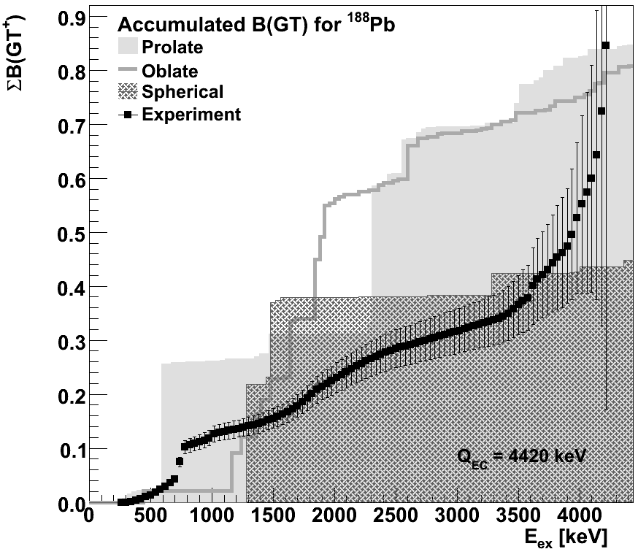
Very preliminary results: ¹⁸⁸Pb
Thesis work of E. Estevez, in preparation.
Theory from PRC 72, 054317 (2005)
Preliminary results consistent with spherical picture. Calculations may require fine-tuning
Notes:
186Pb decay high resolution unknown
188Pb decay poorly known
Pb are spherical
Hg shape evolution
Pt the same

Slide 36
The first two proposals IS370 and IS398,
Were focused in deducing the deformation of the
Ground state of neutron deficient Sr (Z=38) and Kr (Z=36) isotopes from
the B(GT) distribution of their ß+ decay
Strong oblate-prolate competition and rapid shape changes
To extract information
on the sign of the
deformation
is not easy

