Slide 1
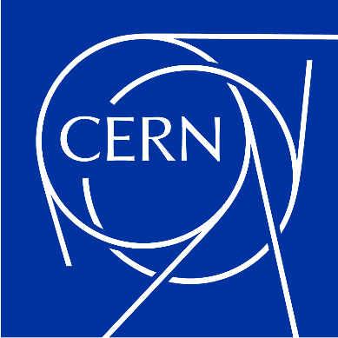

Beam induced power in muon RCS RF systems
F. Batsch, I. Karpov, H. Damerau
HEMAC meeting #14
19/1/2023

Slide 2
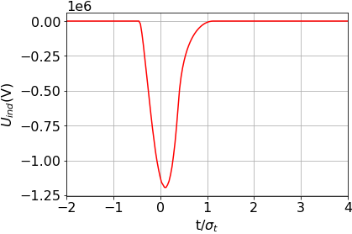
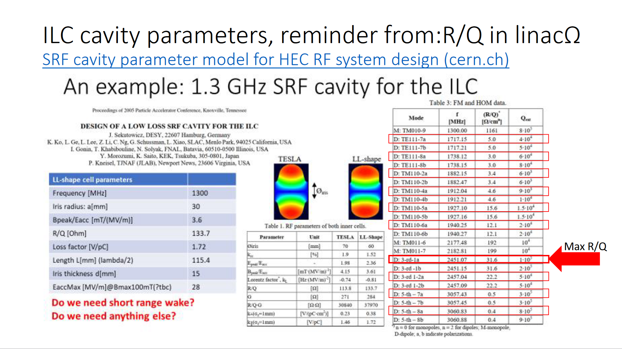
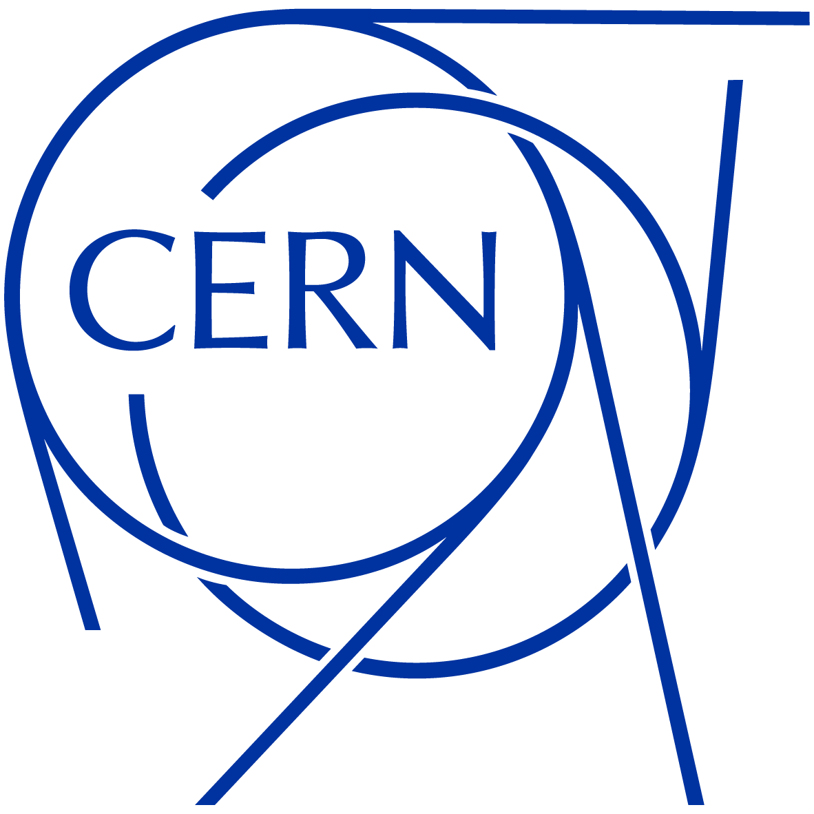
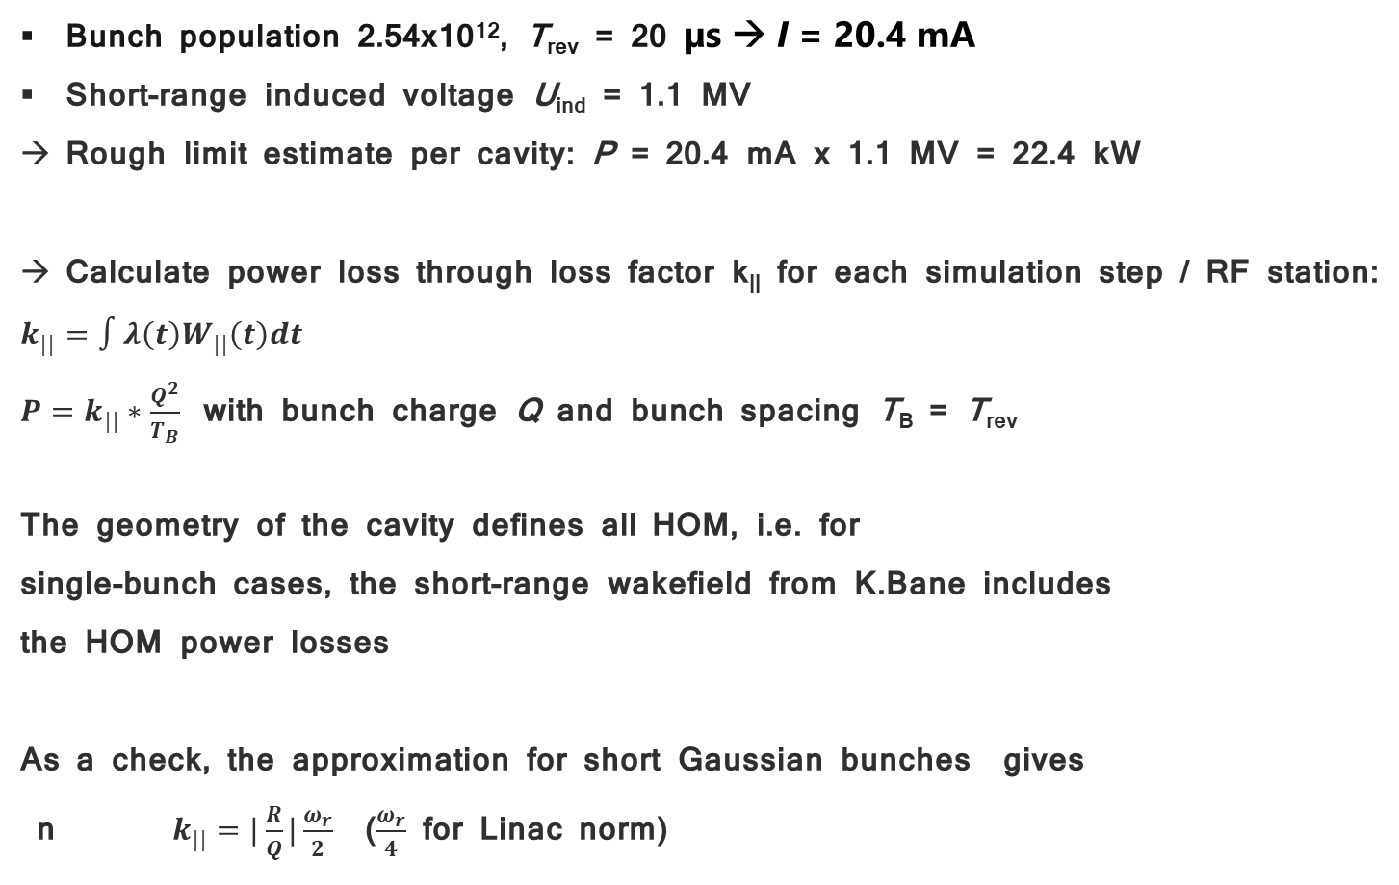
HOM power for the TESLA cavity:
Bunch population 2.54x10¹², T_{rev} = 20 µs → I = 20.4 mA
Short-range induced voltage U_{ind} = 1.1 MV
Rough limit estimate per cavity: P = 20.4 mA x 1.1 MV = 22.4 kW
Calculate power loss through loss factor k|| for each simulation step / RF station:
$k_{||}=∫λ\left(t\right)W_{||}\left(t\right)dt$
$P=k_{||}∗\frac{Q^{2}}{T_{B}}$ with bunch charge Q and bunch spacing T_{B} = T_{rev}
The geometry of the cavity defines all HOM, i.e. for
single-bunch cases, the short-range wakefield from K.Bane includes
the HOM power losses
As a check, the approximation for short Gaussian bunches gives
n $k_{||}=|\frac{R}{Q}|\frac{ω_{r}}{2}$ ($\frac{ω_{r}}{4}$ for Linac norm)
t/4σ_{t}
Reminder on HOM, from Alexej, see here & paper
2

Slide 3
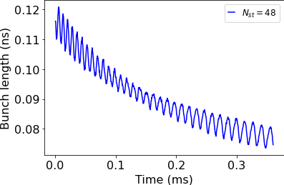
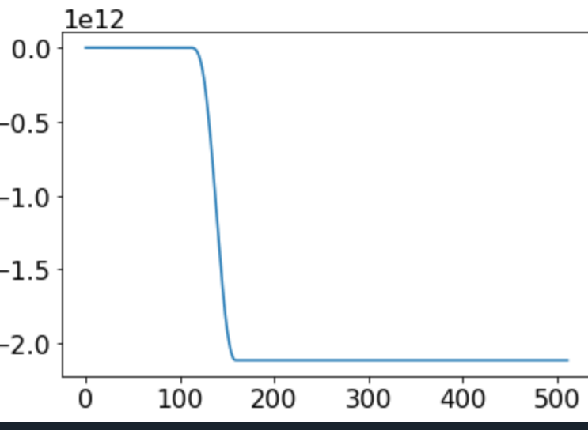
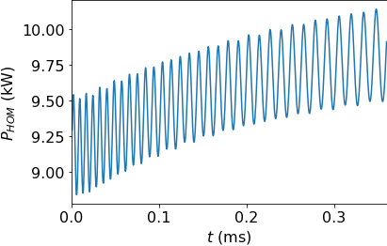
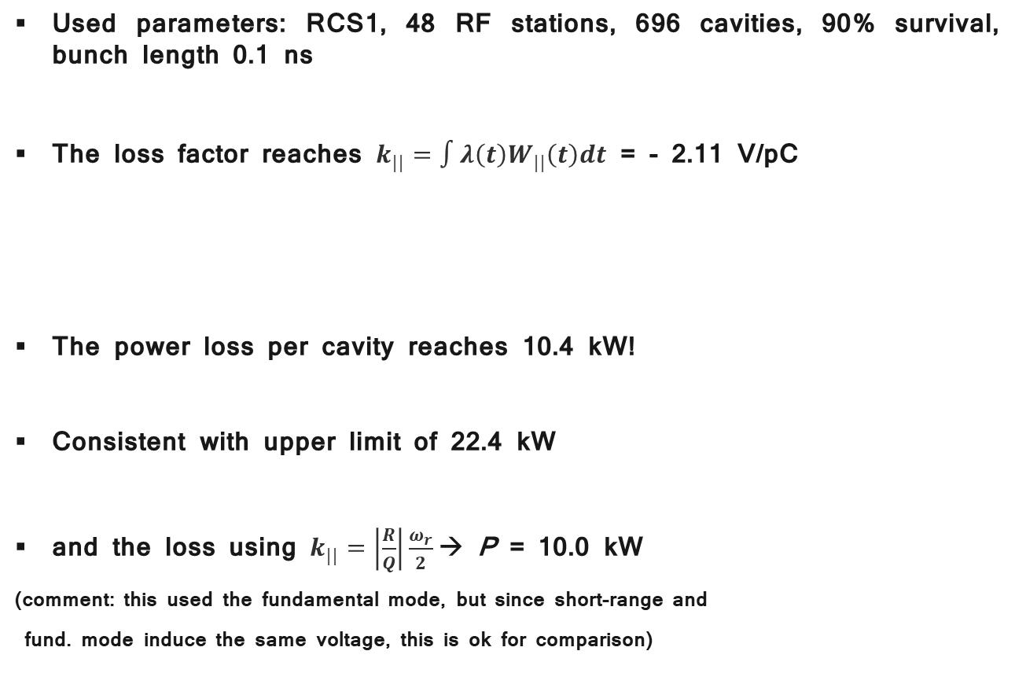
Beam-induced power in RCS1:
Used parameters: RCS1, 48 RF stations, 696 cavities, 90% survival, bunch length 0.1 ns
The loss factor reaches $k_{||}=∫λ\left(t\right)W_{||}\left(t\right)dt$ = - 2.11 V/pC
The power loss per cavity reaches 10.4 kW!
Consistent with upper limit of 22.4 kW
and the loss using $k_{||}=\left|\frac{R}{Q}\right|\frac{ω_{r}}{2}$→ P = 10.0 kW
(comment: this used the fundamental mode, but since short-range and
fund. mode induce the same voltage, this is ok for comparison)
3

Slide 4
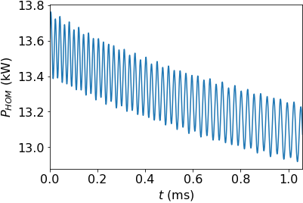
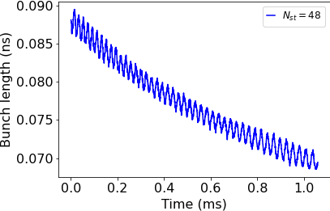
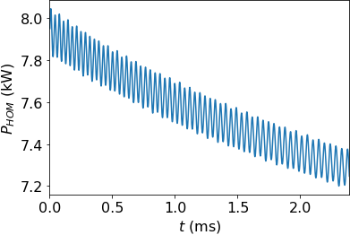
Beam-induced power in the other RCSs:
Larger power loss due to shorter bunches:
RCS2, 48 RF stations:
RCS3, 48 RF stations:
4
Larger ring gives smaller average power

Slide 5
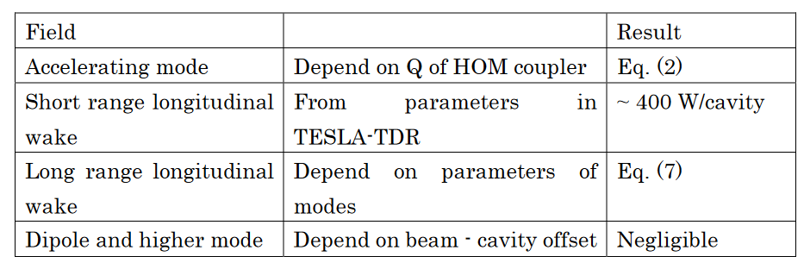
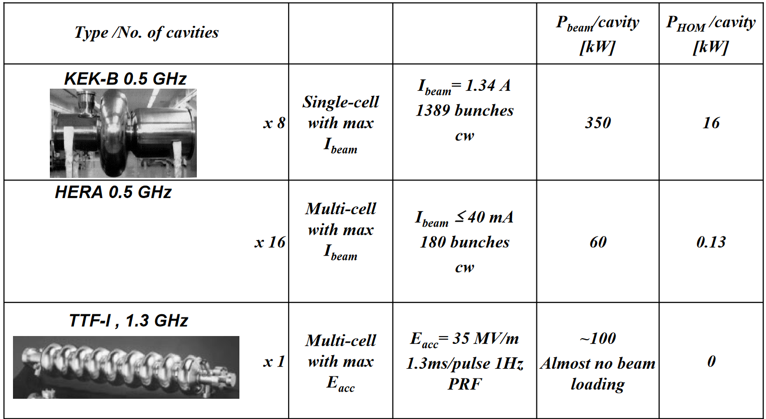
Comparison with ILC:
 | ILC | RCS1
Number of bunches, n_{b} | 1312 | 1 each μ⁺ and μ⁻
Bunch length σ_{z} | 300 μm | 0.1 ns to 0.02 ns (5 mm)
Bunch spacing, τ_{bs} | 554 ns | T_{rev} = 20 μs
Bunch intensity, N_{b} | 2 ∙ 10¹⁰ p/b | 2.5 ∙ 10¹² p/b
Average beam current, I_{b} | 5.8 mA | 2 × ~20 mA
From Heiko’s presentation:
A rough estimate of the short-range power loss per cavity gives:
More under cavities under [link, p.78]
5
[K. Kubo , Link]

Slide 6
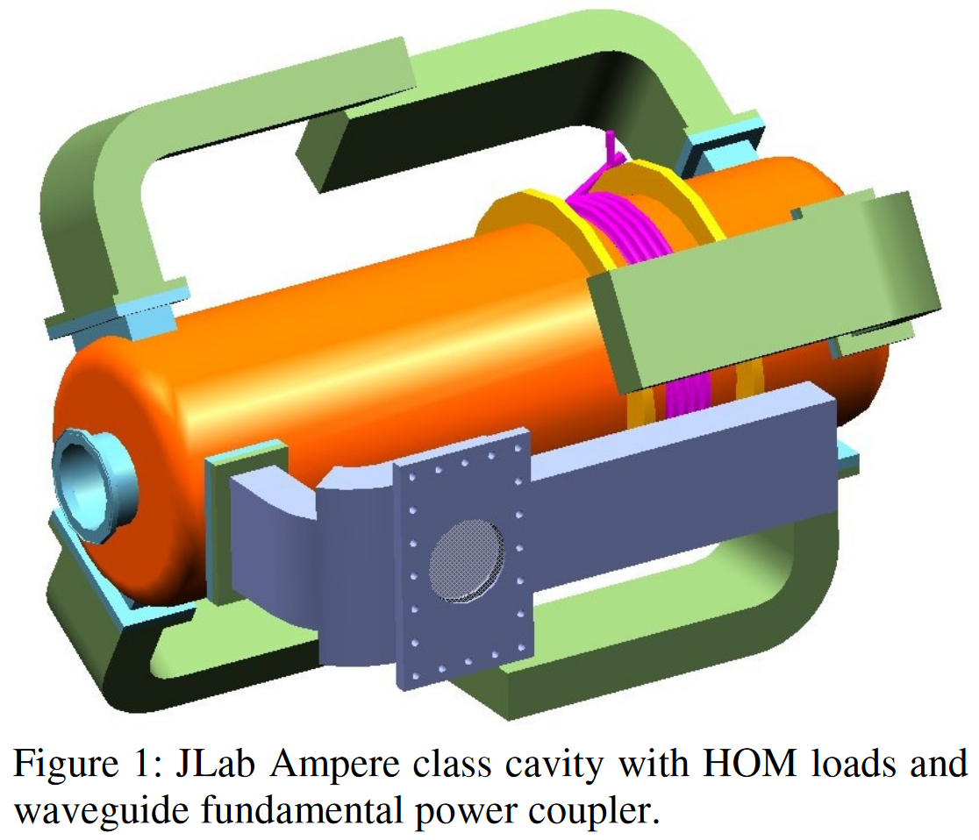
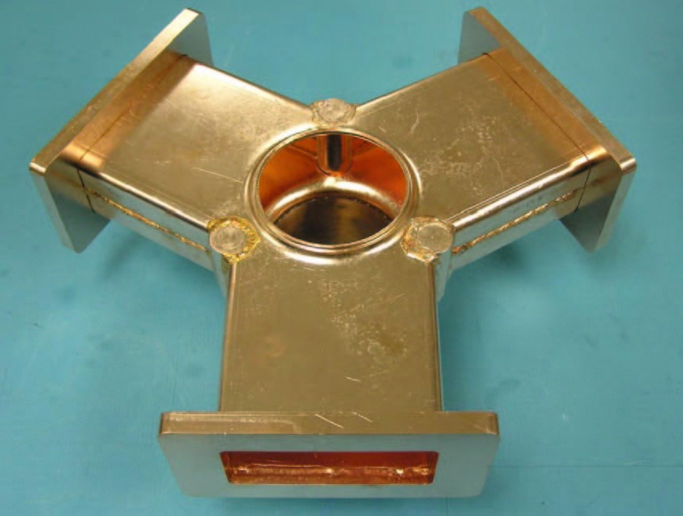
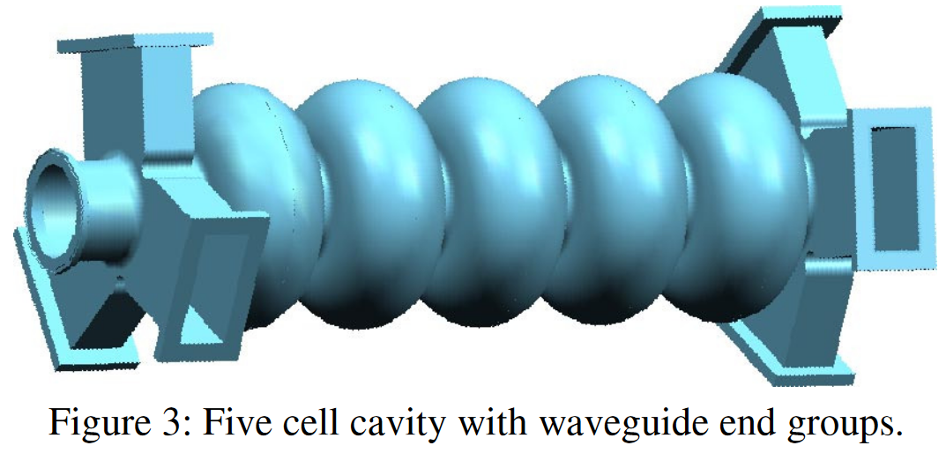
Summary / Discussion:
The induced power is very large, above 10 kW for RCS 1&2 per bunch -> bunch crossings?
HOM power capability limit is 3-4 kW
Without other adjustments, the wakefields scale with a², a the iris radius
A factor of 2.5 in power corresponds to √2.5 in iris radius or frequency
1.3 GHz / √2.5 = 822 MHz ?
BUT: The JLAB cryomodule (750 MHz) HOM power capability is estimated to be 20kW per cavity [ref], with 5 HOM waveguide absorbers per cavity: [R.Rimmer]
Need definition of maximal acceptable power level to keep 1.3 GHz or switch to lower frequency
all from [R.Rimmer]

Slide 7
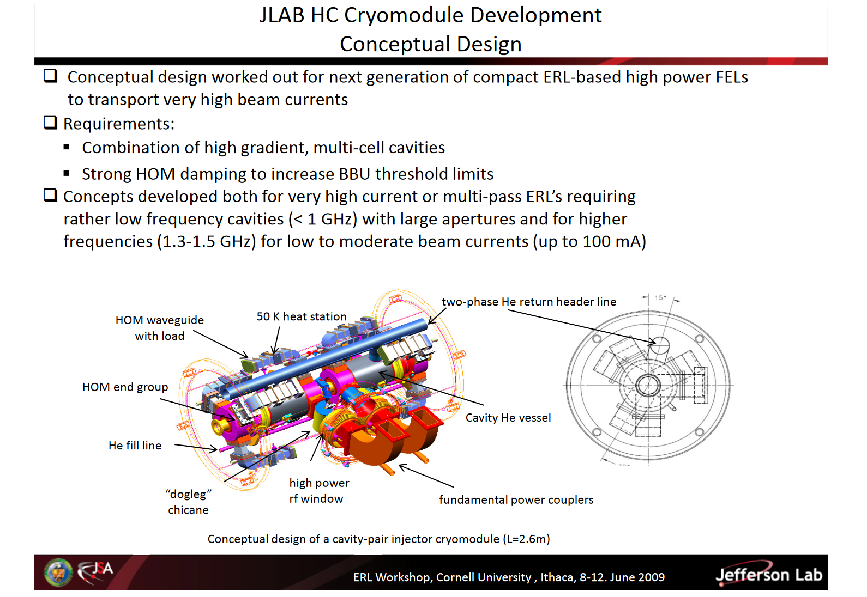
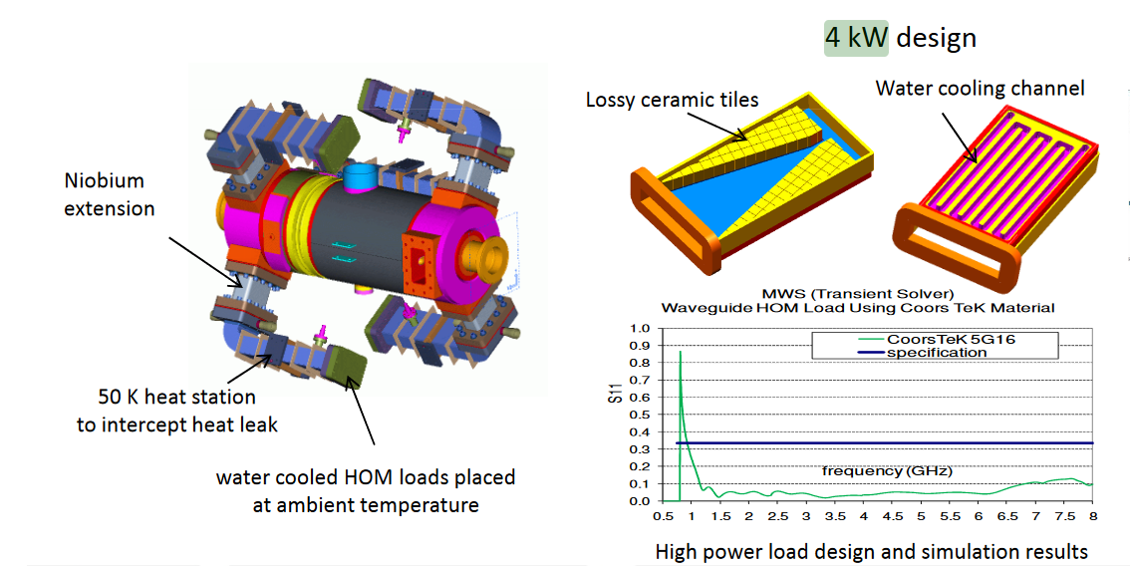
Summary / Discussion:
Concepts with up to 4 kW and 1.5 GHz presented: see [F.Marhauser2009, PERLE coll. Meeting 2022 ]
See also Shahnam’s PhD thesis

Slide 8
What would look different with 802 MHz cavities?
Some parameter that change with the FCC-ee 5-cell cavity:
 | TESLA/ILC | FCC-
Frequency f_{RF} [MHz] | 1300 | 801.58
Cells | 9 | 5
Active length L_{active} [mm] | 1038 | 935
Cavity length L_{cav} [mm] | 1276 | 1291
Gradient [MV/m] | 30 (conservative) | 25
Number of cavities RCS1 | 696 | 835
Straight length RCS 1 | 2334 | 2334
Straight length with RF | 38 % | 46 %

Slide 9
