Slide 1
Magnetic Measurements on MCBRDP4
Piotr Rogacki
Lucio Fiscarelli
Carlo Petrone
Matthias Bonora
Agnieszka Chmielinska
and other colleagues in the section
EDMSID: 2779805 01/02/2023

Slide 2
Outline
  Measurement setup
  Measurement Cycles Overview
  Standard Cycles
  Comparison with other MCBRD magnets

Slide 3
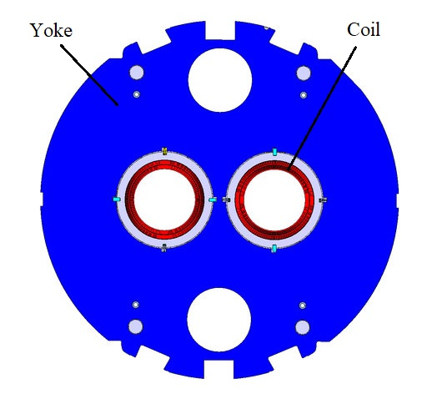
Setup
Vertical field in AP1:
- main field B₁ (normal)
- first allowed multipole b₃
AP1
Horizontal field in AP2:
- main field A₁ (skew)
- first allowed multipole a₃
AP2
Reference radius 35 mm
Rotating-coil in the helium bath of vertical cryostat ClusterD in SM18
  5 segments (500 mm each, 2.5 m total)
    Centered around Segment 3
3

Slide 4
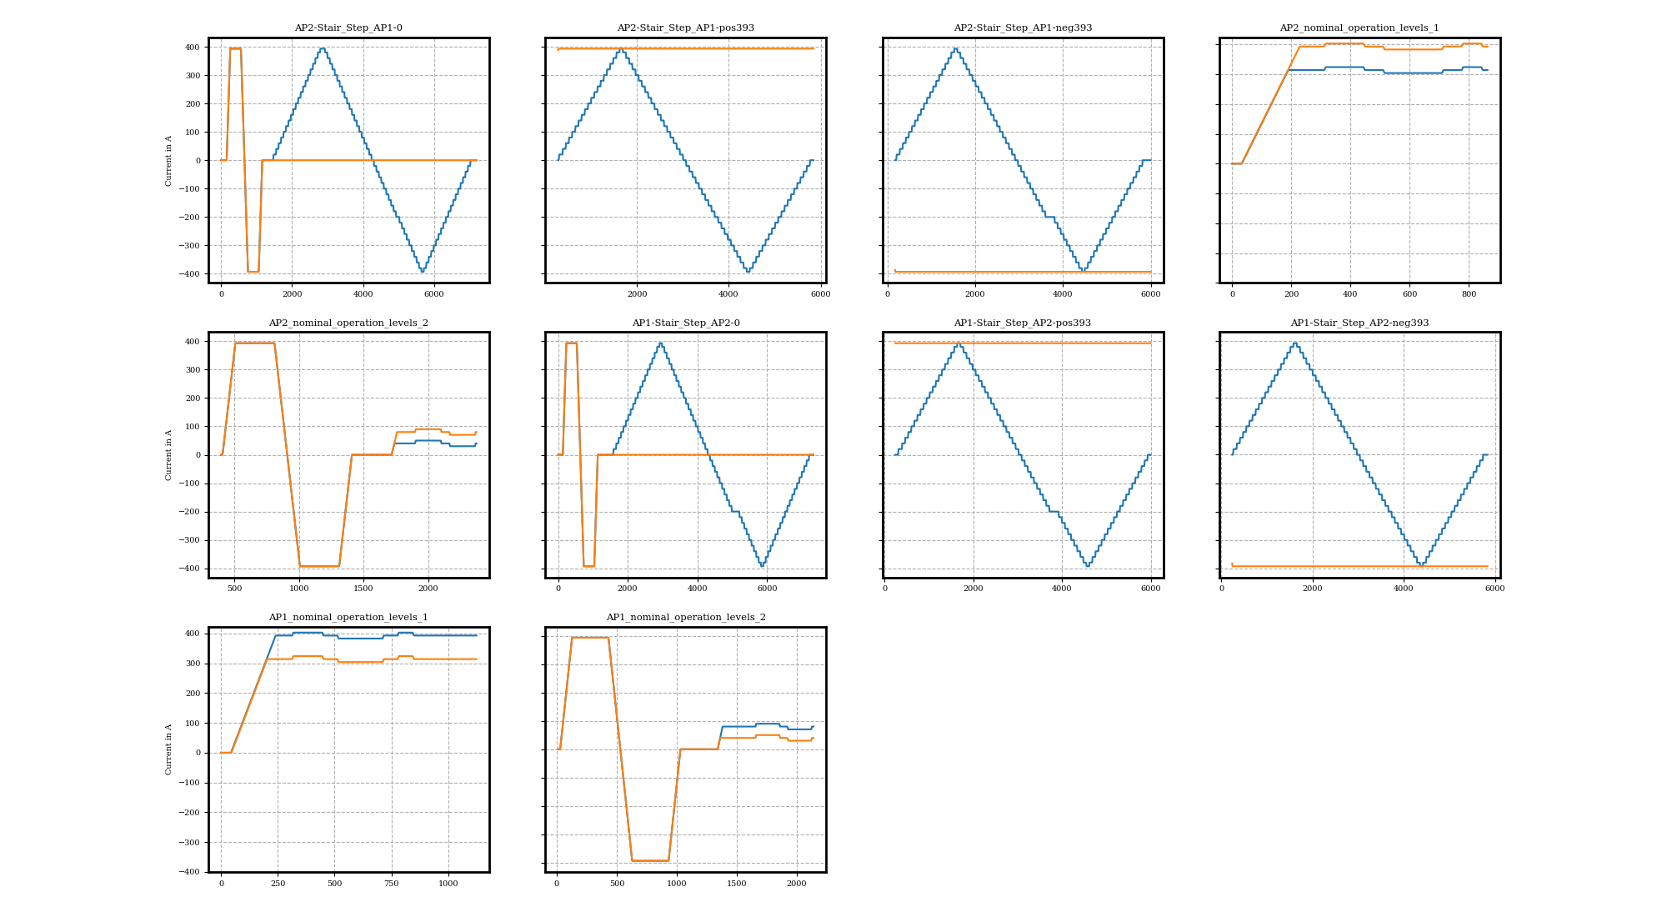
Measurement Cycles Overview
Standard cycles

Slide 5
Standard Cycles
Integrated Field Strength
Difference individual-combined:
AP1: 18 units
AP2: 12 units
  AP1 at 393 A
    Individual Powering: 4.991 Tm
    Combined Powering: 4.982 Tm
  AP2 at 393 A
    Individual Powering: 4.986 Tm
    Combined Powering: 4.980 Tm
Difference AP1-AP2:
+10 units (individual)
+4 units (combined)
Difference AP1-AP2
at warm:
-10 units (AP2>AP1)
5

Slide 6
Standard Cycles
Integrated Field Strength Comparison
 | AP1 |  |  | AP2
 | Individual | Combined | Diff from average | Individual | Combined | Diff from average
 | Tm | Tm | unit | Tm | Tm | unit
MCBRDP1 | 5.003 | 4.993 | 18 | 4.996 | 4.989 | 6
MCBRDP2 | 4.997 | 4.988 | 6 | 4.996 | 4.989 | 6
MCBRDP3 | 4.987 | 4.977 | -14
MCBRDP4 | 4.991 | 4.982 | -6 | 4.986 | 4.980 | -14
MCBRD01 | 4.992 | 4.983 | -4 | 4.994 | 4.987 | 2
Difference individual-combined:
AP1: 19±1 units
AP2: 13±1 units
6

Slide 7
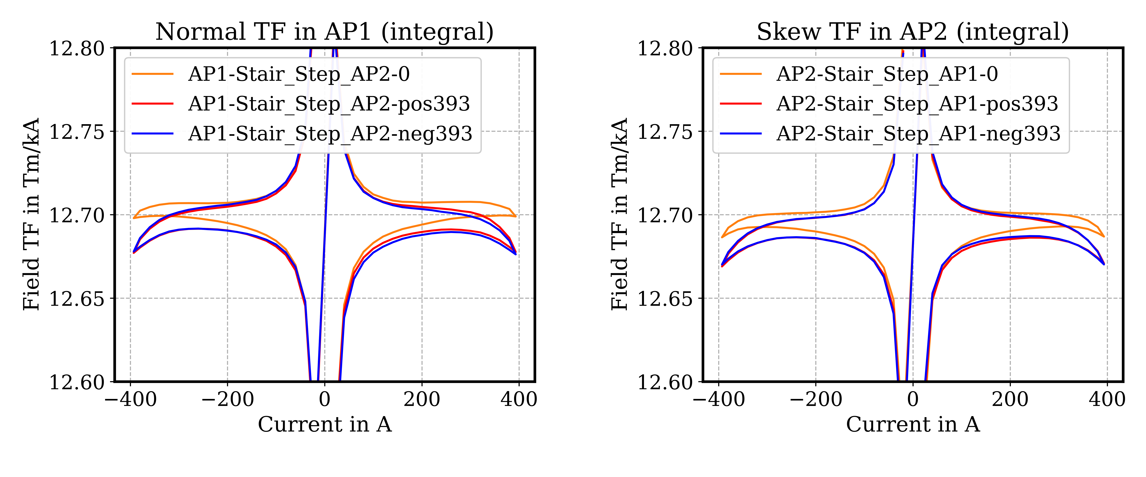
Transfer function

Slide 8
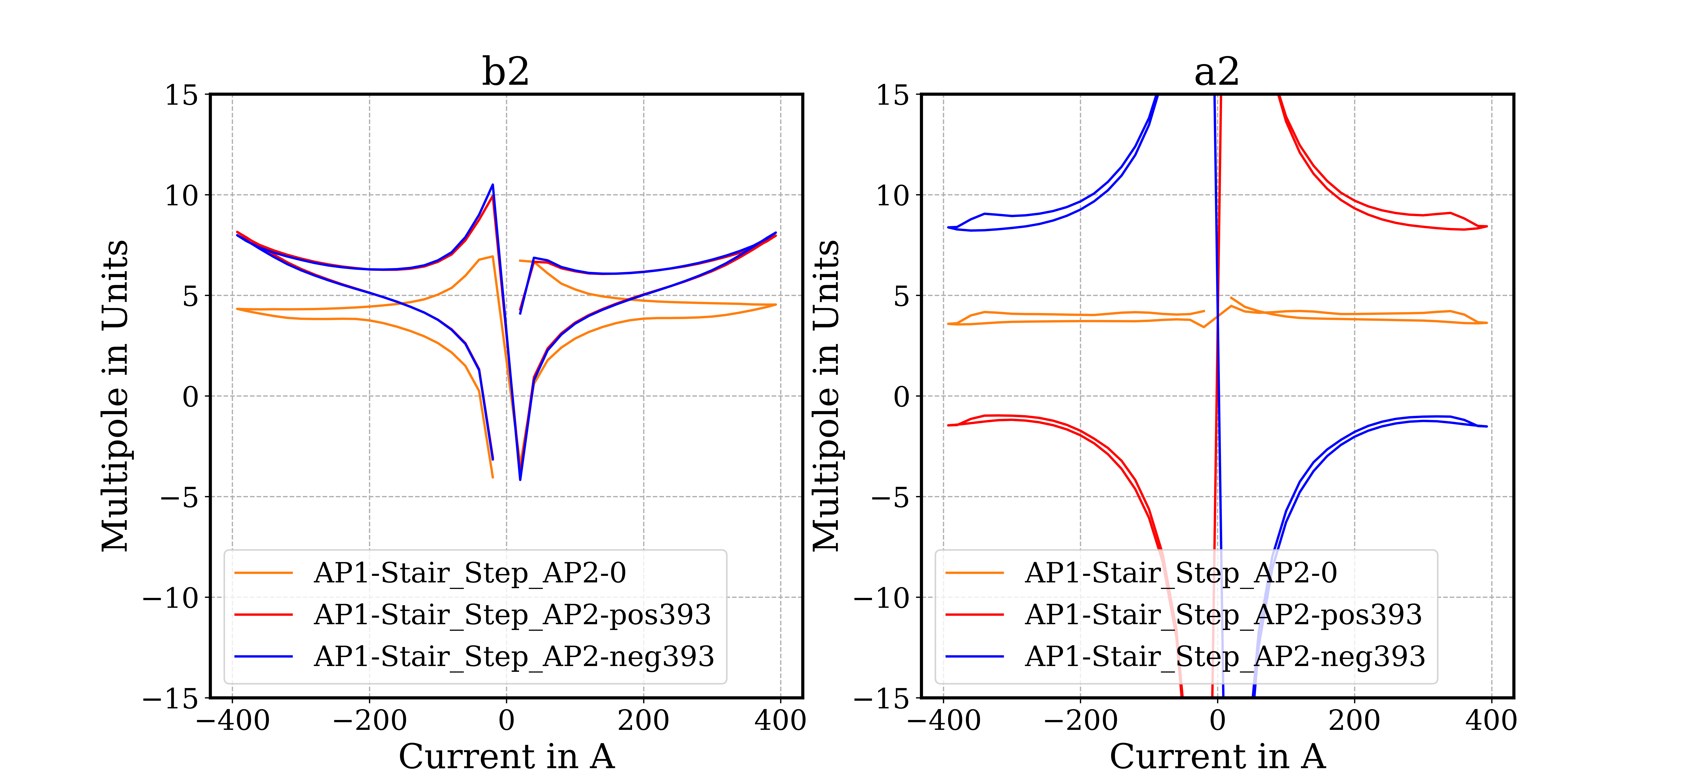
AP1 - Multipoles b2/a2

Slide 9
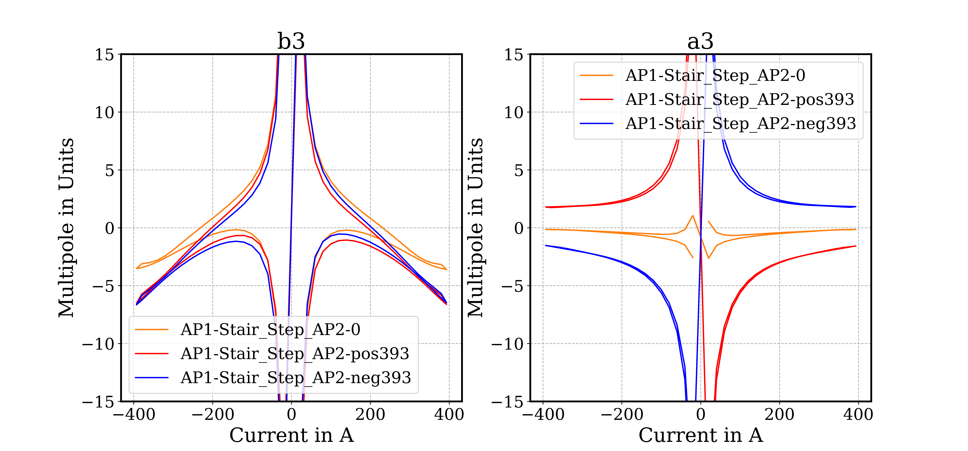
AP1 - Multipoles b3/a3

Slide 10
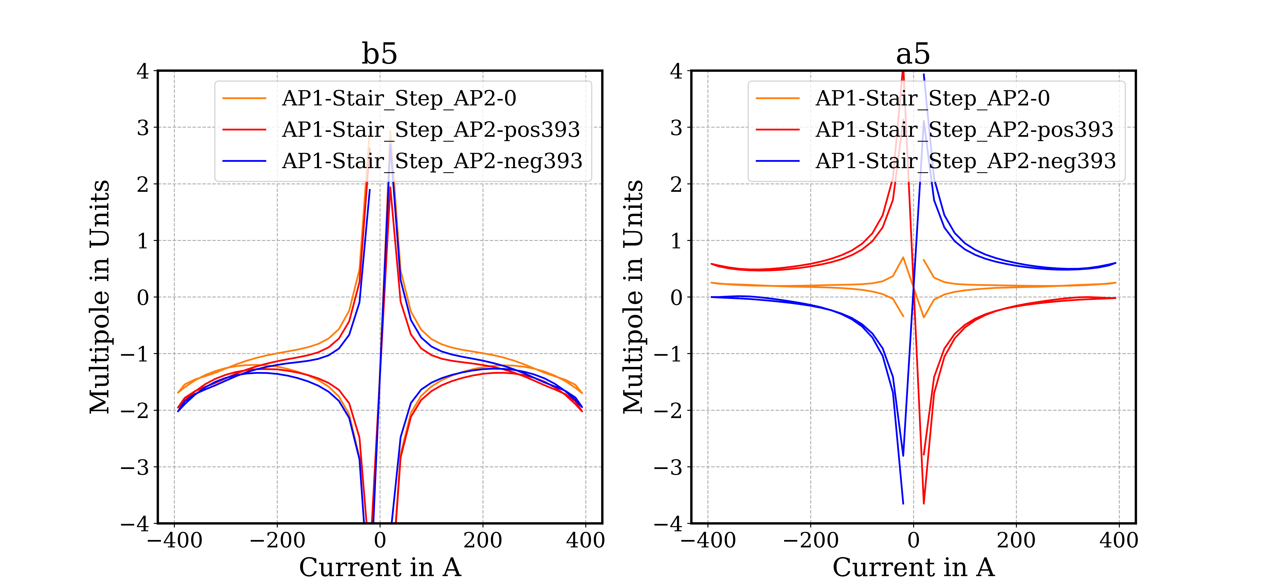
AP1 - Multipoles b5/a5

Slide 11
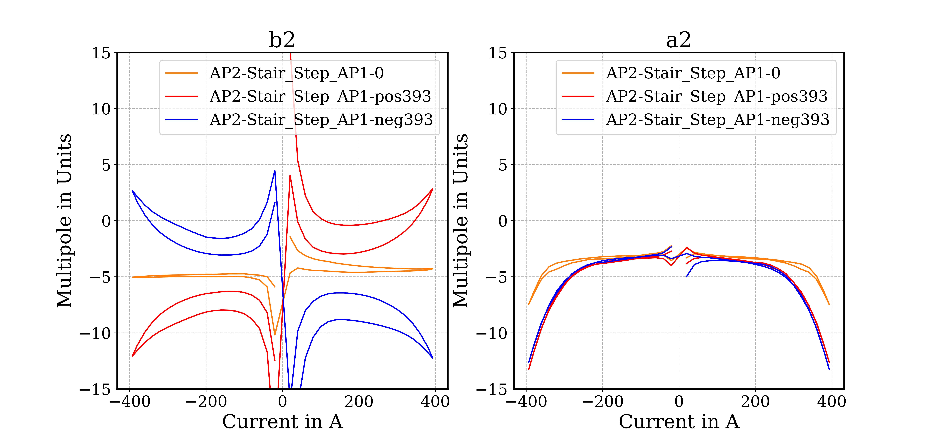
AP2 - Multipoles b2/a2

Slide 12
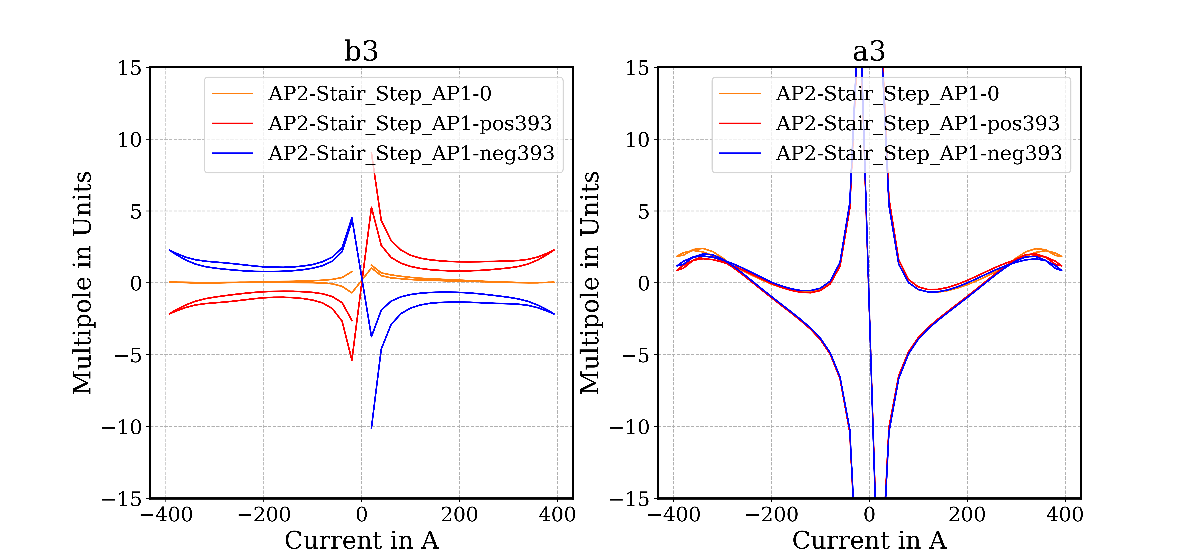
AP2 - Multipoles b3/a3

Slide 13
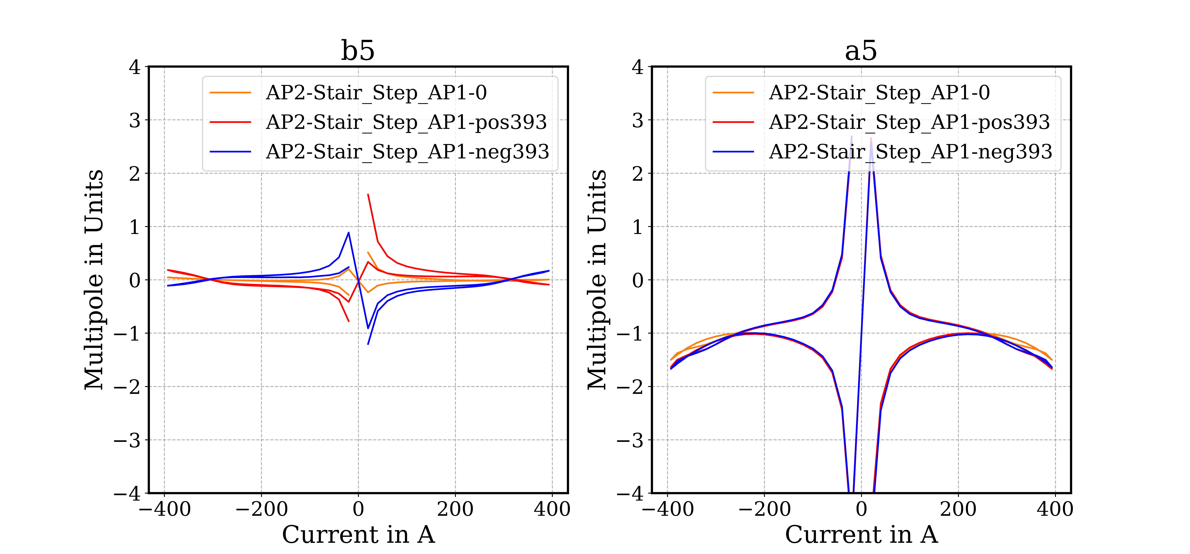
AP2 - Multipoles b5/a5

Slide 14
Field-quality tables - Integral
APERTURE 1
Individual powering (positive-negative mean) |  |  | Difference from individual to combined powering
AP1 at ±393A AP2 at 0A |  |  | AP1 at ±393A AP2 at ±393A
 | Unit | Value |  | Unit | Value
Norm. TF | Tm/kA | 12.699 | Norm. TF Δ* | units | -18
Int. B1 | Tm | 4.991 | Int. B1 Δ* | units | -18
n | bn | an | n | Δbn** | Δan**
2 | 4.98 | 3.16 | 2 | 3.97 | ±5.60
3 | -4.29 | 0.14 | 3 | -3.41 | ±1.90
4 | -0.36 | -0.15 | 4 | 0.34 | ±0.81
5 | -1.74 | 0.23 | 5 | -0.32 | ±0.34
6 | 0.14 | 0.05 | 6 | -0.02 | ±0.12
7 | 0.36 | -0.09 | 7 | -0.02 | ±0.04
8 | 0.07 | -0.03 | 8 | -0.01 | ±0.00
9 | 0.02 | -0.07 | 9 | -0.01 | ±0.01
10 | 0.01 | 0.01 | 10 | 0.00 | ±0.00
11 | 0.01 | -0.01 | 11 | 0.00 | ±0.00
12 | -0.01 | 0.00 | 12 | -0.01 | ±0.00
13 | 0.00 | 0.00 | 13 | 0.00 | ±0.00
14 | 0.00 | 0.00 | 14 | 0.00 | ±0.00
15 | 0.00 | 0.00 | 15 | 0.00 | ±0.00
APERTURE 2
Individual powering (positive-negative mean) |  |  | Difference from individual to combined powering
AP2 at ±393A AP1 at 0A |  |  | AP2 at ±393A AP1 at ±393A
 | Unit | Value |  | Unit | Value
Skew TF | Tm/kA | 12.687 | Skew TF Δ* | units | -12
Int. A1 | Tm | 4.986 | Int. A1 Δ* | units | -12
n | bn | an | n | Δbn** | Δan**
2 | -4.66 | -7.46 | 2 | ±7.46 | -5.48
3 | 0.05 | 1.84 | 3 | ±2.22 | -0.82
4 | 0.11 | -0.18 | 4 | ±0.10 | -0.17
5 | 0.02 | -1.50 | 5 | ±0.14 | -0.16
6 | 0.07 | 0.15 | 6 | ±0.05 | -0.07
7 | 0.04 | -0.31 | 7 | ±0.02 | -0.01
8 | -0.10 | 0.04 | 8 | ±0.01 | 0.00
9 | 0.01 | -0.01 | 9 | ±0.01 | 0.01
10 | 0.01 | 0.01 | 10 | ±0.00 | 0.00
11 | 0.00 | -0.01 | 11 | ±0.00 | 0.00
12 | 0.00 | 0.00 | 12 | ±0.00 | 0.00
13 | 0.00 | 0.00 | 13 | ±0.00 | 0.00
14 | 0.00 | 0.00 | 14 | ±0.00 | 0.00
15 | 0.00 | 0.00 | 15 | ±0.00 | 0.00
* Relative difference in units to nominal value in individual powering
** Difference in units between individual and combined powering - the ‘±’ indicates that the sign of the difference is dependent on the powering quadrant.

Slide 15
Field-quality
Multipole decay

Slide 16
Standard Cycles
Integrated Allowed Multipoles Comparison
 | AP1 |  | AP2
 | b3 | b5 | a3 | a5
MCBRDP1 | -11 (-14) | 0.5 (0.4) | 7.5 (7) | 1 (0.9)
MCBRDP2 | -13.3 (-17.1) | 0.7 (0.3) | 10.3 (9.4) | 0.6 (0.5)
MCBRDP3 | -5 (-9)
MCBRDP4 | -4.3 (-7.7) | -1.7 (-2.0) | 1.8 (1.0) | -1.5 (-1.7)
MCBRD01 | -5.1 (-8.9) | -1.7 (-2.1) | 2.3 (1.6) | -2.1 (-2.3)
multipoles in units at nominal current
values in parenthesis - combined powering
16

Slide 17
Summary
TF value within ±15 units from the average
Field quality: all multiples within ±10 units
Cross talk as expected from previous measurements on other magnets
17

Slide 18
Measurements at ambient temperature

Slide 19
Ambient temperature measurements

Slide 20
Ambient temperature summary
AP1 (Pink) | Str. section |  |  | Integral
Current | 0.2475 | [A] |  | 0.2475 | [A]
B1 | 1.6290 | [mT] |  | 3.1130 | [mT m]
TF | 6.5825 | [mT/A] |  | 12.5794 | [mT m/A]
n | bn | an | n | bn | an
2 | 8.70 | -3.02 | 2 | 8.16 | -4.42
3 | 1.66 | 0.31 | 3 | 5.00 | -0.02
4 | 0.28 | -0.02 | 4 | 0.47 | -0.22
5 | -1.30 | 0.08 | 5 | -2.41 | -0.14
6 | 0.12 | 0.00 | 6 | 0.12 | 0.00
7 | 0.19 | 0.00 | 7 | 0.31 | -0.01
8 | 0.01 | -0.02 | 8 | 0.02 | -0.01
9 | -0.06 | 0.01 | 9 | -0.04 | 0.01
10 | 0.00 | 0.00 | 10 | 0.00 | -0.01
11 | 0.01 | 0.00 | 11 | 0.00 | 0.00
12 | 0.00 | 0.00 | 12 | 0.00 | 0.00
13 | 0.00 | 0.00 | 13 | 0.00 | 0.00
14 | 0.00 | 0.00 | 14 | 0.00 | 0.00
15 | 0.00 | 0.00 | 15 | 0.00 | 0.00
 | Units at 35 mm reference radius
AP2 (Black) | Str. section |  |  | Integral
Current | 0.2476 | [A] |  | 0.2476 | [A]
A1 | 1.6311 | [mT] |  | 3.1167 | [mT m]
TF | 6.5880 | [mT/A] |  | 12.5885 | [mT m/A]
n | bn | an | n | bn | an
2 | 4.97 | 4.87 | 2 | -4.88 | -6.08
3 | 0.19 | -0.67 | 3 | 8.36 | -8.33
4 | 0.07 | 0.27 | 4 | 0.27 | -0.27
5 | 0.02 | 0.09 | 5 | -2.26 | -2.26
6 | 0.00 | 0.04 | 6 | -0.04 | 0.03
7 | -0.01 | -0.01 | 7 | 0.27 | -0.27
8 | 0.01 | 0.01 | 8 | 0.01 | -0.02
9 | -0.01 | -0.01 | 9 | -0.04 | -0.04
10 | 0.00 | 0.00 | 10 | 0.00 | 0.01
11 | 0.00 | 0.00 | 11 | 0.01 | -0.01
12 | 0.00 | 0.00 | 12 | 0.00 | 0.00
13 | 0.00 | 0.00 | 13 | 0.00 | 0.00
14 | 0.00 | 0.00 | 14 | 0.00 | 0.00
15 | 0.00 | 0.00 | 15 | 0.00 | 0.00
 | Units at 35 mm reference radius

Slide 21
Ambient temperature field multipoles
AP1 (Pink)
AP2 (Black)

Slide 22
Other Integral Multipoles

Slide 23
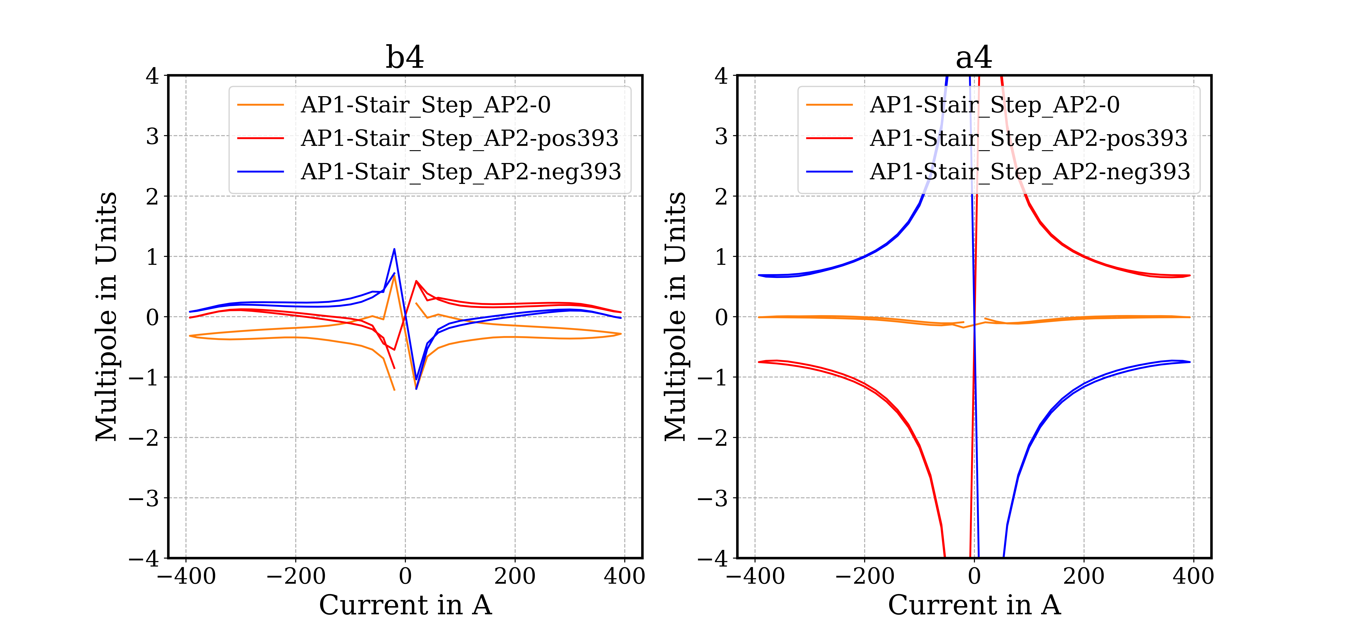
AP1 - Multipoles b4/a4

Slide 24
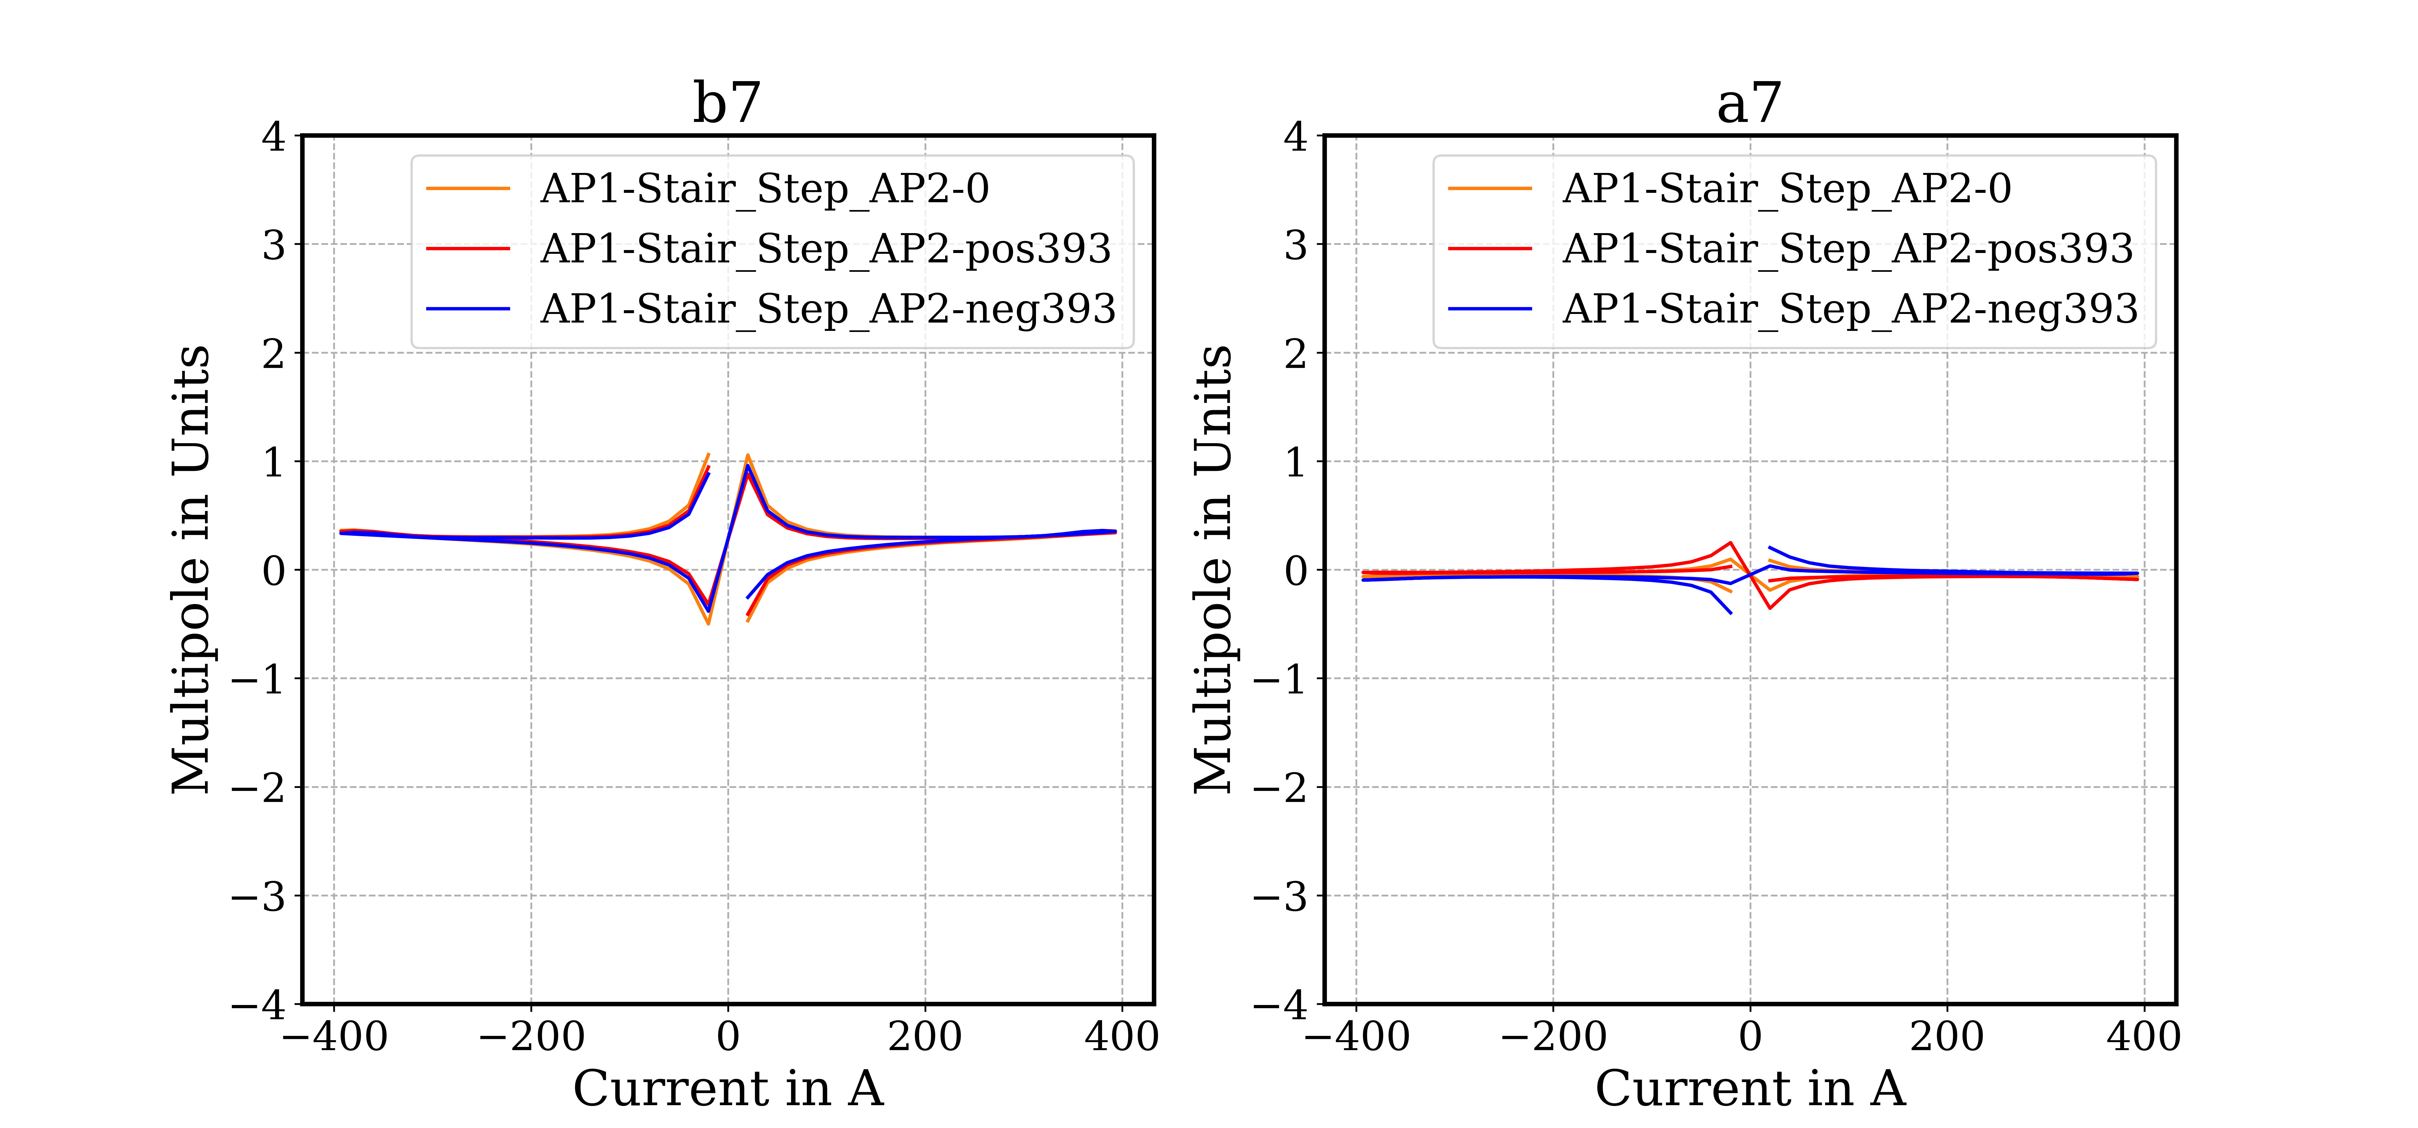
AP1 - Multipoles b7/a7

Slide 25
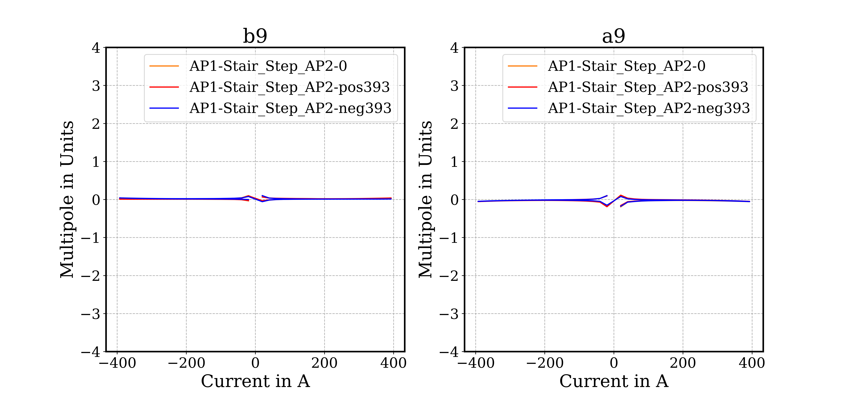
AP1 - Multipoles b9/a9

Slide 26
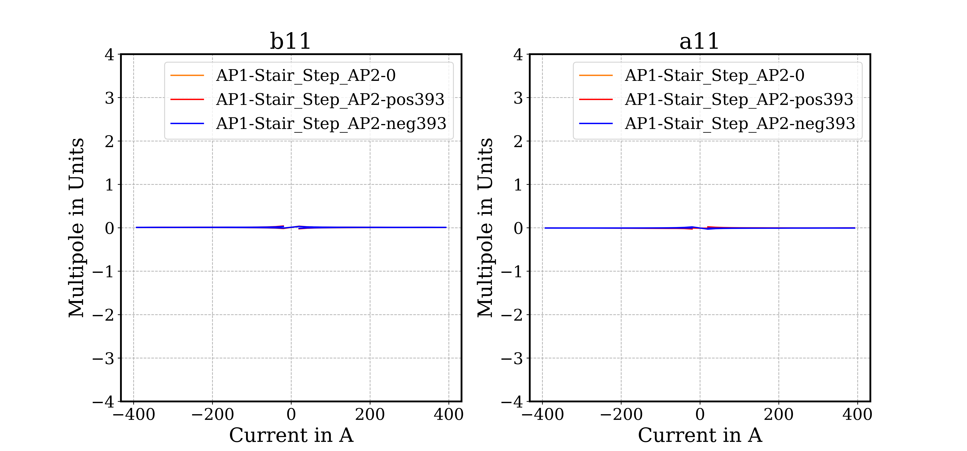
AP1 - Multipoles b11/a11

Slide 27
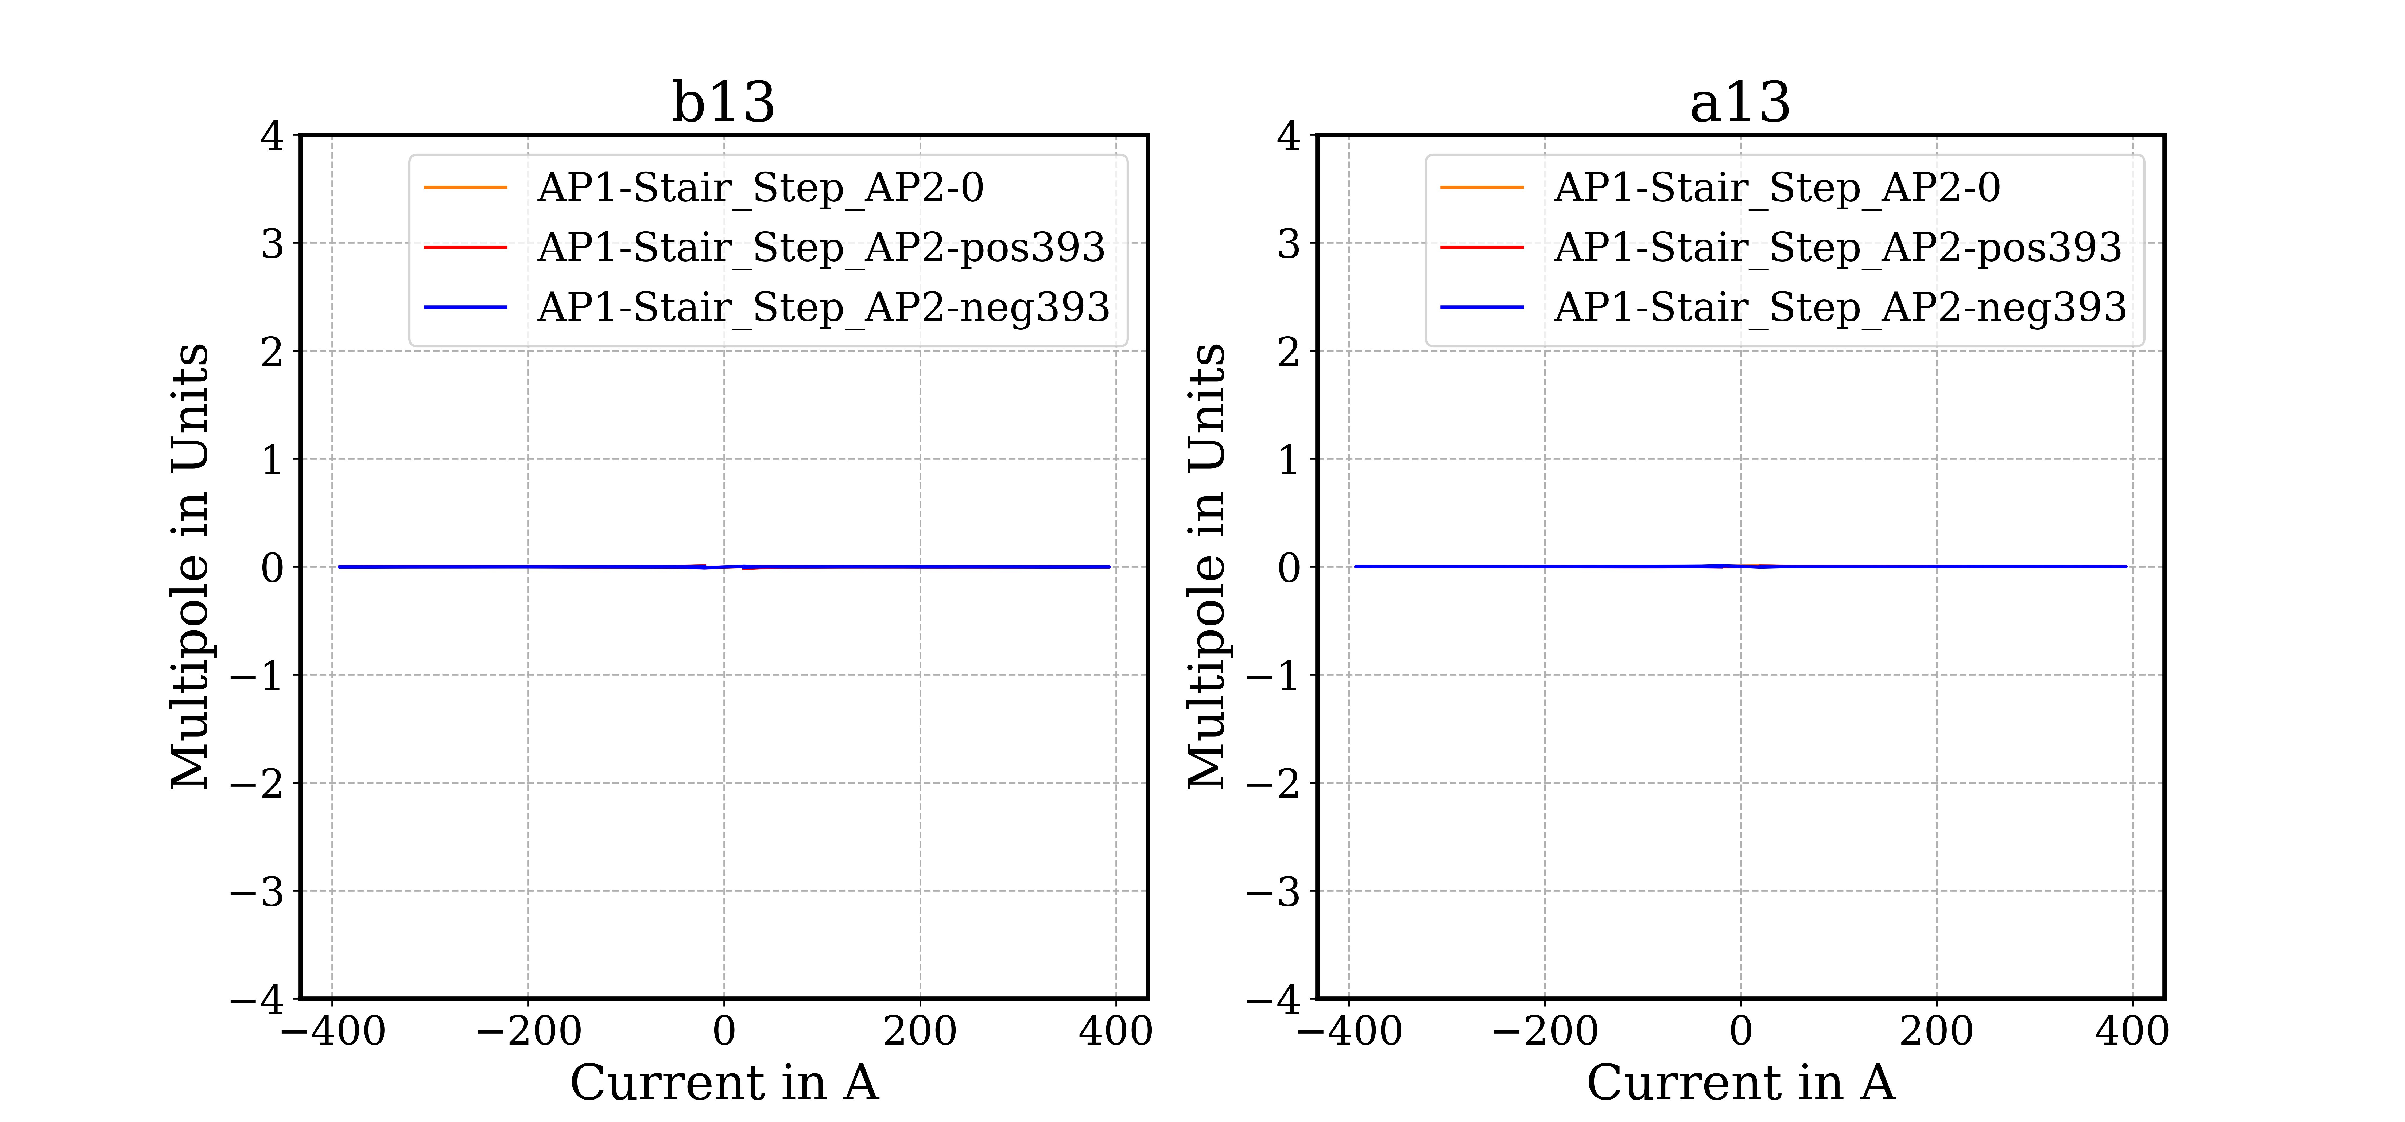
AP1 - Multipoles b13/a13

Slide 28
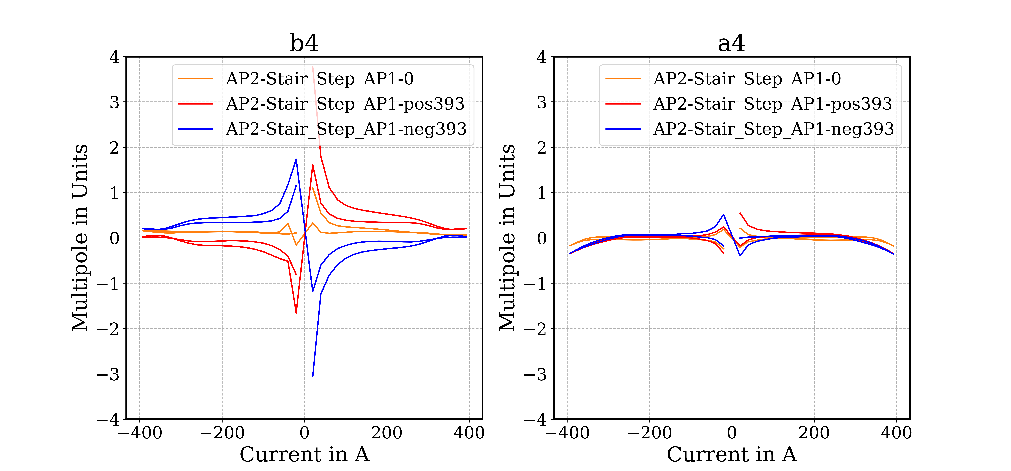
AP2 - Multipoles b4/a4

Slide 29
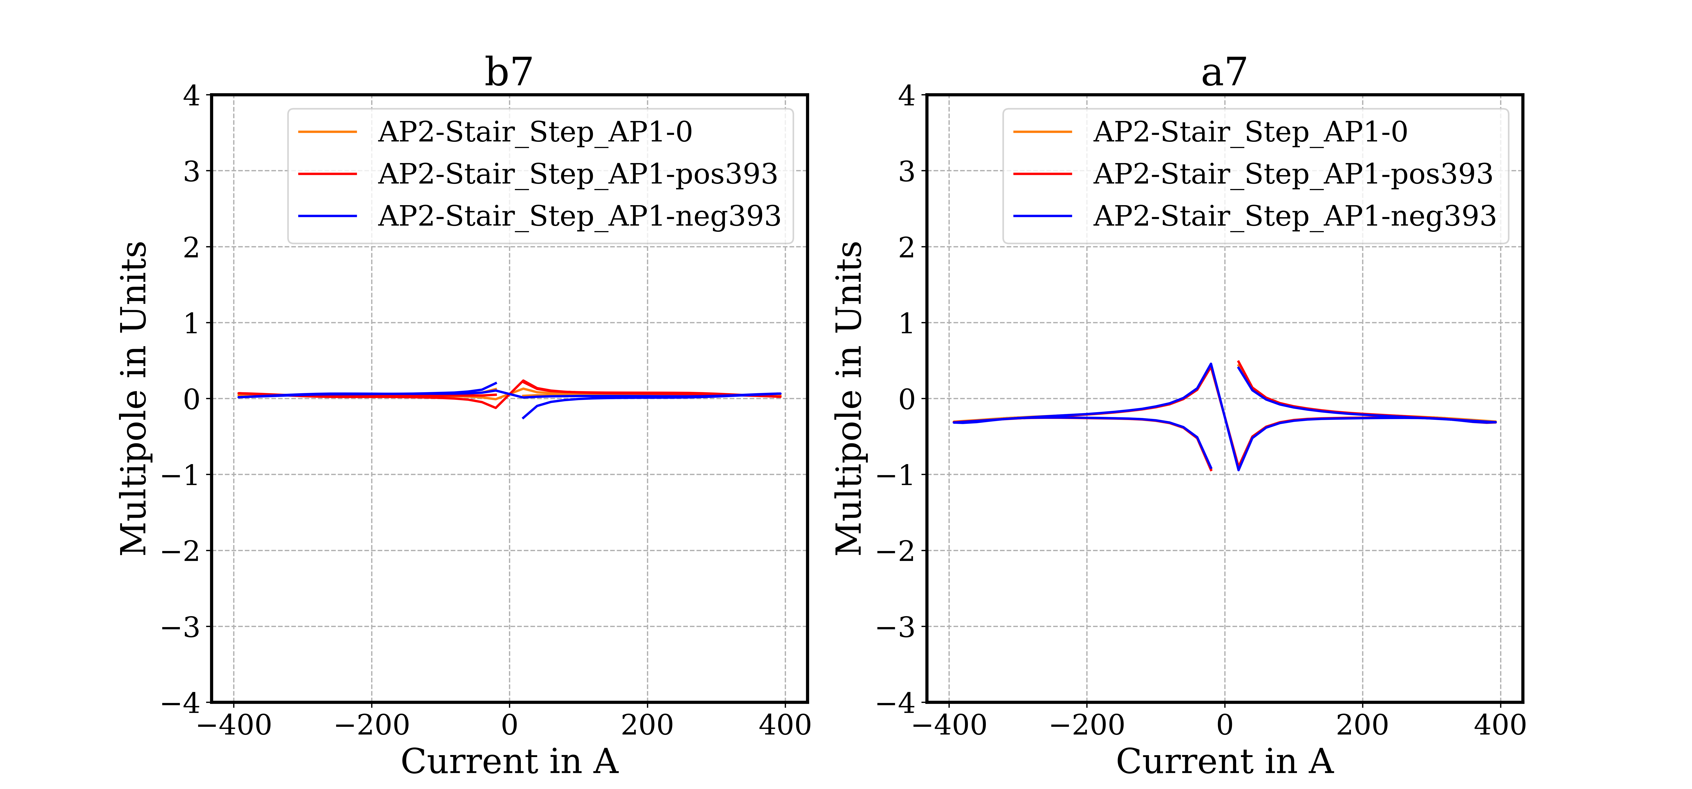
AP2 - Multipoles b7/a7

Slide 30
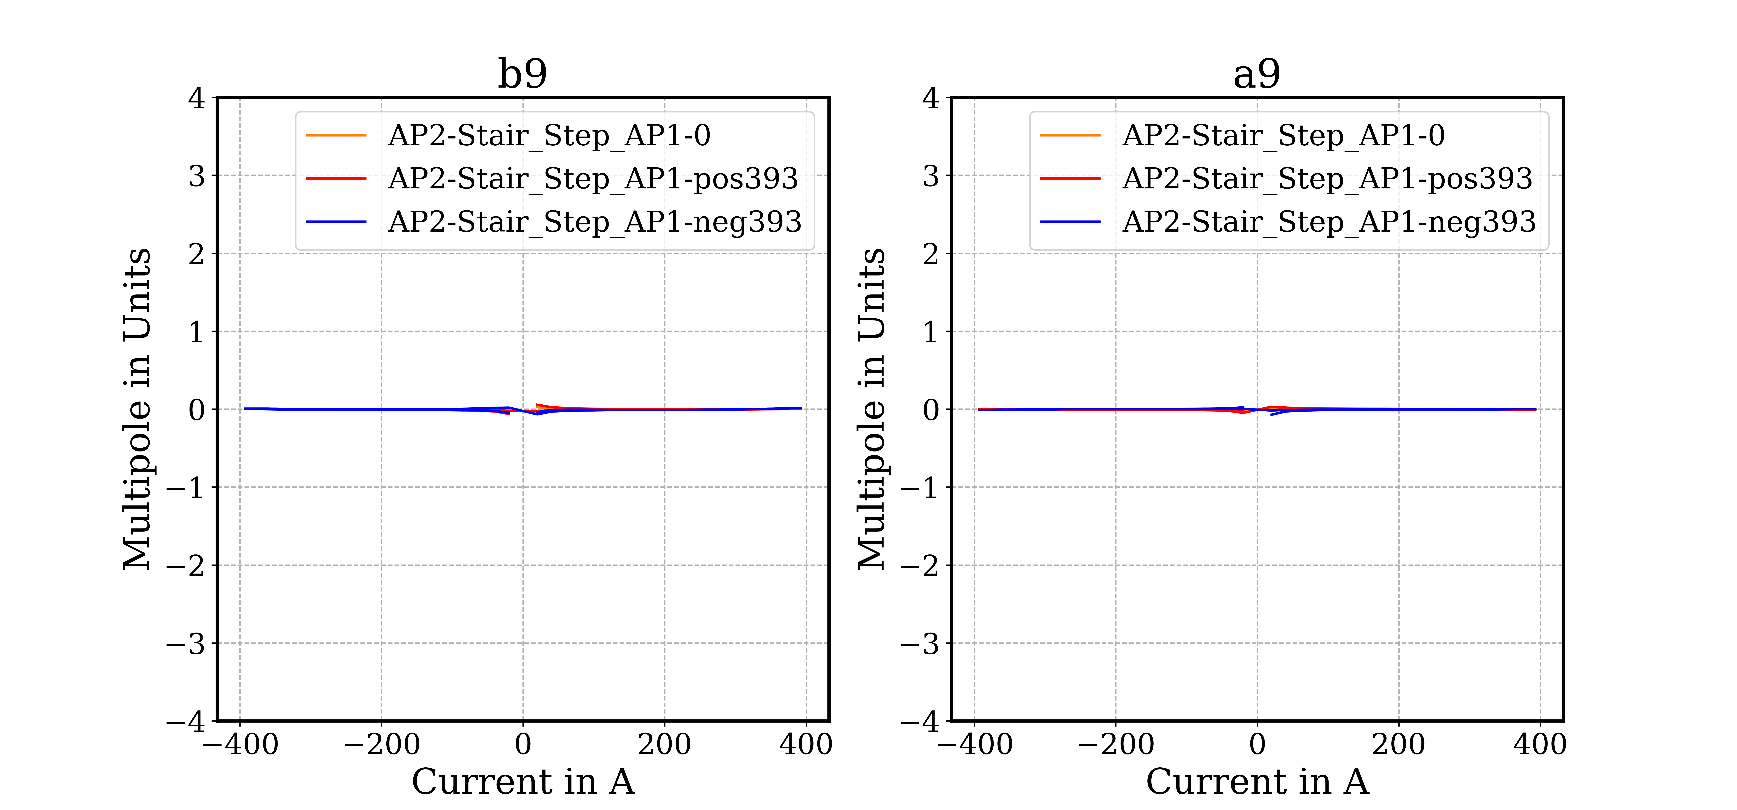
AP2 - Multipoles b9/a9

Slide 31
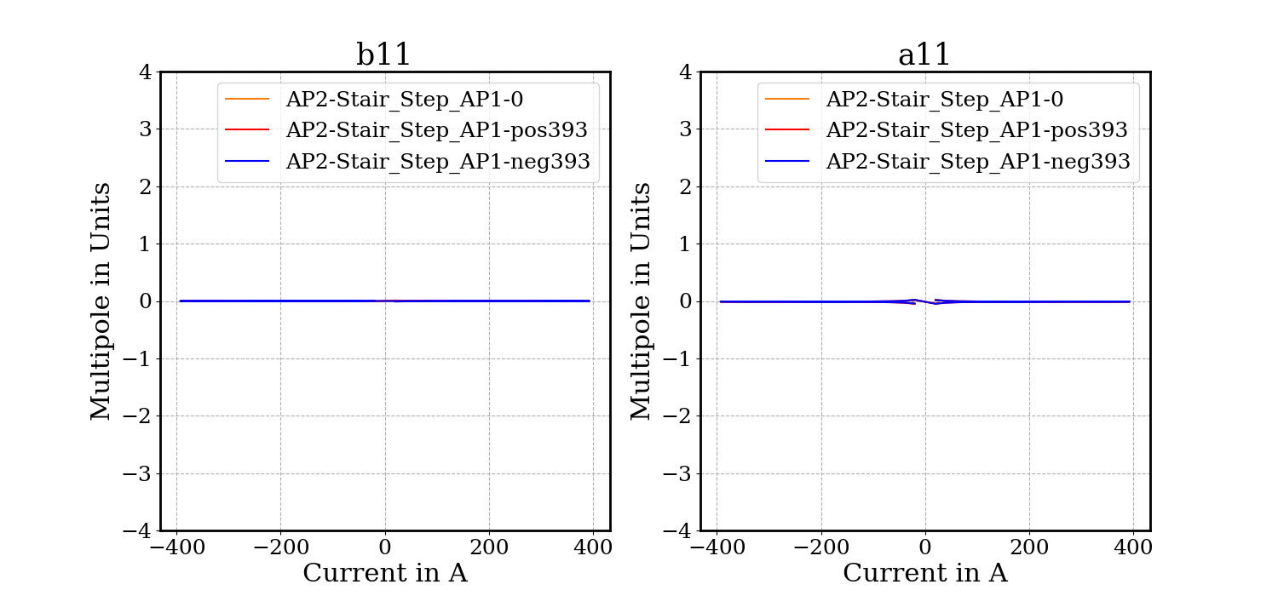
AP2 - Multipoles b11/a11

Slide 32
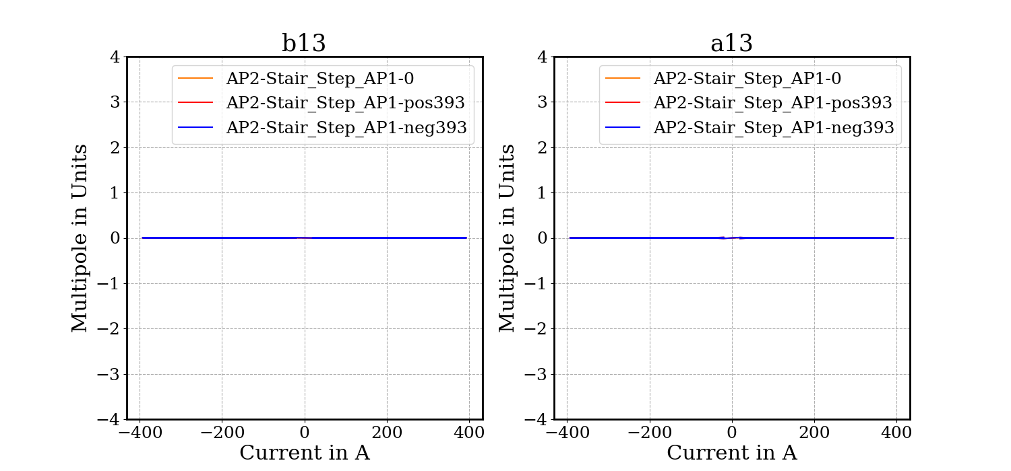
AP2 - Multipoles b13/a13

Slide 33
Integral Field

Slide 34
AP1 Field-quality table - Integral Field
AP1 at 393A AP2 at 0A |  |  | AP1 at -393A AP2 at 0A |  |  | AP1 at 393A AP2 at 393A |  |  | AP1 at -393A AP2 at 393A |  |  | AP1 at 393A AP2 at -393A |  |  | AP1 at -393A AP2 at -393A
 | Unit | Value |  | Unit | Value |  | Unit | Value |  | Unit | Value |  | Unit | Value |  | Unit | Value
TF | Tm/kA | 10.003 | TF | Tm/kA | 10.002 | TF | Tm/kA | 9.984 | TF | Tm/kA | 9.983 | TF | Tm/kA | 9.983 | TF | Tm/kA | 9.984
B1 int | Tm | 3.931 | B1 int | Tm | -3.931 | B1 int | Tm | 3.924 | B1 int | Tm | -3.923 | B1 int | Tm | 3.923 | B1 int | Tm | -3.924
n | bn | an | n | bn | an | n | bn | an | n | bn | an | n | bn | an | n | bn | an
2 | 4.54 | 3.63 | 2 | 4.33 | 3.58 | 2 | 7.97 | 8.43 | 2 | 8.15 | -1.46 | 2 | 8.12 | -1.52 | 2 | 7.99 | 8.38
3 | -3.60 | -0.14 | 3 | -3.52 | -0.14 | 3 | -6.62 | -1.58 | 3 | -6.53 | 1.79 | 3 | -6.47 | 1.83 | 3 | -6.66 | -1.54
4 | -0.28 | -0.01 | 4 | -0.32 | -0.01 | 4 | 0.07 | 0.68 | 4 | -0.02 | -0.75 | 4 | -0.02 | -0.75 | 4 | 0.08 | 0.69
5 | -1.70 | 0.25 | 5 | -1.69 | 0.25 | 5 | -2.02 | -0.02 | 5 | -1.96 | 0.59 | 5 | -1.95 | 0.60 | 5 | -2.02 | -0.00
6 | 0.15 | 0.09 | 6 | 0.14 | 0.08 | 6 | 0.14 | 0.19 | 6 | 0.11 | -0.02 | 6 | 0.12 | -0.02 | 6 | 0.15 | 0.19
7 | 0.36 | -0.06 | 7 | 0.36 | -0.06 | 7 | 0.34 | -0.09 | 7 | 0.35 | -0.03 | 7 | 0.35 | -0.03 | 7 | 0.33 | -0.10
8 | 0.07 | -0.02 | 8 | 0.07 | -0.02 | 8 | 0.06 | -0.03 | 8 | 0.07 | -0.04 | 8 | 0.07 | -0.04 | 8 | 0.06 | -0.03
9 | 0.03 | -0.06 | 9 | 0.03 | -0.05 | 9 | 0.04 | -0.05 | 9 | 0.01 | -0.05 | 9 | 0.01 | -0.05 | 9 | 0.04 | -0.05
10 | 0.02 | 0.01 | 10 | 0.02 | 0.01 | 10 | 0.01 | 0.01 | 10 | 0.01 | 0.01 | 10 | 0.01 | 0.01 | 10 | 0.01 | 0.01
11 | 0.01 | -0.00 | 11 | 0.01 | -0.01 | 11 | 0.01 | -0.00 | 11 | 0.01 | -0.01 | 11 | 0.01 | -0.01 | 11 | 0.01 | -0.01
12 | -0.00 | 0.00 | 12 | -0.00 | 0.00 | 12 | -0.01 | 0.00 | 12 | -0.01 | 0.00 | 12 | -0.00 | 0.00 | 12 | -0.01 | 0.00
13 | -0.00 | 0.00 | 13 | -0.00 | 0.00 | 13 | -0.00 | 0.00 | 13 | -0.00 | -0.00 | 13 | -0.00 | -0.00 | 13 | -0.00 | 0.00
14 | 0.00 | 0.00 | 14 | 0.00 | 0.00 | 14 | 0.00 | 0.00 | 14 | -0.00 | 0.00 | 14 | 0.00 | 0.00 | 14 | 0.00 | 0.00
15 | 0.00 | -0.00 | 15 | 0.00 | 0.00 | 15 | 0.00 | 0.00 | 15 | 0.00 | -0.00 | 15 | 0.00 | -0.00 | 15 | 0.00 | -0.00

Slide 35
AP2 Field-quality table - Integral Field
AP2 at 393A AP1 at 0A |  |  | AP2 at -393A AP1 at 0A |  |  | AP2 at 393A AP1 at 393A |  |  | AP2 at -393A AP1 at 393A |  |  | AP2 at 393A AP1 at -393A |  |  | AP2 at -393A AP1 at -393A
 | Unit | Value |  | Unit | Value |  | Unit | Value |  | Unit | Value |  | Unit | Value |  | Unit | Value
TF | Tm/kA | 12.687 | TF | Tm/kA | 12.686 | TF | Tm/kA | 12.671 | TF | Tm/kA | 12.669 | TF | Tm/kA | 12.670 | TF | Tm/kA | 12.670
A1 int | Tm | 4.986 | A1 int | Tm | -4.986 | A1 int | Tm | 4.980 | A1 int | Tm | -4.979 | A1 int | Tm | 4.979 | A1 int | Tm | -4.979
n | bn | an | n | bn | an | n | bn | an | n | bn | an | n | bn | an | n | bn | an
2 | -4.28 | -7.46 | 2 | -5.04 | -7.45 | 2 | 2.84 | -12.61 | 2 | -12.08 | -13.26 | 2 | -12.24 | -13.24 | 2 | 2.68 | -12.62
3 | 0.04 | 1.83 | 3 | 0.05 | 1.85 | 3 | 2.28 | 1.18 | 3 | -2.16 | 0.87 | 3 | -2.17 | 0.85 | 3 | 2.28 | 1.18
4 | 0.06 | -0.18 | 4 | 0.16 | -0.18 | 4 | 0.21 | -0.35 | 4 | 0.02 | -0.35 | 4 | 0.02 | -0.36 | 4 | 0.21 | -0.34
5 | 0.00 | -1.50 | 5 | 0.04 | -1.50 | 5 | -0.09 | -1.67 | 5 | 0.18 | -1.64 | 5 | 0.17 | -1.64 | 5 | -0.11 | -1.67
6 | 0.06 | 0.15 | 6 | 0.07 | 0.15 | 6 | 0.02 | 0.08 | 6 | 0.12 | 0.09 | 6 | 0.13 | 0.09 | 6 | 0.02 | 0.08
7 | 0.04 | -0.30 | 7 | 0.04 | -0.31 | 7 | 0.02 | -0.32 | 7 | 0.07 | -0.31 | 7 | 0.06 | -0.31 | 7 | 0.02 | -0.32
8 | -0.10 | 0.04 | 8 | -0.09 | 0.04 | 8 | -0.10 | 0.03 | 8 | -0.09 | 0.05 | 8 | -0.09 | 0.05 | 8 | -0.10 | 0.03
9 | 0.01 | -0.01 | 9 | 0.01 | -0.01 | 9 | 0.00 | -0.01 | 9 | 0.01 | -0.00 | 9 | 0.01 | -0.00 | 9 | 0.00 | -0.01
10 | 0.01 | 0.01 | 10 | 0.00 | 0.01 | 10 | 0.00 | 0.01 | 10 | 0.00 | 0.01 | 10 | 0.01 | 0.01 | 10 | 0.00 | 0.01
11 | -0.00 | -0.01 | 11 | -0.00 | -0.01 | 11 | -0.00 | -0.01 | 11 | -0.00 | -0.01 | 11 | -0.00 | -0.01 | 11 | -0.00 | -0.01
12 | 0.00 | 0.00 | 12 | 0.00 | 0.00 | 12 | 0.00 | 0.00 | 12 | 0.00 | 0.00 | 12 | 0.00 | 0.00 | 12 | 0.00 | 0.00
13 | 0.00 | -0.00 | 13 | 0.00 | -0.00 | 13 | 0.00 | -0.00 | 13 | 0.00 | -0.00 | 13 | 0.00 | -0.00 | 13 | 0.00 | -0.00
14 | 0.00 | 0.00 | 14 | 0.00 | 0.00 | 14 | 0.00 | 0.00 | 14 | 0.00 | 0.00 | 14 | 0.00 | 0.00 | 14 | 0.00 | 0.00
15 | 0.00 | -0.00 | 15 | 0.00 | -0.00 | 15 | -0.00 | -0.00 | 15 | 0.00 | 0.00 | 15 | 0.00 | 0.00 | 15 | 0.00 | -0.00

Slide 36
Central Field on Straight section

Slide 37
Field-quality tables - Straight section
APERTURE 1
Individual powering (positive-negative mean) |  |  | Difference from individual to combined powering
AP1 at ±393A AP2 at 0A |  |  | AP1 at ±393A AP2 at ±393A
 | Unit | Value |  | Unit | Value
Norm. TF | T/kA | 6.676 | Norm. TF Δ* | units | -19
B1 | T | 2.624 | B1 Δ* | units | -19
n | bn | an | n | Δbn** | Δan**
2 | 4.44 | 3.61 | 2 | 3.62 | ±4.95
3 | -3.56 | -0.14 | 3 | -3.01 | ±1.69
4 | -0.30 | -0.01 | 4 | 0.33 | ±0.72
5 | -1.70 | 0.25 | 5 | -0.29 | ±0.30
6 | 0.15 | 0.09 | 6 | -0.02 | ±0.11
7 | 0.36 | -0.06 | 7 | -0.02 | ±0.03
8 | 0.07 | -0.02 | 8 | -0.01 | ±0.01
9 | 0.03 | -0.06 | 9 | -0.01 | ±0.00
10 | 0.02 | 0.01 | 10 | -0.01 | ±0.00
11 | 0.01 | -0.01 | 11 | 0.00 | ±0.00
12 | 0.00 | 0.00 | 12 | -0.01 | ±0.00
13 | 0.00 | 0.00 | 13 | 0.00 | ±0.00
14 | 0.00 | 0.00 | 14 | 0.00 | ±0.00
15 | 0.00 | 0.00 | 15 | 0.00 | ±0.00
APERTURE 2
Individual powering (positive-negative mean) |  |  | Difference from individual to combined powering
AP2 at ±393A AP1 at 0A |  |  | AP2 at ±393A AP1 at ±393A
 | Unit | Value |  | Unit | Value
Skew TF | T/kA | 6.671 | Skew TF Δ* | units | -12
A1 | T | 2.622 | A1 Δ* | units | -12
n | bn | an | n | Δbn** | Δan**
2 | -5.26 | -8.91 | 2 | ±8.37 | -6.09
3 | -0.13 | 2.38 | 3 | ±2.46 | -0.85
4 | 0.09 | -0.11 | 4 | ±0.06 | -0.17
5 | 0.07 | -1.51 | 5 | ±0.18 | -0.18
6 | 0.07 | 0.16 | 6 | ±0.07 | -0.08
7 | 0.03 | -0.31 | 7 | ±0.03 | -0.01
8 | -0.09 | 0.05 | 8 | ±0.01 | 0.00
9 | 0.02 | 0.00 | 9 | ±0.01 | 0.00
10 | 0.00 | 0.01 | 10 | ±0.00 | 0.00
11 | 0.00 | -0.01 | 11 | ±0.00 | 0.00
12 | 0.00 | 0.00 | 12 | ±0.00 | 0.00
13 | 0.00 | 0.00 | 13 | ±0.00 | 0.00
14 | 0.00 | 0.00 | 14 | ±0.00 | 0.00
15 | 0.00 | 0.00 | 15 | ±0.00 | 0.00
* Relative difference in units to nominal value in individual powering
** Difference in units between individual and combined powering - the ‘±’ indicates that the sign of the difference is dependent on the powering quadrant.

Slide 38
AP1 Field-quality table - Straight section
AP1 at 393A AP2 at 0A |  |  | AP1 at -393A AP2 at 0A |  |  | AP1 at 393A AP2 at 393A |  |  | AP1 at -393A AP2 at 393A |  |  | AP1 at 393A AP2 at -393A |  |  | AP1 at -393A AP2 at -393A
 | Unit | Value |  | Unit | Value |  | Unit | Value |  | Unit | Value |  | Unit | Value |  | Unit | Value
TF | T/kA | 6.676 | TF | T/kA | 6.676 | TF | T/kA | 6.664 | TF | T/kA | 6.664 | TF | T/kA | 6.663 | TF | T/kA | 6.664
B1 | T | 2.624 | B1 | T | -2.624 | B1 | T | 2.619 | B1 | T | -2.619 | B1 | T | 2.619 | B1 | T | -2.619
n | bn | an | n | bn | an | n | bn | an | n | bn | an | n | bn | an | n | bn | an
2 | 5.08 | 3.18 | 2 | 4.88 | 3.13 | 2 | 8.85 | 8.63 | 2 | 9.06 | -2.57 | 2 | 9.04 | -2.63 | 2 | 8.86 | 8.57
3 | -4.32 | 0.14 | 3 | -4.25 | 0.14 | 3 | -7.77 | -1.47 | 3 | -7.63 | 2.33 | 3 | -7.58 | 2.37 | 3 | -7.80 | -1.42
4 | -0.34 | -0.15 | 4 | -0.38 | -0.14 | 4 | 0.03 | 0.64 | 4 | -0.08 | -0.98 | 4 | -0.09 | -0.98 | 4 | 0.04 | 0.65
5 | -1.74 | 0.22 | 5 | -1.73 | 0.23 | 5 | -2.10 | -0.08 | 5 | -2.01 | 0.61 | 5 | -2.01 | 0.62 | 5 | -2.10 | -0.06
6 | 0.14 | 0.05 | 6 | 0.13 | 0.04 | 6 | 0.13 | 0.17 | 6 | 0.09 | -0.08 | 6 | 0.10 | -0.07 | 6 | 0.14 | 0.17
7 | 0.35 | -0.09 | 7 | 0.36 | -0.09 | 7 | 0.33 | -0.12 | 7 | 0.35 | -0.05 | 7 | 0.35 | -0.06 | 7 | 0.33 | -0.13
8 | 0.07 | -0.03 | 8 | 0.07 | -0.03 | 8 | 0.06 | -0.05 | 8 | 0.07 | -0.05 | 8 | 0.06 | -0.05 | 8 | 0.06 | -0.05
9 | 0.02 | -0.06 | 9 | 0.02 | -0.07 | 9 | 0.03 | -0.06 | 9 | -0.00 | -0.07 | 9 | 0.00 | -0.07 | 9 | 0.03 | -0.06
10 | 0.01 | 0.01 | 10 | 0.01 | 0.01 | 10 | 0.01 | 0.01 | 10 | 0.01 | 0.01 | 10 | 0.01 | 0.01 | 10 | 0.01 | 0.01
11 | 0.01 | -0.01 | 11 | 0.01 | -0.00 | 11 | 0.01 | -0.00 | 11 | 0.01 | -0.00 | 11 | 0.01 | -0.01 | 11 | 0.01 | -0.01
12 | -0.00 | 0.00 | 12 | -0.01 | 0.00 | 12 | -0.01 | 0.00 | 12 | -0.01 | 0.00 | 12 | -0.01 | 0.00 | 12 | -0.01 | 0.00
13 | -0.00 | -0.00 | 13 | -0.00 | 0.00 | 13 | -0.00 | 0.00 | 13 | -0.00 | -0.00 | 13 | -0.00 | -0.00 | 13 | -0.00 | -0.00
14 | 0.00 | 0.00 | 14 | 0.00 | 0.00 | 14 | 0.00 | -0.00 | 14 | -0.00 | 0.00 | 14 | 0.00 | 0.00 | 14 | 0.00 | 0.00
15 | 0.00 | 0.00 | 15 | 0.00 | -0.00 | 15 | 0.00 | -0.00 | 15 | 0.00 | -0.00 | 15 | 0.00 | 0.00 | 15 | 0.00 | -0.00

Slide 39
AP2 Field-quality table - Straight section
AP2 at 393A AP1 at 0A |  |  | AP2 at -393A AP1 at 0A |  |  | AP2 at 393A AP1 at 393A |  |  | AP2 at -393A AP1 at 393A |  |  | AP2 at 393A AP1 at -393A |  |  | AP2 at -393A AP1 at -393A
 | Unit | Value |  | Unit | Value |  | Unit | Value |  | Unit | Value |  | Unit | Value |  | Unit | Value
TF | T/kA | 6.671 | TF | T/kA | 6.670 | TF | T/kA | 6.661 | TF | T/kA | 6.660 | TF | T/kA | 6.661 | TF | T/kA | 6.661
A1 | T | 2.622 | A1 | T | -2.621 | A1 | T | 2.618 | A1 | T | -2.617 | A1 | T | 2.618 | A1 | T | -2.618
n | bn | an | n | bn | an | n | bn | an | n | bn | an | n | bn | an | n | bn | an
2 | -4.88 | -8.92 | 2 | -5.64 | -8.90 | 2 | 3.15 | -14.65 | 2 | -13.57 | -15.36 | 2 | -13.74 | -15.33 | 2 | 3.00 | -14.66
3 | -0.14 | 2.37 | 3 | -0.12 | 2.39 | 3 | 2.34 | 1.70 | 3 | -2.57 | 1.37 | 3 | -2.57 | 1.35 | 3 | 2.35 | 1.70
4 | 0.03 | -0.11 | 4 | 0.14 | -0.11 | 4 | 0.15 | -0.28 | 4 | 0.03 | -0.28 | 4 | 0.03 | -0.29 | 4 | 0.15 | -0.28
5 | 0.05 | -1.51 | 5 | 0.09 | -1.51 | 5 | -0.08 | -1.71 | 5 | 0.27 | -1.66 | 5 | 0.26 | -1.67 | 5 | -0.10 | -1.70
6 | 0.06 | 0.16 | 6 | 0.07 | 0.16 | 6 | 0.01 | 0.08 | 6 | 0.14 | 0.09 | 6 | 0.15 | 0.09 | 6 | 0.01 | 0.07
7 | 0.03 | -0.31 | 7 | 0.03 | -0.31 | 7 | 0.01 | -0.32 | 7 | 0.06 | -0.32 | 7 | 0.06 | -0.32 | 7 | 0.00 | -0.32
8 | -0.09 | 0.05 | 8 | -0.09 | 0.05 | 8 | -0.10 | 0.04 | 8 | -0.09 | 0.06 | 8 | -0.09 | 0.07 | 8 | -0.10 | 0.04
9 | 0.02 | -0.00 | 9 | 0.02 | -0.00 | 9 | 0.01 | -0.01 | 9 | 0.02 | 0.01 | 9 | 0.02 | 0.01 | 9 | 0.01 | -0.01
10 | -0.00 | 0.01 | 10 | -0.00 | 0.01 | 10 | -0.00 | 0.01 | 10 | -0.00 | 0.01 | 10 | -0.00 | 0.01 | 10 | -0.00 | 0.01
11 | -0.00 | -0.01 | 11 | -0.00 | -0.01 | 11 | -0.00 | -0.01 | 11 | -0.00 | -0.01 | 11 | -0.00 | -0.01 | 11 | -0.00 | -0.01
12 | 0.00 | 0.00 | 12 | 0.00 | 0.00 | 12 | 0.00 | 0.00 | 12 | 0.00 | 0.00 | 12 | 0.00 | 0.00 | 12 | 0.00 | 0.00
13 | 0.00 | -0.00 | 13 | 0.00 | -0.00 | 13 | 0.00 | -0.00 | 13 | 0.00 | -0.00 | 13 | 0.00 | -0.00 | 13 | 0.00 | -0.00
14 | 0.00 | 0.00 | 14 | 0.00 | 0.00 | 14 | 0.00 | 0.00 | 14 | 0.00 | 0.00 | 14 | 0.00 | 0.00 | 14 | -0.00 | 0.00
15 | -0.00 | -0.00 | 15 | -0.00 | -0.00 | 15 | -0.00 | -0.00 | 15 | 0.00 | -0.00 | 15 | 0.00 | -0.00 | 15 | -0.00 | -0.00

Slide 40
Operation Levels

Slide 41
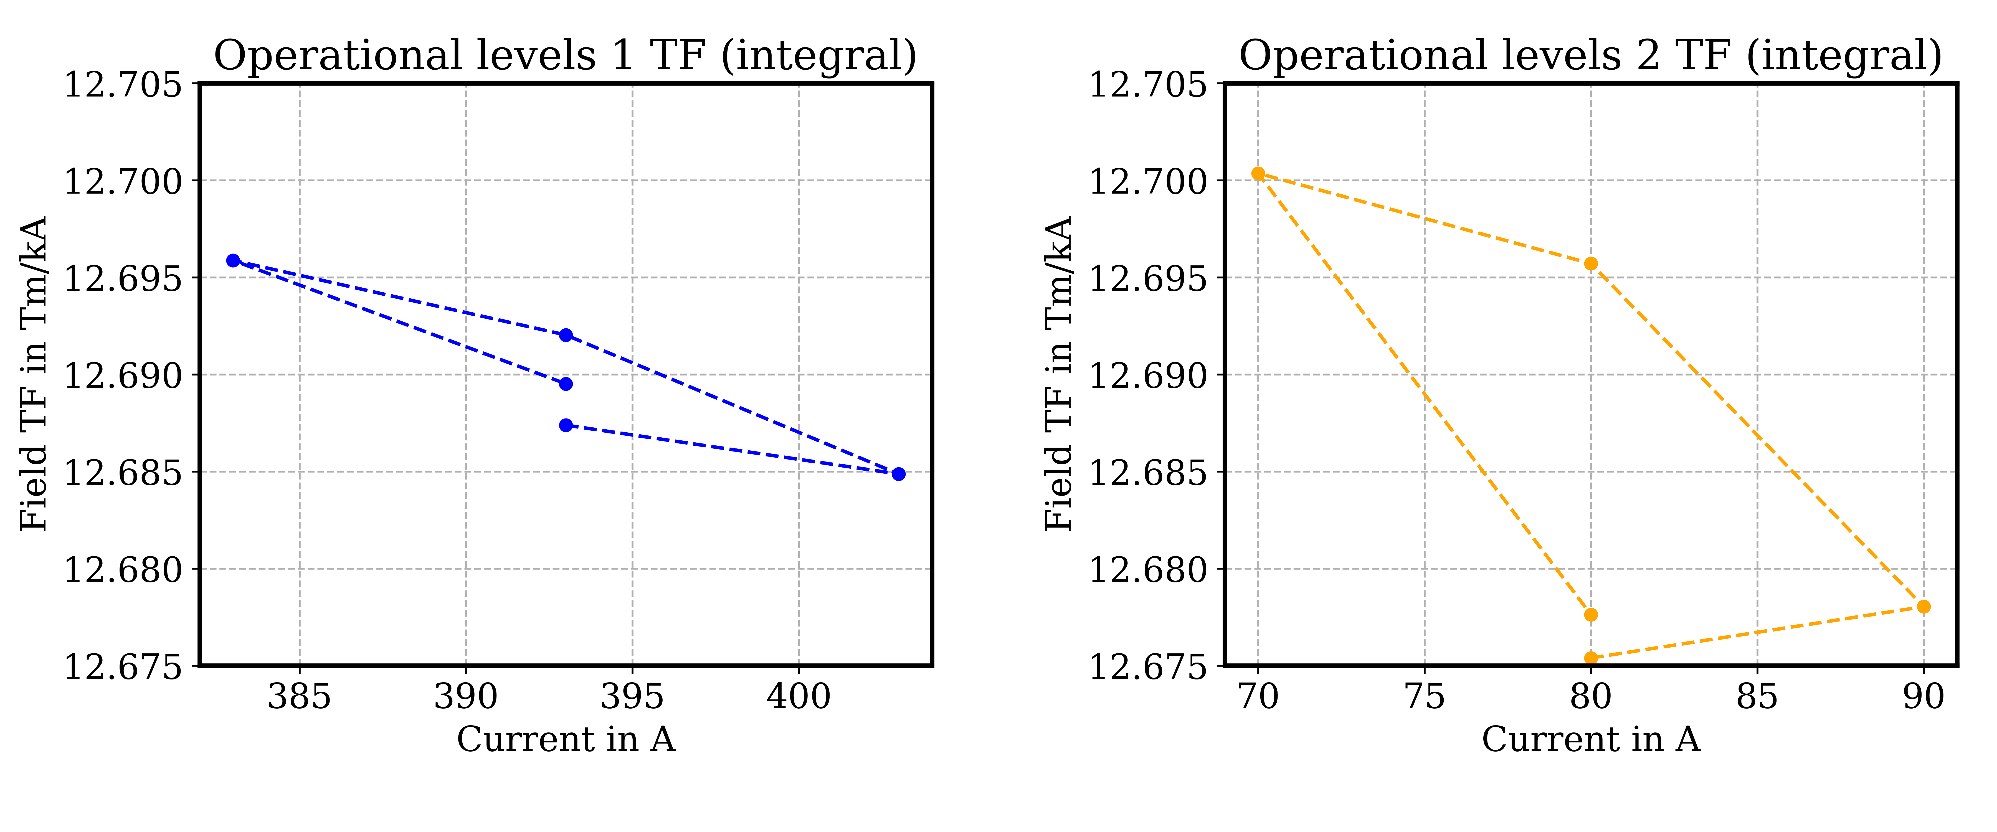
AP1 - Operation Levels TF

Slide 42
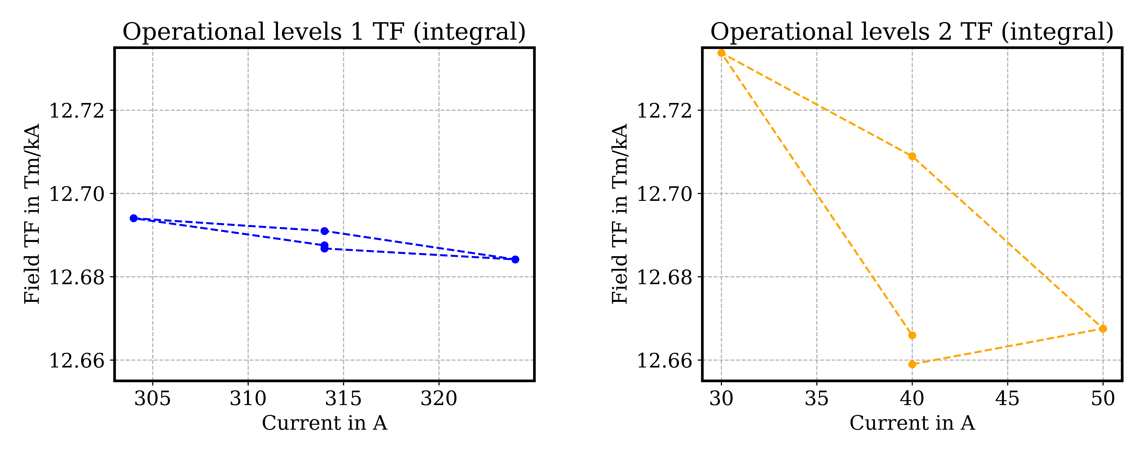
AP2 - Operation Levels TF

Slide 43
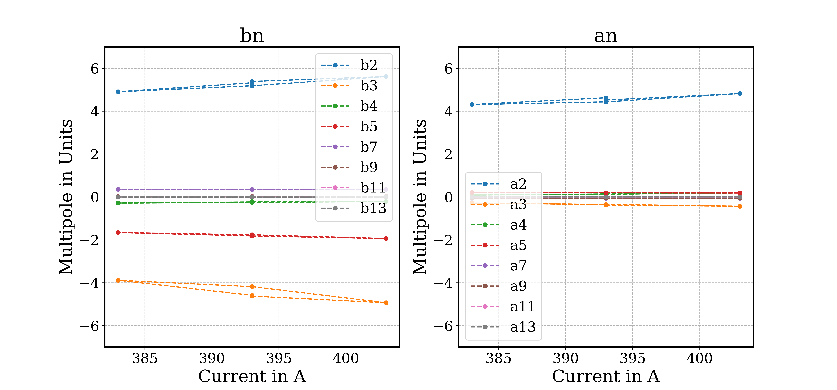
AP1 Nominal Op. Level 1 - Multipoles

Slide 44
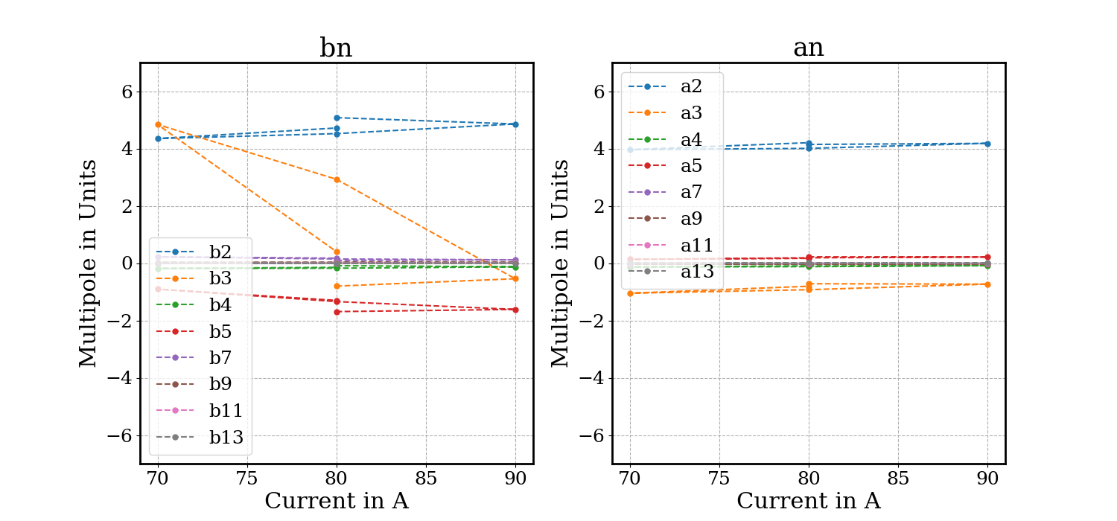
AP1 Nominal Op. Level 2 - Multipoles

Slide 45
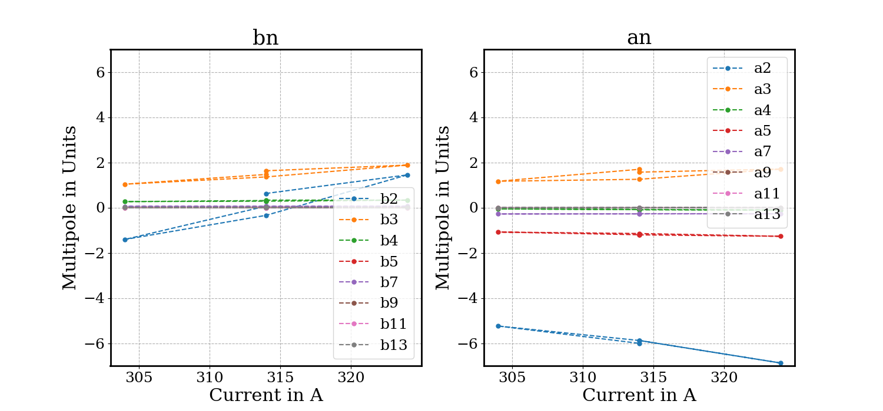
AP2 Nominal Op. Level 1 - Multipoles

Slide 46
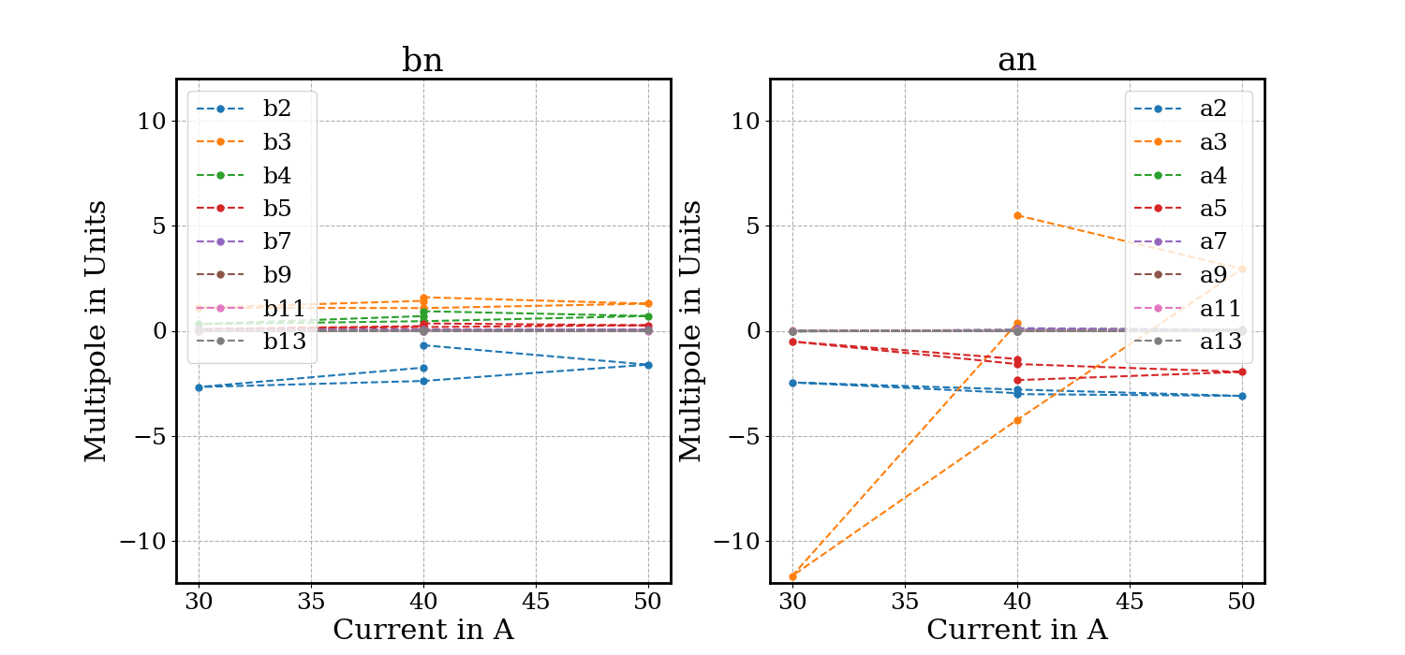
AP2 Nominal Op. Level 2 - Multipoles

Slide 47
Operation Levels Field-quality table - Integral
AP1
AP1 at 393A AP2 at 314A |  |  | AP1 at 80A AP2 at 40A
 | Unit | Value |  | Unit | Value
TF | Tm/kA | 12.690 | TF | Tm/kA | 12.683
B1 int | Tm | 4.987 | B1 int | Tm | 1.015
n | bn | an | n | bn | an
2 | 5.30 | 4.53 | 2 | 4.77 | 4.12
3 | -4.46 | -0.36 | 3 | 0.84 | -0.82
4 | -0.24 | 0.14 | 4 | -0.14 | -0.11
5 | -1.80 | 0.19 | 5 | -1.45 | 0.19
6 | 0.14 | 0.10 | 6 | 0.12 | 0.09
7 | 0.35 | -0.07 | 7 | 0.14 | -0.02
8 | 0.07 | -0.02 | 8 | 0.06 | -0.01
9 | 0.03 | -0.05 | 9 | 0.02 | -0.04
10 | 0.02 | 0.01 | 10 | 0.01 | 0.01
11 | 0.01 | -0.00 | 11 | 0.00 | -0.00
12 | -0.00 | 0.00 | 12 | -0.00 | 0.00
13 | -0.00 | 0.00 | 13 | -0.00 | 0.00
14 | 0.00 | 0.00 | 14 | 0.00 | 0.00
15 | 0.00 | 0.00 | 15 | 0.00 | 0.00
AP2
AP2 at 314A AP1 at 393A |  |  | AP2 at 40A AP1 at 80A
 | Unit | Value |  | Unit | Value
TF | Tm/kA | 12.688 | TF | Tm/kA | 12.678
A1 int | Tm | 3.984 | A1 int | Tm | 0.507
n | bn | an | n | bn | an
2 | 0.11 | -5.92 | 2 | -1.61 | -2.93
3 | 1.48 | 1.50 | 3 | 1.37 | 0.54
4 | 0.31 | -0.09 | 4 | 0.70 | 0.05
5 | 0.01 | -1.19 | 5 | 0.25 | -1.76
6 | 0.07 | 0.06 | 6 | 0.10 | 0.06
7 | 0.05 | -0.28 | 7 | 0.06 | 0.06
8 | -0.07 | 0.03 | 8 | -0.10 | 0.06
9 | -0.00 | -0.00 | 9 | 0.01 | 0.00
10 | 0.01 | 0.01 | 10 | 0.01 | 0.01
11 | -0.00 | -0.01 | 11 | -0.00 | 0.00
12 | 0.00 | 0.00 | 12 | 0.00 | 0.00
13 | 0.00 | -0.00 | 13 | 0.00 | -0.00
14 | 0.00 | 0.00 | 14 | -0.00 | 0.00
15 | -0.00 | -0.00 | 15 | -0.00 | 0.00

