Slide 1
FROM MWPC TO MPGD
Fabio SAULI
CERN
RD51 Micro Pattern Gaseous Detectors School
CERN November 27, 2023 to December 1, 2023

Slide 2
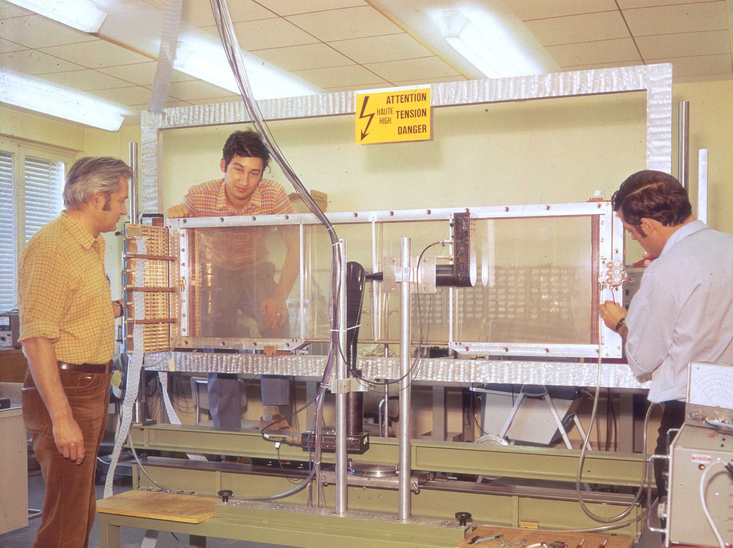
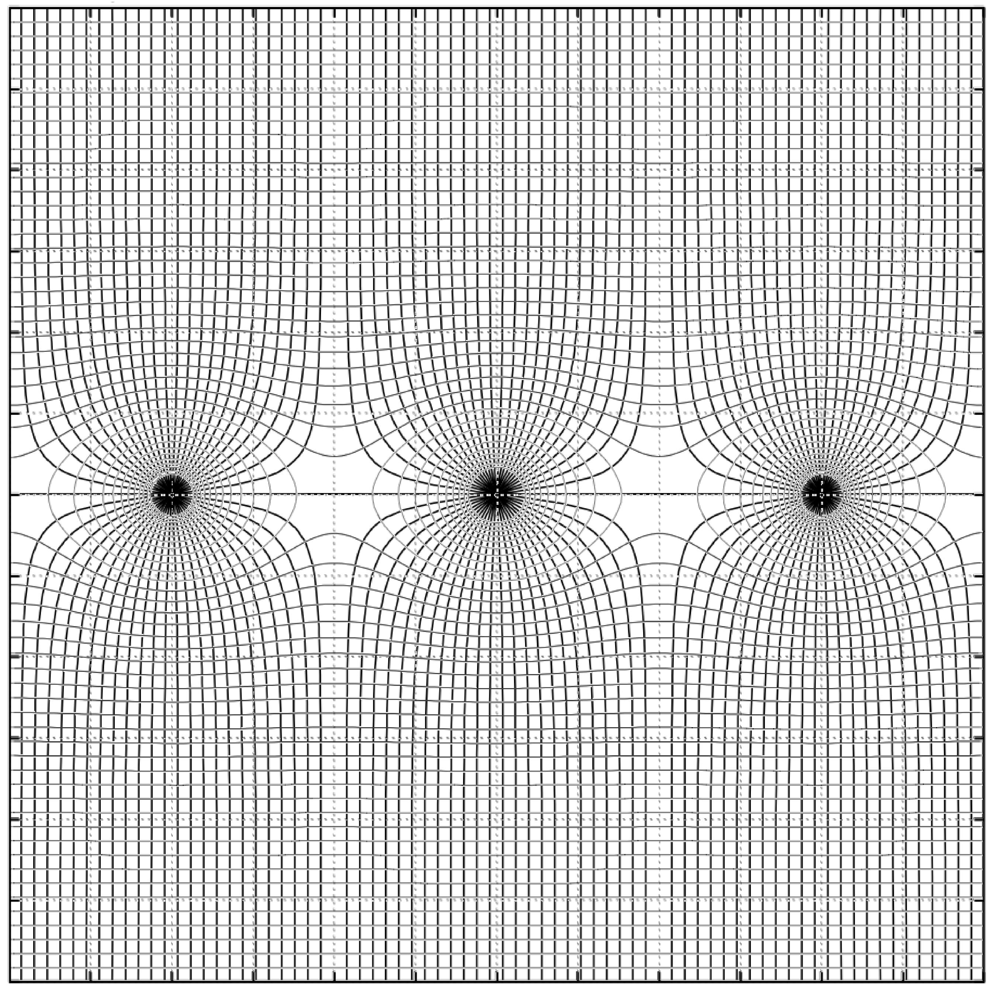

MULTIWIRE PROPORTIONAL CHAMBER (MWPC)
FIRST LARGE MWPC (CERN 1970)
-HV
Ionization
e⁻
+
Drift
Multiplication
GND
-HV
Georges Charpak
G. Charpak et al,
Nucl. Instr. Meth. 62(1968)282
1992

Slide 3
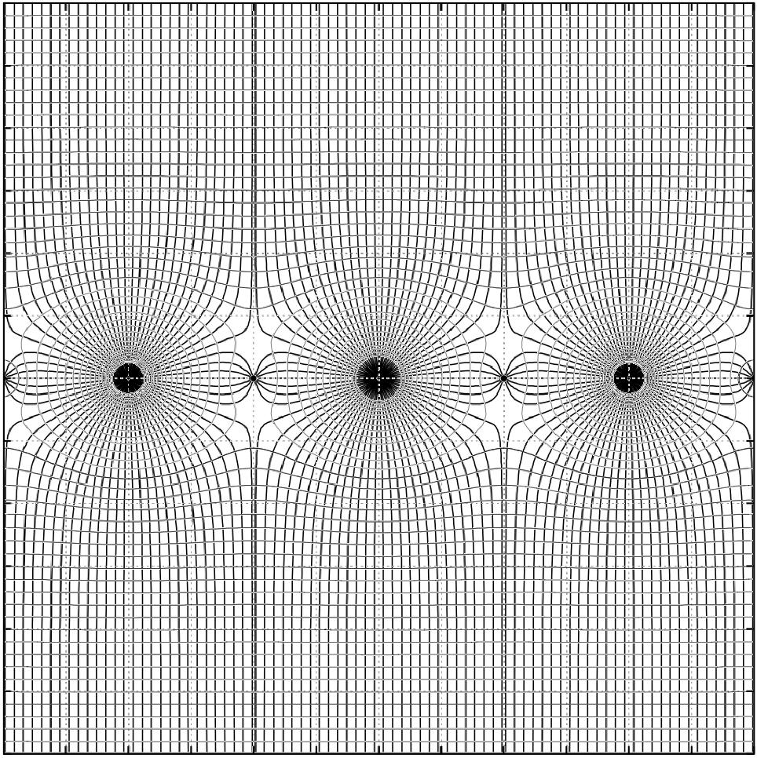
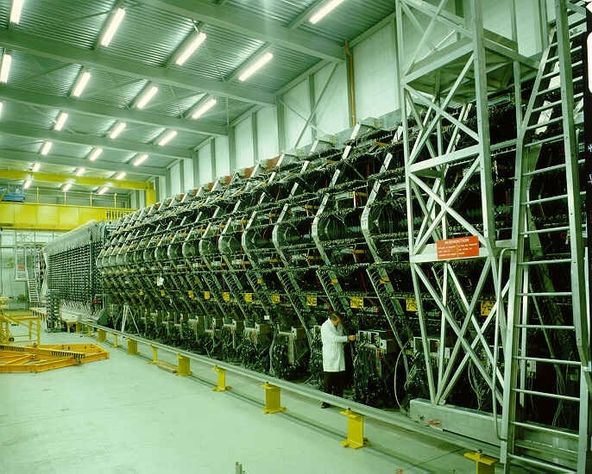
MULTIWIRE DRIFT CHAMBERS
Measurement of electron drift time t
s = w t
WA1 NEUTRINO DETECTOR AT CERN
s
A. H. Walenta et al
Nucl. Instr. Meth. 92(1971)373
G. Marel et al, Nucl. Instr. Meth. 141(1977)43

Slide 4
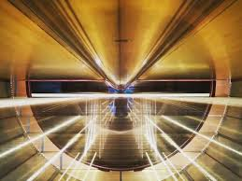
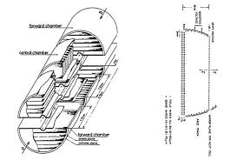
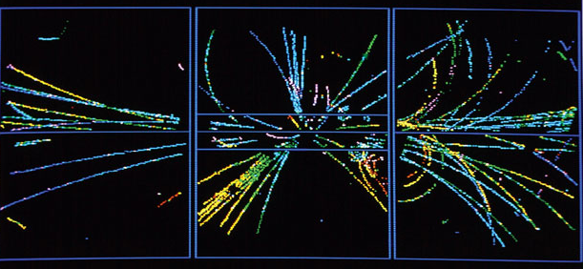
MULTIWIRE DRIFT CHAMBERS
UA1 EXPERIMENT - CERN PROTON-ANTIPROTON COLLIDER
XY FROM WIRE CHAMBER
Z FROM ELECTRONS DRIFT TIME
_
pp COLLISION (1982)
Discovery of the W and Z vector bosons
C. Rubbia, Simon van der Meer
Nobel Laureates 1984

Slide 5
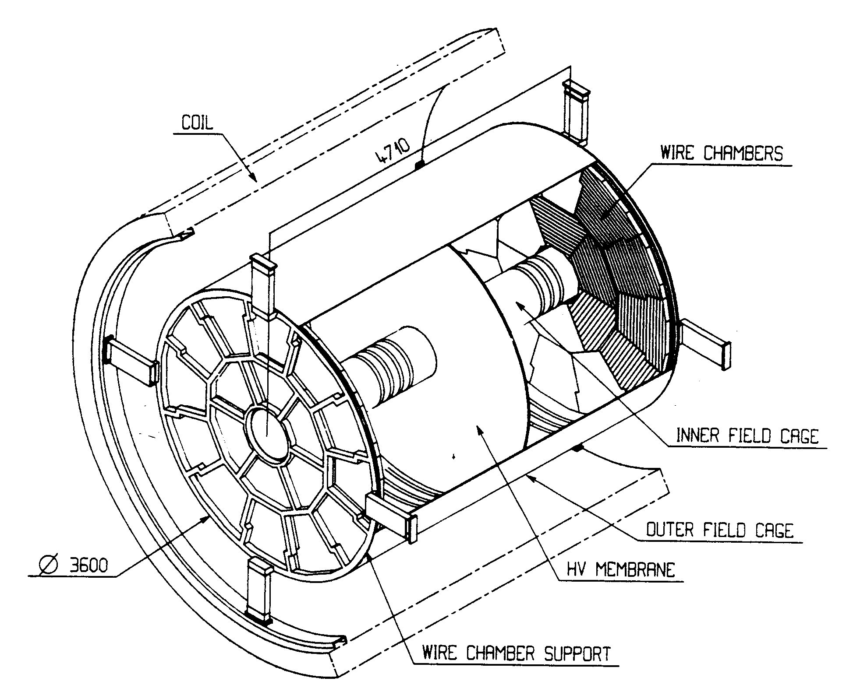
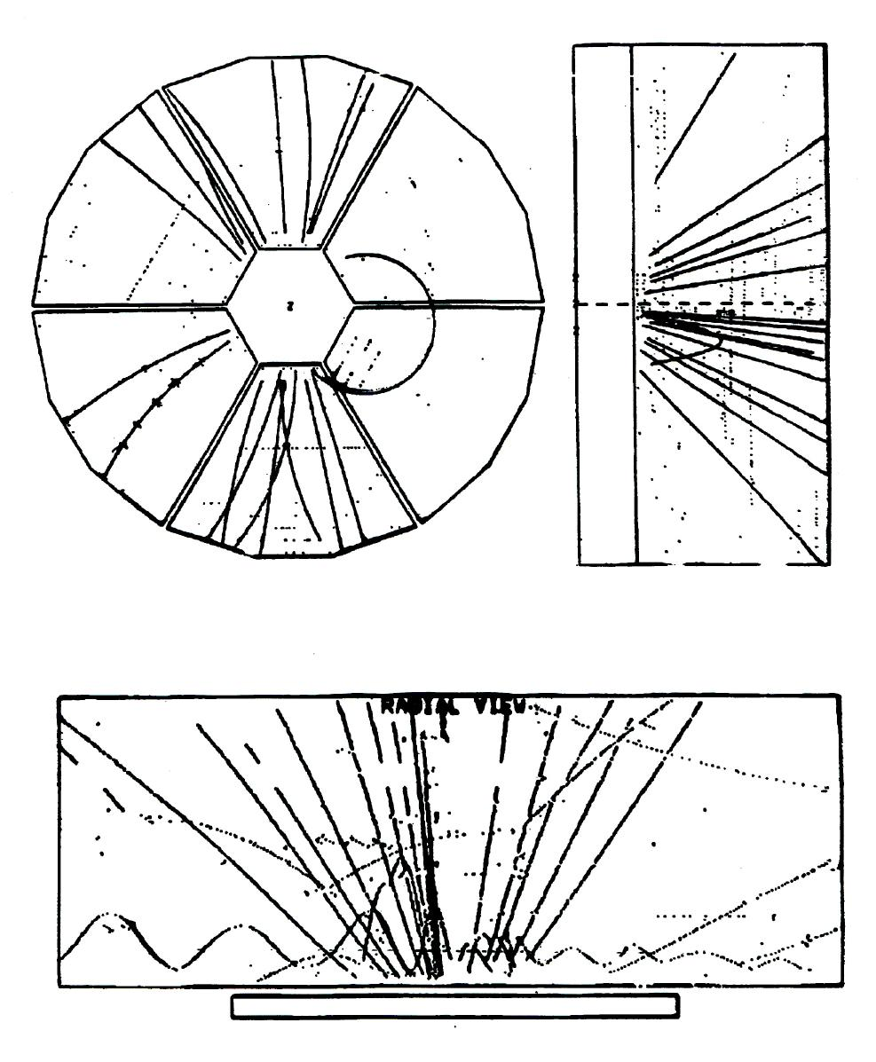
TIME PROJECTION CHAMBER (TPC)
DAVID NYGREN (1975)
LBL PEP-4 TPC
ALEPH TPC (CERN LEP)
D. Decamp et al,
Nucl. Instr. Meth. A294(1990)125
3-D TRACKING
dE/dx: PARTICLE IDENTIFICATION

Slide 6
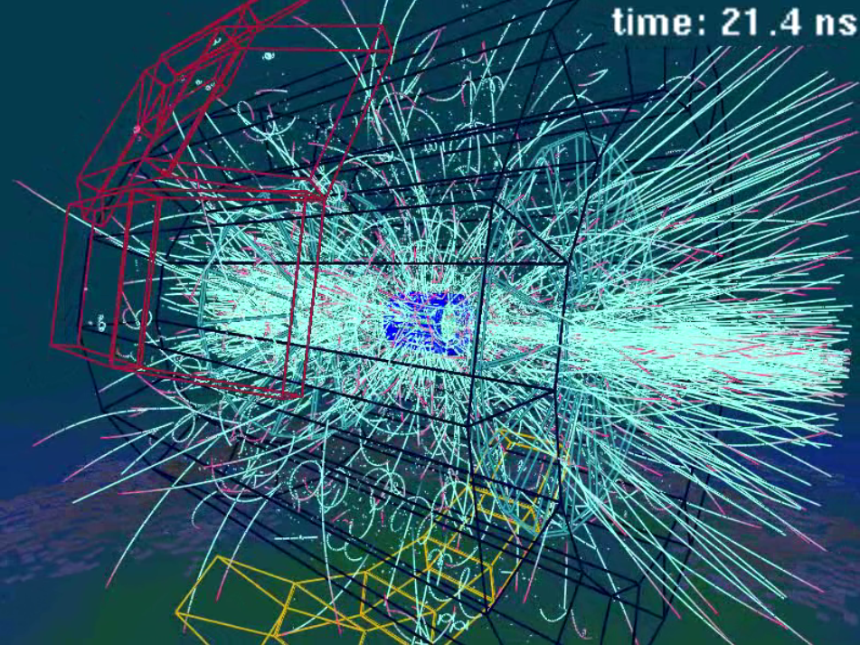
LARGE HADRON COLLIDER AT CERN (LHC):
LHC: 10⁹ pp COLLISIONS/sec
HIGH LUMINOSITY LHC: UP TO 50 kHz Pb-Pb MINIMUM BIAS EVENTS
SIMULATED LEAD-LEAD COLLISION
MWPC LIMITATIONS:
TWO-TRACKS RESOLUTION ~ mm
RATE CAPABILITY ~ 10⁴ mm⁻² s⁻¹
AGING
HARD TO BUILD, FRAGILE

Slide 7
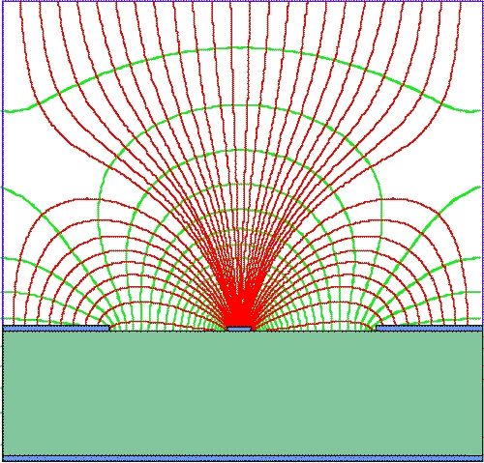
MICROSTRIP GAS COUNTER (MSGC)
Anton Oed, 1988
ALTERNATING ANODE AND CATHODE STRIPS ENGRAVED ON GLASS WITH PHOTOLITHOGRAPHY
100-200 µm
A. Oed, ucl. Instr. Meth. 263(1988)351
Space Accuracy ~ 50 µm
Two-track Resolution ~ 500 µm
Rate capability ~ 10⁶ mm⁻² s⁻¹

Slide 8
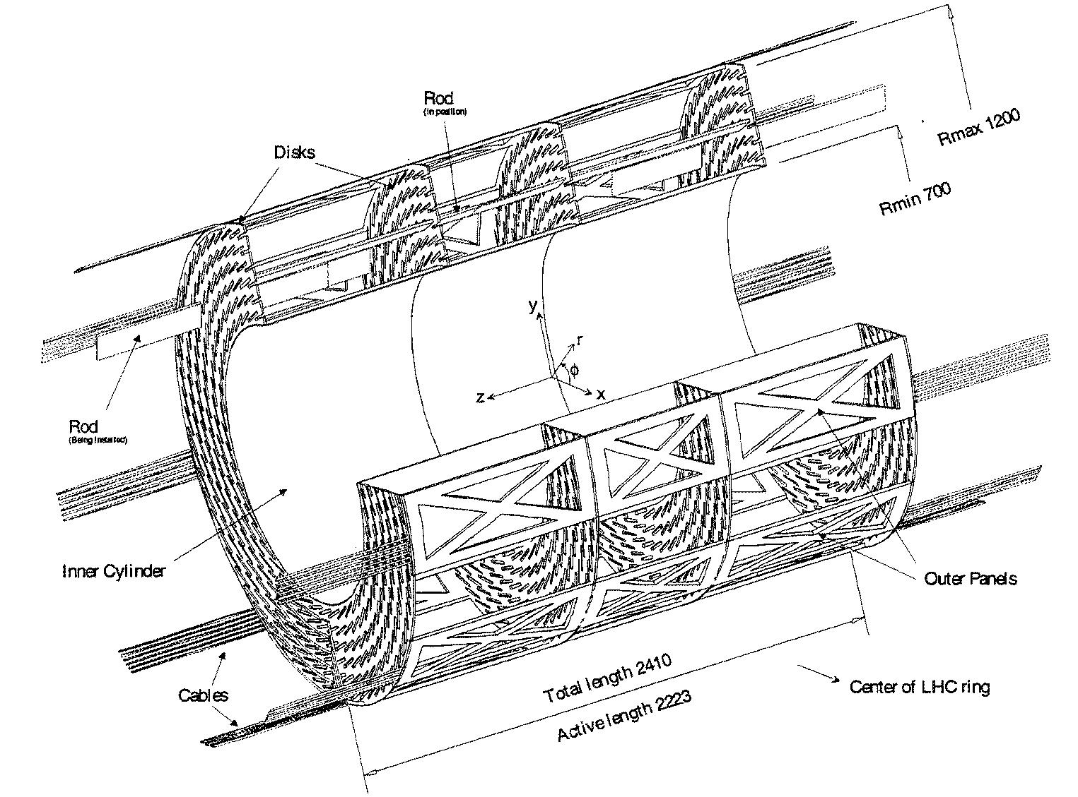
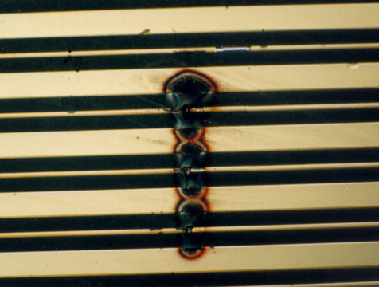
MICROSTRIP GAS COUNTER (MSGC)
CMS MSGC BARREL TRACKER (1999)
DISCHARGE PROBLEMSAND
LONG TERM RELIABILIY
~ 15,000 MSGCs
GAIN TO DETECT MIPs (100 e⁻) : ~10⁴ Δ Q ~ 10⁶
~ MeV NEUTRON CONVERSION (~ 10⁴ e⁻) ΔQ ~ 10⁸ >> RAETHER LIMIT!

Slide 9
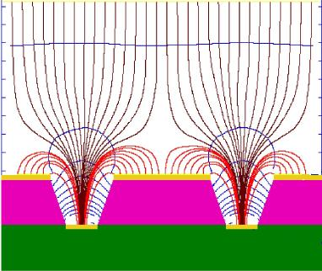
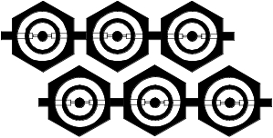
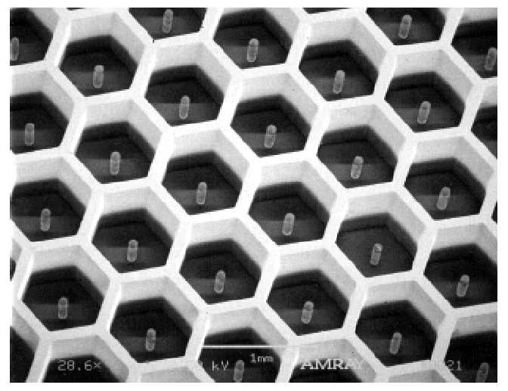
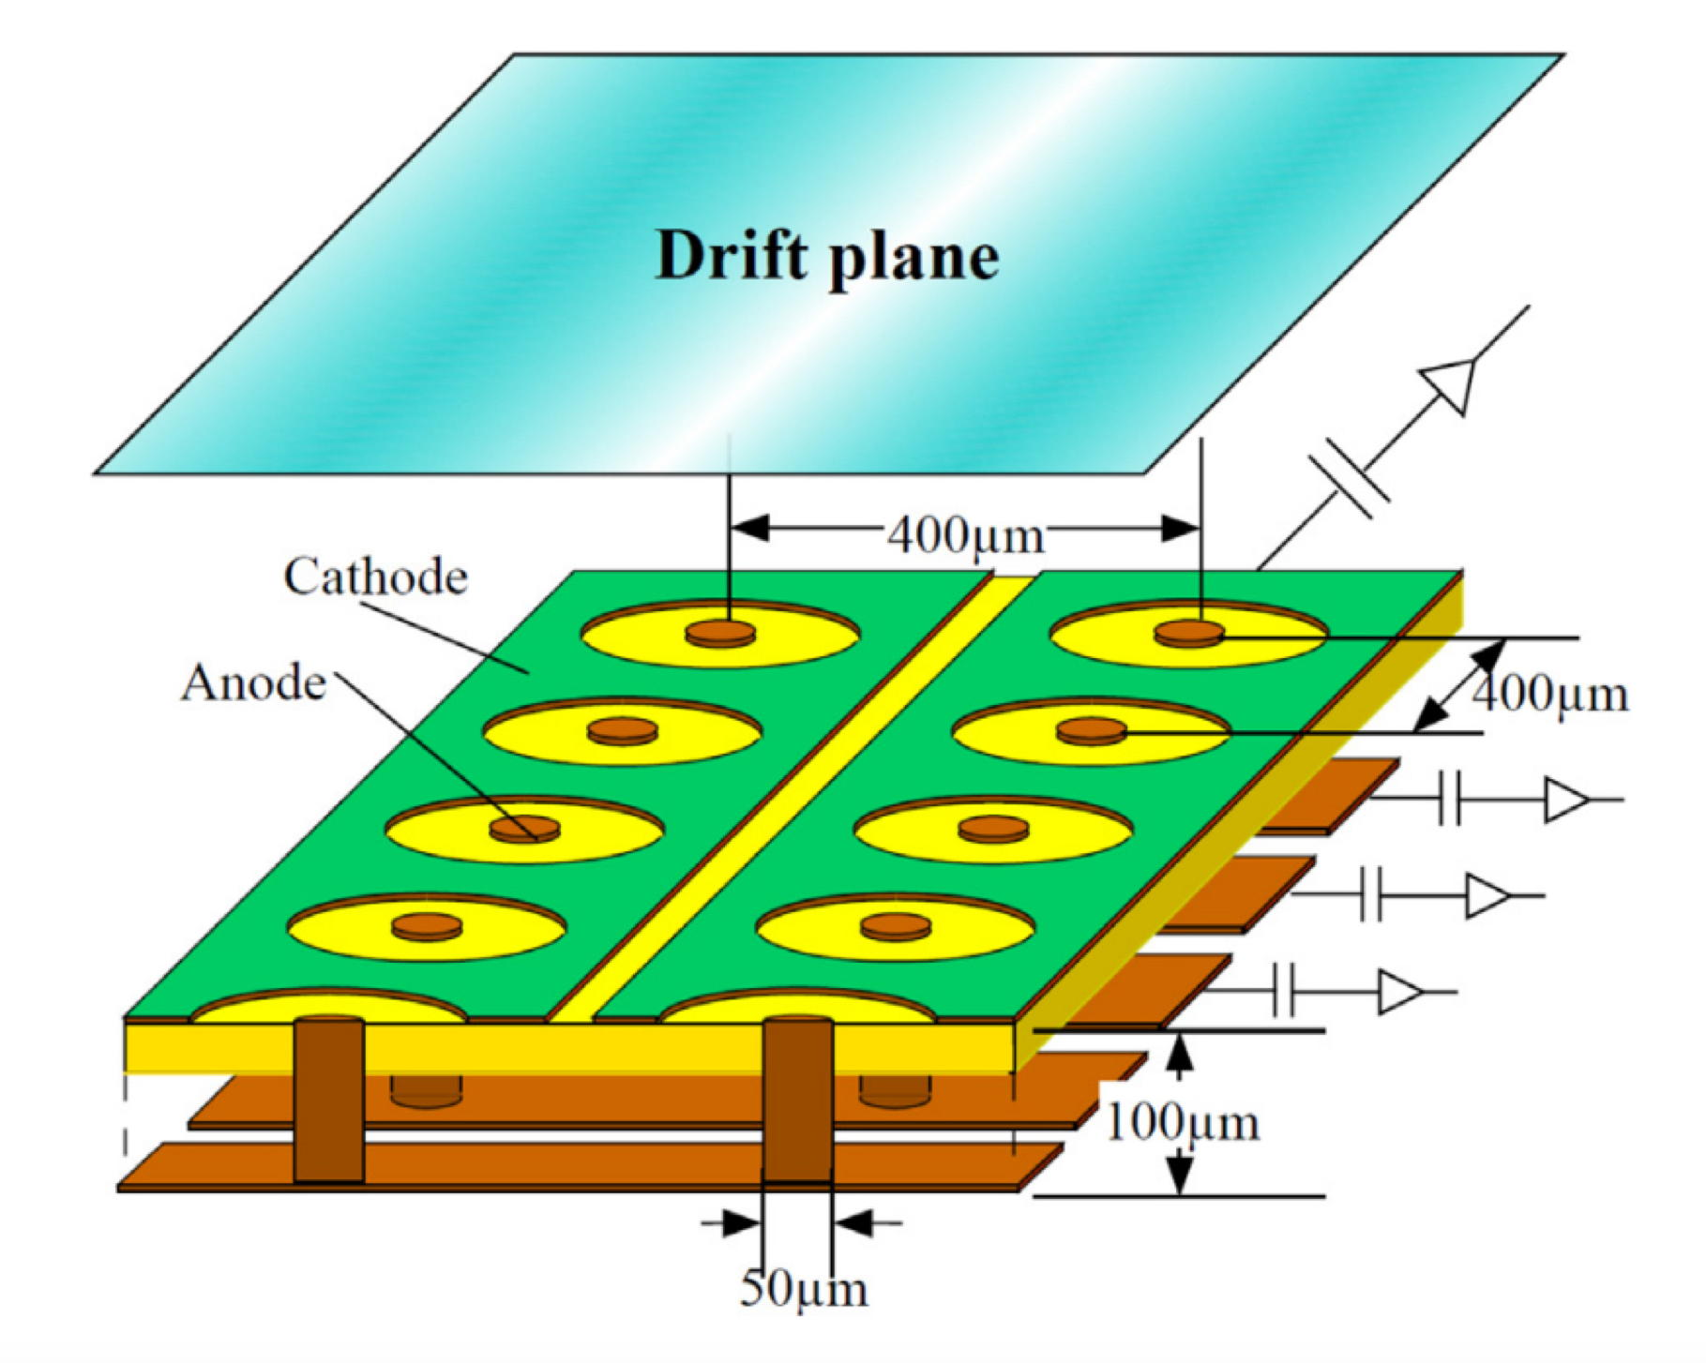
NEW MICRO-PATTERN GASEOUS DETECTORS (MPGD) - 1999 to PRESENT
MICRO GROOVE (R. Bellazzini, 1999)
MICRODOT (S.Biagi, 1995)
MICRO-PIN ARRAY (P. Rehak, 2000)
MICRO-PIXEL DETECTOR (A.Ochi, 2001)

Slide 10
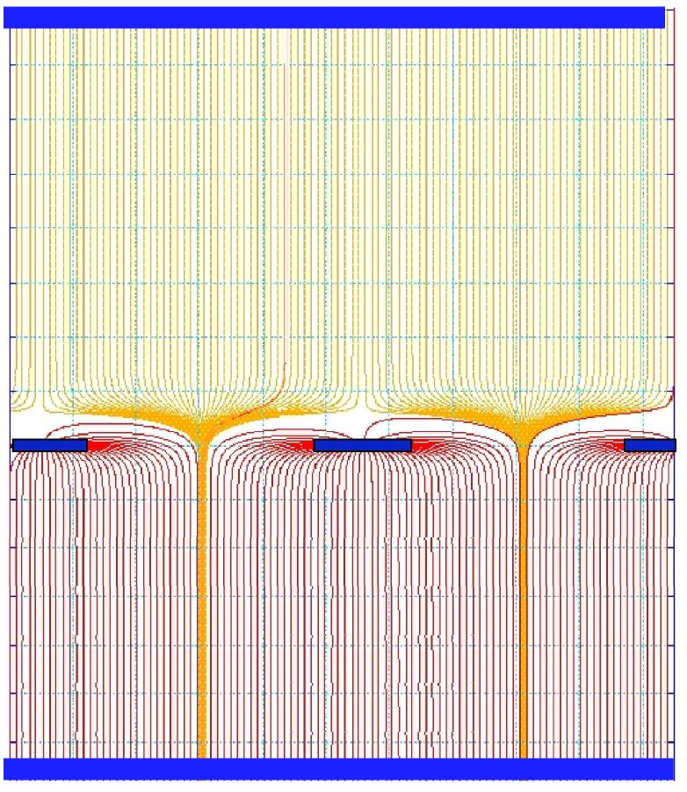
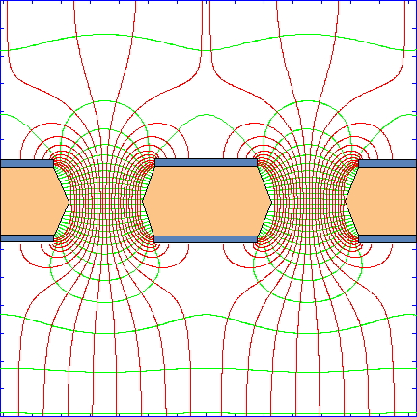
NEW MICRO-PATTERN GASEOUS DETECTORS (MPGD) - 1999 to PRESENT
MICROMEGAS
GAS ELECTRON MULTIPLIER (GEM)
I. Giomataris et al,
Nucl. Instr. Meth. A376(1996)29
F. Sauli, Nucl. Instr. Meth. A386(1997)531
Esther Ferrer Ribas: MPGD TECHNOLOGIES 1
Eraldo Oliveri: MPGD TECHNOLOGIES 2

Slide 11
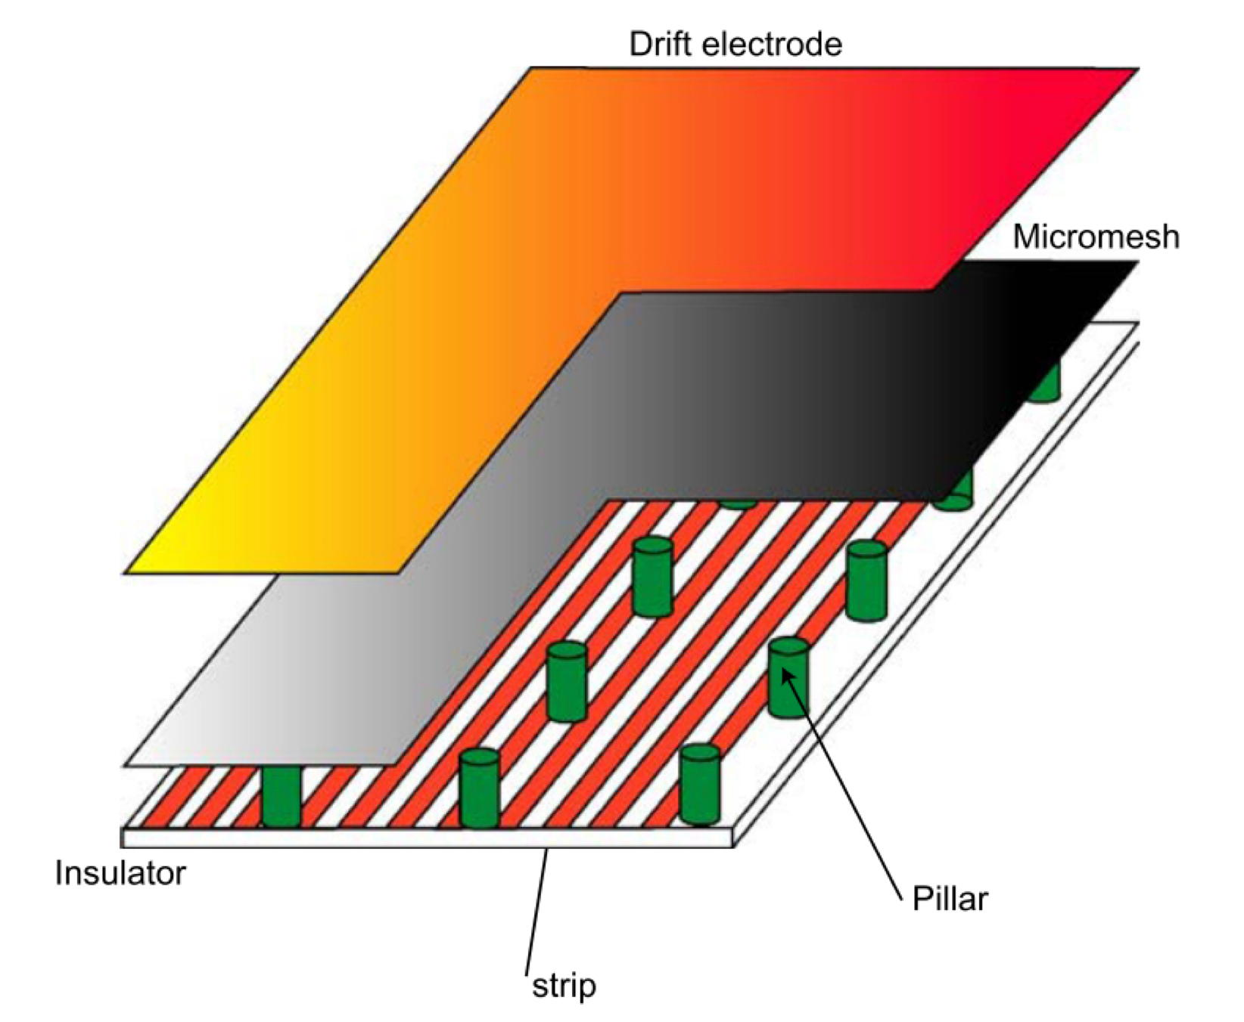
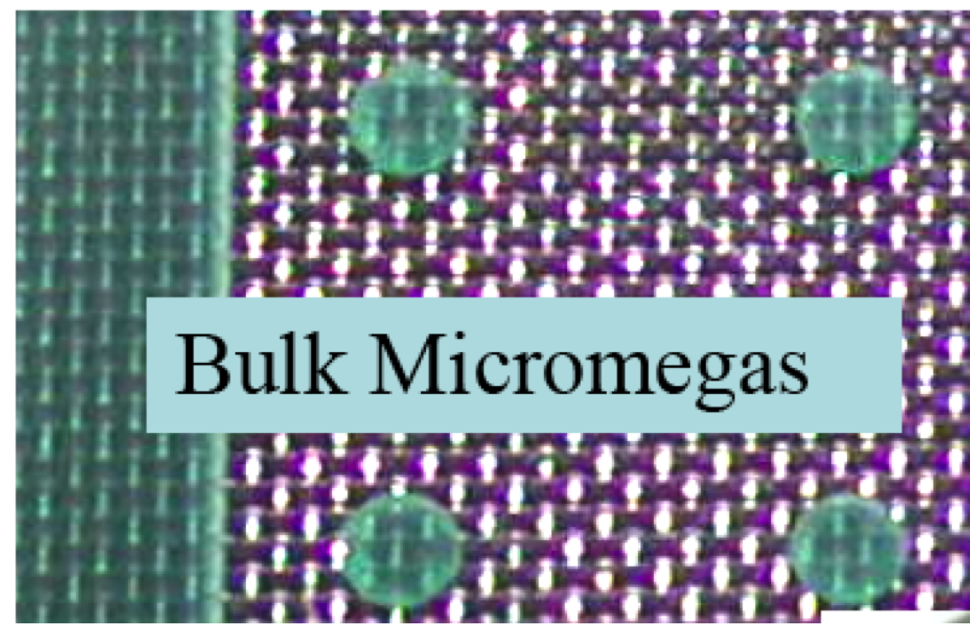
MICRO-MESH GASEOUS CHAMBER (MICROMEGAS)
I. Giomataris et al,
Nucl. Instr. Meth. A560(2006)405
Rui de Oliveira: MPGD MANUFACTURING

Slide 12
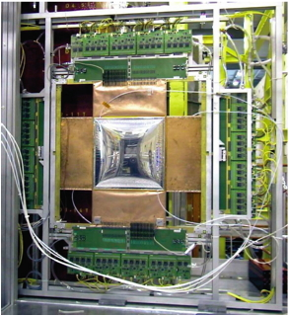
MICRO-MESH GASEOUS CHAMBER (MICROMEGAS)
COMPASS SPECTROMETER TRACKER AT CERN
12 PLANES 40x40 cm² aCTIVE
3 XYUV STATIONS
POSITION ACCURACY ~ 70 µm
C. Bernet et al, Nucl. Instr. Meth. A536(2005)61

Slide 13
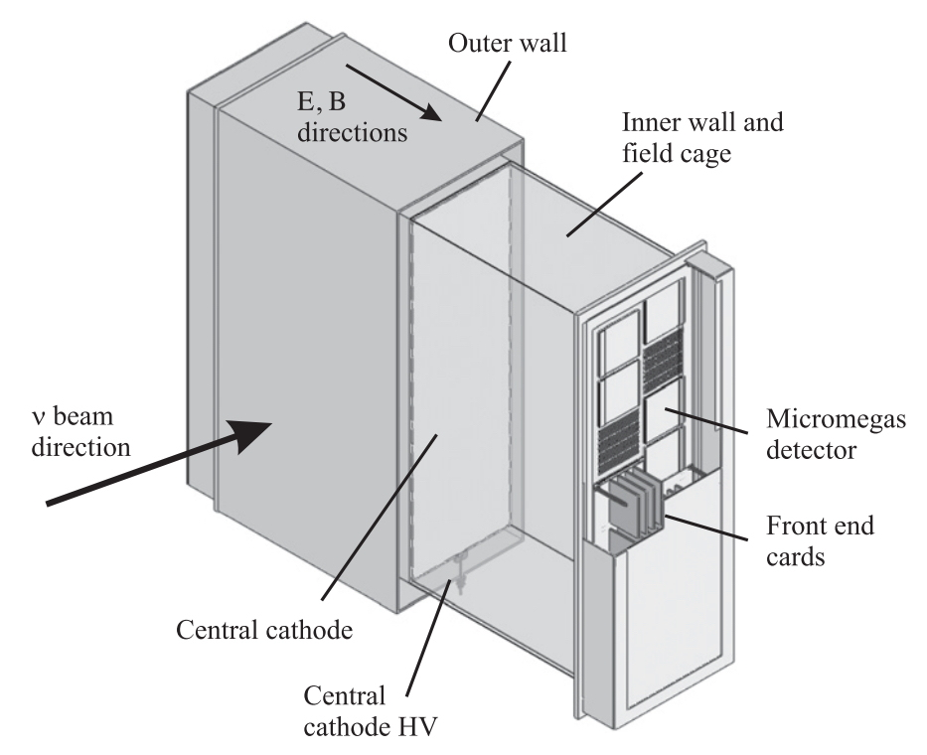
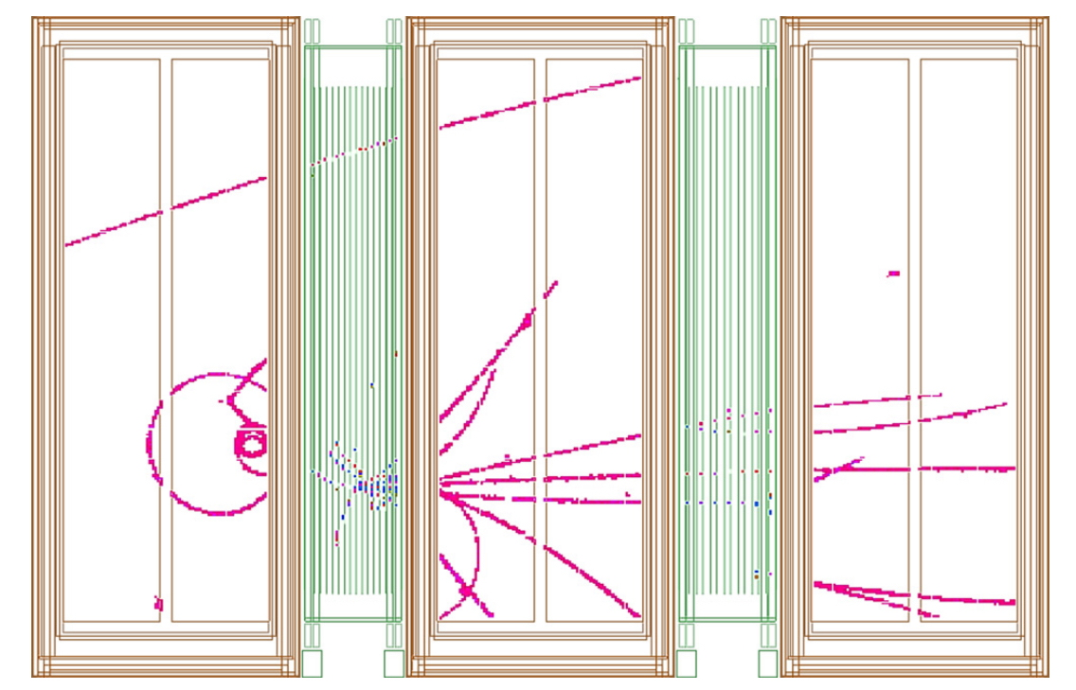
MICRO-MESH GASEOUS CHAMBER (MICROMEGAS)
TIME PROJECTION CHAMBER FOR THE T2K NEAR DETECTOR
N. Abrgall et al, Nucl. Instr. Meth. A637(2011)25

Slide 14
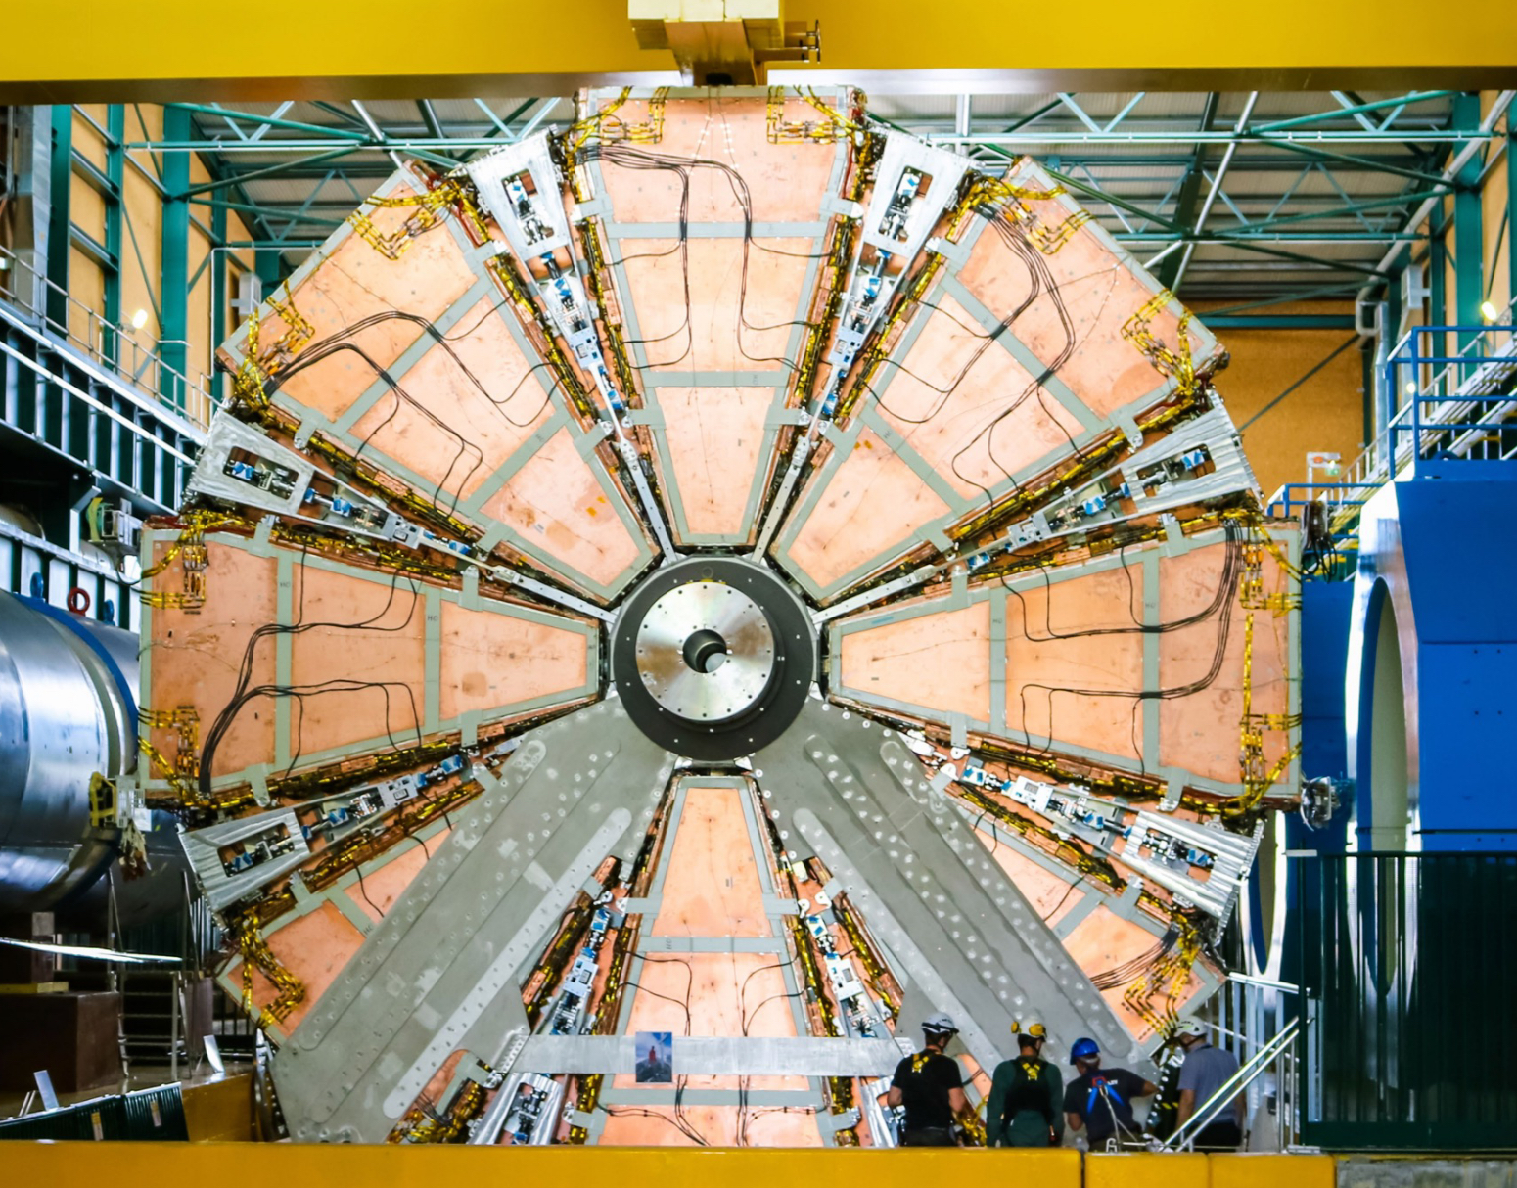
MICROMEGAS
ATLAS MICROMEGAS UPGRADE
1280 m2 active surface
2.1 M readout channels
128 detectors / 4 types
4 layers
2 to 3 m2 area
T. Alexopoulos et al, Nucl. Instr. Meth. A955(2020)162086

Slide 15
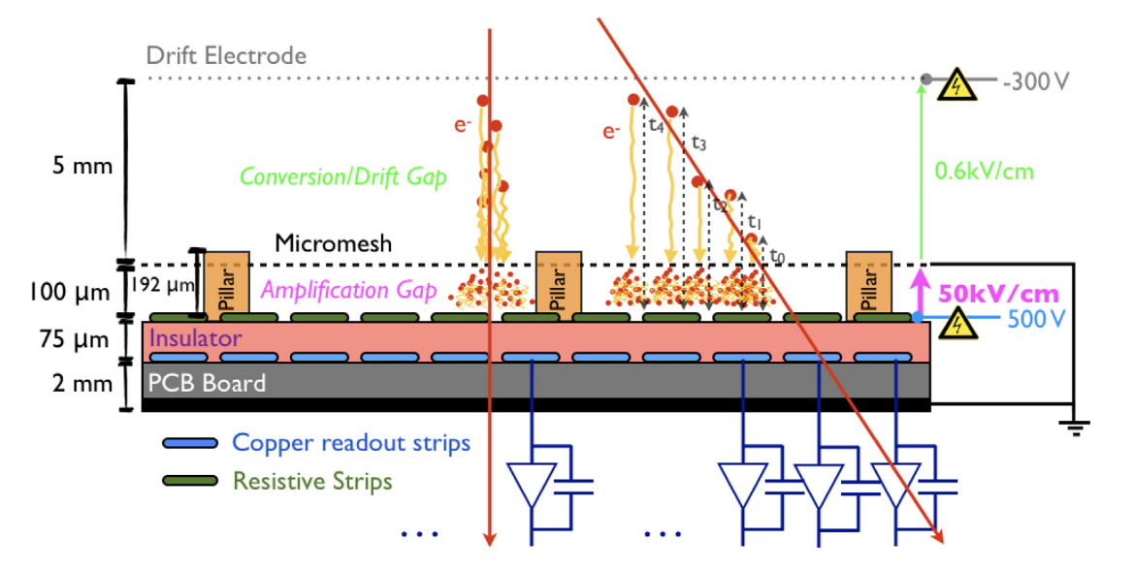
MICROMEGAS
RESISTIVE MICROMEGAS: DISCHARGES SUPPRESSION
F. Kruger, Nucl. Instr. Meth. A845(2017)248

Slide 16
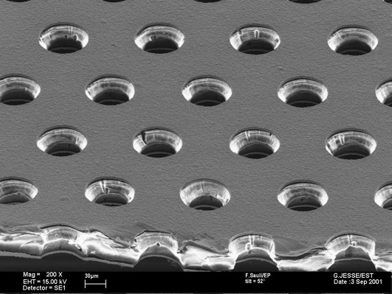
GAS ELECTRON MULTIPLIER (GEM)
50 µm thick Kapton, 5 µm Cu-coated
70 µm Ø
140 µm
F. Sauli, Nucl. Instr. Meth. A386(1997)531

Slide 17
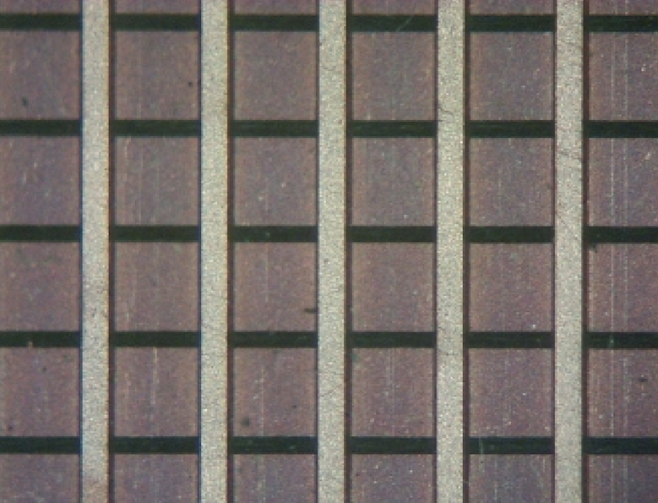
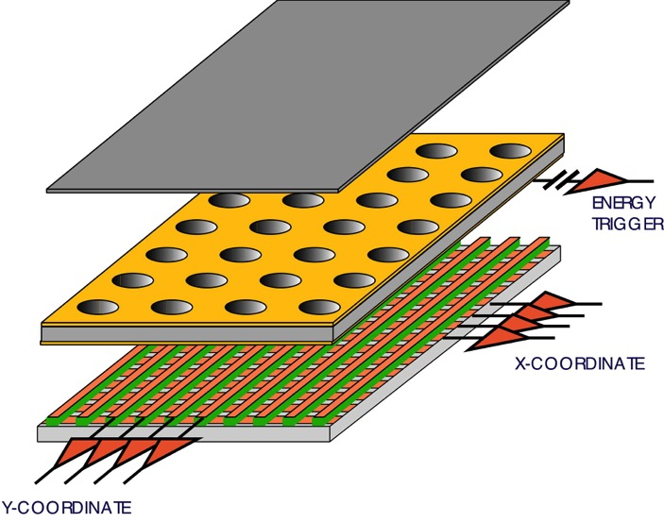
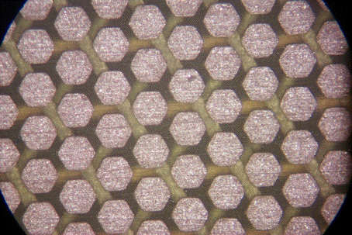
GAS ELECTRON MULTIPLIER (GEM)
STANDARD XY 400 µm PITCH
GEM CHAMBER WITH
2-DIMENSIONAL READOUT
PAD MATRIX 500 µm PICH

Slide 18
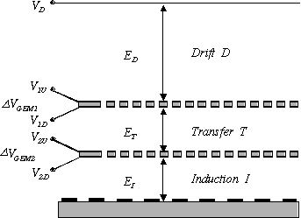
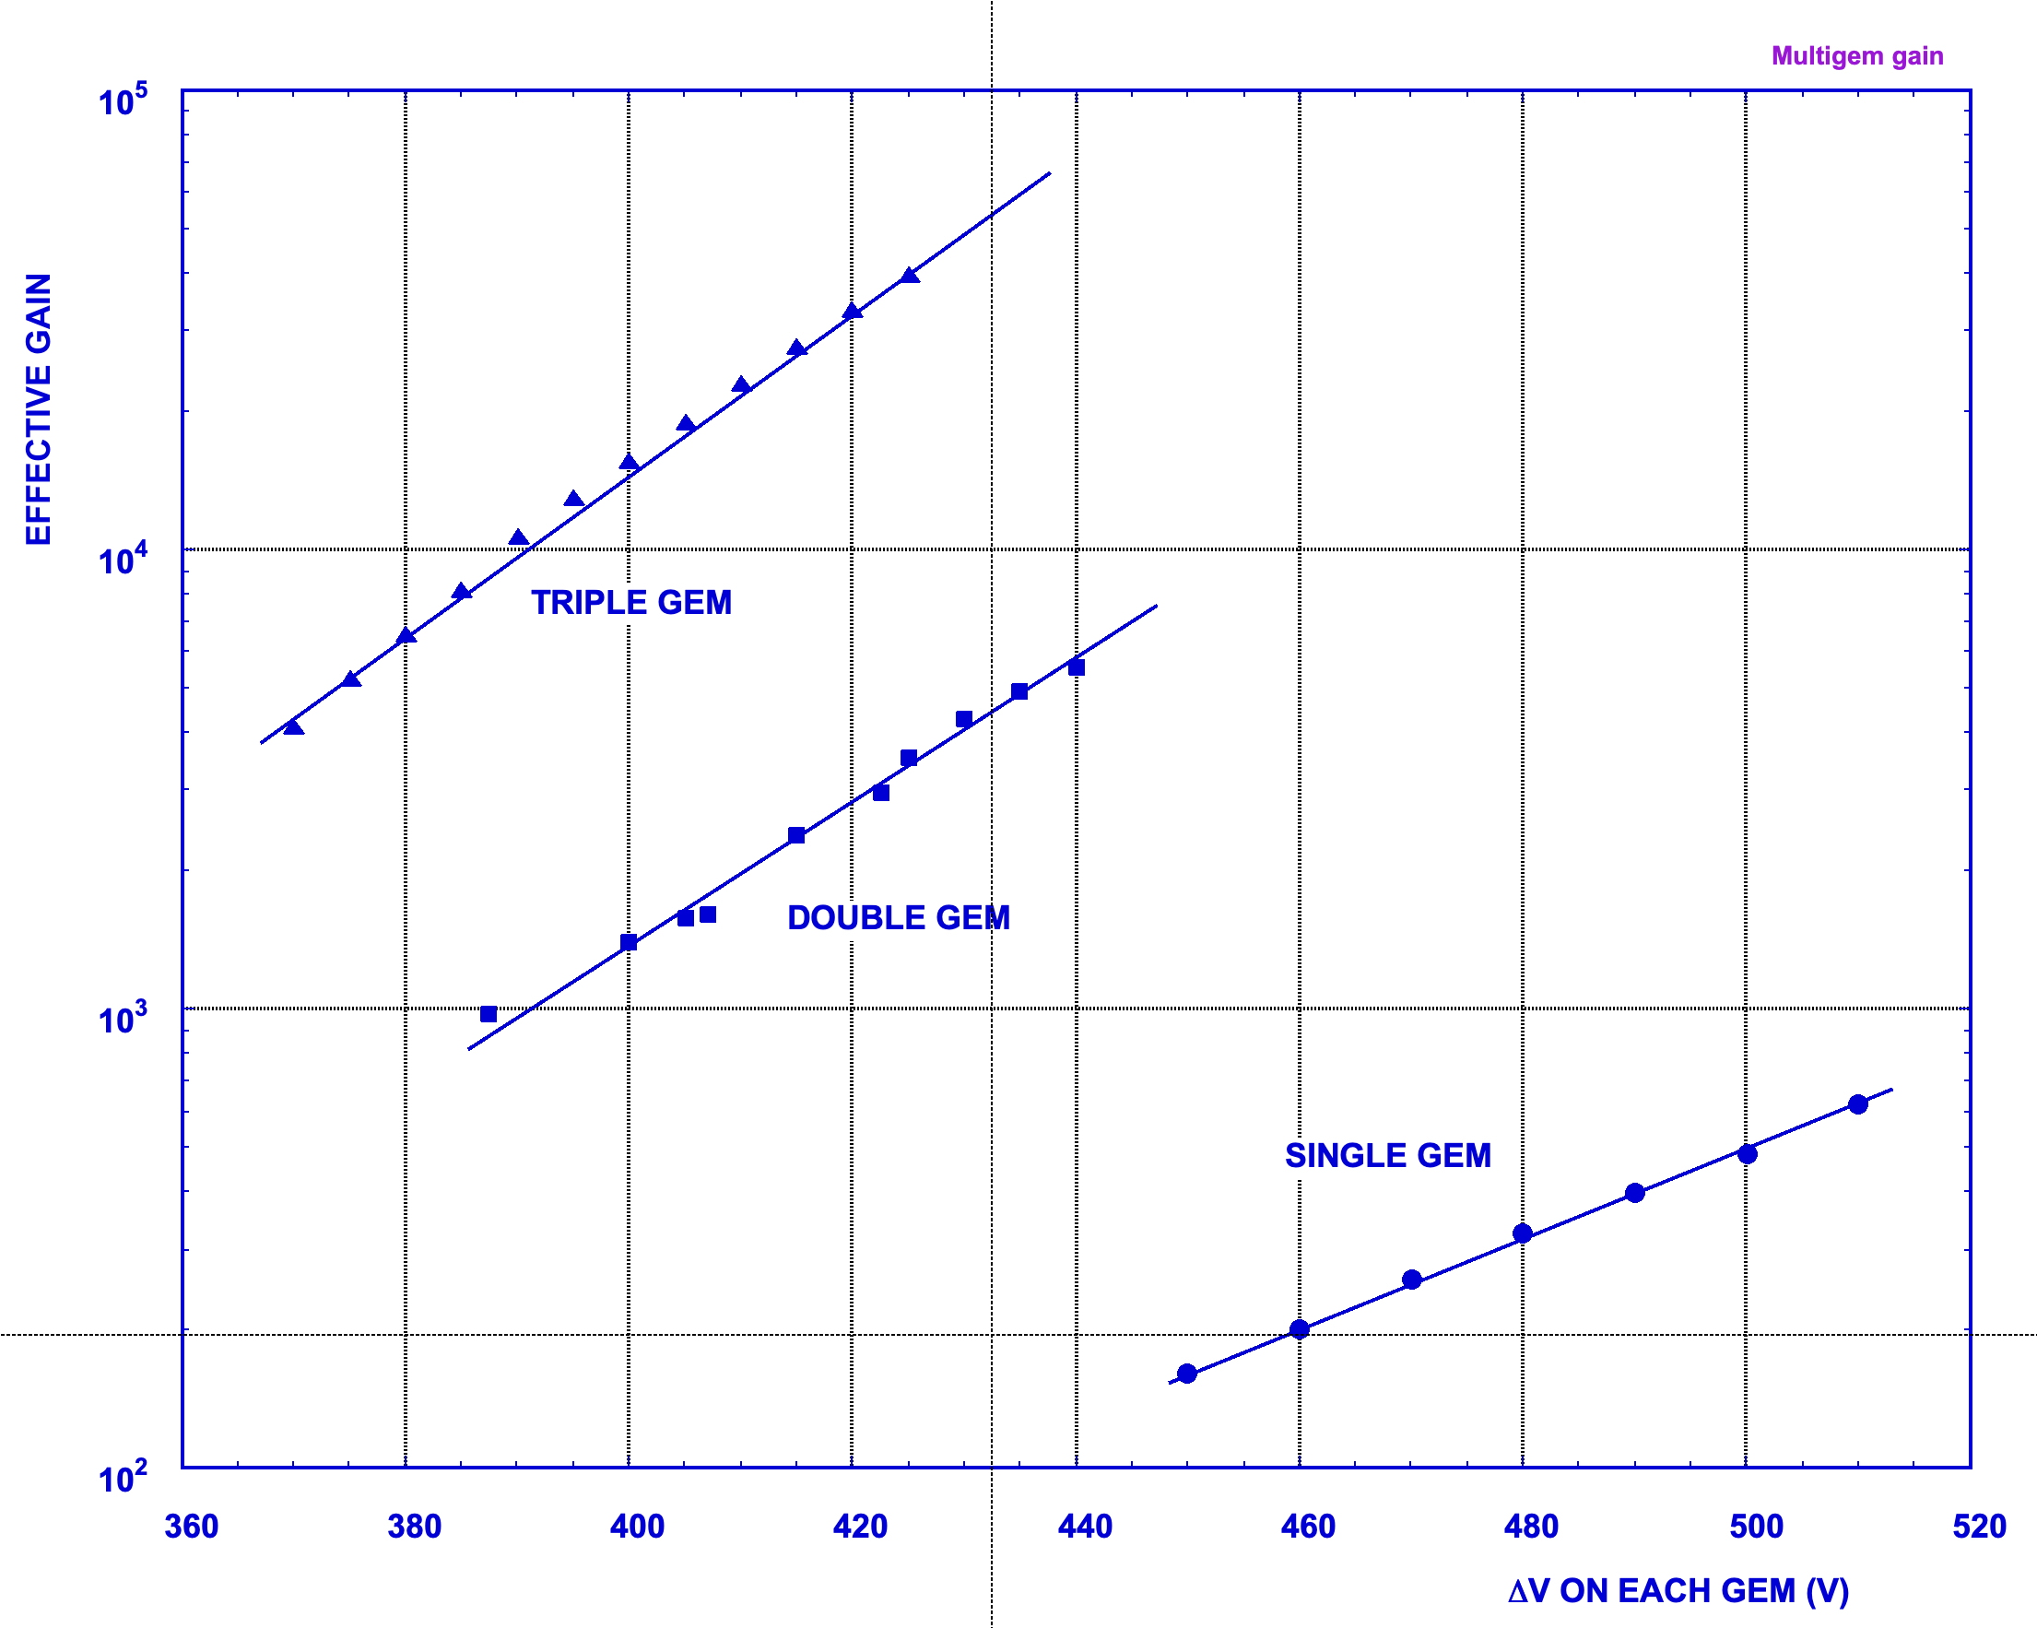
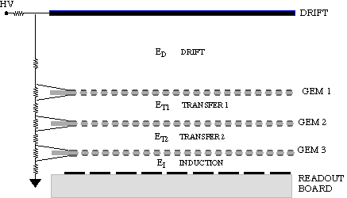
MULTI-GEM DETECTORS
LOWER VOLTAGE ON EACH GEM
HIGHER SAFE TOTAL GAIN
S. Bachmann et al, Nucl. Instr. Meth. A479(2012)294

Slide 19
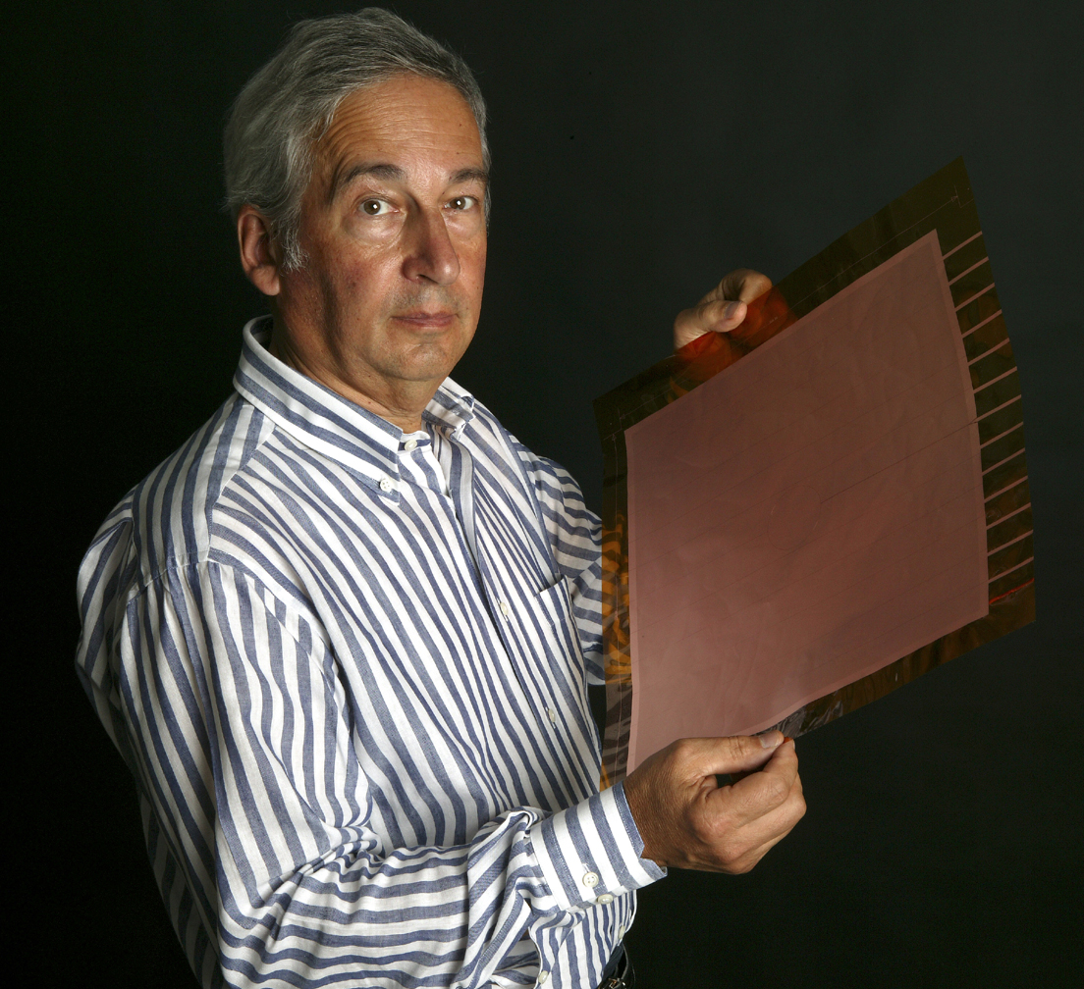
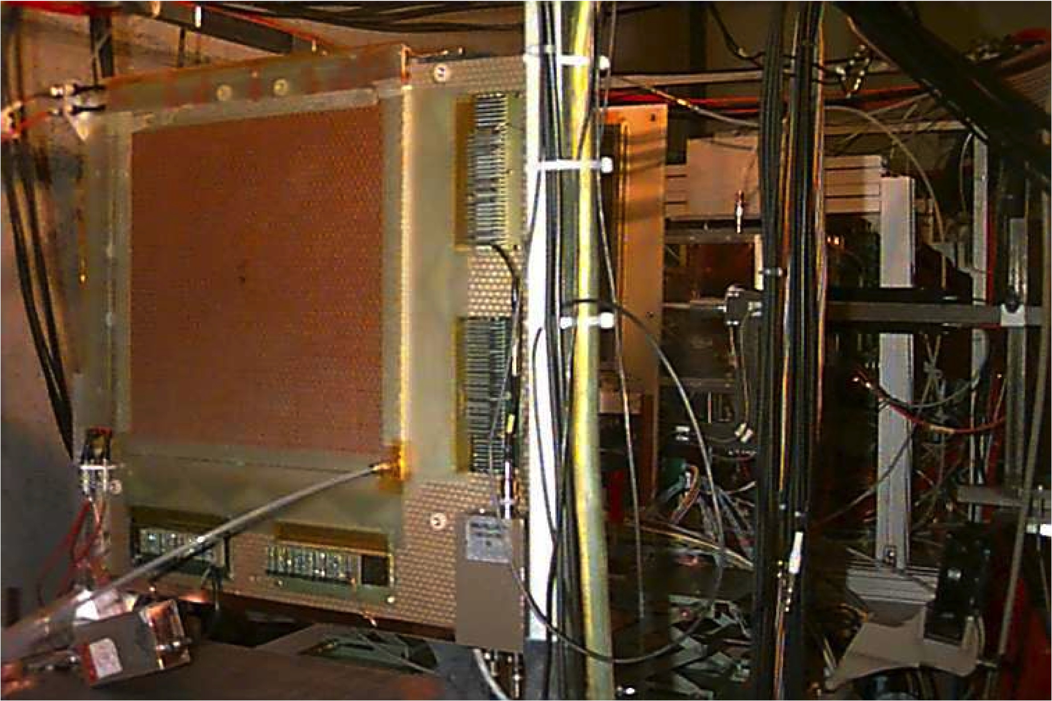
LARGE MULTI-GEM DETECTOR SYSTEMS
COMPASS TRACKER AT CERN (2001-2020)
A 30x30 cm² GEM ELECTRODE
~ 30 TRIPLE-GEM DETECTORS
30x30 cm² – 2-D Readout
C. Altunbas et al, Nucl. Instr. Meth. A490(2002)480

Slide 20
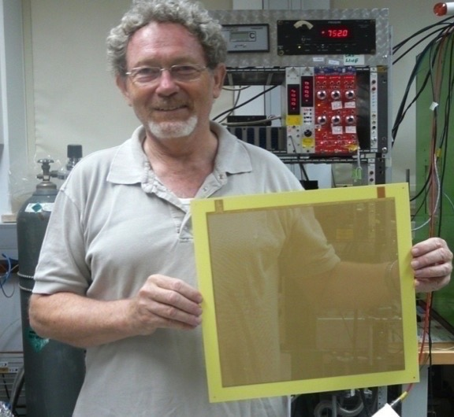
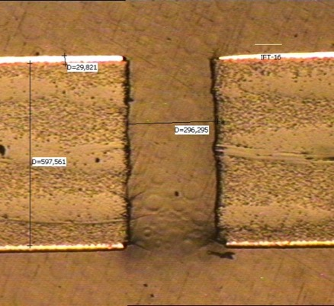
GEM FOILS MANUFACTURING
THIK GEM (also LEM: Large Electron Multiplier):
MECHANICAL DRILLING OF METAL-CLAD PCB
1 mm THICK, 400 µm HOLES
R.Chechik et al, Nucl. Instr. and Meth. A535(2004)303
Rui de Oliveira: MPGD MANUFACTURING

Slide 21
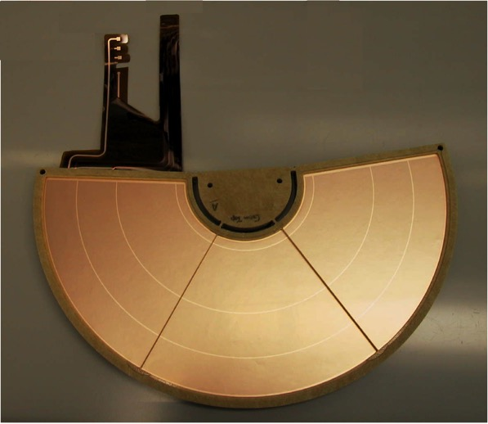
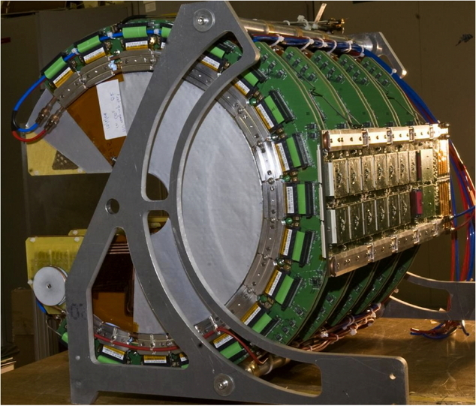
LARGE MULTI-GEM DETECTOR SYSTEMS
HALF-MOON TRIPLE-GEM GEM DETECTORS FOR TOTEM AT CERN
M.G. Bagliesi et al, Nucl. Instr. Meth. A617(2010)134

Slide 22
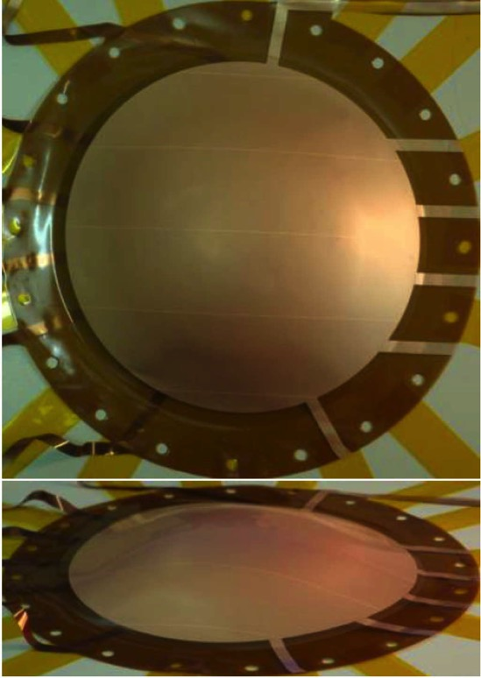
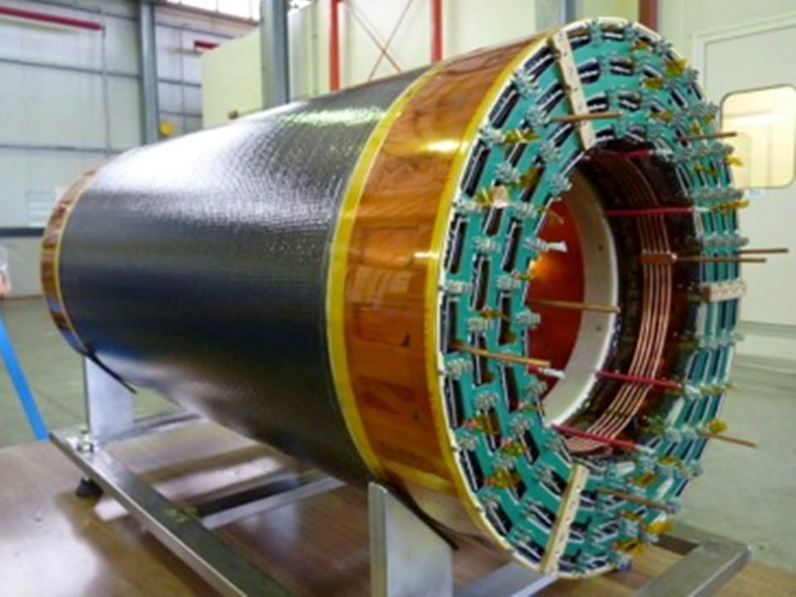
CYLINDRICAL AND SPHERICAL GEMs
KLOE-2 INNER TRACKER
A. Balla et al,
Nucl. Instr. Meth. A732(2013)221
S. Duarte Pinto arXiv:1011.5528v1
IEEE 2011 Nucl. Sci. Symp. Conf. Rec.

Slide 23
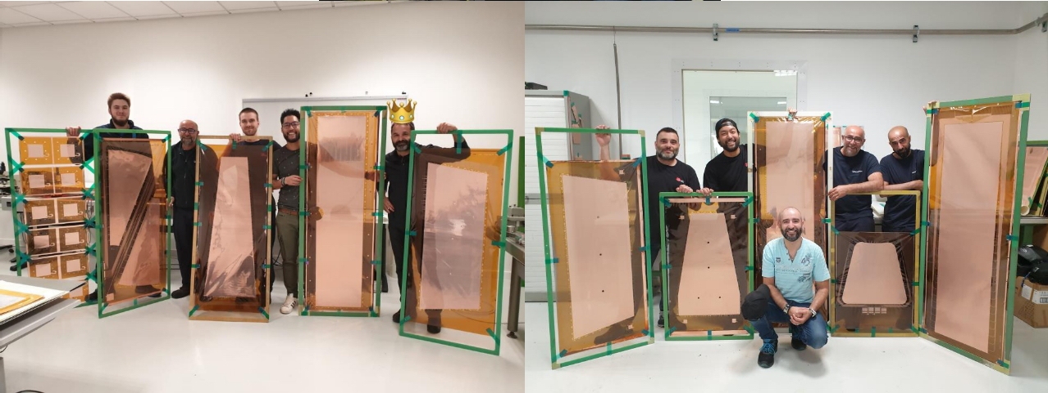
CMS FORWARD MUON DETECTOR
GEM UPGRADE: 3 NEW STATIONS WITH TRIPLE-GEMs
CERN DETECTORS TECHNOLOGIES

Slide 24
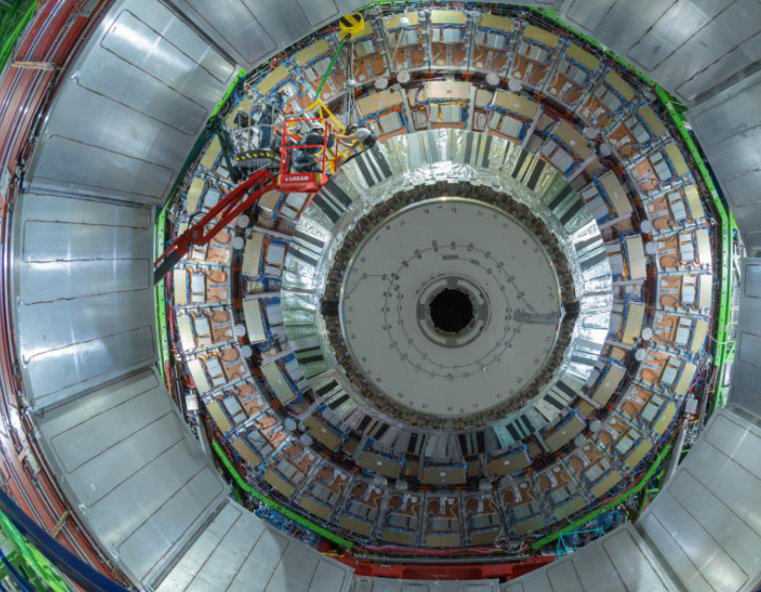
CMS FORWARD MUON DETECTOR
INSTALLATION OF 36 SUPER-CHAMBERS FOR FIRST AND SECOND END-CAP

Slide 25
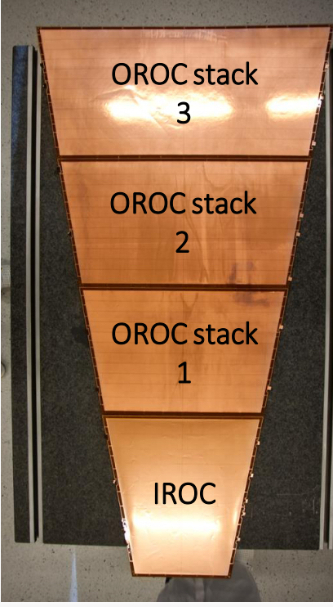
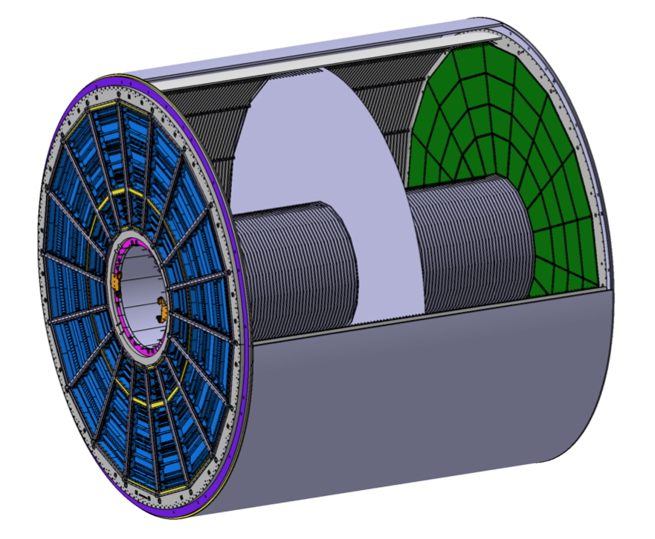
ALICE TPC UPGRADE: QUAD GEM
87 cm
72 GEM MODULES
165 cm
Piotr Gasik: GAS DETECTORS PHYSICS 2

Slide 26
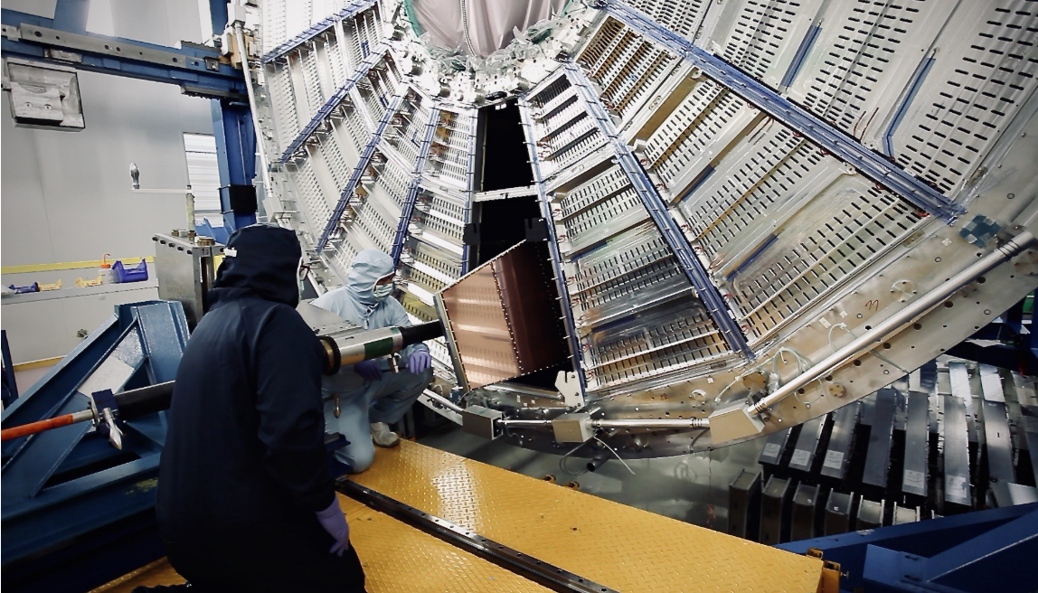
ALICE TPC GEM UPGRADE
J. Adolfsson et al, JINST16 (20210)P03021
Paolo Iengo: MPGDs in LHC EXPERIMENTS

Slide 27
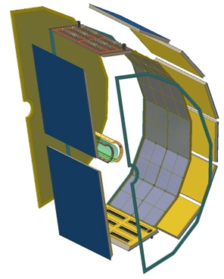
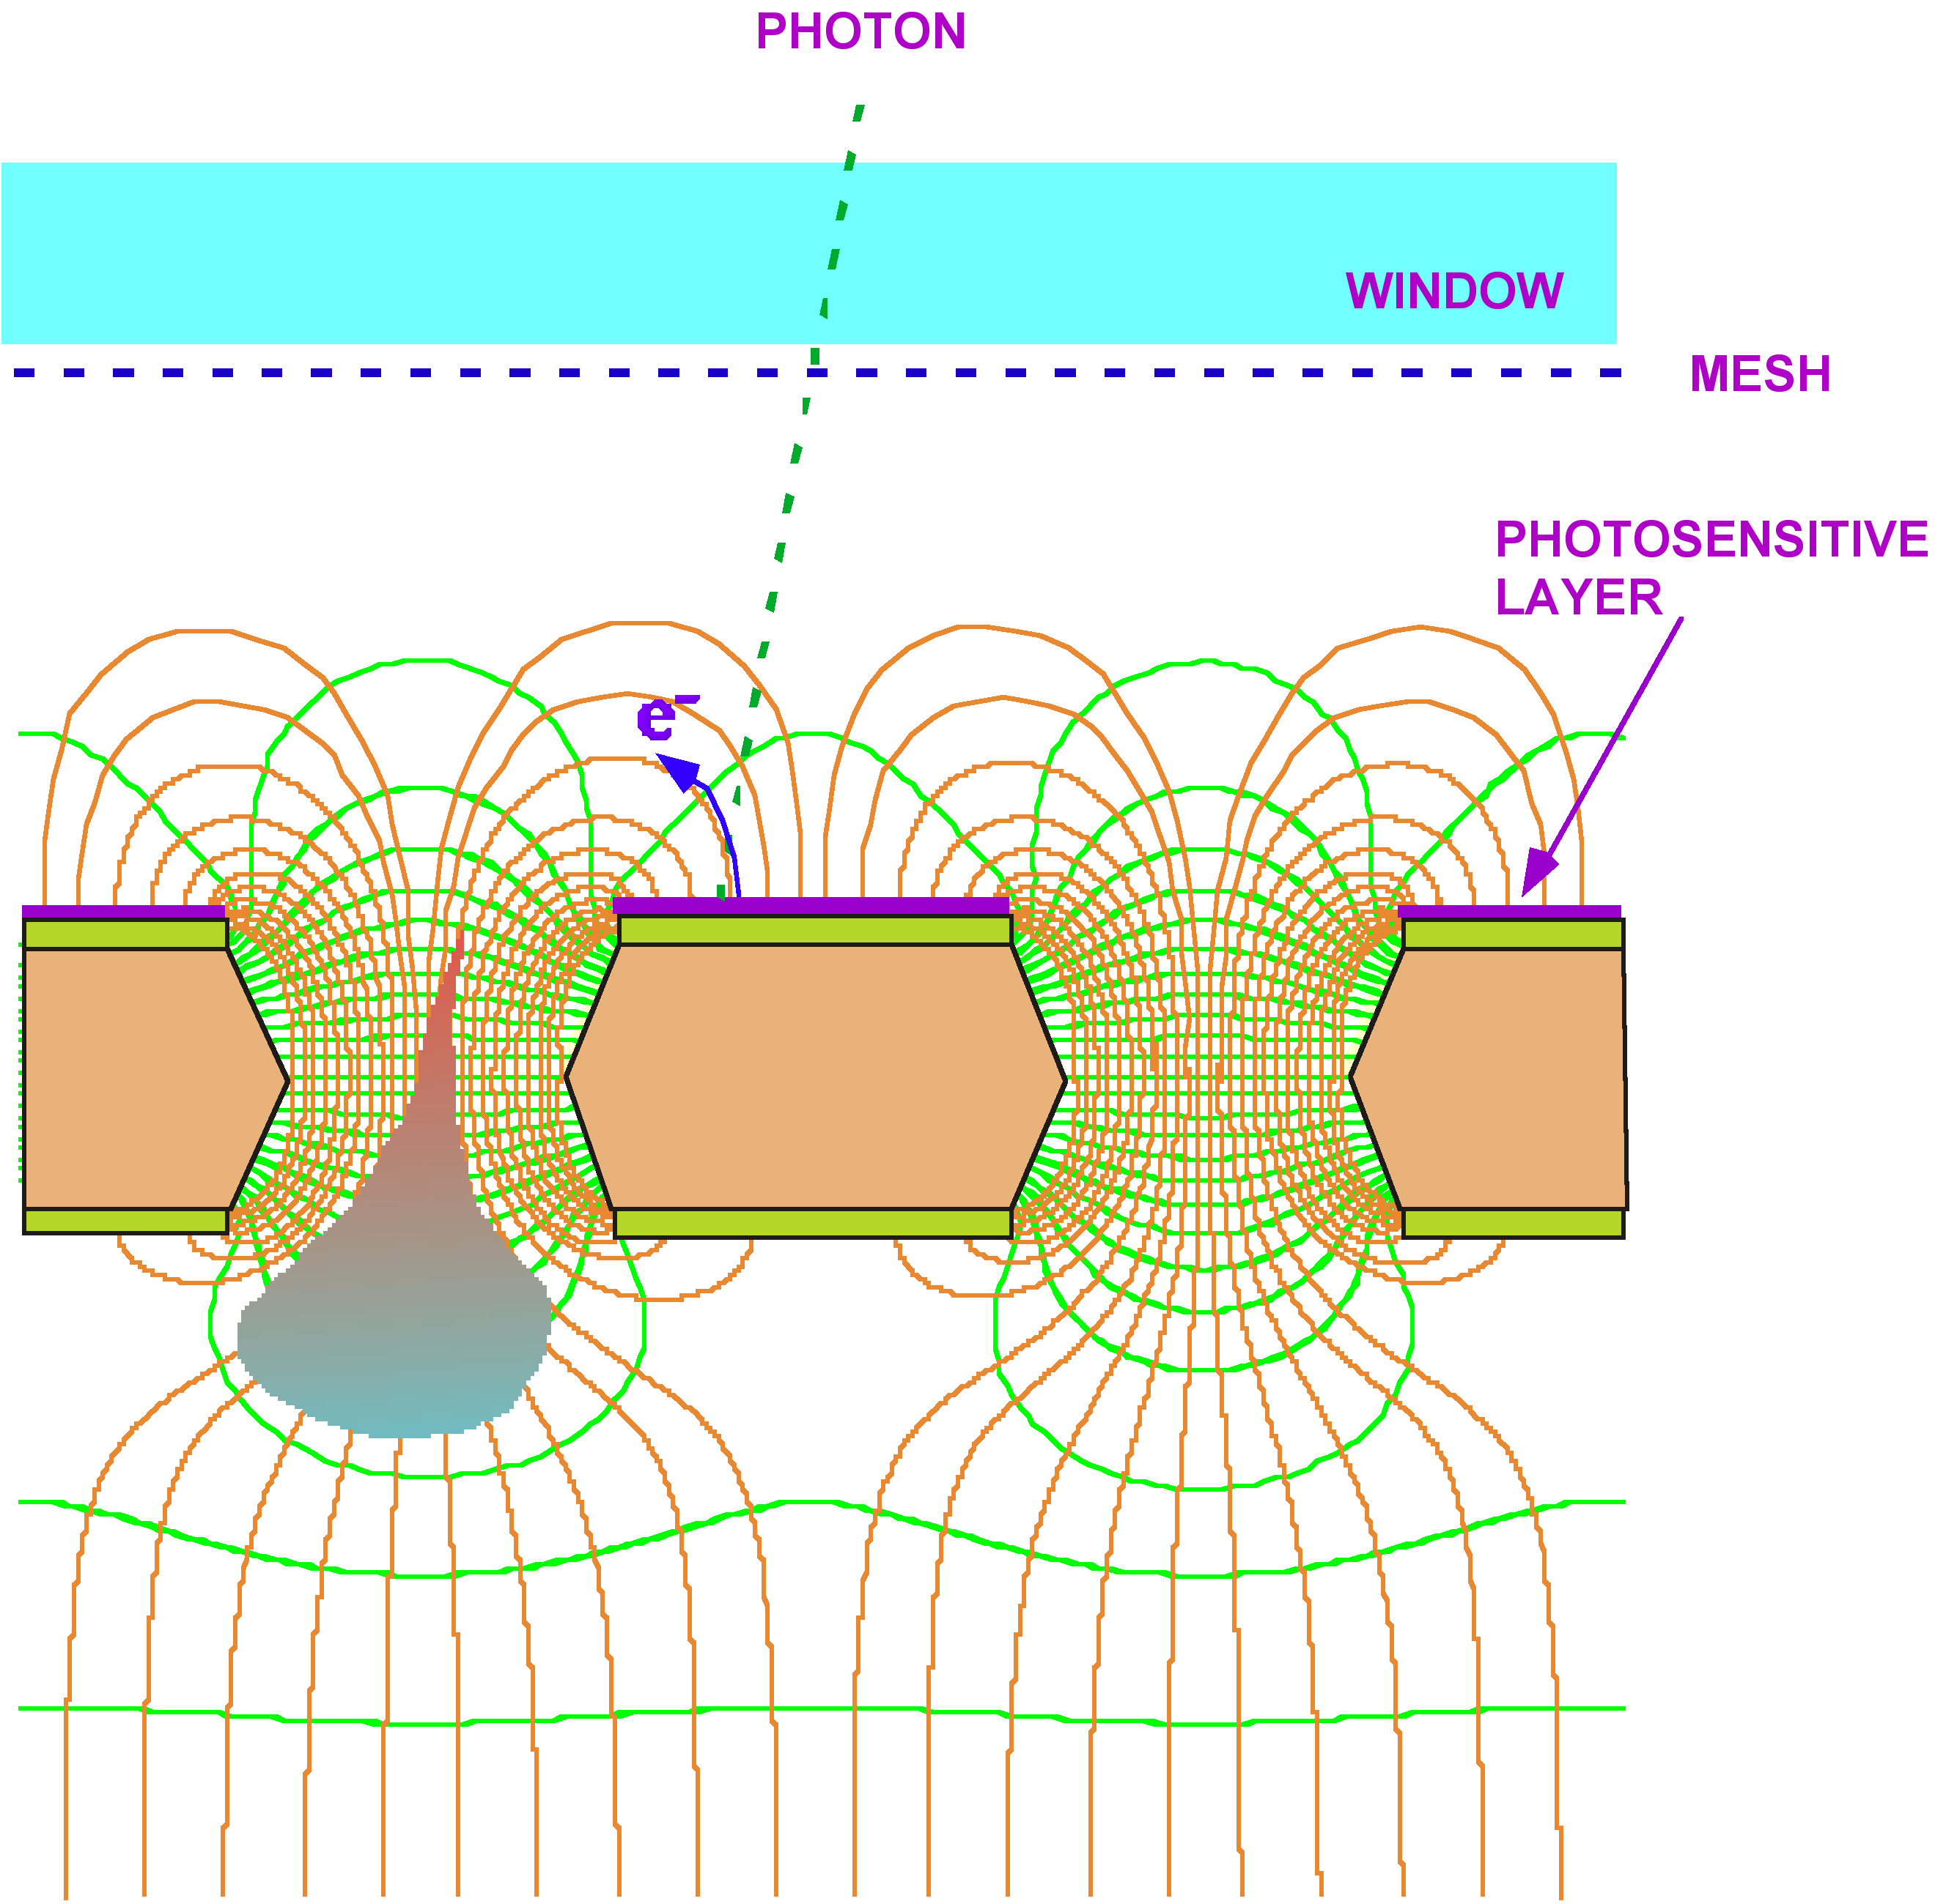
UV PHOTONS DETECTION
GEM WITH REVERSE CsI PHOTOCATHODE
HADRON BLIND DETECTOR FOR PHENIX
T. Meinschad, L. Ropelewski and F. Sauli,
Nucl. Instr. Meth. A 535(2004)324
W. Anderson et al, Nucl. Instr. Meth. A646(2011)35

Slide 28
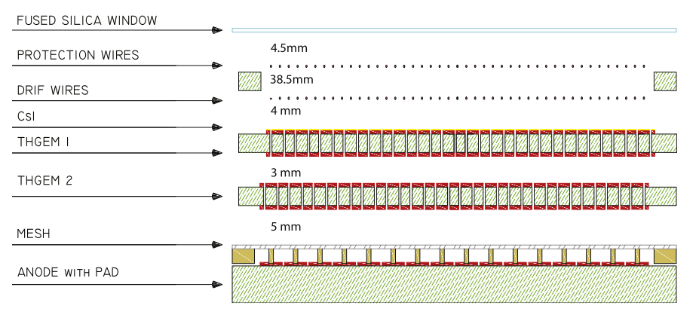
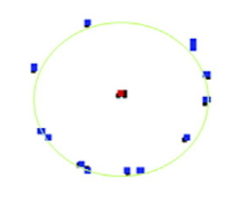

HYBRID MPGD: GEM + MICROMEGAS
CHERENKOV RING IMAGING (COMPASS)
LARGE GAINS, REDUCED POSITIVE IONS BACKFLOW
CHERENKOV RING
J. Agarwala et al, Nucl. Instr. Meth. A952(2020) ﻿161832

Slide 29



SOFT X-RAY POLARIMETRY
5.9 keV PHOTOELECTRON (80 µm pixels pitch):
~ 1 mm
L. Baldini et al, Astroparticle Physics (2021
R. Bellazzini et al, Nucl. Instr. and Meth. A720(2013)173

Slide 30


NASA IMAGING X-RAY POLARIMETRY EXPLORER (IXPE)
GAS PIXEL DETECTOR
POLARIZATION MAP OF
221009A GAMMA RAY BURST
L. Baldini et al, Astroparticle Physics (2021)
LAUNCHED DECEMBER 15, 2021
M. Negro et al,
Astro. J. Letters 946(1923)L21
Marco Cortesi: Applications beyond HEP
Jona Bortfield: Applications beyond fundamental research

Slide 31




OPTICAL GEMS: CARBON TETRAFLUORIDE SCINTILLATION
CF₄ SECONDARY SCINTILLATION
MeV α PARTICLES
n INTERACTIONS IN ³He
TRIPLE GEM
CCD CAMERA
F.A.F. Fraga, et al, Nucl. Instr. and Meth. A478(2002) 357

Slide 32



OPTICAL MPGD IMAGING
GEM: BEAM IMAGER
SOFT X-RAY RADIOGRAPHY
MUON TRACKS
HADRONIC SHOWER
F. Brunbauer et al, JINST 13(2018)T02006

Slide 33



OPTICAL MPGD IMAGING
CYGNO:
DIRECTIONAL DARK MATTER SEARCH
D. Pinci et al,
Nucl. Instr. Meth. A936(2019)453
Davide Pinci: OPTICAL AND HYBRID READOUT TECHNIQUES

Slide 34


DUAL-PHASE LIQUID ARGON TIME PROJECTION CHAMBER
Proto-DUNE
C. Cuesta et al, ﻿arXiv:1910.10115v1(2019)

Slide 35

THE END
OF THE INTRODUCTION

