Slide 1
Gas Detectors Physics 1
Basic Detection Processes
Energy Loss: Coulomb Interactions
Drift and Diffusion of Charges
Collisional Excitation and Ionization
Avalanche Charge Multiplication
Signal Formation and Detection
Fabio Sauli RD51 MPGD School November 27, 2023 CERN

Slide 2
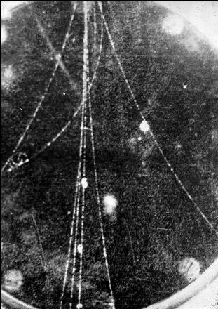
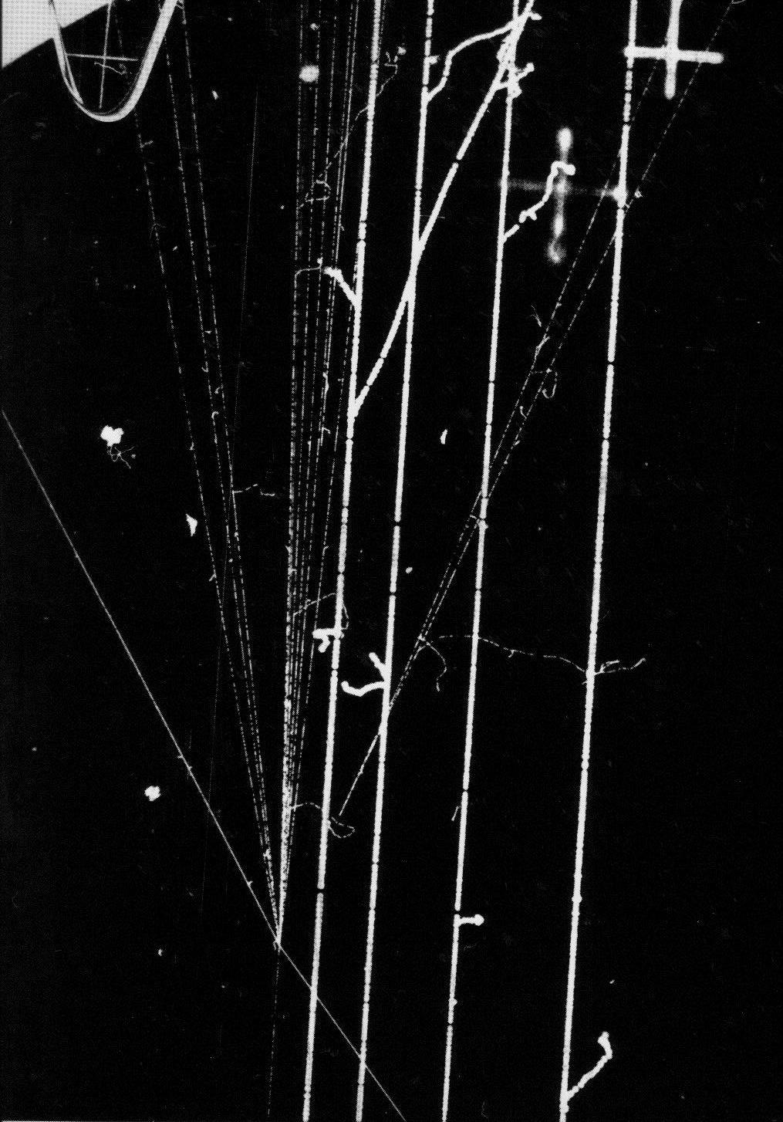
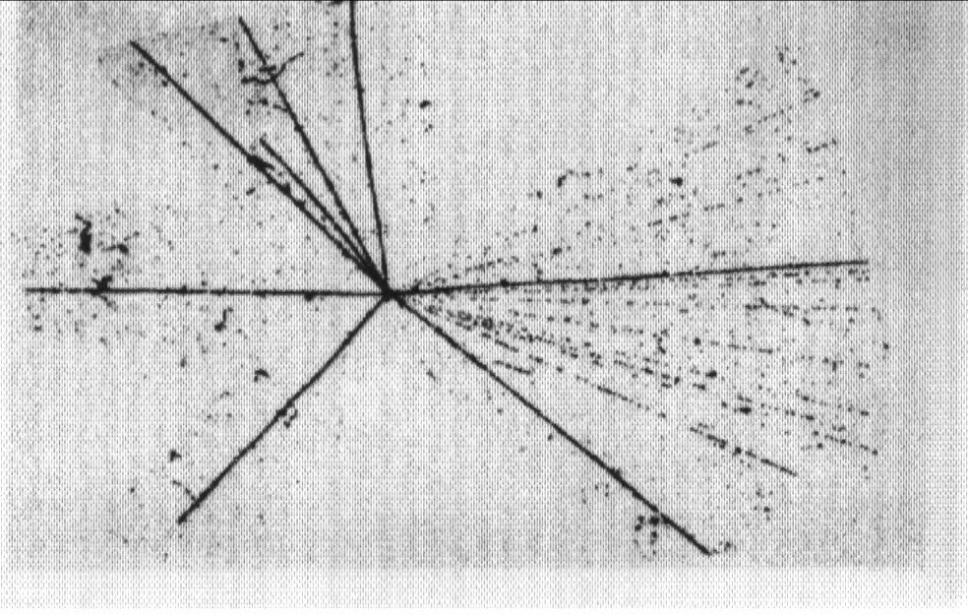
Imaging of Charged Particles Interactions
~ 1930
Cloud Chamber
~1940
Emulsions
~ 1960
Bubble Chamber

Slide 3
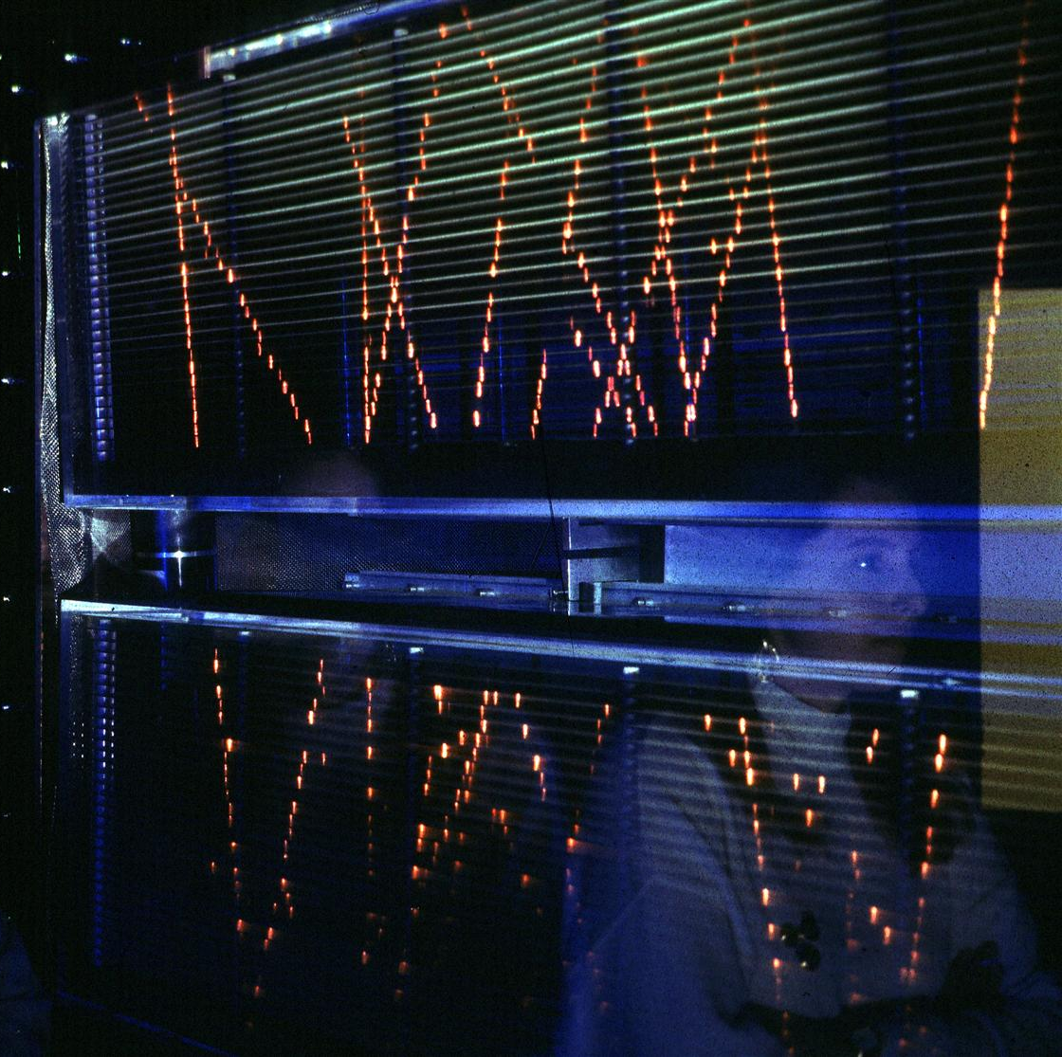
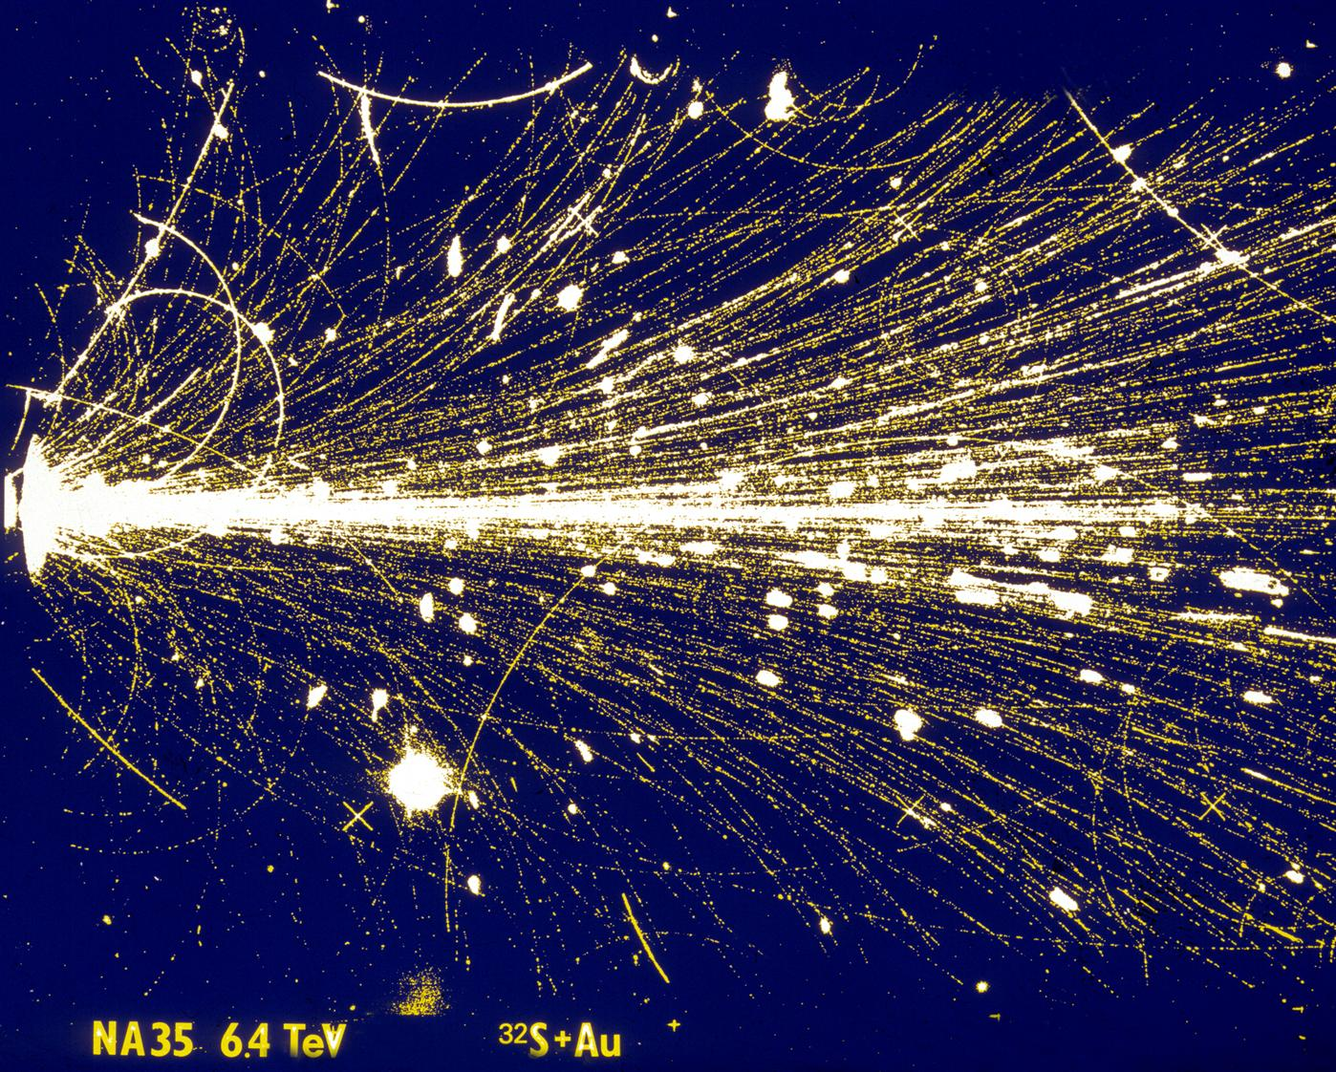
Imaging of Charged Particles Interactions
~1960
Spark and Streamer Chambers

Slide 4
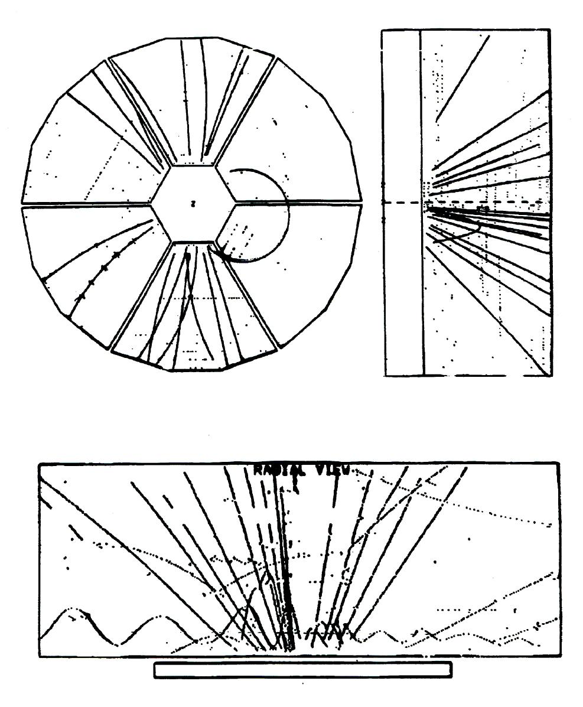
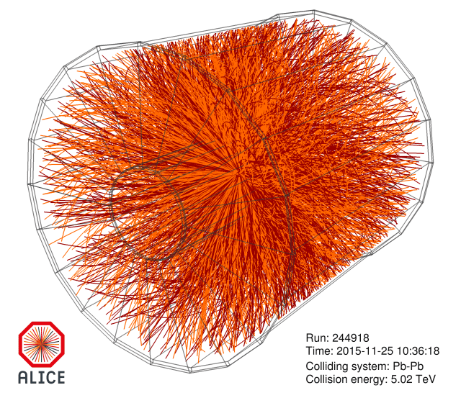
Imaging of Charged Particles Interactions
~2000
~1970
2016: GEM TPC UPGRADE
Time Projection Chamber (TPC)

Slide 5
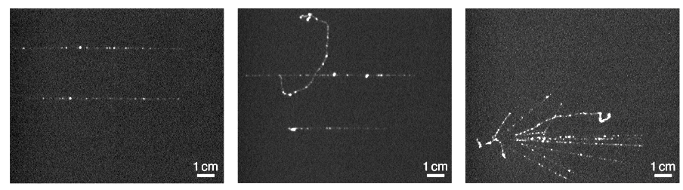
Imaging of Charged Particles Interactions
THE FUTURE?
MUON TRACKS
DELTA RAY
HADRONIC SHOWER
F. Brunbauer et al, JINST 13(2018) ﻿T02006
Optical Gas Electron Multiplier (GEM)

Slide 6
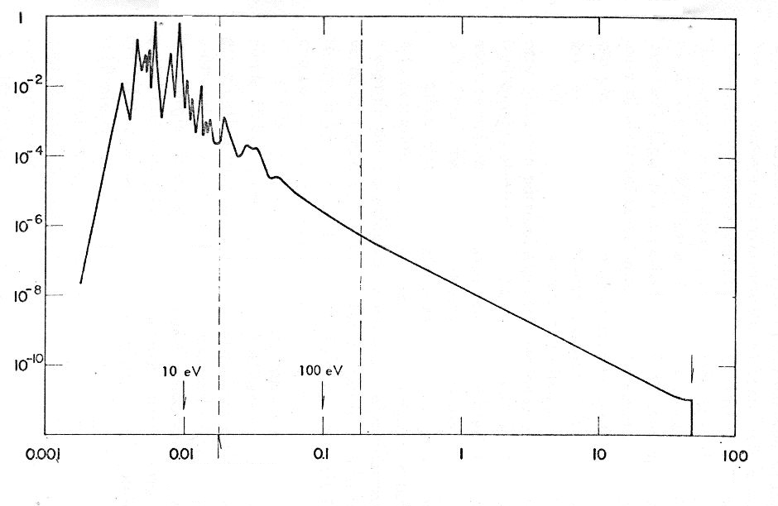
Charged Particles
Coulomb Interactions: Excitations and Ionizations
Clusters
Excitations
Primary ionizations
δ Rays: Secondary ionizations
H₂O
PROBABILITY
Excitations due to distant collisions
Ionizations due to distant collisions
Ionizations due to close collisions
ENERGY TRANSFER (keV)

Slide 7
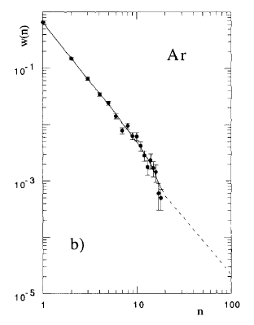
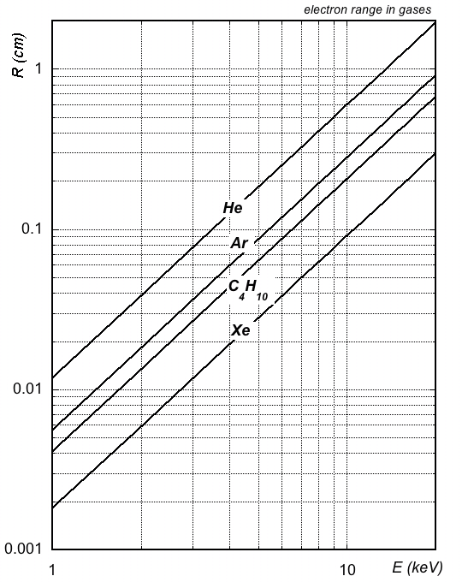
Charged Particles
Cluster Size and δ Electrons Range
AVERAGE CLUSTER SIZE ~3.5
GASES AT NTP
20⁰C 1 Atm
Probability P(n)
180 µm
Cluster size n
2 keV
H. Fischle et al, Nucl. Instr. and Meth. A301 (1991) 202

Slide 8
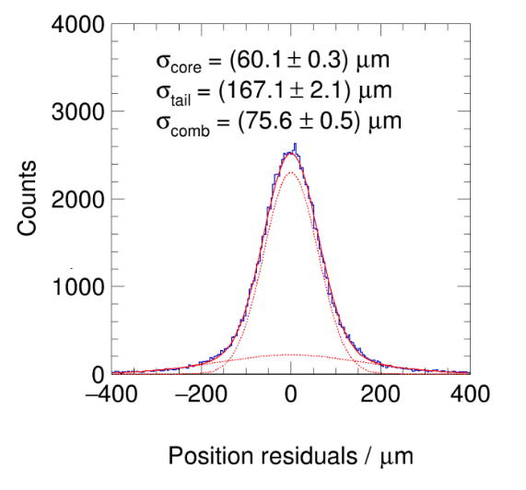
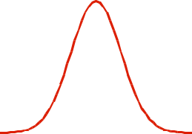
Charged Particles
δ Electrons
Energy Loss Asymmetry:
Core Gaussian + Tails
Perpendicular Tracks
L. Scharenberg, MPGD 2022

Slide 9
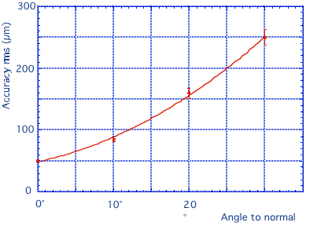
Charged Particles
δ Electrons
Position Accuracy
vs
Incidence Angle:
Energy loss asymmetry:
large incidence angles
G. Charpak et al, NIM 167 (1979) 455

Slide 10
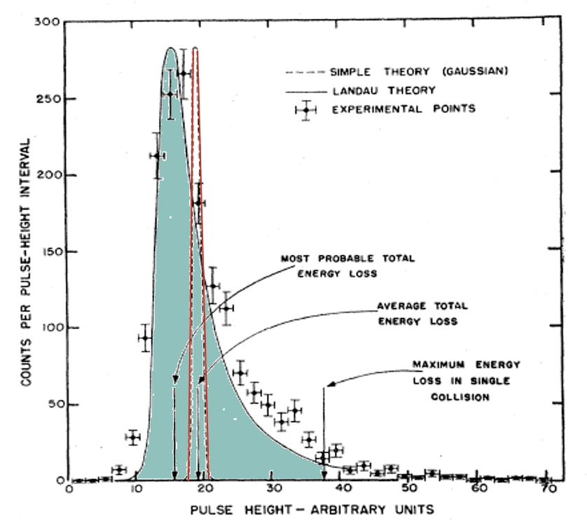
Charged Particles
Energy Loss Statistics: Gauss vs Landau
Differential Energy Loss in thin Gas Samples:
Gaussian
Landau
Experimental

Slide 11
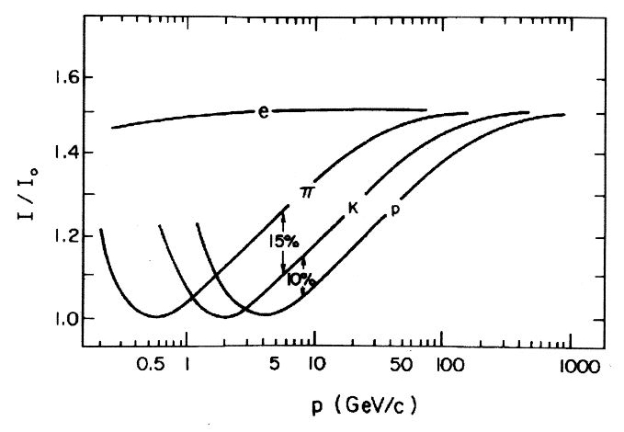
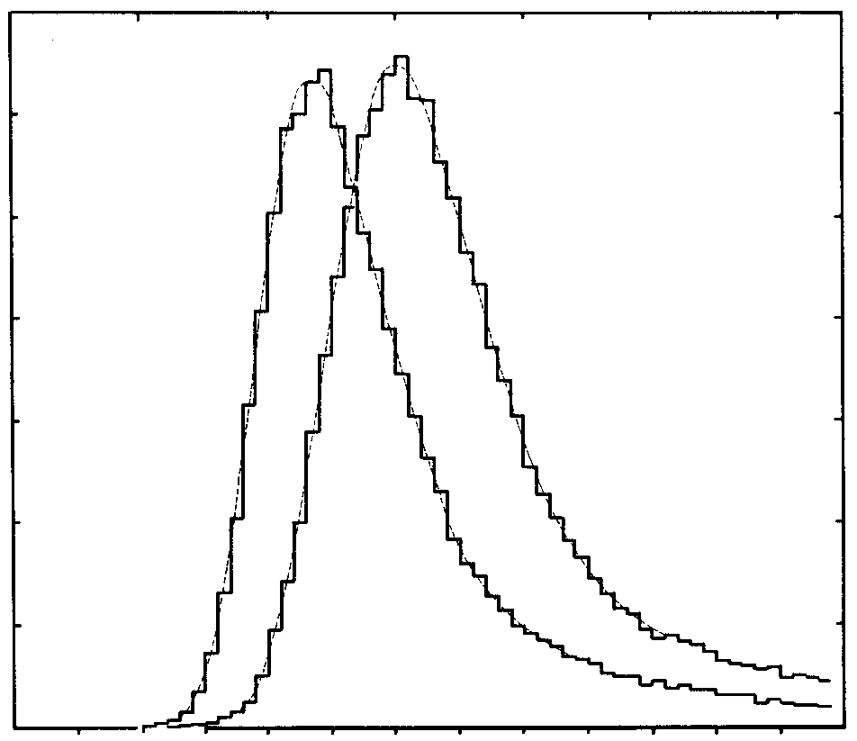
Charged Particles
Energy Loss Statistics: Gauss vs Landau
Particle Identification:
Most Probable Energy Loss
SINGLE SAMPLE
Energy Loss:
Counts
15 GeV/c
6000
protons
electrons
4000
2000
0
0
500
1000
N (i.p)
I. Lehraus et al, Phys. Scripta 23(1981)727
Enery Loss resolution:
Statistical Multisample Analysis

Slide 12
Charged Particles
Particle Identification
Alice GEM-TPC
Differential Energy Loss (Truncated mean)
Ph. Hauer, Nucl. Instr. Meth. 1039 (2022)167023

Slide 13
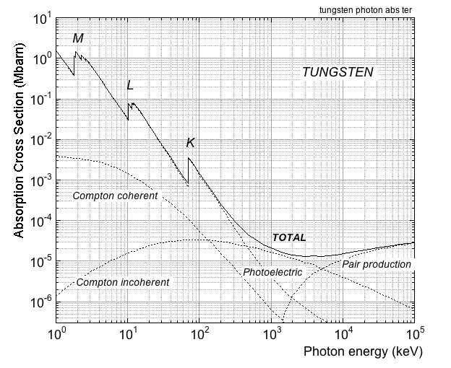
Photons
Photoelectric, Compton, Pair Production
Photoelectric:
E_{γ}
E_{γ} - E_{K,L,M..}
Compton:
E_{C}
E_{γ}
Θ_{C}
Θ_{e}
E_{e}
Pair Production:
E_{γ}
e⁺
e⁻
A. Thompson et al, X-RAY DATA BOOKLET (2001)

Slide 14
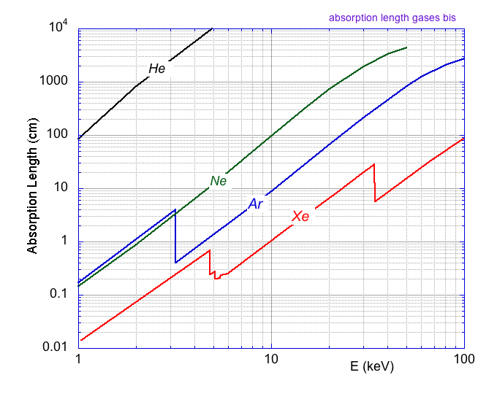
Soft X-Rays
Absorption Length
in Gases at NTP
100 m
20 cm
2 cm
3 mm
⁵⁵Fe 5.9 keV

Slide 15
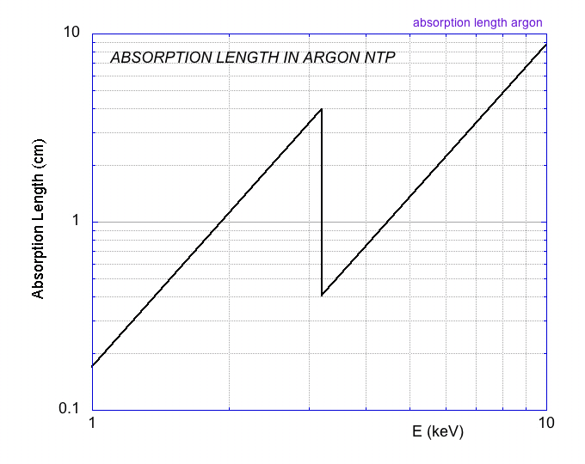
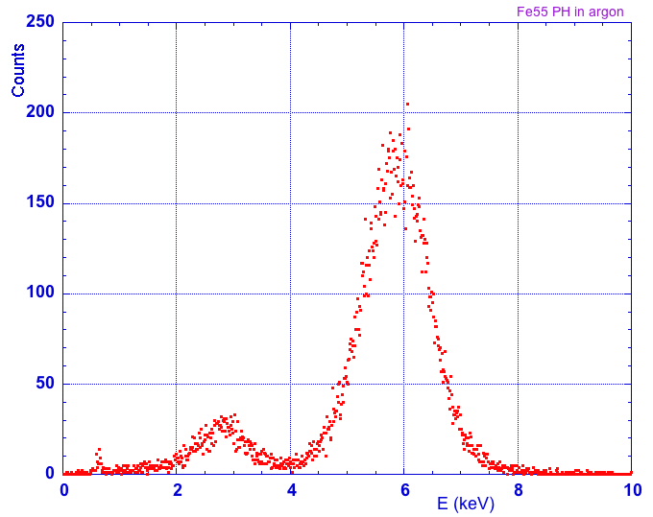
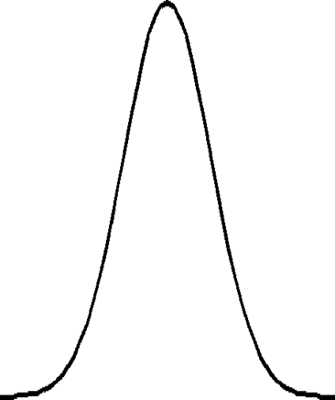
Soft X-Rays
ESCAPE PEAK
4 cm
Argon NTP
2 cm
5.9 keV
Gaussian
N=220 e⁻
E_{K} 3.2 keV
σ=15 e⁻
⁵⁵Fe 5.9 keV
~ 2.7 keV
FULL
ESCAPE
Escape
Main Peak

Slide 16
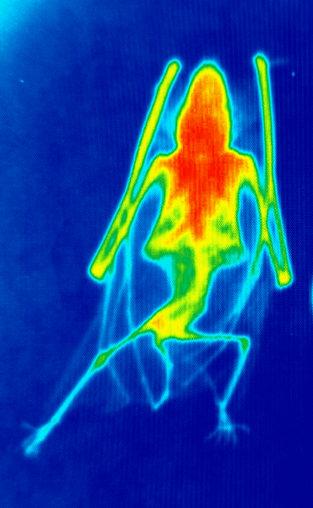
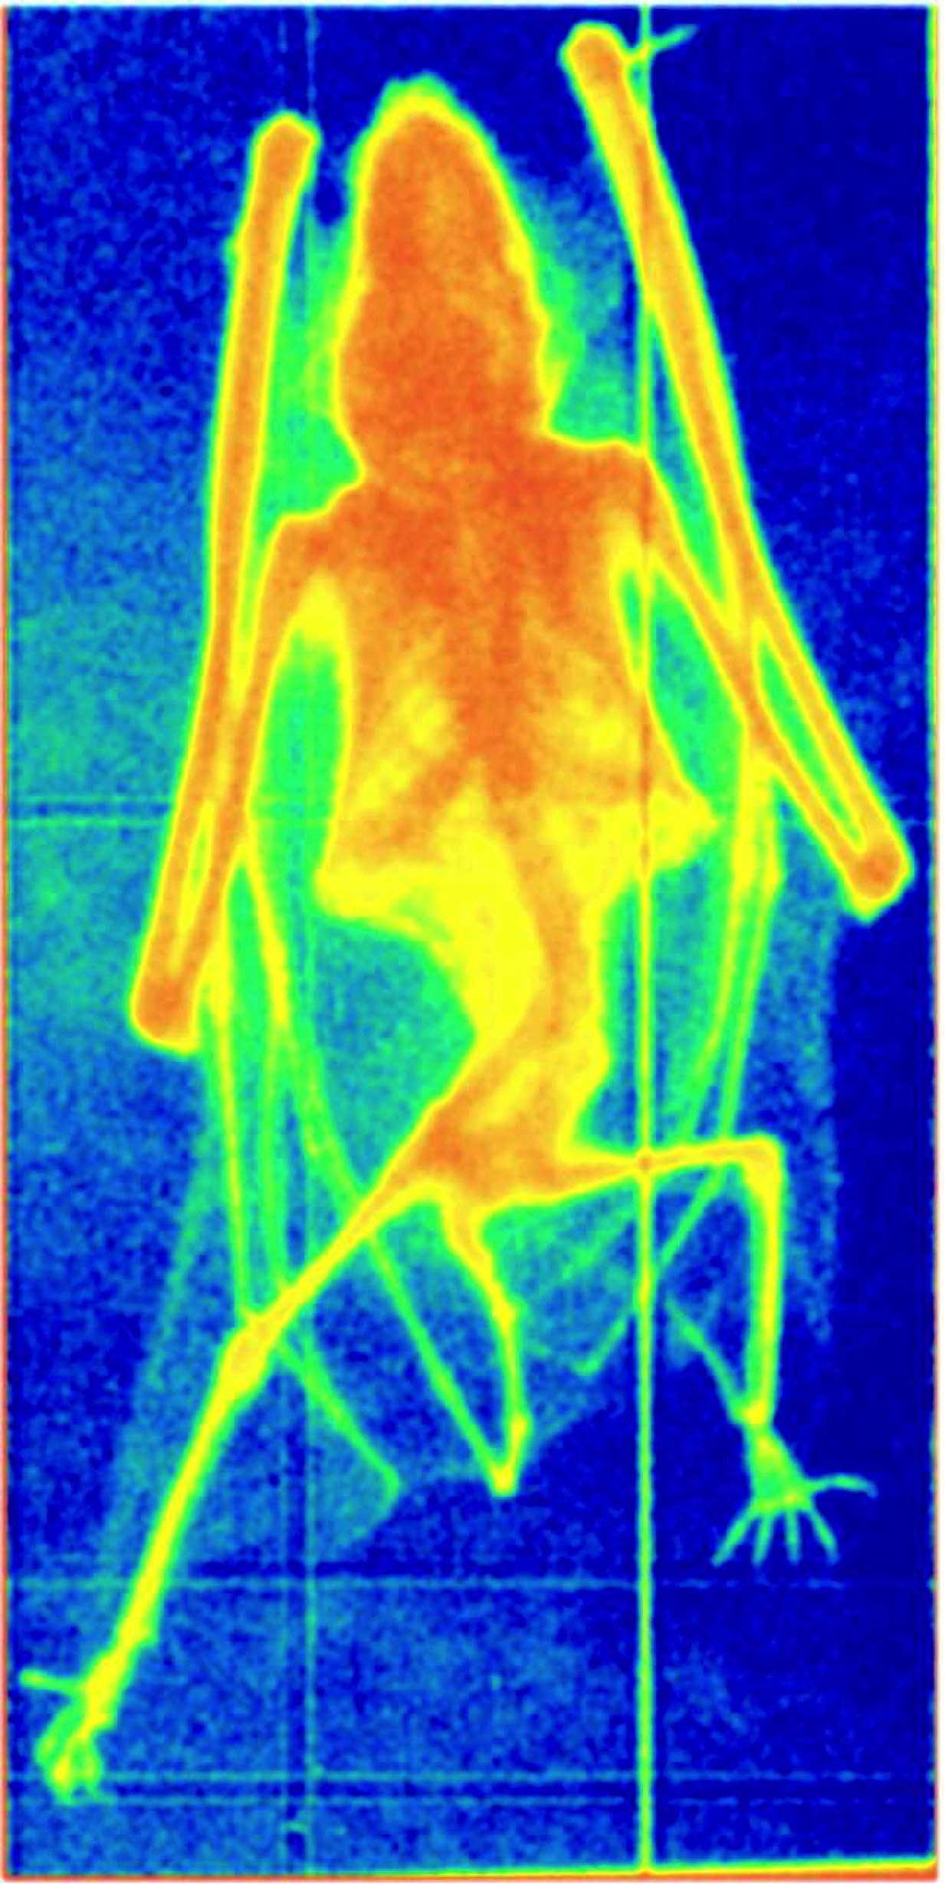
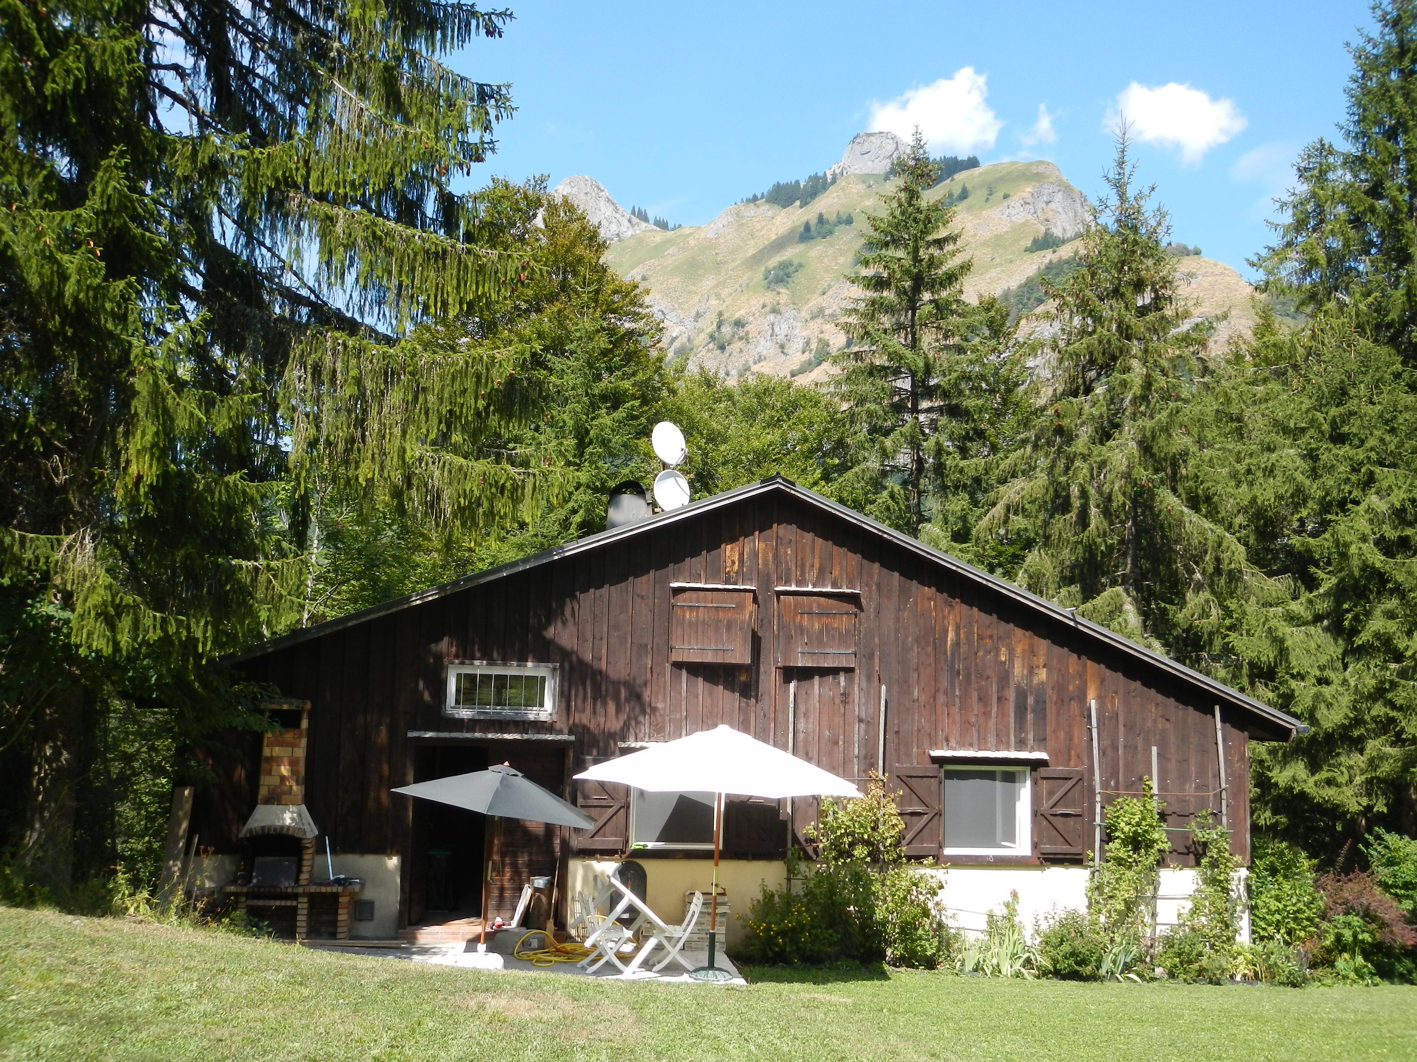

Soft X-Rays Absorption Radiography
2001:
GEM with Electronic Readout
2018:
GEM with Optical Readout
The GDD Bat
F. Sauli
Nucl. Instr. Meth. A461(2001)47
F. Brunbauer et al,
JINST13 (2018)T02006

Slide 17
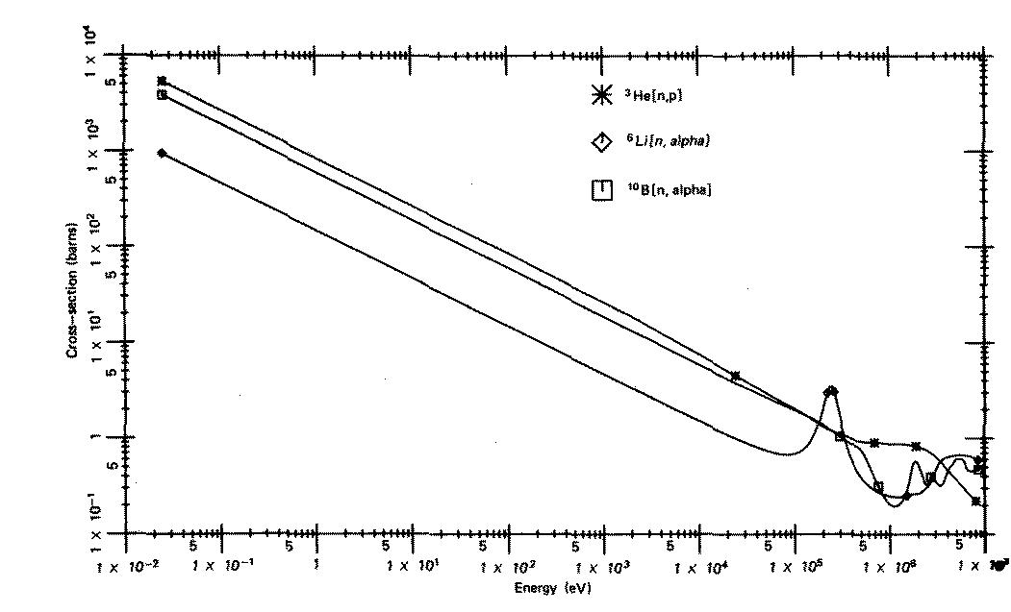
Detection of Neutrons
protons
tritons
α particles
fission fragments
n + M -->
³He
Cross Section (barn)
⁶Li
¹⁰B
Energy (eV)

Slide 18
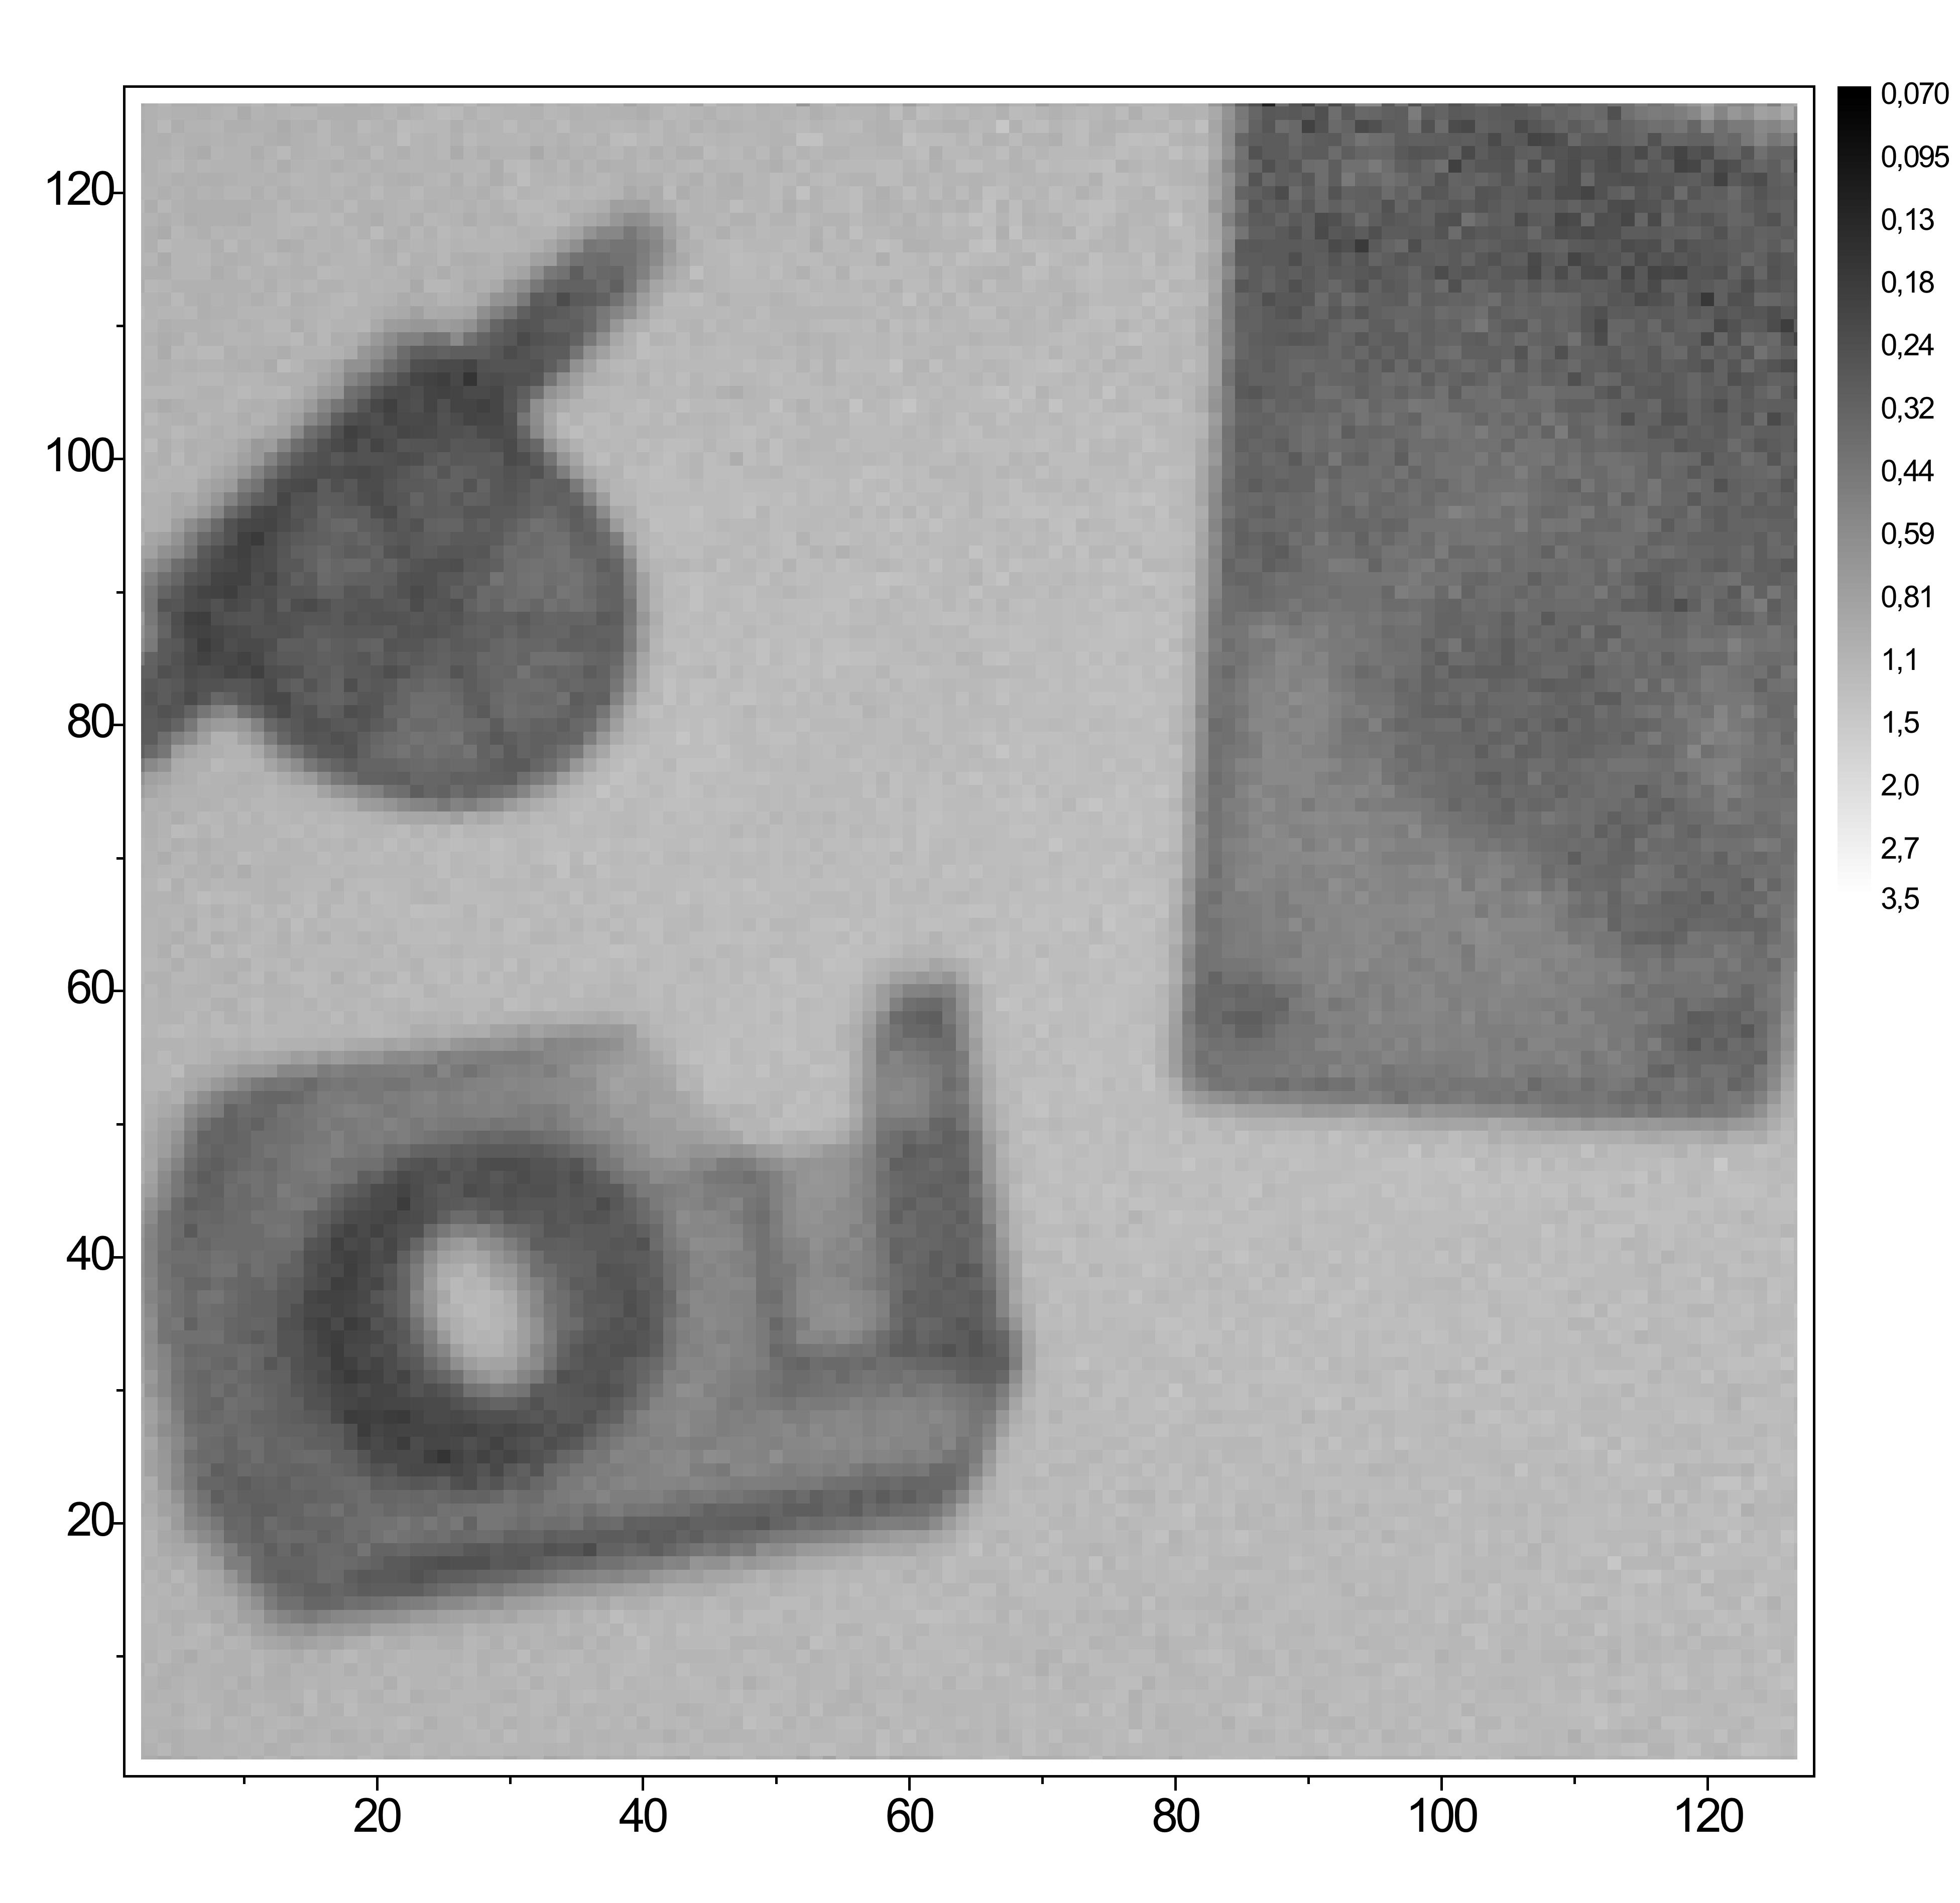
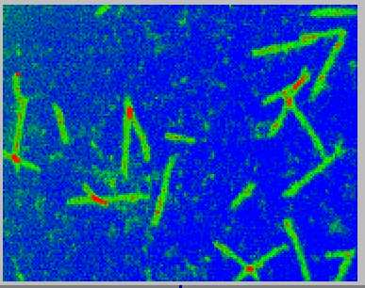
Detection of Neutrons
Ionization Chamber with
Otical GEM Readout
Thermal Neutrons Radiography
¹⁰B Coated GEM
F.A.F. Fraga et al,
Nucl. Instr. and Meth. A478 (2002) 357
M. Klein and Ch. Schmidt
Nucl. Instr. and Meth. A628 (2011) 9

Slide 19
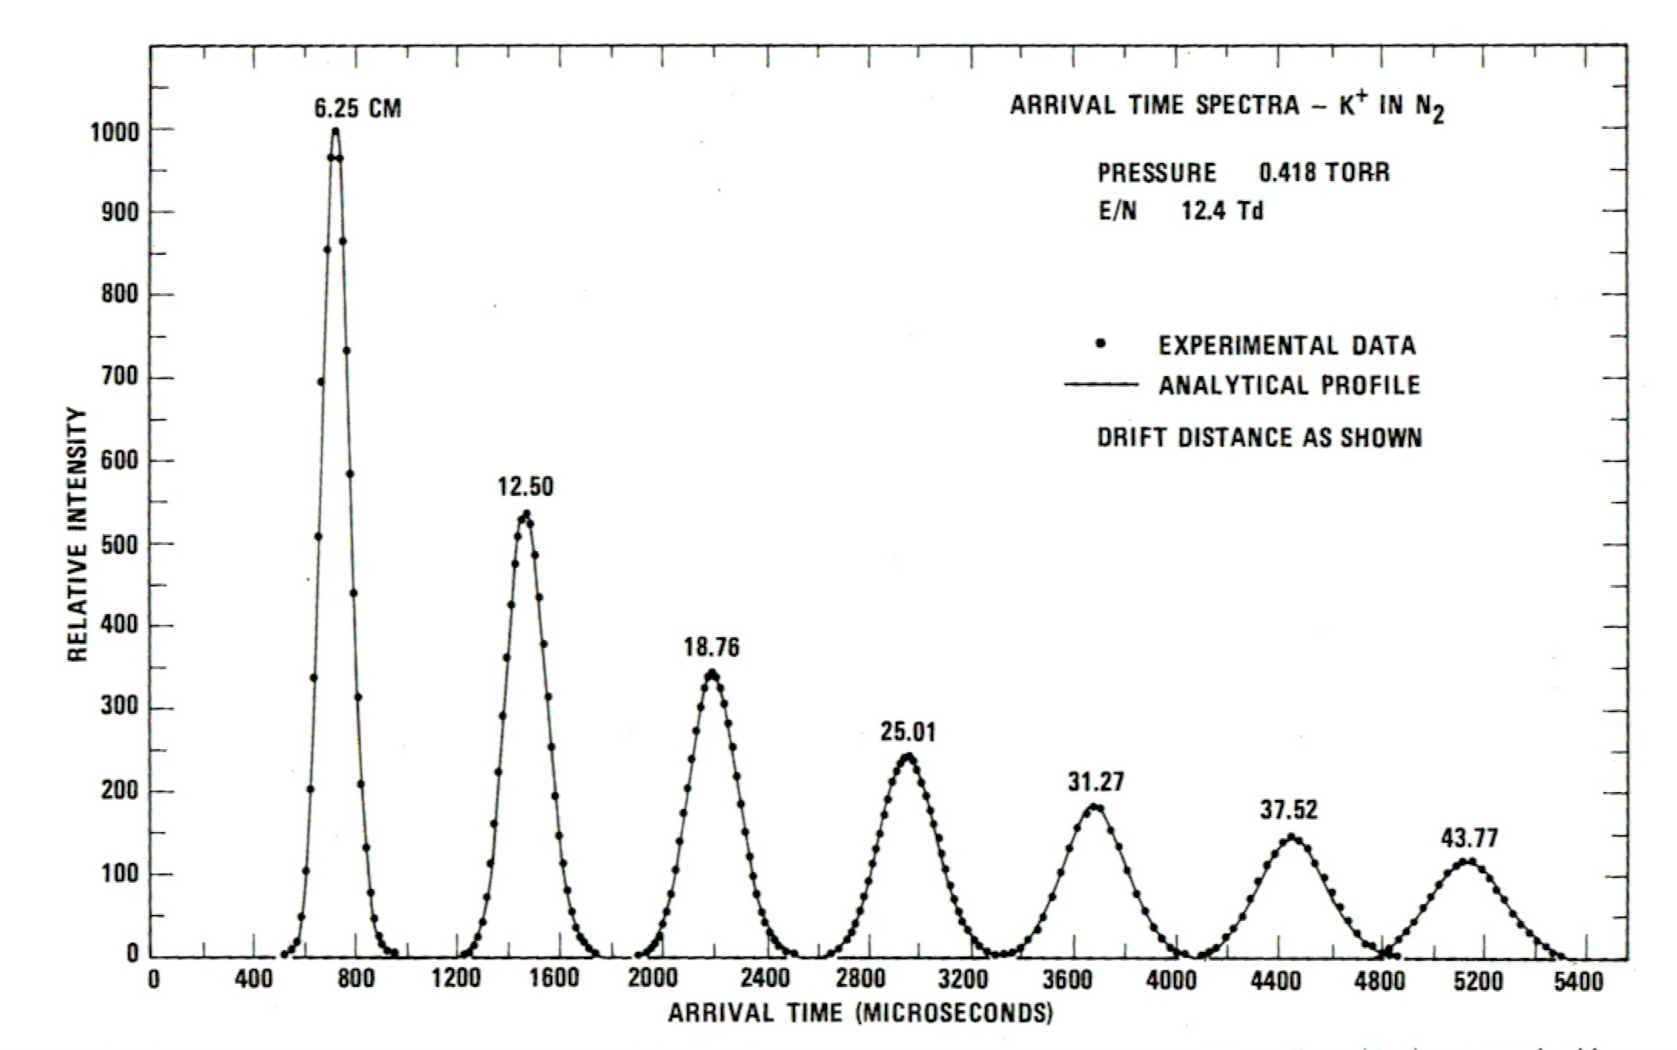
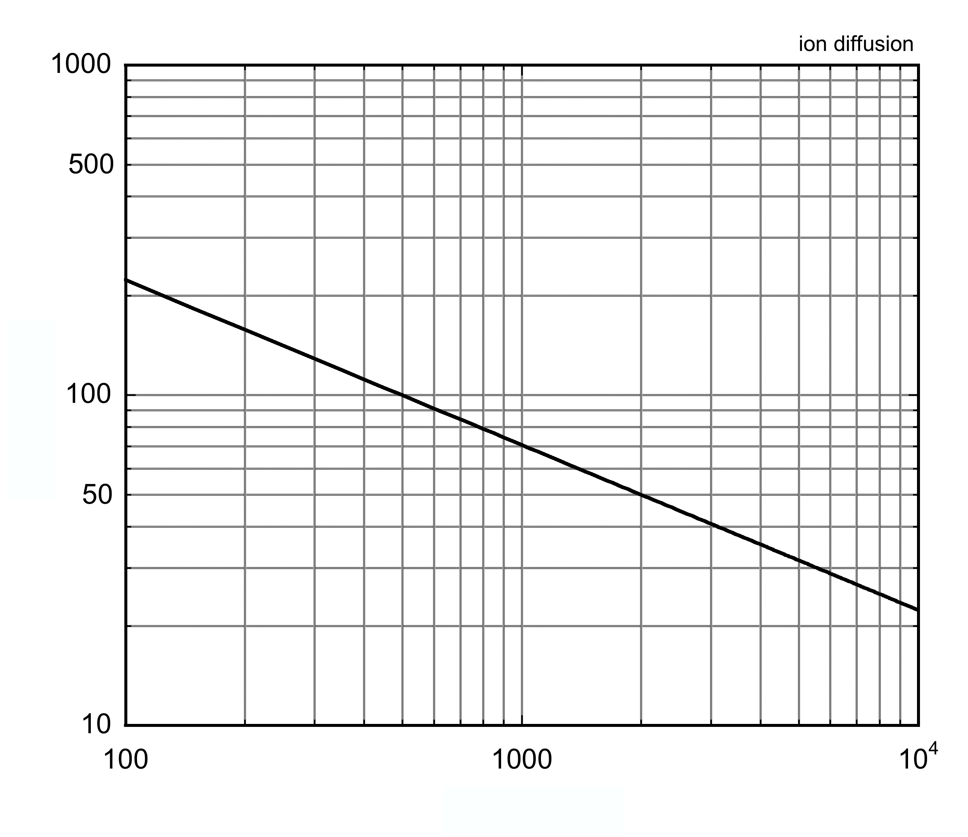
Drift and Diffusion of Ions
Diffusion:
Independent from Ion Type
s
Drift Velocity:
W=
__
t
W
Mobility:
μ =
__
µ⁺ ≈ µ⁻
E (V/cm)
E
@ 1 kV/cm σ_{x} = 70 µm/√cm

Slide 20
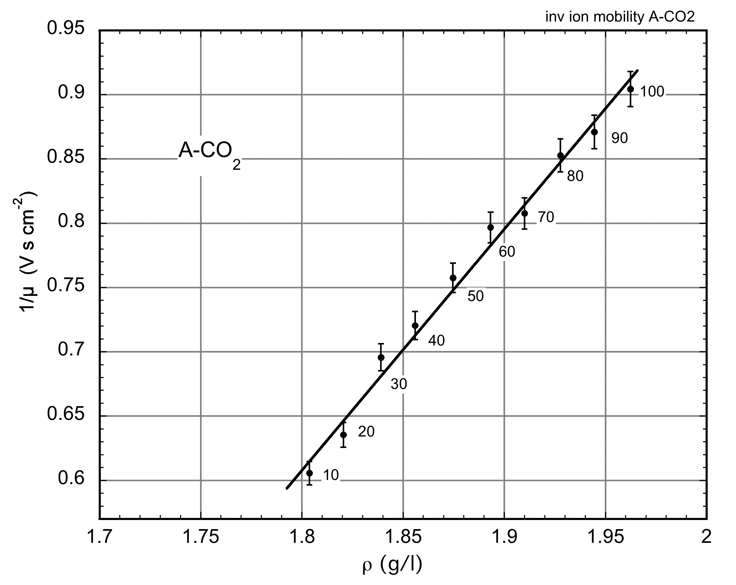
Drift and Diffusion of Ions
CO₂⁺ Ions Mobility Ar-CO₂ Mixtures:
GAS | ION | µ (cm² V⁻¹ s⁻¹)
He | He⁺ | 13.0
Ar | Ar⁺ | 1.7
CH₄ | CH₄⁺ | 2.22
Ar | CH₄⁺ | 1.87
Ar | CO₂⁺ | 1.72
Ar-CO₂
% CO₂
Collisional Charge Transfer:
If E_{i}(B) < E_{i}(A) :
A⁺ + B --> A + B⁺
Blanc’s Law:
Ar-CO₂ 80-20. µ = 0.64 cm² V⁻¹ s⁻¹
@ E=200 V cm⁻¹ W ~ 130 cm s⁻¹
Ions Backflow and Space Charge

Slide 21
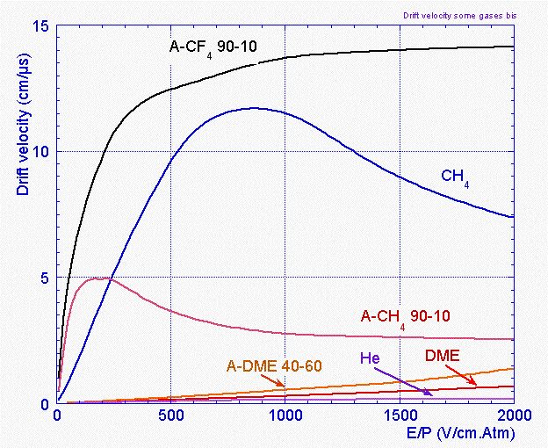
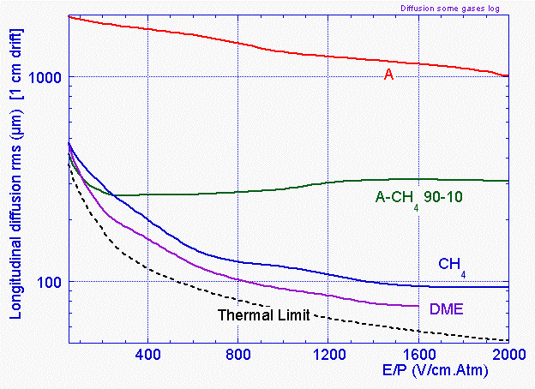
Drift and Diffusion of Electrons
Drift Velocity w⁻ = s/t
Diffusion
ε_{κ}: Characteristic Energy
ε_{κ} = kT : Thermal Limit
Rob Veenhof and Piet Verwilligen: MODELLING AND SIMULATIONS

Slide 22
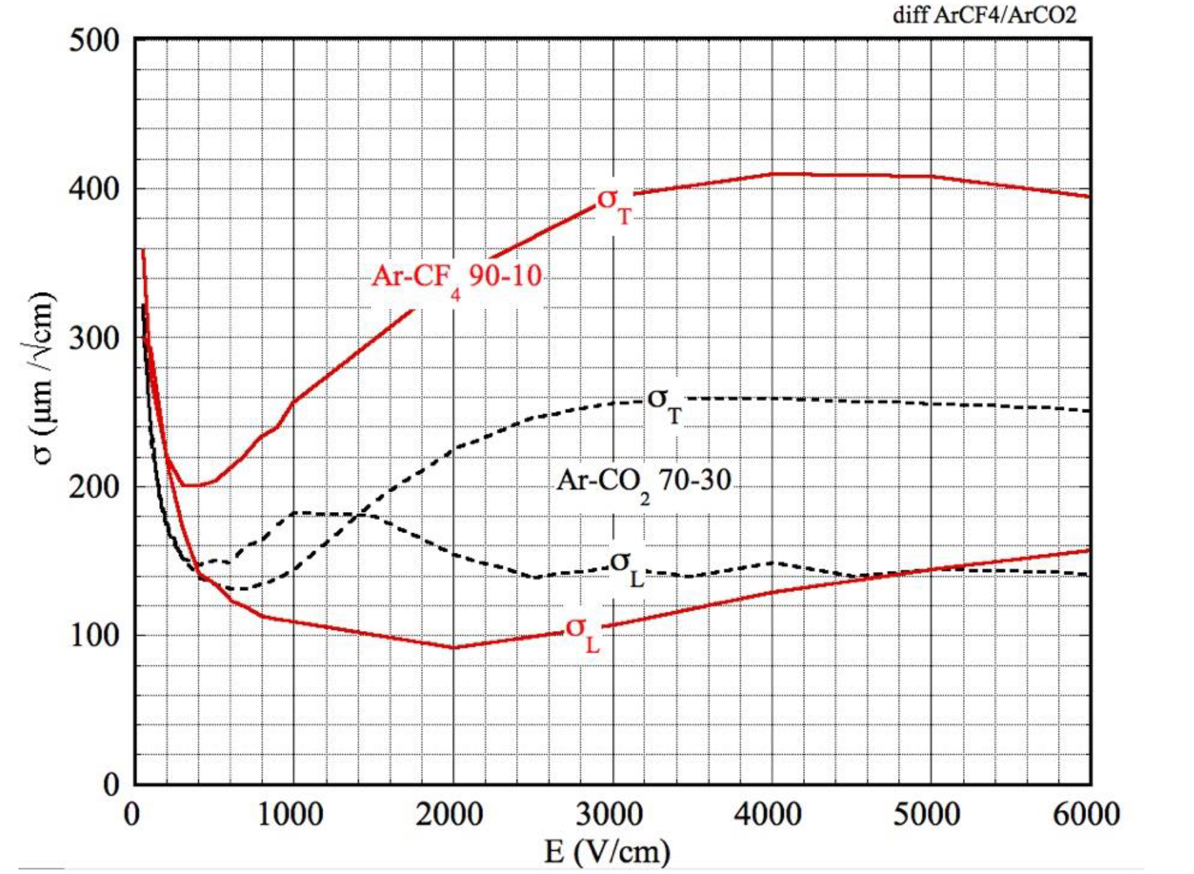
Drift and Diffusion of Electrons
Longitudinal and Transverse Diffusion
Low Electric Field
σ
High Electric Field
σ_{Τ}
σ_{L}
Better Longitudinal
(Drif) Accuracy
F. Sauli, Gaseous Detectors Handbook (CERN 2022)
http://fabio.home.cern.ch/fabio/

Slide 23
Drift of Electrons in Magnetic Field
Lorentz Force:
Changes Drift Velocity, Direction and Diffusion
Particular Cases:
⊥
Larmor frequency
τ : Average time between electron-molecule collisions
σ
T
Time Projection Chambers:
Better Transverse (X-Y)
Position Resolution
//
σ
L
w
B
r
B

Slide 24
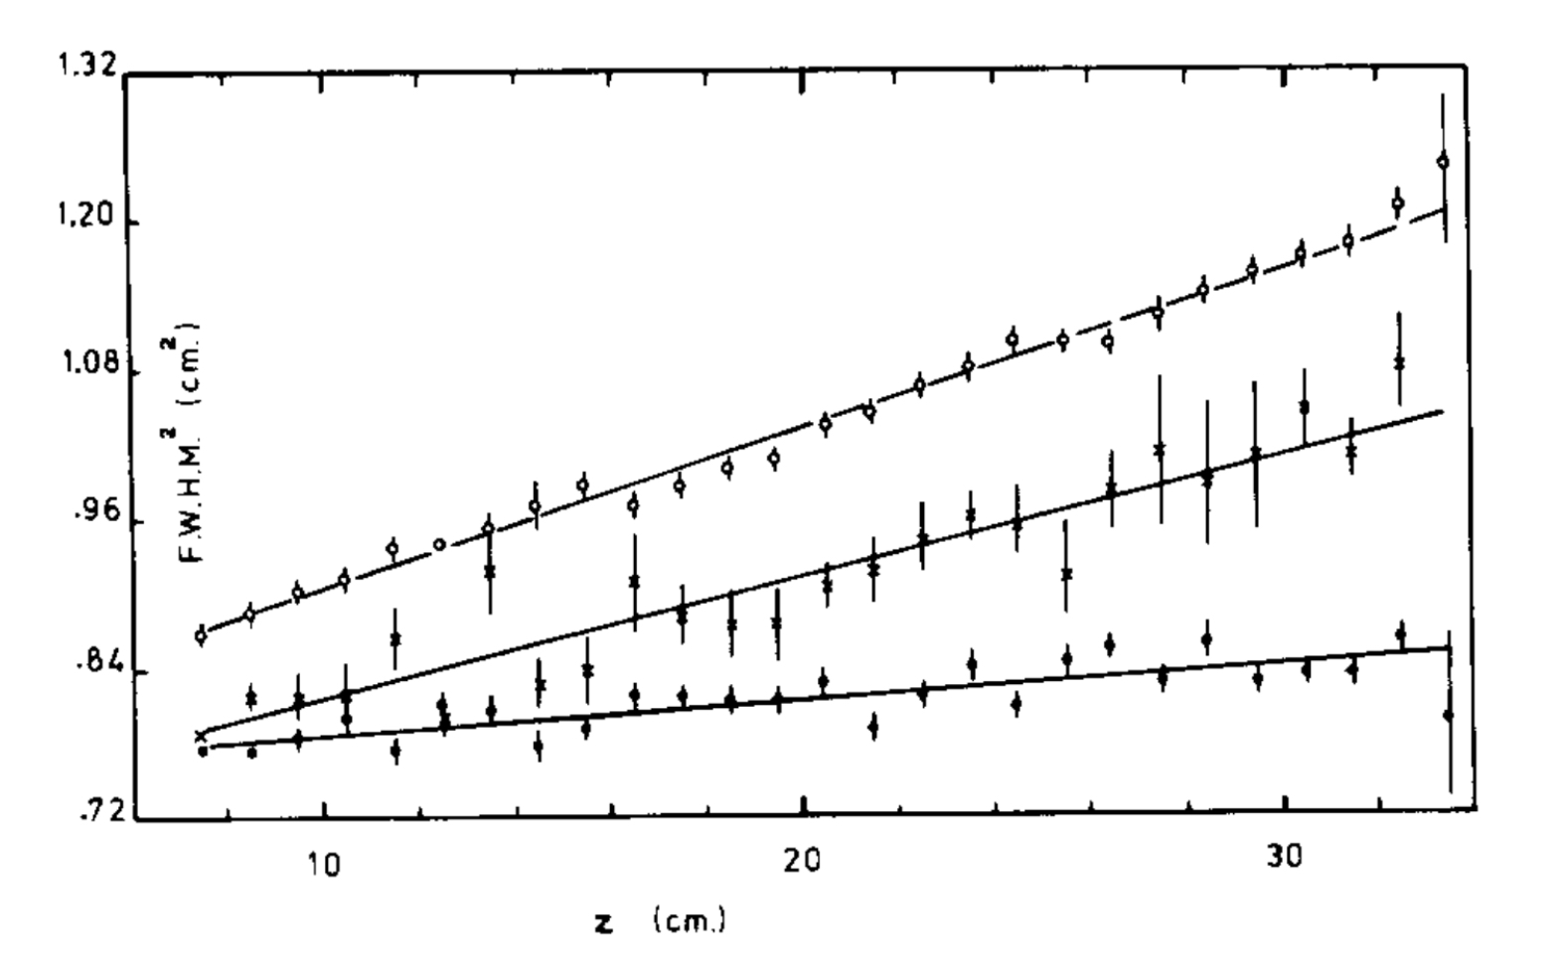
Drift of Electrons in Magnetic Field: E // B
Time Projection Chambers:
Longitudinal Position Accuracy vs Drift Length
Magnetic Field Dependence:
Ar-CH₄ (80-20)
E_{D} 250 V/cm
E
B
B=0
B=2.3 kG
z
FWHM² (cm²)
e⁻
B=8.5 kG
Drift Distance z (cm)
x, y
C. Hargrove et al, Nucl. Instr. Meth. 219(1984)481
Depends from Gas and Fields

Slide 25
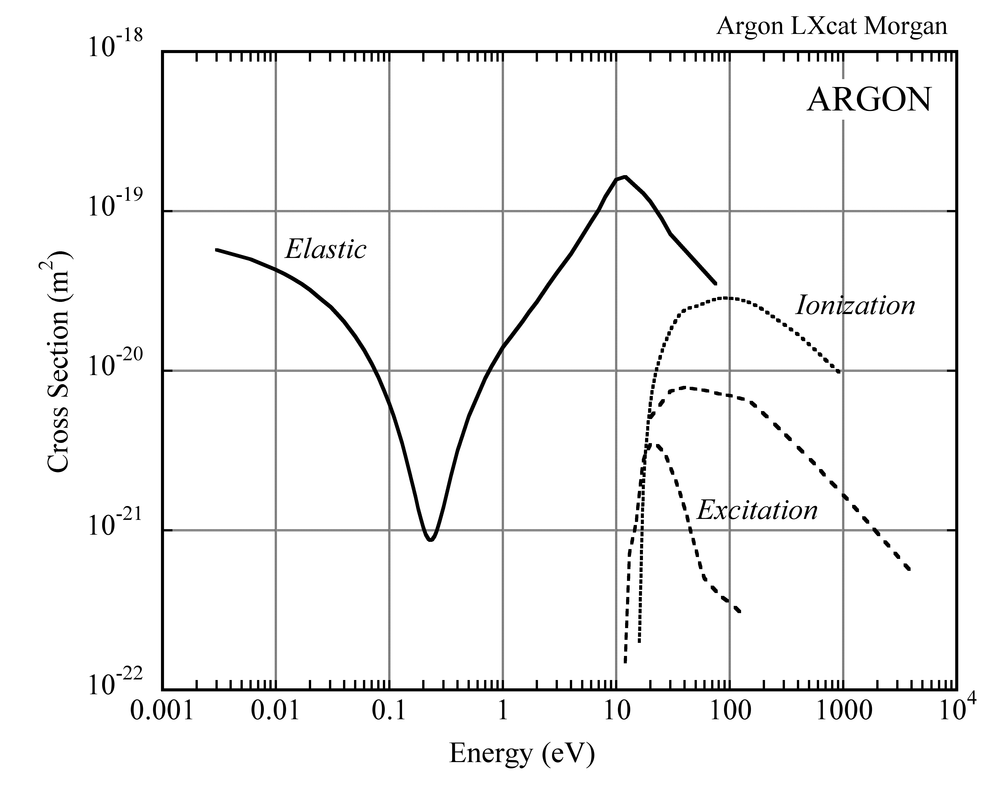
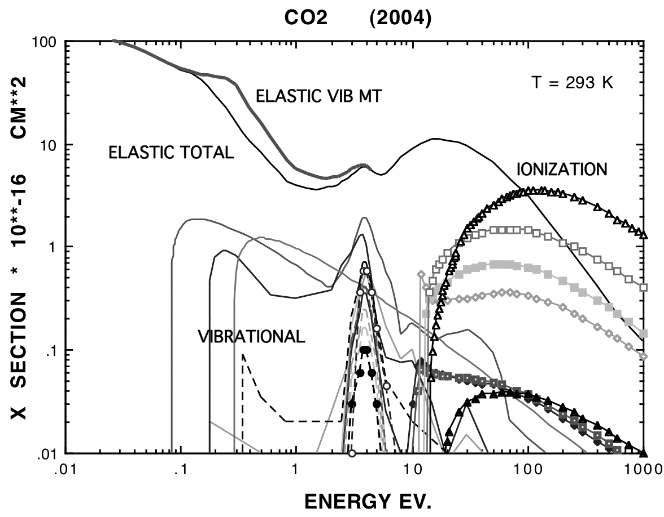
Electron-Molecule Collisions
Eletron-Molecule Cross Section at Increasing Electric Fields:
Thermal
0.025 eV @ 20 ⁰C
https://nl.lxcat.net/home/

Slide 26
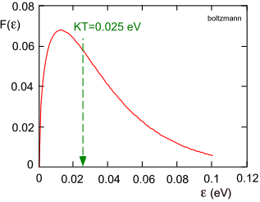
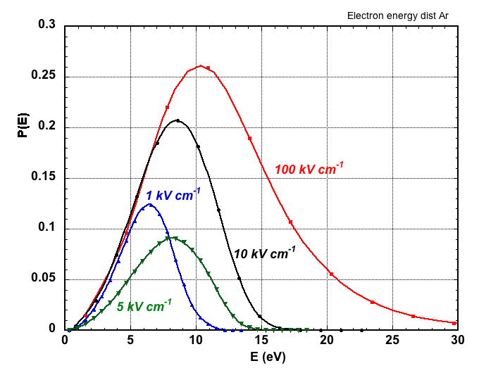
Electrons Energy Distribution
Room Temperature E=0
Electrons in Any Gas:
High Electric Fields: Pure Argon
E_{x}=10.6 eV
E_{i}=15.7 eV
Ar NTP
 | E_{X} (eV) | E_{I} (eV)
ARGON | 11.6 | 15.8
CO₂ | 5.2 | 13.7

Slide 27
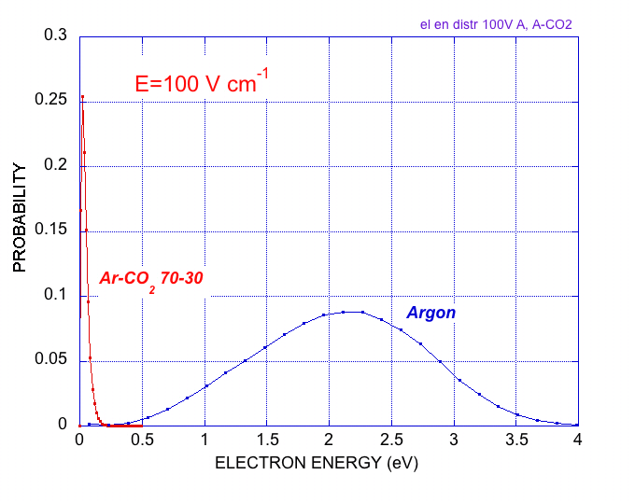
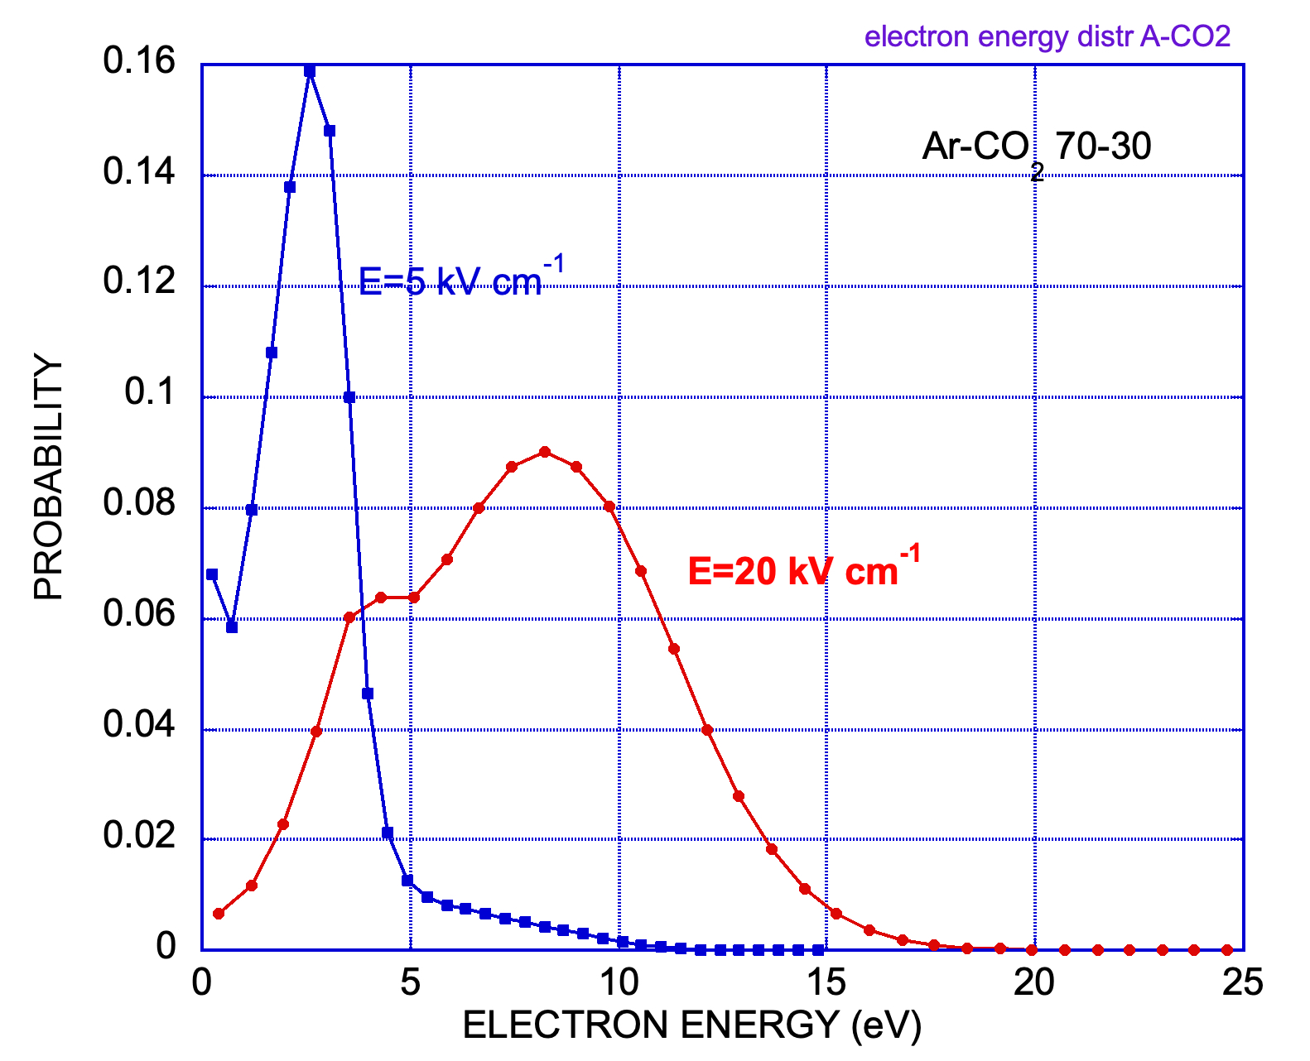
Electrons Energy Distribution
“Cooling” Effect of Molecular Gas Additions
Ar and Ar-CO₂
Argon-CO₂ (70-30)
100 V/cm

Slide 28
Inelastic Electron-Molecule Collisions
Major Outcomes of the Electron-Molecule Colllisions
e +A e+A* Excitation
e +A e+e+A^{+.} Ionization
A* A+ γ Radiative Deexcitation
e +A⁺ A+ γ Radiative recombination
A⁺+B AB+ γ. Radiative recombination
e +M M⁻ + γ Radiative capture
A*+A A*₂ A+A+γ Dimers formation
e +AB AB⁻ A + B⁻ Dissociative capture
e + A+B A⁻+B Three body collision
A*+B A+B*+e Penning effect (if E_{i}(B) < E_{x}(A))
………..
………..
➙
➙
Charge Multiplication
➙
➙
➙
Fluorescence
➙
➙
➙
➙
➙
➙
➙
Improved Energy Loss Resolution

Slide 29
Fluorescence ad Scintillation
Noble Gases and Low Ionization Potential Vapors:
Vacuum UV Near UV Visible

Slide 30
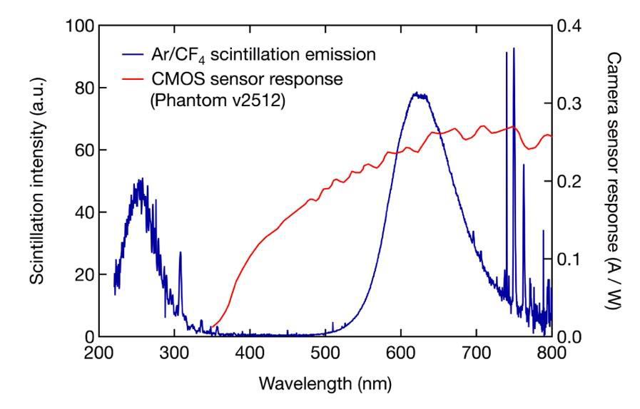
Fluorescence ad Scintillation
CF4 Scintillation:
Decay of Excited
Molecular States:
(CF₃⁺)*
and
(CF₄⁺)*
F. Brunbauer, CERN GDD (2020)

Slide 31
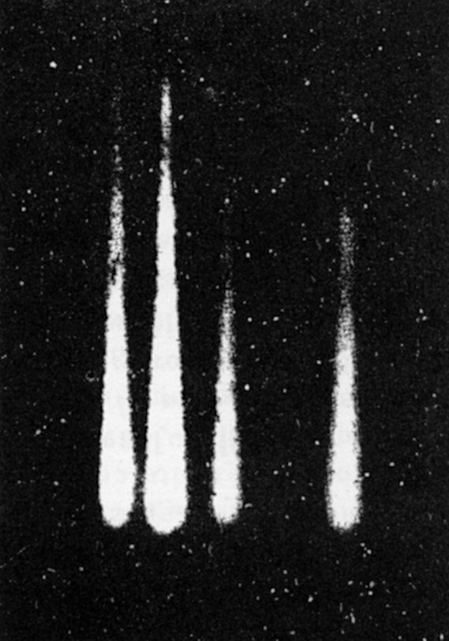
High Fields : Charge Multiplication
Cloud chamber Images of Avalanches:
λ
E
x
Ions
Electrons
α = α(E): Townsend coefficient
Charge Gain
H. Raether
Electron Avalanches and Breakdown in Gases (Butterworth 1964)

Slide 32
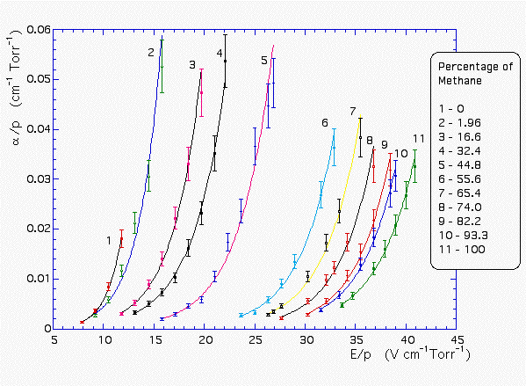
Charge Multiplication
Townsend Coefficient α in Ar-Methane Mixtures
Ar-CH₄
in Argon
A. Sharma and F. Sauli, Nucl. Instr. and Meth. A334(1993)420

Slide 33
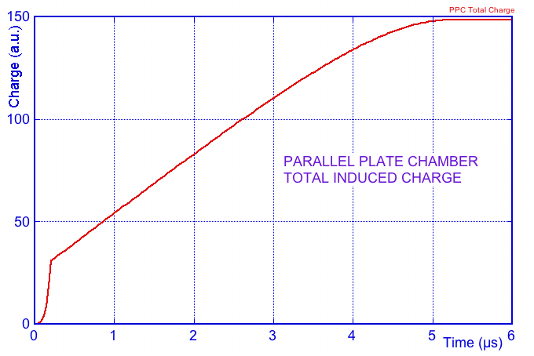
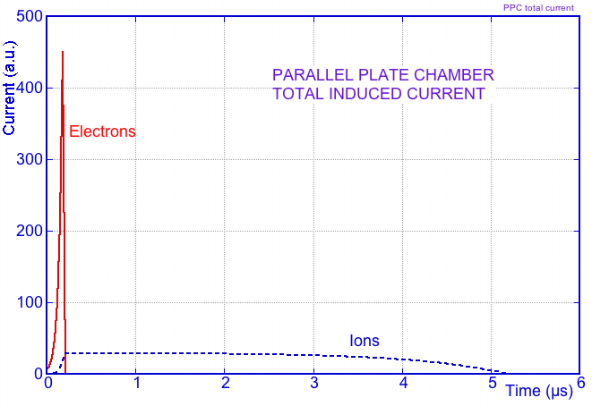
Charge Multiplication
-V₀
Parallel Plate Counter
s₀
0
Induced Charge on Anode:
Induced Current on Anode:
On Cathode:
Q_{C}(t)= - Q_{A}(t)
I_{C}(t)= - I_{A}(t)

Slide 34
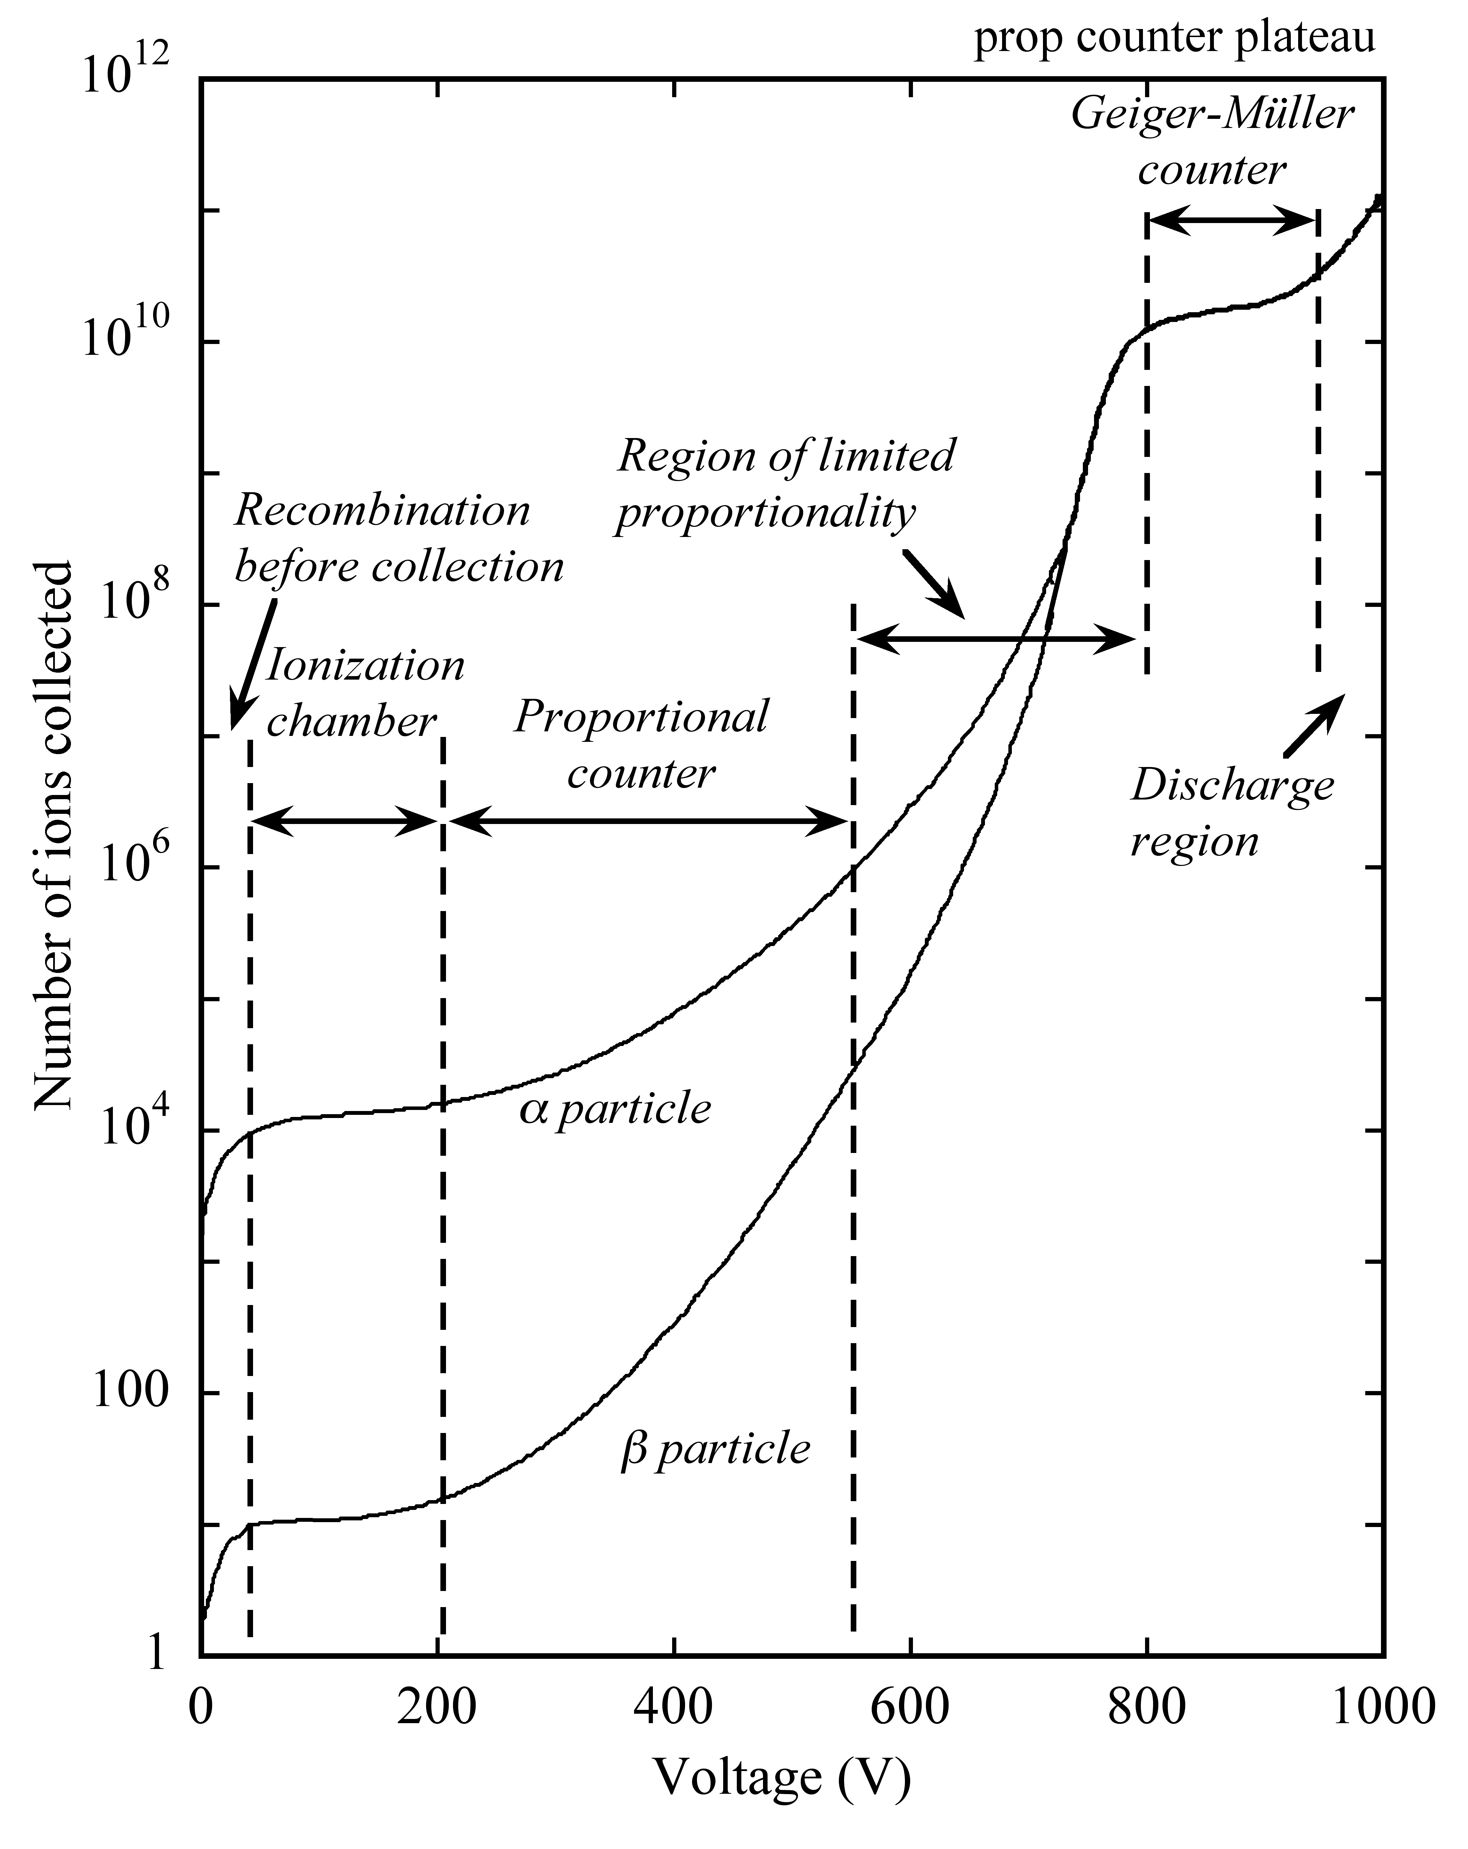
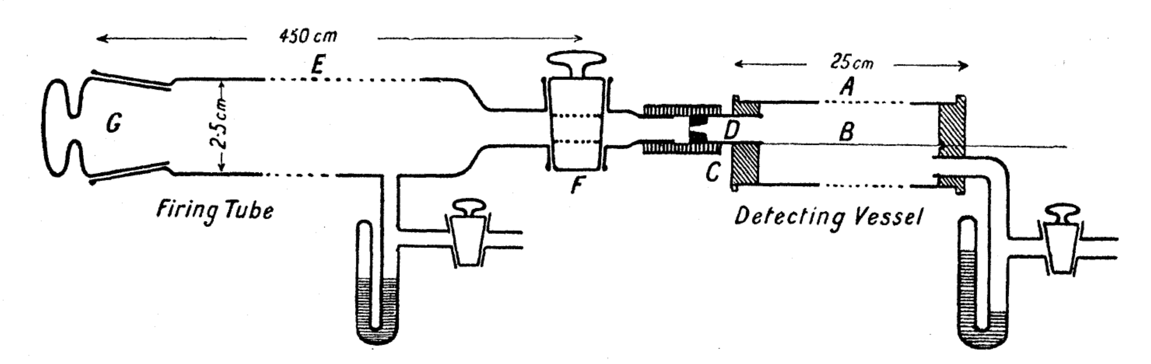
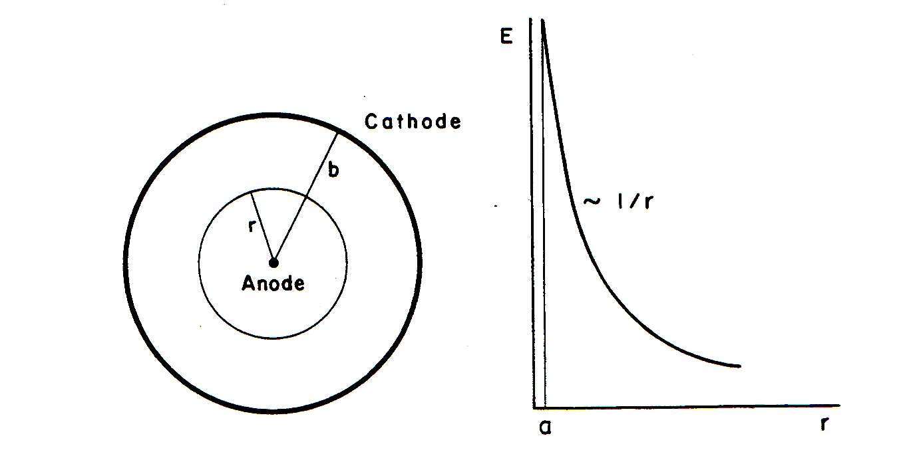
PROPORTIONAL COUNTER
Single Wire Counter
Rutherford and Geiger (1908)
Radial Electric Field
Critical Field
Multiplication
Drift

Slide 35
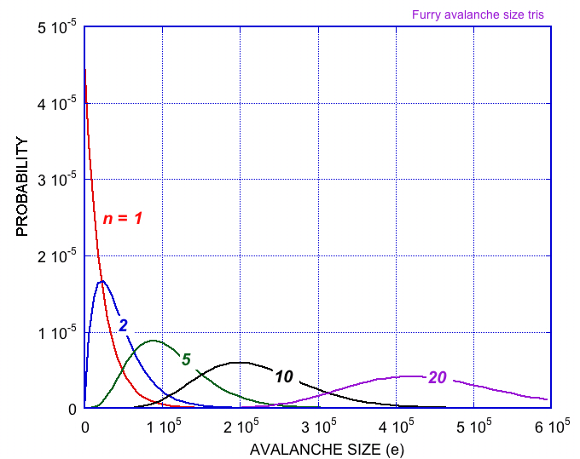
Charge Multiplication
Avalanche Size Probablility
for 1 Primary Electron
(Furry Law):
Avalanche Size Probablility
for n Primary Electrons:

Slide 36


Charge Multiplication
Avalanche Size Probability at
High Fields (High Gains)
Polya function:
Single Electron Avalanche Size
at Increasing Gains (Experimental):
H. Sclumbohm, Zeit. Physik 151(1958)563

Slide 37



GASEOUS COUNTERS: MWPCs TO MPGDs
MWPC
MICROMEGAS
GEM
+
MiroGroove, MicroGap,MicroPixel
Resistive Plate Well ………..

Slide 38


MICROMEGAS
Proportional Gain
Localization Accuracy for MIPs
J. Bortfieldt et al, Nucl. Instr. Meth. 718A(2013)406

Slide 39



GEM
GAIN > 10³
RATE CAPABILITY > 10⁶ mm⁻² s⁻¹
⁵⁵Fe X-rays
J. Benlloch et al,
Nucl. Instr. Meth. 419A(1998)410

Slide 40


MULTIGEM
TRIPLE-GEM
CASCADED GEM ELECTRODES
GAIN AND DISCHARGE PROBABILITY ON 5 MeV α
LOWER VOLTAGE ON EACH GEM
HIGHER SAFE TOTAL GAIN
DISCHARGE
C. Büttner et al, Nucl. Instr. and Meth. A409(1998)79

Slide 41
Very High Fields:
Transition Avalanche ➞ Streamer ➞ Discharge
The field is Increased in Front and Behind the Avalanche
Photons are Emitted and Reconverted in the High Field:
Tansition to Forward-Backward
Streamer:
Secondary Avalanches Formation:
DISCHARGE !
Raether Limit: ~ 10⁷ electrons-ions

Slide 42

Discharge
Destructive Effects of Discharges:
Drift Chamber (1974)
MSGC (1994)
Discharge Prevention and Mitigation in MPGDs:
Piotr Gasik: GAS DETECTORS PHYSICS 2

Slide 43



To Know More on Gaseous Detectors:
F. Sauli and E. Oliveri: Gas Detectors Handbook
http://fabio.home.cern.ch/fabio/handbook.html
…. and the other lectures at this School!

