Slide 1
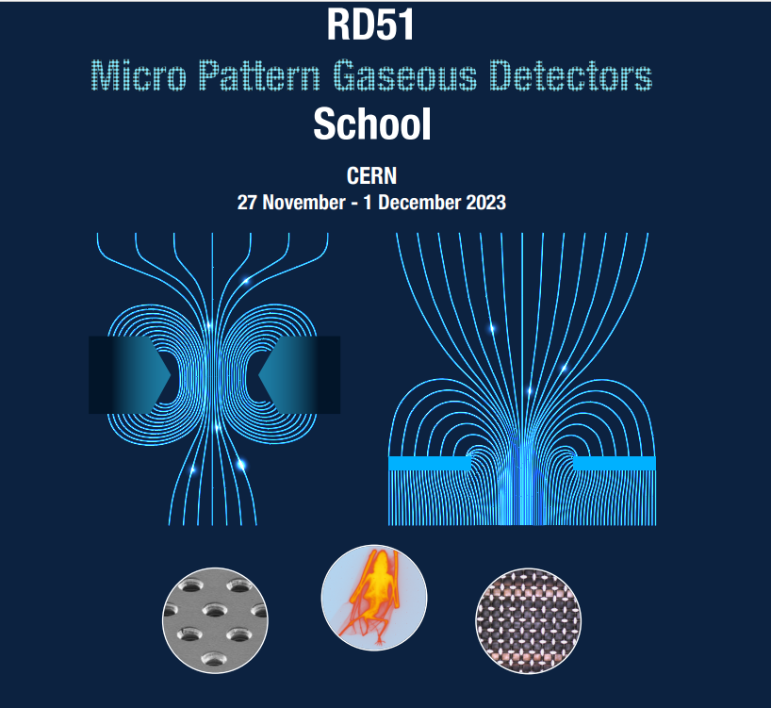
MPGD technologies 1
Micro Pattern Gaseous Detectors 1
Esther Ferrer Ribas
IRFU/CEA

Slide 2
MPGD technologies 1
Outline
Birth of Micro Pattern Gaseous Detectors (MPGD)
Gas Electron Multipliers
Micromegas
Micro Resistive Well
Applications

Slide 3
Birth of Micro Pattern Gaseous Detectors
In the 90’s advances in microelectronics and photolithographic technology on flexible and standard PCB substrates favored the invention
Pitch size of a few hundred microns, an order of magnitude improvement in granularity over wire chambers
First Micro Pattern Gaseous Detector (MPGD): Micro-strip Gas Counter (MSGC) Oed, 1988

Slide 4
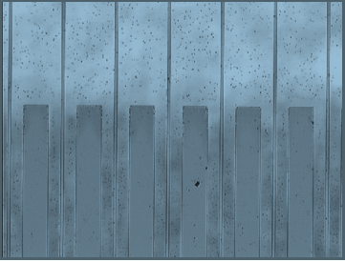
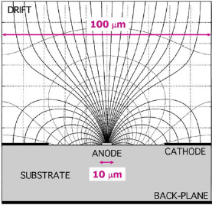
MSGC
Performance
Intrinsic high-rate capability (>10⁶ Hz/mm²),
excellent spatial resolution (down to 30 μm),
multiparticle resolution (∼500 μm),
single photo-electron time resolution in the ns-range,
large sensitive area and dynamic range.
Limitations:
Destructive sparks,
time-dependent gain shifts (substrate polarization and charging up),
deterioration during sustained irradiation (“aging”),
Credit: Sauli « Gaseous Radiation Detectors »

Slide 5

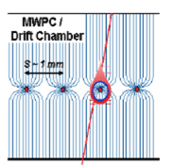
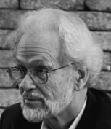
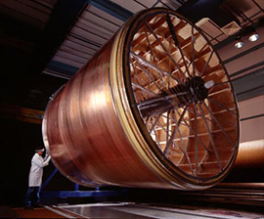
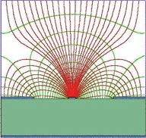
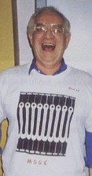
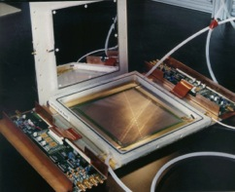

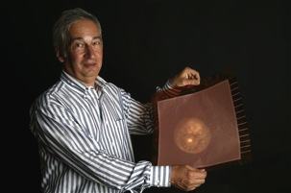
Birth of MPGD
MWPC
Multi-Wire Proportional Chamber
G. Charpak et al., 1968
TPC
Time Projection Chamber
D. R. Nygren et al., 1974
MPGD
MSGC
Micro-Strip Gas Chamber
A. Oed, 1988
CATHODE
ANODE
CATHODE
200 µm
GEM
Gas Electron Multiplier
F. Sauli, 1997
MICROMEGAS
MICRO-MEsh GAseous Structure
I. Giomataris et al., 1996

Slide 6
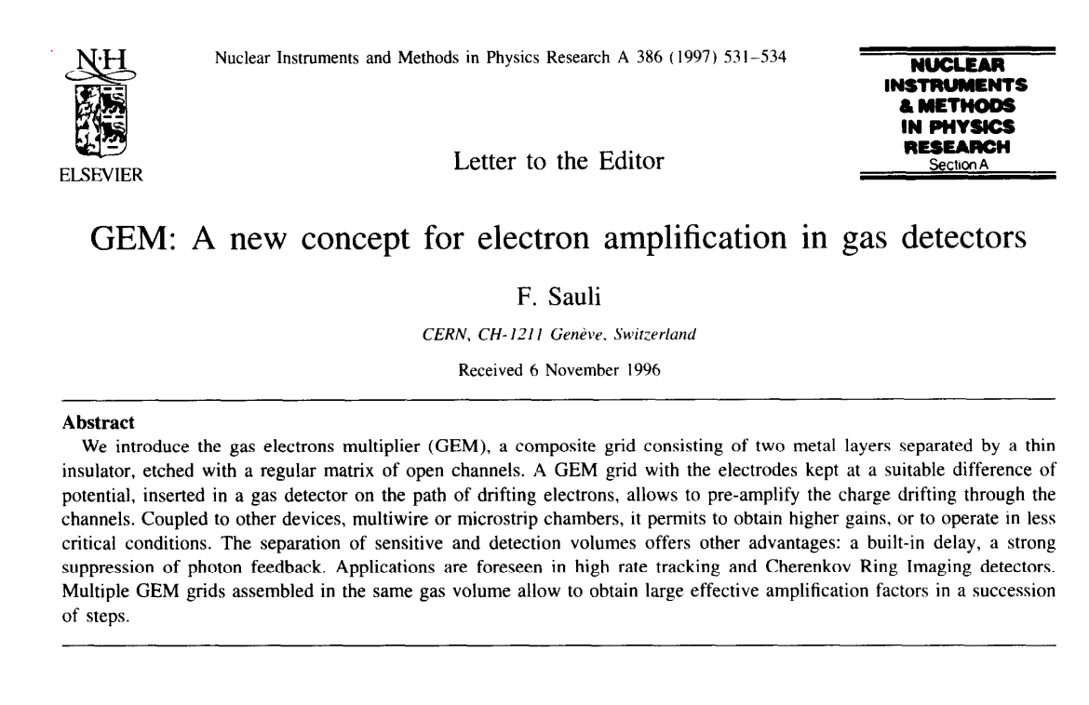
Gas Electron Multiplier (GEM)

Slide 7
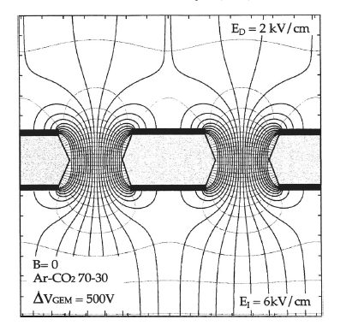
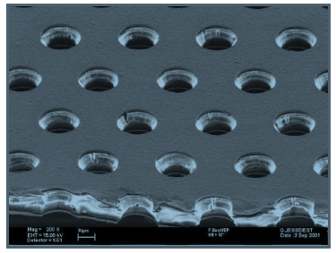
GEM
A thin, metal-clad polymer foil chemically perforated by a high density of holes, typically 100/mm²
Large ΔV between the two sides of the foil creates a high field
Electrons released in the upper region, drift towards the holes acquiring enough energy to provoke ionisations
Large fraction of electrons are transferred into the lower section

Slide 8
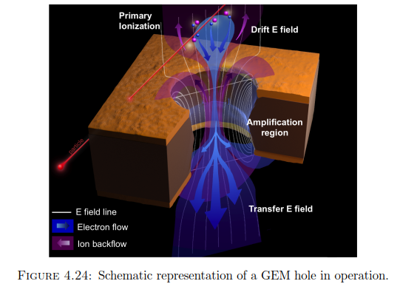
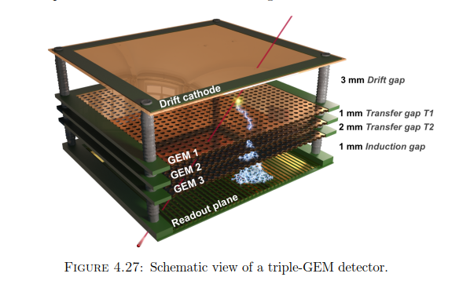
GEM
Full decoupling of amplification stage (GEM) and readout stage (PCB, anode)
Amplification and readout structures can be optimized independently
“Study of long-term sustained operation of gaseous detectors for the high rate environment in CMS”, Jérémie Merlin,
CERN PHD theses, https://cds.cern.ch/record/2155685/files/CERN-THESIS-2016-041.pdf

Slide 9
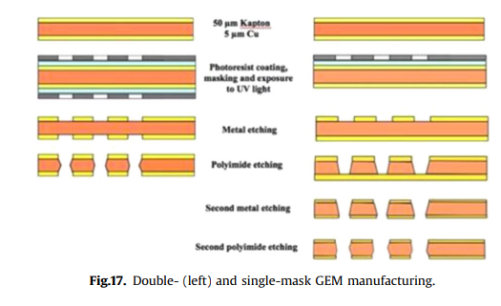
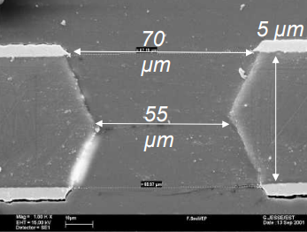
Manufacturing of GEM
Details tomorrow « Manufacturing techniques » by Rui de Oliveira

Slide 10
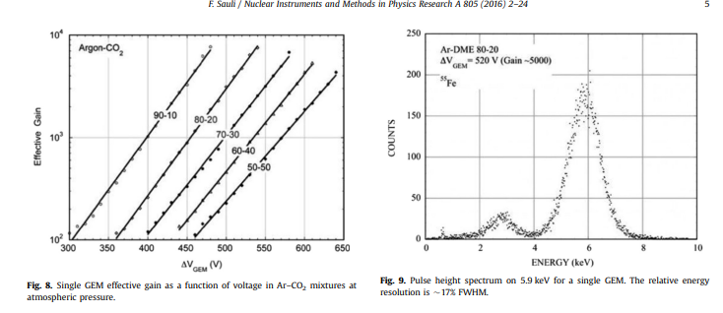
Performance in single GEM

Slide 11
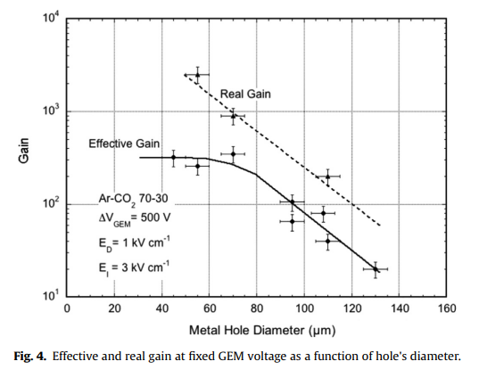
Influence of the holes geometry
Optimum hole diameter ~ foil thickness
Narrower holes larger fields for a fixed V but losses on the wall compensante for the higher gain
Effective gain= Detected electrons/Primary electrons
F. Sauli, NIM A 805 (2016) 2-24
Notes:
Doble conical shape higher gains but slow gain increase at the start of operation
Cylindrical more stable operation but more prone to discharges at high gains

Slide 12
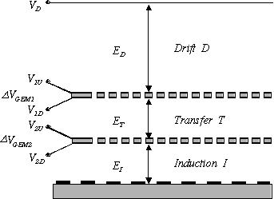
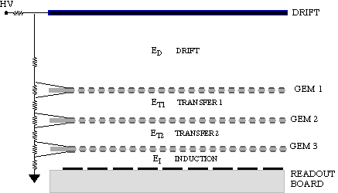
Multi-GEM
Cascade of GEM electrodes
Allows attaining higher gain with each GEM at lower voltage
Discharges disfavoured
S. Bachmann et al,
Nucl. Instr. and Meth. A479(2002)294
Notes:
Use of three GEM electrodes adn an anode separated by 2mm gaps.
A scheme to distributed the apropriated voltage to all electrodes
The detector gain is characterised with an Fe source.
The maximum safe operating voltage is found and then with an alpha source Radon
Amount of moisture in the gas should be kept below 50 ppm

Slide 13
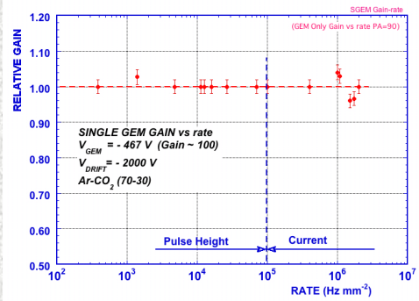
GEM Rate capability
5.9 keV X-rays:
> 2.10⁶ mm⁻²
J. Benlloch et al, IEEE NS-45(1998)234

Slide 14
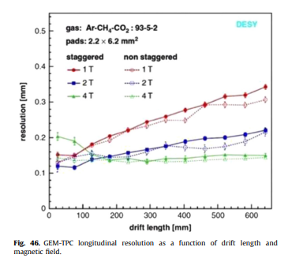
GEM spatial resolution
F. Sauli, NIM A 805 (2016) 2-24
Notes:
Staggered: pads in every second row are shifted by half pitch

Slide 15
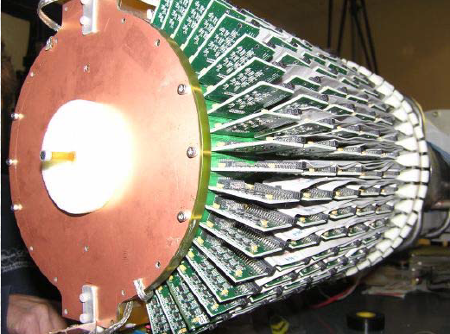
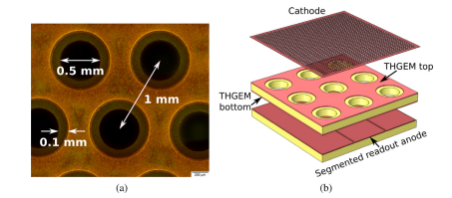
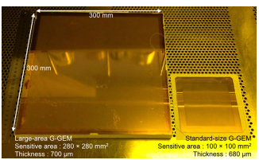
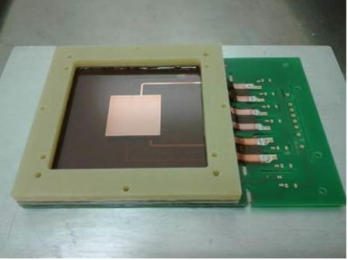
GEM family
Cylindrical GEM
THICKGEM/LEM
S. Bressler et al. , Progress Particle and Nuclear Physics 130 (2023) 104029
GEMPix: a triple GEM structure read by 50 micron pixels
GLASSGEM
F. Murtas, JINST (2014) 9 C01058
Y. Mitsuya et al., NIM A 795 (2015) 156-159
Notes:
Depending on the insulator substrate kapton, pcb, or glass. You can hace standard gem, thick gem also called Large electron multiplier.
You can curve them an obtained a cylindrical GEM or if you coupled GEM electodes to a Medipix chip o Timepix you will have a GEMPIX which is an extremely pixelated structure

Slide 16
GEM Properties
High Rate Capability ➔ MHz/mm² (MIP - Minimum Ionizing Particles, 2MeV cm² /g)
High Gain ➔Up to 10⁵ -10⁶
High Space Resolution➔ <100 μm
Good Time Resolution ➔In general few ns , sub-ns in specific configuration
Good Energy Resolution➔10-20% FWHM @ soft X-Ray (6 KeV)
Excellent Radiation Hardness
Good Ageing Properties
Ion Backflow Reduction ➔ ~% level, below % in particular configurations
Large size
Low material budget
Low cost

Slide 17
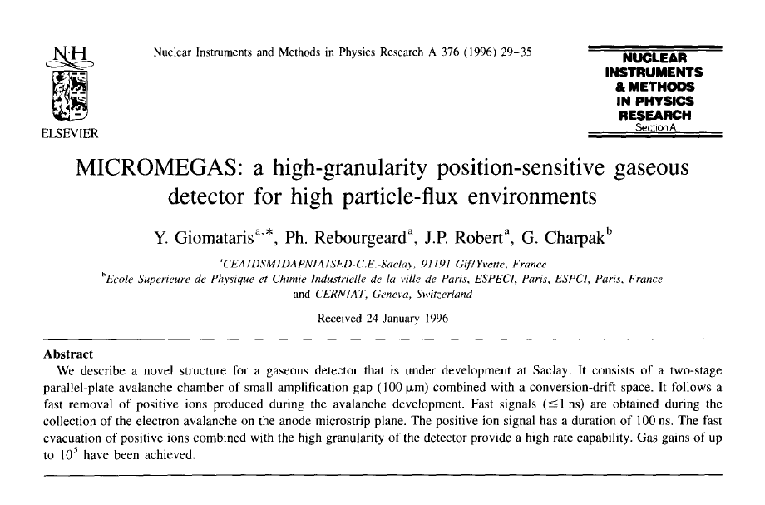
Micromegas

Slide 18
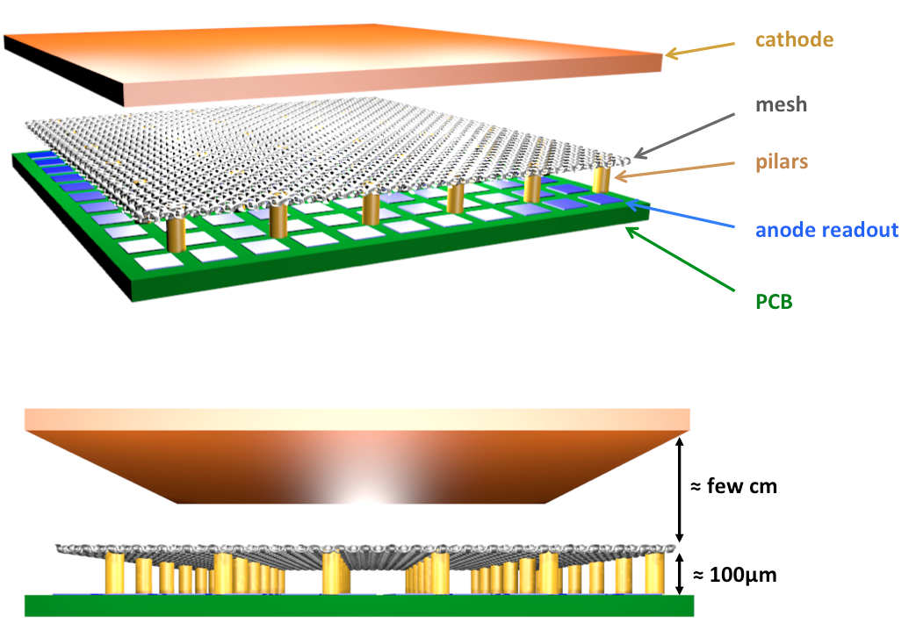
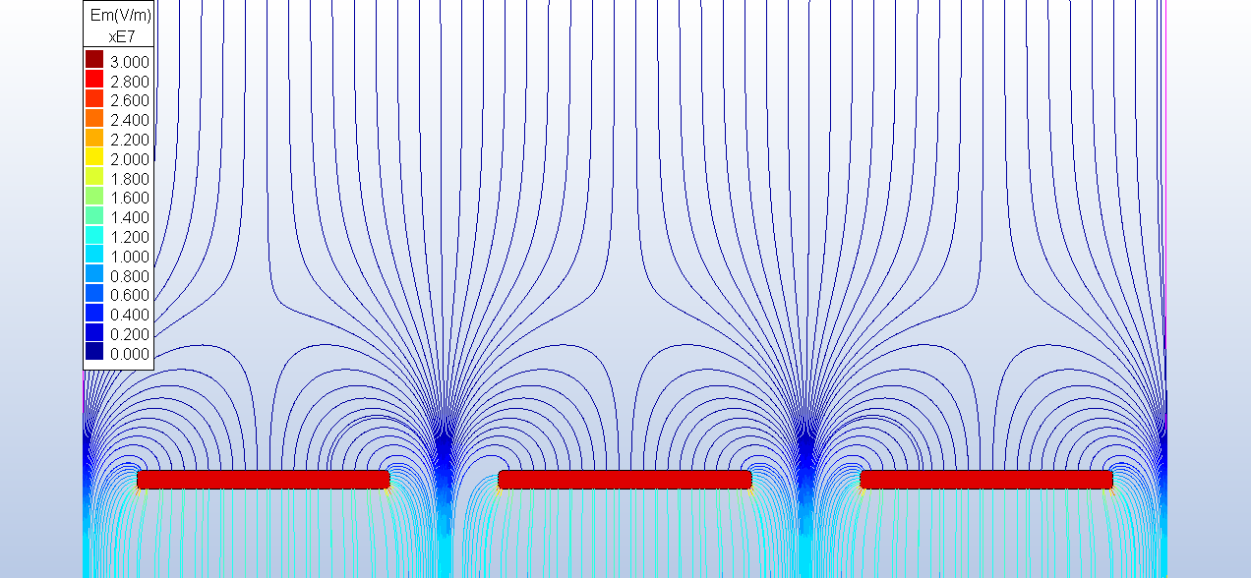
Micromegas

Slide 19
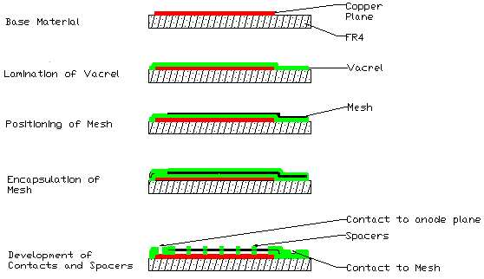
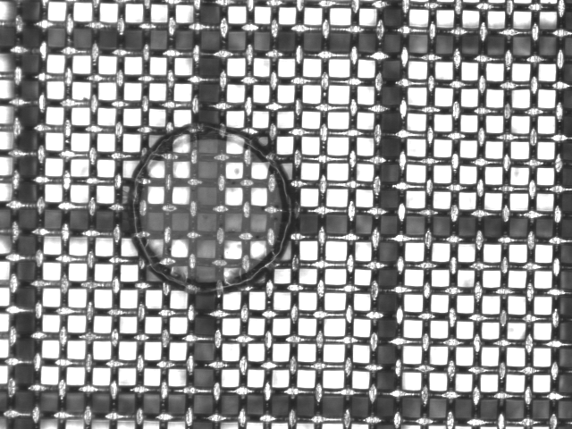
Manufacturing of Micromegas
I. Giomataris et al., NIM. A 560 (2006) 405-40

Slide 20
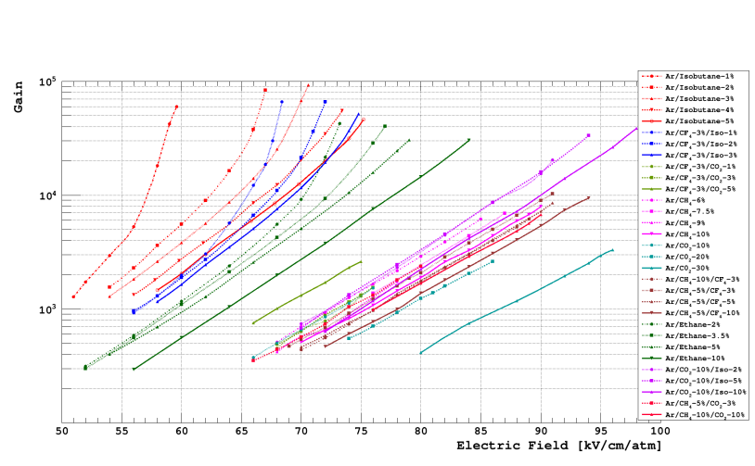
Micromegas Gain
David Attié, “Gaseous tracking detectors for academic and societal applications”, Habilitation à diriger des recherches, Octobre 2022

Slide 21
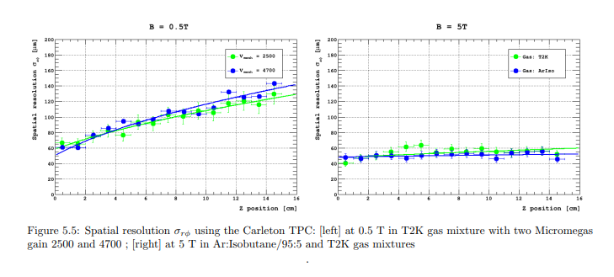
Micromegas spatial resolution
David Attié, “Gaseous tracking detectors for academic and societal applications”, Habilitation à diriger des recherches, Octobre 2022

Slide 22
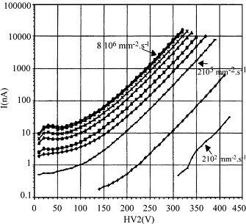
Micromegas rate capability
Current increases with the flux
All curves parallel
Gain independent of the rate
No saturation is observed
G. Puill et al., IEEE Trans Nuclear Science, 46 (1999) 6

Slide 23
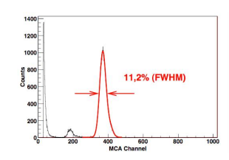
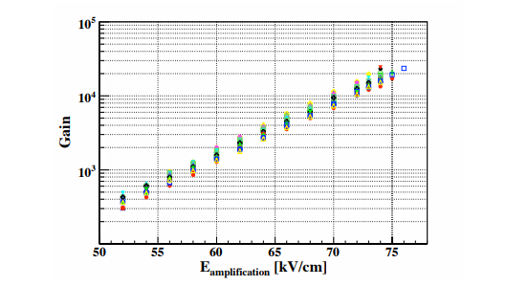
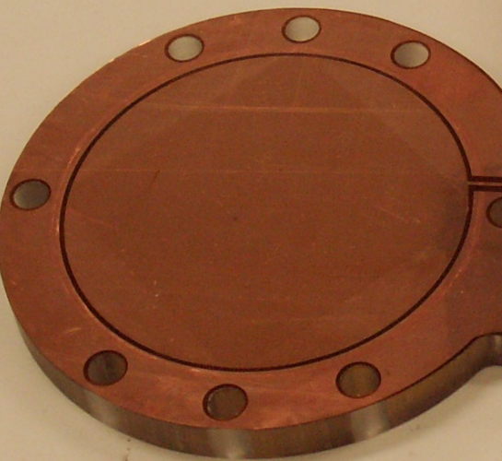
Microbulk
Pitch 100 µm,
Holes 30 µm
Micromesh
5 µm copper
Kapton 50 µm
Readout pads
S. Andriamonje et al. JINST 2010 5 P02001

Slide 24
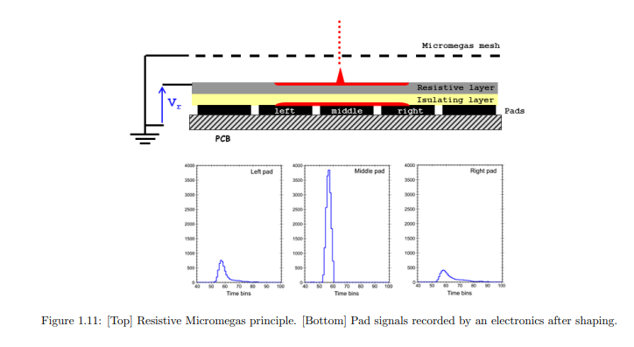
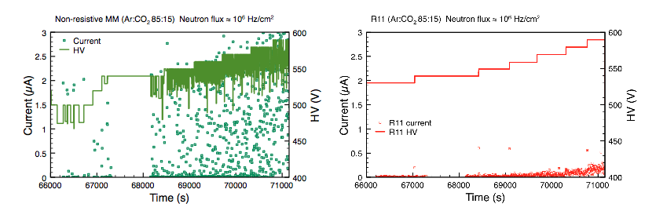
Resistive Micromegas
Resistive coating:
  Charge dispersion
  Spark protection
David Attié, HDR, October 2022
T. Alexopoulos et al., NIM 1 640 (2011) 110-118

Slide 25
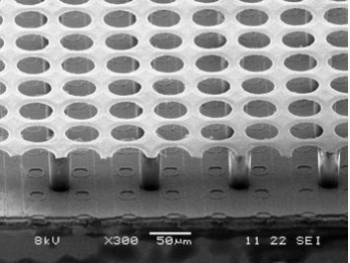
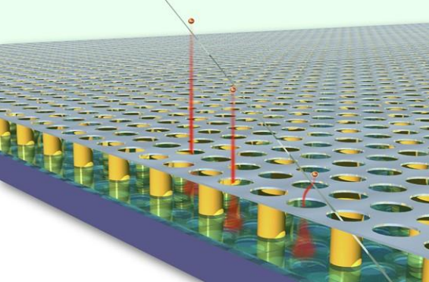
Ingrid
M. Chefdeville et al., Nucl. Instr. Meth. Phys. Res. A 556, 490 (2006)
H. van der Graaf, Nucl. Instr. Meth. Phys. Res. A 580, 1023 (2007)
Mesh is directly built on the silicon pixel readout chip
High gain and small pixel size allow single electron detection
High resitive silicon oxide layer protection against discharges

Slide 26
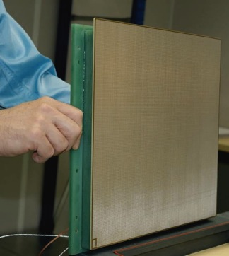
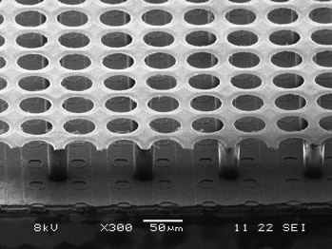
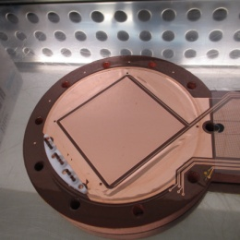
Micromegas family
Classical
1996
Bulk
2003
Ingrid
2005
Microbulk
2006
Mesh
Readout plane
TWO mechanical entities
INTEGRATED:
ONE single entity
Type of mesh
Any
type
30 µm
Stainless steel
1 µm
Aluminium
5 µm
Copper
Advantages
Demontability
Large Surface
Robust
Industrial manufacturing process (PCB)
Excellent energy resolution
Single electron efficiency
Intrinsically Flexible
Low mass
Radiopure

Slide 27
Micromegas properties
High gain ( >10⁴)
Good energy (11% @ 6 keV) and time resolution (< 1 ns)
Good spatial resolution (~100 µm)
Reduced ion feedback < 1%
Radiation hardness (10¹⁶ p/cm²)
Fast ion collection→ operation at high flux
Good Ageing Properties
Large size
Low material budget
Low cost
Cope with sparks: resistive coating

Slide 28
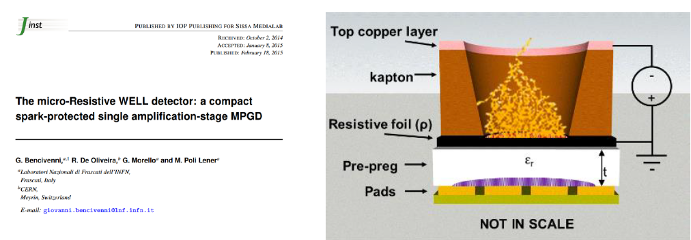
µ-Rwell
The µRWELL is composed of a µ-RWELL PCB + Cathode
µRWELL PCB : amplification stage coupled to the readout PCB through a resistive layer
Resistive layer: Diamond-Like-Carbon with a resistivity 20-100 MOhm/square

Slide 29
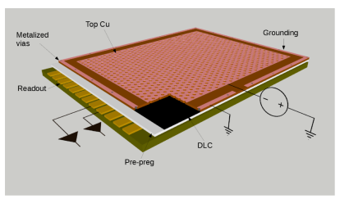
µ-Rwell Low rate: Single resistive layer
Single resistive layer
2D current evacuation based on a single resistive layer
Grounding around the active area
For large area: problem the path of the current depends on position=> detectot inhomogeneity
Limited rate capability < 100 kHz/cm²
M. Poli Lener, MPGD 2022

Slide 30
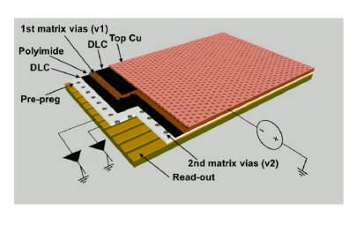
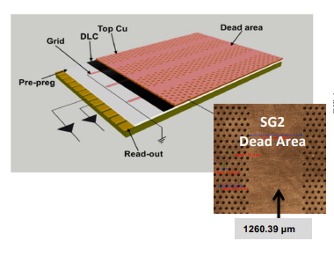
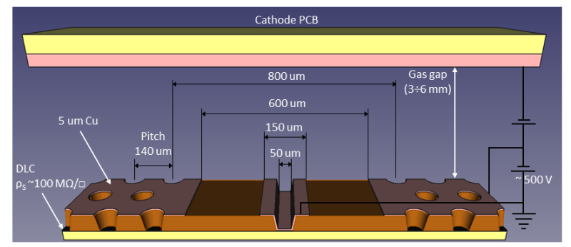
µ-Rwell high rate
M. Poli Lener, MPGD 2022
Double resistive layer
Silver grid
PEP (Patterning-Etching-Plating)
Very good performance
Complex manufacturing due to the double matrix of vias
Good performance
2D evacuation scheme by a conductive grid (screen printed or etched)
Alignment of the conductive grid pattern with the amplification pattern difficult
Single DLC layer
DLC grounding from top by kapton etching and plating
No alignment problems
Scalable to large sizes

Slide 31
MPGD Applications*
*Obviously Not exhaustive

Slide 32




GEM Implementations
COMPASS
TOTEM
KLOE-2
BONUS RADIAL TPC
Notes:
COMPASS 30 x 30 cm2 with 2D readout
TOTEM TWO-ARMS FORWARD TRACKER IN CMS
Cylindrical Inner tracker for the Kloe 2 experiment
BONUS radial TPC at the CLAS experiment at JLAB

Slide 33



GEM Implementations
ALICE TPC UPGRADE
LHCB
HBD for PHENIX
Notes:
Hadron Blind detector for phenix to improve hadron rejection
Upgrade of the ALICE TPC with 4 GEM foils: Two standard pitch GEM and two with larger pitch GEM: energy resolution, ion back flow and spark rate
Triple-GEM detectors for the innermost region of the muon apparatus at the LHCb experiment

Slide 34





Micromegas Implementations
NTOF
COMPASS
CLAS12
T2K
CAST

Slide 35





Micromegas implementations
MINOS
ACTAR-TPC
ATLAS-NSW
ND280 upgrade High-Angle TPCs

Slide 36





Hybrid Implementation: GEM + Micromegas

Slide 37



Micromegas for axion solar search: CAST and BabyIAXO
CAST
Specifications for the detectors:
High detection efficiency in the RoI (0-10 keV)
Very low background < 10 keV: 10⁻⁷ c/keV/cm²/s : less than 1 event per 6 months of data taking!
  ➔ use of shielding
  ➔ radiopurity
  ➔ advanced event discrimination strategies
BabyIAXO
Abeln et al. JHEP 05 (2021) 137

Slide 38



Micromegas for axion solar search: CAST and BabyIAXO
Standard Micromegas/Floating Mesh
Microbulk

Slide 39


Micromegas for axion solar search: CAST and BabyIAXO
BabyIAXO Microbulk prototype
S. Aune et al., JINST 9 (2014) 9 P01001
F. Aznar et al., JCAP 12 (2015) 9 008

Slide 40



Micromegas for axion solar search: CAST and BabyIAXO

Slide 41


GEM TOTEM T2 Tracker (LHC)
Dedicated to diffractive and forward physics
Measurement of inelastically produced charge particles in Interaction Point 5
Each arm of the telescope 20 triple GEM
Tracking and trigger capabilities
IP5

Slide 42

GEM TOTEM T2 Tracker (LHC)
Detector requirements
Rate capability: charge particle rates 10⁴ p/mm²/s¹
Ageing: 1 year of continuous operation 10¹¹ p/mm²
Discharges : 10 discharges/cm²/year
Time resolution < 10 ns
Spatial resolution < 100 µm
Efficiency > 97%
Half Moon Triple GEM chamber: 40 detectors
Inner diameter 80 mm and outer diameter 300 mm.
Readout: tracking and triggering
Radial strips (accurate track’s anle): 512 strips, 400 µm pitch, 80 µm width
Pad matrix (fast trigger): 1560 pads

Slide 43
GEM TOTEM T2 Tracker (LHC)
M.G. Bagliesi et al, Nucl. Instr. Meth. A617(2010)134

Slide 44
Summary
MPGDs are mature technologies
MPGDs today: GEM, Micromegas and µRWell
Versatile, adaptable ➔ wide range of applications
  « MPGD 2 » Eraldo Oliveri
  « MPGD in HEP » Paulo Iengo
  « Applications beyond HEP » Marco Cortesi
  « Applications beyond fundamental research » Jona Bortfeld
Challenging R&D
  Optical readout
  High rates/Aging
  Large areas

Slide 45
Thanks!
Acknowledgements
D. Attié, F. Jeanneau, E. Oliveri, T .Papaevangelou, F. Sauli, M. Titov, M. Vandenbroucke

Slide 46
Further reading
F. Sauli and A. Sharma, «Micro-patern Gaseous Detectors», Ann.Rev.Nucl.Part.Sci. 49 (1999) 341-388
Y. Giomataris, “Development and prospects of the new gaseous detector Micromegas”, NIM A 419 (1998) 239-250
F. Sauli, “The gas electron multiplier (GEM): Operating principles and applications”, NIM A 805 (2016) 2-24
S. Bressler, «The Thick Gas Electron Multiplier and its derivatives: Physics, technologies and applications, Progress Particle and Nuclear Physics 130 (2023) 104029
D. Attié et al., « Current Status and Future Developments of Micromegas Detectors for Physics and Applications”, Appl.Sciences 11 (2021) 12, 5362
Gaseous Radiation Detectors, Fundamental and Applications, Fabio Sauli, Cambridfe Monographs on Particle Physics, Nuclear Physics and Cosmology, Cambridge University Press.

