Slide 1
Manufacturing techniques:
Photolithography
Chemical etching
Plating techniques
Gluing techniques
Drilling techniques
Tuesday 28 November 11h30
Building 40 - Salle Curie 40/S2-C01

Slide 2
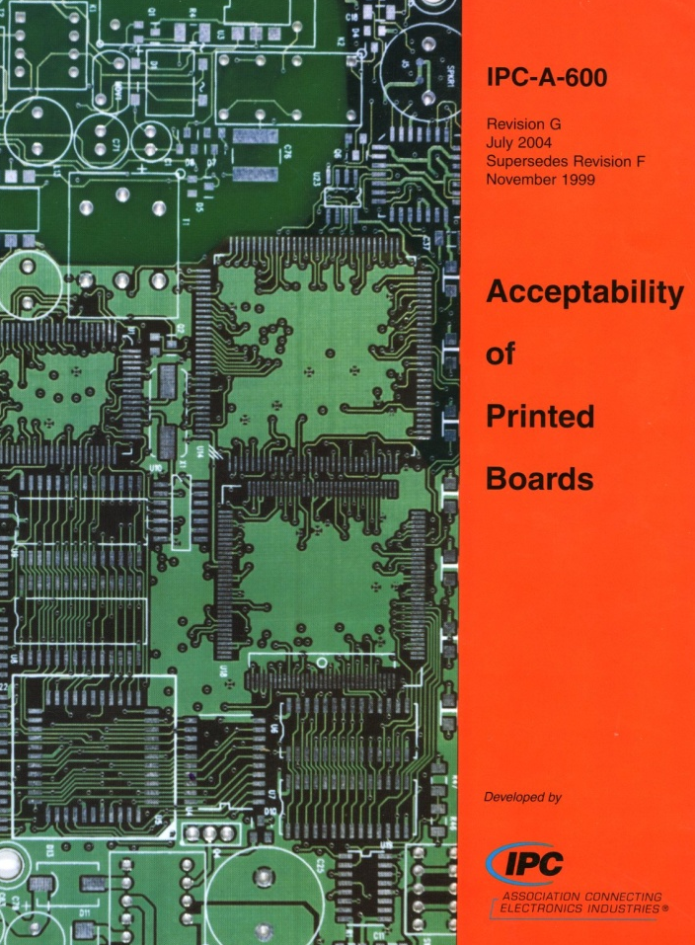
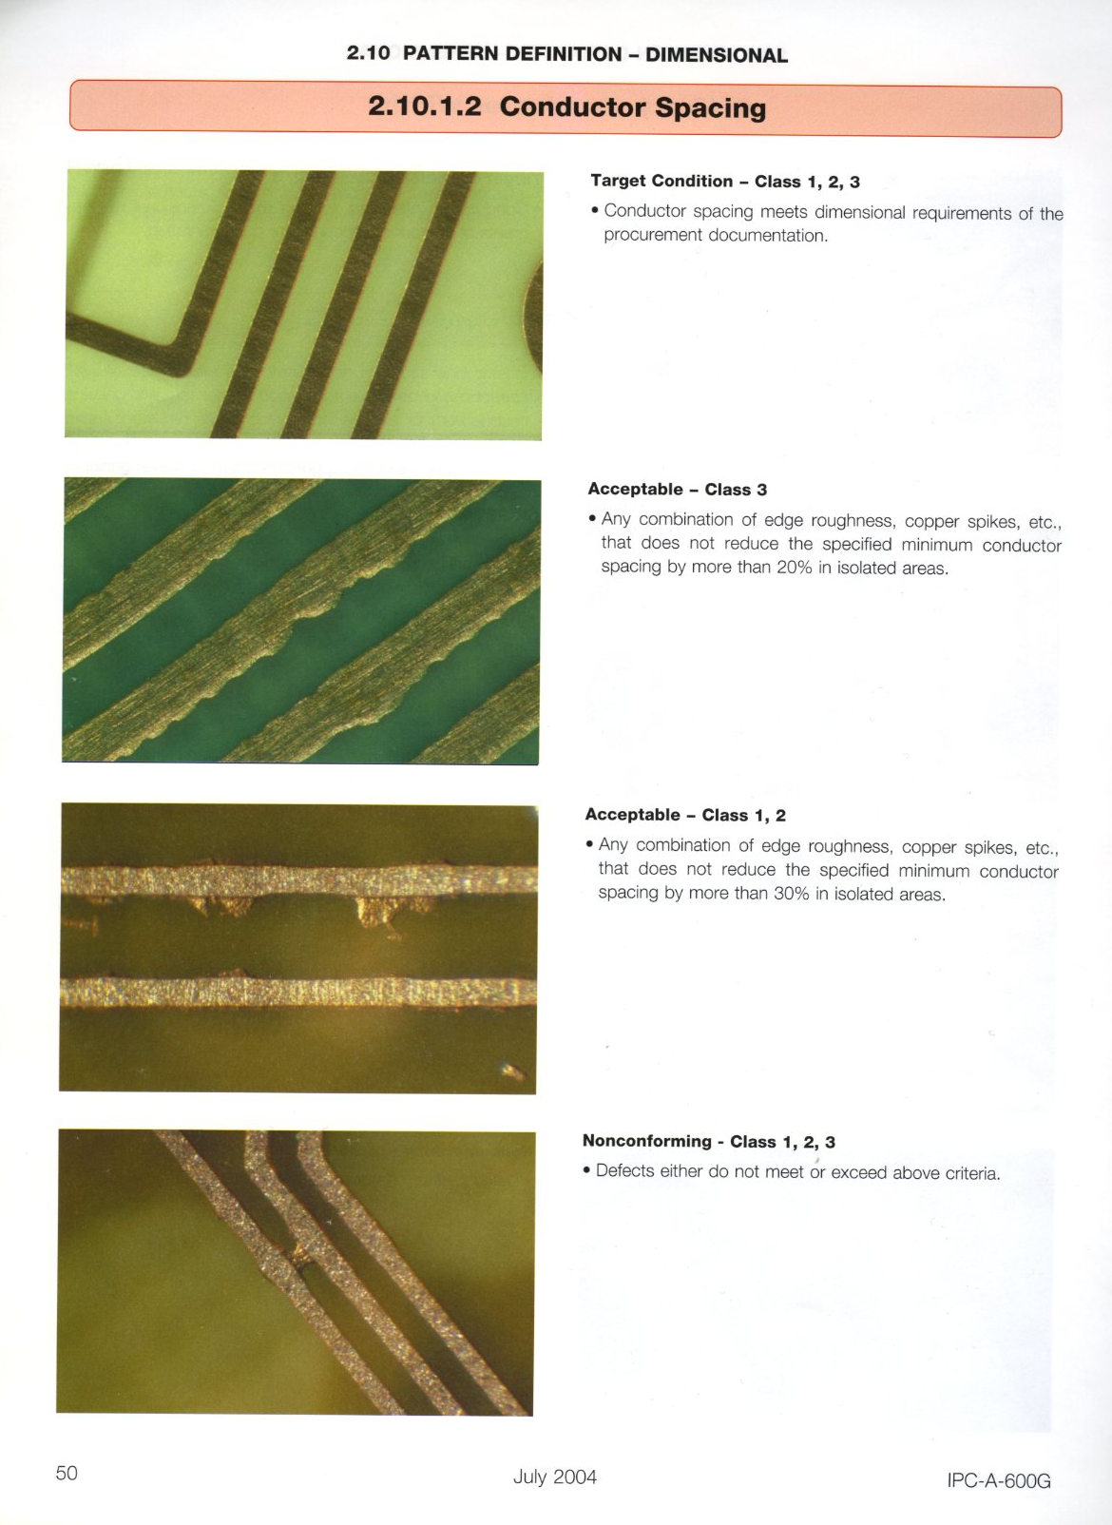
Production rules
Ex: lines quality
IPC standard define the parameters
to check and set 3 levels of quality
Class 1: Worse level but the PCB
works → general electronic
Products.
Class 2: Industrial products for
which uninterrupted service
is desired but not critical.
Class 3: High reliability
electronics products.
No possibility to exchange boards
during its full life

Slide 3
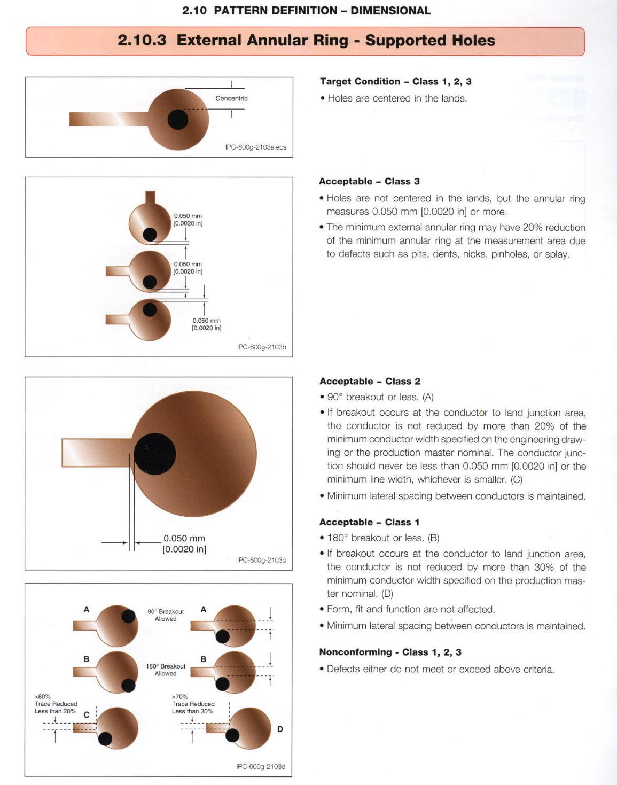
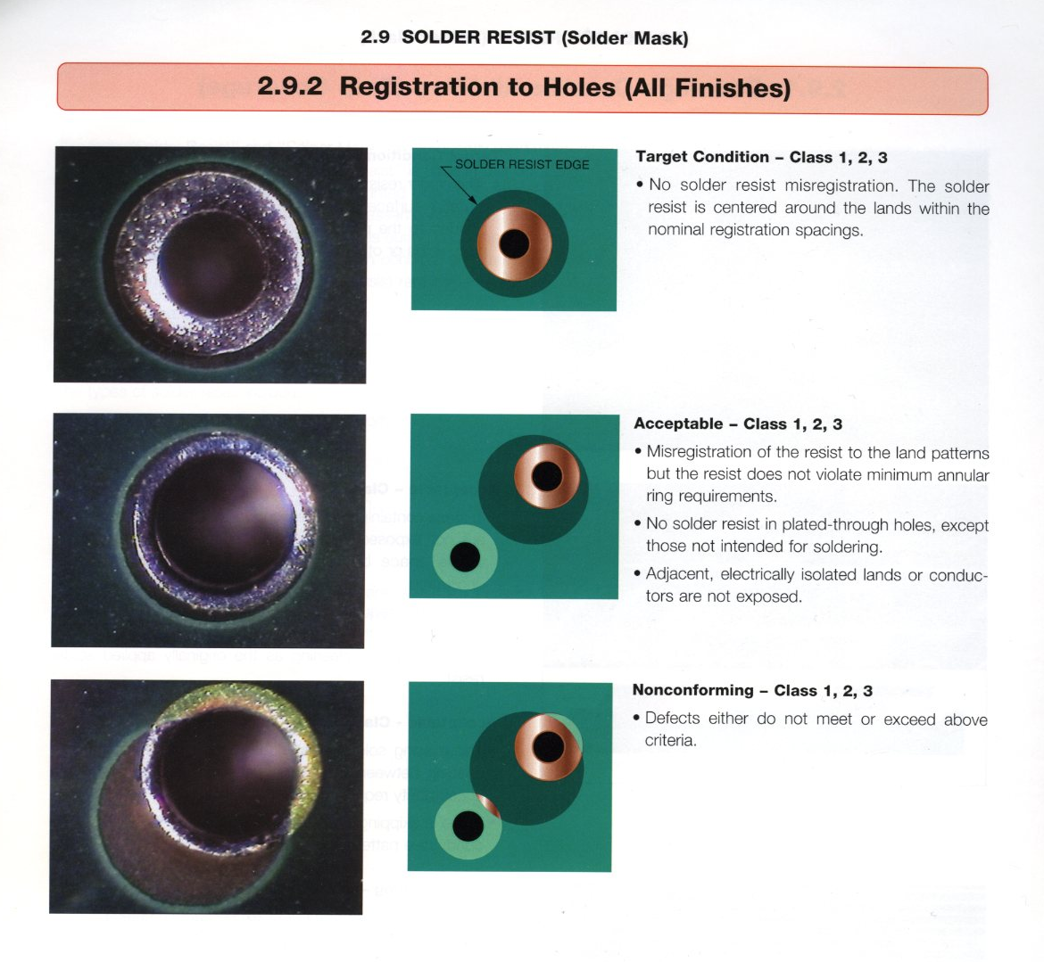

Slide 4
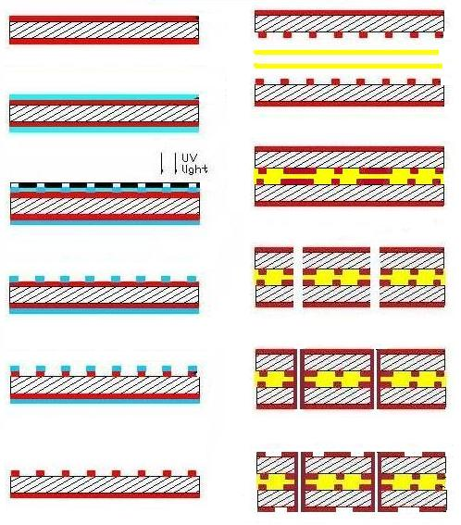
Talk outline → 4 Layer PCB production steps
Base material
Gluing
Drilling
Photolithography
Plating
External layers
patterning

Slide 5
Photolithography basics
Base material with copper
Photoresist deposition
UV exposure through a mask
Resist development
Copper Etching
Resist Stripping

Slide 6
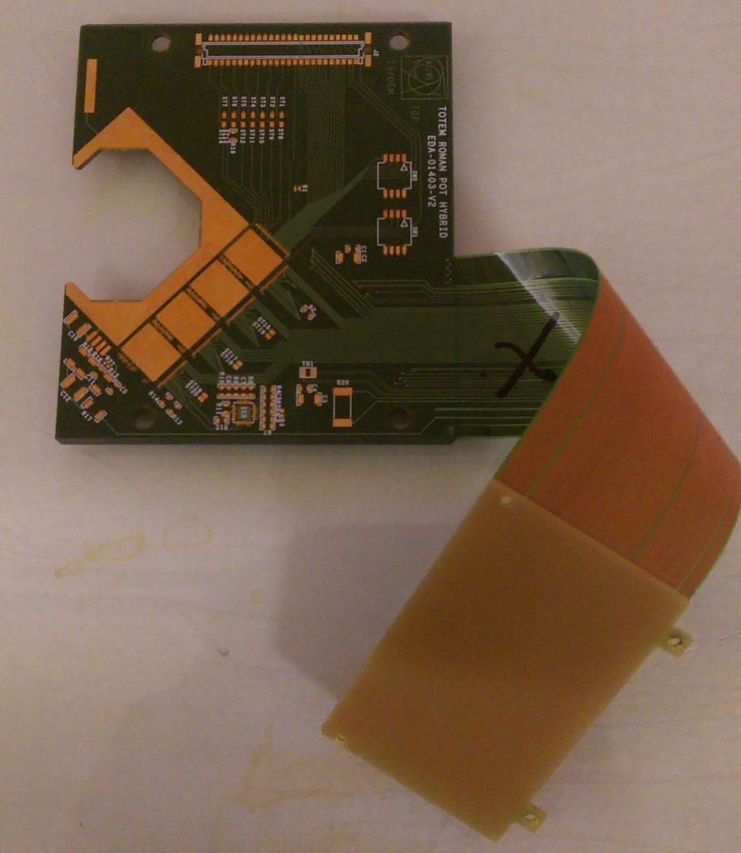
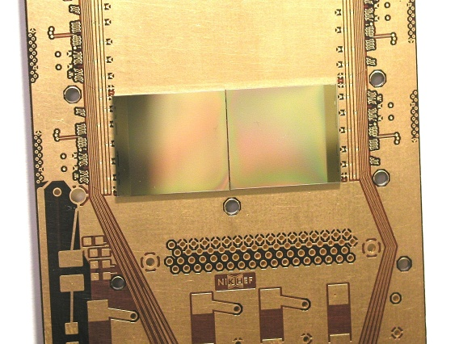
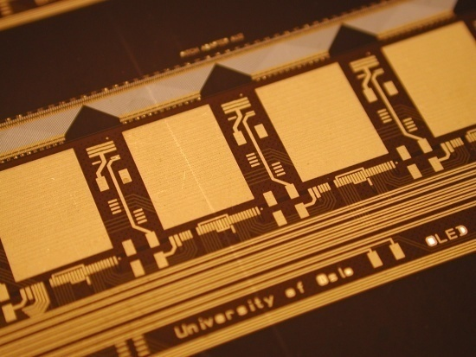
Used for Printed Circuit Boards production
Creation of all the conductive tracks
Protective layers : soldermask & coverlay
Legend ink
Micro via patterning

Slide 7
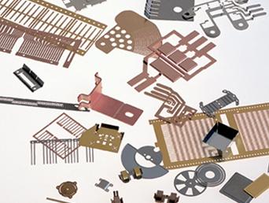
Chemical milling and electroforming
Wave guides
Meshes
Heat sinks
Ink jet nozzles
Optical parts
Fuel cell parts
Lead frames
Encoder discs
Flow sensors

Slide 8
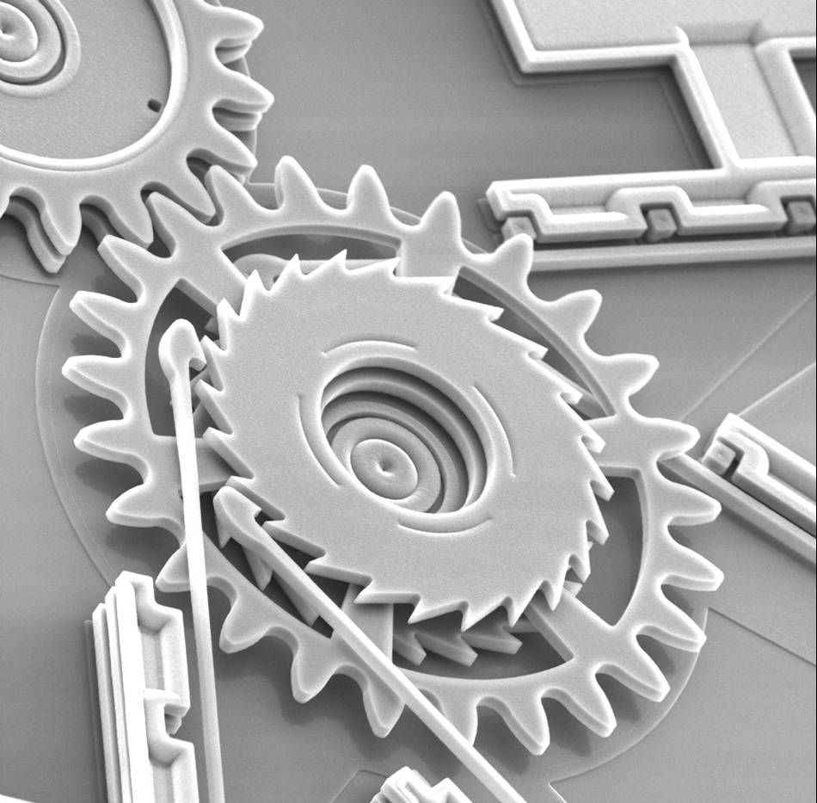
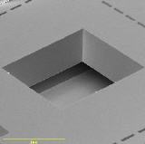
Semiconductor industry
Creation of metal lines for interconnection
Define areas for selective doping
Patterning of protective layers
Micromachining of silicon
  Ink jet printer heads
  Pressure sensors
  Accelerometers
  Magnetic sensors
  Actuators by electroforming magnetic materials

Slide 9
4 Layer PCB
Base material

Slide 10
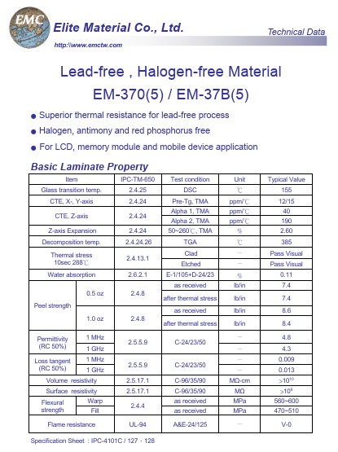
Substrates
Example of data sheet
Glass epoxy
  G10 , FR4, High TG, Low loss , low Dk , anti CAF , low CTE etc..
Aramid Epoxy
  Low CTE
Glass polyimide
  G30 ,High temperature , high reliability
Glass Teflon , ceramic Teflon
  High frequencies
  not good for high radiation dose.
Polyimide
  General flex application
Peek
  High reliability flex application
  low moisture absorption
  High frequencies
Bakelite
  Low cost

Slide 11
4 Layer PCB
Resist deposition

Slide 12
Photo-imageable materials
Liquid resist
  Thicknesses ranging from 1um up to 5um
  Spin , spray ,deep , screen-printing coatings
  Aqueous or solvent development
  Fine lines , sub micron capabilities
Solid resist
  Thicknesses ranging from 15um up to 100um
  laminated
  Aqueous development
  Minimum line 20um
Solder-mask (not sacrificial)
  Protect external lines on rigid boards
  Solid or liquid
  Typical thickness 30um
  Many colors available
Photo-imageable Cover-layer (not sacrificial)
  Protect lines on flexible boards
  Solid or liquid
  Typical thickness 30um
  Aqueous development
Legend inks (not sacrificial)
  Most of the time liquid
  Typical Thickness 20um
  Many colors
Polyimide (usually not sacrificial)
  Make 3D shapes , protect Chips
  liquid
  Thickness ranging from 1 to 30um
Epoxy (usually not sacrificial)
  Make 3D shapes
  SU8 , used in many MEMs
  Thickness ranging from 1 to 100um

Slide 13
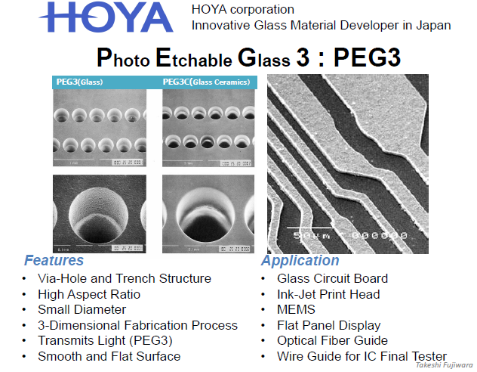
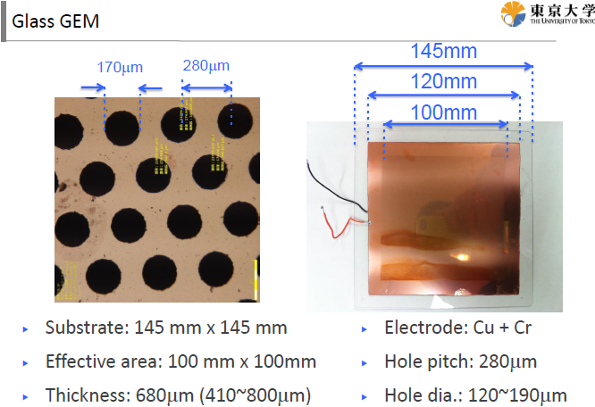

Slide 14
Resist deposition
-Spinning - semiconductor production
  Thin layers, Highest resolution
-Dip coating - fine lines for PCBs or 3D objects
  Fine lines, large sizes
-Curtain coating - solder mask deposition
  Fast, not accurate, cheap
-Spray - liquid resist, solder mask deposition
  3D best coverage, best quality for solder mask
-Screen printing - solder mask deposition
  Ultra-fast but medium quality
-Dry film lamination- PCB production
  Fast, good resolution

Slide 15
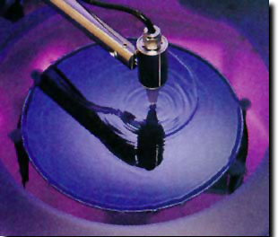
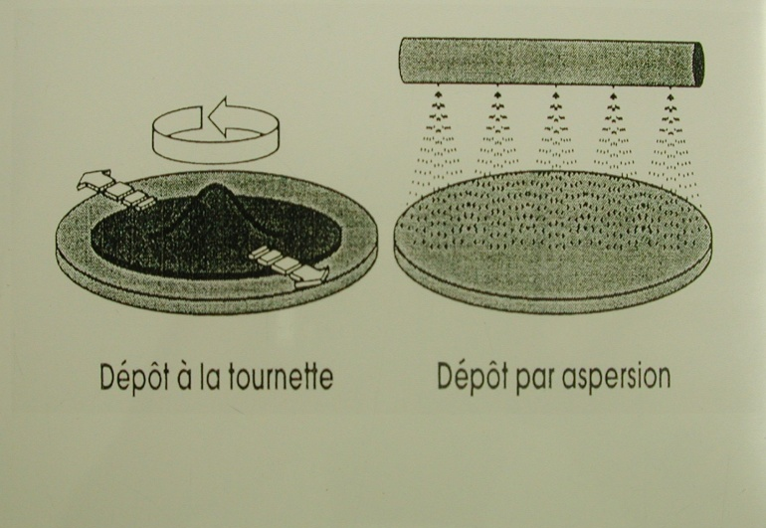
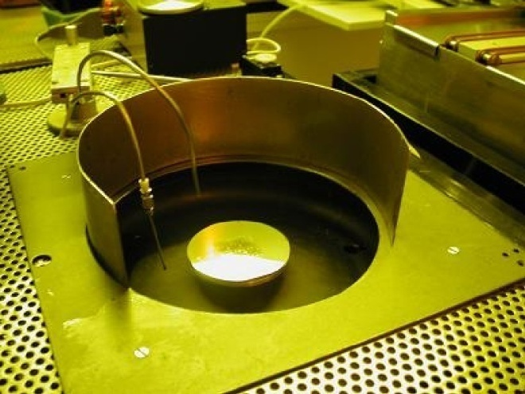
Spin Coating
Spin
Spin & spray
Best deposition !
Deposition by centrifugation
Uniform thickness
Ultra-thin :down to 1 μm
Excellent repeatability
Clean room mandatory

Slide 16
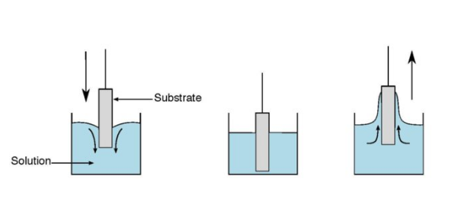
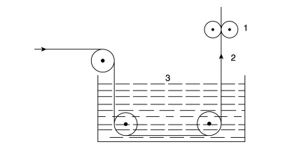
Dip Coating
Really simple principle but difficult to tune
with small productions
Thin depositions
Fine patterns
Good for continuous mass production lines
1/vertical dryer
2/base material
3/tank with liquid resist

Slide 17
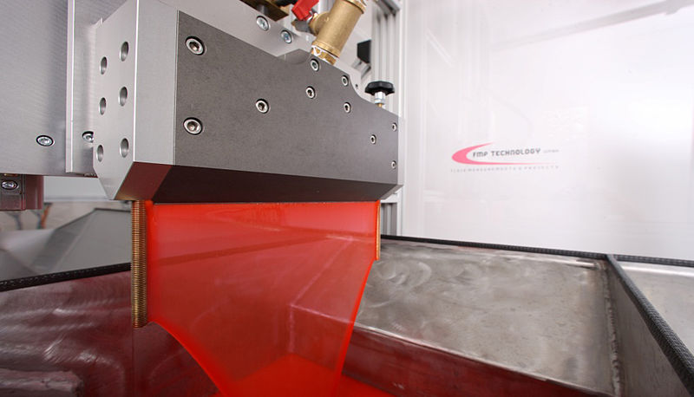
Curtain coating
Liquid resist
PCB
PCB
Good for solder-mask deposition
-fast deposition
-thickness not really accurate

Slide 18
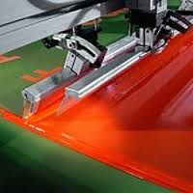
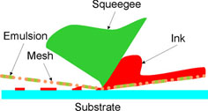
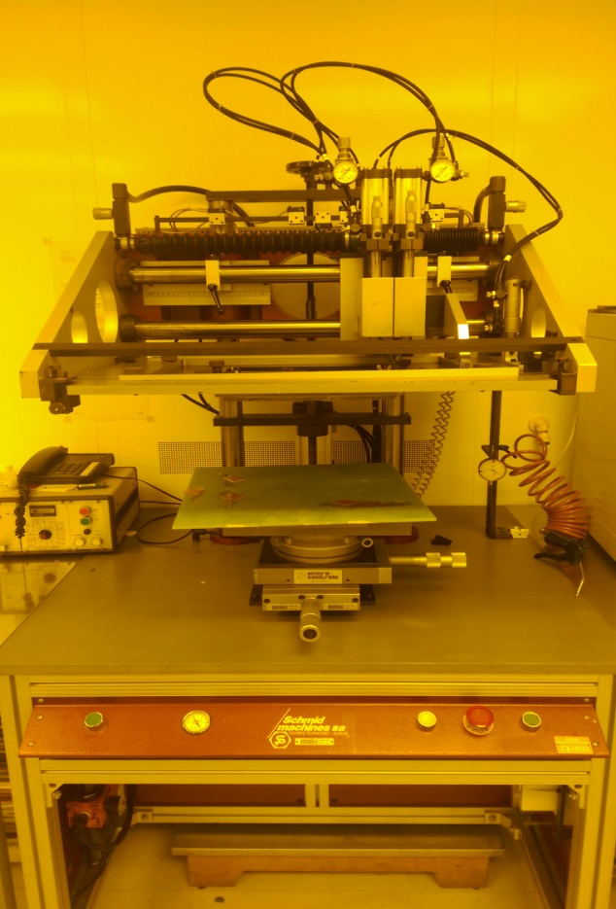
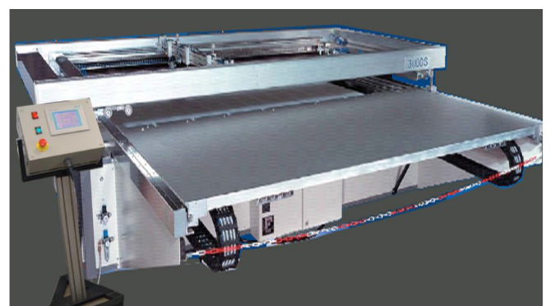
Screen printing
Good for solder-mask deposition
-fast deposition
-thickness not really accurate
CERN precise machine
20cm x20cm deposition
CERN Semi automatic machine 1.5m x 2m
General purpose

Slide 19
Hot roll lamination
Hot rubber roll
PCB
Best speed Vs quality compromise !
Dry process
Medium class clean room
Large size
Precise thickness
Easy to process
Resolution 30μm line/space
Not compatible with 3D shapes
Solid photoresist
Hot rubber roll
Solid photoresist roll

Slide 20
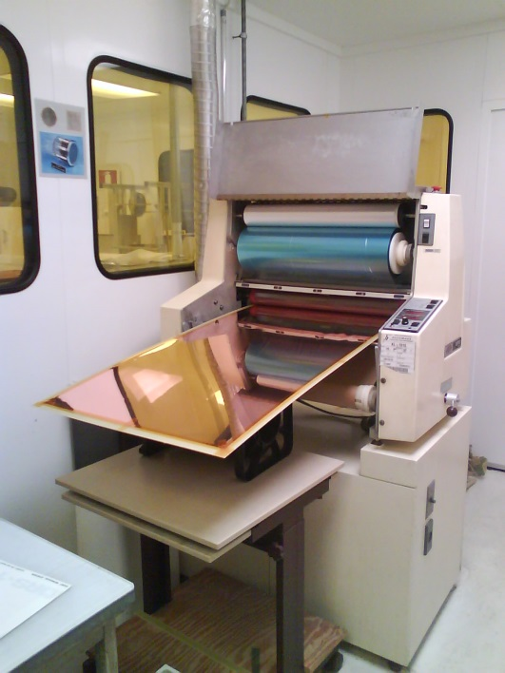
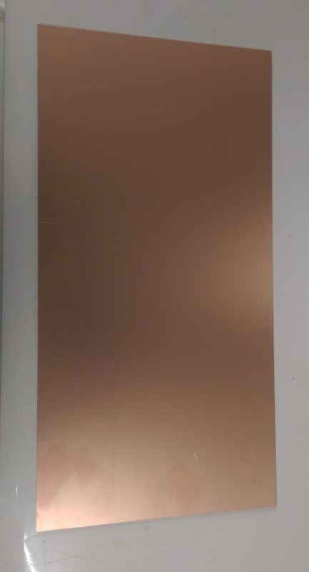
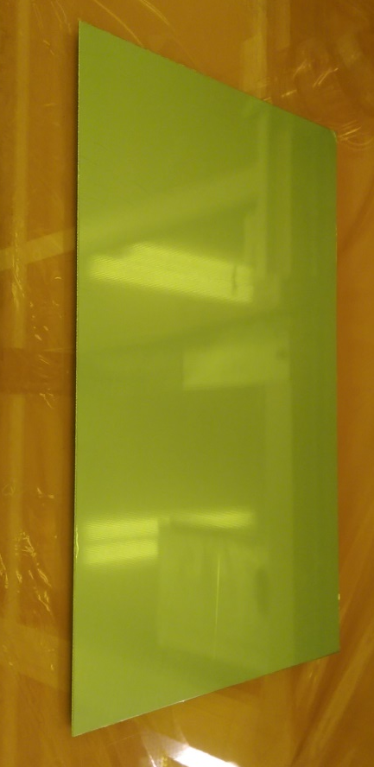
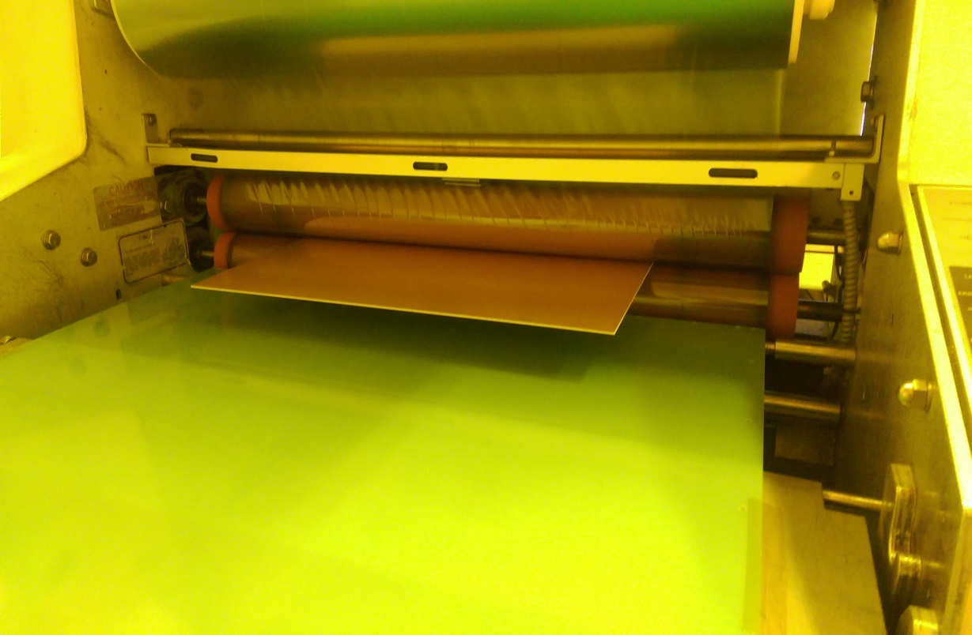
Hot roll lamination deposition
Cu/Glass-Epoxy/Cu plate
Or flex
Plate + Photoresist
Resist deposition by Lamination

Slide 21
4 Layer PCB
UV exposure
Resist development

Slide 22
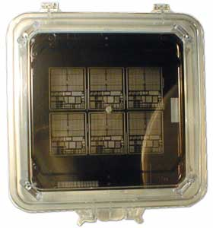
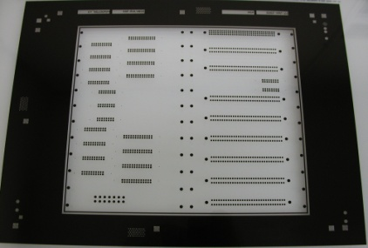
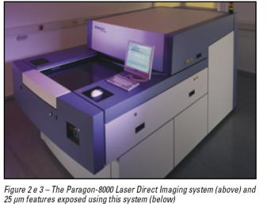
Masks
Glass mask : Glass or Quartz
-Cr on thick soda lime glass
-Direct laser ablation of thin vacuum deposited Chromium
  -Sub-micron resolution possible
  -up to 1m x 0.6m
Polyester mask : 100um thick
  -Minimum line and width around 20um
  -up to 2m x 1.5m
  -Laser exposure of a photosensitive layer on a polyester film
Laser direct imaging : no mask
  -Minimum 15um strips
  -up to 80cm x 60cm
  -resist direct Laser exposure

Slide 23
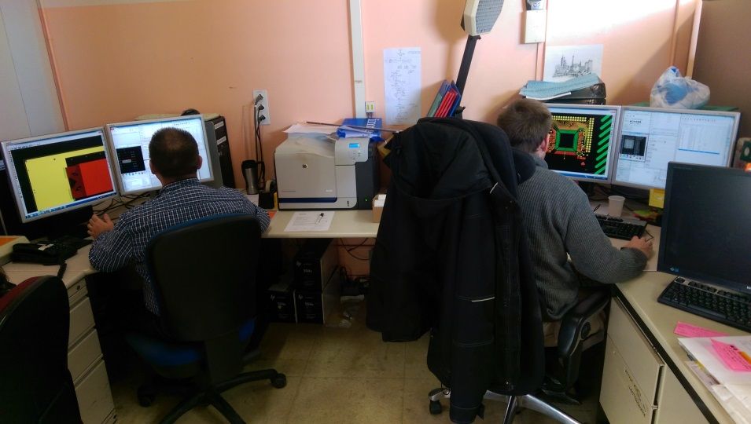
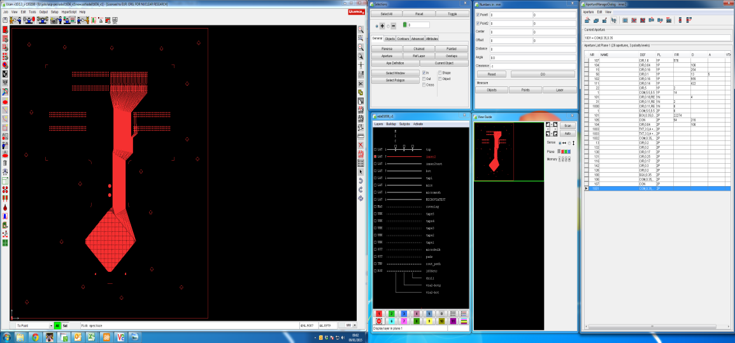
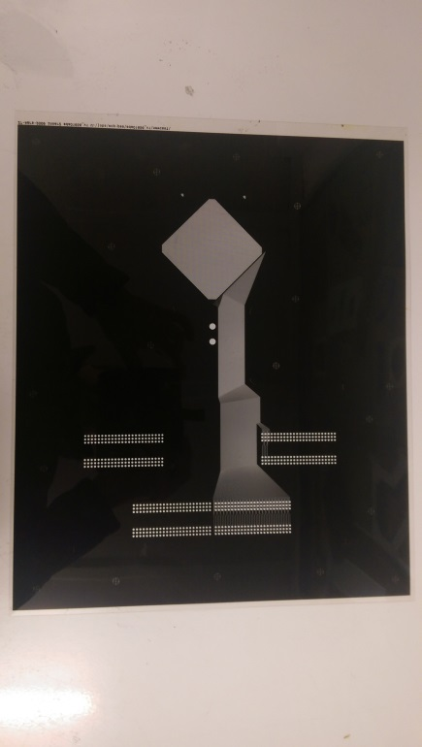
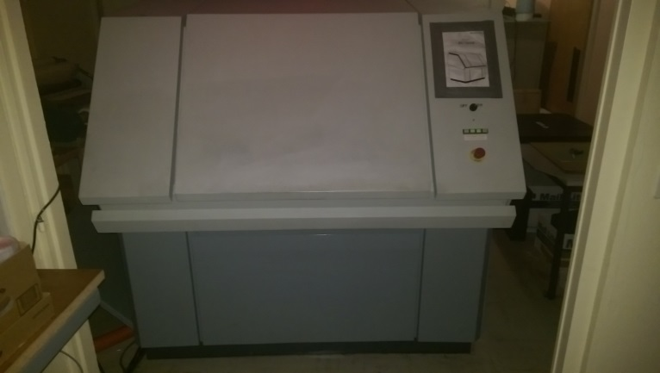
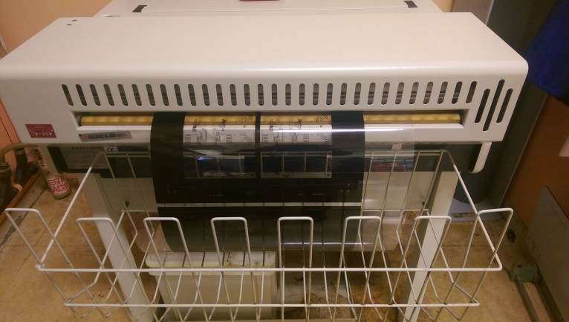
Polyester Mask production
UCAM software (GERBER → DPF)
-Corrections for over etch
-DRC
-conversion to Plotter Format : DPF to raster file
start with GERBER file
Or DXF files
Laser photo plotter
Chemical Mask development
Mask

Slide 24
light diffusion problem
Diffuse UV
From a neon tube
Collimated UV

Slide 25
light absorption problem
Thin layers ok
Problem with thick layers

Slide 26
light diffraction problem
Diffraction in glass or polyester
Less with quartz
Ultra thin patterns
Micrometric range

Slide 27
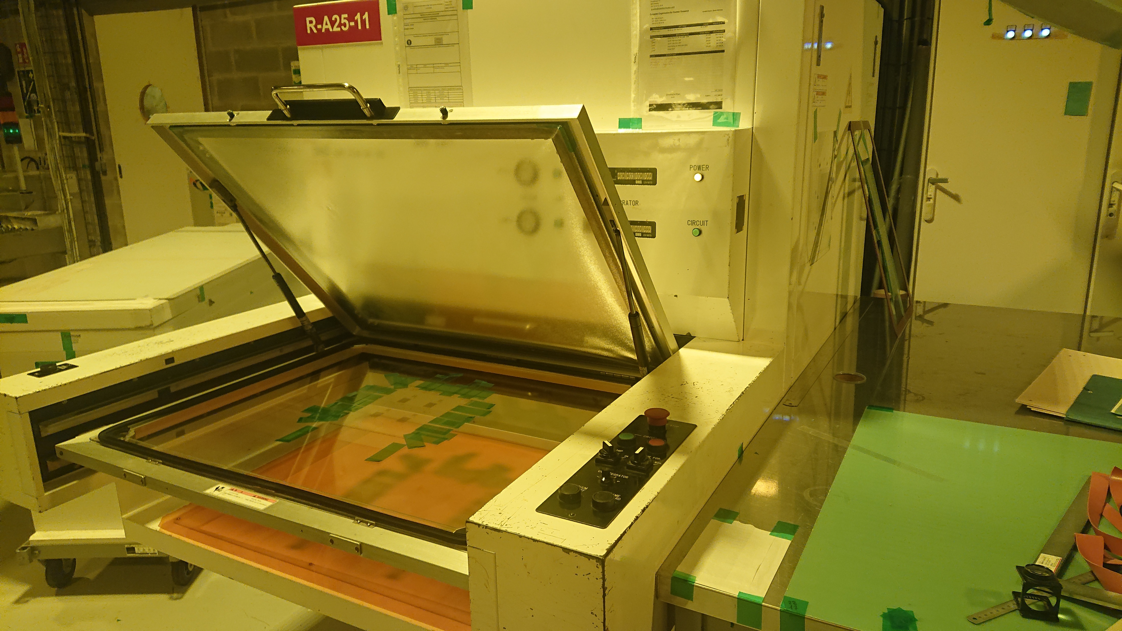
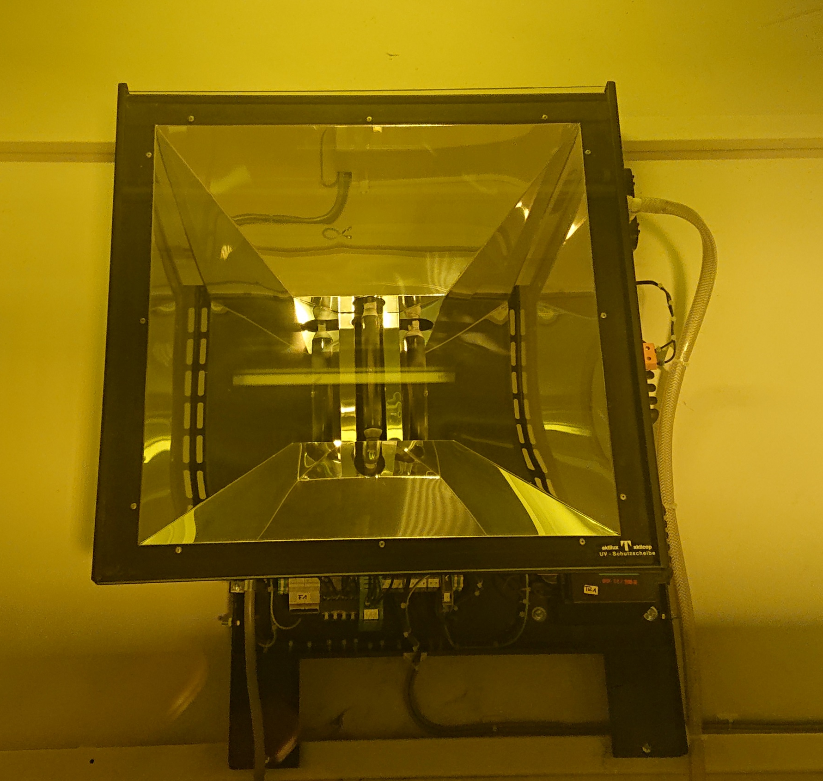
STD UV exposure
Two UV bulbs
Vacuum Drawer (open)
Sliding in the machine.
Stack up:
-Polyester foil
-Mask → manual alignment
-PCB with resist to pattern
-Glass plate
Deflectors to
Improve collimation

Slide 28
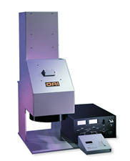
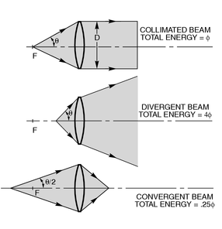
Collimated UV lamps avoid diffuse light
Precise large size lens up to 12 inches
The lens quality is the base of this system
UV Source alone for multipurpose application
or
Combined with a high precision mechanical
system for alignment: “Mask aligner”

Slide 29
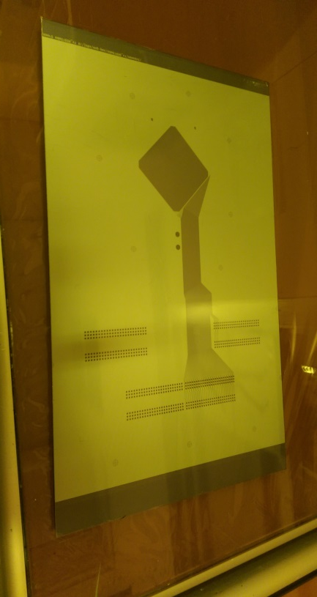
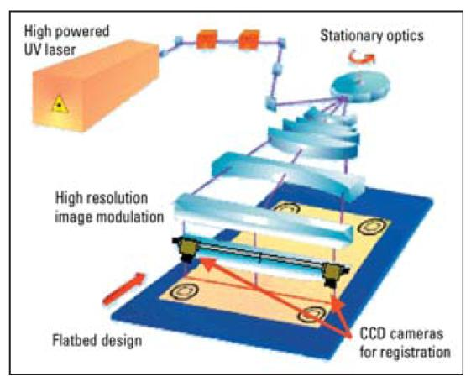
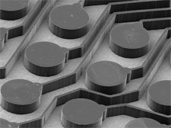
LDI: laser Direct Imaging
Increasing local energy can beat the 3 problems
But with thick resist the absorption remains .
Precision: 0.5 μm to 2 μm
(depending on laser type)
LDI

Slide 30
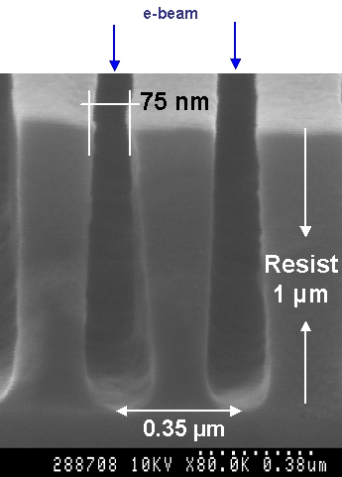
Electron beam exposure beats all the problems
Current dedicated systems have produced line widths of 10 nm or smaller
The primary advantage of electron beam lithography is that it is one way to beat the diffraction limit and make features in the nanometer regime
Angle due to Electron scattering in resist

Slide 31
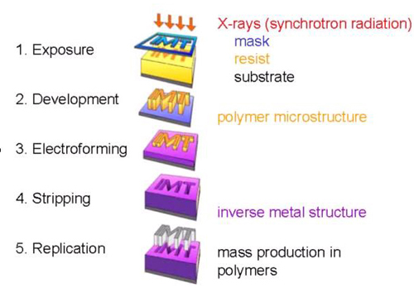
Advanced image transfer with
X-ray exposure
LIGA technology uses X-ray lithography to obtain polymer structures with extremely high aspect ratios (lateral precision bellow 1μm in a 0.1 to 2mm thick polymer).
LIGA is a German acronym →in English Lithography, Electroplating, and Molding.
Because of the high collimation of X-rays needed, the source must be synchrotron light.
This technology is the base for many MEMS,
It beats the limitation of light absorption in the photoresist.

Slide 32
Cheaper way to avoid light absorption problem
Resist lamination
+ UV exposure
Second Resist lamination
+ second UV exposure
After development
That’s how we produce
Thick pillars for Micromegas

Slide 33
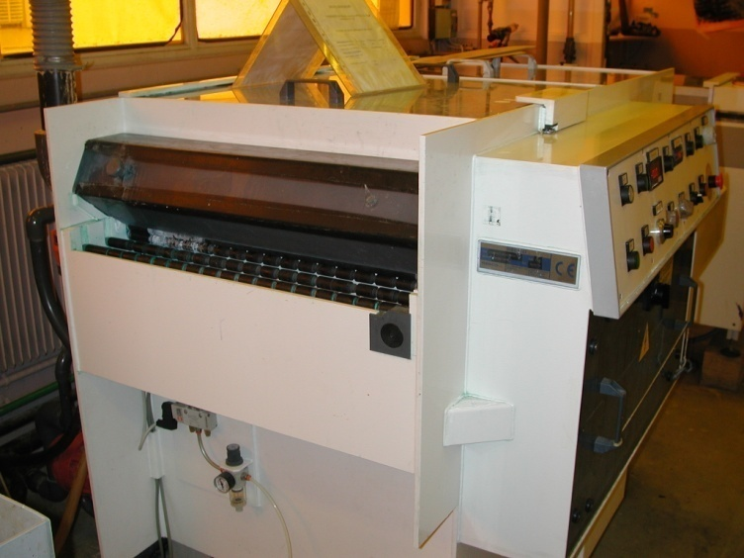

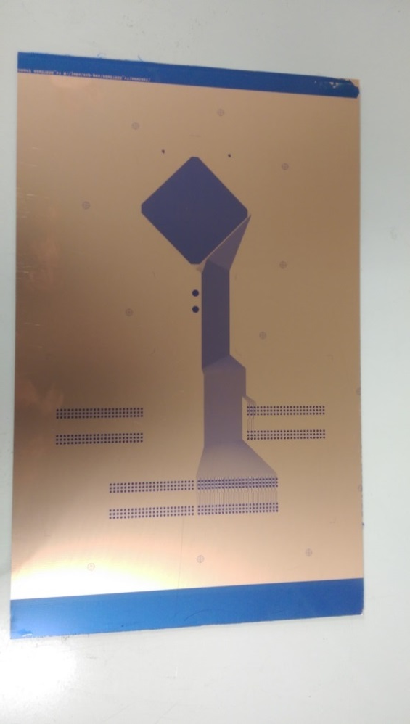
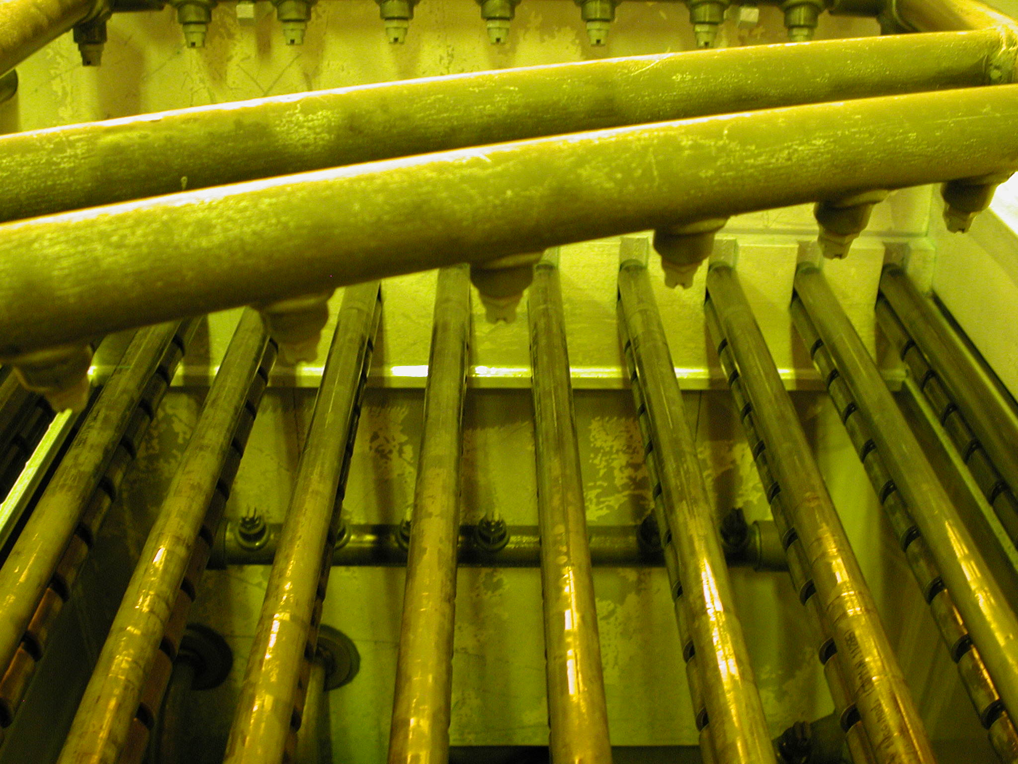
After exposure →Wet development
After Exposure
After Development
Development with NA2CO3

Slide 34
4 Layer PCB
Etching
Resist stripping

Slide 35
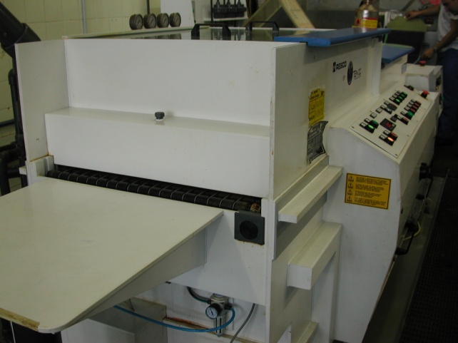
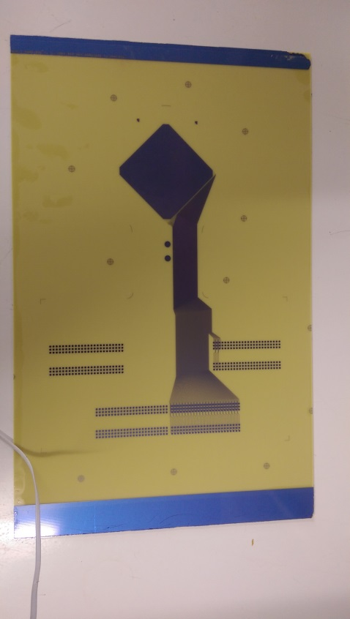

Wet spray Etching
Resist Image
Wet spray horizontal etching
Some examples of chemistries:
-Ferric Perchloride for Copper/SS/Aluminium
-Phosphoric/sulphuric/Fluoridric acid for Niobium
-Fluoridric acid for Titanium
-Potassium Ferrocyanide for Tungsten
-Iode/Iodine for Gold
-Iron nitrate for Silver etc.. etc..
After Etching

Slide 36

Anisotropic , Isotropic wet etching
Most metals can be wet etched
The etching is isotropic for nearly all of them
Most of the dielectrics are difficult to wet etch
Some exceptions
  Silicon etching is anisotropic due to its crystalline structure
  Polyimide etching can also be anisotropic
Anisotropic etching
Big limitation with thick layers
Minimum opening 3 to 4 time the thickness

Slide 37




Polyimide wet etching , isotropic and anisotropic
First type of polyimide:
Perfect anisotropic etching
No under etch
Perfect to make small holes
OK
OK
Second type of polyimide:
Fully isotropic etching
Not satisfactory
bad
bad
Les than 10% of PIs available on the market are OK

Slide 38

Laser etching
-Laser direct metal patterning is not yet used to make lines in PCBs.
-With thick layers ( above a few um), the speed /quality ratio is much worse than chemical etching.
-Powerful and fast laser ablation produces poor quality lines
-And to get good quality lines the throughput is too slow
-But laser is nice for repairs .
Full of shorts
Cleaned up
It looks simple but the process is complex

Slide 39

Electroforming to beat wet etching isotropy
Thick resist
Electro plating
Resist stripping
Seed layer removal

Slide 40

After wet etching → resist Stripping
Stripping with:
NAOH
KOH
Solvents
After copper Etching
After stripping

Slide 41



After stripping → Automatic Optical inspection (AOI)
Compare the scanned image with the design file
Minimum track or space 20um
Minimum detectable defect around 5 um ( pixel 2.5um)
Cannot detect hole plating defect
Short circuit
Open
Bonding pad

Slide 42


At the end →Electrical test
Control netlist integrity
Including PTH this time
Flying probe
2 in front 2 in bottom
AOI

Slide 43
Gluing

Slide 44


First step →prepare the metals
Some metals can be nearly directly glued:
- Aluminum , Titanium
Some need to be micro-structurized
- Copper and alloys
Other need to be chemically treated
- Ni, stainless steel
All of them need to be degassed
1/Detergent Cleaner
2/Pre-conditioning
3/Micro structurizing Chemistry
4/DI water Rinse
5/Dry

Slide 45


Gluing Equipment
Isostatic press
Vacuum chamber
5 Heating plates
Mechanical Hydraulic pressure (40 Bars)
Plate size 600mm x 700mm
Presses with plates above 1m is exceptional
Short cycles
usually only used for flat plates
Autoclave
The parts to glue are in a vacuum bag
Pressure coming from compressed air (10 Bars)
STD size 2m x 1m
Machine with a length of 20m are existing
Long cycles
3D objects

Slide 46

Glue
Liquid
  Rarely used
  Difficult to apply , difficult to clean , thicknesses not accurate
Prepregs
  Wowen glass impregnated with a bi-stage polymer glue (um precision thickness)
Cast
  Thin layer glue (solid) on a carrier (um precision thickness)
Cover-layer
  Polyimide layer with a thin layer of glue on one side
Bond-ply
  Polyimide foil with glue on both sides
Pressure sensitive adhesive
  Thin layer of adhesive on a carrier

Slide 47
Gluing principle
Pressure (30 kg/cm2)
Thick Stainless steel
PCB
Stack under vacuum
Heat all the stack
glue
PCB
Thick Stainless steel
Metallic guiding pins

Slide 48
Gluing principle
Pressure (30 kg/cm2)
Thick Stainless steel
PCB
Stack under vacuum
Heat all the stack
glue
PCB
Thick Stainless steel
Metallic guiding pins
Problem :
Flatness of the SS plates , press , PCB
Thickness uniformity of Prepreg , Glues
Thickness variation on a patterned PCB

Slide 49

Release and conformal layers
Pacothane
  release sheet
Pacolon
  High temperature release sheet
Pacopads
  Melting with temperature → Planarity corrections up to 200um
PacoFlex
  Encapsulate strips , the coverlayer will follow the strips shape
Pacovia
  Melting and hermetic →avoid glue coming out from buried holes
Pacotherm
  Large Planarity corrections up to 1mm
Typical Rigid PCB stack

Slide 50


Others configuration
Configuration to avoid glue bleeding
Typical Flex stack

Slide 51

Autoclave configuration
Foam
Conformal
stack

Slide 52


Curing cycle
PrePreg
Cast

Slide 53
Drilling

Slide 54




Different type of holes
8 layers staggered vias
8 layers stacked vias

Slide 55


Mechanical drilling
Spindle
0.15 mm tool minimum
Some machines can go below 100um
180 000 RPM
1.4m x 0.6m drilling area
Max rate 3H/s
Industry : 10 H/s
Optical camera
Xray Camera
Tool store

Slide 56



Mechanical Milling
Tool store
Spindle
80 000 RPM
0.3mm min tool

Slide 57



Chemical drilling → GEM
Base material : Polyimide 50um + 5um on both sides
Double mask
Single mask
Same base material
Hole patterning in Cu
Polyimide etch
Bottom electro etch
Second Polyimide Etch
Limited to 40cm x 40cm due to:
  The 2 masks alignment precision
  And Glass mask cost
30um hole minimum
Limited to 2m x 60cm due to:
  Base material
  Equipment
30um holes minimum

Slide 58



Laser or plasma drilling
C02 laser
UV laser
RIE Plasma
DRIE Plasma
Punching
Thin spiral cut
-Many possible base Materials.
-Holes perfectly clean.
-Small patterns
-30um holes
-Not competitive with Wet drilling
-Many possible base Materials.
-Machines can drill both metals and polymers
-20um holes
-Not yet competitive with Wet drilling
-Moderate machine cost .
-Holes perfectly clean
-50um holes
-Not uniform on large size.
-Isotropic Etching
-Perfect cylindrical holes.
-Holes perfectly clean
-Ultra precise patterns
-20um holes
-limitation on size : dia 20cm max.

Slide 59

Sand blast drilling
Anisotropic etching
Can treat nearly all materials
Smooth walls
Millimetric scale patterns

Slide 60
Plating

Slide 61
Plating
Electro-plating
Electroless plating
Vacuum plating
Screen printing

Slide 62

Dielectric treatment before Electro-plating
1/Deasmear
  Remove the dust in holes
  Remove material burnt by drilling
  Come back to fresh dielectric
2/Deposit conductive material on dielectric:
  Nano Carbon deposition
  Or organic Palladium
Carbon line:
Detergent
Carbon full covering
Micro-etch to remove Carbon on Copper
Deasmear line:
Sweller
+ Potassium permanganate

Slide 63




Electro plating
Solid piece
Basket with copper balls
CU
NI
Au
Copper plating Bath
2m x 0.6m panels
Anode
Cathode
Filter/pump

Slide 64


Horizontal Ni or Cu or Ni/Cu line continuous deposition
Dry → Blower
Rince → Spray
Passivation →Spray
Ni Bath
horizontal
Cu Bath
Horizontal
Cascade Rince
spray
Cascade Rince
spray

Slide 65


Electro-less plating
Protect copper from oxidation
- Guaranty an easy soldering
- Allow Aluminum or Gold wire Bonding
ENIG : Electroless nickel (5um) , Immersion Gold (0.07um)
ENEPIG: Electroless nickel , electroless Palladium , Immersion Gold
Ag: Chemical silver less than 1um
Tin: Chemical Tin
Immersion Au
Electroless Ni

Slide 66





Vacuum plating
Pulsed DC Magnetron vacuum
deposition machine
Drum unloading
after processing
70cm copper target

Slide 67
Possibilities
Applications
Deposited Materials.
  Metals : Cu , Al ,Cr
  Resistive materials DLC, Si
  Converters B4C
Possibility to co-deposit 3 materials.
Possibility to sequentially deposit 3 materials.
Built in heater.
RF plasma cleaning.
3 gas inputs for reactive sputtering.
Can treat flex or rigid substrates.
Inner trackers
  Low mass flexes, Al conductors.
  Solid-state detectors embedded in flex.
MPGD
  Resistive protection layers.
  Layers for neutron detection.
  Photoelectric layers

Slide 68




Thin film deposition→ Lift Off

Slide 69





Thick Film Printing
High density
High Thermal Conductivity
Low Vacuum compatible
Conductive Layers: noble metals
Dielectrics : Ceramic
Sequential deposits by screen printing
Followed with 850 Celsius curing

Slide 70

Resistive materials deposition
50um Kapton
Full layer deposition
Pattern DLC with :
-sand blasting
-lift Off
ATLAS
NSW
Direct screen printing
with resistive paste

Slide 71
End of production
or back to the beginning

Slide 72
Examples

Slide 73
Interconnection technologies names
Integrated
chips
Nominal line and space
20um
MCM/D (deposited)
25um
Thin film
50um
MCM/C (ceramic)
75um
HDI circuits
100um
Thick film
120um
PCB
200um
Technologies names
In green available at CERN
Screen printed circuits
Cabling

Slide 74




Inner Trackers → Low Mass Aluminium circuits
ALICE inner tracker BUS (5 Aluminum layers)
Double-sided flex for ILC Vertex sensor
ATLAS IBL Low Mass 8 layers
ALICE inner tracker

Slide 75



Magnets calibration → ultra precise field sensors
Multi layer coils :
-1.5m long
-up to 40 layers
-30um maximum registration error
-Line and space down to 50um/50um
-Printed Coils are 10 time more accurate than
wounded structures

Slide 76




LHC machine protection
Niobium Titanium supraconductor quench detector.
Others:
-Heating foils
-High power resistors
-Optical targets for UHV
-etc..
Stainless steel or SS/Cu mix Quench Heaters
Long flexes up to 15m x 0.6m

Slide 77

HDI for ATLAS pixel detectors
Silicon pixel detector below
control chip
Output bus
bonding
Size in the range of 8cm x 2cm

Slide 78


HDI CMS strip detectors
Front end Asics
Rigid flex
Glass pitch adaptor
Silicon strip detector
Size in the range of 10cm x 20cm

Slide 79


PCB for CMS Pre-shower

Slide 80



Full Aluminium flex with embedded silicon detector (R&D)
Top
bottom
Thinned chip 50um
100um thick end device
Full aluminium
No bonding

Slide 81





CMS GEM with single Mask
Microscopic view
Single mask GEM
CMS experiment
Cross section
GE1/1 → 400 GEM (1.3m x 0.5m) made at CERN
GE2/1→ 1000 GEM (1.3m x 0.5m) CERN/Korea
GEM producers' capabilities:
-CERN MPT : 500m2/year
-Mecaro Korea : 250m2/year
Triple GEM stack
GE1/1 Muon detector
CMS nose

Slide 82



And many more
Other detectors with GEM single mask technique
Future CMS ME0 → 1000 GEMs
KLOE – Cylindrical Detector
ALICE TPC → 700 GEM
-BM@N in Dubna (1.6m x 0.5m)
-SBS tracker Jefferson lab
-CBM at Fair
-BESIII China
-SOLID
-BONUS 12
-P-RAD
-S-Phenix TPC
-COMPASS upgrade
-GEM for nuclear physics TPCs
-ESS for neutron detectors
-and lot of small GEMs for academic purpose

Slide 83



BULK and Floating mesh Micromegas detectors
BULK Micromegas
Floating mesh Micromegas

Slide 84







BULK Micromegas detectors
T2K TPC ,J.Beucher
1.8m x 0.8m plane
With 12 detectors
ILC DHCAL , M.Chefdeville
1m x 1m plane
With 6 detectors
Early ATLAS NSW R&D
Joerg Wotschack
1.5m x 0.5m plane
Single panel
CLAS 12
Cylindrical Micromegas bulk
Thin substrate
33 sectors , 12cm diameter detector
2.5mm dead space for sectorizing
1mm hole for HV connection

Slide 85
Introduction of a resistive layer in floating MM
50um Kapton + resistive strips
PCB + readout strips
25um solid Glue
High temp Gluing
mesh
Pillars creation

Slide 86

Atlas NSW
Close to 2000 Micromegas detectors produced with modules sizes up to 2m x 0.5m
PCBs with pillars built at ELTOS (IT) and ELVIA (FR)
Panels construction and detector Assy :
-Dubna
-INFN Frascati
-CEA Saclay
-LMU Munich
MPT participated to the R&D and was also involved in the mass production with industry
-Specification
-Companies selection
-Technology transfer

Slide 87

All Resistive MM structures
Medium-rate detectors 100kHz/cm2
Side evacuation of the charges
High-rate detectors 10Mhz/cm2
Charge evacuation inside active area
2013
2015
Screen printed resistive strips (ATLAS NSW)
2 layers with screen printed pads
or
or
2015
2020
1 full DLC layer
2 DLC layers without patterns

Slide 88
uRwell detectors
After vacuum gluing
Polyimide coated foil: copper top , DLC bottom
Prepreg
Kapton etching with GEM process
Any PCB or flex with any kind of R/O structure
X/Y , UVW , Pads, Capacitive sharing etc..

Slide 89



Medium rate µRwell
Lateral evacuation of charges
High rate uRwell
Charge evacuation in the active area
1 DLC layer
Evacuation line
DLC connected by plated grooves or holes
10cm x 10cm µRwell detector
“STD kit”
2 DLC layers connected by plated holes

Slide 90




uRwell examples
Frascati R&D
1D PEP uRwell
Active area:
40cm x 5cm
Frascati R&D
1D PEP uRwell
Active area:
30cm x 30cm
CLAS12 R&D
2D PEP uRwell
Active area:
150cm x 50cm
CLAS12 uRwell
rolled in an oven
for E-cleaning

Slide 91
Thank you for your attention

