Slide 1
LAB on Simulation
RD51 School
27/11/2023 – 01/12/2023
Riccardo Farinelli
Piet Verwilligen

Slide 2


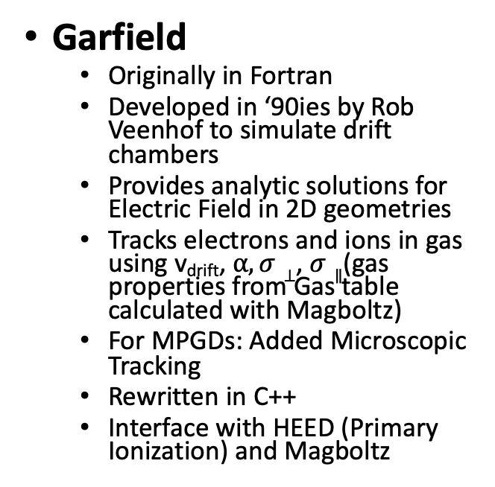
Simulation Frameworks
Garfield
  Originally in Fortran
  Developed in ‘90ies by Rob Veenhof to simulate drift chambers
  Provides analytic solutions for Electric Field in 2D geometries
  Tracks electrons and ions in gas using v_{drift}, $α, σ⊥$, $σ∥$(gas properties from Gas table calculated with Magboltz)
  For MPGDs: Added Microscopic Tracking
  Rewritten in C++
  Interface with HEED (Primary Ionization) and Magboltz
GEANT
  Originally in Fortran
  (GEANT 3) then C++ (4)
  Tracks particles through geometry with materials
  Calculates energy loss in materials
  Simulated Hit = Energy deposit in sensitive medium
  Maintained / developed by GEANT4 collaboration
    Extensive validation
  Does not simulate what happens with electrons created in energy deposit

Slide 3
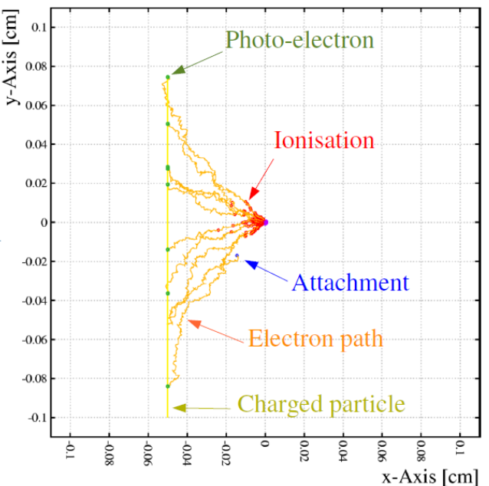
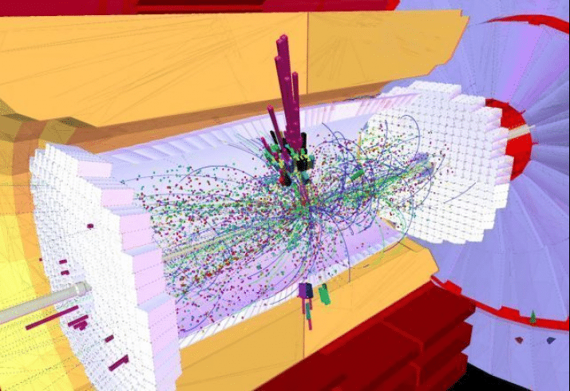
Simulation Frameworks

Slide 4
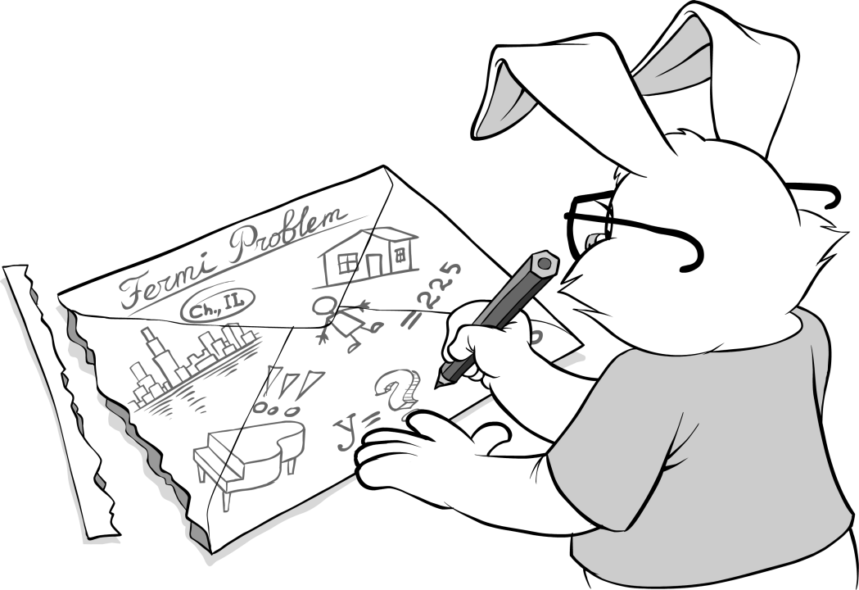
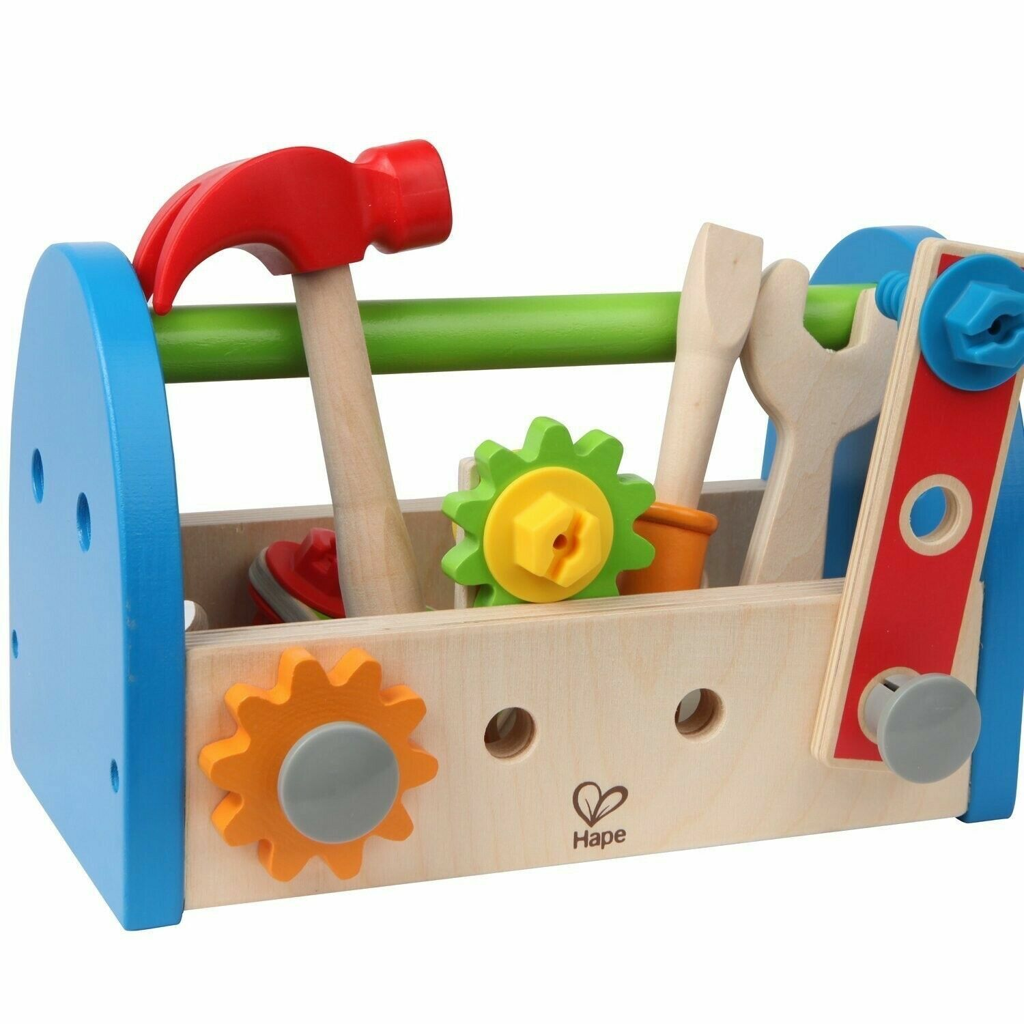





Simulation Toolbox
Toolbox of Simulator / Physicist:
=

Slide 5
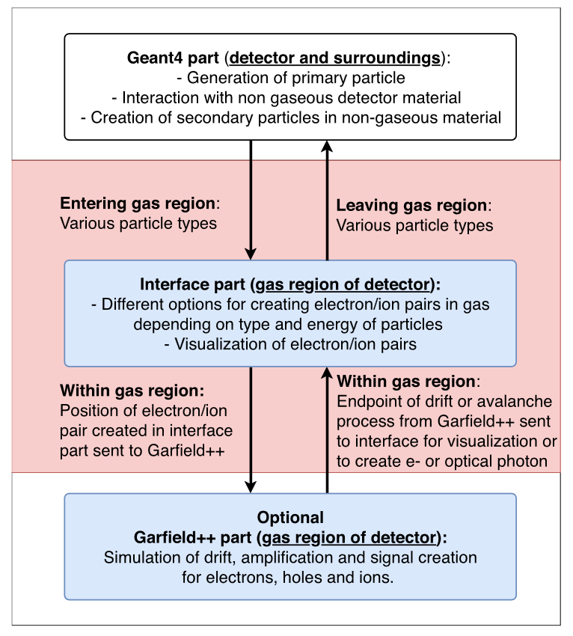
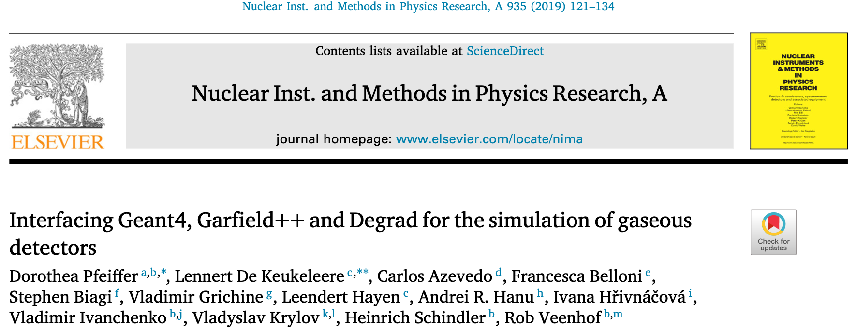
Garfield – GEANT4 Interface
User need to define when and how to hand over information from GEANT to Garfield
Useful for detailed simulation of:
Testbeam environment (beam is not clean)
Neutron / Photon detectors
Not-understood effects in the detector assuming only muons / MIPs

Slide 6
Garfield++
Open-source toolkit for detailed simulation of charge transport and signals in particle detectors
Can now simulate also semiconductor devices
Typical steps:
  Calculate static electric fields
  Simulate Primary ionization (electron-ion pairs)
  Simulate the trajectories of Primary and Secondary e-
    Including multiplication if field > critical value
  Calculate current induced on a readout electrode

Slide 7
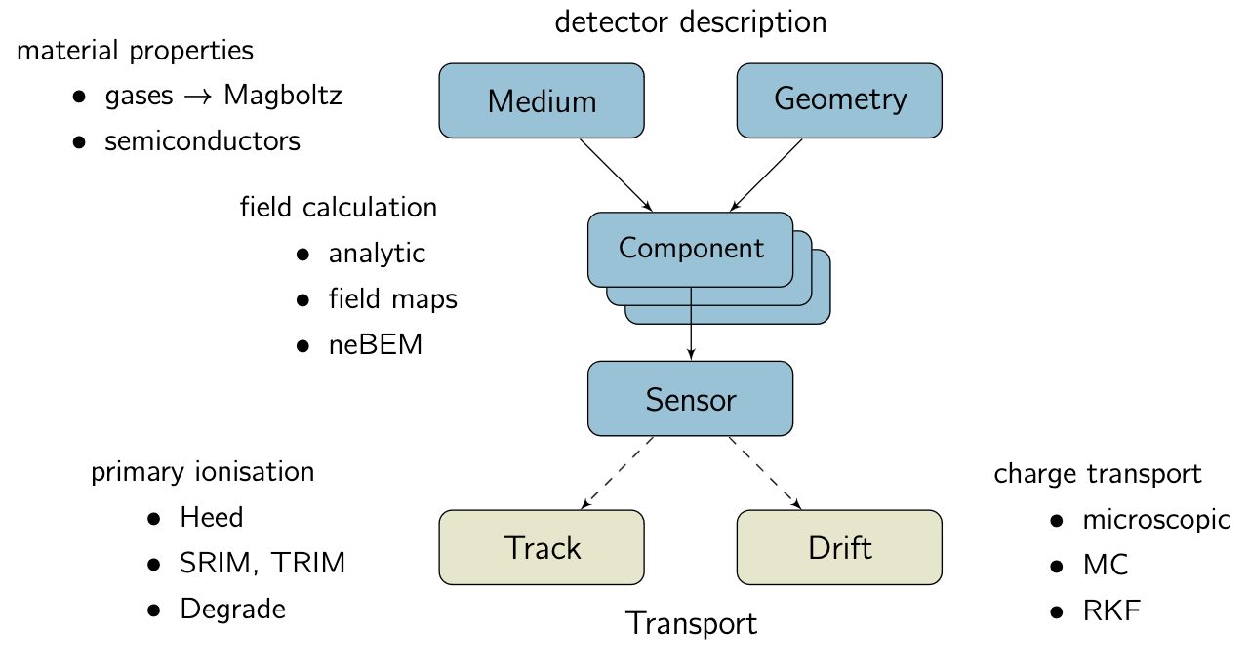
Garfield++

Slide 8
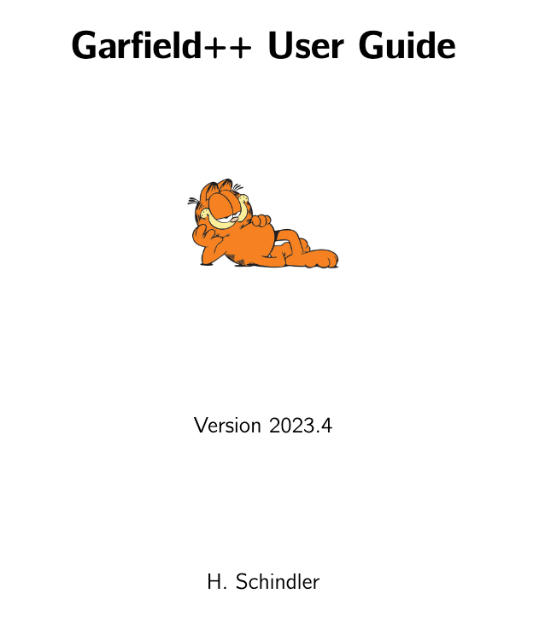
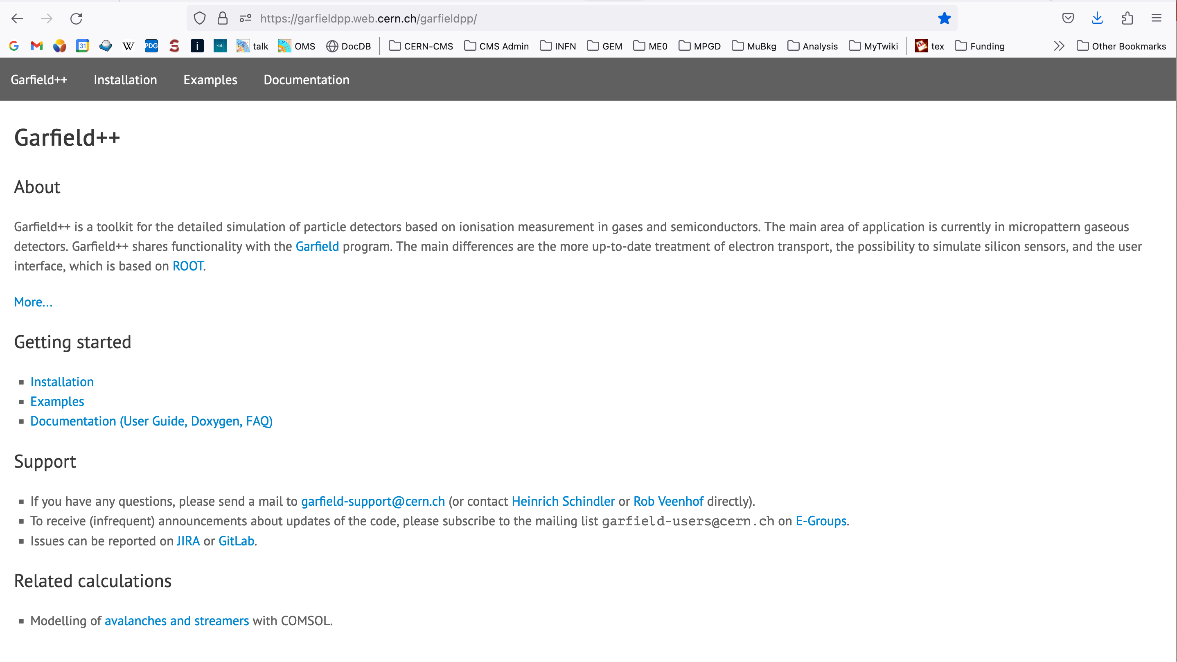
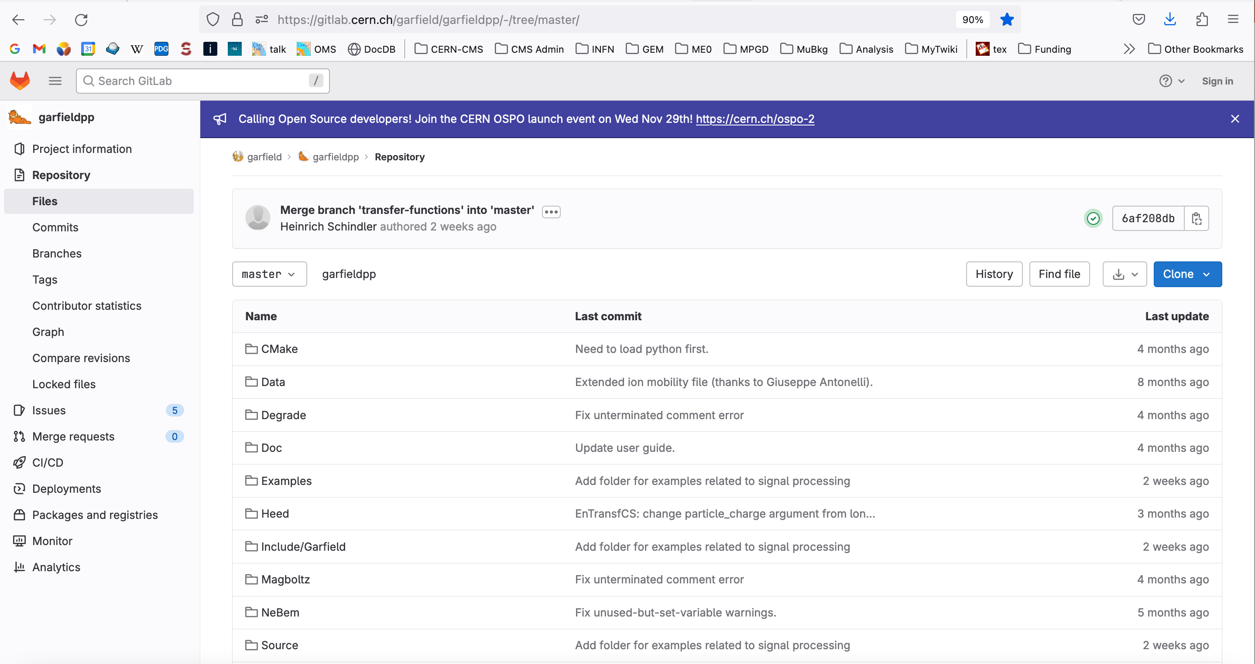
Your Friends:
Your best friends: the Holy Trinity: The Manual, The Source Code, The Examples
Maybe also your tutors - we will do our best ☺
https://garfieldpp.web.cern.ch/garfieldpp/documentation/UserGuide.pdf
https://gitlab.cern.ch/garfield/garfieldpp/-/tree/master/
https://garfieldpp.web.cern.ch/garfieldpp/documentation/

Slide 9
Prepared Exercises
Exercise 1 :: install Garfield, Electric Fields (plot V, E)
Exercise 2 :: Simulate Primary Ionization (calculate N_{prim})
  Homework: find the Bethe-Bloch function for energy loss
Exercise 3 :: Electron transport (plot v_{drift}, track e⁻ in detector)
  Homework: Evaluate the diffusion as function of the distance
Exercise 4 :: Gas Gain (simulate avalanche in Single-GEM)
  Homework: find the gain curve for a single-GEM detector
Exercise 5 :: Signal Induction in Parallel-Plate Avalanche Counter
  Homework: find the signal in a single-GEM detector
Exercise 6 :: Gain in a Triple-GEM detector
Exercise 7 :: Parametrized simulation of a Triple-GEM detector

Slide 10
Contact - Questions
Riccardo.farinelli@cern.ch
piet.Verwilligen@cern.ch

