Slide 1
MD6104: Half-Integer Resonance Studies in the PSB
T. Prebibaj*, F. Antoniou, F. Asvesta, H. Bartosik, G. Franchetti
With the inputs of:
S. Albright, C. Bracco, A. Calia, G.P. Di Giovanni, D. Gamba, E. H. Maclean, T. Levens, K. Li, B. Mikulec, E. Renner, F. Roncarolo, G. Sterbini
And the great MD planning and support of:
A. Huschauer, B. Salvant and PSB OP
30/01/2023
IPP MD Days
*tirsi.prebibaj@cern.ch

Slide 2
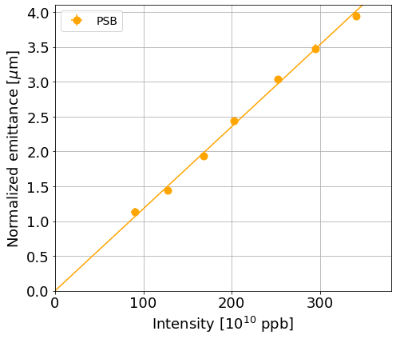
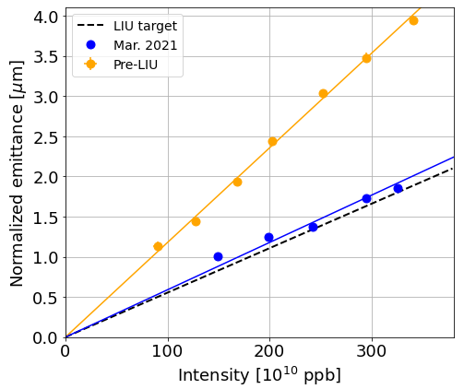
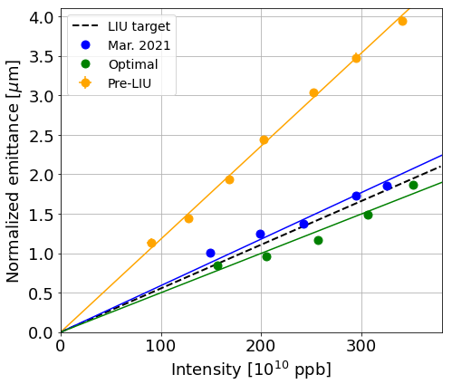
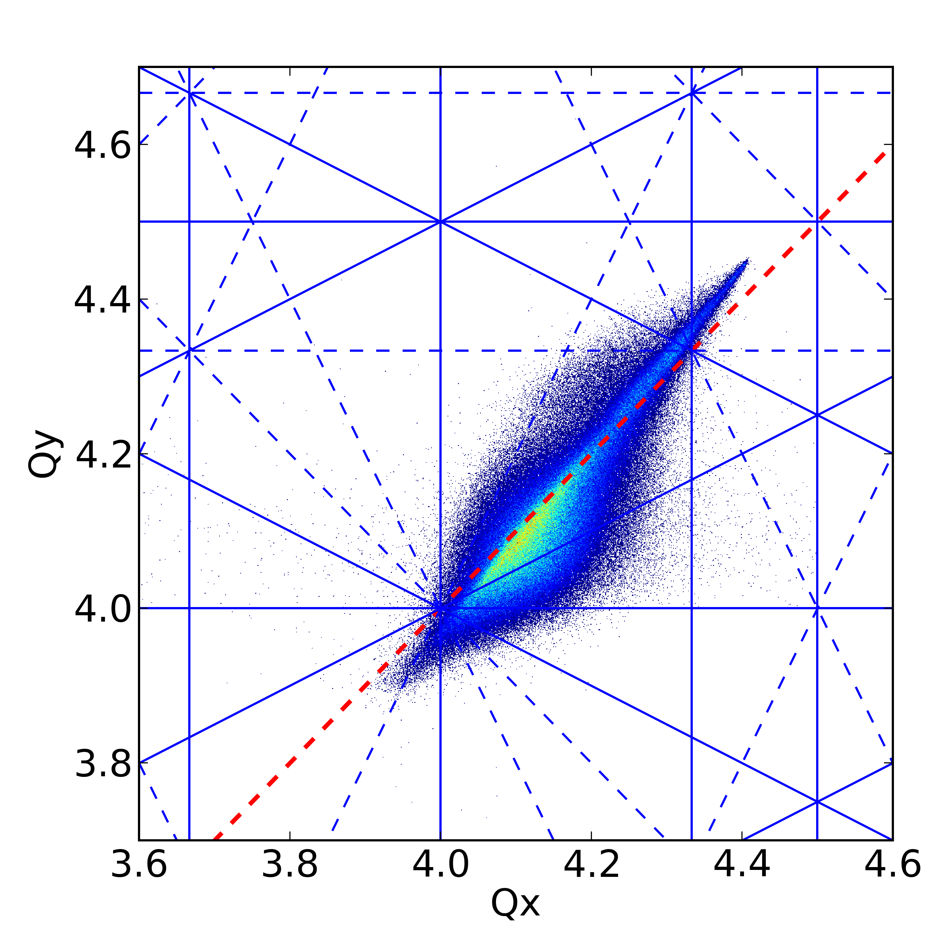

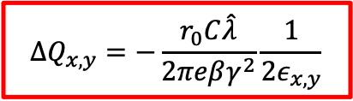

Introduction
PSB brightness performance is limited by space charge effects at injection.
Max. space charge tune shift for Gaussian
For high beam intensities (high space charge), the detuning is so large that the emittance blows-up by the integer resonances.
Higher intensity → higher emittance blow-up → constant brightness.
A mitigation technique is to increase beam energy → LIU upgrades.
Another mitigation technique is to stay as far as possible from the integer resonances:
Practically, this means to increase the working point and optimize the tune evolution.
In this case, the half-integer resonance effects become important.
A brightness gain was demonstrated by injecting closer to the half-integer (beta-beating, tune and resonance correction were needed [1-4]).
$$ΔQ_{x,y}=−\frac{r_{0}C\hat{λ}}{2πeβγ^{2}}\frac{1}{2ε_{x,y}}$$
$$4Q_{x}=16$$
$$4Q_{y}=16$$
IPP MD Days 2023
tirsi.prebibaj@cern.ch

Slide 3
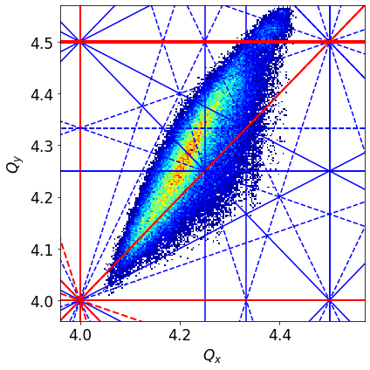
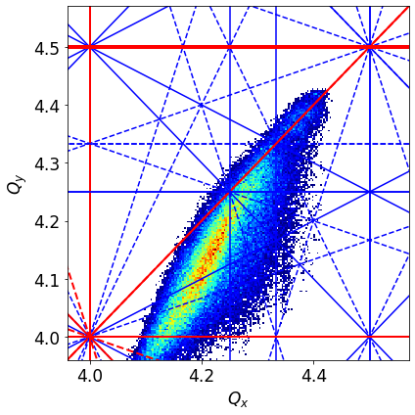



MD goals
MD6104 studies if we can achieve a brightness gain by injecting above the half-integer resonance and then crossing it.
$$4Q_{x}=16$$
Characterize all the space charge effects near the half-integer resonance (experimentally + simulations)
$$2Q_{y}=9$$
Find optimal crossing scenario to increase the beam brightness.
$$4Q_{y}=16$$
IPP MD Days 2023
tirsi.prebibaj@cern.ch

Slide 4
MD challenges
Control of the half-integer AND higher order resonances (quadrupole, sextupole and octupole correctors).
✓
Characterize all the space charge effects near the half-integer resonance (experimentally + simulations)
✓
Flexible tune control and measurement (BBQ).
✓
Range of intensities and emittances ($H^{−}$ injection).
✓
Bunched AND coasting beams.
✓
Ramp AND flat-bottom cycle.
✓
Flexible and robust Wire Scanner.
Find optimal crossing scenario to increase the beam brightness.
PSB satisfies all these criteria.
IPP MD Days 2023
tirsi.prebibaj@cern.ch

Slide 5
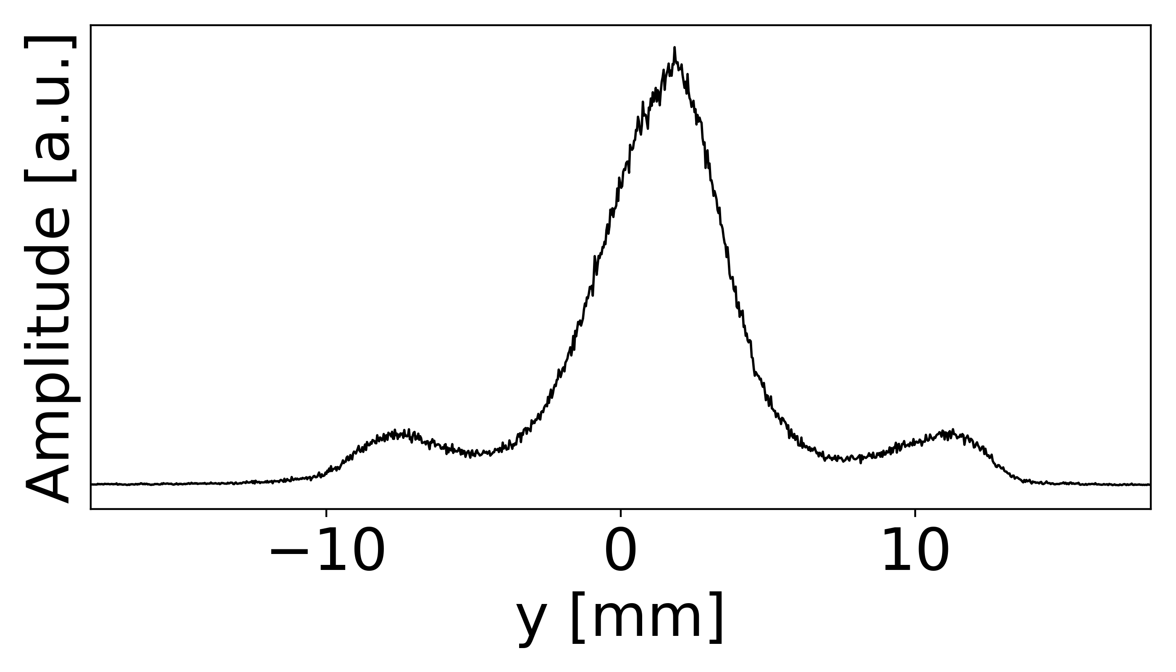
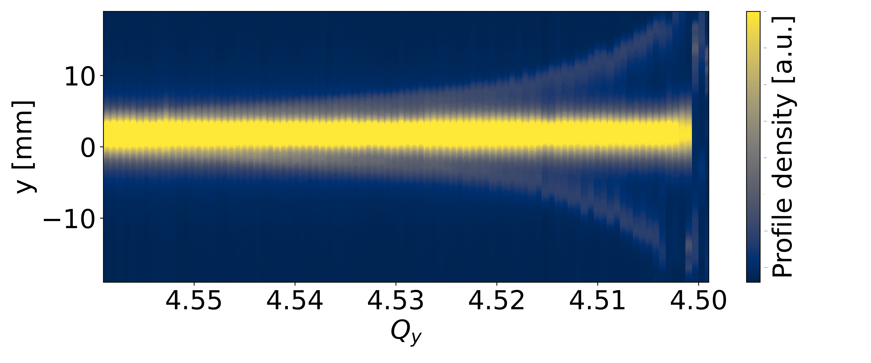
MD results
Characterize all the space charge effects near the half-integer resonance (experimentally + simulations)
Particle trapping in the half-integer resonance islands [5-7].
Measurement
IPP MD Days 2023
tirsi.prebibaj@cern.ch

Slide 6
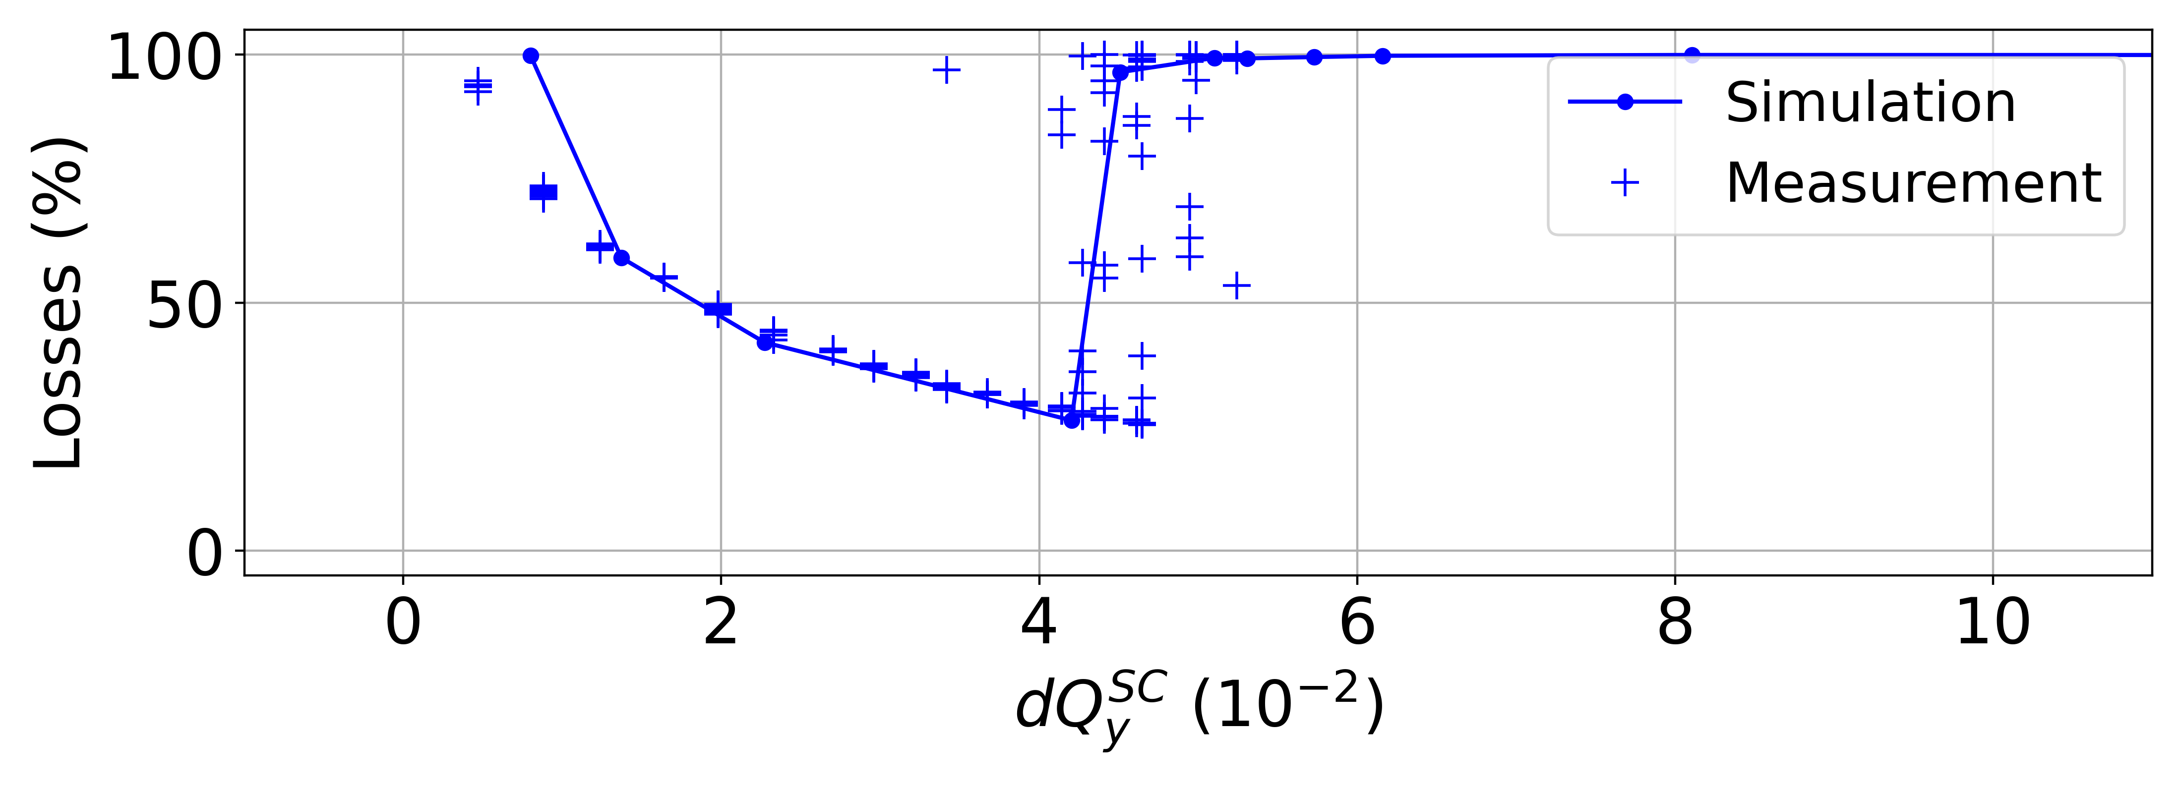
MD results
Characterize all the space charge effects near the half-integer resonance (experimentally + simulations)
Particle trapping in the half-integer resonance islands [5-7].
Trapping under special beam conditions (very strong space charge and slow crossing) → beam behaviour not well understood [8].
Effects of chromaticity and synchrotron motion [9].
Crossing the resonance with different crossing speeds [9].
…
IPP MD Days 2023
tirsi.prebibaj@cern.ch

Slide 7
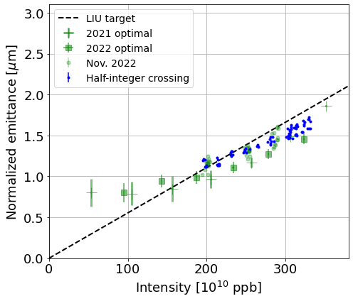
MD results
Find optimal crossing scenario to increase the beam brightness.
Green data: optimal brightness when staying below the half-integer resonance.
Blue data: brightness when injecting above and dynamically crossing the half-integer.
Although an extremelly challenging exercise, the half-integer crossing is feasible with a very decent beam quality (brightness still exceeding LIU target, profiles with similar tails) [10].
But, not achieving the expected brightness gain (yet…).
To seek for further optimizations in 2023.
IPP MD Days 2023
tirsi.prebibaj@cern.ch

Slide 8

Summary and Plans for 2023
MD6104 started in 2021 for studying the vertical half-integer resonance with the view of exploring if injection above the half-integer resonance is beneficial for the brightness.
Many interesting effects were observed along the way: some of them are well explained some are still under investigation. Methods to address the open points to be tested in 2023 MDs.
The injection and dynamic crossing of the half-integer resonance for the LHC-type beams under operational conditions is not unreachable. Fine details of the method and possible uses to be reviewed in 2023.
IPP MD Days 2023
tirsi.prebibaj@cern.ch

Slide 9
References
[1]: “Injection Chicane Beta-Beating Correction for Enhancing the Brightness of the CERN PSB Beams”, HB2021 (MOP18).
[2]: “Beta-beat correction in the PSB during injection bump decay”, ABP Injectors WG Meeting, 04/2020 [Online].
[3]: “Status of the k-modulation application”, IPP Meeting, 11/2020 [Online].
[4]: “K-Modulation Application”, Accelerating Python Q4 2020 Meeting (link).
[5]: “Studies on the Vertical Half-Integer Resonance in the CERN PS Booster”, IPAC22, 06/2022 (MOPOST058).
[6]: “PSB Half-Integer experiment”, Space Charge WG Meeting 16/12/2021 (link).
[7]: “Effects of Space Charge close to the Half-Integer Resonance in the PSB”, INC Section Meeting 01/02/2022 (link).
[8]: “Half-Integer crossing simulations”, Space Charge WG Meeting, 02/05/2022 (link)
[9]: “Half-integer Studies”, INC Section Meeting 28/07/2022 (link).
[10]: “Crossing the half-integer under operational conditions”, Space Charge WG Meeting 14/12/2022 (link).
IPP MD Days 2023
tirsi.prebibaj@cern.ch

Slide 10
Backup

Slide 11
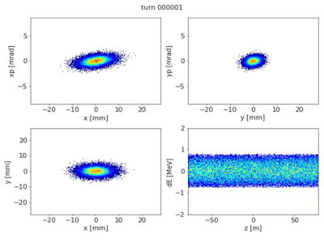
Trapping under strong space charge and slow crossing
When the space charge is very strong and/or the crossing is very slow, the beam seems to get unstable both in measurements and simulations (beam is fully lost)!
The exact reasons for this are not yet fully understood, both for measurements and simulations.
Currently running simulations with other codes (Xsuite, Micromap, …).
PyOrbit simulation
IPP MD Days 2023
tirsi.prebibaj@cern.ch

Slide 12
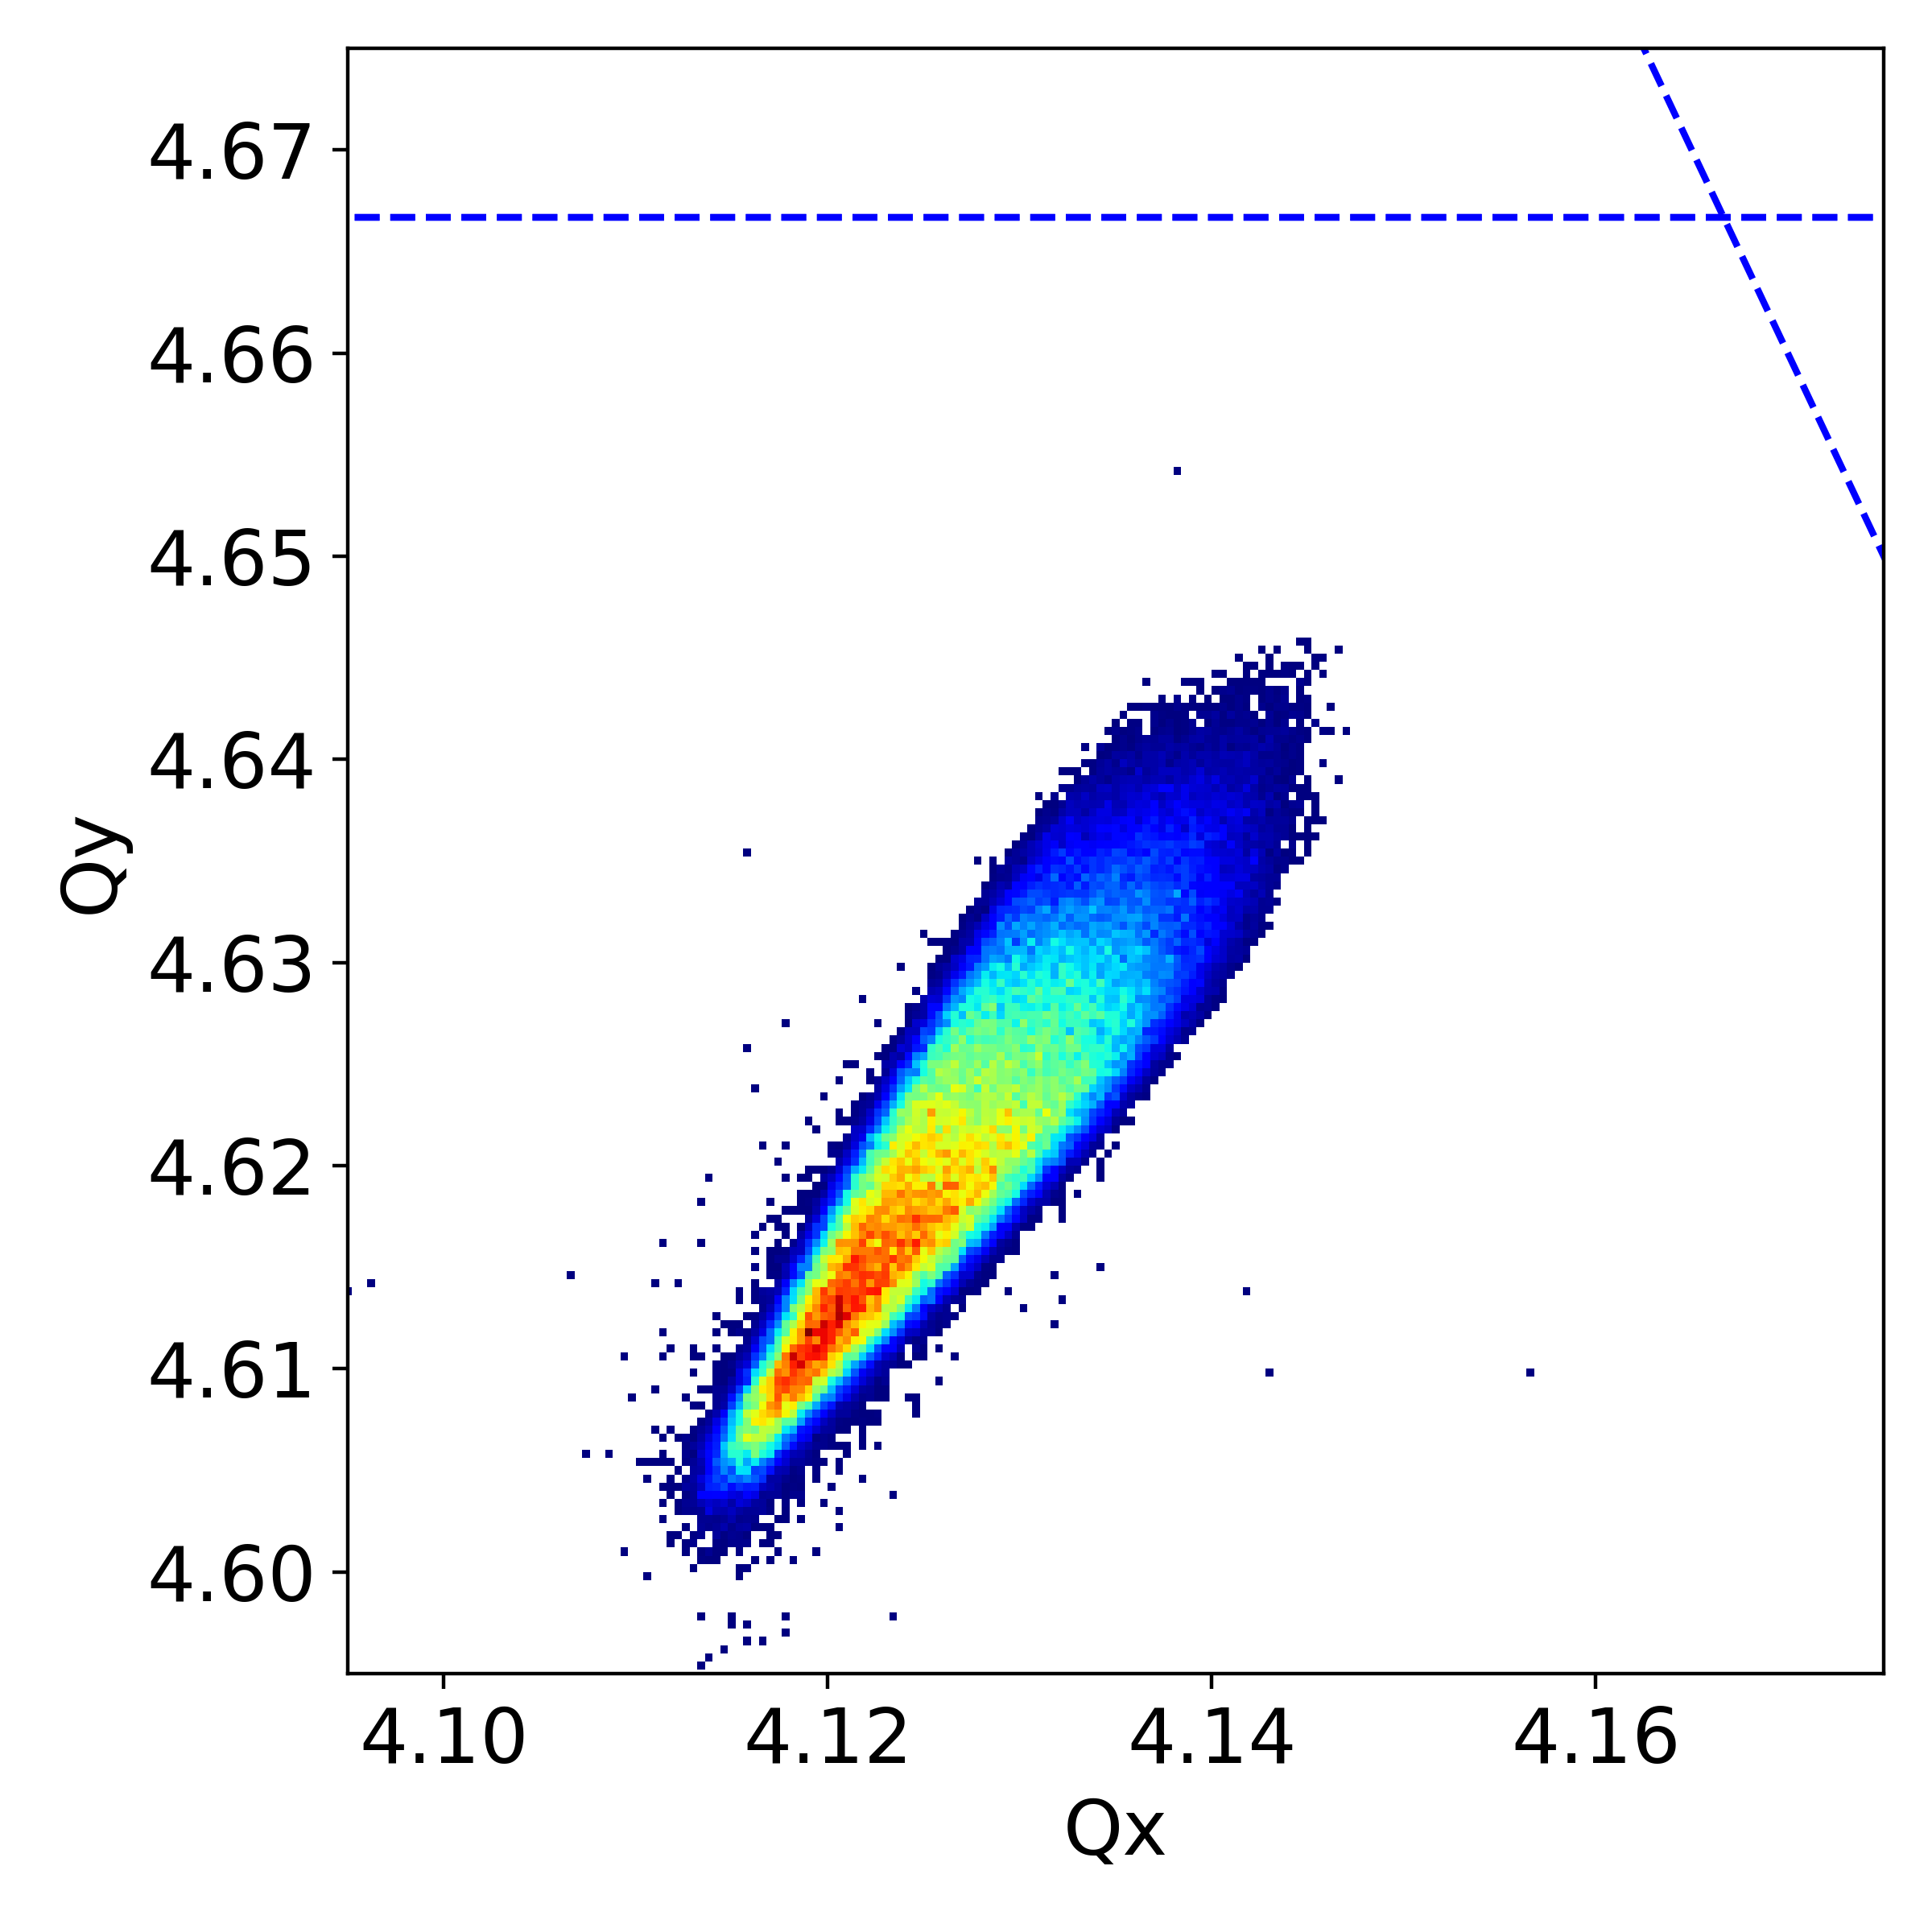
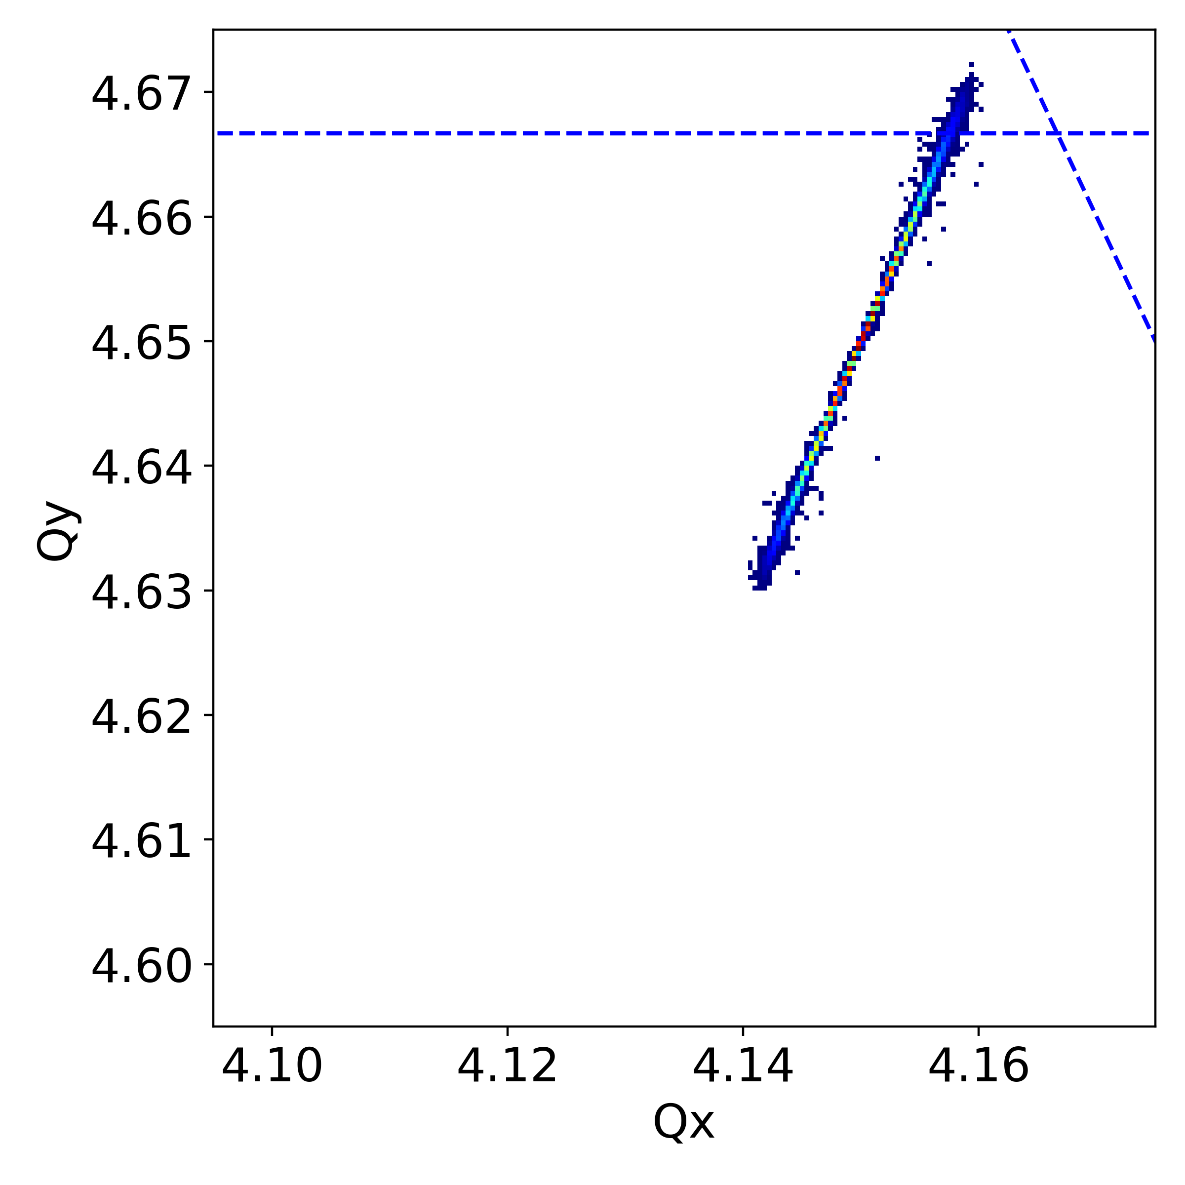
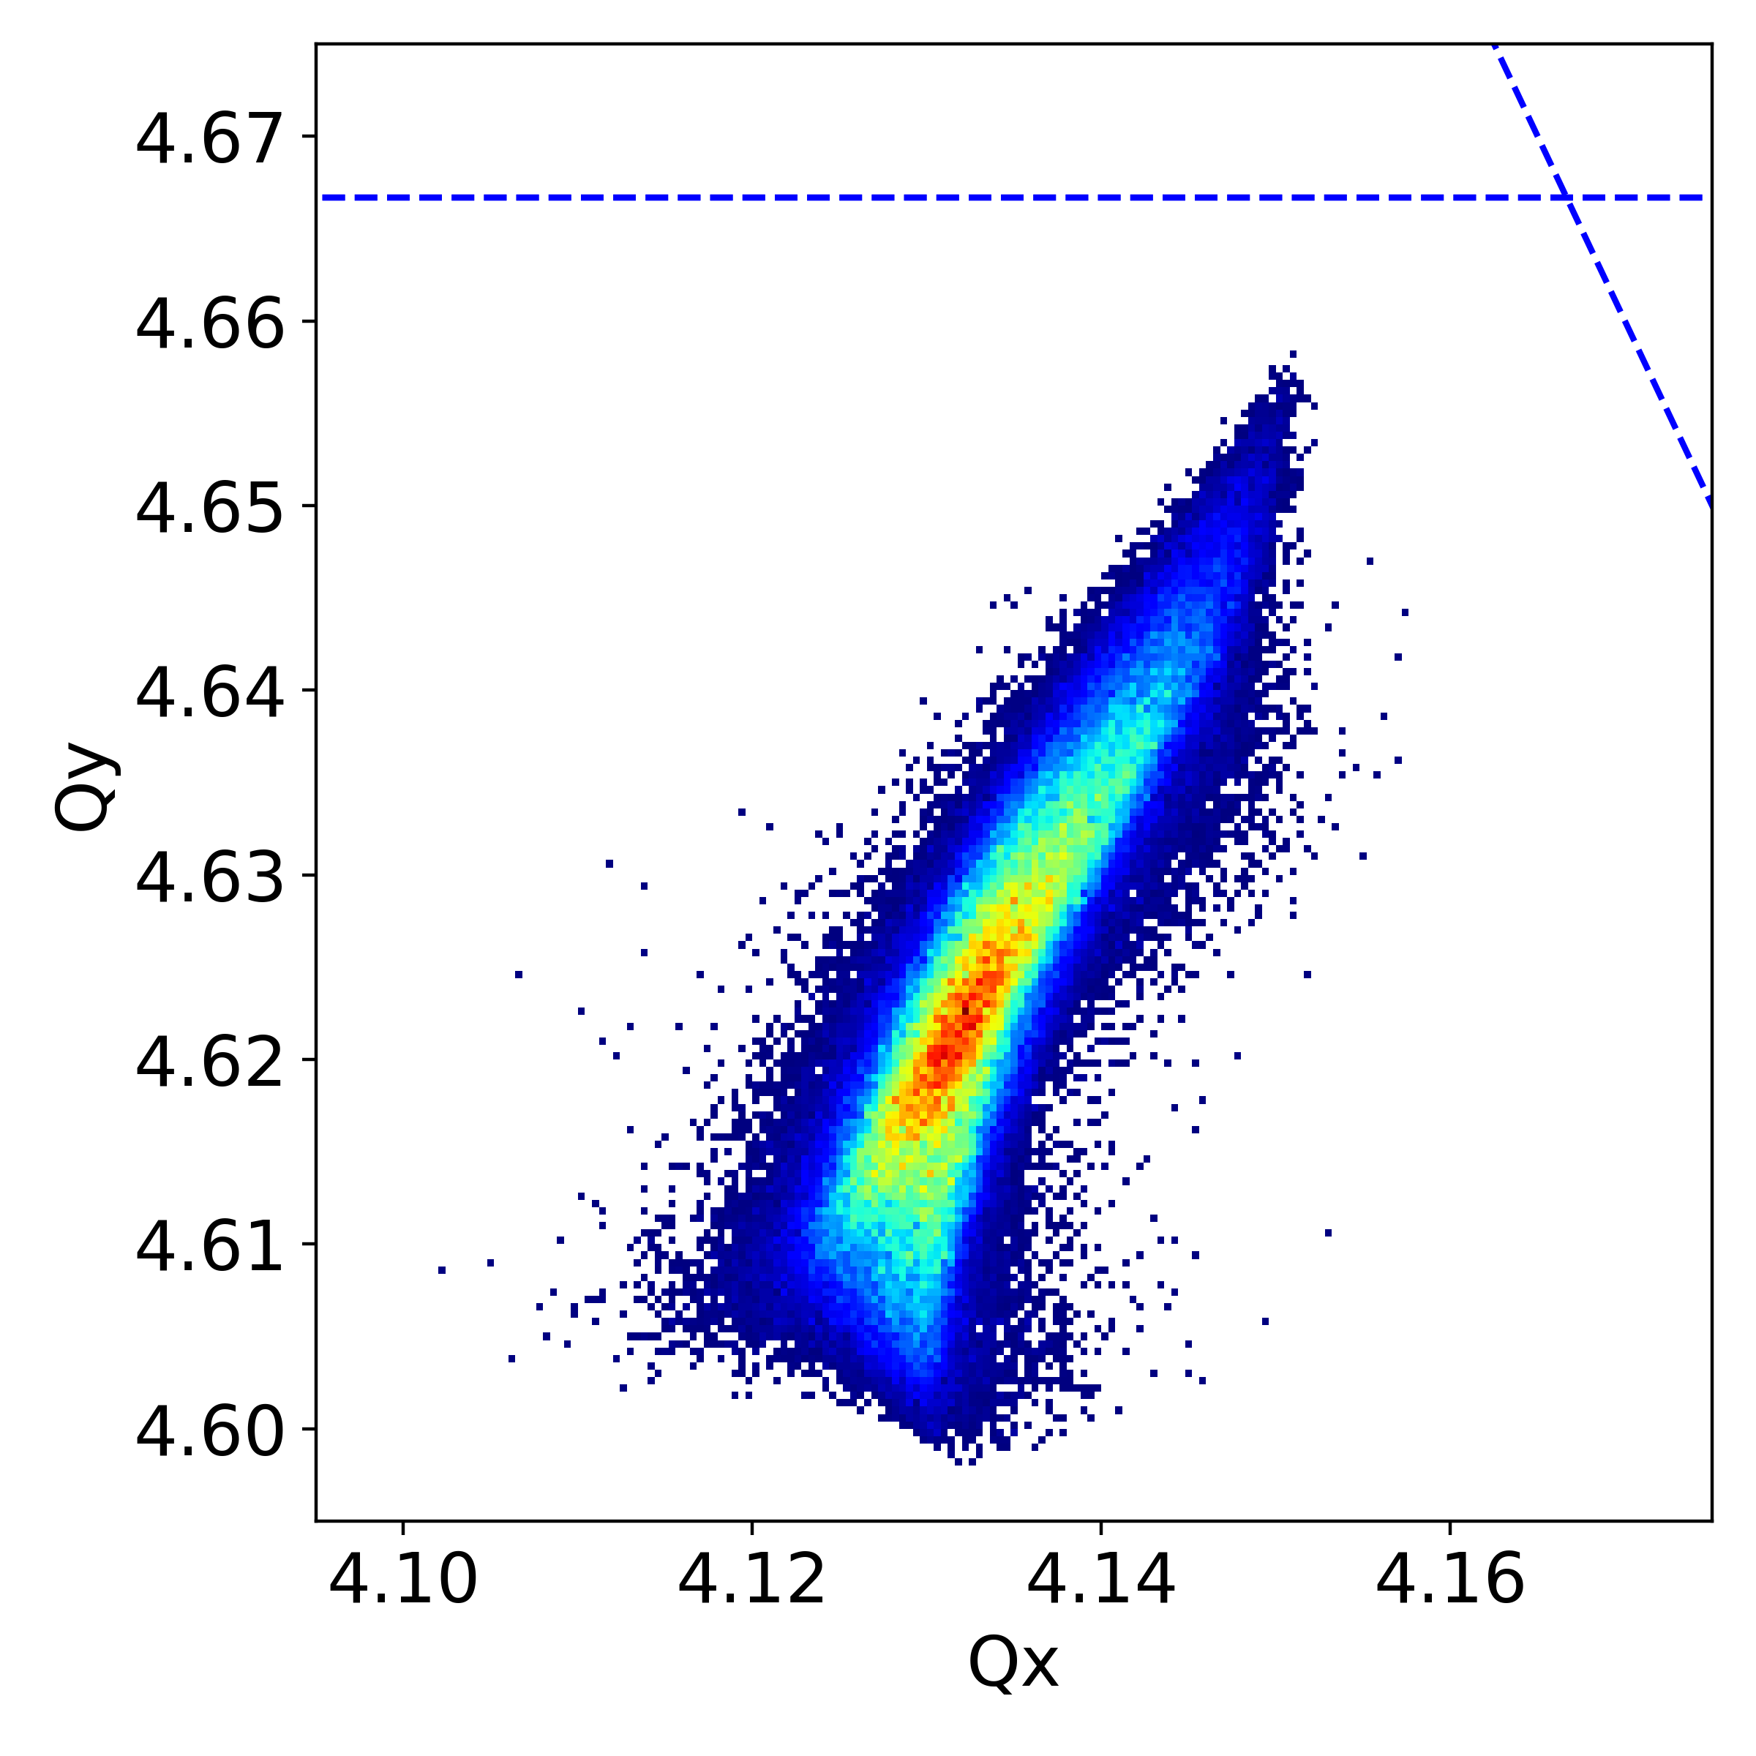
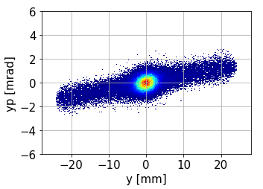
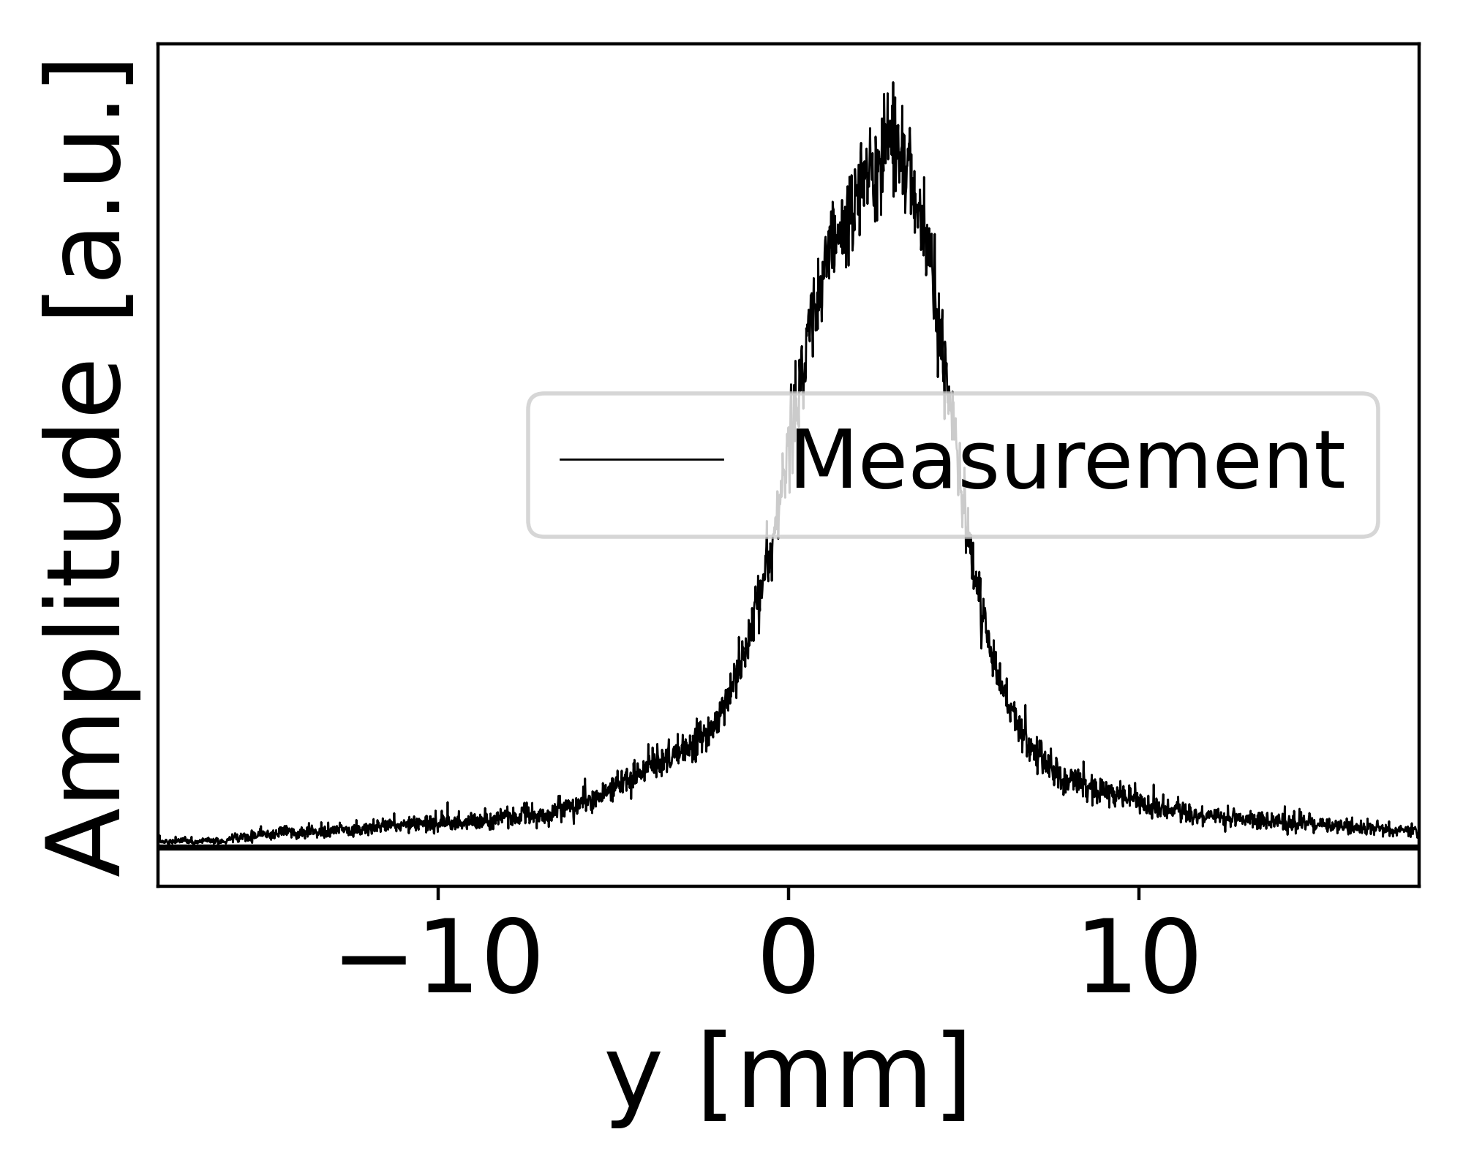
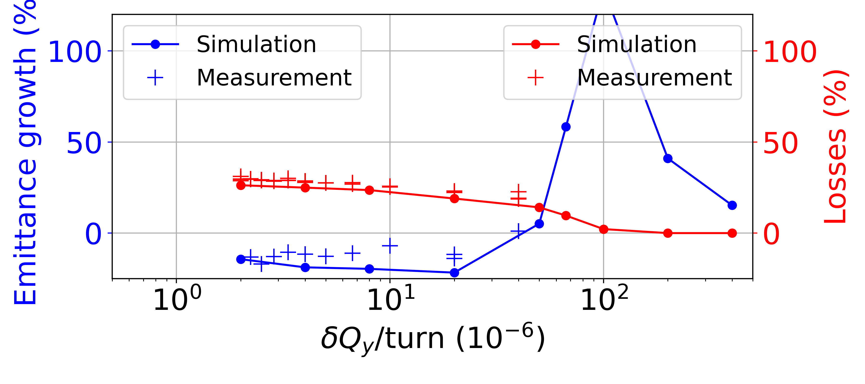
Chromaticity and crossing speed
Chromaticity induces adittional detuning.
Space charge
Chromaticity
Space charge + chroma
Appearance of multiple islands for different momentum offsets.
adiabatic region
non-adiabatic region
Beam effects change when crossing the resonance with different speeds.
IPP MD Days 2023
tirsi.prebibaj@cern.ch

Slide 13
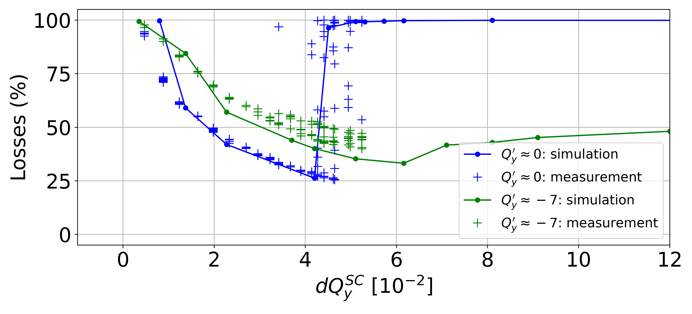
Effects of chromaticity
With non-zero chromaticity:
More losses (the beam loss region increases).
Beam not unstable for very strong space charge.
IPP MD Days 2023
tirsi.prebibaj@cern.ch

Slide 14
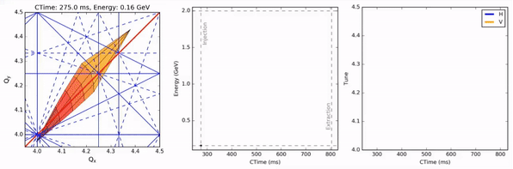
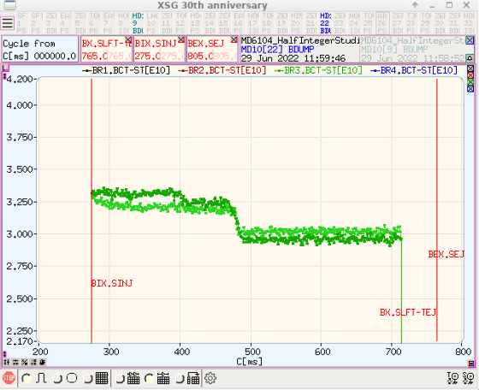
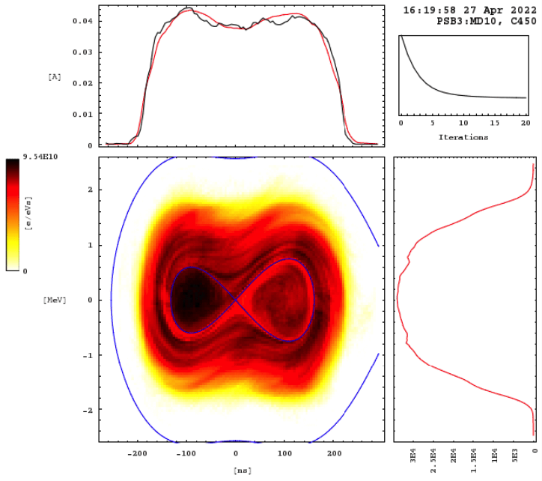
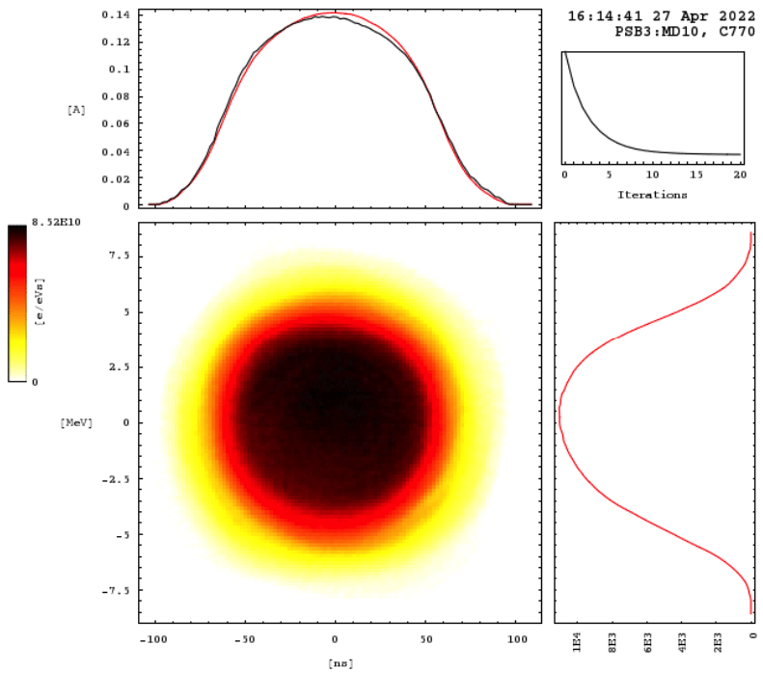
Operational conditions of LHC-beams
Beam is accelerated: space charge constantly changes. Higher order resonances are also crossed.
Half-integer is compensated but not perfectly (~3% losses).
Beam is bunched and goes from double harmonic to single harmonic.
Chromaticity cannot be corrected in both planes simultaneously.
IPP MD Days 2023
tirsi.prebibaj@cern.ch

Slide 15
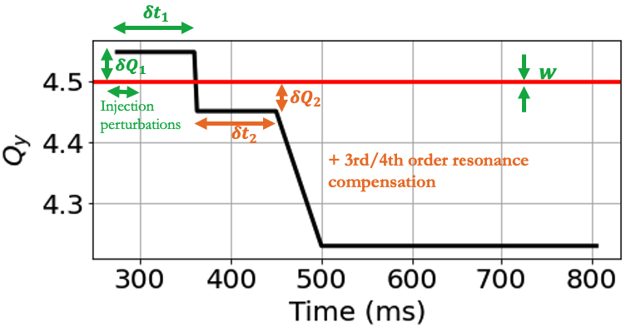
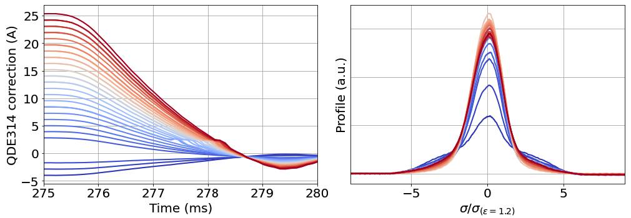
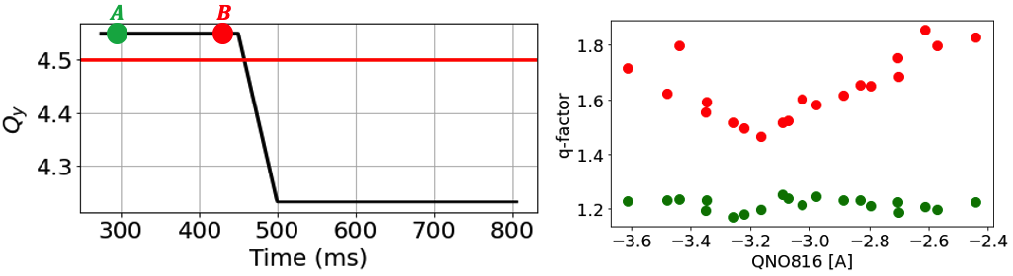
Optimizations when crossing under operational conditions
Optimize tune evolution when crossing
Optimize injection chicane perturbations above the half-integer
Optimize half-integer compensation using various techniques
IPP MD Days 2023
tirsi.prebibaj@cern.ch

Slide 16
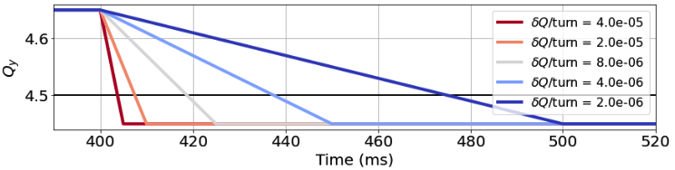
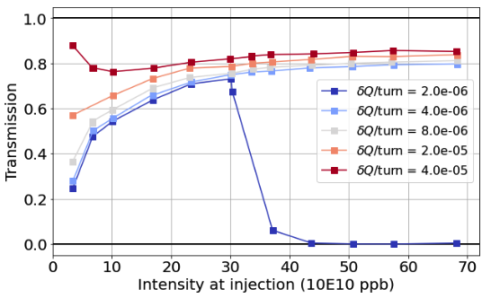
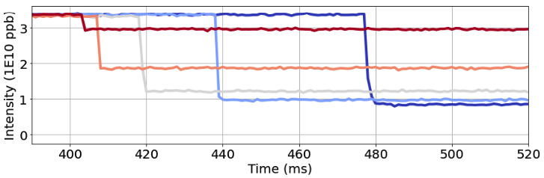
Dynamic tune scans: coasting
Crossing faster → better transmission (beam is stable)
IPP MD Days 2023
tirsi.prebibaj@cern.ch

Slide 17
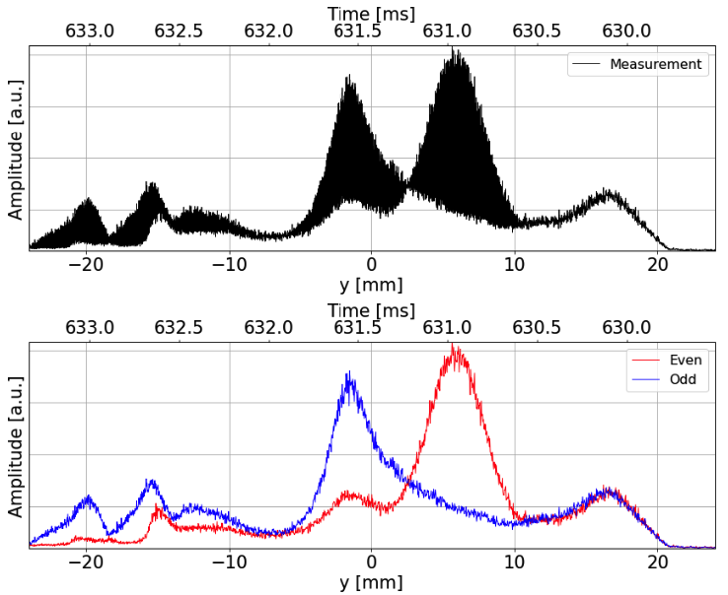
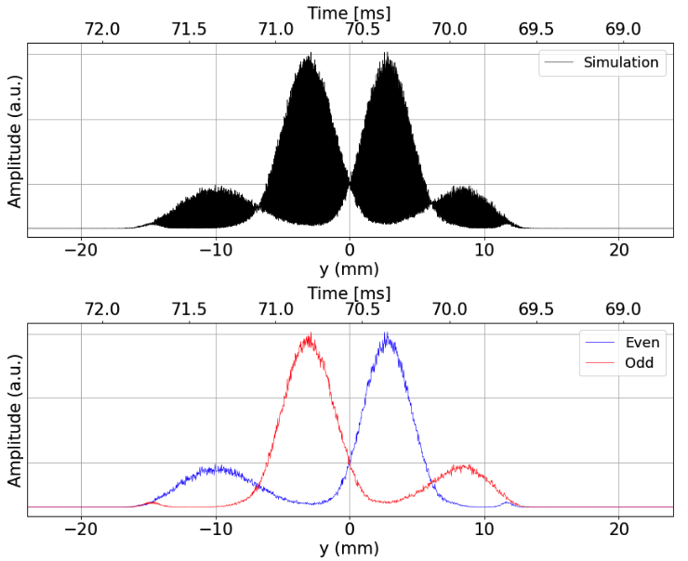
Profile measurement when beam is “unstable”
WS measurement
Simulating the WS in PyOrbit
IPP MD Days 2023
tirsi.prebibaj@cern.ch

