Slide 1
RFKO by Emittance Blowup in CERN Proton Synchrotron
Thomas Bass (SY-ABT-BTP, TECH)
30th January 2023

Slide 2
Objectives
Masters project as CERN Technical Student (via Royal Holloway Uni. of London)
Studying methods of improving Slow Extraction, especially simulation methods
Specifically looking at using Emittance Blowup (e-BU) to drive radio-frequency knock-out (RFKO) slow-extraction
Emittance BU provided by transverse feedback (TFB) systems
MDs required to obtain benchmarking data for simulation work
Objectives similar to beam studies for CHIMERA, capacity to work in parallel

Slide 3
MD Process
Using CPS MD9044_IEAST_Pb_750
Lead⁺⁵⁴ ions
750 MeV E_{k}/nucleon at T8 east area -> equivalent to 4.535 GeV E_{k} Protons
Extraction to east dump
Use Qmeter2 TFB, repeated sweeps across 1/3rd integer resonance (“chirps”)
Monitoring extracted beam at East F61 with BXSCINT
Gas Beam Current Measurement (F61.BCGAA023)
n measurements
t interval
n turns
Q=1/3
frequency/amplitude
frequency
time
time

Slide 4
MDs completed in 2022
MD 8923 – 1st & 3rd Nov 22 – 12h
MD 9044 – 16th to 23rd Nov 22 – 36h
Work completed with Eliott Johnson (SY-ABT-BTP)
First attempts at using Qmeter2 TFB to drive slow extraction
Using ions, extracting to East area dump
Established basic configuration for successful extraction
Found improvements with data acquisition methods
BXSCAL could not provide accurate data
BXSCINT was used instead
Worked with Tom Levens (SY-BI-IQ) and Gerd Kotzian (SY-RF-FB) to implement new TFB signal generator
Enabled chirps with intervals below 1ms
Qmeter2 has a 1ms interval limitation
New signal generator installed to create frequency modulated chirps at a sub-1ms interval
Successfully extracted beam using sub-1ms intervals
Successfully performed parameter scans to obtain transfer functions

Slide 5
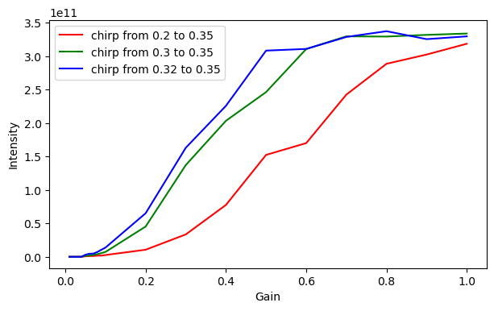
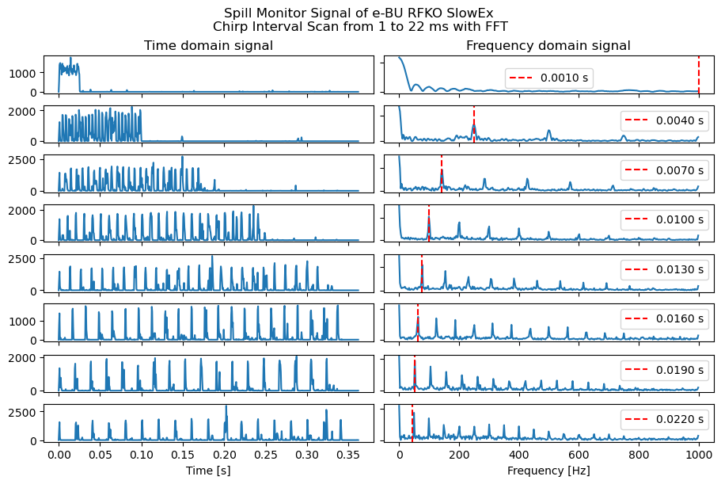
2022 MD Results
MD 8923
Basic Method Investigation & Verification
Chirps between 1ms and 20ms
A smaller chirp interval – at a constant chirp time – produces higher intensity, as more time is spent near resonance
Spill signals from BXSCINT Gas Scintillator clearly show presence of driving interval frequency.

Slide 6
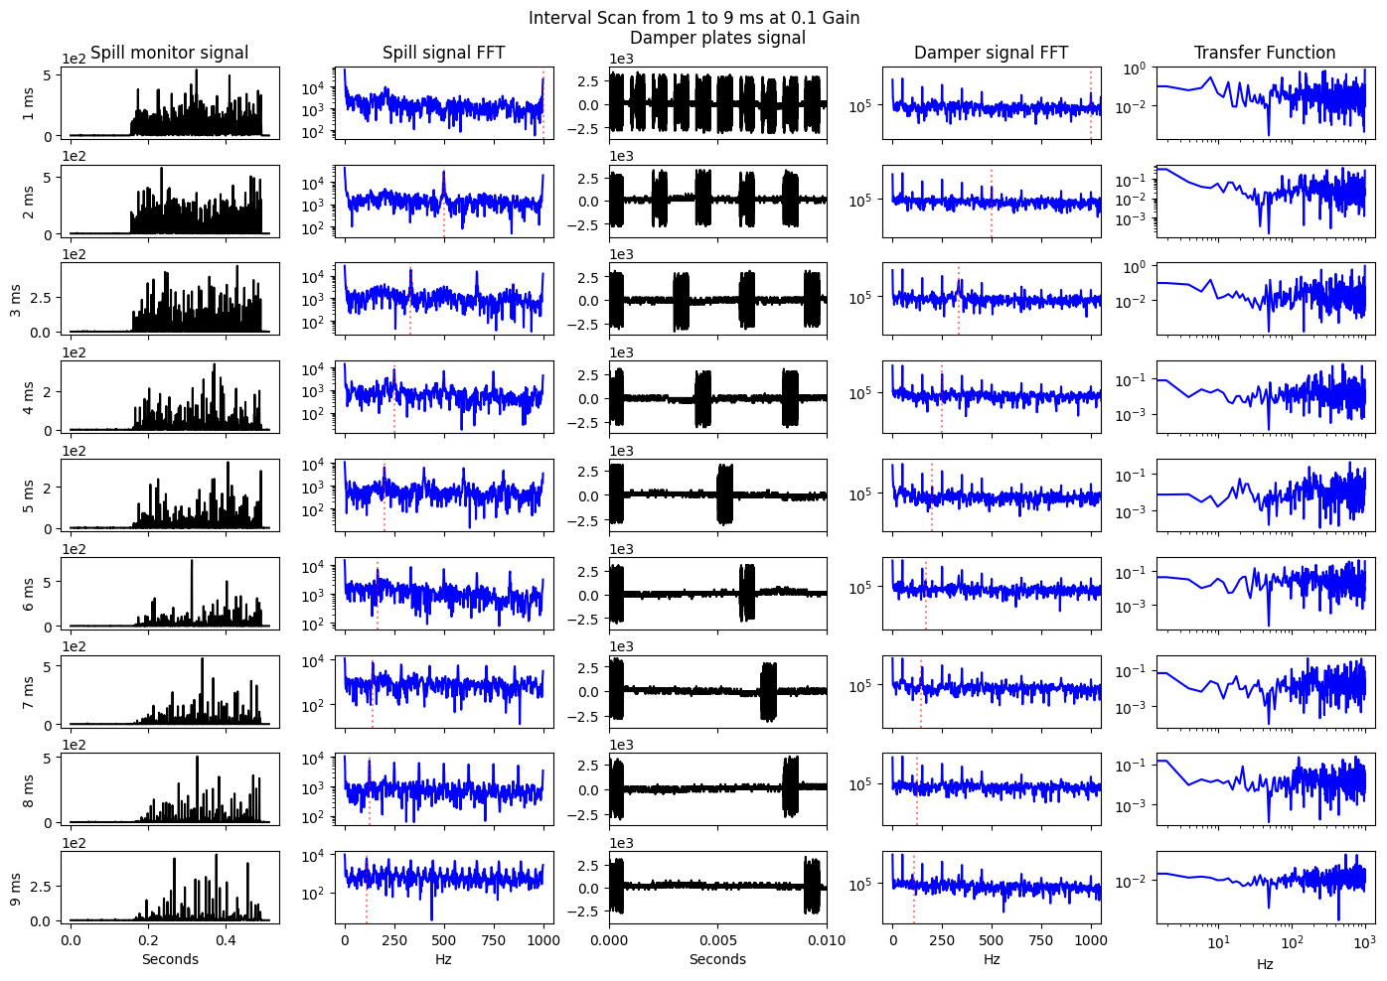
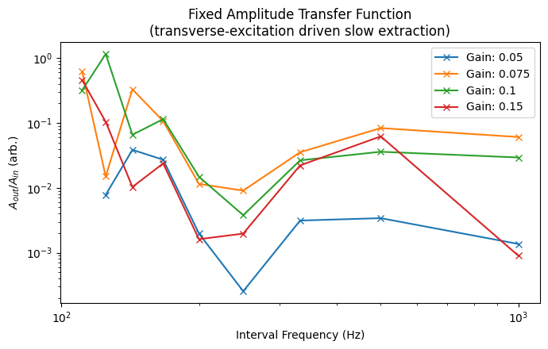
2022 MD Results
MD 9044
Parameter scans completed using Qmeter2
Successfully shown chirp interval effect on spill quality
Fixed-amplitude transfer function obtained

Slide 7
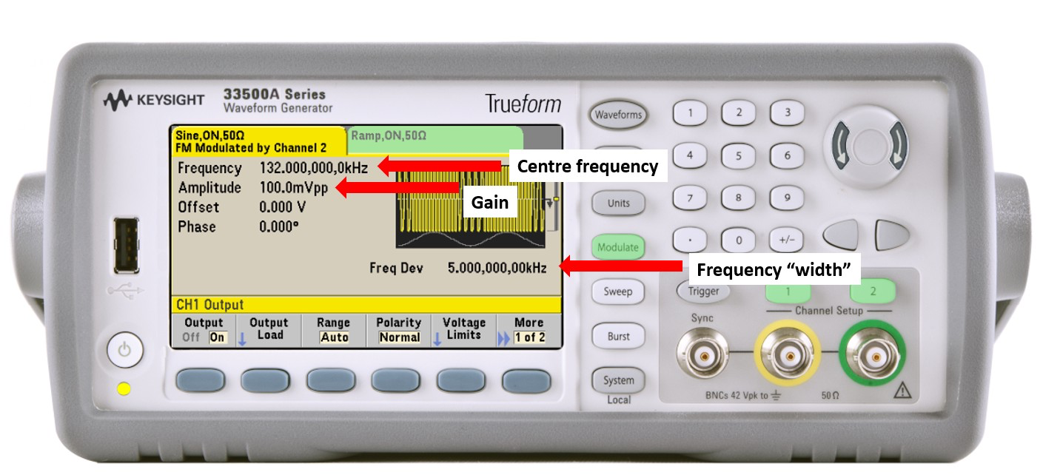
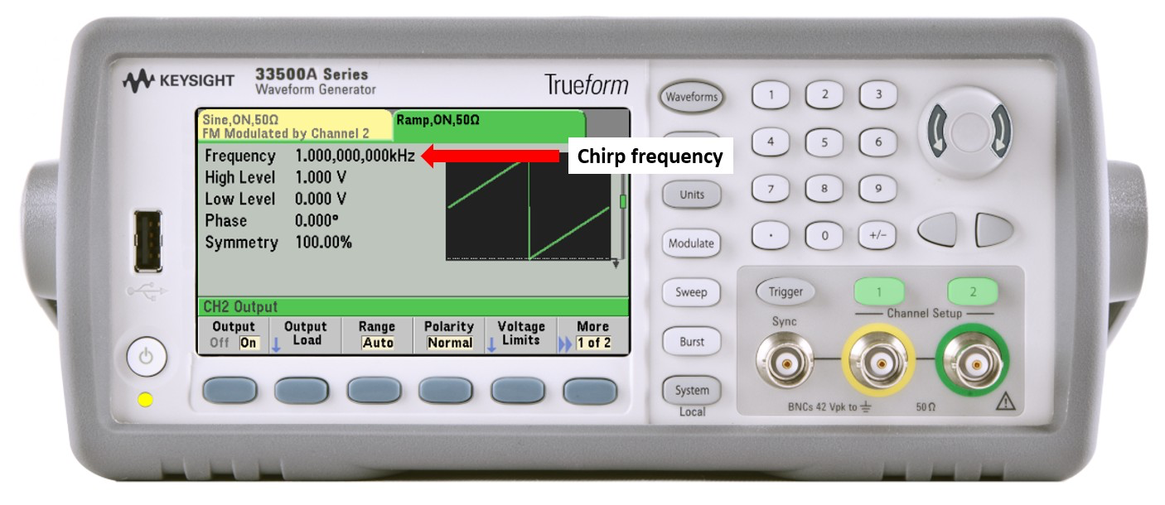
New Signal Generator
Qmeter2 is limited to 1ms minimum interval
New signal generator installed to control TFB
Allows for sin-wave frequency modulated by ramp/saw wave
Frequency of ramp/saw wave = interval frequency
Implemented by Tom Levens and Gerd Kotzian with Eliott Johnson

Slide 8
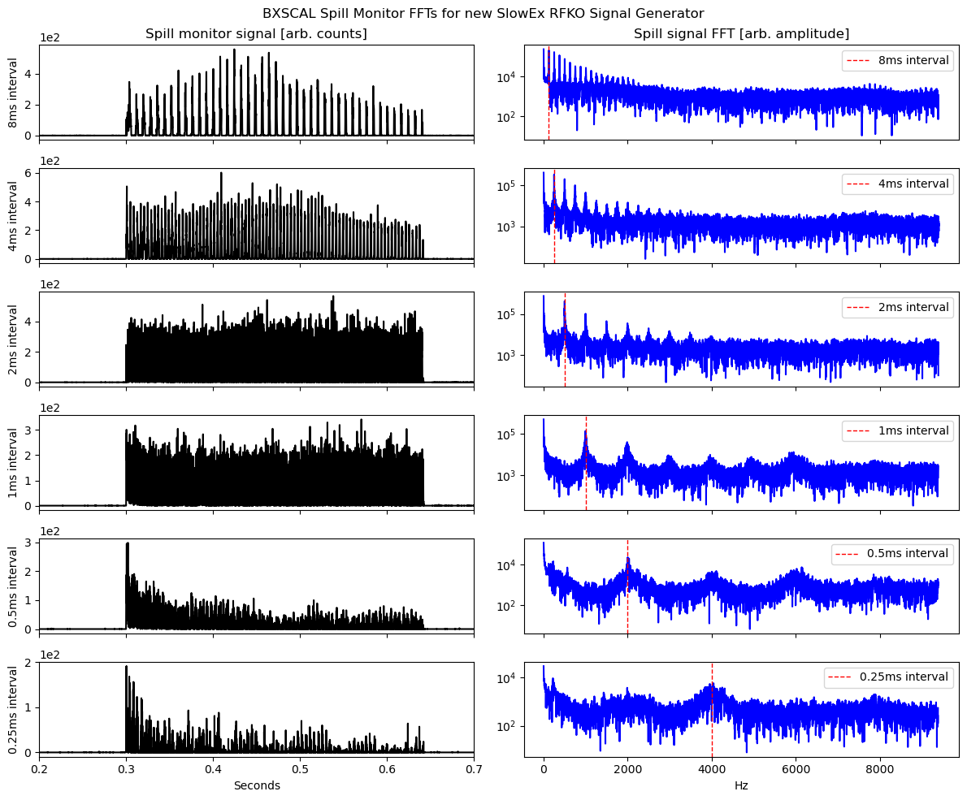
2022 MD Results
MD 9044
Parameter scans completed using custom signal generator to achieve chirp intervals below 1ms
Successfully shown chirp interval effect on spill quality

Slide 9
Goals for 2023
Obtain more data when Ions are available in PS
Parameter scans over wider ranges
Multiple repeats for higher confidence
Explore faster (sub-1ms) chirp interval
Amplitude-modulated chirp signal to improve spill quality
Spill shape appears to change with gain
Higher gain creates higher initial spill, then a decay; Lower gain creates a slow rise to plateau
Need better results to quantify this, and explore amplitude modulation to achieve constant spill
All with the aim of verifying simulations of Slow Extraction with Xsuite/MAD-X
MD Requests
4.53 GeV Protons at PS to East Area
Equivalent to 0.75 GeV Pb+54 ions
Four to eight MD slots (projected)

