Slide 1
Optimization of the operational cycle for the neutron Time-Of-Flight (n-TOF) Beam
D.Cotte (BE-OP-PS)
On behalf of PS operation and PS coordinators, Heiko Damerau, Yann Dutheil.

Slide 2
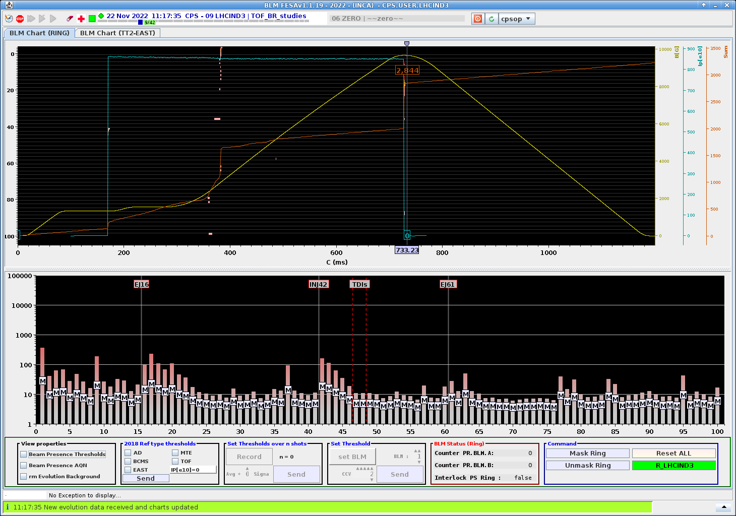
Operational cycle for nToF
Beam produced from PSB Ring 2 (R3 can be used as back-up)
Beam intensity ~850 x 10¹⁰ p per pulse)
Main losses occur at transition crossing and extraction.
Bunch rotation before extraction in order to reach 40ns or 28ns bunch length
2GeV Injection @ C170
Crossing Transition
20GeV/c Extraction @ C728
PS magnetic cycle
Beam losses
Beam losses per straight section
Notes:
1BP cycle length
Inject 1 big bunch coming from Booster R2 at 850e10
Main losses are around transition and extraction
This cycle is pretty simple RF point of view H8 a along the cycle with a bunch rotation just before extraction

Slide 3
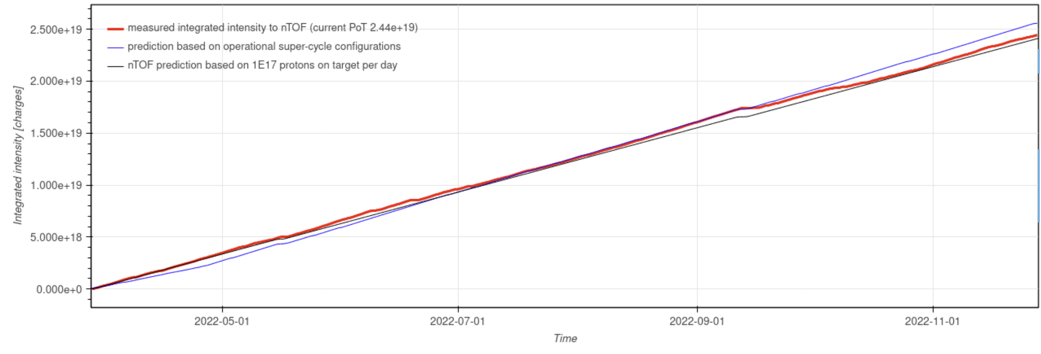
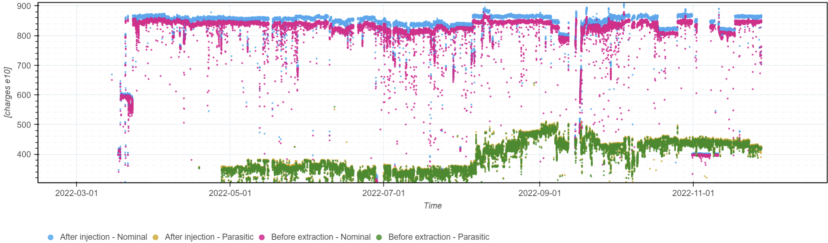
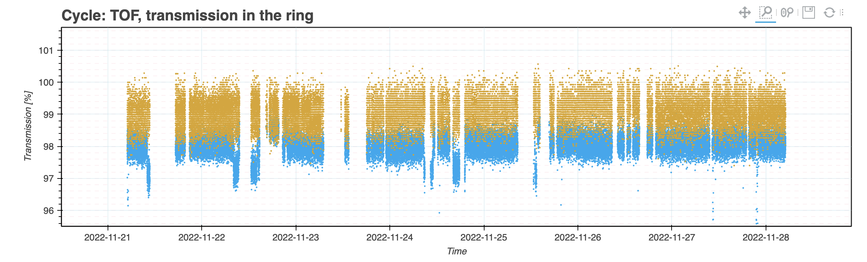
Delivered intensity in 2022
http://bpt.cern.ch/ps/TOF/2022/
Total delivery of 2.45E19 protons (~1E17 protons per day)
Stable operation since March (TOF~850e10ppp / TOF-EAST~400e10ppp) and (~98% transmission)
Maximum proton flux on Target was 1.6e12 proton per second. Tested (with RP and STI) at 2.2e12 pps in September 2022 adding more TOF cycles in Super Cycle.
Notes:
In 2022, we sent the requested number of Proton on Target 2.45E19 with stable operation a along the year and nice transmission.
Proton flux is currently limited to 1.6 e12 pps, in september 2022 we also tested higher proton flux on target up to 2.2e12 pps

Slide 4
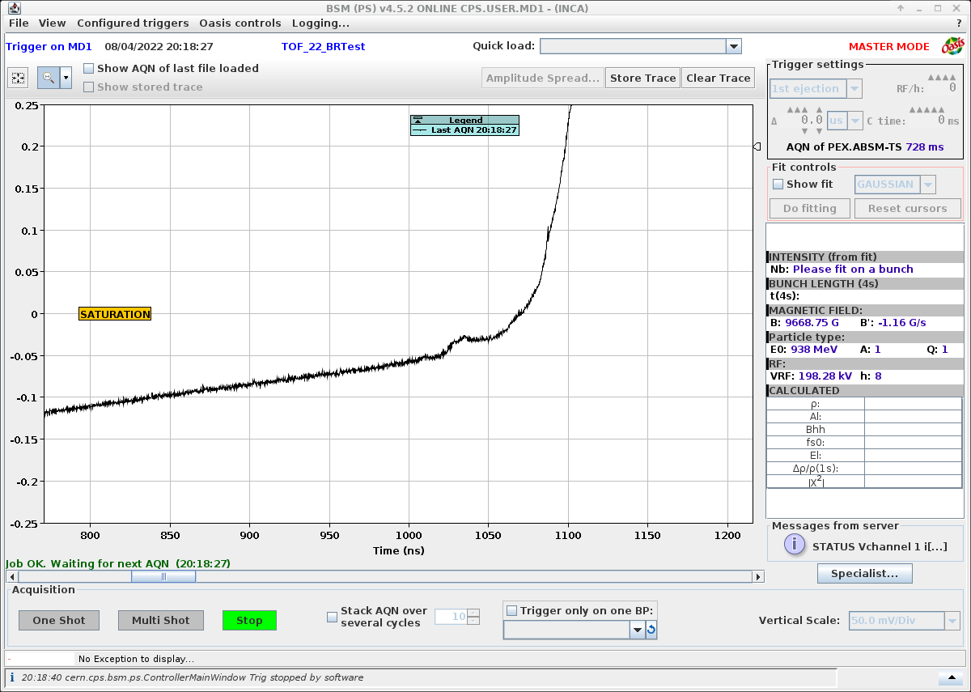
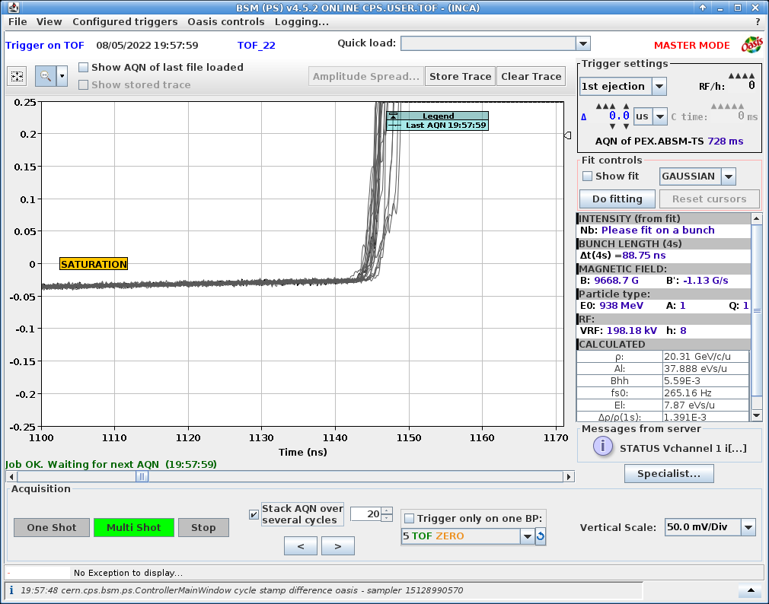
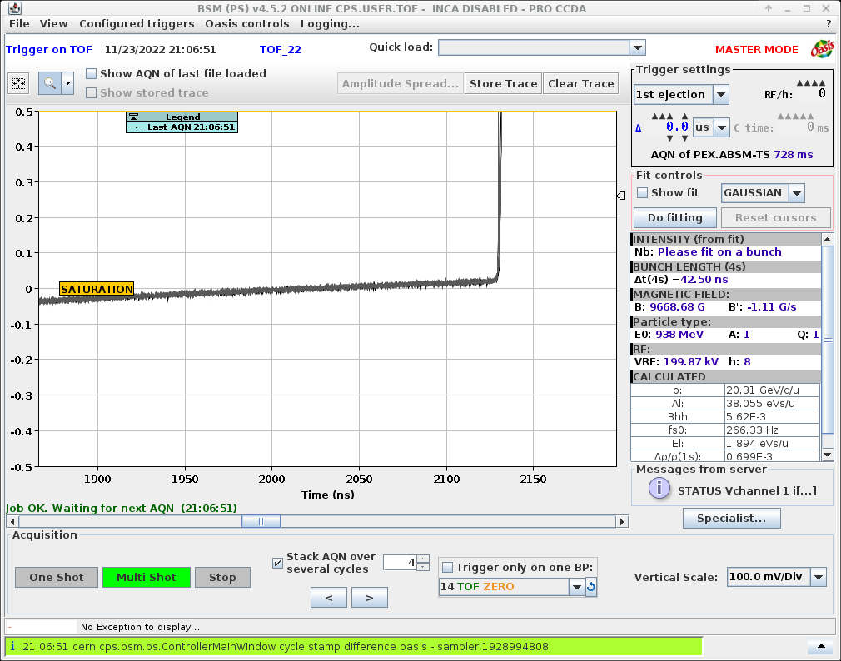
Feedback from experiments and solutions
Pre-pulses observed by the experiment at the start of 2022
Caused by satellite bunches on the bucket in front of the main bunch -> solved by adjusting Injection RF voltage + KFA timings.
Careful observation with the BSM (front-tail) and adjustment of the bunch rotation solved the issue.
Front tail on TOF bunch
No Front tail and steep rising edge
https://indico.cern.ch/event/1194548/contributions/5093904/attachments/2555875/4413220/JAPW_n_TOF-ISOLDE_2022(2).pdf
Notes:
One feedback of the experiment was the presence of pre-pulse (satellite bunches) in front of the main bunch.
This issue ahs been solved by adjusting bunch rotation and RF voltage at injection. However we kept a longer bunch length at 42ns.

Slide 5
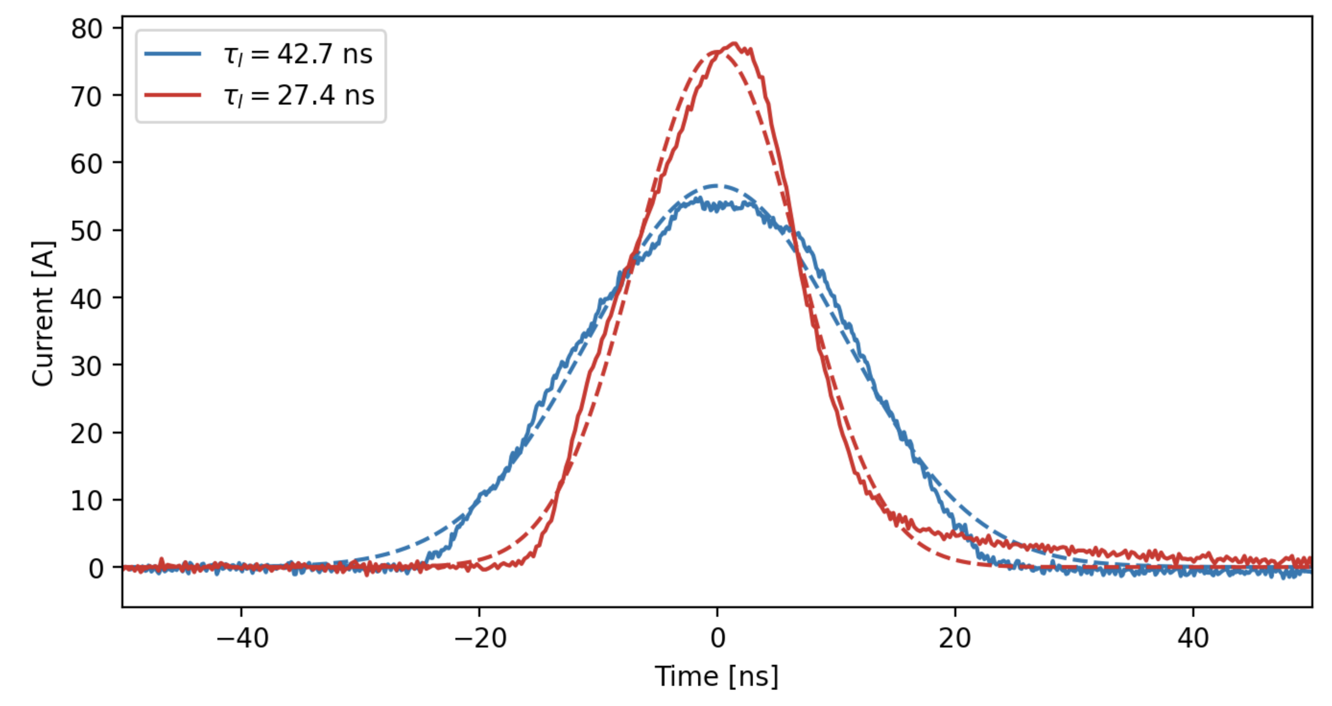
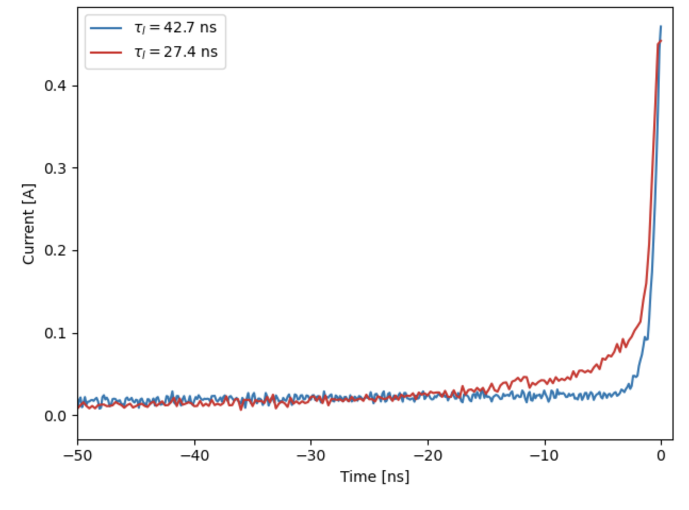
Feedback from experiments and solutions
Bunch length at extraction: Bl=28ns requested in 2023
Present setup at 42ns with larger longitudinal emittance provides reduced losses at extraction and easier transition crossing.
Lower longitudinal emittance, careful adjustment of transition crossing and bunch rotation can provide a 28ns with higher extraction losses.
Concerning transition crossing, reloading pre-LS2 functions of the triplet magnets helped, but also an increase of the doublet and triplet amplitudes. Input from ABP would be appreciated in order to better optimize transition.
Bunch lenght (43ns vs 28ns)
Front tail (43ns vs 28ns)
Notes:
42ns version produce lower losses at extraction and easier transition crossing
Later we investigate the possibility to switch back to 28ns, we saw higher losses at extraction.
Concerning transiiton crossing, the help of ABP is welcome in order to better adjust and anderstand transion crossing.

Slide 6
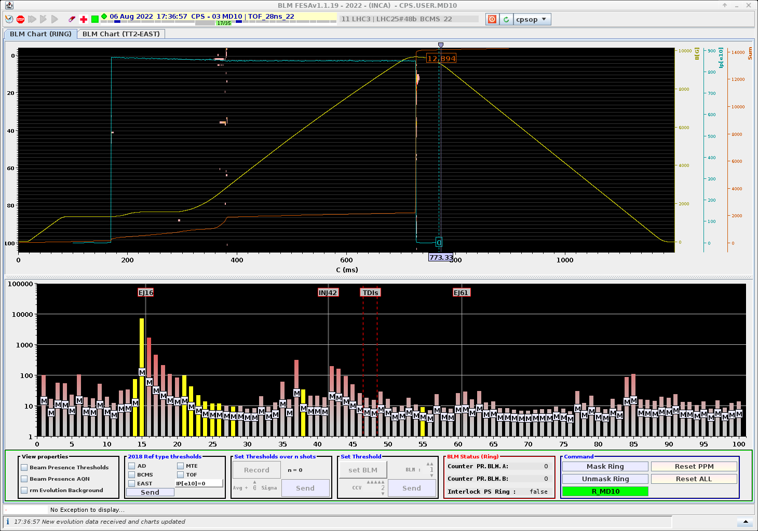
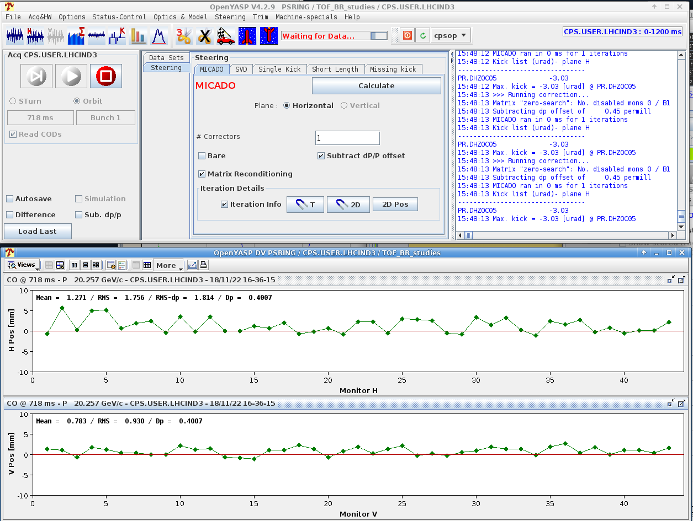
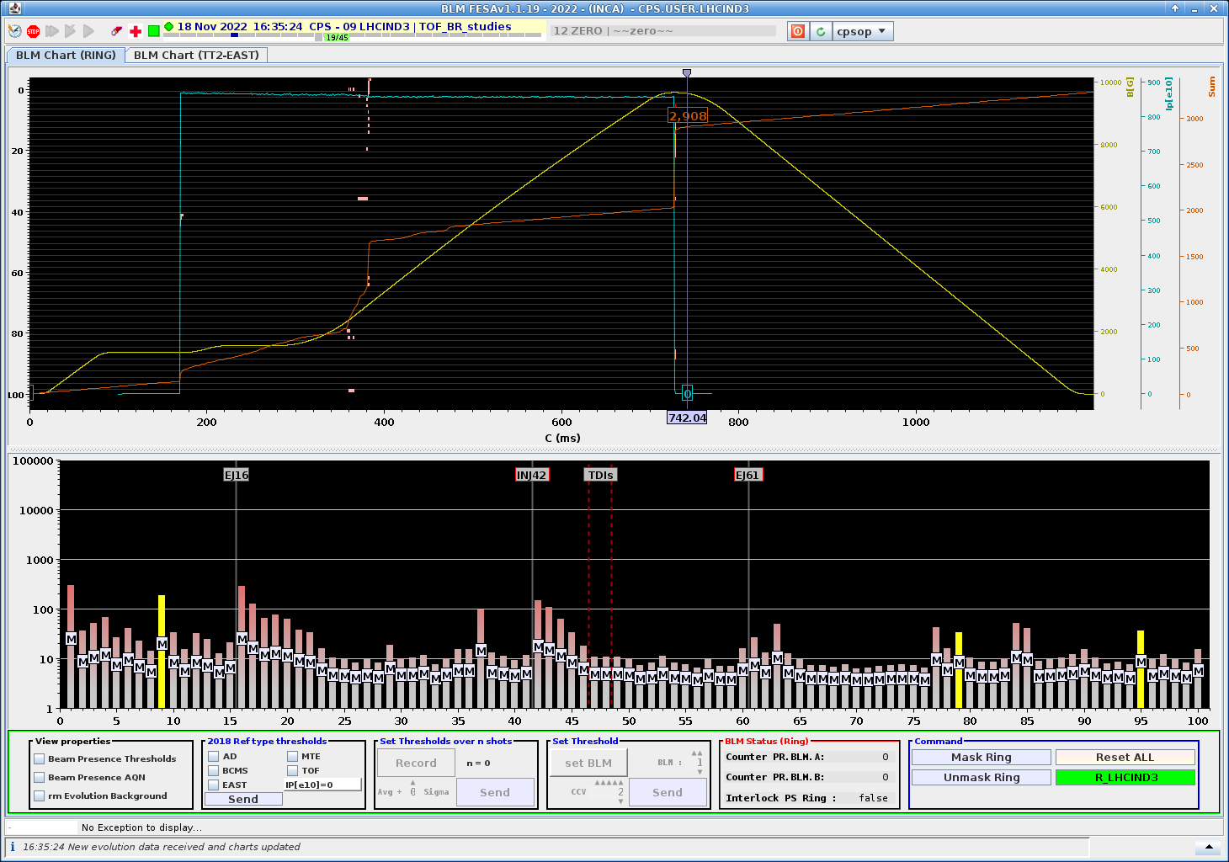
Prospect for 2023
Bunch length at extraction : from 42ns to 28ns
28ns compared to 42ns, shows ~50% larger losses at extraction but stable transition crossing
Extraction losses benefit strongly from the removal of the dummy septum (needed for MTE without barrier bucket)
2023 : recommissioning with 28ns configuration with adjustment of ring and FTN optics (42 ns version available in case of problems)
28ns TOF bunch with TPS15 IN
High Energy Orbit correction
28ns TOF bunch with TPS15 OUT
Notes:
In 2023 we will restart with 28ns version with TPS15 out (pretty nice beam losses point of view)
Keeping 42 ns as back up

Slide 7
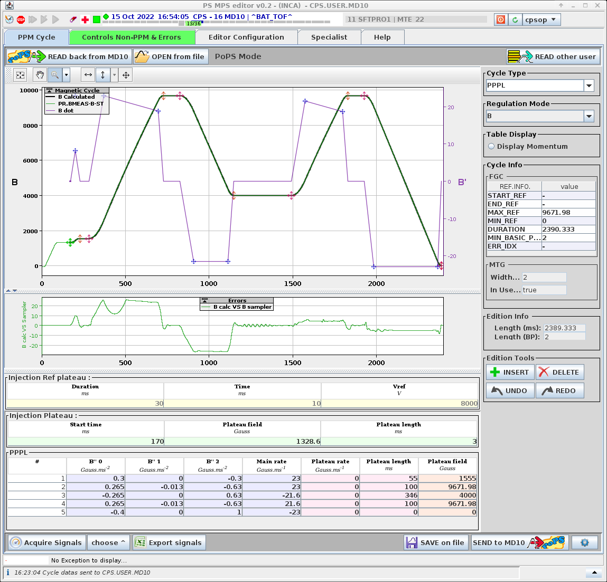
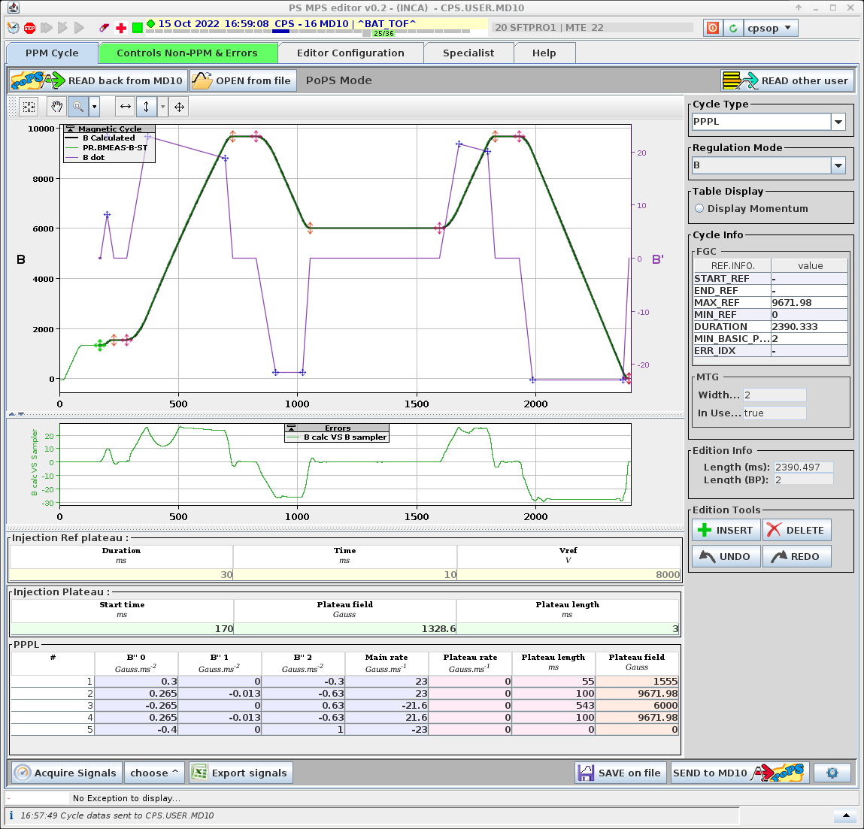
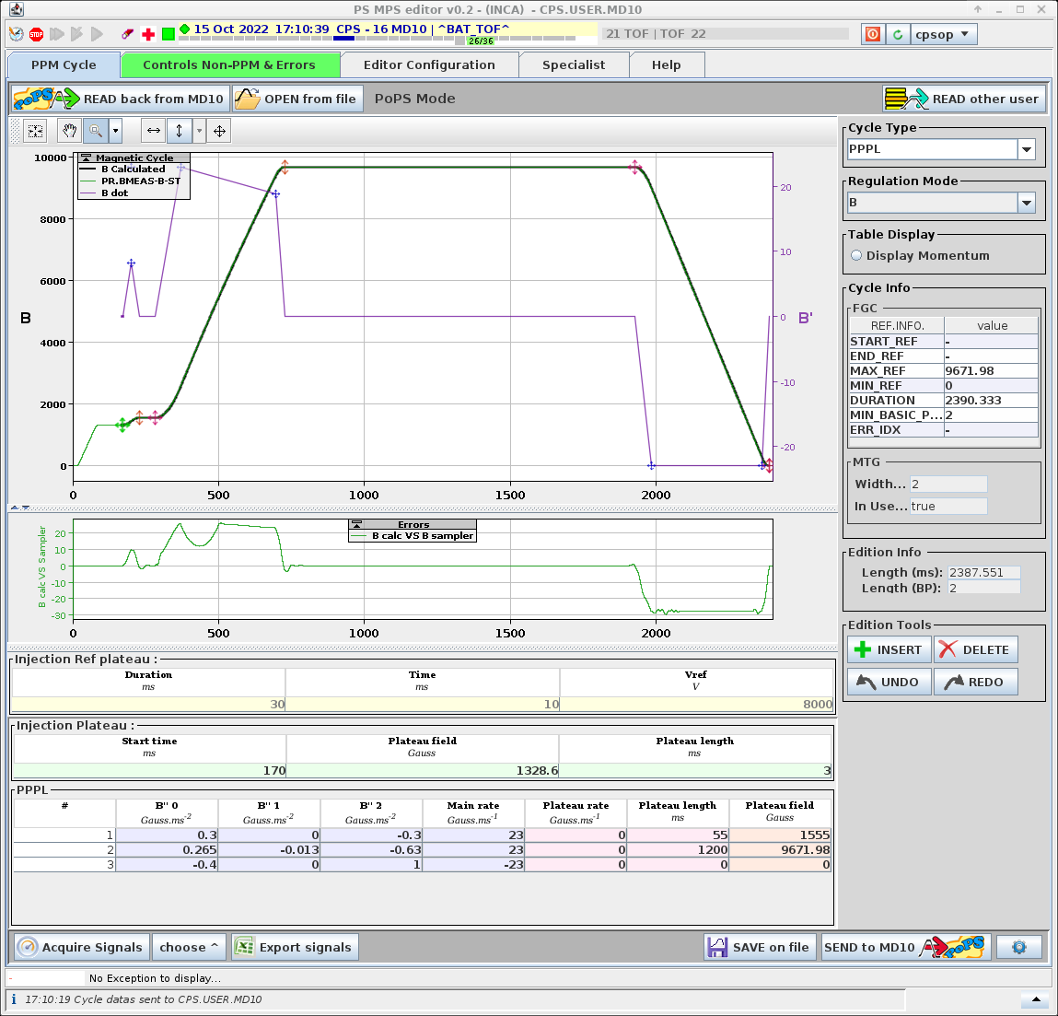
Double batch TOF beam (MTOF or BAT_TOF)
Serve the same user with multiple extractions, using a single injection from the PSB.
M shape is not anymore needed. Much better for the beam stability and for POPS too !
POPS IRMS = 2450A
POPS IRMS = 2580A
POPS IRMS = 3114A
Notes:
Idea of double batch TOF also called MTOF in the past.
Most of you, already seen this M shape of the magnetique cycle, it is not needed anymore. RMS current stays below trheshold for POPS and figure of 8.

Slide 8
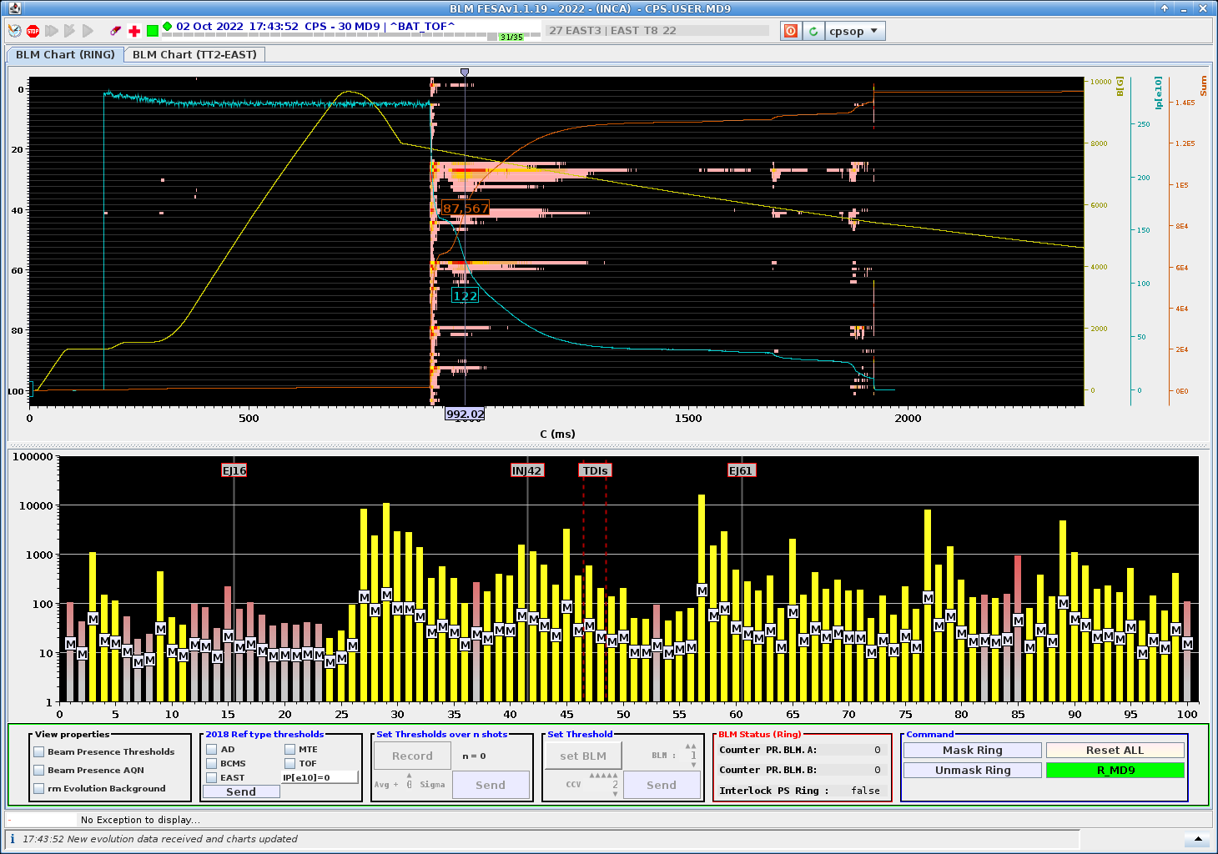

Double batch TOF beam (MTOF or BAT_TOF)
Serve the same user with multiple extractions, using a single injection from the PSB.
M shape is not anymore needed. Much better for the beam stability and for POPS too !
POPS IRMS = 2450A
POPS IRMS = 2580A
POPS IRMS = 3114A
Notes:
Much better for beam stability and POPS ;-)

Slide 9
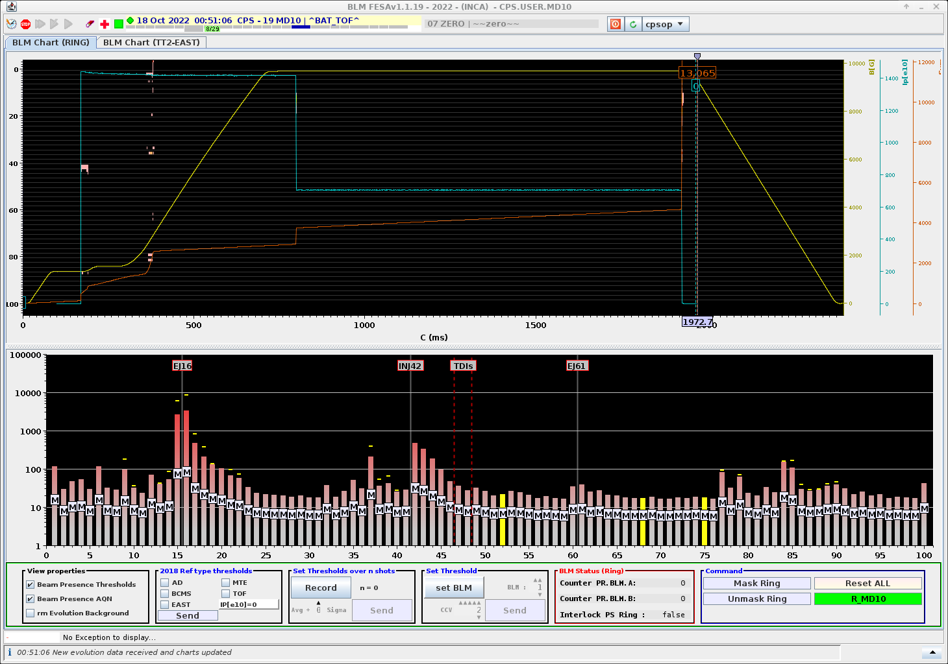
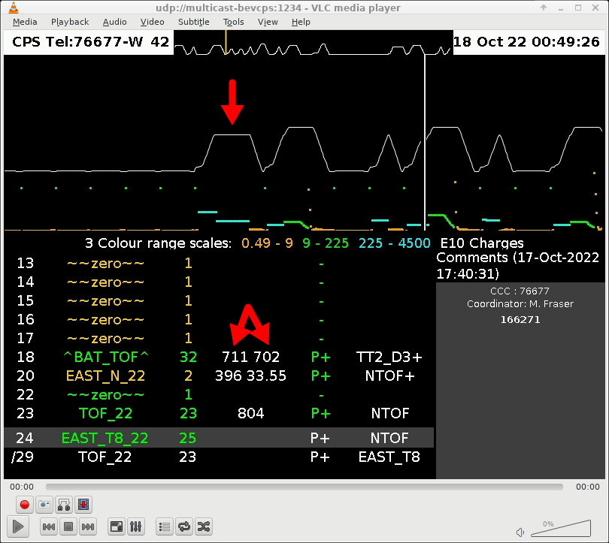
Double batch TOF beam
Single PS cycle with 2 bunches extracted ~1.2s apart to allow for increased flux
Main timing constraints come from :
SMH16 Interrupts control/acquisition (POWM1556) –> PEX.MC-CTML and PE2X.MC-CTML swapped
PE2X.MC-CTML on EAST cycles -> PE2X.MC-CTML cannot be programed before C800.
2 bunches from PSB
PE2X = C800
PEX = C1928
1128 ms
First bunch extraction
Second bunch extraction
CPS Vistar with double TOF at 2x700e10 ppp
Notes:
We have some timing constraints. We swapped

Slide 10
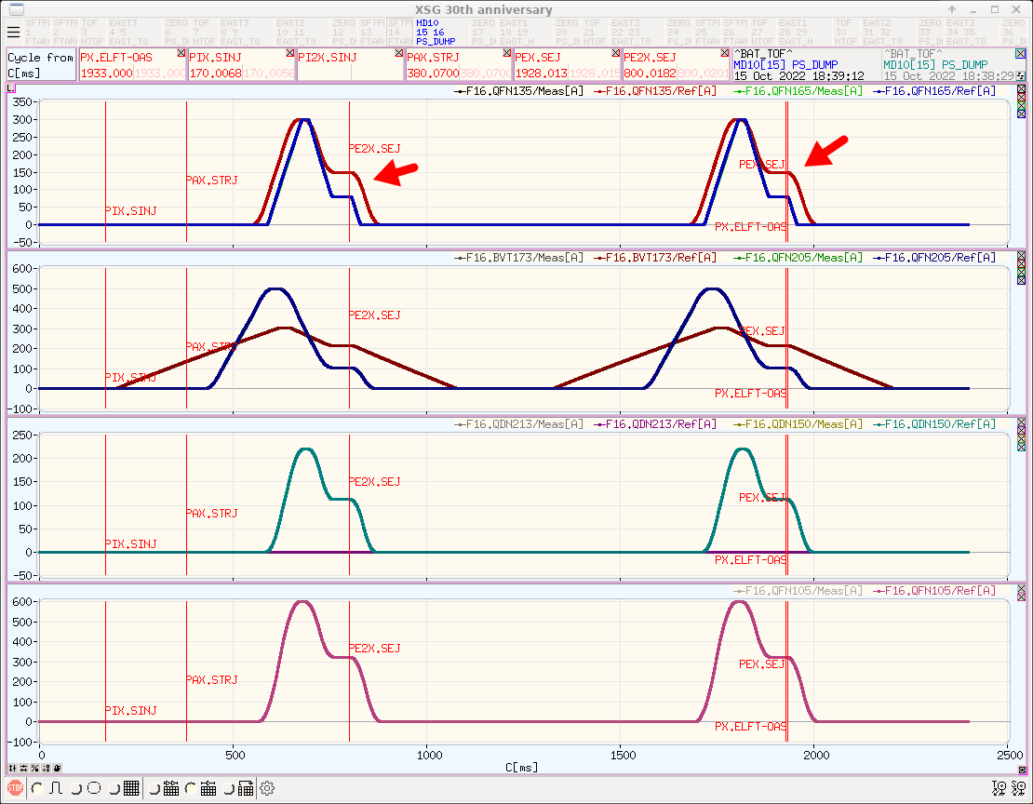
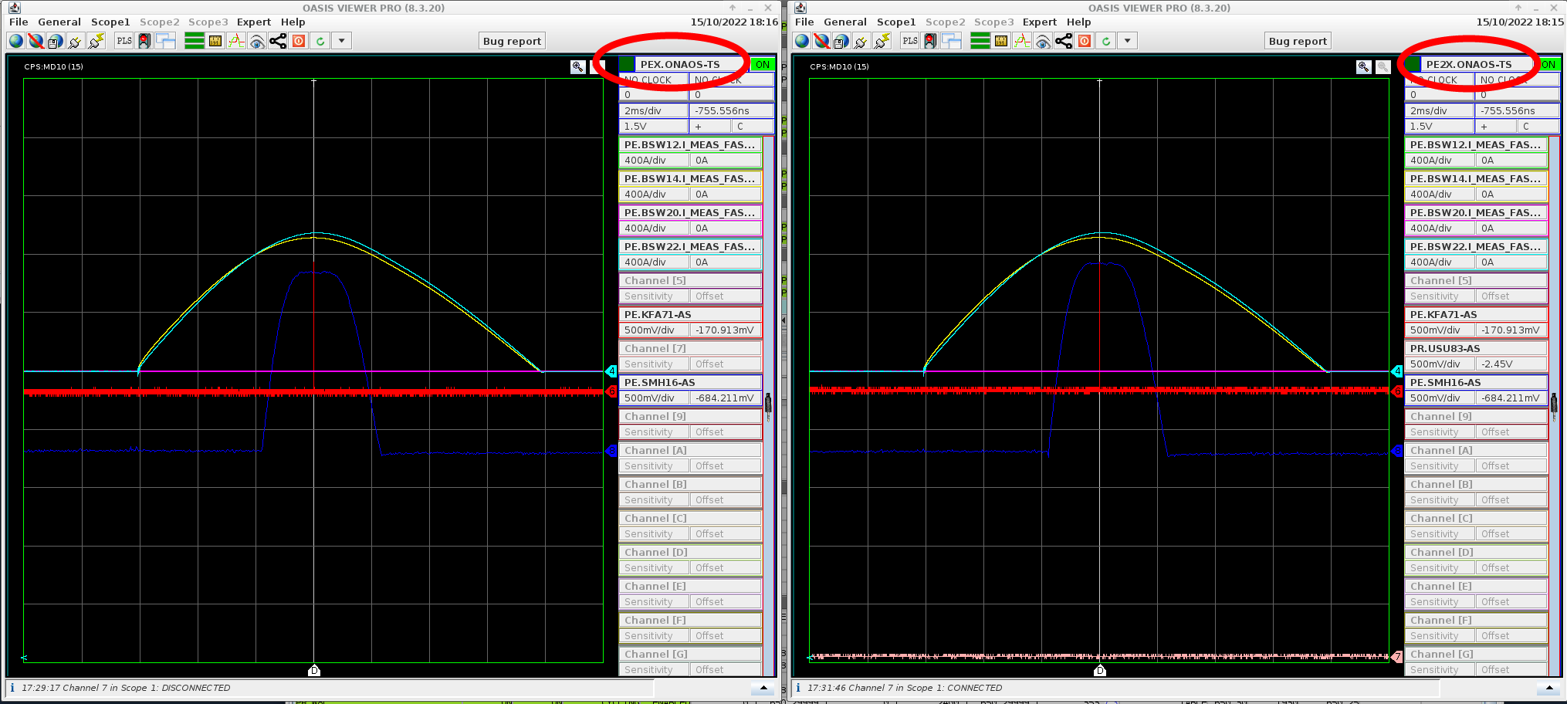
Double batch TOF beam
Timings
The extraction equipment must be able to pulse twice in the same cycle just like TT2 and FTN line.
Timing modification performed during 2022-ITS2. [https://issues.cern.ch/browse/INST-4843 and https://issues.cern.ch/browse/INST-4844]
Same modification foreseen on nTOF triggers during this YETS [https://issues.cern.ch/browse/TIMING-4212]
Extraction power supplies triggered by PE2X and PEX
TT2 power supplies triggered by PE2X and PEX
Notes:
Timing modification implemented during Technical Stop 2 in order to make extraction equipement and TT2 line pulsing twice during the cycle. Same modification ongoing for nTOF triggers.

Slide 11
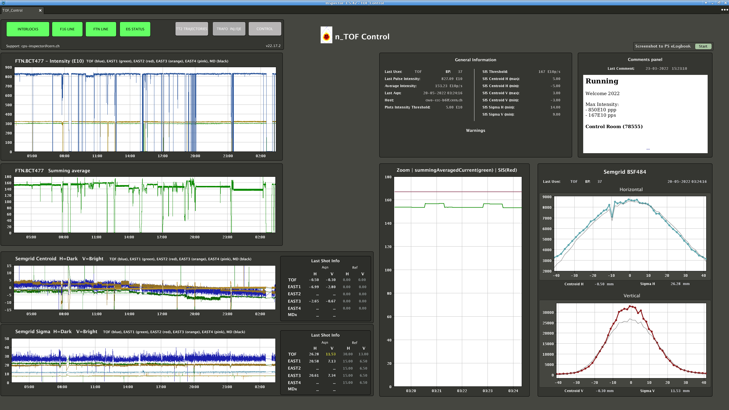
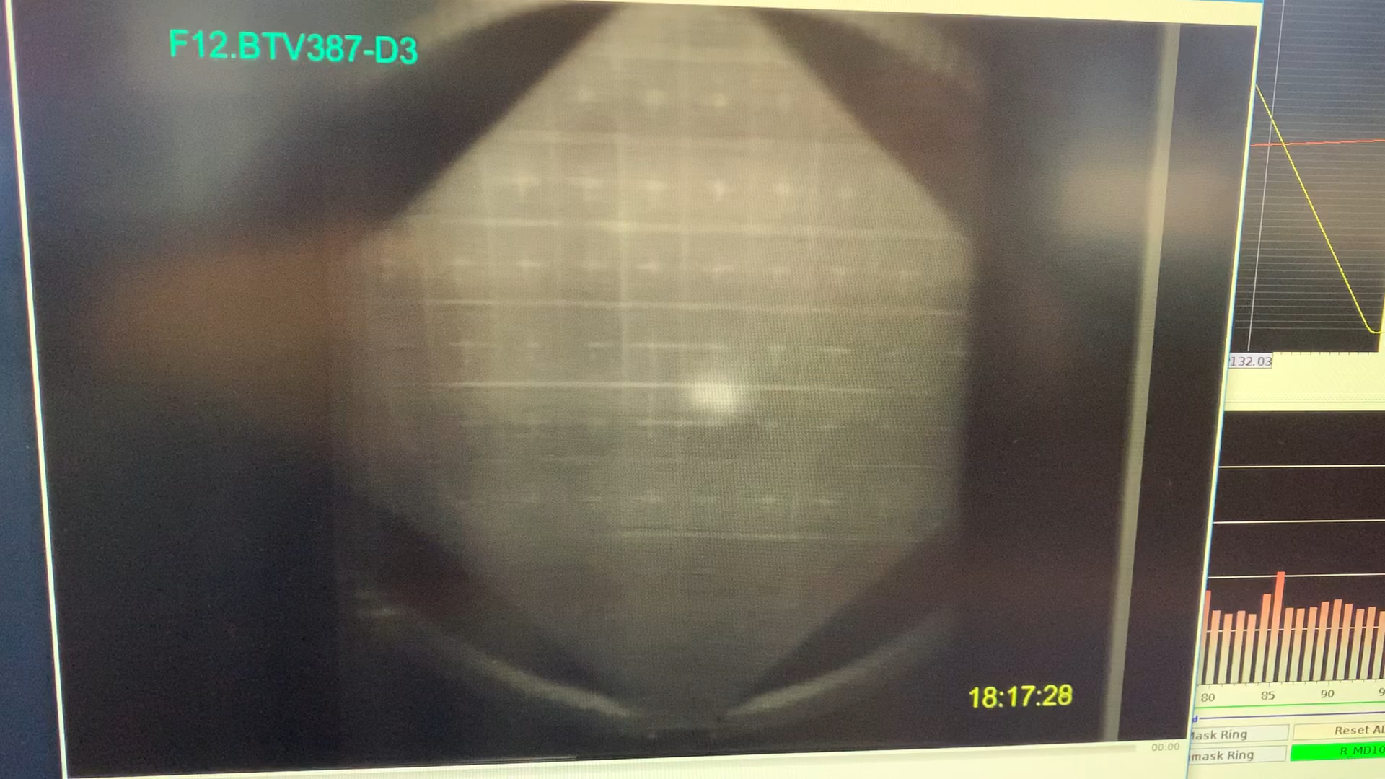
Double batch TOF beam
Beam observation
BI equipment only refreshed on PEX event (2d extraction) – we are blind concerning 1st extraction (only BTVs are available to check the beam)
BI equipment needs to become compatible with two extractions per cycle (at least for BCTs and SEMs)
Followed up by Ana Guerrero (SY-BI-SW)
Beam position on SEMGrid before nTOF target (2d extraction only).
Last screen of TT2 before D3 Dump with both extraction.
Notes:
In 2022, BI equipements were only compatible with 1 ejection (link to PEX)
We made a request to adapt BI FESA classes (for BCTs and SEMGrids) in order to get Beam observation for both extraction.

Slide 12
Conclusion
TOF cycle is currently operating up to 850E10 ppb, “Ultimate” bunch intensity could be explored.
Flexible adaptation of the SC to exploit maximum flux of 2.2e12 pps → still waiting for approbation.
Commissioning of ring and transfer line with 28ns version at the start of 2023. (TPS15 OUT)
Taking care of extraction losses and front tail presence.
Measure and modify transfer line optics with optimised aperture model.
Additional requirements for double-batch TOF before it can become operational:
BI equipment needs to become compatible with two extractions per cycle.
Performed 28ns modifications and bunch rotation / anti-rotation / rotation again

