Slide 1
High-intensity LHC beam study campaign in PS (Quadrupolar coupled-bunch feedback)
Jan Paszkiewicz, Ben Woolley, Heiko Damerau, Alexandre Lasheen
Injectors Performance Panel MD Days, 31 January 2023

Slide 2
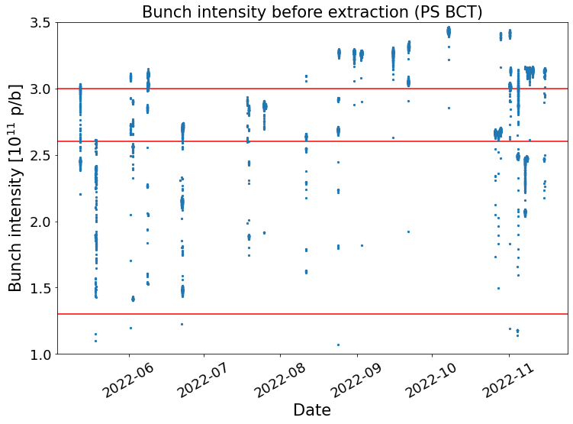
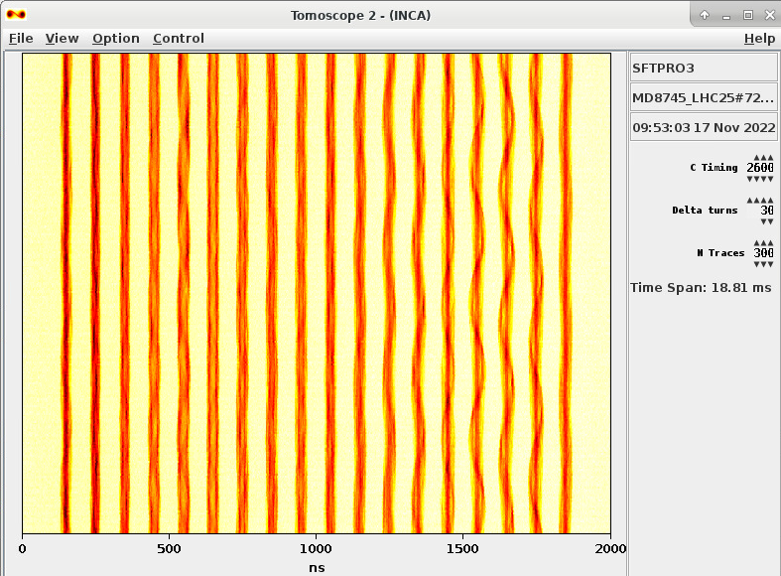
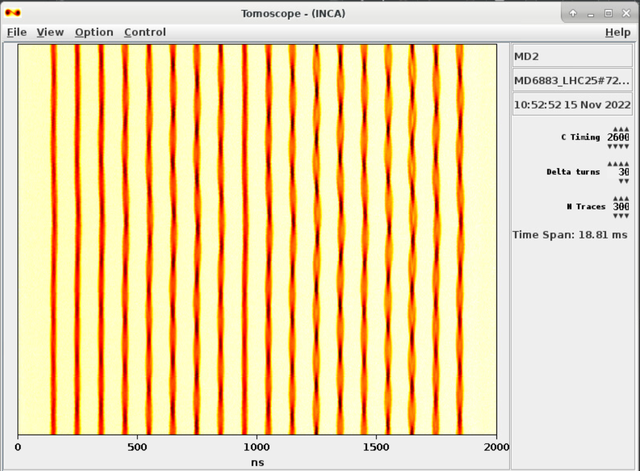
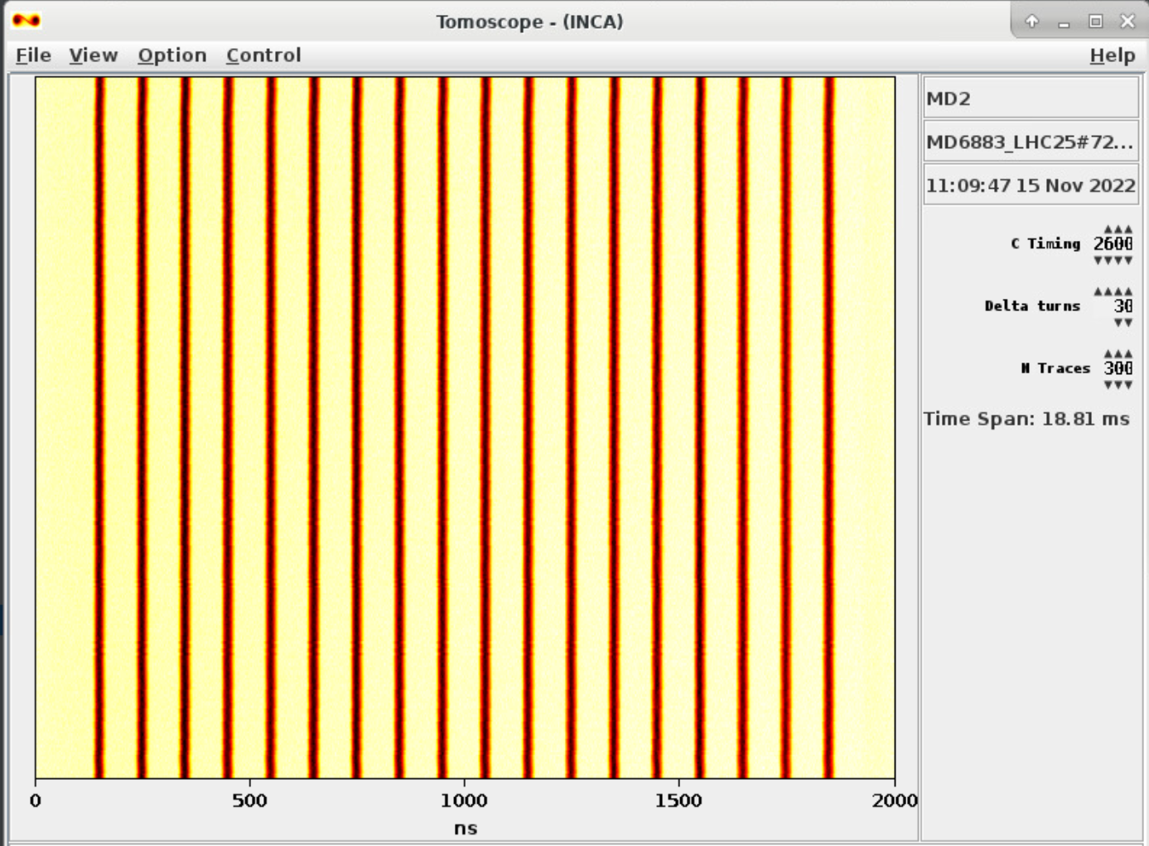
Coupled-Bunch Feedback Overview
Dipole-mode feedback necessary for multi-bunch LHC beam.
Quadrupole-mode feedback relevant for high intensities: good beam quality with 3.15×10¹¹ p/b with LHC25ns beam in the PS (NB: no bunch rotation at this intensity due to large beam loading on 40 & 80 MHz cavities)
Frequency-domain approach: one channel per f_{rev} harmonic pair: 10 channels for h=21 beam.
4 PS One-Turn Feedback boards with 4 channels each, Finemet longitudinal kicker.
LIU baseline
Nominal
No CBFB
Dipole FB only (no 40 MHz cav.)
Dipole & quad FBs (no 40 MHz cav.)
3.15e11 p/b equiv.

Slide 3
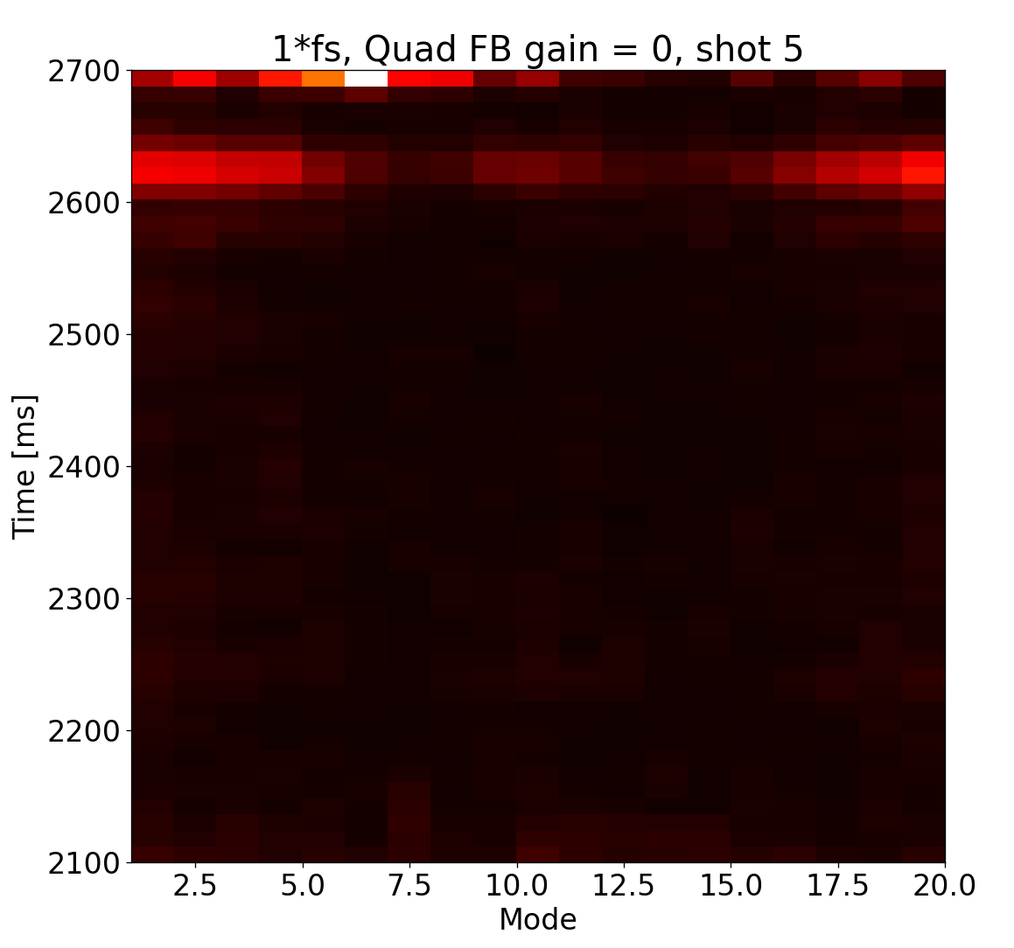
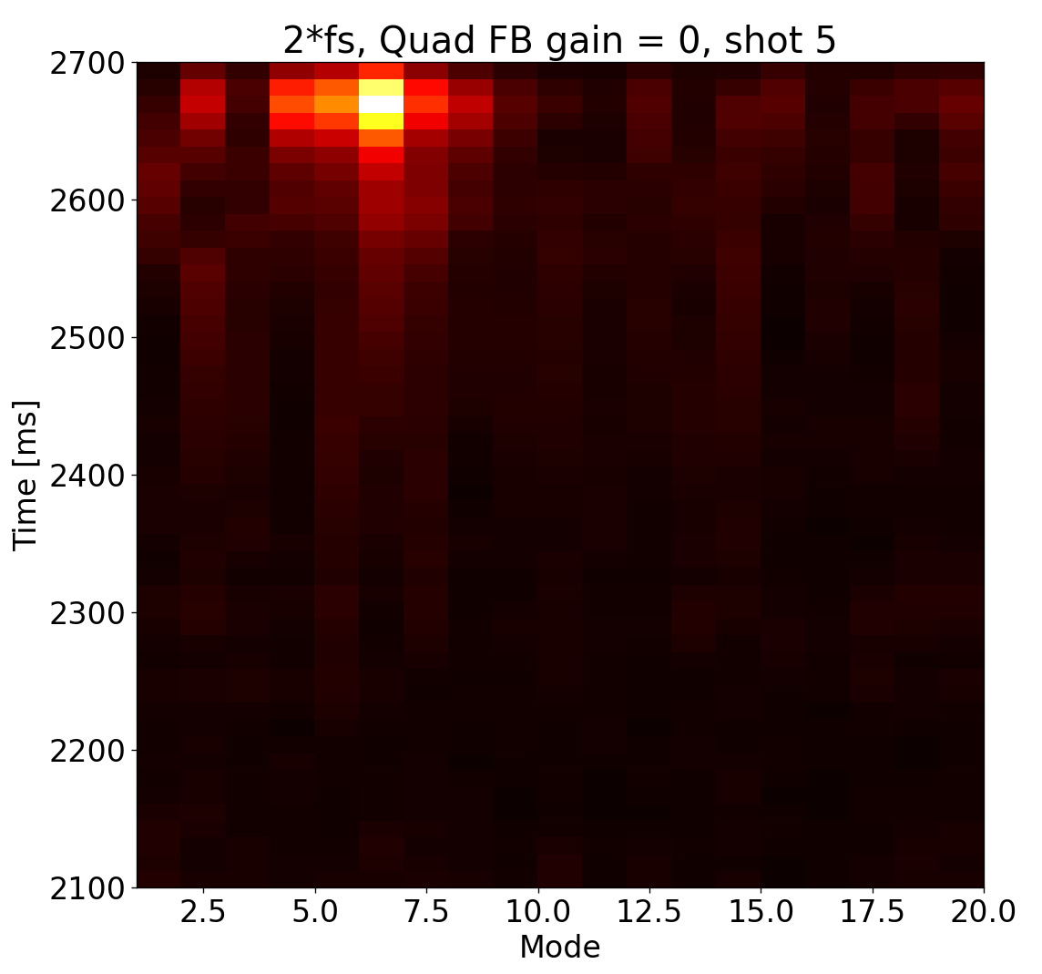
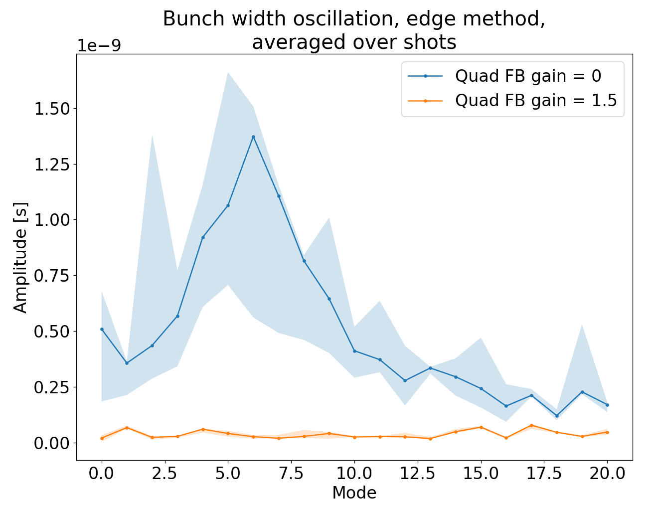
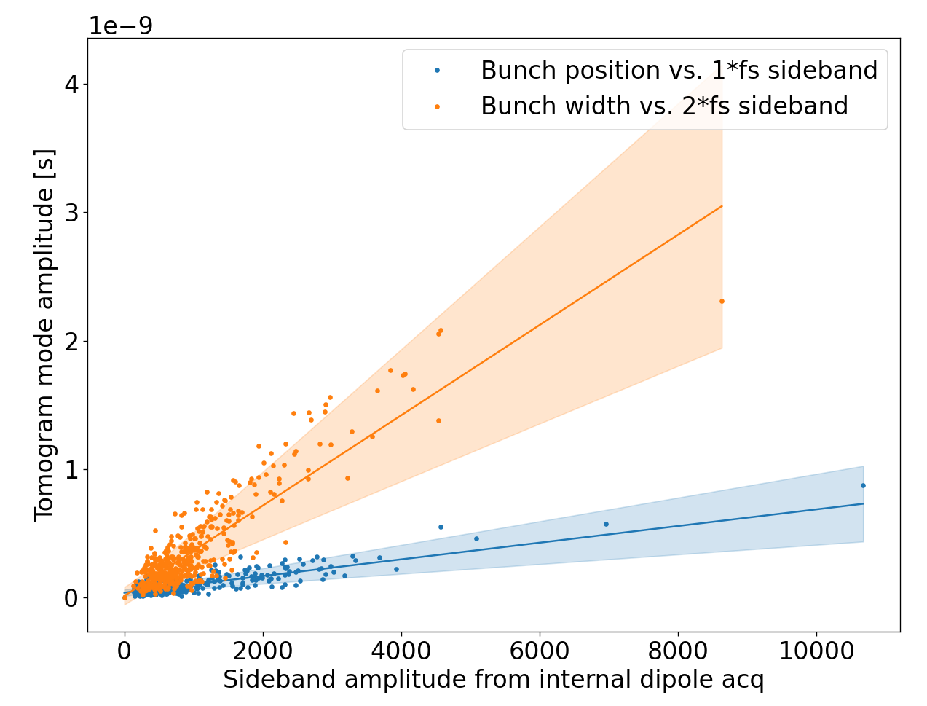
Internal Acquisition
Dipole mode spectrum vs. time:
Quad. mode spectrum vs. time:
Record baseband data for each channel
±2 kHz about each f_{rev} harmonic.
2 modes per channel can be obtained from IQ data.
Dipole and quadrupole mode data.
Powerful diagnostic tool
Example shown here with dipole FB on and quadrupole FB on.
Features such as growing instability, SPS synchro loop kick, start of splittings visible.
Good correlation with mode spectra obtained from processing tomoscope data.
Can observe the whole cycle for every cycle.
Data available PPM.
Quadrupole mode spectrum from processing tomoscope data:
Correlation between internal signal and tomo-derived data:

Slide 4
CBFB Architecture (One Module, 4 Channels)
Quadrupole-mode feedback
sin(2πf_{rev}h_{in}t)
FIR
↓4
Feedback channels
FIR
↑4
Comp. filter
Peak filter
Feedback channels
Feedback channels
Feedback channels
Beam
Σ
Out
FIR
↓4
Feedback channels
FIR
↑4
Feedback channels
Feedback channels
Feedback channels
4
4
Dipole-mode feedback
Internal FGC
Quadrupole gains
4
Dipole gains
Gain scaling functions
4

Slide 5
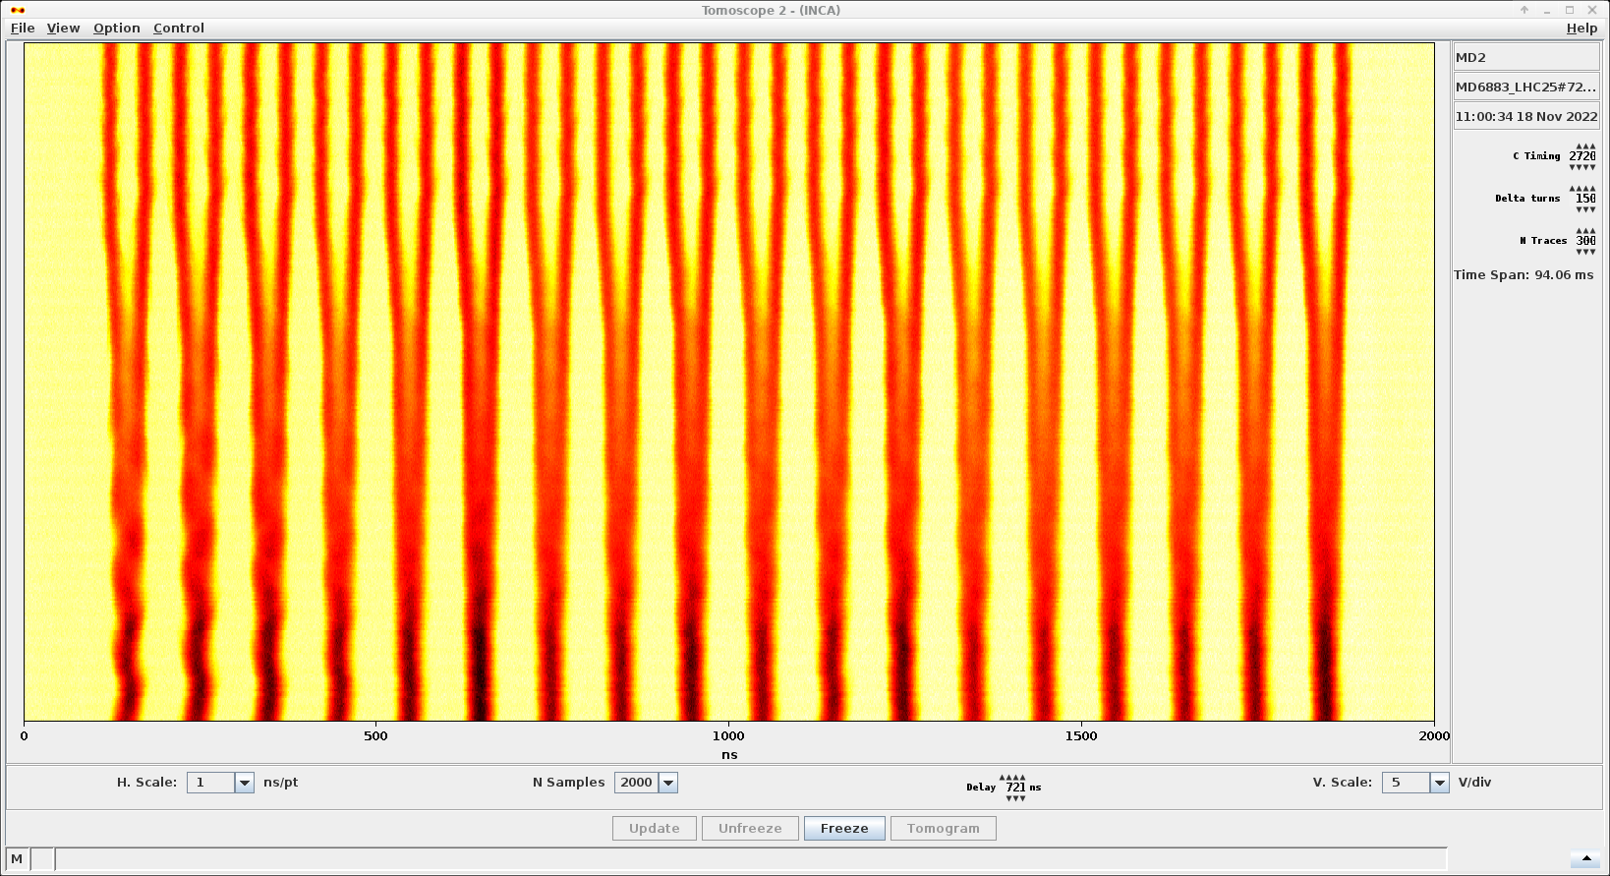
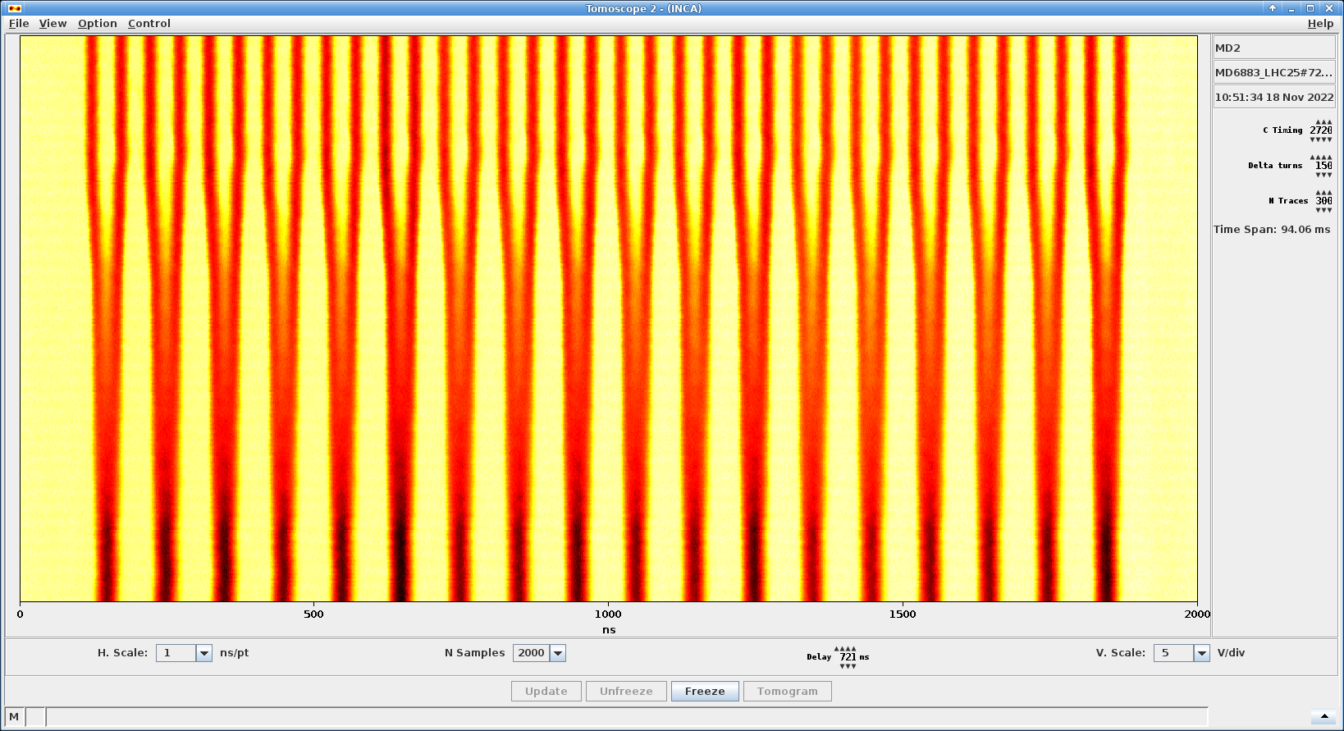
CBFB During Splittings
Abrupt stop at C2710:
Smooth reduction of feedback gain to zero during splitting
CB oscillations during splitting can cause bunch to bunch charge variation.
Only abrupt stop was possible in previous iterations.
CBFB gain can now be reduced gradually as the h=21 accelerating voltage is reduced during the splitting.
Quadrupole feedback off.
CBFB gain scaling
Smooth taper to zero:
h=21
First 2-split
h=42
Second 2-split
Boards 0,1,2
CTime

Slide 6
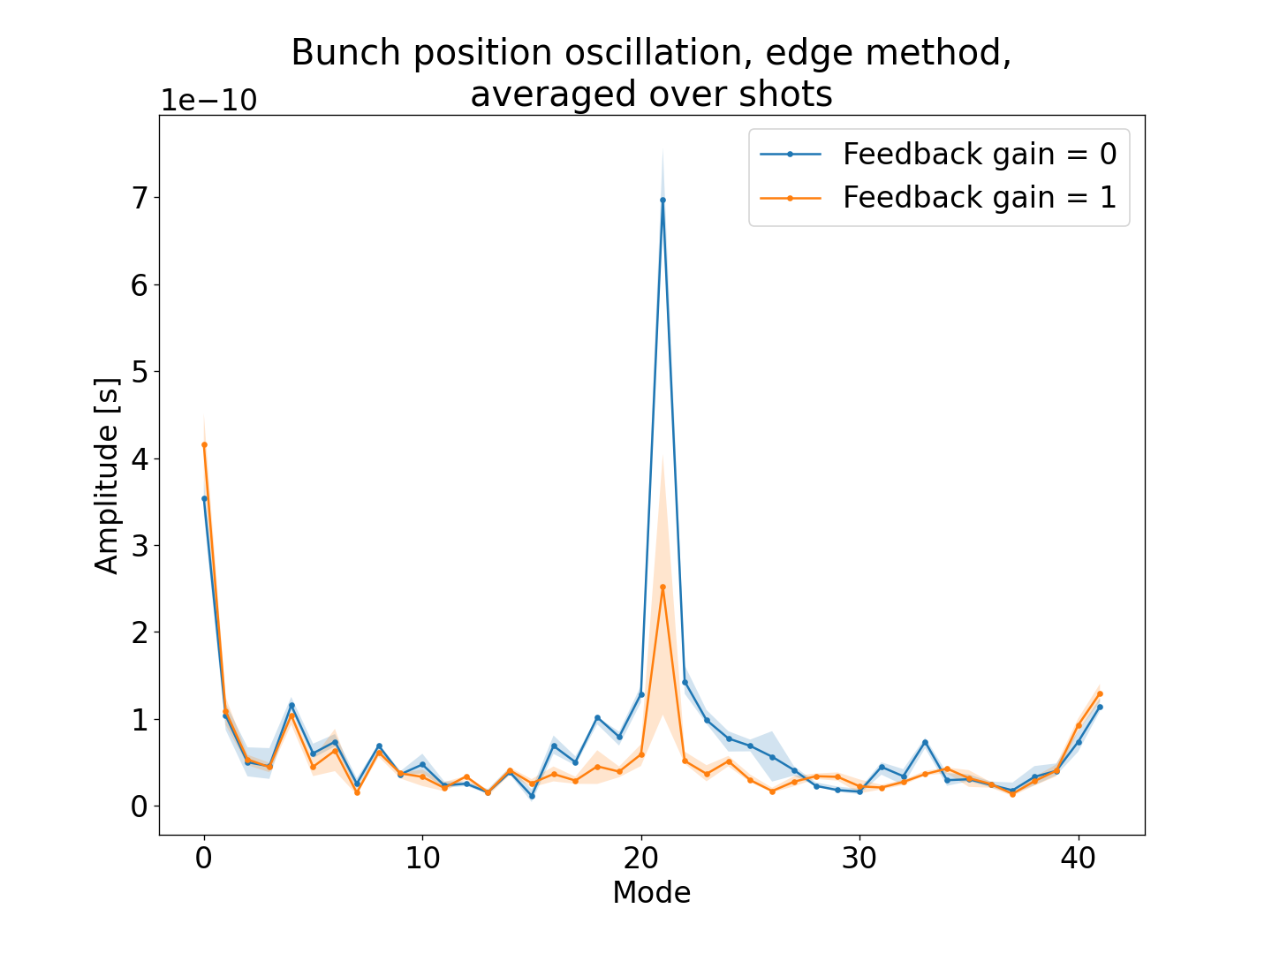
CBFB During Splittings
Damping of π-mode after first 2-split
Dipole feedback on h=21 after first double splitting
Coupled-bunch modes during splittings thought to contribute to beam halo, implications on PS-SPS transfer and losses in SPS.
Configure board 3 to stabilize h=42 beam: π-mode at h=42 corresponds to signal at h=21
Possibly extend this to second 2-split (h=84) if sufficient motivation exists.
Might prove more challenging.
Low impedance of Finemet at these frequencies
Decimation to h=64 in firmware will need to be removed.
Finemet kicker S₂₁ (Matthias Haase)
CBFB gain scaling
h=21
First 2-split
h=42
Second 2-split
Boards 0,1,2
Board 3
CTime

Slide 7
Next Steps
Dipole and quadrupole-mode coupled-bunch feedbacks are now operational.
Good performance in damping longitudinal CB oscillations at high intensities.
FESA classes and basic Inspector panel deployed, PyQt GUI in development.
Baseband acquisition: try to find applications as a general diagnostic.
2023 MDs:
Optimisation of feedback during splittings, determine implications on PS-SPS transfer.
Application of CBFB before transition to MTE beam (next slide).
Find optimal combination of dipole and quadrupole gains.
Study higher modes (e.g. sextupole and octupole) which are seen occasionally.
Simultaneous Finemet cavity feedback and CBFB (Requires firmware change and retuning).

Slide 8
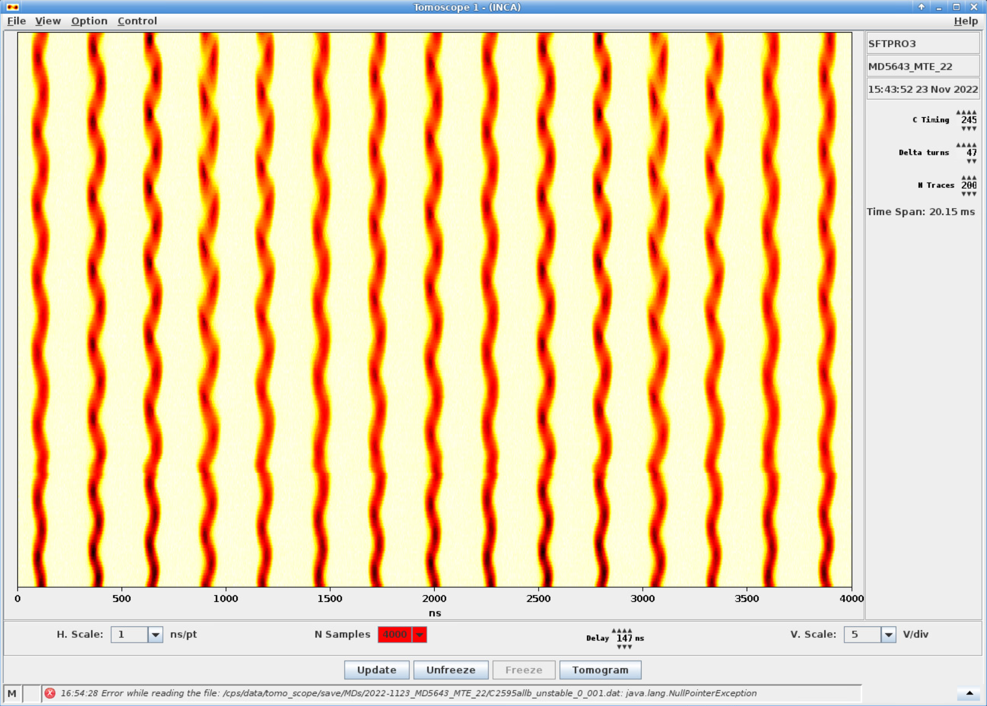
Coupled-Bunch Instability Before Transition
Dipole instabilities seen before transition in h=8 MTE beams.
Applying CBFB not attempted yet but could be set up without firmware modifications.
Input and output harmonics are programmable PPM.
E.g. h=7 → h=1 for MTE beam, h=20 → h=1 for LHC beam.
Dipole oscillations in MTE beam (Mihaly Vadai)

