Slide 1



The LHC: How does it work?
Dutch Language Teacher Programme
30 November 2023
Accelerating Science and Innovation
Jan Uythoven, CERN
Notes:
1

Slide 2
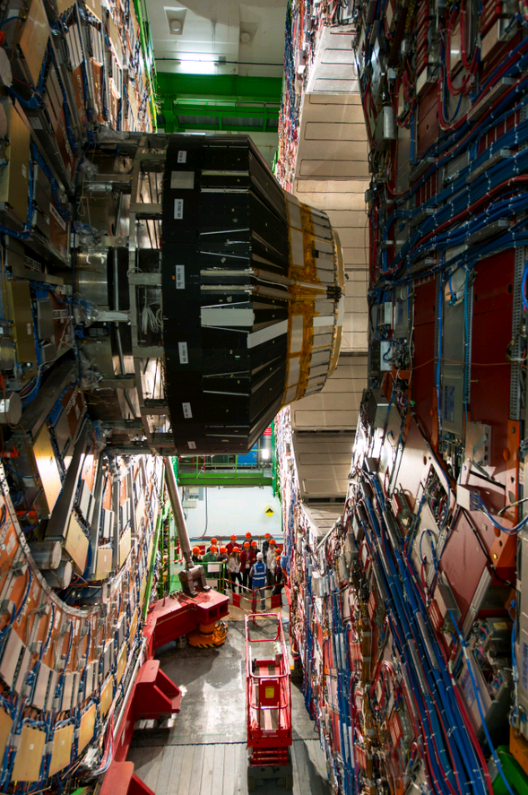
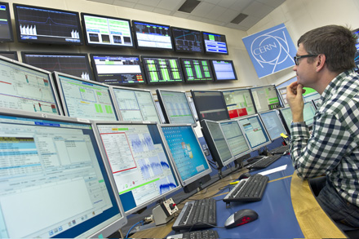
How does the accelerator work?
  Magnets
  Radio Frequency
  …
Energy in the beam
The future
Compact Muon Solenoid
Cern Control Centre

Slide 3


Slide 4
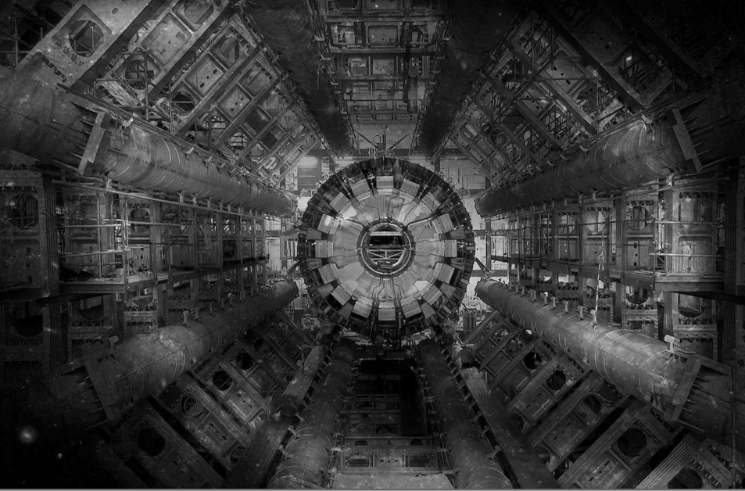
The LHC
Very big
Very cold
Very high energy

Slide 5
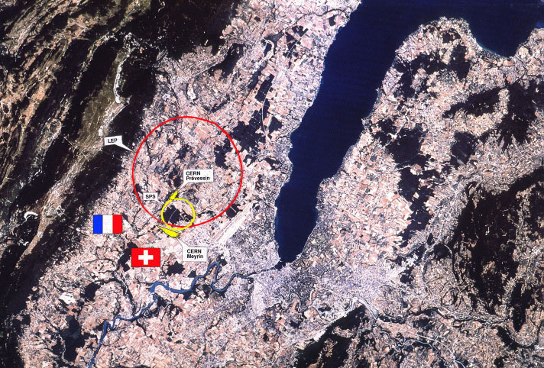

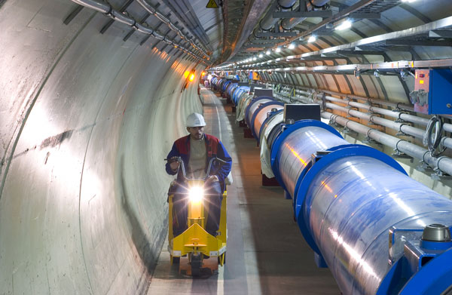
The LHC
Two beams of trillions of protons race around the 27 km ring at 0.999999991 times the speed of light in opposite directions…
So a particle goes around the LHC 11’000 times per second !

Slide 6

LHC tunnel
Circumference = 26.7 km
Depth = 70-140 m
Slope = 1.4 %

Slide 7
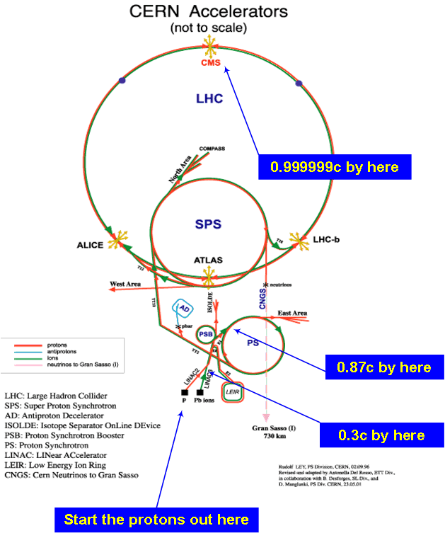
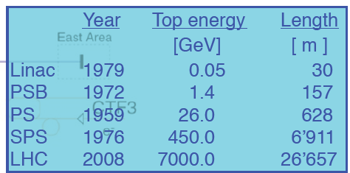
LHC Injector Chain
New Linac4 in 2020: H⁻
0.16
2.0
Normal operation with protons, but every year few weeks of operation with heavy ions (Pb⁸²⁺)
7

Slide 8
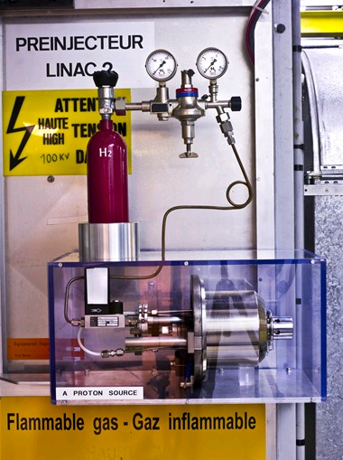
Where do the Protons come from?

Slide 9
Basic ingredients of a particle accelerator
Magnetic field to
  Bend the beam around the circle (dipole magnets)
  Keep the particles together (quadrupole magnets = lenses)
Electric field to accelerate the particles
  Very fast varying electric fields = Radio Frequency cavities

Slide 10
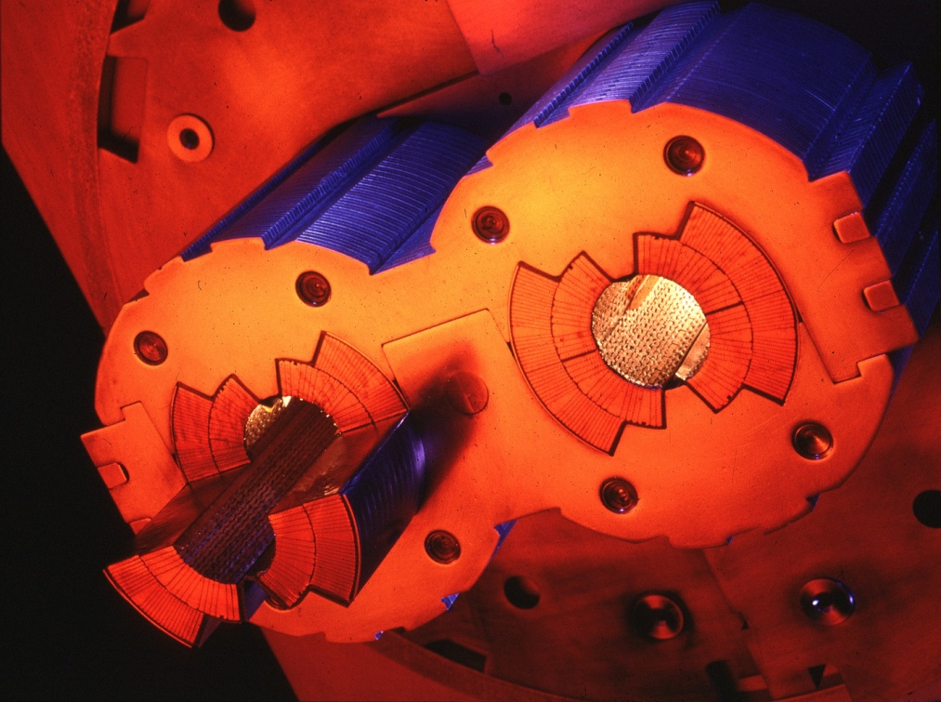
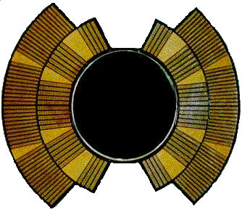
Dipole Magnets
Bend the beam around the circle
Number of dipoles 1232
Dipole field at 450 GeV 0.535 T
Dipole field at 7 TeV 8.33 T
Bending radius 2803.95 m
Main Dipole Length 14.3 m
Openings (full aperture) 56 mm
I
I
I
B
SUPERCONDUCTING!
Cooled with superfluid helium at 1.9 K

Slide 11
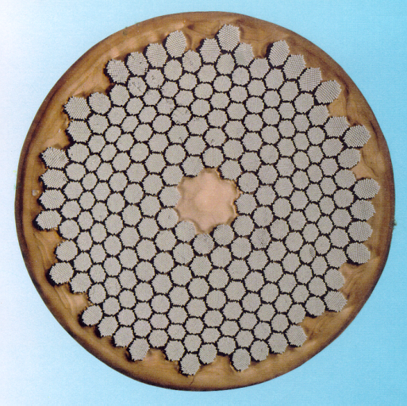
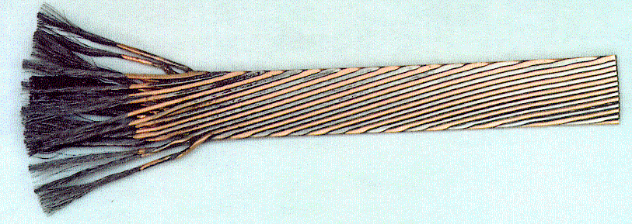
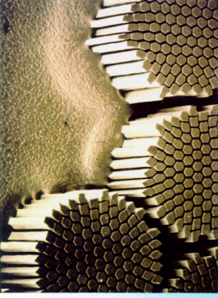
The superconductor
Niobium-titanium Rutherford cable
Strand
Cable
Filament
Used 1200 tonnes/7600 km of cable
Single cable carries current up to 12 kA

Slide 12
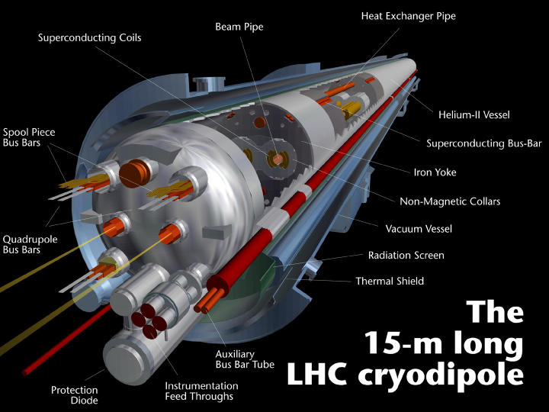
More than just some coils…
12

Slide 13
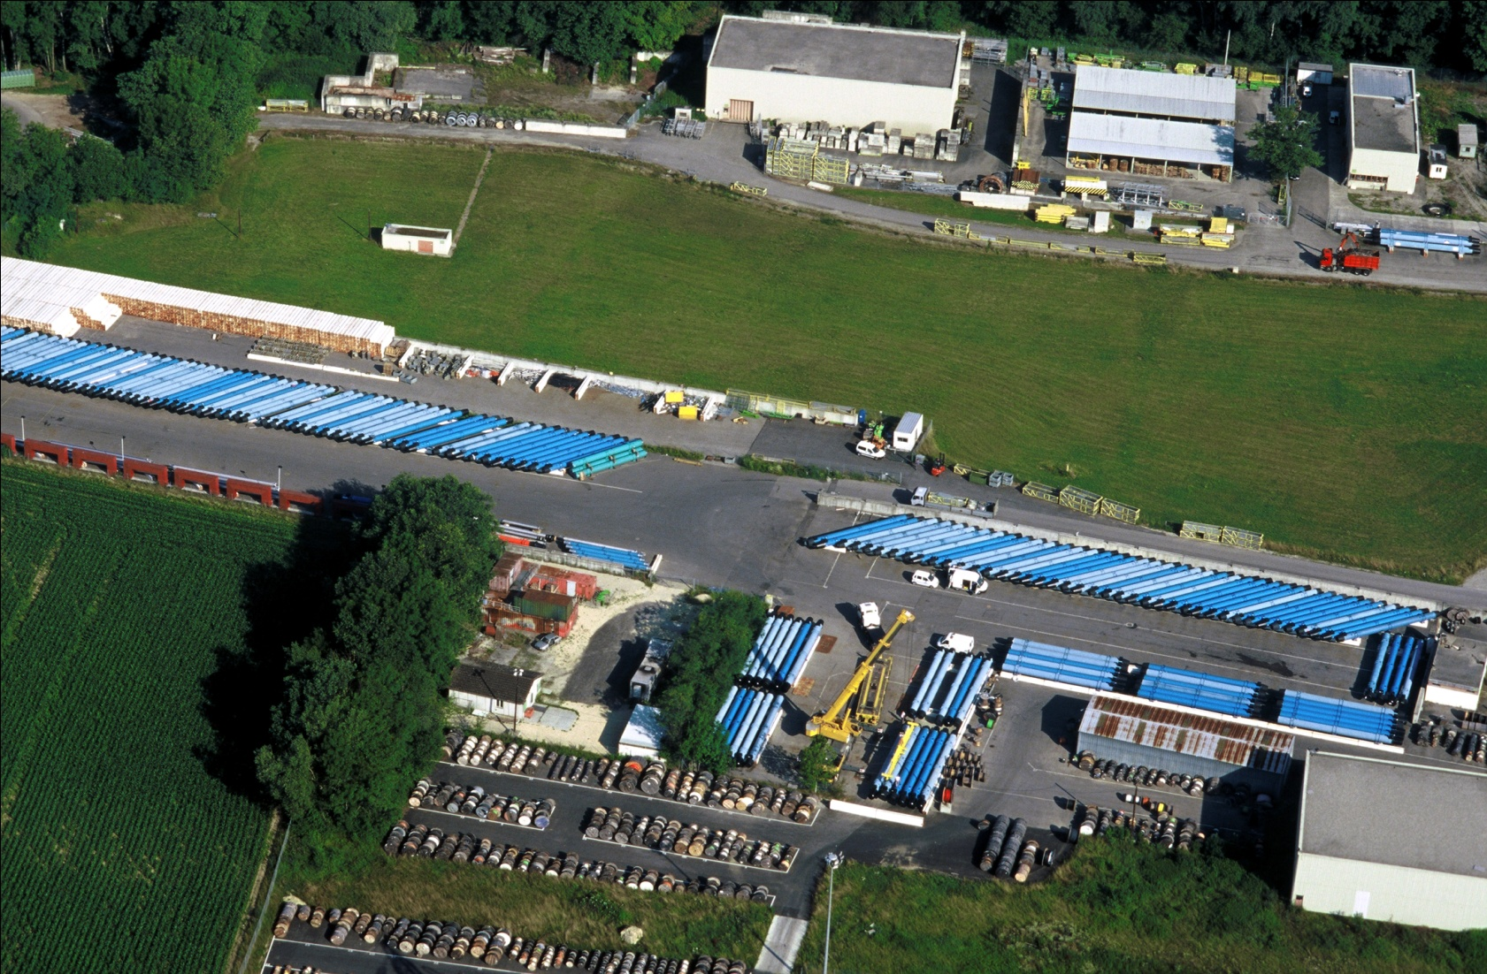
During construction: Dipoles all over

Slide 14
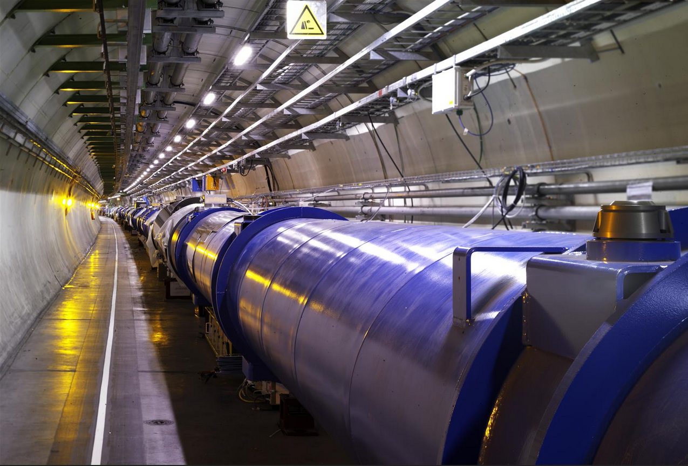
In the LHC tunnel
?
?
?
?
?

Slide 15
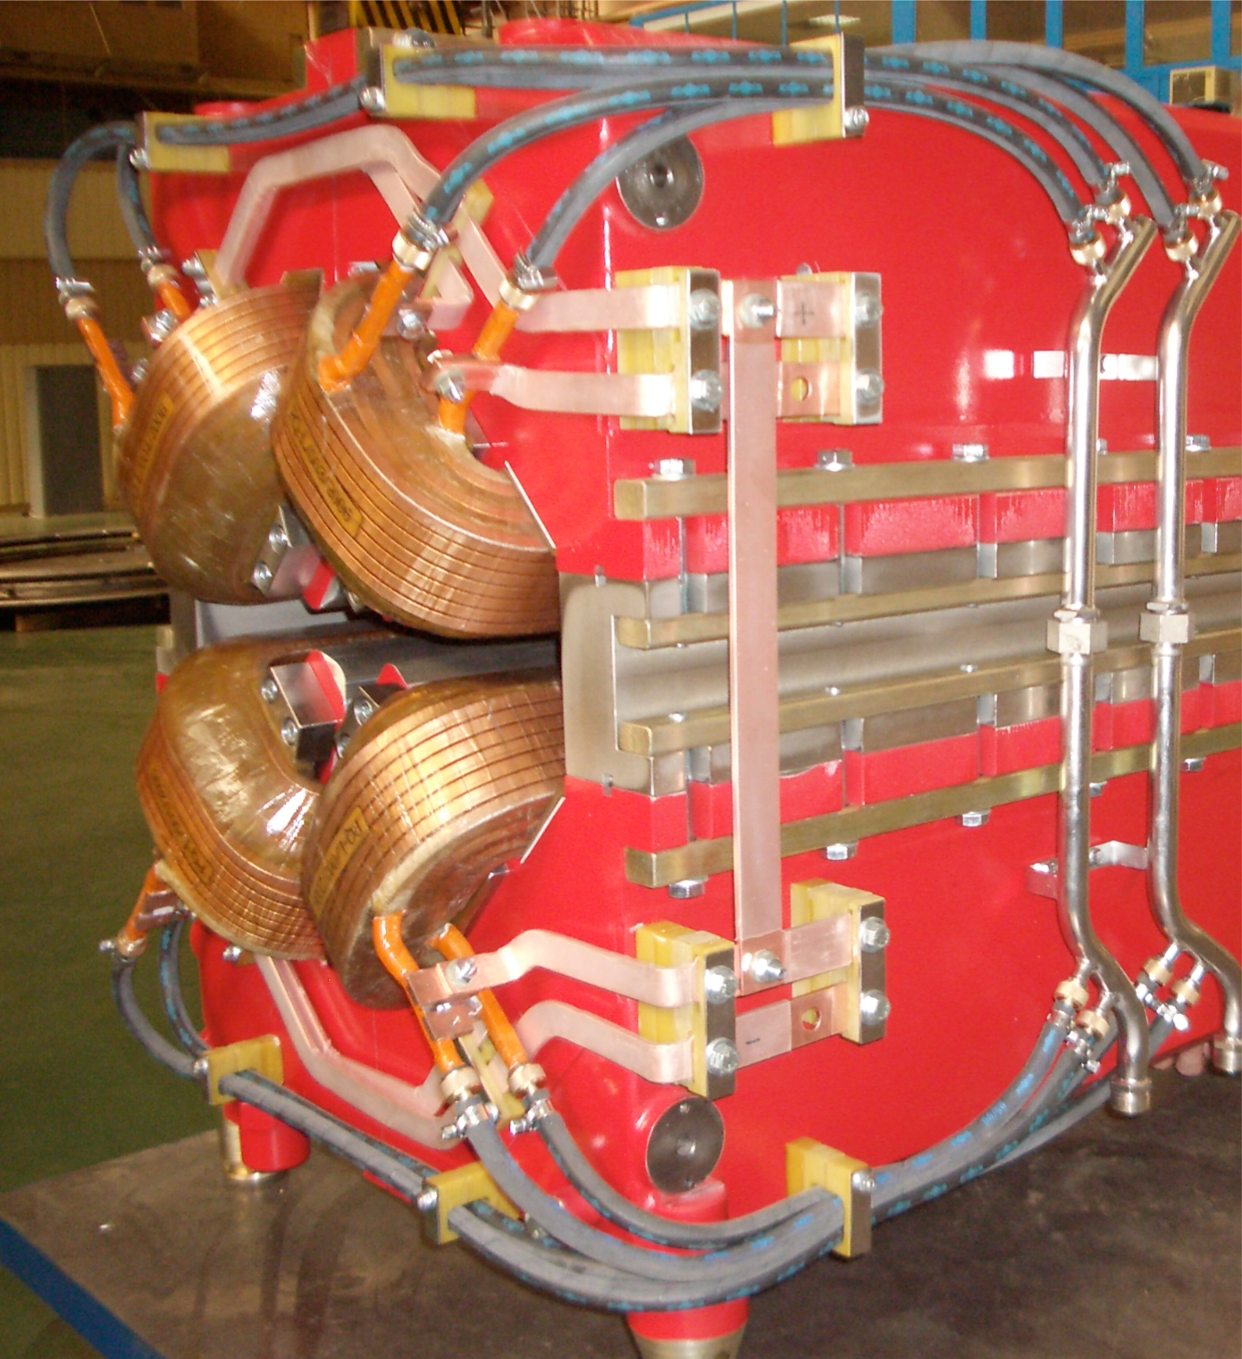
Beam is divergent
Many particles many initial conditions
Vertical
displacement
→ s
Many different angles
Quadrupole magnet

Slide 16
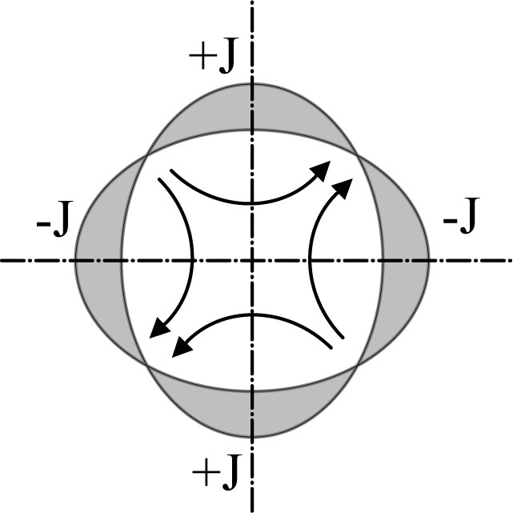
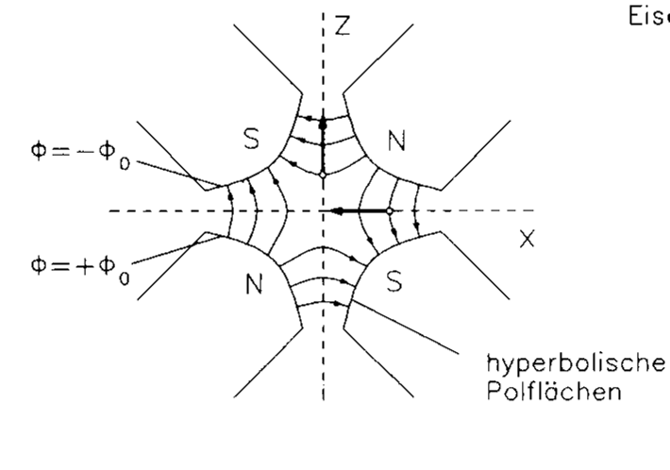
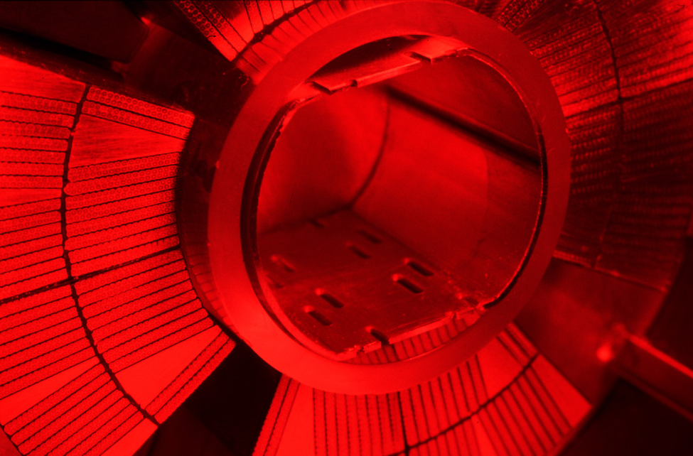
Quadrupole magnets
A quadrupole magnet will focus in one plane and de-focus in the other.
Convention: a “focusing” quadrupole focuses in the horizontal plane

Slide 17
Alternate gradient focusing
x
s
The general linear magnet lattice can be parameterized by a ‘varying spring constant’, K=K(s).
K(s) describes the distribution of focusing strength along the lattice and is periodic.
(and similarly for the vertical plane y)
This is Hill’s equation.

Slide 18
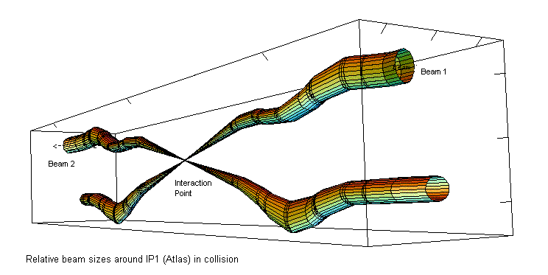
Squeeze
Beam 1
Beam 2
Focus beam down to very small sizes in the experiments
using quadrupole magnets

Slide 19
Accelerating the Particles
LHC: beams with an energy of 6.8 TeV
=
6 800 000 000 000 V
Tera Giga Mega kilo

Slide 20
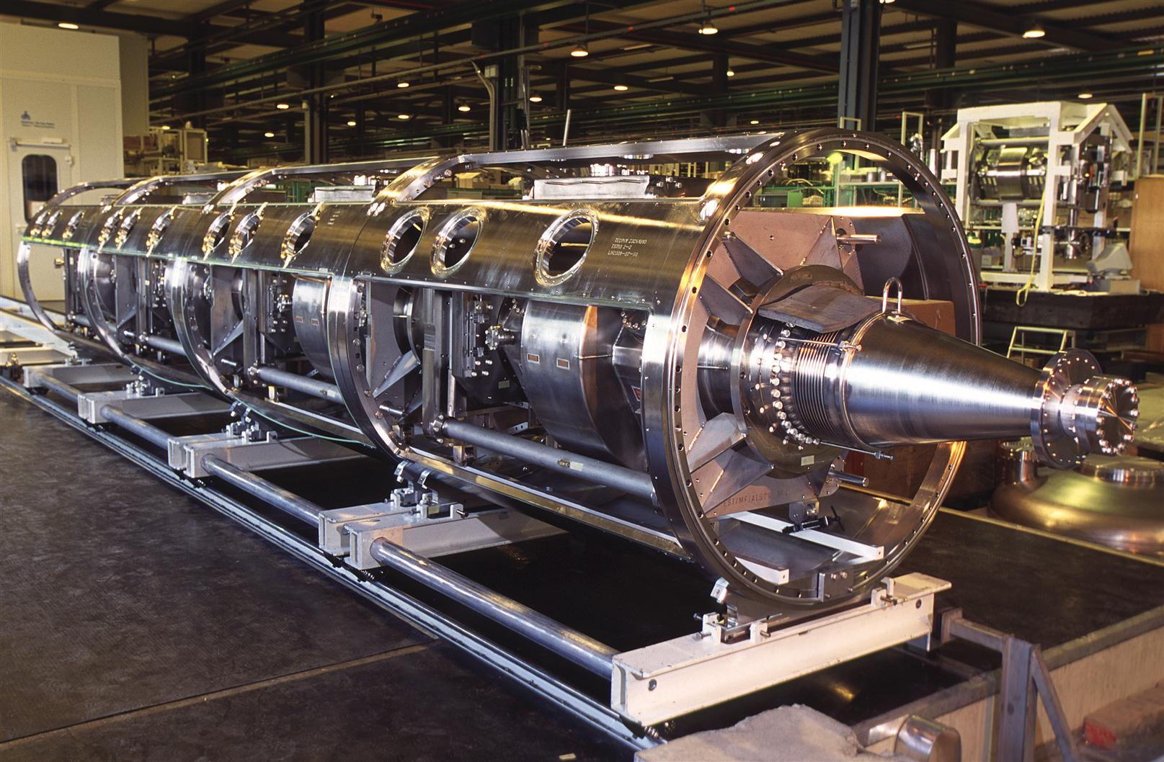
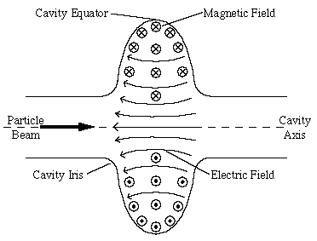
Radio Frequency Cavities
RF = Oscillation of field at 400 MHz (Radio Frequency)
Use the Electrical Field at each passage
4 cavities/module - 2 modules/beam - 16 MV (5.5 MV/m)
Superconducting to reduce Beam Impedance
4 Cavity RF Module

Slide 21
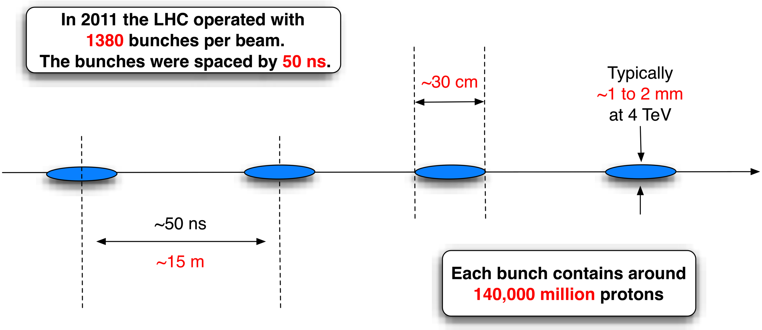
Lots of bunches
In 2023 the LHC has been operation with up to 2500 bunches per beam, separated by 25 ns
Transverse size typically 1 mm
25 ns = 7.5 m

Slide 22
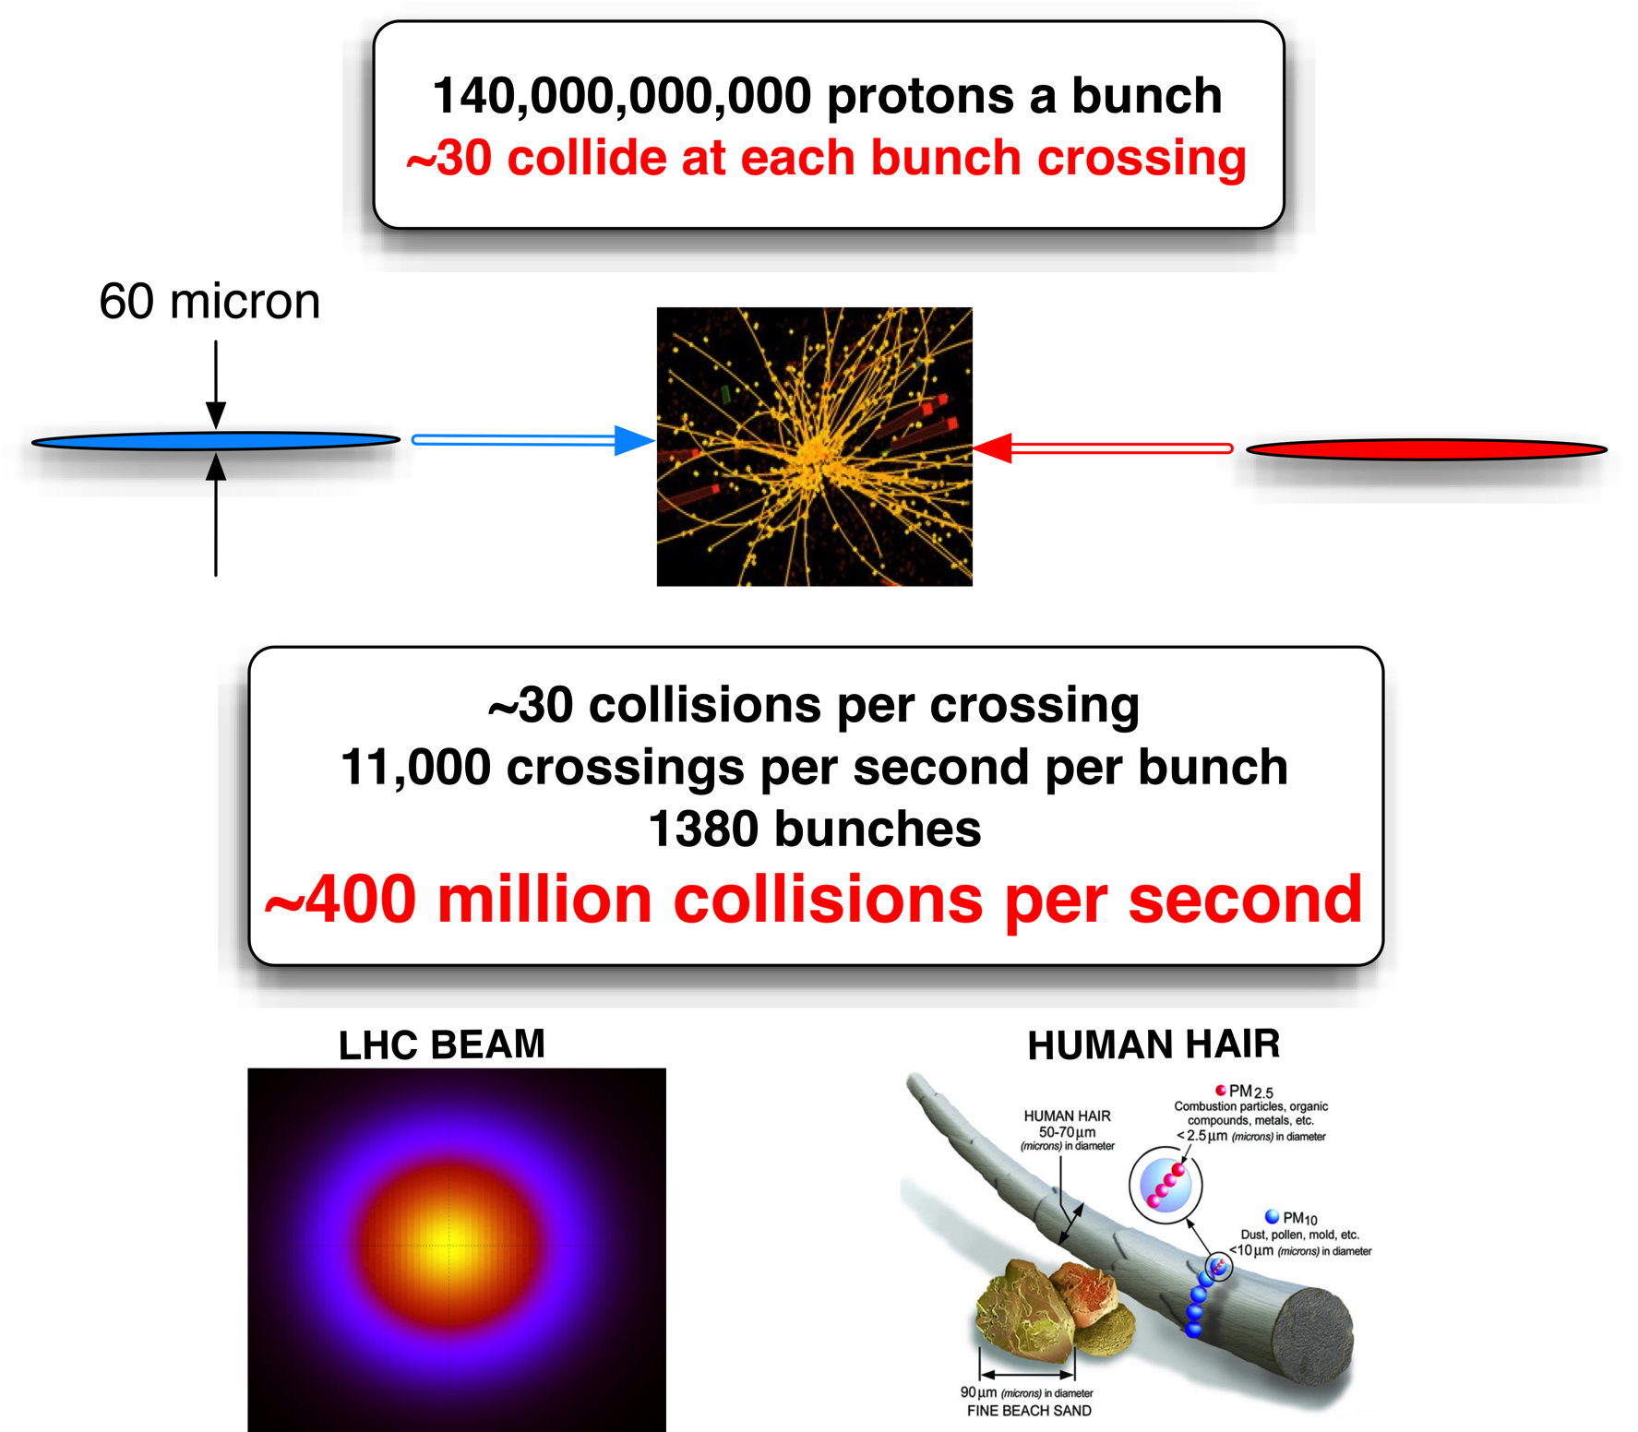
12 micron
Up to 50 collisions per crossing
11’000 crossings per second
2200 bunches per beam (2016)
1 Billion Collissions Per Second → GRID

Slide 23
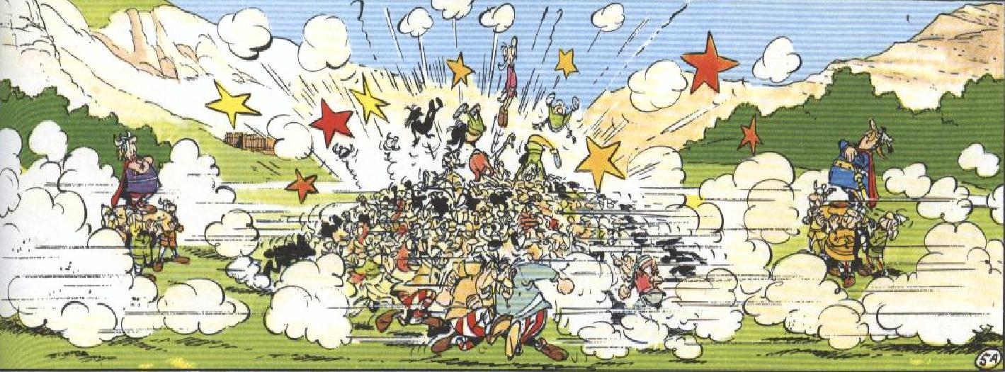
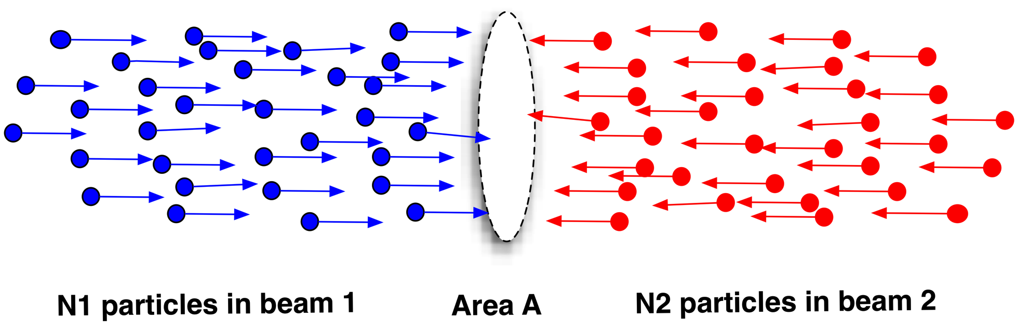
Luminosity

Slide 24
Luminosity
N | Number of particles per bunch
k_{b} | Number of bunches
f | Revolution frequency
σ* | Beam size at interaction point
F | Reduction factor due to crossing angle
ε | Emittance
ε_{n} | Normalized emittance
β* | Beta function at IP

Slide 25
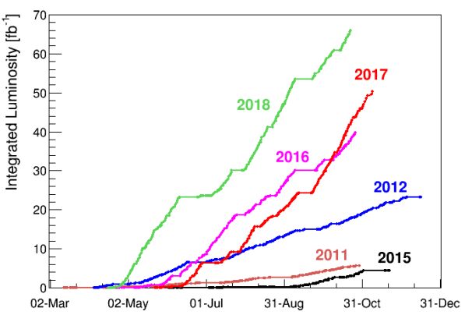
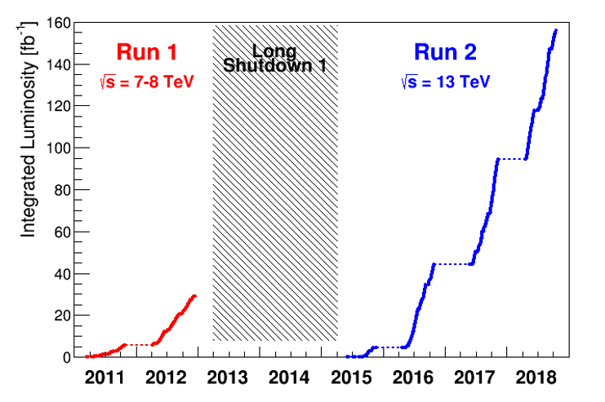
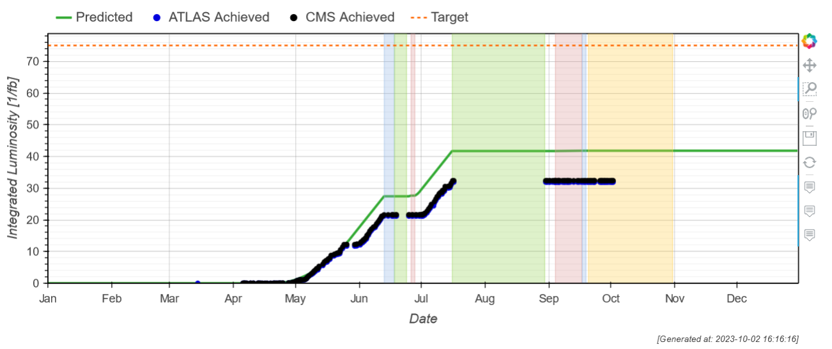

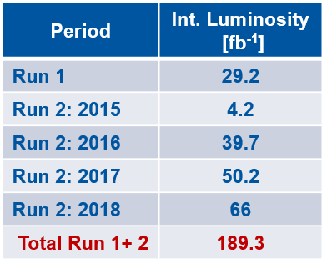
It is all about Luminosity
2023: not a record breaking year
IT.L8 leak
Ion operation
2018

Slide 26

Energy in the Beam
Electric Energy (RF cavity) → Kinetic energy
E-beam | 6.5 TeV = 6.5e12 eV
1 eV | 1.6e-19 Joules
Number of bunches | 2300
Number of protons per bunch | 1.3e11 protons
Energy | 311 MJoules
What would be the speed of a car to have the same kinetic energy ?

Slide 27
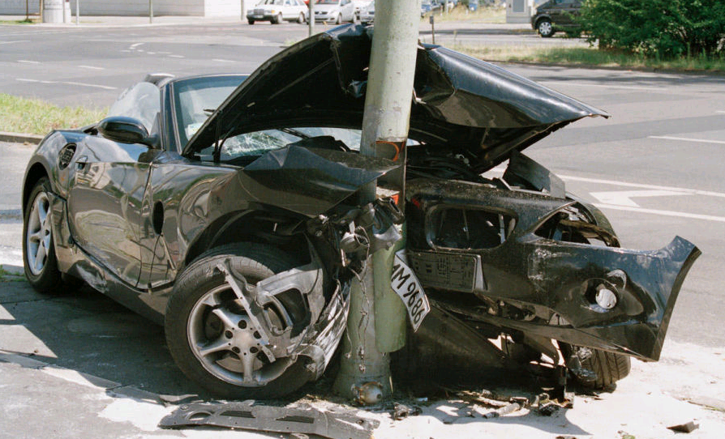
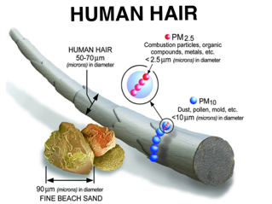
Car Versus Beam
Electric Energy of the beam → Kinetic energy
E-beam | 6.5 TeV = 6.5e12 eV
1 eV | 1.6e-19 Joules
Number of bunches | 2300 (for 2016)
Number of protons per bunch | 1.3e11 protons
Energy | 311 MJoules
Kinetic Energy of the car
Mass car | 1800 kg
Kinetic energy | 306 MJoules
V | 583 m/s
V | 2100 km/h
But at the size smaller than a hair ….

Slide 28
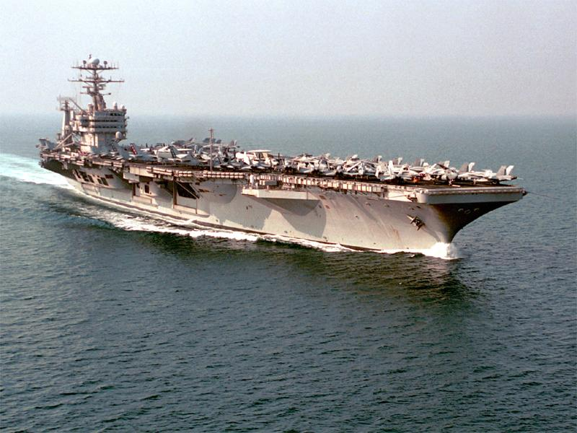
Don’t break the machine!
Energy per beam up to 360 MJ
British aircraft carrier at 12 knots
Thread through a very cold, very dark, very small hole...
28
28

Slide 29
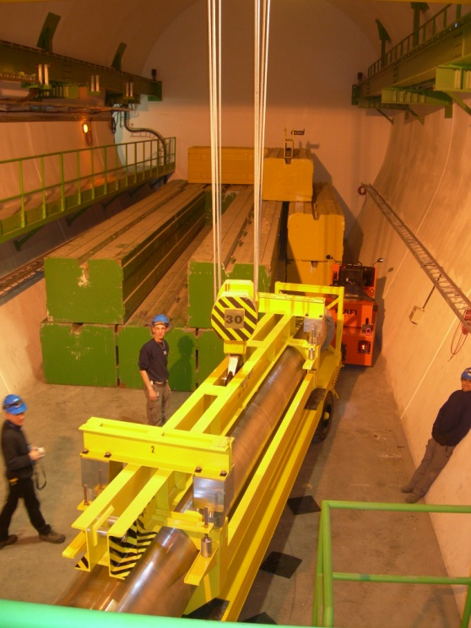
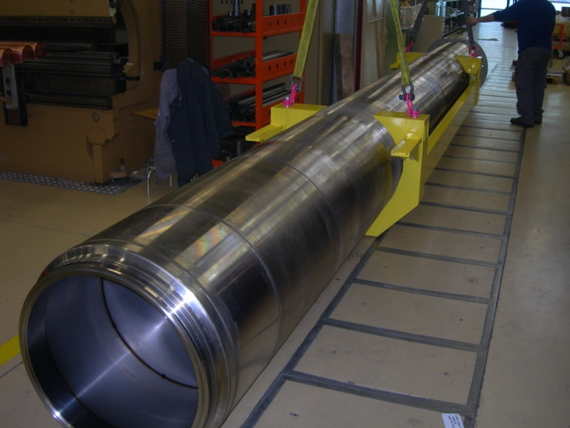
Beam dump block (TDE)
700 mm ∅ graphite core, with graded density of 1.1 g/cm³ and 1.7 g/cm³
12 mm wall, stainless-steel welded pressure vessel, at 1.2 bar of N₂
Surrounded by ~1000 tonnes of concrete/steel radiation shielding blocks
0.7 m
3.5 m
3.5 m
beam
1.7 g/cm³
1.1 g/cm³
1.7 g/cm³
29
29

Slide 30
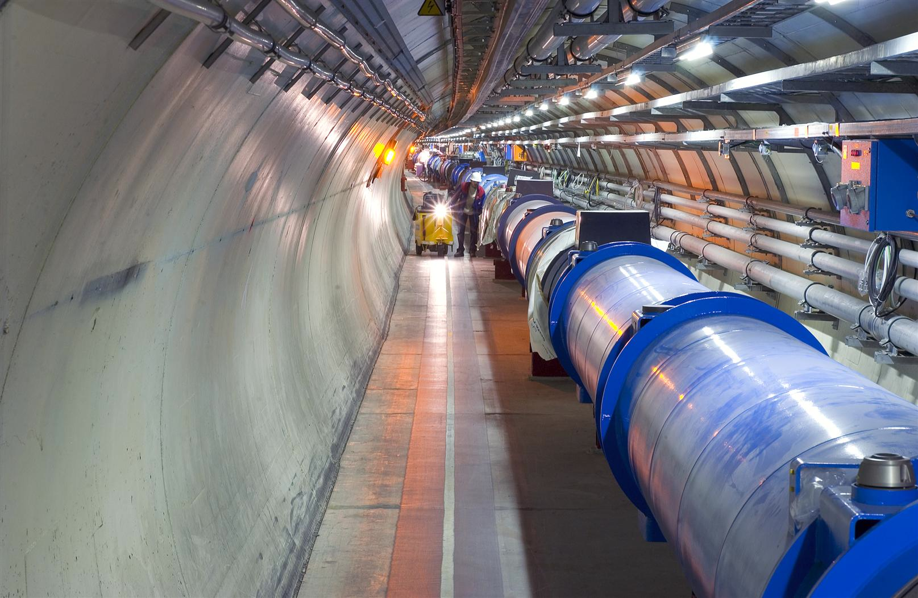
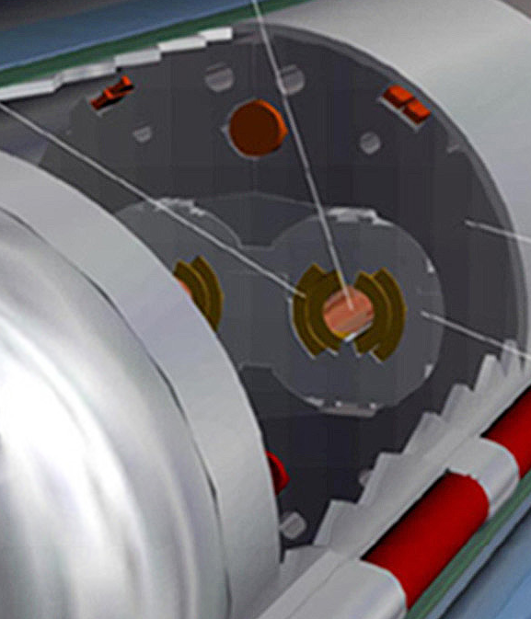
Quench Limit of LHC Super-Conducting Magnets
Nominal design at 7 TeV
Beam
360 MJ
56 mm
SC Coil: quench limit
5-30 mJ/cm³

Slide 31
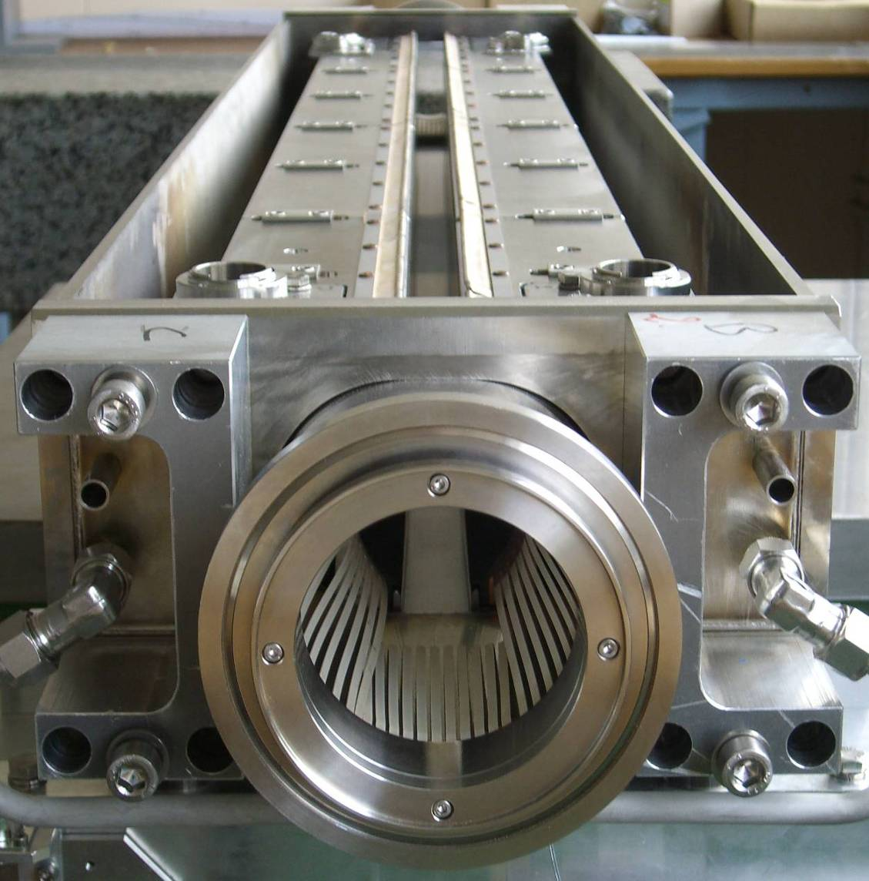
Collimation
1.2 m
Almost 100 collimators and absorbers.
Alignment tolerances < 0.1 mm to ensure that over 99.99% of the protons are intercepted.
Primary and secondary collimators are made of reinforced graphite – robust.
beam
31
31

Slide 32
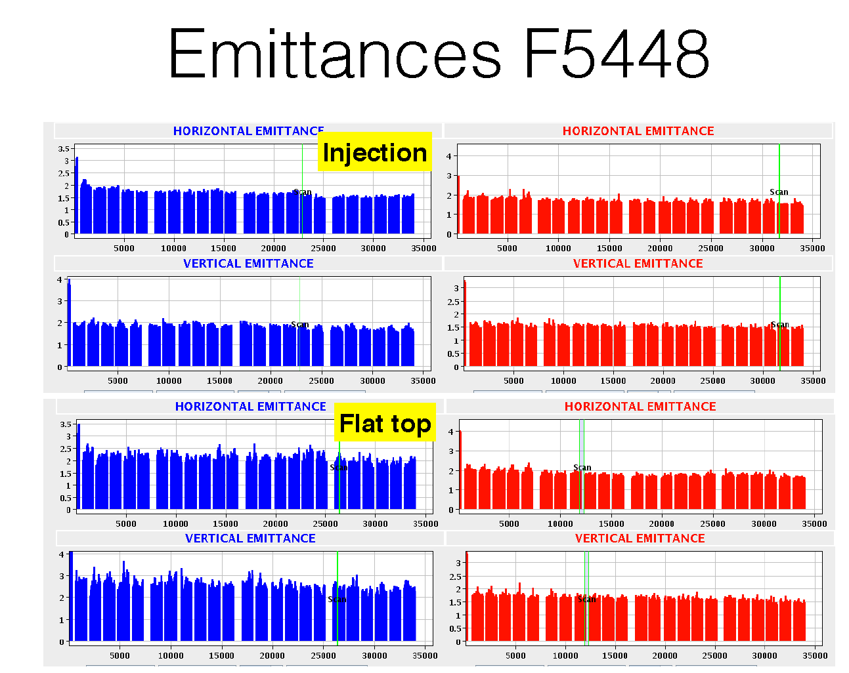

Slide 33
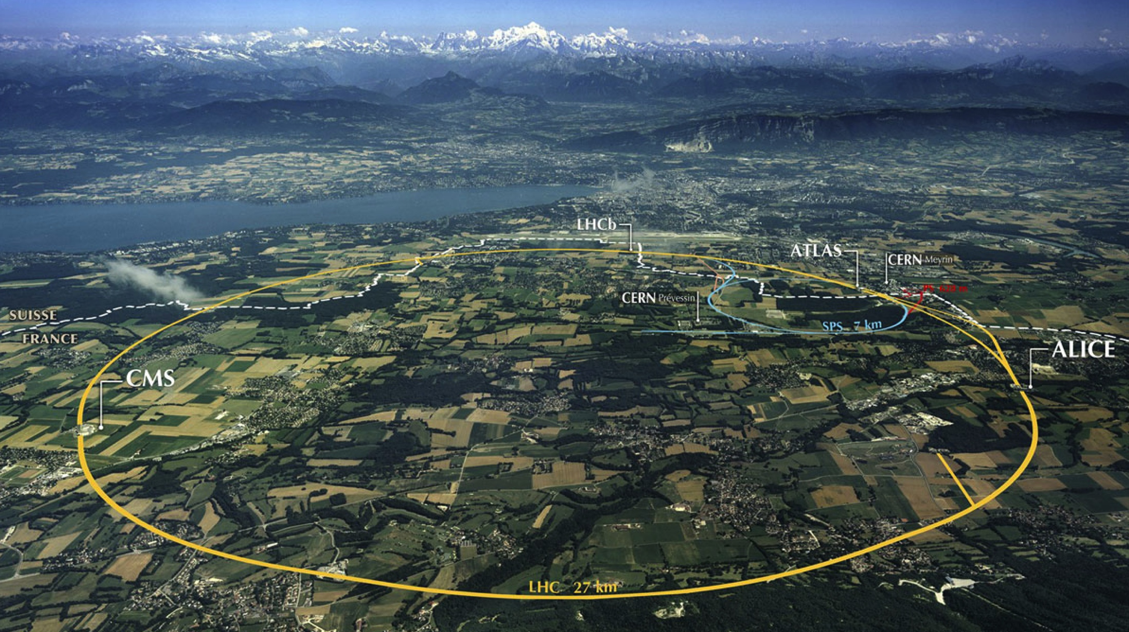
LHC: big, cold, high energy
Collimation
Injection B2
Beam dumps
Injection B1
Collimation
RF
1720 Power converters
> 9000 magnetic elements
7568 Quench detection systems
1088 Beam position monitors
~4000 Beam loss monitors
120 tonnes of Helium, down to 1.9 K
360 MJ stored beam energy per beam
11 GJ total stored energy in magnetic systems

Slide 34

Machine Elements
Magnets: guidance and transverse ‘stability’
  Dipoles, Quadrupoles, Sextupoles, Octupoles
Radio Frequency – Longitudinal motion
  Acceleration
  Feedback
Injection and Beam Dumping Systems
  Fast Pulsed Magnets (‘Kicker Magnets’)
  Septum Magnets
  Beam dump block
Machine Protection
  Collimation System, other absorbers, Interlock Systems
Beam Diagnostics & Protection
  Beam Position, Beam Loss Monitors, Tune Measurement, Synchrotron Light Measurements, Beam Size Measurements
Cryogenics & Vacuum

Slide 35
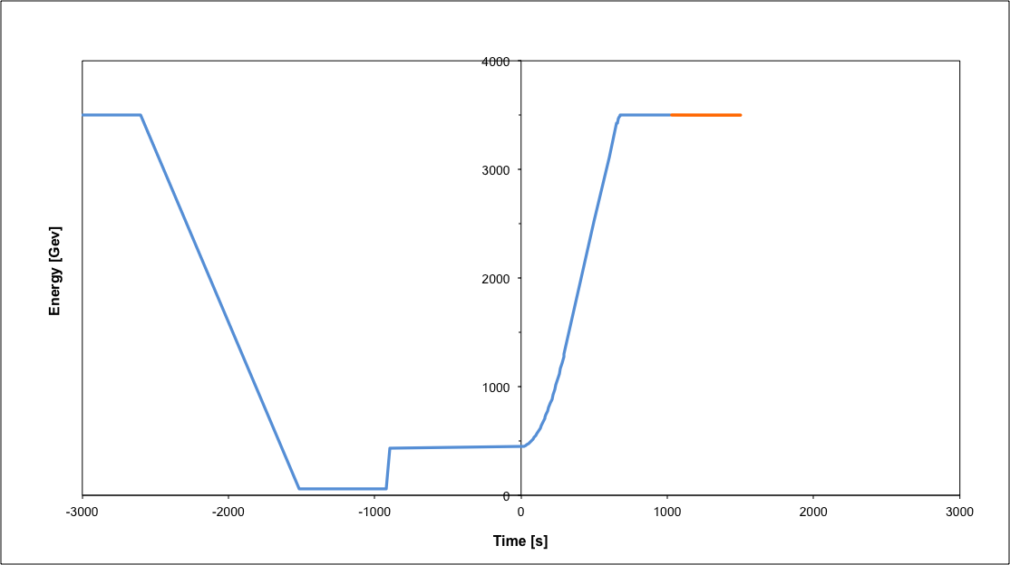
Operational cycle
Beam dump
Squeeze
Stable beams
Collide
Ramp
Ramp down/precycle
Ramp down | 35 mins
Injection | ~30 mins
Ramp | 12 mins
Squeeze | 15 mins
Collide | 5 mins
Stable beams | 0 – 30 hours
Injection
Turn around from stable beams to stable beams - 2 to 3 hours on a good day, followed by Stable Beams, average 6 hours.

Slide 36
Luminosity
Beam intensity

Slide 37
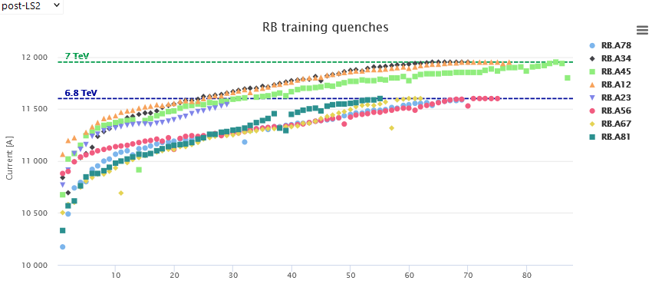
Magnet Training to reach 7 TeV Beam Energy
‘Nominal’
6.8 TeV
Present Operation
6.5 TeV = Operation <= 2018
During the training after LS2 (2021) we needed 3x a sector warm-up – delay of about 3 months each time, partly in parallel

Slide 38
Magnet Training to reach 7 TeV Beam Energy
6.8 TeV
‘Nominal’
6.8 TeV
Present Operation
6.5 TeV = Operation <= 2018
During the training after LS2 (2021) we needed 3x a sector warm-up – delay of about 3 months each time, partly in parallel

Slide 39
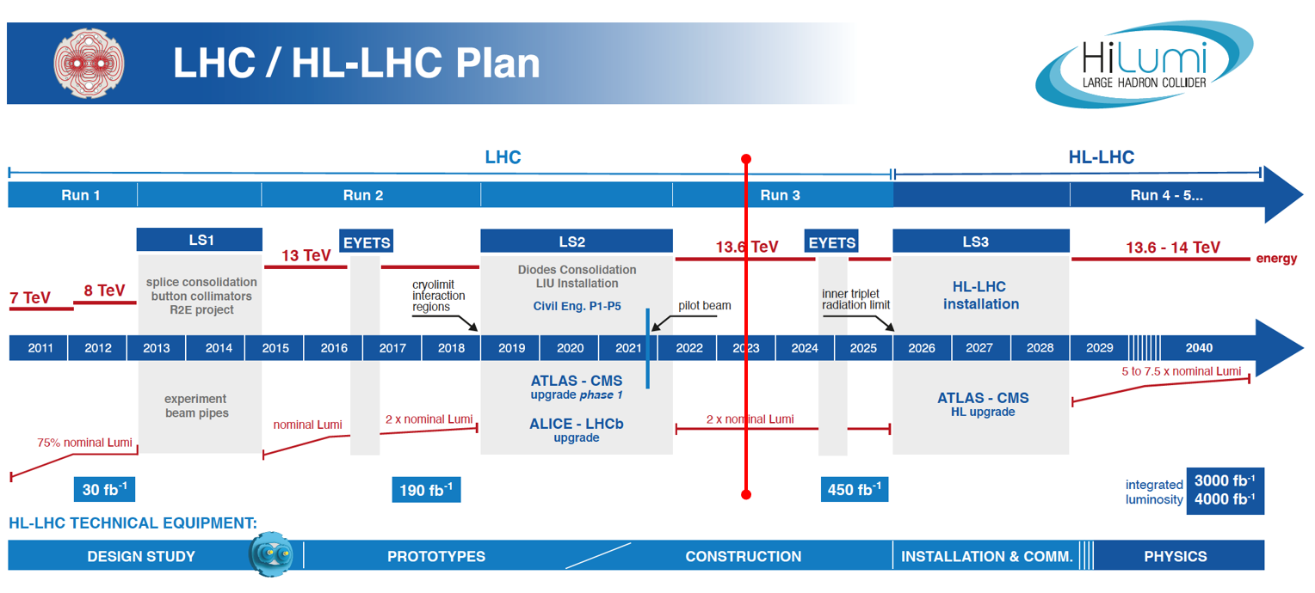
What’s Next ?
High-Luminosity LHC
Injectors upgrade and LHC civil engineering
HL-LHC upgrade

Slide 40
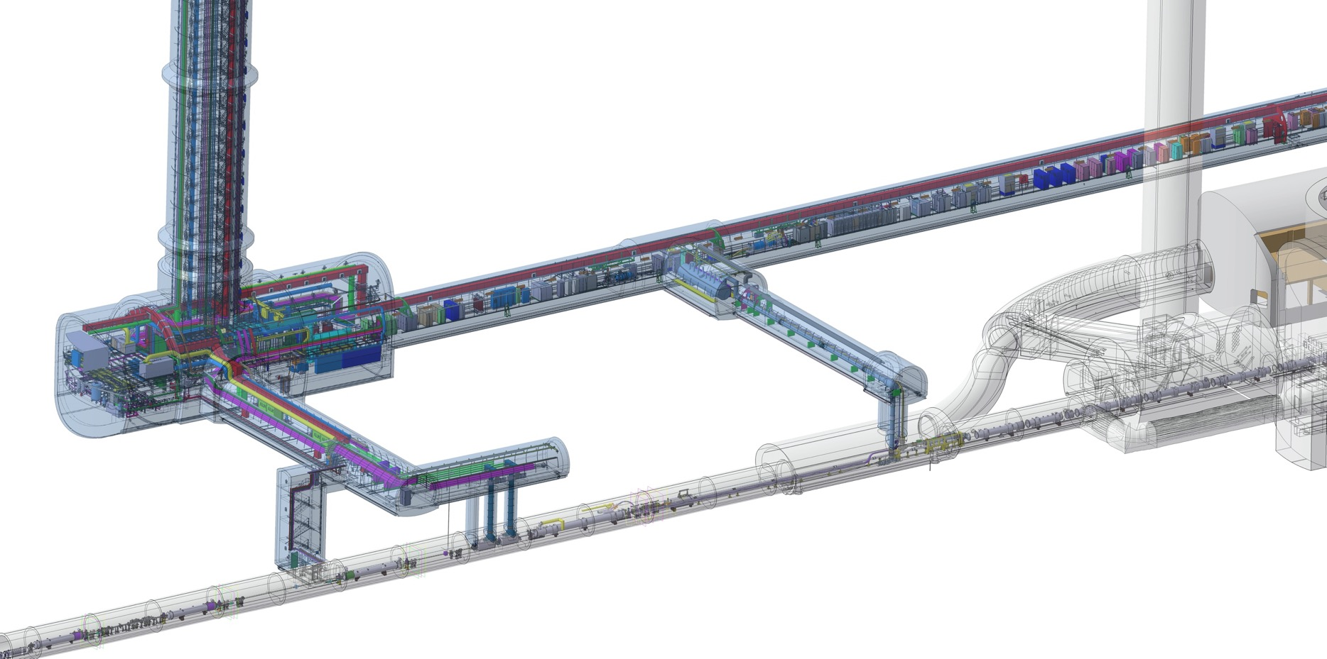
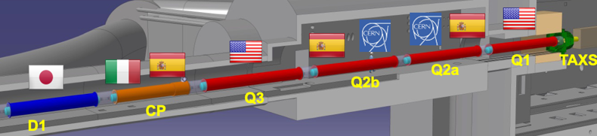
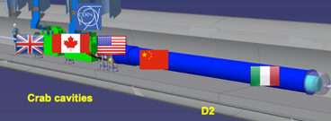
High Luminosity LHC
Prepare the machine for operation beyond 2025 and up to ~2041
Operation scenarios for a total integrated luminosity of 3000 fb⁻¹
Warm Diodes
QDS
UR55
CLIQ
PIC,BIS
CDBs
OC EE
Valve box
DFHX
D2 OC PCs
D2 PC
DFHM
OC PCs
US57
D1 PC
UW57
PC IT
PCs IT Trims
CDBs
DSHX
D2 OC EE
UL57
Cold box
DSHM
UA57
D1
CP
Q3
Q2B
Q2A
Q1
Cooling and Ventilation
RF Powering
DFM
DCM
UPR57
DFX
Cold Diodes
TAXN
Crab
Cavities
D2
DQHDS
Q4
Q5
Q6

Slide 41
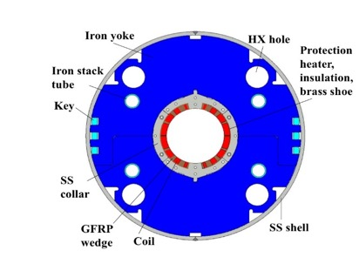
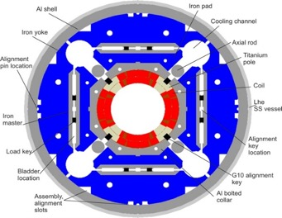
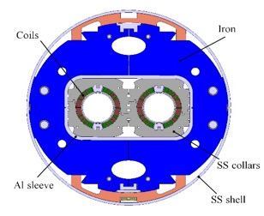















HL-LHC: IR magnets
Final focus quadrupoles
New wide-aperture superconducting magnets for the interaction regions
Nb₃Sn technology → Larger operational peak fields (~12 T)
Large aperture: 150 mm
  Allows for smaller beam size at the experiments
  Allows introducing tungsten shielding to protect the magnet from radiation generated by collisions
Series production in progress
Final focus
quadrupole (MQXF)
Separation/recombination dipoles
Higher order correctors
Dipole correctors

Slide 42
The Future @ CERN after the HL-LHC

Slide 43

European Strategy for Particle Physics Update 2020
“An electron-positron Higgs factory is the highest-priority next collider.”
“For the longer term, the European particle physics community has the ambition to operate a proton-proton collider at the highest achievable energy.”
“Europe, together with its international partners, should investigate the technical and financial feasibility of a future hadron collider at CERN with a centre-of-mass energy of at least 100 TeV and with an electron-positron Higgs and electroweak factory as a possible first stage.”
e+e- machine as a Higgs factory
High energy hadron collider

Slide 44

Really going to have make the case because…

Slide 45




FCC integrated program: inspired by LEP- LHC
Comprehensive long-term program maximizing physics opportunities:
Stage 1: FCC-ee (Z, W, H, $\text{t}\overline{\text{t}}$) as Higgs factory, electroweak & top factory at highest luminosities
Stage 2: FCC-hh (~100 TeV) as natural continuation at energy frontier, with ion and eh options
FCC-ee
FCC-hh
2020 - 2040
2045 - 2063
2070 - 2095

Slide 46


Optimized placement and layout for feasibility study
Major achievement: optimization of the ring placement
Layout chosen out of ~100 initial variants, based on geology and
surface constraints, environment, infrastructure.
PA: Experiment
PB: technical
Lowest-risk baseline: 90.7 km ring, 8 surface points,
4-fold superperiodicity, possibility of 2 or 4 IPs
Whole project now adapted to this placement
PL: technical
PD: experiment
Number of surface sites | 8
LSS@IP (PA, PD, PG, PJ) | 1400 m
LSS@TECH (PB, PF, PH, PL) | 2032 m
Arc length | 9.6 km
Sum of arc lengths | 76.9 m
Total length | 90.7 km
PJ: experiment
PF: technical
PH: technical
46
PG: experiment

Slide 47




Power consumption and electrical grid infrastructure
Powering concept and max power load by sub-stations:
The loads could be charged on the three sub-stations (optimum connections to existing regional HV grid):
Point D, with a new sub-station covering PB – PD – PF – PG
Point H with a new dedicated sub-station for collider RF
Point L, with a sub-station covering PJ – PL – PA
→ Alternative to new sub-station at Point L is reusing the existing CERN Prevession station to PA
All options pursued with RTE
Powering concept and max. power rating of the three sub-stations compatible FCC-hh.

Slide 48



Integration of environmental challenges in future accelerators
Very much work in progress
Future machines – full lifecycle
    Starts with choice of fundamental design and technology
    Least resource-heavy designs compatible with the long-term scientific goals
    Footprint given by full lifecycle, civil engineering, construction…
Technology – energy efficiency
  SRF, klystrons, magnets (SC, HTS, permanent) etc. etc.
  Technical infrastructure: efficiency, heat recovery…
Operations
  Source renewable power
  Dynamically follow renewable power availability
Innovative technology
    Power/energy distribution (HTS, smart grids, hydrogen…)
    Energy storage (SC magnets, hydrogen…)
Support to alternatives
    Fusion – ITER
    ADS, thorium – MYRHHA
Procurement
  Energy use considered in system design, specifications, arbitration

Slide 49





Muon Collider
20 T, 200 mm
Radiation heat load ≈ 5…10 kW
Radiation dose: 80 MGy
NC ±1.8 T, 400 Hz 100 mm x 30 mm
SC < 10T
100 mm x 30 mm
SC dipole
NC dipole
NC dipole
SC dipole
RCS
> 40 T, 60 mm
16 T peak, 160 mm
Radiation heat load ≈ 5 W/m
Radiation dose ≈ 20…40 MGy
Luca Bottura

Slide 50




LEGEND
CERN ExistingLHC
LHC
FCC
Muon Collider
CLIC
FCC
CLIC
Muon Collider ring
Muon Acceleration ring

Slide 51

Compare FCC to the LHC timeline …

Slide 52






Nobel Price and HL-LHC for years to come …
Apotheosis and atonement
Trial/descent in the underworld
4 July, 2012
November 29, 2009
Resurrection and rebirth
2009
2010
2011
2012
2013
Ascension
Heroic subplot
March 30, 2010
First collisions at 3.5 TeV

Slide 53
Bedankt voor jullie aandacht !
Accelerating Science and Innovation
Notes:
53

Slide 54
SPARE SLIDES

Slide 55

CMS: heavier than the Eifel tower

Slide 56

ATLAS: large as a building of 5 floors

Slide 57

ALICE: very sensitive, optimised for ion collisions

Slide 58

LHCb: asymmetric, B-physics

Slide 59

Aim of the game
We want to deliver maximum number of collisions at the maximum beam energy for maximum physics reach
E = m ⋅c ²

Slide 60


The Higgs field gives mass to other particles

Slide 61

Why is the Higgs so special?

Slide 62

Reduced Energy – the history
10th September 2008: First circulating beams – all smiles

Slide 63



Reduced energy – the history
19th September 2008: electrical arc ruptured bus-bar interconnection during tests without beam – violent He blow-off

Slide 64


Reduced energy – the history
Major damage over a few hundred meters. Back in operation 1 year later.

Slide 65


2013 – 2014: Long Shutdown to repair defective connections between superconducting magnets
2015: Restart with beam energy of 6.5 TeV

Slide 66

Next 10 years
Followed by many years of HL-LHC running
The LHC has a long future ahead ….

Slide 67

The HL-LHC Project
New IR-quads Nb₃Sn (inner triplets)
  New 11 T Nb₃Sn (short) dipoles
  Collimation upgrade
  Cryogenics upgrade
  Crab Cavities
  Cold powering
  Machine protection
  …
Major intervention on more than 1.2 km of the LHC

Slide 68



















High Luminosity LHC Participants

Slide 69
































CLIC Collaboration
29 Countries – over 70 Institutes
Accelerator
collaboration
Detector
collaboration
Accelerator + Detector collaboration

Slide 70





CERN: Particle Physics and Innovation
Interfacing between fundamental science and key technological developments
CERN Technologies and Innovation
Accelerating particle beams
Detecting particles
Large-scale computing (Grid)
Notes:
70

Slide 71






Medical Application as an Example of Particle Physics Spin-off
Combining Physics, ICT, Biology and Medicine to fight cancer
Hadron Therapy
Tumour Target
Leadership in Ion Beam Therapy now in Europe and Japan
Protons
light ions
Accelerating particle beams
~30’000 accelerators worldwide
~17’000 used for medicine
X-ray
protons
>70’000 patients treated worldwide (30 facilities)
>21’000 patients treated in Europe (9 facilities)
Imaging
PET Scanner
Clinical trial in Portugal for new breast imaging system (ClearPEM)
Detecting particles
Notes:
71

Slide 72





CERN Education Activities
Latin American School
Natal, Brazil, 2011
Arequipa, Peru, 2013
NEW:
Asia-Europe-Pacific School of High-Energy Physics
Fukuoka, Oct 2012
India, 2014
Scientists at CERN
Academic Training Programme
Young Researchers
CERN School of High Energy Physics
CERN School of Computing
CERN Accelerator School
CERN School of Physics
Hungary, June 2013
Physics Students
Summer Students
Programme
CERN Teacher Schools
International and National Programmes

Slide 73









August 2008
First injection test
November 29, 2009
Beam back
August, 2011
2.3e33, 2.6 fb⁻¹
1380 bunches
September 10, 2008
First beams around
June 28 2011
1380 bunches
October 14 2010
1e32
248 bunches
4 July, 2012
1380
6 June, 2012
6.8e33
2008
2009
2010
2011
2012
November 2010
Ions
March 30, 2010
First collisions at 3.5 TeV
September 19, 2008
Disaster
Accidental release of 600 MJ stored in one sector of LHC dipole magnets
18 June, 2012
6.6 fb⁻¹
to ATLAS & CMS
LHC Timeline

Slide 74

The highlight of a remarkable year 2012

Slide 75


Nobel Prize in Physics 2013
The Nobel Prize in Physics 2013 was awarded jointly to François Englert and Peter W. Higgs "for the theoretical discovery of a mechanism that contributes to our understanding of the origin of mass of subatomic particles, and which recently was confirmed through the discovery of the predicted fundamental particle, by the ATLAS and CMS experiments at CERN's Large Hadron Collider”.

Slide 76


The Worldwide LHC Computing Grid
Tier-0 (CERN): data recording, reconstruction and distribution
nearly 160 sites,
35 countries
~250’000 cores
Tier-1: permanent storage, re-processing,
analysis
173 PB of storage
> 2 million jobs/day
Tier-2: Simulation,
end-user analysis
10 Gb links
An International collaboration to distribute and analyse LHC data
Integrates computer centres worldwide that provide computing and storage resource into a single infrastructure accessible by all LHC physicists

Slide 77


Verification of Dump Protection
Image of the dumped beam
Switch off the RF
  Debunching fills the abort gap
Dump Beam
  Loss in point 6 on absorber elements
  Some losses collimation
  Clean at experiments:
  factor 1 : 10 000
Measured Beam losses around the whole Machine
Rest of the machine is clean
Dump
Collimation
77
77

Slide 78



Only one way to safely get rid of the beam
LHC Beam Dumping System
TCDQ
Extraction Kickers
2 x 15 Systems
10 Dilution kickers MKB
TCDS
78
78

Slide 79
Beam dump block (TDE)
700 mm ∅ graphite core, with graded density of 1.1 g/cm³ and 1.7 g/cm³
12 mm wall, stainless-steel welded pressure vessel, at 1.2 bar of N₂
Surrounded by ~1000 tonnes of concrete/steel radiation shielding blocks
0.7 m
3.5 m
3.5 m
beam
1.7 g/cm³
1.1 g/cm³
1.7 g/cm³
79
79

Slide 80
Extraction kicker – Abort Gap
Within 3 turns of dump request
Synchronised
dump trigger
Extraction kicker MKD deflection
LHC
Beam
3.0 μs
particle-free
abort gap
80
80

Slide 81

At every dump: Check the Extraction Kickers
3 µs ‘Abort Gap’ without beam
81
81

Slide 82

At every dump: Check the Dump Pattern
82
82

Slide 83

At every dump: Check the Beam Losses
83
83

Slide 84
Protection against ‘Kicker Sweep’
Beam in the Abort Gap
Asynchronous beam dump → quench or damage
  Several failures possible (synchronisation, MKD erratic)
Precautionary measures include:
  TCDS (fixed) – 6 m long diluter protects extraction septum
  TCDQ/TCS (mobile) – 7 m long diluter kept at about 7-8 σ from the beam at all times
84
84

